Slide 1
IST 511 Information Management: Information and Technology
Complexity, complex systems, computational complexity and scaling
Dr. C. Lee Giles
David Reese Professor, College of Information Sciences and Technology
Professor of Computer Science and Engineering
Professor of Supply Chain and Information Systems
The Pennsylvania State University, University Park, PA, USA
giles@ist.psu.edu
http://clgiles.ist.psu.edu
Thanks to Peter Andras, Costas Busch

Slide 2
Last time
What is information
  Information
  Informatics
  information science
  information theory
Information in all aspects of science and society
  What is defined often depends on the domain
How much information is there?
  Giga, tera, peta, exa, zetta
  When did it happen
  Where is it going

Slide 3
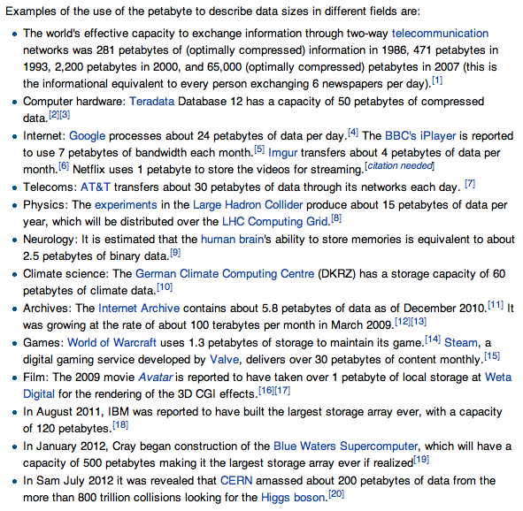
Today

Slide 4
Today
What is complexity
  Complex systems
  Measuring complexity
    Computational complexity – Big O
  Scaling
Why do we care
  Scaling is often what determines if information technology works
  Scaling basically means systems can handle a great deal of
    Inputs
    Users
Methodology – scientific method

Slide 5
Tomorrow
Topics used in IST
Representation
AI
Machine learning
Information retrieval and search
Text
Encryption
Social networks
Probabilistic reasoning
Digital libraries
Others?

Slide 6
Theories in Information Sciences
Enumerate some of these theories in this course.
Issues:
  Unified theory?
  Domain of applicability
  Conflicts
Theories here are mostly algorithmic
Quality of theories
  Occam’s razor
  Subsumption of other theories

Slide 7
What we know
Complex systems are everywhere
More and more information/data born digital
  Tera and exa and petabytes of stuff
Information management is important
  Companies, governments, organizations, individuals spend significant resources managing information/data and complex systems

Slide 8
What is complexity ?
The buzz word ‘complexity’:
‘complexity of a trust’ (Guardian, February 12, 2002)
‘increasing complexity in natural resource management’ (Conservation Ecology, January 2002)
‘citizens add an additional level of complexity’ (Political Behavior, March 2001)

Slide 9
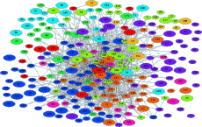
Complex micro-worlds
gene interaction system;
protein interaction system;
protein structure;
The system of functional protein interaction clusters in the yeast (www.cellzome.com).

Slide 10
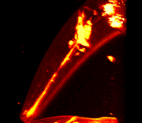
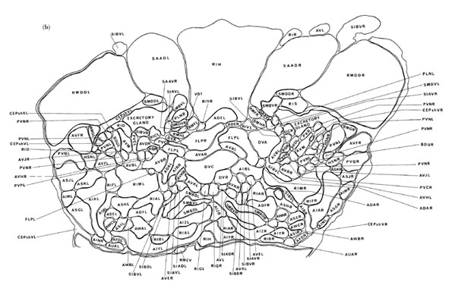
Complex organisms
C. Elegans (devbio-mac1.ucsf.edu)
complex cell patterns;
complex organs;
complex behaviours;
C. Elegans ventral ganglion transverse-section (www.wormbase.org)

Slide 11
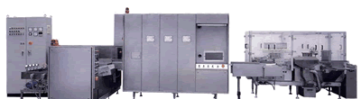
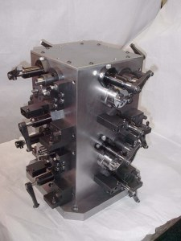
Complex machines

Slide 12
Complex organizations

Slide 13
Complex ecosystems

Slide 14
Complexity for information science
Why complexity?
Modeling & prediction of behavior of a complext system
Also for evaluating difficulty in scaling up a problem
  How will the problem grow as resources increase?
  Information retrieval search engines often have to scale!
Knowing if a claimed solution to a problem is optimal (best)
Optimal (best) in what sense?

Slide 15
Complex systems
A complex system is a system composed of interconnected parts that as a whole exhibit one or more properties (behavior among the possible properties) not obvious from the properties of the individual parts.
A system’s complexity may be of one of two forms:
  disorganized complexity and organized complexity. In essence, disorganized complexity is a matter of a very large number of parts,
  organized complexity is a matter of the subject system (quite possibly with only a limited number of parts) exhibiting emergent properties.
From Wikipedia

Slide 16
Features of complex systems
Difficult to determine boundaries
  It can be difficult to determine the boundaries of a complex system. The decision is ultimately made by the observer (modeler).
Complex systems may be open
  Complex systems are usually open systems — that is, they exist in a thermodynamic gradient and dissipate energy. In other words, complex systems are frequently far from energetic equilibrium: but despite this flux, there may be pattern stability.
Complex systems may have a memory (often called state)
  The history of a complex system may be important. Because complex systems are dynamical systems they change over time, and prior states may have an influence on present states. More formally, complex systems often exhibit hysteresis.
Complex systems may be nested
  The components of a complex system may themselves be complex systems. For example, an economy is made up of organizations, which are made up of people, which are made up of cells - all of which are complex systems.

Slide 17
Features of complex systems
Dynamic network of multiplicity
  As well as coupling rules, the dynamic network of a complex system is important. Small-world or scale-free networks which have many local interactions and a smaller number of inter-area connections are often employed. Natural complex systems often exhibit such topologies. In the human cortex for example, we see dense local connectivity and a few very long axon projections between regions inside the cortex and to other brain regions.
May produce emergent phenomena
  Complex systems may exhibit behaviors that are emergent, which is to say that while the results may be sufficiently determined by the activity of the systems' basic constituents, they may have properties that can only be studied at a higher level. For example, the termites in a mound have physiology, biochemistry and biological development that are at one level of analysis, but their social behavior and mound building is a property that emerges from the collection of termites and needs to be analyzed at a different level.

Slide 18
Features of complex systems
Relationships are nonlinear
  In practical terms, this means a small perturbation may cause a large effect (see butterfly effect), a proportional effect, or even no effect at all. In linear systems, effect is always directly proportional to cause.
Relationships contain feedback loops
  Both negative (damping) and positive (amplifying) feedback are always found in complex systems. The effects of an element's behaviour are fed back to in such a way that the element itself is altered.

Slide 19
Examples of complex systems
From complexity to simplicity
Big history: how the universe creates complexity

Slide 20
Complexity for information science
Complex systems
  University of Michigan Center for Complex Systems
Models of complexity
  Computational (algorithmic) complexity
  Information complexity
  System complexity
  Physical complexity
  Others?

Slide 21
Why do we have to deal with this?
Moore’s law
Growth of information and information resources
Management
  Storage
  Search
  Access
  Privacy
Modeling

Slide 22
Types of Complexity
Computational (algorithmic) complexity
Information complexity
System complexity
Physical complexity
Others?

Slide 23
Impact
The efficiency of algorithms/methods
The inherent "difficulty" of problems of practical and/or theoretical importance
    A major discovery in the science was that computational problems can vary tremendously in the effort required to solve them precisely. The technical term for a hard problem is "NP-complete" which essentially means: "abandon all hope of finding an efficient algorithm for the exact (and sometimes approximate) solution of this problem".
Liars vs damn liars

Slide 24
Optimality
A solution to a problem is sometimes stated as “optimal”
Optimal in what sense?
  Empirically?
  Theoretically? (the only real definition)
  Cause we thought it to be so?
Different from “best”

Slide 25
We will use algorithms
An algorithm is a recipe, method, or technique for doing something. The essential feature of an algorithm is that it is made up of a finite set of rules or operations that are unambiguous and simple to follow (i.e., these two properties:
  definite and
  effective, respectively).

Slide 26
Which algorithm to use?
You have a friend arriving at the airport, and your friend needs to get from the airport to your house. Here are four different algorithms that you might give your friend for getting to your home:
The taxi algorithm:
  Go to the taxi stand.
  Get in a taxi.
  Give the driver my address.
The call-me algorithm:
  When your plane arrives, call my cell phone.
  Meet me outside baggage claim.
The rent-a-car algorithm:
  Take the shuttle to the rental car place.
  Rent a car.
  Follow the directions to get to my house.
The bus algorithm:
  Outside baggage claim, catch bus number 70.
  Transfer to bus 14 on Main Street.
  Get off on Elm street.
  Walk two blocks north to my house.

Slide 27
Which algorithm to use?
An algorithm for solving a problem is not unique. Which should we use?
Based on cost
  Number of inputs
  Number of outputs
  Time (time vs space)
  Likely to succeed
  etc
Most solutions often based on similar problems

Slide 28
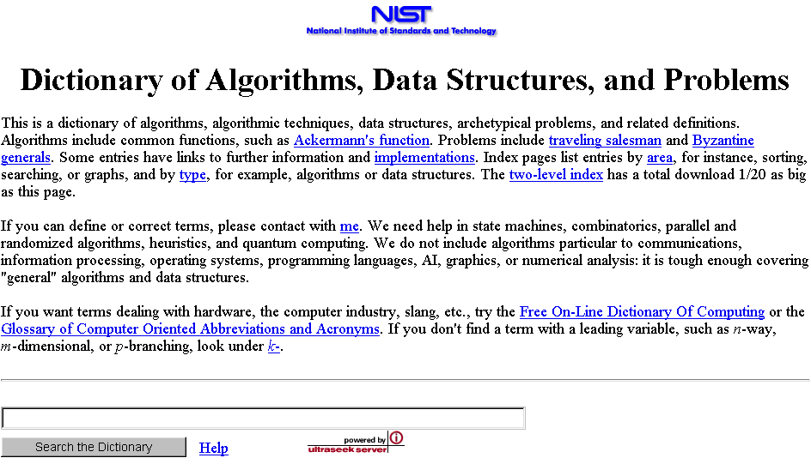
Good source of definitions
http://www.nist.gov/dads/

Slide 29
Scenarios
I’ve got two algorithms that accomplish the same task
  Which is better?
I want to store some data
  How do my storage needs scale as more data is stored
Given an algorithm, can I determine how long it will take to run?
  Input is unknown
  Don’t want to trace all possible paths of execution
For different input, can I determine how an algorithm’s runtime changes?

Slide 30
Measuring the Growth of Work or Hardness of a Problem
While it is possible to measure the work done by an algorithm for a given set of input, we need a way to:
Measure the rate of growth of an algorithm based upon the size of the input (or output)
Compare algorithms to determine which is better for the situation
Compare and analyze for large problems
  Examples of large problems?

Slide 31
Time vs. Space
Very often, we can trade space for time:
For example: maintain a collection of students’ with ID information.
  Use an array of a billion elements and have immediate access (better time)
  Use an array of number of students and have to search (better space)

Slide 32
Introducing Big O Notation
Will allow us to evaluate algorithms.
Has precise mathematical definition
Used in a sense to put algorithms into families
Worst case scenario
  What does this mean?
  Other types of cases?

Slide 33
Why Use Big-O Notation
Used when we only know the asymptotic upper bound.
  What does asymptotic mean?
  What does upper bound mean?
If you are not guaranteed certain input, then it is a valid upper bound that even the worst-case input will be below.
Why worst-case?
May often be determined by inspection of an algorithm.

Slide 34
Size of Input
(measure of work)
In analyzing rate of growth based upon size of input, we’ll use a variable
Why?
  For each factor in the size, use a new variable
  n is most common…
Examples:
  A linked list of n elements
  A 2D array of n x m elements
  A Binary Search Tree of p elements

Slide 35
Formal Definition of Big-O
For a given function g(n), O(g(n)) is defined to be the set of functions
O(g(n)) = {f(n) : there exist positive constants c and n₀ such that
0 ≤ f(n) ≤ cg(n) for all n ≥ n₀}

Slide 36
Visual O( ) Meaning
cg(n)
Upper Bound
f(n)
f(n) = O(g(n))
Work done
Our Algorithm
n₀
Size of input

Slide 37
Simplifying O( ) Answers
We say Big O complexity of
3n² + 2 = O(n²) ← drop constants!
because we can show that there is a n₀ and a c such that:
0 ≤ 3n² + 2 ≤ cn² for n ≥ n₀
i.e. c = 4 and n₀ = 2 yields:
0 ≤ 3n² + 2 ≤ 4n² for n ≥ 2
What does this mean?

Slide 38
Simplifying O( ) Answers
We say Big O complexity of
3n² + 2n = O(n²) + O(n) = O(n²) ← drop smaller!

Slide 39
Correct but Meaningless
You could say
  3n² + 2 = O(n⁶) or 3n² + 2 = O(n⁷)
But this is like answering:
What’s the world record for the mile?
  Less than 3 days.
How long does it take to drive to Chicago?
  Less than 11 years.

Slide 40
Comparing Algorithms
Now that we know the formal definition of O( ) notation (and what it means)…
If we can determine the O( ) of algorithms…
This establishes the worst they perform.
Thus now we can compare them and see which has the “better” performance.

Slide 41
Comparing Factors
N²
N
Work done
log N
1
Size of input

Slide 42
Correctly Interpreting O( )
O(1) or “Order One”
  Does not mean that it takes only one operation
  Does mean that the work doesn’t change as n changes
  Is notation for “constant work”
O(n) or “Order n”
  Does not mean that it takes n operations
  Does mean that the work changes in a way that is proportional to n
  Is a notation for “work grows at a linear rate”

Slide 43
Complex/Combined Factors
Algorithms typically consist of a sequence of logical steps/sections
We need a way to analyze these more complex algorithms…
It’s easy – analyze the sections and then combine them!

Slide 44
Example: Insert in a Sorted Linked List
Insert an element into an ordered list…
  Find the right location
  Do the steps to create the node and add it to the list
head
17
38
142
//
Step 1: find the location = O(N)
Inserting 75

Slide 45
Example: Insert in a Sorted Linked List
Insert an element into an ordered list…
  Find the right location
  Do the steps to create the node and add it to the list
head
17
38
142
//
75
Step 2: Do the node insertion = O(1)

Slide 46
Combine the Analysis
Find the right location = O(n)
Insert Node = O(1)
Sequential, so add:
  O(n) + O(1) = O(n + 1) =
O(n)
Only keep dominant factor

Slide 47
Can have multiple resources
N
M
P
V

Slide 48
Example: Search a 2D Array
Search an unsorted 2D array (row, then column)
  Traverse all rows
  For each row, examine all the cells (changing columns)
1
2
3
4
5
O(N)
Row
1 2 3 4 5 6 7 8 9 10
Column

Slide 49
Example: Search a 2D Array
Search an unsorted 2D array (row, then column)
  Traverse all rows
  For each row, examine all the cells (changing columns)
1
2
3
4
5
Row
1 2 3 4 5 6 7 8 9 10
Column
O(M)

Slide 50
Combine the Analysis
Traverse rows = O(N)
  Examine all cells in row = O(M)
Embedded, so multiply:
  O(N) x O(M) = O(N*M)

Slide 51
Sequential Steps
If steps appear sequentially (one after another), then add their respective O().
loop
. . .
endloop
loop
. . .
endloop
N
O(N + M)
M

Slide 52
Embedded Steps
If steps appear embedded (one inside another), then multiply their respective O().
loop
loop
. . .
endloop
endloop
M
N
O(N*M)

Slide 53
Correctly Determining O( )
Can have multiple factors:
  O(NM)
  O(logP + N²)
But keep only the dominant factors:
  O(N + NlogN) →
  O(N*M + P)→
  O(V² + VlogV) →
Drop constants:
  O(2N + 3N²) →
O(NlogN)
O(N*M)
O(V²)
  What about O(NM)
& O(N²)?
O(N + N²)
→ O(N²)

Slide 54
Summary
We use O() notation to discuss the rate at which the work of an algorithm grows with respect to the size of the input.
O() is an upper bound, so only keep dominant terms and drop constants

Slide 55
Best vs worse vs average
Best case is the best we can do
Worst case is the worst we can do
Average case is the average cost
Which is most important?
Which is the easiest to determine?

Slide 56
Poly-time vs expo-time
Such algorithms with running times of orders O(log n), O(n ), O(n log n), O(n²), O(n³) etc.
Are called polynomial-time algorithms.
On the other hand, algorithms with complexities which cannot be bounded by polynomial functions are called exponential-time algorithms. These include "exploding-growth" orders which do not contain exponential factors, like n!.

Slide 57
The Traveling Salesman Problem
The traveling salesman problem is one of the classical problems in computer science.
A traveling salesman wants to visit a number of cities and then return to his starting point. Of course he wants to save time and energy, so he wants to determine the shortest path for his trip.
We can represent the cities and the distances between them by a weighted, complete, undirected graph.
The problem then is to find the circuit of minimum total weight that visits each vertex exactly one.

Slide 58
The Traveling Salesman Problem
Example: What path would the traveling salesman take to visit the following cities?
Toronto
650
550
700
700
Boston
Chicago
200
600
New York
Solution: The shortest path is Boston, New York, Chicago, Toronto, Boston (2,000 miles).

Slide 59
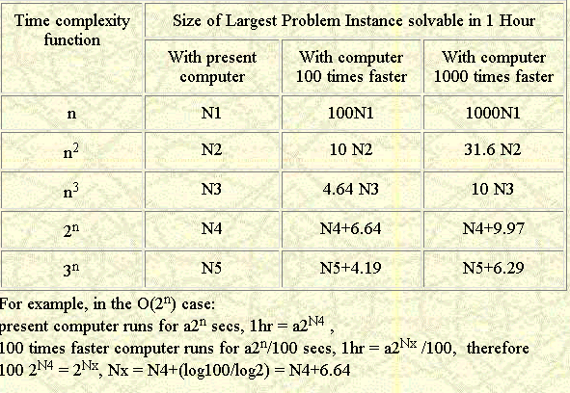
Costs as computers get faster

Slide 60
Blowups
That is, the effect of improved technology is multiplicative in polynomial-time algorithms and only additive in exponential-time algorithms. The situation is much worse than that shown in the table if complexities involve factorials. If an algorithm of order O(n!) solves a 300-city Traveling Salesman problem in the maximum time allowed, increasing the computation speed by 1000 will not even enable solution of problems with 302 cities in the same time.

Slide 61
The Towers of Hanoi
A B C
Goal: Move stack of rings to another peg
  Rule 1: May move only 1 ring at a time
  Rule 2: May never have larger ring on top of smaller ring

Slide 62
Towers of Hanoi: Solution
Original State
Move 1
Move 2
Move 3
Move 4
Move 5
Move 6
Move 7

Slide 63
Towers of Hanoi - Complexity
For 3 rings we have 7 operations.
In general, the cost is 2^{N} – 1 = O(2^{N})
Each time we increment N, we double the amount of work.
This grows incredibly fast!

Slide 64
Towers of Hanoi (2^{N}) Runtime
For N = 64
2^{N} = 2⁶⁴ = 18,450,000,000,000,000,000
If we had a computer that could execute a billion instructions per second…
It would take 584 years to complete
But it could get worse…

Slide 65
Where Does this Leave Us?
Clearly algorithms have varying runtimes or storage costs.
We’d like a way to categorize them:
  Reasonable, so it may be useful
  Unreasonable, so why bother running

Slide 66
Performance Categories of Algorithms
Sub-linear O(Log N)
Linear O(N)
Nearly linear O(N Log N)
Quadratic O(N²)
Exponential O(2^{N})
O(N!)
O(N^{N})
Polynomial

Slide 67
Reasonable vs. Unreasonable
Reasonable algorithms have polynomial factors
  O (Log N)
  O (N)
  O (N^{K}) where K is a constant
Unreasonable algorithms have exponential factors
  O (2^{N})
  O (N!)
  O (N^{N})

Slide 68
Reasonable vs. Unreasonable
Reasonable algorithms
May be usable depending upon the input size
Unreasonable algorithms
Are impractical and useful to theorists
Demonstrate need for approximate solutions
Remember we’re dealing with large N (input size)

Slide 69
Two Categories of Algorithms
Unreasonable
10³⁵
10³⁰
10²⁵
10²⁰
10¹⁵
trillion
billion
million
1000
100
10
N^{N}
2^{N}
Runtime
N⁵
Reasonable
N
Don’t Care!
2 4 8 16 32 64 128 256 512 1024
Size of Input (N)

Slide 70
Summary
Reasonable algorithms feature polynomial factors in their O( ) and may be usable depending upon input size.
Unreasonable algorithms feature exponential factors in their O( ) and have no practical utility.

Slide 71
Complexity example
Messages between members of of a small company that grows every week by one
N members
Number of messages; big O
Archive once every week for SNA analysis
How does the storage grow?

Slide 72
Computational complexity examples
Big O complexity in terms of n of each expression below and order the following as to increasing complexity. (all unspecified terms are to be positive constants)
O(n) Order (from most complex to least)
      1000 + 7 n
      6 + .001 log n
      3 n² log n + 21 n²
      n log n + . 01 n²
      8n! + 2^{n}
      10 k^{n}
      a log n +3 n³
      b 2^{n} + 10⁶ n²
      A n^{n}

Slide 73
Computational complexity examples
Big O complexity in terms of n of each expression below and order the following as to increasing complexity. (all unspecified terms are to be determined constants)
O(n) Order (from most complex to least)
      1000 + 7 n n
      6 + .001 log n log n
      3 n² log n + 21 n² n² log n
      n log n + . 01 n² n²
      8n! + 2^{n} n!
      10 k^{n} k^{n}
      a log n +3 n³ n³
      b 2^{n} + 10⁶ n² 2^{n}
      A n^{n} n^{n}

Slide 74
Computational complexity examples
Give the Big O complexity in terms of n of each expression below and order the following as to increasing complexity. (all unspecified terms are to be determined constants)
O(n) Order (from most complex to least)
      1000 + 7 n n
      6 + .001 log n log n
      3 n² log n + 21 n² n² log n
      n log n + . 01 n² n²
      8n! + 2^{n} n!
      10 k^{n} k^{n}
      a log n +3 n³ n³
      b 2^{n} + 10⁶ n² 2^{n}
      A n^{n} n^{n}

Slide 75
Decidable vs. Undecidable
Any problem that can be solved by an algorithm is called decidable.
  Problems that can be solved in polynomial time are called tractable (easy).
  Problems that can be solved, but for which no polynomial time solutions are known are called intractable (hard).
Problems that can not be solved given any amount of time are called undecidable.

Slide 76
Complexity Classes
Problems have been grouped into classes based on the most efficient algorithms for solving the problems:
  Class P: those problems that are solvable in polynomial time.
  Class NP: problems that are “verifiable” in polynomial time (i.e., given the solution, we can verify in polynomial time if the solution is correct or not.)

Slide 77
Decidable vs. Undecidable Problems

Slide 78
Decidable Problems
We now have three categories:
  Tractable problems
  NP problems
  Intractable problems
All of the above have algorithmic solutions, even if impractical.

Slide 79
Undecidable Problems
No algorithmic solution exists
  Regardless of cost
  These problems aren’t computable
  No answer can be obtained in finite amount of time

Slide 80
The Halting Problem
Given an algorithm A and an input I, will the algorithm reach a stopping place?
    loop
    exitif (x = 1)
    if (even(x)) then
    x <- x div 2
    else
    x <- 3 * x + 1
    endloop
In general, we cannot solve this problem in finite time.

Slide 81
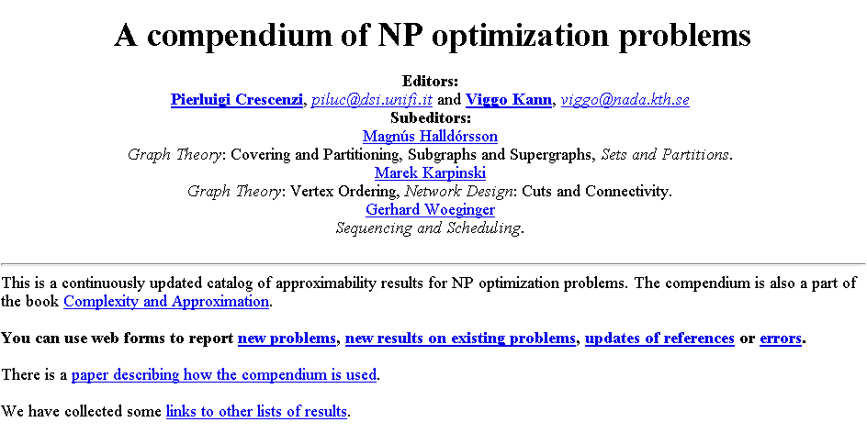
List of NP problems
http://www.nada.kth.se/~viggo/problemlist/compendium.html

Slide 82
What is a good algorithm/solution?
If the algorithm has a running time that is a
polynomial function of the size of the input, n,
otherwise it is a “bad” algorithm.
  A problem is considered tractable if it has a polynomial time solution and intractable if it does not.
  For many problems we still do not know if the
    are tractable or not.

Slide 83
Reasonable vs. Unreasonable
Reasonable algorithms have polynomial factors
  O (Log n)
  O (n)
  O (n^{k}) where k is a constant
Unreasonable algorithms have exponential factors
  O (2^{n})
  O (n!)
  O (n^{n})

Slide 84
Halting problem
No program can ever be written to determine whether any arbitrary program will halt. Since many questions can be recast to this, many programs are absolutely impossible, although heuristic or partial solutions are possible.
What does this mean?

Slide 85
What’s this good for anyway?
Knowing hardness of problems lets us know when an optimal solution can exist.
  Salesman can’t sell you an optimal solution
    What is meant by optimal?
    What is meant by best?
Keeps us from seeking optimal solutions when none exist, use heuristics instead.
  Some software/solutions used because they scale well.
Helps us scale up problems as a function of resources.
Many interesting problems are very hard (NP)!
  Use heuristic solutions
Only appropriate when problems have to scale.

Slide 86
Measuring the growth of work or how does it scale (scalability)
As input size N increases, how well does our automated system work or scale?
  Depends on what you want to do!
Use algorithmic complexity theory:
  Use measure big o: O(N) which means worst case
Important for
  Search engines
  Databases
  Social networks
  Crime/terrorism
Performance classes
Polynomial
Sub-linear O(Log N)
Linear O(N)
Nearly linear O(N Log N)
Quadratic O(N²)
Exponential O(2^{N})
O(N!)
O(N^{N})
Death to
scaling

Slide 87
Two Categories of Algorithms
Lifetime of the universe 10¹⁰ years = 10¹⁷ sec
Unreasonable
10³⁵
10³⁰
10²⁵
10²⁰
10¹⁵
trillion
billion
million
1000
100
10
N^{N}
2^{N}
Runtime sec
N⁵
Reasonable
N
Don’t Care!
2 4 8 16 32 64 128 256 512 1024
Size of Input (N)

Slide 88
Two Categories of Algorithms
Lifetime of the universe 10¹⁰ years = 10¹⁷ sec
10³⁵
10³⁰
10²⁵
10²⁰
10¹⁵
trillion
billion
million
1000
100
10
Unreasonable
N^{N}
2^{N}
Reasonable
Runtime sec
Impractical
N²
Practical
N
Don’t Care!
2 4 8 16 32 64 128 256 512 1024
Size of Input (N)

Slide 89
Summary of algorithmic complexity
Measures of hardness (complicated; many issues open)
Decidable
  Tractable
    Reasonable
      Practical
      Impractical
    Unreasonable
  Intractable
  NP (contains Polynomial class)
Undecidable
No matter what the class, approximations may help and be
useful.

Slide 90
Complexity
Helps in figuring out what solutions to pursue
Measures of hardness
  Decidable vs undecdiable
    Tractable vs intractable
      Reasonable vs unreasonable
        Practical vs impractical

Slide 91
Complex vs complicated
Complex systems deal with several components, many complex themselves
Complexity is a measure of systems
Algorithmic complexity measures work
Complex is not necessarily complicated

Slide 92
Introduced Big O Notation
Measurement of scaling
Worst case scenario of cost of work n
  Important for bounds on costs
Good question for any research that has to scale
  Confused about which one to use: put in a very large number
Cases:
  Worst case: O – bounded above
  Average case
  Best case: Ω – bounded below
Which is best?

Slide 93
What’s this good for anyway?
Knowing hardness of problems lets us know when an optimal solution can exist.
  Salesman can’t sell you an optimal solution
Keeps us from seeking optimal solutions when none exist, use heuristics instead.
  Some software/solutions used because they scale well even though for small problems others outperform.
Helps us scale up problems as a function of resources.
Apply the right approach to the right problem
Many interesting problems are very hard (NP)!
  Use heuristic solutions
Only appropriate when problems have to scale.

Slide 94
Questions
Is big O always useful?
When is it not?
How do I avoid using it?
Space vs time complexity – which matters most
Complex systems are everywhere; are they always modelable?

