Slide 1
Text Processing, Tokenization,
& Characteristics
Thanks to:
Baldi, Frasconi, Smyth
M. Hearst
W. Arms
R. Krovetz
C. Manning, P. Raghavan, H. Schutze

Slide 2
Previously
Documents
  Corpus
  Tokens (terms)
Evaluation
  Relevance
  Precision/recall
  F measure
  Competitions
Web crawlers
  Crawler policy / breath vs depth first search
  Robots.txt
  Scrapy

Slide 3
Text
Text parsing
  Tokenization, terms
  A bit of linguistics
Text characteristics
  Zipf’s law
  Heap’s law

Slide 4
Why the focus on text?
Language is the most powerful query model
Language can be treated as text
Others?

Slide 5
Text Documents
A text digital document consists of a sequence of words and other symbols, e.g., punctuation.
The individual words and other symbols are known as tokens or terms.
A textual document can be:
• Free text, also known as unstructured text, which is a
continuous sequence of tokens.
• Fielded text, also known as structured text, in which the text
is broken into sections that are distinguished by tags or other
markup.
Examples?

Slide 6
Text Based Information Retrieval
Most matching methods are based on Boolean operators.
Most ranking methods are based on the vector space model.
Web search methods combine vector space model with ranking based on importance of documents.
Many practical systems combine features of several approaches.
In the basic form, all approaches treat words as separate tokens with minimal attempt to interpret them linguistically.

Slide 7
Query Engine
Index
Pre-indexing
Interface
Indexer
Text processing
(preprocessing)
Users
Crawler
Web
A Typical Web Search Engine

Slide 8
Focus on documents
Decide what is an individual document
  Can vary depending on problem
Documents are basic units consisting of a sequence of tokens or terms and are to be indexed.
Terms (derived from tokens) are words or roots of words, semantic units or phrases which are the atoms of indexing
Repositories (databases) and corpora are collections of documents.
Query is a request for documents on a query-related topic.

Slide 9
Building an index
Collect documents to be indexed
  Create your corpora
Tokenize the text
Linguistic processing
Build the inverted index from terms

Slide 10
What is a Document?
A document is a digital object with an operational definition
  Indexable (usually digital)
  Can be queried and retrieved.
Many types of documents
  Text or part of text
  Web page
  Image
  Audio
  Video
  Data
  Email
  Etc.

Slide 11
What is Text?
Text is so common that we often ignore its importance
What is text?
  Strings of characters (alphabets, ideograms, ascii, unicode, etc.)
    Words
    . , : ; - ( ) _
    Σψμβολσ
    1 2 3, 3.1415, 10¹⁰
    f = ma, H₂0
    Tables
    Figures
  Anything that is not an image, etc.
  Why is text important?
    Text is language capture
      an instantiation of language, culture, science, etc.

Slide 12
Collection of text
Corpora: collection of texts
  especially if complete and self contained; the corpus of Anglo-Saxon verse
  Special collection
In linguistics and lexicography, a body of texts, utterances or other specimens considered more or less representative of a language and usually stored as an electronic database (The Oxford Companion to the English Language 1992)
A collection of naturally occurring language text chosen to characterize a state or variety of a language (John Sinclair Corpus Concordance Collocation OUP 1991)
Types:
  Written vs Spoken
  General vs Specialized
  Monolingual vs Multilingual
    e.g. Parallel, Comparable
  Synchronic (at a particular pt in time) vs Diachronic (over time)
  Annotated vs Unannotated
  Indexed vs unindexed
  Static vs dynamic

Slide 13
Written corpora
B
r
o
w
n
L
O
B
T
i
m
e
o
f
c
o
m
p
i
l
a
t
i
o
n
1
9
6
0
s
1
9
7
0
s
C
o
m
p
i
l
e
d
a
t
B
r
o
w
n
U
n
i
v
e
r
s
i
t
y
(
U
S
)
L
a
n
c
a
s
t
e
r
,
O
s
l
o
,
B
e
r
g
e
n
L
a
n
g
u
a
g
e
v
a
r
i
e
t
y
W
r
i
t
t
e
n
A
m
e
r
i
c
a
n
E
n
g
l
i
s
h
W
r
i
t
t
e
n
B
r
i
t
i
s
h
E
n
g
l
i
s
h
S
i
z
e
1
m
i
l
l
i
o
n
w
o
r
d
s
(
5
0
0
t
e
x
t
s
o
f
2
0
0
0
w
o
r
d
s
e
a
c
h
)
D
e
s
i
g
n
B
a
l
a
n
c
e
d
c
o
r
p
o
r
a
;
1
5
g
e
n
r
e
s
o
f
t
e
x
t
,
i
n
c
l
.
p
r
e
s
s
r
e
p
o
r
t
a
g
e
,
e
d
i
t
o
r
i
a
l
s
,
r
e
v
i
e
w
s
,
r
e
l
i
g
i
o
n
,
g
o
v
e
r
n
m
e
n
t
d
o
c
u
m
e
n
t
s
,
r
e
p
o
r
t
s
,
b
i
o
g
r
a
p
h
i
e
s
,
s
c
i
e
n
t
i
f
i
c
w
r
i
t
i
n
g
,
f
i
c
t
i
o
n

Slide 14
Text Processing – Lexical Analysis
Standard Steps:
  Recognize language class [english] (very easy)
  Recognize document structure
    titles, sections, paragraphs, etc.
  Break into tokens – type of markup
    Tokens are delimited text
      Hello, how are you.
      _hello_,_how_are_you_._
    usually space and punctuation delineated
    special issues with Asian languages
  Lemmatization, stemming/morphological analysis
  What is left are terms
  Store in inverted index
Lexical analysis is the process of converting a sequence of characters into a sequence of tokens.
  A program or function which performs lexical analysis is called a lexical analyzer, lexer or scanner.

Slide 15





Basic indexing pipeline
Documents to
be indexed.
Friends, Romans, countrymen.
Tokenizer
Token stream.
Friends
Romans
Countrymen
Linguistic modules
Modified tokens (terms).
friend
roman
countryman
Indexer
friend
2
4
roman
1
2
Inverted index.
countryman
13
16

Slide 16
Parsing a document
(lexical analysis)
What format is it in?
  pdf/word/excel/html?
What language is it in?
What character set is in use?
Each of these is a classification problem which can be solved using heuristics or machine learning methods.
But there are complications …

Slide 17
Format/language stripping
Documents being indexed can include docs from many different languages
  A single index may have to contain terms of several languages.
Sometimes a document or its components can contain multiple languages/formats
  French email with a Portuguese pdf attachment.
What is a unit document?
  An email?
  With attachments?
  An email with a zip containing documents?

Slide 18
Tokenization is the basic part of document preprocessing
Convert byte sequences into a linear sequence of characters
Trivial with ascii, but not so with Unicode or others
  Use ML classifiers or heuristics.
Crucial problem for commercial systems!

Slide 19
Tokenization
Fundamental to Natural Language Processing (NLP), IR, deep Learning and AI
Parsing (chopping up) the document into basic units that are candidates for later indexing
  What parts of text to use and what not
Issues with
  Punctuation
  Numbers
  Special characters
  Equations
  Formula
  Languages
  Normalization (often by stemming)

Slide 20
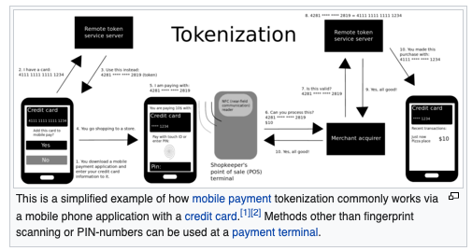
Tokenization
Not the tokenization of how to make data secure

Slide 21

Tokenization
Not the tokenization of how to make data secure

Slide 22
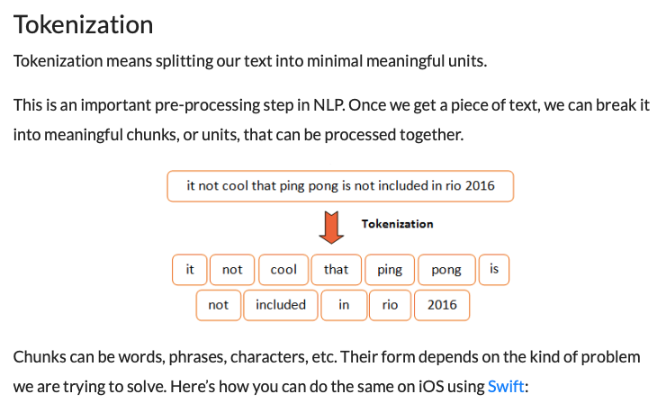
Sometimes called ”parsers”

Slide 23
What tokenization did you use?
For real problems always ask this!
A fundamental question for all text processing
  Natural language processing
  Text mining
  Machine learning and AI
  Information retrieval and search

Slide 24

Natural Language Toolkit (NLTK)
A suite of Python libraries for symbolic and statistical natural language programming
  Developed at the University of Pennsylvania
  Has its own tokenization
Developed to be a teaching tool and a platform for research NLP prototypes
  Data types are packaged as classes
  Goal of code is to be clear, rather than fastest performance
Online book: http://www.nltk.org/book/
  Authors: Edward Loper, Ewan Kline and Steven Bird

Slide 25
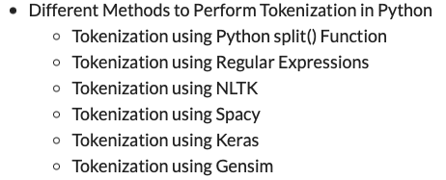
Lots of tokenizers out there

Slide 26
Tokenization example
Input: “Friends, Romans and Countrymen”
Output: Tokens
  friends
  romans
  countrymen
Each such token is now a candidate for an index entry, after further processing
  Described below
But what are valid tokens to emit?

Slide 27
Tokenization
Issues in tokenization:
  Finland’s capital →
  Finland? Finlands? Finland’s?
  Hewlett-Packard →
    Hewlett and Packard as two tokens?
    State-of-the-art: break up hyphenated sequence.
    co-education ?
    the hold-him-back-and-drag-him-away-maneuver ?
  San Francisco: one token or two? How do you decide it is one token?

Slide 28
Numbers
3/12/91
Mar. 12, 1991
55 B.C.
B-52
My PGP key is 324a3df234cb23e
100.2.86.144
  Generally, don’t index as text.
  Will often index “meta-data” separately
    Creation date, format, etc.

Slide 29
Tokenization: Language issues
L'ensemble → one token or two?
  L ? L’ ? Le ?
  Want ensemble to match with un ensemble
German noun compounds are not segmented
  Lebensversicherungsgesellschaftsangestellter
  ‘life insurance company employee’

Slide 30
Tokenization: language issues
Chinese and Japanese have no spaces between words:
  Not always guaranteed a unique tokenization
Further complicated in Japanese, with multiple alphabets intermingled
  Dates/amounts in multiple formats
  フォーチュン500社は情報不足のため時間あた$500K(約6,000万円)
Katakana
Hiragana
Kanji
“Romaji”
End-user can express query entirely in hiragana!

Slide 31
Tokenization: language issues
Arabic (or Hebrew) is basically written right to left, but with certain items like numbers written left to right
Words are separated, but letter forms within a word form complex ligatures
استقلت الجزائر في سنة 1962 بعد 132 عاما من الاحتلال الفرنسي.
← → ← → ← start
‘Algeria achieved its independence in 1962 after 132 years of French occupation.’
With Unicode, the surface presentation is complex, but the stored form is straightforward

Slide 32
Normalization
Need to “normalize” terms in indexed text as well as query terms into the same form
  We want to match U.S.A. and USA
We most commonly implicitly define equivalence classes of terms
  e.g., by deleting periods in a term
Alternative is to do limited expansion:
  Enter: window Search: window, windows
  Enter: windows Search: Windows, windows
  Enter: Windows Search: Windows
Potentially more powerful, but less efficient

Slide 33
Case folding
Reduce all letters to lower case
  exception: upper case (in mid-sentence?)
    e.g., General Motors
    Fed vs. fed
    SAIL vs. sail
  Often best to lower case everything, since users will use lowercase regardless of ‘correct’ capitalization

Slide 34
Normalizing Punctuation
Ne’er vs. never: use language-specific, handcrafted “locale” to normalize.
  Which language?
  Most common: detect/apply language at a pre-determined granularity: doc/paragraph.
U.S.A. vs. USA – remove all periods or use locale.
a.out

Slide 35
Thesauri and soundex
Handle synonyms and homonyms
  Hand-constructed equivalence classes
    e.g., car = automobile
    color = colour
Rewrite to form equivalence classes
Index such equivalences
  When the document contains automobile, index it under car as well (usually, also vice-versa)
Or expand query?
  When the query contains automobile, look under car as well

Slide 36
Soundex
Traditional class of heuristics to expand a query into phonetic equivalents
  Language specific – mainly for names
  E.g., chebyshev → tchebycheff

Slide 37
Stemming and Morphological Analysis
Goal: “normalize” similar words
Morphology (“form” of words)
  Inflectional Morphology
    E.g,. inflect verb endings and noun number
    Never change grammatical class
      dog, dogs
  Derivational Morphology
    Derive one word from another,
    Often change grammatical class
      build, building; health, healthy

Slide 38
Lemmatization
Reduce inflectional/variant forms to base form
E.g.,
  am, are, is → be
  car, cars, car's, cars' → car
the boy's cars are different colors → the boy car be different color
Lemmatization implies doing “proper” reduction to dictionary headword form

Slide 39
Stemming
Morphological variants of a word (morphemes). Similar terms derived from a common stem:
engineer, engineered, engineering
use, user, users, used, using
Stemming in Information Retrieval. Grouping words with a common stem together.
For example, a search on reads, also finds read, reading, and readable
Stemming consists of removing suffixes and conflating the resulting morphemes. Occasionally, prefixes are also removed.

Slide 40
Stemming
Reduce terms to their “roots” before indexing
“Stemming” suggest crude affix chopping
  language dependent
  e.g., automate(s), automatic, automation all reduced to automat.
for example compressed
and compression are both
accepted as equivalent to
compress.
for exampl compress and
compress ar both accept
as equival to compress

Slide 41
Porter’s algorithm
Commonest algorithm for stemming English
  Results suggest at least as good as other stemming options
Conventions + 5 phases of reductions
  phases applied sequentially
  each phase consists of a set of commands
  sample convention: Of the rules in a compound command, select the one that applies to the longest suffix.

Slide 42
Typical rules in Porter
sses → ss
ies → i
ational → ate
tional → tion
Weight of word sensitive rules
(m>1) EMENT →
    replacement → replac
    cement → cement

Slide 43
Other stemmers
Other stemmers exist, e.g., Lovins stemmer http://www.comp.lancs.ac.uk/computing/research/stemming/general/lovins.htm
  Single-pass, longest suffix removal (about 250 rules)
  Motivated by Linguistics as well as IR
Full morphological analysis – at most modest benefits for retrieval
Do stemming and other normalizations help?
  Often very mixed results: really help recall for some queries but harm precision on others

Slide 44
Automated Methods are the norm
Powerful multilingual tools exist for morphological analysis
  PCKimmo, Xerox Lexical technology
  Require a grammar and dictionary
  Use “two-level” automata
Stemmers:
  Very dumb rules work well (for English)
  Porter Stemmer: Iteratively remove suffixes
  Improvement: pass results through a lexicon

Slide 45
Porter’s algorithm
Commonest algorithm for stemming English
Conventions + 5 phases of reductions
  phases applied sequentially
  each phase consists of a set of commands
  sample convention: Of the rules in a compound command, select the one that applies to the longest suffix.
Typical rules
  sses → ss
  ies → i
  ational → ate
  tional → tion

Slide 46
Categories of Stemmer
The following diagram illustrate the various categories of stemmer. Porter's algorithm is shown by the red path.
Conflation methods
Manual Automatic (stemmers)
Affix Successor Table n-gram
removal variety lookup
Longest Simple
match removal

Slide 47
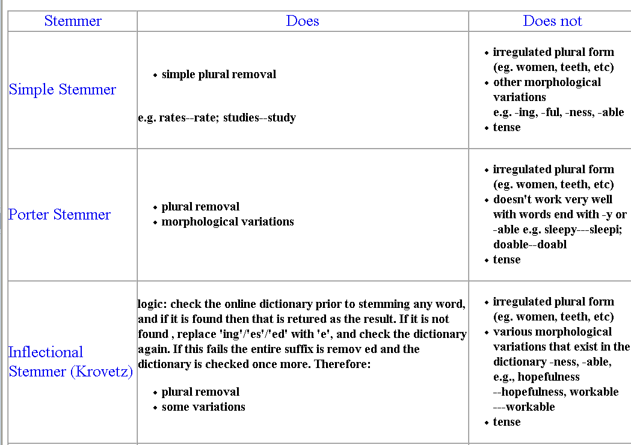
Comparison of stemmers

Slide 48
Stemming in Practice
Evaluation studies have found that stemming can affect retrieval
performance, usually for the better, but the results are mixed.
• Effectiveness is dependent on the vocabulary. Fine distinctions may be lost through stemming.
• Automatic stemming is as effective as manual conflation.
• Performance of various algorithms is similar.
Porter's Algorithm is entirely empirical, but has proved to be an
effective algorithm for stemming English text with trained users.

Slide 49
Language-specificity
Many of the above features embody transformations that are
  Language-specific and
  Often, application-specific
These are “plug-in” addenda to the indexing process
Both open source and commercial plug-ins available for handling these

Slide 50
Normalization: other languages
Accents: résumé vs. resume.
Most important criterion:
  How will your users write their queries for these words?
Even in languages that standardly have accents, users often may not type them
German: Tuebingen vs. Tübingen
  Should be equivalent

Slide 51
Normalization: other languages
Need to “normalize” indexed text as well as query terms into the same form
Character-level alphabet detection and conversion
  Tokenization not separable from this.
  Sometimes ambiguous:
7月30日 vs. 7/30
Is this
German “mit”?
Morgen will ich in MIT …

Slide 52
Dictionary entries – first cut
ensemble.french
時間.japanese
MIT.english
mit.german
guaranteed.english
entries.english
sometimes.english
tokenization.english
These may be grouped by language. More on this in ranking/query processing.

Slide 53
Query Engine
Index
Interface
Indexer
Users
Crawler
Web
A Typical Web Search Engine

Slide 54
Content Analysis of Text
Automated Transformation of raw text into a form that represent some aspect(s) of its meaning
Including, but not limited to:
  Token creation
  Matrices and Vectorization
  Phrase Detection
  Categorization
  Clustering
  Summarization

Slide 55
Techniques for Content Analysis
Statistical / vector
  Single Document
  Full Collection
Linguistic
  Syntactic
  Semantic
  Pragmatic
Knowledge-Based (Artificial Intelligence)
Hybrid (Combinations)

Slide 56
Stop Lists
Very common words, such as of, and, the, are rarely of use in information retrieval.
A stop list is a list of such words that are removed during lexical analysis.
NOT INDEXED
A long stop list saves space in indexes, speeds processing, and eliminates many false hits.
However, common words are sometimes significant in information retrieval, which is an argument for a short stop list. (Consider the query, "To be or not to be?")

Slide 57
Suggestions for Including Words in a Stop List
• Include the most common words in the English language (perhaps 50 to 250 words).
• Do not include words that might be important for retrieval (Among the 200 most frequently occurring words in general literature in English are time, war, home, life, water, and world).
• In addition, include words that are very common in context (e.g., computer, information, system in a set of computing documents).

Slide 58
Example: the WAIS stop list
(first 84 of 363 multi-letter words)
about above according across actually adj after afterwards again against all almost alone along already also although always among amongst an another any anyhow anyone anything anywhere are aren't around at be became because become becomes becoming been before beforehand begin beginning behind being below beside besides between beyond billion both but by can can't cannot caption co could couldn't
did didn't do does doesn't don't down during each eg eight eighty
either else elsewhere end ending enough
etc even ever every everyone everything

Slide 59
Stop list policies
How many words should be in the stop list?
• Long list lowers recall
Which words should be in list?
• Some common words may have retrieval importance:
-- war, home, life, water, world
• In certain domains, some words are very common:
-- computer, program, source, machine, language
There is very little systematic evidence to use in selecting a stop list.

Slide 60
Stop Lists in Practice
The modern tendency is:
have very short stop lists for broad-ranging or multi-lingual document collections, especially when the users are not trained (or none at all – Moore’s law)
have longer stop lists for document collections in well-defined fields, especially when the users are trained professional.
Web search engines have no stop lists

Slide 61
Token generation - stemming
What are tokens for documents?
  Words (things between spaces)
Some words equivalent
Stemming finds equivalences among words
Removal of grammatical suffixes

Slide 62
Stemming
Reduce terms to their roots before indexing
  language dependent
  e.g., automate(s), automatic, automation all reduced to automat.
for example compressed
and compression are both
accepted as equivalent to
compress.
for exampl compres and
compres are both accept as
equival to compres.

Slide 63
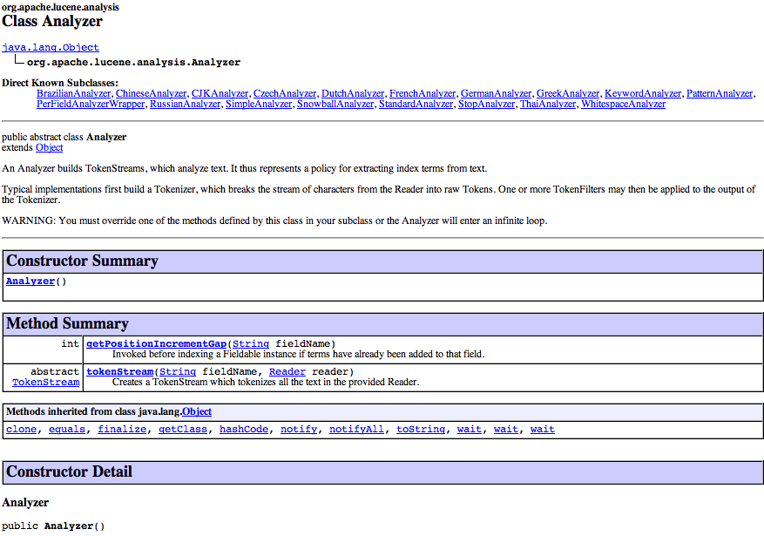

Slide 64
Analyzer:
Lucene Tokenization
Tokenizes the input text
Common Analyzers
  WhitespaceAnalyzer
  Splits tokens on whitespace
  SimpleAnalyzer
  Splits tokens on non-letters, and then lowercases
  StopAnalyzer
  Same as SimpleAnalyzer, but also removes stop words
  StandardAnalyzer
  Most sophisticated analyzer that knows about certain token types, lowercases, removes stop words, ...

Slide 65
Analysis example
“The quick brown fox jumped over the lazy dog”
WhitespaceAnalyzer
  [The] [quick] [brown] [fox] [jumped] [over] [the] [lazy] [dog]
SimpleAnalyzer
  [the] [quick] [brown] [fox] [jumped] [over] [the] [lazy] [dog]
StopAnalyzer
  [quick] [brown] [fox] [jumped] [over] [lazy] [dog]
StandardAnalyzer
  [quick] [brown] [fox] [jumped] [over] [lazy] [dog]

Slide 66
Another analysis example
“XY&Z Corporation – xyz@example.com”
WhitespaceAnalyzer
  [XY&Z] [Corporation] [-] [xyz@example.com]
SimpleAnalyzer
  [xy] [z] [corporation] [xyz] [example] [com]
StopAnalyzer
  [xy] [z] [corporation] [xyz] [example] [com]
StandardAnalyzer
  [xy&z] [corporation] [xyz@example.com]

Slide 67
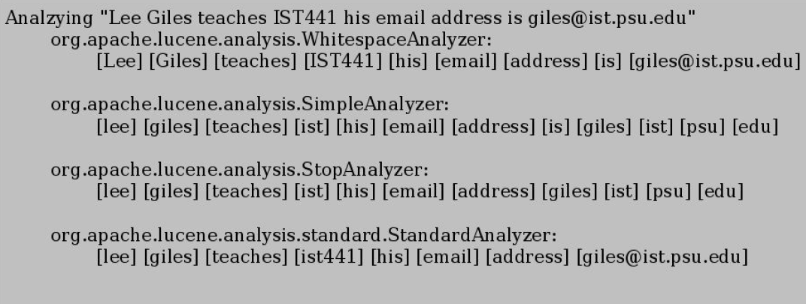
Example of tokenizing a document with different Lucene Analyzers

Slide 68
What’s inside an Analyzer?
Analyzers need to return a TokenStream
public TokenStream tokenStream(String fieldName,
Reader reader)
TokenStream
Tokenizer
TokenFilter
Reader
Tokenizer
TokenFilter
TokenFilter
lemmatization

Slide 69
Lucene Tokenizers and TokenFilters
Tokenizer
  WhitespaceTokenizer
  KeywordTokenizer
  LetterTokenizer
  StandardTokenizer
  ...
TokenFilter
  LowerCaseFilter
  StopFilter
  PorterStemFilter
  ASCIIFoldingFilter
  StandardFilter
  ...

Slide 70
Other Analyzers
Also available
  GermanAnalyzer
  RussianAnalyzer
  (Lucene Sandbox)
    BrazilianAnaylzer
    ChineseAnalyzer (UTF-8)
    CzechAnalyzer
    DutchAnalyzer
    FrenchAnalyzer
    GreekAnalyzer
    KoreanAnalyzer
    JapaneseAnalyzer

Slide 71
Analyzer for Lucene
Tokenization: Create an Analyser
  Options
    WhitespaceAnalyzer
      divides text at whitespace
    SimpleAnalyzer
      divides text at non-letters
      convert to lower case
    StopAnalyzer
      SimpleAnalyzer
      removes stop words
    StandardAnalyzer
      good for most European Languages
      removes stop words
      convert to lower case

Slide 72
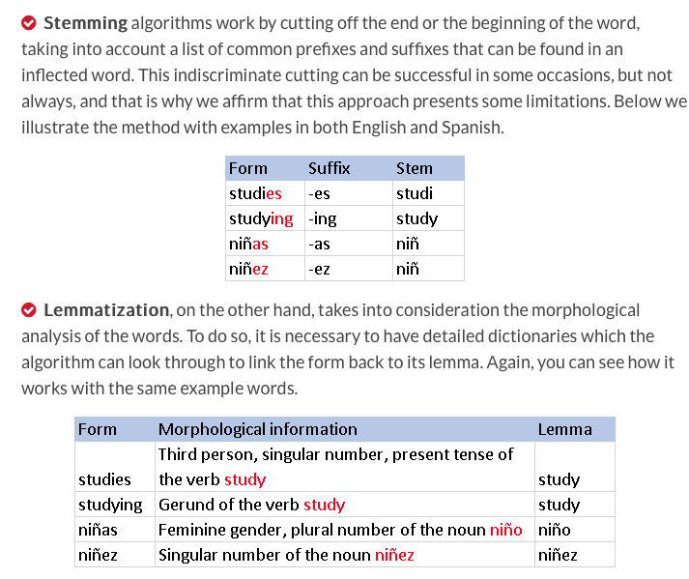

Slide 73
Summary of Text
Text is reduced to tokens (terms)
Stop words can be removed
Tokenizer has many features
Stemmers widely used for token generation
  Porter stemmer most common

Slide 74
Selection of tokens, weights, stop lists and stemming
Special purpose collections (e.g., law, medicine, monographs)
Best results are obtained by tuning the search engine for the characteristics of the collections and the expected queries.
It is valuable to use a training set of queries, with lists of relevant documents, to tune the system for each application.
General purpose collections (e.g., web search)
The modern practice is to use a basic weighting scheme (e.g., tf.idf), a simple definition of token, a short stop list and no stemming except for plurals, with minimal conflation.
Web searching combine similarity ranking with ranking based on document importance.

Slide 75
Indexing Subsystem
documents
Documents
assign document IDs
text
document numbers and *field numbers
break into tokens
tokens
stop list*
non-stoplist tokens
stemming*
*Indicates optional operation.
stemmed terms
term weighting*
terms with weights
Index database

Slide 76
Search Subsystem
query
parse query
query tokens
ranked document set
stop list*
non-stoplist tokens
ranking*
stemming*
stemmed terms
Boolean operations*
*Indicates optional operation.
retrieved document set
Index database
relevant document set

Slide 77
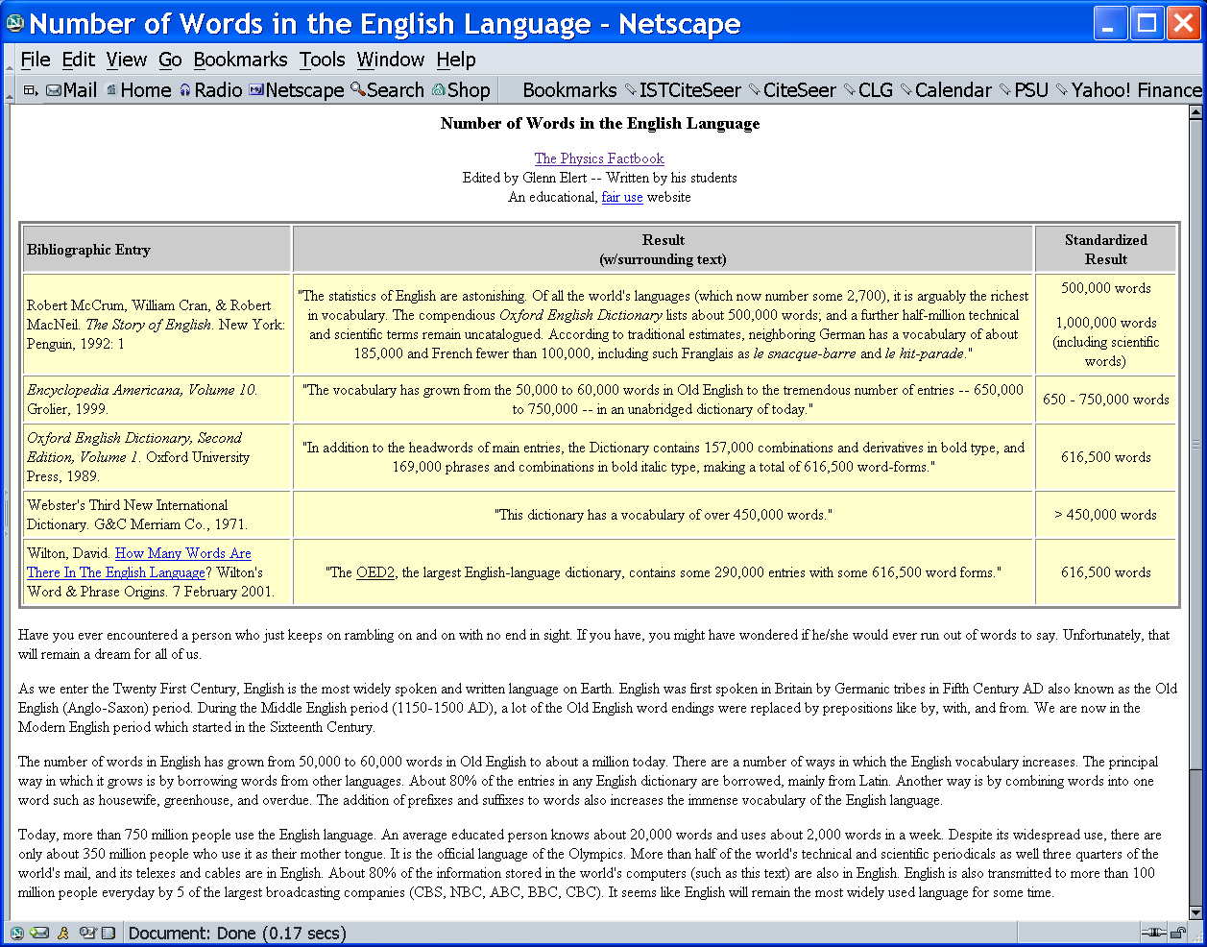

Slide 78
Try out queries on Google
fish
fishs
fishes
fishing

Slide 79
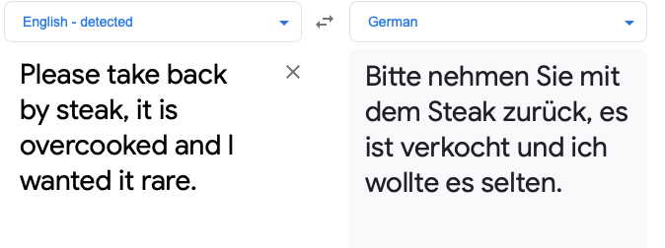
Google Translate Example - problems

Slide 80
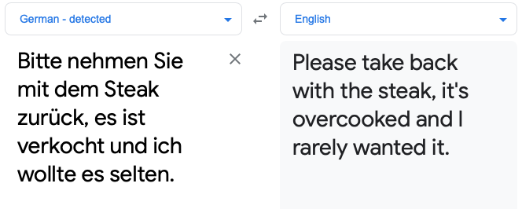

Slide 81
Statistical Properties of Text
Token occurrences in text are not uniformly distributed
They are also not normally distributed
They do exhibit a Zipf distribution
  Also known as “discrete Pareto distribution”

Slide 82
Zipf Distribution
https://www.youtube.com/watch?v=fCn8zs912OE&ab_channel=Vsauce

Slide 83
A More Standard Collection
Government documents, 157734 tokens, 32259 unique
8164 the
4771 of
4005 to
2834 a
2827 and
2802 in
1592 The
1370 for
1326 is
1324 s
1194 that
973 by
969 on
915 FT
883 Mr
860 was
855 be
849 Pounds
798 TEXT
798 PUB
798 PROFILE
798 PAGE
798 HEADLINE
798 DOCNO
1 ABC
1 ABFT
1 ABOUT
1 ACFT
1 ACI
1 ACQUI
1 ACQUISITIONS
1 ACSIS
1 ADFT
1 ADVISERS
1 AE

Slide 84
Plotting Word Frequency by Rank
Main idea: count
  How many times tokens occur in the text
    Over all texts in the collection
Now rank these according to how often they occur. This is called the rank.

Slide 85
Rank Freq Term
1 37 system
2 32 knowledg
3 24 base
4 20 problem
5 18 abstract
6 15 model
7 15 languag
8 15 implem
9 13 reason
10 13 inform
11 11 expert
12 11 analysi
13 10 rule
14 10 program
15 10 oper
16 10 evalu
17 10 comput
18 10 case
19 9 gener
20 9 form
Most and Least Frequent Terms
150 2 enhanc
151 2 energi
152 2 emphasi
153 2 detect
154 2 desir
155 2 date
156 2 critic
157 2 content
158 2 consider
159 2 concern
160 2 compon
161 2 compar
162 2 commerci
163 2 clause
164 2 aspect
165 2 area
166 2 aim
167 2 affect

Slide 86
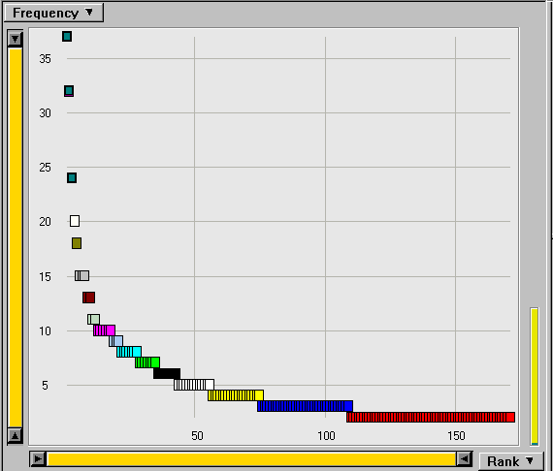
Rank Freq
1 37 system
2 32 knowledg
3 24 base
4 20 problem
5 18 abstract
6 15 model
7 15 languag
8 15 implem
9 13 reason
10 13 inform
11 11 expert
12 11 analysi
13 10 rule
14 10 program
15 10 oper
16 10 evalu
17 10 comput
18 10 case
19 9 gener
20 9 form
The Corresponding Zipf Curve

Slide 87
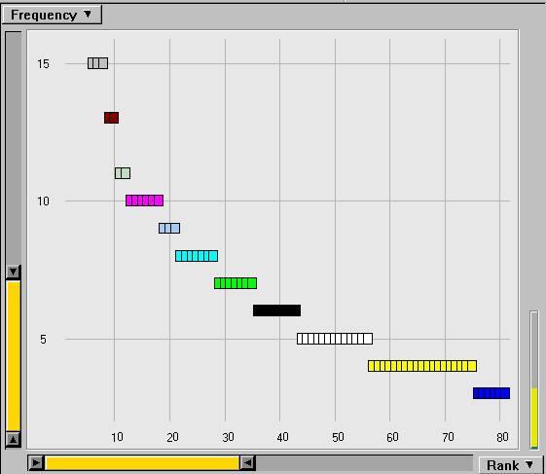
43 6 approach
44 5 work
45 5 variabl
46 5 theori
47 5 specif
48 5 softwar
49 5 requir
50 5 potenti
51 5 method
52 5 mean
53 5 inher
54 5 data
55 5 commit
56 5 applic
57 4 tool
58 4 technolog
59 4 techniqu
Zoom in on the Knee of the Curve

Slide 88
Zipf Distribution
The Important Points:
  a few elements occur very frequently
  a medium number of elements have medium frequency
  many elements occur very infrequently
  Self similarity
    Same shape for large and small frequency words
  Long tail
  Not necessarily obeys central limit theorem

Slide 89
Zipf Distribution
The product of the frequency of words (f) and their rank (r) is approximately constant
  Rank = order of words’ frequency of occurrence
Another way to state this is with an approximately correct rule of thumb:
  Say the most common term occurs C times
  The second most common occurs C/2 times
  The third most common occurs C/3 times
  …

Slide 90
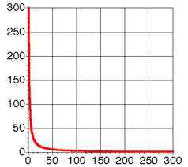
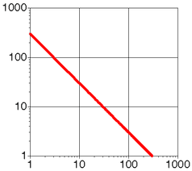
Zipf Distribution
(linear and log scale)

Slide 91
What Kinds of Data Exhibit a Zipf Distribution?
Words in a text collection
  Virtually any language usage
Library book checkout patterns
Incoming Web Page Requests (Nielsen)
Outgoing Web Page Requests (Cunha & Crovella)
Document Size on Web (Cunha & Crovella)
Many sales with certain retailers

Slide 92
Prevalence of Zipfian Laws
Many items exhibit a Zipfian distribution.
  Population of cities
  Wealth of individuals
    Discovered by sociologist/economist Pareto in 1909
  Popularity of books, movies, music, web-pages, etc.
  Popularity of consumer products
    Chris Anderson’s “long tail”
Notes:
92

Slide 93
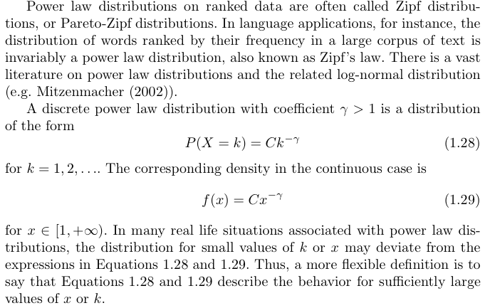
Power Laws

Slide 94
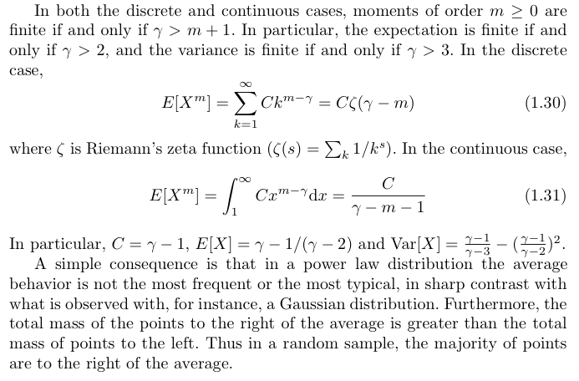
Power Law Statistics - problems with means

Slide 95
Power-law distributions
The degree distributions of most real-life networks follow a power law
Right-skewed/Heavy-tail distribution
  there is a non-negligible fraction of nodes that has very high degree (hubs)
  scale-free: no characteristic scale, average is not informative
In stark contrast with the random graph model!
  Poisson degree distribution, z=np
  highly concentrated around the mean
  the probability of very high degree nodes is exponentially small
p(k) = Ck^{-α}

Slide 96
Power-law signature
Power-law distribution gives a line in the log-log plot
α : power-law exponent (typically 2 ≤ α ≤ 3)
log p(k) = -α logk + logC
frequency
log frequency
α
degree
log degree

Slide 97
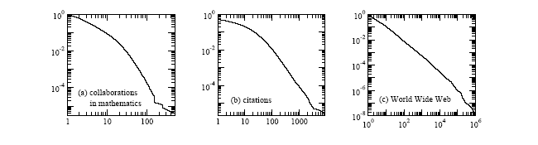
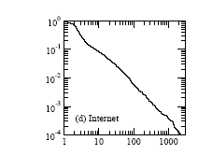
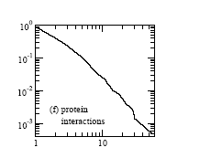
Examples of degree distribution for power laws
Taken from [Newman 2003]

Slide 98

Power Law Statistics - long tails
Power of the long tail:
The phrase The Long Tail, as a proper noun, was first coined by Chris Anderson. The concept drew in part from an influential February 2003 essay by Clay Shirky, "Power Laws, Weblogs and Inequality" that noted that a relative handful of weblogs have many links going into them but "the long tail" of millions of weblogs may have only a handful of links going into them. Beginning in a series of speeches in early 2004 and culminating with the publication of a Wired magazine article in October 2004, Anderson described the effects of the long tail on current and future business models. Anderson later extended it into the book The Long Tail: Why the Future of Business is Selling Less of More (2006).
Anderson argued that products that are in low demand or have low sales volume can collectively make up a market share that rivals or exceeds the relatively few current bestsellers and blockbusters, if the store or distribution channel is large enough. Examples of such mega-stores include the online retailer Amazon.com and the online video rental service Netflix. The Long Tail is a potential market and, as the examples illustrate, the distribution and sales channel opportunities created by the Internet often enable businesses to tap into that market successfully.

Slide 99
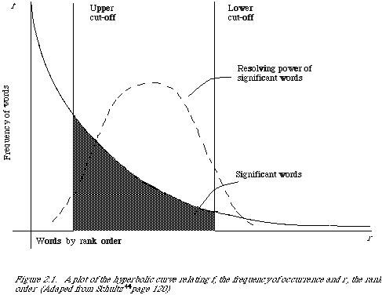
Word Frequency vs. Resolving Power
The most frequent words are not the most descriptive.
van Rijsbergen 79

Slide 100
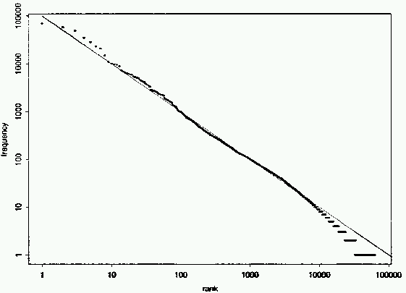
Fit to Zipf for Brown Corpus
k = 100,000
Notes:
100

Slide 101
Does Real Data Fit Zipf’s Law?
A law of the form y = kx^{c} is called a power law.
Zipf’s law is a power law with c = –1
On a log-log plot, power laws give a straight line with slope c.
Zipf is quite accurate except for very high and low rank.
Notes:
101

Slide 102
Mandelbrot (1954) Correction
The following more general form gives a bit better fit:
Notes:
102

Slide 103
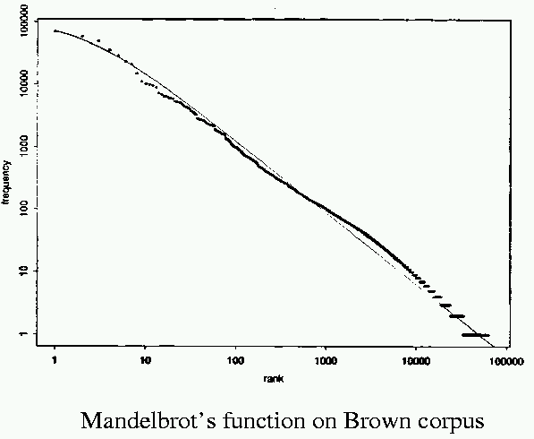
Mandelbrot Fit
P = 10^{5.4}, B = 1.15, ρ = 100
Notes:
103

Slide 104
Explanations for Zipf’s Law
Zipf’s explanation was his “principle of least effort.” Balance between speaker’s desire for a small vocabulary and hearer’s desire for a large one.
Debate (1955-61) between Mandelbrot and H. Simon over explanation.
Simon explanation is “rich get richer.”
Li (1992) shows that just random typing of letters including a space will generate “words” with a Zipfian distribution.
  http://linkage.rockefeller.edu/wli/zipf/
Notes:
104

Slide 105
Zipf’s Law Impact on IR
Good News:
  Stopwords will account for a large fraction of text so eliminating them greatly reduces inverted-index storage costs.
  Postings list for most remaining words in the inverted index will be short since they are rare, making retrieval fast.
Bad News:
  For most words, gathering sufficient data for meaningful statistical analysis (e.g. for correlation analysis for query expansion) is difficult since they are extremely rare.
Notes:
105

Slide 106
Vocabulary Growth
How does the size of the overall vocabulary (number of unique words) grow with the size of the corpus?
This determines how the size of the inverted index will scale with the size of the corpus.
Vocabulary not really upper-bounded due to proper names, typos, etc.
Notes:
106

Slide 107
Heaps’ Law
If V is the number of distinct words, size of the vocabulary, and the n is the length of the corpus in words:
Typical constants:
  K ≈ 10−100
  β ≈ 0.4−0.6 (approx. square-root)
H.S. Heaps, G. Herdon
Notes:
107

Slide 108
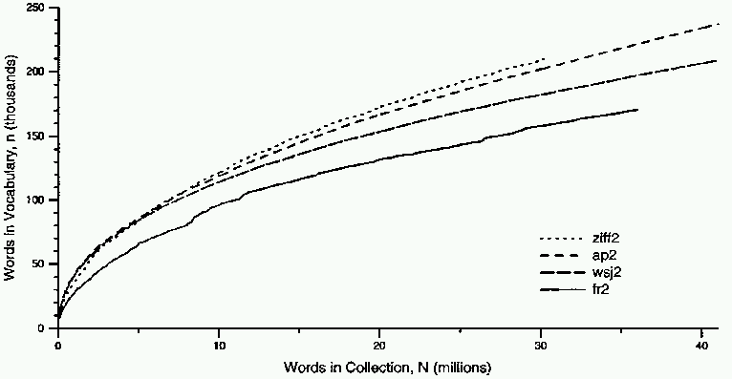
Heaps’ Law Data
Notes:
108

Slide 109
Explanation for Heaps’ Law
Can be derived from Zipf’s law by assuming documents are generated by randomly sampling words from a Zipfian distribution.
Notes:
109

Slide 110
Consequences for Heaps’ Law
Heaps' law means that as more instance text is gathered, there will be diminishing returns in terms of discovery of the full vocabulary from which the distinct terms are drawn.
Heaps' law also applies to situations in which the "vocabulary" is just some set of distinct types which are attributes of some collection of objects. For example, the objects could be people, and the types could be country of origin of the person. If persons are selected randomly (that is, we are not selecting based on country of origin), then Heaps' law says we will quickly have representatives from most countries (in proportion to their population) but it will become increasingly difficult to cover the entire set of countries by continuing this method of sampling. Heaps' law has been observed also in single-cell transcriptomes[4] considering genes as the distinct objects in the "vocabulary".
Notes:
110

Slide 111
Consequences of Zipf for IR
There are always a few very frequent tokens that are not good discriminators.
  Called “stop words” in IR
  Usually correspond to linguistic notion of “closed-class” words
    English examples: to, from, on, and, the, ...
    Grammatical classes that don’t take on new members.
There are always a large number of tokens that occur once and can mess up algorithms.
Medium frequency words most descriptive

Slide 112
Text Metadata
Information about a document that may not be a part of the document itself (data about data).
Descriptive metadata is external to the meaning of the document:
  Author
  Title
  Source (book, magazine, newspaper, journal)
  Date
  ISBN
  Publisher
  Length
Notes:
112

Slide 113
Metadata (cont)
Semantic metadata concerns the content:
  Abstract
  Keywords
  Subject Codes
    Library of Congress
    Dewey Decimal
    UMLS (Unified Medical Language System)
Subject terms may come from specific ontologies (hierarchical taxonomies of standardized semantic terms).
Notes:
113

Slide 114
Web Metadata
META tag in HTML
  <META NAME=“keywords” CONTENT=“pets, cats, dogs”>
META “HTTP-EQUIV” attribute allows server or browser to access information:
  <META HTTP-EQUIV=“expires” CONTENT=“Tue, 01 Jan 02”>
  <META HTTP-EQUIV=“creation-date” CONTENT=“23-Sep-01”>
Notes:
114

Slide 115
Markup Languages
Language used to annotate documents with “tags” that indicate layout or semantic information.
Most document languages (Word, RTF, Latex, HTML) primarily define layout.
History of Generalized Markup Languages:
Standard
eXtensible
GML(1969)
SGML (1985)
XML (1998)
HTML (1993)
HyperText
Notes:
115

Slide 116
Markup Languages
More about this later when we talk about the semantic web
Notes:
116

Slide 117
Text as queries
Text is a natural query model.
Discuss this next.
Notes:
117

Slide 118
Lemmatization vs stemming
In general, lemmatization offers better precision than stemming, but at the expense of recall.
Stemming and lemmatization are effective techniques to expand recall
lemmatization gives up some recall to increase precision.
But both techniques can feel like crude instruments, but Google uses them
Lemmatization and stemming are special cases of normalization. They identify a canonical representative for a set of related word forms. The entire process is often called normalization
Some use lemmatization to refer to both

Slide 119
Text - Summary
Perform lexical analysis - processing text into tokens or terms
  Many issues: normalization, lemmatization
  Most language dependent
  Languages on the internet
Stemming reduces the number of tokens
  Porter stemmer most common
Lemmatization reduces the number of tokes
  Can operate on stimms
  can include stemming
Stop words removed to improve performance
  Can be omitted
Lucene Analyzers perform tokenization
  Many tokenizers available (Python)
What remains are terms to be indexed
Text has power law distribution (Zipf)
  Words with resolving power in the middle and tail of the distribution
  Heap/s law shows how vocab growth tapers off
Text as metadata and queries

Slide 120
https://odu.zoom.us/my/fanchyna?pwd=M0d4V0YwRkF2aTJEQnZVTTR1ZUllZz09
Password: 23529

