Slide 1
Customizing your Search Engine
Shaurya Rohatgi
Thanks to Agnese Chiatti

Slide 2
Recap
Crawling the necessary contents with Scrapy
Dumping the results in mirror format for HTML pages
Retrieving the stored HTML pages from file system
Indexing the crawled contents into Elasticsearch
Time to create your own interface!

Slide 3
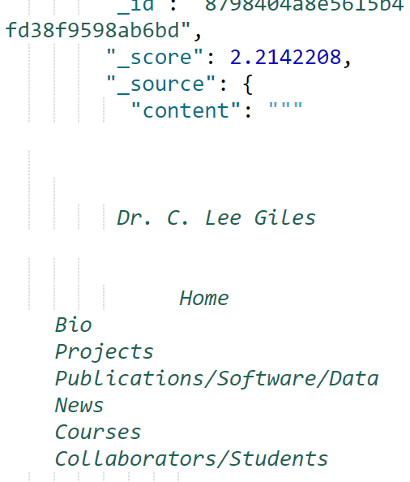
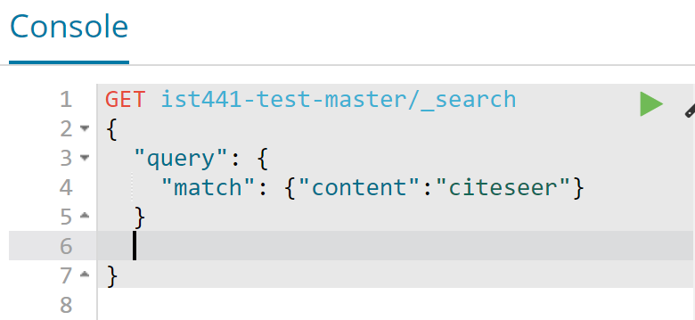
Test & Trials from Kibana First
query for a specific keyword
Notes:
GET ist441-test-master/_search
{
"query": {
"match": {"content":"citeseer"}
}
}

Slide 4
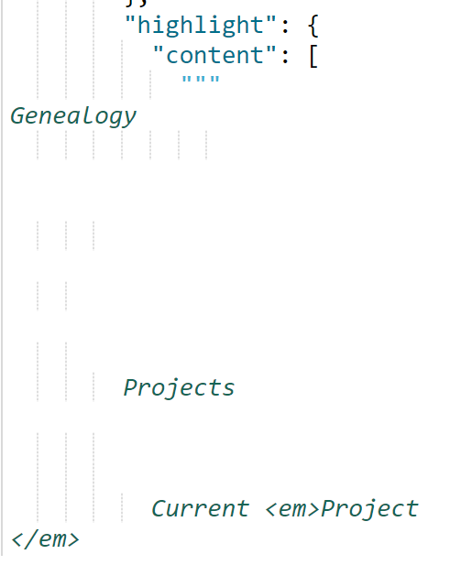
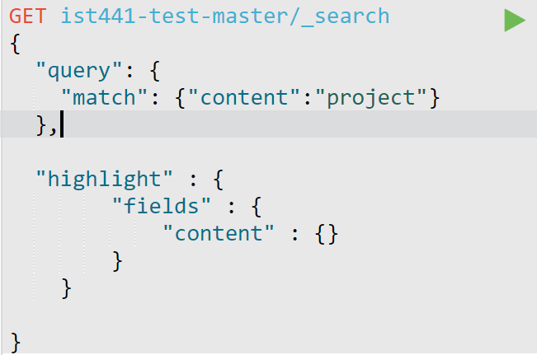
Test & Trials from Kibana First
Adding Text Highlighting
Notes:
GET ist441-test-master/_search
{
"query": {
"match": {"content":"project"}
},
"highlight" : {
"fields" : {
"content" : {}
}
}
}

Slide 5
Django Web Apps in a nutshell
Python scripts are run as backend
Front-end is handled through HTML and CSS
Project with specific folder structure
We are interested in models.py, views.py and HTML templates specifically
For more details you can check out the docs (we are using version 1.5)

Slide 6
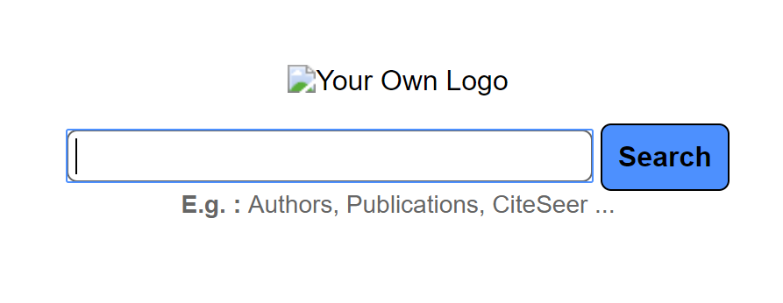
Visit your baseline search page
From a browser (in VLABS or other classroom computer) visit: http://ist441giles.ist.psu.edu:808 + team no/home e. g. http://ist441giles.ist.psu.edu:8081/home for team 1
http://ist441giles.ist.psu.edu:8090/home for team 10

Slide 7
models.py
under /data/ist441/teamno/search/interface/rsc/models.py
Defines the “database” object that you will be dealing with
Here you can model the attributes your search results will have
… as Python objects

Slide 9
views.py
under /data/team<id>/UI/ist441/ist441/seer/views.py
Defines dynamics (i.e., which HTML page is viewed and when)
through Python methods
Thus, we can use the Elasticsearch API for Python
To link the interface we the Lucene index we created last time

Slide 10
What you will need to change for this demo
Your team’s Elasticsearch port number -- line 16
Your index name (based on the index created during the last tutorial) -- line 19

Slide 11
Adding the Pagination Feature

Slide 12
The actual HTML interface
All HTML templates used for this demo are stored under /data/team<id>/UI/ist441/ist441/seer/templates/seer/
index.html is the main page
htmlresult.html handles the look of your result list
/data/team<id>/UI/ist441/ist441/ist441/settings.py

Slide 13
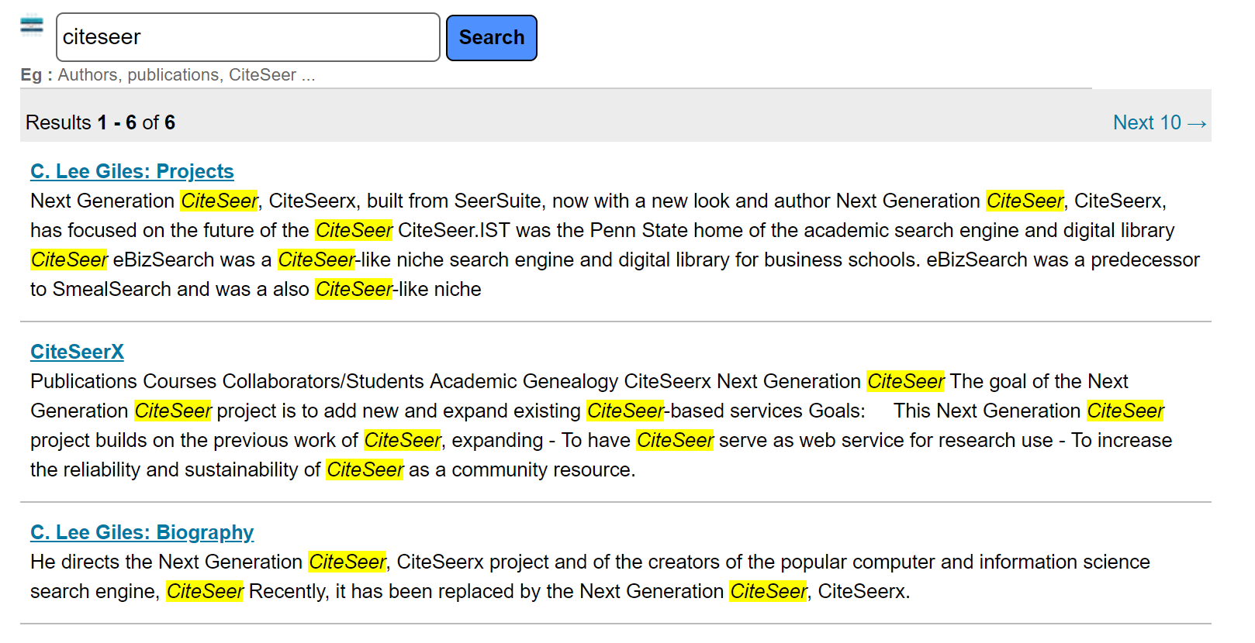
Text search and Highlighting in action

Slide 14
Take-home message
After this basic tutorial you should be able to:
Link the static HTML pages you previously crawled and indexed to a Web interface
Play around with the search bar to verify that you get the same results as from the Kibana console
Next…
You can go ahead and add your own Logo, custom interface features gradually and check the results as you go

Slide 15
Questions?

