Slide 1
Spiders, crawlers, harvesters, bots
Thanks to
B. Arms
R. Mooney
P. Baldi
P. Frasconi
P. Smyth
C. Manning

Slide 2
Last time
Evaluation of IR/Search systems
  Quality of evaluation – Relevance
  Evaluation is empirical
  Measurements of Evaluation
    Precision vs recall
    F measure
  Test Collections/TREC

Slide 3
This time
Web crawlers
Crawler policy
Robots.txt
Scrapy

Slide 4
Query Engine
Index
Evaluation
Interface
Indexer
Users
Crawler
Web
A Typical Web Search Engine

Slide 5
Elastic/Lucene
Query Engine
Index
Interface
Users
Indexer
Crawler
Scrapy
Web
A Typical Web Search Engine

Slide 6
Components of Web Search Service
Components
• Web crawler
• Indexing system
• Search system
Considerations
• Economics
• Scalability
• Legal issues

Slide 7
Query Engine
Index
Interface
Indexer
Users
Crawler
Web
A Typical Web Search Engine

Slide 8
What is a Web Crawler?
The Web crawler is a foundational species!
Without crawlers, search engines would not exist.
  But they get little credit!
Outline:
  What is a crawler
  How they work
  How they are controlled
    Robots.txt
  Issues of performance
  Research

Slide 9
What a web crawler does
Gets data!!!
Can get fresh data.
Gets data for search engines:
  Creates and repopulates search engines data by navigating the web, downloading documents and files
  Follows hyperlinks from a crawl list and hyperlinks in the list
  Without a crawler, there would be nothing to search

Slide 10
Web crawler policies
The behavior of a Web crawler is the outcome of a combination of policies:
  a selection policy that states which pages to download,
  a re-visit policy that states when to check for changes to the pages,
  a duplication policy,
  a politeness policy that states how to avoid overloading Web sites, and
  a parallelization policy that states how to coordinate distributed Web crawlers.

Slide 11
Crawlers vs Browsers vs Scrapers
Crawlers automatically harvest all types of files on the web
Browsers are manual crawlers
Web Scrapers automatically harvest the visual files for a web site, are manually directed, and are limited crawlers (sometimes called “screen scrapers”)

Slide 12
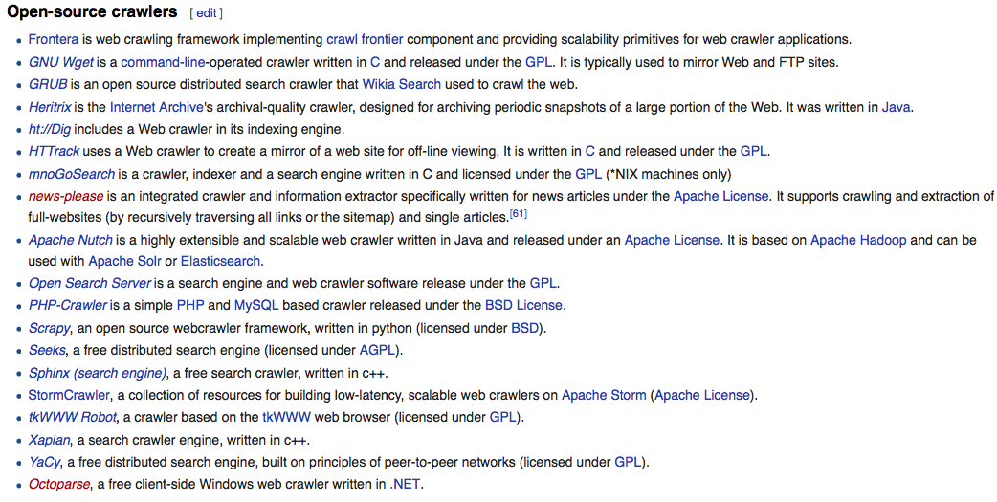
Open source crawlers

Slide 13
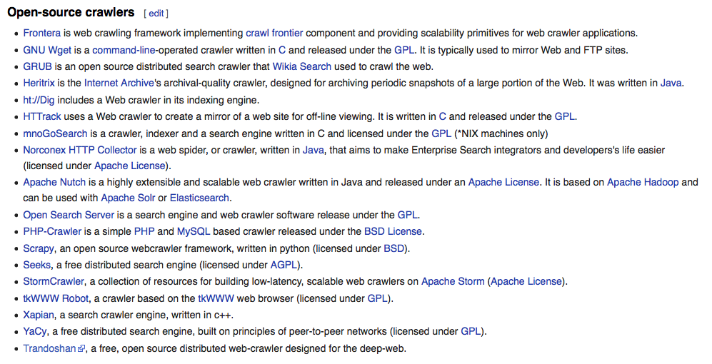
Open source crawlers

Slide 14
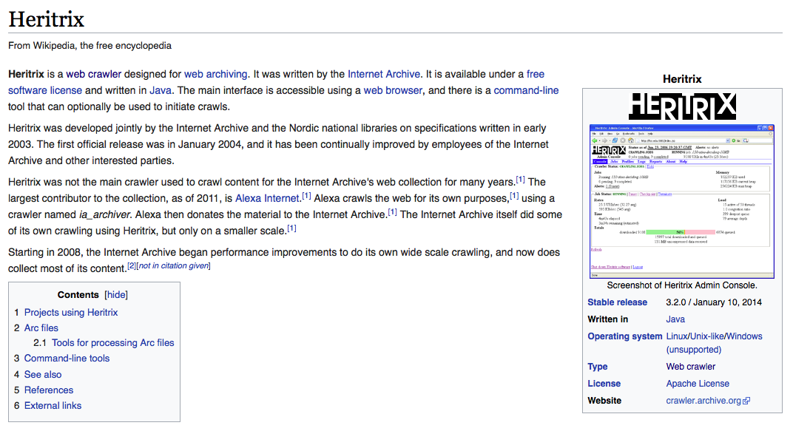
Heritrix

Slide 15
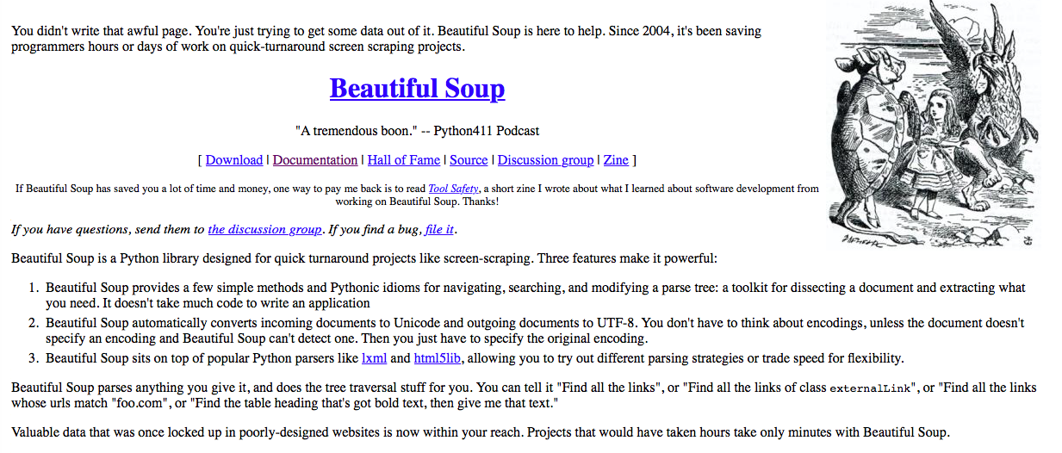
Beautiful Soup – scraper

Slide 16
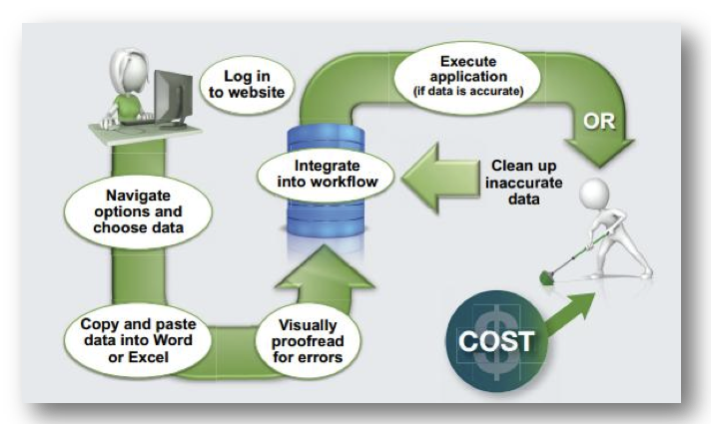
Why use a scrapper

Slide 17
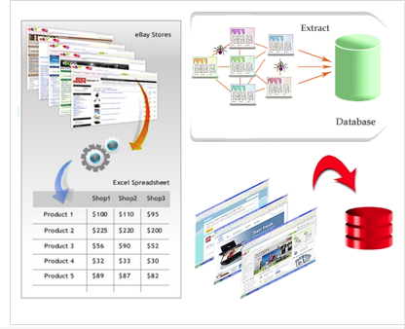

Slide 18
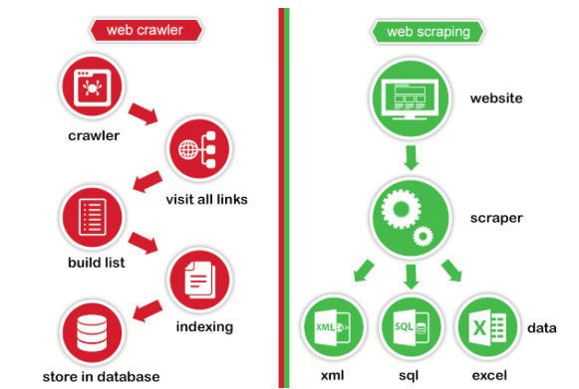
Web Crawler vs web scraper

Slide 19
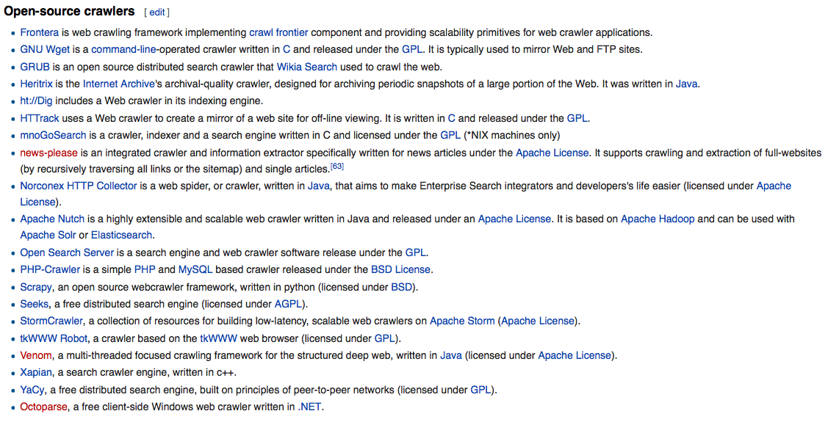
Open source crawlers

Slide 20
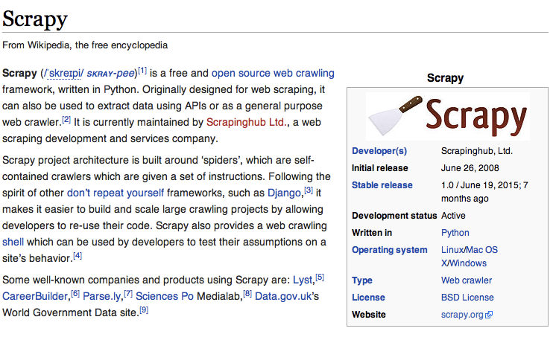
Open source crawlers

Slide 21
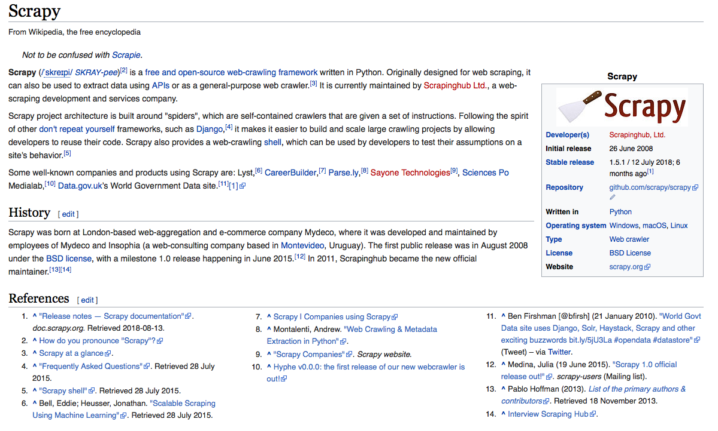
Open source crawlers

Slide 22
Web Scrapers
Web scraping deals with the gathering of unstructured data on the web, typically in HTML format, putting it into structured data that can be stored and analyzed in a central local database or spreadsheet.
Usually a manual process
Usually does not go down into the url links

Slide 23
Web Crawler Specifics
A program for downloading web pages.
• Given an initial set of seed URLs, it recursively downloads every page that is linked from pages in the set.
• A focused web crawler downloads only those pages whose content satisfies some criterion.
Also known as a web spider, bot, harvester.

Slide 24
Crawling the web
URLs crawled
and parsed
Unseen Web
Seed
pages
URLs frontier
Web

Slide 25
Simple picture – complications
Sec. 20.1.1
Web crawling difficult with one machine
  All of the above steps can be distributed
Malicious pages
  Spam pages
  Spider traps – incl dynamically generated
Even non-malicious pages pose challenges
  Latency/bandwidth to remote servers vary
  Webmasters’ stipulations
    How “deep” should you crawl a site’s URL hierarchy?
  Site mirrors and duplicate pages
Politeness – don’t hit a server too often

Slide 26
What any crawler must do
Sec. 20.1.1
Be Polite: Respect implicit and explicit politeness considerations
  Only crawl allowed pages
  Respect robots.txt (more on this shortly)
Be Robust: Be immune to spider traps and other malicious behavior from web servers

Slide 27
What any crawler should do
Sec. 20.1.1
Be capable of distributed operation: designed to run on multiple distributed machines
Be scalable: designed to increase the crawl rate by adding more machines
Performance/efficiency: permit full use of available processing and network resources

Slide 28
What any crawler should do
Sec. 20.1.1
Fetch pages of “higher quality” first
Continuous operation: Continue fetching fresh copies of a previously fetched page
Extensible: Adapt to new data formats, protocols

Slide 29
More detail
URLs crawled
and parsed
Unseen Web
Seed
Pages
URL frontier
Crawling thread

Slide 30
URL frontier
The next node to crawl
Can include multiple pages from the same host
Must avoid trying to fetch them all at the same time
Must try to keep all crawling threads busy

Slide 31
Explicit and implicit politeness
Sec. 20.2
Explicit politeness: specifications from webmasters on what portions of site can be crawled
  robots.txt
Implicit politeness: even with no specification, avoid hitting any site too often

Slide 32
Robots.txt
Sec. 20.2.1
Protocol for giving spiders (“robots”) limited access to a website, originally from 1994
  www.robotstxt.org/wc/norobots.html
Website announces its request on what can(not) be crawled
  For a server, create a file /robots.txt
  This file specifies access restrictions

Slide 33
Robots.txt example
Sec. 20.2.1
No robot should visit any URL starting with
"/yoursite/temp/", except the robot called “searchengine":
User-agent: *
Disallow: /yoursite/temp/
User-agent: searchengine
Disallow:

Slide 34
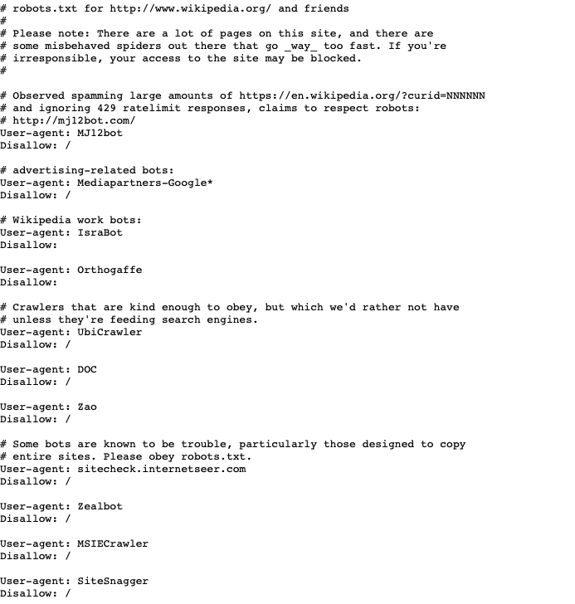

Slide 35
Processing steps in crawling
Sec. 20.2.1
Pick a URL from the frontier
Fetch the document at the URL
Parse the URL
  Extract links from it to other docs (URLs)
Check if URL has content already seen
  If not, add to indexes
For each extracted URL
  Ensure it passes certain URL filter tests
  Check if it is already in the frontier (duplicate URL elimination)
Which one?
E.g., only crawl .edu, obey robots.txt, etc.

Slide 36
Basic crawl architecture
Sec. 20.2.1
WWW
DNS
Doc
FP’s
robots
filters
URL
set
Parse
Fetch
Content
seen?
URL
filter
Dup
URL
elim
URL Frontier

Slide 37
Crawling Algorithm
Initialize queue (Q) with initial set of known URL’s.
Until Q empty or page or time limit exhausted:
Pop URL, L, from front of Q.
If L is not to an HTML page (.gif, .jpeg, .ps, .pdf, .ppt…)
continue loop.
If already visited L, continue loop.
Download page, P, for L.
If cannot download P (e.g. 404 error, robot excluded)
continue loop.
Index P (e.g. add to inverted index or store cached copy).
Parse P to obtain list of new links N.
Append N to the end of Q.

Slide 38
Pseudocode for a Simple Crawler
Start_URL = “http://www.ebizsearch.org”;
List_of_URLs ={}; #empty at first
append(List_of_URLs,Start_URL); # add start url to list
While(notEmpty(List_of_URLs)) {
for each URL_in_List in (List_of_URLs) {
if(URL_in_List is_of HTTProtocol) {
if(URL_in_List permits_robots(me)){
Content=fetch(Content_of(URL_in_List));
Store(someDataBase,Content); # caching
if(isEmpty(Content) or isError(Content){
skip to next_URL_in_List;
} #if
else {
URLs_in_Content=extract_URLs_from_Content(Content);
append(List_of_URLs,URLs_in_Content);
} #else
} else { discard(URL_in_List); skip to next_URL_in_List; }
if(stop_Crawling_Signal() is TRUE) { break; }
} #foreach
} #while

Slide 39
Web Crawler
A crawler is a program that picks up a page and follows all the links on that page
Crawler = Spider = Bot = Harvester
Usual types of crawler:
  Breadth First
  Depth First
  Combinations of the above

Slide 40
Breadth First Crawlers
Use breadth-first search (BFS) algorithm
Get all links from the starting page, and add them to a queue
Pick the 1st link from the queue, get all links on the page and add to the queue
Repeat above step till queue is empty

Slide 41
Search Strategies BF
Breadth-first Search

Slide 42
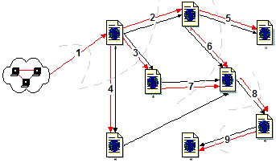
Breadth First Crawlers

Slide 43
Depth First Crawlers
Use depth first search (DFS) algorithm
Get the 1st link not visited from the start page
Visit link and get 1st non-visited link
Repeat above step till no no-visited links
Go to next non-visited link in the previous level and repeat 2nd step

Slide 44
Search Strategies DF
Depth-first Search

Slide 45
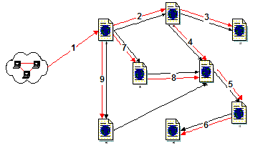
Depth First Crawlers

Slide 46
How Do We Evaluate Search?
What makes one search scheme better than another?
Consider a desired state we want to reach:
  Completeness: Find solution?
  Time complexity: How long?
  Space complexity: Memory?
  Optimality: Find shortest path?

Slide 47
Performance Measures
Completeness
Is the algorithm guaranteed to find a solution when there is one?
Optimality
Is this solution optimal?
Time complexity
How long does it take?
Space complexity
How much memory does it require?

Slide 48
Important Parameters
Maximum number of successors of any node
→ branching factor b of the search tree
Minimal length of a path in the state space between the initial and a goal node
→ depth d of the shallowest goal node in the
search tree

Slide 49
Bread-First Evaluation
b: branching factor
d: depth of shallowest goal node
Complete
Optimal if step cost is 1
Number of nodes generated:
1 + b + b² + … + b^{d} = (b^{d+1}-1)/(b-1)
= O(b^{d})
Time and space complexity is O(b^{d})

Slide 50
Depth-First evaluation
b: branching factor
d: depth of shallowest goal node
m: maximal depth of a leaf node
Complete only for finite search tree
Not optimal
Number of nodes generated:
1 + b + b² + … + b^{m} = O(b^{m})
Time complexity is O(b^{m})
Space complexity is O(bm) or O(m)

Slide 51
Evaluation Criteria
completeness
  if there is a solution, will it be found
time complexity
  how long does it take to find the solution
  does not include the time to perform actions
space complexity
  memory required for the search
optimality
  will the best solution be found
main factors for complexity considerations:
branching factor b, depth d of the shallowest goal node, maximum path length m

Slide 52
Depth-First vs. Breadth-First
depth-first goes off into one branch until it reaches a leaf node
  not good if the goal node is on another branch
  neither complete nor optimal
  uses much less space than breadth-first
    much fewer visited nodes to keep track of
    smaller fringe
breadth-first is more careful by checking all alternatives
  complete and optimal
  very memory-intensive

Slide 53
Comparison of Strategies
Breadth-first is complete and optimal, but has high space complexity
Depth-first is space efficient, but neither complete nor optimal

Slide 54
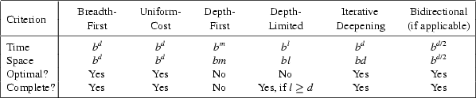
Comparing search strategies
b: branching factor
d: depth of shallowest goal node
m: maximal depth of a leaf node

Slide 55
Search Strategy Trade-Off’s
Breadth-first explores uniformly outward from the root page but requires memory of all nodes on the previous level (exponential in depth). Standard spidering method.
Depth-first requires memory of only depth times branching-factor (linear in depth) but gets “lost” pursuing a single thread.
Both strategies implementable using a queue of links (URL’s).

Slide 56
Avoiding Page Duplication
Must detect when revisiting a page that has already been spidered (web is a graph not a tree).
Must efficiently index visited pages to allow rapid recognition test.
  Tree indexing (e.g. trie)
  Hashtable
Index page using URL as a key.
  Must canonicalize URL’s (e.g. delete ending “/”)
  Not detect duplicated or mirrored pages.
Index page using textual content as a key.
  Requires first downloading page.
Solr/Lucene Deduplication

Slide 57
Spidering Algorithm
Initialize queue (Q) with initial set of known URL’s.
Until Q empty or page or time limit exhausted:
Pop URL, L, from front of Q.
If L is not to an HTML page (.gif, .jpeg, .ps, .pdf, .ppt…)
continue loop.
If already visited L, continue loop.
Download page, P, for L.
If cannot download P (e.g. 404 error, robot excluded)
continue loop.
Index P (e.g. add to inverted index or store cached copy).
Parse P to obtain list of new links N.
Append N to the end of Q.

Slide 58
Queueing Strategy
How new links added to the queue determines search strategy.
FIFO (append to end of Q) gives breadth-first search.
LIFO (add to front of Q) gives depth-first search.
Heuristically ordering the Q gives a “focused crawler” that directs its search towards “interesting” pages.

Slide 59
Restricting Spidering
Restrict spider to a particular site.
  Remove links to other sites from Q.
Restrict spider to a particular directory.
  Remove links not in the specified directory.
Obey page-owner restrictions (robot exclusion).

Slide 60
Link Extraction
Must find all links in a page and extract URLs.
  <a href=“http://clgiles.ist.psu.edu/courses”>
Must complete relative URL’s using current page URL:
  <a href=“projects”> to http://clgiles.ist.psu.edu/courses/ist441/projects
  <a href=“../ist441/syllabus.html”> to http:// clgiles.ist.psu.edu/courses/ist441/syllabus.html

Slide 61
URL Syntax
A URL has the following syntax:
  <scheme>://<authority><path>?<query>#<fragment>
An authority has the syntax:
  <host>:<port-number>
A query passes variable values from an HTML form and has the syntax:
  <variable>=<value>&<variable>=<value>…
A fragment is also called a reference or a ref and is a pointer within the document to a point specified by an anchor tag of the form:
  <A NAME=“<fragment>”>

Slide 62
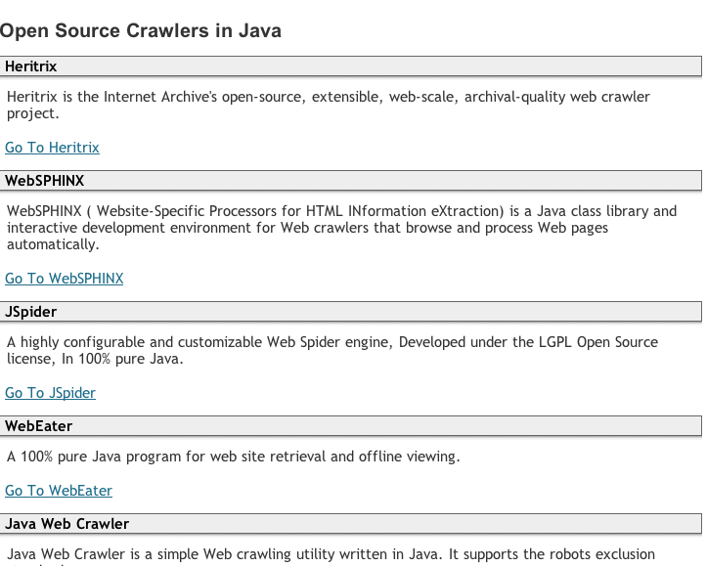

Slide 63
Sample Java Spider
Generic spider in Spider class.
Does breadth-first crawl from a start URL and saves copy of each page in a local directory.
This directory can then be indexed and searched using InvertedIndex.
Main method parameters:
  -u <start-URL>
  -d <save-directory>
  -c <page-count-limit>

Slide 64
Java Spider (cont.)
Robot Exclusion can be invoked to prevent crawling restricted sites/pages.
  -safe
Specialized classes also restrict search:
  SiteSpider: Restrict to initial URL host.
  DirectorySpider: Restrict to below initial URL directory.

Slide 65
Spider Java Classes
HTMLPage
link
text
outLinks
absoluteCopy
Link
HTMLPageRetriever
getHTMLPage()
URL
url
String
LinkExtractor
page
extract()

Slide 66
Link Canonicalization
Equivalent variations of ending directory normalized by removing ending slash.
  http://clgiles.ist.psu.edu/courses/ist441/
  http://clgiles.ist.psu.edu/courses/ist441
Internal page fragments (ref’s) removed:
  http://clgiles.ist.psu.edu/welcome.html#courses
  http://clgiles.ist.psu.edu/welcome.html

Slide 67
Link Extraction in Java
Java Swing contains an HTML parser.
Parser uses “call-back” methods.
Pass parser an object that has these methods:
  HandleText(char[] text, int position)
  HandleStartTag(HTML.Tag tag, MutableAttributeSet attributes, int position)
  HandleEndTag(HTML.Tag tag, int position)
  HandleSimpleTag (HTML.Tag tag, MutableAttributeSet attributes, int position)
When parser encounters a tag or intervening text, it calls the appropriate method of this object.

Slide 68
Link Extraction in Java (cont.)
In HandleStartTag, if it is an “A” tag, take the HREF attribute value as an initial URL.
Complete the URL using the base URL:
  new URL(URL baseURL, String relativeURL)
  Fails if baseURL ends in a directory name but this is not indicated by a final “/”
  Append a “/” to baseURL if it does not end in a file name with an extension (and therefore presumably is a directory).

Slide 69
Cached Copy with Absolute Links
If the local-file copy of an HTML page is to have active links, then they must be expanded to complete (absolute) URLs.
In the LinkExtractor, an absoluteCopy of the page is constructed as links are extracted and completed.
“Call-back” routines just copy tags and text into the absoluteCopy except for replacing URLs with absolute URLs.
HTMLPage.writeAbsoluteCopy writes final version out to a local cached file.

Slide 70
Anchor Text Indexing
Extract anchor text (between <a> and </a>) of each link followed.
Anchor text is usually descriptive of the document to which it points.
Add anchor text to the content of the destination page to provide additional relevant keyword indices.
Used by Google:
  <a href=“http://www.microsoft.com”>Evil Empire</a>
  <a href=“http://www.ibm.com”>IBM</a>

Slide 71
Anchor Text Indexing (cont)
Helps when descriptive text in destination page is embedded in image logos rather than in accessible text.
Many times anchor text is not useful:
  “click here”
Increases content more for popular pages with many in-coming links, increasing recall of these pages.
May even give higher weights to tokens from anchor text.

Slide 72
Robots.txt
Sec. 20.2.1
Protocol for giving spiders (“robots”) limited access to a website, originally from 1994
  www.robotstxt.org/wc/norobots.html
Website announces its request on what can(not) be crawled
  For a server, create a file /robots.txt
  This file specifies access restrictions

Slide 73
Robot Exclusion
How to control those robots!
Web sites and pages can specify that robots should not crawl/index certain areas.
Two components:
  Robots Exclusion Protocol (robots.txt): Site wide specification of excluded directories.
  Robots META Tag: Individual document tag to exclude indexing or following links inside a page that would otherwise be indexed

Slide 74
Robots Exclusion Protocol
Site administrator puts a “robots.txt” file at the root of the host’s web directory.
  http://www.ebay.com/robots.txt
  http://www.cnn.com/robots.txt
  http://clgiles.ist.psu.edu/robots.txt
  http://en.wikipedia.org/robots.txt
File is a list of excluded directories for a given robot (user-agent).
  Exclude all robots from the entire site:
User-agent: *
Disallow: /
New Allow:
Find some interesting robots.txt

Slide 75
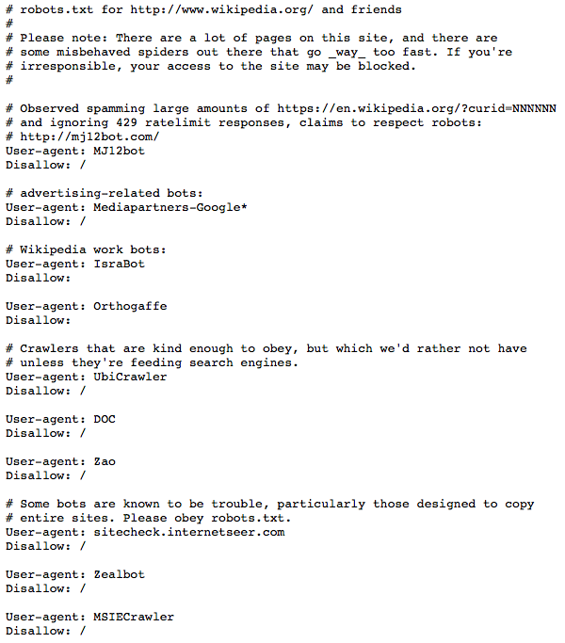
Robots.txt example
Sec. 20.2.1

Slide 76
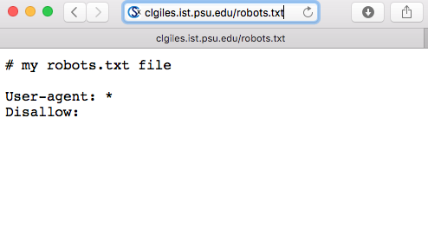

Slide 77
Robots.txt example
Sec. 20.2.1
Find some interesting robots.txt

Slide 78
Robot Exclusion Protocol Examples
Exclude specific directories:
User-agent: *
Disallow: /tmp/
Disallow: /cgi-bin/
Disallow: /users/paranoid/
Exclude a specific robot:
User-agent: GoogleBot
Disallow: /
Allow a specific robot and disallow all others:
User-agent: GoogleBot
Disallow:
User-agent: *
Disallow: /

Slide 79
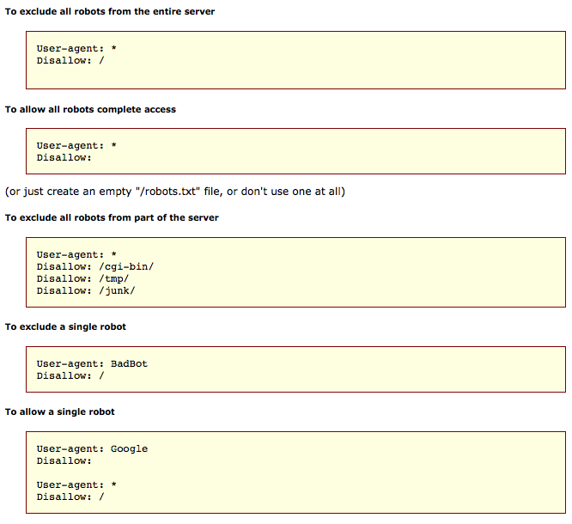
Robot Exclusion Protocol Examples

Slide 80
Robot Exclusion Protocol Not Well Defined Details
Only use blank lines to separate different User-agent disallowed directories.
One directory per “Disallow” line.
No regex (regular expression) patterns in directories.
What about “robot.txt”?
Ethical robots obey “robots.txt” as best as they can interpret them

Slide 81
Robots META Tag
Include META tag in HEAD section of a specific HTML document.
  <meta name=“robots” content=“none”>
Content value is a pair of values for two aspects:
  index | noindex: Allow/disallow indexing of this page.
  follow | nofollow: Allow/disallow following links on this page.

Slide 82
Robots META Tag (cont)
Special values:
  all = index,follow
  none = noindex,nofollow
Examples:
<meta name=“robots” content=“noindex,follow”>
<meta name=“robots” content=“index,nofollow”>
<meta name=“robots” content=“none”>

Slide 83
History of the Robots Exclusion Protocol
A consensus June 30, 1994 on the robots mailing list
Revised and Proposed to IETF in 1996 by M. Koster^{[14]}
Never accepted as an official standard
Continues to be used and growing
Notes:
83

Slide 84
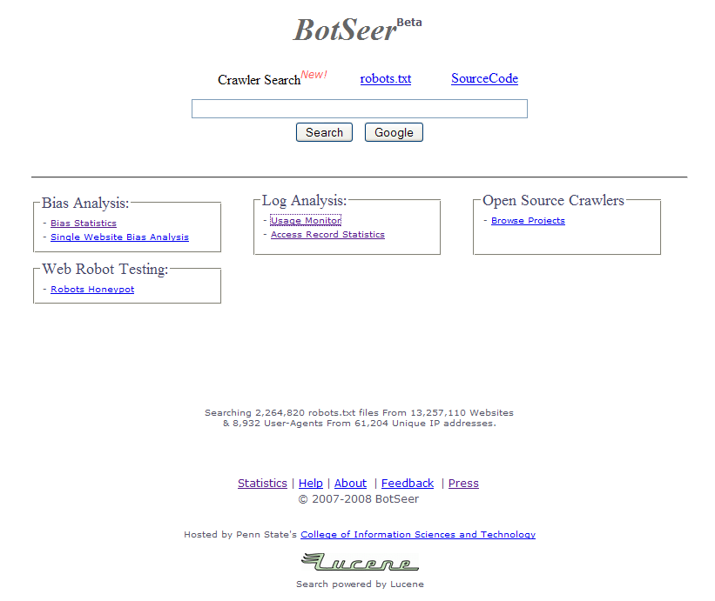
BotSeer - Robots.txt search engine
Notes:
84

Slide 85
Top 10 favored and disfavored robots – Ranked by ∆P favorability.
Notes:
85

Slide 86
Comparison of Google, Yahoo and MSN
Notes:
86

Slide 87
Search Engine Market Share vs. Robot Bias
Pearson product-moment correlation coefficient: 0.930, P-value < 0.001
* Search engine market share data is obtained from NielsenNetratings^{[16]}
Notes:
87

Slide 88
Robot Exclusion Issues
META tag is newer and less well-adopted than “robots.txt”. (growing in use – xml sitemaps)
Standards are conventions to be followed by “good robots.”
  Companies have been prosecuted for “disobeying” these conventions and “trespassing” on private cyberspace.
“Good robots” also try not to “hammer” individual sites with lots of rapid requests.
  “Denial of service” attack.
T OR F: robots.txt file increases your pagerank?

Slide 89
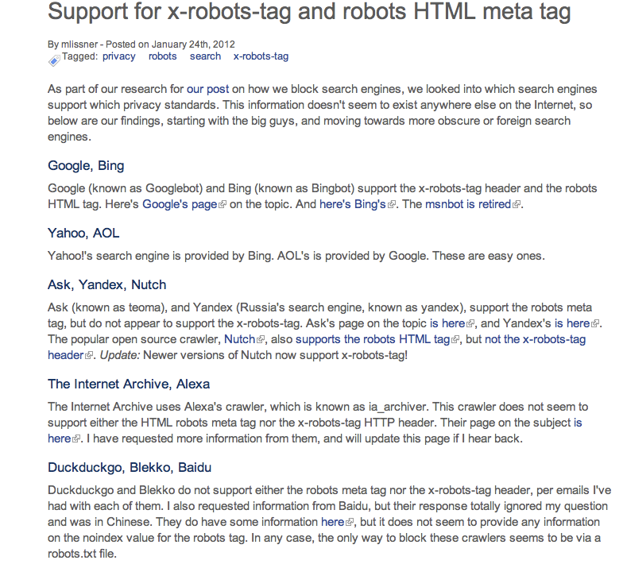

Slide 90
Web bots
Not all crawlers are ethical (obey robots.txt)
Not all webmasters know how to write correct robots.txt files
  Many have inconsistent Robots.txt
Bots interpret these inconsistent robots.txt in many ways.
Many bots out there!
  It’s the wild, wild west

Slide 91
Multi-Threaded Spidering
Bottleneck is network delay in downloading individual pages.
Best to have multiple threads running in parallel each requesting a page from a different host.
Distribute URL’s to threads to guarantee equitable distribution of requests across different hosts to maximize through-put and avoid overloading any single server.
Early Google spider had multiple co-ordinated crawlers with about 300 threads each, together able to download over 100 pages per second.

Slide 92
Directed/Focused Spidering/Crawling
Sort queue to explore more “interesting” pages first.
Two styles of focus:
  Topic-Directed
  Link-Directed

Slide 93
Simple Web Crawler Algorithm
Basic Algorithm
Let S be set of URLs to pages waiting to be indexed. Initially S is the singleton, s, known as the seed.
Take an element u of S and retrieve the page, p, that it references.
Parse the page p and extract the set of URLs L it has links to.
Update S = S + L - u
Repeat as many times as necessary.

Slide 94
Not so Simple…
Performance -- How do you crawl 1,000,000,000 pages?
Politeness -- How do you avoid overloading servers?
Failures -- Broken links, time outs, spider traps.
Strategies -- How deep do we go? Depth first or breadth first?
Implementations -- How do we store and update S and the other data structures needed?

Slide 95
What to Retrieve
No web crawler retrieves everything
Most crawlers retrieve only
  HTML (leaves and nodes in the tree)
  ASCII clear text (only as leaves in the tree)
Some retrieve
  PDF
  PostScript,…
Indexing after crawl
  Some index only the first part of long files
  Do you keep the files (e.g., Google cache)?

Slide 96
Building a Web Crawler: Links are not Easy to Extract
Relative/Absolute
CGI
  Parameters
  Dynamic generation of pages
Server-side scripting
Server-side image maps
Links buried in scripting code

Slide 97
Crawling to build an historical archive
Internet Archive:
http://www.archive.org
A non-for profit organization in San Francisco, created by Brewster Kahle, to collect and retain digital materials for future historians.
Services include the Wayback Machine.

Slide 98
Scraping Google
Google does not take legal action against scraping, likely for self-protective reasons. However Google is using a range of defensive methods that makes scraping their results a challenging task.

Slide 99
Scraping Google problems
Google is testing the User-Agent (Browser type) of HTTP requests and serves a different page depending on the User-Agent. Google is automatically rejecting User-Agents that seem to originate from a possible automated bot. [Part of the Google error page: Please see Google's Terms of Service posted at http://www.google.com/terms_of_service.html ]
A typical example would be using the command line browser cURL, Google will directly reject to serve any pages to it while Bing is a bit more forgiving
Bing does not seem to care about User-Agents.[3]

Slide 100
Scraping Google
Google is using a complex system of request rate limitation which is different for each Language, Country, User-Agent as well as depending on the keyword and keyword search parameters. The rate limitation can make it unpredictable when accessing a search engine automated as the behaviour patterns are not known to the outside developer or user.
Network and IP limitations are as well part of the scraping defense systems. Search engines can not easily be tricked by changing to another IP, while using proxies is a very important part in successful scraping. The diversity and abusive history of an IP is important as well.
Offending IPs and offending IP networks can easily be stored in a blacklist database to detect offenders much faster. The fact that most ISPs give dynamic IP addresses to customers requires that such automated bans be only temporary, to not block innocent users.

Slide 101
Scraping Google
Behaviour based detection is the most difficult defense system. Search engines serve their pages to millions of users every day, this provides a large amount of behaviour information. A scraping script or bot is not behaving like a real user, aside from having non-typical access times, delays and session times the keywords being harvested might be related to each other or include unusual parameters. Google for example has a very sophisticated behaviour analyzation system, possibly using deep learning software to detect unusual patterns of access. It can detect unusual activity much faster than other search engines.
HTML markup changes, depending on the methods used to harvest the content of a website even a small change in HTML data can render a scraping tool broken until it was updated.
General changes in detection systems. In the past years search engines have tightened their detection systems nearly month by month making it more and more difficult to reliable scrape as the developers need to experiment and adapt their code regularly.

Slide 102
Example: Heritrix Crawler
A high-performance, open source crawler for production and research
Developed by the Internet Archive and others.

Slide 103
Heritrix: Design Goals
Broad crawling: Large, high-bandwidth crawls to sample as much of the web as possible given the time, bandwidth, and storage resources available.
Focused crawling: Small- to medium-sized crawls (usually less than 10 million unique documents) in which the quality criterion is complete coverage of selected sites or topics.
Continuous crawling: Crawls that revisit previously fetched pages, looking for changes and new pages, even adapting its crawl rate based on parameters and estimated change frequencies.
Experimental crawling: Experiment with crawling techniques, such as choice of what to crawl, order of crawled, crawling using diverse protocols, and analysis and archiving of crawl results.

Slide 104
Heritrix
Design parameters
• Extensible. Many components are plugins that can be rewritten for different tasks.
• Distributed. A crawl can be distributed in a symmetric fashion across many machines.
• Scalable. Size of within memory data structures is bounded.
• High performance. Performance is limited by speed of Internet connection (e.g., with 160 Mbit/sec connection, downloads 50 million documents per day).
• Polite. Options of weak or strong politeness.
• Continuous. Will support continuous crawling.

Slide 105
Heritrix: Main Components
Scope: Determines what URIs are ruled into or out of a certain crawl. Includes the seed URIs used to start a crawl, plus the rules to determine which discovered URIs are also to be scheduled for download.
Frontier: Tracks which URIs are scheduled to be collected, and those that have already been collected. It is responsible for selecting the next URI to be tried, and prevents the redundant rescheduling of already-scheduled URIs.
Processor Chains: Modular Processors that perform specific, ordered actions on each URI in turn. These include fetching the URI, analyzing the returned results, and passing discovered URIs back to the Frontier.

Slide 106
Mercator (Altavista Crawler): Main Components
• Crawling is carried out by multiple worker threads, e.g., 500 threads for a big crawl.
• The URL frontier stores the list of absolute URLs to download.
• The DNS resolver resolves domain names into IP addresses.
• Protocol modules download documents using appropriate protocol (e.g., HTML).
• Link extractor extracts URLs from pages and converts to absolute URLs.
• URL filter and duplicate URL eliminator determine which URLs to add to frontier.

Slide 107
Mercator: The URL Frontier
A repository with two pluggable methods: add a URL, get a URL.
Most web crawlers use variations of breadth-first traversal, but ...
• Most URLs on a web page are relative (about 80%).
• A single FIFO queue, serving many threads, would send many simultaneous requests to a single server.
Weak politeness guarantee: Only one thread allowed to contact a particular web server.
Stronger politeness guarantee: Maintain n FIFO queues, each for a single host, which feed the queues for the crawling threads by rules based on priority and politeness factors.

Slide 108
Mercator: Duplicate URL Elimination
Duplicate URLs are not added to the URL Frontier
Requires efficient data structure to store all URLs that have been seen and to check a new URL.
In memory:
Represent URL by 8-byte checksum. Maintain in-memory hash table of URLs.
Requires 5 Gigabytes for 1 billion URLs.
Disk based:
Combination of disk file and in-memory cache with batch updating to minimize disk head movement.

Slide 109
Mercator: Domain Name Lookup
Resolving domain names to IP addresses is a major bottleneck of web crawlers.
Approach:
• Separate DNS resolver and cache on each crawling computer.
• Create multi-threaded version of DNS code (BIND).
These changes reduced DNS loop-up from 70% to 14% of each thread's elapsed time.

Slide 110
Robots Exclusion
The Robots Exclusion Protocol
A Web site administrator can indicate which parts of the site should not be visited by a robot, by providing a specially formatted file on their site, in http://.../robots.txt.
The Robots META tag
A Web author can indicate if a page may or may not be indexed, or analyzed for links, through the use of a special HTML META tag
See: http://www.robotstxt.org/wc/exclusion.html

Slide 111
Robots Exclusion
Example file: /robots.txt
# Disallow allow all robots
User-agent: *
Disallow: /cyberworld/map/
Disallow: /tmp/ # these will soon disappear
Disallow: /foo.html
# To allow Cybermapper
User-agent: cybermapper
Disallow:

Slide 112
Extracts from: http://www.nytimes.com/robots.txt
# robots.txt, nytimes.com 4/10/2002
User-agent: *
Disallow: /2000
Disallow: /2001
Disallow: /2002
Disallow: /learning
Disallow: /library
Disallow: /reuters
Disallow: /cnet
Disallow: /archives
Disallow: /indexes
Disallow: /weather
Disallow: /RealMedia

Slide 113
The Robots META tag
The Robots META tag allows HTML authors to indicate to visiting robots if a document may be indexed, or used to harvest more links. No server administrator action is required.
Note that currently only a few robots implement this.
In this simple example:
<meta name="robots" content="noindex, nofollow">
a robot should neither index this document, nor analyze it for links.
http://www.robotstxt.org/wc/exclusion.html#meta

Slide 114
High Performance Web Crawling
The web is growing fast:
• To crawl a billion pages a month, a crawler must download about 400 pages per second.
• Internal data structures must scale beyond the limits of main memory.
Politeness:
• A web crawler must not overload the servers that it is downloading from.

Slide 115
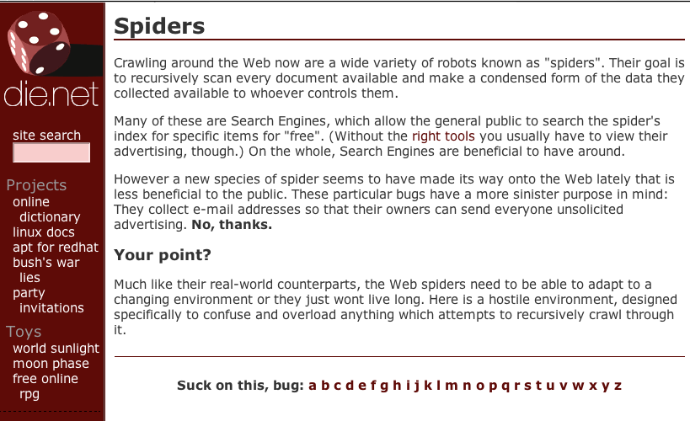
http://spiders.must.die.net

Slide 116
Spider Traps
A spider trap (or crawler trap) is a set of web pages that may intentionally or unintentionally be used to cause a web crawler or search bot to make an infinite number of requests or cause a poorly constructed crawler to crash.
Spider traps may be created to "catch" spambots or other crawlers that waste a website's bandwidth. Common techniques used are:
  creation of indefinitely deep directory structures like
    http://foo.com/bar/foo/bar/foo/bar/foo/bar/.....
  dynamic pages like calendars that produce an infinite number of pages for a web crawler to follow.
  pages filled with a large number of characters, crashing the lexical analyzer parsing the page.
  pages with session-id's based on required cookies
  Others?
There is no algorithm to detect all spider traps. Some classes of traps can be detected automatically, but new, unrecognized traps arise quickly.

Slide 117
Research Topics in Web Crawling
Intelligent crawling - focused crawling
  How frequently to crawl
  What to crawl
  What strategies to use.
• Identification of anomalies and crawling traps.
• Strategies for crawling based on the content of web pages (focused and selective crawling).
• Duplicate detection.

Slide 118
Detecting Bots
It’s the wild, wild west out there!
Inspect Server Logs:
User Agent Name - user agent name.
Frequency of Access - A very large volume of accesses from the same IP address is usually a tale-tell sign of a bot or spider.
Access Method - Web browsers being used by human users will almost always download all of the images too. A bot typically only goes after the text.
Access Pattern - Not erratic

Slide 119
Web Crawler
Program that autonomously navigates the web and downloads documents
For a simple crawler
  start with a seed URL, S₀
  download all reachable pages from S₀
  repeat the process for each new page
  until a sufficient number of pages are retrieved
Ideal crawler
  recognize relevant pages
  limit fetching to most relevant pages
Notes:
Crawlers exploit the graph structure of the web to move from one page to another
Motivation for a crawler is to add web pages to a local repository, which is then used by applications such as search engine
The web is a dynamic entity. All the time we have new pages that are being added, old pages are removed, modified or moved, so to have a current system, periodic crawls are needed
A simple crawler consists of a seed URL. It then uses the external links within the seed to download linked pages. For each new page, this process is repeated, until a sufficient number of pages are retrieved

Slide 120
Nature of Crawl
Broadly categorized into
  Exhaustive crawl
    broad coverage
    used by general purpose search engines
  Selective crawl
    fetch pages according to some criteria, for e.g., popular pages, similar pages
    exploit semantic content, rich contextual aspects
Notes:
Search engines can be classified as general purpose search engine, which are designed for the largest subset of users, to answer a user query. These search engines strive for broad coverage, exhaustive in their approach
Selective crawlers that fetch pages within a certain topic are focused crawlers
Focused crawlers – lead to subspaces in the web relevant to a particular user community

Slide 121
Selective Crawling
Retrieve web pages according to some criteria
Page relevance is determined by a scoring function s_{θ}^{(ξ)}(u)
  ξ relevance criterion
  θ parameters
  for e.g., a boolean relevance function
    s(u) =1 document is relevant
    s(u) =0 document is irrelevant
Notes:
Broadly categorized into
Exhaustive crawl
broad coverage
used by general purpose search engines
Selective crawl
fetch pages according to some criteria, for e.g., popular pages, similar pages
exploit semantic content, rich contextual aspects

Slide 122
Selective Crawler
Basic approach
  sort the fetched URLs according to a relevance score
  use best-first search to obtain pages with a high score first
  search leads to most relevant pages
Notes:
insert and extract URLs in the queue

Slide 123
Examples of Scoring Function
Depth
  length of the path from the site homepage to the document
  limit total number of levels retrieved from a site
  maximize coverage breadth
Popularity
  assign relevance according to which pages are more important than others
  estimate the number of backlinks
Notes:
identify most important pages

Slide 124
Examples of Scoring Function
PageRank
  assign value of importance
  value is proportional to the popularity of the source document
  estimated by a measure of indegree of a page
Notes:
Rank of a document is high if the sum of the parent’s rank is high
The more links there are on a page, the less PageRank value your page will receive from it.

Slide 125
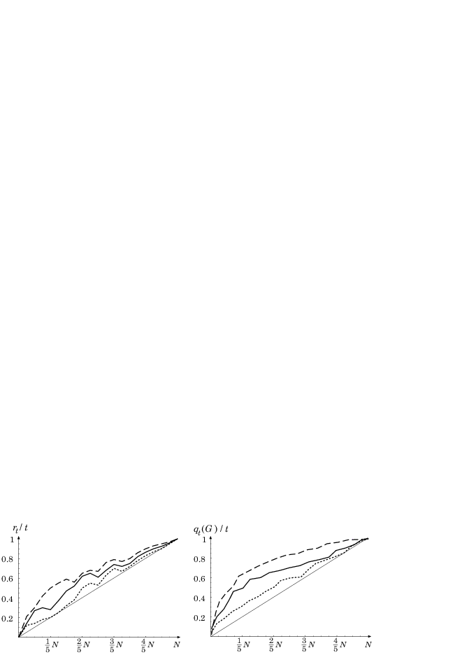
Efficiency of Selective Crawlers
BFS crawler
Crawler using backlinks
Crawler using PageRank
Diagonal line - random crawler
N pages, t fetched
rt # of fetched pages with min score
Cho, et.al 98

Slide 126
Focused Crawling
Fetch pages within a certain topic
Relevance function
  use text categorization techniques
  s_{θ}^{(topic)}(u) = P(c|d(u),θ )
  s score of topic, c topic of interest, d page pointed to by u, θ statistical parameters
Parent based method
  score of parent is extended to children URL
Anchor based method
  anchor text is used for scoring pages
Notes:
Refined selective crawler
Relevance is defined w.r.t expected page utility for users
Score canot be computed exactly, we use several techniques for approximation score

Slide 127
Focused Crawler
Basic approach
  classify crawled pages into categories
  use a topic taxonomy, provide example URLs, and mark categories of interest
  use a Bayesian classifier to find P(c|p)
  compute relevance score for each page
  R(p) = ∑_{c∈good} P(c|p)

Slide 128
Focused Crawler
Soft Focusing
  compute score for a fetched document, S₀
  extend the score to all URL in S₀
  s_{θ}^{(topic)}(u) = P(c|d(v), θ )
  if same URL is fetched from multiple parents, update s(u);
  v is a parent of u
Hard Focusing
  for a crawled page d, find leaf node with highest probability (c*)
  if some ancestor of c* is marked good, extract URLS from d
  else the crawl is pruned at d
Notes:
topic locality principle

Slide 129
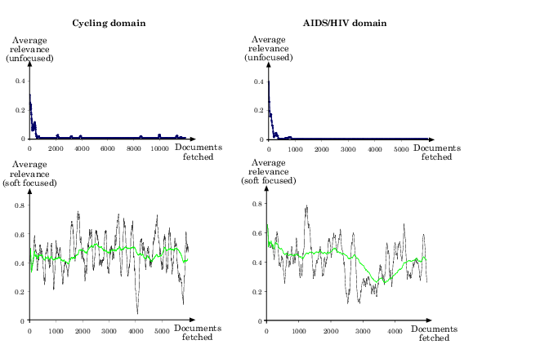
Efficiency of a Focused Crawler
Chakrabarti, 99
Average relevance of fetched docs vs # of fetched docs.

Slide 130
Context Focused Crawlers
Classifiers are trained
  to estimate the link distance between a crawled page and the relevant pages
  use context graph of L layers for each seed page
Notes:
Inlinks to the seed are in layer 1

Slide 131
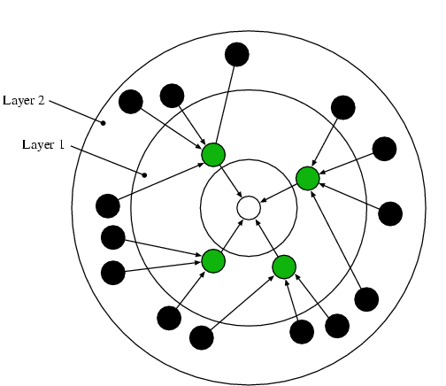
Context Graphs
Seed page forms layer 0
Layer i contains all the parents of the nodes in layer i-1

Slide 132
Context Graphs
To compute the relevance function
  set of Naïve Bayes classifiers are built for each layer
  compute P(t|c1) from the pages in each layer
  compute P(c1 |p)
  class with highest probability is assigned the page
  if (P (c1 | p) < τ, then page is assigned to ‘other’ class
Diligenti, 2000

Slide 133
Context Graphs
Maintain a queue for each layer
Sort queue by probability scores P(cl|p)
For the next URL in the crawler
  pick top page from the queue with smallest l
  results in pages that are closer to the relevant page first
  explore outlink of such pages

Slide 134
Reinforcement Learning
Learning what action yields maximum rewards
To maximize rewards
  learning agent uses previously tried actions that produced effective rewards
  explore better action selections in future
Properties
  trial and error method
  delayed rewards
Notes:
actions affect immediate rewards, and next situation, and therefore subsequent rewards

Slide 135
Elements of Reinforcement Learning
Policy π(s,a)
  probability of taking an action a in state s
Rewards function r(a)
  maps state-action pairs to a single number
  indicate immediate desirability of the state
Value Function V^{π}(s)
  indicate long-term desirability of states
  takes into account the states that are likely to follow, and the rewards available in those states

Slide 136
Reinforcement Learning
Optimal policy π* maximizes value function over all states
LASER uses reinforcement learning for indexing of web pages
  for a user query, determine relevance using TFIDF
  propagate rewards into the web
  discounting them at each step, by value iteration
  after convergence, documents at distance k from u provides a contribution γ^{K} times their relevance to the relevance of u

Slide 137
Fish Search
Web agents are like the fishes in sea
  gain energy when a relevant document found agents
  search for more relevant documents
  lose energy when exploring irrelevant pages
Limitations
  assigns discrete relevance scores
    1 – relevant, 0 or 0.5 for irrelevant
  low discrimination of the priority of pages

Slide 138
Shark Search Algorithm
Introduces real-valued relevance scores based on
  ancestral relevance score
  anchor text
  textual context of the link

Slide 139
Distributed Crawling
A single crawling process
  insufficient for large-scale engines
  data fetched through single physical link
Distributed crawling
  scalable system
  divide and conquer
  decrease hardware requirements
  increase overall download speed and reliability

Slide 140
Parallelization
Physical links reflect geographical neighborhoods
Edges of the Web graph associated with “communities” across geographical borders
Hence, significant overlap among collections of fetched documents
Performance of parallelization
  communication overhead
  overlap
  coverage
  quality

Slide 141
Performance of Parallelization
Communication overhead
  fraction of bandwidth spent to coordinate the activity of the separate processes, with respect to the bandwidth usefully spent to document fetching
Overlap
  fraction of duplicate documents
Coverage
  fraction of documents reachable from the seeds that are actually downloaded
Quality
  e.g. some of the scoring functions depend on link structure, which can be partially lost

Slide 142
Crawler Interaction
Recent study by Cho and Garcia-Molina (2002)
Defined framework to characterize interaction among a set of crawlers
Several dimensions
  coordination
  confinement
  partitioning

Slide 143
Coordination
The way different processes agree about the subset of pages to crawl
Independent processes
  degree of overlap controlled only by seeds
  significant overlap expected
  picking good seed sets is a challenge
Coordinate a pool of crawlers
  partition the Web into subgraphs
  static coordination
    partition decided before crawling, not changed thereafter
  dynamic coordination
    partition modified during crawling (reassignment policy must be controlled by an external supervisor)

Slide 144
Confinement
Specifies how strictly each (statically coordinated) crawler should operate within its own partition
Firewall mode
  each process remains strictly within its partition
  zero overlap, poor coverage
Crossover mode
  a process follows interpartition links when its queue does not contain any more URLs in its own partition
  good coverage, potentially high overlap
Exchange mode
  a process never follows interpartition links
  can periodically dispatch the foreign URLs to appropriate processes
  no overlap, perfect coverage, communication overhead

Slide 145
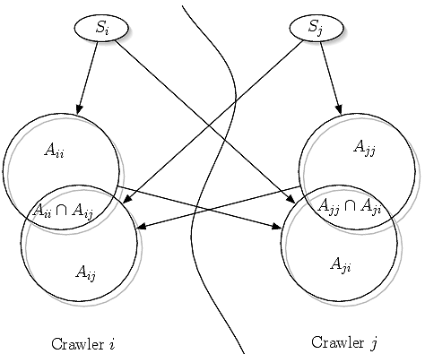
Crawler Coordination
Let Aij be the set of documents belonging to partition i that can be reached from the seeds Sj

Slide 146
Partitioning
A strategy to split URLs into non-overlapping subsets to be assigned to each process
  compute a hash function of the IP address in the URL
    e.g. if n∈ {0,…,2³²-1} corresponds to IP address
    m is the number of processes
    documents with n mod m = i assigned to process i
  take to account geographical dislocation of networks

Slide 147
Simple picture – complications
Search engine grade web crawling isn’t feasible with one machine
  All of the above steps distributed
Even non-malicious pages pose challenges
  Latency/bandwidth to remote servers vary
  Webmasters’ stipulations
    How “deep” should you crawl a site’s URL hierarchy?
  Site mirrors and duplicate pages
Malicious pages
  Spam pages
  Spider traps – incl dynamically generated
Politeness – don’t hit a server too often

Slide 148
What any crawler must do
Be Polite: Respect implicit and explicit politeness considerations
  Only crawl allowed pages
  Respect robots.txt (more on this shortly)
Be Robust: Be immune to spider traps and other malicious behavior from web servers

Slide 149
What any commercial grade crawler should do
Be capable of distributed operation: designed to run on multiple distributed machines
Be scalable: designed to increase the crawl rate by adding more machines
Performance/efficiency: permit full use of available processing and network resources

Slide 150
What any crawler should do
Fetch pages of “higher quality” first
Continuous operation: Continue fetching fresh copies of a previously fetched page
Extensible: Adapt to new data formats, protocols

Slide 151
Crawling research issues
Open research question
  Not easy
  Domain specific?
    No crawler works for all problems
  Evaluation
    Complexity
  Crucial for specialty search

Slide 152
Search Engine Web Crawling Policies
Their policies determine what gets indexed
Freshness
  How often the SE crawls
What gets ranked and how
  SERP (search engine results page)
Experimental SEO
  Make changes; see what happens

Slide 153
Web Crawling
Web crawlers are foundational species
  No web search engines without them
  Scrapers subclass of crawlers
Crawl policy
  Breath first
  Depth first
Crawlers should be optimized for area of interest
  Focused crawlers
robots.txt – gateway to web content
  Crawlers obey robots.txt

Slide 154
Practical Web Crawling Issues
Politeness
  How often to retrieve documents?
Crawlability
  Robots.tex let you crawl?
Document choice
  What to get – html, doc, pdf, png, etc?
  Must be specified
https://www.promptcloud.com/blog/crawling-web-trends-and-challenges/

