Slide 1
web crawling in CiteSeerX
Jian Wu
IST 441 (Spring 2016) invited talk

Slide 2
OUTLINE
Crawler in the CiteSeerX architecture
Modules in the crawler
Hardware
Choose the right crawler
Configuration
Crawl Document Importer
CiteSeerX Crawling Stats
Challenges and promising solutions

Slide 3
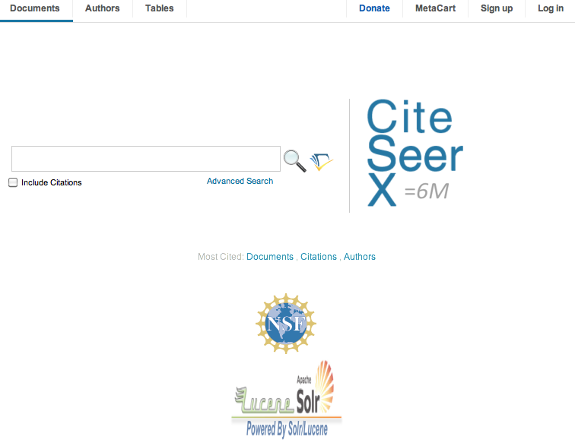
http://citeseerx.ist.psu.edu

Slide 4
CiteSeerX facts
Nearly a million unique users (from unique IP access) world wide, most in the USA
Over a billion hits per year.
170 million documents downloaded annually.
42 million queries annually (~1 trillion for Google; 1/25,000 of Google ).
Over 6 million full text English documents and related metadata.
Growth from 3 million to nearly 7 million in 2 years and this is increasing.
Related metadata with 20 million author and 150 million citations mentions.
Citation graph with 46 million nodes and 113 million edges.
Metadata shared weekly with researchers worldwide under a CC license; notable users are IBM, AllenAI, Stanford, MIT, CMU, Princeton, UCL, Berkeley, Xerox Parc, Sandia
OAI metadata accessed 30 million times annually.
URL list of crawled and indexed scholarly documents with duplicates - 10 million. Adding new documents at the rate of 200,000 a month.
Query "CiteSeerX OR CiteSeer" in Google returns nearly 9 million results.
Consistently ranked in the top 10 of world's repositories (Webometrics).
MyCiteSeer has over 50,000 users.
All data and metadata freely available under a CC license.
All code with documentation freely available under the Apache license.
Public document metadata extraction code for authors, titles, citations, author disambiguation,tables, and table data extraction.

Slide 5
Architecture of CiteSeerX
crawl database
django
crawl web server
API
CDI
extraction
Internet
web crawler
CDI
crawl repository
NFS
index
traffic
load balancer
web servers
repository
ingestion
database
Notes:
It is not suggested to put all functions into one server, because web crawling can consume lots of CPU time, RAM, and disk IO.
Instead it is more practical to use multiple servers to take different jobs.

Slide 6
Web Crawling Modules
Web crawler: automatically download PDF files
Crawl database: store document metadata (URLs etc.)
Crawl repository: save imported documents and metadata
Crawl web server: a web service where we can
Check stats
Submit URLs
CDI Middleware: import crawled documents to the crawl repository and database
Crawl API: an API that
Retrieve documents from crawl database.
Set the state of a document in the crawl database

Slide 7
Hardware
4 machines
main crawl server
secondary crawl server
crawl database server
crawl web server
Our main crawler: 24 cores, 32GB RAM, 30TB storage

Slide 8
Agent: citeseerxbot
A focused crawler automatically downloading PDF files from the Web
Current Setups
Two instances
Main crawler: crawl a list of high quality URLs we accumulated or gathered
Secondary crawler: user submitted URLs
Open Source Crawlers ever used by CiteSeerX
Python Crawler written by Shuyi Zheng: 2008 – 2012
Heritrix 1.14.4: 2012 – 2014
Heritrix 3.3.0: 2014 – Now

Slide 9
Choose the Right Crawler
Crawlers | Pros | Cons
Python Crawler | Incremental Integrated with Crawl Repo and DB | Lack of documentation and support, limited functionality, poor maintainability, e.g., not support Crawl-delay
Heritrix 1.14.4 (Java) | Friendly Web UI, most configurations Easy to run out-of-box Best for medium sized batch crawl Flexible saved data format: mirror, WARC | Files have to be saved in intermediate format Does not support concurrent jobs Not actively developed
Heritrix 3.3.0 (Java) | Scales well (10 M) Supports shell commands Flexible saved data format: mirror, WARC Actively developed | Web UI not quite friendly Configuration requires expertise knowledge
All of them are multi-threaded.

Slide 10
Why do we need to configure a crawler?
The internet is too big (nearly unlimited), complicated, and changing
The bandwidth is limited
The storage is limited
Specific uage

Slide 11
Configure Heritrix – 1
Traverse algorithm: Breadth-first
Depth: 2 for main crawler, 3 for user submitted URLs
Scalability: 50 threads
Politeness:
Honor all robots.txt files
Delay factor: 2 (minDelay, maxDelay, retryDelay)
De-duplicates: handled automatically by Heritrix

Slide 12
Configure Heritrix – 2
Filters:
Blacklist: places we don’t want to go (forbidden, dangerous, useless)
Whitelist: places we prefer to go
Mime-type filter: application/pdf
URL Pattern filter: e.g., ^.*\.js(\?.*|$)
Parsers:
HTTP Header
HTML
CSS
SWF
JS

Slide 13
Blacklist vs. Whitelist Policy
Blacklist | Whitelist
URLs never to crawl matched from a list of host and domains | High quality URLs to crawl Limit crawl scope within seed domains
Disadvantages Created and edited manually Difficult to predict and decide which hosts should be blacklisted May slow down the crawl with a long crawl list | Advantages Can be generated automatically Guaranteed to be crawlable and useful Will not slow down crawling when it is long Provide the majority of document resources

Slide 14
Configure Heritrix – 3
Writers
In which format downloaded files are saved
Downloaded ≠ Saved
Mirror (retain original files)
Compressed (e.g., WARC)

Slide 15
Crawling Policy
seed
d=0
Breadth-First (BF)
Breadth-First Search Crawling Yields High-Quality Pages (Najork & Wiener 2001)
Crawl Depth
Scheduled Crawling – 2: trade-off between coverage and efficiency
Submission Crawling – 3: higher quality, weight on coverage
Blacklist (BL)
URLs/hostnames/domains where we do not want to go
Publisher websites, e.g., springer.com, cambridge.org, wiley.com etc.
Digital libraries with strict access limit: ACM, arXiv, IEEE Xplore
Upon request: light weighted server, no robots.txt
Excluded before inserted to frontier
Whitelist (WL)
High quality seed URLs selected from crawl database
Each URL links to at least one ingestible document, e.g., http://clgiles.ist.psu.edu is a parent url http://clgiles.ist.psu.edu/pubs/PLoSONE-2014.pdf is a document url
Periodically regenerated
Crawl scope: do not go outside of domains defined by whitelist
Pros: increases crawl efficiency – higher fraction of academic documents
Cons: reduced chance to discover URLs in new domains
not crawled
parent url
document url

Slide 16
Generate Whitelist
Current Approach
A parent URL is selected if its webpage contains at least one ingestible document
Current whitelist: 1.1 million parent URLs
Limit Crawl Scope
Example: if whitelist includes the three URLs below:
http://cgiles.ist.psu.edu/
http://www.cs.cmu.edu/~tom/publications.html
http://oak.cs.ucla.edu/~cho/pubs.html
The crawl scope is limited to .psu.edu, .cmu.edu, and .ucla.edu
Proposed Approach
Add web page updating rate into whitelist generation algorithm
Goals:
Prioritize more frequently updated URLs
Generate whitelist on a daily basis

Slide 17
More Crawling Policy: Deciding Rules
Deciding Rules
Heritrix default deciding rules
Accept URLs in a SURT file (refer to Heritrix Glossary for SURT URL and SURT prefixes, important to know when setting a blacklist/whitelist)
Restrict URLs within the crawl depth
Allow to go to other domains from seed URLs
Reject URLs with too many path-segment pattern repetitions
Reject URLs with too many segments in the path
Customized filters (for CiteSeerX)
Limit crawl scopes to be within whitelist domains
reject URLs in blacklisted domain/host names
avoid visit javascript URLs
Formats of Saved Files
MirrorWriter: save documents in hierarchical order in their original file system
Only save documents with content-type = application/pdf
Alternative: WARCWriter (need special tools to extract documents out, e.g., CDI)

Slide 18
More Crawling Policy – Ethics
Crawlers can cause trouble, even unwillingly, if not properly designed to be “polite” and “ethical”
For example, CiteSeerX used to be brought down due to overwhelmingly crawling activities from baiduspider. Sending too many requests in rapid succession to a single server can amount to a Denial of Service (DoS) attack!
Server administrator and users will be upset
Crawler developer/admin IP address may be blacklisted
CiteSeerX Crawler Setups
delayFactor = 10: a very polite setting (probably too polite). For example, if it took 100 milliseconds to fetch the last URL from a host, the frontier will wait 1000 milliseconds before allowing another URI from that host to be processed.
minDelayMs = 10000 (10 s): minimum time to wait til the next fetch, overriding delay time calculated by delayFactor
maxDelayMs = 1000000 (1000 s): maximum time to wait til the next fetch, overriding delay time calculated by delayFactor
retryDelaySeconds = 900: how long the wait period is between retries
maxRetries = 30: number of fetch retries attempted on a URI due to transient errors
Always honor robots.txt

Slide 19
Crawl Database
Field | Type | Description
id | int(11) | Document ID
url | varchar(255) | Document URL
md5 | varchar(32) | url md5 value
host | varchar(255) | url host name
content_sha1 | varchar(40) | document SHA1
discover_date | datetime | first time to crawl this url
update_date | datetime | last time to crawl this url
parent_id | int(11) | parent URL ID (foreign key)
state | int(11) | ingested or not
documenturl
Field | Type | Description
id | int(11) | parent URL ID
url | varchar(255) | parent URL
md5 | varchar(32) | parent URL md5 value
first_crawl_date | datetime | time of the first visit
last_crawl_date | datetime | time of the last visit
parenturl

Slide 20
Crawl Document Importer (CDI)
A Python middleware used to import crawled/downloaded documents into the crawler database and repository, built on top of the django framework
The CDI plays as a “bridge” between the crawler and the crawl database/repository. Heritrix can be replaced by another crawled data or a downloaded repository.
CDI supports Heritrix MirrorWriter and WARCWriter but users can also write their own log parsers.
seeds
crawl database
crawl
downloads
CDI
Heritrix
crawl repository (document+metadata)
log

Slide 21
CiteSeerX Crawl Stats
Crawl speed (full speed):
40-100 URLs/second
100,000-200,000 PDFs per day
Database
#document URLs: 27.6 million
Size: 13GB (managed by MySQL)
Repository
26TB
Document Quality
30–40% are academic documents
Rank | #Document | Domain
1 | 764594 | arxiv.org
2 | 444090 | nih.gov
3 | 295306 | cmu.edu
4 | 284344 | mit.edu

Slide 22
Challenges and Solutions
Seed URLs
Coverage
Freshness
Diversity
Solution:
take advantage of giant search engines, e.g., Google, Bing
sitemaps of other digital libraries
open-access repositories, e.g., PubMed
Increase the # of IPs
Archive and Backup
Huge amount of space for archival data (data that are not frequently accessed)
Cloud storage and/or Storage Area Network (SAN)

Slide 23
Filters (DecidingScope)
crawl-order: scope
decide-rules
rejectByDefault
acceptIfSurPrefixed
rejectIfTooManyHops
acceptIfTranscluded (remove to limit crawl scope within whitelist domains)
rejectIfPathological
reject4IfTooManyPathSegs
acceptIfPrerequisite
rejectIfOnDomain (apply blacklist)
rejectIfMatchRegex (reject javascripts)
fetch-processors: HTTP
HTTP#decide-rules
mid-fetch-decide-rules
rejectMatchContentType (reject javascripts not ending with “.js”)
write-processors: MirrorWriter
MirrorWriter#decide-rules
rejectAll (by default, do not write anything to disk)
acceptIfMatchReg (only write PDF files to disk)

Slide 24
Tips of Using Heritrix
We strongly recommend users to start with the default configurations and change them little by little if you want to fully customize your crawler. A big change away from the default may cause unexpected results which is difficult to fix, unless you understand what you are doing.

