Slide 1
Scalability for Search and Big O
Thanks to George Bebis, Sartaj K Sahni, Costas Busch, Peter Andras

Slide 2
Last time
Introduction to class
Exercises
Exam
Project
Search engine use continues to grow
Impact on society still now well understood

Slide 3
Scalability for Search
What is scaling
What is scaling for search
Big O as a measure
Examples
Practical vs impractical

Slide 4
Why use Big O?
It can keep you from getting fired!
Your boss is not that smart.
You know your competition!
Not all IT sorts are that well trained!
Nothing about algorithms?

Slide 5
Why the interest in scaling
Scaling determines how your system or business will grow.
If your system or business does not scale well, it will stay where it’s at.
What methods or algorithms used are appropriate and don’t blow up.
One algorithm does not ”rule them all”.
“No Free Lunch Theorem”
THERE IS NO BEST ALGORITHM FOR EVERYTHING

Slide 6
Why the interest in scaling
Helps manage data
Keeps costs under control
May keep you from being fired

Slide 7
Scalability for Search
Scaling means how a system must grow if resources or work grows
Scalability is the ability of a system, network, process, or algorithm to handle growing amounts of work in a graceful manner or its ability to be enlarged to accommodate that growth (wikipedia)
Search usually must scale in various ways:
Number of things searched – N
Number of searchers – M
Algorithms for indexing, ranking, etc.

Slide 8
We will use algorithms for search
An algorithm is a recipe, method, or technique for doing something. The essential feature of an algorithm is that it is made up of a finite set of rules or operations that are unambiguous and simple to follow (i.e., these two properties:
definite and
effective, respectively).

Slide 9
Which algorithm to use?
You have a friend arriving at the airport, and your friend needs to get from the airport to your house. Here are four different algorithms that you might give your friend for getting to your home:
The taxi algorithm:
Go to the taxi stand.
Get in a taxi.
Give the driver my address.
The call-me algorithm:
When your plane arrives, call my cell phone.
Meet me outside baggage claim.
The rent-a-car algorithm:
Take the shuttle to the rental car place.
Rent a car.
Follow the directions to get to my house.
The bus algorithm:
Outside baggage claim, catch bus number 70.
Transfer to bus 14 on Main Street.
Get off on Elm street.
Walk two blocks north to my house.

Slide 10
Scenarios
I’ve got two algorithms that accomplish the same task
Which is better?
I want to store some data
How do my storage needs scale as more data is stored
Given an algorithm, can I determine how long it will take to run?
Input is unknown
Don’t want to trace all possible paths of execution
For different input, can I determine how an algorithm’s runtime changes?

Slide 11
Which algorithm to use?
An algorithm for solving a problem is not unique. Which should we use?
Based on cost
Number of inputs
Number of outputs
Time (time vs space)
Likely to succeed
etc
Most solutions often based on similar problems

Slide 12
Measuring the Growth of Work or Hardness of a Problem
While it is possible to measure the work done by an algorithm for a given set of inputs, we need a way to:
Measure the rate of growth of an algorithm based upon the size of the input (or output)
Compare algorithms to determine which is better for the situation
Compare and analyze for large problems
Examples of large problems?

Slide 13
Time vs. Space
Very often, we can trade space for time:
For example: maintain a collection of students’ with ID information.
Use an array of a billion elements and have immediate access (better time)
Use an array of number of students and have to search (better space)

Slide 14
Time vs. Space
Always trade time for space!
Unless you’re the “outlander” or otherwise immortal.

Slide 15
Introducing Big O Notation
Will allow us to evaluate algorithms and understand scaling.
Has precise mathematical definition
Used in a sense to put algorithms into families
Gives the Worst case scenario
What does this mean?
Other types of cases?

Slide 16
Why Use Big-O Notation
Used when we only know the asymptotic upper bound.
What does asymptotic mean?
What does upper bound mean?
If you are not guaranteed certain input, then it is a valid upper bound that even the worst-case input will be below.
Why worst-case?
(It’s the worse it can get!!!)
May often be determined by inspection of an algorithm.

Slide 17
Size of Input (measure of work)
In analyzing rate of growth based upon size of input, we’ll use a variable
Why?
For each factor in the size, use a new variable
n is most common…
Examples:
A linked list of n elements
A 2D array of n x m elements
A Binary Search Tree of p elements

Slide 18
Formal Definition of Big-O
For a given function g(n), O(g(n)) is defined to be the set of functions
O(g(n)) = {f(n) : there exist positive constants c and n₀ such that 0 ≤ f(n) ≤ cg(n) for all n ≥ n₀}

Slide 19
Visual O( ) Meaning
cg(n)
Upper Bound
f(n)
f(n) = O(g(n))
Work done
Our Algorithm
n₀
Size of input

Slide 20
Simplifying O( ) Answers
We say Big O complexity of
3n² + 2 = O(n²) ← drop constants!
because we can show that there is a n₀ and a c such that:
0 ≤ 3n² + 2 ≤ cn² for n ≥ n₀
i.e. c = 4 and n₀ = 2 yields:
0 ≤ 3n² + 2 ≤ 4n² for n ≥ 2
What does this mean?

Slide 21
Simplifying O( ) Answers
We say Big O complexity of
3n² + 2n = O(n²) + O(n) = O(n²) ← drop smaller!

Slide 22
Correct but Meaningless
You could say
3n² + 2 = O(n⁶) or 3n² + 2 = O(n⁷)
But this is like answering:
What’s the world record for the mile?
Less than 3 days.
How long does it take to drive to Chicago?
Less than 11 years.

Slide 23
Big O issues
Useful for scaling
Sometimes constants matter for real problems; c is a constant
c is .0001 vs c is 10⁶
Use Big O carefully

Slide 24
Summary
We use O() notation to discuss the rate at which the work of an algorithm grows with respect to the size of the input.
O() is an upper bound, so only keep dominant terms and drop constants

Slide 25
Best vs worse vs average
Best case is the best we can do
Worst case is the worst we can do
Average case is the average cost
Which is most important?
Which is the easiest to determine?

Slide 26
Wikipedia Big O
Orders of common functions
How to break a big number:
Take its log
Consider n^{n}
log n^{n} = n log n
log or ln ?
Doesn’t matter – related by a constant
log n = ln n/ ln 10

Slide 27
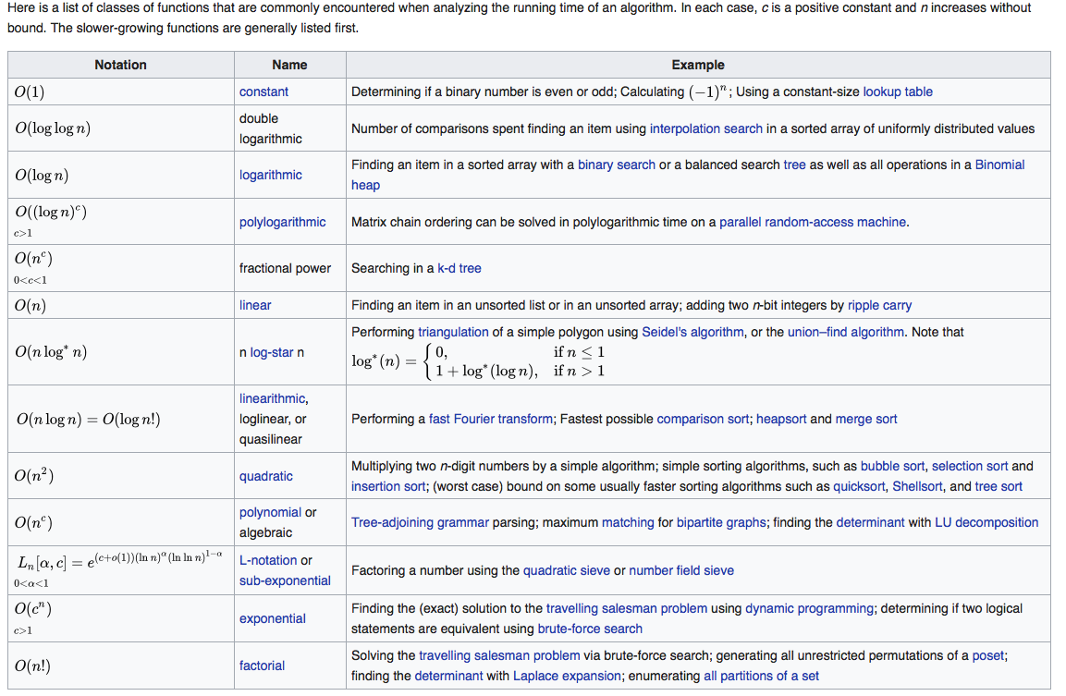
Orders of common functions

Slide 28
Measuring the Growth of Work
As input size N increases, how well does our automated system work?
Depends on what you want to do!
Use algorithmic complexity theory:
Use measure big O: O(N) which means worst case
Important for
Search engines
Databases
Social networks
Crime/terrorism
Performance classes
Polynomial
Sub-linear O(Log N)
Linear O(N)
Nearly linear O(N Log N)
Quadratic O(N²)
Exponential O(2^{N})
O(N!)
O(N^{N})
practical
Usually death to
scaling
impractical
MapReduce
may help

Slide 29
Two Categories of Algorithms
Lifetime of the universe 10¹⁰ years = 10¹⁷ sec
Unreasonable
10³⁵
10³⁰
10²⁵
10²⁰
10¹⁵
trillion
billion
million
1000
100
10
N^{N}
2^{N}
Runtime sec
N⁵
Reasonable
N
Don’t Care!
2 4 8 16 32 64 128 256 512 1024
Size of Input (N)

Slide 30
Two Categories of Algorithms
Lifetime of the universe 10¹⁰ years = 10¹⁷ sec
10³⁵
10³⁰
10²⁵
10²⁰
10¹⁵
trillion
billion
million
1000
100
10
Unreasonable
N^{N}
2^{N}
Reasonable
Runtime sec
Impractical
N²
Practical
N
Don’t Care!
2 4 8 16 32 64 128 256 512 1024
Size of Input (N)

Slide 31
Two Categories of Algorithms
Lifetime of the universe 10¹⁰ years = 10¹⁷ sec
Unreasonable
10³⁵
10³⁰
10²⁵
10²⁰
10¹⁵
trillion
billion
million
1000
100
10
N^{N}
2^{N}
Reasonable
Runtime sec
N⁵
N
Don’t Care!
2 4 8 16 32 64 128 256 512 1024
Size of Input (N)

Slide 32
Reasonable vs. Unreasonable
Reasonable algorithms have polynomial factors
O (Log N)
O (N)
O (N^{K}) where K is a constant
Unreasonable algorithms have exponential factors
O (2^{N})
O (N!)
O (N^{N})

Slide 33
Reasonable vs. Unreasonable
Reasonable algorithms
May be usable depending upon the input size
Unreasonable algorithms
Are impractical and useful to theorists
Demonstrate need for approximate solutions
Remember we’re dealing with large N (input size)

Slide 34
Reasonable vs. Unreasonable examples
Compare every web page crawled with all the others
N x N problem - N²
N is 10M, N² ?

Slide 35
Decidable vs. Undecidable
Any problem that can be solved by an algorithm is called decidable.
Problems that can be solved in polynomial time are called tractable (easy).
Problems that can be solved, but for which no polynomial time solutions are known are called intractable (hard).
Problems that can not be solved given any amount of time are called undecidable.

Slide 36
Complexity Classes
Problems have been grouped into classes based on the most efficient algorithms for solving the problems:
Class P: those problems that are solvable in polynomial time.
Class NP: problems that are “verifiable” in polynomial time (i.e., given the solution, we can verify in polynomial time if the solution is correct or not.)

Slide 37
Decidable vs. Undecidable Problems

Slide 38
Decidable Problems
We now have three categories:
Tractable problems
NP problems
Intractable problems
All of the above have algorithmic solutions, even if impractical.

Slide 39
Undecidable Problems
No algorithmic solution exists
Regardless of cost
These problems aren’t computable
No answer can be obtained in finite amount of time
Lots of undecidable problems
Program halts, virus detection, vulnerability detection,

Slide 40
The Halting Problem
Given an algorithm A and an input I, will the algorithm reach a stopping place?
loop
exitif (x = 1)
if (even(x)) then
x <- x div 2
else
x <- 3 * x + 1
endloop
In general, we cannot solve this problem in finite time.

Slide 41
AI Hard Problems
In artificial intelligence, the most difficult problems are informally known as AI-complete or AI-hard, implying that the difficulty of these computational problems is equivalent to that of solving the central artificial intelligence problem—making computers as intelligent as people, or strong AI. To call a problem AI-complete reflects a belief that it would not be solved by a simple specific algorithm.

Slide 42
AI Hard Problems
AI-complete problems are hypothesized to include computer vision, natural language understanding, and dealing with unexpected circumstances while solving any real world problem.
Currently, AI-complete problems cannot be solved with modern computer technology alone, but would also require human computation. This property can be useful, for instance to test for the presence of humans as with CAPTCHAs, and for computer security to circumvent brute-force attacks.

Slide 43
List of NP problems
http://www.nada.kth.se/~viggo/problemlist/compendium.html

Slide 44
What is a good algorithm/solution?
If the algorithm has a running time that is a
polynomial function of the size of the input, n,
otherwise it is a “bad” algorithm.
A problem is considered tractable if it has a polynomial time solution and intractable if it does not.
For many problems we still do not know if they
are tractable or not.

Slide 45
Reasonable vs. Unreasonable
Reasonable algorithms have polynomial factors
O (Log n)
O (n)
O (n^{k}) where k is a constant
Unreasonable algorithms have exponential factors
O (2^{n})
O (n!)
O (n^{n})

Slide 46
Halting problem
No program can ever be written to determine whether any arbitrary program will halt. Since many questions can be recast to this, many programs are absolutely impossible, although heuristic or partial solutions are possible.
What does this mean?

Slide 47
What’s this good for anyway?
Knowing hardness of problems lets us know when an optimal solution can exist.
Salesman can’t sell you an optimal solution
What is meant by optimal?
What is meant by best?
Keeps us from seeking optimal solutions when none exist, use heuristics instead.
Some software/solutions used because they scale well.
Helps us scale up problems as a function of resources.
Many interesting problems are very hard (NP)!
Use heuristic solutions
Only appropriate when problems have to scale.

Slide 48
Measuring the growth of work or how does it scale (scalability)
As input size N increases, how well does our automated system work or scale?
Depends on what you want to do!
Use algorithmic complexity theory:
Use measure big o: O(N) which means worst case
Important for
Search engines
Databases
Social networks
Crime/terrorism
Performance classes
Polynomial
Sub-linear O(Log N)
Linear O(N)
Nearly linear O(N Log N)
Quadratic O(N²)
Exponential O(2^{N})
O(N!)
O(N^{N})
Death to
scaling

Slide 49
Two Categories of Algorithms
Lifetime of the universe 10¹⁰ years = 10¹⁷ sec
Unreasonable
10³⁵
10³⁰
10²⁵
10²⁰
10¹⁵
trillion
billion
million
1000
100
10
N^{N}
2^{N}
Runtime sec
N⁵
Reasonable
N
Don’t Care!
2 4 8 16 32 64 128 256 512 1024
Size of Input (N)

Slide 50
Two Categories of Algorithms
Lifetime of the universe 10¹⁰ years = 10¹⁷ sec
10³⁵
10³⁰
10²⁵
10²⁰
10¹⁵
trillion
billion
million
1000
100
10
Unreasonable
N^{N}
2^{N}
Reasonable
Runtime sec
Impractical
N²
Practical
N
Don’t Care!
2 4 8 16 32 64 128 256 512 1024
Size of Input (N)

Slide 51
Summary of algorithmic complexity
Measures of hardness (complicated; many issues open)
Decidable
Tractable
Reasonable
Practical
Impractical
Unreasonable
Intractable
NP (contains Polynomial class)
Undecidable
No matter what the class of problems, approximations may help and be useful.

Slide 52
Computational Complexity
Helps in figuring out what solutions to pursue
Measures of hardness
Decidable vs undecdiable
Tractable vs intractable
Reasonable vs unreasonable
Practical vs impractical

Slide 53
What we covered
Search has a large amount of inputs, outputs,& resources
Search is complex - one method of measuring cost – Big O
Not taking these issues into account can doom any project.
Models of best vs good enough
Asking how any method scales gives credence and value to a project
Usually not necessary for small scale projects
Are such ”toy” projects useful or a waste of time

Slide 54
Basic Big O intro
https://www.youtube.com/watch?v=__vX2sjlpXU

