Slide 1
Large Language Models (LLMs): Information Retrieval and Extraction
C. Lee Giles
The Pennsylvania State University
University Park, PA, USA
clg20@psu.edu
http://clgiles.ist.psu.edu

Slide 2
Outline
Machine learning – dominant AI model
Neural networks – deep learning
Most popular ML methods
Large Language models (LLMs)- made with deep learning transformers
LLMs for information retrieval
LLMs for information extraction (tabular data)
Verification by example – theories?
Future directions

Slide 3
Slides Acknowledgements
Thanks to
Andrew Yates, Rodrigo Nogueira, and Jimmy Lin
NVIDIA
WidthAI
LifeArchitect.ai

Slide 4
Take home
LLMs can give good explanations and answers
Generative agents can be useful
Can write and debug some code
Math can be a problem
Some AI’s are dumb idiot savants
Do not try to beat them in games WE have taught them how to play
They have no common sense and can’t always be trusted
Legal issues are there
Who will be sued?
AI’s can be & are useful and this use will grow
The future – human computing
We and computers work together

Slide 5
What is machine learning?
A branch of artificial intelligence, concerned with the design and development of algorithms that allow computers to change their behavior based on empirical data
Data driven
Automating automation
Getting computers to program themselves
Since writing software can be a bottleneck, let the data do the work instead!
Intelligence requires knowledge, thus computers acquire knowledge but through data
Currently, the most successful application method in AI and is usually what is meant by AI

Slide 6
Machine Learning - Deep Learning
Deep learning is the most popular ML (AI) method
Why?
State of the art and significant results on many ML tasks
Computer vision
Natural language processing
Robotics
etc
Relations to AI
Machine Learning is part of Artificial intelligence
Deep Learning is part of Machine Learning
Deep Learning is an extension of Neural Networks
https://clgiles.ist.psu.edu/IST597/

Slide 7
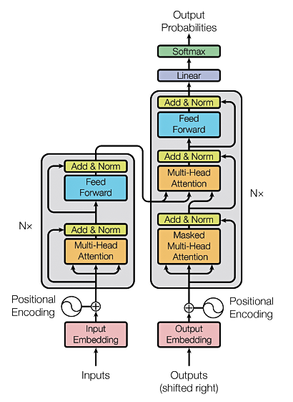
Transformers
The T in GPT & BERT
Source: Vaswani, Ashish, et al. "Attention is all you need." Advances in Neural Information Processing Systems. 2017.

Slide 8
Background
The RNN and LSTM neural models were designed to process language and perform tasks like classification, summarization, translation, and sentiment detection
RNN: Recurrent Neural Network
LSTM: Long Short Term Memory
In both models, layers get the next input word and have access to some previous words, allowing it to use the word’s left context
They used word embeddings where each word was encoded as a vector of 100-300 real numbers representing its meaning

Slide 9
Background for transformers
Transformers extend this to allow the network to process a word input knowing the words in both its left and right context
This provides a more powerful context model
Transformers add additional features, like attention, which identifies the important words in this context and connects the encoder and decoder
And break the problem into two parts:
An encoder (e.g., BERT)
A decoder (e.g., GPT)

Slide 10
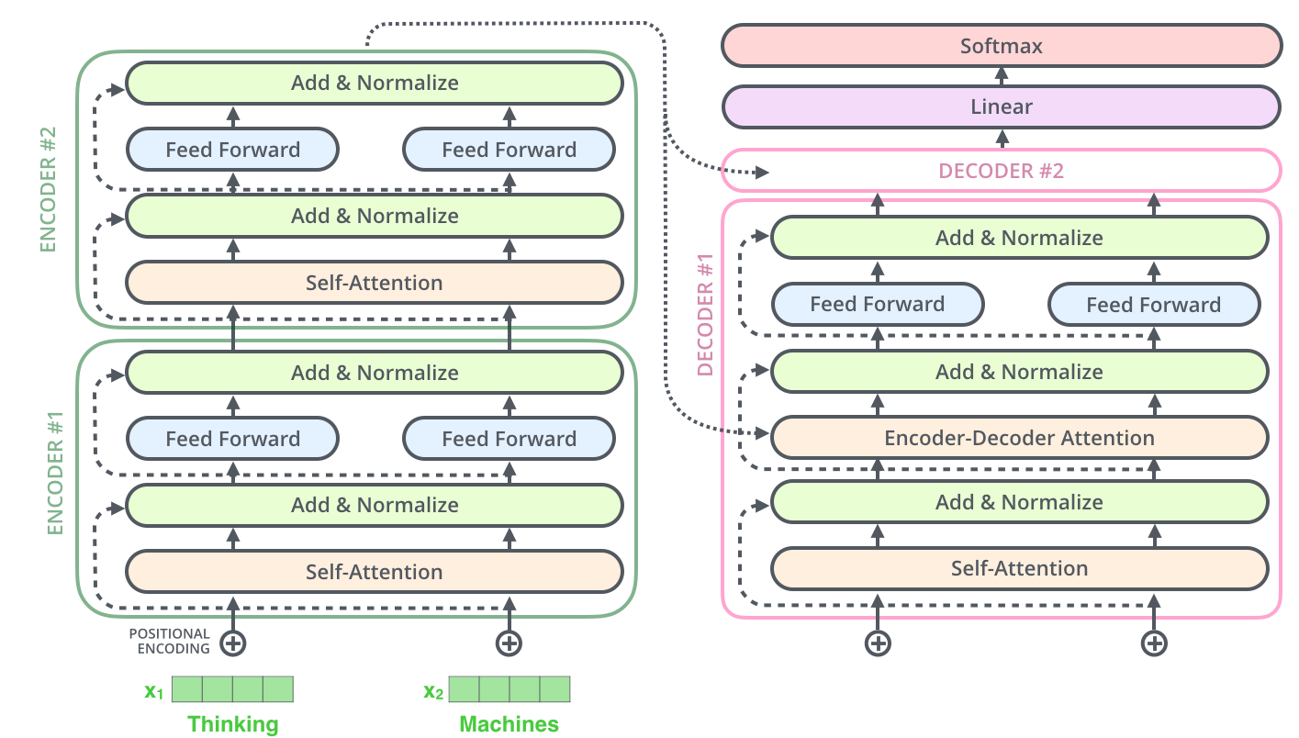
Transformer model
Encoder (e.g., BERT)
Decoder (e.g., GPT)
https://jalammar.github.io/illustrated-transformer/

Slide 11
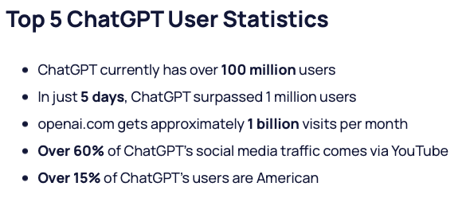
Popularity of ChatGPT
GPT = Generative Pretrained Transformer
Generative Pretrained Transformer (GPT)
https://explodingtopics.com/blog/chatgpt-users#growth

Slide 12
Large Language Models (LLMs)
A deep learning algorithm (transformer) that can recognize, summarize, translate, predict and generate text and other content based on knowledge gained from massive datasets.
LLMs are among the most successful applications of transformer models. They aren’t just for teaching AIs human languages, but for understanding proteins, writing software code, and much more.
In addition to accelerating natural language processing applications — like translation, chatbots and AI assistants — large language models are used in healthcare, software development and use cases in many other fields.
NVIDIA Blog

Slide 13
Large Language Models (LLMs)
Large language models largely represent a class of deep learning architectures called transformer networks.
A transformer model is a neural network that learns context and meaning by tracking relationships in sequential data, like the words in this sentence.
A transformer is made up of multiple transformer blocks, also known as layers.
For example, a transformer has self-attention layers, feed-forward layers, and normalization layers, all working together to decipher input to predict streams of output at inference.
The layers can be stacked to make deeper transformers and powerful language models. Transformers were first introduced by Google in the 2017 paper “Attention Is All You Need.”
NVIDIA Blog

Slide 14
Popularity of ChatGPT
https://explodingtopics.com/blog/chatgpt-users#growth

Slide 15
How they work
NVIDIA Blog

Slide 16
Key Innovations
Two key innovations: positional encodings and self-attention.
Positional encoding embeds the order of which the input occurs within a given sequence.
Essentially, instead of feeding words within a sentence sequentially into the neural network, thanks to positional encoding, the words can be fed in non-sequentially.
Self-attention assigns a weight to each part of the input data while processing it.
This weight signifies the importance of that input in context to the rest of the input.
Now models no longer have to dedicate the same attention to all inputs and can focus on the parts of the input that actually matter.
This representation of what parts of the input the neural network needs to pay attention to is learnt over time as the model sifts and analyzes mountains of data.
NVIDIA Blog

Slide 17
GPUs
These two techniques in conjunction allow for analyzing the subtle ways and contexts in which distinct elements influence and relate to each other over long distances, non-sequentially.
The ability to process data non-sequentially enables the decomposition of the complex problem into multiple, smaller, simultaneous computations.
Naturally, GPUs are well suited to solve these types of problems in parallel, allowing for large-scale processing of large-scale unlabelled datasets and enormous transformer networks.
NVIDIA Blog

Slide 18
Uses
As LLMs have grown in size, so have their capabilities. Broadly, LLM use cases for text-based content can be divided up in the following manner:
Generation (e.g., story writing, marketing content creation)
Summarization (e.g., legal paraphrasing, meeting notes summarization)
Translation (e.g., between languages, text-to-code)
Classification (e.g., toxicity classification, sentiment analysis)
Chatbot (e.g., open-domain Q+A, virtual assistants)
NVIDIA Blog

Slide 19
How they work
Large language models are trained using unsupervised learning.
With unsupervised learning, models can find previously unknown patterns in data using unlabelled datasets.
This also eliminates the need for extensive data labeling, which is one of the biggest challenges in building AI models.
Thanks to the extensive training process that LLMs undergo, the models don’t need to be trained for any specific task and can instead serve multiple use cases. These types of models are known as foundation models.
NVIDIA Blog

Slide 20
Foundation Models
The ability for the foundation model to generate text for a wide variety of purposes without much instruction or training is called zero-shot learning.
Different variations of this capability include one-shot or few-shot learning, wherein the foundation model is fed one or a few examples illustrating how a task can be accomplished to understand and better perform on select use cases.
Despite the tremendous capabilities of zero-shot learning with large language models, developers and enterprises many specialized needs.
To deploy these large language models for specific use cases, the models can be customized using several techniques to achieve higher accuracy. Some techniques include prompt tuning, fine-tuning, and adapters.
NVIDIA Blog

Slide 21
Theories about LLMs
Universal approximation theorem
PAC learnability
No free lunch theorems
Turing equivalence
------
Turing test, Winograd schemas, etc?
LLMs? examples!!
How do we judge (test) them?
Safety, ruefulness, verification

Slide 22
Types of LLMs
Encoder only: These models are typically suited for tasks that can understand language, such as classification and sentiment analysis. Examples of encoder-only models include BERT (Bidirectional Encoder Representations from Transformers).
Decoder only: This class of models is extremely good at generating language and content. Some use cases include story writing and blog generation. Examples of decoder-only architectures include GPT-3 (Generative Pretrained Transformer 3).
Encoder-decoder: These models combine the encoder and decoder components of the transformer architecture to both understand and generate content. Some use cases where this architecture shines include translation and summarization. Examples of encoder-decoder architectures include T5 (Text-to-Text Transformer).
https://vitalflux.com/large-language-models-concepts-examples/

Slide 23
Google’s BERT
(Bidirectional Encoder Representations from Transformers)
Uses Transformer attention mechanism to learn contextual relations between words
Transformer includes two mechanisms
An Encoder that reads text input
A Decoder that produces a prediction for the task
Since BERT’s goal is to generate a language model, only the encoder mechanism is necessary
Uses Bidirectional training
Deeper sense of context/flow than single-direction
Masked LM (MLM) allows bidirectional training
Code Open Source
Sargur Srihari

Slide 24
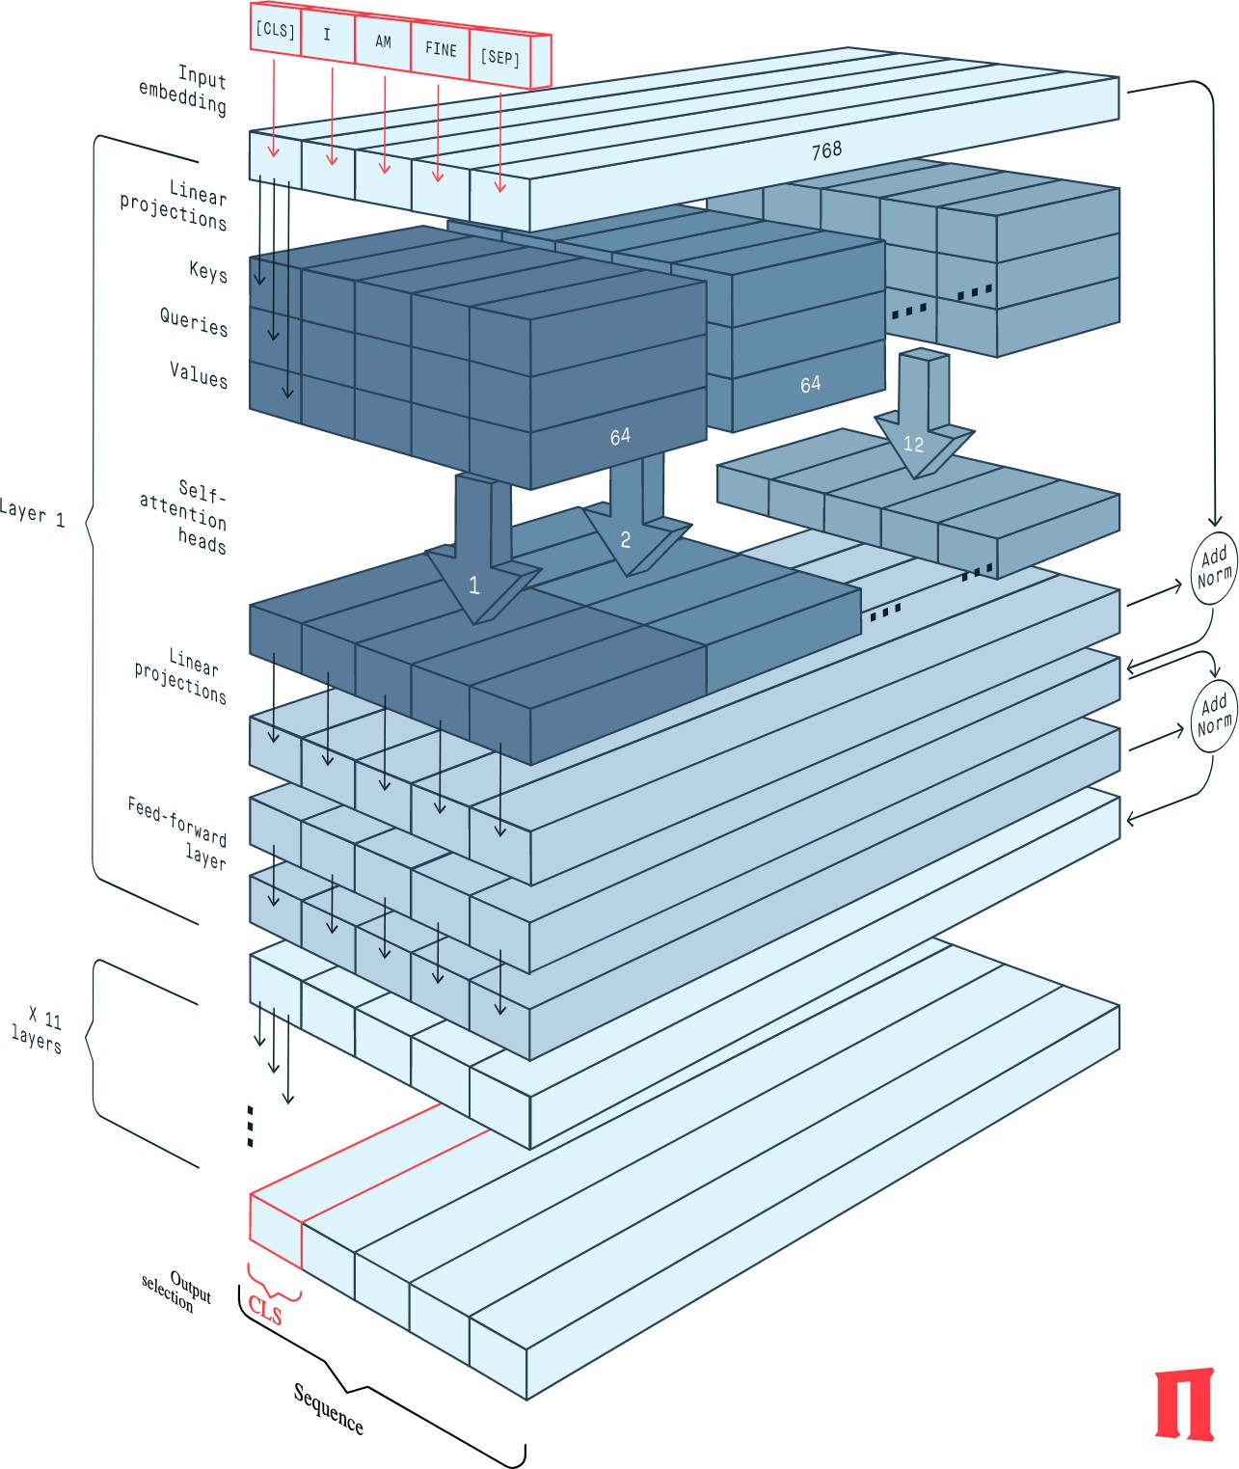
Structure of BERT
The BERT Encoder block implements the base version of the BERT network
It is composed of 12 successive transformer layers, each having 12 attention heads
The total number of parameters is 110 million.
https://peltarion.com/knowledge-center/documentation/modeling-view/build-an-ai-model/
blocks/bert-encoder?fbclid=IwAR2rt4ObbHCMvuGsfrNNOnotfW_Dfc-5y3QorqW1nQUbw4XzuwjjCbnQDy0

Slide 25
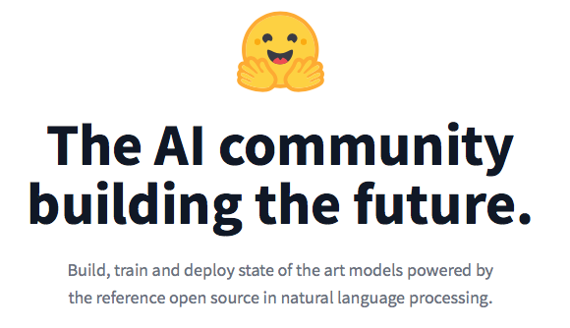
The BERT Zoo from huggingface
25K Transformers at huggingface with 190 supported
https://github.com/huggingface/transformers

Slide 26
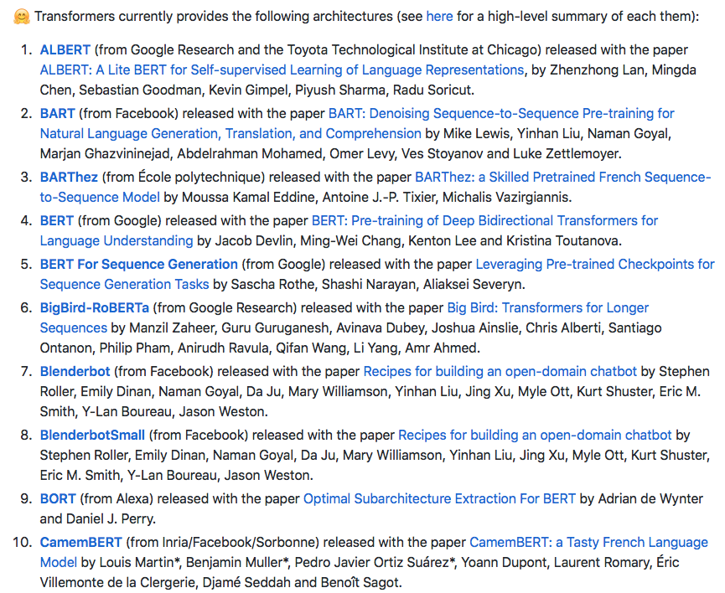
The BERT Zoo

Slide 27
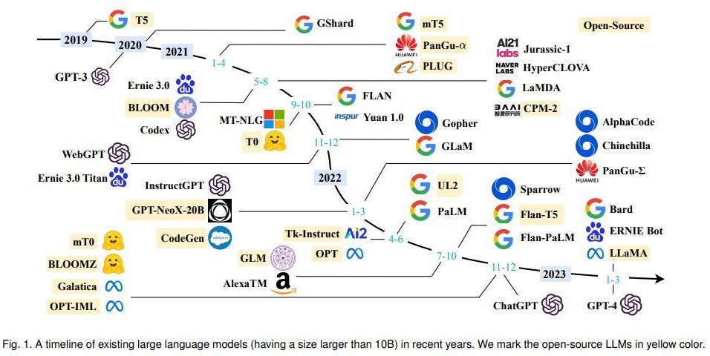
Timeline of LLMs
https://github.com/RUCAIBox/LLMSurvey

Slide 28
Some LLMs
Turing NLG (Microsoft)
Gopher, Chichilla (Deepmind)
Switch transformer, GLAM, PALM, Lamba, T5, MT5, BARD (Google)
OPT, Fairseq Dense (Meta)
GPT-3 versions such as GPT-Neo, GPT-J, & GPT-NeoX (Open-AI)
Ernie 3.0 (Baidu)
Jurassic (AI21Labs)
Exaone (LG)
Pangu Alpha (Huawei)
Roberta, XML-Roberta, Deberta
DistilBert
XLNet
https://vitalflux.com/large-language-models-concepts-examples/

Slide 29
Open source LLMs
Dolly
BLOOM
GLM-130B
GPT-Neo, GPT-NeoX, GPT-j
GPT-2
PaLM
OPT
CerebrasGPT
Flan-T5
Llama
Alpaca
https://analyticsindiamag.com/14-open-source-llms-you-need-to-know/

Slide 30
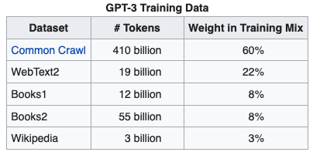
GPT-3
https://www.kdnuggets.com/2020/06/gpt-3-deep-learning-nlp.html

Slide 31
GPT-3 Models
$12 million cost for a single training run
https://www.springboard.com/blog/data-science/machine-learning-gpt-3-open-ai/

Slide 32
ChatGPT Training
Training

Slide 33
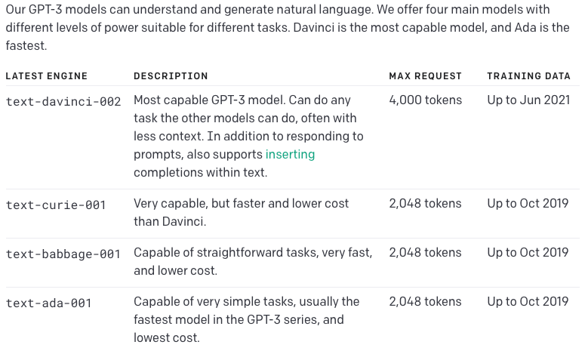
OpenAI’s GPT-3s products
https://beta.openai.com/docs/engines

Slide 34
OpenAI gpt-4’s

Slide 35
OpenAI products

Slide 36
An Open Source GPT (LLM)
GPT-Neo, GPT-J, GPT-NeoX
GPT-Neo released March 2021; GPT-J, June 2021, NeoX, Feb 2020
-- all created by EleutherAI
(a collective of researchers working to open source AI).
GPT-Neo has 3 versions: 125 million parameters, 1.3 billion parameters (equivalent to GPT-3 Babbage), and 2.7 billion parameters.
GPT-J has 6 billion parameters. This is a direct equivalent of GPT-3 Curie.
GPT-NeoX is a 20 billion parameter (smaller versions available) model trained in collaboration with CoreWeave
https://medium.com/geekculture/list-of-open-sourced-fine-tuned-large-language-models-llm-8d95a2e0dc76

Slide 37
Problems with Transformers
Do you really know (understand) what we are asking or wanting?
Is it correct?
Is it lying?
Prompts are very important

Slide 38
Deep Learning (GPT 3) has problems answering simple Math questions
https://lacker.io/ai/2020/07/06/giving-gpt-3-a-turing-test.html

Slide 39
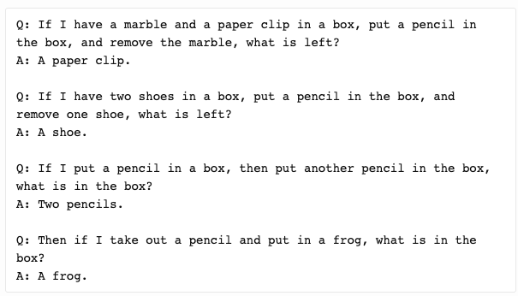
Others - reasoning

Slide 40
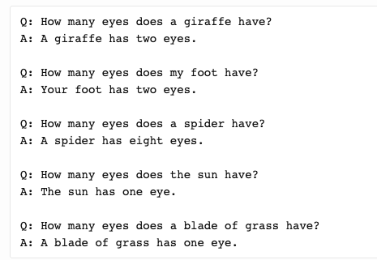
Others – related knowledge
GPT-3 has a limited short-term memory, and has trouble reasoning about more than one or two objects in a sentence.

Slide 41
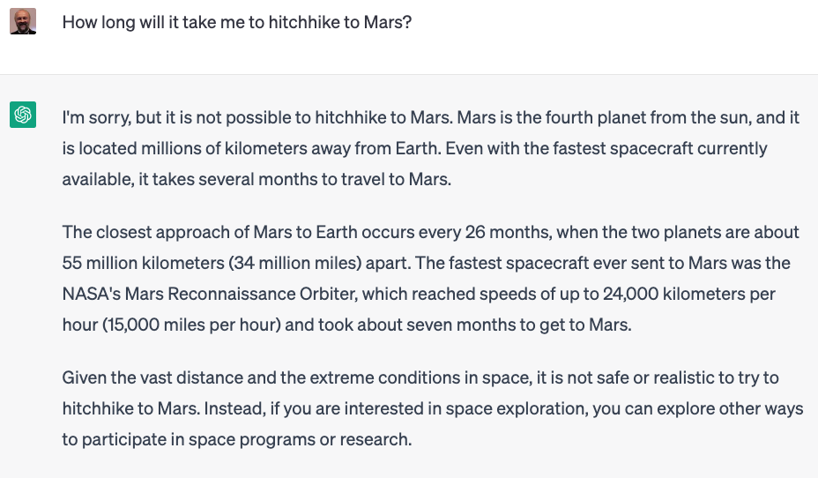

Slide 42
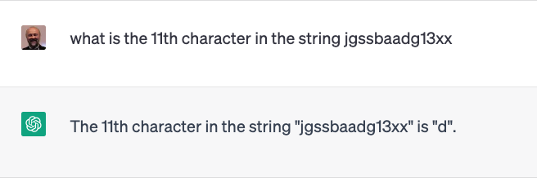
Counting and math

Slide 43
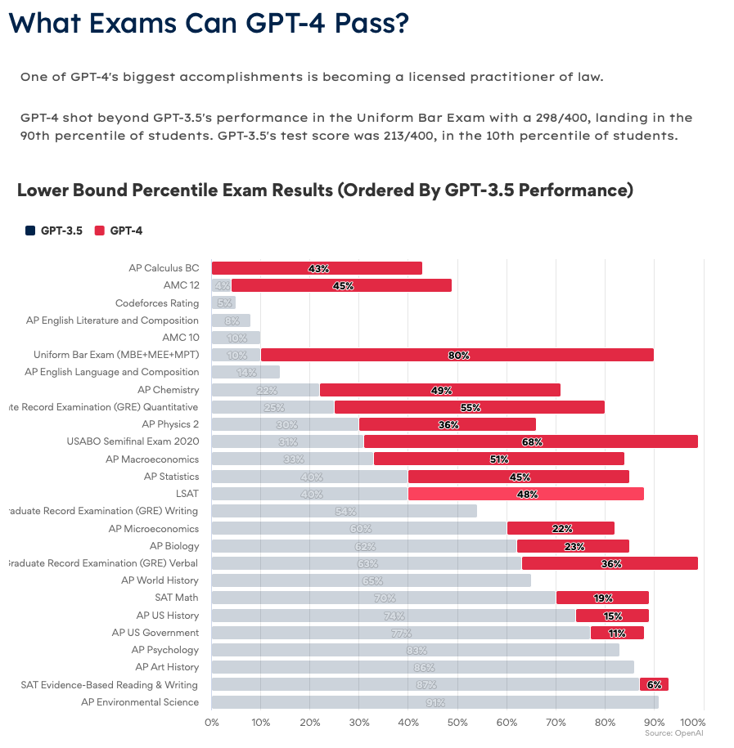

Slide 44
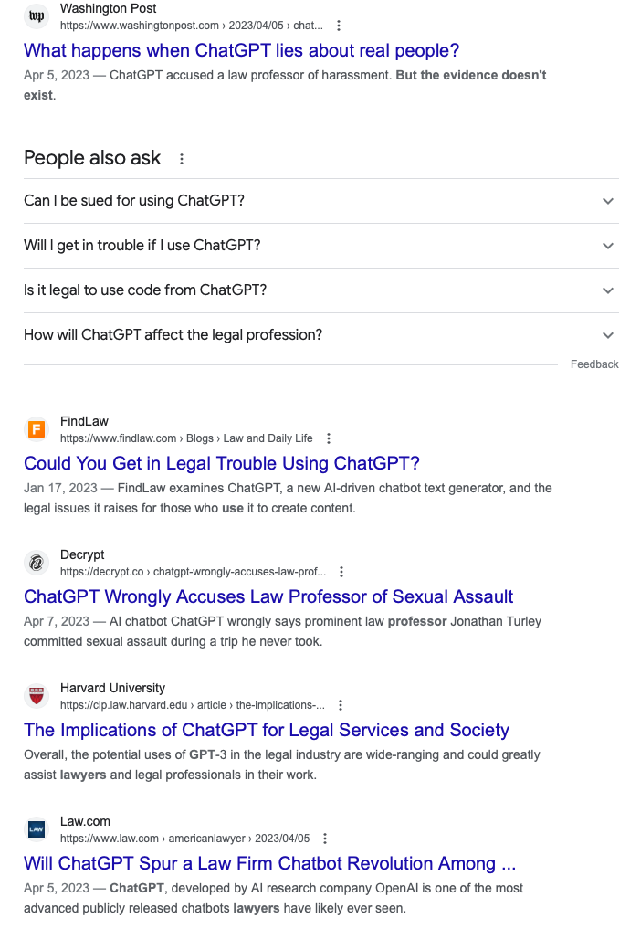

Slide 45
GPT-4
https://openai.com/research/gpt-4
GPT 3 to GPT 4
https://www.youtube.com/watch?v=rLE0b8_OQMk

Slide 46
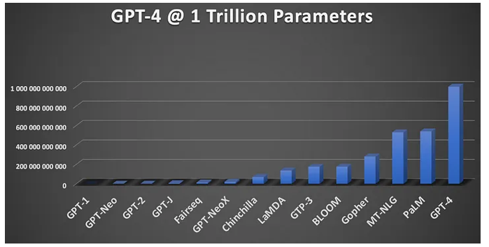
GPT-4

Slide 47
Bubeck 2023

Slide 48
Language Competence
Two different aspects of language use:
formal linguistic competence, which includes knowledge of rules and patterns of a given language
functional linguistic competence, a host of cognitive abilities required for language understanding and use in the real world.
“Dissociating Language and Thought in Large Language Models: a
Cognitive Perspective,” Kyle Mahowald, Anna Ivanova et. al

Slide 49
Language Competence
LLMs seem to have only formal linguistic competence
They don’t understand what they are saying.
Misunderstanding by humans is due to the fallacy
Good at language -> good at thought
“Dissociating Language and Thought in Large Language Models: a
Cognitive Perspective,” Kyle Mahowald, Anna Ivanova et. al

Slide 50
Mahowald 2023

Slide 51
Mahowald 2023

Slide 52
LLMs challenges
Inconsistent accuracy - fabrications
Lack of useful languages and data (tables, graphs) (much is not on the web)
Limited controllability
Stale training data
Personal data risk
Reasoning issues - explain results
Margo Poda

Slide 53
Running out of Data?
Villalobos, et.al 2022.

Slide 54
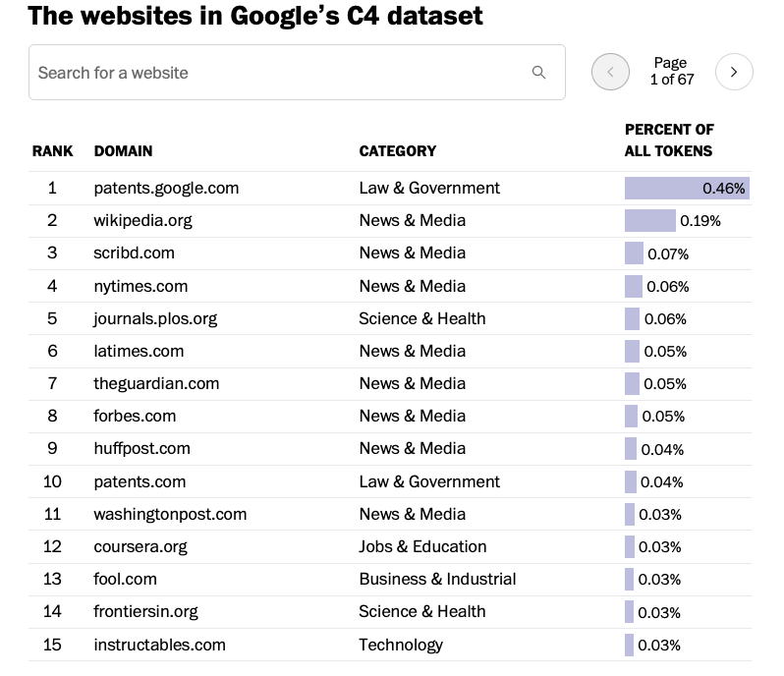
Used to train Bard
Not ChatGPT data!
https://www.searchenginejournal.com/google-bard-training-data/478941/#close

Slide 55
Using LLMs to write scholarly papers
Content generated by LLMs should be checked by a domain expert;
In the instance of errors of biases, co-authors should be held accountable;
Investigators should disclose the use of LLMs and indicate text written or co-written by LLMs;
When content of a publication is impacted, even in the absence of using AI-generated text, the following should be disclosed;
And investigators should not use LLMs to fabricate or falsify data.
Hosseini et al, JAMA ’23

Slide 56
Issues for LLMs for PDFs
LLMs cannot read PDFs.
Convert to ascii using PDFBox, OCR, etc
Extract figures using boxing algorithms or pdffigures2, etc
XML extraction using GROBID for technical/scientitic papers
OCR based methods: LayoutLM, Donut,

Slide 57
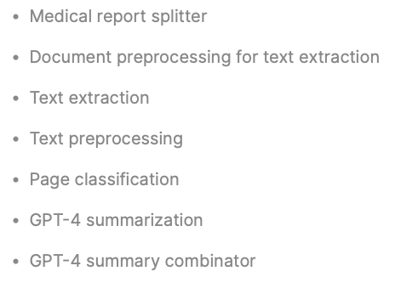
LLMs for Information Extraction
Extracting data from files
Extraction pipeline – medical records example
https://www.width.ai/post/gpt-4-medical-record-summarization-pipeline

Slide 59
Medical record pipeline

Slide 61
Document Understanding Transformer (Donut)
https://arxiv.org/abs/2111.15664

Slide 62
LayoutLMv3
https://arxiv.org/abs/2204.08387

Slide 63
Text extraction
and labeling

Slide 69
Table detection and extraction PubTables-1M
TD
TSR
TFA
https://arxiv.org/abs/2110.00061

Slide 70
Table structure recognition

Slide 71
End-to-End Object Detection with Transformers - DETR

Slide 72
TableFormer

Slide 73
Performance
GriTS – grid table similarity score

Slide 74
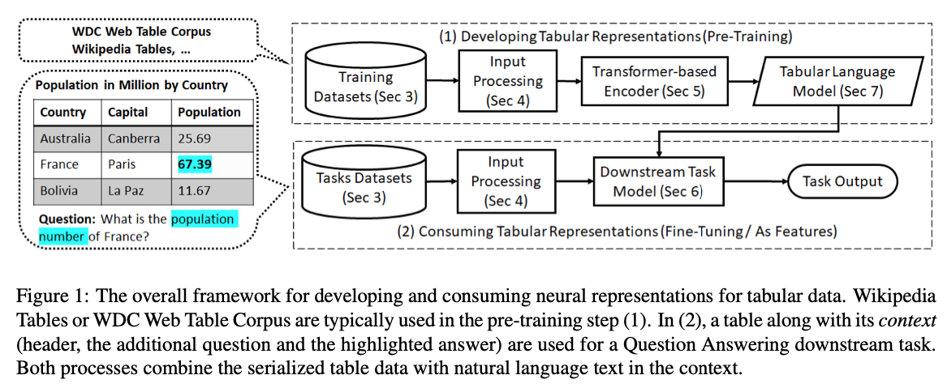
2023 Table Transformers Survey
Transformers for Tabular Data Representation: A Survey of Models and Applications; Gilbert Badaro, Mohammed Saeed, Paolo Papotti

Slide 77
Transformers for Tabular Data
Many available
Performance equivalent to state of the art
Lot’s of data
A few open source
TATR (MS)
TableFormer (IBM)

Slide 78
LLMs and Search Engines
Google uses some type of BERT in every 1 in 10 ranking for queries.
Methods we believe to be used are Rerankings

Slide 79
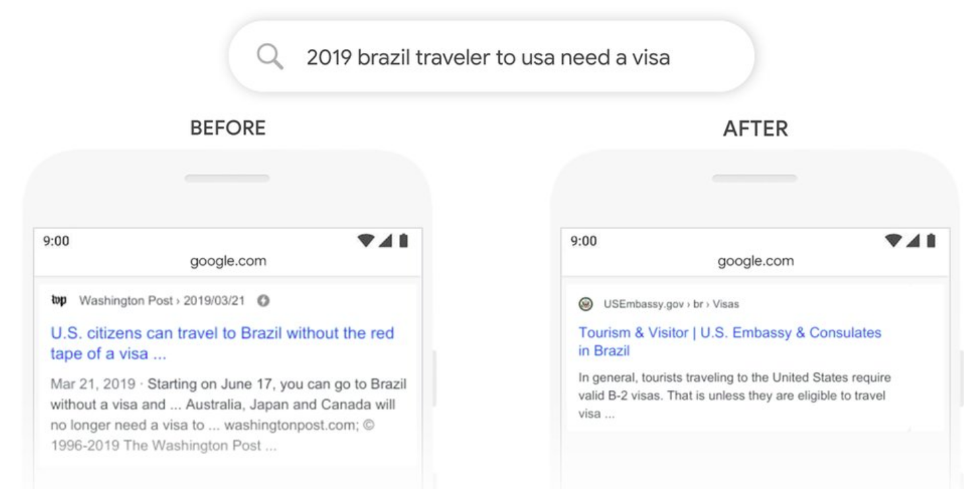
Adoption by Commercial Search Engines
Google Search
MS Bing
We’re making a significant improvement to how we understand queries, representing the biggest leap forward in the past five years, and one of the biggest leaps forward in the history of Search.
Starting from April of this year (2019), we used large transformer models to deliver the largest quality improvements to our Bing customers in the past year.
source
source

Slide 80
A Simple Search Engine Reranker
Key | Value
"chair" | [text #83, text #743, ...]
"store" | [text #1003, text #50, ...]
... | ...

Slide 81
MS MARCO Data Set
https://microsoft.github.io/msmarco/

Slide 83
monoBERT:
BERT reranker
Relevant
Non-relevant
s_{i} = softmax(T_{[CLS]}W + b)₁
We want:
s_{i} = P(Relevant = 1|q, d_{i})
softmax
D × 2
query q
text d_{i}
https://arxiv.org/abs/1910.14424

Slide 84
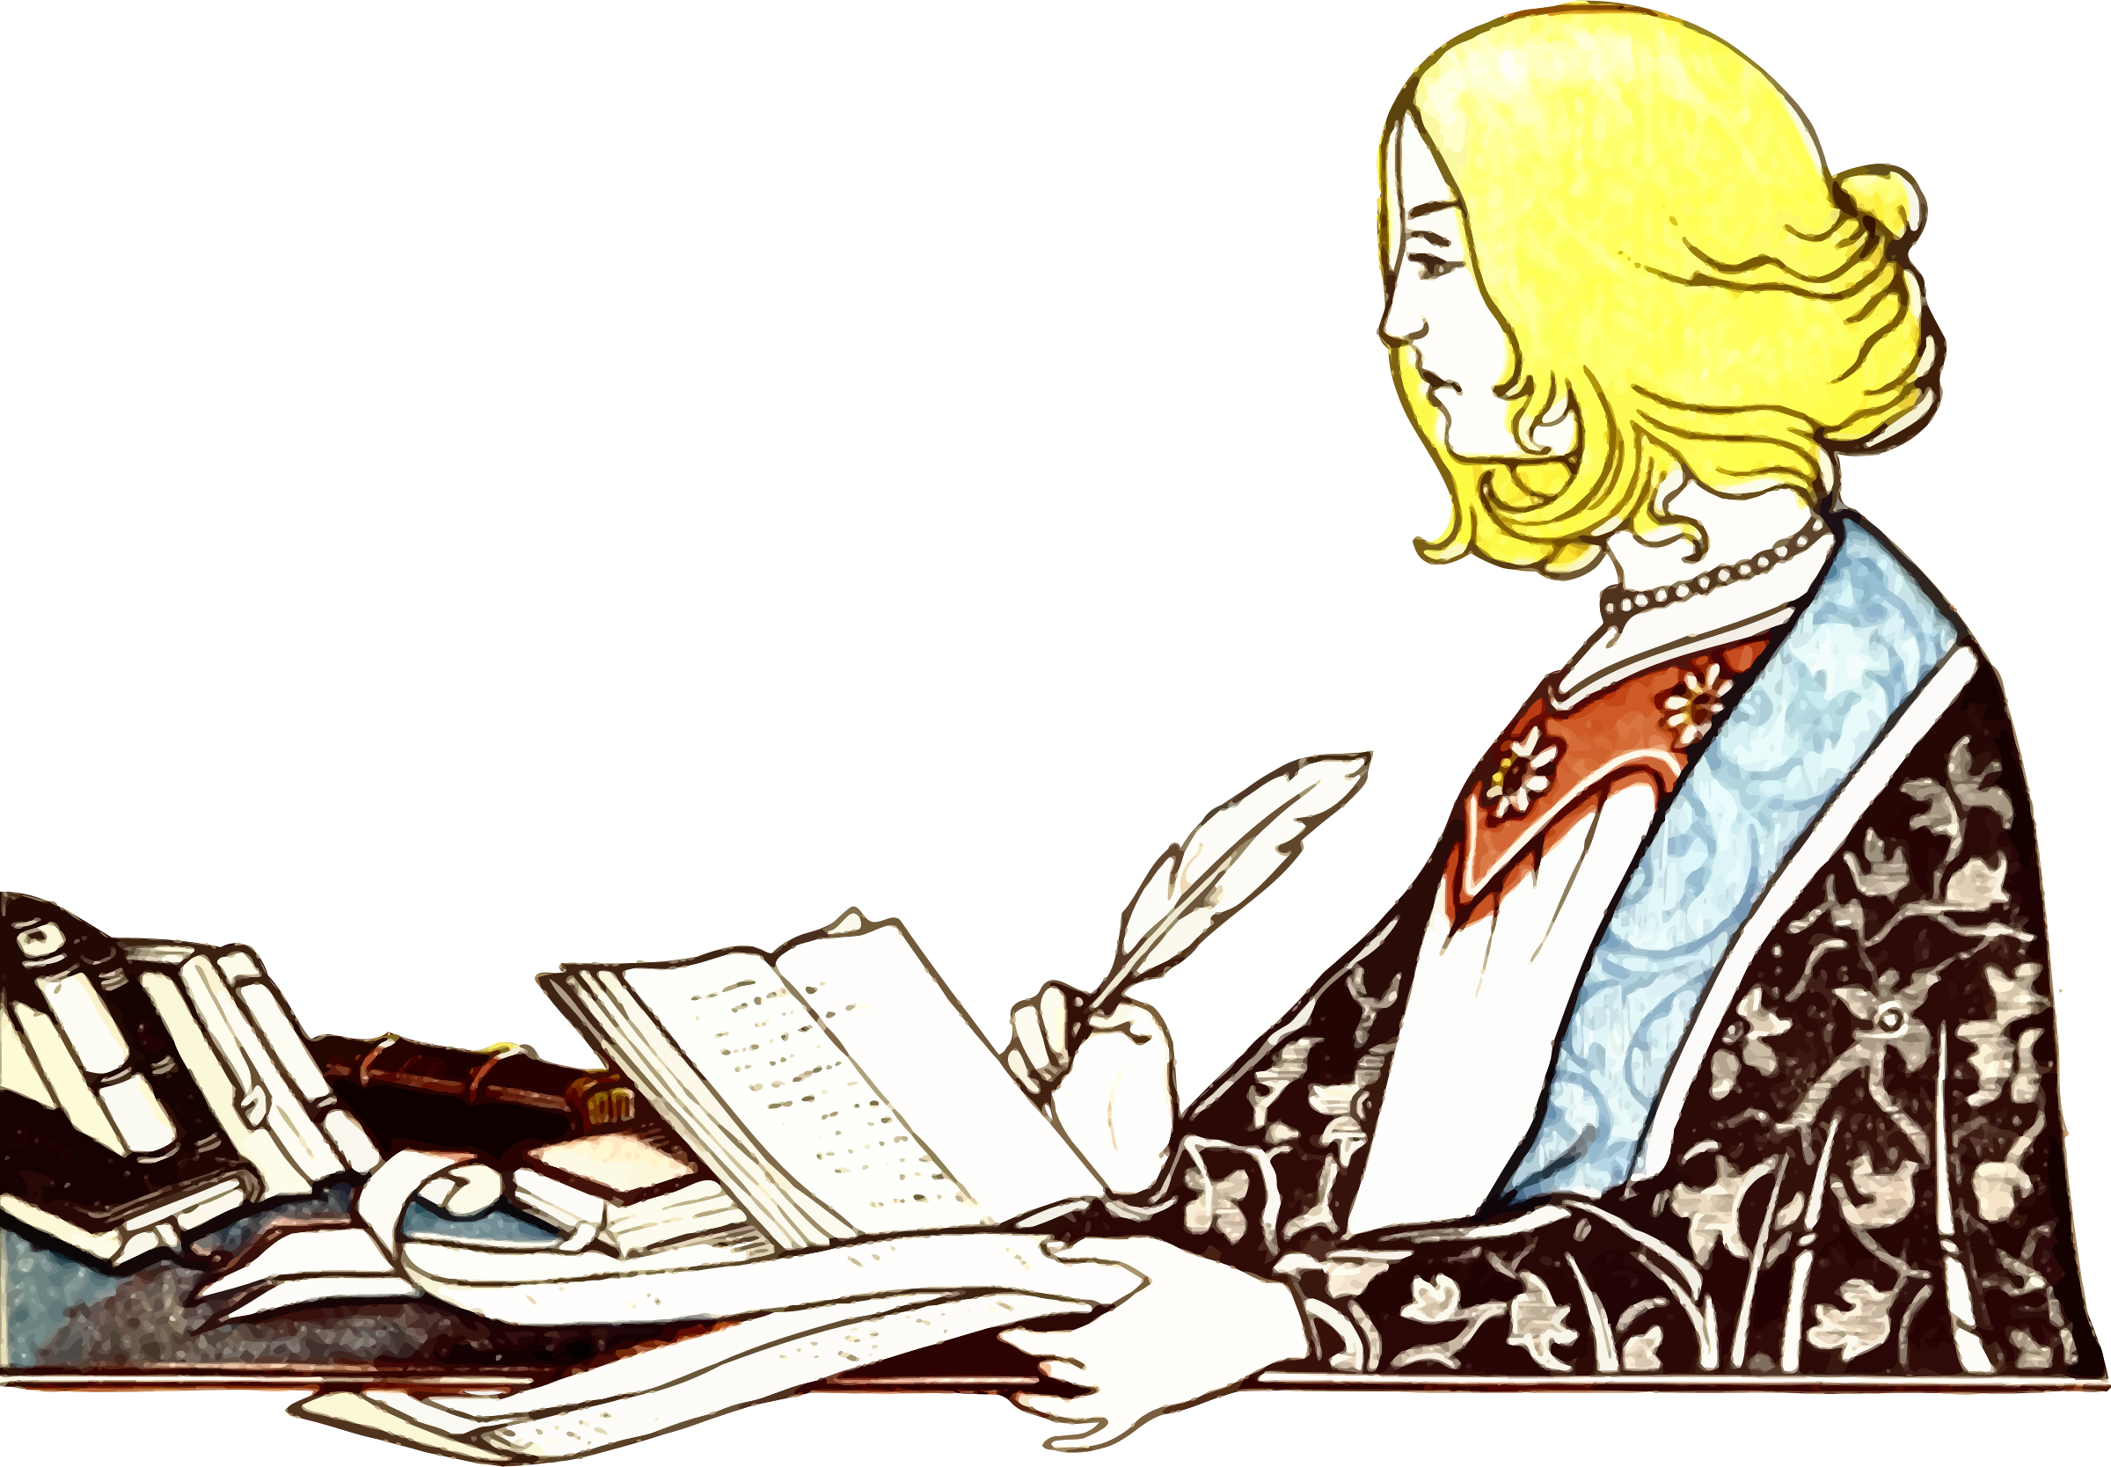
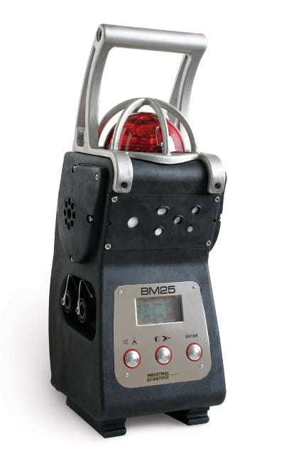
Training monoBERT
Loss:
Humans
BM25

Slide 85
Once monoBERT is trained...
H₀
R₀
H₁
R₁
q
BM25
d₁
monoBERT
d₅
d₂
d₂
Inverted Index
d₃
d₃
q
d₄
d₁
mono
BERT
s_{i}
d_{i}
d₅
d₄

Slide 86
TREC 2019 - Deep Learning Track - Passage
 | nDCG@10 | MAP | Recall@1k
BM25 | 0.506 | 0.377 | 0.739
monoBERT | 0.738 | 0.506 | 0.739
BM25 + RM3 | 0.518 | 0.427 | 0.788
monoBERT | 0.742 | 0.529 | 0.788

Slide 87
From Single to Multiple Rerankers

Slide 88
Why Multi-stage?
Trade-off between effectiveness (quality of the ranked lists) and efficiency (retrieval latency)
efficiency
effectiveness
Fewer Candidates

Slide 89
Multi-stage Rerankers
why multi-stage?
duoBERT
Cascade Transformers

Slide 90
Multi-stage with duoBERT
H₀
R₀
H₁
R₁
H₂
R₂
q
BM25
d₁
monoBERT
d₅
duoBERT
d₃
d₂
d₂
d₅
Doc Pairwise
Inverted
Index
d₃
d₃
d₂
d₂
d₃
d₃
d₅
d₅
d₂
q
d₃
d₅
d₂
d₅
d₂
d₃
d₄
mono
BERT
s_{i}
q
d₅
d_{i}
d_{i}
duo
BERT
p_{i,j}
d_{j}
Nogueira, Yang, Cho, Lin. Multi-stage document ranking with bert. 2019.

Slide 91
duoBERT's Input Format
p_{i,j}
D ྾ 2
...
...
duoBERT
T_{[CLS]}
U₁
U₂
U₃
T_{[SEP1]}
V₁
V_{m}
T_{[SEP2]}
X₁
X_{n}
T_{[SEP3]}
E_{[CLS]}
E₁
E₂
E₃
E_{[SEP1]}
F₁
...
F_{m}
E_{[SEP2]}
G₁
...
G_{n}
E_{[SEP3]}
[CLS]
...
[SEP]
d₁^{j}
...
d₁^{j}
[SEP]
[CLS]
A₁
q₁
A₂
q₂
A₃
q₃
[SEP]
[SEP]
B₁
d₁^{i}
B₂
Token
Embeddings
d_{m}^{i}
+
+
+
+
+
+
...
+
+
+
...
+
+
Segment
Embeddings
E_{A}
E_{A}
E_{A}
E_{A}
E_{A}
E_{B}
E_{B}
E_{B}
E_{C}
E_{C}
E_{C}
+
+
+
+
+
+
...
+
+
+
...
+
+
Position
Embeddings
P₀
P₁
P₂
P₃
P₄
P₅
P_{m+4}
P_{m+5}
P_{m+6}
P_{m+n+5}
P_{m+n+6}
query
text d_{i}
text d_{j}

Slide 92
Training duoBERT
Loss:
Is doc d_{i} more relevant than doc d_{j} to the query q?
p_{i,j} = p(d_{i}>d_{j} | q)
duoBERT
CLS
Query q
SEP
text d_{i}
SEP
text d_{j}

Slide 93
Inference with duoBERT
R₁
Text Pairs
R₂
d₁
d₂
d₁
d₁
d₂
d₂
d₃
d₃
monoBERT
d₂
d₃
d₂
d₃
d₁
d₃
d₁
d₂
d₃
d₁
q
Pairwise aggregation:
s₁ = p_{1,2} + p_{1,3}
s₂ = p_{2,1} + p_{2,3}
s₃ = p_{3,1} + p_{3,2}
d₁
duo
BERT
p_{1,2} = p(d₁>d₂ | q)
d₂

Slide 94
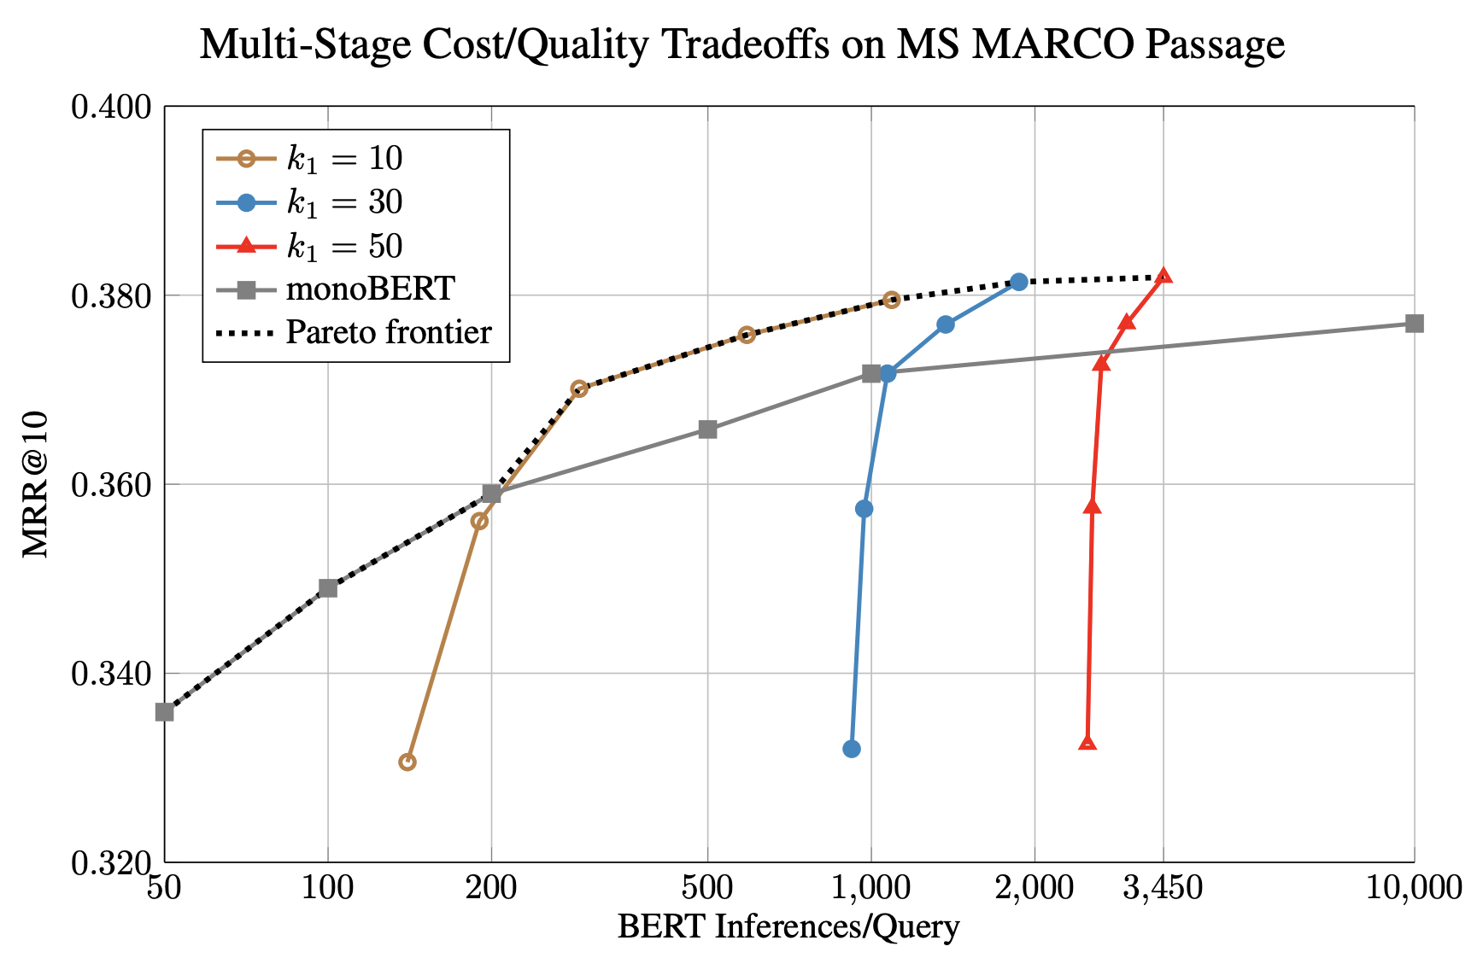
monoBERT vs. duoBERT

Slide 95
Conclusions (Lin et al)
Pretrained Transformers showed significant improvements in various IR benchmarks
Reproduced and adopted by many in academia and industry
No doubt we are in the age of BERT and Transformers
Some open source rerankers
ReFr
Reranker
Re2g-reranker-trex

Slide 96
Some Open Questions
Transformers for ranking: others
What is the future of:
zero-shot learning, transfer learning, domain adaptation, and task-specific fine-tuning?
dense vs. sparse retrieval?
multi-stage ranking architectures?
What can IR bring to transformers?
E.g.: REALM (Guu et al., 2020) -> Text retrieval into pretraining

Slide 97
Foundational ML
Foundation models (BERT, GPTs, CLIP, Codex) are models trained on broad data at scale such that they can be adapted to a wide range of downstream tasks.
These models will not only transform how AI systems are built, but will also lead to significant societal consequences.
Many applications are built on these.
https://hai.stanford.edu/news/introducing-center-research-foundation-models-crfm

Slide 98
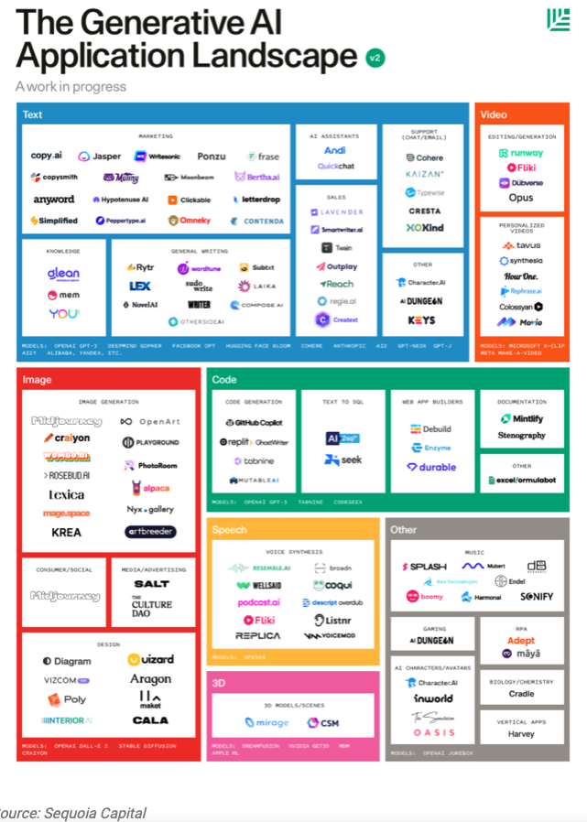

Slide 102
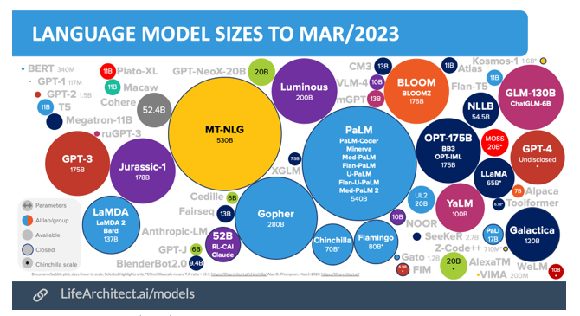

Slide 105
Chomsky’s comment
The human mind is not, like ChatGPT and its ilk, a lumbering statistical engine for pattern matching, gorging on hundreds of terabytes of data and extrapolating the most likely conversational response or most probable answer to a scientific question.
On the contrary, the human mind is a surprisingly efficient and even elegant system that operates with small amounts of information; it seeks not to infer brute correlations among data points but to create explanations.
https://www.nytimes.com/2023/03/08/opinion/noam-chomsky-chatgpt-ai.html

Slide 106
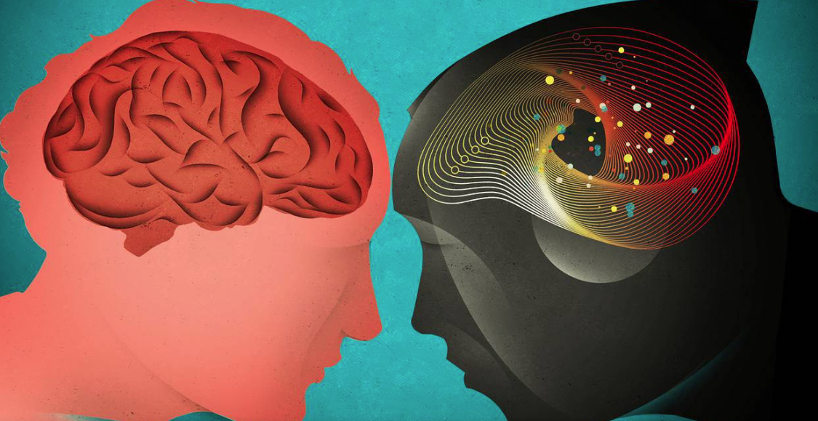
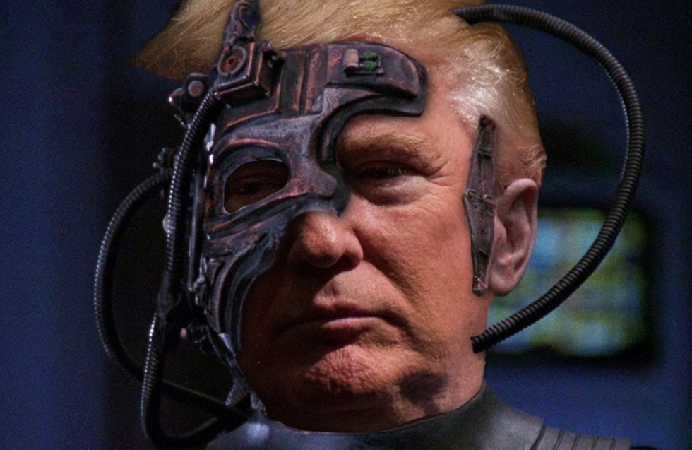
Types of AI
Hard (Strong) AI (GOFAI)
AI that replaces the people
Artificial General Intelligence (AGI)
• Soft AI
AI by and for the people
Human computing; humans in the loop
Let the computers do what they are good at and we do what we are good at
Hopefully not the Borg
https://www.wsj.com/articles/should-artificial-intelligence-copy-the-human-brain-1533355265

Slide 107
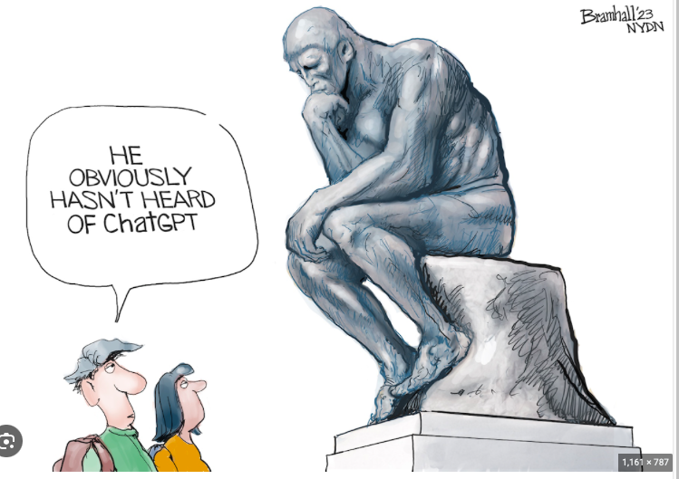

Slide 108
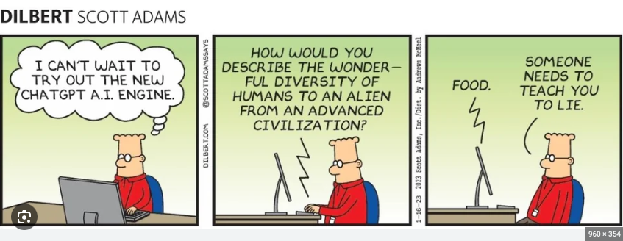

Slide 109
Research Questions in AI (LLMs)
Learn with little data
Adaptive learning
Hierarchical structure
Open-ended inference/reasoning
Transparency/interpretability
Use of prior knowledge
Causation vs correlation
Stable world (problems with nonstationarity)
Build trust (verification, bias removal)
Difficult to build
Marcus, G. (2018). Deep learning: A critical appraisal. arXiv preprint arXiv:1801.00631

Slide 110
Summary
Examples of LLMs for IR/search and information extraction are encouraging
Levels of competence exceeded expectations
LLMs have many! applications
Several startups worldwide
Issues with data fabrication (not hallucination!)
Serious problems with math
Representation problems - more parameters can’t help
Some legal/copyright issues
Revised models of cognition
New definitions of intelligence

Slide 111
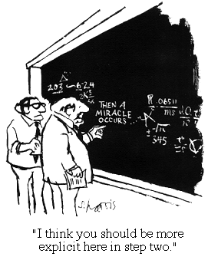
“The future ain’t what it used to be.” Yogi Berra, catcher/philosopher, NY Yankees.
“Predicting the future is easy …, getting it right is the hard part.”
For more information
http://clgiles.ist.psu.edu
clg20@psu.edu
gitbhub.com/SeerLabs
Why not use a transformer?

Slide 112
Worst Predictions
“I think there is a world market for maybe five computers.” — Thomas Watson, chairman of IBM, 1943.
“Where a calculator on the ENIAC is equipped with 18,000 vacuum tubes and weighs 30 tons, computers in the future may have only 1,000 vacuum tubes and weigh only 1.5 tons.” — Popular Mechanics, 1949.
“I have traveled the length and breadth of this country and talked with the best people, and I can assure you that data processing is a fad that won’t last out the year.” — The editor in charge of business books for Prentice Hall, 1957.
“But what…is it good for?” — Engineer at the Advanced Computing Systems Division of IBM, 1968, commenting on the microchip.
“There is no reason anyone would want a computer in their home.” — Ken Olson, president, chairman and founder of Digital Equipment Corp., 1977.
“640K ought to be enough for anybody.” — Attributed to Bill Gates, 1981, but believed to be an urban legend.
“This ‘telephone’ has too many shortcomings to be seriously considered as a means of communication. The device is inherently of no value to us.” — Western Union internal memo, 1876
“The Americans have need of the telephone, but we do not. We have plenty of messenger boys.” — Sir William Preece, chief engineer of the British Post Office, 1876.
“The wireless music box has no imaginable commercial value. Who would pay for a message sent to nobody in particular?” — David Sarnoff’s associates in response to his urgings for investment in the radio in the 1920s.
“While theoretically and technically television may be feasible, commercially and financially it is an impossibility.” — Lee DeForest, TV inventor.
“The concept is interesting and well-formed, but in order to earn better than a ‘C’, the idea must be feasible.” — A Yale University management professor in response to Fred Smith’s paper proposing reliable overnight delivery service. (Smith went on to found Federal Express Corp.)

Slide 113
References
Borji, Ali. "A categorical archive of ChatGPT failures." arXiv preprint arXiv:2302.03494 (2023).
Mahowald, K., Ivanova, A. A., Blank, I. A., Kanwisher, N., Tenenbaum, J. B., & Fedorenko, E.
“Dissociating language and thought in large language models: a cognitive perspective. “
arXiv preprint arXiv:2301.06627 (2023).
Bubeck, Sébastien, Varun Chandrasekaran, Ronen Eldan, Johannes Gehrke, Eric Horvitz,
Ece Kamar, Peter Lee et al. "Sparks of artificial general intelligence: Early experiments with
gpt-4." arXiv preprint arXiv:2303.12712 (2023).
Lin, Jimmy, Rodrigo Nogueira, and Andrew Yates. "Pretrained transformers for text ranking: Bert and
beyond." Synthesis Lectures on Human Language Technologies 14, no. 4 (2021): 1-325.
Alan Thompson, https://lifearchitect.ai/models/

