Slide 1
Project Ideas
IST 597: Foundation of Deep Learning
Spring 2023

Slide 2
Can Neural Networks understand Symbolic Relationships
Consider a Circular Ordered Sequence of symbols:
Define Operations : * such that:
* gives the next symbol in sequence e.g.
Train NN to learn these relationships under given set of symbols
Train neural networks to generate sequence for a given Grammar

Slide 3
Can Neural Networks learn operations on numbers (+ / - / x / $÷)$
Here the input to the neural network is the two numbers and the operation. The output should be the result
E.g. Input : 12 , 13, + ; Output : 25
What about fractional input?
Can we extend this to solve numerical expressions?
Can we learn NN in compositional way
Graph NN vs TreeNN vs Transformers ?
2nd Order RNNs and Memory Modules?

Slide 4
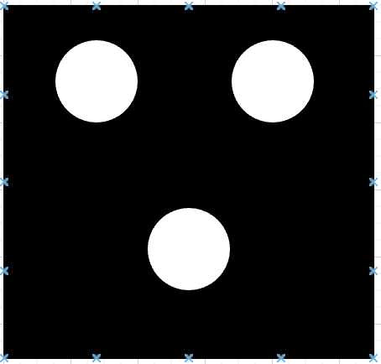
Can Neural Networks understand Comparisons? (> / < / ==, bonus : >=, <=)
23 > 4, 5 == 5 etc, What about math expressions?
Compare number of objects in an image:
>

Slide 5
Neural Power Units for combined Symbolic and numeral Data
https://arxiv.org/pdf/2006.01681.pdf
Can we reduce a mathematical expression using Neural Power Units?
Are these units compositional ?

Slide 6
Datasets:
Mathematical Reasoning:
https://artofproblemsolving.com/community/c3158_usa_contests
https://dlmf.nist.gov
https://github.com/deepmind/mathematics_dataset
https://math-qa.github.io
https://www.cs.rit.edu/~dprl/ARQMath/arqmath-resources.html

Slide 7
Datasets
American Sign Language Dataset:
https://www.kaggle.com/datasets/grassknoted/asl-alphabet
https://www.kaggle.com/datasets/datamunge/sign-language-mnist
YELP Dataset
https://www.kaggle.com/datasets/yelp-dataset/yelp-dataset
Fake News Detection
https://paperswithcode.com/datasets?task=fake-news-detection

Slide 8
Datasets:
Summerization:
https://github.com/allenai/scitldr
https://paperswithcode.com/datasets?q=summarization&v=lst&o=match
https://huggingface.co/datasets?task_categories=task_categories:summarization&sort=downloads
Hugging Face:
https://huggingface.co/datasets
ACL Anthologies
https://github.com/shauryr/ACL-anthology-corpus

Slide 9
Project Ideas:
Stanford CS230 past projects:
https://cs230.stanford.edu/past-projects/
CMU 11-785 past projects:
https://deeplearning.cs.cmu.edu/shared/project.html

