Slide 1
Problem Statement Motivation & Introduction
Prediction of fluid injection characteristics (e.g., injectivity) from geophysical data (e.g., micro-seismicity) is essential to a suite of energy-related applications such as geothermal energy recovery and carbon sequestration.
Micro-seismicity data consist of the record of micro-seismic events (i.e., small earthquakes) that occur during and following injection. The data provide the location and magnitude of micro-earthquakes.
There are available datasets from field-scale “experiments” that include both micro-seismicity and injection data. One example is data collected in DOE EGS-Collab Project.

Slide 2
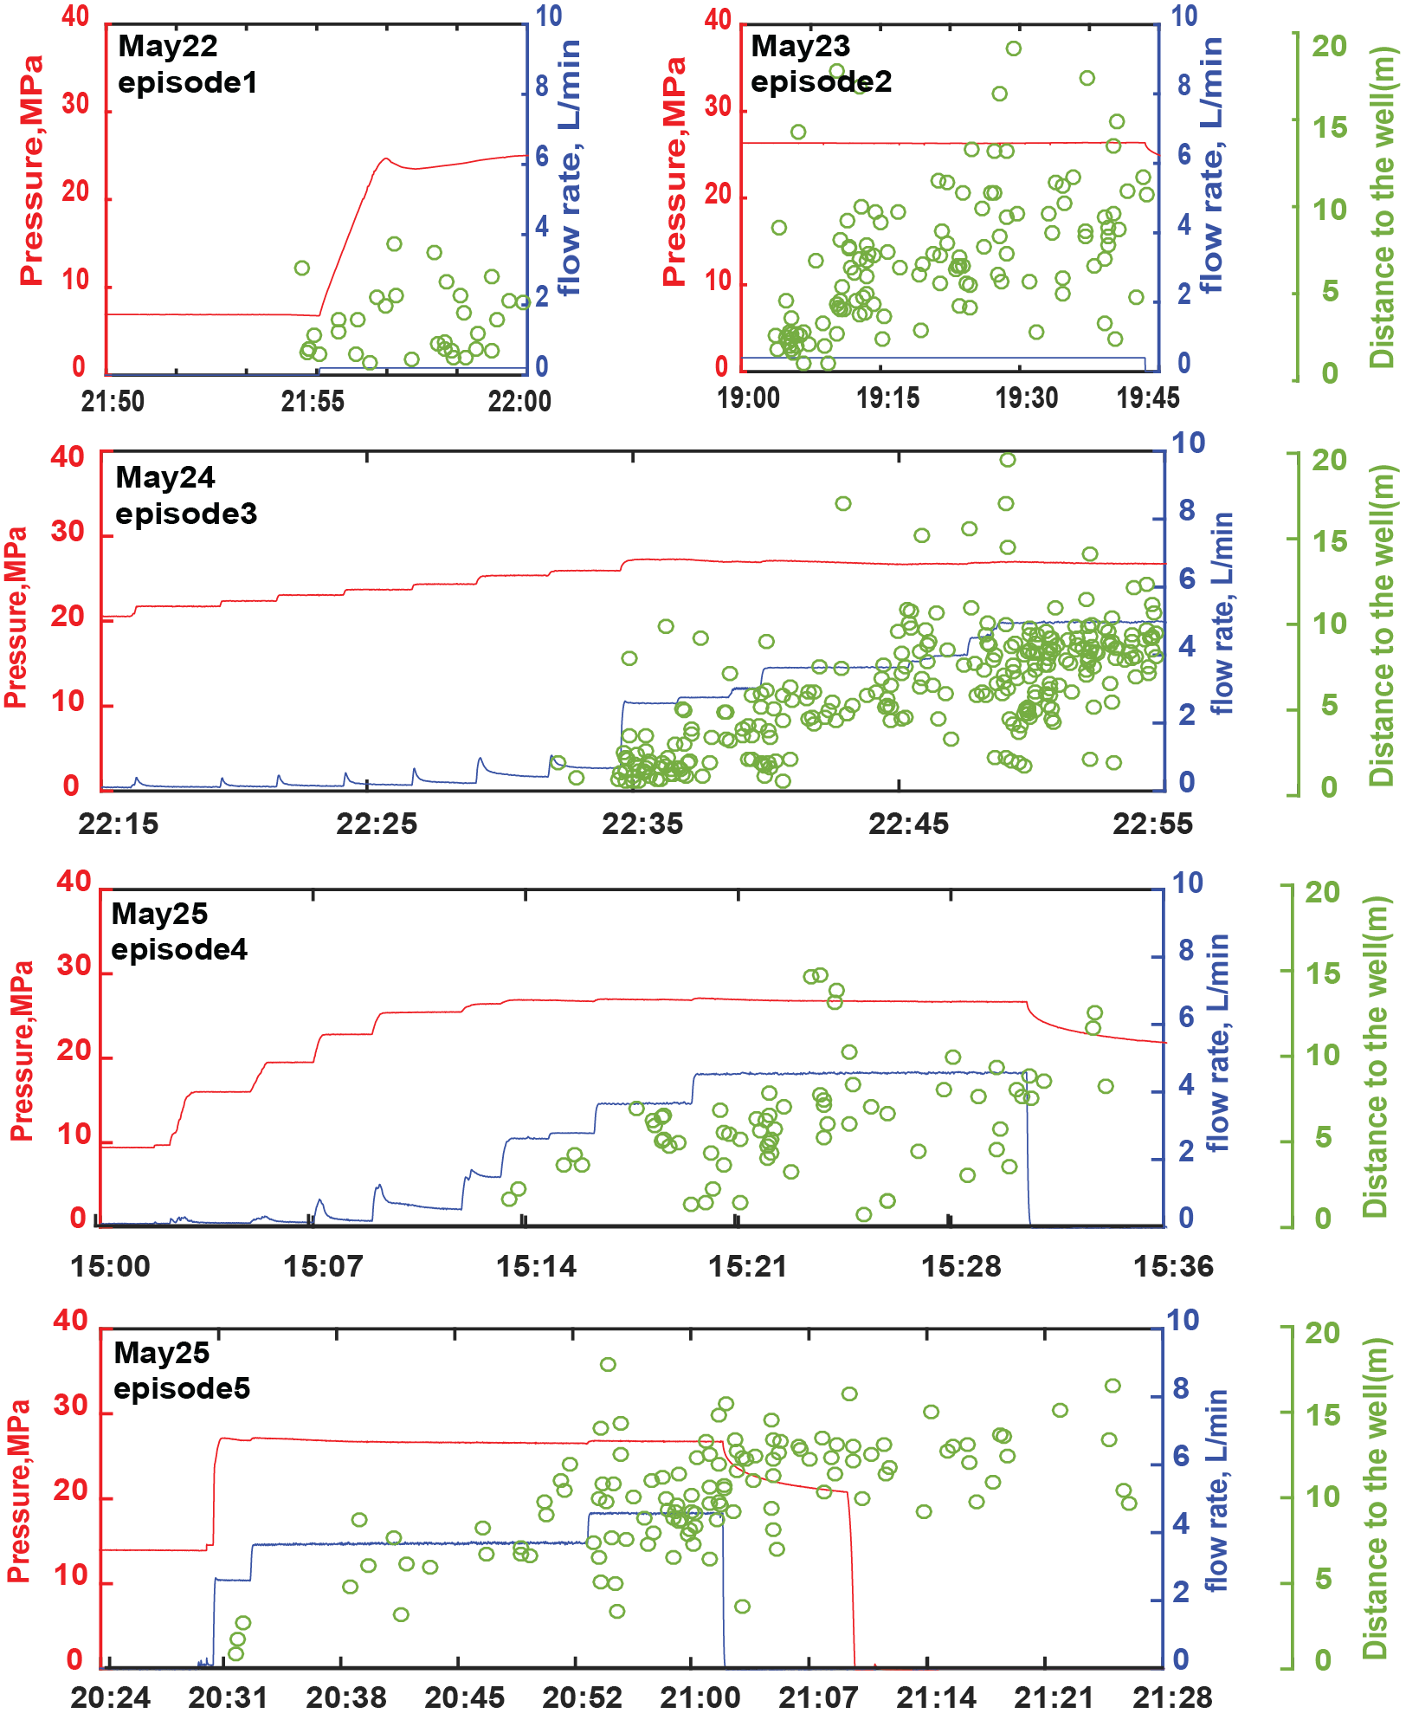
DOE EGS Collab Project
Data for Injection Episodes – #1 - #5
Injector-Producer + Instrumentation
(b)
[Schoenball et al., 2020]

Slide 3
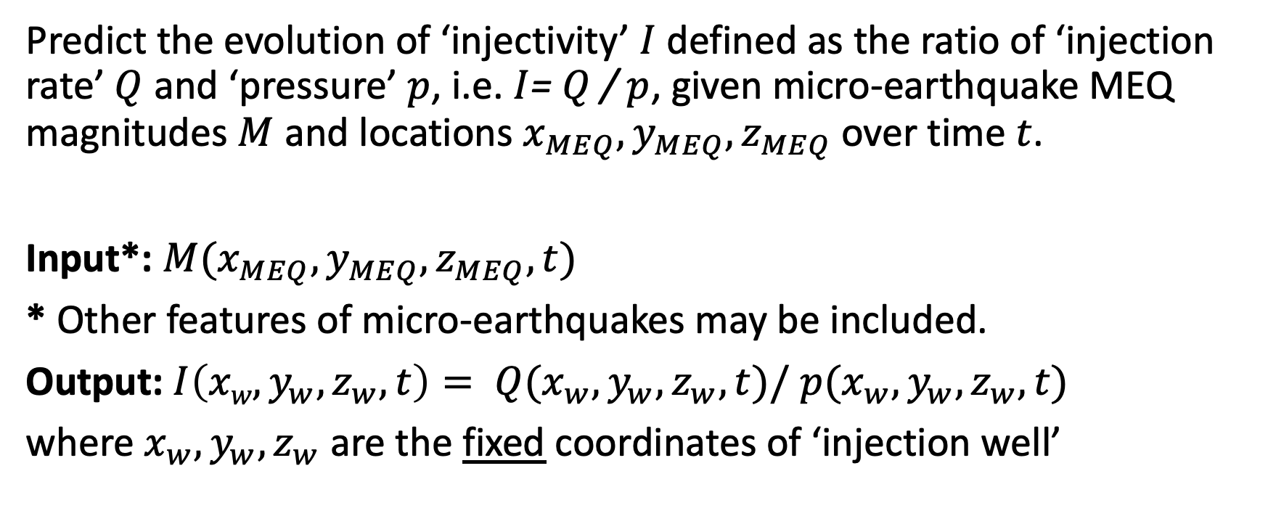
ML Problem Statement Formulation
Predict the evolution of ‘injectivity’ $I$ defined as the ratio of ‘injection rate’ $Q$ and ‘pressure’ $p$, i.e. $I$= $Q$/ $p$, given micro-earthquake MEQ magnitudes $M$ and locations $x_{MEQ},y_{MEQ},z_{MEQ}$over time $t$.
Input*: $M(x_{MEQ},y_{MEQ},z_{MEQ}, t)$
* Other features of micro-earthquakes may be included.
Output: ${I\left({xw,y}_{w},z_{w},t\right)= Q(x}_{w},y_{w},z_{w},t)/$ ${p(x}_{w},y_{w},z_{w},t)$
where $x_{w},y_{w},z_{w}$ are the fixed coordinates of ‘injection well’

Slide 4
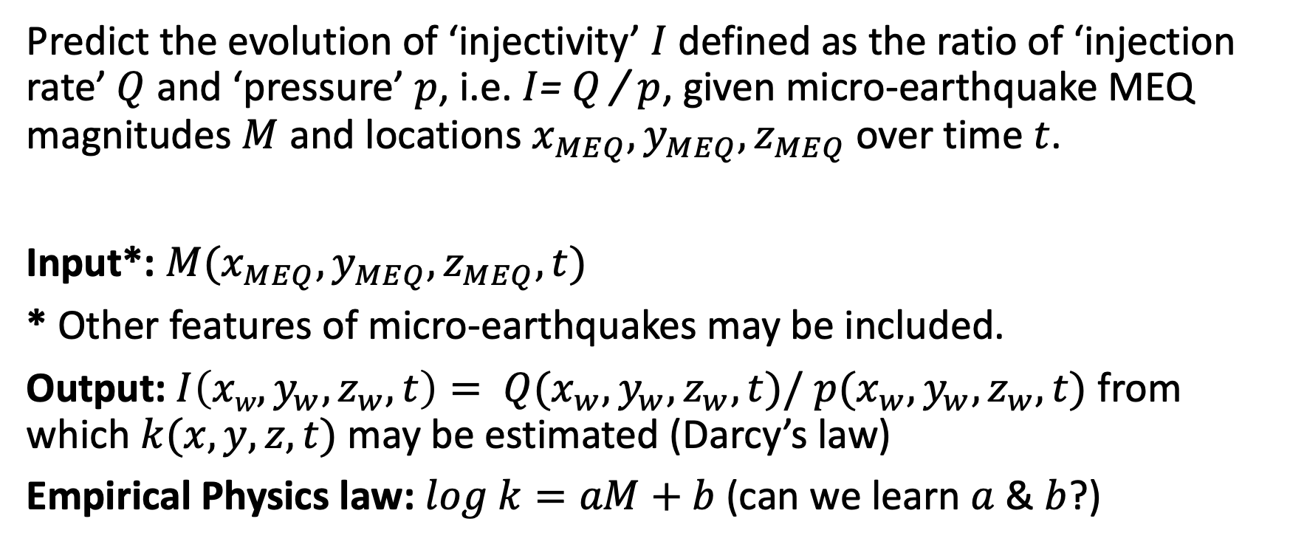
Physics-Informed ML ? Formulation
Predict the evolution of ‘injectivity’ $I$ defined as the ratio of ‘injection rate’ $Q$ and ‘pressure’ $p$, i.e. $I$= $Q$/ $p$, given micro-earthquake MEQ magnitudes $M$ and locations $x_{MEQ},y_{MEQ},z_{MEQ}$over time $t$.
Input*: $M(x_{MEQ},y_{MEQ},z_{MEQ}, t)$
* Other features of micro-earthquakes may be included.
Output: ${I\left({xw,y}_{w},z_{w},t\right)= Q(x}_{w},y_{w},z_{w},t)/$ ${p(x}_{w},y_{w},z_{w},t)$ from which $k(x,y,z, t)$ may be estimated (Darcy’s law)
Empirical Physics law: $log k=aM+b$(can we learn $a$ & $b$?)

