Slide 1
Projects on Mathematical Understanding of Neural Networks
- Neisarg Dave

Slide 2
All projects follow the following steps:
Do a thorough literature survey listing neural networks making any type of comparison between data objects.
Identify or create potential dataset
Identify any existing baselines
Report results on the performance of different types of network architectures e.g. MLP, Convolutional, RNN, GNN etc.
Report any interesting observation

Slide 3
1. Can Neural Networks Count
Counting objects in an Image
Counting characters in a string e.g. aaabbddd has 3 a’s, 2 b’s 0 c’s and 3 d’s
Counting number of 0’s or 1’s in a binary number. e.g. binary of 20 is 1100, it has two 1 and two 0

Slide 4
2. Can Neural Networks understand Symbolic Relationships
Consider a Circular Ordered Sequence of symbols:
Define Operations : * such that:
* gives the next symbol in sequence e.g.
Train NN to learn these relationships under given set of symbols

Slide 5
3. Can Neural Networks learn operations on numbers (+ / - / x / $÷)$
Here the input to the neural network is the two numbers and the operation. The output should be the result
E.g. Input : 12 , 13, + ; Output : 25
This approach can be extended to include functions.
Can we extend this to solve numerical expressions?

Slide 6
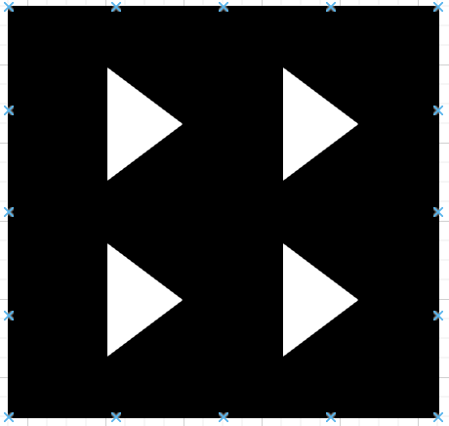
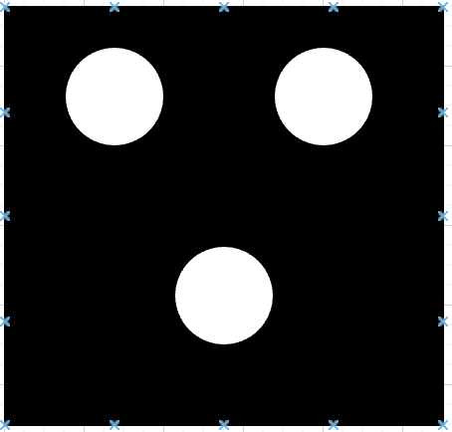
4. Can Neural Networks understand Comparisons? (> / < / ==, bonus : >=, <=)
23 > 4, 5 == 5 etc.
Compare number of objects in an image:
>

