Slide 1
Indexing with ElasticSearch
IST 441 - Spring 2021
Shaurya Rohatgi
IST, PhD Student
Credits and Thanks to Ruslan Zavacky

Slide 2
Recap and Prerequisites
Crawled something already (datascience Stackexchange webpage)
Dumped the data crawled into data.jsonl

Slide 3
Next Steps
Crawled something already (datascience Stackexchange webpage)
Dumped the data crawled into data.jsonl
Index this data.jsonl using ElasticSearch

Slide 4
Overview
ElasticSearch
Look at the tools and features available
Index Demo using Kibana and ES’s Python API

Slide 5
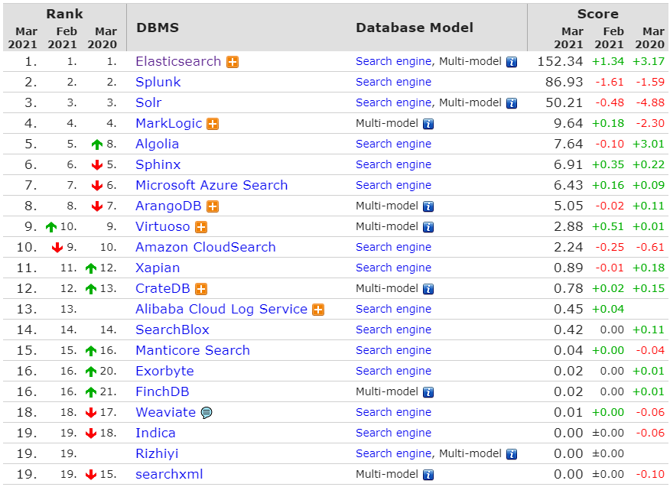
Why ElasticSearch ? Not Anything Else ?
Elasticsearch or Solr, both of which are steadily ranked in the top two spots among open source and commercial search engines, according to DB-Engines.
ES just dominates the rankings
Link to Google Trends
ElasticSearch is the only open source search-engine with an official Python API
http://solr-vs-elasticsearch.com/
Source : https://db-engines.com/en/ranking/search+engine
https://db-engines.com/en/system/Elasticsearch

Slide 6
real time analytics
Search isn’t just free text search anymore - it’s about exploring your data. Understanding it. Gaining insights that will make your business better or improve your product.
high availability
Elasticsearch clusters are resilient - they will detect and remove failed nodes, and reorganise themselves to ensure that your data is safe and accessible.

Slide 7
document oriented
Store complex real world entities in Elasticsearch as structured JSON documents. All fields are indexed by default, and all the indices can be used in a single query, to return results at breath taking speed.

Slide 8
restful api
per-operation persistence
Elasticsearch puts your data safety first. Document changes are recorded in transaction logs on multiple nodes in the cluster to minimise the chance of any data loss.
Elasticsearch is API driven. Almost any action can be performed using a simple RESTful API using JSON over HTTP. An API already exists in the language of your choice.
apache 2 open source license
Elasticsearch can be downloaded, used and modified free of charge. It is available under the Apache 2 license, one of the most flexible open source licenses available.

Slide 9
Other ElasticSearch Benefits
Features are based on what their have asked for in the past - not random
Fast version releases
Great community and online resources - Actual developers answer your questions
Actual support engineers are hired by the company to help
It is fast and scalable
Tools like Elastic Cloud Enterprise - Manage and replicate multiple ElasticSearch clusters
Caching for frequent queries

Slide 10
ElasticSearch Success Stories
Source:
https://www.elastic.co/use-cases/

Slide 11
GITHUB - Search
An Exhibition of ElasticSearch capabilities

Slide 12
Unstructured search

Slide 13
Structured search

Slide 14
Enrichment

Slide 15
Sorting

Slide 16
Pagination

Slide 17
Aggregation

Slide 18
Suggestions

Slide 19
Capabilities
Create a schema for your data - Manipulate your data record by record
Or use Multi-document APIs to do Bulk ops
Perform Queries/Filters on your data for insights
Or if you are DevOps person, use APIs to monitor
Do not forget about built-in Full-Text search and analysis

Slide 20
Autocompletion in ES
Multiple Inputs
Single Unified Output
Scoring
Payloads
Synonyms
Ignoring stopwords
Going fuzzy
Statistics

Slide 21
ES Software Stack - Development Tools – the ELK stack
ElasticSearch - Core indexing and Searching API
Should be thought of as a database with querying and searching capabilities inherited from Lucene
Logstash -
Useful in importing data from sources to ElasticSearch “database”
Prebuilt importers for Databases - SQL, Server logs, metrics etc.
Kibana -
GUI Dashboard and Console - Visual Tool
Discovering insights

Slide 22
ES Software Stack - Development Tools – the ELK stack
ElasticSearch - Core indexing and Searching API
Should be thought of as a database with querying and searching capabilities inherited from Lucene
Logstash -
Useful in importing data from sources to ElasticSearch “database”
Prebuilt importers for Databases - SQL, Server logs, metrics etc.
Kibana -
GUI Dashboard and Console - Visual Tool
Discovering insights

Slide 23
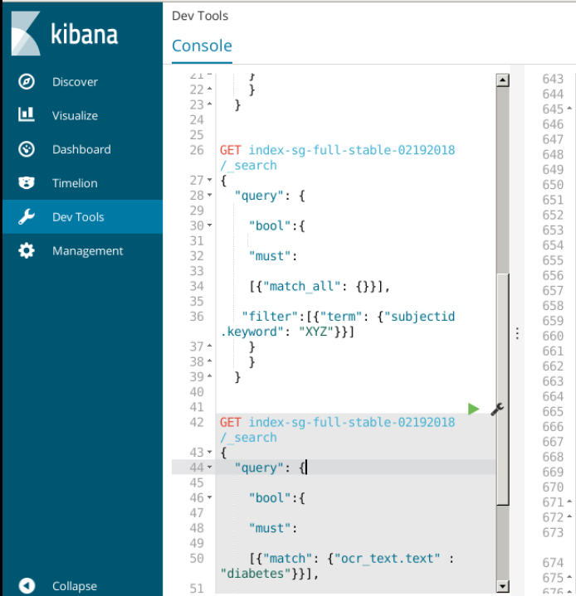
Kibana
“Kibana lets you visualize your Elasticsearch data and navigate the Elastic Stack, so you can do anything from learning why you're getting paged at 2:00 a.m. to understanding the impact rain might have on your quarterly numbers.”
Demo

Slide 24
CiteSeerX Research-Cluster
Notes:
http://localhost:2061/app/kibana#/visualize/create?type=pie&indexPattern=9c801520-5dcd-11ea-9346-75c52408de98&_g=()&_a=(filters:!(),linked:!f,query:(language:kuery,query:''),uiState:(),vis:(aggs:!((enabled:!t,id:'1',params:(),schema:metric,type:count),(enabled:!t,id:'2',params:(field:publisher.keyword,missingBucket:!f,missingBucketLabel:Missing,order:desc,orderBy:'1',otherBucket:!f,otherBucketLabel:Other,size:5),schema:segment,type:terms)),params:(addLegend:!t,addTooltip:!t,dimensions:(metric:(accessor:0,aggType:count,format:(id:number),params:())),isDonut:!t,labels:(last_level:!t,show:!f,truncate:100,values:!t),legendPosition:right,type:pie),title:'',type:pie))

Slide 25
Accessing Kibana
Open Browser in Vlabs
ist441.ist.psu.edu:5601

Slide 26
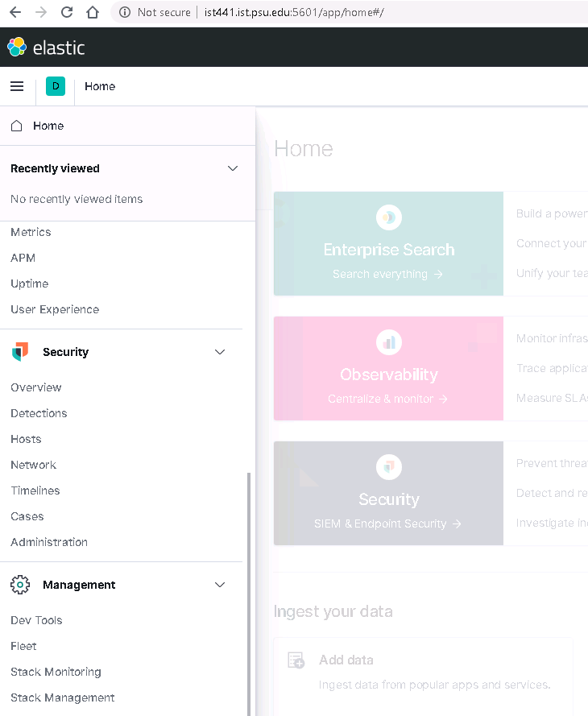
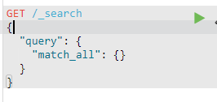
Kibana Homepage
Steps-
Open Dev tools
2. List all index names in ES :
GET /_cat/indices?v
3.
Get all ! Just to check if kibana can communicate with ES

Slide 27
Time to Index !

Slide 28
Prerequisites - HTTP Methods
GET
retrieve data from a server at the specified resource
PUT
send data to the API sever to create or update a resource
POST
create or update a resource. The difference is that PUT requests are idempotent.

Slide 29
ES Index API
Adds a JSON document to the specified data stream or index and makes it searchable. If the target is an index and the document already exists, the request updates the document and increments its version.
POST <target_index>/_doc/

Slide 30
ES Search API
Allows you to execute a search query and get back search hits that match the query. You can provide search queries using the q query string parameter or request body.
GET /<target>/_search
<target> is your index name
_search is the method which is being called
Source : https://www.elastic.co/guide/en/elasticsearch/reference/current/search-search.html

Slide 31
Search Request Example
Index name
Method
Request Body

Slide 32
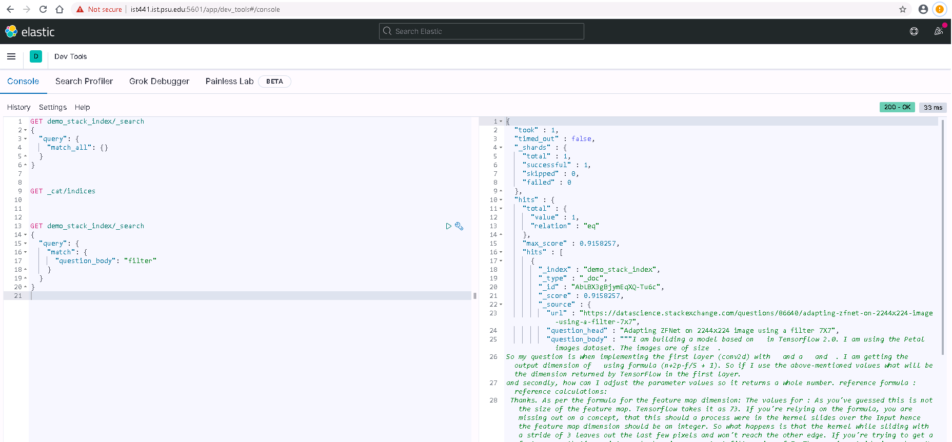
Kibana Dev Tools
Response Pane
Request Command Pane

Slide 33
What all has already been done for you !
Elastic Requires Java. It has been installed on the server
Elastic’s Python API has been installed
Kibana is also running as a service for each team at port – 5601
Kibana has been made accessible on IST network at
ist441.ist.psu.edu:5601
Code is also available in indexing directory in respective team folders

Slide 34
Understanding our code pipeline
1
2
DATA
Kibana
Ingestion code
Indexes and stores the documents
Tools to query and visualize data
ist441.ist.psu.edu:5601

Slide 35
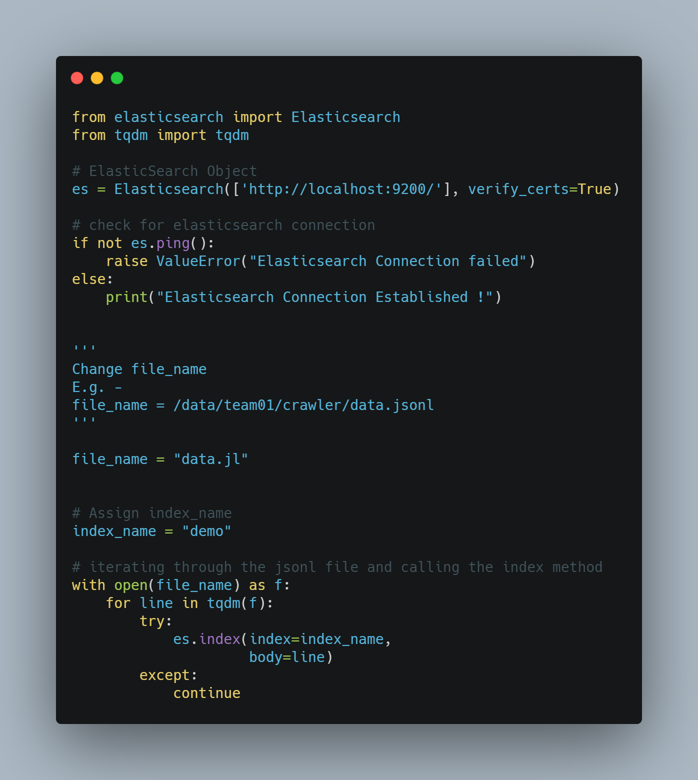
Python Code for Indexing
Commands to run –
1. Go to your team folder
cd /data/team<team_number>/indexing/
Edit the indexing.py file with your index name
E.g. team01_index
Run indexing.py
python indexing.py

Slide 36
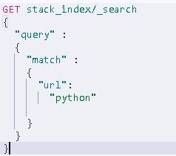
Querying Using Kibana
In vlabs Chrome –
Go to : ist441.ist.psu.edu:5601
Json request – (copy please)
GET stack_index/_search
{ "query":
{ "match":
{ "body": "python"
}
}
}

Slide 37
Next Steps
Optimizing ES – after 2 weeks
Trying other analysers/tokenizers – link
Set it up on your local machine and try working with it - http://www.elasticsearchtutorial.com/elasticsearch-in-5-minutes.html

