Slide 1
What are search engines and information retrieval (IR)
Why is it important?
Why do we care?
Thanks to:
UCB Course SIMS 202 and
IIT Course on IR
Jim Gray, Rich Belew, Bruce Croft,
Don Metzler, Trevor Sthrohman

Slide 2
Overview
Importance of search engines
Intro to IR
Information vs knowledge
IR and search engines
The IR process

Slide 3
Search engines
Give us information we need (want)
Control our lives
  What/why we buy
  What we read
  What we believe
How do they do that?
Are they fair/responsible/ethical?

Slide 4
What are search engines?
Valuable to everyday life!
Our portal to the world?
Who makes sure they are honest/fair?
Where we can find all we need?

Slide 5
How do we search for?
Bad people
How to find out about sensitive topics and not be known
What should I be afraid of

Slide 6
What is information retrieval
Gathering information from a source(s) based on an information need usually from a query
  Major assumption - that the information need can be specified
  Broad definition of information
  Most methods are automated - scaling
Sources of information
  Other people
  Archived information (libraries, maps, etc.)
  Social media, news services, etc.
  Web (search engines)
  Natural settings
Information retrieval is more than just web search

Slide 7
information retrieval vs ?
Information retrieval (IR) is the activity or process of obtaining information resources relevant to an information need from a collection of information resources.
Data mining is the process that attempts to discover patterns in large data sets.
Information extraction (IE) is the task of automatically extracting structured information from unstructured and/or semi-structured machine-readable documents

Slide 8
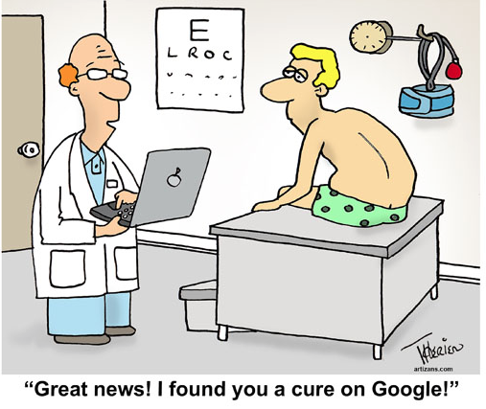

Slide 9
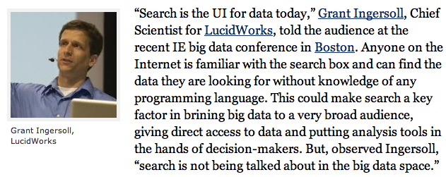
Search and Big Data

Slide 10
Data, information, knowledge
Data - Facts, observations, or perceptions.
Information - Subset of data, only including those data that possess context, relevance, and purpose.
Knowledge - A more simplistic view considers knowledge as being at the highest level in a hierarchy with data (at the lowest level) and information (at the middle level).
Data refers to bare facts void of context.
  A telephone number.
Information is data in context.
  A phone book.
Knowledge is information that facilitates action.
  Recognizing that a phone number belongs to a good client, who needs to be called once per week to get his orders.

Slide 11



How much information is there?
Yotta
Zetta
Exa
Peta
Tera
Giga
Mega
Kilo
Soon most everything will be recorded and indexed
Most bytes will never be seen by humans.
Data summarization,
trend detection,
anomaly detection, etc.
are key technologies
See Mike Lesk:
How much information is there: http://www.lesk.com/mlesk/ksg97/ksg.html
See Lyman & Varian:
How much information
http://www.sims.berkeley.edu/research/projects/how-much-info/
Everything
Recorded
All Books
MultiMedia
Gray - Microsoft
All books
(words)
.Movie
A Photo
A Book
24 Yecto, 21 zepto, 18 atto, 15 femto, 12 pico, 9 nano, 6 micro, 3 milli

Slide 12
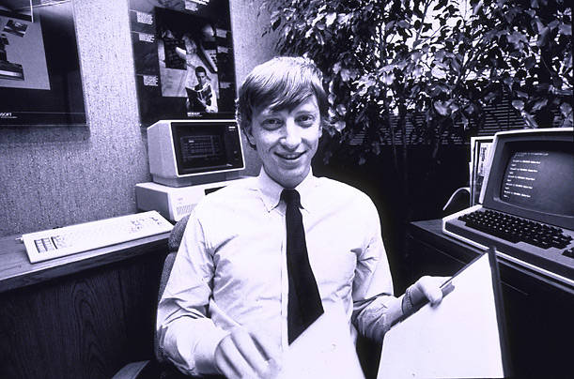
How much data?
Google processes 20 PB a day (2008)
  200 PB/day today
Wayback Machine has 3 PB + 100 TB/month (3/2009)
Facebook has 100 PB of user data (2012)
eBay has 6.5 PB of user data + 50 TB/day (5/2009)
CERN’s Large Hydron Collider (LHC) generates 15 PB a year (2012)
640K ought to be enough for anybody.

Slide 13
Ideal Information Retrieval
The answer should be:
  what is actually needed (relevant)
    IR is very concerned with relevance
  available when you want it
  available where you want it
  how you want it
    tailored to the user (personalization)
  your information needs anticipated

Slide 14
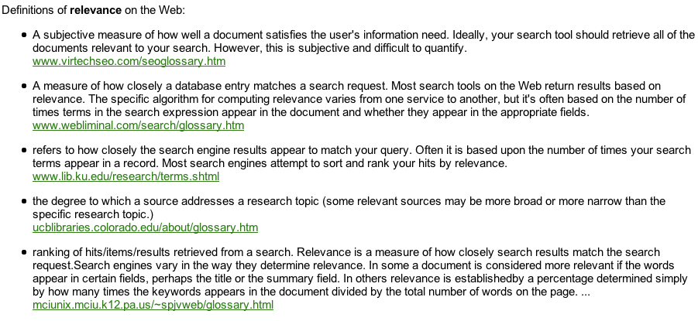
What is relevance?
An answer(s) that fits your need.

Slide 15
How is IR accomplished
Ask someone (can be very good when you can do it)
Search
  Search for someone to ask
  Search for needed information - library
  Use a search engine
Process of IR
  Queries or questions
  Returns answers

Slide 16
Information to be retrieved
Tacit vs explicit information
  Tacit: in someone’s mind
  Explicit: written down
Permanent vs Impermanent information
  Conversation, events
  Documents (in a general sense)
    Text, tweets
    Video
    Files
    Pictures
    Data
Both
Assumption: it exists!
What doesn’t exist on the web?

Slide 17
The information acquisition process
Know what you want, where it is and go get it
Ask questions to information sources as needed (queries) - manifestation of SEARCH - and let them suggest (rank) answers
Have information sent to you on a regular basis based on some predetermined information need or source preference
Push/pull models (RSS)

Slide 18
What IR assumes
Information is stored or available
A user has an information need
Usually, an automated system exists from which information can be retrieved
  Why an automated system?
It works when you need it!!

Slide 19
What is search?
Search vs Information retrieval
Differences
Many definitions of search
  IR (information retrieval)
  CS (computer science)
  Convention

Slide 20
What is SEARCH?
DEFINITIONS FROM THE WEB
the activity of looking thoroughly in order to find something or someone
an investigation seeking answers; "a thorough search of the ledgers revealed nothing"; "the outcome justified the search"
an operation that determines whether one or more of a set of items has a specified property; "they wrote a program to do a table lookup"
the examination of alternative hypotheses; "his search for a move that would avoid checkmate was unsuccessful"
try to locate or discover, or try to establish the existence of; "The police are searching for clues"; "They are searching for the missing man in the entire county"
To request the electronic retrieval of documents based on the presence of specific terms and within other restrictions established (e.g., subject, date, journal, etc.). Search results list The list of documents retrieved as a result of a search request submitted. Settings The record of the personal details related to an individual user, containing information such as, name, address, e-mail, and display preferences (if available), etc. Settings are used to set up a personal profile for the user, and are available only on systems that have user/password authentication.
Intelligently seeking answers to a known or unknown question, often as part of solving a larger problem (AI, planning, strategy, etc.)

Slide 21
What IR is usually not about
Not about structured data (databases)
  Why?
  Grow of structured data?
  Google Bigtable
Retrieval from databases is usually not considered
  Database querying assumes that the data is in a standardized format
  Transforming all information, news articles, web sites into a database format is difficult for large data collections
INTEGRATED IR and database search
  Ex: Craigslist

Slide 22
What is different about IR from other areas, say
parts of Computer Science
Many problems have a right answer
  How much money did you make last year?
IR problems usually don’t
  Find all documents relevant to “hippos in a zoo”
Answers are usually “good enough”
IR defines “good enough”

Slide 23

Good enough is the enemy of perfect

Slide 24
What an IR system should do
Store/archive information
Provide access to that information
Answer queries with relevant information
Stay current
Wish list
  Understand the user’s queries
  Understand the user’s need
  Acts as an assistant

Slide 25
What is relevance?
In IR relevance is everything
  Defining “good enough”
Relevant information is that suited to your information need.
Dependent on
  User
  Space/time
  Group
  Context
Examples?

Slide 26
How good is the IR system
Measures of performance based on what the system returns:
Relevance
Coverage
Recency
Functionality (e.g. query syntax)
Speed
Availability
Usability
Time/ability to satisfy user requests

Slide 27
How good is the IR system
Measures of performance based on what the system returns:
What we will use:
Relevance

Slide 28
How IR systems work
Algorithms implemented in software
Gathering of information
Storage of information
Processing and indexing
Interaction
Evaluation

Slide 29
Some IR History
  Roots in the scientific “Information Explosion” following WWII
  Interest in computer-based IR from mid 1950’s
    Key word indexing H.P. Luhn at IBM (1958)
    Probabilistic models at Rand (Maron & Kuhns) (1960)
    Boolean system development at Lockheed (‘60s)
    Vector Space Model (Salton at Cornell 1965)
    Statistical Weighting methods and theoretical advances (‘70s)
    Refinements and Advances in application (‘80s)
    User Interfaces, Large-scale testing and application (‘90s)
  Then came the web and search engines and everything changed
  More History

Slide 30
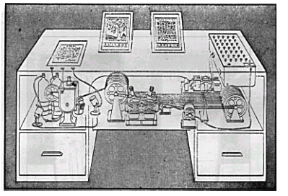
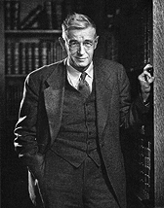
Vannevar Bush - Memex - 1945
Early ideas of IR-search
"A memex is a device in which an individual stores all his books, records, and communications, and which is mechanized so that it may be consulted with exceeding speed and flexibility. It is an enlarged intimate supplement to his memory.”
Bush seems to understand that computers won’t just store information as a product; they will transform the process people follow to produce and use information.

Slide 31
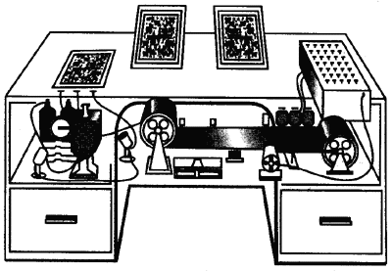
Bush 1945 – As We May Think
The memex is a desktop
machine, consisting of:
A user interface.
A repository of documents.
A search engine.
A linking mechanism.
Memex II can learn from its experience.

Slide 32
Quotes from As We May Think
“The human mind … operates by association. With one item in its grasp, it snaps instantly to the next that is suggested by the association of thoughts, in accordance with some intricate web of trails carried by the cells of the brain. … trails that are not frequently followed are prone to fade …. Yet the speed of action, the intricacy of trails, … is awe-inspiring beyond all else in nature.”
“A memex is a device in which an individual stores all his books, records, and communications, and which is mechanized so that it may be consulted with exceeding speed and flexibility. It is an enlarged intimate supplement to his memory.”
“There is a new profession of trail blazers, those who find delight in the task of establishing useful trails through the enormous mass of the common record.”
Notes:
Read this quote if there is time.

Slide 33
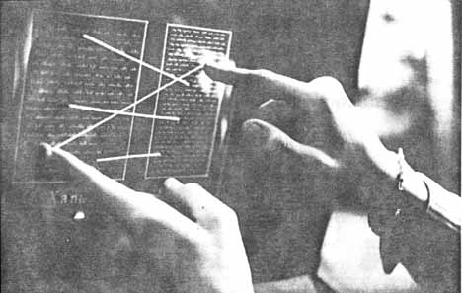
Nelson’s Hypertext
A universal hypertext.
Xanadu is a distributed network of documents (1960’s).
User interface - transpointing windows.
Elaborate copyright mechansim.
Superceded by WWW

Slide 34
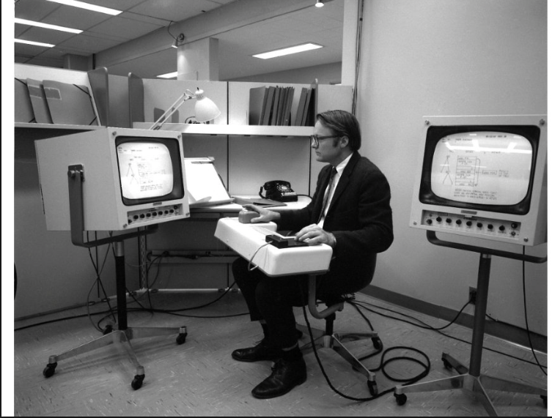
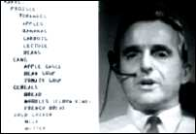
Engelbart’s oNLine System (1968)
First working hypertext system, where documents were linked together (funded by DARPA).

Slide 35
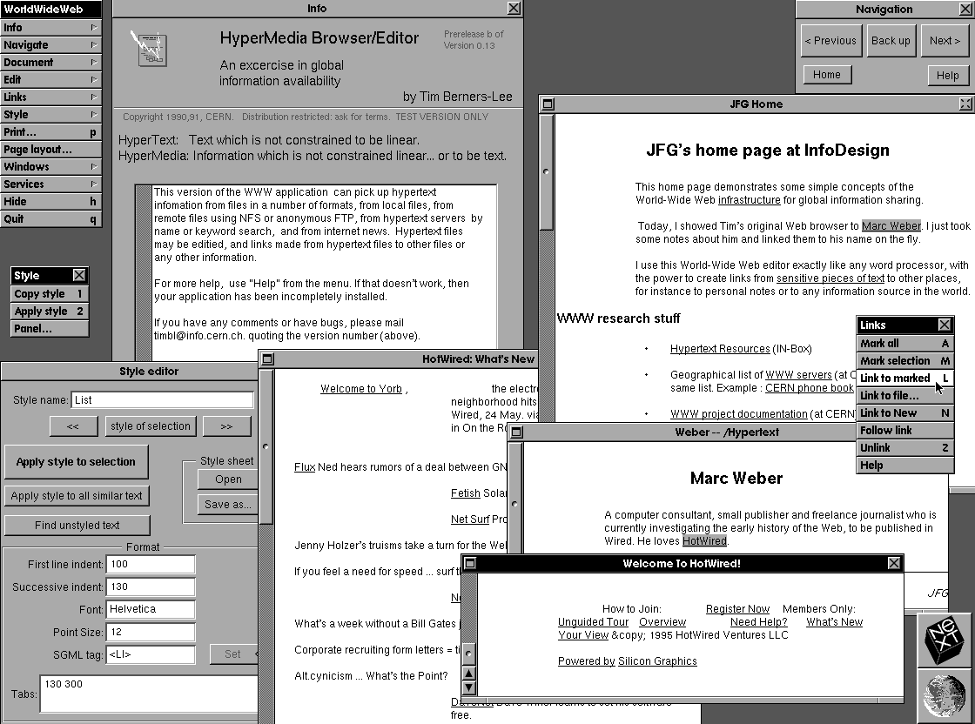
Tim Berners-Lee’s WWW
CERN 1990 - First Browser
Web protocols & languages
  URL
  HTTP
  HTML
World Wide Web Consortium (W3C) founded in 1994

Slide 36
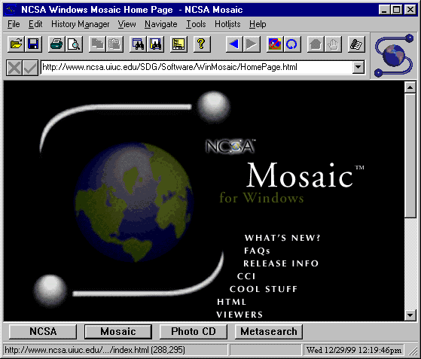

Mosaic – The Web Browser that changed history
Released late 1993 – developed by Marc Andreessen
Netscape triggered the boom of WWW throughout the 90’s
Browser wars with Microsoft – IE won (2003 stats: 95.6% - IE, 3.7% NS)
Chrome now dominates
What browsers do you use?

Slide 37
Difference between the internet and the web
Internet – physical computer network infrastructure on which the web is built.
The World Wide Web (web) is a virtual network defined through the web protocols.
The internet supports other protocols such as email, ftp and instant messaging.

Slide 38
Math/data structures/algorithms used in search engines
Little theory:
lots of heuristics in computer and information science
Math:
Set theory
Vector and matrix models
Similarity measures
Indexing – no databases – sometimes NoSQL
Graphs
Ranking
Scaling – Big O – users, documents
Code: Linux – C, C++, Python, Java

Slide 39
Measuring the Growth or Cost of Work or Hardness of a Problem – Big O
While it is possible to measure the work done by an algorithm for a given set of inputs, we need a way to:
Measure the rate of growth of an algorithm based upon the size of the input (or output)
  users, documents, hardware
Compare algorithms to determine which is better for the situation
Compare and analyze for large problems
  Examples of large problems?

Slide 40
IR and Search Engines
Search engines are an IR application.
Search engines have become the most popular IR tools.
Why?

Slide 41
IR and Search Engines
A search engine is the practical application of information retrieval techniques to large scale text collections
Web search engines are best-known examples, but many others
  Open source search engines are important for research and development
    e.g., Lucene, Lemur/Indri, Galago
Big issues include main IR issues but also some others

Slide 42
IR and Search Engines
Information Retrieval
Search Engines
Performance
-Efficient search and indexing
Incorporating new data
-Coverage and freshness
Scalability
-Growing with data and users
Adaptability
-Tuning for applications
Specific problems
-e.g. Spam
Relevance
-Effective ranking
Evaluation
-Testing and measuring
Information needs
-User interaction

Slide 43
Search Engine Issues
Performance
  Measuring and improving the efficiency of search
    e.g., reducing response time, increasing query throughput, increasing indexing speed
  Indexes are data structures designed to improve search efficiency
    designing and implementing them are major issues for search engines

Slide 44
Search Engine Issues
Dynamic data
  The “collection” for most real applications is constantly changing in terms of updates, additions, deletions
    e.g., web pages
  Acquiring or “crawling” the documents is a major task
    Typical measures are coverage (how much has been indexed) and freshness (how recently was it indexed)
  Updating the indexes while processing queries is also a design issue

Slide 45
Search Engine Issues
Scalability
  Making everything work with millions of users every day, and many terabytes of documents
  Distributed processing is essential
Adaptability
  Changing and tuning search engine components such as ranking algorithm, indexing strategy, interface for different applications

Slide 46
Spam
For Web search, spam in all its forms is one of the major issues
Affects the efficiency of search engines and, more seriously, the effectiveness of the results
Many types of spam
  e.g. spamdexing or term spam, link spam, “optimization”
New subfield called adversarial IR, since spammers are “adversaries” with different goals

Slide 47
Search Engine Basics
What we search – usually the World Wide Web (WWW)
Search engines
  Types
  Business models
Representation
  Text - vectors
Ranking
  Text similarity
  Link analysis (graph search)
Google
  THE dominant search engine
{
Text processing

Slide 48
Search Engines
Search engines
History of search engines
There are many types: Wikipedia list
Many types are not on this list.
  Academic search engines

Slide 49
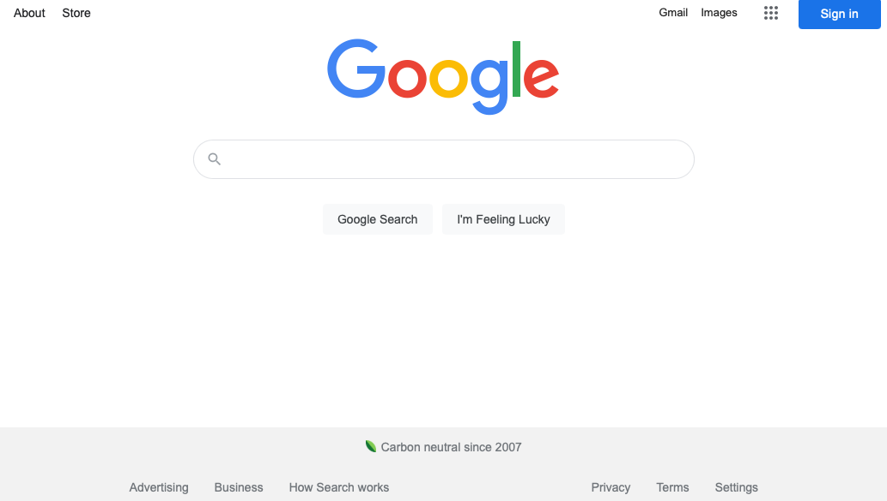
Existing Popular IR System:
Search Engine - Fall 2022

Slide 50
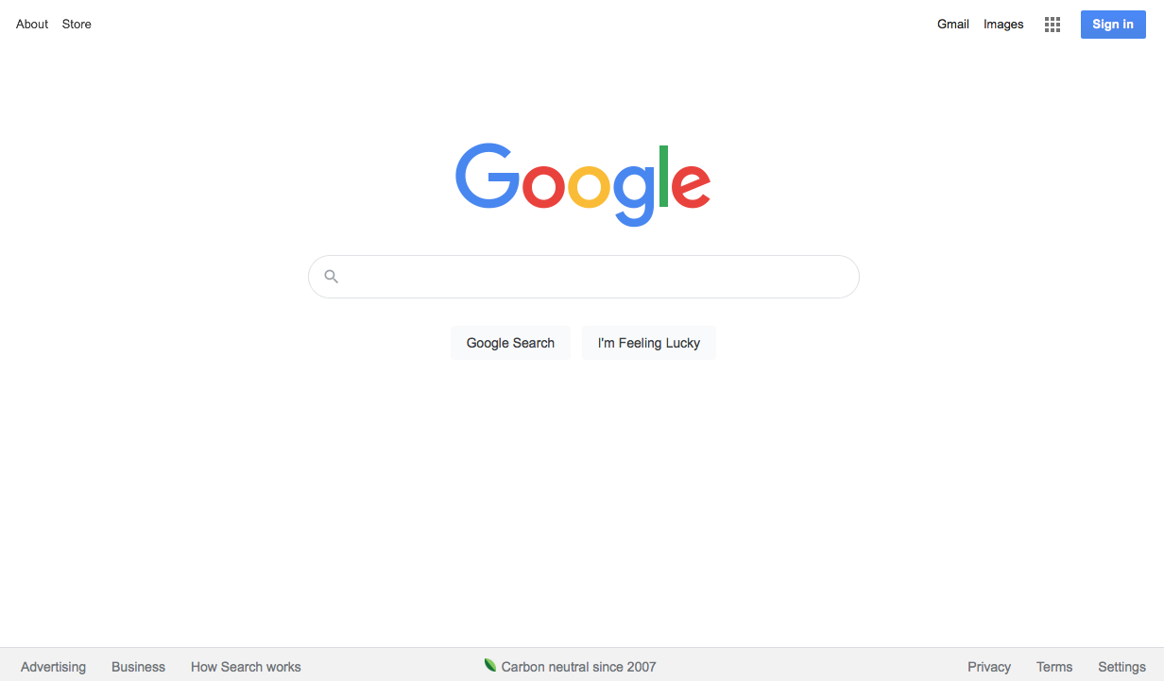
Existing Popular IR System:
Search Engine - Fall 2021

Slide 51
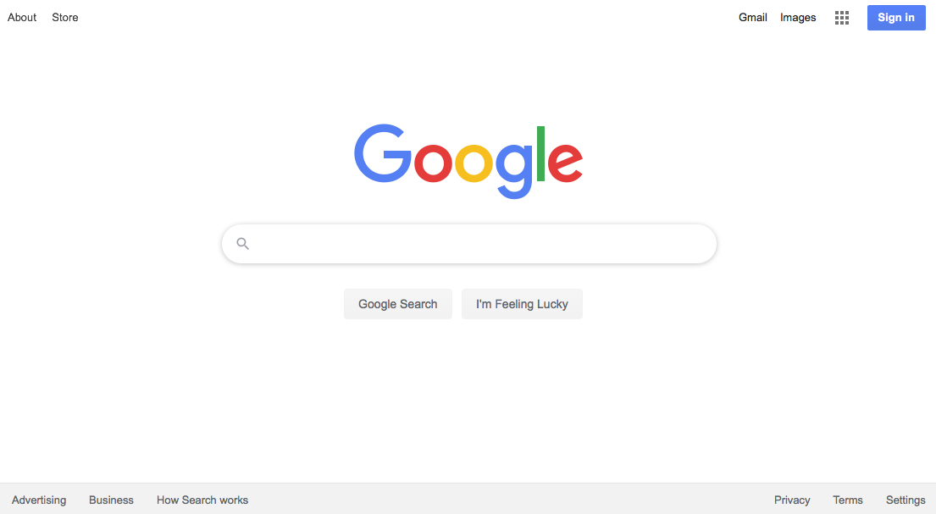
Existing Popular IR System:
Search Engine - Spring 2020

Slide 52
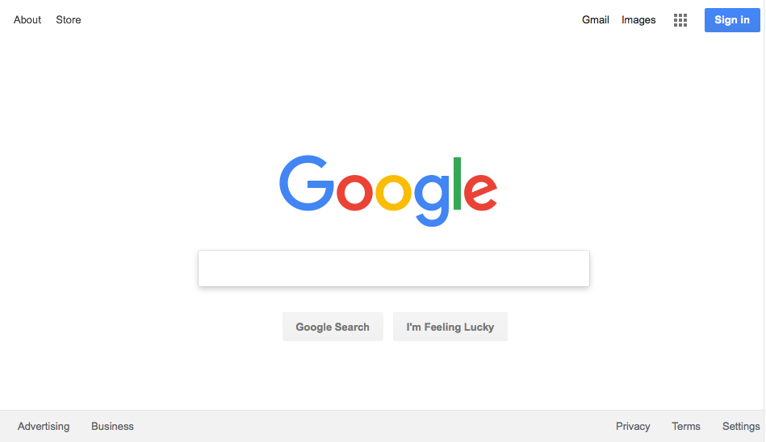
Existing Popular IR System:
Search Engine - Spring 2019

Slide 53
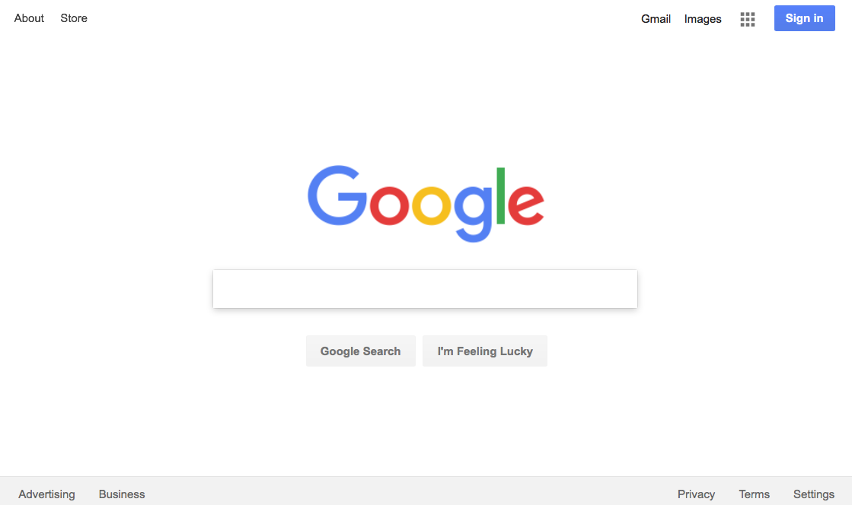
Existing Popular IR System:
Search Engine - Spring 2018

Slide 54
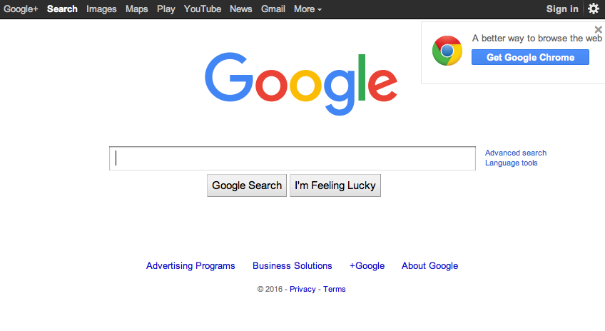
Existing Popular IR System:
Search Engine - Spring 2016

Slide 55
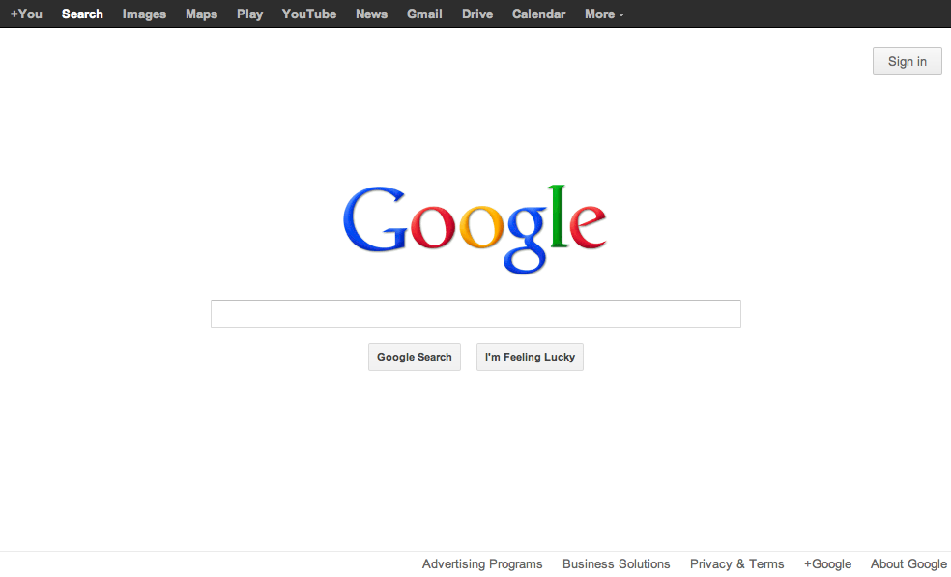
Existing Popular IR System:
Search Engine - Spring 2013

Slide 56
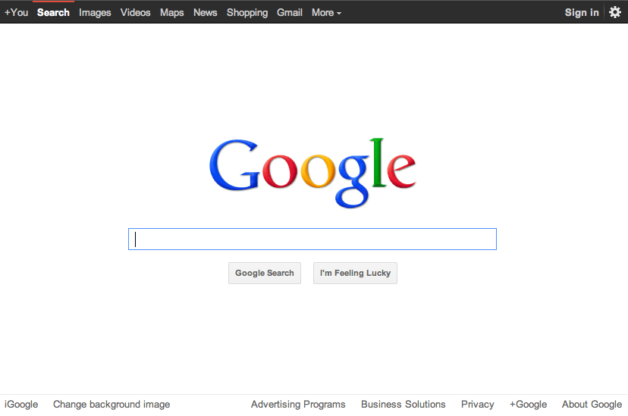
Existing Popular IR System:
Search Engine - Spring 2012

Slide 57
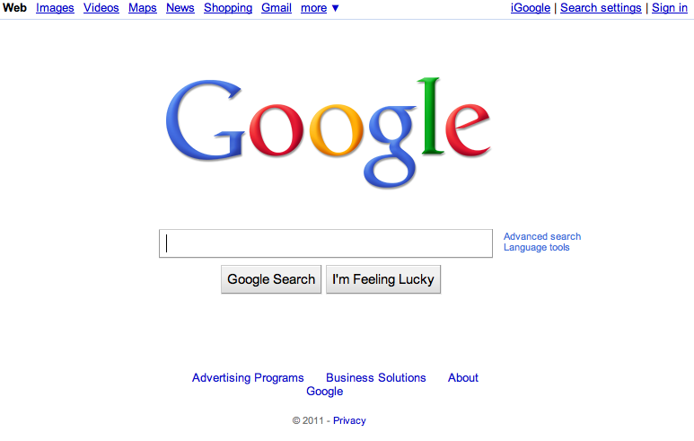
Existing Popular IR System:
Search Engine - Spring 2011

Slide 58
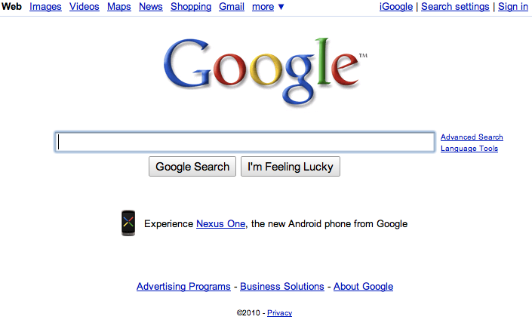
Search Engine - Spring 2010

Slide 59
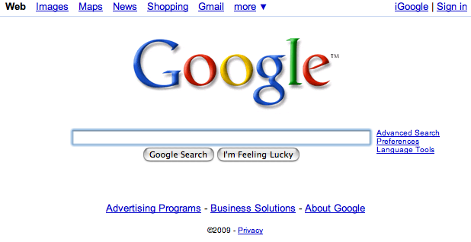
Search Engine - Spring 2009

Slide 60
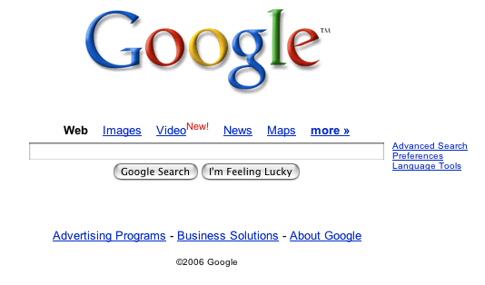
Search Engine - Fall 2006

Slide 61
New search engines slowly emerging
Reasonably new search engines
  Bing
  Wolfram Alpha
  Cuil (deceased)
    July 2008 – Sept 2010
  DuckDuckGo
Which one is best? Ask the search engines!
  best search engine

Slide 62
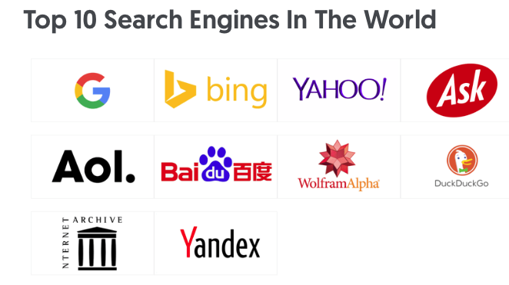

Slide 63
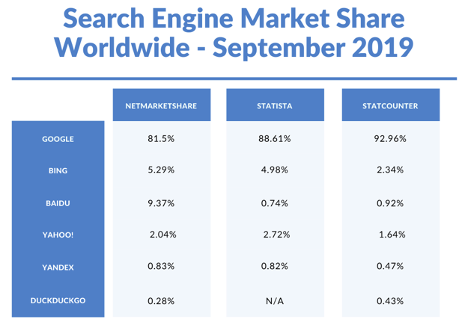

Slide 64
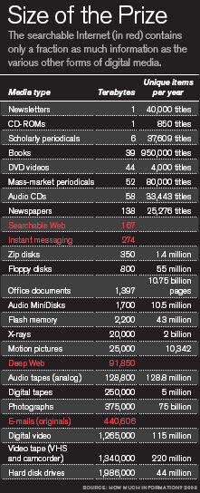
Why important
Web searchable information seems to always increase
Enterprise search growth
Storage is dropping radically in cost!

Slide 65
Impact of search engines
Make the web scale!
  Without search engines, the web probably wouldn’t be that important
Unbelievable access to information
  Implications are only just being understood
  Democratization of humankind’s knowledge
The online world
  I “googled” him just to see …
  Search is crucial part of many’s everyday existence and 2nd most popular online activity after email
  Social interactions - blogs
The death of anonymity/privacy
  Nearly everyone is searchable
    Choicepoint
    Facebook
Digital divide

Slide 66
What is a Search Engine?
An IR system with an active data harvester to actively collect information,
  Crawler, spider, web bot
Search engines usually collect this information on the web or some part of it.
  Not always – enterprise search
“how search engines work”

Slide 67
Query Engine
Index
Interface
Indexer
Users
Crawler
No Databases!
Use an index
Web
A Typical Web Search Engine

Slide 68
Google relevance
Changed everything - 2nd gen search
1st gen Search engine relevance - key words
Google - relevance is popularity
  -who links to you!

Slide 69
Crawlers
Web crawlers (spiders) gather information (files, URLs, etc) from the web.
Primitive IR systems

Slide 70
What is a Web Crawler?
Also called: spider, bot, harvester
The Web crawler is a foundational species!
Without crawlers, search engines would not exist.
  But they get little credit!
How they are controlled
    Robots.txt

Slide 71
Robots Exclusion Protocol
Site administrator puts a “robots.txt” file at the root of the host’s web directory.
  http://www.ebay.com/robots.txt
  http://www.cnn.com/robots.txt
  http://clgiles.ist.psu.edu/robots.txt
  http://en.wikipedia.org/robots.txt
File is a list of excluded directories for a given robot (user-agent).
  Exclude all robots from the entire site:
User-agent: *
Disallow: /
New Allow:
Find some interesting robots.txt

Slide 72
The Web of documents
Sec. 19.2
No design/co-ordination
Distributed content creation, linking, democratization of publishing
Content includes truth, lies, obsolete information, contradictions …
Unstructured (text, html, …), semi-structured (XML, annotated photos), structured (Databases)…
Scale much larger than previous text collections … but corporate records are catching up
Growth – slowed down from initial “volume doubling every few months” but still expanding
Content can be dynamically generated
The Web

Slide 73
PageRank Algorithm
Let S be the total set of pages.
Let ∀p∈S: E(p) = α/|S| (for some 0<α<1, e.g. 0.15)
Initialize ∀p∈S: R(p) = 1/|S|
Until ranks do not change (much) (convergence)
For each p∈S:
For each p∈S: R(p) = cR´(p) (normalize)
New algorithms to replace PageRank are being explored!

Slide 74
PageRank Idea
Just measuring in-degree (citation count) doesn’t account for the authority of the source of a link.
Initial page rank equation for page p:
  N_{q} is the total number of out-links from page q.
  A page, q, “gives” an equal fraction of its authority to all the pages it points to (e.g. p).
  c is a normalizing constant set so that the rank of all pages always sums to 1.

Slide 75
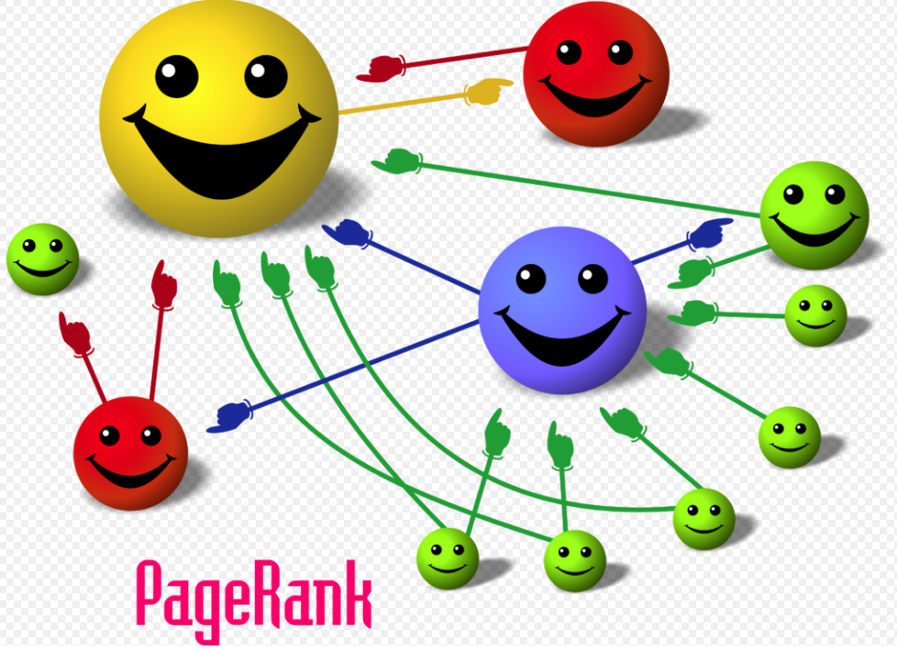
3D Web

Slide 76
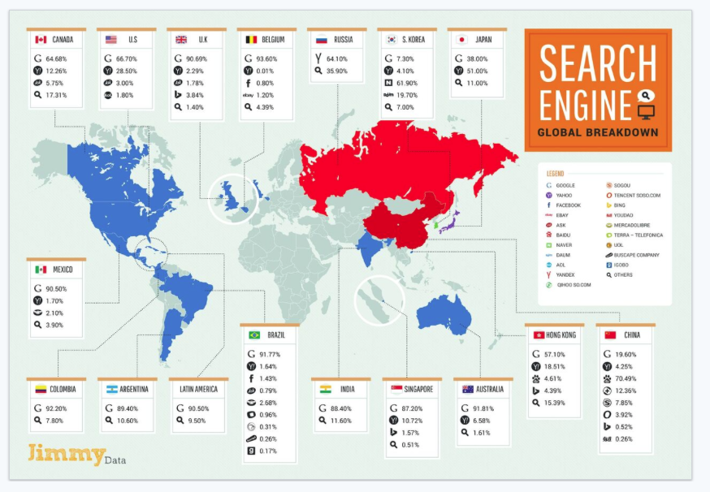
Multiplatform Usage 2016
Effect of PageRank – Google Rules

Slide 77
Finding Out About (FOA)
(Reference R. Belew)
Three phases:
  Asking of a question (the Information Need)
  Construction of an answer (IR proper)
  Assessment of the answer (Evaluation)
Part of an iterative process

Slide 78
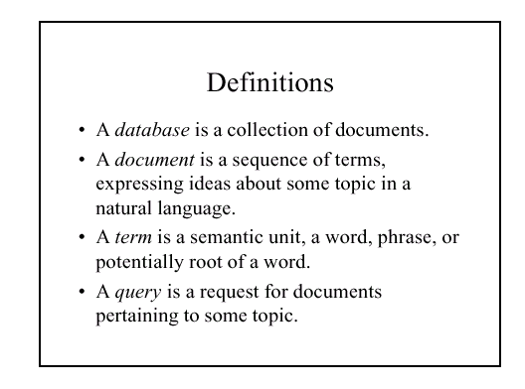

Slide 79

IR is an Iterative Process
Goals
Repositories
Workspace

Slide 80
User’s
Information
Need
text input
Parse
Query

Slide 81
Collections
Pre-process
Index

Slide 82
User’s
Information
Need
Collections
Pre-process
text input
Parse
Query
Index
Rank or Match

Slide 83
User’s
Information
Need
Collections
Pre-process
text input
Parse
Query
Index
Rank or Match
Query Reformulation

Slide 84
Question Asking
Person asking = “user”
  In a frame of mind, a cognitive state
  Aware of a gap in their knowledge
  May not be able to fully define this gap
Paradox of Finding Out About something:
  If user knew the question to ask, there would often be no work to do.
    “The need to describe that which you do not know in order to find it” Roland Hjerppe
Query
  External expression of this ill-defined state

Slide 85
Question Answering
Consider - question answerer is human.
  Can they translate the user’s ill-defined question into a better one?
  Do they know the answer themselves?
  Are they able to verbalize this answer?
  Will the user understand this verbalization?
  Can they provide the needed background?
Consider - answerer is a computer system.

Slide 86
Assessing the Answer to an IR System
How well does it answer the question?
  Complete answer? Partial?
  Background Information?
  Hints for further exploration?
How relevant is it to the user?
Notion of relevance.
What about IBM’s Watson?

Slide 87

Watson
IBM’s Artificial Intelligence computer system
Capable of answering questions in natural language
Competed against champions on Jeopardy and won

Slide 88

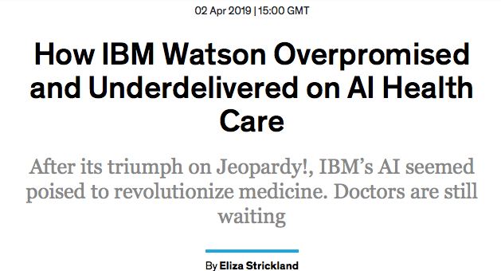
But not everything goes as planned
Real Fake news and advertisements!
Contender for the ”most notorious hype” award.
IEEE Spectrum, April,’19

Slide 89
IR is usually a dialog
  The exchange doesn’t end with first answer
  User can recognize elements of a useful answer
  Questions and understanding changes as the process continues.

Slide 90
Information Seeking Behavior
Two parts of the process:
  search and retrieval
  analysis and synthesis of search results
examples?

Slide 91
Information Retrieval
Revised Goal Statement:
  Build a system that retrieves documents that users are likely to find relevant to their queries.
This set of assumptions underlies the field of Information Retrieval.

Slide 92
Structure of an IR System
Search
Line
Interest profiles
& Queries
Documents
& data
Storage
Line
Information Storage and Retrieval System
Rules of the game =
Rules for subject indexing +
Thesaurus (which consists of
Lead-In
Vocabulary
and
Indexing
Language
Formulating query in
terms of
descriptors
Indexing
(Descriptive and
Subject)
Storage of
profiles
Storage of
Documents
Store1: Profiles/
Search requests
Comparison/
Matching
Store2: Document
representations
Adapted from Soergel, p. 19
Potentially
Relevant
Documents

Slide 93
Structure of an IR System
Search
Line
Interest profiles
& Queries
Documents
& data
Storage
Line
Information Storage and Retrieval System
Rules of the game =
Rules for subject indexing +
Thesaurus (which consists of
Lead-In
Vocabulary
and
Indexing
Language
Formulating query in
terms of
descriptors
Indexing
(Descriptive and
Subject)
Storage of
profiles
Storage of
Documents
Store1: Profiles/
Search requests
Comparison/
Matching
Store2: Document
representations
Adapted from Soergel, p. 19
Potentially
Relevant
Documents

Slide 94
Structure of an IR System
Search
Line
Interest profiles
& Queries
Documents
& data
Storage
Line
Information Storage and Retrieval System
Rules of the game =
Rules for subject indexing +
Thesaurus (which consists of
Lead-In
Vocabulary
and
Indexing
Language
Formulating query in
terms of
descriptors
Indexing
(Descriptive and
Subject)
Storage of
profiles
Storage of
Documents
Store1: Profiles/
Search requests
Comparison/
Matching
Store2: Document
representations
Adapted from Soergel, p. 19
Potentially
Relevant
Documents

Slide 95
Structure of an IR System
Search
Line
Interest profiles
& Queries
Documents
& data
Storage
Line
Information Storage and Retrieval System
Rules of the game =
Rules for subject indexing +
Thesaurus (which consists of
Lead-In
Vocabulary
and
Indexing
Language
Formulating query in
terms of
descriptors
Indexing
(Descriptive and
Subject)
Storage of
profiles
Storage of
Documents
Store1: Profiles/
Search requests
Comparison/
Matching
Store2: Document
representations
Adapted from Soergel, p. 19
Potentially
Relevant
Documents

Slide 96
Measures of performance
How good is that IR system?
BUDLITE SEARCH – never fills you up.

Slide 97
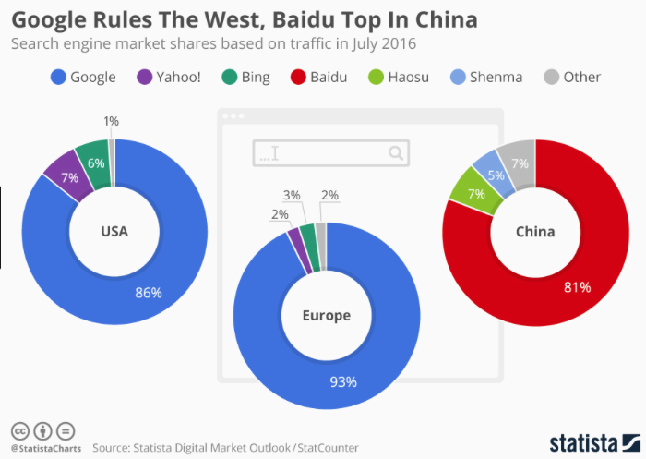
2017

Slide 98
2012

Slide 99
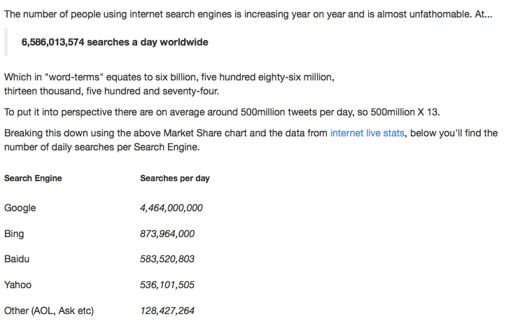
March 2016 – Net Share Market
Trillions a year

Slide 100
Are Google rankings fair?
Are any search engines rankings fair?
Try out certain queries
  about “jews”
  “tiananmen square”
    Google.com
    Google.cn
    Baidu.com

Slide 101
Breaking Google with queries
Odd queries:
  Who doesn’t like me
  How far …
  Will a sponge ball crash through a glass table
  I could get my trophy home in my suit case because it was too big. What is too big?
Question/answering still an issue

Slide 102
What is role of search engines in society
Should these queries be banned?
  “how do I make a dirty bomb”
  “how do I make a black hole”
Do search engines have a social responsibility?

Slide 103
Social implications of public search engines
What is the web role of search in society
  Human flesh search engine
  What is the responsibility of search engines?
The googlization of everything
Should governments control search engines
  Positions
    Search is too important to be left to the private sector
    Search will only work from 8 to 5 on weekdays and will be off on holidays and government shutdowns.
  New Chinese government search engine
    Panguso

Slide 104
Which search engine to use?
General queries
  Google
  Bing
Specialty (vertical) search engines for special search
  Amazon
  eBay
  Google Scholar, Semantic Scholar, CiteSeerX
Language dependent
  Yandex, Baidu, … except Latin alphabet languages

Slide 105
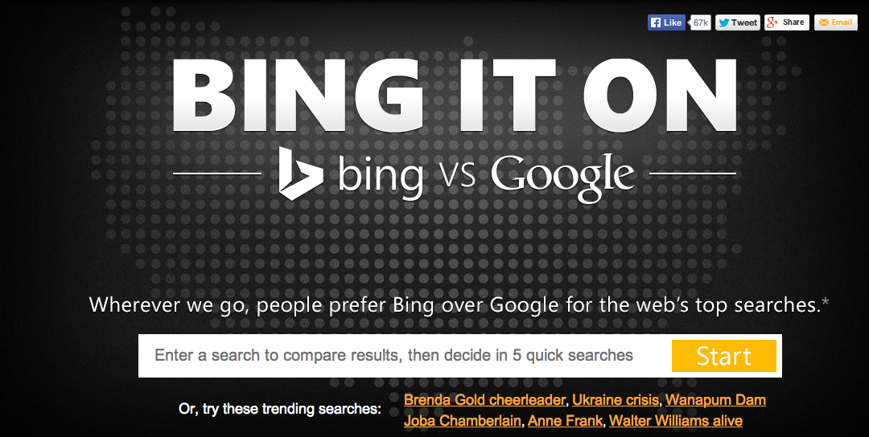
Google vs Bing

Slide 106
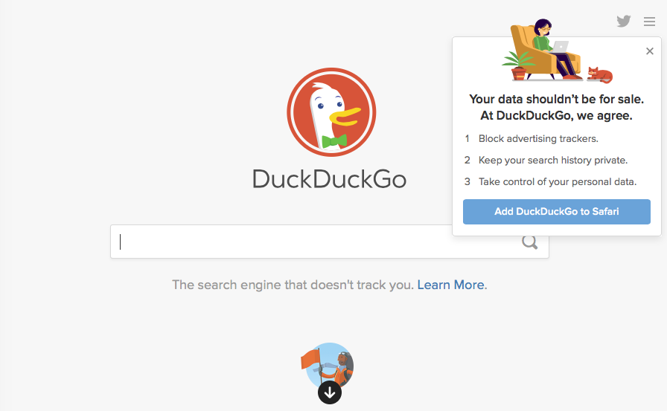
Privacy Search Engine

Slide 107
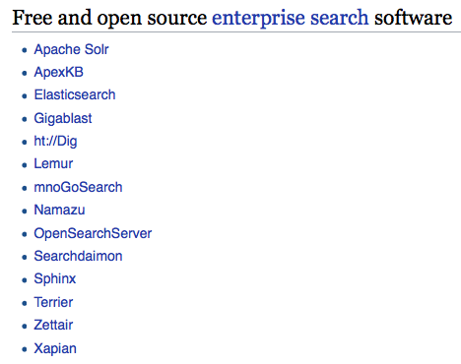
Open Source Search/Indexing Tools
Enterprise Search is Growing
Wikipedai-open-tools

Slide 108
Elastic/Lucene
Query Engine
Index
Interface
Users
Indexer
Crawler
Scrapy
Web
Web Search Engine with Open Source Parts

Slide 109
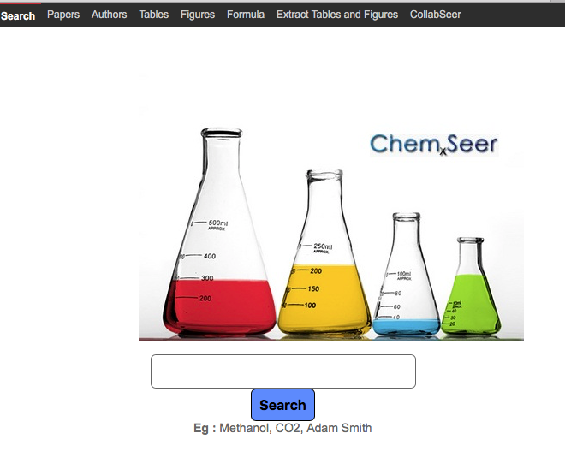
Google vs Bing

Slide 110
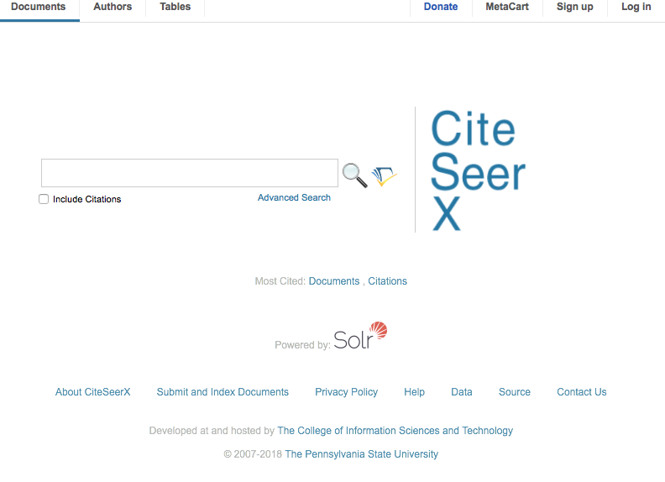
Google vs Bing

Slide 111
How Does Google Work?
Google

Slide 112

Future of Search:
Semantic Web and Natural Language Processing Search
Do this by:
Somehow making data and metadata available on the Web in machine-understandable form (formalized) (Web 3.0)
Structure the data and meta-data in ontologies
Have Natural Language Processing Search Engines!
Google as an AI

Slide 113
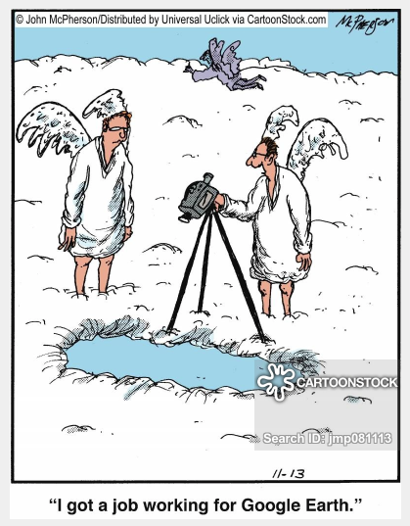

Slide 114
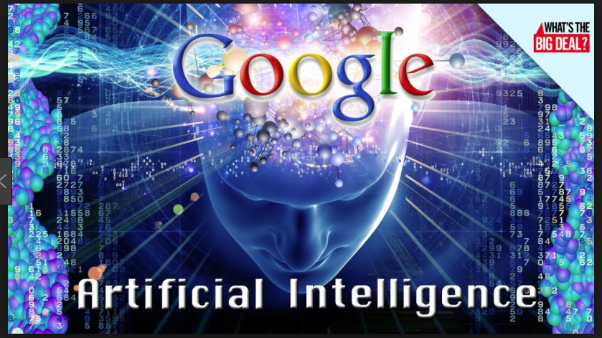
AI Google

Slide 115
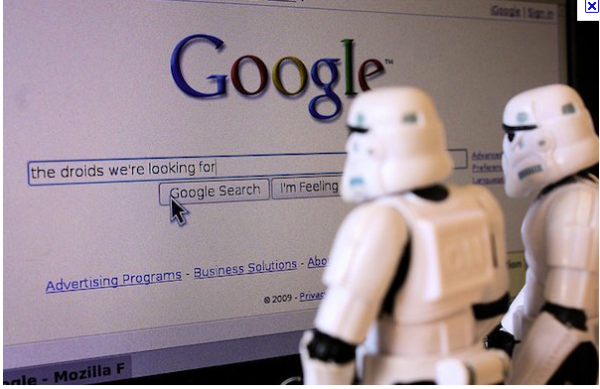
Google of the future

Slide 116
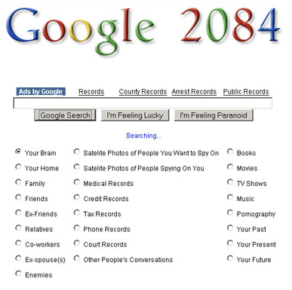
What next? GoogleFace or Faceoogle

Slide 117
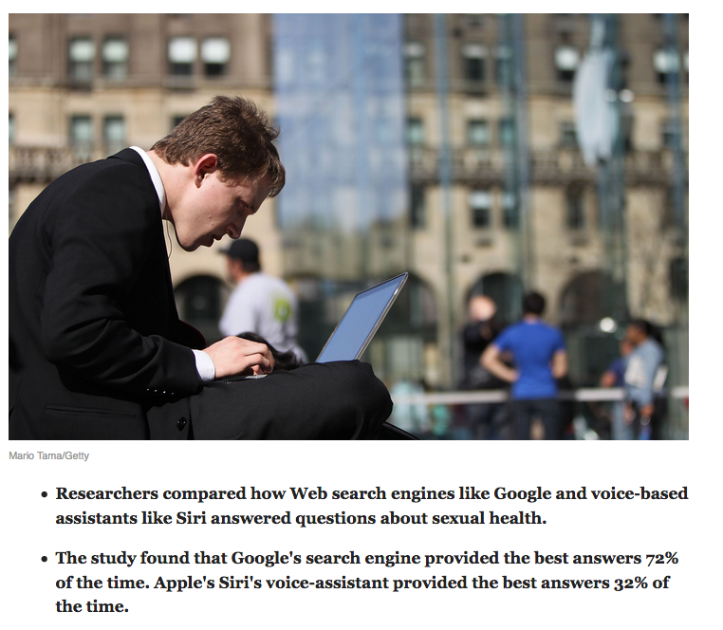
Do search engines still matter?

Slide 118
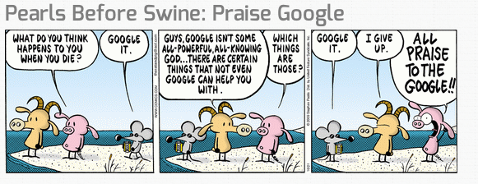

Slide 119
Search in the Future?
Enterprise search
Web gets smarter – Web 3.0
Search gets smarter - Natural language queries
Search agent (avatar) understands and anticipates your needs
Personal life search with avatar

Slide 120
What we covered
IR vs search engines
IR Field is relatively old
  Legal search
  Library search
Computers/web changed IR
Little theory – lots of math and data structures
Does not use databases for the most part
Pioneered foundations of many large scale systems

Slide 121
Some Research directions in IR
Semantic search, indexing, and retrieval
  Natural language understanding and generation
  Question and answering
  Knowledge graphs
  Machine learning (deep learning”
New data to index and search
  Images; video
  Equations, figures, tables, etc
Automate, automate, automate
Data integration
Search and HCI
Privacy, security

Slide 122
Is Information Retrieval?
discovering new knowledge
capturing existing knowledge
sharing knowledge with others
applying knowledge
app for large data
Should we really be studying knowledge retrieval?
Seems to be Google’s new goal

