Slide 1
Indexing with Elasticsearch
Agnese Chiatti and Lee Giles

Slide 2
Recap
Crawling the necessary contents with Heritrix
Dumping the results in mirror format for HTML pages
Retrieving the stored HTML pages from file system
Indexing the crawled contents into Elasticsearch

Slide 3
Accessing Kibana
Open browser (from within VLabs or ISTNetwork wired computer)
ist441giles.ist.psu.edu:56+<teamno>
e.g., for team 1 → ist441giles.ist.psu.edu:5601
for team2 → ist441giles.ist.psu.edu:5602
… and so forth

Slide 4
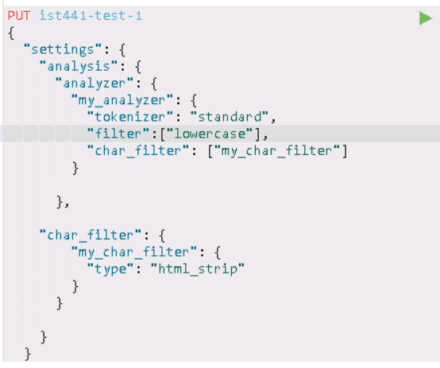
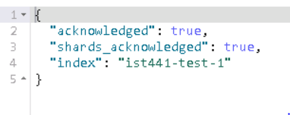
Defining Text Preprocessing
How to create a new index that filters out HTML tags and extracts/indexes just text ?

Slide 5
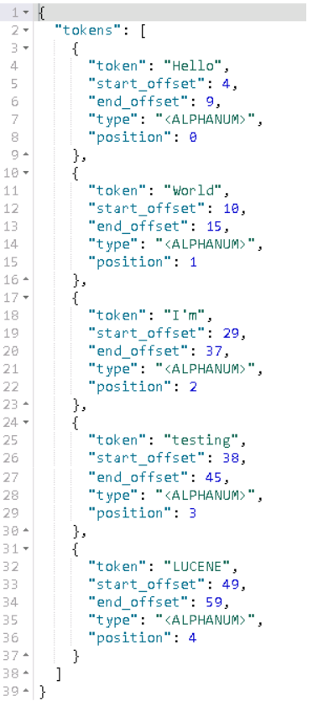
Testing your Lucene analyzer
On some sample text before indexing everything!
References to Tokenizers and Filters in ElasticSearch 6.1 HTML strip char filter Elasticsearch Lucene Tokenizers

Slide 6
File System (FS) crawler (Actually an indexer!)
We will be using a plugin to ingest data into Elasticsearch
It is actually an indexing system, do not be misled by the name!
Access the class server through PUTTY
cd /data/ist441/<teamno>/data-ingest/fscrawler-2.4
screen
bin/fscrawler ist441-test-1

Slide 7
Configuring FS crawler
5. vim ~/.fscrawler/ist441-test-1/_settings.json
5. Press i to start modifying
6. “url” should point to the mirror folder where your crawled content is stored, for example: /data/ist441/team1/crawler/heritrix-3.3.0-SNAPSHOT/jobs/test1/latest/mirror

Slide 8
Configuring FS crawler (2)
7. The update rate can be modified from minutes to days
8. Change elasticsearch “host” to “ist441giles.ist.psu.edu”
9. And the elasticsearch “port” to 92+<team-number>
10. At line 31, add “index”: “ist441-test-1”

Slide 9
Configuring FS crawler (3)
11. The HTTP default port should be changed from 8080 to 808+<team-number> e.g. 8081 or 8090 if you are team 10, 8091 for team 11 and so forth
12. When your are done with modifications, press Esc + :wq
13. run bin/fscrawler ist441-test-1 again
13. Press Ctrl a + d to detach from screen

Slide 10
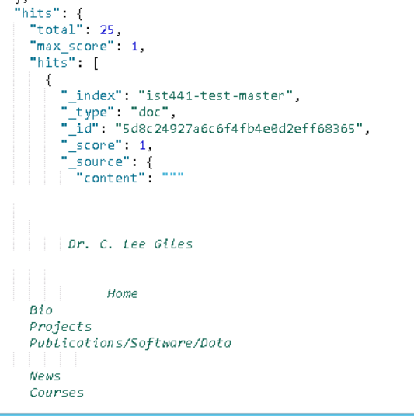
Getting started with queries

