Slide 1
Specialty/Vertical Search Engines Enterprise Search
Thanks to Jennifer English, T.B. Rajashekar

Slide 3
Specialty Search Engines
Focuses on a specific type of information
Subject area, geographic area, resource type, enterprise
Also called
Niche search
Vertical search
Enterprise search
Can be part of a general purpose engine
Can use a crawler to build the document collection
Web pages
Other information specific to the area of focus, or combine crawler with human built directory
Crawler is focused (focused crawler)
Information resources to be indexed
Internal to an organization
External - web
Both

Slide 4
Why Specialty Search Engines
Focused collection
Improved relevance
Faster search
Specialized features
Easter to maintain
Privacy
More up to date

Slide 5
List of Search Engines
There are many types: Wikipedia list
Many types are not on this list.
Academic search engines
Many of these are specialty search engines

Slide 6
Enterprise search
Another type of specialty search engine
Search for the enterprise
Usually private search
Can be for public use
Sometimes called vertical search
Search on specific business practices
Examples?

Slide 7
Enterprise search: definition
Search implemented within an enterprise context for internal users
Intranet vs internet
Index internal content
Serve internal clients and end-users
Vs web search or desktop search but can incorporate these
As opposed to companies “optimizing” search (SEO) of their organization on the Internet, which is more of an external, marketing and PR function
Buying ads
Optimizing content
Often specifically about internally-facing search for employees – usually not the enterprise’s public site
Notes:
Most organizations do not invest resources in improving search, whereas Internet search engine companies employee hundreds, and thousands in some cases, of developers whose sole mission is to improve search.
User task
Searching on the Internet is more frequently geared towards finding a starting point and gathering background information on a particular topic, whereas searching at work is focused more on finding the right answer to a specific question, which is a much harder goal to achieve.
Statistical Data
Internet search engines are able to constantly analyze and improve their ranking algorithms based large amounts of statistical data they collect about their users searches. One example is click through rates on documents that are returned for a particular query. Enterprises, IF they have the resources to purchase or build functionality like this, have far fewer data points on which to base these calculations. Some of the algorithms in use on the Internet simply won’t work in the Enterprise.
Another major difference is with Enterprise content. Documents within organizations tend not to contain many links to each other – so the use of in-link analysis also will not work for most Enterprises.

Slide 8
Enterprise search: how it’s different
Initially expected to be the killer app for search, not web search!
Now catching up
Search is not the business of the enterprise
Most organizations do not invest any time in search
As opposed to companies whose life-blood is improving search
User task is different
Internet: find an answer or a starting point
Intranet: find the right answer, know it’s the right answer
Statistical data is usually not there (but this is changing)
Fewer searches per day
Less content
In-links are not there (importance measure)
Crucial for improving relevancy on the Internet
In-link ranking nearly impossible; importance measure up for grabs
Uses old ranking methods – word frequency, etc.
Notes:
Most organizations do not invest resources in improving search, whereas Internet search engine companies employee hundreds, and thousands in some cases, of developers whose sole mission is to improve search.
User task
Searching on the Internet is more frequently geared towards finding a starting point and gathering background information on a particular topic, whereas searching at work is focused more on finding the right answer to a specific question, which is a much harder goal to achieve.
Statistical Data
Internet search engines are able to constantly analyze and improve their ranking algorithms based large amounts of statistical data they collect about their users searches. One example is click through rates on documents that are returned for a particular query. Enterprises, IF they have the resources to purchase or build functionality like this, have far fewer data points on which to base these calculations. Some of the algorithms in use on the Internet simply won’t work in the Enterprise.
Another major difference is with Enterprise content. Documents within organizations tend not to contain many links to each other – so the use of in-link analysis also will not work for most Enterprises.

Slide 9
Enterprise search: Challenges
The major challenge: index documents from a variety of sources such as: file systems, intranets, document management systems, e-mail, and databases
Adapters to index content from a variety of repositories, such as databases and content management systems.
Provide effective federated search
(1) transforming a query and broadcasting it to a group of disparate databases with the appropriate syntax
(2) merging the results collected from the databases
(3) presenting them in a succinct and unified format with minimal duplication,
(4) providing a means, performed either automatically or by the portal user, to sort the merged result set.
Entity extraction that seeks to locate and classify elements in text into predefined categories such as the names of persons, organizations, locations, expressions of times, quantities, monetary values, percentages, etc.
Faceted search for accessing a collection of information represented using a faceted classification, allowing users to explore by filtering available information.
Access control, usually in the form of an Access control list (ACL) to restrict access to documents based on individual user identities. There are many types of access control mechanisms for different content sources making this a complex task to address comprehensively in an enterprise search environment.
Notes:
Most organizations do not invest resources in improving search, whereas Internet search engine companies employee hundreds, and thousands in some cases, of developers whose sole mission is to improve search.
User task
Searching on the Internet is more frequently geared towards finding a starting point and gathering background information on a particular topic, whereas searching at work is focused more on finding the right answer to a specific question, which is a much harder goal to achieve.
Statistical Data
Internet search engines are able to constantly analyze and improve their ranking algorithms based large amounts of statistical data they collect about their users searches. One example is click through rates on documents that are returned for a particular query. Enterprises, IF they have the resources to purchase or build functionality like this, have far fewer data points on which to base these calculations. Some of the algorithms in use on the Internet simply won’t work in the Enterprise.
Another major difference is with Enterprise content. Documents within organizations tend not to contain many links to each other – so the use of in-link analysis also will not work for most Enterprises.

Slide 11
Specialty Search Engines - Advantages
Saves time
Greater relevance
Unique indexes
Car search: Jaguar, etc
CiteSeerX
Searches academic documents
Vetted database, unique entries and annotations

Slide 12
Specialty Search Engines -Disadvantages
Maintenance overhead
Constant crawling
System management
Google custom search (CSE) eliminates this
Interface design
Naïve users
Freshness

Slide 13
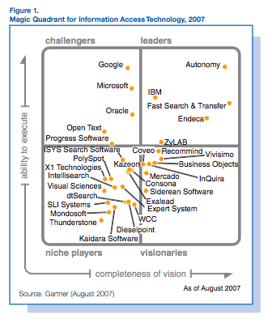
Enterprise Commercial Search Market Place – 2007

Slide 14
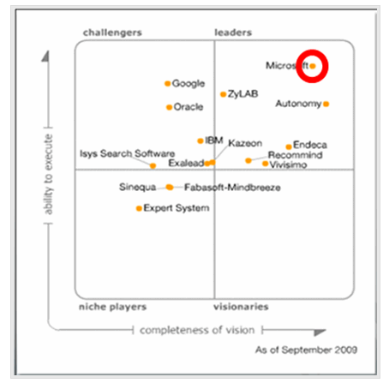
Enterprise Commercial Search Market Place – 2009

Slide 15
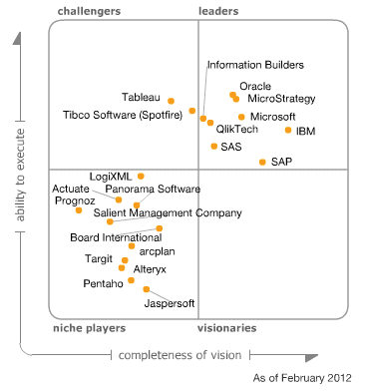
Enterprise Commercial Search Market Place – 2012

Slide 16
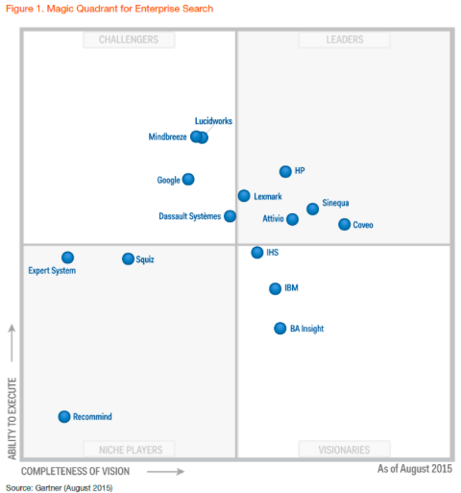
Enterprise Commercial Search Market Place – 2015

Slide 17
Enterprise Growth
Billions

Slide 18
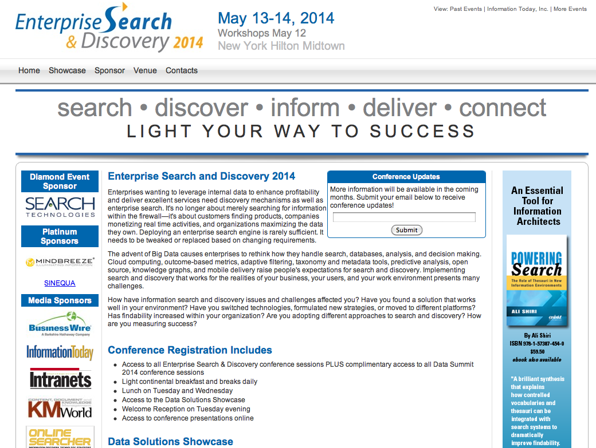

Slide 21
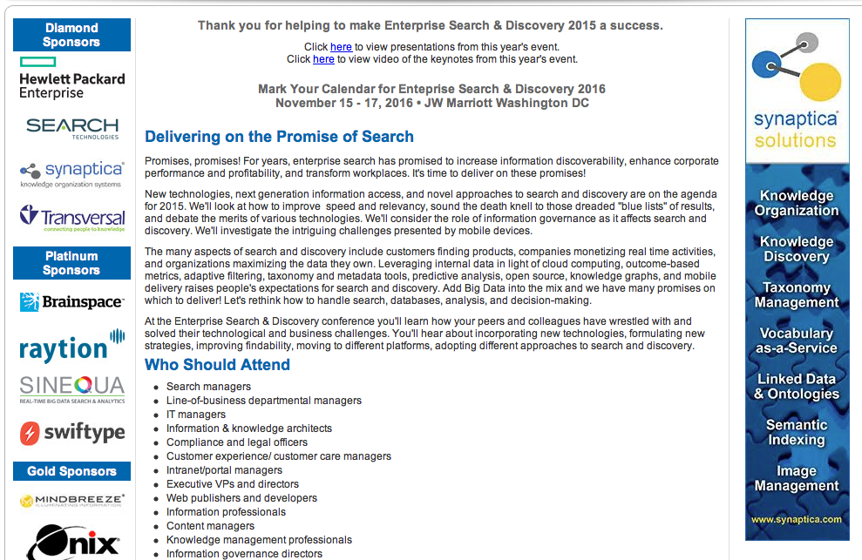

Slide 22
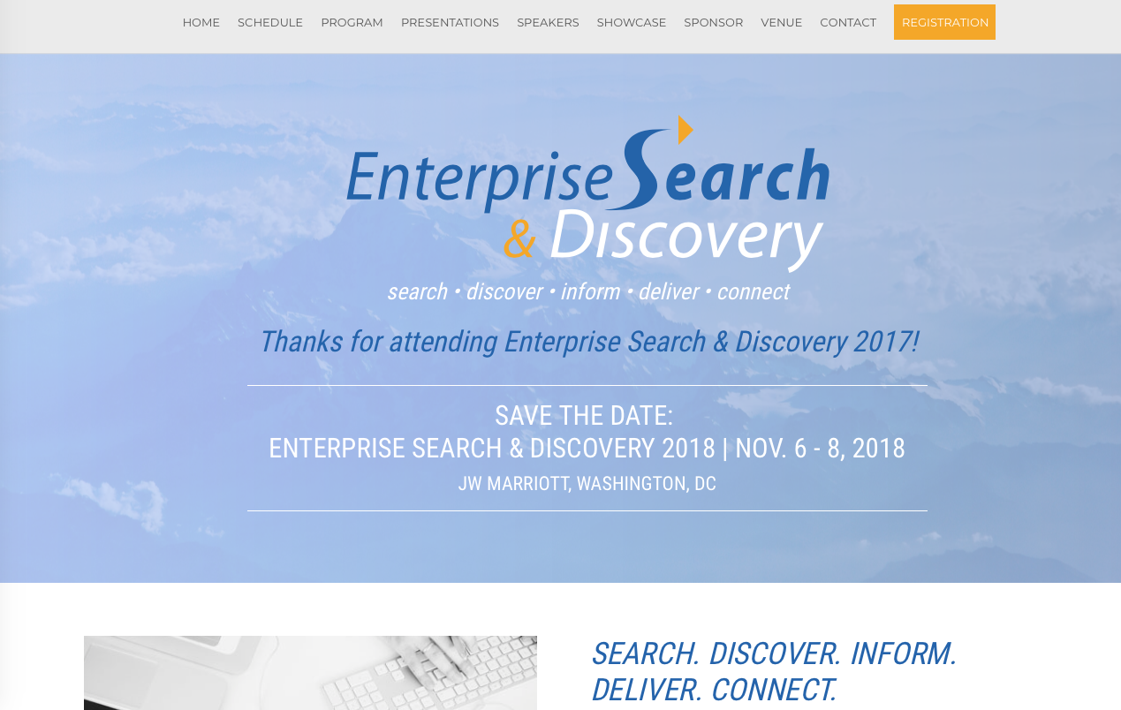
http://www.enterprisesearchanddiscovery.com/2018/

Slide 23
https://www.enterprisesearchanddiscovery.com/2022/default.aspx

Slide 29
ElasticON

Slide 31
Enterprise Commercial Search Market Place – 2014
Lots of enterprise platforms
The Big Three/Four
Google Search Appliance – discontinued in 2019
Microsoft Sharepoint
Solr-Elastic Lucene – embedded
IBM Watson

Slide 32
Enterprise Commercial Search Market Place – 2017
Lots of enterprise platforms
The Big Three
Google Search Appliance – discontinued in 2019
Microsoft Sharepoint
Solr-Elastic Lucene – open source – embedded
Next – enterprise search in the cloud
Google
Amazon
others

Slide 33
Enterprise Commercial Search Market Place – 2018
Lots of enterprise platforms
The Big Three
Google Search Appliance – discontinued in 2019
Microsoft Sharepoint
Solr-Elastic Lucene – open source – embedded
IBM Watson (?)
Next – enterprise search in the cloud
Google
Amazon
others

Slide 34
Enterprise Commercial Search Market Place – 2020
Lots of enterprise platforms
The Big Three
Google Search Appliance – discontinued in 2019
Microsoft Sharepoint
Solr or Elasticsearch Lucene – open source – embedded
IBM Watson (?)
Next – enterprise search in the cloud
Google
Amazon
others

Slide 35
Google Enterprise Search Appliance – Dead?
Issues
Web search is not enterprise search
Enterprise search is hard
No links
Customized search is necessary
Application specific
Solution – move to the cloud

Slide 36
Best Enterprise Tools 2021

Slide 37
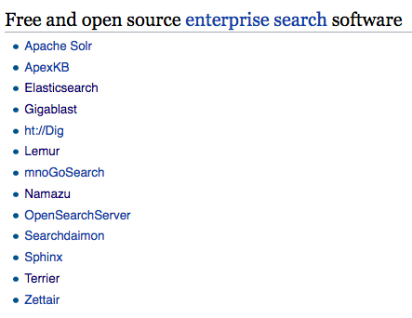
Open Source Search/Indexing Tools
Wikipedai-open-tools

Slide 38
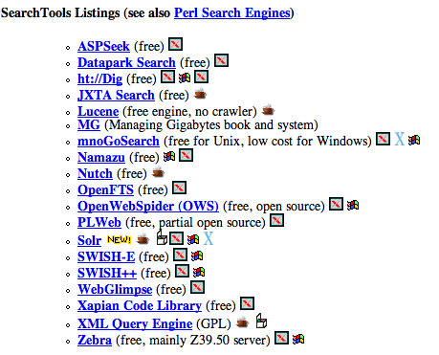
Open Source Search/Indexing Tools
Searchtools

Slide 39
Specialty Search - Examples
Science and Medicine:
Medhunt (www.hon.ch/MedHunt)
Code search (www.koders.com)
CiteSeerX (citeseerx.ist.psu.edu)
Chemfinder (www.chemfinder.com)
Blob search
www.technorati.com
Enterprise
www.psu.edu
News
news.google.com/news
Multimedia
Images - ditto.com
Airline images - www.airliners.net
Movies - www.imbd.com
Countries
China: www.baidu.com

Slide 40
Specialty Search Location
How to find specialty search engines?
searchenginewatch.com/links
Searchengineguide.com
Search engine tools
www.searchtools.com/

Slide 41
Specialty Search software approaches
Web based
Lucene/nutch
Google Custom Search
Some enterprise search tools
Enterprise
Fast/Microsoft
Autonomy
Google appliance
Lucene/nutch
Vivisimo
others

Slide 42
Example of Vertical Search
BotSeer
Search engine for robots.txt files
Unique (for now)
Built with Lucene
Home made JAVA crawler from:
Apache commons httpclient
Fetching
Threadpool
For multithreading

Slide 43
Types of Search Engines
Specialty search engine, aka
Vertical
Niche
Topical
Focuses on a specific segment of online content
Enterprise
Makes content from multiple enterprise-type sources, such as databases and intranets, searchable to a defined audience.
Others?

Slide 44
Course Project
You will find a customer that wants a specialty search engine
Working with the customer, you will design and build a specialty engine.
You will compare it to one you build for the customer with a Google custom search engine (CSE).
Process:
Find a client/customer - decide on a topic
Event finder for Penn State
Company privacy policies
Etc.
Suggested tool
Elasticsearch; scrapy
Can’t be too big; can’t be too small. Should be just right!
Loosely quoting Goldilocks

