Slide 2
Pretrained Transformers for Text Ranking: BERT and Beyond
Andrew Yates, Rodrigo Nogueira, and Jimmy Lin
@andrewyates @rodrigfnogueira @lintool

Slide 3
Pretrained Transformers for Text Ranking: BERT and Beyond
Based on the survey:
by Jimmy Lin, Rodrigo Nogueira, and Andrew Yates https://arxiv.org/abs/2010.06467
Tutorial organization:
Recorded tutorial
Live sessions: hands-on component and Q&A

Slide 4
Transformer Videos
Illustrated Guide to Transformer Neural Network
NLP for Developers: Transformers | Rasa
NLP for Developers: BERT
BERT

Slide 5
Text Ranking
Text ranking problems
Transformers

Slide 6
Definition
Given: a piece of text (keywords, question, news article, …)
Rank: other pieces of text
(passages, documents, queries, …)
Ordered by: their similarity
e.g., Web search

Slide 7
Focus: Ad hoc Retrieval
collection of texts
Given: query q
Return: a ranked list of k texts d₁ … d_{k}
Maximizing: a metric of interest
metric: 0.66
1.
2.
query
black bear attacks
collection
...
3.

Slide 8
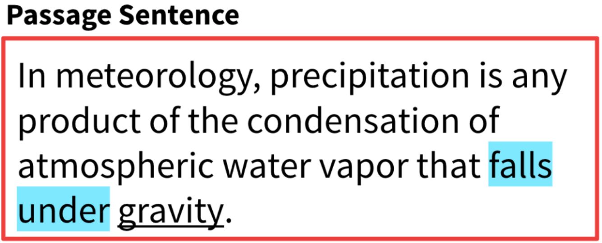
Other Problems: Question Answering
Approach:
Rank passages
Rank answer spans
Source: SQuAD

Slide 9
Other Problems: Community Question Answering
New question: What is the longest airline flight?
Source: Quora

Slide 10
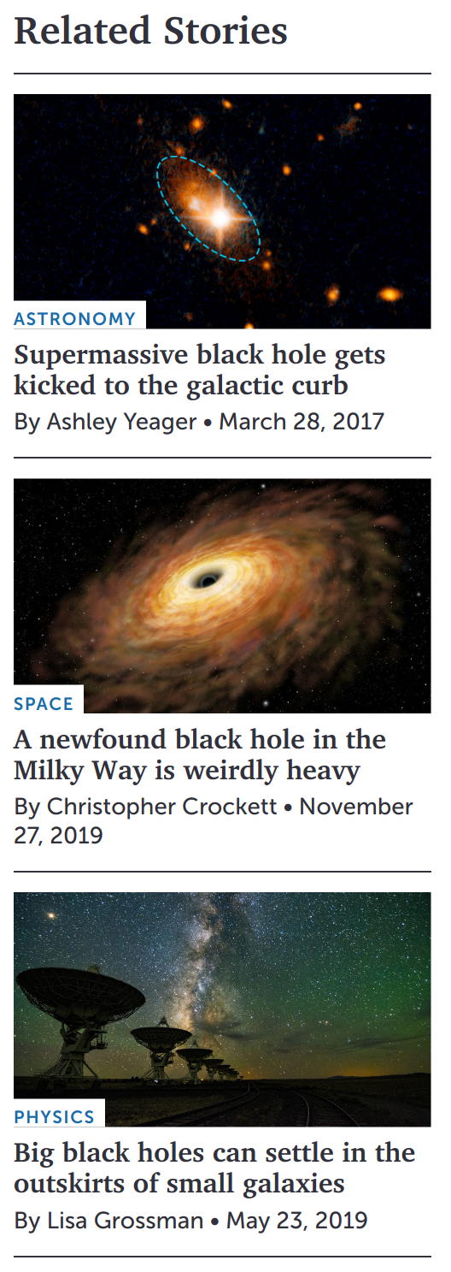
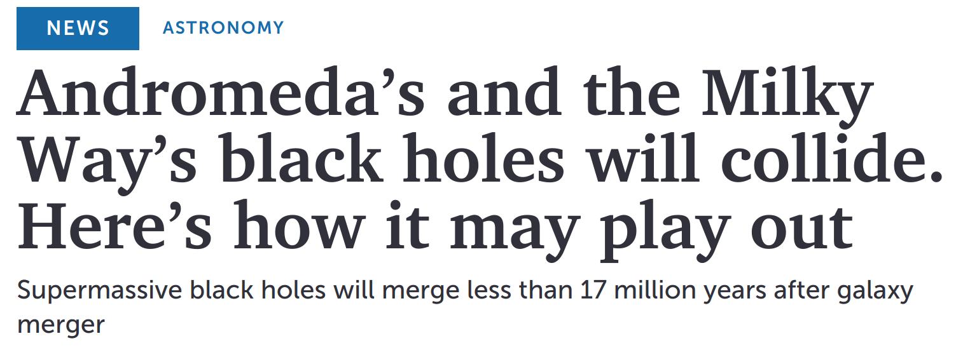
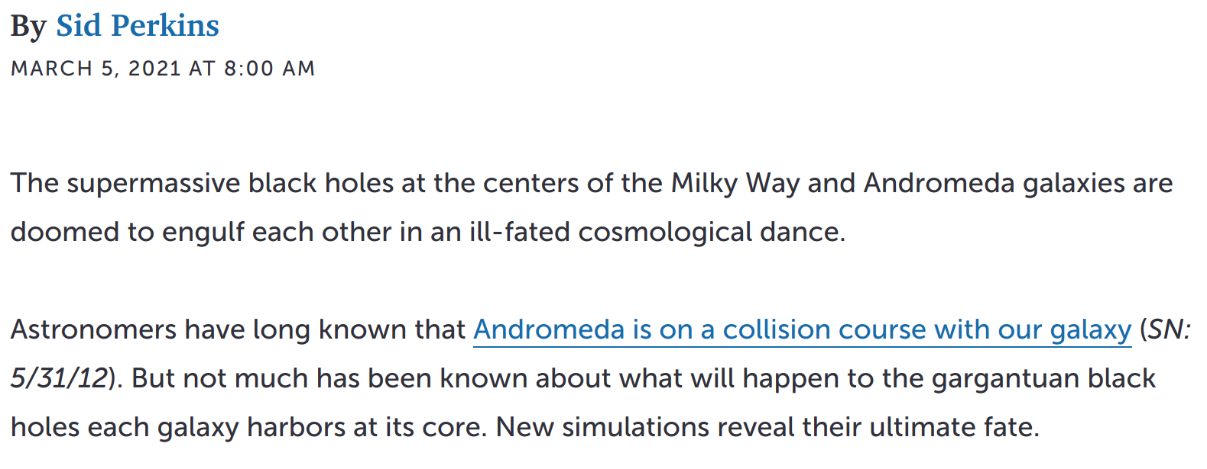
Other Problems: Text Recommendation
Source: Science News

Slide 11
Focus: Content-based Similarity
Agreement between query and a piece of text

Slide 12
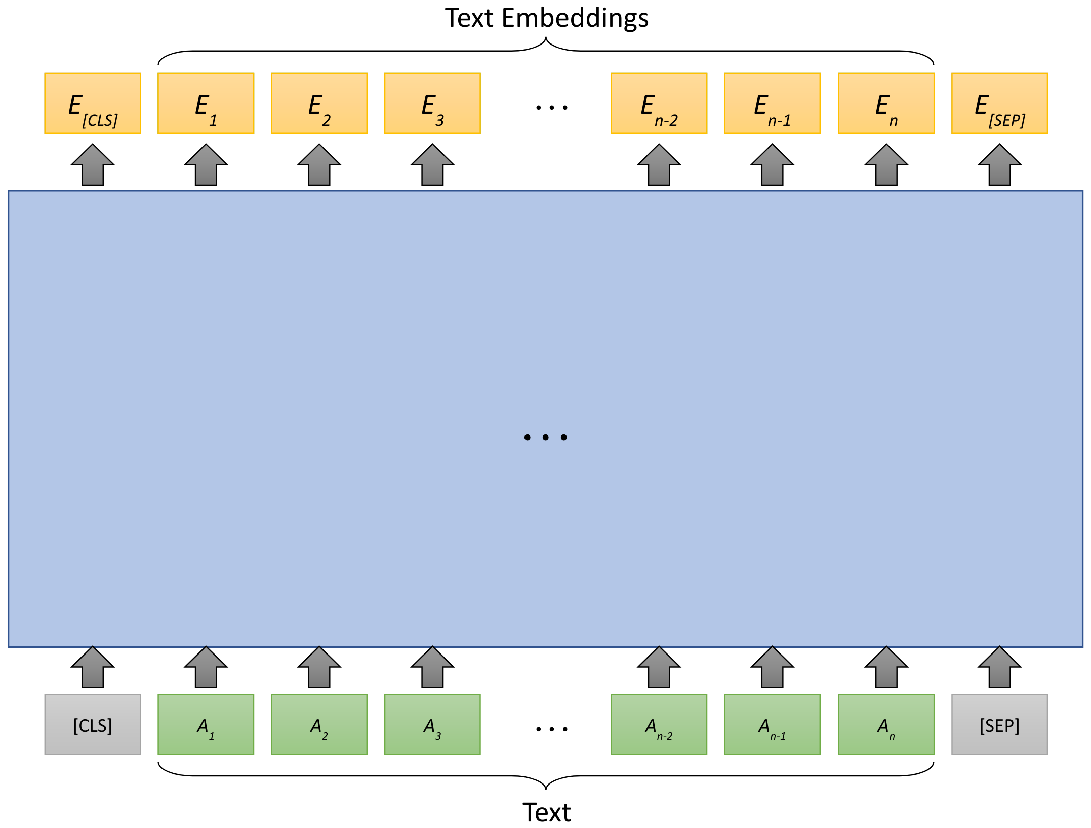
Transformers

Slide 13
Pretrained Transformers
Initialized via pretraining

Slide 14
IR Background
Unsupervised ranking methods
Metrics
Test collections

Slide 15
Unsupervised Ranking Methods
term score
input

Slide 16
Unsupervised Ranking Methods
Inverse Document Frequency
(more discriminative)
the
and
but
...
data
ranking
SIGIR
...
Term Frequency

Slide 17
Unsupervised Ranking Methods
Sparse representations

Slide 18
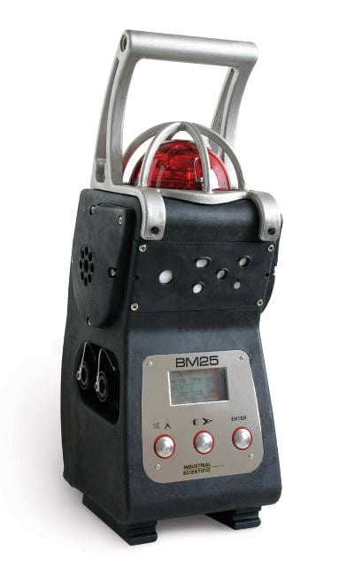
Unsupervised Ranking Methods
IDF component
TF component
term saturation
length normalization

Slide 19
Vocabulary Mismatch
document ranking
Expand
text ranking
query, search,
ranking, retrieval, ...
document retrieval
Web search
Enrich query or document representations → move beyond exact matching
Unsupervised: pseudo-relevance feedback
Later: document expansion with a neural method

Slide 20
Benchmarking: Relevance Judgments
Is this document relevant to the query?
(Subjective)

Slide 21
Evaluation Metrics: Precision & Recall
# relevant docs
returned
# results returned
# relevant docs
returned
# relevant docs
in collection

Slide 22
Evaluation Metrics: Average Precision
precision when relevant doc returned
# relevant docs
in collection

Slide 23
Evaluation Metrics: Reciprocal Rank
rank of relevant doc

Slide 24
Graded Relevance Judgments
How relevant is this document to the query?
“related”
more
relevant
“highly relevant”

Slide 25
Evaluation Metrics: nDCG
i=1
how relevant?
i=2
decreasing
gain
how early?
i=3
ideal DCG (sorted by relevance)

Slide 26
Test Collections
documents
queries
...
judgments

Slide 27
Test Collections
ID: 336
Title: black bear attacks
Description: A relevant document would discuss the frequency of vicious black bear attacks worldwide and the possible causes for this savage behavior.
Narrative: It has been reported that food or cosmetics sometimes attract hungry black bears, causing them to viciously attack humans. Relevant documents would include the aforementioned causes as well as speculation preferably from the scientific community as to other possible causes of vicious attacks by black bears. A relevant document would also detail steps taken or new methods devised by wildlife officials to control and/or modify the savageness of the black bear.
TREC Robust04
News
Keywords
Natural language

Slide 28
Test Collections
ID: 130510
Text: definition declaratory judgment
MS MARCO
Web
Questions
Passage collection
Document collection
Sparse judgments
ID: 1131069
Text: how many sons robert kraft has
TREC Deep Learning
Same passages / docs
New (dense) judgments
ID: 1131069
Text: when did rock n roll begin?
ID: 1103153
Text: who is thomas m cooley

Slide 29
Documents and Mean / Median Lengths

Slide 30
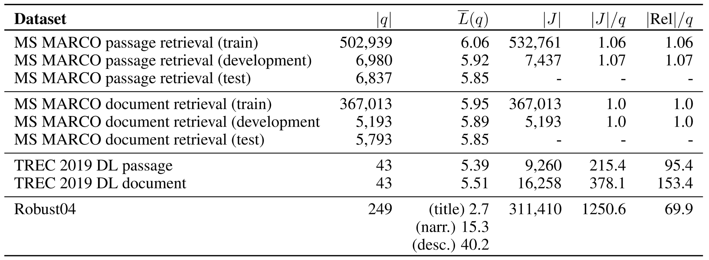
Queries, Query Lengths, and Judgments

Slide 31
A Simple Search Engine
e.g., BM25

Slide 32
Machine Learning Background
Learning to rank
Deep learning for ranking
BERT

Slide 33
Machine Learning Background
Learning to rank
Deep learning for ranking
BERT

Slide 34
A Simple Search Engine
Key | Value
"chair" | [text #83, text #743, ...]
"store" | [text #1003, text #50, ...]
... | ...
This section

Slide 35
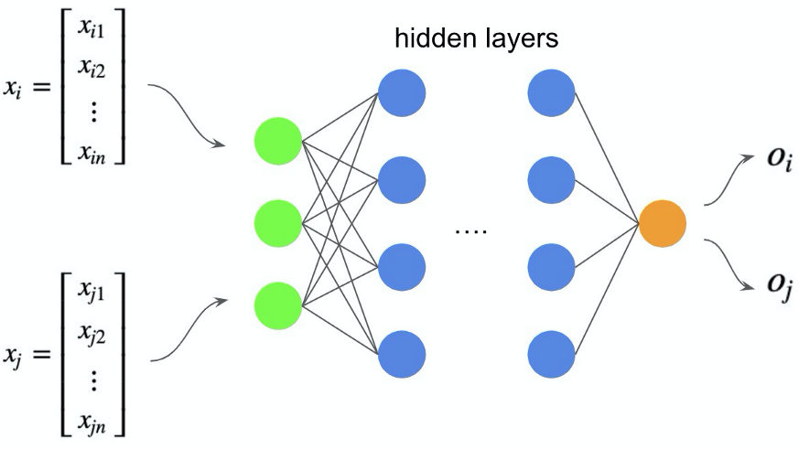
Learning to Rank (> 1990)
Supervised machine learning techniques
Typically based on hand-crafted features:
Content (e.g. term frequencies, document lengths)
Meta-data (e.g.: PageRank scores)
RankNet (Burges et al., 2005): a neural net
Different from DL models because they require hand-crafted features
Gained popularity with user click data (Burges., 2010)

Slide 36
Learning to Rank - Types of Losses
query q, texts d₁ ,d₂, d₃, a ranker f_{𝜃}, and a loss L:
Pointwise:
L ( f_{𝜃}, q, d₁ ,d₂, d₃) = L( f_{𝜃}, q, d₁) + L( f_{𝜃}, q, d₂) + L( f_{𝜃}, q, d₃)
Pairwise:
L ( f_{𝜃}, q, d₁ ,d₂, d₃) = L( f_{𝜃}, q, d₁, d₂) + L( f_{𝜃}, q, d₁, d₃) + L( f_{𝜃}, q, d₂, d₃)
Listwise:
L ( f_{𝜃}, q, d₁ ,d₂, d₃) = L( f_{𝜃}, q, d₁, d₂, d₃)

Slide 37
Learning to Rank - Types of Losses
An example:
Rel(d₁) > Rel(d₂) > Rel(d₃), f_{𝜃} = a neural network that outputs a probability, L = cross-entropy
Pointwise
Pairwise
Listwise
>
>
>
p₁
p₂
p_{1,2}
p_{2,1}
p_{1,2,3}
p_{3,2,1}
neural net
neural net
neural net
neural
net
neural net
neural net
q
d₁
q
d₂
q
d₁
d₂
q
d₂
d₁
q
d₁
d₂
d₂
q
d₃
d₂
d₁

Slide 38
Machine Learning Background
Learning to rank
Deep learning for ranking
BERT

Slide 39
Neural Ranking Models (> 2016)
Interaction-based
We will revisit these architectures in Dense Retrieval Section
Representation-based

Slide 40
Popular Neural Ranking Models
DESM (Nalisnick et al., 2016)
MatchPyramid (Pang et al., 2016)
DUET (Mitra et al., 2017)
PACRR (Hui et al., 2017)
Co-PACRR (Hui et al., 2018)
ConvKNRM (Dai et al., 2018)
Query Expansion w/ Embeddings
(Diaz et al., 2016, Roy et al., 2016)
….
Check Mitra and Craswell, (2017) for an excellent survey of these methods

Slide 41
Machine Learning Background
Learning to rank
Deep learning for ranking
BERT

Slide 42
Progress in Information Retrieval - Robust04
Some of them are
zero-shot!
Li et al., 2020;
Nogueira et al., 2020
Yilmaz et al., 2019; MacAvaney et al. 2019
Source: Yang et al., (2019)

Slide 43
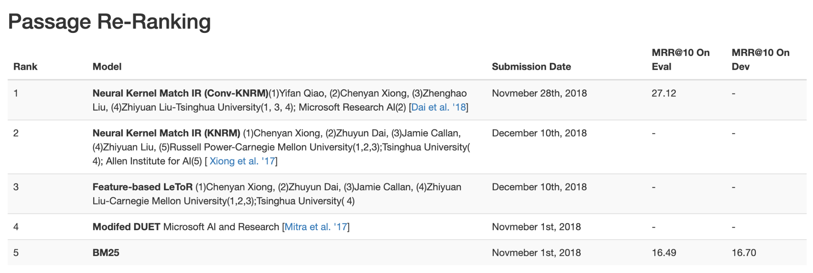
MS MARCO Passage Ranking Leaderboard on December 2018

Slide 44
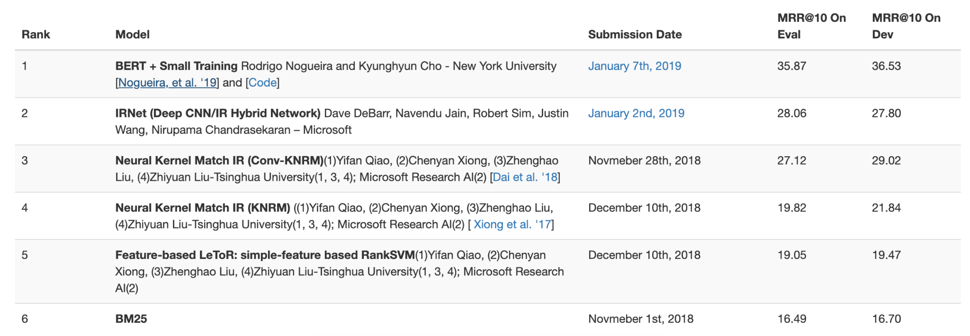
MS MARCO Passage Ranking Leaderboard on January 2019
~8 points!

Slide 45
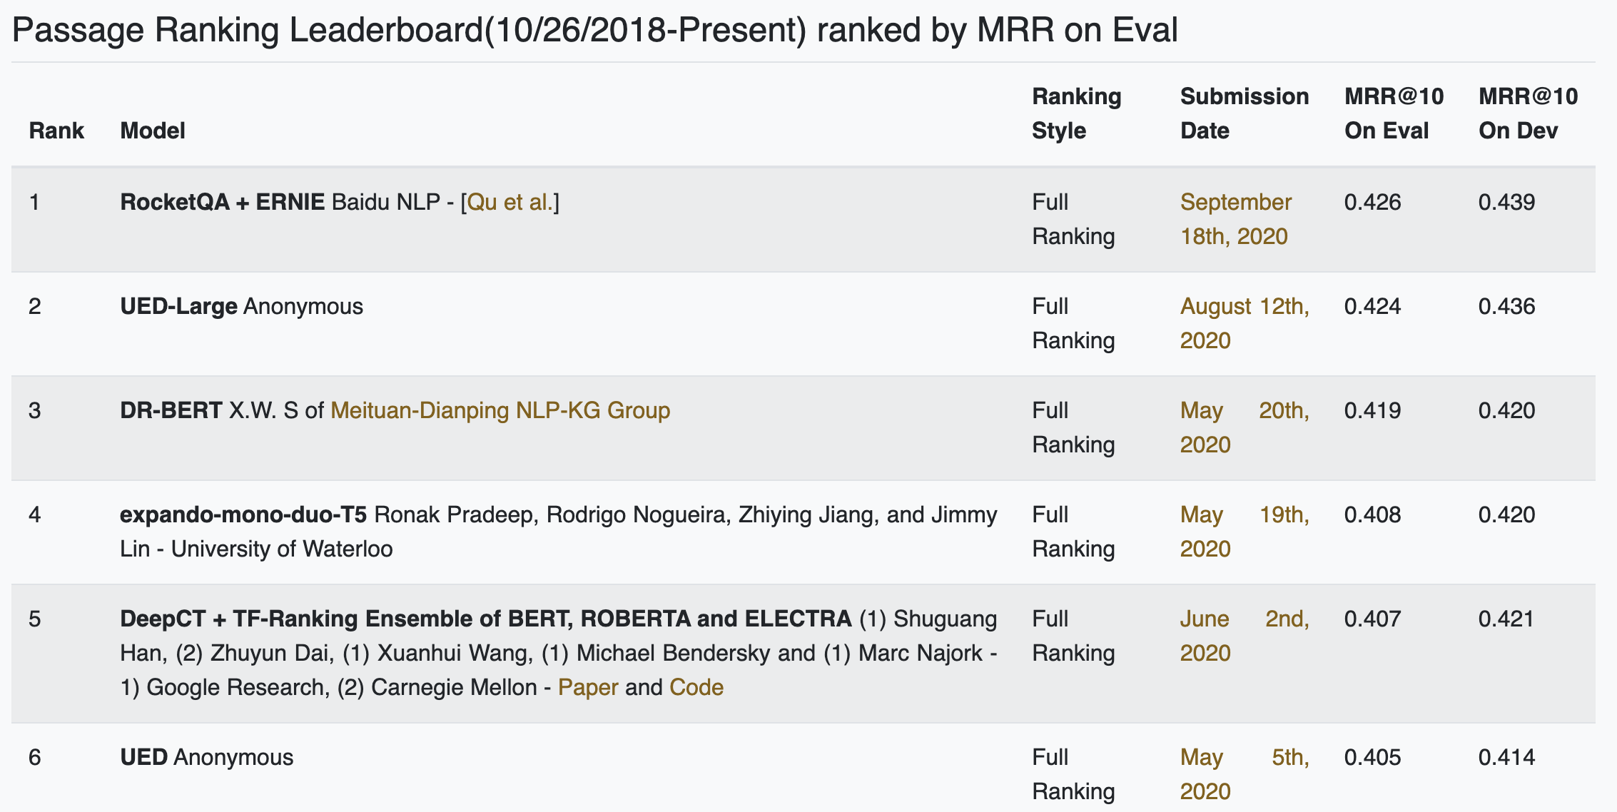
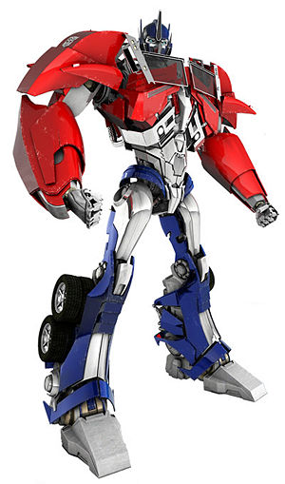
MS MARCO Passage Ranking Leaderboard on June/2021

Slide 46
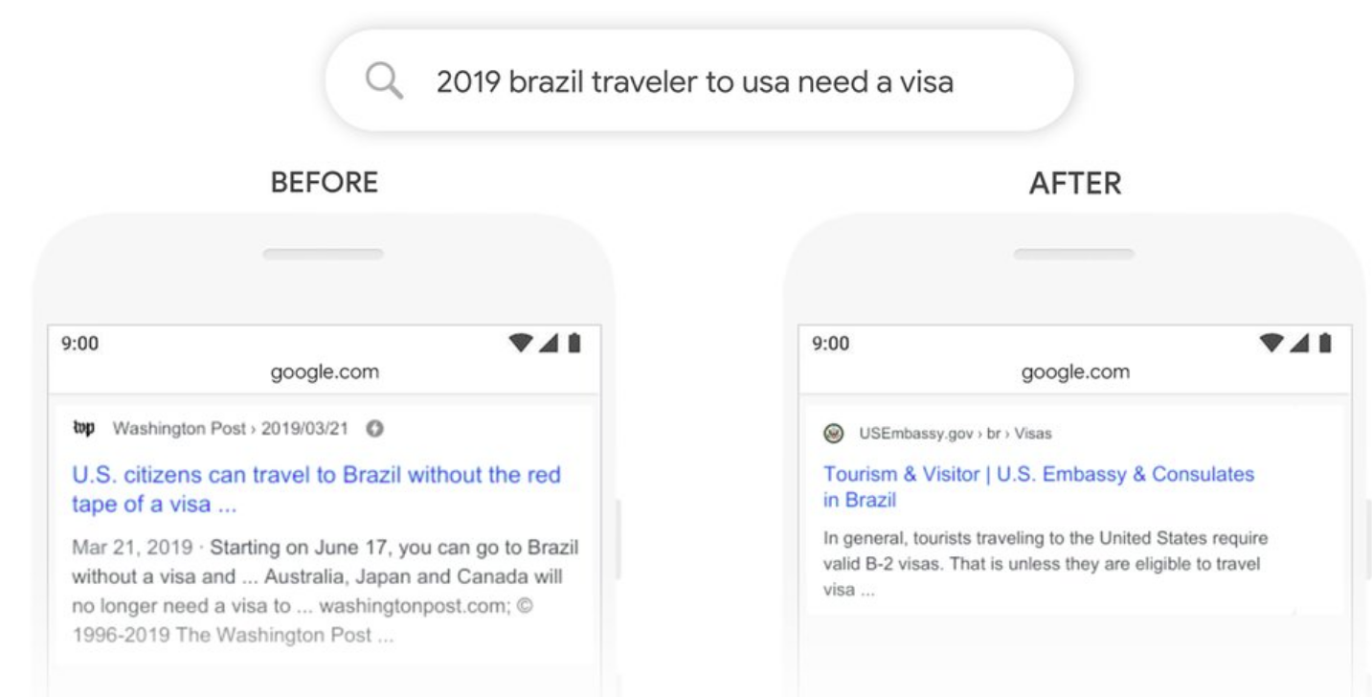
Adoption by Commercial Search Engines
Google Search
MS Bing
We’re making a significant improvement to how we understand queries, representing the biggest leap forward in the past five years, and one of the biggest leaps forward in the history of Search.
Starting from April of this year (2019), we used large transformer models to deliver the largest quality improvements to our Bing customers in the past year.
source
source

Slide 47
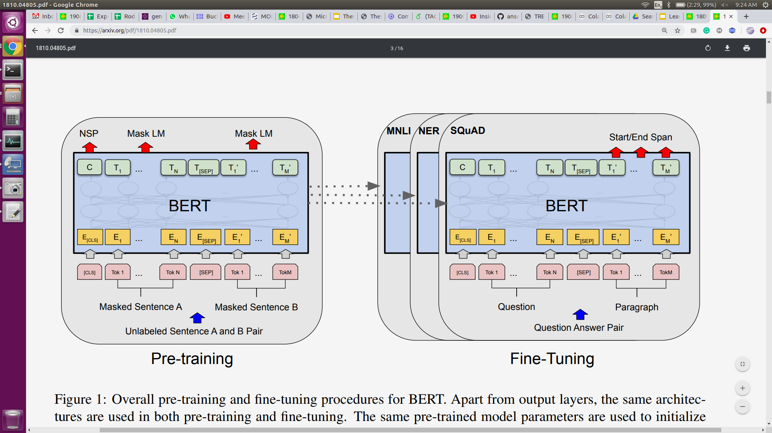
What is BERT?
Self-supervised: ∞ training data
Supervised: (few) labeled examples
Devlin, Chang, Lee, Toutanova. BERT: Pre-training of Deep Bidirectional Transformers for Language Understanding. NAACL 2019.

Slide 48
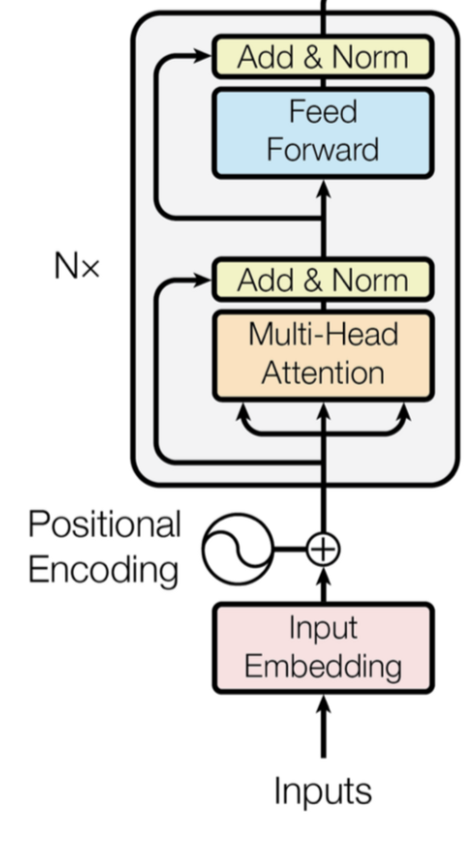
BERT's Pretraining Ingredients
+
+
Transformer (encoder-only)
with lots of parameters
Lots of texts
Lots of Compute

Slide 49
BERT
T_{[CLS]}
T₁
T₂
T₃
T₄
T₅
T₆
T₇
T_{[SEP]}
string → sequence of vectors
…
…
…
…
…
…
…
…
…
E_{[CLS]}
E₁
E₂
E₃
E₄
E₅
E₆
E₇
E_{[SEP]}
[CLS]
t₇
[SEP]
[CLS]
A₁
t₁
A₂
t₂
A₃
t₃
[SEP]
t₄
B₁
t₅
B₂
Token
Embeddings
t₆
+
+
+
+
+
+
+
+
+
Segment
Embeddings
E_{A}
E_{A}
E_{A}
E_{A}
E_{A}
E_{A}
E_{A}
E_{A}
E_{A}
+
+
+
+
+
+
+
+
+
Position
Embeddings
P₀
P₁
P₂
P₃
P₄
P₅
P₆
P₇
P₈
Tokens
[CLS]
The
bank
makes
loans
to
clients
.
[SEP]
String
The bank makes loans to clients.

Slide 50
Loss = -log (P("to" | masked input))
Pretraining - Masked Language Modeling
softmax
D ྾ V
T_{[CLS]}
T₁
T₂
T₃
T₄
T₅
T₆
T₇
T_{[SEP]}
…
…
…
…
…
…
…
…
…
E_{[CLS]}
E₁
E₂
E₃
E₄
E₅
E₆
E₇
E_{[SEP]}
[CLS]
t.
[SEP]
[CLS]
A₁
t_{The}
A₂
t_{bank}
A₃
t_{makes}
[SEP]
t_{loans}
B₁
t_{[MASK]}
B₂
Token
Embeddings
t_{clients}
+
+
+
+
+
+
+
+
+
Segment
Embeddings
E_{A}
E_{A}
E_{A}
E_{A}
E_{A}
E_{A}
E_{A}
E_{A}
E_{A}
+
+
+
+
+
+
+
+
+
Position
Embeddings
P₀
P₁
P₂
P₃
P₄
P₅
P₆
P₇
P₈
Random masking
The
bank
makes
loans
[MASK]
clients
.

Slide 51
Pretraining
year 0.02
century 0.94
car 0.00
…
land 0.01
Europe 0.97
is 0.00
…
Token Probability
softmax
softmax
...
linear
...
linear
...
vec i
vec j
BERT
The Mongol invasion of Europe in the 13th [MASK] was the conquest of much of [MASK] by the Mongol Empire.
Random Masking
The Mongol invasion of Europe in the 13th century was the conquest of much of Europe by the Mongol Empire.
Input: a document

Slide 52
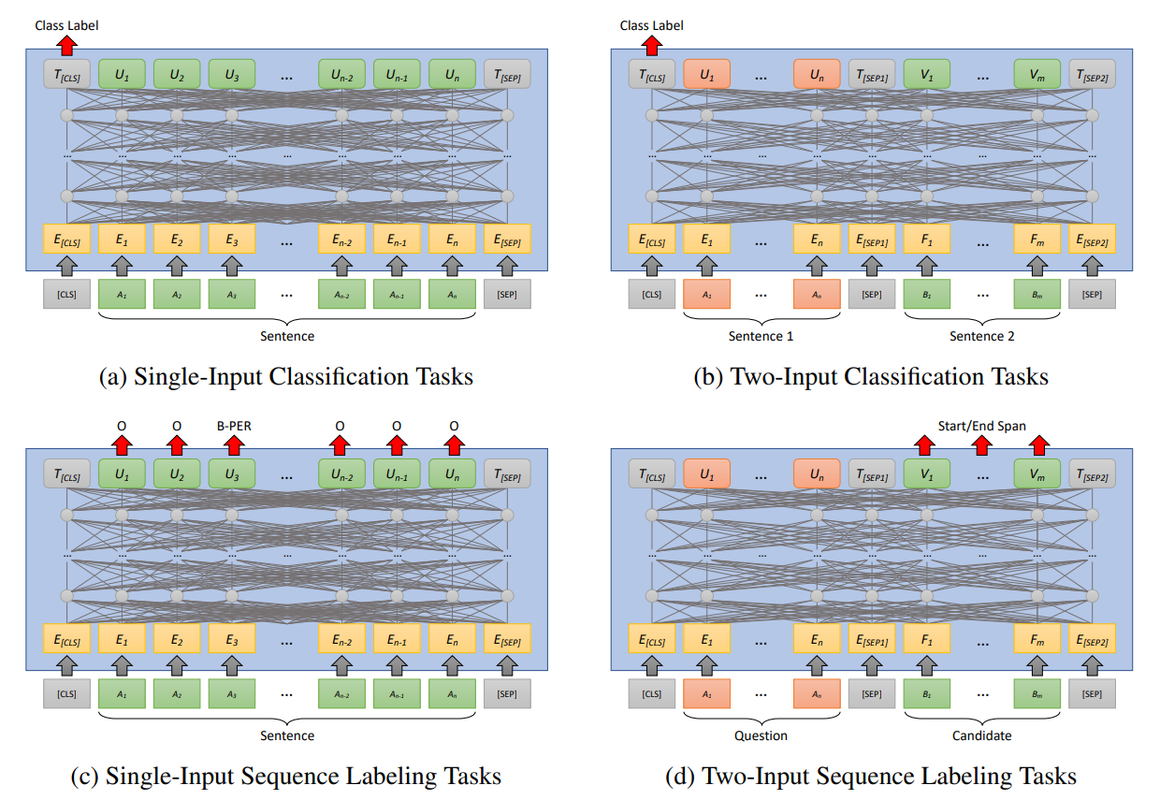
Finetuning

Slide 53
BERT
for Relevance Classification
(aka monoBERT)

Slide 54
monoBERT:
BERT reranker
Relevant
Non-relevant
s_{i} = softmax(T_{[CLS]}W + b)₁
We want:
s_{i} = P(Relevant = 1|q, d_{i})
softmax
D × 2
query q
text d_{i}

Slide 55
Training monoBERT
Loss:
Humans
BM25

Slide 56
Once monoBERT is trained...
H₀
R₀
H₁
R₁
q
BM25
d₁
monoBERT
d₅
d₂
d₂
Inverted Index
d₃
d₃
q
d₄
d₁
mono
BERT
s_{i}
d_{i}
d₅
d₄

Slide 57
TREC 2019 - Deep Learning Track - Passage
 | nDCG@10 | MAP | Recall@1k
BM25 | 0.506 | 0.377 | 0.739
monoBERT | 0.738 | 0.506 | 0.739
BM25 + RM3 | 0.518 | 0.427 | 0.788
monoBERT | 0.742 | 0.529 | 0.788

Slide 58
TREC 2019 - Deep Learning Track - Passage
 | nDCG@10 | MAP | Recall@1k
BM25 | 0.506 | 0.377 | 0.739
monoBERT | 0.738 | 0.506 | 0.739
BM25 + RM3 | 0.518 | 0.427 | 0.788
monoBERT | 0.742 | 0.529 | 0.788
5 points in Recall@1k →2 points in MAP
Why?
Hypothesis: Mismatch between training and inference lists

Slide 59
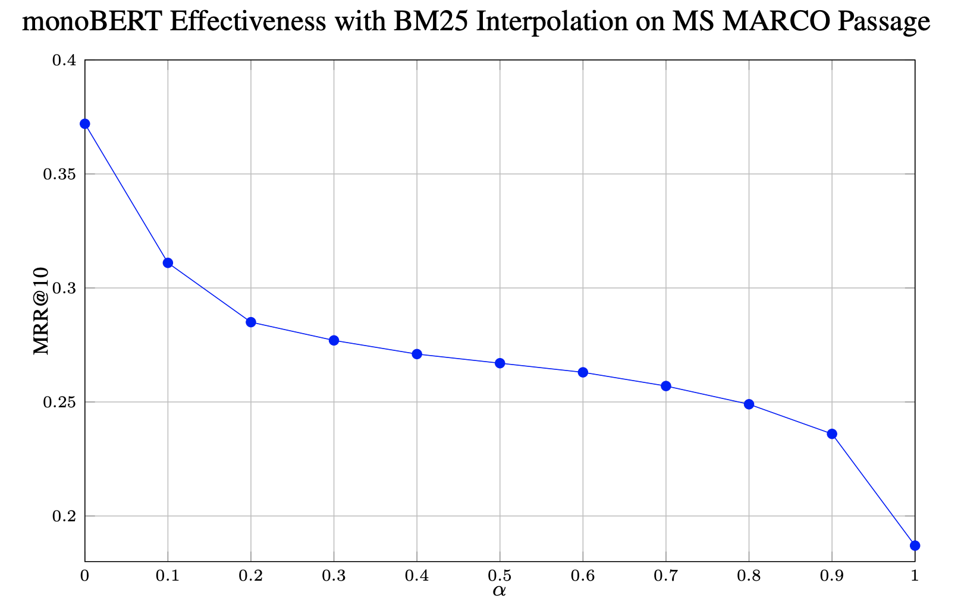
How useful is the BM25 signal?

Slide 60
Recap: Pre-BERT vs. monoBERT

Slide 61
Q&A
5 minutes

Slide 62
Break
Resume at 9:00 PDT

Slide 63
Part 2: Ranking with Relevance Classification

Slide 64
BERT’s Limitations
T_{[CLS]}
T₁
T₂
T₃
T₄
T₅
T₆
T₇
T_{[SEP]}
…
…
…
…
…
…
…
…
…
E_{[CLS]}
E₁
E₂
E₃
E₄
E₅
E₆
E₇
E_{[SEP]}
[CLS]
t₇
[SEP]
[CLS]
A₁
t₁
A₂
t₂
A₃
t₃
[SEP]
t₄
B₁
t₅
B₂
Token
Embeddings
t₆
Cannot input entire documents
what do we input?
& how do we label it?
+
+
+
+
+
+
+
+
+
Segment
Embeddings
E_{A}
E_{A}
E_{A}
E_{A}
E_{A}
E_{A}
E_{A}
E_{A}
E_{A}
+
+
+
+
+
+
+
+
+
Position
Embeddings
P₀
P₁
P₂
P₃
P₄
P₅
P₆
P₇
P₈
need separate embedding for every possible position
restricted to indices 0-511

Slide 65
BERT’s Limitations
T_{[CLS]}
T₁
T₂
T₃
T₄
T₅
T₆
T₇
T_{[SEP]}
computationally expensive layers
e.g., 110+ million learned weights
…
…
…
…
…
…
…
…
…
(later: Beyond BERT & Dense Representations)
E_{[CLS]}
E₁
E₂
E₃
E₄
E₅
E₆
E₇
E_{[SEP]}
[CLS]
t₇
[SEP]
[CLS]
A₁
t₁
A₂
t₂
A₃
t₃
[SEP]
t₄
B₁
t₅
B₂
Token
Embeddings
t₆
Multi-stage ranking pipeline
Identify candidate documents
Rerank
+
+
+
+
+
+
+
+
+
Segment
Embeddings
E_{A}
E_{A}
E_{A}
E_{A}
E_{A}
E_{A}
E_{A}
E_{A}
E_{A}
+
+
+
+
+
+
+
+
+
Position
Embeddings
P₀
P₁
P₂
P₃
P₄
P₅
P₆
P₇
P₈

Slide 66
From Passages to Documents

Slide 67
Handling Length Limitation: Training
Chunk documents
Transfer labels (approximation)

Slide 68
Handling Length Limitation: Inference
Aggregate Evidence

Slide 69
Approach #1: Score Aggregation
Document Score
Over passage scores. Dai, Callan. Deeper Text Understanding for IR with Contextual Neural Language Modeling. SIGIR 2019.
Over sentence scores. Yilmaz, Yang, Zhang, Lin. Cross-Domain Modeling of Sentence-Level Evidence for Document Retrieval. EMNLP '19.
s₁
s₂
s₃
…
…
…
…
…
…

Slide 70
Over Passage Scores: BERT-MaxP, FirstP, SumP
Document Score
s₁
s₂
s₃
Take max, first, or sum
…
…
…
…
…
…
Dai, Callan. Deeper Text Understanding for IR with Contextual Neural Language Modeling. SIGIR 2019.

Slide 71
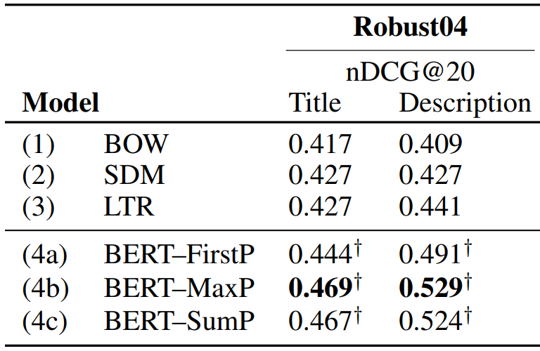
Over Passage Scores: Results
Dai, Callan. Deeper Text Understanding for IR with Contextual Neural Language Modeling. SIGIR 2019.

Slide 72
Over Sentence Scores: Birch
First-stage retrieval score
Sentence scores
Trained on sentence-level judgments like tweets
Interpolation weights are tuned on target dataset
Yilmaz, Yang, Zhang, Lin. Cross-Domain Modeling of Sentence-Level Evidence for Document Retrieval. EMNLP '19.

Slide 73
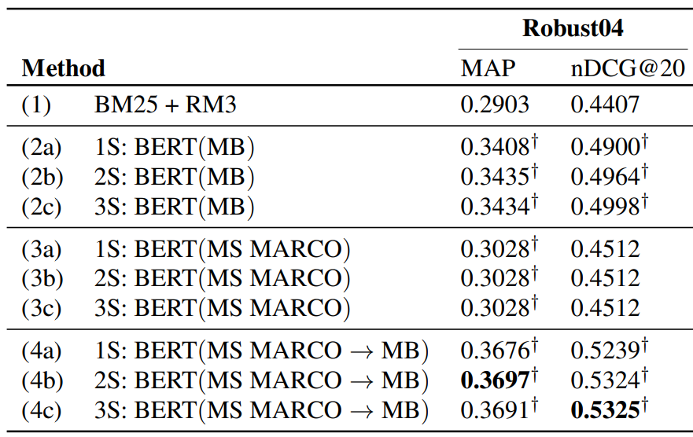
Over Sentence Scores: Results
Yilmaz, Yang, Zhang, Lin. Cross-Domain Modeling of Sentence-Level Evidence for Document Retrieval. EMNLP '19.

Slide 74
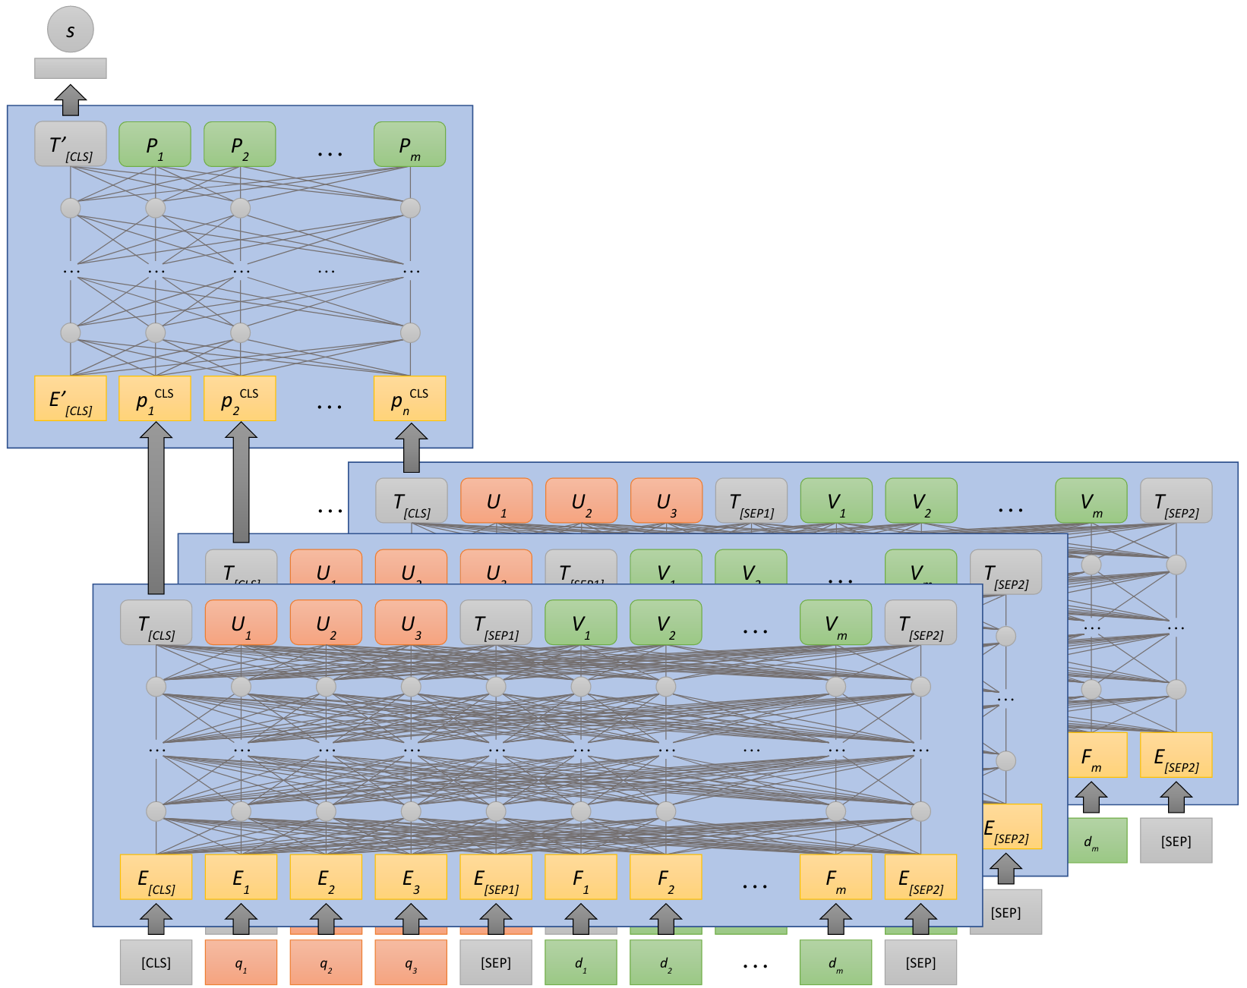
Approach #2: Representation Aggregation
Over term embeddings. MacAvaney, Yates, Cohan, Goharian. CEDR: Contextualized Embeddings for Document Ranking. SIGIR 2019.
Over passage representations. Li, Yates, MacAvaney, He, Sun. PARADE: Passage Representation Aggregation for Document Reranking. arXiv 2020.
passage
representations

Slide 75
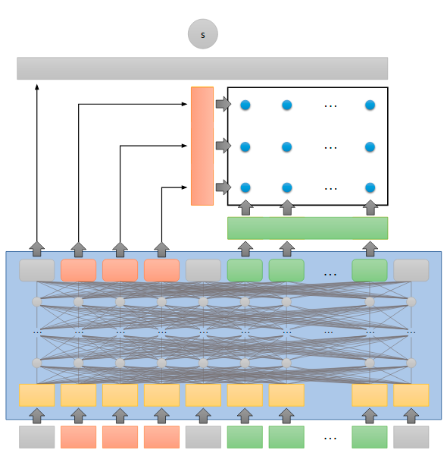
Over Term Embeddings: CEDR
similarity matrix using
contextualized embeddings (concatenate passages)
interaction-based pre-BERT
model (PACRR, KNRM)
MacAvaney, Yates, Cohan, Goharian. CEDR: Contextualized Embeddings for Document Ranking. SIGIR 2019.

Slide 76
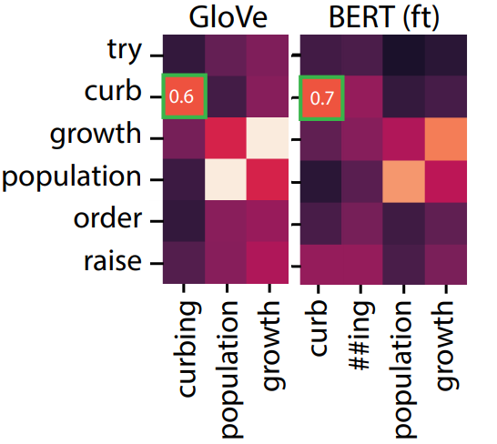
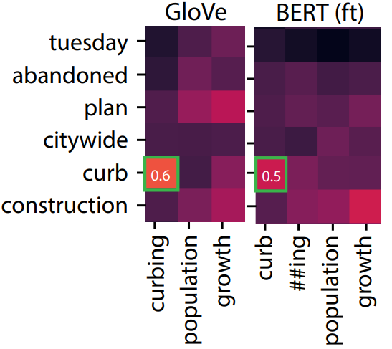
Over Term Embeddings: CEDR
Relevant Document
Nonrelevant
MacAvaney, Yates, Cohan, Goharian. CEDR: Contextualized Embeddings for Document Ranking. SIGIR 2019.

Slide 77
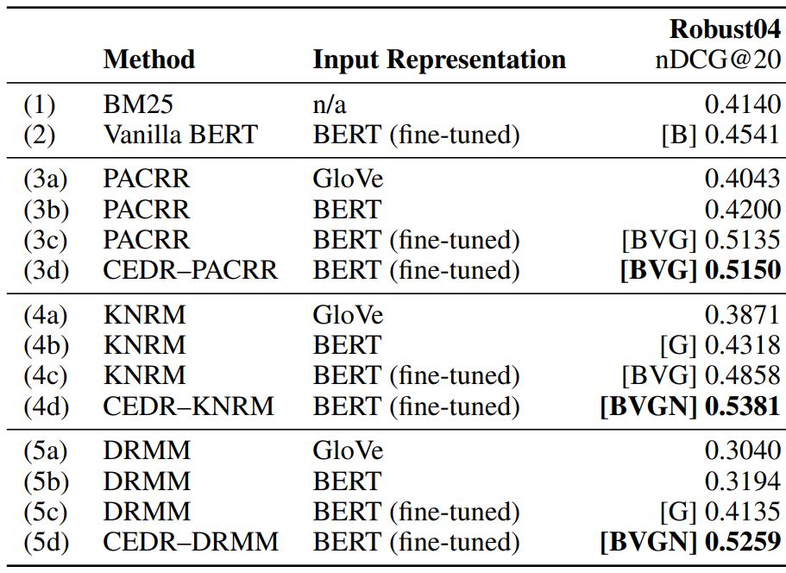
Over Term Embeddings: Results
MacAvaney, Yates, Cohan, Goharian. CEDR: Contextualized Embeddings for Document Ranking. SIGIR 2019.

Slide 78
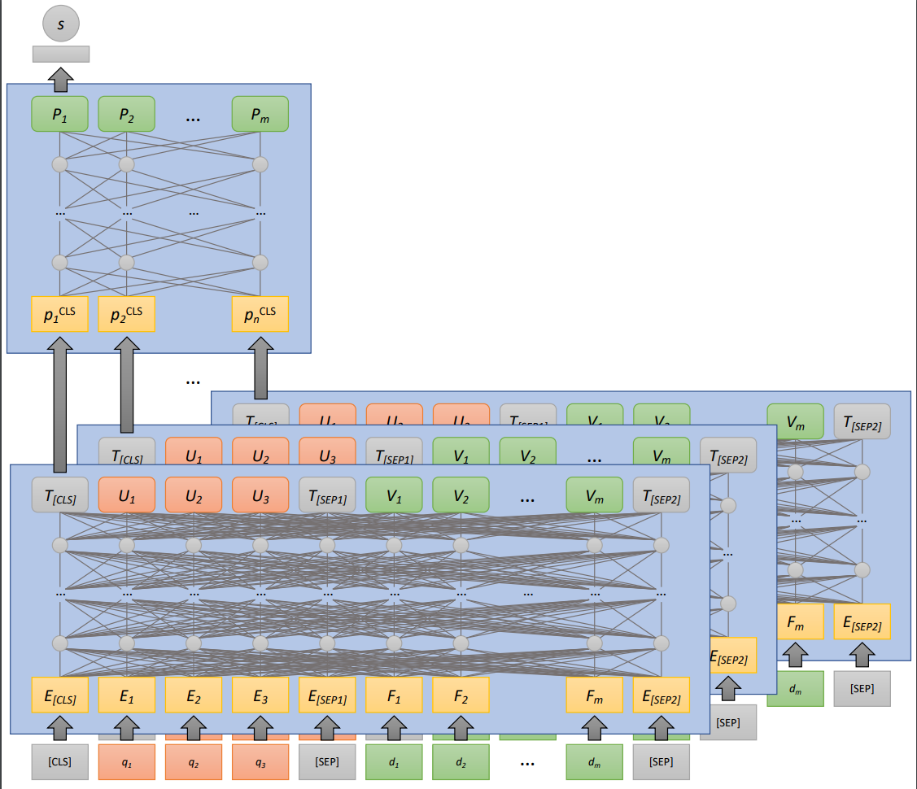
Over Passage Representations: PARADE
Aggregation approaches: (increasing complexity)
Average feature value
Max feature value
Attn-weighted average
Two Transformer layers
Aggregation of passages’ CLS embeddings
Li, Yates, MacAvaney, He, Sun. PARADE: Passage Representation Aggregation for Document Reranking. arXiv 2020.

Slide 79
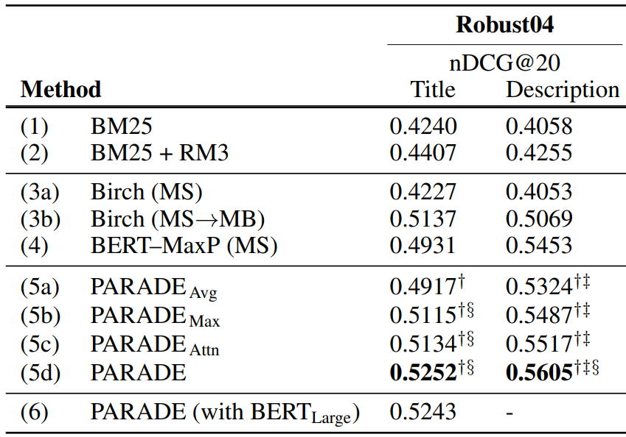
Over Passage Representations: Results
Li, Yates, MacAvaney, He, Sun. PARADE: Passage Representation Aggregation for Document Reranking. arXiv 2020.

Slide 80
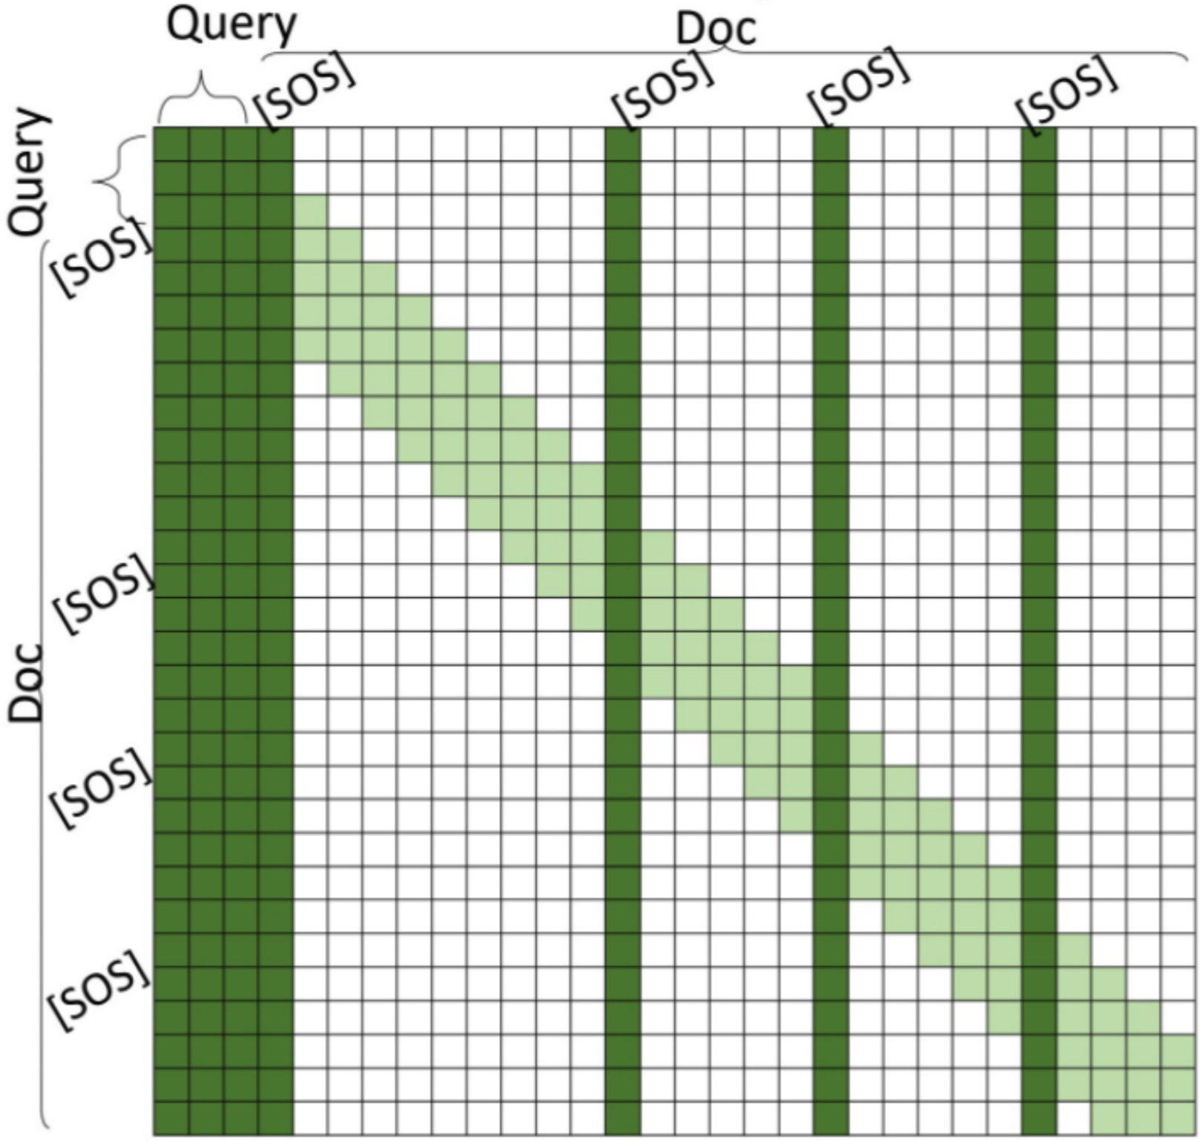
Enlarge Passage Representations: Longformer, QDS
Longformer: sparse attention
QDS-Transformer: specialize to IR
Beltagy, Peters, Cohan. Longformer: The Long-Document Transformer. arXiv 2020.
Jiang, Xiong, Lee, Wang. Long Document Ranking with Query-Directed Sparse Transformer. Findings of EMNLP 2020.

Slide 81
Multi-stage rerankers
why multi-stage?
duoBERT
Cascade Transformers

Slide 82
Multi-stage rerankers
why multi-stage?
duoBERT
Cascade Transformers

Slide 83
From Single to Multiple Rerankers

Slide 84
Why Multi-stage?
Trade-off between effectiveness (quality of the ranked lists) and efficiency (retrieval latency)
efficiency
effectiveness
Fewer Candidates

Slide 85
Multi-stage Rerankers
why multi-stage?
duoBERT
Cascade Transformers

Slide 86
Multi-stage with duoBERT
H₀
R₀
H₁
R₁
H₂
R₂
q
BM25
d₁
monoBERT
d₅
duoBERT
d₃
d₂
d₂
d₅
Doc Pairwise
Inverted
Index
d₃
d₃
d₂
d₂
d₃
d₃
d₅
d₅
d₂
q
d₃
d₅
d₂
d₅
d₂
d₃
d₄
mono
BERT
s_{i}
q
d_{i}
d₅
d_{i}
duo
BERT
p_{i,j}
d_{j}
Nogueira, Yang, Cho, Lin. Multi-stage document ranking with bert. 2019.

Slide 87
duoBERT's Input Format
p_{i,j}
D ྾ 2
...
...
duoBERT
T_{[CLS]}
U₁
U₂
U₃
T_{[SEP1]}
V₁
V_{m}
T_{[SEP2]}
X₁
X_{n}
T_{[SEP3]}
...
...
E_{[CLS]}
E₁
E₂
E₃
E_{[SEP1]}
F₁
F_{m}
E_{[SEP2]}
G₁
G_{n}
E_{[SEP3]}
...
...
[CLS]
[SEP]
d₁^{j}
d₁^{j}
[SEP]
[CLS]
A₁
q₁
A₂
q₂
A₃
q₃
[SEP]
[SEP]
B₁
d₁^{i}
B₂
Token
Embeddings
d_{m}^{i}
+
+
+
+
+
+
...
+
+
+
...
+
+
Segment
Embeddings
E_{A}
E_{A}
E_{A}
E_{A}
E_{A}
E_{B}
E_{B}
E_{B}
E_{C}
E_{C}
E_{C}
+
+
+
+
+
+
...
+
+
+
...
+
+
Position
Embeddings
P₀
P₁
P₂
P₃
P₄
P₅
P_{m+4}
P_{m+5}
P_{m+6}
P_{m+n+5}
P_{m+n+6}
query
text d_{i}
text d_{j}

Slide 88
Training duoBERT
Loss:
Is doc d_{i} more relevant than doc d_{j} to the query q?
p_{i,j} = p(d_{i}>d_{j} | q)
duoBERT
CLS
Query q
SEP
text d_{i}
SEP
text d_{j}

Slide 89
Inference with duoBERT
R₁
Text Pairs
R₂
d₁
d₂
d₁
d₁
d₂
d₂
d₃
d₃
monoBERT
d₂
d₃
d₂
d₃
d₁
d₃
d₁
d₂
d₃
d₁
q
Pairwise aggregation:
s₁ = p_{1,2} + p_{1,3}
s₂ = p_{2,1} + p_{2,3}
s₃ = p_{3,1} + p_{3,2}
d₁
duo
BERT
p_{1,2} = p(d₁>d₂ | q)
d₂

Slide 90
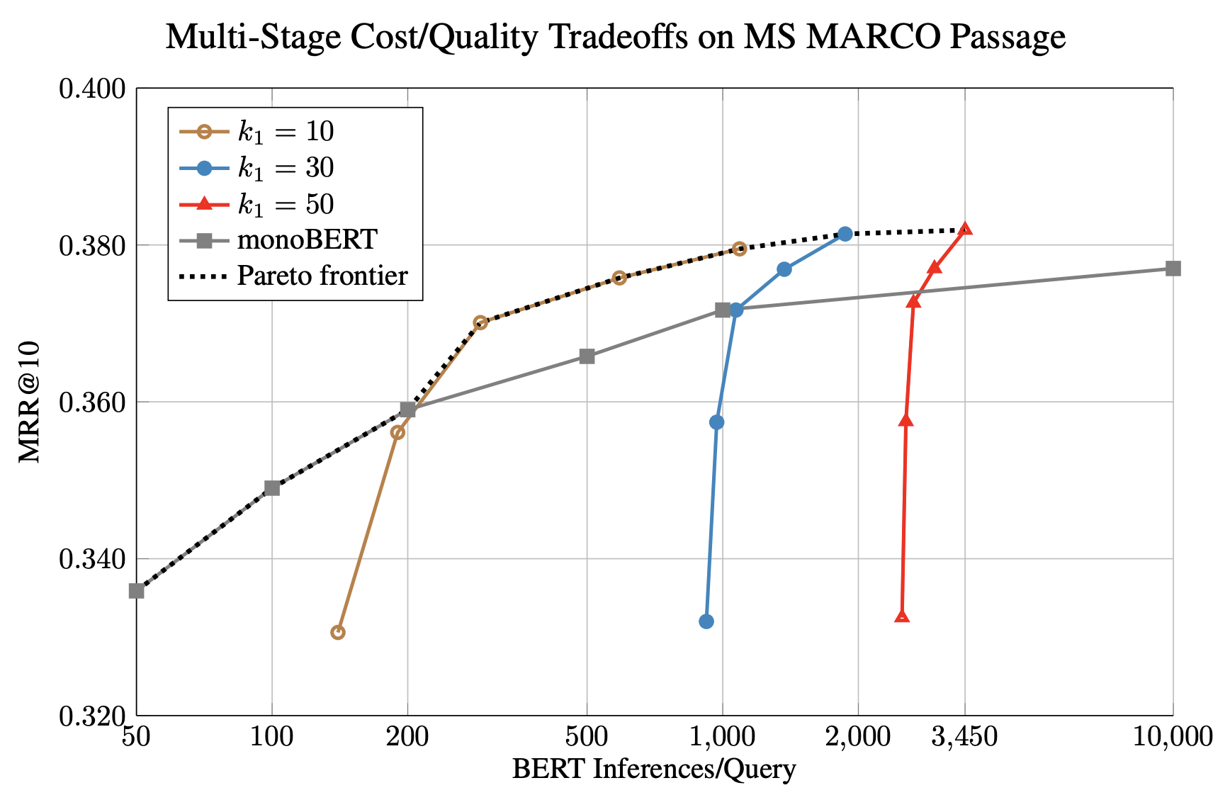
monoBERT vs. duoBERT

Slide 91
Multi-stage Rerankers
why multi-stage?
duoBERT
Cascade Transformers

Slide 92
Cascade Transformers (Soldaini and Moschitti, 2020)
s₁, s₄
|D| × 2
Key Observation: Subsets of the Transformer layers can be seen as a reranker
monoBERT layers 9-12
CLS
q
SEP
d1
SEP
CLS
q
SEP
d4
SEP
s₁, s₂, s₄
|D| × 2
monoBERT layers 5-8
CLS
q
SEP
d1
SEP
CLS
q
SEP
d2
SEP
CLS
q
SEP
d4
SEP
s₁, s₂, s₃, s₄
|D| × 2
monoBERT layers 1-4
CLS
q
SEP
d1
SEP
CLS
q
SEP
d2
SEP
CLS
q
SEP
d3
SEP
CLS
q
SEP
d4
SEP

Slide 93
Cascade Transformers
Key Observation: Subsets of monoBERT layers can be used as rerankers
R₀
H₁
R₁
H₂
R₂
H₃
R₃
d₁
monoBERT
layers 1-4
d₅
monoBERT
layers 5-8
d₂
monoBERT
layers 9-12
d₂
d₂
d₂
d₃
d₄
d₃
d₃
d₄
q
q
q
d₄
d₄
mono
BERT
1-4
s_{i}
mono
BERT
5-8
s_{i}
mono
BERT
9-12
s_{i}
d_{i}
d_{i}
d_{i}
d₅
For efficiency, activations from the previous reranker are passed to the next one
Soldaini, Moschitti. The Cascade Transformer: an Application for Efficient Answer Sentence Selection. ACL 2020.

Slide 94
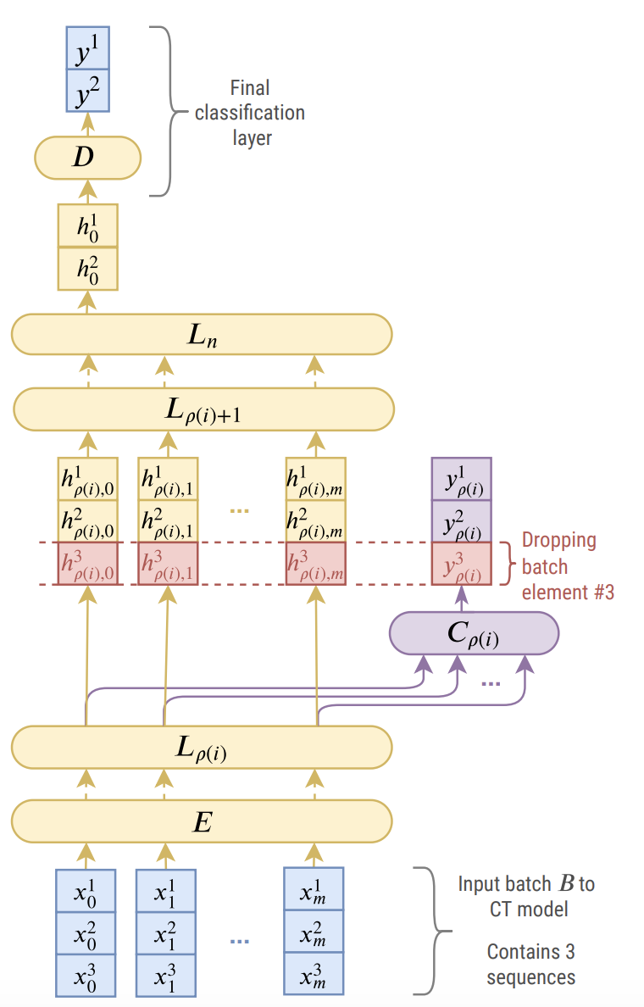
Cascade Transformers
For efficiency, all candidate texts are packed in the same GPU batch

Slide 95
Results
𝛼: proportion of candidates to be discarded at each stage
Works well for answer selection → short sequences
How to pack 100 documents into a GPU batch?

Slide 96
Takeaways of Multi-stage Rerankers
Advantage:
more tuning knobs → more flexibility in effectiveness/efficiency tradeoff space
Disadvantage:
more tuning knobs → more complexity
We are only starting exploring the design space for multi-stage reranking pipelines with Transformers

Slide 97
Document Preprocessing Techniques
Query vs document expansion
doc2query
DeepCT
DeepImpact

Slide 98
Document Preprocessing Techniques
Query vs document expansion
doc2query
DeepCT
DeepImpact

Slide 99
A Simple Search Engine
This section

Slide 100
Query Reformulation (aka query expansion)
query: "Where can I buy a small car?"
Query Reformulator
reformulated query: "compact car sales store"
Search Engine
Better Retrieved Docs

Slide 101
Query reformulation as a translation task
Query Reformulator
Query Language
Document Language
Hard: Input has little information
Document Translator
Query Language
Document Language
Easier: Input has a lot of information

Slide 102
Document Preprocessing Techniques
Query vs document expansion
doc2query
DeepCT
DeepImpact

Slide 103
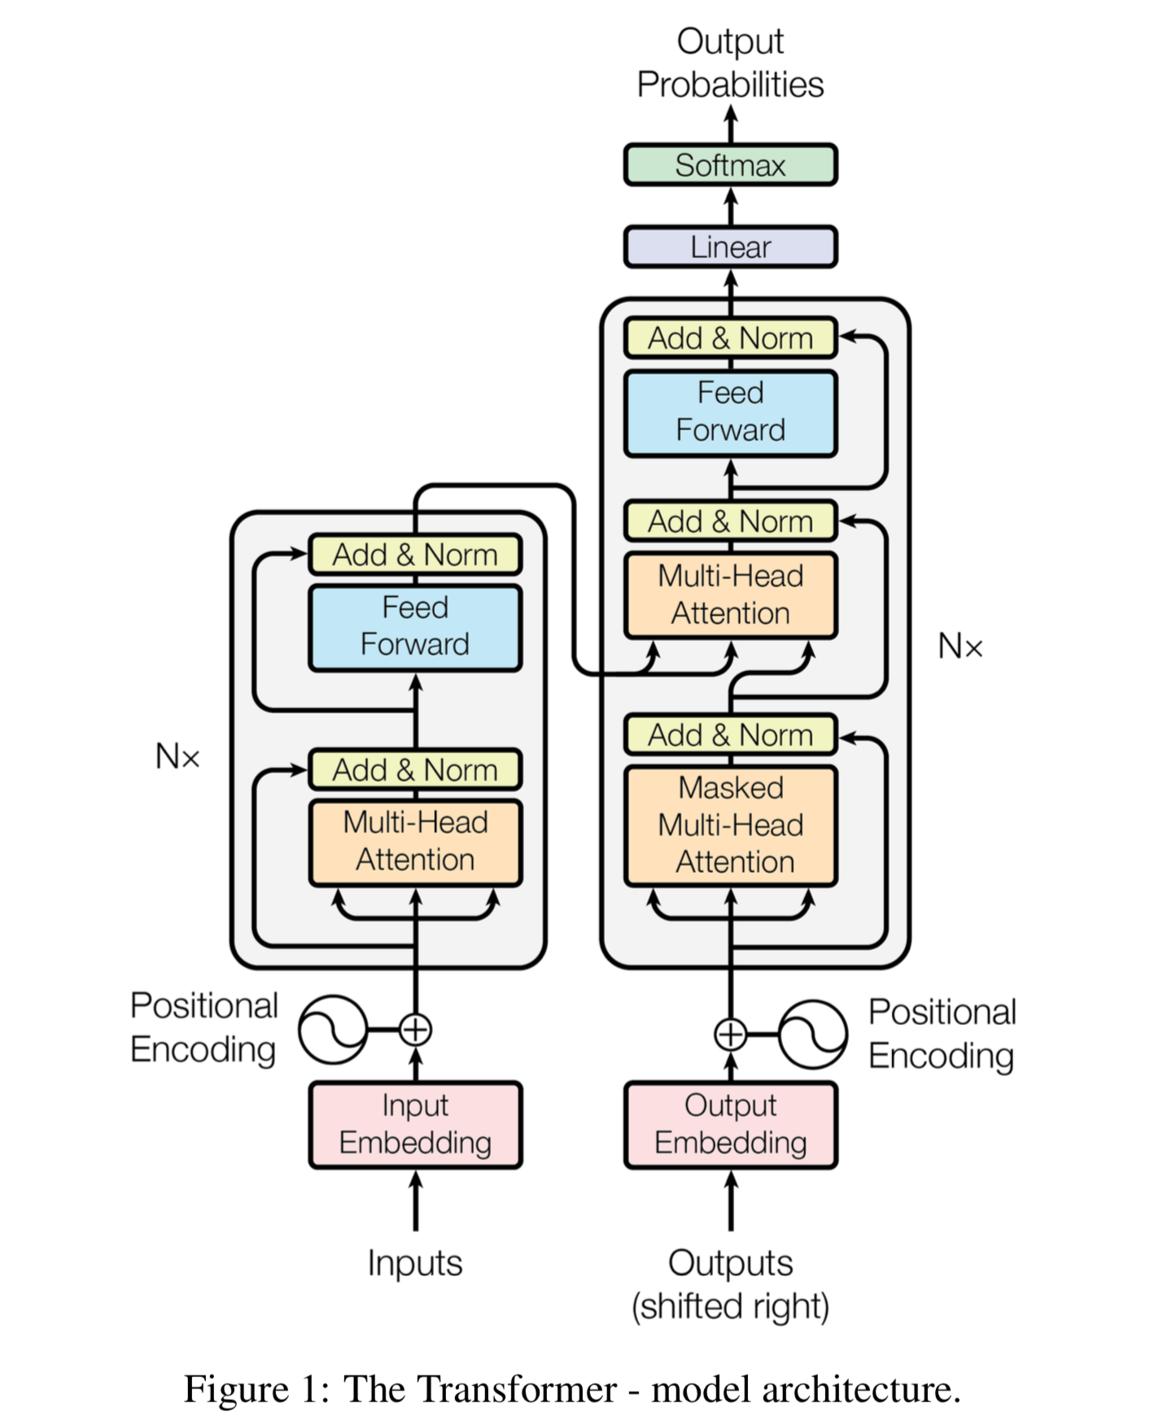
doc2query
Document
seq2seq Transformer
Query
Supervised training:
pairs of <query, relevant document>
Nogueira, Yang, Lin, Cho. Document expansion by query prediction. 2019.
Source: Vaswani et al., 2017

Slide 104
doc2query
In practice: 5-40 queries are sampled
with top-k or nucleus sampling
Input: Document
Output: Predicted Query
Researchers are finding that cinnamon reduces blood sugar levels naturally when taken daily...
doc2query
does cinnamon lower blood sugar?
+
Concatenate
Researchers are finding that cinnamon reduces blood sugar levels naturally when taken daily...
Expanded Document:
does cinnamon lower blood sugar?
Index
Better Retrieved Docs
User's Query
foods and supplements to lower blood sugar
Search Engine

Slide 105
Results
 | MARCO Passage (MRR@10) | TREC-DL 19 (nDCG@10) | TREC-COVID (nDCG@20) | Robust04 (nDCG@20)
BM25 | 0.184 | 0.506 | 0.659 | 0.428
+ doc2query | 0.277 | 0.642 | 0.6375 | 0.446
BM25 + RM3 | 0.156 | 0.518 | - | 0.450
+ doc2query | 0.214 | 0.655 | - | 0.466
BM25 + monoBERT/T5* | 0.365 | 0.738 | 0.7785* | -
+ doc2query | 0.379 | 0.754 | 0.7939 | -
zero-shot: doc2query was trained only on MS MARCO

Slide 106
What is more important? copied or new words?
Predicted queries are "better" than documents

Slide 107
Examples
Excluding
stop-words:
69% copied
31% new

Slide 108
Document Preprocessing Techniques
Query vs document expansion
doc2query
DeepCT
DeepImpact

Slide 109
DeepCT
Target Scores
0.0 1.0 1.0 0.0 0.0 0.0 0.0 0.0 0.0 0.0 0.0
Predicted Scores
0.2 0.5 0.2 0.1 0.4 0.1 0.0 0.6 0.2 0.4 0.3
D × 1
D × 1
...
D × 1
DeepCT (BERT)
Text d:
The Geocentric Theory was proposed by the greeks under the guidance...
Relevant query q: "who proposed the geocentric theory"
Dai, Callan. Context-aware sentence/passage term importance estimation for first stage retrieval. 2019.

Slide 110
Once DeepCT is trained...
Index
New document: "Researchers Researchers … finding finding … that that … cinnamon cinnamon ... reduces ... "
Term Frequencies:
10 0 20 10 90 80 90 100 40 20 0 10 40
Predicted Scores
0.1 0.0 0.2 0.1 0.9 0.8 0.9 1.0 0.4 0.2 0.0 0.1 0.4
D × 1
D × 1
...
D × 1
DeepCT (BERT)
Text d:
Researchers are finding that cinnamon reduces blood sugar levels naturally when taken daily...

Slide 111
Results on MS MARCO Passage Dev Set
Model | MRR@10 | R@1000 | BERT Inferences per doc
BM25 | 0.184 | 0.853 | -
+ doc2query | 0.229 | 0.907 | 1
+ doc2query | 0.277 | 0.944 | 40
DeepCT | 0.243 | 0.913 | 1

Slide 112
Document Preprocessing Techniques
Query vs document expansion
doc2query
DeepCT
DeepImpact

Slide 113
DeepImpact: combining doc2query with DeepCT
Output: Predicted Query
Researchers are finding that cinnamon reduces blood sugar levels naturally when taken daily...
Input Document
doc2query
does cinnamon lower blood sugar?
+
Concatenate
Researchers are finding that cinnamon reduces blood sugar levels naturally when taken daily...
Expanded Document:
does cinnamon lower blood sugar?
Term Scorer (~DeepCT)
{Researchers: 31, are: 0, finding: 4, that: 1, ...}
Index
Better Retrieved Docs
User's Query
foods and supplements to lower blood sugar
Search Engine
Mallia, Khattab, Tonellotto, and Suel. Learning Passage Impacts for Inverted Indexes. 2021

Slide 114
Results on MS MARCO Passage Dev Set
Model | MRR@10 | R@1000 | Latency (ms/query)
BM25 | 0.184 | 0.853 | 13
DeepCT | 0.243 | 0.913 | 11
doc2query | 0.278 | 0.947 | 12
DeepImpact | 0.326 | 0.948 | 58
BM25 + monoBERT | 0.355 | 0.853 | (GPU) 10,700

Slide 115
How to Expand Long Documents?
windows of N sentences
doc2query
DeepCT
DeepImpact
Queries or
Terms
doc2query
DeepCT
DeepImpact
Queries or
Terms
+
doc2query
DeepCT
DeepImpact
Queries or
Terms
doc2query
DeepCT
DeepImpact
Queries or
Terms

Slide 116
Takeaways of Document Expansion
Advantages:
Documents have more context than queries →easy prediction task
Documents can be processed offline and in parallel
Run on CPU at query time
Disadvantages:
Have to iterate over the entire collection
Not as effective as rerankers (yet)

Slide 117
Beyond BERT
Improving effectiveness or efficiency

Slide 118
Improving Effectiveness: Model Variants
BERT Variants:
Improve training → replacement prediction rather than mask prediction (ELECTRA)
Modify training → tune hyper-parameters, remove NSP task (RoBERTa)
Modify architecture → share weights across Transformer layers (ALBERT)

Slide 119
Improving Effectiveness: Model Variants
T_{[CLS]}
T₁
T₂
T₃
T₄
T₅
T₆
T₇
T_{[SEP]}
…
…
…
…
…
…
…
…
…
E_{[CLS]}
E₁
E₂
E₃
E₄
E₅
E₆
E₇
E_{[SEP]}
Random masking
The
bank
makes
loans
[MASK]
clients
.
BERT
Term replacement
The
store
makes
loans
and
clients
.
ELECTRA
The
bank
makes
loans
to
clients
.
Original text

Slide 120
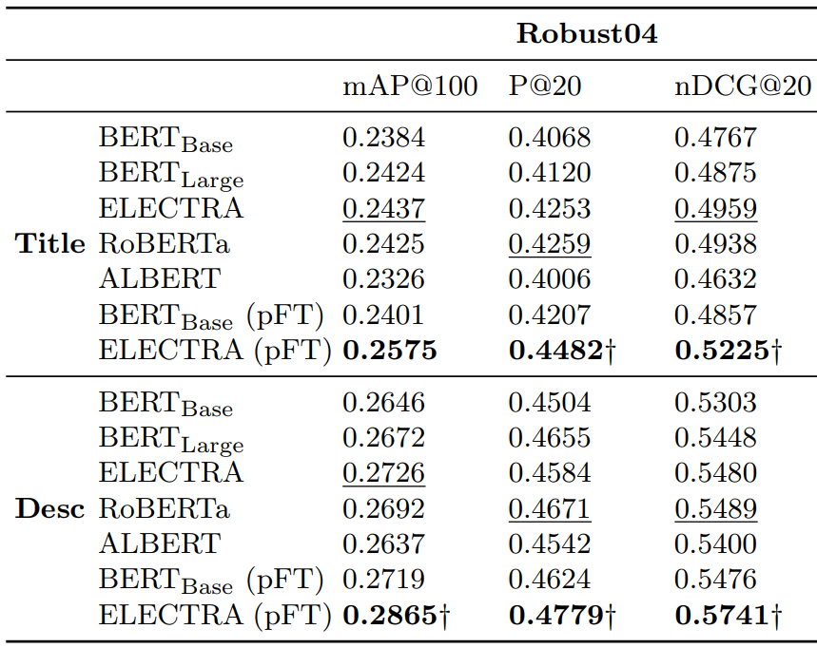
Improving Effectiveness: BERT Variants
Zhang, Yates, Lin. Comparing Score Aggregation Approaches for Pretrained Neural Language Models. ECIR 2021.

Slide 121
Improving Effectiveness: T5
Sequence2Sequence Model (T5): larger, improved pre-training
Input: query: [q] document: [d] relevant:
Training:
"true" or "false"
Inference:
score = P(token="true" | q, d)
w₁
w₂
...
w_{N}
Source
Raffel, Shazeer, Roberts, Lee, Narang, Matena, Zhou, Li, Liu. Exploring the Limits of Transfer Learning with a Unified Text-to-Text Transformer. JMLR 2020.

Slide 122
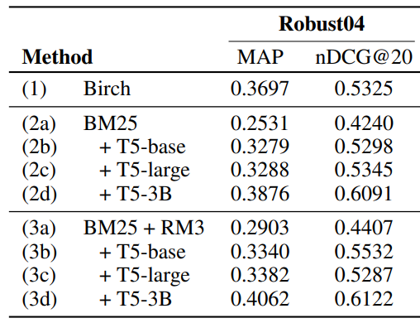
Improving Effectiveness: T5
(desc.)
Nogueira, Jiang, Pradeep, Lin. Document Ranking with a Pretrained Sequence-to-Sequence Model. Findings of EMNLP 2020.

Slide 123
Improving Efficiency: Distillation & Architectures
Distillation:
Train a smaller model (“student”) to mimic a larger model (“teacher”)
Can be performed before fine-tuning, after, or both (best)
Cross-entropy loss
Teacher & student logits

Slide 124
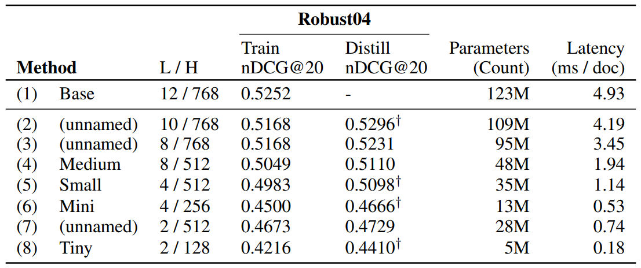
Improving Efficiency: Distillation
(titles)
Li, Yates, MacAvaney, He, Sun. PARADE: Passage Representation Aggregation for Document Reranking. arXiv 2020.

Slide 125
Improving Efficiency: Distillation & Architectures
Distillation:
Train a smaller model (“student”) to mimic a larger model (“teacher”)
Can be performed before fine-tuning, after, or both (best)
Smaller architectures:
TK, TKL, CK → skip pretraining and reduce the number of Transformer layers
Take GloVe embeddings as input

Slide 126
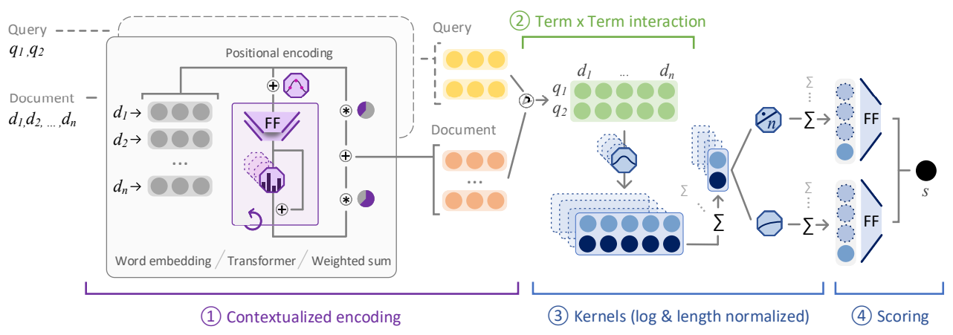
Improving Efficiency: TK Architectures
Similarity matrix & KNRM
Small Transformer stack
Hofstatter, Zlabinger, Hanbury. Interpretable & Time-Budget-Constrained Contextualization for Re-Ranking. ECAI 2020.

Slide 127
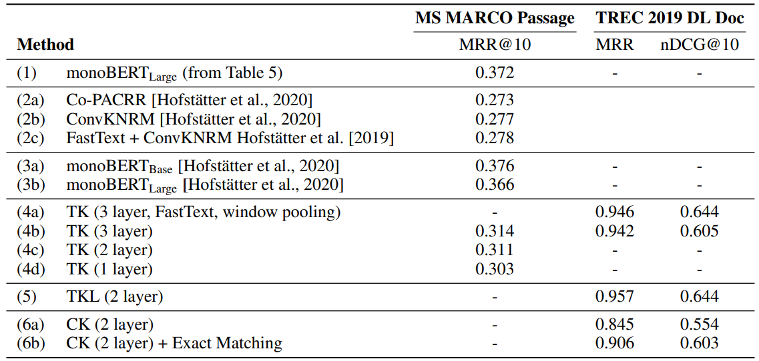
Improving Efficiency: TK Architectures
Hofstatter, Zlabinger, Hanbury. Interpretable & Time-Budget-Constrained Contextualization for Re-Ranking. ECAI 2020.

Slide 128
Domain-specific Applications

Slide 129
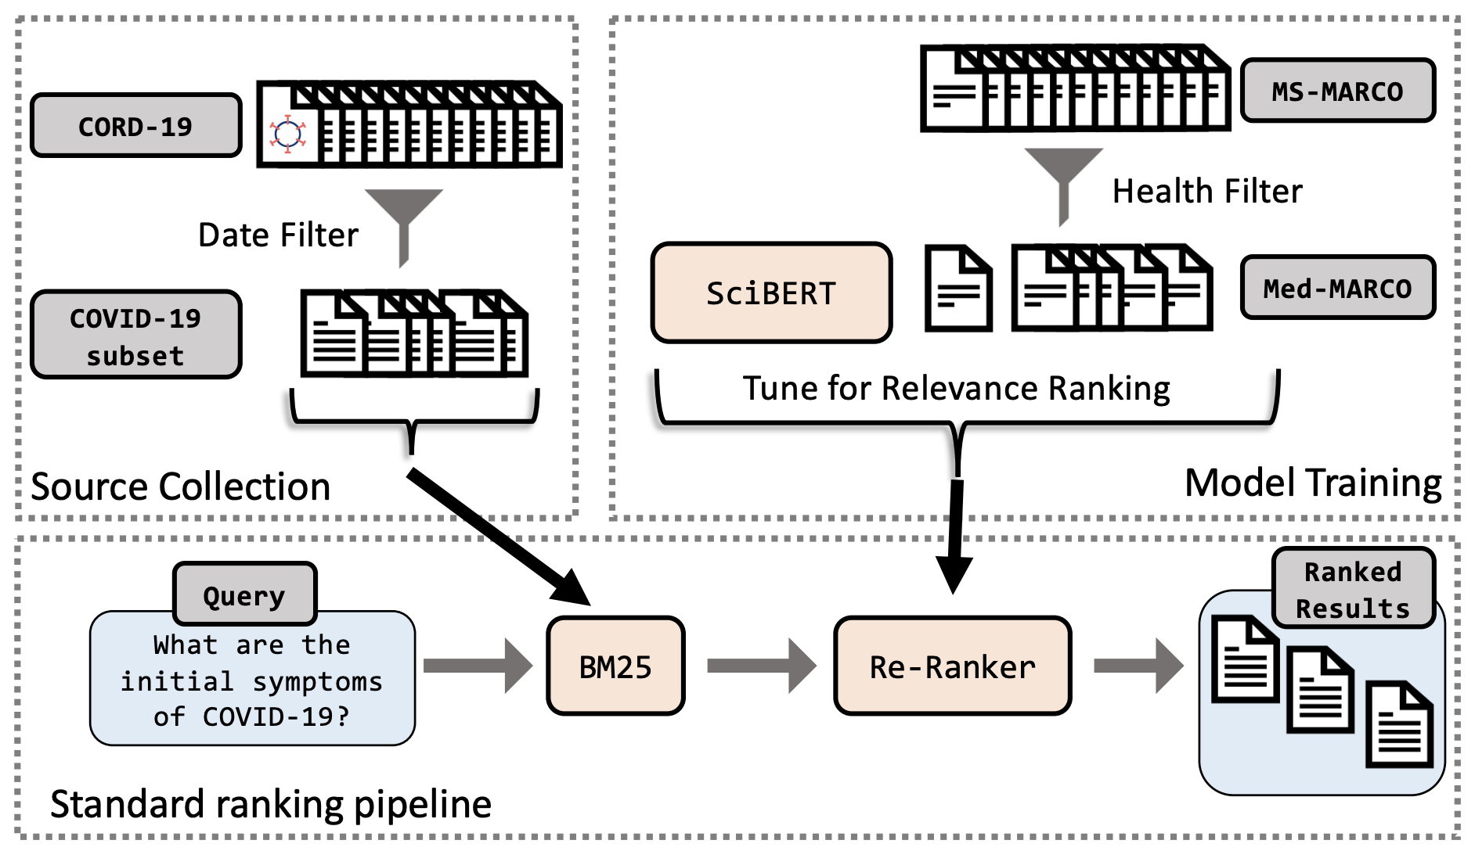
TREC-COVID (April-September 2020)
Task: Find scientific articles relevant to questions such as:
Are patients taking Angiotensin-converting enzyme inhibitors (ACE) at increased risk for COVID-19?
MacAvaney, Cohan, Goharian. SLEDGE-Z: A Zero-Shot Baseline for COVID-19 Literature Search. EMNLP 2020.

Slide 130
TREC 2020 - Precision Medicine Track
Task: Find relevant scientific articles in PubMed for questions such as:
Is Dabrafenib effective for the melanoma disease in patients with gene BRAF (V600E) mutation?
BERT-based models work fine with small tweaks:
Model | nDCG@30
median | 0.2857
BM25 | 0.3081
+ monoT5_{rct} | 0.4193
damoespb1 | 0.4255
Zero-shot:
Finetuned only on MS MARCO!
Roberts, Demner-Fushman, Voorhees, Bedrick, Hersh, Overview of the TREC 2020 Precision Medicine Track. TREC 2020.

Slide 131
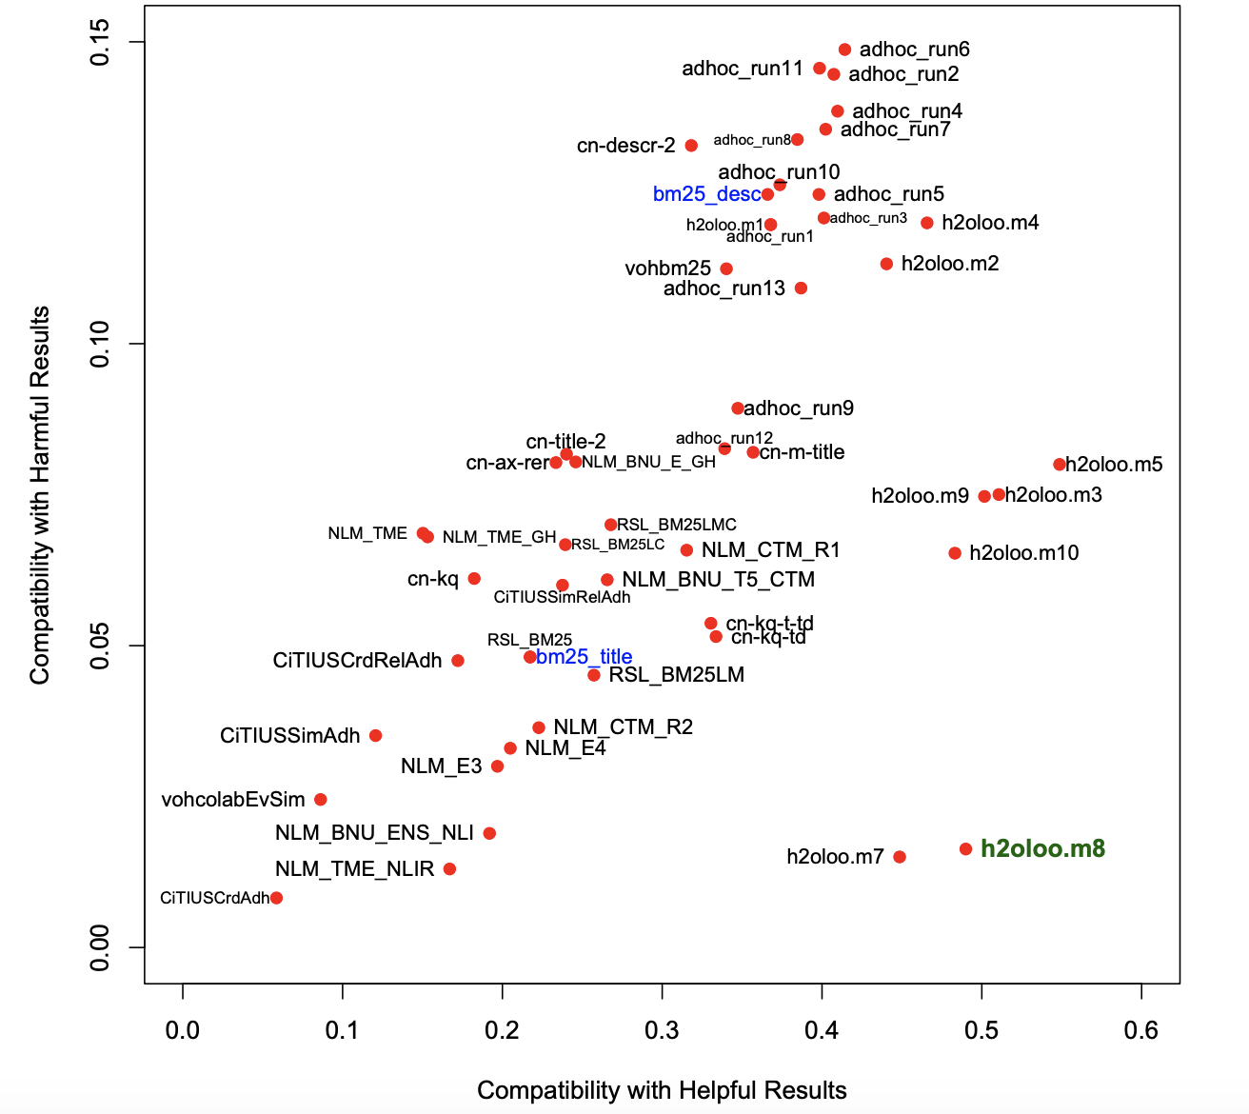
TREC 2020 - Health Misinformation
Task: Find relevant documents to questions such as:
Can ibuprofen worsen COVID-19?
Metric penalizes documents that contain incorrect information
BM25 + monoT5
Better
BM25 + monoT5 + LabelT5

Slide 132
Legal Domain
COLIEE 2020, Task 1:
Find relevant cases in a corpus that support the decision of a given case.
Method | F1
BM25 | 0.5287
BM25 + BERT | 0.6397
Method | F1
Pre-BERT | 0.5148
BERT | 0.6379
Pre-BERT + BERT | 0.6682
Team JNLP (Nguyen et al. 2020)
Team TLIR (Shao et al. 2020)

Slide 133
Takeaways
Zero-shot BERT-based models are starting show better effectiveness than classical retrieval
Simple domain adaptation techniques work well with transformer architectures (eg: SLEDGE-Z)

Slide 134
Q&A
10 minutes

Slide 135
Break
Resume at 10:40 PDT

Slide 136
Part 3: Ranking with Dense Representations

Slide 137
Sparse Representations
Task: Estimate the relevance of text d to a query q:
q = "fix my air conditioner"
d = "... AC repair ..."
Advantages: 1) Fast to retrieve candidates from a inverted index because q is usually short. 2) Fast to compute because q ∩ d is usually small
Disadvantage: Terms need to match exactly

Slide 138
Dense Representations
Continuous dense vectors ℝ^{D}
q = "fix my air conditioner"
Encoder
0.8 | -1.2 | ... | 2.4 | -0.3
𝜂(q)
d = "... AC repair ..."
Encoder
0.5 | 0.0 | ... | 2.6 | -0.7
𝜂(d)
𝜙 is a similarity function (e.g., inner product or cosine similarity)
𝜙(𝜂(q), 𝜂(d)) → ideally measures how relevant q and d are to each other

Slide 139
Nearest Neighbor Search

Slide 140
Task: find the top k most relevant texts to a query
Brute-force search:
query
texts
𝜙
𝜙(𝜂(q), 𝜂(d₁))
𝜙
Top k
𝜙
𝜙
...
𝜙(𝜂(q), 𝜂(d_{|C|}))
We often need to search many (e.g.: billions) of texts
Brute-force won't scale

Slide 141
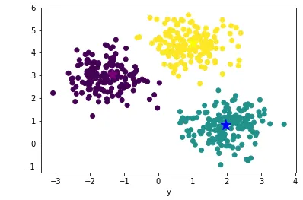
Approximate Nearest Neighbor Search
Exchange accuracy for speed
E.g.: k-means:
Centroids
𝜙 (𝜂(q), 𝜂(d₁))
…
𝜙 (𝜂(q), 𝜂(d_{m}))
𝜙 (𝜂(q), 𝜂(c₁))
𝜙 (𝜂(q), 𝜂(c₂))
𝜙 (𝜂(q), 𝜂(c₃))
query 𝜂(q)
In practice, ANN implementations are more complicated
We assume a fast dense retrieval library is available (e.g.: Faiss, Annoy, ScaNN)

Slide 142
Pre-BERT Dense Representations

Slide 143
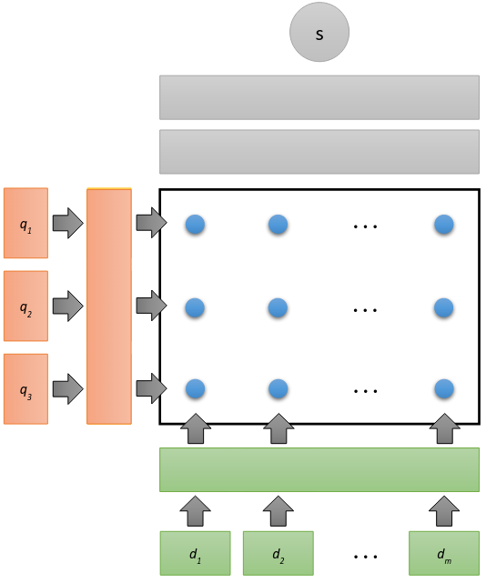
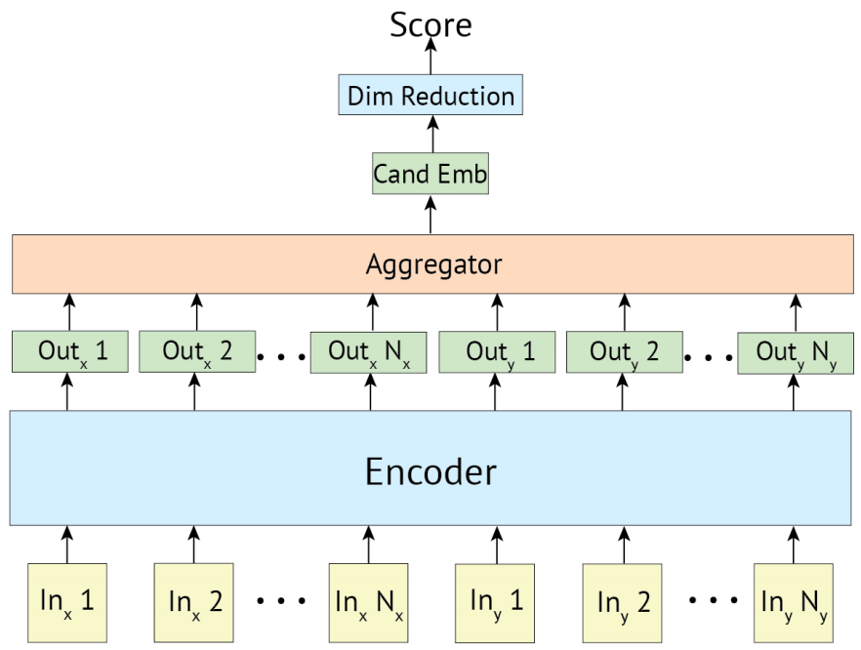
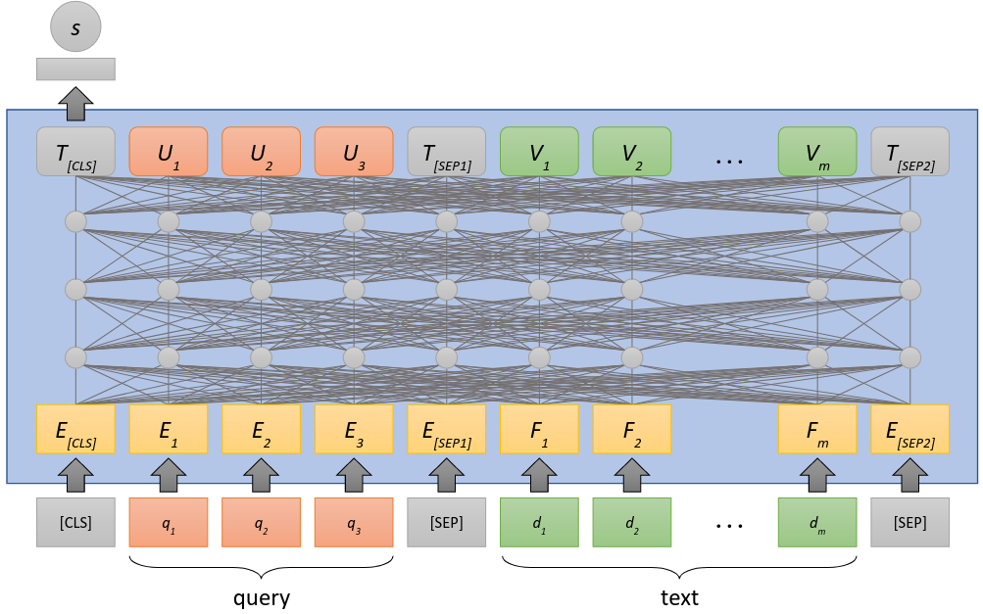
Types of Encoders: Cross-encoder
Source

Slide 144
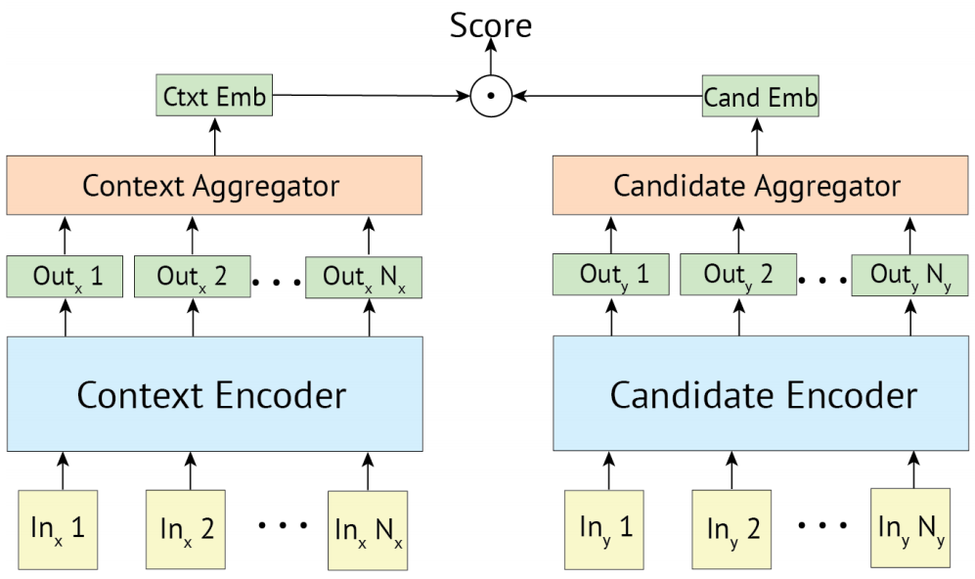
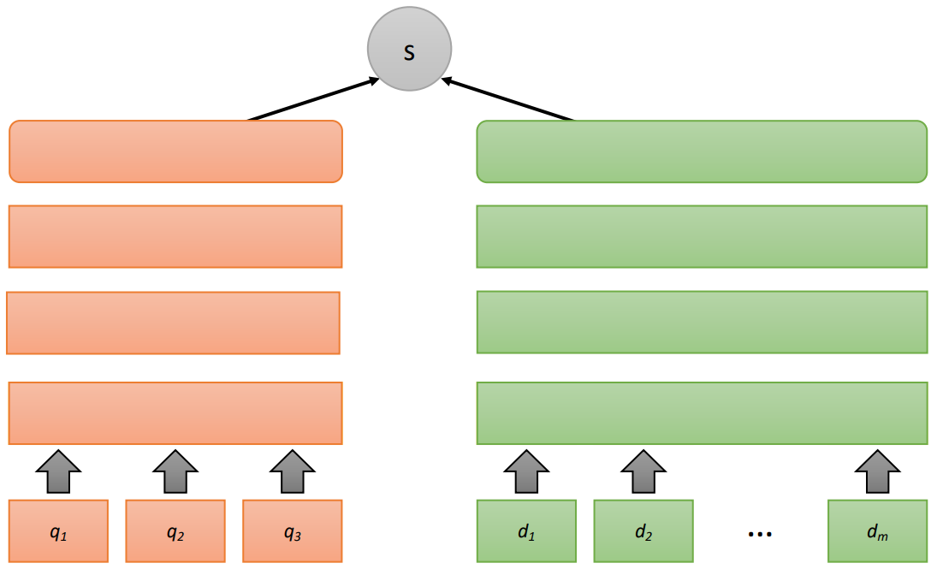
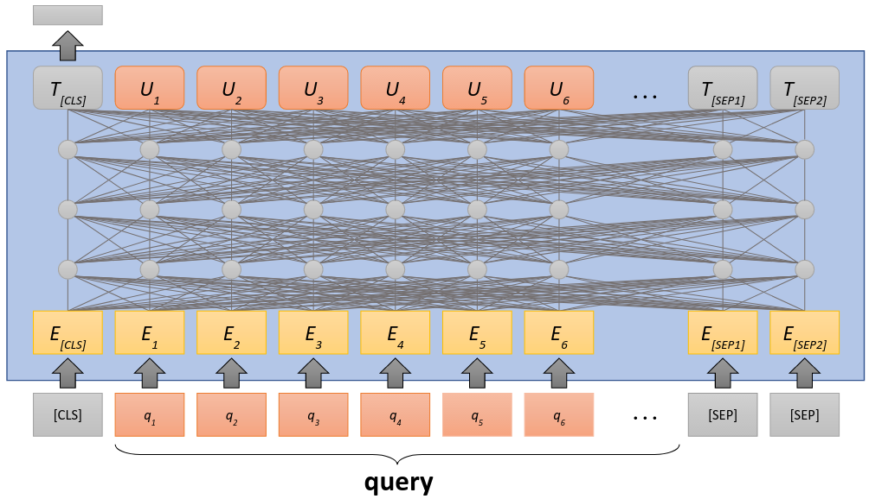
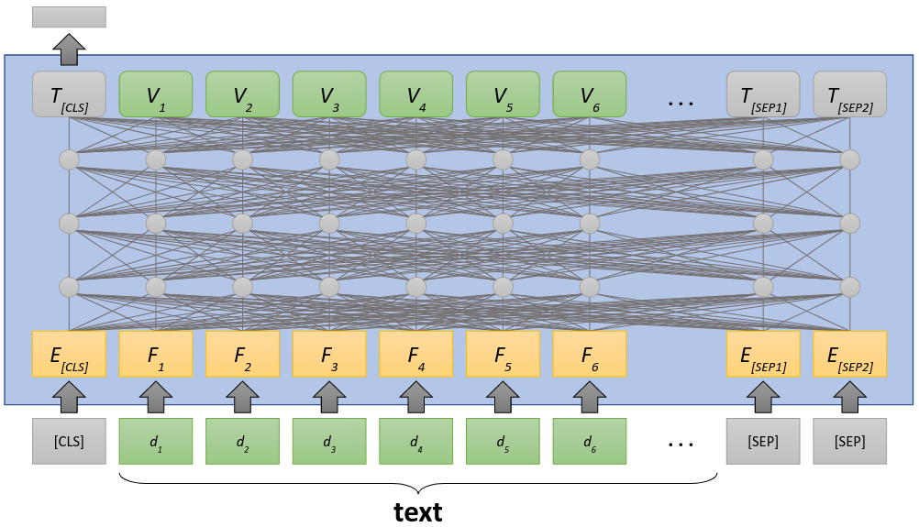
Types of Encoders: Bi-encoder
𝜙(𝜂(q), 𝜂(d))
s
𝜂(q)
𝜂(d)
𝜙(𝜂(q), 𝜂(d))
𝜂(q)
𝜂(d)
Source

Slide 145
Pre-BERT: Dual Embedding Space Model
Query Term Embeddings
Document
Centroid
Similarity
Function
Leverage term embeddings and → pretrained word2vec
Mitra, Nalisnick, Craswell, Caurana. A Dual Embedding Space Model for Document Ranking. arXiv & WWW 2016.

Slide 146
Similarity Functions: Distance vs. Comparison
Comparison
Distance

Slide 147
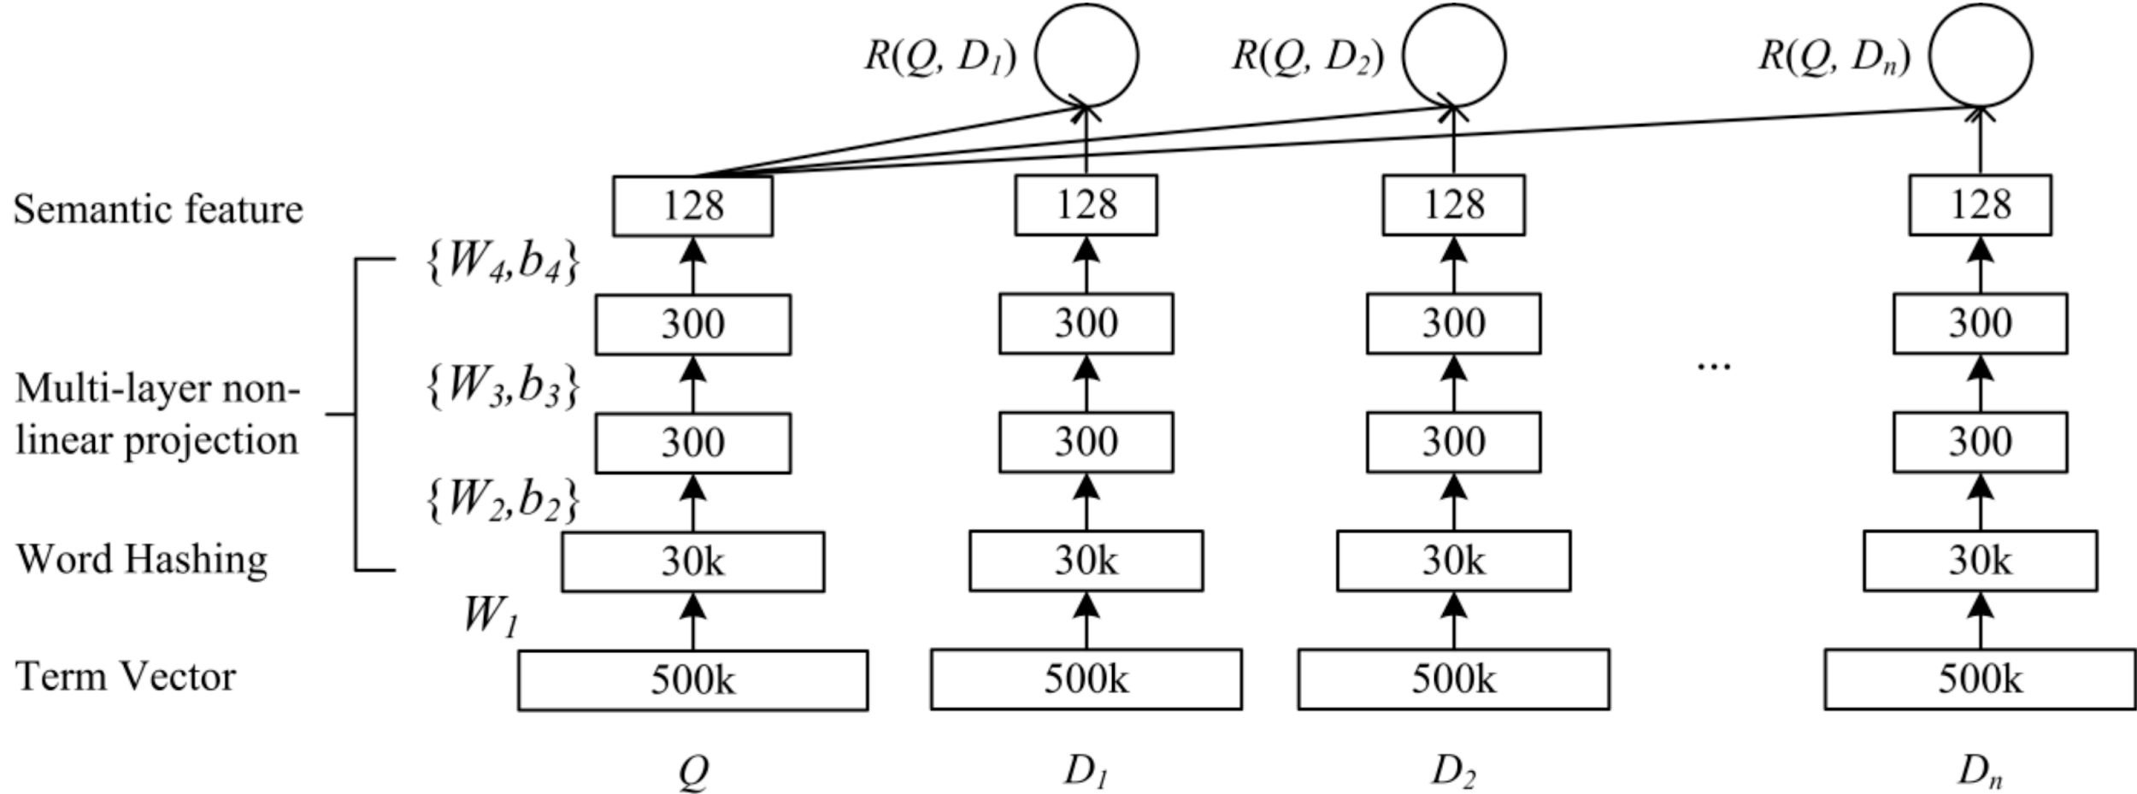
Pre-BERT: Deep Structured Semantic Model
Cosine similarity
Representation
Feedforward
Network
Term Hashing
Huang, He, Gao, Deng, Acero, Heck. Learning Deep Structured Semantic Models for Web Search using Clickthrough Data. CIKM 2013.

Slide 148
Distance-based Transformer Representations

Slide 149
Distance-based Representations
Key characteristic
Simple similarity function → inner (dot) product, cosine similarity, …
Compatible with ANN search
Johnson, Douze, Jégou. Billion-scale similarity search with GPUs. arXiv 2017.

Slide 150
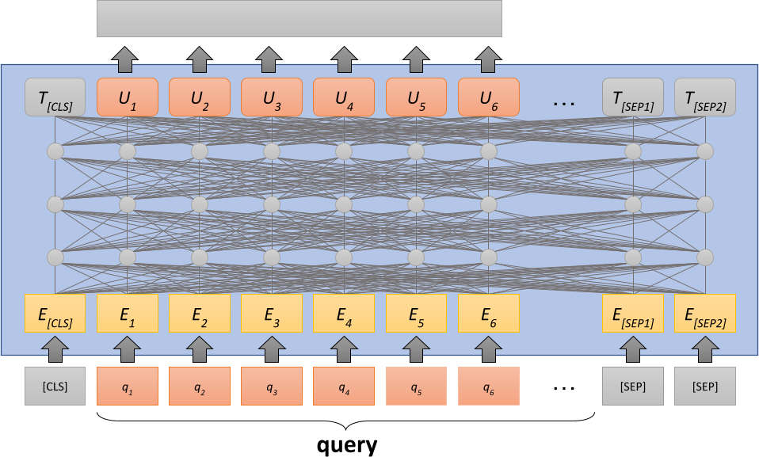
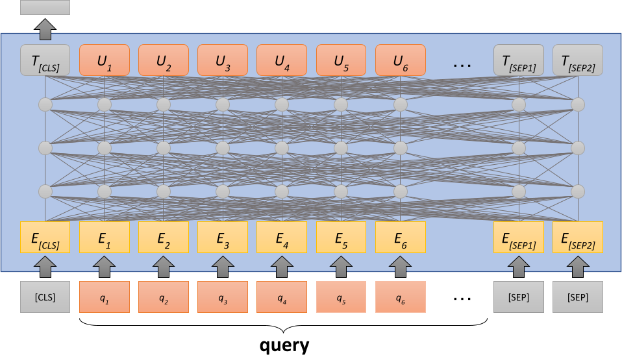
Distance-based: SentenceBERT
Text representation:
CLS
Text representation:
CLS
Mean
Max
Reimers, Gurevych. Sentence-BERT: Sentence Embeddings using Siamese BERT-Networks. EMNLP 2019.

Slide 151
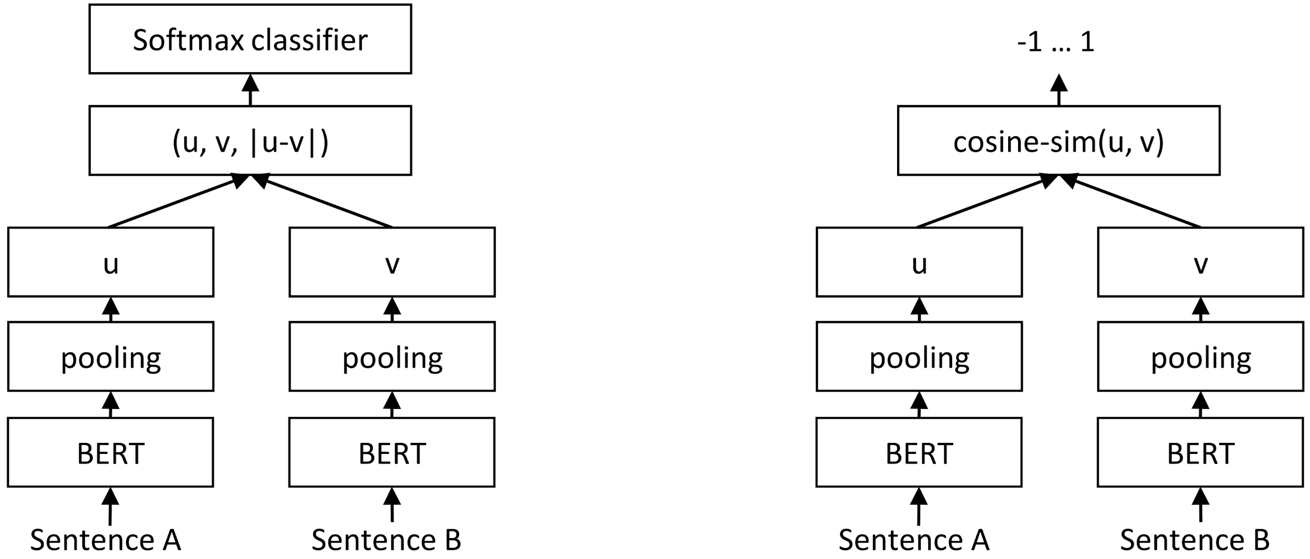
Distance-based: SentenceBERT
Classification
Regression
Reimers, Gurevych. Sentence-BERT: Sentence Embeddings using Siamese BERT-Networks. EMNLP 2019.

Slide 152
SentenceBERT Result Highlights
Zero-shot:
Mean: GloVe > BERT
BERT Mean > CLS
CLS is very poor
Fine-tuned:
Mean > CLS and Max
Close to cross-encoder
CLS is slightly worse
Classification:
is essential
Reimers, Gurevych. Sentence-BERT: Sentence Embeddings using Siamese BERT-Networks. EMNLP 2019.

Slide 153
Dense Passage Retrieval (DPR)
Highlights:
QA reader & retriever
Selecting negative examples: random, BM25, or in batch
 | Similarity Function (𝜙) | Representation
SentenceBERT | Cosine similarity | CLS, Mean, or Max
DPR | Inner product | CLS
Batch
Query-1 Query-2
Karpukhin, Oğuz, Min, Lewis, Wu, Edunov, Chen, Yih. Dense Passage Retrieval for Open-Domain Question Answering. EMNLP 2020.

Slide 154
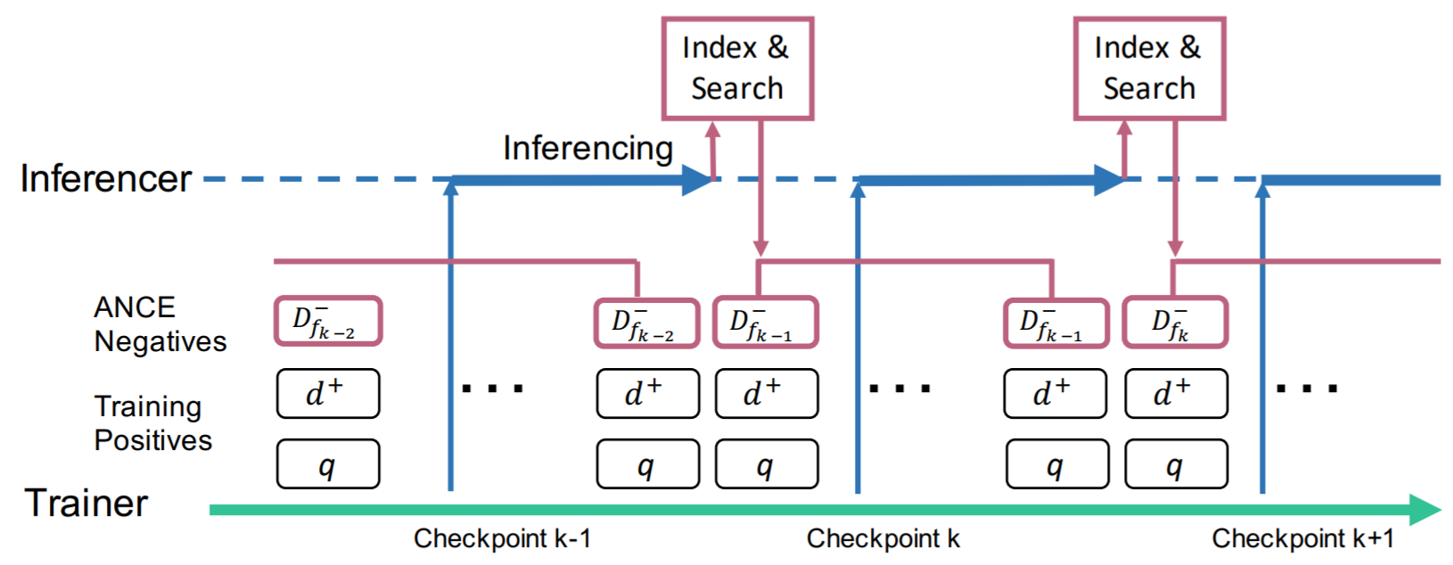
ANCE
Negative Contrastive Estimation:
Choose hard negatives (for model)
 | Similarity Function (𝜙) | Representation
SentenceBERT | Cosine similarity | CLS, Mean, or Max
DPR | Inner product | CLS
ANCE | Inner product | CLS
Checkpoint regularly
L. Xiong, C. Xiong, Li, Tang, Liu, Bennett, Ahmed, Overwikj. Approximate Nearest Neighbor Negative Contrastive Learning for Dense Text Retrieval. ICLR 2021.

Slide 155
Selecting Negative Examples: Results

Slide 156
CLEAR
Highlights:
Prepend QRY or DOC
Exact matching component
Negatives: matching errors
Dynamic hinge loss margin
 | Similarity Function (𝜙) | Representation
SentenceBERT | Cosine similarity | CLS, Mean, or Max
DPR | Inner product | CLS
ANCE | Inner product | CLS
CLEAR | Inner product + BM25 | Mean
Gao, Dai, Chen, Fan, van Durme, Callan. Complementing Lexical Retrieval with Semantic Residual Embedding. arXiv 2020; ECIR 2021.

Slide 157
RepBERT
Exact match signal:
Reduces MRR (-2%)
Improves recall (+1%)
 | Similarity Function (𝜙) | Representation
SentenceBERT | Cosine similarity | CLS, Mean, or Max
DPR | Inner product | CLS
ANCE | Inner product | CLS
CLEAR | Inner product + BM25 | Mean
RepBERT | Inner product | Mean
Zhan, Mao, Liu, Zhang, Ma. RepBERT: Contextualized Text Embeddings for First-Stage Retrieval. arXiv 2020.

Slide 158
EPIC
Highlights:
Vocabulary vector
Term importance weights
 | Similarity Function (𝜙) | Representation
SentenceBERT | Cosine similarity | CLS, Mean, or Max
DPR | Inner product | CLS
ANCE | Inner product | CLS
CLEAR | Inner product + BM25 | Mean
RepBERT | Inner product | Mean
EPIC | Inner product | |V|-dimension vector
MacAvaney, Nardini, Perego, Tonellotto, Goharian, Frieder. Expansion via Prediction of Importance with Contextualization. SIGIR 2020.

Slide 159
Distance-based: Results

Slide 160
Comparison-based Transformer Representations

Slide 161
Comparison-based: Poly-encoders
Number of interacting representations
Two
(Query, Document)
N
(|Query| + |Document|)
Computational Cost
Humeau, Shuster, Lachaux, Weston. Poly-encoders: Transformer Architectures and Pre-training Strategies for Fast and Accurate Multi-sentence Scoring. ICLR 2020.

Slide 162
Comparison-based: Poly-encoders
M context codes
Compatible with ANN?
Unclear
Data-dependent
Humeau, Shuster, Lachaux, Weston. Poly-encoders: Transformer Architectures and Pre-training Strategies for Fast and Accurate Multi-sentence Scoring. ICLR 2020.

Slide 163
Comparison-based: ColBERT
MaxSim operator
Khattab, Zaharia. ColBERT: Efficient and Effective Passage Search via Contextualized Late Interaction over BERT. SIGIR 2020.

Slide 164
Comparison-based: ColBERT
Sum
Max Pool
MaxSim:
Sim-mat max pooling
(along query dimension)
Khattab, Zaharia. ColBERT: Efficient and Effective Passage Search via Contextualized Late Interaction over BERT. SIGIR 2020.

Slide 165
Comparison-based: ColBERT
Compatible with ANN?
Unclear
Data-dependent
70x faster than BERT-large
Khattab, Zaharia. ColBERT: Efficient and Effective Passage Search via Contextualized Late Interaction over BERT. SIGIR 2020.

Slide 166
Comparison-based: ColBERT

Slide 167
Q&A
5 minutes

Slide 168
Break
Resume at 11:35 PDT

Slide 169
Conclusions and Future Directions

Slide 170
Conclusions
Pretrained Transformers showed significant improvements in various IR benchmarks
Reproduced and adopted by many in academia and industry
No doubt we are in the age of BERT and Transformers

Slide 171
Open Questions
Transformers for ranking: apply (T5), adapt (Parade), or redesign (TK/CK)?
What is the future of:
zero-shot learning, transfer learning, domain adaptation, and task-specific fine-tuning?
dense vs. sparse retrieval?
multi-stage ranking architectures?
What can IR bring to transformers?
E.g.: REALM (Guu et al., 2020) -> Text retrieval into pretraining

Slide 172
Pretrained Transformers for Text Ranking: BERT and Beyond
Thanks!
Learn more in survey (& upcoming book):
by Jimmy Lin, Rodrigo Nogueira, and Andrew Yates https://arxiv.org/abs/2010.06467

