Slide 1
Query Interface using Django
Shaurya Rohatgi and Dr. C. Lee Giles
Special Thanks to – Jason Chhay and Agnese Chiatti

Slide 2
Recap
Crawling the necessary contents with Scrapy
Dumped everything into data.jl
Indexed data.jl using Python api for ElasticSearch
Time to create your own interface!

Slide 3
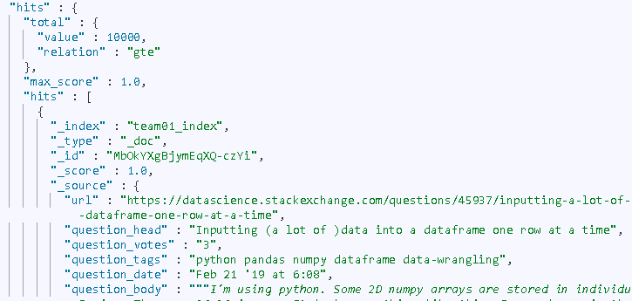
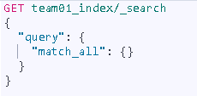
Test & Trials from Kibana First
query for a specific keyword
Notes:
GET ist441-test-master/_search
{
"query": {
"match": {"content":"citeseer"}
}
}

Slide 4
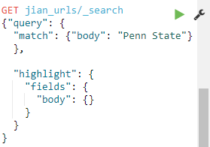
Test & Trials from Kibana First
Adding Text Highlighting
Notes:
GET ist441-test-master/_search
{
"query": {
"match": {"content":"project"}
},
"highlight" : {
"fields" : {
"content" : {}
}
}
}

Slide 5
Django Web Apps in a nutshell
Python scripts are run as backend
Front-end is handled through HTML and CSS
Project with specific folder structure
We are interested in models.py, views.py and HTML templates specifically
For more details you can check out the docs (we are using version 1.5)

Slide 6
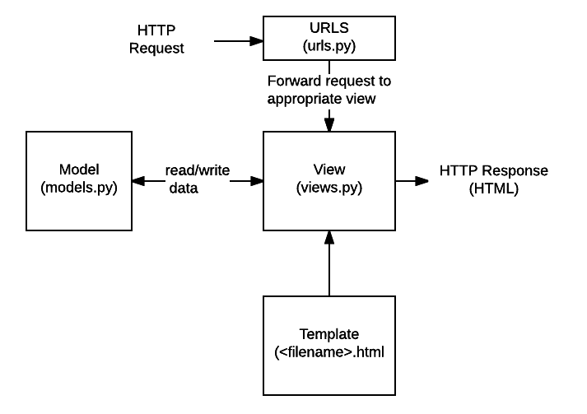
Model View Template (MVT)
URLs: A URL mapper is used to redirect HTTP requests to the appropriate view based on the request URL
View: A view is a request handler function, which receives HTTP requests and returns HTTP responses. Views access the data needed to satisfy requests via models, and delegate the formatting of the response to templates.
Models: Models are Python objects that define the structure of an application's data, and provide mechanisms to manage (add, modify, delete) and query records in the database.
Templates: A template is a text file defining the structure or layout of a file (such as an HTML page), with placeholders used to represent actual content. A view can dynamically create an HTML page using an HTML template, populating it with data from a model. A template can be used to define the structure of any type of file; it doesn't have to be HTML!
Source : https://developer.mozilla.org/en-US/docs/Learn/Server-side/Django/Introduction

Slide 7
models.py
under /data/teamno/GUI/seer/models.py
Defines the “database” object that you will be dealing with
Here you can model the attributes your search results will have
… as Python objects

Slide 9
views.py
under /data/teamno/GUI/seer/views.py
Defines dynamics (i.e., which HTML page is viewed and when)
through Python methods
Thus, we can use the Elasticsearch API for Python
To link the interface we the Lucene index we created last time

Slide 10
What you will need to change for this demo
Your index name (based on the index created during the last tutorial) -- line 14

Slide 11
Adding the Pagination Feature

Slide 12
Where and how to run the service? (already done for each team)
Go to vlabs
Go to your team jupyter lab
Inside terminal – cd /data/team<team_id>/GUI
Run the command - python manage.py runserver ist441.ist.psu.edu:92<team_id>
E.g Team06 - python manage.py runserver ist441.ist.psu.edu:9206
The service will start running on - ist441.ist.psu.edu:92<team_id>
Team11 port : 8001
Github link - https://github.com/shauryr/ist441_gui

Slide 13
Demo time

Slide 14
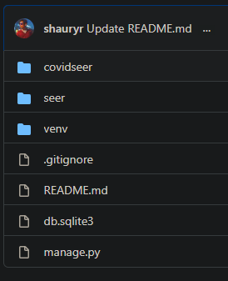
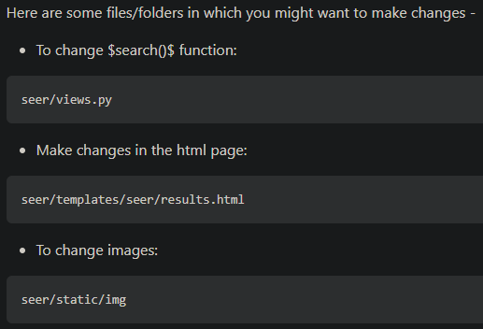
Understanding the folder structure

Slide 15
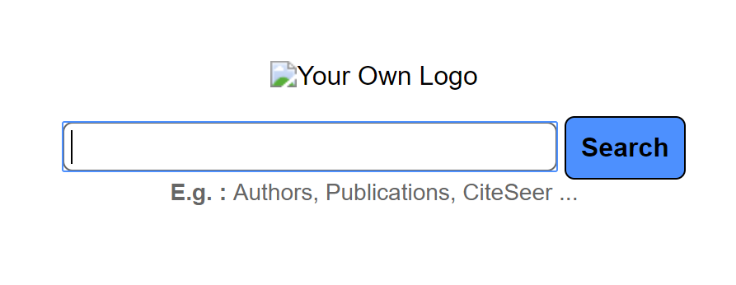
Visit your baseline search page
From a browser (in VLABS or other classroom computer) visit: http://ist441.ist.psu.edu:92 + team no e. g. http://ist441.ist.psu.edu:9201 for team 1

Slide 16
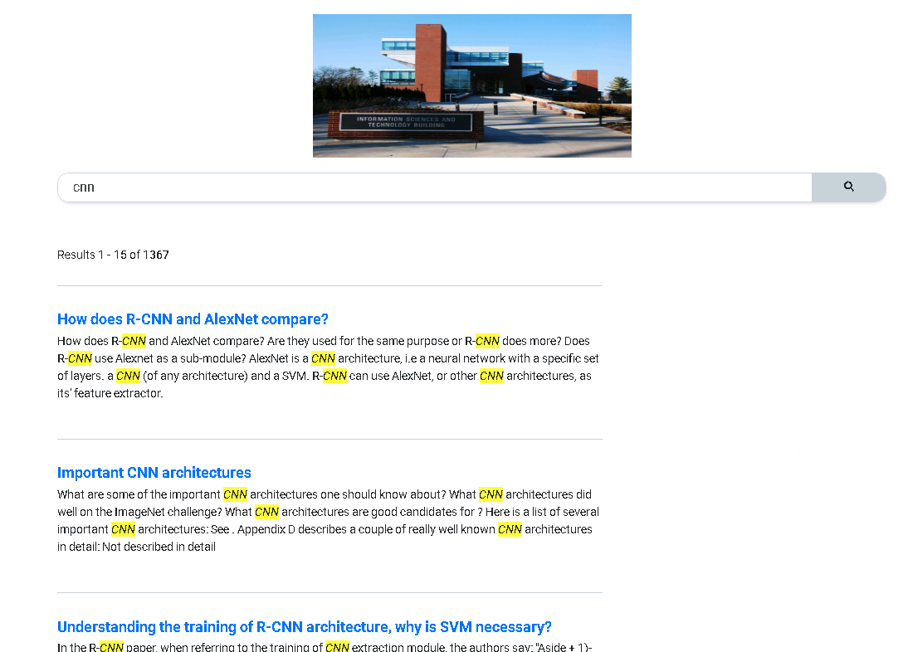
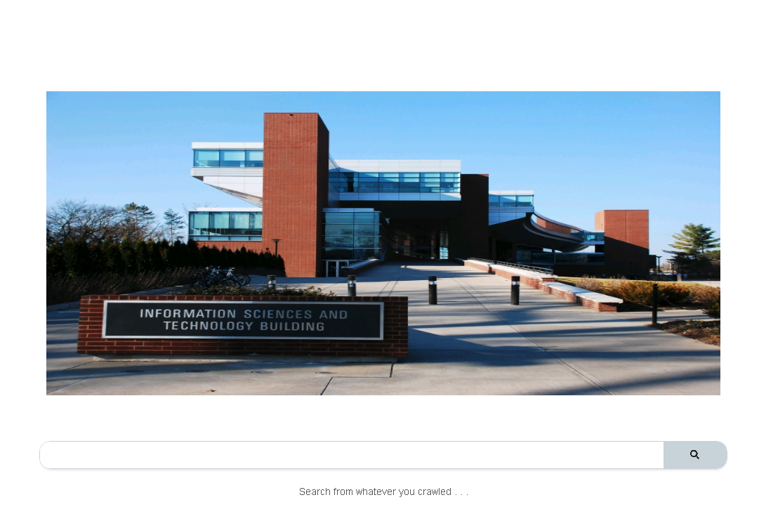
Text search and Highlighting in action
SERP
Query Interface Landing Page

Slide 17
ES Search API
We will play with ES query and search APIs to see what results come out and relevant they are
I have included some ways you can search your interface in the comments in the code.
Play around with it!
Test & Trials from Kibana First!

Slide 18
Take-home message
After this basic tutorial you should be able to:
Link the static HTML pages you previously crawled and indexed to a Web interface
Play around with the search bar to verify that you get the same results as from the Kibana console
Next…
You can go ahead and add your own Logo, custom interface features gradually and check the results as you go

Slide 19
Questions?

