Slide 1
Scaleable Entity Resolution
Kunho Kim

Slide 2
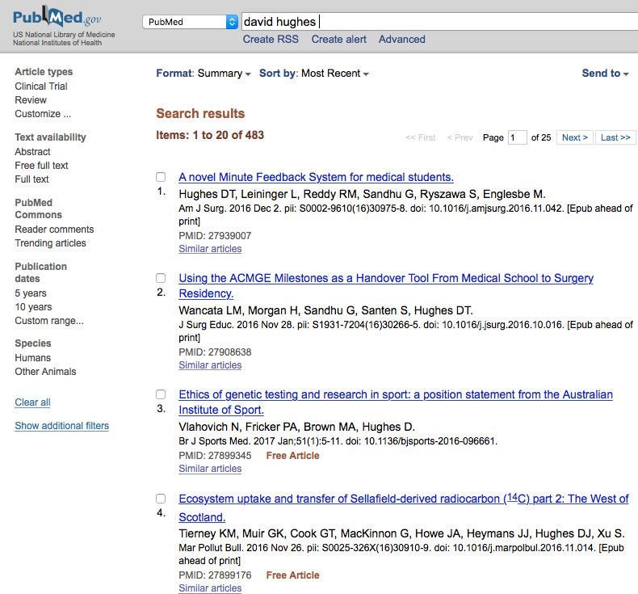
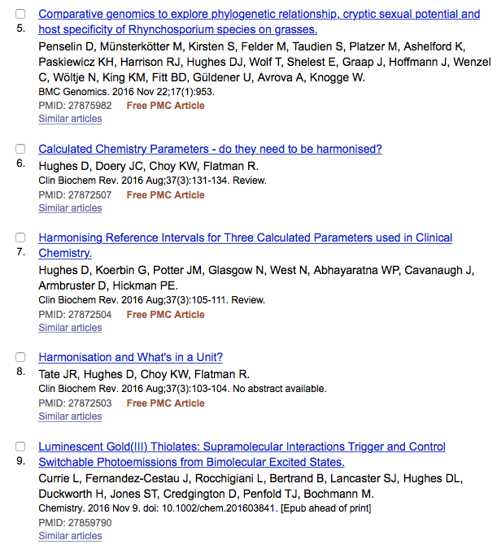
Why We Need Entity Resolution?

Slide 3
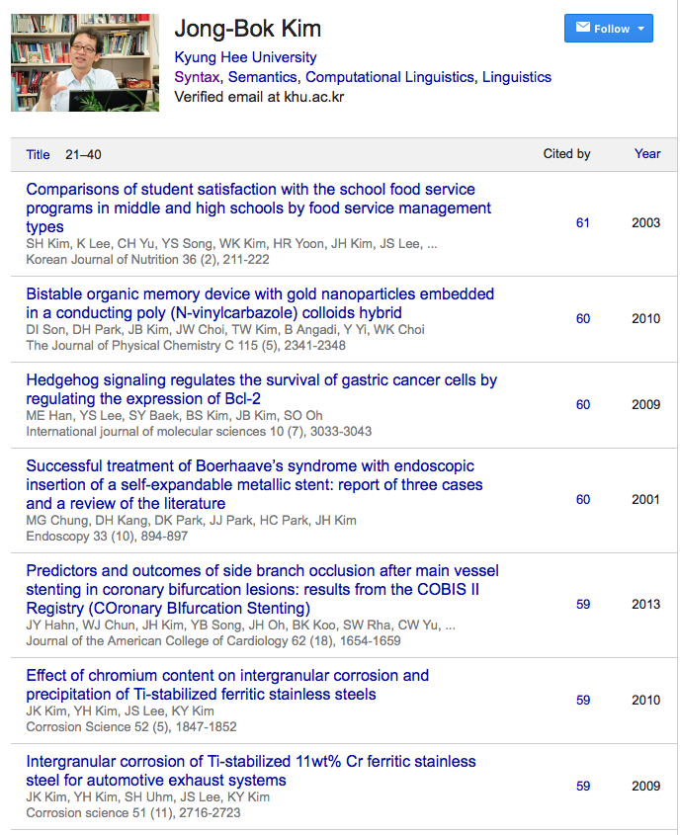
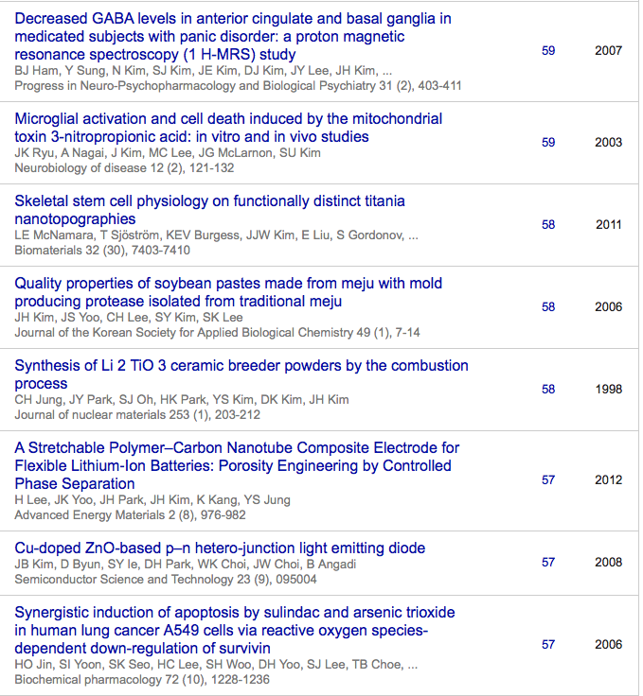
Why We Need Entity Resolution?

Slide 4
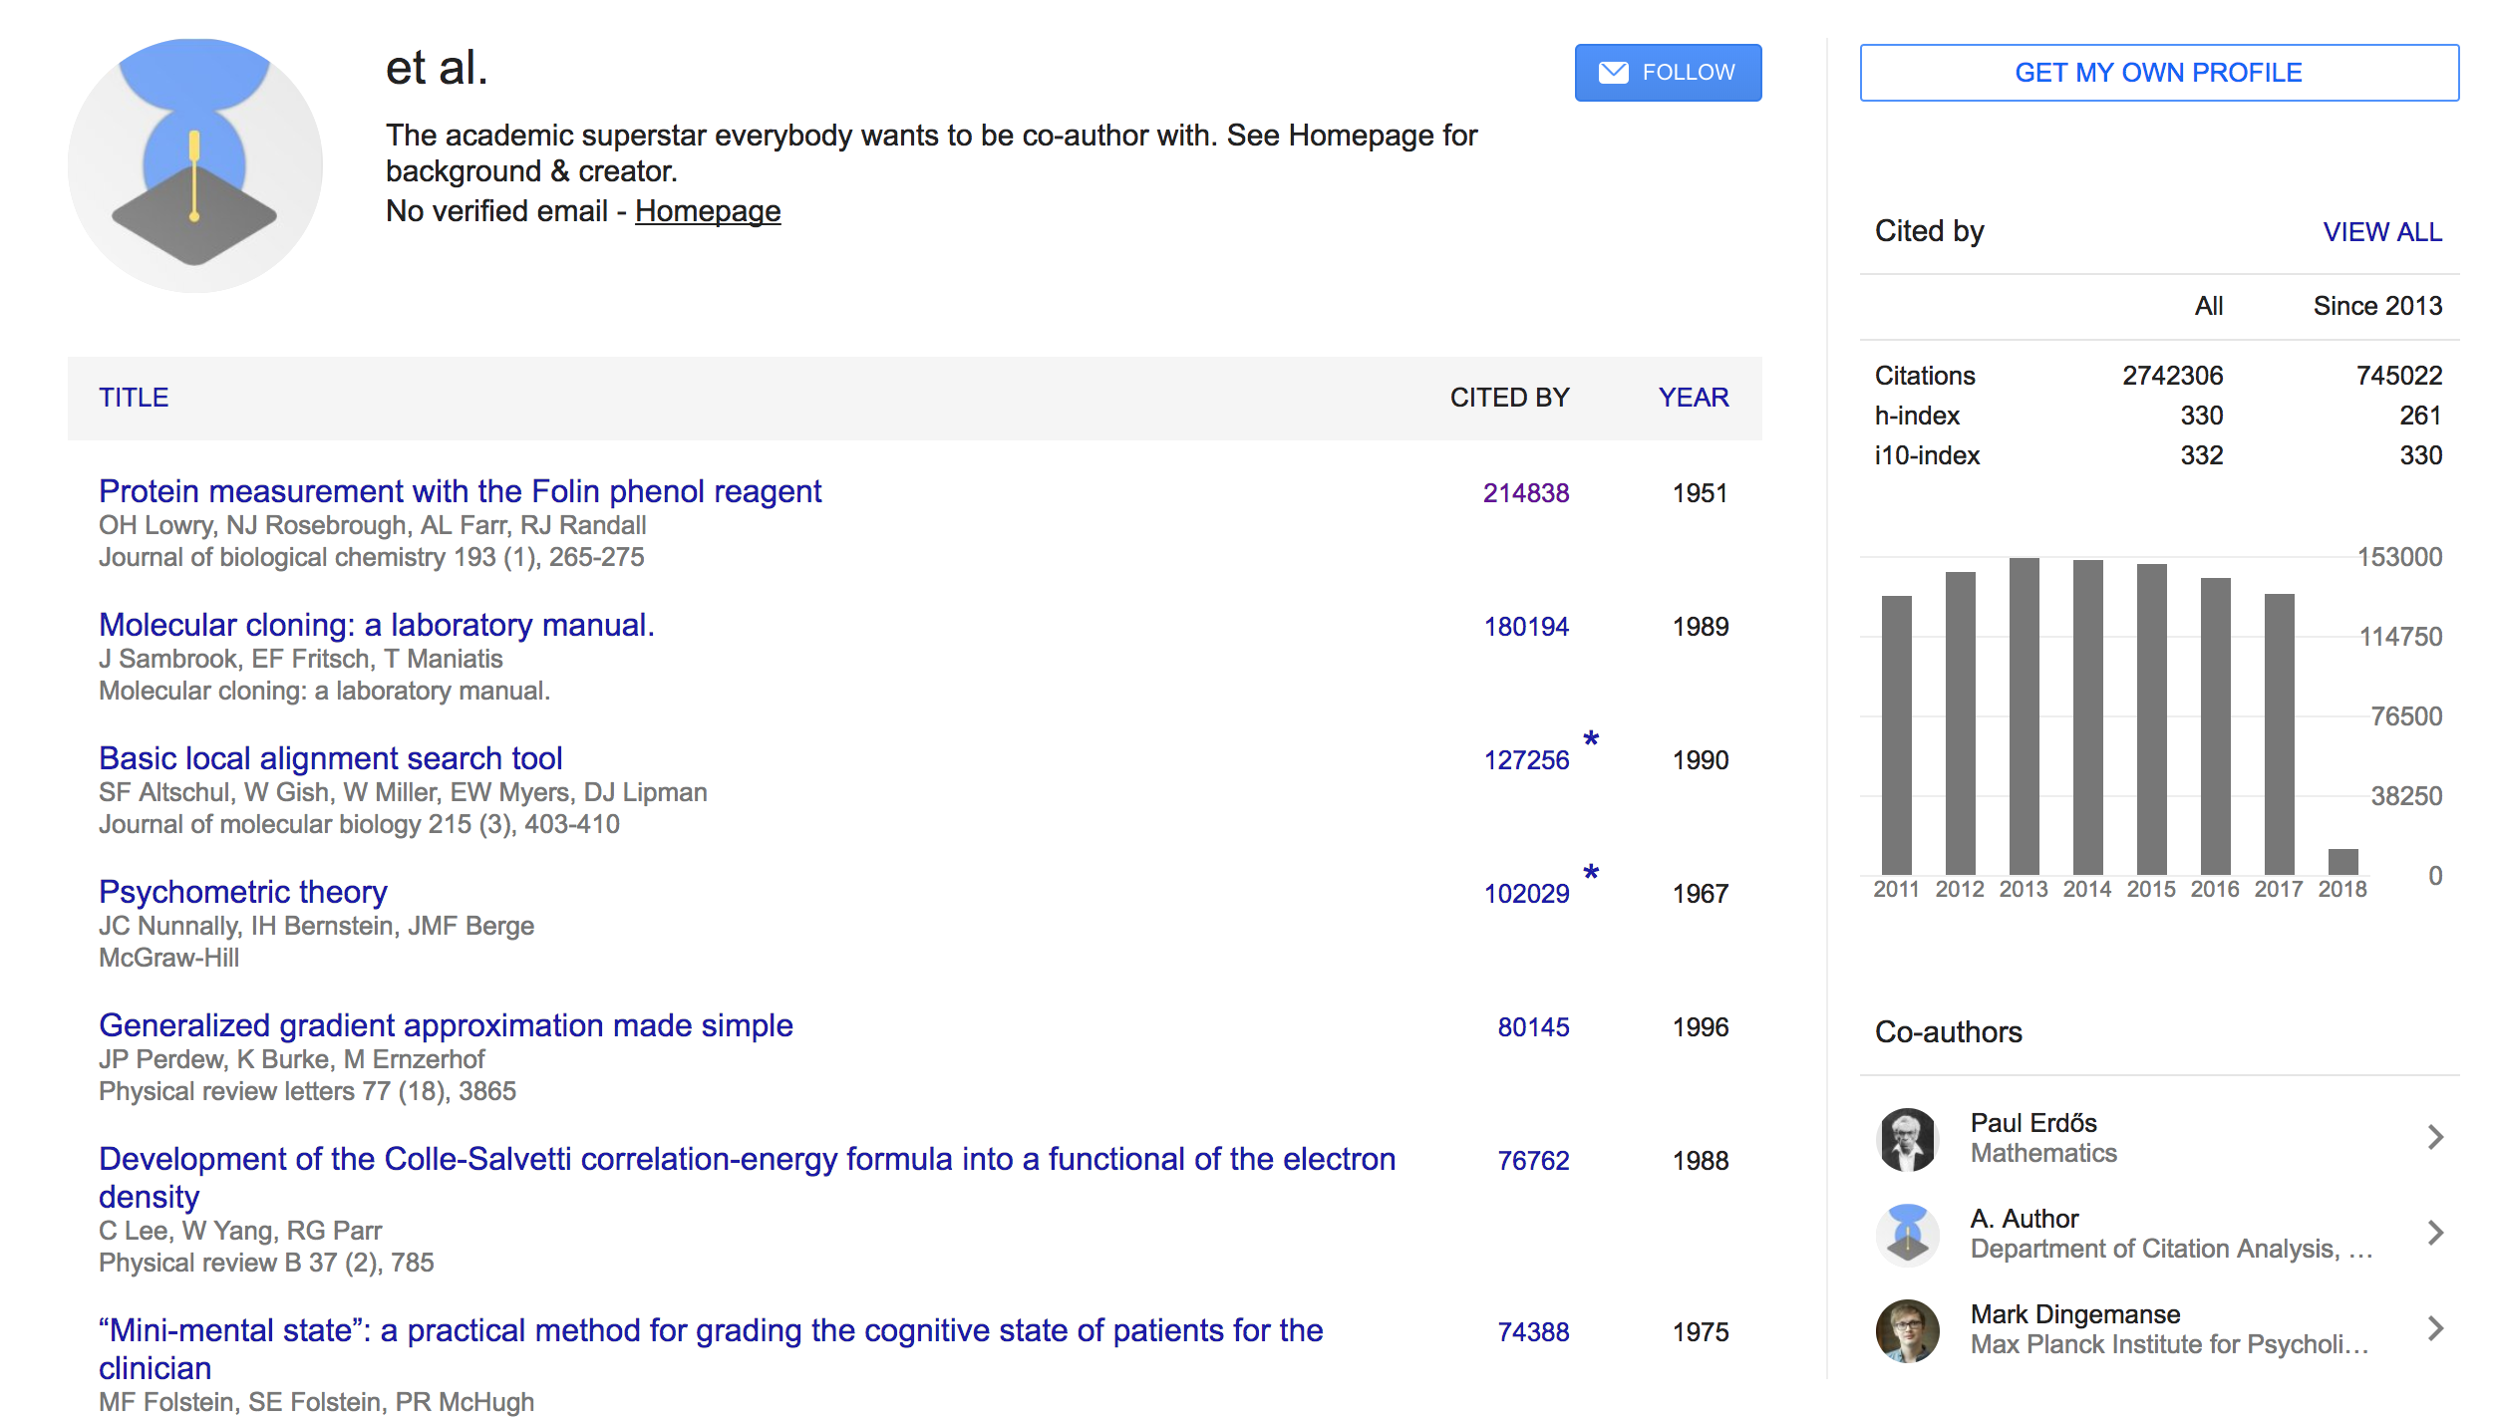
Why We Need Entity Resolution?

Slide 5
Why We Need Entity Resolution?

Slide 6
Why We Need Entity Resolution?

Slide 7
Entity Resolution (ER)
Problem of identifying, matching, and grouping same name entities from a single collection or multiple ones in data
Why is it important?
Real world databases are often made up of data from multiple sources
Unique identifier does not always exist
Example
Finding a person’s medical records from multiple hospital records
Matching same products for a comparative online shopping service

Slide 8
Entity Resolution (ER)
Disambiguation
Let D_{i}={p_{i1}, p_{i2}, … , p_{in}} be a database D_{i}, where each record p_{im} has set of values of the attribute set T_{i} = {t_{i1}, t_{i2}, …, t_{ik}}.
Find an assignment function Θ:D_{i} → E_{i} where E_{i} is the set of real name entity, and Θ(p_{ix}) = Θ(p_{iy}) if and only if p_{ix} and p_{iy} refer to the same entity
Record linkage
Let D_{j}={p_{j1}, p_{j2}, …, p_{jm}} is another database with the attribute set T_{j} = {t_{j1}, t_{j2}, …, t_{jl}}
Find a matching function Θ:D_{i}$×$D_{j} → {0,1} where Θ(p_{ix}, p_{jy}) = 1 if matches and 0 if not matches, and the result set R = {(p_{ix}, p_{jy}) | Θ(p_{ix}, p_{jy}) = 1

Slide 9
ER in Scholarly Databases
Several problems to solve
Author name disambiguation
Publication, author profile record linkage
Serves as an important preprocessing step
Process author related queries
Better biblometric analysis
Scalability is the key issue

Slide 10
Challenges
Scalability is the key issue – time complexity is O(n²)
Database | # of papers | # of author mentions | # of author mentions / papers | Process time
CiteSeerX | 10,130,097 | 31,996,749 | 3.159 | 1 week
Pubmed | 24,358,073 | 87,976,808 | 3.612 | 4 weeks
Web of Science | 45,261,744 | 162,569,706 | 3.592 | 16 weeks (estimate)
Total # of papers in Pubmed (cumulative)

Slide 11
Entity Resolution Pipeline
Database 1
Database
Pre-
processing
Pre-
processing
Blocking
(Indexing)
Blocks
Pairwise Classification
Blocking
(Indexing)
Blocks
Pairwise Classification
Pre-
processing
Clustering
Database 2
Disambiguation
Record Linkage

Slide 12
Step 1: Preprocessing
Normalize the representation of each attribute
Example: & → and, Dr → Doctor
Parse some attributes if necessary
Example: Full name → First + middle + last name
Remove punctiations, diacritics
Domain specific, differs from database to database
Typically done with lookup tables and regular expressions

Slide 13
Step 2: Blocking
Essential step to make the algorithm scale
Separates all data into small blocks with blocking key(s)
Sherri M Schwartz
Simon D Schwartz
Robert B Schwartz
Simon F Schwartz
Tony Schwartz
Seth Schwartz
R + Schwartz
S + Schwartz
T + Schwartz

Slide 14
Step 3: Pairwise Classification
Classifies whether each pair of records is from the same entity or not
Classification features
Set of string distances for record attributes (exact, Jaccard, edit, Jaro-Winkler, Soundex etc.)
Classification methods
Rule-based heuristics
Using machine learning classifiers
Naïve Bayes and support vector machine(SVM) [Han et al. 2004]
Online active SVM [Huang et al. 06]
pLSA and LDA [Song et al. 07]
Random Forest [Treeratpituk and Giles 09] [Khabsa et al. 2015] [Kim et al. 2016]
Graphical Approaches
[Bhattacharya and Getoor 07][Fan et al. 11][Hermansson et al. 13]
Limitations on scalability
Improvement with user feedback [Godoi et al. 13]

Slide 15
String Distance Metrics
Jaccard : $\frac{S1∩S2}{S1∪S2}$
Edit : minimum number of operations required to transform S₁ to S₂
Jaro-Winkler
Jaro Distance
Jaro-Winkler Distance
n_{m}: number of matches (chars no farther than half length of longer string -1)
n_{t} : number of transpositions
l_{prefix} : length of common prefix (up to 4 chars)
p : scale factor(0.1)

Slide 16
String Distance Metrics
Soundex : give credit for phonetically similar strings
Retain first letter
Remove a, e, i, o, u, y, h, w
Replace similar consonants to a same number (use at most 3)
b, f, p, v → 1
c, g, j, k, q, s, x, z → 2
d, t → 3
l → 4
m, n → 5
r → 6

Slide 17
String Distance Metrics

Slide 18
Step 4: Clustering
Form clustered entities based on the pairwise classification results
Clustering Methods
Agglomerative (Hierarchical) clustering [Mann and Yarowsky 03]
K-spectral clustering [Han et al. 05]
Density based clustering (DBSCAN) [Huang et al. 06] [Khabsa et al. 15]
Graphical approach using Markov Chain Monte Carlo(MCMC) [Wick et al. 12]

Slide 19
Applications
Inventor Name Disambiguation [JCDL 16] [IJCAI-SBD 16]
Financial Entity Record Linkage [SIGMOD-DSMM 16]

Slide 20
Inventor Name Disambiguation
Name | Title
Charles A. Spaulding | Shower surround
Charles Anthony Spaulding | Tub/shower surround
Charles Spaulding | Tub
Name | Title
Charles P. Spaulding | High temperature end fitting
Charles Spaulding | Tub
Charles D. Spaulding | Call center monitoring system
Carl P. Spaulding | Absolute encoder using multiphase analog signals
Charles A. Spaulding | Shower surround
Charles Anthony Spaulding | Tub/shower surround
Carl P. Spaulding | Incremental encoder
Charles Spaulding | End fitting for hoses
Name | Title
Charles P. Spaulding | High temperature end fitting
Charles Spaulding | End fitting for hoses
Name | Title
Carl P. Spaulding | Absolute encoder using multiphase analog signals
Carl P. Spaulding | Incremental encoder

Slide 21
USPTO PatentsView
Patent search tool serviced by United States Patent and Trademark Office(USPTO)
Inventor name disambiguation challenge in 2015 to disambiguate all inventor records
Raw data is publicly available via the competition’s web page
http://www.dev.patentsview.org/workshop
Raw data contains all published US patent grants from 1976 to 2014
Total 5.4M patents, 12.3M inventor mentions

Slide 22
Overview of the Process
Preprocessing : remove punctuation, diacritics
Blocking : First name initial + Last Name
Pairwise classification : Random Forest
Clustering : DBSCAN
Parallelization with GNU Parallel

Slide 23
Feature set
Category | Subcategory | Features
Inventor | First name | Exact, Jaro-Winkler, Soundex
 | Middle name | Exact, Jaro-Winkler, Soundex
 | Last name | Exact, Jaro-Winkler, Soundex
 | Suffix | Exact
 | Order | Order comparision
Affiliation | City | Exact, Jaro-Winkler, Soundex
 | State | Exact
 | Country | Exact
Co-author | Last name | # of name shared, IDF, Jaccard
Assignee | Last name | Exact, Jaro-Winkler, Soundex
Group | Group | Exact
 | Subgroup | Exact
Title | Title | # of term shared

Slide 24
Pairwise Classifier Selection
Pairwise classifier is trained to distinguish whether each pair of inventor records is the same person or not
Tested supervised classifiers with proposed feature set
Mixture of two training datasets
4-fold cross validation
Method | Precision | Recall | F1
Naïve Bayes | 0.9246 | 0.9527 | 0.9384
Logistic Regression | 0.9481 | 0.9877 | 0.9470
SVM | 0.9613 | 0.9958 | 0.9782
Decision Tree | 0.9781 | 0.9798 | 0.9789
Conditional Inference Tree | 0.9821 | 0.9879 | 0.9850
Random Forest | 0.9839 | 0.9946 | 0.9892

Slide 25
Clustering: DBSCAN
Randomly select a point, expand based on the density

Slide 26
Clustering: DBSCAN
Randomly select a point, expand based on the density

Slide 27
Evaluation
USPTO PatentView Competition
2 Training sets
Mixture : random mixture of IS and E&S dataset
Common Characteristics : subsampled E&S according to match characteristics of the USPTO database
5 Test Sets
ALS, ALS Common : inventors from Association of Medical Colleges(AAMC) faculty
IS : Israeli inventors
E&S : patent records of engineers and scientists
Phase2 : random mixtures of above
Calculate pairwise precision/recall/F1
Intel Xeon X5660@2.80Ghz, 12 cores, 40 GB memory
Total process time : 6.5 hours

Slide 28
Pairwise Precision / Recall / F1

Slide 29
Results
Test Set | Training Set | Precision | Recall | F1
ALS | Mixture | 0.9963 | 0.9790 | 0.9786
 | Common | 0.9960 | 0.9848 | 0.9904
ALS Common | Mixture | 0.9841 | 0.9796 | 0.9818
 | Common | 0.9820 | 0.9916 | 0.9868
IS | Mixture | 0.9989 | 0.9813 | 0.9900
 | Common | 0.9989 | 0.9813 | 0.9900
E&S | Mixture | 0.9992 | 0.9805 | 0.9898
 | Common | 0.9995 | 0.9810 | 0.9902
Phase2 | Mixture | 0.9912 | 0.9760 | 0.9836
 | Common | 0.9916 | 0.9759 | 0.9837
Test Set | F1(Ours) | F1(Winner)
ALS | 0.9904 | 0.9879
ALS Common | 0.9868 | 0.9815
IS | 0.9900 | 0.9783
E&S | 0.9902 | 0.9835
Phase2 | 0.9837 | 0.9826
Average(±stddev.) | 0.9882±0.0029 | 0.9827±0.0035
Comparison with the winner
P Value: 0.03125
Detailed results on 5 test sets

Slide 30
Financial Entity Record Linkage
Financial Entity Identification and Information Integration (FEIII) Challenge
Identify matching entities across two of the databases
FFIEC : Federal Financial Institution Examination Council
LEI : Legal Entity Identifiers
SEC : Securities and Exchange Commission
Limited set of shared attributes
Name, address, city, state, zip

Slide 31
Process Overview
Database 1
Pre-
processing
Blocks
Exact Match
No
Pairwise Classification
No
Not
Match
Blocking
(Indexing)
Pre-
processing
Yes
Yes
Match
Match
Database 2

Slide 32
Preprocessing
Different name and address formats among the data sources
Apply rules below to clean names and addresses
Each rule is applied using a regular expression
Rule | Example
Remove dots | U.S. Bank → US Bank
Remove article | The First → First
Abbreviation to full form | Corp. → Corporation
& → and | B&W → B and W
Remove postfix “company” | Trust Company → Trust
Remove postfix “/…” | Bank /TA → Bank
Rule | Example
Remove dots | P.O. Box → PO Box
Unify direction term | N → North
& → and | M&T → M and T
Abbreviation to full form | Rd → Road
Rules to clean the entity address
Rules to clean the entity name

Slide 33
Blocking
Compare only record pairs that can potentially match
Prefix articles, capitalized or not (e.g. The, A, An, a) are ignored
Heuristic: First word of the entity name + state
Name | State | Blocking Key Value
The First Bank | PA | First_PA
First State Bank | IL | First_IL
First Bank | PA | First_PA

Slide 34
Features
Use common attributes among financial databases to generate features
Entity name, street address, city, state, zip code
Category | Features
Name | Jaro-Winkler, Jaccard
Address | Jaro-Winkler, Jaccard
City | Jaro-Winkler, Exact
State | Exact
Zip | Exact

Slide 35
Results
Task | Training Set | Precision | Recall | F1
FFIEC → LEI | LEI | 99.16% | 95.77% | 97.44%
 | LEI + SEC | 97.71% | 94.56% | 96.11%
FFIEC → SEC | SEC | 87.84% | 84.78% | 86.28%
 | LEI + SEC | 86.78% | 85.65% | 86.21%
Best: 99.24% / 96.37% / 97.44%
Best: 92.82% / 85.65% / 88.38%

Slide 36
Recent / On-going Researches
Improve blocking for better scalability [Kim et al. 17]
Typical blocking on author name disambiguation uses simple heuristic (First name initial + Last name)
Can we train the blocking function given the labeled data?
Approach
Use sequential covering algorithm to train blocking function
Can learn disjunctive normal form (DNF) and conjunctive normal form (CNF) with same algorithm, thanks to De Morgan’s Laws
Showed CNF is better for blocking on AND problems – empty values on many attributes
Ensuring disjointness of each blocks with proposed disjoint CNF blocking
Improve pairwise classification with deep neural networks
Can we automatically learn feature representation instead of manual feature engineering?
Improvement of the classification result itself

Slide 37
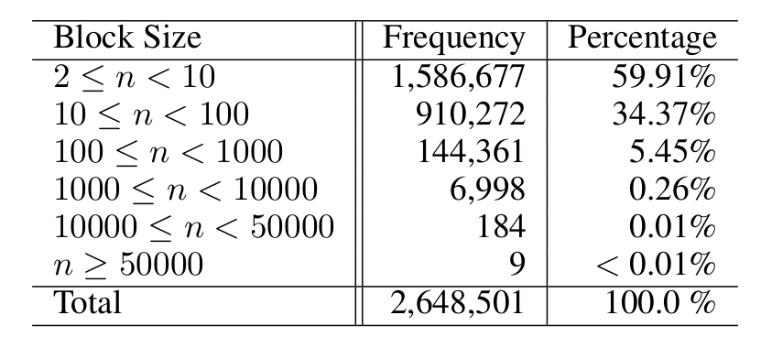
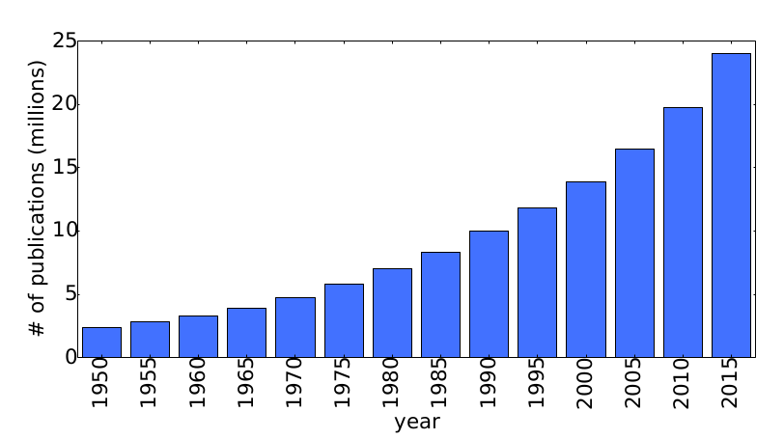
Improving Blocking
Typically a heuristic is used for author name disambiguation (AND) problem [Torvik and Smalheiser 09], [Levin et al. 12], [Liu et al. 14], [Khabsa et al. 14], [Kim et al. 16]
(First name, initial) AND (Last name, full)
Problem
Imbalance of block size distribution, especially extremely large blocks can dominate the computation for O(n²)
Rapid growth of scholarly databases can make the problem worse

Slide 38
PubmedSeer: Disambiguated Author Search on Pubmed
A specialty search engine for disambiguated pubmed authors
Author name disambiguation serves as an important pre-processing step for variety of problems
Processing author-related query
Calculating author-related statistics
Studying relationship between authors
Researchers use Authority explorer (http://abel.lis.illinois.edu/cgi-bin/exporter/search.pl) , which was built around 2010
Built with Elasticsearch + django

Slide 39
PubmedSeer API : Author Name Disambiguation API for Pubmed
Author name disambiguation (AND) is studied for a long time (Torvik and Smalheiser 2009, Levin et al. 2012, Liu et al. 2014, Khabsa et al. 2014, Kim et al. 2016), but limited access of the disambiguated data is available for users
Few publicly available codes : Early version of CiteSeerX, AMiner
Some scholarly search engines provide author search module
CiteSeerX, Google Scholar, DBLP, Semantic Scholar, …
Limitation : hard to extract data
Some organizations are registering researchers and give unique ID
ORCID : 4.3M IDs, 1.7M with records
High quality but not complete
SCOPUS, ResearcherID

Slide 40
PubmedSeer API : Author Name Disambiguation API for Pubmed
Goal : Provide appropriate web service for users to use the disambiguated author data easily

