Slide 1
Autoencoders (AEs)
Thanks to Sargur Srihari, Fei-Fei Li, Justin Johnson, Serena Yeung, Sosuke Kobayashi, Yingyu Liang, Guy Golan, Song Han, Jason Brownlee, Jefferson Hernandez

Slide 2
Previously
Principles of machine learning
Deep Feedforward NNs
Regularization
Optimization
Convolutional NNs
Recurrent NNs
Memory NNs
Today Autoencoders, GANs

Slide 3
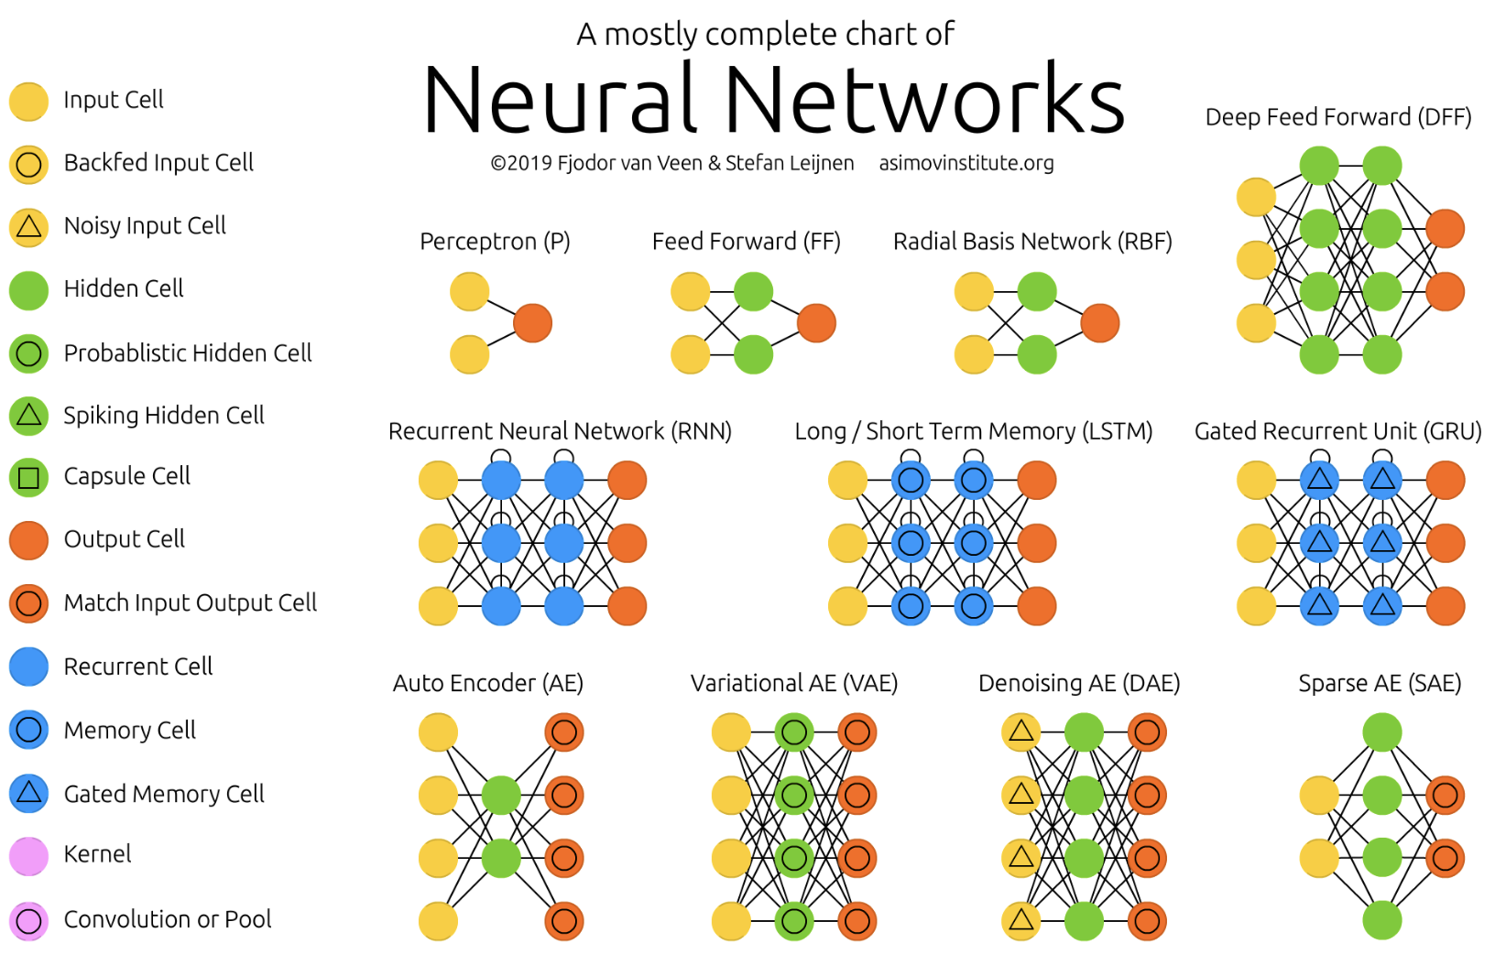
Generic Neural Architectures (1-11)
14 types of neurons

Slide 4
Topics in Autoencoders
What is an autoencoder?
Undercomplete Autoencoders
Regularized Autoencoders
Representational Power, Layout Size and Depth
Stochastic Encoders and Decoders
Denoising Autoencoders
Learning Manifolds and Autoencoders
Contractive Autoencoders
Predictive Sparse Decomposition
Applications of Autoencoders

Slide 5
Some Autoencoder Applications
Dimensionality Reduction
Image Compression
Image Denoising
Feature Extraction
Image generation
Sequence to sequence prediction
Encoders for transformers

Slide 6
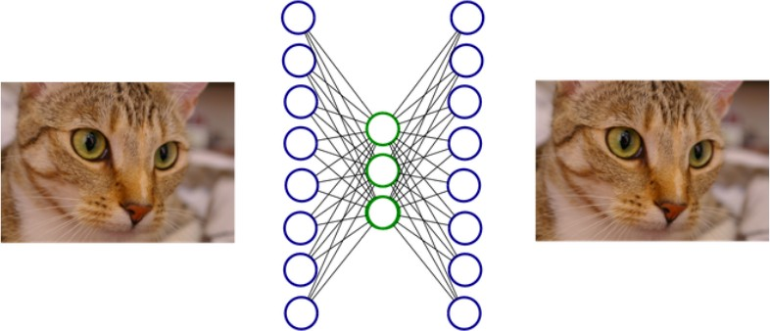
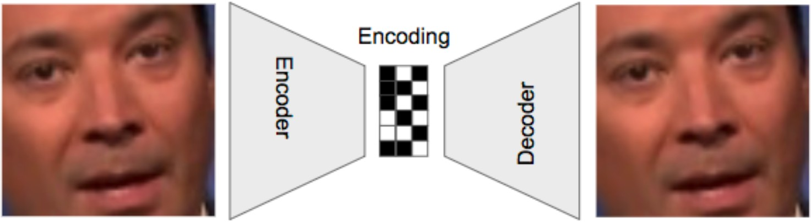
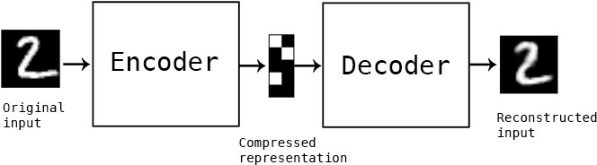
What is an Autoencoder (AE) ?
A neural network trained using unsupervised learning
  Trained to copy its input to its output
  Learns an embedding h

Slide 7
Embedding is a Point on a Manifold
An embedding is a low-dimensional vector
  With fewer dimensions than the ambient space of which the manifold is a low-dimensional subset
Embedding Algorithm
  Maps any point in ambient space x to its embedding h
  Embeddings of related inputs form a manifold

Slide 8
Other Embeddings
All are dimensionally reduction methods:
Principle component analysis (PCA):
PCA is a feature extraction technique — it combines the variables, and then it drops the least important variables while still retains the valuable parts of the variables
Probably the most widely used embedding to date. The idea is simple: Find a linear transformation of features that maximizes the captured variance or (equivalently) minimizes the quadratic reconstruction error.
Multidimensional Scaling (MDS):
Unsupervised ML methods that represent high-dimensional data in a lower dimensional space, while preserving the inter-point distances as best as possible.

Slide 9
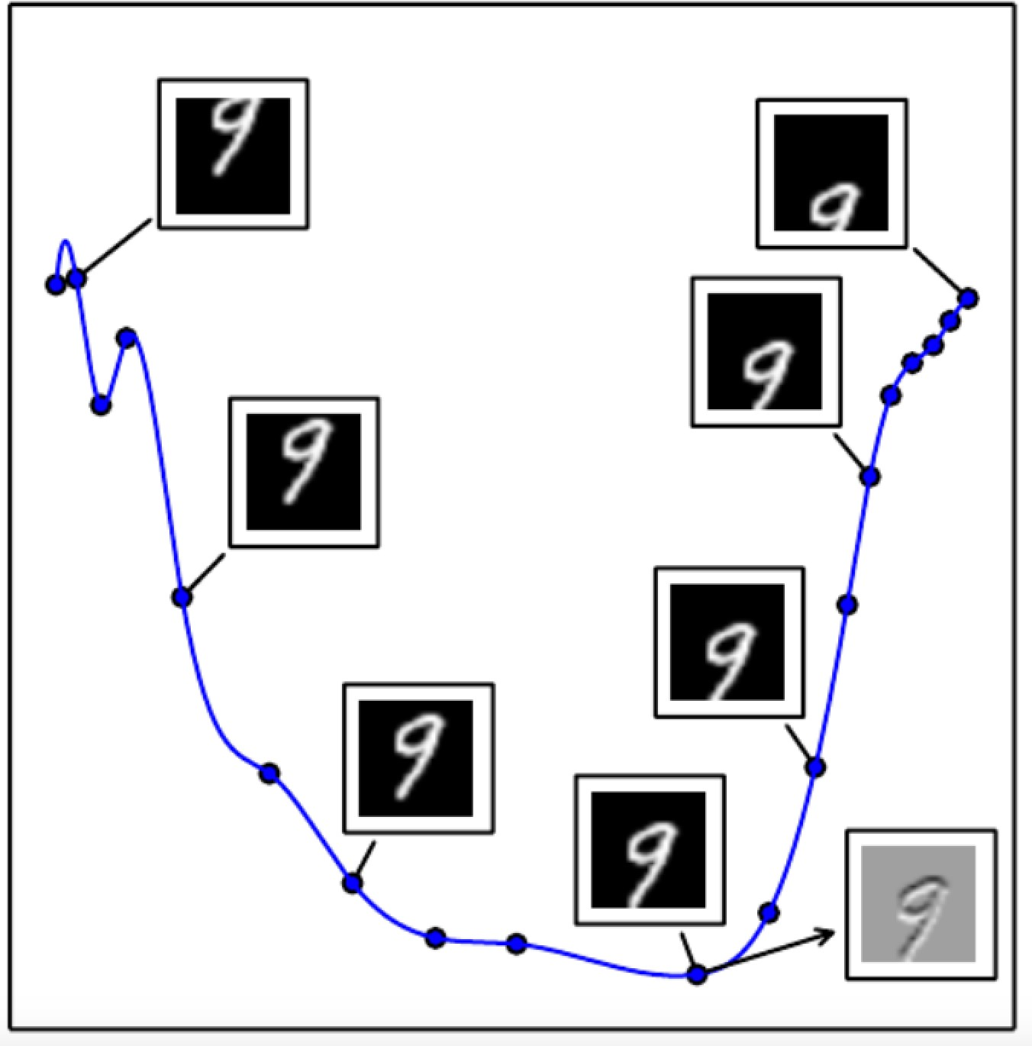
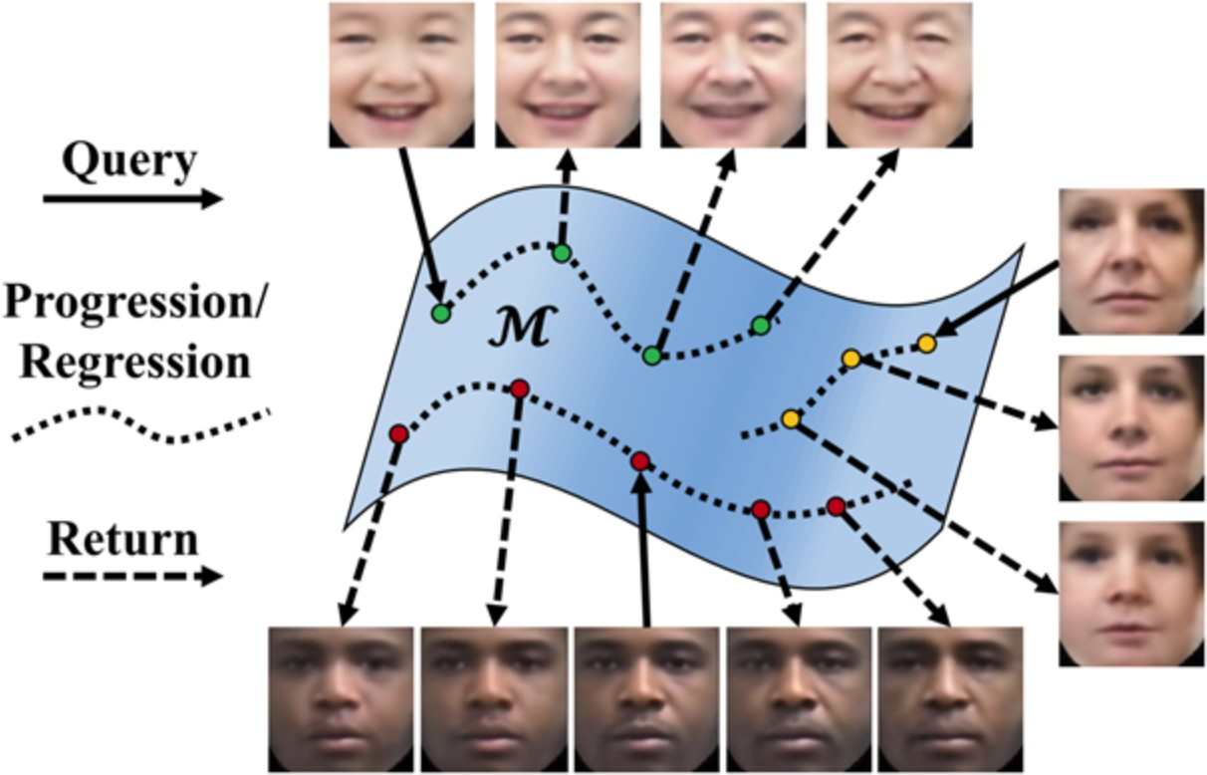
A Manifold in Ambient Space
Embedding: map x to lower dimensional h
1-D manifold in 2-D space
Derived from 28x28=784 space
Age Progression/Regression by Conditional Adversarial Autoencoder (CAA Github: https://github.com/ZZUTK/Face-Aging-CAAE

Slide 10
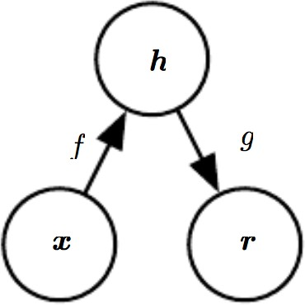
General Structure of an Autoencoder
Maps an input x to an output r (called a reconstruction) through an internal representation code h
  Hidden layer h describes a code used to represent the input
The network has two parts
  The encoder function h=f(x)
  A decoder that produces a reconstruction r=g(h)

Slide 11
Autoencoders Differ from Classical Data Compression
Autoencoders are data-specific
    i.e., only able to compress data similar to what they have been trained on
  Different from MP3 or JPEG compression algorithm
  These make general assumptions about "sound/images”, but not about specific types of sounds/images
  Autoencoder for pictures of cats would do poorly in compressing pictures of trees
    Features it would learn would be cat-specific
Autoencoders are lossy
  Their decompressed outputs will be degraded compared to the original inputs (similar to MP3 or JPEG compression).
  This differs from lossless arithmetic compression
Autoencoders are learned

Slide 12
Deep Compression – an aside
Deep networks for compression
Or
Compressing large NNs for space and power savings

Slide 13
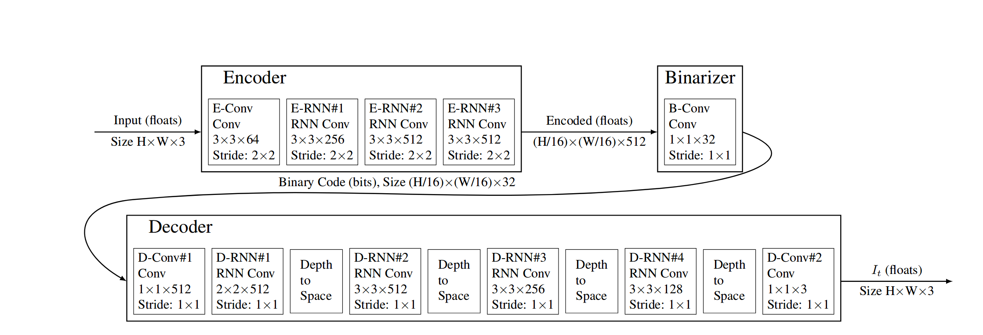
Deep Image Compression - Google
Model diagram for single iteration i of shared recurrent neural network (RNN) architecture [Toderici ‘15 , Toderici ‘16]

Slide 14
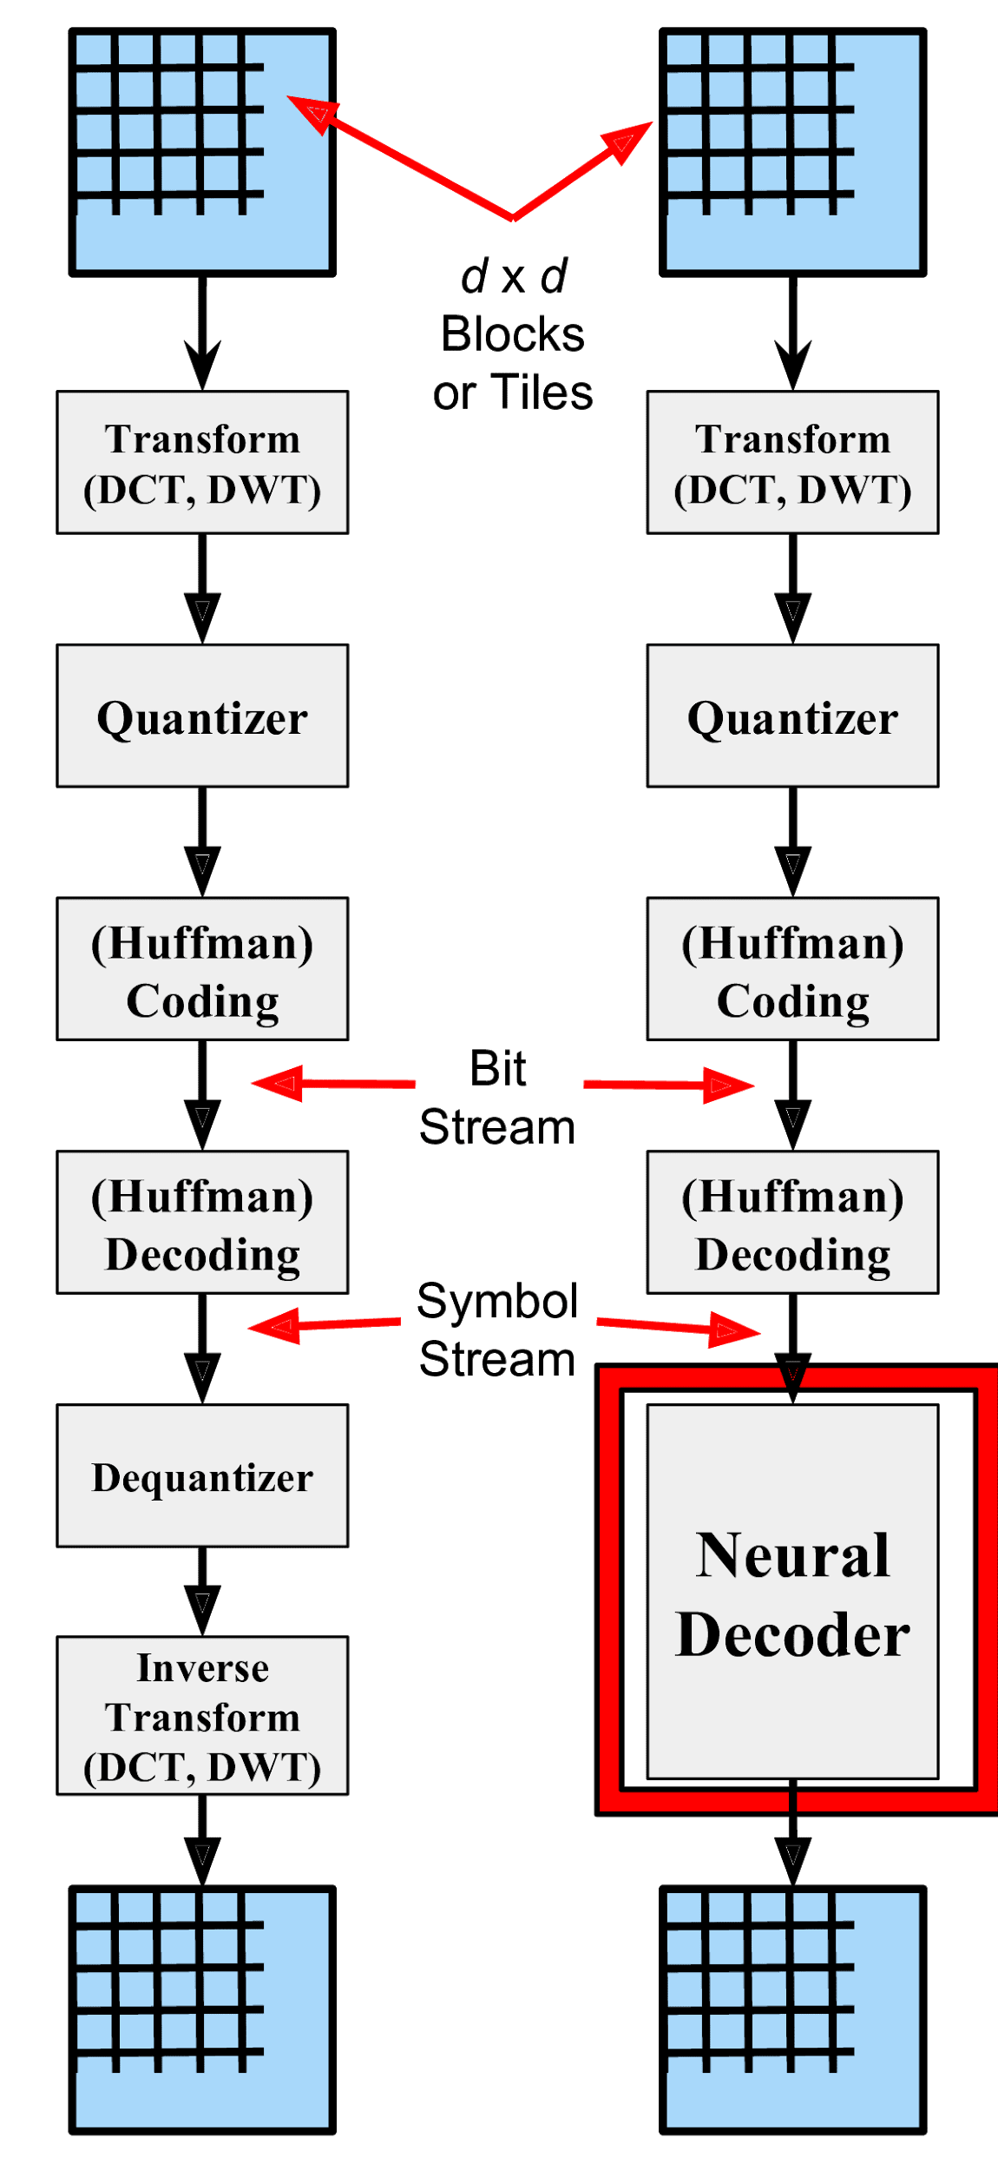
Hybrid Deep Compression
Standard method
Ours
Design an iterative, RNN-based hybrid estimator for decoding instead of using transformations.
  Replaces dequantizer and inverse encoding transform modules with a function approximator.
  Neural decoder is single layer RNN with 512 units.
An iterative refinement algorithm learns an iterative estimator of this function approximator
  Exploits both causal & non-causal information to improve low bit rate reconstruction.
  Applies to any image decoding problem
    Handles a wide range of bit rate values
Uses multi-objective loss function for image compression.
Uses a new annealing schedule - i.e annealed stochastic learning rate.
Achieved +0.971 dB gain over Google neural model on Kodak Test set.
Ororbia, Mali, DCC ‘19

Slide 15
Motivation
Deep Neural Networks are BIG ... and getting BIGGER
  e.g. AlexNet (240 MB), VGG-16 (520 MB)
Too big to store on-chip SRAM and DRAM accesses use a lot of energy
Not suitable for low-power mobile/embedded systems
Solution: Deep Compression

Slide 16
Deep Compression
Another meaning
Technique to reduce size of neural networks without losing accuracy
      Pruning to Reduce Number of Weights
      Quantization to Reduce Bits per Weight
      Huffman Encoding
“Deep Compression: Compressing Deep Neural Networks with Pruning, Trained Quantization and Huffman Coding”, Song Han et al., ICLR 2016

Slide 17
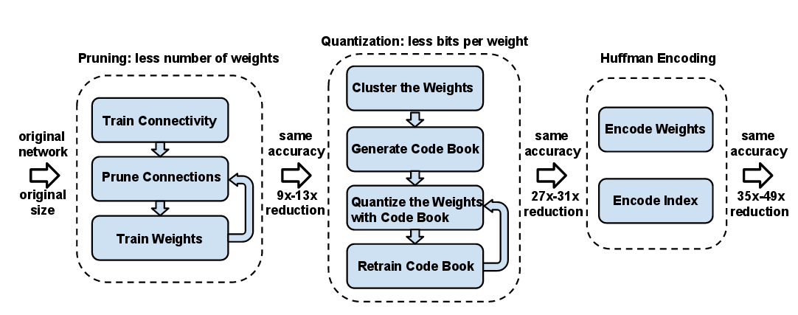
Deep Compression
“Deep Compression: Compressing Deep Neural Networks with Pruning, Trained Quantization and Huffman Coding”, Song Han et al., ICLR 2016

Slide 18
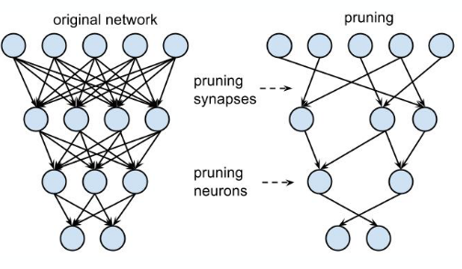
Pruning
Remove weights/synapses “close to zero”
Retrain to maintain accuracy
Repeat
Sparse Network

Slide 19
Pruning Results

Slide 21
What does an Autoencoder Learn?
Learning g (f (x))=x everywhere is not useful
Autoencoders are designed to be unable to copy perfectly
  Restricted to copying only approximately
Autoencoders learn useful properties of the data
  Forced to prioritize which aspects of input should be copied
Can learn stochastic mappings
  Go beyond deterministic functions to mappings p_{encoder}(h|x) and p_{decoder}(x|h)

Slide 22
Autoencoder History
Part of neural network landscape for decades
  Used for dimensionality reduction and feature learning
Historical note: goes back to (LeCun, 1987; Bourlard and Kamp, 1988; Hinton and Zemel, 1994).
Theoretical connection to latent variable models
  AE’s brought them into forefront of generative models
    Variational Autoencoders

Slide 23
Basic Types of Autoencoders (AEs)
We distinguish between two types of AE structures:
Undercomplete
Overcomplete

Slide 24





Undercomplete AE
Hidden layer is Undercomplete if smaller than the input layer
  Compresses the input
  Compresses well only for the training distribution
$$\hat{x}$$
$$w′$$
$$f\left(x\right)$$
Hidden nodes will be
  Good features for the training distribution.
  Bad for other types on input
$$w$$
$$x$$

Slide 25




Overcomplete AE
Hidden layer is Overcomplete if greater than the input layer
  No compression in hidden layer.
  Each hidden unit could copy a different input component.
$$\hat{x}$$
$$w′$$
$$f\left(x\right)$$
No guarantee that the hidden units will extract meaningful structure.
$$w$$
Adding dimensions is good for training a linear classifier (XOR case example).
A higher dimension code helps model a more complex distribution.
$$x$$

Slide 26
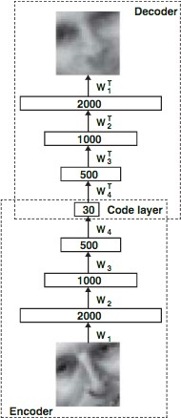
An autoencoder architecture
Decoder g
Weights W are learned using:
Training samples, and
a loss function
Encoder f

Slide 27
Autoencoder Training Methods
Autoencoder is a feed-forward non-recurrent neural net
  With an input layer, an output layer and one or more hidden layers
  Can be trained using the same techniques
    Compute gradients using back-propagation
    Followed by minibatch gradient descent
Unlike feedforward networks, can also be trained using
Recirculation
  Compare activations on the input to activations of the reconstructed input
  More biologically plausible than back-prop but rarely used in ML

Slide 28
1. Undercomplete Autoencoder
Copying input to output seems useless but we have no interest in decoder output
Want h to take on useful properties
Undercomplete autoencoder
  Constrain h to have lower dimension than x
  Force it to capture most salient features of training data

Slide 29
Autoencoder with Linear Decoder +MSE is a PCA
Learning process is minimizing a loss function
L(x, g ( f (x)))
  where L is a loss function penalizing g( f (x)) for being dissimilar from x
    Exs: L² norm of difference: mean squared error
  When the decoder g is linear and L is the mean squared error, an undercomplete autoencoder learns to span the same subspace as PCA
    In this case the autoencoder trained to perform the copying task has learned the principal subspace of the training data as a side-effect
Autoencoders with nonlinear f and g can learn more powerful nonlinear generalizations of PCA
  But high capacity is not desirable

Slide 30
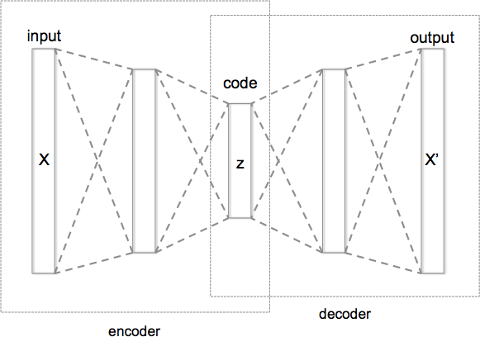
Autoencoder Training Using a Loss Function
Encoder f and decoder g
f : Χ → h
g : h → X
Autoencoder with 3 fully connected hidden layers
arg min X −(f ! g)X
2
f ,g
One hidden layer
  Non-linear encoder
  Takes input x ε R^{d}
h
Maps into output h ε R^{p}
h = σ₁(Wx + b)
Decoder g
Encoder f
x ' = σ₂(W 'h + b')
o is an element-wise activation function such as sigmoid or Relu
Trained to minimize reconstruction error (such as sum of squared errors)
2
2
x − σ (W ^{t} (σ (Wx + b))+ b ')
2 1
L(x,x ') = x − x ' =
Provides a compressed representation of the input x

Slide 31
Encoder/decoder Capacity
If encoder f and decoder g are allowed too much capacity
  autoencoder can learn to perform the copying task without learning any useful information about the distribution of data
Autoencoder with a one-dimensional code and a very powerful nonlinear encoder can learn to map x^{(i)} to code i.
  The decoder can learn to map these integer indices back to the values of specific training examples
Autoencoder trained for copying task fails to learn anything useful if f/g capacity is too great
A model with too little capacity cannot learn the training dataset meaning it will underfit, whereas a model with too much capacity may memorize the training dataset, meaning it will overfit or may get stuck or lost during the optimization process.
The capacity of a neural network model is defined by configuring the number of nodes and the number of layers.

Slide 32
Cases When Autoencoder Learning Fails
When do autoencoders fail to learn anything useful:
  Capacity of encoder/decoder f/g is too high
    Capacity controlled by depth
  Hidden code h has dimension equal to input x
  Overcomplete case: where hidden code h has dimension greater than input x
    Even a linear encoder/decoder can learn to copy input to output without learning anything useful about data distribution

Slide 33
2. Correct AE Design: use Regularization
Ideally, choose code size (dimension of h) small and capacity of encoder f and decoder g based on complexity of distribution modeled
Regularized autoencoders
  Rather than limiting model capacity by keeping encoder/decoder shallow and code size small, use a loss function that encourages the model to have properties other than copy its input to output

Slide 34
Regularized Autoencoder Properties
Regularized AEs have properties beyond copying input to output:
  Sparsity of representation
  Smallness of the derivative of the representation
  Robustness to noise
  Robustness to missing inputs
Regularized autoencoders can be nonlinear and overcomplete
  Still can learn something useful about the data distribution even if model capacity is great enough to learn trivial identity function

Slide 35
Generative Models Viewed as AEs
Beyond regularized autoencoders
Generative models with latent variables and an inference procedure (for computing latent representations given input) can be viewed as a particular form of autoencoder
Generative modeling approaches which have a connection with autoencoders are descendants of the Helmholtz machine.
Examples
  Variational autoencoder
  Generative stochastic networks

Slide 36
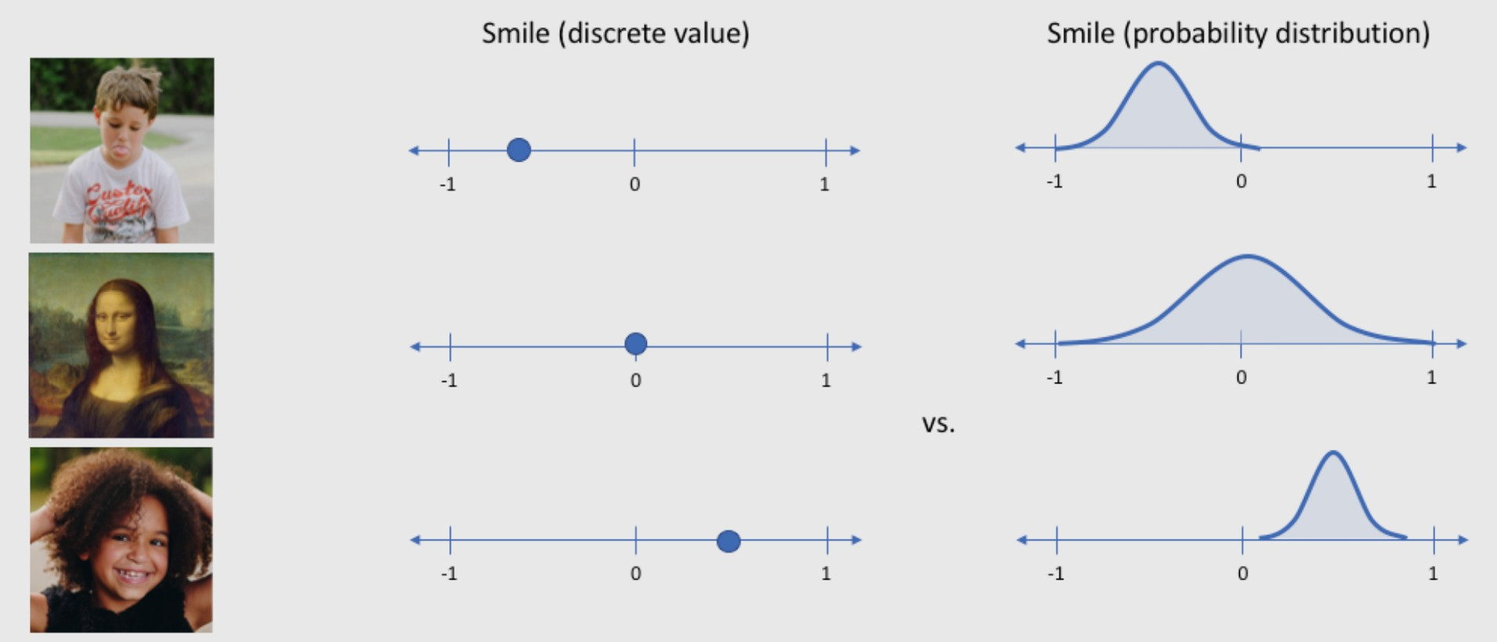
Latent variables treated as distributions
Source: https://www.jeremyjordan.me/variational-autoencoders/

Slide 37
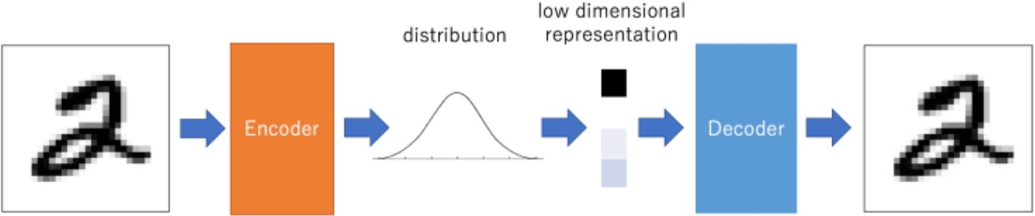
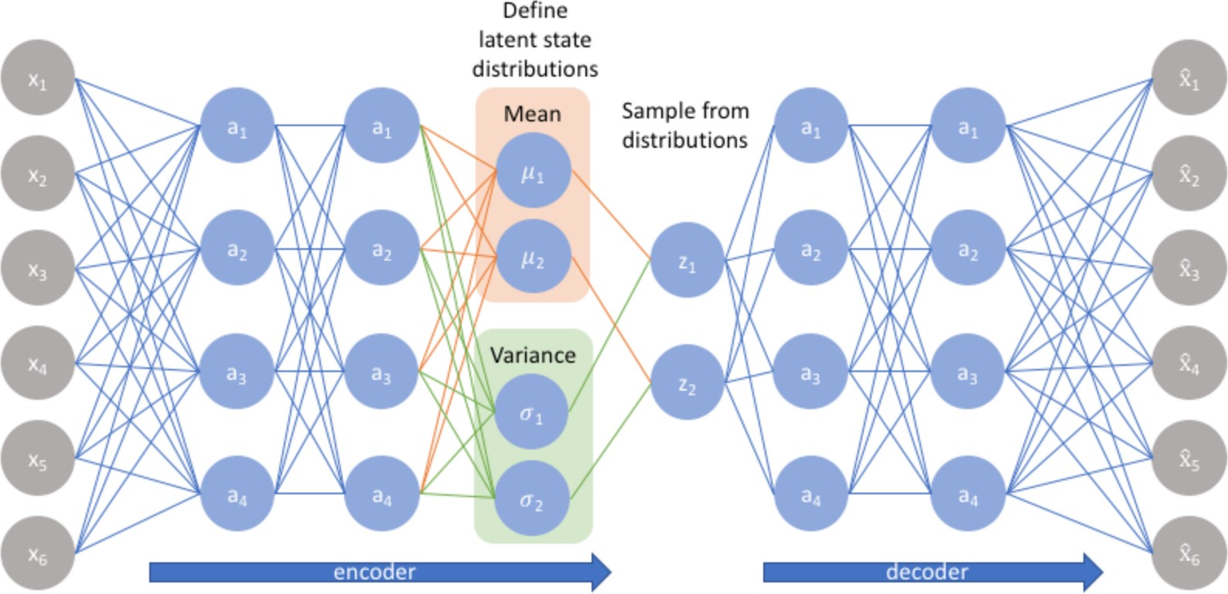
Variational Autoencoder (VAE)
VAE is a generative model
  able to generate samples that look like samples from training data
    With MNIST, these fake samples would be synthetic images of digits
Due to random variable between input & output it cannot be trained using backprop
  Instead, backprop uses the parameters of the latent distribution
  Called reparameterization trick
N(μ,Σ) = μ + Σ N(0, I)
Where Σ is diagonal
21

Slide 38
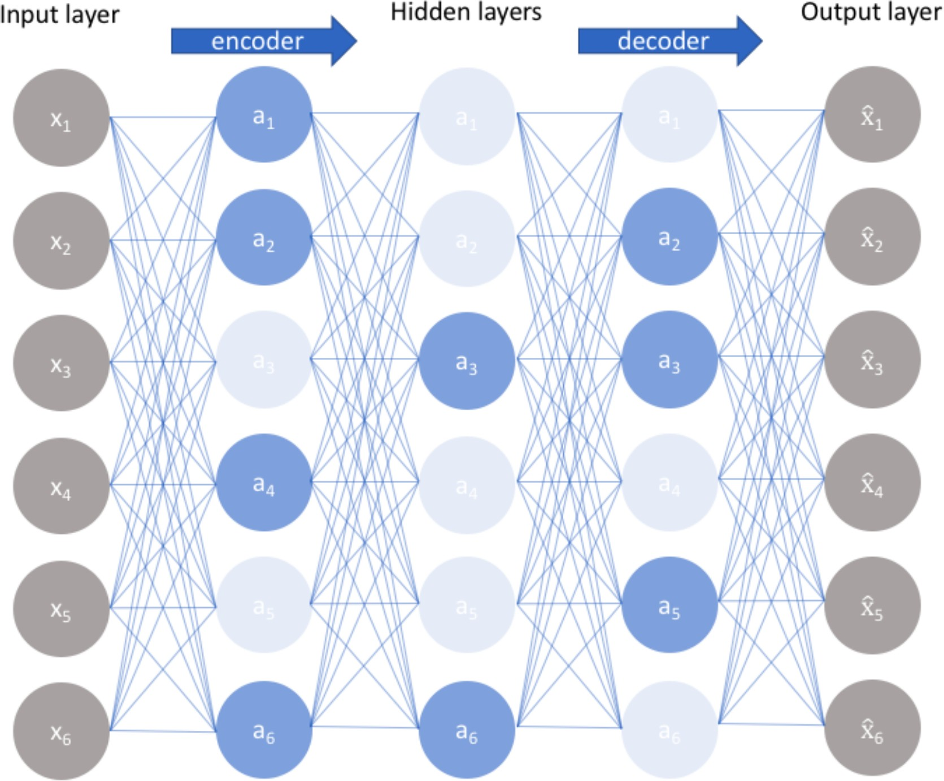
Sparse Autoencoder
Only a few nodes are encouraged to activate when a single sample is fed into the network
Fewer nodes activating while still maintaining performance guarantees that the autoencoder is actually learning latent representations instead of redundant information in the input data

Slide 39
Sparse Autoencoder Loss Function
A sparse autoencoder is an autoencoder whose
  Training criterion includes a sparsity penalty Ω(h) on the code layer h in addition to the reconstruction error:
L(x, g ( f (x))) + Ω(h)
  where g (h) is the decoder output and typically we have h = f (x)
Sparse encoders are typically used to learn features for another task such as classification
An autoencoder that has been trained to be sparse must respond to unique statistical features of the dataset rather than simply perform the copying task
  A sparsity penalty can yield a model that has learned useful features as a byproduct

Slide 40
Sparse encoder doesn’t have a Bayesian Interpretation
Penalty term Ω(h) is a regularizer term added to a feedforward network
  Primary task: copy input to output (with Unsupervised learning objective)
  Also perform some supervised task (with Supervised learning objective) that depends on the sparse features
In supervised learning regularization term corresponds to prior probabilities over model parameters
  Regularized MLE corresponds to maximizing p(θ|x), which is equivalent to maximizing log p(x|θ)+log p(θ)
    First term is data log-likelihood and second term is log-prior over parameters
  Regularizer depends on data and thus is not a prior
    Instead, regularization terms express a preference over functions

Slide 41
Generative Model View of Sparse AE
Rather than thinking of a sparsity penalty as a regularizer for the copying task, think of a sparse autoencoder as approximating ML training of a generative model that has latent variables
Suppose model has visible/latent variables x and h
Explicit joint distribution is p_{model}(x,h) = p_{model}(h) p_{model}(x|h)
  where p_{model}(h) is model’s prior distribution over latent variables
    Different from p(θ) being distribution of parameters
The log-likelihood can be decomposed aslog p_{model}(x,h) = log ∑ p_{model}(h,x)
Autoencoder approximates the sum with a point estimate for just one highly likely value of h, the output of a parametric encoder
  For a chosen h we are maximizing log p_{model}(x,h) = log p_{model}(h)+log p_{model}(x|h)
h

Slide 42

Sparsity-inducing Priors
The log p_{model}(h) term can be sparsity-inducing. For example the Laplace prior
λ
−λ|h |
p (h ) = e
i
model i
2
corresponds to an absolute value sparsity penalty
Expressing the log-prior as an absolute value penalty
where
Ω(h) = λ∑h
i
i
where the constant term depends only on λ and not on h
We treat λ as a hyperparameter and discard the constant term, since it does not affect parameter learning

Slide 43
Denoising Autoencoders (DAE)
Rather than adding a penalty Ω to the cost function, we can obtain an autoencoder that learns something useful by changing the reconstruction error of the cost function
Traditional autoencoders minimize L(x, g ( f (x)))
  where L is a loss function penalizing g( f (x)) for being dissimilar from x, such as L² norm of difference: mean squared error
A DAE minimizes
L(x,g(f ( )))
where is a copy of x that has been corrupted by some form of noise
The autoencoder must undo this corruption rather than simply copying their input
Denoising training forces f and g to implicitly learn the structure of p_{data}(x)
Another example of how useful properties can emerge as a by -product of minimizing reconstruction error

Slide 44
Regularizing by Penalizing Derivatives
Another strategy for regularizing an autoencoder
Use penalty as in sparse autoencoders
L(x, g ( f (x))) + Ω(h,x)
But with a different form of Ω
Ω(h,x) = λ∑ ∇_{x}h_{i}
i
2
Forces the model to learn a function that does not change much when x changes slightly
Called a Contractive Auto Encoder (CAE)
This model has theoretical connections to
  Denoising autoencoders
  Manifold learning
  Probabilistic modeling

Slide 45
3. Representational Power, Layer Size and Depth
Autoencoders are often trained with with a single layer
However using a deep encoder offers many advantages
  Recall: Although universal approximation theorem states that a single layer is sufficient, there are disadvantages:
    number of units needed may be too large
    may not generalize well
Common strategy: greedily pretrain a stack of shallow autoencoders

Slide 46
4. Stochastic Encoders and Decoders
General strategy for designing the output units and loss function of a feedforward network is to
  Define the output distribution p(y|x)
  Minimize the negative log-likelihood –log p(y|x)
  In this case y is a vector of targets such as class labels
In an autoencoder x is the target as well as the input
  Yet we can apply the same machinery as before

Slide 47
Loss function for Stochastic Decoder
Given a hidden code h, we may think of the decoder as providing a conditional distribution p_{decoder}(x|h)
We train the autoencoder by minimizing –log p_{decoder}(x|h)
The exact form of this loss function will change depending on the form of p_{decoder}(x|h)
As with feedforward networks we use linear output units to parameterize the mean of the Gaussian distribution if x is real
  In this case negative log-likelihood is the mean-squared error
With binary x values correspond to a Bernoulli distribution with parameters given by a sigmoid output
Discrete x values correspond to a softmax output
The output variables are treated as being conditionally independent given h so the probably distribution is inexpensive to evaluate

Slide 48
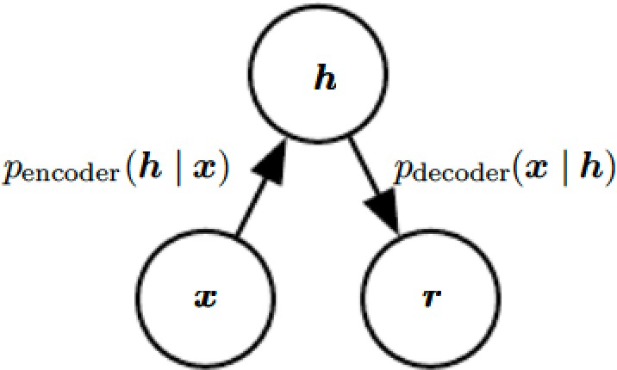
Stochastic Encoder
We can also generalize the notion of an encoding function f(x)
to an encoding distribution p_{encoder}(h|x)

Slide 49
Structure of stochastic autoencoder
Both the encoder and decoder are not simple functions but involve a distribution
The output is sampled from a distribution p_{encoder}(h|x) for the encoder and p_{decoder}(x|h) for the decoder

Slide 50
Relationship to the Joint Distribution
Any latent variable model p_{model}(h|x) defines a stochastic encoder p_{encoder}(h|x)=p_{model}(h|x)
And a stochastic decoder p_{decoder}(x|h)=p_{model}(x|h)
In general the encoder and decoder distributions are not conditional distributions compatible with a unique joint distribution p_{model}(x,h)
Training the autoencoder as a denoising autoencoder will tend to make them compatible asymptotically
With enough capacity and examples

Slide 51
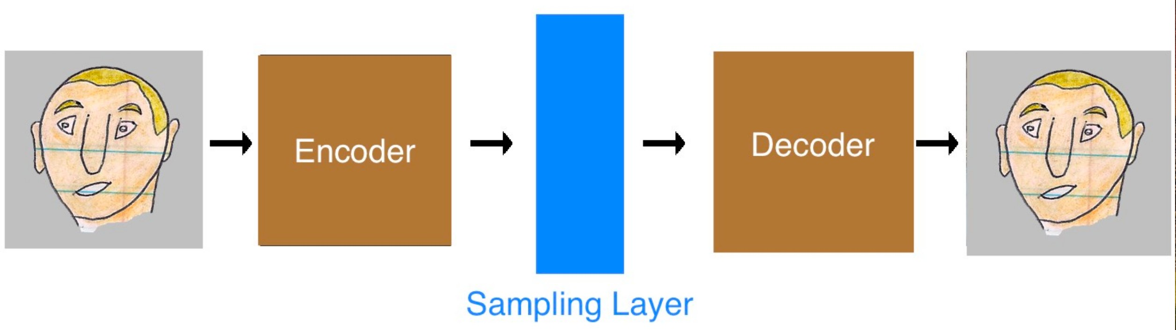
Sampling p_{model}(h|x)
x
^{p}encoder^{(h|x)}
^{p}decoder^{(x|h)}

Slide 52
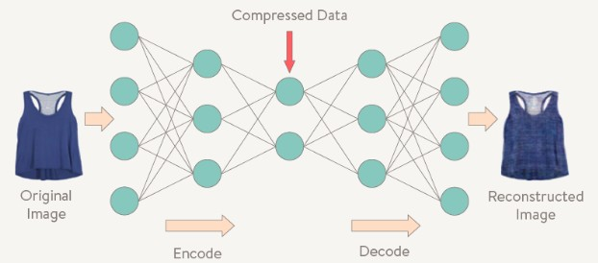
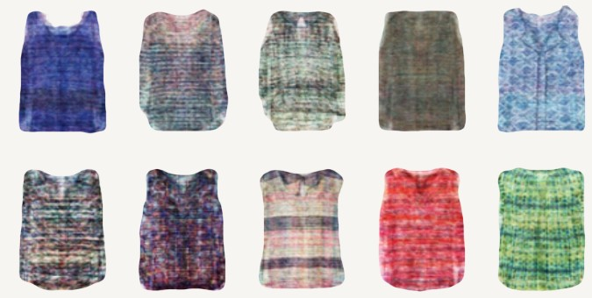
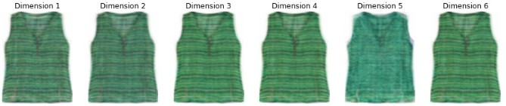
Ex: Sampling p(x|h): Deepstyle
Look at a representation which relates to style
  By iterating neural network through a set of images learn efficient representations
Choosing a random numerical description in encoded space will generate new images of styles not seen
Using one input image and changing values along different dimensions of feature space you can see how the generated image changes (patterning, color texture) in style space

Slide 53
Topics in Autoencoders
What is an autoencoder?
Undercomplete Autoencoders
Regularized Autoencoders
Representational Power, Layout Size and Depth
Stochastic Encoders and Decoders
Denoising Autoencoders
Learning Manifolds and Autoencoders
Contractive Autoencoders
Predictive Sparse Decomposition
Applications of Autoencoders

Slide 54
5. Denoising Autoencoders (DAEs)
Defined as an autoencoder that receives a corrupted data point as input and is trained to predict the original, uncorrupted data point as its output
  Traditional autoencoders minimize L(x, g ( f (x)))
    where L is a loss function penalizing g( f (x)) for being dissimilar from
x, such as L² norm of difference: mean squared error
  A DAE minimizes L(x,g(f ( )))
where is a copy of x that is corrupted by some form of noise
The autoencoder must undo this corruption rather than simply copying their input

Slide 55
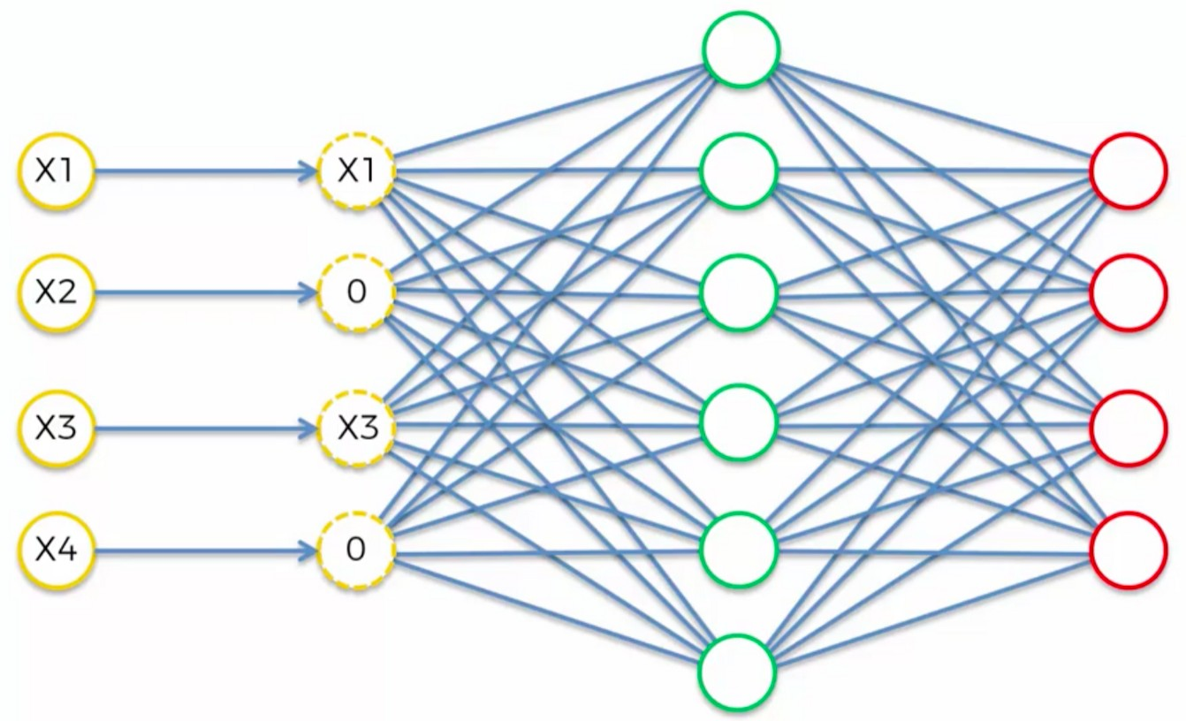
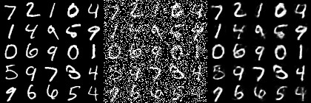
Example of Noise in a DAE
An autoencoder with high capacity can end up learning an identity function (also called null function) where input=output
A DAE can solve this problem by corrupting the data input
How much noise to add?
  Corrupt input nodes by setting 30-50% of random input nodes to zero
Original input, corrupted data, reconstructed data

Slide 56
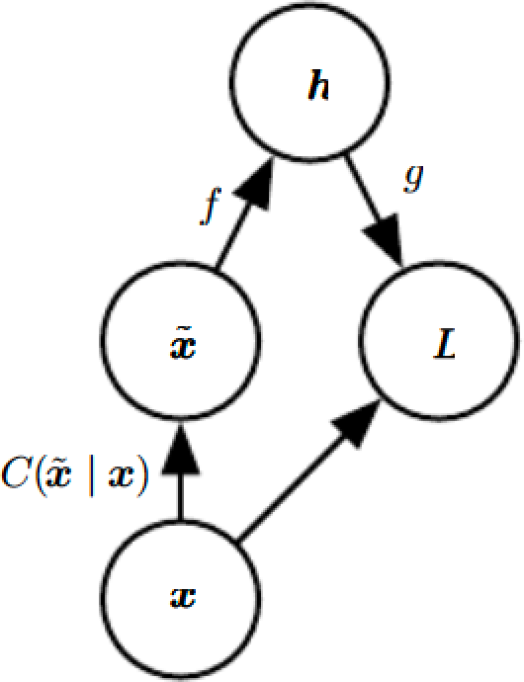
DAE Training Procedure
Computational graph of cost function below
  DAE trained to reconstruct clean data point x from the corrupted Accomplished by minimizing loss L=-log p_{encoder}(x|h=f(x))
Corruption process, C( |x) is a conditional distribution over corrupted samples given the data sample x
The autoencoder learns a reconstruction distribution p_{reconstruct}(x| )) ) estimated from training pairs (x, )) as follows:
1 Sample a training sample x from the training data
Sample a corrupted version from C( |||x)
Use (x, )) as a training example for estimating the autoencoder distribution p_{recoconstruct}(x| | ) =p_{decoder}(x|h) with h the output of encoder f( ) and p_{decoder} typically defined by a decoder g(h)
DAE performs SGD on the expectation E_{x! ~p^data(x)} log p_{decoder}(x|h=f( ))

Slide 57
DAE for MNIST Data
Python/Theano
import theano.tensor as T
from opendeep.models.model import Model
•
•
•
•
•
•
•
•
•
•
•
•
•
•
•
•
•
•
•
•
•
•
•
•
•
•
•
•
•
•
•
from opendeep.utils.nnet import get_weights_uniform, get_bias from opendeep.utils.noise import salt_and_pepper
from opendeep.utils.activation import tanh, sigmoid
from opendeep.utils.cost import binary_crossentropy
# create our class initialization!
class DenoisingAutoencoder(Model):
"""
A denoising autoencoder will corrupt an input (add noise) and try to reconstruct it.
"""
def init (self):
# Define some model hyperparameters to work with MNIST images!
input_size = 28*28 # dimensions of image
Unsupervised Denoising Autoencoder Left: original test images Center: corrupted noisy images Right: reconstructed images
hidden_size = 1000 # number of hidden units - generally bigger than input size for DAE
# Now, define the symbolic input to the model (Theano)
# We use a matrix rather than a vector so that minibatch processing can be done in parallel.
x = T.fmatrix("X") self.inputs = [x]
# Build the model's parameters - a weight matrix and two bias vectors
W = get_weights_uniform(shape=(input_size, hidden_size), name="W") b0 = get_bias(shape=input_size, name="b0")
b1 = get_bias(shape=hidden_size, name="b1") self.params = [W, b0, b1]
# Perform the computation for a denoising autoencoder! # first, add noise (corrupt) the input
corrupted_input = salt_and_pepper(input=x, corruption_level=0.4)
# next, compute the hidden layer given the inputs (the encoding function)
hiddens = tanh(T.dot(corrupted_input, W) + b1)
# finally, create the reconstruction from the hidden layer (we tie the weights with W.T)
reconstruction = sigmoid(T.dot(hiddens, W.T) + b0)
# the training cost is reconstruction error - with MNIST this is binary cross-entropy
self.train_cost = binary_crossentropy(output=reconstruction, target=x)

Slide 58



Denoising Autoencoders
Intuition:
We still aim to encode the input and to NOT mimic the identity function.
We try to undo the effect of corruption process stochastically applied to the input.
A more robust model
Encoder
Decoder
Noisy Input
Latent space representation
Denoised Input

Slide 59
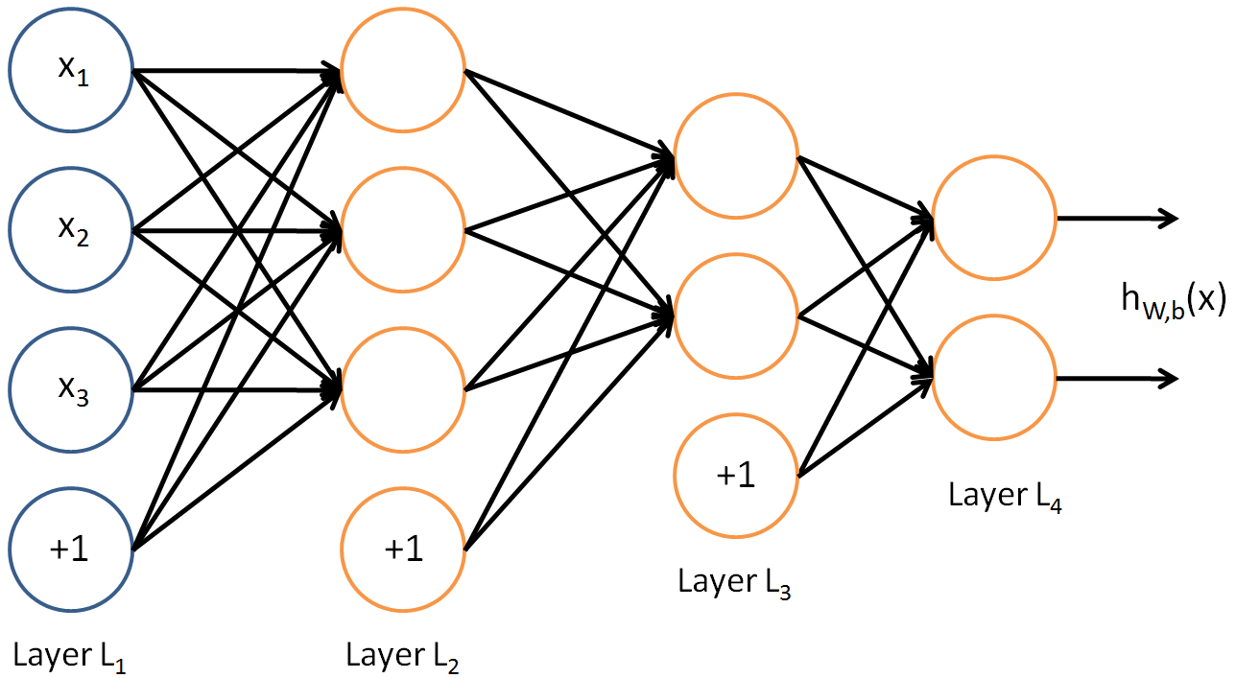
Denoising Autoencoders
Use Case:
Extract robust representation for a NN classifier.
Encoder
Noisy Input
Latent space representation

Slide 60
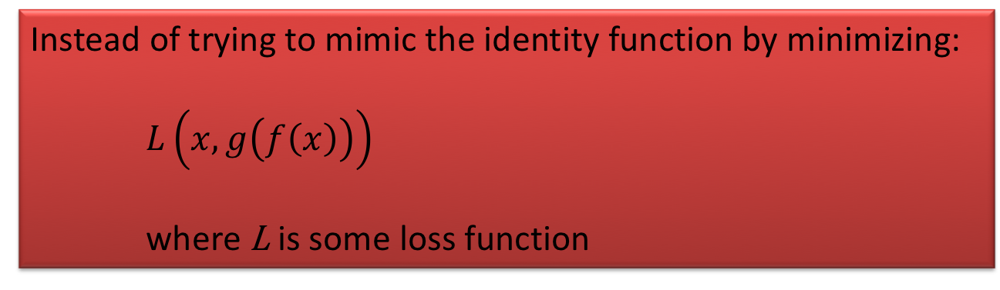
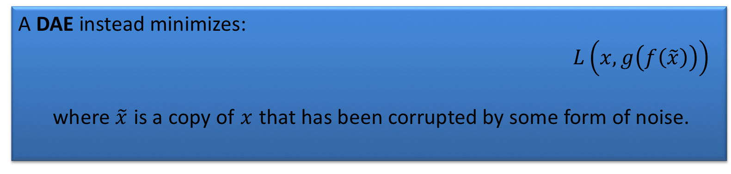
Denoising Autoencoders
Instead of trying to mimic the identity function by minimizing:
$L\left(x,g\left(f\left(x\right)\right)\right)$
where L is some loss function
A DAE instead minimizes:
  $L\left(x,g\left(f\left(\tilde{x}\right)\right)\right)$
  where $\tilde{x}$ is a copy of $x$ that has been corrupted by some form of noise.

Slide 61
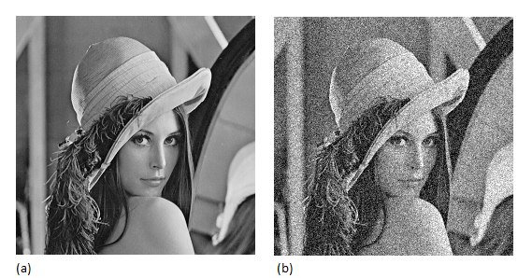

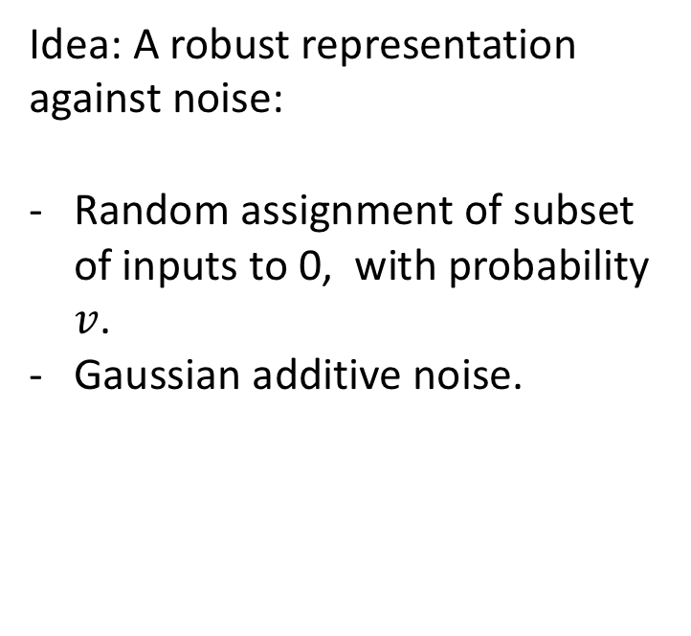



Denoising Autoencoders
Idea: A robust representation against noise:
Random assignment of subset of inputs to 0, with probability $v$.
Gaussian additive noise.
$$\hat{x}$$
$$w′$$
$$f\left(x\right)$$
$$w$$
$$x$$

Slide 62




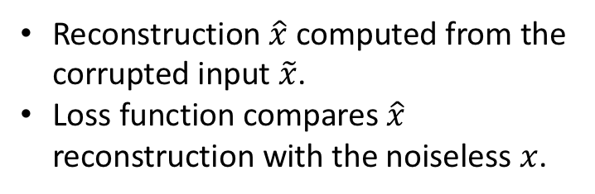

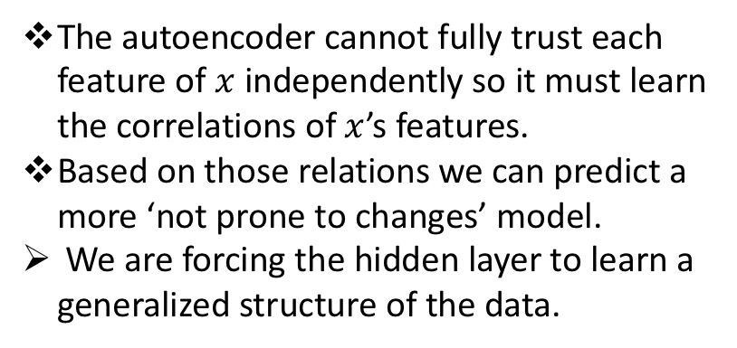
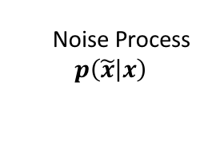
Denoising Autoencoders
$$\hat{x}$$
Reconstruction $\hat{x}$ computed from the corrupted input $\tilde{x}$.
Loss function compares $\hat{x}$ reconstruction with the noiseless $x$.
$$w′$$
$$f\left(\tilde{x}\right)$$
The autoencoder cannot fully trust each feature of $x$ independently so it must learn the correlations of $x$’s features.
Based on those relations we can predict a more ‘not prone to changes’ model.
We are forcing the hidden layer to learn a generalized structure of the data.
$$w$$
$$\tilde{x}$$
0
0
0
Noise Process
$$p\left(\left.\tilde{x}\right|x\right)$$
$$x$$

Slide 63
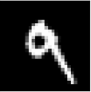

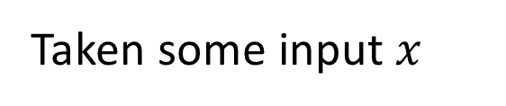

Denoising Autoencoders - process
Taken some input $x$
Apply Noise
$$\tilde{x}$$

Slide 64

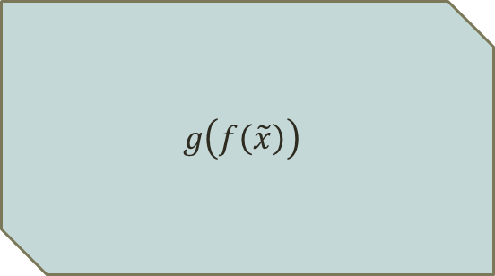
Denoising Autoencoders - process
DAE
$$\tilde{x}$$
Encode And Decode
DAE
$$g\left(f\left(\tilde{x}\right)\right)$$

Slide 65


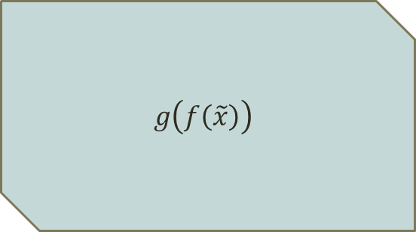
Denoising Autoencoders - process
DAE
DAE
$$\hat{x}$$
$$g\left(f\left(\tilde{x}\right)\right)$$

Slide 66

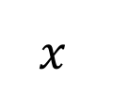
Denoising Autoencoders - process
$$\hat{x}$$
Compare
$$x$$

Slide 67
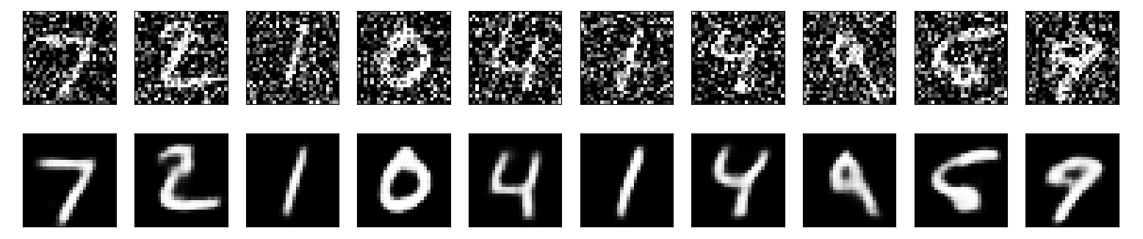
Denoising convolutional AE – Keras
- 50 epochs.
- Noise factor 0.5
- 92% accuracy on validation set.

Slide 68
Estimating the Score
An autoencoder can be based on encouraging the model to have the same score as the data distribution at every training point x
  The score is a particular gradient field is: ∇_{x} log p(x)
  Learning the gradient field of log p_{data} is one way to learn the structure of
p_{data} itself
Score Matching works by fitting the slope (score) of the model density to the slope of the true underlying density at the data points
DAE with conditionally Gaussian p(x|h) estimates this score as (g(f(x)-x)
  The DAE is trained to minimize ||g(f( )-x)||²
DAE estimates a vector fields as illustrated next

Slide 69
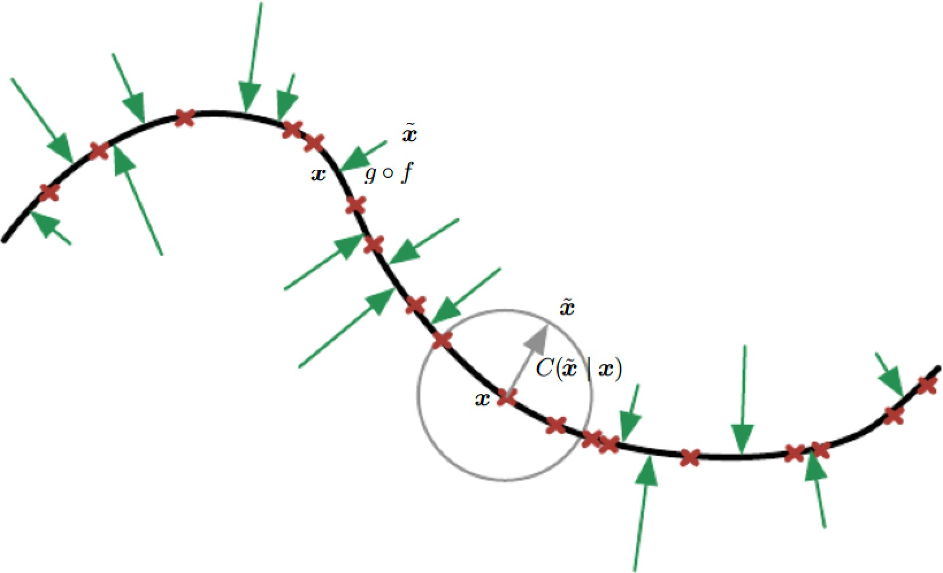
DAE learns a vector field
Training examples x lie on a low-dimensional manifold
  Training examples x are red crosses
Gray circle is equiprobable corruptions
The vector field (g(f(x)-x), indicated by green arrows, estimates the score ∇_{x} log p(x) which is the slope of the density of data

Slide 70
Manifold
In mathematics, a manifold is a topological space that locally resembles Euclidean space near each point. More precisely, an n-dimensional manifold, or n-manifold for short, is a topological space with the property that each point has a neighborhood that is homeomorphic to the Euclidean space of dimension n.
A homeomorphism, topological isomorphism, or bicontinuous function is a continuous function between topological spaces that has a continuous inverse function.

Slide 71
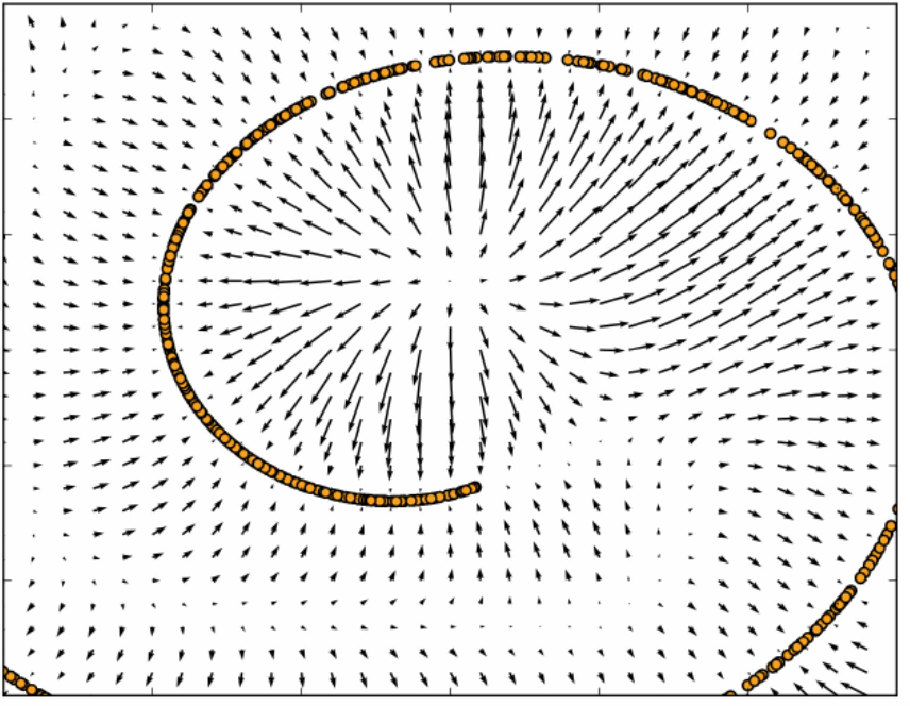
Vector field learnt by a DAE
1-D curved manifold near which the data concentrate
Each arrow proportional to reconstruction minus input vector of DAE and points towards higher probability
Where probability is maximum arrows shrink

Slide 72
Topics in Autoencoders
What is an autoencoder?
Undercomplete Autoencoders
Regularized Autoencoders
Representational Power, Layout Size and Depth
Stochastic Encoders and Decoders
Denoising Autoencoders
Learning Manifolds with Autoencoders
Contractive Autoencoders
Predictive Sparse Decomposition
Applications of Autoencoders

Slide 73
Topics in Learning Manifolds with Autoencoders
Manifold Hypothesis
Definition of a mathematical manifold
Manifold in Machine Learning
Specifying manifolds using tangent planes
Specialized autoencoders

Slide 74
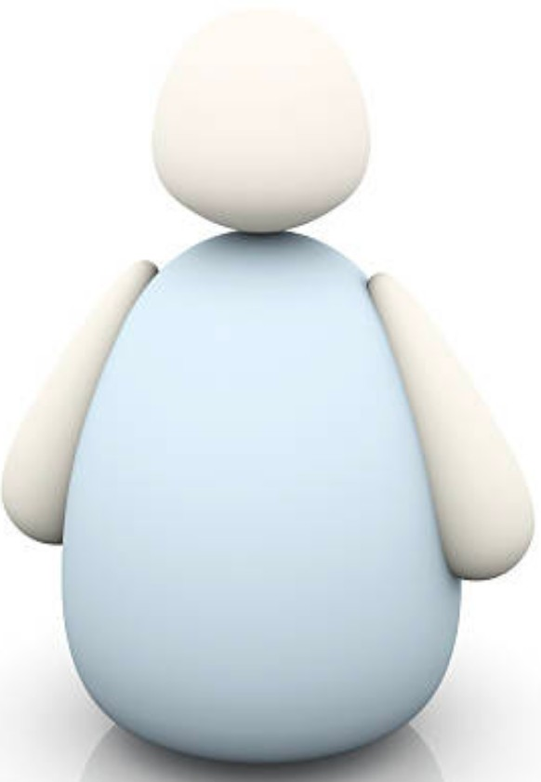
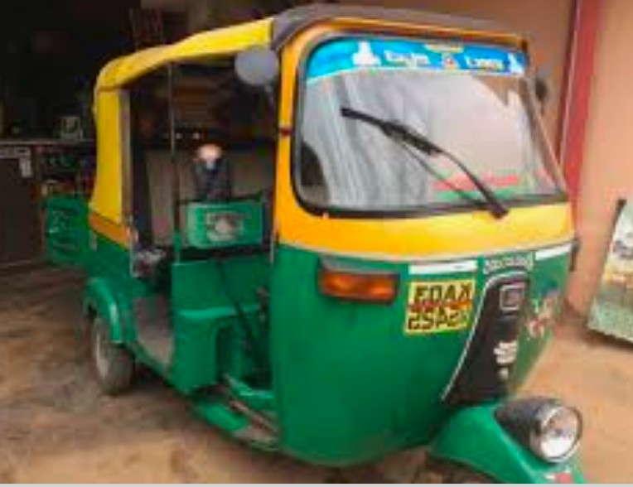
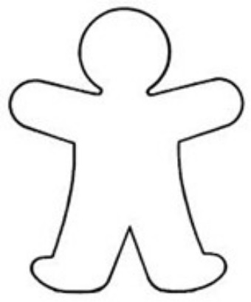
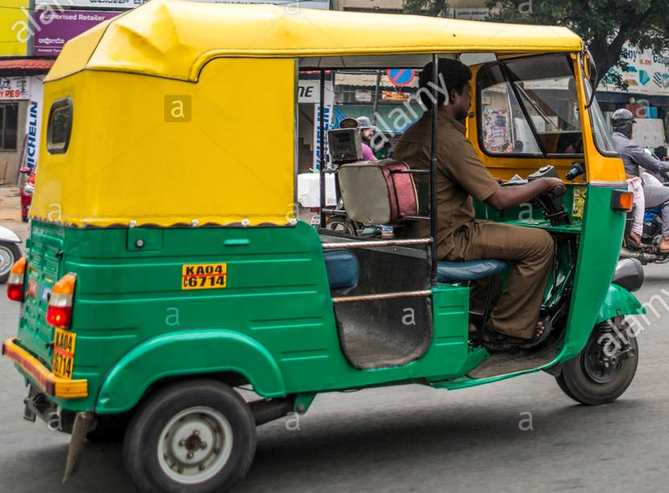
Autoencoders
h
x
Encoder
Manifold
Decoder
r(x)

Slide 75
Manifold Hypothesis
Data concentrates around a low-dimensional manifold
  Manifold Hypothesis
Why study nature of manifolds?
  Some ML algorithms have unusual behavior if given an input that is off of the manifold
Autoencoders aim to learn the structure of the manifold

Slide 76
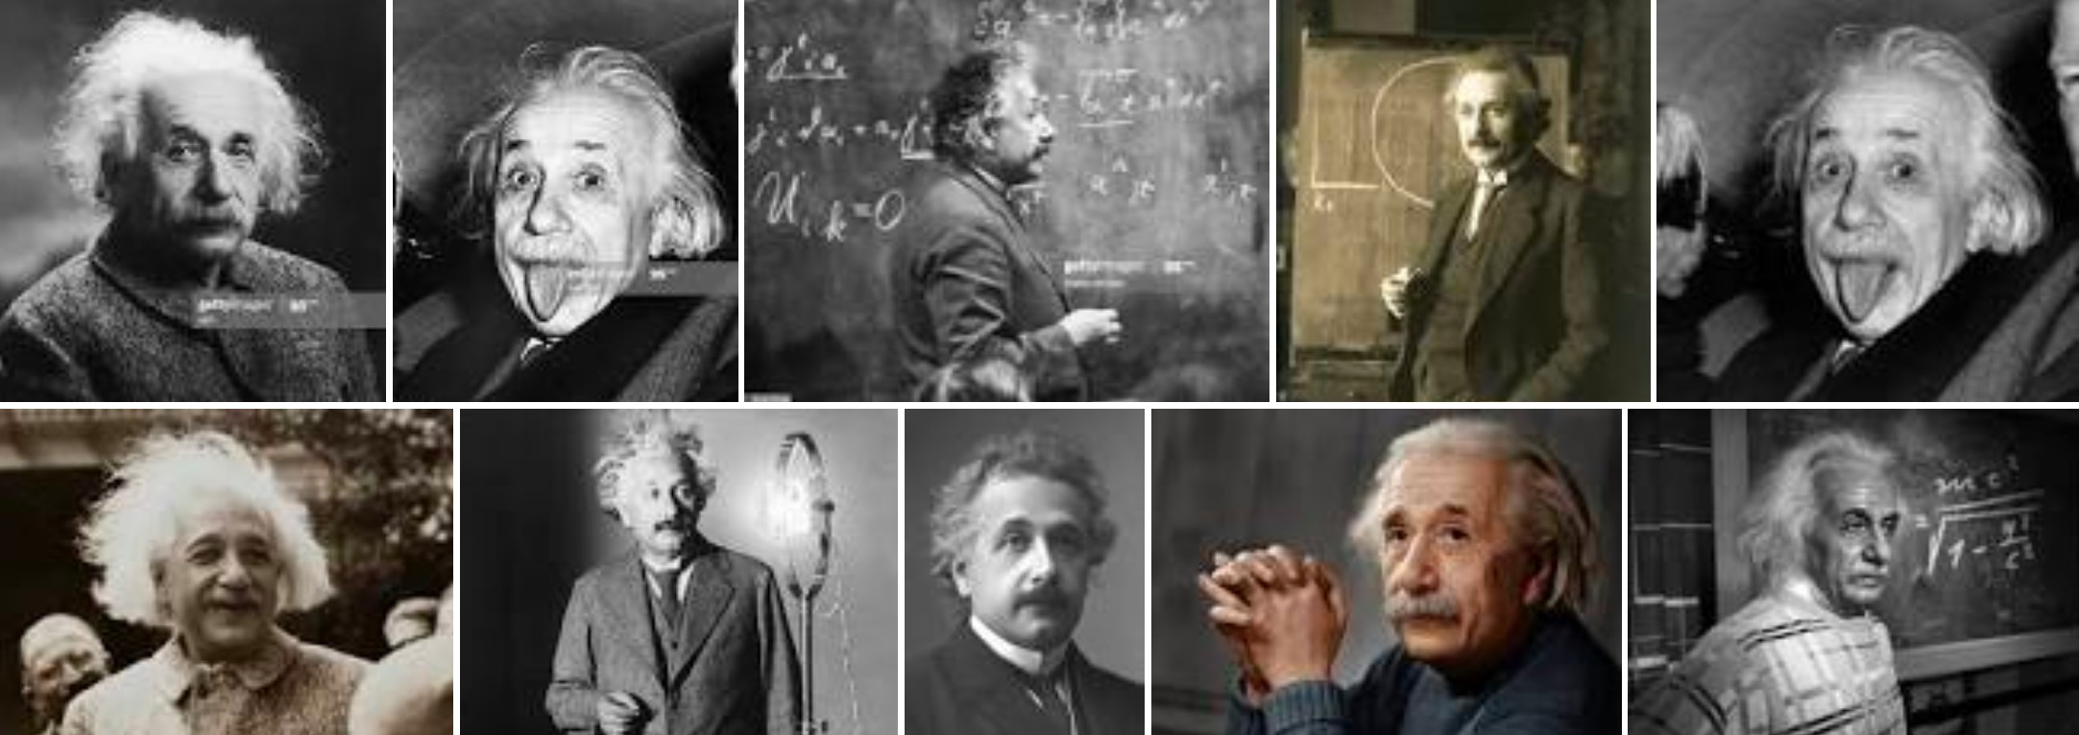
Why does data lie on a Manifold?
Suppose we want to classify all (b&w) images with m x n pixels
  Each pixel has a numerical value
  An image is a single point of dimension N = mn
Suppose all m x n images are photos of Einstein
We are restricted on choice of values for the pixels
Random choices will not generate such images
Therefore, we expect there to be less freedom of choice
Manifold hypothesis states that that this subset should actually live in an (ambient) space of lower dimension, in fact a dimension much, much smaller than N

Slide 77
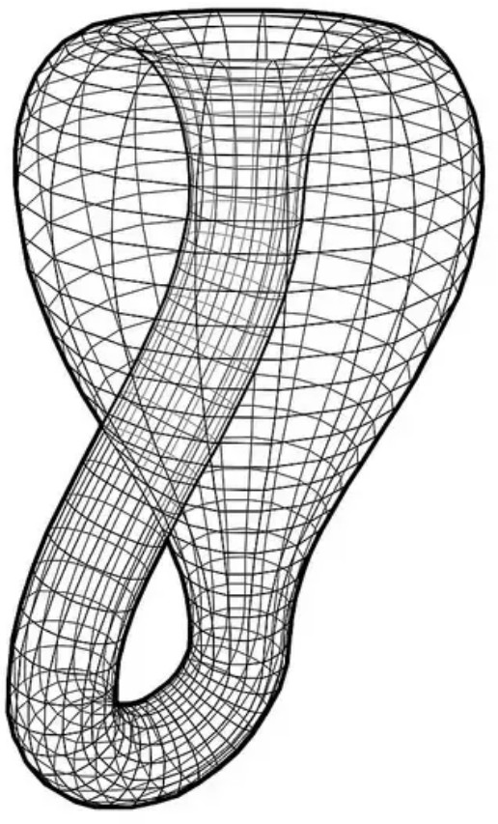
Reason for Low-dimensional manifolds
Low dimensional structure arises due to constraints arising from physical laws
Empirical study
  Large no. of 3×3 images represented as points in R⁹
  Lie on a 2-D manifold known as the Klein bottle

Slide 78
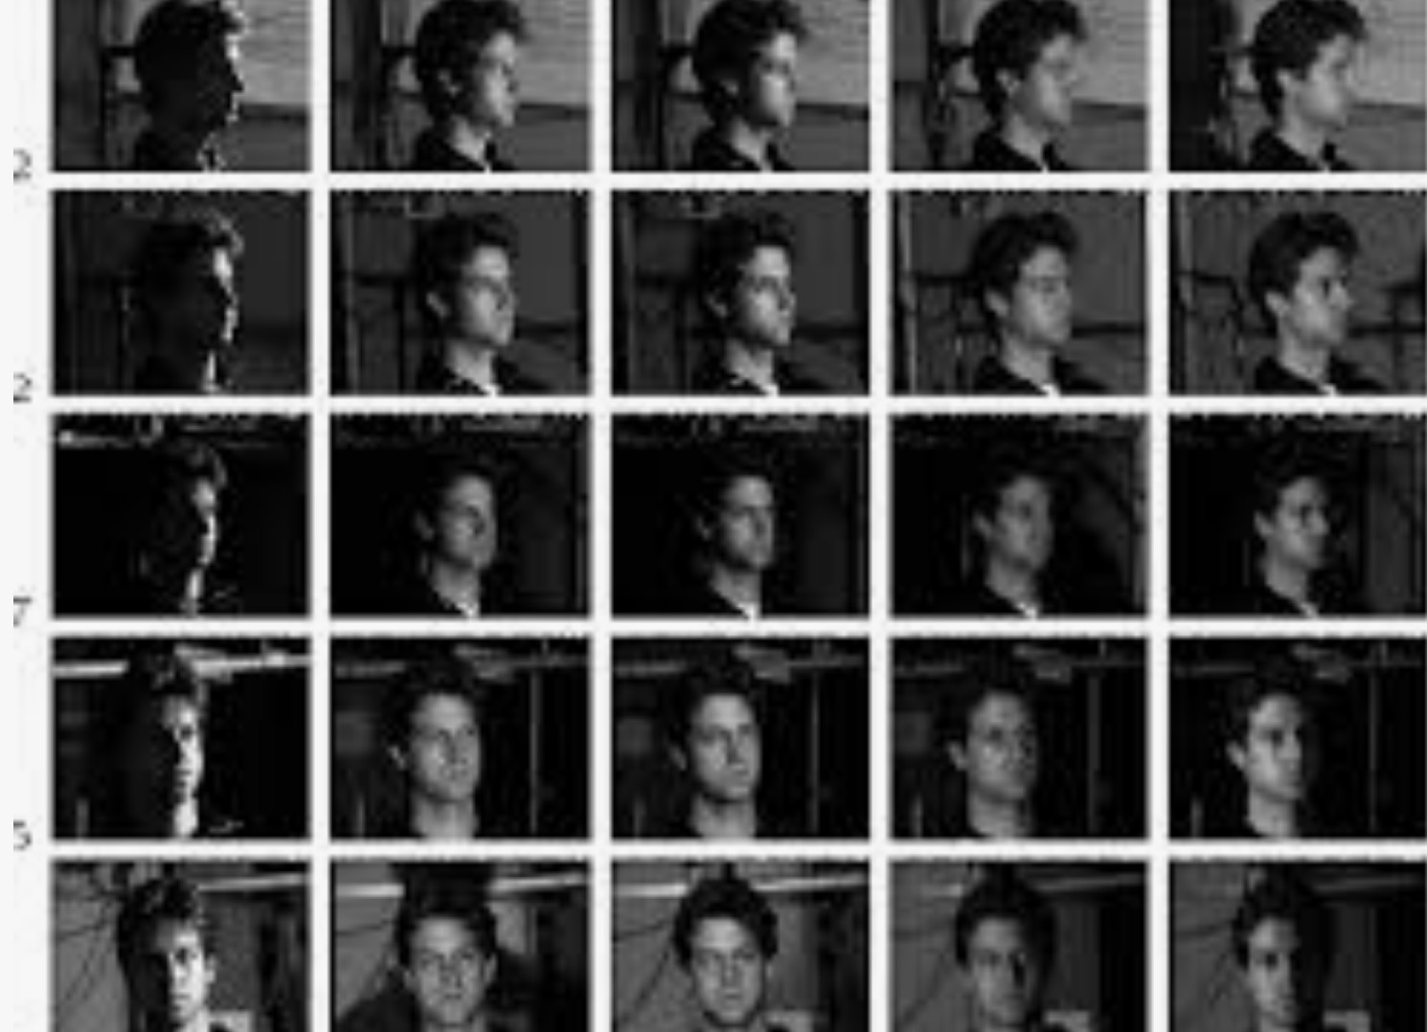
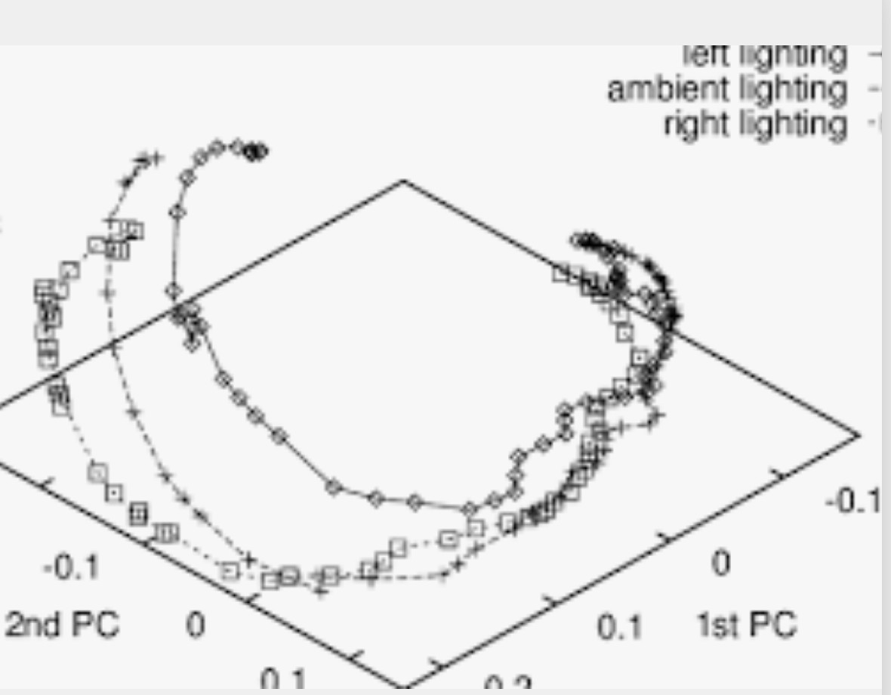
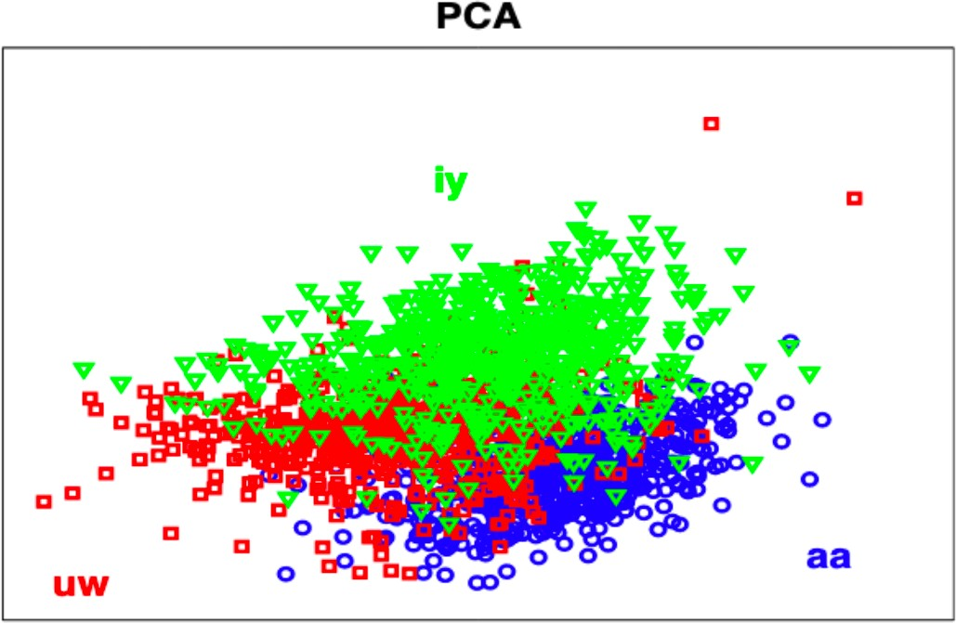
Low-dimensional manifolds embedded in high dimensional spaces
Image vectors of 3D objects under illuminations, camera views
Manifold formed by three face sequences under different lighting conditions rotating from
profile-to-profile (−90 • to +90 • ).
Phonemes in speech signals
DFT
Features

Slide 79




Definition of Manifold
A Manifold is a topological space that locally resembles Euclidean space near each point
  An n-dimensional manifold is a topological space M for which every point
x ∈ M has a neighborhood homeomorphic to Euclidean space R^{n}
3-D manifold M
_{R}3
Homeomorphism in topology is also called a continuous transformation
  One-to-one correspondence in two geometric figures or topological spaces that is continuous in both direction
Homomorphism in algebra
  The most important functions between two groups are those that “preserve” group operations, and they are called homomorphisms
  A function f: G→H between two groups is a homomorphism when
f ( xy) = f (x) f (y) for all x and y in G

Slide 80


A manifold has a dimension
A 2-D manifold is a surface
  It could also be a union of several surfaces, too
    We assume manifolds are connected
A 1-D manifold is a curve
A 0-D manifold is a point
All of 3-space, ℝ³, is a 3-D manifold

Slide 81

2-D Manifold in R³ homeomorphic to R²
In mathematics, a manifold is a topological space that locally resembles Euclidean space near each point
A topological space may be defined as a set of points, along with a set of neighborhoods for each point, satisfying a set of axioms relating points and neighborhoods

Slide 82

Manifold in Machine Learning
In the observed M-dimensional input space, the data is distributed on an M_{h}-dimensional manifold
{x ∈ R^{M}: h ∈ R^{Mh} s.th. x=g^{gen}(h)}
where g^{gen}(·) is smooth
x₁
_{h}nat
x₂
M=2
M_{h}=1
1-D manifold in R²
12

Slide 83


Manifolds are specified by Tangent Planes
Tangents specify how x can change while staying on manifold
  1-D: y = f (x) at point x = 𝑥⁰ is given by 𝑦 ≈ 𝑓(𝑥⁰) + 𝑓′(𝑥⁰) (𝑥− 𝑥⁰)
  2-D: 𝑧 =𝑓(𝑥, 𝑦) at the point (𝑥⁰, 𝑦⁰) is given by
z = 𝑓(𝑥⁰, 𝑦⁰) +𝑓_{𝑥}(𝑥⁰, 𝑦⁰) (𝑥−𝑥⁰) + 𝑓_{𝑦}(𝑥⁰, 𝑦⁰) (𝑦−𝑦⁰)
At a point x on a d-dimensional manifold, the tangent plane is given by d basis vectors that span the local directions of variation allowed on the manifold
1-D
manifold (line)
2-D
manifold (surface)

Slide 84


Tangents of 1- and 2-D manifolds
A 1-D manifold in 784-D space (MNIST with 784 pixels)
  Image is translated vertically
  Figure below is projection into 2-D space using PCA
    n-dimensional manifold has n-dimensional plane
Tangent is oriented parallel to the surface at that point
Image shows how this tangent direction appears in image space
Gray pixels indicate pixels that do not change as we move along tangent.
White pixels indicate pixels that brighten, and black those that darken
Tangent Line
Tangent Plane
MNIST
with 3-D PCA

Slide 85
Autoencoder performs trade-off between two forces
Learns representation h of training example x such that x can be recovered through a decoder
  That x is drawn from training data is crucial
    It means the autoencoder need not reconstruct improbable inputs
Satisfies the regularization penalty:
  Limits the capacity of the autoencoder
  Or it can be a regularization term added to the reconstruction cost
L(x, g ( f (x))) + Ω(h)
  These techniques prefer solutions less sensitive to input
Together they force the hidden representation to capture information about the data generating distribution

Slide 86
What the encoder represents
Encoder captures only variations needed to reconstruct training examples
If data generating distribution concentrates near a low- dimensional manifold, this yields representations that implicitly captures a local coordinate system for this manifold
  Only the variations tangential to this manifold around x need to correspond to changes in h =f(x)
  Hence encoder learns a mapping from input space x to a representation space
    A mapping that is only sensitive to changes along manifold directions
    But that is insensitive to changes orthogonal to the manifold

Slide 87

Capturing manifold structure by Invariance
When reconstruction is insensitive to perturbations around data points, autoencoder recovers manifold structure
  Ex: 1-D case: manifold is a collection of 0-dimensional manifolds
    Dashed diagonal line: identity function for target of reconstruction
    Optimal reconstruction function crosses the identity function whenever there is a data point
    Horizontal arrows at bottom indicate r(x)-x reconstruction direction vector always pointing towards the nearest “maifold”- a single data point

Slide 88
Why autoencoders are useful to learn a manifold
Compare to other approaches
Autoencoder
  Characterizes a manifold
    Represents data on or near the manifold
  Representation for a particular example is an embedding
    An embedding has fewer dimensions than the ambient space of which the manifold is a low-dimensional subset
Other algorithms
  Non-parametric manifold algorithms
    Directly learn an embedding for each training example
  Learn a more general mapping
    A function to map points in ambient space to embedding

Slide 89


Nonparametric manifold learning
Build a nearest-neighbor graph where
  Nodes represent training examples (one node per sample)
  Directed edges indicate nearest neighbor relationships
Procedures to
Obtain tangent plane associated with a neighborhood of the graph
Associate each training example with an embedding vector
Works when no of examples is large to cover manifold twists
Queen Mary University of London Multiview Face Dataset
Method associates each node with a tangent plane
One that spans the directions of variations associated with the difference vectors between the example and its neighbors

Slide 90

Tiling a manifold
A global coordinate system can then be obtained through optimization or by solving a linear system
A manifold can be tiled by a large no of locally linear Gaussian- like patches (or pancakes, because the Gaussians are flat in the tangent directions)
A mixture of Gaussians
These methods can only generalize the shape of the manifold by interpolating between neighboring examples.
Unfortunately, manifolds in AI problems are very complicated that can be difficult to capture from only local interpolation

Slide 91

Manifold learning in medical imaging
Linear techniques unsuitable for capturing variations in anatomical structures
Structure in the data (CT, MRI, ultrasound) allows
a lower dimensional object to describe the degrees of freedom, such as in a manifold structure.

Slide 92




Overcomplete and Contractive Autoencoder
1. Overcomplete
Contractive
  Method to avoid uninteresting solutions
  Add an explicit term in the loss that penalizes that solution
  We wish to extract features that only reflect variations observed in the training set
  We would like to be invariant to other variations

Slide 93

Contractive Autoencoder (CAE) Loss Function
Contractive autoencoder has an explicit regularizer on h=f(x),
encouraging the derivatives of f to be as small as possible:
2
Ω(h) = λ ^{∂ f (x)}
∂x
F
Where L(f (x)) + Ω(h)
  Penalty Ω(h) is the squared Frobenius norm (sum of squared elements) of the Jacobian matrix of partial derivatives associated with encoder function

Slide 94
Difference between DAE and CAE
Denoising Autoencoders make the reconstruction function
r=g(f(x)) resist small but finite-sized perturbations of the input
  DAE minimizes L(x,g(f ( )))
Contractive Autoencoders make the feature extraction function resist inifinitesimal perturbations of the input
CAE minimizes L(f (x)) + Ω(h) where
2
Ω(h) = λ ^{∂f (x)}
∂x
F
It uses a Jacobian-based contractive penalty to pretrain features f(x) for use with a classifier, with L(x, g ( f (x))) + Ω(h,x)
Ω(h,x) = λ∑ ∇_{x}h_{i}
I
2

Slide 95
Contractive AE Warps Space
The name contractive arises from the way the CAE warps space
Because CAE is trained to resist perturbations of its input, it is encouraged to map a neighborhood of input points to a smaller neighborhood of output points
  We can think of this as contracting the input neighborhood to a smaller output neighborhood

Slide 96
Which autoencoder?
DAE make the reconstruction function resist small, finite sized perturbations in input.
CAE make the feature encoding function resist small, infinitesimal perturbations in input.
- Both denoising AE and contractive AE perform well!
- Both are over overcomplete

Slide 97
Which autoencoder?
  Advantage of DAE: simpler to implement
    Requires adding one or two lines of code to regular AE.
    No need to compute Jacobian of hidden layer.
  Advantage of CAE: gradient is deterministic.
    - Might be more stable than DAE, which uses a sampled gradient.
    - One less hyper-parameter to tune (noise-factor)

Slide 98
Stacked AE
Motivation:
We want to harness the feature extraction quality of an AE for our advantage.
For example: we can build a deep supervised classifier where its input is the output of a SAE.
The benefit: our deep model’s W are not randomly initialized but are rather “smartly selected”
Also using this unsupervised technique lets us have a larger unlabeled dataset.

Slide 99
Stacked AE
- Building a SAE consists of two phases:
  1. Train each AE layer one after the other.
  2. Connect any classifier (SVM / FC NN layer etc.)

Slide 100


Stacked AE
SAE
Classifier
$$x$$
$$y$$

Slide 101





Stacked AE – training process
First Layer Training (AE 1)
$$x$$
$$f_{1}\left(x\right)$$
$$z_{1}$$
$$g_{1}\left(z_{1}\right)$$
$$\hat{x}$$

Slide 102





Stacked AE – training process
Second Layer Training (AE 2)
$$x$$
$$f_{1}\left(x\right)$$
$$z_{1}$$
$$f_{2}\left(z_{1}\right)$$
$$z_{2}$$
$$g_{2}\left(z_{2}\right)$$
$${\hat{z}}_{1}$$

Slide 103

Stacked AE – training process
Add any classifier
$$x$$
Classifier
$$f_{1}\left(x\right)$$
$$z_{1}$$
$$f_{2}\left(z_{1}\right)$$
$$z_{2}$$
Output

Slide 104

Convolutional AE

Slide 105

ECG Compression with Convolutional AE
Yildirim, Cognitive Systems, ‘18.

Slide 106
Undercomplete AE VS overcomplete AE
Two basic types of AE structures: both are used
Undercomplete
Overcomplete

Slide 107

Masked and autoregressive methods in NLP are at heart Denoising autoencoders
Masked autoencoders (MAEs) are a class of autoencoder that corrupt the input and ask the model to predict the un-corrupted version
For images this would mean applying geometric transformations, color transformations, masking pixels, shuffluling pixels, etc

Slide 108

How to tokenize images the same way as text?
The paper AN IMAGE IS WORTH 16X16 WORDS introduces the main way to tokenize images for transformers, just split then into patches of 16 by 16 pixels and pass then through a linear layer

Slide 109
(MAE) Masked Autoencoders Are Scalable Vision Learners
With the introduction of visual transformers (ViTs), we can do masked image modelling the same way we do mask language modelling in BERT.
Unlike BERT, MAE uses an asymmetric design. The encoder only operates on the masked input (No [MASKED] token) and a lightweight decoder that reconstructs the full signal from the latent representation and [MASKED] tokens.

Slide 110




MAE Architecture
1) Mask original image

Slide 111
MAE Architecture
2) Encode visible tokens
1) Mask original image

Slide 112
MAE Architecture
3) Add [M]
tokens
2) Encode visible tokens
1) Mask original image

Slide 113
MAE Architecture
3) Add [M]
tokens
2) Encode visible tokens
1) Mask original image
4) Predict image

Slide 114

MAE Architecture
3) Add [M]
tokens
2) Encode visible tokens
1) Mask original image
4) Predict image
5) L2 pixel Loss

Slide 115

MAE Architecture
3) Add [M]
tokens
2) Encode visible tokens
1) Mask original image
4) Predict image
5) L2 pixel Loss

Slide 116

Qualitative Results

Slide 117
Qualitative Results

Slide 118
Qualitative Results

Slide 119

Results
The authors do self-supervised pre-training on the ImageNet-1K (IN1K) training set. Then they do supervised training to evaluate the representations with (i) end-to-end fine-tuning or (ii) linear probing.
Baseline model: ViT-Large:
ViT-Large (ViT-L/16) is the backbone in their ablation study.
ViT-L is very big and tends to overfit.
It is very hard to train supervised ViT-L from scratch and a good recipe with strong regularization is needed .

Slide 120

Many types of AEs (deep zoo)
Here are some:

Slide 121
Conclusions/What Did We Learn?
Autocoders are latent compression models but not used for compression
Both overcomplete and undercomplete useful
A representation learning method
Used in pretraining of a DL
Can be considered a generative model
Applications
  Dimensionality reduction
  Image processing
  Information retrieval
    Semantic hashing
    Visual transformers
  NLP
    Word embeddings
    Machine translation
    Document clustering
    Sentiment analysis
    Paraphrase detection
    Transformers

Slide 122
Conclusions/What Did We Learn?
Deep compression
  A system for doing compression
  A compression of a deep neural network for space and power reasons

