Slide 1
Generative Adversarial Networks (GANs)
Thanks to Ian Goodfellow et al., Srihari
Binglin, Shashank & Bhargav
Adapted for Purdue MA 598, Spring 2019 from
http://slazebni.cs.illinois.edu/spring17/lec11_gan.pptx

Slide 2
Outline
Part 1: Review of GANs
Part 2: Some challenges with GANs
Part 3: Applications of GANs

Slide 3
Growth of GAN papers
Gan Zoo

Slide 4
Why GANs were popular
GANs can learn high-dimensional, complex real data distributions
Without relying on any assumptions
Can simply generate realistic samples from latent space
This has lead to various applications
image synthesis, image attribute editing, image translation, domain adaptation and other academic fields

Slide 5
GAN Problems
Many GAN models suffer the following major problems:
Non-convergence: the model parameters oscillate, destabilize and never converge,
Mode collapse: the generator collapses which produces limited varieties of samples,
Diminished gradient: the discriminator gets too successful that the generator gradient vanishes and learns nothing,
Unbalance between the generator and discriminator causing overfitting, &
Highly sensitive to the hyperparameter selections.
https://jonathan-hui.medium.com/gan-why-it-is-so-hard-to-train-generative-advisory-networks-819a86b3750b

Slide 6
GAN videos
A Friendly Introduction to Generative Adversarial Networks (GANs)
Goodfellow's talk at NIPS workshop
MIT Deep Generative Modeling

Slide 7
Generative Adversarial Network (GAN)
GANs are generative models that are implemented using two stochastic neural network modules: Generator and Discriminator.
Generator tries to generate samples from random noise as input
Discriminator tries to distinguish the samples from Generator and samples from the real data distribution.
Both networks are trained adversarially (in tandem) to fool the other component. In this process, both models become better at their respective tasks.
Many GAN variants (GAN Zoo)

Slide 8
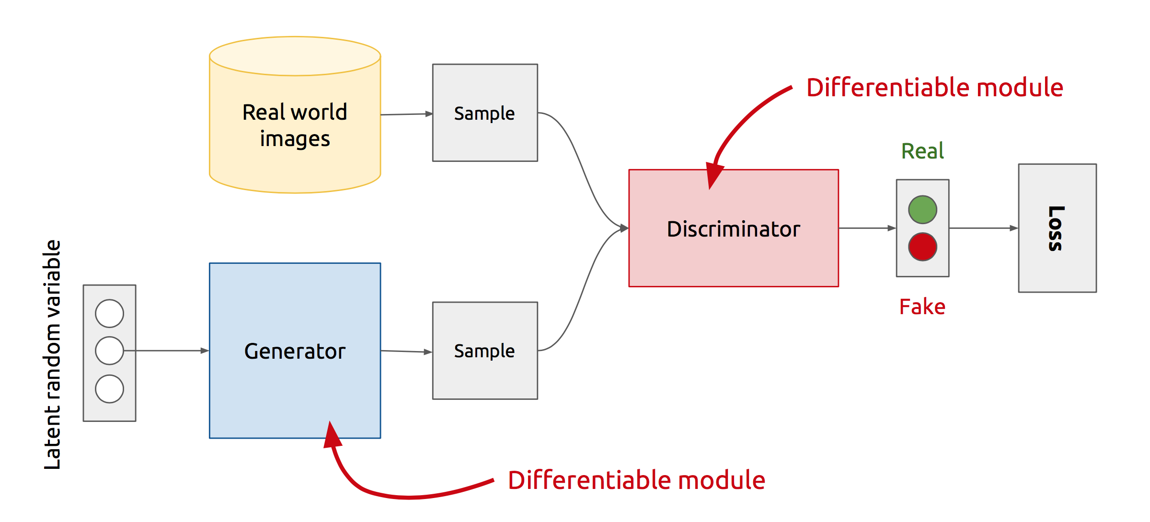
GAN’s Architecture
x
D
D(x)
G
z
G(z)
D(G(z))
Z is some random noise (Gaussian/Uniform).
Z can be thought as the latent representation of the image.
Notes:
Let’s look at the real GAN architecture now :-
-- We have two networks here Generator and Discriminator
-- Discriminator gets input from both the Generator and Real training samples and predicts which one is real and which one is fake.
-- The way Generator generates fake images is .. It randomly samples a noise z, passes it through its network, and the output of the network gives us the image.
-- So, the rationale with that will be that z is sort of your latent representation for the image.. And you generate the image from your latent representation by passing it through the generator network.
Never directly see true samples.

Slide 9
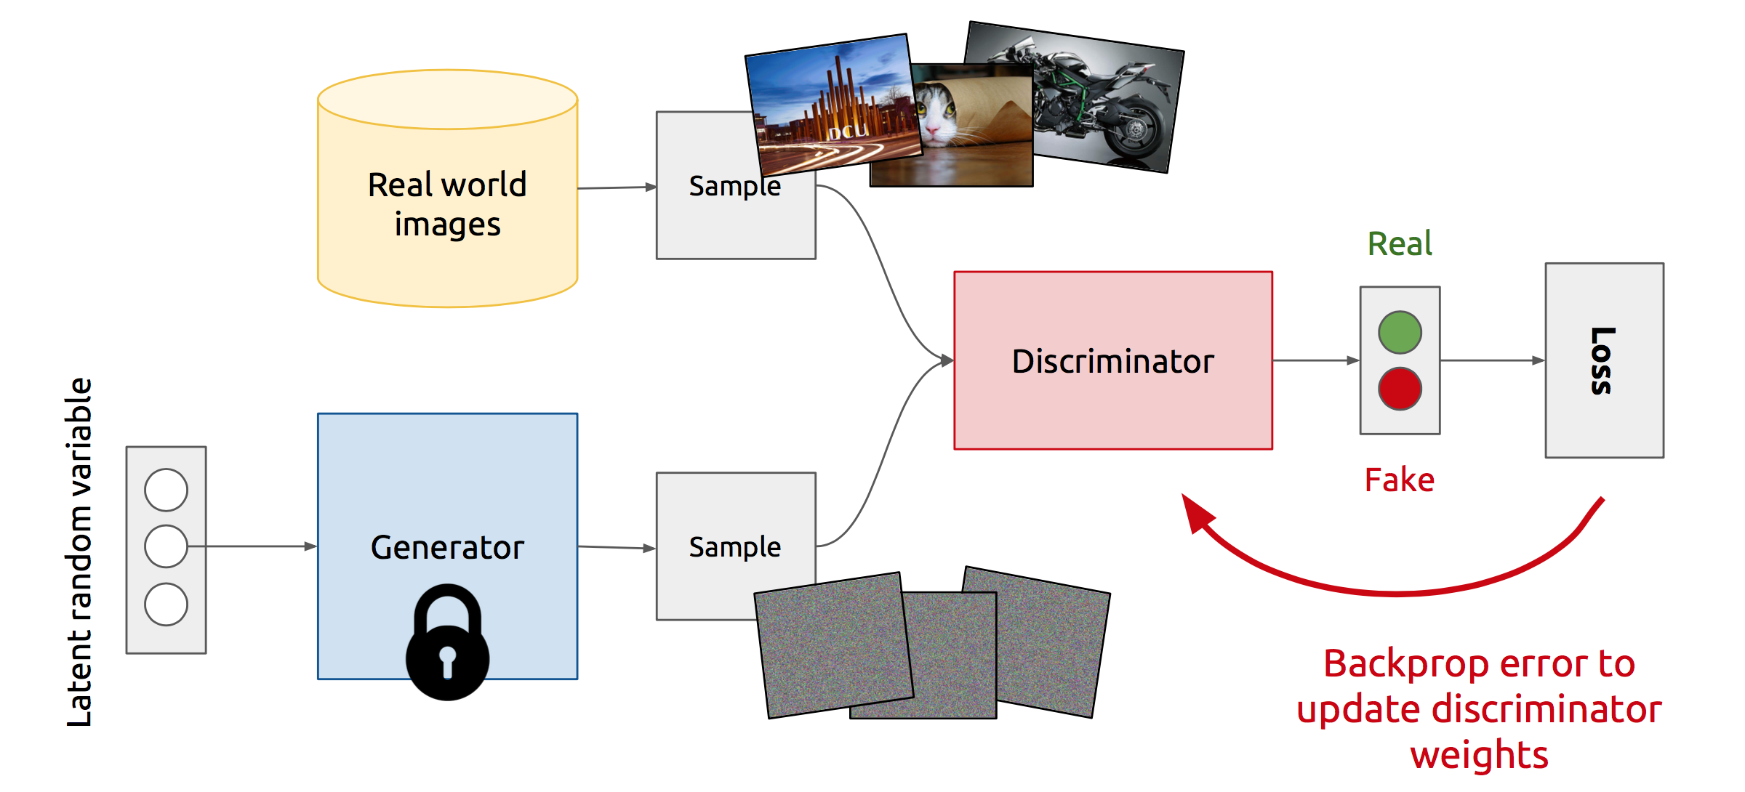
Training Discriminator
Notes:
So, this is how GANs operate :-
At the start of the iteration, a true example is selected and passed through the discriminator. The discriminator outputs the probability of it being a real example, calculate its loss, and update its weights while keeping the generator weights as constant.

Slide 10
Training Generator
Notes:
Now :-
Generator selects a random noise z, passes it through the generator network to generate a fake image, and then passes it through the discriminator network to output the probability of it being fake. It then calculates its loss, and update its weights while keeping the discriminator’s weights as constant
And we repeat this process of Alternate updates.
Act as complicated loss function.

Slide 11
GAN’s formulation
$$\min_{G}{\max_{D}{V\left(D, G\right)}}$$
It is formulated as a minimax game, where:
The Discriminator is trying to maximize its reward $V\left(D, G\right)$
The Generator is trying to minimize Discriminator’s reward (or maximize its loss)
$$V\left(D, G\right)=𝔼_{x∼p(x)}\left[\log{D\left(x\right)}\right]+𝔼_{z∼q(z)}\left[\log\left(1−D\left(G(z)\right)\right)\right]$$
The Nash equilibrium of this particular game is achieved at:
$P_{data}\left(x\right)=P_{gen}\left(x\right) ∀x$
D$\left(x\right)=\frac{1}{2} ∀x$
Notes:
So, the idea is pretty straightforward, but the real smart thing about GANs is how they formulate their objective.
They formulate it as a [..]
i.e. Basically for fixed generator’s parameters, you maximize Discriminator’s reward, and then you fix Discriminator’s parameters and minimize Discriminator’s reward with respect to Generator’s parameters, and repeat.
[..]
D(x) should be 1 for real examples
0 for fake examples

Slide 12
Discriminator updates
Generator updates
Notes:
So combining all these ideas, let’s quickly look at the algorithm more formally that I had explained earlier

Slide 13
Vanishing gradient strikes back again…
$$\min_{G}{\max_{D}{V\left(D, G\right)}}$$
$$V\left(D, G\right)=𝔼_{x∼p(x)}\left[\log{D\left(x\right)}\right]+𝔼_{z∼q(z)}\left[\log\left(1−D\left(G(z)\right)\right)\right]$$
$$∇_{θ_{G}}V(D,G)=∇_{θ_{G}}𝔼_{z\sim q(z)}\left[\log\left(1−D\left(G\left(z\right)\right)\right)\right]$$
$∇_{a}\log\left(1−σ\left(a\right)\right)=\frac{−∇_{a} σ(a)}{1− σ(a)}=$ $\frac{−σ\left(a\right) \left(1−σ\left(a\right)\right)}{1− σ(a)}=−σ\left(a\right)$ = $−D\left(G\left(z\right)\right)$
Gradient goes to $0$ if $D$ is confident, i.e. $D\left(G\left(z\right)\right) →0$
Minimize $−𝔼_{z\sim q\left(z\right)}\left[\log{D\left(G\left(z\right)\right)}\right]$ for Generator instead (keep Discriminator as it is)
Notes:
Ask the class to figure out the problem with the formulation
[..]
The new formulation has the same optimal point as the old one, but doesn’t suffer from the vanishing gradients problem
However, with the new modified loss, you can’t compactly write down the formulation as a zero-sum min-max game
a is the output before sigmoid

Slide 14
Synthetic faces from GANs

Slide 15
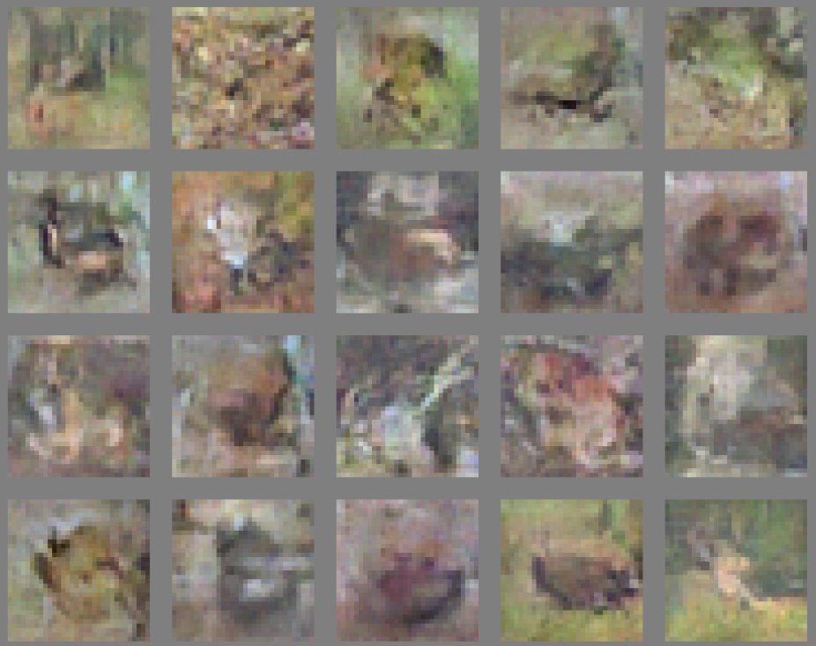
CIFAR
Notes:
However, when trained on CIFAR dataset, the quality of images is not that good..
One can argue that it is easy to generate faces as compared to different classes of objects
So, this wasn’t so inspiring.. Then came the first GAN architecture that did a great job at generating high quality images .. DCGAN

Slide 16
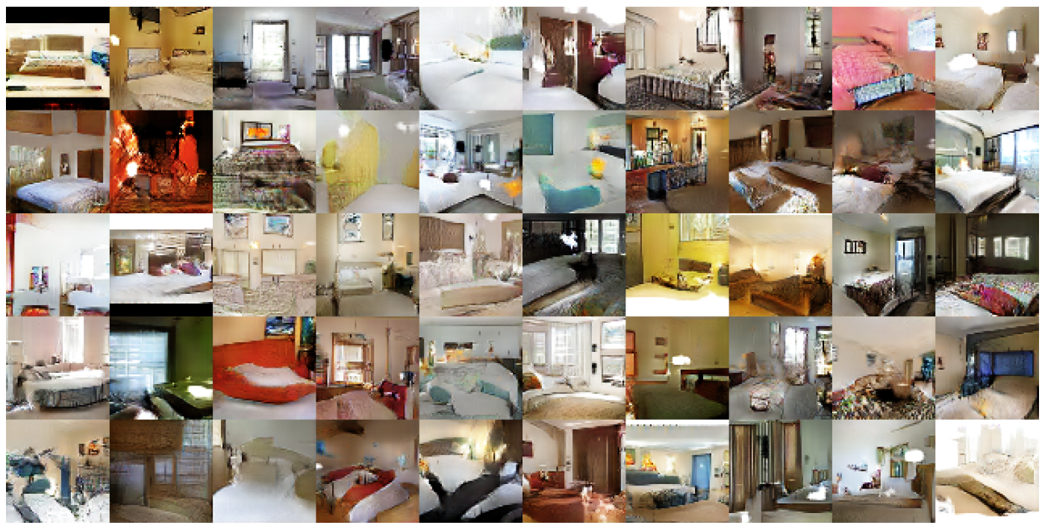
DCGAN: Bedroom images
Notes:
For instance, with DCGAN you can generate such nice looking bedroom images .. Since these are low resolution, zooming it up will pixelate it, so we won’t zoom on a single image

Slide 17
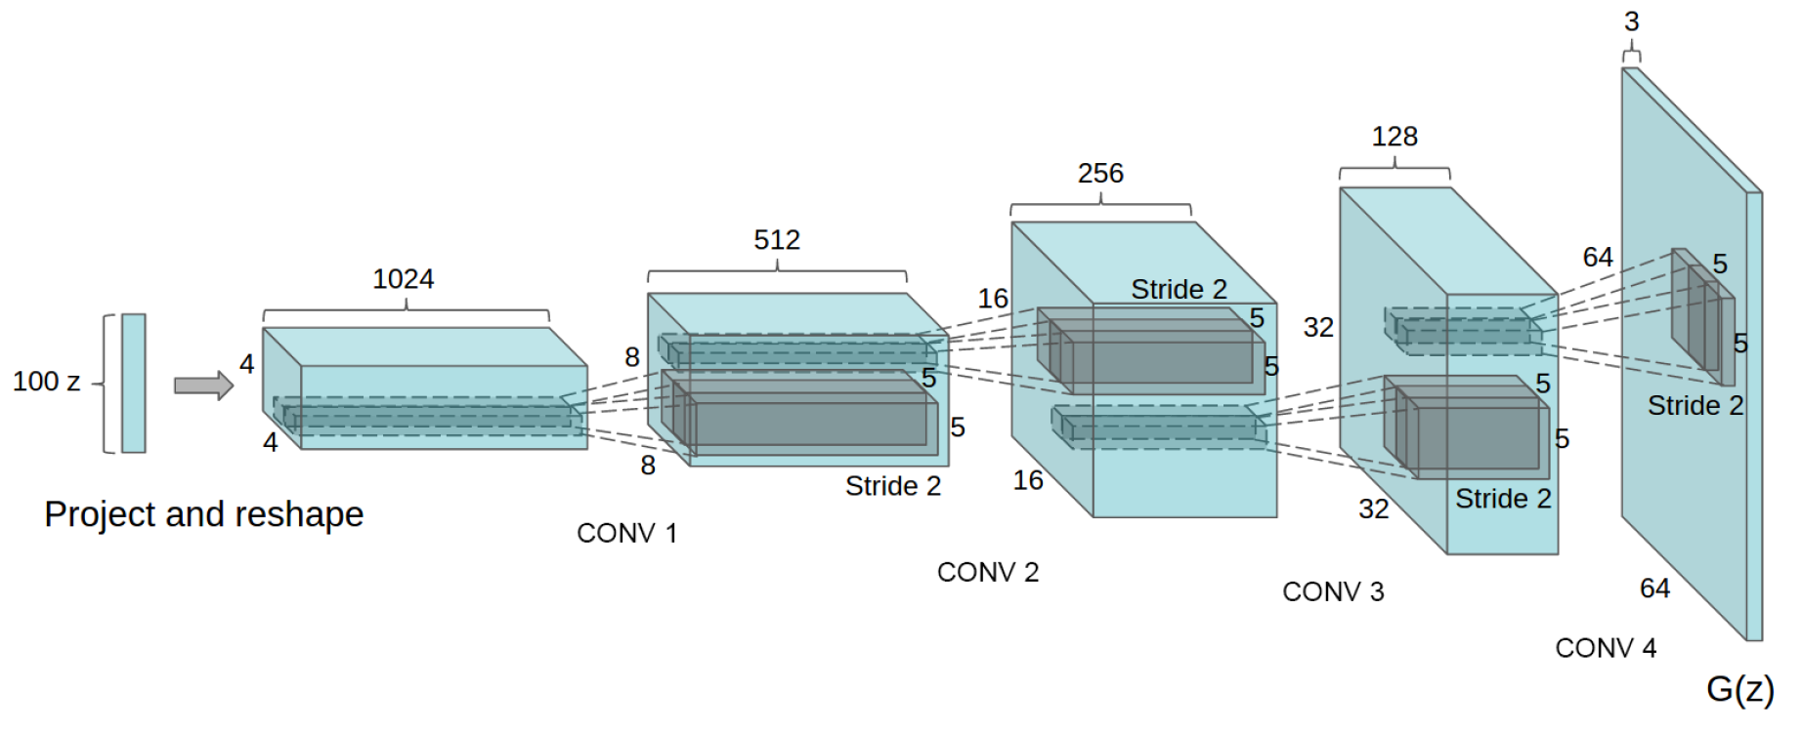
Deep Convolutional GANs (DCGANs)
Key ideas:
Replace FC hidden layers with Convolutions
Generator: Fractional-Strided convolutions
Use Batch Normalization after each layer
Inside Generator
Use ReLU for hidden layers
Use Tanh for the output layer
Generator Architecture
Notes:
[..]
Reference :- Fractionally-Strided Convolutions: Liwei’s Presentation

Slide 18
Part 2
Training Challenges
Non-Convergence
Mode-Collapse
Proposed Solutions
Supervision with Labels
Mini-Batch GANs
Modification of GAN’s losses
Discriminator (EB-GAN)
Generator (InfoGAN)
Notes:
In the next 20 mins., we’ll look at
-- the advantages of GANs over other models
-- some Training challenges in GANs
-- some proposed solutions to counter those challenges
-- and, some modifications of basic GAN’s loss to be able to do some cool stuff
-- we’ll look at modifications for both the Discriminator and Generator

Slide 19
Non-Convergence
Deep Learning models (in general) involve a single player
The player tries to maximize its reward (minimize its loss).
Use SGD (with Backpropagation) to find the optimal parameters.
SGD has convergence guarantees (under certain conditions).
Problem: With non-convexity, we might converge to local optima. $\min_{G}{L\left(G\right)}$
GANs instead involve two (or more) players
Discriminator is trying to maximize its reward.
Generator is trying to minimize Discriminator’s reward.
SGD was not designed to find the Nash equilibrium of a game.
Problem: We might not converge to the Nash equilibrium at all.
$$\min_{G}{\max_{D}{V\left(D, G\right)}}$$
Notes:
Having seen an example of Non-Convergence, let’s see why this might be happening…
[..]
--So, what kind of convergences guarantees do we really have?

Slide 20
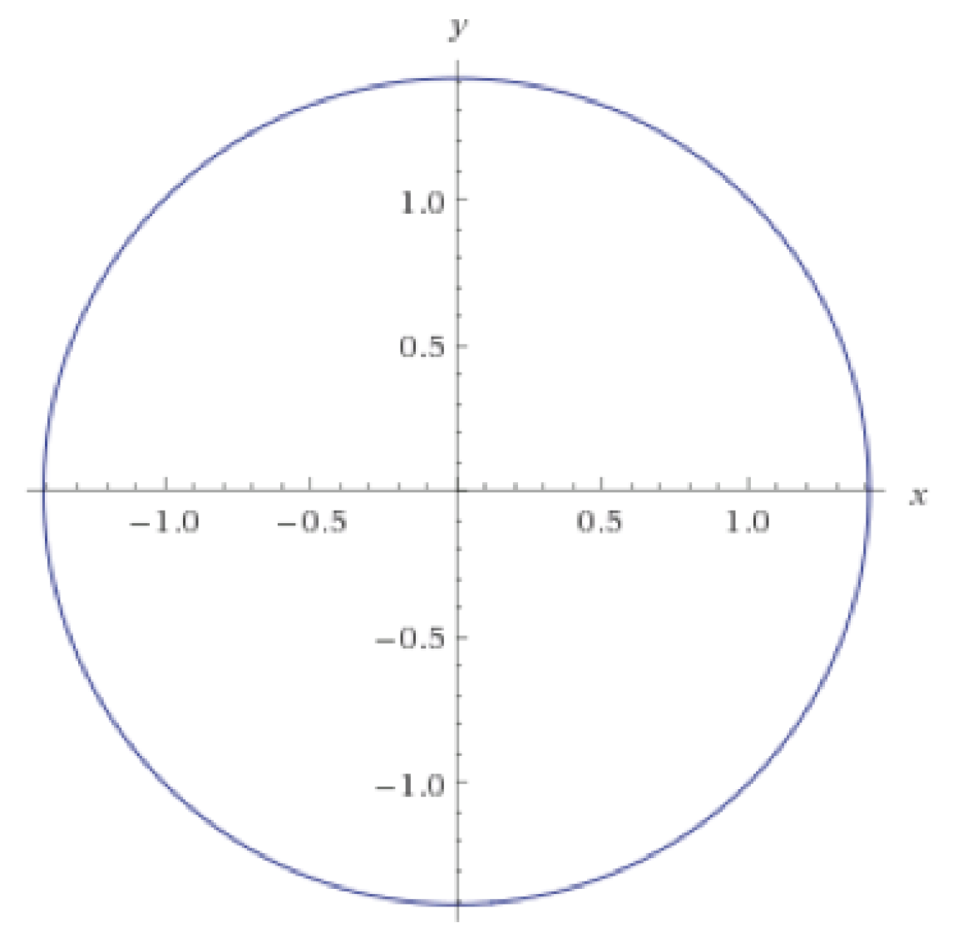
Non-Convergence
$$\min_{x}{\max_{y}{ xy}}$$
$\frac{∂}{∂x}=−y … \frac{∂}{∂y}=x$
$\frac{∂^{2}}{∂y^{2}}=$ $\frac{∂}{∂x}=−y$
Differential equation’s solution has sinusoidal terms
Even with a small learning rate, it will not converge
Notes:
For very few values of hyper-parameters, it might lead to damped oscillations, but not in general .. which is contrary to Backprop where if you’ll let the program run long enough with decaying step size, it will converge

Slide 21
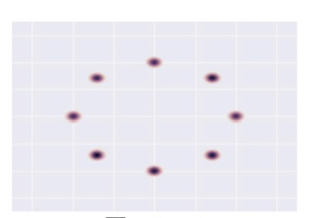
Mode-Collapse
Generator fails to output diverse samples
Target
8 modes 2D Gaussian
Expected
Output
Notes:
[..]
-- For instance, given that your real examples are generated from this 2D Gaussian Distribution (with 8 modes), you would expect your generated distribution to follow this trajectory
-- However, in practice, this happens.. i.e. your generated samples move from one mode to another, and fail to capture all the modes .. Thus, you don’t get diversity in the generated samples

Slide 22
How to reward sample diversity?
At Mode Collapse,
Generator produces good samples, but a very few of them.
Thus, Discriminator can’t tag them as fake.
To address this problem,
Let the Discriminator know about this edge-case.
More formally,
Let the Discriminator look at the entire batch instead of single examples
If there is lack of diversity, it will mark the examples as fake
Thus,
Generator will be forced to produce diverse samples.
Notes:
-- So intuitively, when mode collapse happens .. Our generator is still producing good samples .. But a very few number of them
-- And thus, the Discriminator can’t do anything about it since the fake samples are still realistic.
-- So, if we want to tackle this problem, one way to do that is to let the Discriminator know about this edge-case, so that when it sees it happening, it can mark those samples as fake.
-- To be more formal, let the Discriminator look at the entire batch of generated samples instead of a single example, so that if it sees lack of diversity, it can assign fake labels to the entire batch.
-- Thus, to fool the Discriminator, your Generator will be forced to generate diverse samples.

Slide 23
Mini-Batch GANs
Extract features that capture diversity in the mini-batch
For e.g. L2 norm of the difference between all pairs from the batch
Feed those features to the discriminator along with the image
Feature values will differ b/w diverse and non-diverse batches
Thus, Discriminator will rely on those features for classification
This in turn,
Will force the Generator to match those feature values with the real data
Will generate diverse batches
Notes:
-- So, that’s the underlying idea, however, in practice, we just mine some features from the batch that capture the diversity .. For instance L2 norm of the distance between pair of samples .. And feed those features to the discriminator along with the image.
-- Since, the real dataset will have diversity.. These features will have a different value as compared to the values for a non-diverse fake batch .. Thus Discriminator will be able to identify the fake samples … which in turn will force the Generator to produce diverse samples

Slide 24
Supervision with Labels
Label information of the real data might help
Replace D with a Multi-class classification problem where K classes are for the K labels in the dataset, and the K+1th class is for the fake image.
Modify cross-entropy loss
Empirically generates much better samples
Car
Dog
Real
D
D
Human
Fake
Fake
Notes:
A purely heuristic method – there is no understanding as to why this method works…
The idea is very simple i.e. instead of having a binary classification problem of Fake vs Real in the Discriminator .. You replace it with a Multi-class classification problem where K classes are for the K labels in the dataset, and the K+1th class is for the fake image.
And correspondingly modify the cross-entropy loss .. So the new cross entropy loss now will contain K+1 terms.

Slide 25
Alternate view of GANs
$$\min_{G}{\max_{D}{V\left(D, G\right)}}$$
$$V\left(D, G\right)=𝔼_{x∼p(x)}\left[\log{D\left(x\right)}\right]+𝔼_{z∼q(z)}\left[\log\left(1−D\left(G(z)\right)\right)\right]$$
$$D^{∗}{= arg\max_{D}{V\left(D, G\right)} G^{∗}= }arg\min_{G}{V\left(D, G\right)}$$
In this formulation, Discriminator’s strategy was $D\left(x\right)→1, D\left(G\left(z\right)\right)→0$
Alternatively, we can flip the binary classification labels i.e. Fake = 1, Real = 0
$$V\left(D, G\right)=𝔼_{x∼p(x)}\left[log\left(1 −D\left(x\right)\right)\right]+𝔼_{z∼q(z)}\left[\log\left(D\left(G(z)\right)\right)\right]$$
In this new formulation, Discriminator’s strategy will be $D\left(x\right)→0, D\left(G\left(z\right)\right)→1$
Notes:
<<Insert Conditions on such a Energy Function>>
This kind of loss function can be generalized by having the discriminator as an Energy function that assigns high energy to fake samples and low energy to real samples.
Outputting probabilities require

Slide 26
Alternate view of GANs (Contd.)
If all we want to encode is $D\left(x\right)→0, D\left(G\left(z\right)\right)→1$
$$D^{∗}={argmax_{D} 𝔼}_{x∼p(x)}\left[log\left(1 −D\left(x\right)\right)\right]+𝔼_{z∼q(z)}\left[\log\left(D\left(G(z)\right)\right)\right]$$
$$D^{∗}={argmin_{D} 𝔼}_{x∼p\left(x\right)}\log\left(D\left(x\right)\right)+𝔼_{z∼q(z)}\left[\log\left(1 −D\left(G\left(z\right)\right)\right)\right]$$
Now, we can replace cross-entropy with any loss function (Hinge Loss)
$${D^{∗}=argmin_{D} 𝔼}_{x∼p\left(x\right)}D\left(x\right)+𝔼_{z∼q\left(z\right)}\max\left(0, m−D\left(G\left(z\right)\right)\right)$$
And thus, instead of outputting probabilities, Discriminator just has to output :-
High values for fake samples
Low values for real samples
We can use this
Notes:
<<Insert Conditions on such a Energy Function>>
This kind of loss function can be generalized by having the discriminator as an Energy function that assigns high energy to fake samples and low energy to real samples.
Outputting probabilities require

Slide 27
Energy-Based GANs (EB-GANs)
Modified game plans
Generator will try to generate samples with low values
Discriminator will try to assign high scores to fake values
Use AutoEncoder inside the Discriminator
Use Mean-Squared Reconstruction error as $D\left(x\right)$
High Reconstruction Error for Fake samples
Low Reconstruction Error for Real samples
$$D\left(x\right)= ||Dec\left(Enc\left(x\right)\right) −x||_{MSE}$$
Notes:
<<Some thoughts on the changes in the training algo. here>>
<<Also, include some results from the paper i.e. what did this objective achieve>>
<<Some people have also tried Denoising AutoEncoders>>

Slide 28
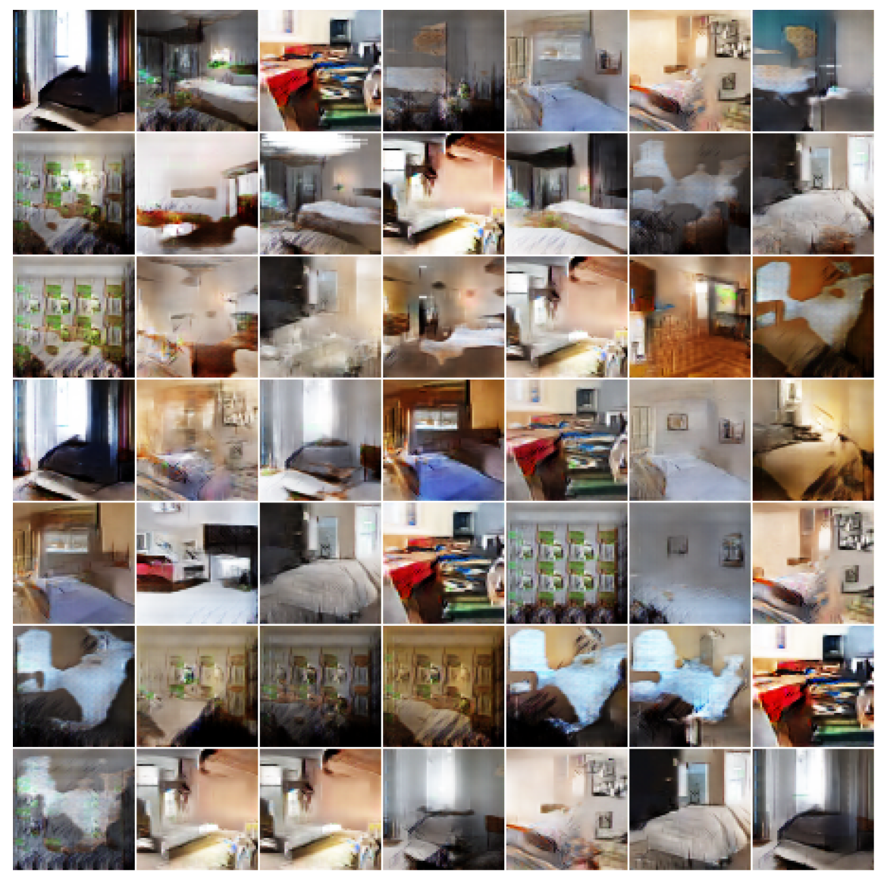
More Bedrooms EB-GAN
Notes:
Like DC-GAN .. EB-GANs are able to generate good high resolution images

Slide 29
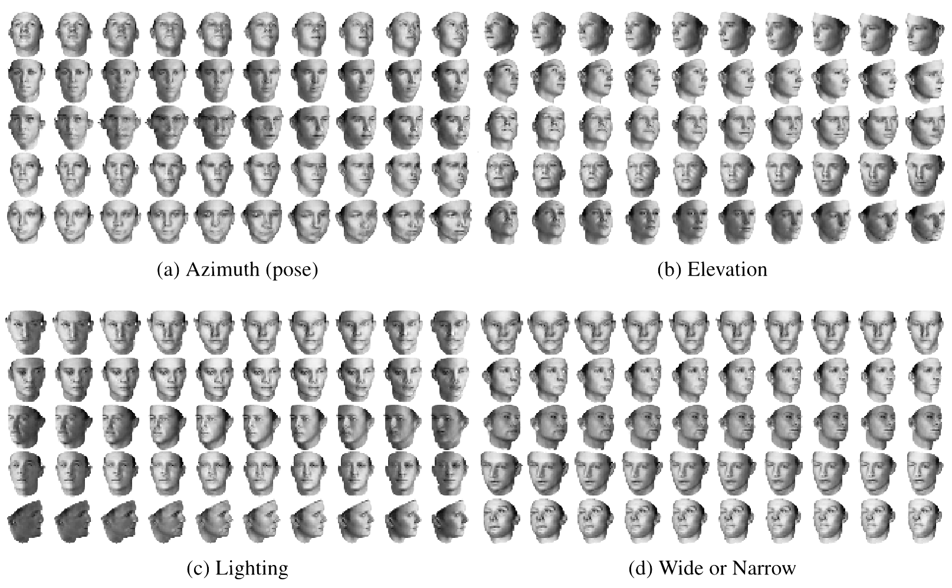
Feature parameterization
3D Faces
Notes:
-- So, training GANs is tricky, but when they do work, they can do some really cool stuff.. I’ll cover one such cool application, and then Bhargav will go over the rest
-- So, until now we just said that, if you want to generate an image from GANs, sample from a noise distribution, and propagate it through the network.. However, we had no control over what we’ll end up generating
-- Won’t it be cool, if by changing just one dimension in the noise vector, we can control some aspect of the image
-- For instance, let’s say with one initialization of the z vector, I get the first image, now if by changing just one dimension of the z vector, I can make my image to change the pose, it would be pretty cool.. So, in that case, that particular dimension will be handling the pose
of the image.
-- Similarly, a second z dimension can cover the Elevation of the image, a third z dimension can cover the Lighting and the fourth, the
width of the image.
-- Note that, you’ll most likely never find so many poses of the same person in your training set, however, your generator has learnt to control these aspects by looking at different poses of different people.
-- So, this is pretty cool… Just imagine how much robust your standard training can become by looking at all these additional examples

Slide 30
Feature parameterization
So, training GANs is tricky
Up to now if you want to generate an image from GANs, sample from a noise distribution, and propagate it through the network.. However, we had no control over what we’ll end up generating
By changing just one dimension in the noise vector, can control some aspect of the image
For instance, let’s say with one initialization of the z vector, we get the first image,
now if by changing just one dimension of the z vector, we can make my image to change the pose
in that case, that particular dimension will be handling the pose of the image.
Similarly, a second z dimension can cover the Elevation of the image, a third z dimension can cover the Lighting and the fourth, the width of the image.
Note that, you’ll most likely never find so many poses of the same person in your training set, however, your generator has learned to control these aspects by looking at different poses of different people.
Now how much robust your standard training can become by looking at all these additional examples
Notes:
-- So, training GANs is tricky, but when they do work, they can do some really cool stuff.. I’ll cover one such cool application, and then Bhargav will go over the rest
-- So, until now we just said that, if you want to generate an image from GANs, sample from a noise distribution, and propagate it through the network.. However, we had no control over what we’ll end up generating
-- Won’t it be cool, if by changing just one dimension in the noise vector, we can control some aspect of the image
-- For instance, let’s say with one initialization of the z vector, I get the first image, now if by changing just one dimension of the z vector, I can make my image to change the pose, it would be pretty cool.. So, in that case, that particular dimension will be handling the pose
of the image.
-- Similarly, a second z dimension can cover the Elevation of the image, a third z dimension can cover the Lighting and the fourth, the
width of the image.
-- Note that, you’ll most likely never find so many poses of the same person in your training set, however, your generator has learnt to control these aspects by looking at different poses of different people.
-- So, this is pretty cool… Just imagine how much robust your standard training can become by looking at all these additional examples

Slide 31
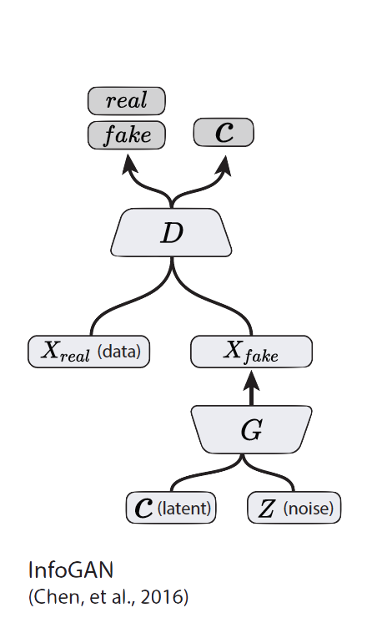
How to reward Disentanglement?
Disentanglement means individual dimensions independently capturing key attributes of the image
Let’s partition the noise vector into 2 parts :-
z vector will capture slight variations in the image
c vector will capture the main attributes of the image
For e.g. Digit, Angle and Thickness of images in MNIST
If c vector captures the key variations in the image,
Will c and $x_{fake}$ be highly correlated or weakly correlated?

Slide 32
Mutual Information
Mutual Information captures the mutual dependence between two variables
Mutual information between two variables $X, Y$ is defined as:
$$I\left(X;Y\right)= \sum_{x,y}{p\left(x,y\right)\log\left(\frac{p\left(x,y\right)}{p\left(x\right)p\left(y\right)}\right)}$$
$$I\left(X;Y\right)=H\left(X\right)−H\left(X | Y\right)=H\left(Y\right)−H(Y|X)$$

Slide 33
InfoGAN
We want to maximize the mutual information $I$ between $c$ and $x=G(z,c)$
Incorporate in the value function of the minimax game.
$$\min_{G}{\max_{D}{V_{I}\left(D,G\right)=V\left(D,G\right) −λ I\left(c;G\left(z,c\right)\right)}}$$

Slide 34
InfoGAN
Mutual Information’s Variational Lower bound
$$I\left(c;G\left(z,c\right)\right)=H\left(c\right)−H\left(c | G\left(z,c\right)\right)$$
$$= 𝔼_{x \sim G\left(z,c\right)}\left[𝔼_{c^{′}\sim P\left(c | x\right)}\left[\log{P\left(c^{′} | x\right)}\right]\right]+H(c)$$
$$= 𝔼_{x \sim G\left(z,c\right)}\left[{D_{KL}(P|\left|Q\right)+ 𝔼}_{c^{′}\sim P\left(c | x\right)}\left[\log{Q\left(c^{′} | x\right)}\right]\right]+H(c)$$
$$≥𝔼_{x \sim G\left(z,c\right)}\left[{ 𝔼}_{c^{′}\sim P\left(c | x\right)}\left[\log{Q\left(c^{′} | x\right)}\right]\right]+H(c)$$
$$≥𝔼_{c\sim P\left(c\right), x \sim G\left(z,c\right)}\left[\log{Q(c|x)}\right]+H(c)$$
$$D$$
$$Q$$
Notes:
Posterior like term

Slide 35
Part 3
Conditional GANs
Applications
Image-to-Image Translation
Text-to-Image Synthesis
Face Aging
Advanced GAN Extensions
Coupled GAN
LAPGAN – Laplacian Pyramid of Adversarial Networks
Adversarially Learned Inference
Summary
Notes:
Quick Recap here.

Slide 36
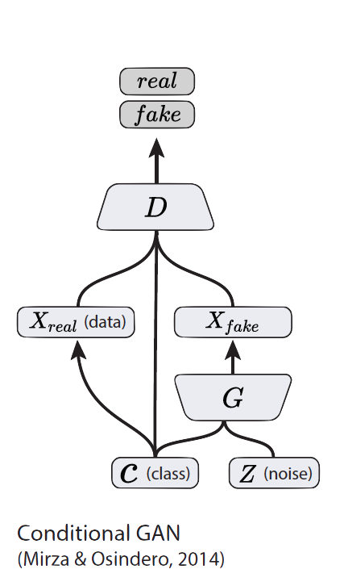
Conditional GANs (CGANs)
Simple modification to the original GAN framework that conditions the model on additional information for better multi-modal learning.
Lends to many applications of GANs when we have explicit supervision available.
Image Credit: Figure 2 in Odena, A., Olah, C. and Shlens, J., 2016. Conditional image synthesis with auxiliary classifier GANs. arXiv preprint arXiv:1610.09585.

Slide 37
Extension to Conditional Model
GANs can be extended to a conditional model if both G and D are conditioned on some extra information y
y could be any kind of auxiliary information,
– such as class labels or data from other modalities
We can perform the conditioning by feeding y
into both D and G as additional input layer

Slide 38
Conditional GAN Objective Function
In the generator the prior input noise p_{z}(z), and y are combined in joint hidden representation, and the adversarial training framework allows for considerable flexibility in how this hidden representation is composed.
In the discriminator x and y are presented as inputs and to a discriminative function (embodied again by a MLP in this case)
Objective function two-player minimax game is
min_{G}max_{D}V(D,G) =E_{x∼pdata(x)[}logD(x|y)]
+E_{z∼p(z)[}log(1−D(G(z|y)))]

Slide 39
CGAN Architecture

Slide 40
Conditional GANs (CGANs)
MNIST digits
generated conditioned on their class label.
$$\left[1, 0, 0, 0, 0, 0, 0, 0, 0, 0\right]$$
$$\left[0, 1, 0, 0, 0, 0, 0, 0, 0, 0\right]$$
$$\left[0, 0, 1, 0, 0, 0, 0, 0, 0, 0\right]$$
$$\left[0, 0, 0, 1, 0, 0, 0, 0, 0, 0\right]$$
$$\left[0, 0, 0, 0, 1, 0, 0, 0, 0, 0\right]$$
$$\left[0, 0, 0, 0, 0, 1, 0, 0, 0, 0\right]$$
$$\left[0, 0, 0, 0, 0, 0, 1, 0, 0, 0\right]$$
$$\left[0, 0, 0, 0, 0, 0, 0, 1, 0, 0\right]$$
$$\left[0, 0, 0, 0, 0, 0, 0, 0, 1, 0\right]$$
$$\left[0, 0, 0, 0, 0, 0, 0, 0, 0, 1\right]$$
MNIST digits
Figure 2 in the original paper.
Does not have to be class labels. We can condition on any explicit supervision available.
Notes:
Does not have to be class labels. We can condition on any explicit supervision available.

Slide 41
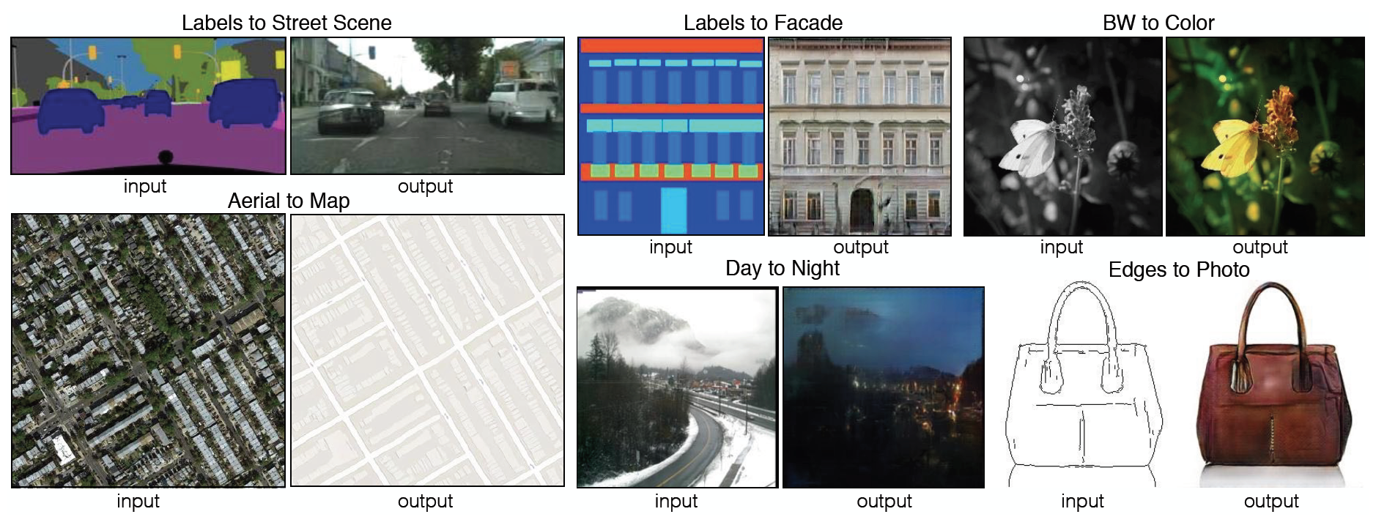
Image-to-Image Translation
Figure 1 in the original paper.
Link to an interactive demo of this paper https://affinelayer.com/pixsrv/

Slide 42
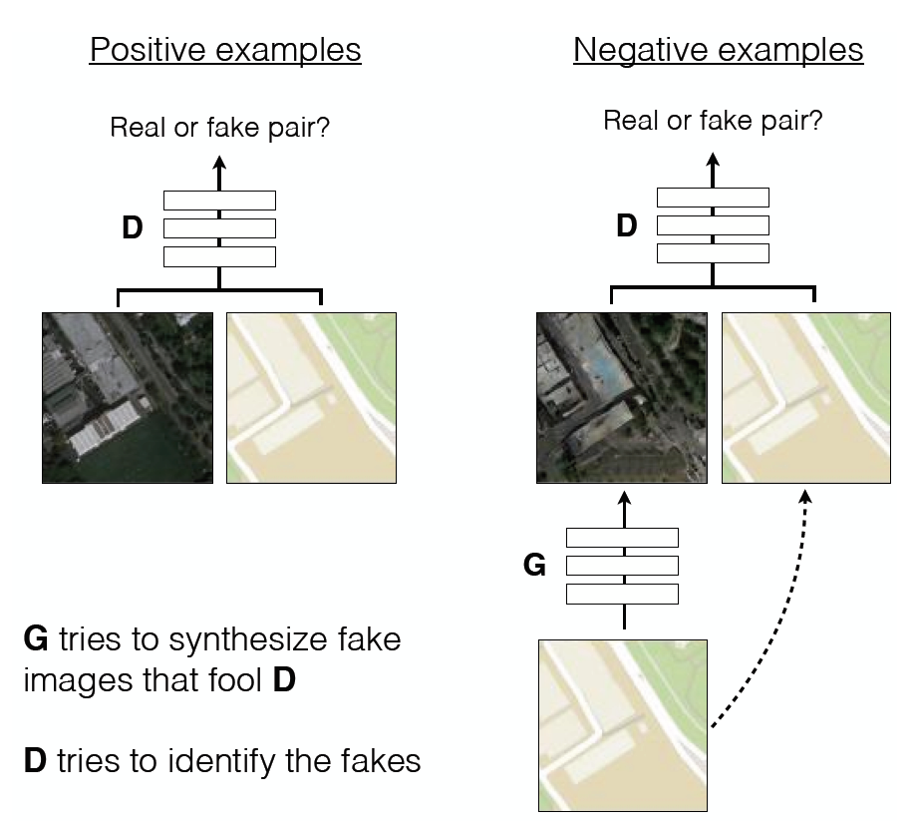
Image-to-Image Translation
Architecture: Deep Convolutional GAN (DCGAN) architecture
Training is conditioned on the images from the source domain.
Conditional GANs provide an effective way to handle many complex domains without worrying about designing structured loss functions explicitly.
Figure 2 in the original paper.
Notes:
DCGAN shows a set of constraints that work for training GANs and most of the application follow their architecture closely.
No need to design effective loss functions for each domain. GAN gives a “structured loss” for free.

Slide 43
Text-to-Image Synthesis
Motivation :Given a text description, generate images closely associated.
Uses a conditional GAN with the generator and discriminator being conditioned on “dense” text embedding.
Note the diversity of images
Figure 1 in the original paper.
Notes:
Talk about the diversity of images also.

Slide 44
Text-to-Image Synthesis
Figure 2 in the original paper.
Positive Example:
Real Image, Right Text
Negative Examples:
Real Image, Wrong Text
Fake Image, Right Text

Slide 45
Face Aging with Conditional GANs
Differentiating Feature: Uses an Identity Preservation Optimization using an auxiliary network to get a better approximation of the latent code (z*) for an input image.
Latent code is then conditioned on a discrete (one-hot) embedding of age categories.
Figure 1 in the original paper.

Slide 46
Face Aging with Conditional GANs
Figure 3 in the original paper.

Slide 47
Part 3
Conditional GANs
Applications
Image-to-Image Translation
Text-to-Image Synthesis
Face Aging
Advanced GAN Extensions
LAPGAN – Laplacian Pyramid of Adversarial Networks
Adversarially Learned Inference
Summary

Slide 48
Laplacian Pyramid of Adversarial Networks
Figure 1 in the original paper. (Edited for simplicity)
Based on the Laplacian Pyramid representation of images. (1983)
Generate high resolution (dimension) images by using a hierarchical system of GANs
Iteratively increase image resolution and quality.
Notes:
So, the Generator generates I3, h2, h1, h0 only.

Slide 49
Laplacian Pyramid of Adversarial Networks
Figure 1 in the original paper.
Image Generation using a LAPGAN
Generator $G_{3}$ generates the base image $\tilde{I_{3}}$ from random noise input $z_{3}$.
Generators ($G_{2},G_{1},G_{0}$) iteratively generate the difference image ($\hat{h})$ conditioned on previous small image ($l$).
This difference image is added to an up-scaled version of previous smaller image.
Notes:
So, the Generator generates I3, h2, h1, h0 only.

Slide 50
Laplacian Pyramid of Adversarial Networks
Figure 2 in the original paper.
Training Procedure:
Models at each level are trained independently to learn the required representation.
Notes:
Red -> Blur and Downscale (by a factor of 2)
Green -> Upsample (by a factor of 2)
Models at each level is trained independently to learn the required representation.

Slide 51
Adversarially Learned Inference
Basic idea is to learn an encoder/inference network along with the generator network.
Consider the following joint distributions over $x$ (image) and $z$ (latent variables) :
$$q\left(x, z\right) = q\left(x\right) q(z|x)$$
$$p\left(x, z\right)= p\left(z\right) p(x|z)$$
encoder distribution
generator distribution

Slide 52
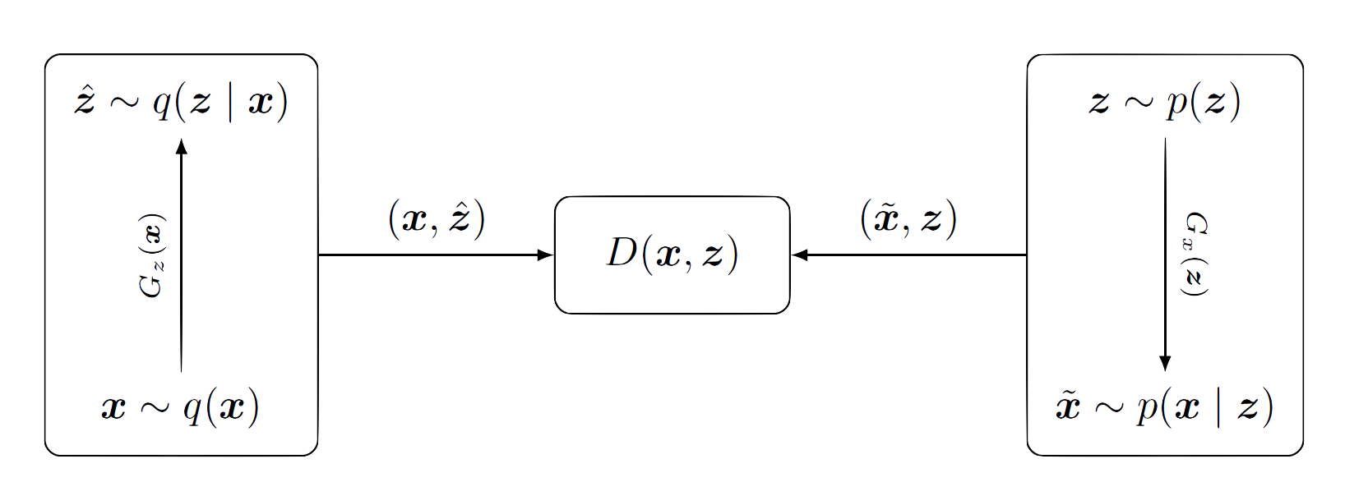
Adversarially Learned Inference
Discriminator Network
Encoder/Inference Network
Generator Network
Figure 1 in the original paper.
$$\min_{G}{\max_{D}{ 𝔼_{q\left(x\right)}[\log\left(D\left(x, G_{z}\left(x\right)\right)\right]+𝔼_{p\left(x\right)}\left[\log\left(1 −D\left(G_{x}\left(z\right), z\right)\right)\right]}}$$

Slide 53
Adversarially Learned Inference
Nash equilibrium yields
Joint: $p\left(x, z\right) \sim q\left(x,z\right)$
Marginals: $p\left(x\right) \sim q\left(x\right)$ and $p\left(z\right)\sim q\left(z\right)$
Conditionals: $p\left(x|z\right) \sim q(x|z)$ and $p\left(z|x\right) \sim q\left(z|x\right)$
Inferred latent representation successfully reconstructed the original image.
Representation was useful in the downstream semi-supervised task.

Slide 54
Why use GANs for Generation?
Can be trained using back-propagation for Neural Network based Generator/Discriminator functions.
Sharper images can be generated.
Faster to sample from the model distribution: single forward pass generates a single sample.

Slide 55
Issues with GANs
Very difficult to train
Two major problems: mode collapse, and non-convergence.
Used less since generative models usually outperform them
GigGAN hopes to change that
Uses an improved GAN architecture to enable a one billion parameter model trained with over 2.5 billion training images.
Can generate images from text input, is an order of magnitude faster than Stable Diffusion, and enables efficient image processing through prompting.
An upscaling variant of GigaGAN can upscale 128 pixel images to detailed 4K images.

Slide 56
GAN Variants
GAN Zoo
6 GAN Architectures you really should know

Slide 57
Growth of GAN papers
Gan Zoo
With LLMs however, GANs seem to be losing their appeal.

Slide 58
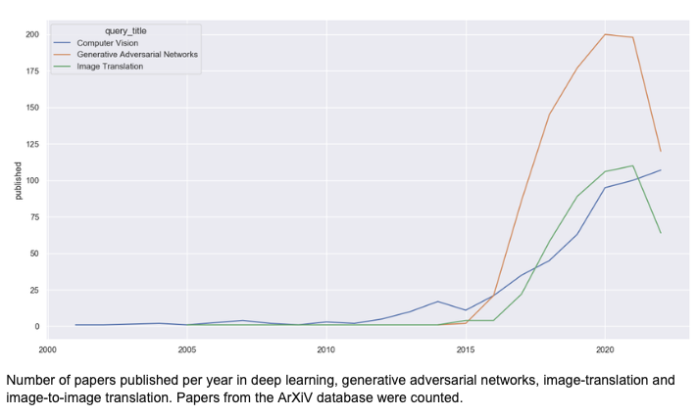
https://www.researchgate.net/figure/Number-of-papers-published-per-year-in-deep-learning-generative-adversarial-networks_fig1_365225347

Slide 59
Summary
GANs are generative models that are implemented using two stochastic neural network modules: Generator and Discriminator.
Generator tries to generate samples from random noise as input
Discriminator tries to distinguish the samples from Generator and samples from the real data distribution.
Both networks are trained adversarially (in tandem) to fool the other component. In this process, both models become better at their respective tasks.
Many GAN variants (GAN Zoo)

Slide 60
Reading List
Goodfellow, I., Pouget-Abadie, J., Mirza, M., Xu, B., Warde-Farley, D., Ozair, S., Courville, A. and Bengio, Y. Generative adversarial nets, NIPS (2014).
Goodfellow, Ian NIPS 2016 Tutorial: Generative Adversarial Networks, NIPS (2016).
Radford, A., Metz, L. and Chintala, S., Unsupervised representation learning with deep convolutional generative adversarial networks. arXiv preprint arXiv:1511.06434. (2015).
Salimans, T., Goodfellow, I., Zaremba, W., Cheung, V., Radford, A., & Chen, X. Improved techniques for training gans. NIPS (2016).
Chen, X., Duan, Y., Houthooft, R., Schulman, J., Sutskever, I., & Abbeel, P. InfoGAN: Interpretable Representation Learning by Information Maximization Generative Adversarial Nets, NIPS (2016).
Zhao, Junbo, Michael Mathieu, and Yann LeCun. Energy-based generative adversarial network. arXiv preprint arXiv:1609.03126 (2016).
Mirza, Mehdi, and Simon Osindero. Conditional generative adversarial nets. arXiv preprint arXiv:1411.1784 (2014).
Liu, Ming-Yu, and Oncel Tuzel. Coupled generative adversarial networks. NIPS (2016).
Denton, E.L., Chintala, S. and Fergus, R., 2015. Deep Generative Image Models using a Laplacian Pyramid of Adversarial Networks. NIPS (2015)
Dumoulin, V., Belghazi, I., Poole, B., Lamb, A., Arjovsky, M., Mastropietro, O., & Courville, A. Adversarially learned inference. arXiv preprint arXiv:1606.00704 (2016).
Applications:
Isola, P., Zhu, J. Y., Zhou, T., & Efros, A. A. Image-to-image translation with conditional adversarial networks. arXiv preprint arXiv:1611.07004. (2016).
Reed, S., Akata, Z., Yan, X., Logeswaran, L., Schiele, B., & Lee, H. Generative adversarial text to image synthesis. JMLR (2016).
Antipov, G., Baccouche, M., & Dugelay, J. L. (2017). Face Aging With Conditional Generative Adversarial Networks. arXiv preprint arXiv:1702.01983.

