Slide 1
Neural Architectures with Memory
Thanks to Alexander Ororbia, Nitish Gupta, Shreya Rajpal, Jason Weston, John Canny, Alex Graves, Ankur Mali, and friends

Slide 2
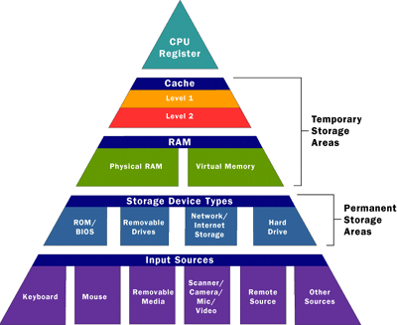
Computer Architecture Memory Hierarchy
  Increasing performance and increasing cost
Slow and inexpensive

Slide 3
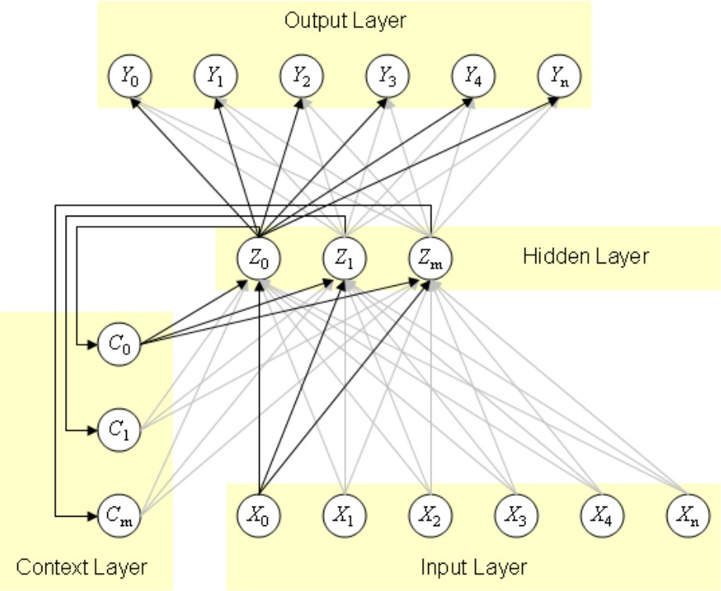
RNN as a network with cycles and local memory
An RNN is a class of neural networks where connections between units form a directed cycle
This creates an internal state of the network which allows it to exhibit dynamic temporal behavior
The internal memory can be used to process arbitrary sequences of inputs
Three layer network with input x , hidden layer z and output y
Context units c maintain a copy of the previous value of the hidden units

Slide 4
Neural Networks and Memory is an Old Idea
Early neural networks looked like state machines and sequential circuits and played a large role in automata theory
For this we need a brief introduction to automata
McCulloch, Warren S., and Walter Pitts. "A logical calculus of the ideas immanent in nervous activity." The bulletin of mathematical biophysics 5 (1943): 115-133.

Slide 5
Deep Learning & Automata
Automata and formal grammars are building blocks for software, compilers, and many finite state machines such as VLSI, elevators, ATMs, etc.
Automata and their grammars are transparent
  We know what they are doing
  Because they are transparent, they are verifiable
  More trustworthy
Automata have rules and structure
  Use knowledge - Insert rules?
  Refine rules
Understanding the deep learner
Verification, safety, robustness, validation

Slide 6
Formal Grammars and Automata
Foundations of Computer Science
Formal Grammars - branch of applied mathematics
  Applications are found in theoretical computer science, theoretical and applied linguistics, formal semantics, mathematical logic
Automata theory - study of abstract machines and automata, as well as the computational problems that can be solved using them (complexity, hardness, decidability, NP, etc.)
  Defines what is computable
  Theory in theoretical computer science and discrete mathematics
  Automata play a major role in theory of computation, compiler construction, artificial intelligence, parsing and formal verification.
Applications include system design, parsing, VLSI, operating systems, regular expressions, AI, security, switches-routers, time series, etc.

Slide 7
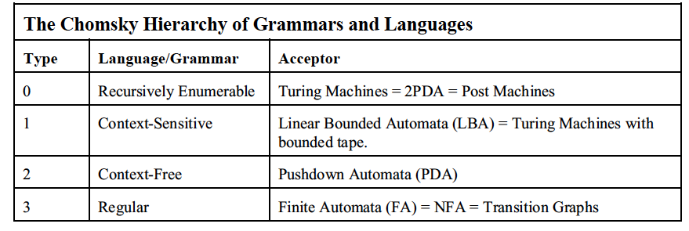
Chomsky Hierarchy of Grammars and Automata
Automata require stateful processes and memory

Slide 8
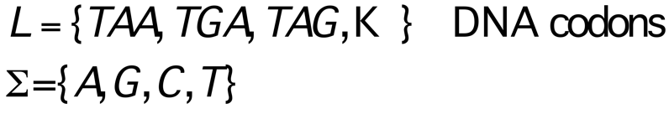
Regular Automata, Grammars, Languages
Language: a set of strings L over some finite alphabet Σ
  Ex:
Automaton (Machine): abstract (=simplified) model of a computing device. Used to “recognize” strings of a language L
  Ex:
Grammar: finite set of string rewriting rules. Used to “generate” strings of a language (production rules)
  Ex:
L = {aa, ab, abbb, ….}
Σ = {a,b}
b
A
B
Finite Automaton
Finite State Machine (FSM)
Deterministic Finite Automata (DFA)
a
a
b
S → A
aA → A
bA → B
aB → A
bB → B
B → E

Slide 9
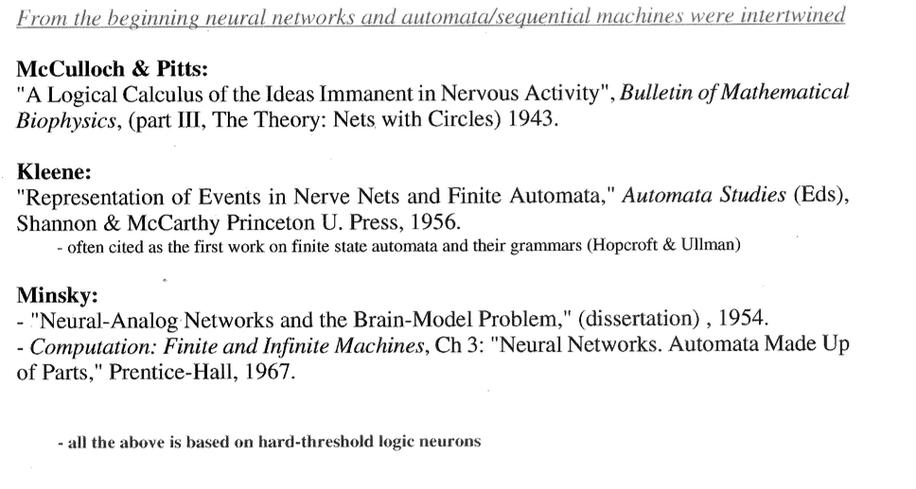
Neural Networks – Automata/sequential Machines

Slide 10
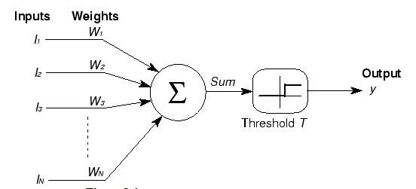
McCulloch-Pitts Logical Calculus
With feedback, a finite automata
Kiyoshi Kawaguchi

Slide 11
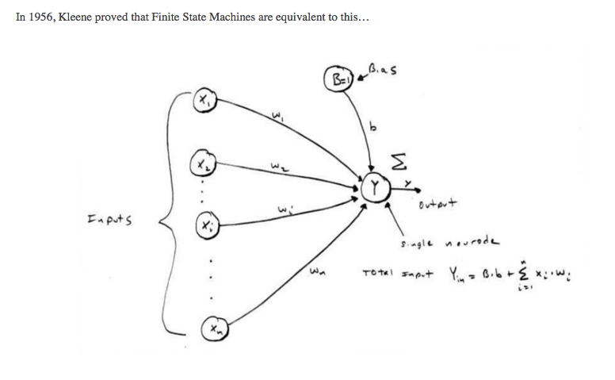
Kleene Theorem
“Neural nets: How Regular Expressions brought about Deep Learning,” Matt Painter
Theorem: A language L is accepted by a FSA iff L is a regular language.

Slide 12
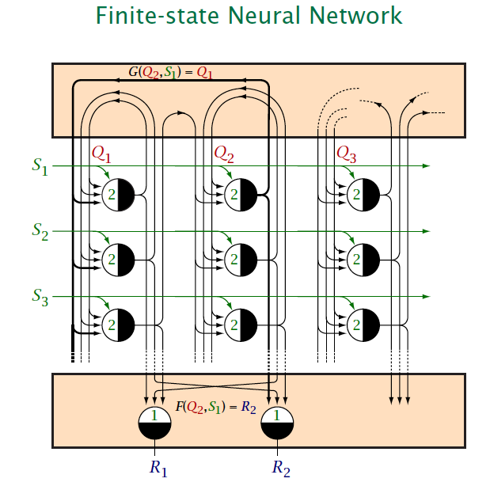
M Minsky, Computation: Finite and Infinite Machines, Ch3 “Neural Networks:
Automata Made up of Parts,” 1967.

Slide 13
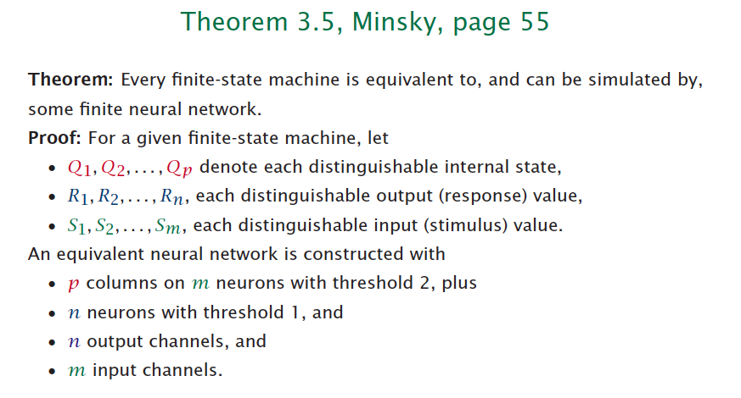
M Minsky, Computation: Finite and Infinite Machines, Ch3 “Neural Networks:
Automata Made up of Parts,” 1967.

Slide 14
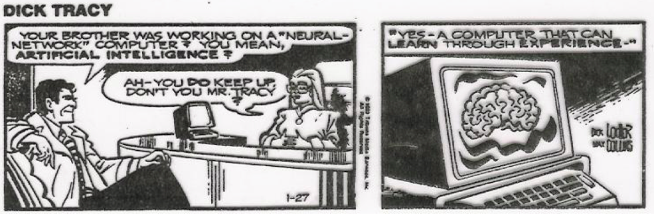
Dick Tracy – ahead of his time - 1986

Slide 15
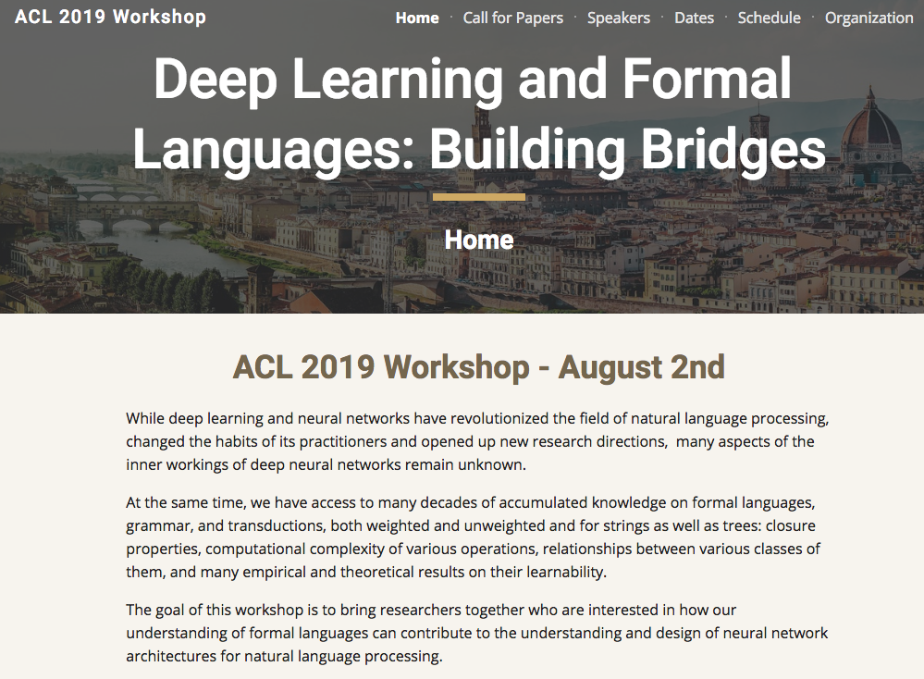

Slide 16
Deep Learning & Automata
Applications
Automated design
Controllers, switches
Automated code correction and writing (holy grail)
Rule checking
Malware detection, security
Code bug detection
NN explainability, verification
Sequence modeling, finance, DNA

Slide 17
Motivation
Explainability of DLs
RNNs are stateful DLs; what can they do?
  Stateful vs stateless
Interpret trained RNNs
Verification of RNNs
  What the …. IS that DL doing?
Improved sequence learning
Expand RNNs to use Memory structures

Slide 18
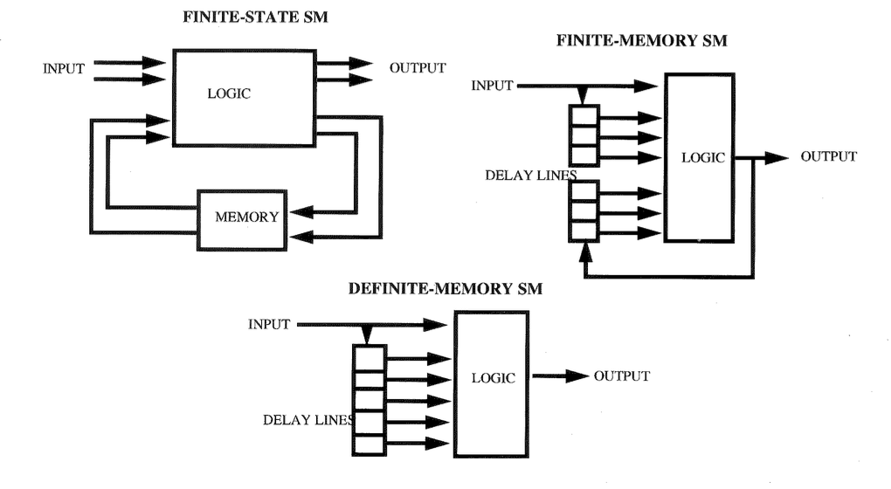
State machine topologies
Kohavi, 1978
Often termed – Sequential Machines

Slide 19
State machines as recurrent networks
Replace logic by layers of neural networks –
Recurrent neural networks
Kohavi, 1978
Often termed – Sequential Machines

Slide 20
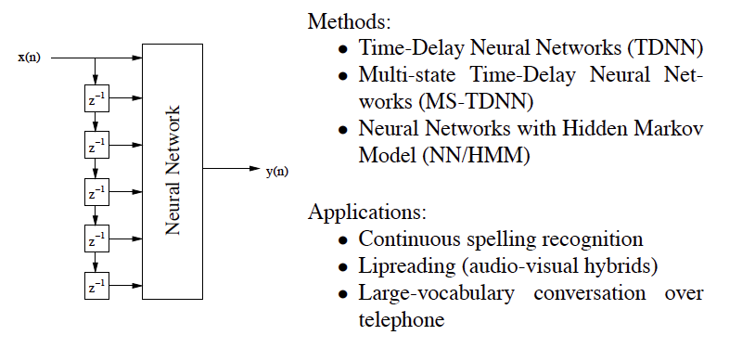
Time Delay NNs

Slide 21
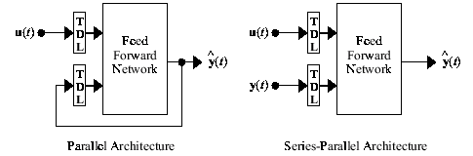
Time Delay NNs

Slide 22
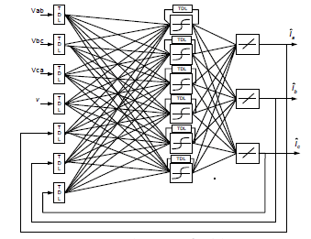
Time Delay NNs - NARX

Slide 23
State machines and RNNs
State machines, finite state machines (FSM), deterministic finite automata (DFA)
  State machines can be implemented with logic – sequential machines
  Recognize strings
  Generate strings
  DFA a special case of FSM
RNNs are topologically similar to implementations of DFAs
  Replace hard logic and gates with neurons
Equivalence?
  Some theoretical work on equivalence
  Turing equivalence established
  Stability and DFA mapping
Siegelmann ’91,’97
Omlin ‘96

Slide 24
Our contributions in the 90’s
Second order recurrent neural networks (tensor networks) which contributed to the following - w_{ijk}
Learn regular grammars from labeled strings
Regular grammar rules
  Rule extraction
  Rule insertion
  Rule refinement
  Provable rule stability
Learning reasonably large De Bruijn (finite memory) automata
Design of a Neural Network Pushdown Automata (NNPDA) using a recurrent neural network to control an analog stack
  Third order NNs - w_{ijkl}
Learning of a few context free grammars (CFGs)
Rules easier to extract from tensor networks
Theoretically showed finite state machines can be stably encoded in RNNs ( JACM ’96)

Slide 25
Bibliography
C.L. Giles, C.B. Miller, D. Chen, H.H. Chen, G.Z. Sun, Y.C. Lee, “Learning and Extracting Finite State Automata with Second-Order Recurrent Neural Networks,” Neural Computation, 4(3), 393-405, 1992.
C.L. Giles, S. Lawrence, A-C. Tsoi, “Noisy Time Series Prediction Using a Recurrent Neural Network and Grammatical Inference,” Machine Learning, 44, 161-183, 2001.
T. Lin, B.G. Horne, P. Tino, C.L. Giles, “Learning Long-term dependencies with NARX networks,” IEEE Trans. on Neural Networks, 7(6), p. 1329, 1996 (IEEE Trans. on Neural Networks outstanding paper award for 1996).
C.W. Omlin, C.L. Giles, “Constructing Deterministic Finite-State Automata in Recurrent Neural Networks,” Journal of the ACM, 45(6), p. 937, 1996.
C.W. Omlin, C.L. Giles, “Rule Revision with Recurrent Neural Networks,” IEEE Trans. on Knowledge and Data Engineering, 8(1), p. 183, 1996.
C.W. Omlin, C.L. Giles, “Stable Encoding of Large Finite-State Automata in Recurrent Neural Networks with Sigmoid Discriminants,” Neural Computation, 8(4), p. 675, 1996.
C.W. Omlin, C.L. Giles, “Extraction of Rules from Discrete-Time Recurrent Neural Networks,” Neural Networks, 9(1), p. 41. 1996.
C.L. Giles, B.G. Horne, T. Lin, “Learning a Class of Large Finite State Machines with a Recurrent Neural Network,” Neural Networks, 8(9), p. 1359, 1995.
D.S. Clouse, C.L. Giles, B.G. Horne, G.W. Cottrell, “Representation and Induction of Finite State Machines using Time-Delay Neural Networks,” NIPS9, (eds) M. Mozer, M. Jordan, T. Petsche, MIT Press, p. 403, 1997.
G.Z. Sun, C.L. Giles, H.H. Chen, Y.C. Lee, “The Neural Network Pushdown Automation: Architecture, Dynamics and Learning,” in Adaptive Processing of Sequences and Data Structures, Lecture Notes in Artificial Intelligence, (eds) C.L. Giles, M. Gori, p.296, Springer-Verlag, 1998
S. Das, C.L. Giles, G.Z. Sun, “Using Prior Knowledge in a NNPDA to Learn Context-Free Languages,” NIPS5, S.J. Hanson, J.D. Cowan, C.L. Giles (eds), Morgan Kaufmann, San Mateo, Ca., p. 65, 1993.

Slide 26
Bibliography
C.L. Giles, T. Maxwell, “Learning, Invariance, and Generalization in High Order Neural Networks,” (invited) Applied Optics, 26(23), 4972-4978, 1987..
T. Lin, B.G. Horne, P. Tino, C.L. Giles, “Learning Long-term dependencies with NARX networks,” IEEE Trans. on Neural Networks, 7(6), p. 1329, 1996 (IEEE Trans. on Neural Networks outstanding paper award for 1996).
H.T. Siegelmann, B.G. Horne, C.L. Giles, “Computational capabilities of recurrent NARX neural networks,” IEEE Trans. on Systems, Man and Cybernetics: Part B - Cybernetics, 27(2), p.208, 1997.
S. Lawrence, C.L. Giles, S. Fong, “Natural Language Grammatical Inference with Recurrent Neural Networks,” IEEE Trans. on Knowledge and Data Engineering, 12(1), p.126, 2000.
T. Lin, B.G. Horne, P. Tino, C.L. Giles, “Learning long-term dependencies is not as difficult with NARX networks, NIPS8, (eds) D. Touretzky, M. Mozer, M. Hasselmo, MIT Press, p. 577, 1996.

Slide 27
Related Work
Early work: using neural networks for grammatical inference and state machines: Cleeresman89, Elman91, Giles92, Giles92, Pollack90, Watrous92, Zeng94.
[Williams89] coupled a recurrent neural network to a memory tape to emulate a Turing machine and to learn the state automaton controller for the balanced-parentheses grammar (a context-free grammar).
RAAM model [Pollack90] proposed an "internal" neural network model of stack memory as a plausible model for cognitive processing. Consider using this model to build a NNPDA.

Slide 28
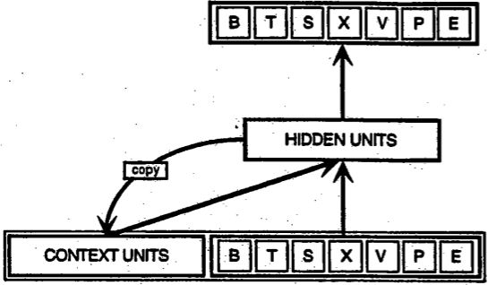
Elman & Jordan Networks
Simple recurrence using one-step context units
  Elman Network – hidden context units
    Can do simple grammatical inference
  Jordan Network – output context units
  Back-propagation through time generalizes Elman Networks (multiple steps in time to increase history)
Image taken from Servan-Schreiber et al., (1991).
Notes:
Servan-Schreiber, D., Cleeremans, A., and McClelland, J. L. (1991). Graded state machines: The representation of temporal contingencies in simple recurrent networks. Machine Learning, 7:161–193.

Slide 29
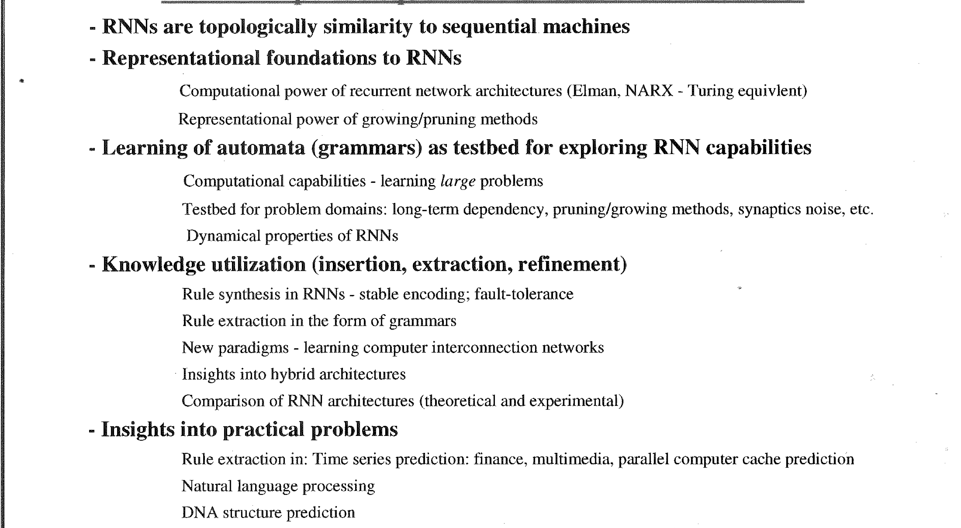
Motivation for RNNs and Sequential Machines

Slide 30
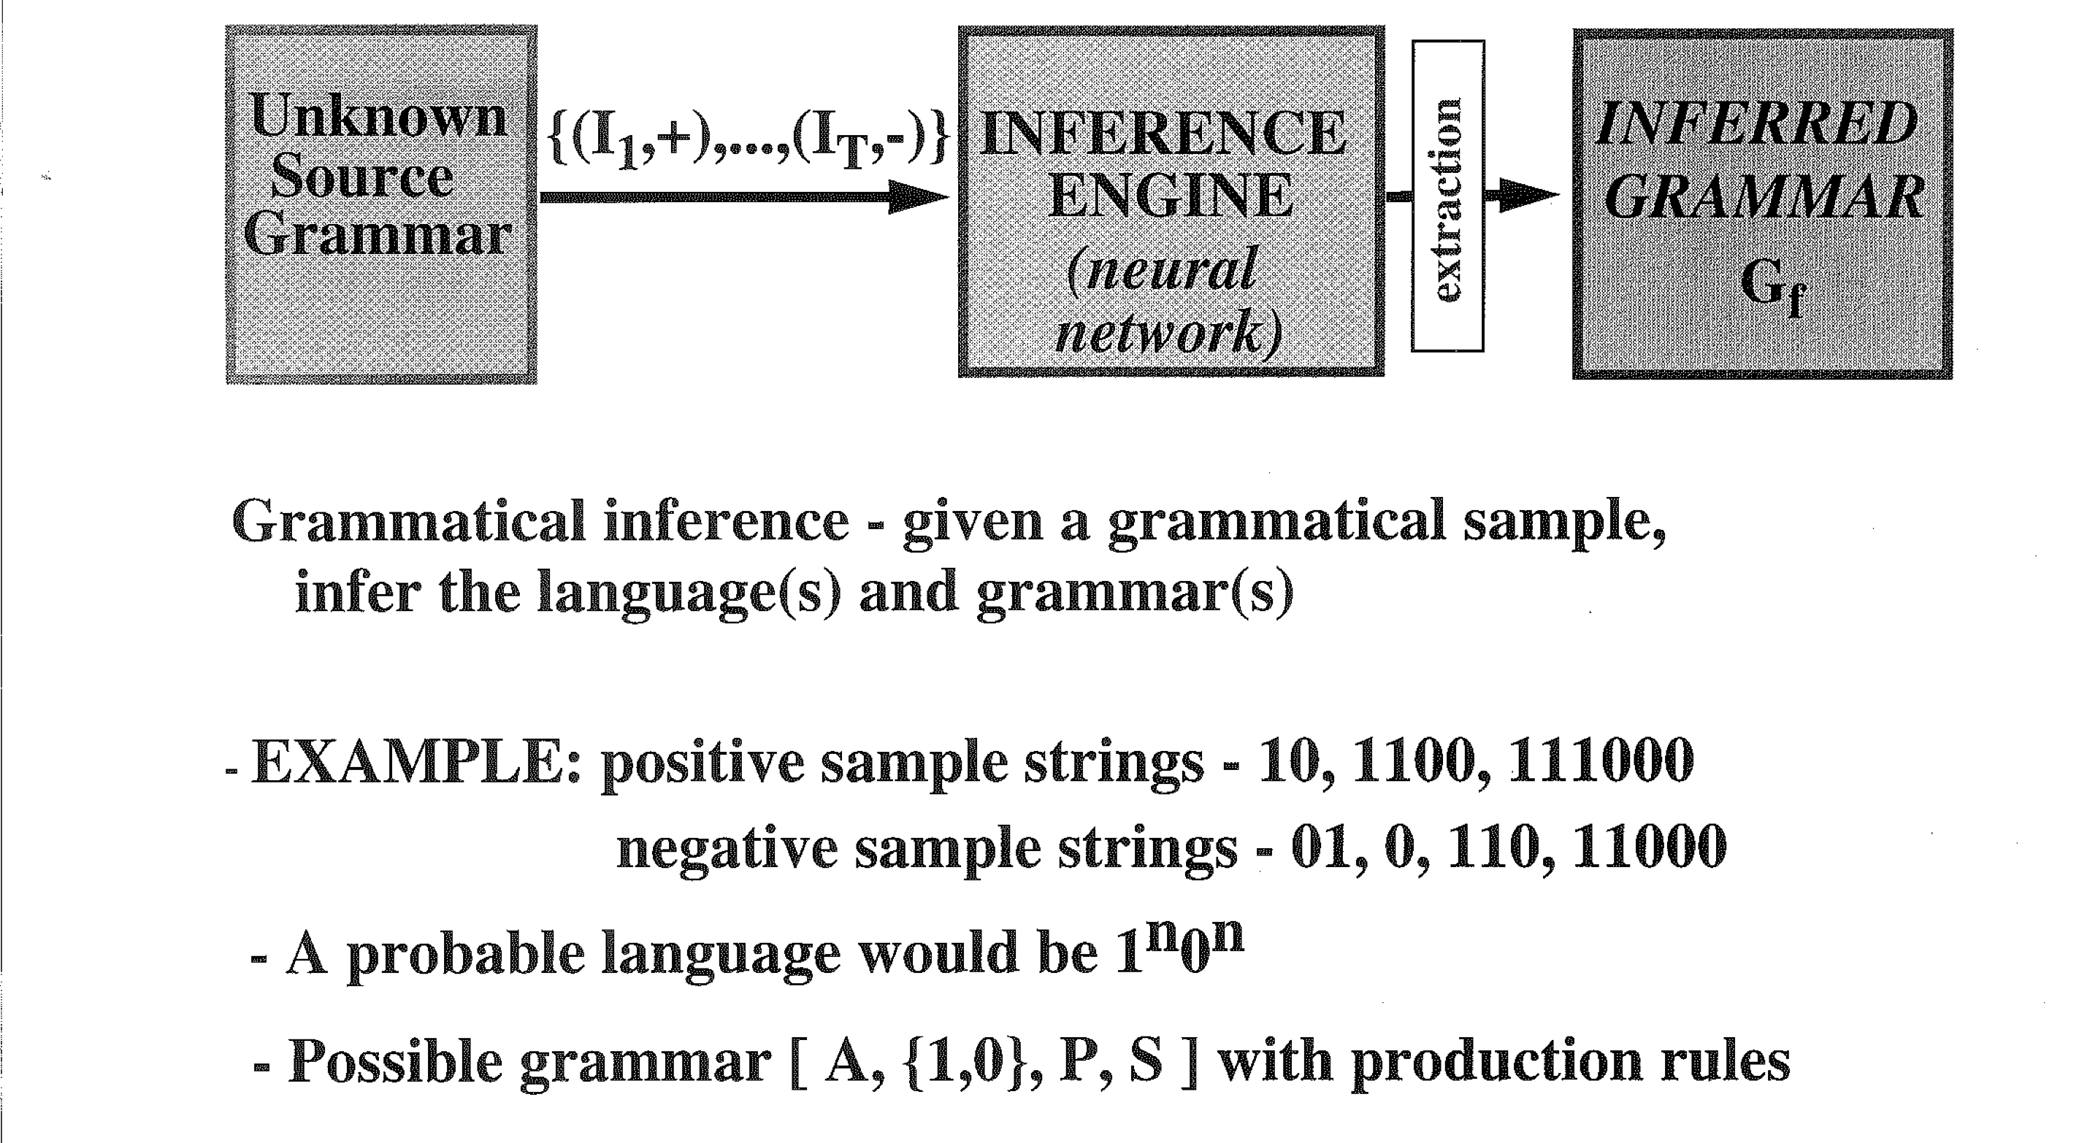
Grammatical Inference - RNNs
Gold, Information and Control, ‘67

Slide 31


Slide 32
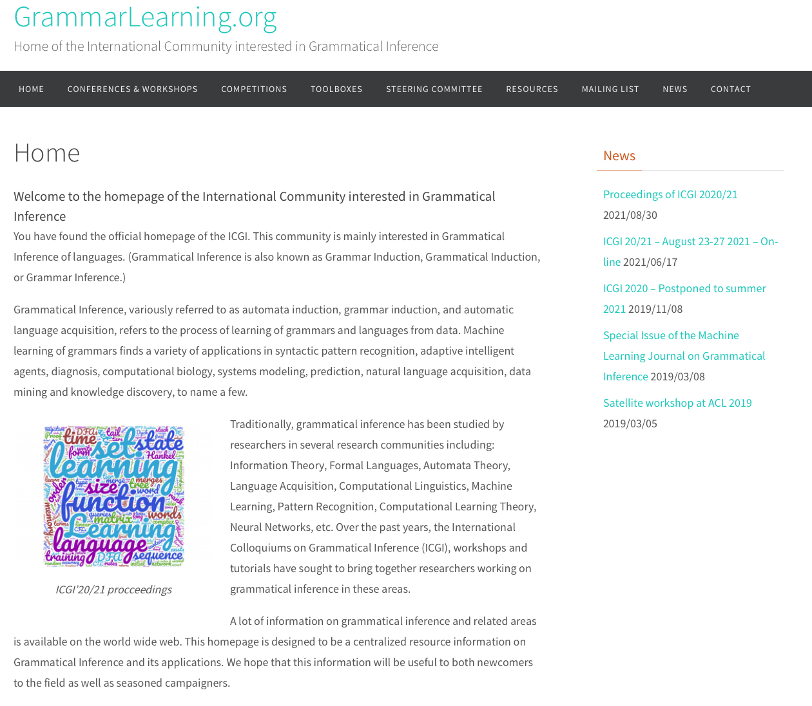

Slide 33
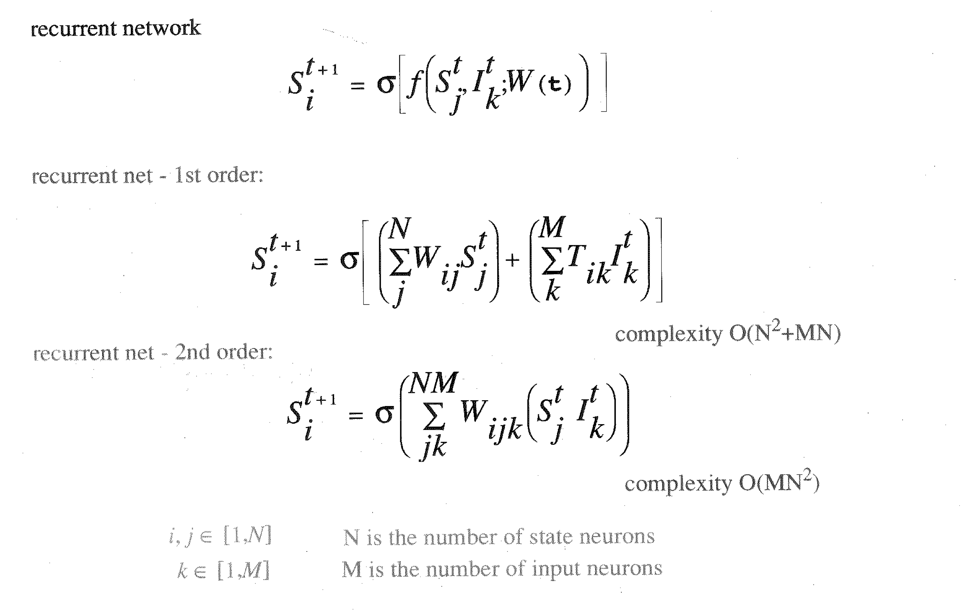
2nd-order RNN (tensors)
W_{ijk} translates easily to production rules for regular grammars

Slide 34
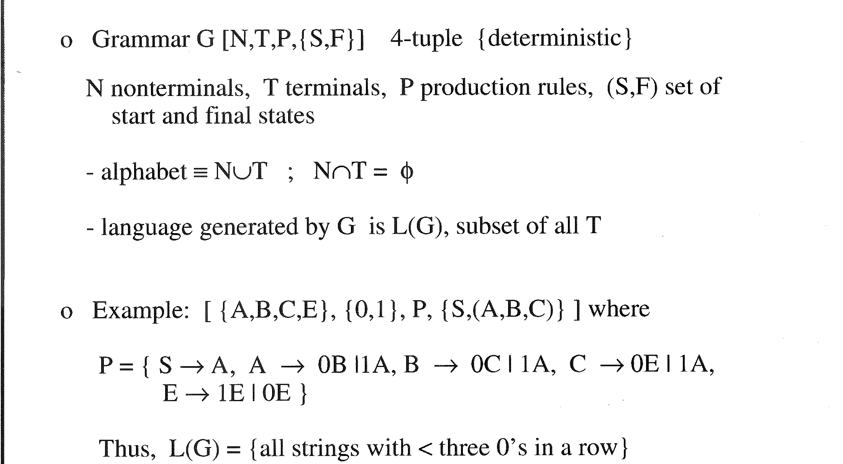
Formal Grammars

Slide 35
Definition of the formal grammar G
G = < V, Σ, P, σ >
V – set of terminal symbols
Σ – set of nonterminal symbols with the restriction
that V and Σ are disjoint
σ – start symbol
P – set of production rules in a form:
  A –> B
where:
  A – is a sequence of symbols having at least one
  nonterminal,
  B – is the result of replacing some nonterminal symbol
  A with a sequence of symbols (possibly empty)
  from V and Σ

Slide 36
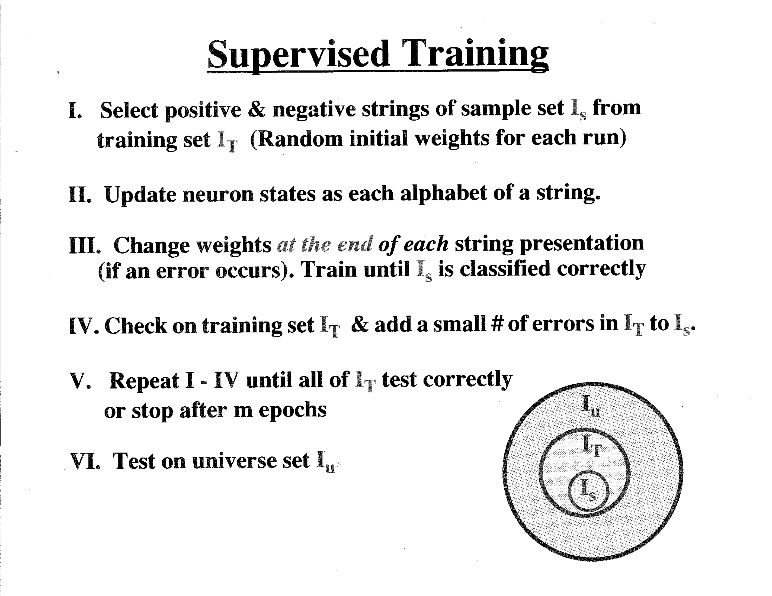

Slide 37
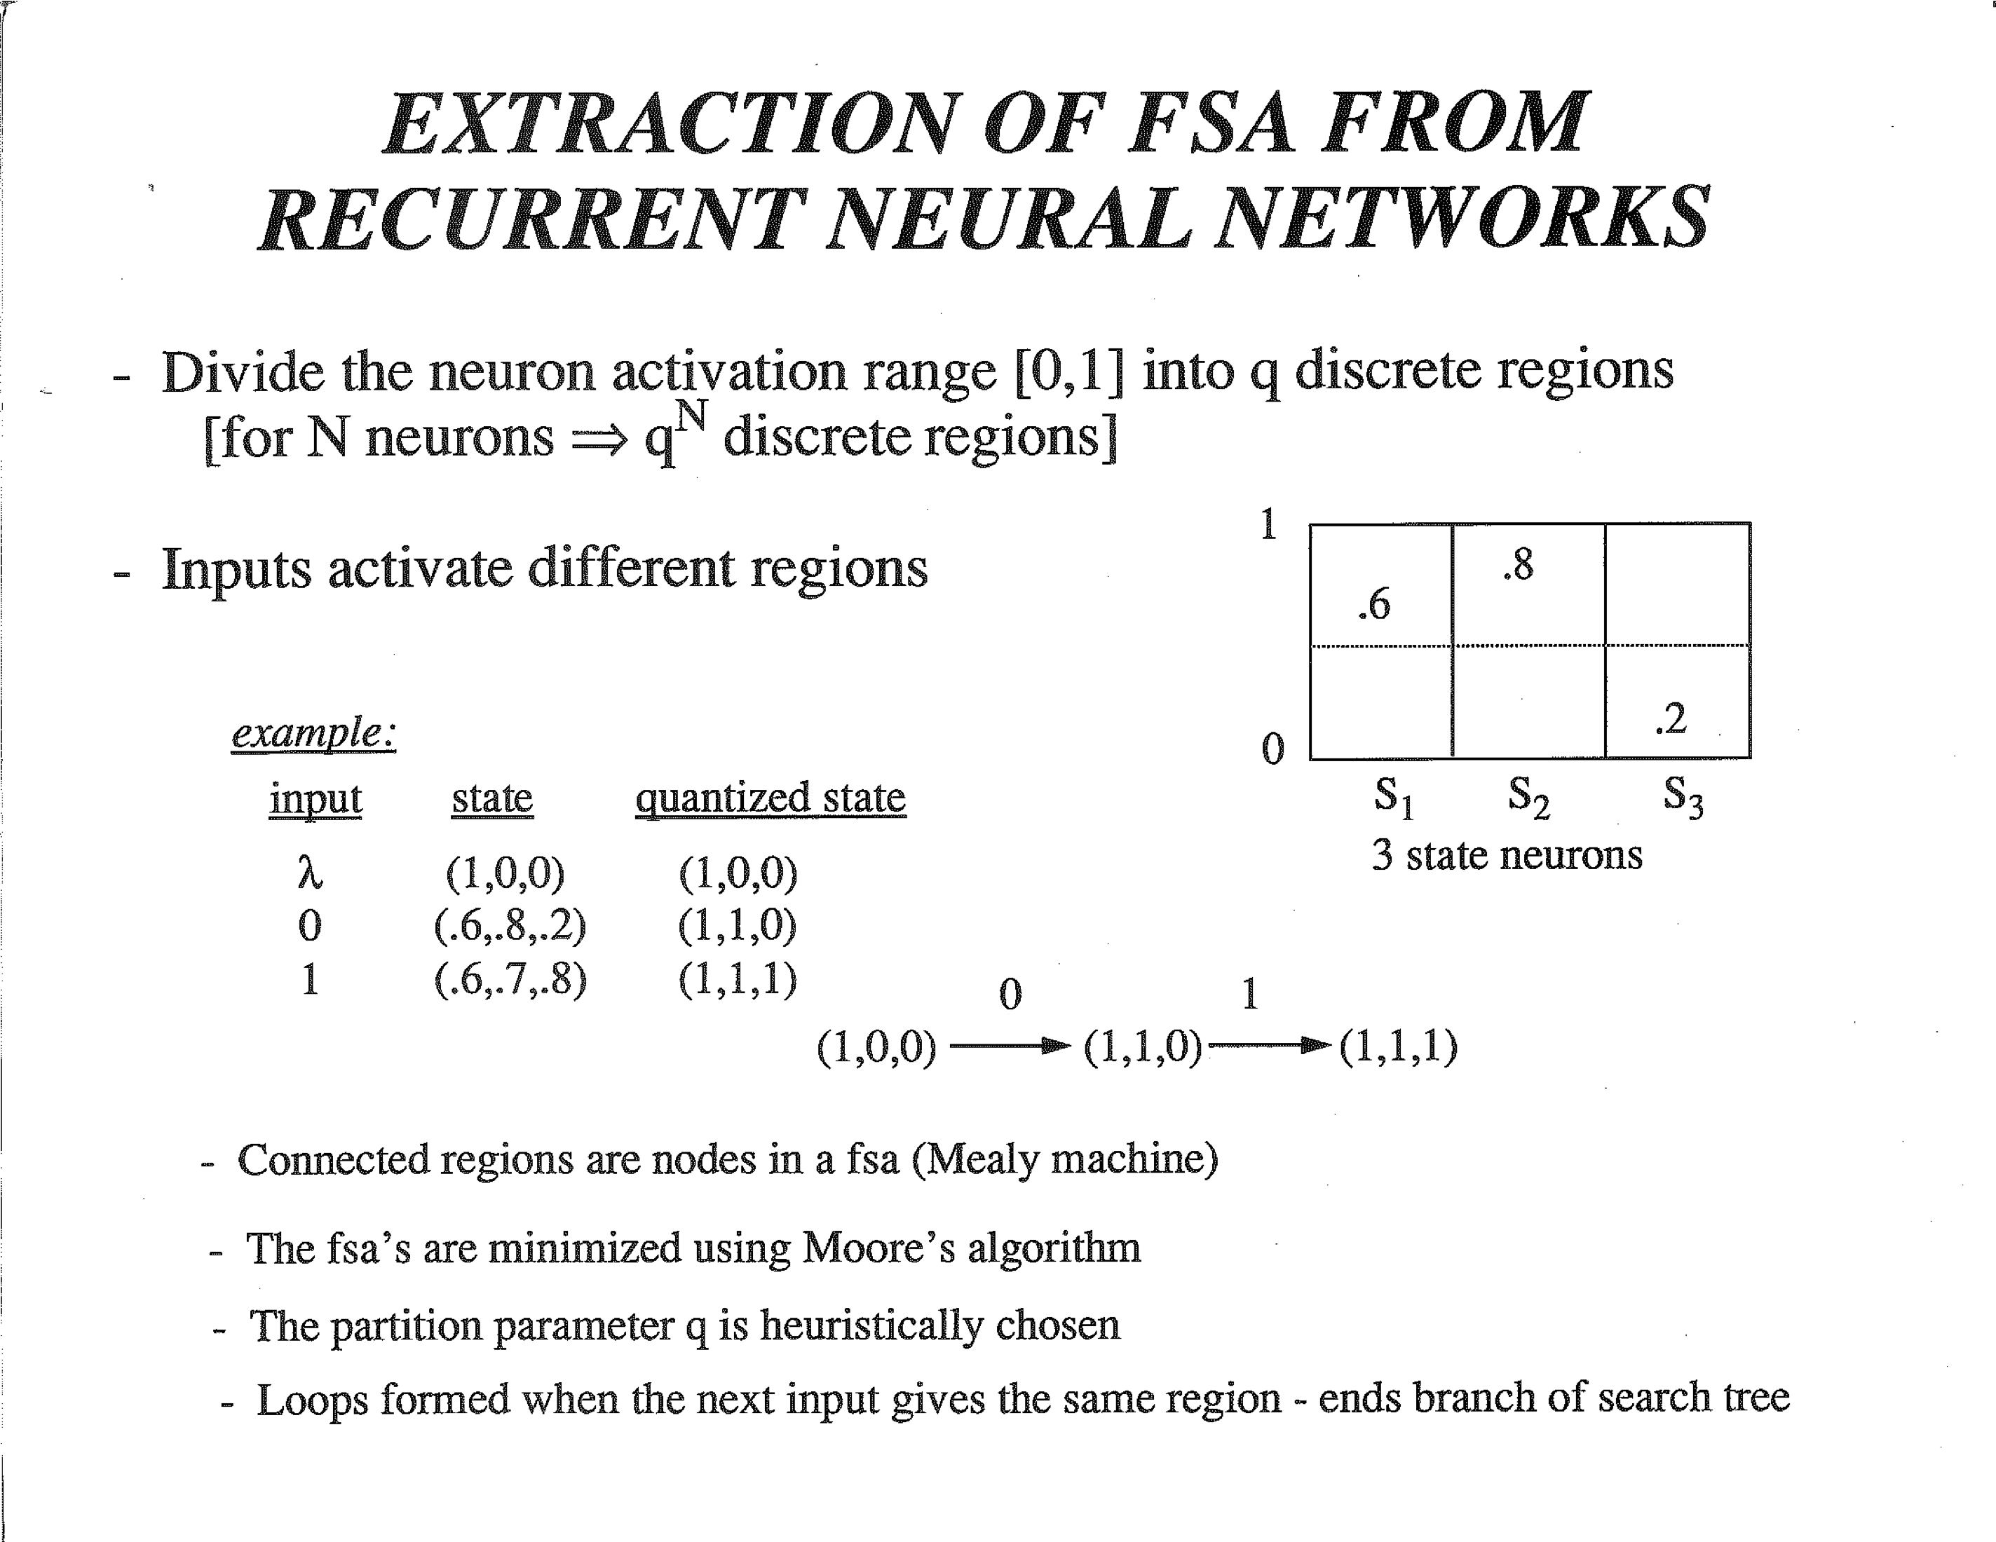

Slide 38
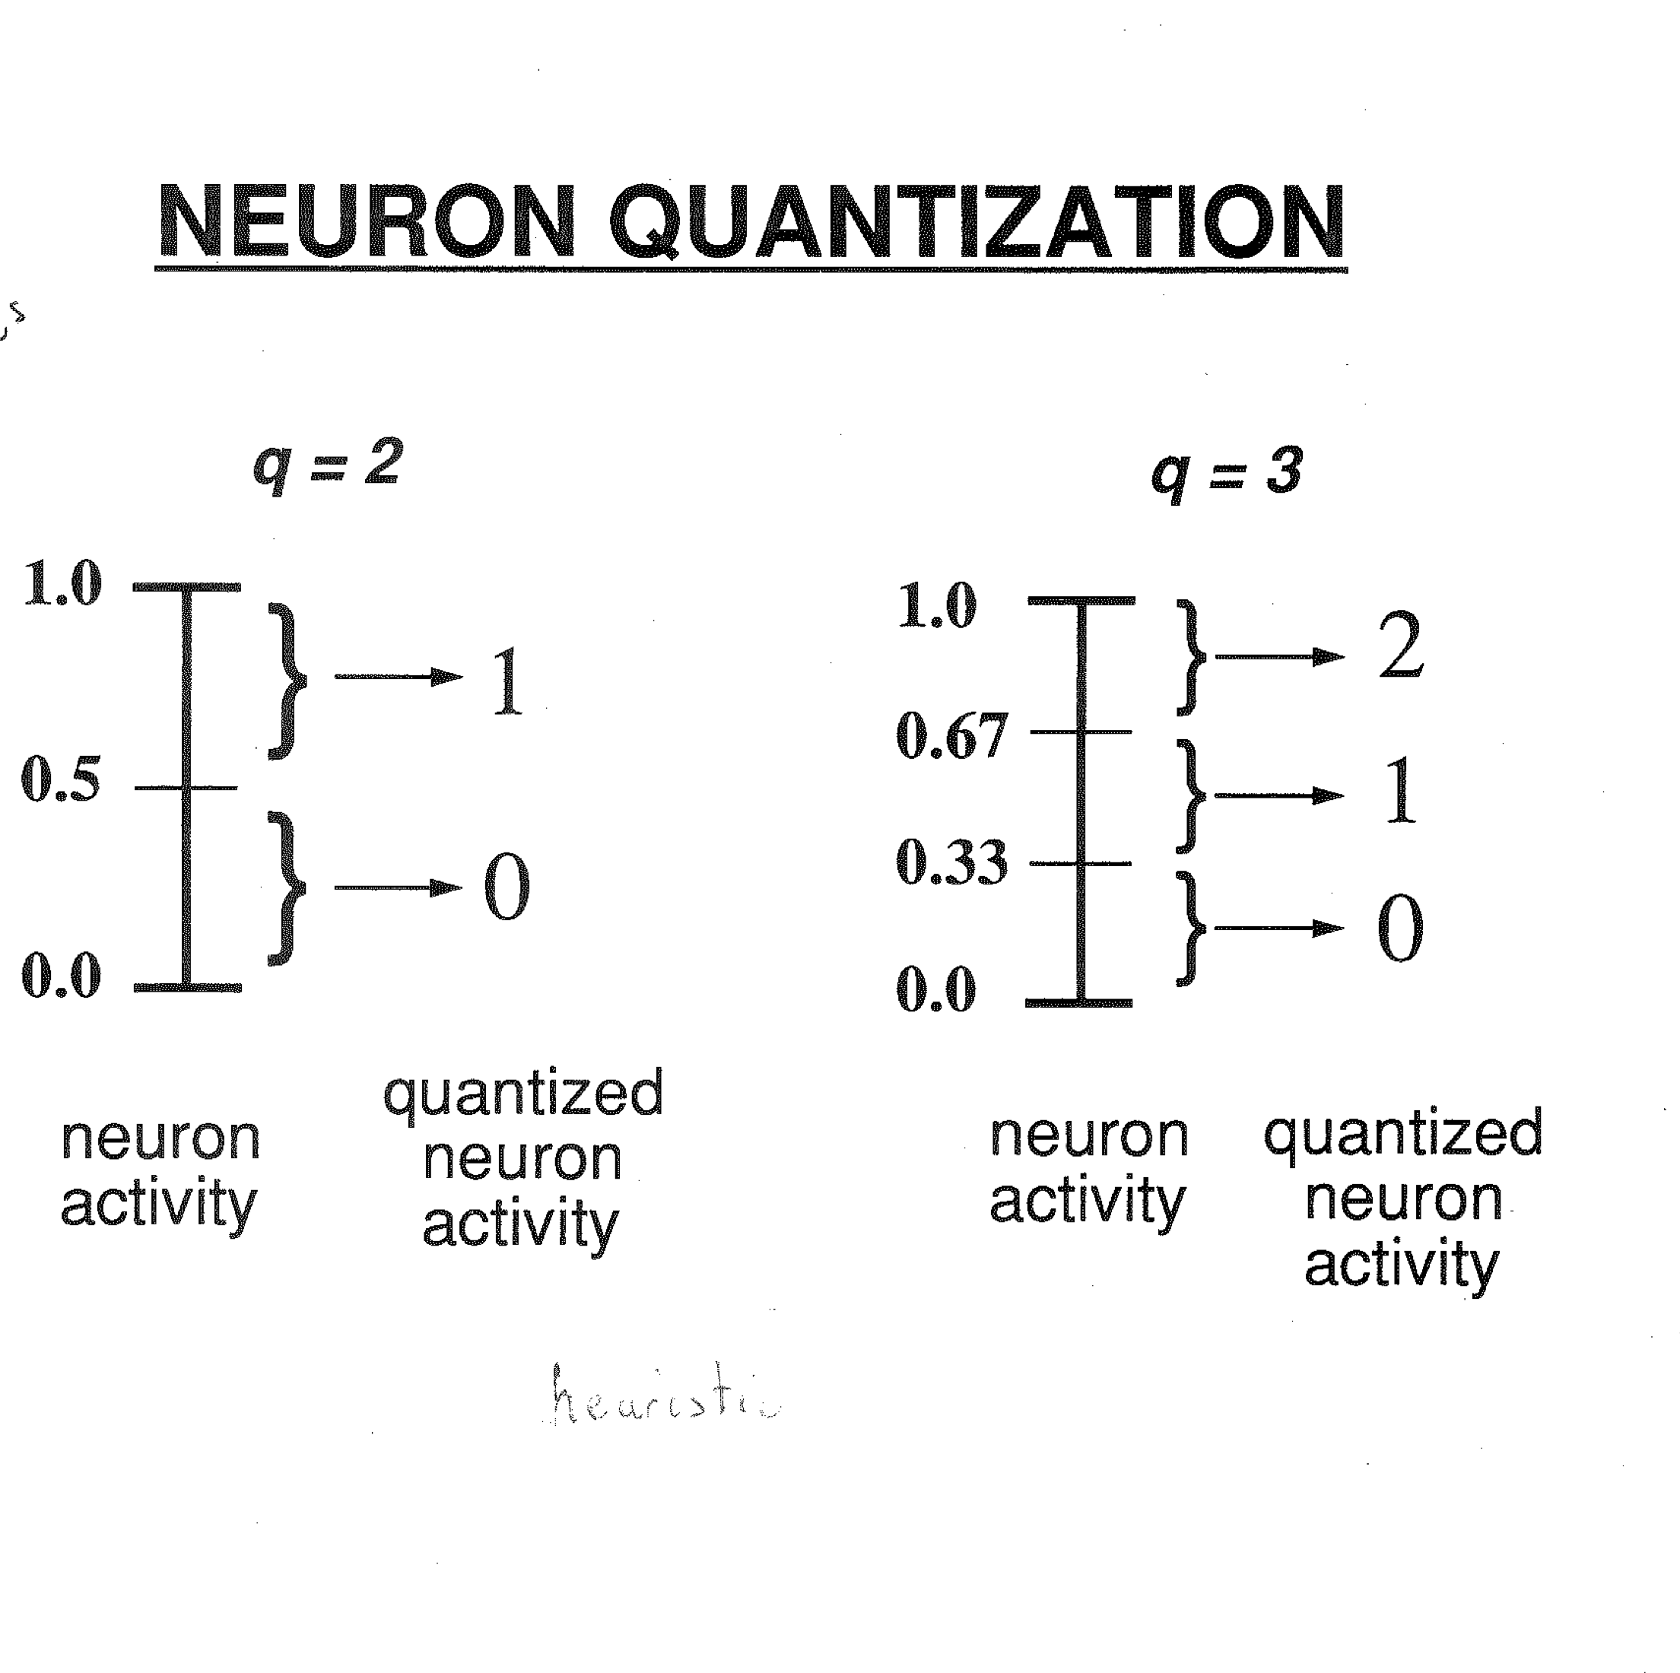

Slide 39
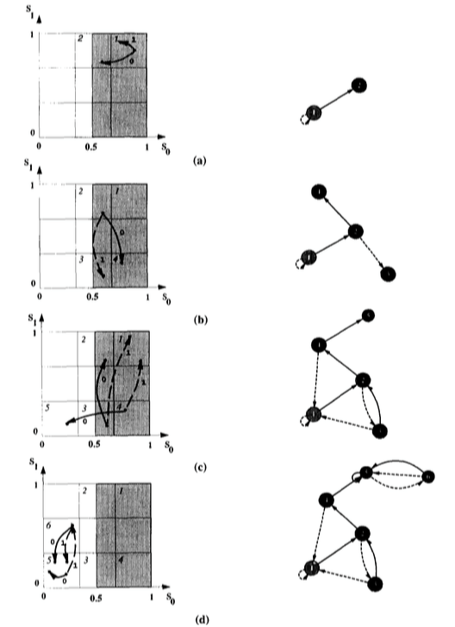

Always get a minimal DFA
using Hopcroft’s algorithm

Slide 40
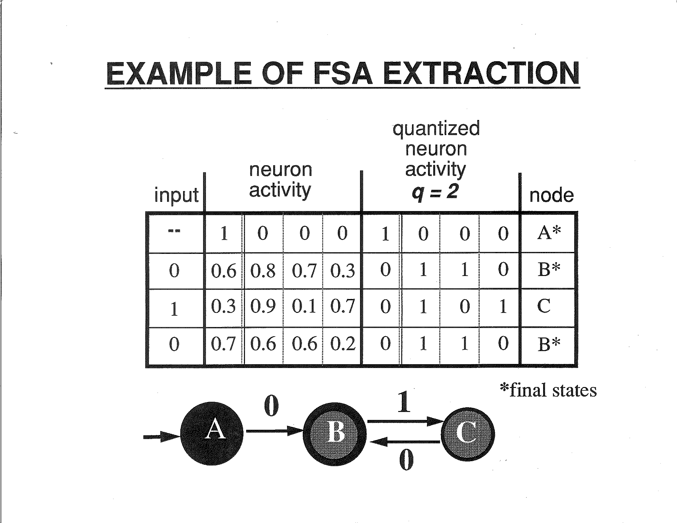

Slide 41
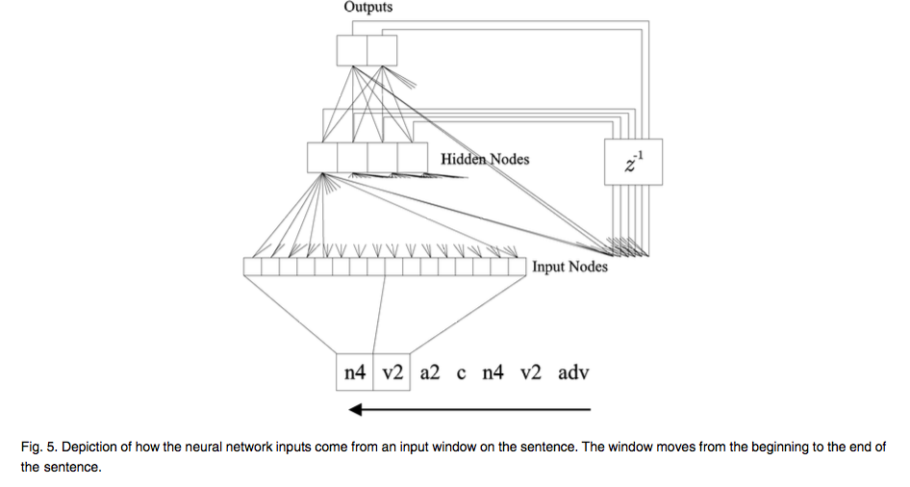
Learning a Universal Grammar - Principles and Parameters linguistic framework, or Government-and-Binding theory.
Lawrence, TKDE 2000

Slide 42
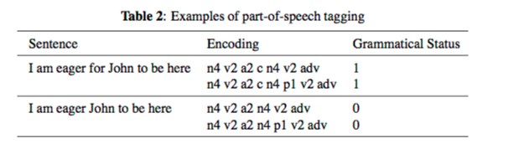
Universal Grammar Examples - Principles and Parameters linguistic framework, or Government-and-Binding theory.

Slide 43
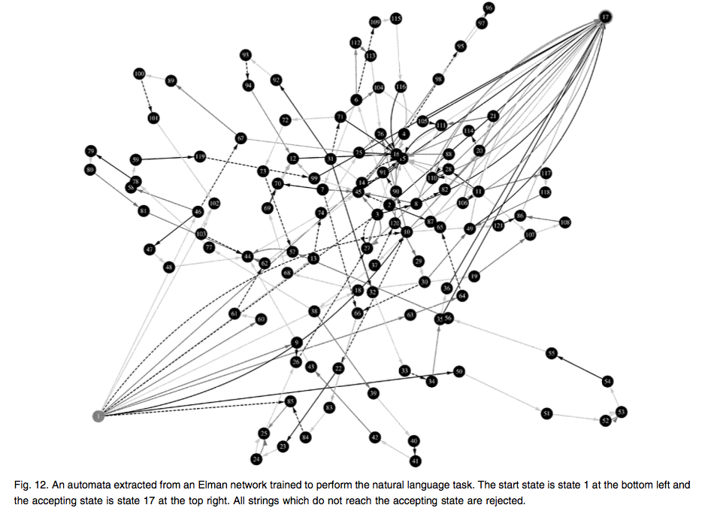

Slide 44
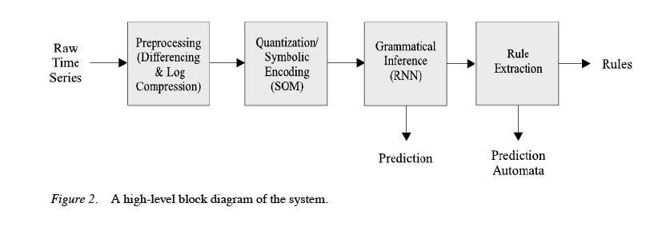
RNNs for Exchange Rate Prediction
C.L. Giles, S. Lawrence, A-C. Tsoi, "Noisy Time Series Prediction Using a Recurrent Neural
Network and Grammatical Inference," Machine Learning, 2001.

Slide 45
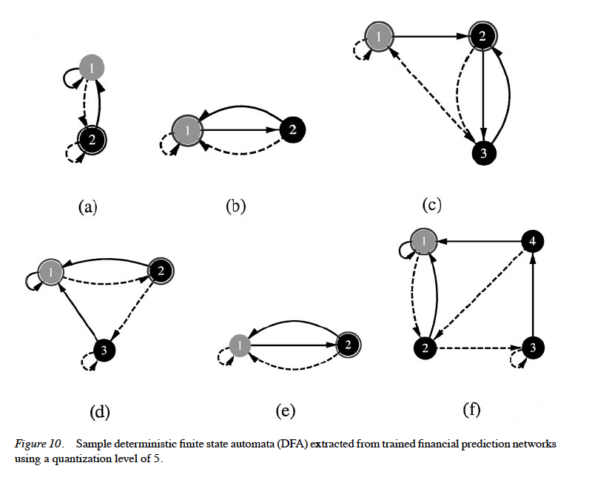
DFA extracted

Slide 46
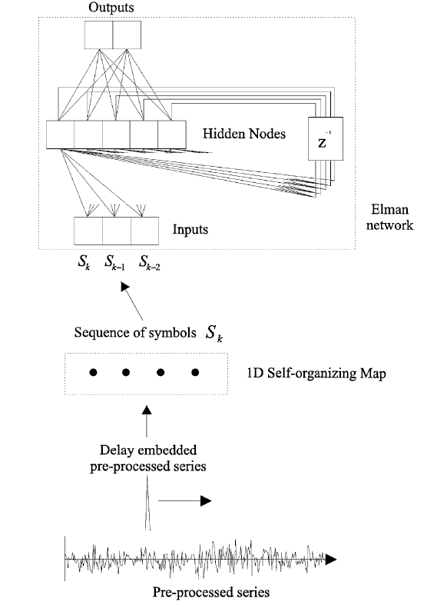

Slide 47
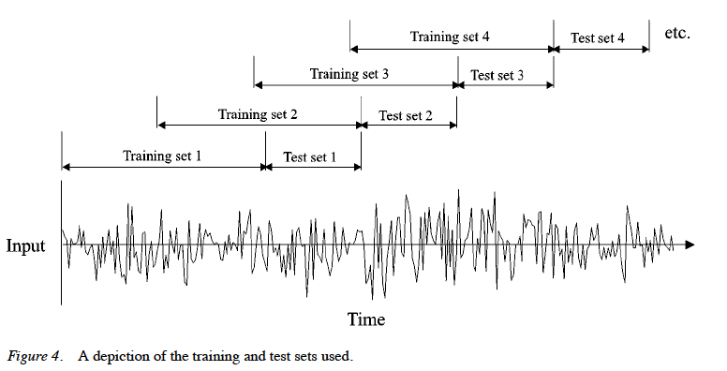
Training and testing sets

Slide 48
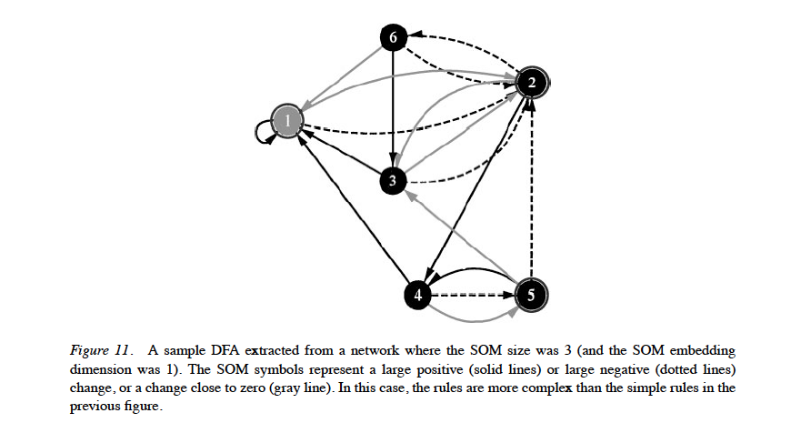
Different alphabet

Slide 49
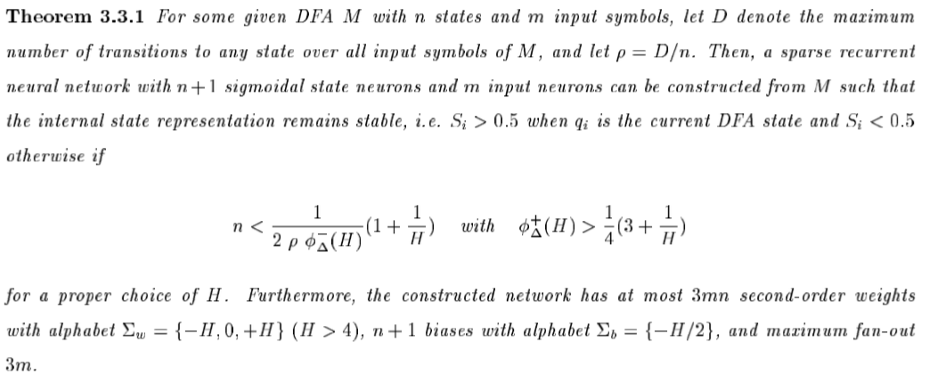
Stability of DFA 2ndorder RNN Encoding
Can we program a RNN
Omlin, Neural Computation, ’96
Omlin, JACM, ‘96

Slide 50
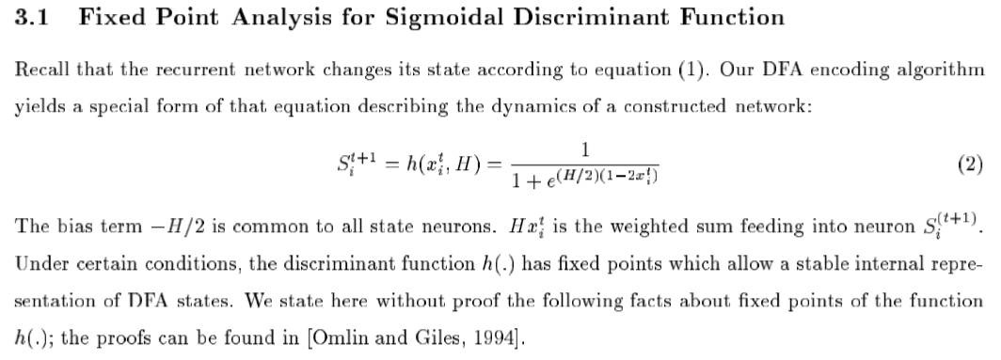
Fixed point analysis
Omlin, Neural Computation, ’96
Omlin, JACM, ‘96

Slide 51
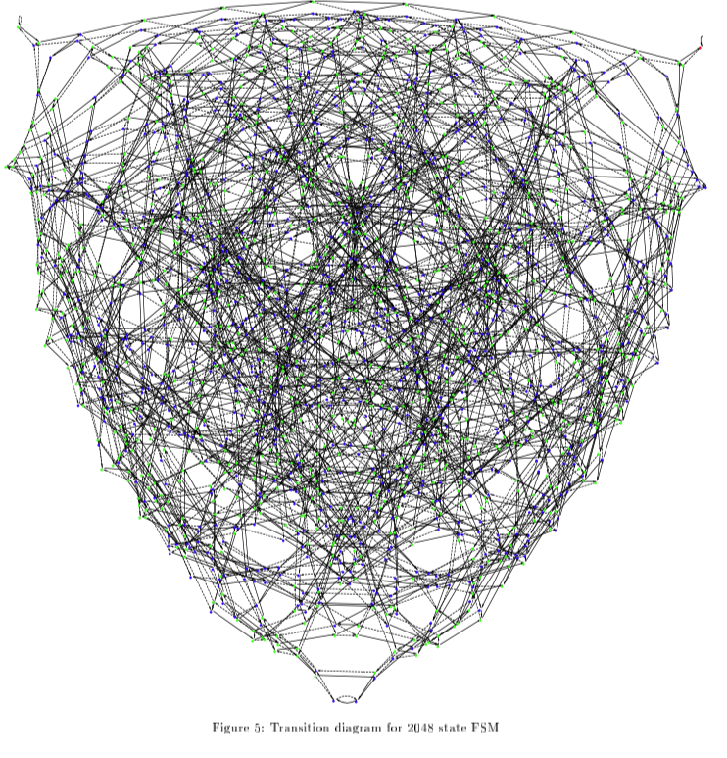
Learning Large DeBruijn Automata
2048 State DeBruijn automata
Some large automata require
much less logic/neurons
DeBurijn automata used in switching
and DNA analysis
NARX neural networks
Giles, Neural Networks,’95

Slide 52
RNNs and Finite State Machines
Not a proof, but think of simple RNNs as approximations of FSMs:
● Effectively order-N Markov chains, but N need not be specified
● Memoryless in theory, but can simulate memory through dependencies:
E.g. ".*a...a" → p(X="a"|"a" was seen four symbols ago)
● Very limited, bounded form of memory
● No incentive under ML objectives to learn dependencies beyond the sort and range observed during training

Slide 53
RNNs and Finite State Machines
Some problems:
● RNN state acts as both controller and "memory"
● Longer dependencies require more "memory"
● Tracking more dependencies requires more "memory"
● More complex/structured dependencies require more "memory"
● Ultimately, FSMs are pretty basic.

Slide 54
Why more than FSM?
Natural Language is arguably at least Context Free (need at least a PDA)
Even if it's not, rule parsimony matters!
E.g. model a^{n}b^{n}, if in practice n is never more than N.
Regular language (N+1 rules) CFG (2 rules)
ε|(ab)|(aabb)|(aaabbb)|... S → a S b
S → ε

Slide 55
Computational Hierarchy
Turing Machines (computable functions)
⬆⬆⬆
Pushdown Automata (context free languages)
⬆⬆⬆
Finite State Machines (regular languages)
We we
want to
be here
We are
Here

Slide 56
Previous Work - On learning CFGs without memory
LSTM for CFGs:- LSTM can recognize and generalize on simple context-free and context-sensitive grammars [ Hochreiter 1997 , Gers 2001].
Counting RNN:- RNNs can learn a mechanism to solve CFGs by adapting to oscillations in principal dimensions (up and down) [Wiles 1995].
Fractal encoding : Special type of encoding coupled with neural networks to solve CGFs.
  Other methods used counter mechanism to solve CFGs [Such approaches might work for certain classes of CFGs but not for all] [Tabor 2000].
Recent work evaluated the performance of LSTM and showed that they fail to generalize on unseen data [Sennhauser 2018, Suzgun 2019]

Slide 57
Previous work - Memory
Memory Tape :- Coupled a recurrent neural network to a memory tape to emulate a Turing machine [Williams 89] .
Connectionist Turing machine :- Showed that stack can be simulated in terms of binary representations of a fractional number which are manipulated by neural network generated actions [ Pollack 90].
NNPDA :- Neural Network Push Down Automaton with an external continuous stack designed to learn Context free grammars(CFGs) with higher order weights [Das 93, Sun 98].
Continuous Stack :- Continuous stack can be used to manipulate “continuous rewrite rules” necessary to parse context-free grammar(CFGs).[Mozer 93]
Discrete Stack :- Discrete stack with recursive nets can generalize to any length of sequences if weights are programmed and trained correctly. [Zeng 94]

Slide 58
New Work – NNs need Memory
Stack RNN :- Differentiable stack with continuous operations and showed promising performance on counting, addition, memorization and language modelling tasks[However required more than 8 stacks to generalize on longer and unseen sequences. [ Joulin 2015]
Unbounded Memory :- Continuously differentiable analogues on data structures such as Stacks, Queues, and DeQues. Superior generalization performance on various transduction tasks. [Grefenstette 2015]
Neural Turing machine :- Extended the capability of neural networks by coupling them to external memory which then interacts with an attention mechanism. End to end differentiable system showed superior performance in inferring algorithmic patterns.[Graves 2014].
Neural random-access machine :- New differentiable memory architecture which manipulates and dereferences pointers to an external variable-size random-access memory. Better performance on tasks which requires pointer manipulation and dereferencing. [Kurach 2015]
Context-Free Transductions using neural stack:- Analyses the behaviour of stack-augmented first order RNNs. Stack-based RNNs can discover intuitive stack-based strategies to solve any given task [Hao 2018]. Other experiments showcase the effect of memory architecture on language modeling task.[Yogatama 2018]
Differentiable neural computer (DNC):- Differentiable neural computer showed that DNCs have the capacity to solve complex, structured tasks that are inaccessible to neural networks without external read–write memory.[Graves 2016]

Slide 59
Previous Work - Memory
Context-Free Transductions using neural stack:- Analyses the behaviour of stack-augmented first order RNNs. Stack-based RNNs can discover intuitive stack-based strategies to solve any given task [Hao 2018]. Other experiments showcase the effect of memory architecture on language modeling task.[Yogatama 2018]
Differentiable neural computer (DNC):- Differentiable neural computer showed that DNCs have the capacity to solve complex, structured tasks that are inaccessible to neural networks without external read–write memory.[Graves 2016]
DFA Rules :- Rule insertion focused on stably encoding Deterministic finite automaton rules into second order RNN [Omlin 96].
NNPDA Rules :- Used information about dead neurons as a form of hints for training NNPDA [Das 93].

Slide 60
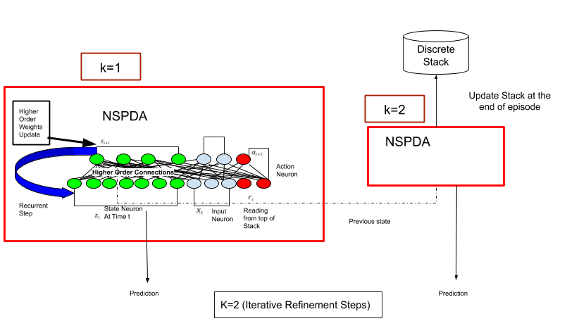
Neural State Machine PDA (NSPDA)
Only one stack used

Slide 61
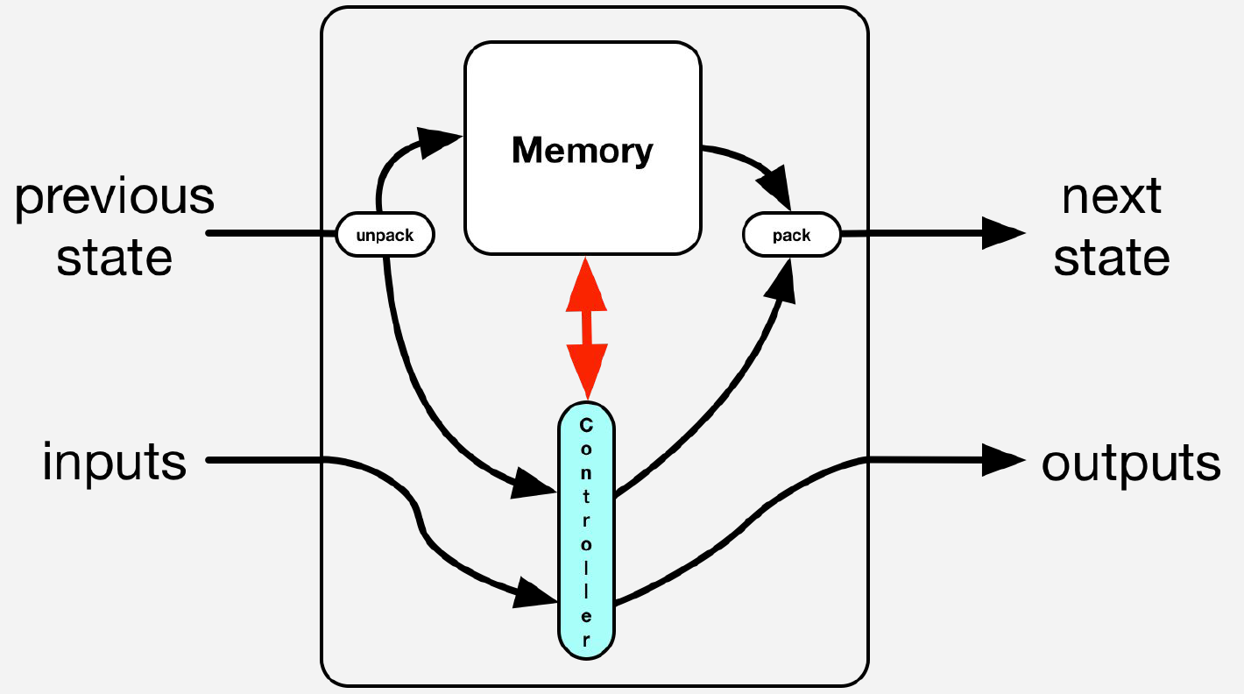
Controller-Memory Split
Here we use Discrete Stack as an unbounded memory. In theory can be replaced by RAM, queue, list).
Controller is recurrent network which has second/third order connection.

Slide 62
Neural Architecture
A full symbol sequence sample(y,X) is defined as X={x1,x2,···,xT} where the binary label y indicates whether the sequence is valid(1) or not (0).
When processing a (binary) symbol/token xt∈ {0,1}_{L×1} at the discrete time step t, the NSPDA is engaged with computing a new state variable vector z_t∈R_{J×1}, where L is the total number of input/sensory neurons(or dimensionality of the input space, sometimes classically referred to as alphabet size) and J is the total number of state neurons.
The action neuron vector is defined as a∈R_{L×1} and the read neuron vector is defined as r∈R_{L×1}, i.e.,the action and read spaces are of the same dimensionality of the input or |x|=|r|=|a|.
Taken together, the above sets of input, state, and read neurons represent a full NSPDA model with parameters Θ ={Ws,Wa,Wo}.
Crucially,Ws and Wa are both 4-dimensional (4D) synpatic weight tensor, i.e., the binary “to-state” tensor Ws∈{0,1}_{J×L×L×L} and the 4D tenary to-action tensor Wa∈{−1,0,1}_{J×L×L×L} (note that:−1 is “pop”,0is “no-op”, and1is “push”)

Slide 63
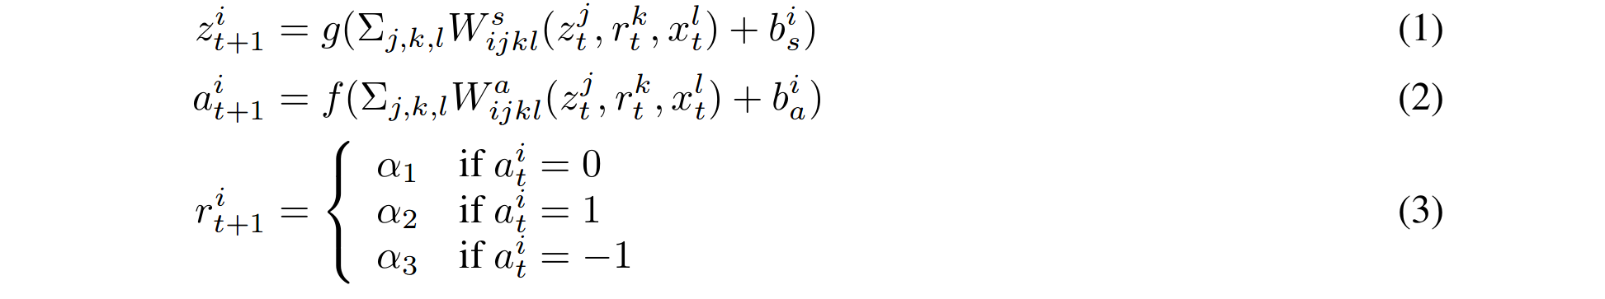
Forward pass for NSPDA at time t [Mali 2019]
Where α1∼U(0.0001,0.008),α2∼U(0.901,0.992), and α3∼U(0.025,0.110), are threshold values that determine what the next state of the discrete read unit rit will be (sampled uniformly from a special interval to create continuous value for backprop to work with). Note that zt+1 is the next hidden state,at+1 is the next stack action, and rt+1 is the next value of the neuron that reads the content at the top of the stack

Slide 64
Inserting Rules [Mali 2019]
To insert rules related to known state transitions into the (N-state) NSPDA, one needs to program its recurrent weights(which could be second or third order). Since the number of states in PDA is not known beforehand, we assume that J > M and that the network has enough capacity to learn an unknown context-free grammar.
we will exploit the similarity between the state transitions of the target PDA and the underlying dynamics of a stack-driven RNN. Considera known transition δ(s_j,a_l,T_s) = (s_i,γ), where Ts is the top of the stack and γ is the sequence of symbols replacing Ts.
We then identify PDA states sj and si, which correspond to state neurons zj and zi, respectively. Recall that each symbol has specific stack operations associated with it, which provide prior knowledge as to when to push and when to pop from the stack. It is desirable that the state neuron zi has a high output close to 1 and zj has a low output close to 0 after reading an input symbol al using input neuron xm and the top of the stack Ts using read neuron rl.
We can achieve this by following simple three steps 1) set the (third order) weightsWsijkl to a large positive value, which helps to ensure that the state neuron zt+1i at the next time step t+ 1 will be high (and sinceˆg(v)is sigmoidal, this tends towards 1), and 2) set Wsjjkl to a large negative value, which would make the output of the state neuron zt+1j low (tendingˆg(v) towards 0).

Slide 65
Inserting Rules [Mali 2019]
The next item to consider are the (ternary) action weights stored in Wa_{ijkl}, which drive the action neurons that yield the stack operations (recall that [-1,0,1] maps to [pop,no-op,push]).
First, we must assume that the total contribution of the weighted output of all state neurons can be neglected – this can be achieved by setting all other state neurons to the lowest value. In addition, we assume that each state neuron can only be assigned to one known state of the PDA.
If we have prior knowledge of accepting and non-accepting states related to a particular neuron, we may then bias its output zi_{t+1}. We start from i= 1(the leftmost neuron in the vectorzt) and work towards i=J, programming each one by one.
Armed with these assumptions, we can then stably encode rules into the NSPDA by programming the weightWs_{ijkl} to be large positive value if the PDA’s state si is an accepting state. Otherwise, we set Ws_{ijkl} to be a large negative value if the state is non-accepting. If no such knowledge of the PDA is available,Ws_{ijkl} remains unchanged.

Slide 66
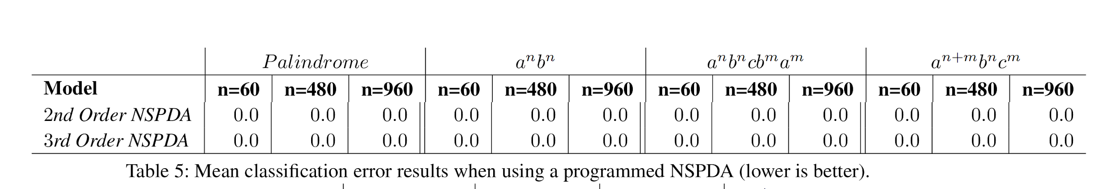
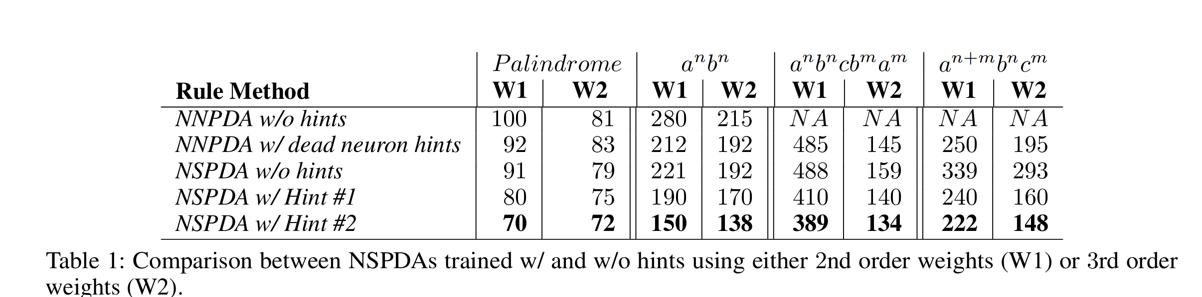
Result on programming weights and inserting rules in NSPDA [Mali 2019]

Slide 67
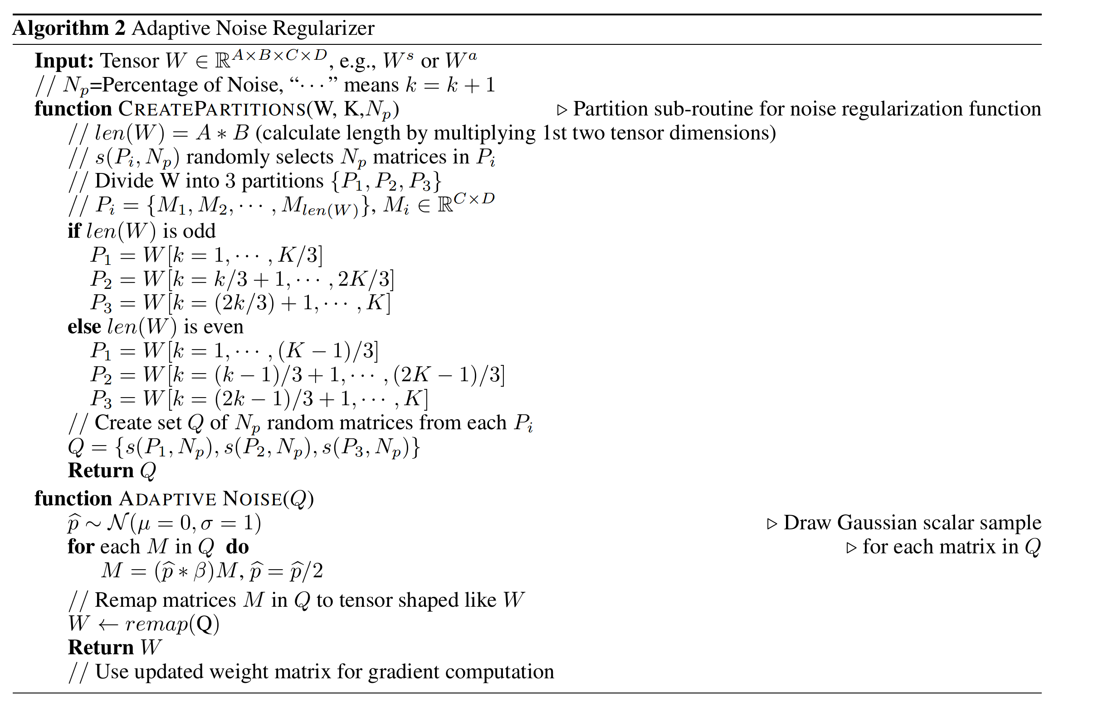
Regularizing higher order recurrent networks [Mali 2019]

Slide 68
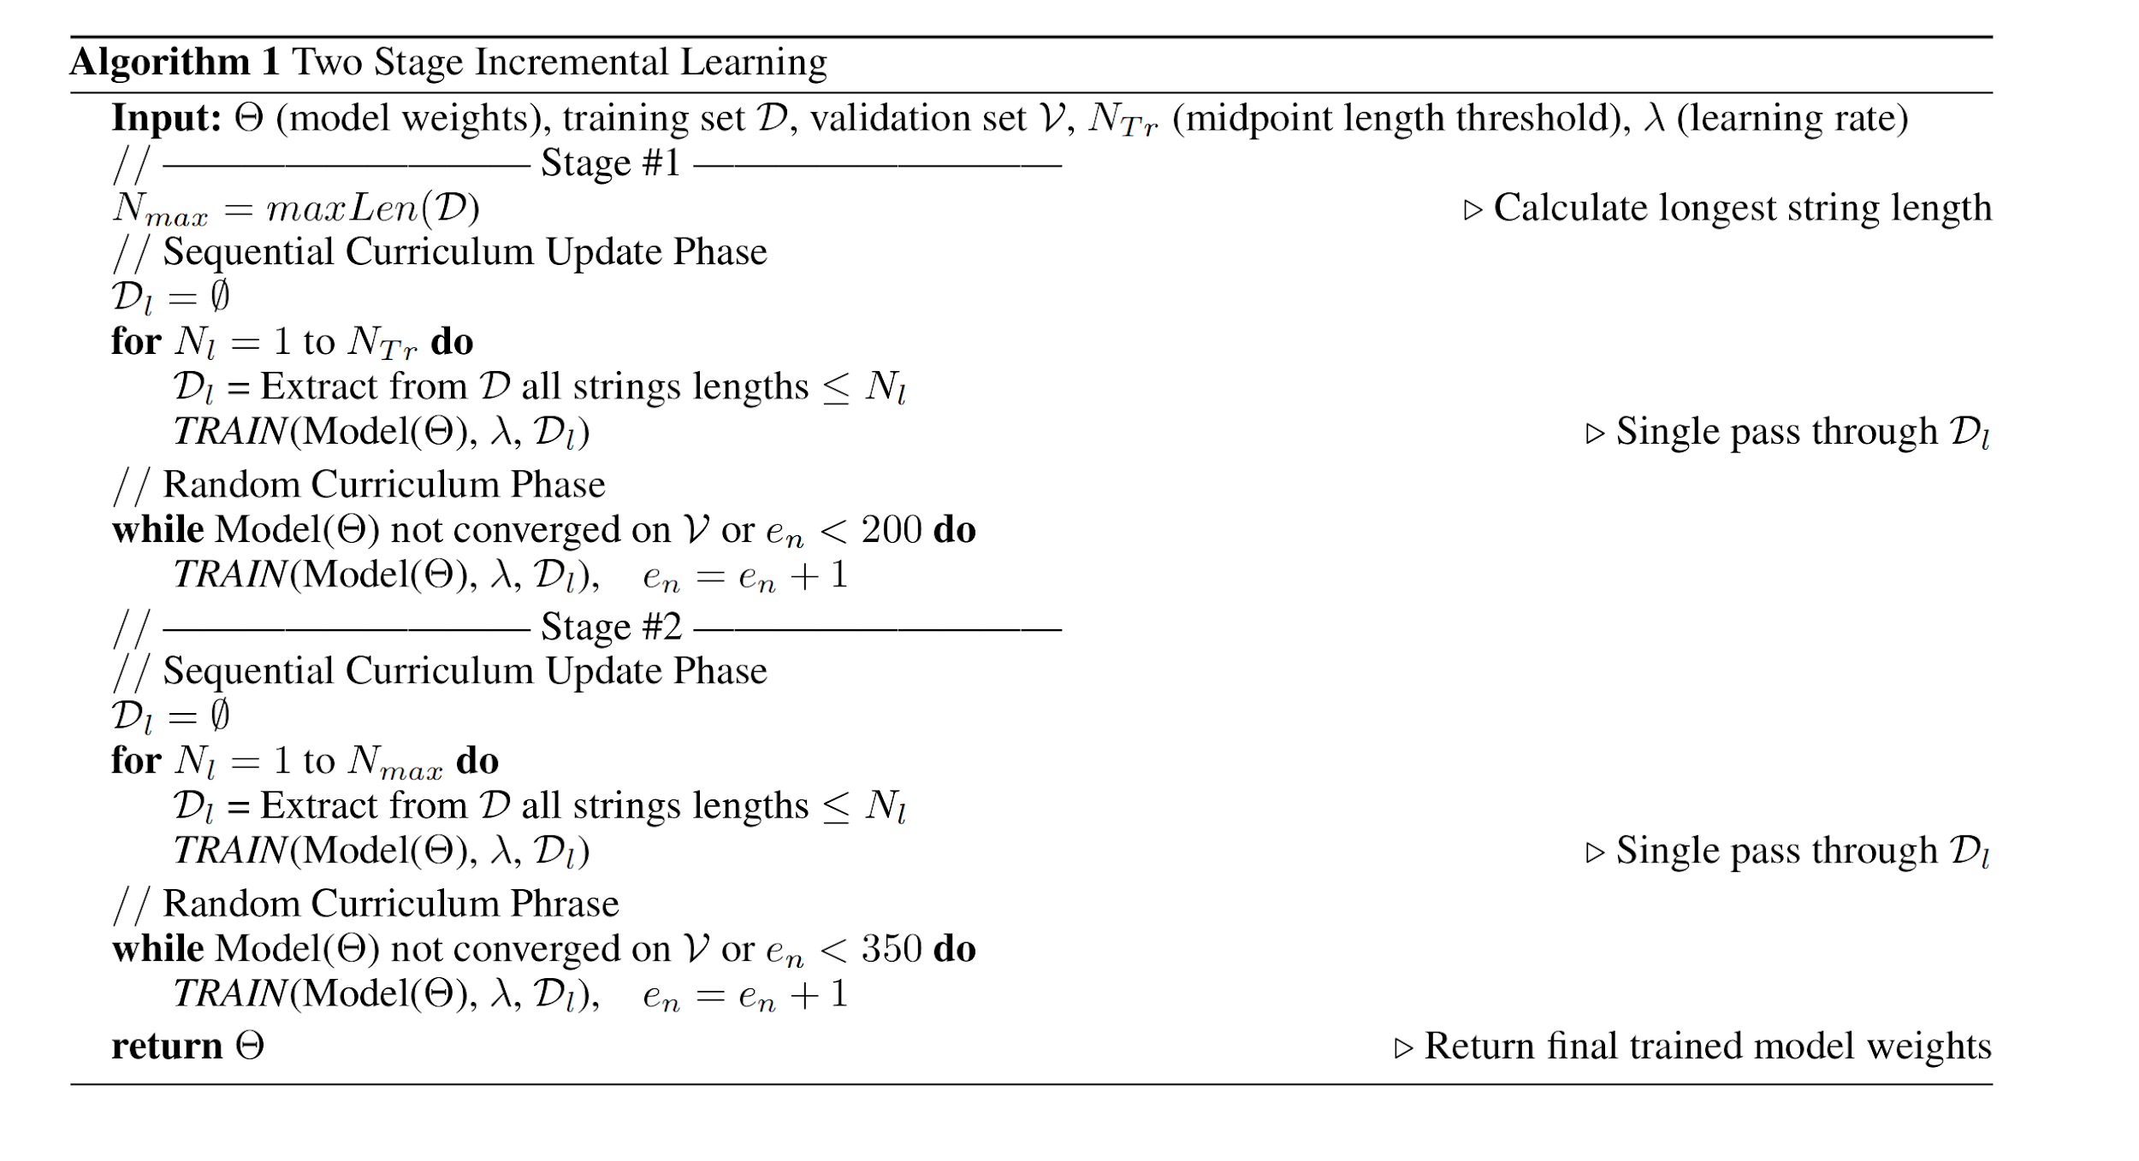
Improved Incremental Learning [Mali 2019]

Slide 69
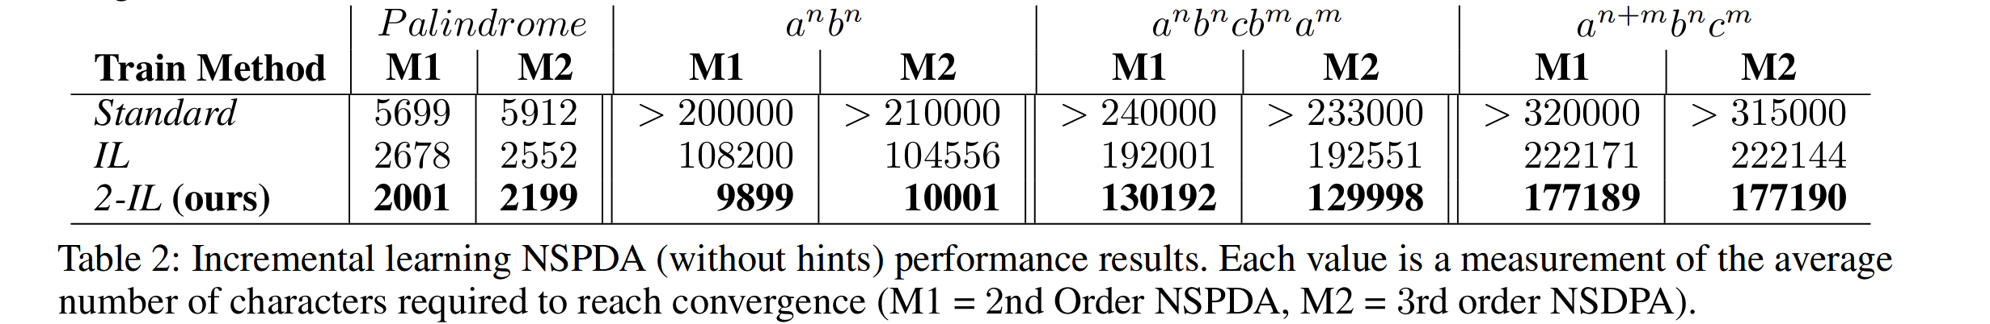
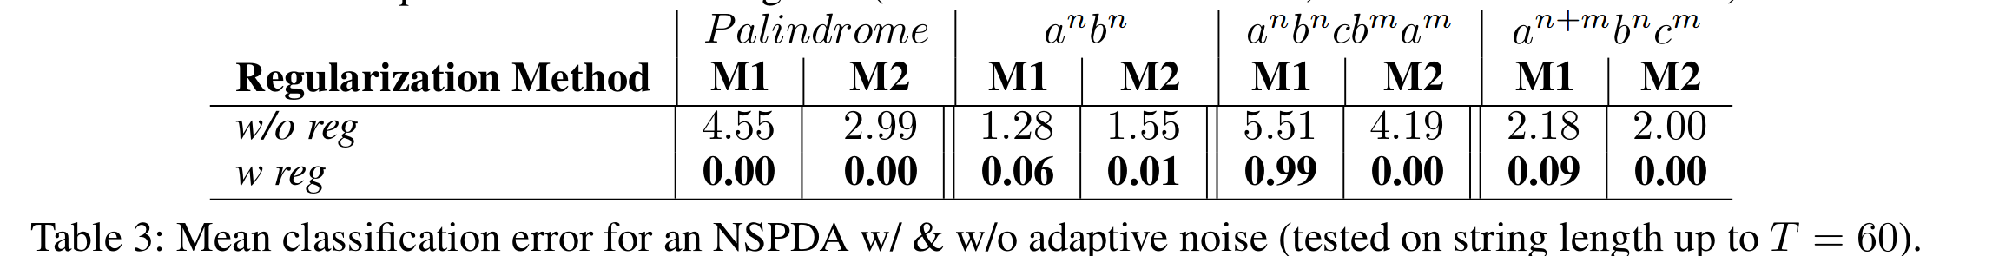
Mean classification error on adaptive noise and improved incremental learning [Mali 2019]

Slide 70
Experimental details
1987 positive samples and 2021 negative samples randomly sampled
Learning algorithms : BPTT, RTRL, UORO
Training set length upto N= 21
Test set length upto N = 60.
M=[2,3,4]
Number of state neurons in third order NSPDA is J=M+U(12,29).
Number of State neurons in second order in NSPDA is J =M+U(2,6).
Iterative refinement steps k = 4
All higher order used our proposed adaptive noise regularizer.
All models used two way incremental learning approach.
For all baseline algorithms, gradients were hard clipped to 13
SGD with stochastic annealing method and initial learning rate = 0.1005000321.
Maximum number of epochs = 500.
Generalization performance is tested using 5 independent test sets containing examples = 17896 each

Slide 71
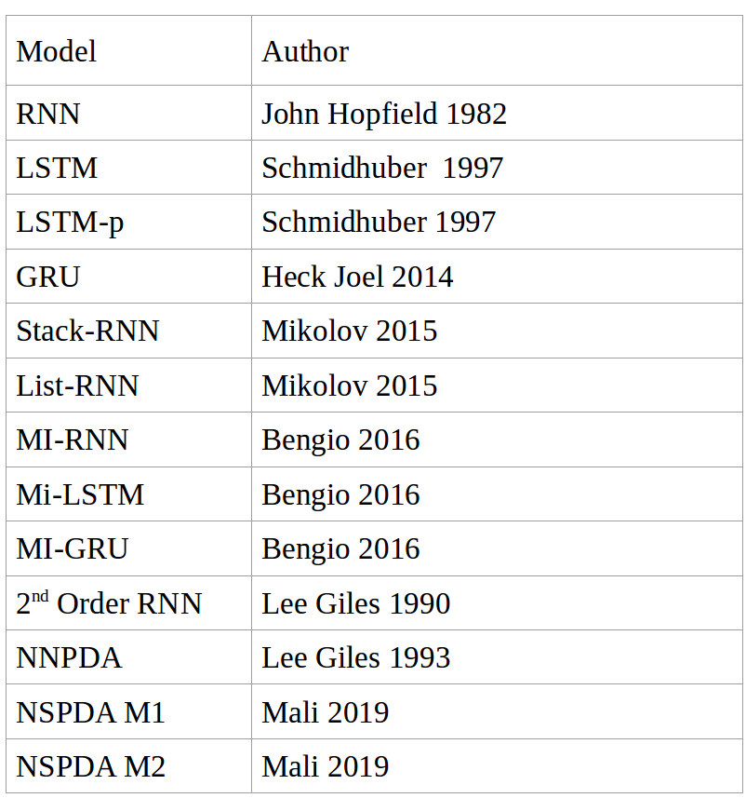
Creator of various RNNs

Slide 72
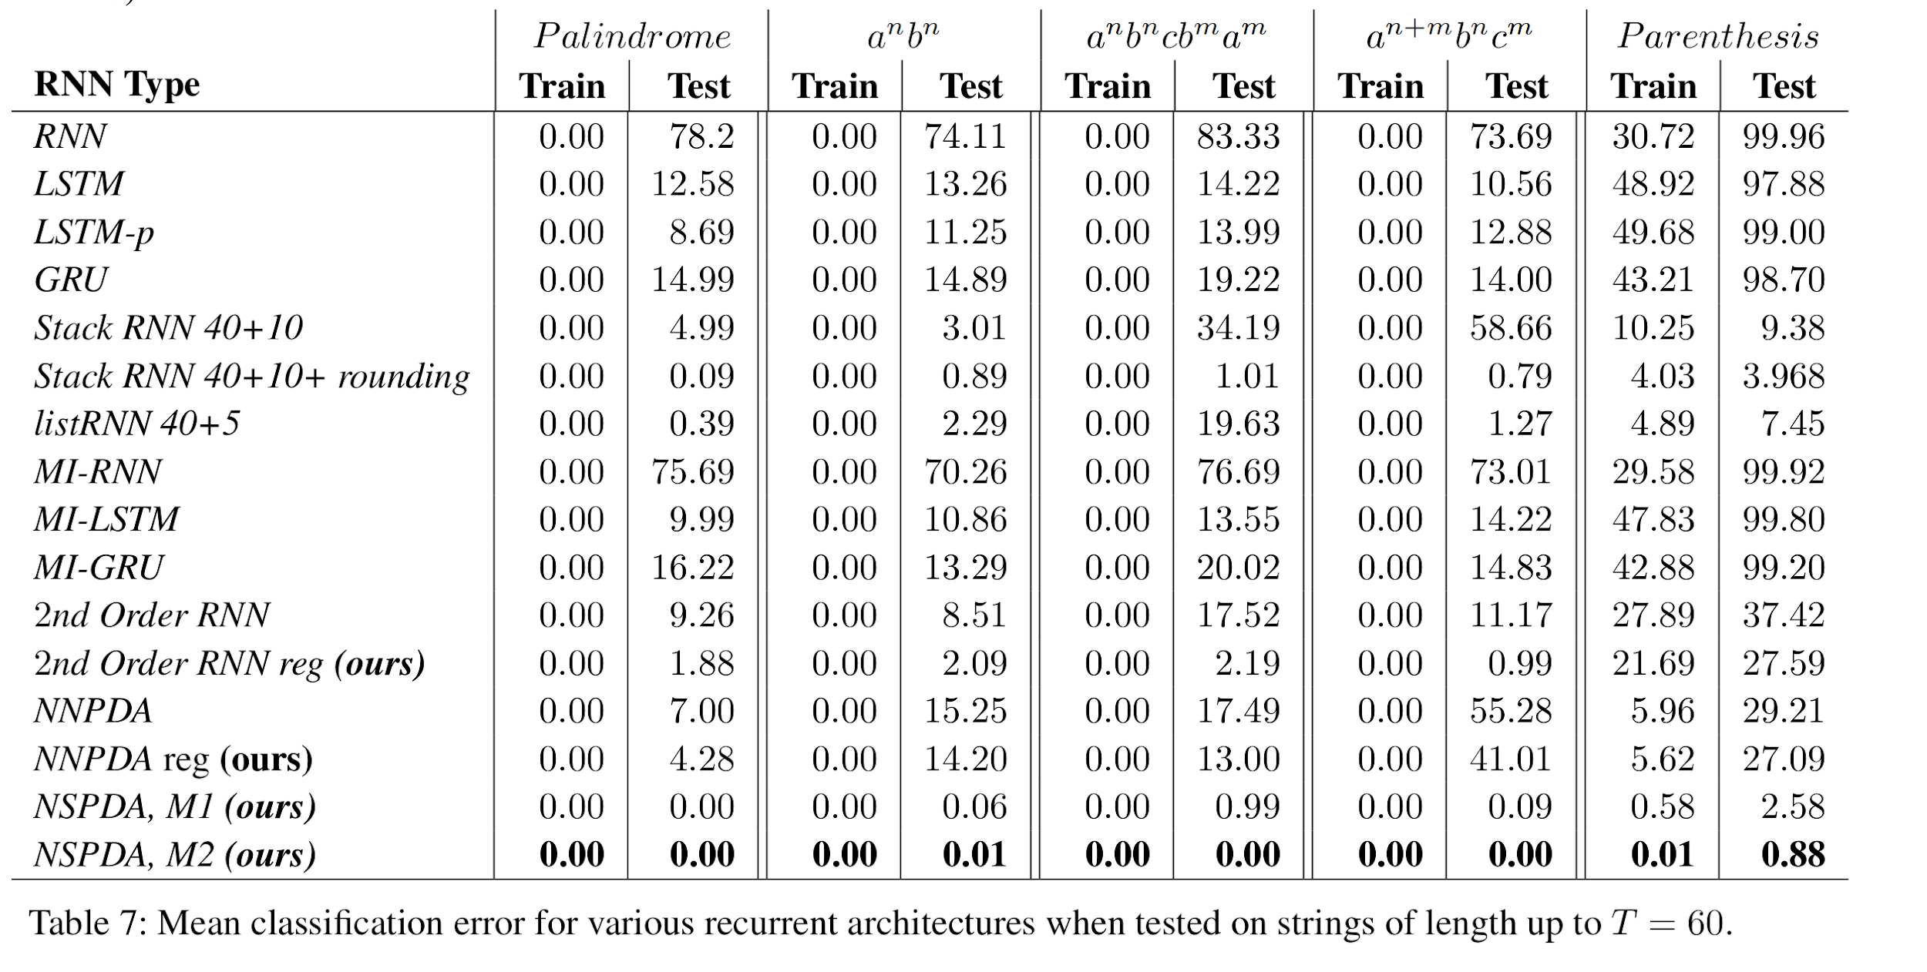
Mean classification error

Slide 73
Conclusions for Stacks with NNs
Our results show that we can successfully program PushDown Automaton using higher order recurrent networks and achieve 0 classification error on arbitrary length sequence.
We trained NSPDA using variety of learning algorithm including BPTT , RTRL and Unbiased Online Recurrent Optimization(UORO) and discovered that higher order networks benefit when trained using UORO.
We proposed first rule insertion method for higher order recurrent networks with stacks and show that it is always better to have prior knowledge.
  Improves generalization performance.
  Leads to faster convergence.
  Models trained using our proposed rule insertion method in almost all cases reach near 0 training error

Slide 74
Conclusion
Adaptive Noise regularizer technique always benefit network in terms of better generalization.
Two way incremental learning is better version of incremental learning and provides lower classification error . This is even true for classical NNPDA models.
NSPDA with 2nd order weights and 3rd order weights with iterative refinement work better when compared with wide variety of recurrent networks.[Note:- We compared with 1st,2nd and 3rd order recurrent networks with and without memory]. Based on our knowledge we are the first to do such large scale comparison.

Slide 75
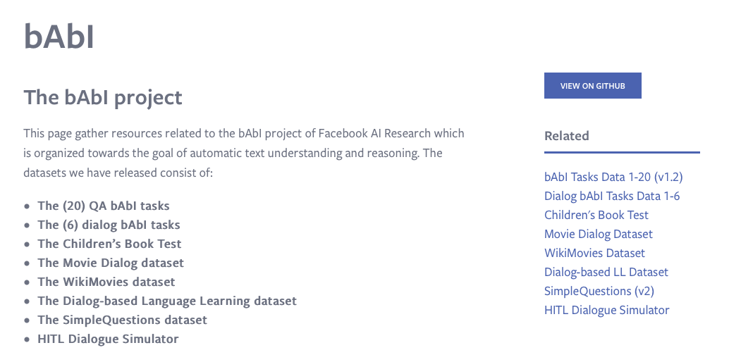
Why memory (another answer)?
Many problems are intractable or only approximated without memory.
Planning
NLP
  Question answering
  NLG
Reasoning
facebook bABI

Slide 76
Story Comprehension
Joe went to the kitchen. Fred went to the kitchen. Joe picked up the milk. Joe travelled to his office. Joe left the milk. Joe went to the bathroom.
Questions from Joe’s angry mother:
Q1 : Where is Joe?
Q2 : Where is the milk now?
Q3 : Where was Joe before the office?

Slide 77
Dialogue System
Hello! What can I do for you today?
I’d like to reserve a table for 6.
Sure! When would you like that reservation?
At 7 PM, please.
Okay. What cuisine would you like?
Actually make that 7:30 PM
Updated! What cuisine?
Is there anything better than a medium rare steak?
Nothing at all! Blackdog has a 4.7 on Yelp.
Sounds perfect! Also, add one more person.
Reservation done for 7, 7:30pm at Blackdog. Enjoy!
Machine
Human

Slide 78
ML models need memory!
Deeper AI tasks require explicit memory and
multi-hop reasoning over it
RNNs have short memory
Cannot increase memory without increasing number of parameters
Need for compartmentalized memory
Read/Write should be asynchronous

Slide 79
Memory Networks
Class of models that combine large memory with learning component that can read and write to it.
Incorporates reasoning with attention over memory (RAM).
Most ML has limited memory which is more-or-less all that’s needed for “low level” tasks e.g. object detection.
Our motivation: long-term memory is required to read a story and then e.g. answer questions about it.
Similarly, it’s also required for dialog: to remember previous dialog (short- and long-term), and respond.
We first test this on the toy (bAbI) tasks.
Any interesting model has to be good on real data as well.
J. Weston, S. Chopra, A. Bordes. Memory Networks. ICLR 2015 (and arXiv:1410.3916).

Slide 80
Memory Networks

Slide 81
Evaluating End-To-End Learners
Long Term goal: A learner can be trained (from scratch?) to understand and use language.
Our main interest: uncover the learning algorithms able to do so.
Inspired by “A Roadmap towards Machine Intelligence” (Mikolov, Joulin, Baroni 2015) we advocate a set of tasks to train & evaluate on:
  Classic Language Modeling (Penn TreeBank, Text8)
  Story understanding (Children’s Book Test, News articles)
  Open Question Answering (WebQuestions, WikiQA)
  Goal-Oriented Dialog and Chit-Chat (Movie Dialog, Ubuntu)

Slide 82
What is a Memory Network? Original paper description of class of models
MemNNs have four component networks (which may or may not have shared parameters):
I: (input feature map) convert incoming data to the internal feature representation.
G: (generalization) update memories given new input.
O: produce new output (in feature representation space) given the memories.
R: (response) convert output O into a response seen by the outside world.

Slide 83
Some Memory Network- related Publications
J. Weston, S. Chopra, A. Bordes. Memory Networks. ICLR 2015 (and arXiv:1410.3916).
S. Sukhbaatar, A. Szlam, J. Weston, R. Fergus. End-To-End Memory Networks. NIPS 2015 (and arXiv:1503.08895).
J. Weston, A. Bordes, S. Chopra, A. M. Rush, B. van Merriënboer, A. Joulin, T. Mikolov. Towards AI-Complete Question Answering: A Set of Prerequisite Toy Tasks. arXiv:1502.05698.
A. Bordes, N. Usunier, S. Chopra, J. Weston. Large-scale Simple Question Answering with Memory Networks. arXiv:1506.02075.
J. Dodge, A. Gane, X. Zhang, A. Bordes, S. Chopra, A. Miller, A. Szlam, J. Weston. Evaluating Prerequisite Qualities for Learning End-to-End Dialog Systems. arXiv:1511.06931.
F. Hill, A. Bordes, S. Chopra, J. Weston. The Goldilocks Principle: Reading Children's Books with Explicit Memory Representations. arXiv:1511.02301.
J. Weston. Dialog-based Language Learning. arXiv:1604.06045.
A. Bordes, Jason Weston. Learning End-to-End Goal-Oriented Dialog. arXiv:1605.07683.

Slide 84
Memory Network Models implemented models..
[Figure by Saina Sukhbaatar]

Slide 85
Variants of the class…
Some options and extensions:
Representation of inputs and memories could use all kinds of encodings: bag of words, RNN style reading at word or character level, etc.
Different possibilities for output module: e.g. multi-class classifier or uses an RNN to output sentences.
If the memory is huge (e.g. Wikipedia) we need to organize the memories. Solution: hash the memories to store in buckets (topics). Then, memory addressing and reading doesn’t operate on all memories.
If the memory is full, there could be a way of removing one it thinks is most useless; i.e. it ``forgets’’ somehow. That would require a scoring function of the utility of each memory..

Slide 86
Task (1) Factoid QA with Single Supporting Fact (“where is actor”)
(Very Simple) Toy reading comprehension task:
John was in the bedroom.
Bob was in the office.
John went to kitchen.
Bob travelled back home.
Where is John? A:kitchen
SUPPORTING FACT

Slide 87
(2) Factoid QA with Two Supporting Facts (“where is actor+object”)
A harder (toy) task is to answer questions where two supporting statements have to be chained to answer the question:
John is in the playground.
Bob is in the office.
John picked up the football.
Bob went to the kitchen.
Where is the football? A:playground
Where was Bob before the kitchen? A:office

Slide 88
(2) Factoid QA with Two Supporting Facts (“where is actor+object”)
A harder (toy) task is to answer questions where two supporting statements have to be chained to answer the question:
John is in the playground.
Bob is in the office.
John picked up the football.
Bob went to the kitchen.
Where is the football? A:playground
Where was Bob before the kitchen? A:office
SUPPORTING FACT
SUPPORTING FACT
To answer the first question Where is the football? both John picked up the football and John is in the playground are supporting facts.
.

Slide 89
Memory Network Models implemented models
[Figure by Saina Sukhbaatar]

Slide 90
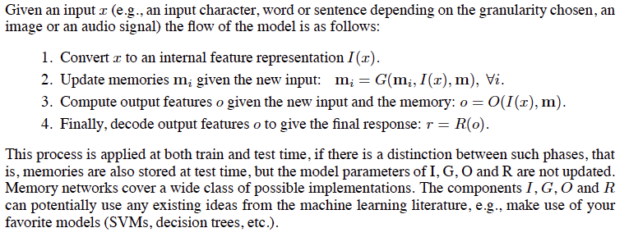
Memory Networks (MemNN)
Memory Networks, Weston et. al., ICLR 2015

Slide 91

Memory Networks (MemNN)
Class of Models with memory $m$ - Array of objects $m_{i}$
Four Components :
  I - Input Feature Map : Input manipulation
  G - Generalization : Memory Manipulation
  O - Output Feature Map : Output representation generator
  R - Response : Response Generator
Each memory here is a dense vector
Memory Networks, Weston et. al., ICLR 2015

Slide 92

MemNN
Input Feature Map
    Imagine input as a sequence of sentences $x_{i}$
Update Memories
Memory Networks, Weston et. al., ICLR 2015

Slide 93

MemNN
Output Representation
    Say if $q$ is a question, compute output representation
Generate Answer Response
Memory Networks, Weston et. al., ICLR 2015

Slide 94

Simple MemNN for Text
Input Feature Map - Bag-of-Words representation
$$I(x_{i})$$
Sentence
Bag-of-Words
Memory Networks, Weston et. al., ICLR 2015

Slide 95

Simple MemNN for Text
Generalization : Store input in new memory
Memories till now (i=4)
Memories after 5 inputs
$${I(x}_{5})$$
Memory Networks, Weston et. al., ICLR 2015

Slide 96


Simple MemNN for Text
Output: Using $k=2$ memory hops with query $x$
Response - Single Word Answer
Score all memories against input
1st Max scoring memory index
2nd Max scoring memory index
Score all memories against input & $o_{1}$
Score all words against query and 2 supporting memories
Max scoring word
Memory Networks, Weston et. al., ICLR 2015

Slide 97
Scoring Function
Scoring Function is an embedding model
What is $Uy$ ?
Scoring Function is just dot-product between sum of word embeddings!!!
Memory Networks, Weston et. al., ICLR 2015

Slide 98
Joe went to the kitchen.
Fred went to the kitchen.
Joe picked up the milk.
Joe travelled to his office.
Joe left the milk. Joe went to the bathroom.
Input Sentences
Memories
Where is the milk now?
Question
1st supporting memory
Where is the milk now?
Question
2nd supporting memory
Where is the milk now?
Office
Question
Response
Memory Networks, Weston et. al., ICLR 2015

Slide 99
Training Objective
Score for true 1st memory
Score for a negative memory
Memory Networks, Weston et. al., ICLR 2015

Slide 100
Training Objective
Score for true 2nd memory
Score for a negative memory
Memory Networks, Weston et. al., ICLR 2015

Slide 101
Training Objective
Score for true response
Score for a negative response
Memory Networks, Weston et. al., ICLR 2015

Slide 102

Experiment
Stored as memories
Large – Scale QA
  14M Statements – (subject, relation, object)
  Memory Hops; $k=1$
  Only re-ranked candidates from other system
Output is highest scoring memory
Method | F1
Fader et. al. 2013 | 0.54
Bordes et. al. 2014b | 0.73
Memory Networks (This work) | 0.72
Why does Memory Network perform exactly as previous model?
Memory Networks, Weston et. al., ICLR 2015

Slide 103
The First MemNN Implemention
I (input): converts to bag-of-word-embeddings x.
G (generalization): stores x in next available slot m_{N}.
O (output): Loops over all memories k=1 or 2 times:
  1st loop max: finds best match m_{i} with x.
  2nd loop max: finds best match m_{J} with (x, m_{i}).
  The output o is represented with (x, m_{i,} m_{J}).
R (response): ranks all words in the dictionary given o and returns best single word. (OR: use a full RNN here)

Slide 104
Matching function
For a given Q, we want a good match to the relevant memory slot(s) containing the answer, e.g.:
Match(Where is the football ?, John picked up the football)
We use a q^{T}U^{T}Ud embedding model with word embedding features:
  LHS features: Q:Where Q:is Q:the Q:football Q:?
  RHS features: D:John D:picked D:up D:the D:football QDMatch:the QDMatch:football
  (QDMatch:football is a feature to say there’s a Q&A word match, which can help.)
The parameters U are trained with a margin ranking loss: supporting facts should score higher than non-supporting facts.

Slide 105
Matching function: 2nd hop
On the 2nd hop we match question & 1st hop to new fact:
Match( [Where is the football ?, John picked up the football], J John is in the playground)
We use the same q^{T}U^{T}Ud embedding model:
  LHS features: Q:Where Q:is Q:the Q:football Q:? Q2: John Q2:picked Q2:up Q2:the Q2:football
  RHS features: D:John D:is D:in D:the D:playground QDMatch:the QDMatch:is .. Q2DMatch:John

Slide 106
Objective function
Minimize:
Where: S_{O} is the matching function for the Output component.
S_{R} is the matching function for the Response component.
x is the input question.
m_{O1} is the first true supporting memory (fact).
m_{O2} is the first second supporting memory (fact).
r is the response
True facts and responses m_{O1,} m_{O2} and r should have higher scores than all other facts and responses by a given margin.

Slide 107
Comparing triples
We also need time information for the bAbI tasks. We tried adding absolute time as a feature: it works, but the following idea can be better:
Seems to work better if we compare triples:
Match(Q,D,D’) returns < 0 if D is better than D’
returns > 0 if D’ is better than D
We can loop through memories, keep best m_{i} at each step.
Now the features include relative time features:
L.H.S: same as before
R.H.S: features(D) DbeforeQ:0-or-1
-features(D’) D’beforeQ:0-or-1 DbeforeD’:0-or-1

Slide 108


Comparing triples: Objective and Inference
Similar to before, except now for both m_{o1} and m_{o2} we need to have two terms considering them as the second or third argument to the S_{Ot} as they may appear on either side during inference:

Slide 109

bAbI Experiment 1
10k sentences. (Actor: only ask questions about actors.)
Difficulty: how many sentences in the past when entity mentioned.
Fully supervised (supporting sentences are labeled).
Compare RNN (no supervision)
and MemNN hops k = 1 or 2, & with/without time features.
Difficulty 5 -- Max mem. sz. required: 65 Average mem. sz. required: 9

Slide 110
bAbI Experiment 1
Example test story + predictions:
Antoine went to the kitchen. Antoine got the milk. Antoine travelled to the office. Antoine dropped the milk. Sumit picked up the football. Antoine went to the bathroom. Sumit moved to the kitchen.
where is the milk now? A: office
where is the football? A: kitchen
where is Antoine ? A: bathroom
where is Sumit ? A: kitchen
where was Antoine before the bathroom? A: office

Slide 111
Unsegmented setup; R module is an RNN
Joe went to the garden then Fred picked up the milk; Joe moved to the bathroom and Fred dropped the milk, and then Dan moved to the living room.
Where is Dan? A: living room I believe
Where is Joe? A: the bathroom
Fred moved to the bedroom and Joe went to the kitchen then Joe took the milk there and Dan journeyed to the bedroom; Joe discarded the milk.
Where is the milk now? A: the milk is in the kitchen
Where is Dan now? A: I think he is in the bedroom
Joe took the milk there, after that Mike travelled to the office, then Joe went to the living room, next Dan went back to the kitchen and Joe travelled to the office.
Where is Joe now? A: I think Joe is in the office

Slide 112
Larger QA: Reverb Dataset in (Fader et al., 13)
14M statements, stored as (subject, relation, object) triples. Triples are REVERB extractions mined from ClueWeb09.
Statements cover diverse topics:
  (milne, authored, winnie-the-pooh)
  (sheep, be-afraid-of, wolf), etc...
Weakly labeled QA pairs and 35M paraphrased questions from WikiAnswers:
  ``Who wrote the Winnie the Pooh books?
  ``Who is poohs creator?’’

Slide 113

Results: QA on Reverb data from (Fader et al.)
14M statements stored in the memNN memory.
k=1 loops MemNN, 128-dim embedding.
R response simply outputs top scoring statement.
Time features are not necessary, hence not used.
We also tried adding bag of words (BoW) features.

Slide 114

Fast QA on Reverb data
Scoring all 14M candidates in the memory is slow.
We consider speedups using hashing in S and O as mentioned earlier:
Hashing via words (essentially: inverted index)
Hashing via k-means in embedding space (k=1000)

Slide 115
A MemNN multitasked on bAbI data and Reverb QA data
The “story” told to the model after training:
Antoine went to the kitchen. Antoine picked up the milk. Antoine travelled to the office.
MemNN’s answers to some questions:
Where is the milk? A: office
Where was Antoine before the office? A: kitchen
Where does milk come from? A: milk come from cow
What is a cow a type of? A: cow be female of cattle
Where are cattle found? A: cattle farm become widespread in brazil
What does milk taste like? A: milk taste like milk
What does milk go well with? A: milk go with coffee

Slide 116
Related Memory Models (published before or ~same time as original paper)
RNNSearch (Bahdanau et al.) for Machine Translation
  Can be seen as a Memory Network where memory goes back only one sentence (writes embedding for each word).
  At prediction time, reads memory and performs a soft max to find best alignment (most useful words). 1 hop only.
Generating Sequences With RNNs (Graves, ‘13)
  Also does alignment with previous sentence to generate handwriting (so RNN knows what letter it’s currently on).
Neural Turing Machines (Graves et al., 14) [on arxiv just 5 days after MemNNs!]
  Has read and write operations over memory to perform tasks (e.g. copy, sort, associative recall).
  128 memory slots in experiments; content addressing computes a score for each slot ➔ slow for large memory?
Earlier work by (Das ‘92), (Schmidhuber et al., 93), DISCERN (Miikkulainen, ‘90) and others...

Slide 117

Experiment
Large – Scale QA
  14M Statements – (subject, relation, object)
  Memory Hops; $k=1$
  Only re-ranked candidates from other system
USELESS EXPERIMENT
Method | F1
Fader et. al. 2013 | 0.54
Bordes et. al. 2014b | 0.73
Memory Networks (This work) | 0.72
Why does Memory Networks not perform as well?

Slide 118


Useful Experiment
Simulated World QA
  4 characters, 3 objects, 5 rooms
  7k statements, 3k questions for training and same for testing
  Difficulty 1 (5) – Entity in question is mentioned in last 1 (5) sentences
  For $k=2$, annotation has intermediate best memories as well
Memory Networks, Weston et. al., ICLR 2015

Slide 119
Limitations
Simple Bag of Words representation
Simulated Question Answering dataset is too trivial
Strong supervision i.e. for intermediate memories is needed
Memory Networks, Weston et. al., ICLR 2015

Slide 120

End-to-End Memory Networks (MemN2N)
Trained end to end
  Requires less training supervision
What if the annotation is:
  Input sentences $x_{1}, x_{2}, …, x_{n}$
  Query $q$
  Answer $a$
Model performs by:
  Generating memories from inputs
  Transforming query into suitable representation
  Process query and memories jointly using multiple hops to produce the answer
  Backpropagate through the whole procedure
Joe went to the kitchen. Fred went to the kitchen. Joe picked up the milk. Joe travelled to his office. Joe left the milk. Joe went to the bathroom.
Where is the milk now?
Office
End-To-End Memory Networks, Sukhbaatar et. al., NIPS 2015

Slide 121




MemN2N architecture
supervision
Output
read
addressing
Controller module
Memory Module
read
addressing
Memory vectors
(unordered)
Internal state
vector
Input
Notes:
The model consists from two parts
…
Let take a closer look at memory module

Slide 122



Memory Module
Weighted Sum
Attention weights
/ Soft address
To controller
(added to
controller state)
Softmax
Dot Product
Addressing signal
(controller
state vector)
Memory vectors
Notes:
Lets take closer look at memory module
…

Slide 123


Question & Answering
Answer
kitchen
Memory Module
Weighted Sum
Controller
Dot product + softmax
1: Sam moved
to garden
2: Sam went
to kitchen
3: Sam drops
apple there
Where is Sam?
Question
Input story
Notes:
Here we are applying our model to QA task
But note that it can be used in other tasks such as lang model

Slide 124
Memory Vectors
E.g.) constructing memory vectors with Bag-of-Words (BoW)
Embed each word
Sum embedding vectors
Embedding Vectors
Memory Vector
E.g.) temporal structure: special words for time and include them in BoW
Time embedding
\text{1: ``Sam drops apple''}\rightarrow v_\text{{\color{Red} Sam}} + v_\text{{\color{Red} drops}} + v_\text{{\color{Red} apple}} + v_\text{{\color{DarkGreen} 1}} = m_1
Notes:
So far I haven’t told you about how we put things in memory
Memory vectors can take many forms
But let me give you one example when inputs are ..
…
Sometimes data might have a structure
Then you have to include them in memory vectors
Time stamp … corresponding embedding vector

Slide 125
Positional Encoding of Words
Representation of inputs and memories could use all kinds of encodings: bag of words, RNN style reading at word or character level, etc.
Also built a positional encoding variant:
Words are represented by vectors as before.
But instead of a bag, position is modeled by a multiplicative term on each word vector with weights depending on the position in the sentence.

Slide 126
Training on 1k stories
Weakly supervised
Supervised Supp. Facts
TASK | N-grams | LSTMs | MemN2N | Memory Networks | StructSVM+coref+srl
T1. Single supporting fact | 36 | 50 | PASS | PASS | PASS
T2. Two supporting facts | 2 | 20 | 87 | PASS | 74
T3. Three supporting facts | 7 | 20 | 60 | PASS | 17
T4. Two arguments relations | 50 | 61 | PASS | PASS | PASS
T5. Three arguments relations | 20 | 70 | 87 | PASS | 83
T6. Yes/no questions | 49 | 48 | 92 | PASS | PASS
T7. Counting | 52 | 49 | 83 | 85 | 69
T8. Sets | 40 | 45 | 90 | 91 | 70
T9. Simple negation | 62 | 64 | 87 | PASS | PASS
T10. Indefinite knowledge | 45 | 44 | 85 | PASS | PASS
T11. Basic coreference | 29 | 72 | PASS | PASS | PASS
T12. Conjunction | 9 | 74 | PASS | PASS | PASS
T13. Compound coreference | 26 | PASS | PASS | PASS | PASS
T14. Time reasoning | 19 | 27 | PASS | PASS | PASS
T15. Basic deduction | 20 | 21 | PASS | PASS | PASS
T16. Basic induction | 43 | 23 | PASS | PASS | 24
T17. Positional reasoning | 46 | 51 | 49 | 65 | 61
T18. Size reasoning | 52 | 52 | 89 | PASS | 62
T19. Path finding | 0 | 8 | 7 | 36 | 49
T20. Agent’s motivation | 76 | 91 | PASS | PASS | PASS

Slide 127
Attention during memory lookups
Samples from toy QA tasks
 | Test Acc | Failed tasks
MemNN | 93.3% | 4
LSTM | 49% | 20
MemN2N 1 hop | 74.82% | 17
2 hops | 84.4% | 11
3 hops | 87.6.% | 11
20 bAbI Tasks

Slide 128
MemN2N
  Convert input to memories $x_{i}→m_{i}$
BOW input
Sum of word-embeddings
Word-Embedding Matrix
  Transform query $q$ into same representation space
  Output Vectors $x_{i}→c_{i}$
End-To-End Memory Networks, Sukhbaatar et. al., NIPS 2015

Slide 129
MemN2N
  Scoring memories against query
Memories
Score for
input/memory
Query (transformed)
  Generate output
Weighted average of all inputs (transformed)
End-To-End Memory Networks, Sukhbaatar et. al., NIPS 2015

Slide 130
MemN2N
  Generating Response
Distribution over response words
Query
Averaged-output
  Training Objective – Maximum Likelihood / Cross Entropy
End-To-End Memory Networks, Sukhbaatar et. al., NIPS 2015

Slide 131

Make averaged output
Response
Score memories
Generate outputs
Generate memories
TransformQuery
End-To-End Memory Networks, Sukhbaatar et. al., NIPS 2015

Slide 132

Multi-hop MemN2N
Hop 3
Hop 2
Different Memories and Outputs for each Hop
Hop 1
End-To-End Memory Networks, Sukhbaatar et. al., NIPS 2015

Slide 133
Experiments
Simulated World QA
  20 Tasks from bAbI dataset - 1K and 10K instances per task
  Vocabulary = 177 words only!!!!!
  60 epochs
  Learning Rate annealing
  Linear Start with different learning rate
  “Model diverged very often, hence trained multiple models”
End-To-End Memory Networks, Sukhbaatar et. al., NIPS 2015

Slide 134


 | MemNN | MemN2N
Error % (1k) | 6.7 | 12.4
Error % (10k) | 3.2 | 7.5
End-To-End Memory Networks, Sukhbaatar et. al., NIPS 2015

Slide 135
Movie Trivia Time!
Subject
Relation
Object
Which was Stanley Kubricks’s first movie?
(2001:a_space_odyssey, directed_by, stanley_kubrick)
(fear_and_dark, directed_by, stanley_kubrick)
…
(fear_and_dark, released_in, 1953)
(full_metal_jacket, released_in, 1987)
…
(2001:a_space_odyssey, released_in, 1968)
…
(the_shining, directed_by, stanley_kubrick)
…
(AI:artificial_intelligence, written_by, stanley_kubrick)
Fear and Desire
When did 2001:A Space Odyssey release?
1968
After The Shining, which movie did its director direct?
Full Metal Jacket
Knowledge Base

Slide 136


Knowledge Base?
Textual Knowledge?
(2001:a_space_odyssey, directed_by, stanley_kubrick)
(fear_and_dark, directed_by, stanley_kubrick)
…
(fear_and_dark, released_in, 1953)
(full_metal_jacket, released_in, 1987)
…
(2001:a_space_odyssey, released_in, 1968)
…
(the_shining, directed_by, stanley_kubrick)
…
(AI:artificial_intelligence, written_by, stanley_kubrick)
Incomplete!
Too Challenging!
Combine using Memory Networks?

Slide 137

Key-Value MemNNs for Reading Documents
Structured Memories as Key-Value Pairs
  Regular MemNNs have single vector for each memory
  Key more related to question and values to answer
  $(k:$Kubrick’s first movie was, $v:$ Fear and Dark)
Keys and Values can be Words, Sentences, Vectors etc.
Key-Value Memory Networks for Directly Reading Documents, Miller et. al., EMNLP 2016

Slide 138
KV-MemNN
Retrieve relevant memories using Hashing Techniques
Retrieved Relevant Memories
All Memories
Use inverted index, locality sensitive hashing, something sensible
Key-Value Memory Networks for Directly Reading Documents, Miller et. al., EMNLP 2016

Slide 139
KV-MemNN
Score Memory-Keys
Distribution over Memory-Keys
Key
Dot-Prod
Sum of Embeddings
BOW
Generate Output
Weighted average of Memory-values
Key-Value Memory Networks for Directly Reading Documents, Miller et. al., EMNLP 2016

Slide 140

KV-MemNN - Multiple Hops
In the $j^{th}$ hop:
Query representation :
Key Addressing
Generate Response
Final Hop
Key-Value Memory Networks for Directly Reading Documents, Miller et. al., EMNLP 2016

Slide 141
KV-MemNN – What to store in memories?
KB Based :
Key: (subject, relation); Value: Object
K: (2001:a_space_odyssey, directed_by); V: stanley_kubrick
Document Based
For each entity in document, extract 5-word window around it
Key: window; Value: Entity
K: screenplay written by and; V: Hampton
Key-Value Memory Networks for Directly Reading Documents, Miller et. al., EMNLP 2016

Slide 142
KV-MemNN – Experiments
WikiMovies Benchmark
  Total 100K QA-pairs
  10% for testing
Method | KB | Doc
E2E Memory Network | 78.5 | 69.9
Key-Value Memory Network | 93.9 | 76.2
Key-Value Memory Networks for Directly Reading Documents, Miller et. al., EMNLP 2016

Slide 143

KV-MemNN
Generate Output using Averaged Memory-Values
Score relevant Memory-Keys
Retrieve relevant Memories
Generate Response
Key-Value Memory Networks for Directly Reading Documents, Miller et. al., EMNLP 2016

Slide 144
KV-MemNN
Key-Value Memory Networks for Directly Reading Documents, Miller et. al., EMNLP 2016

Slide 145
Neural RAM
NEURAL RAM (Random Access Machine)
A Controller which can be a feedforward network or LSTM, similar to NTM. Only trainable part of the model.
R registers, each holding the distribution of an Integer in {0,1,…,M-1}, i.e. the register value is a vector $p ∈ ℛ^{M}$.
Gives differentiable loss, supporting backprop training.
A controller executes modules m_{i} on the registers, and can test values on registers or module outputs.
Neural Random-Access Machines, Kurach et.al, ICLR 2016

Slide 146
Neural RAM
NEURAL RAM
Steps in neural RAM execution:
Controller gets inputs from registers.
Controller updates internal state (if using LSTM).
Controller outputs description of a “fuzzy circuit” with registers as input, a graph of modules, and R outputs.
The values of the registers are overwritten by circuit outputs.
Neural Random-Access Machines, Kurach et.al, ICLR 2016

Slide 147


Neural RAM circuit
NEURAL RAM Circuit
Input to module i is selected from:
$$\left\{r_{1},…,r_{R},o_{1},…,o_{i−1}\right\}$$
where $r_{j}$ is the value of register j at the current time step,
and $o_{j}$ is the output of module j at the current time step.
Neural Random-Access Machines, Kurach et.al, ICLR 2016

Slide 148

Neural RAM updates
NEURAL RAM updates
For each register, a weight vector $c_{i} ∈ ℝ^{R+Q}$ is computed which represents the weight of that registers update from the other registers and circuit nodes:
Neural Random-Access Machines, Kurach et.al, ICLR 2016

Slide 149

Neural Random-Access Machines, Kurach et.al, ICLR 2016

Slide 150

Neural RAM memory
NEURAL RAM Memory
The RAM has M memory locations, each holding a distribution over {0,1,…,M-1} (like the registers).
Therefore each register value or memory cell value can be used as a “value” or a “pointer” into the RAM.
RAM is represented as a matrix $ℳ∈ℝ^{M×M}$ such that $ℳ_{ij}$ is the probability that the i^{th} cell holds the value j.
Neural Random-Access Machines, Kurach et.al, ICLR 2016

Slide 151
Neural RAM memory
NEURAL RAM Memory
Memory accesses are managed with two modules:
READ: Input (register or module) is treated as a pointer, and the “soft contents” is returned. i.e. if the input has distribution p, then $ℳ^{T}p$ is returned.
WRITE: Takes inputs p and a and stores a in location p.
Note: These operations are expensive but once trained, the discretized approximation (choosing mostly likely values for each input) is very accurate, and much faster.
Neural Random-Access Machines, Kurach et.al, ICLR 2016

Slide 152
Neural RAM training
NEURAL RAM Training
ADAM optimization.
Curriculum Learning. Carefully sorted presentation of easy/hard examples.
Gradient Clipping.
Gradient noise.
Distribution correction (sum to 1).
Entropy bonus (not a penalty)!
Range-bounding log values.
Neural Random-Access Machines, Kurach et.al, ICLR 2016

Slide 153

Neural RAM Experiments
NEURAL RAM Experiments
Random Access: given k and array A, return A[k].
Increment: Given an array, increment all elements.
Copy: Given an array and pointer, copy to pointer address.
Reverse: Given an array and pointer, reverse into address.
Swap: Given two pointers and an Array, swap elements.
Permutation: Given two arrays of n elements: one containing data and one containing a permutation, permute the data elements.
ListK: Given a pointer to linked list and k, find k^{th} element.
ListSearch: Given v and pointer to list, return ptr to first v.
Merge: Given pointers to two sorted arrays, merge them.
WalkBST: Given pointer to root of tree and a path (left-right sequence), traverse the tree and return the element.
Neural Random-Access Machines, Kurach et.al, ICLR 2016

Slide 154
Neural RAM Modules
NEURAL RAM Modules used on memory
READ(a,b) → read from location a.
WRITE(a,b) → write a to location b
ZERO(a,b) = 0
ONE(a,b) = 1
TWO(a,b) = 2
INC(a,b) = (a+1) mod M
ADD(a,b) = (a+b) mod M
SUB(a,b) = (a-b) mod M
DEC(a,b) = (a-1) mod M
LESS-THAN(a,b) = [a < b]
LESS-OR-EQUAL-THAN(a,b) = [a ≤ b]
EQUALITY-TEST(a,b) = [a = b]
MIN(a,b) = min(a,b)
MAX(a,b) = max(a,b)

Slide 155

Neural RAM Performance
NEURAL RAM Performance
Generalization sequences had length up to 50

Slide 156

Neural RAM Performance
NEURAL RAM Performance
Training curves
Neural Random-Access Machines, Kurach et.al, ICLR 2016

Slide 157

Takeaways – NRam
Example circuits generated
Neural Random-Access Machines, Kurach et.al, ICLR 2016

Slide 158
Takeaways – NRam
NEURAL RAM Summary
Training very challenging for this model, but it also solved harder problems.
Curriculum learning essential for hard tasks (start with simple concepts, then to harder ones)
Generalization performance was good.
Model seems to converge to low-entropy (sharp values) automatically. Error rates low, and discretization works well.
Neural Random-Access Machines, Kurach et.al, ICLR 2016

Slide 159
CNN : Computer Vision :: ________ : NLP
RNN
Key-Value Memory Networks for Directly Reading Documents, Miller et. al., EMNLP 2016

Slide 160

Dynamic Memory Networks
Episodic memory is the memory of autobiographical events (times, places, associated emotions, and other
contextual who, what, when, where, why knowledge) that can be explicitly stated or conjured. It is the collection
of past personal experiences that occurred at a particular time and place. For example
Ask Me Anything: Dynamic Memory Networks for Natural Language Processing, Kumar et. al. ICML 2016

Slide 161

Dynamic Memory Networks – The Beast
Use RNNs, specifically GRUs for every module
Ask Me Anything: Dynamic Memory Networks for Natural Language Processing, Kumar et. al. ICML 2016

Slide 162

Dynamic Memory Networks – The Beast
Use RNNs, specifically GRUs for every module
Ask Me Anything: Dynamic Memory Networks for Natural Language Processing, Kumar et. al. ICML 2016

Slide 163

DMN
Final GRU Output for $t^{th}$ sentence
Ask Me Anything: Dynamic Memory Networks for Natural Language Processing, Kumar et. al. ICML 2016

Slide 164
DMN
Ask Me Anything: Dynamic Memory Networks for Natural Language Processing, Kumar et. al. ICML 2016

Slide 165


DMN
$$Hop= i$$
$$i = 1$$
Ask Me Anything: Dynamic Memory Networks for Natural Language Processing, Kumar et. al. ICML 2016

Slide 166

DMN
$$Hop= i$$
$$i =2$$
Ask Me Anything: Dynamic Memory Networks for Natural Language Processing, Kumar et. al. ICML 2016

Slide 167
DMN
Ask Me Anything: Dynamic Memory Networks for Natural Language Processing, Kumar et. al. ICML 2016

Slide 168
DMN
Ask Me Anything: Dynamic Memory Networks for Natural Language Processing, Kumar et. al. ICML 2016

Slide 169
DMN
How many GRUs were used with 2 hops?
Ask Me Anything: Dynamic Memory Networks for Natural Language Processing, Kumar et. al. ICML 2016

Slide 170


DMN – Qualitative Results
Ask Me Anything: Dynamic Memory Networks for Natural Language Processing, Kumar et. al. ICML 2016

Slide 171
Algorithm Learning

Slide 172
Neural Turing Machine (NTM)
NNs connected to a tape memory:
Copy Task: Implement the Algorithm
Given a list of numbers at input, reproduce the list at output
Neural Turing Machine Learns to control:
What to write to memory
When to write to memory
When to stop writing
Which memory cell to read from
How to convert result of read into final output

Slide 173

Neural Turing Machine Architecture
Unlike classical Turing Machines, the NTM is a differentiable network. Therefore read/write addressing is “soft” and distributed across the entire memory. However, it is focused on very few cells quantitatively.

Slide 174
Neural Turing Machines
External Input
External Output
Controller
‘Blurry’
Write Heads
Read Heads
Memory
Input/output just like regular NN
Neural Turing Machines, Graves et. al., arXiv:1410.5401
Notes:
Input/ Output like regular neural network
Controller – Feedforward/LSTM network
Operators (called ‘heads’) to interact with memory matrix
‘Blurry’ read and write to make network differentiable

Slide 175


Neural Turing Machine Architecture
NTM updates are very similar to LSTM updates:
Erase update: w_{t} is the weight emitted by the write head, and e_{t} is an erasing vector:
Add update: a_{t} is the add vector:

Slide 176


Slide 177

Neural Turing Machines
‘Blurry’ Memory Addressing
(at time instant ‘t’)
M_{t}
w_{t}
Soft Attention
N
w_{t}(0) = 0.1 | w_{t}(1) = 0.2 | w_{t}(2) = 0.5 | w_{t}(3) = 0.1 | w_{t}(4) = 0.1
M
Neural Turing Machines, Graves et. al., arXiv:1410.5401

Slide 178

Neural Turing Machines
More formally,
Blurry Read Operation
Given: M_{t} (memory matrix) of size NxM
w_{t} (weight vector) of length N
t (time index)
Neural Turing Machines, Graves et. al., arXiv:1410.5401

Slide 179
Neural Turing Machines: Blurry Writes
Blurry Write Operation
Decomposed into blurry erase + blurry add
Given: M_{t} (memory matrix) of size NxM
w_{t} (weight vector) of length N
t (time index)
e_{t} (erase vector) of length M
a_{t} (add vector) of length M
Erase Component
Add Component
Neural Turing Machines, Graves et. al., arXiv:1410.5401

Slide 180
Neural Turing Machines: Erase
1xN
Mx1
w₁(0) = 0.1 | w₁(1) = 0.2 | w₁(2) = 0.5 | w₁(3) = 0.1 | w₁(4) = 0.1
e₁
5 | 7 | 9 | 2 | 12
11 | 6 | 3 | 1 | 2
3 | 7 | 3 | 10 | 6
4 | 2 | 5 | 9 | 9
3 | 5 | 12 | 8 | 4
1.0
0.7
0.2
0.5
0.0
M₀
Neural Turing Machines, Graves et. al., arXiv:1410.5401

Slide 181
Neural Turing Machines: Erase
w₁(0) = 0.1 | w₁(1) = 0.2 | w₁(2) = 0.5 | w₁(3) = 0.1 | w₁(4) = 0.1
4.5 | 5.6 | 4.5 | 1.8 | 10.8
10.23 | 5.16 | 1.95 | 0.93 | 1.86
2.94 | 6.72 | 2.7 | 9.8 | 5.88
3.8 | 1.8 | 3.75 | 8.55 | 8.55
3 | 5 | 12 | 8 | 4
Neural Turing Machines, Graves et. al., arXiv:1410.5401

Slide 182
Neural Turing Machines: Addition
w₁(0) = 0.1 | w₁(1) = 0.2 | w₁(2) = 0.5 | w₁(3) = 0.1 | w₁(4) = 0.1
a₁
4.5 | 5.6 | 4.5 | 1.8 | 10.8
10.23 | 5.16 | 1.95 | 0.93 | 1.86
2.94 | 6.72 | 2.7 | 9.8 | 5.88
3.8 | 1.8 | 3.75 | 8.55 | 8.55
3 | 5 | 12 | 8 | 4
3
4
-2
0
2
Neural Turing Machines, Graves et. al., arXiv:1410.5401

Slide 183
Neural Turing Machines: Blurry Writes
4.8 | 6.2 | 6 | 2.1 | 11.1
10.63 | 5.96 | 3.95 | 1.33 | 2.26
2.74 | 6.32 | 1.7 | 9.6 | 5.68
3.8 | 1.8 | 3.75 | 8.55 | 8.55
3.2 | 5.4 | 13 | 8.2 | 4.2
M₁
Neural Turing Machines, Graves et. al., arXiv:1410.5401

Slide 184

Neural Turing Machines: Demo
Demonstration: Training on Copy Task
Figure from Snips AI's Medium Post
Neural Turing Machines, Graves et. al., arXiv:1410.5401
Notes:
Example of the training procedure of the NTM. The model is given random input sequences and updates its parameters at every step. The output image represents the output from the model at that stage of training, with the corresponding error with regards to the expected output. The state of the memory as the model reads the input and write the output is displayed on the right, with the positions of the corresponding heads. Inspired by A. Graves’ animation at NIPS
- Learns when to read and write by manipulating e_t, a_t

Slide 185


NTM Memory Addressing
Combined Content- and Location-based addressing:

Slide 186

NTM Memory Addressing
Content-addressing:
Key vector
Matching function
Memory vector

Slide 187

NTM Memory Addressing
Content vs. memory (interpolation):
Previous state
New content vector

Slide 188

NTM Memory Addressing
Location-based addressing
Interpolated state
Shift weights
e.g. at -1,0,1

Slide 189











Neural Turing Machine: Attention Model
Steps for generating w_{t}
Content Addressing
Peaking
Interpolation
Convolutional Shift (Location Addressing)
Sharpening
Prev. State
Controller
Outputs
CA
I
CS
S
Neural Turing Machines, Graves et. al., arXiv:1410.5401

Slide 190
Neural Turing Machines: Attention Model
Generating w_{t}
Content Based
Example: QA Task
Score sentences by similarity with Question
Weights as softmax of similarity scores
Location Based
Example: Copy Task
Move to address (i+1) after writing to index (i)
Weights ≈ Transition probabilities
Neural Turing Machines, Graves et. al., arXiv:1410.5401
Notes:
The attention mechanism decides which parts of the memory must be focused on
The controller outputs the normalized weights
Weights based on 2 attention mechanisms: content based, location based
Content Based:
Focuses attention based on similarity of key vector & vectors in memory
Useful for retrieval based lookup
Location Based:
Focuses attention based on addresses of vectors in memory
Useful for iteration over memory. E.g. Copy Task

Slide 191
Neural Turing Machine: Attention Model
Prev. State
Controller
Outputs
:Vector (length M) produced by Controller
Neural Turing Machines, Graves et. al., arXiv:1410.5401

Slide 192

Neural Turing Machine: Attention Model
Prev. State
Controller
Outputs
Step 1: Content Addressing (CA)
CA
Neural Turing Machines, Graves et. al., arXiv:1410.5401

Slide 193

Neural Turing Machine: Attention Model
Prev. State
Controller
Outputs
Step 2: Peaking
CA
Neural Turing Machines, Graves et. al., arXiv:1410.5401

Slide 194
Neural Turing Machine: Attention Model
Prev. State
Controller
Outputs
Step 3: Interpolation (I)
CA
I
Neural Turing Machines, Graves et. al., arXiv:1410.5401

Slide 195

Neural Turing Machine: Attention Model
Prev. State
Controller
Outputs
Step 4: Convolutional Shift (CS)
Controller outputs , a normalized distribution over all N possible shifts
Rotation-shifted weights computed as:
CA
I
CS
Neural Turing Machines, Graves et. al., arXiv:1410.5401

Slide 196

Neural Turing Machine: Attention Model
Prev. State
Controller
Outputs
Step 5: Sharpening (S)
Uses to sharpen as:
CA
I
CS
S
Neural Turing Machines, Graves et. al., arXiv:1410.5401

Slide 197
Neural Turing Machine: Controller Design
Feed-forward: faster, more transparency & interpretability about function learnt
LSTM: more expressive power, doesn’t limit the number of computations per time step
Both are end-to-end differentiable!
Reading/Writing -> Convex Sums
w_{t} generation -> Smooth
Controller Networks
Neural Turing Machines, Graves et. al., arXiv:1410.5401
Notes:
If one compares the controller to the central processing unit in a digital computer and the memory matrix to RAM, then the hidden activations of the recurrent
controller are akin to the registers in the processor.

Slide 198

Neural Turing Machine: Network Overview
Unrolled Feed-forward Controller
Figure from Snips AI's Medium Post
Neural Turing Machines, Graves et. al., arXiv:1410.5401
Notes:
A Neural Turing Machine unfolded in time. The controller (green), a feed-forward neural network, depends on both the input x and the read vector r. It emits read (blue) and write (red) heads to interact with the memory M.

Slide 199
Neural Turing Machines vs. MemNNs
MemNNs
Memory is static, with focus on retrieving (reading) information from memory
NTMs
Memory is continuously written to and read from, with network learning when to perform memory read and write

Slide 200
Neural Turing Machines: Experiments
Task | Network Size |  | Number of Parameters
 | NTM w/ LSTM* | LSTM | NTM w/ LSTM | LSTM
Copy | 3 x 100 | 3 x 256 | 67K | 1.3M
Repeat Copy | 3 x 100 | 3 x 512 | 66K | 5.3M
Associative | 3 x 100 | 3 x 256 | 70K | 1.3M
N-grams | 3 x 100 | 3 x 128 | 61K | 330K
Priority Sort | 2 x 100 | 3 x 128 | 269K | 385K
Neural Turing Machines, Graves et. al., arXiv:1410.5401

Slide 201

Neural Turing Machines: ‘Copy’ Learning Curve
Trained on 8-bit sequences, 1<= sequence length <= 20
Neural Turing Machines, Graves et. al., arXiv:1410.5401

Slide 202


Neural Turing Machines: ‘Copy’ Performance
LSTM
NTM
Neural Turing Machines, Graves et. al., arXiv:1410.5401
Notes:
Describe x, y axes

Slide 203
Neural Turing Machines (NTMs)
Experiments demonstrate that NTM are capable of learning simple algorithms and some generalization
Code is not easy to use
No examples of grammatical inference or other interesting problems

Slide 204
Neural Turing Machines triggered an outbreak of Memory Architectures!
Notes:
Add the storm here!

Slide 205
Dynamic Neural Turing Machines
Experimented with addressing schemes
  Dynamic Addresses: Addresses of memory locations learnt in training – allows non-linear location-based addressing
  Least recently used weighting: Prefer least recently used memory locations + interpolate with content-based addressing
  Discrete Addressing: Sample the memory location from the content-based distribution to obtain a one-hot address
  Multi-step Addressing: Allows multiple hops over memory
Results: bAbI QA Task
 | Location NTM | Content NTM |  | Soft DNTM | Discrete DNTM
1-step | 31.4% | 33.6% |  | 29.5% | 27.9%
3-step | 32.8% | 32.7% |  | 24.2% | 21.7%
Dynamic Neural Turing Machine with Soft and Hard Addressing Schemes, Gulchere et. al., arXiv:1607.00036

Slide 206

Dynamic Neural Turing Machines
Dynamic Neural Turing Machine with Soft and Hard Addressing Schemes, Gulchere et. al., arXiv:1607.00036

Slide 207

Stack Augmented Recurrent Networks
Learn algorithms based on stack implementations (e.g. learning fixed sequence generators)
Uses a stack data structure to store memory (as opposed to a memory matrix)
Inferring Algorithmic Patterns with Stack-Augmented Recurrent Nets, Joulin et. al., arXiv:1503.01007

Slide 208

Stack Augmented Recurrent Networks
Inferring Algorithmic Patterns with Stack-Augmented Recurrent Nets, Joulin et. al., arXiv:1503.01007

Slide 209

Stack Augmented Recurrent Networks
Blurry ‘push’ and ‘pop’ on stack. E.g.:
Some results:
Inferring Algorithmic Patterns with Stack-Augmented Recurrent Nets, Joulin et. al., arXiv:1503.01007

Slide 210
NSPDA compared with other memory models - Results
Rule insertion gives hints that improves generalization
On parenthesis LSTM = 2%, Neural Stack = 95%, DNC = 97%, NSPDA = 99.2%
Mali et al., IEEE TAI ’21

Slide 211
NSPDA compared with other memory models - Results
Rule insertion gives hints that improves generalization
Model learns to push and pop
Requires only 8 neurons and 2000 samples to converge, generalizes on unseen data

Slide 212
NSPDA compared with other memory models - Results
Rule insertion gives hints that improves generalization
Model learns to push and pop
Requires only 8 neurons and 2000 samples to converge and generalize on unseen data

Slide 213

Neural State Turing Machine - Results
Mali et al., Arxiv ’22c

Slide 214

Neural State Turing Machine - Results
Transformers is 3 layer deep with positional encoding and access to start and stop token
LSTM has 2 layers
Rest of the models have only one layer
Mali et al., Arxiv ’22c

Slide 215
Differentiable Neural Computers (DNCs)
Advanced addressing mechanisms:
  Content Based Addressing
  Temporal Addressing
    Maintains notion of sequence in addressing
    Temporal Link Matrix L (size NxN), L[i,j] = degree to which location I was written to after location j.
  Usage Based Addressing
Hybrid computing using a neural network with dynamic external memory, Graves et. al., Nature vol. 538

Slide 216
DNC: Usage Based Addressing
Writing increases usage of cell, reading decreases usage of cell
Least used location has highest usage-based weighting
Interpolate b/w usage & content based weights for final write weights
Hybrid computing using a neural network with dynamic external memory, Graves et. al., Nature vol. 538
Notes:
- Memory utilization. Reading doesn’t utilize memory, only writing does
We trained
the DNC on a copy problem, in which a series of 10 random sequences was presented as input. After each input sequence was presented, it was recreated as output. Once the output was generated, that input sequence was not needed again and could be erased from memory. We used a DNC with a feedforward controller and a memory of 10 locations—insufficient to store all 50 input vectors with no overwriting. The goal was to test whether the memory allocation system would be used to free and re-use locations as needed. As shown by the read and write weightings, the same locations are repeatedly used. The free gate is active during the read phases, meaning that locations are deallocated immediately after they are read from. The allocation gate is active during the write phases, allowing the deallocated locations to be re-used.

Slide 217


Slide 218

DNC: Example
Memory utilization: Reading doesn’t, writing does
Hybrid computing using a neural network with dynamic external memory, Graves et. al., Nature vol. 538
Notes:
- Memory utilization. Reading doesn’t utilize memory, only writing does
We trained the DNC on a copy problem, in which a series of 10 random sequences was presented as input. After each input sequence was presented, it was recreated as output. Once the output was generated, that input sequence was not needed again and could be erased from memory. We used a DNC with a feedforward controller and a memory of 10 locations—insufficient to store all 50 input vectors with no overwriting. The goal was to test whether the memory allocation system would be used to free and re-use locations as needed. As shown by the read and write weightings, the same locations are repeatedly used. The free gate is active during the read phases, meaning that locations are deallocated immediately after they are read from. The allocation gate is active during the write phases, allowing the deallocated locations to be re-used.

Slide 219
DNC: Improvements over NTMs
NTM
Large contiguous blocks of memory needed
No way to free up memory cells after writing
DNC
Memory locations non-contiguous, usage-based
Regular de-allotment based on usage-tracking
Hybrid computing using a neural network with dynamic external memory, Graves et. al., Nature vol. 538

Slide 220


Slide 221
DNC: Experiments
Graph Tasks
Graph Representation: (source, edge, destination) tuples
Types of tasks:
Traversal: Perform walk on graph given source, list of edges
Shortest Path: Given source, destination
Inference: Given source, relation over edges; find destination
Hybrid computing using a neural network with dynamic external memory, Graves et. al., Nature vol. 538

Slide 222
DNC: Experiments
Graph Tasks
Training over 3 phases:
Graph description phase: (source, edge, destination) tuples fed into the graph
Query phase: Shortest path (source, ____, destination), Inference (source, hybrid relation, ___), Traversal (source, relation, relation …, ___)
Answer phase: Target responses provided at output
Trained on random graphs of maximum size 1000
Hybrid computing using a neural network with dynamic external memory, Graves et. al., Nature vol. 538

Slide 223


Slide 224

DNC: Experiments
Graph Tasks: London Underground
Hybrid computing using a neural network with dynamic external memory, Graves et. al., Nature vol. 538

Slide 225

DNC: Experiments
Graph Tasks: London Underground
Input Phase
Hybrid computing using a neural network with dynamic external memory, Graves et. al., Nature vol. 538

Slide 226


DNC: Experiments
Graph Tasks: London Underground
Traversal Task
Query Phase
Answer Phase
Hybrid computing using a neural network with dynamic external memory, Graves et. al., Nature vol. 538

Slide 227


DNC: Experiments
Graph Tasks: London Underground
Shortest Path Task
Query Phase
Answer Phase
Hybrid computing using a neural network with dynamic external memory, Graves et. al., Nature vol. 538

Slide 228


DNC: Experiments
Graph Tasks: Freya’s Family Tree
Hybrid computing using a neural network with dynamic external memory, Graves et. al., Nature vol. 538

Slide 229

The Chomsky Hierarchy
A containment hierarchy of classes of formal languages
Recursively-
Enumerable
(Turing Machines)
We can represent a grammar using finite automaton or regular expression
Context-
Sensitive
(Linear
Bounded
Automata)
Context-
Free
(Push Down
Automata)
+ Memory (stack or tape) = PDA or TM
Regular
(Finite
Automata)
229
Notes:
When you add Memory, you can have better capabilities and can learn complex languages

Slide 230

The Chomsky Hierarchy
Recursively-
Enumerable
(Turing Machines)
Context-
Sensitive
(Linear
Bounded
Automata)
Context-
Free
(Push Down
Automata)
Regular
(Finite
Automata)
Turing Completeness
230

Slide 231
The Chomsky Hierarchy
Recursively-
Enumerable
(Turing Machines)
Context-
Sensitive
(Linear
Bounded
Automata)
Context-
Free
(Push Down
Automata)
Regular
(Finite
Automata)
RNN, GRU – Merrill-19
Weiss-19
Second-order RNN- Omlin 96, Mali 23
231

Slide 232
Conclusions
Many memory models
  Different from memory in RNNs such as LSTM, etc.
Machine Learning models require memory and multi-hop reasoning seem to perform AI tasks better
Memory Networks for Text are an interesting direction but very simple
Generic architectures with memory, such as Neural Turing Machine, limited applications shown
Future directions should be focusing on applying generic neural models with memory to more AI Tasks.
Stack based methods seem the best for long complex strings such as CFGs.
Hybrid computing using a neural network with dynamic external memory, Graves et. al., Nature vol. 538

Slide 233
Reading List
Ask Me Anything: Dynamic Memory Networks for Natural Language Processing, Kumar et. al. ICML 2016
Hybrid computing using a neural network with dynamic external memory, Graves et. al., Nature vol. 538
Memory Networks, Weston et. al., ICLR 2015
End-To-End Memory Networks, Sukhbaatar et. al., NIPS 2015
Inferring Algorithmic Patterns with Stack-Augmented Recurrent Nets, Joulin et. al., arXiv:1503.01007
Neural Turing Machines, Graves et. al., arXiv:1410.5401
Dynamic Neural Turing Machine with Soft and Hard Addressing Schemes, Gulchere et. al., arXiv:1607.00036
Key-Value Memory Networks for Directly Reading Documents, Miller et. al., EMNLP 2016
G.Z. Sun, C.L. Giles, H.H. Chen, Y.C. Lee, “The Neural Network Pushdown Automation: Architecture, Dynamics and Learning,” in Adaptive Processing of Sequences and Data Structures, Lecture Notes in Artificial Intelligence, (eds) C.L. Giles, M. Gori, p.296, Springer-Verlag, 1998

Slide 234
Reading List
Karol Kurach, Marcin Andrychowicz & Ilya Sutskever Neural Random-Access Machines, ICLR, 2016
Emilio Parisotto & Ruslan Salakhutdinov Neural Map: Structured Memory for Deep Reinforcement Learning, ArXiv, 2017
Pritzel et. al. Neural Episodic Control, ArXiv, 2017
Oriol Vinyals,Meire Fortunato, Navdeep Jaitly Pointer Networks, ArXiv, 2017
Jack W Rae et al., Scaling Memory-Augmented Neural Networks with Sparse Reads and Writes, ArXiv 2016
Antoine Bordes, Y-Lan Boureau, Jason Weston, Learning End-to-End Goal-Oriented Dialog, ICLR 2017
Junhyuk Oh, Valliappa Chockalingam, Satinder Singh, Honglak Lee, Control of Memory, Active Perception, and Action in Minecraft, ICML 2016
Wojciech Zaremba, Ilya Sutskever, Reinforcement Learning Neural Turing Machines, ArXiv 2016

