Slide 1
Sequence Modeling: Recurrent and Recursive Nets
(How to make deep learning stateful and give it some memory)
Thanks to Alexander Ororbia, Sargur Srihari, Fei-Fei Li, Justin Johnson, Serena Yeung, Sosuke Kobayashi, Geoff Hinton

Slide 2
Previously
Principles of machine learning
Deep Feedforward NNs
Regularization
Optimization
Convolutional NNs
Today – recurrent NNs

Slide 3
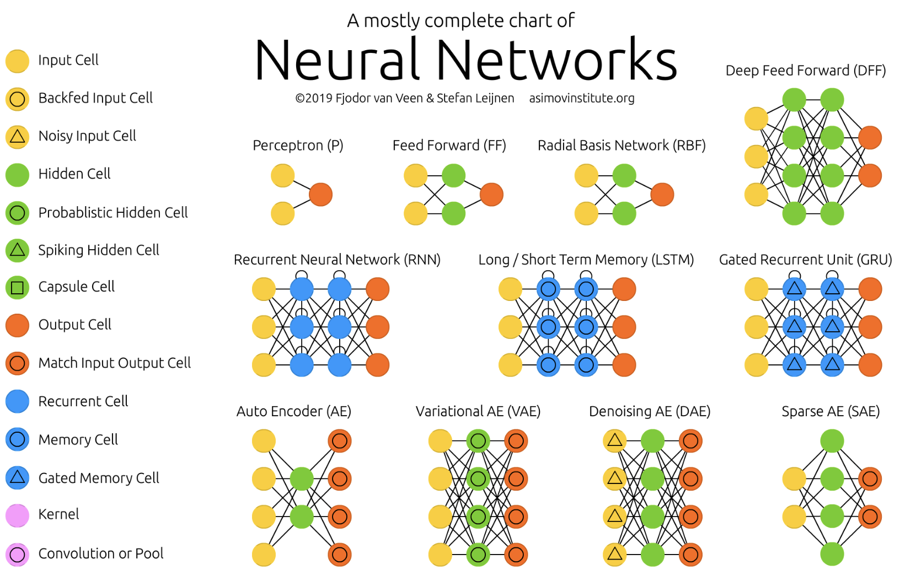
Generic Neural Architectures (1-11)
Today
14 types of neurons

Slide 4
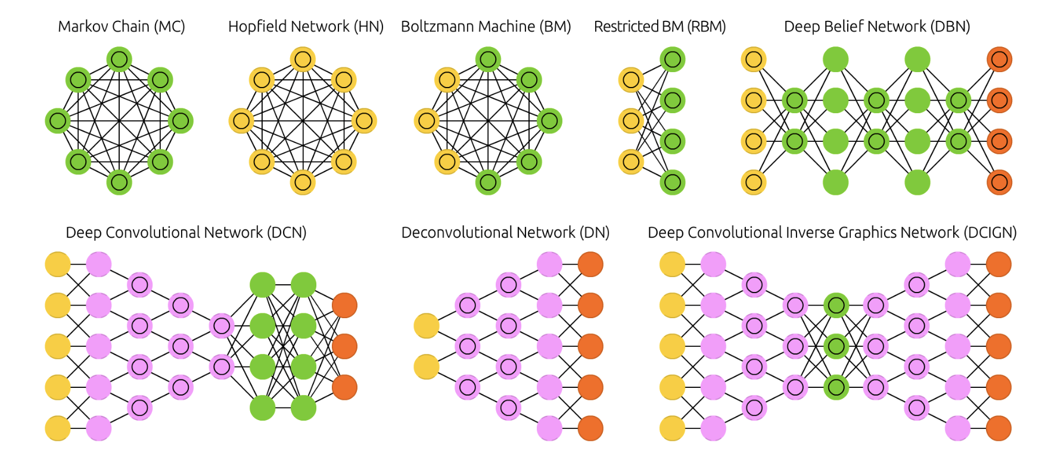
Generic Neural Architectures (12-19)

Slide 5
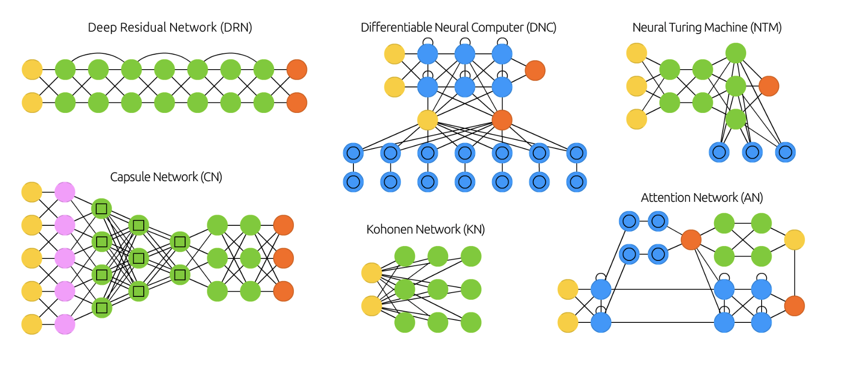
Generic Neural Architectures (20-26)
Note blue recurrent neurons

Slide 6
Topics
Sequential Data and RNN Overview
Deterministic, Stochastic, Chaotic, Multivariate
Unfolding Computational Graphs
Recurrent Neural Networks
Bidirectional RNNs
Encoder-Decoder Sequence-to-Sequence Architectures
Deep Recurrent Networks
Recursive Neural Networks
The Challenge of Long-Term Dependencies
Echo-State Networks
Leaky Units and Other Strategies for Multiple Time Scales
LSTM and Other Gated RNNs
Optimization for Long-Term Dependencies
Explicit Memory

Slide 7
Sequential Data Examples
Often arises through measurement of time and time series or sequences
Examples:
  Acoustic features at successive time frames in speech recognition
  Sequence of characters in a sentence
  Parts of speech of successive words
  Snowfall and rainfall measurements on successive days
  Daily values of currency exchange rate
  Nucleotide base pairs in a strand of DNA

Slide 8
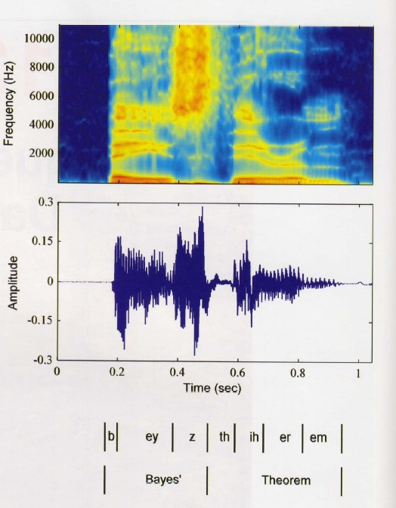
Sound Spectrogram to Word Sequence
Decompose sound waves into frequency, amplitude using Fourier transforms
Plot of the intensity of the spectral coefficients versus time index
Successive observations of speech spectrum highly correlated (Markov dependency)
Bayes Theorem

Slide 9
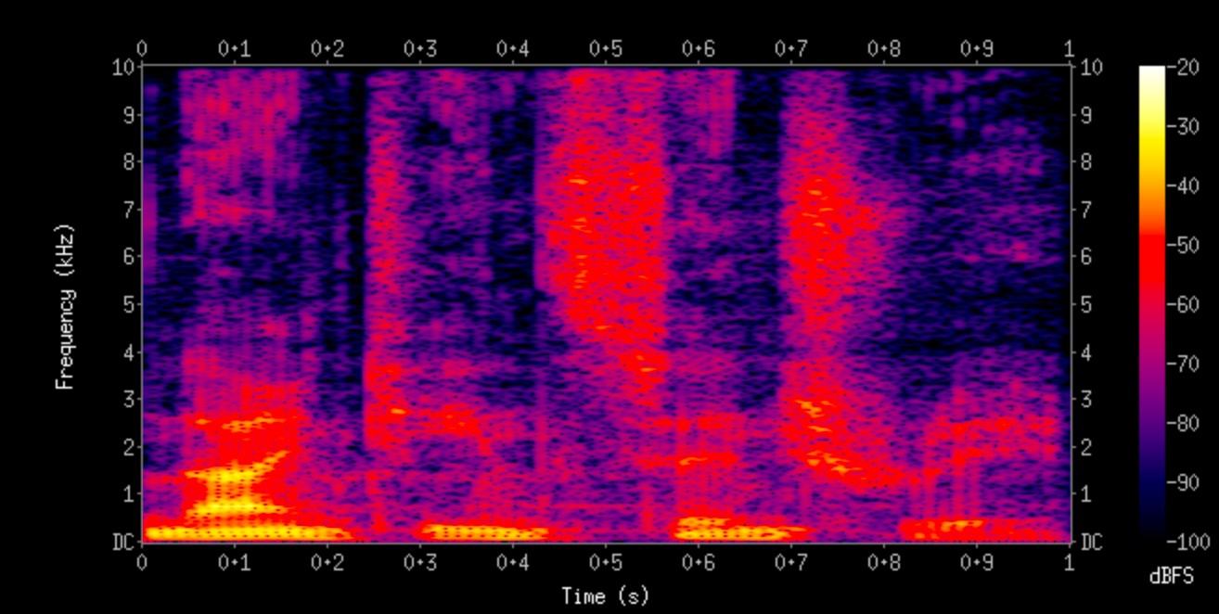
Two common tasks with sequential data
Sequence-to-sequence
  Speech recognition using a sound spectrogram
    decompose sound waves into frequency, amplitude using Fourier transforms
→ “Nineteenth Century”
Frequencies increase up the vertical axis, and time on the horizontal axis. The lower frequencies are more dense because it is a male voice.
Legend on right shows that the color intensity increases with density
NLP: Named Entity Recognition
  Input: Jim bought 300 shares of Acme Corp. in 2006
  NER: [Jim]_{Person} bought 300 shares of [Acme Corp.]_{Organization} in [2006]_{Time}
Machine Translation: insurance salesman → versicherungskaufmann
2. Sequence-to-symbol
Sentiment:
  Best movie ever → Positive
Speaker recognition
  Sound spectrogram → Harry

Slide 10
Recurrent neural networks (RNNs) process sequential data
RNNs are a family of neural nets for sequential data
Compare to Convolutional Neural Networks
  Specialized architectures
    CNN is specialized for grid of values, e.g., image
    RNN is specialized for a sequence of values x ⁽¹⁾,..,x ^{(τ)}
  Scaling & Variable length
    CNNs readily scale to images with large width/height
      CNNs can process variable size images
    RNNs scale to longer sequences than would be impractical for networks without sequence-based adaptations
      RNNs can also process variable-length sequences
RNNs are stateful, CNNs are stateless
  (except during training – nearly all training is stateful)
RNNs have memory, CNNs are memoryless

Slide 11
Stateful vs Non-stateful processes
State means the next situation or state depends on the previous one
Basic concept in physics and science
Ex – weather, finance, language
x(t+1) = f(x(t))
x(t+1) = f(x(t), s(t))
Slap in the face? Your response depends on your state

Slide 12
Stationary vs non-Stationary Processes
Probably Denisity Function changes over time – e.g weather, markets, sequences in which order matters
  Physics is non-stationary!
  Earth falls into the sun 10*26 years
  Do we care? Depends on who we are.
Stochastic processes have noise
Quasi-stationarity

Slide 13
Deterministic vs Nondeterministic Processes
Are nondeterministic processed stochastic?
Not necessarily
Many processes occur in parallel, not necessarily in sequence
  VLSI design
  Petri nets
  Parallel processing
  Multiuniverses

Slide 14
Chaotic Processes
Both deterministic and nondeterministic
Stochastic and nonstochastic
Based on initial conditions.
Who has the luxury of initial conditions?
How appropriate for continuous processes?
  Buchi automata
Bakker, R., Schouten, J. C., Giles, C. L., Takens, F., & Van den Bleek, C. M. (2000). Learning chaotic attractors by neural networks. Neural Computation, 12(10), 2355-2383.

Slide 15
RNNs share same weights across time steps
To go from a multilayer networks to RNNs:
  Need to share parameters across different parts of the NN
  Separate parameters for each value cannot generalize to sequence lengths not seen during training
  Share statistical strength across different sequence lengths and across different positions in time
Sharing important when information can occur at multiple positions in the sequence
  Given “I went to Nepal in 1999 ” and “In 1999, I went to Nepal ”, an ML method to extract the year should extract 1999 whether in position 6 or 2
  A feed-forward network that processes sentences of fixed length would have to learn all of the rules of language separately at each position
    However some transformers & LLMs do this
  An RNN shares the same weights across several time steps

Slide 16
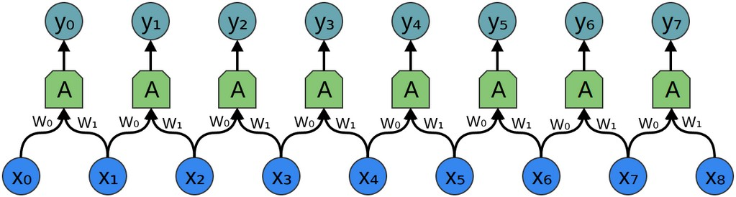

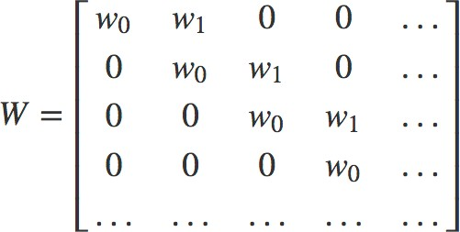
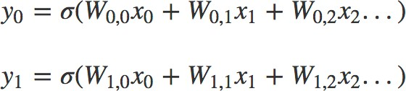
1-D CNN used with a time sequence
Kernel g(t):
Time Sequence
Equations for outputs of this network:
Note that kernel gets flipped in convolution
y₀ = σ (w₀x₀+w₁x₁-b)
y₁ = σ (w₀x₁+w₁x₂-b)
etc. upto y₈
We can also write the equations in terms of elements of a general 8 ✕ 8 weight matrix W as:
where
etc. upto y₈
http://colah.github.io/posts/2014-07-Understanding-Convolutions/

Slide 17
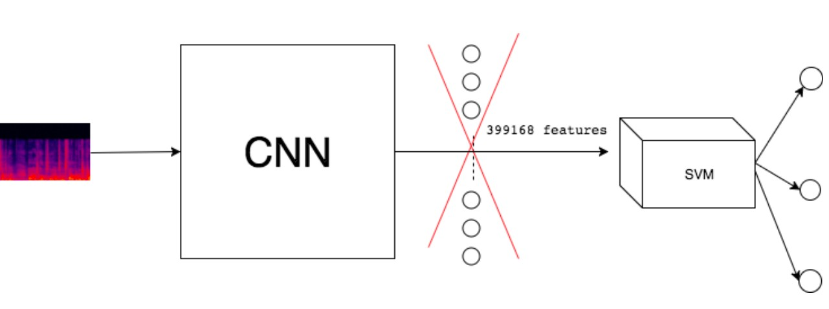
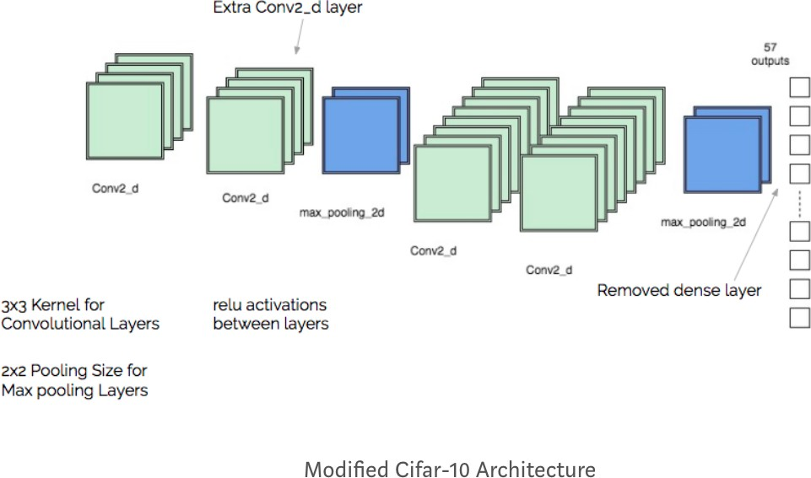
Speaker Recognition with CNN
A sequence to symbol task
CNN
Feature Extractor (Transfer Learning)

Slide 18
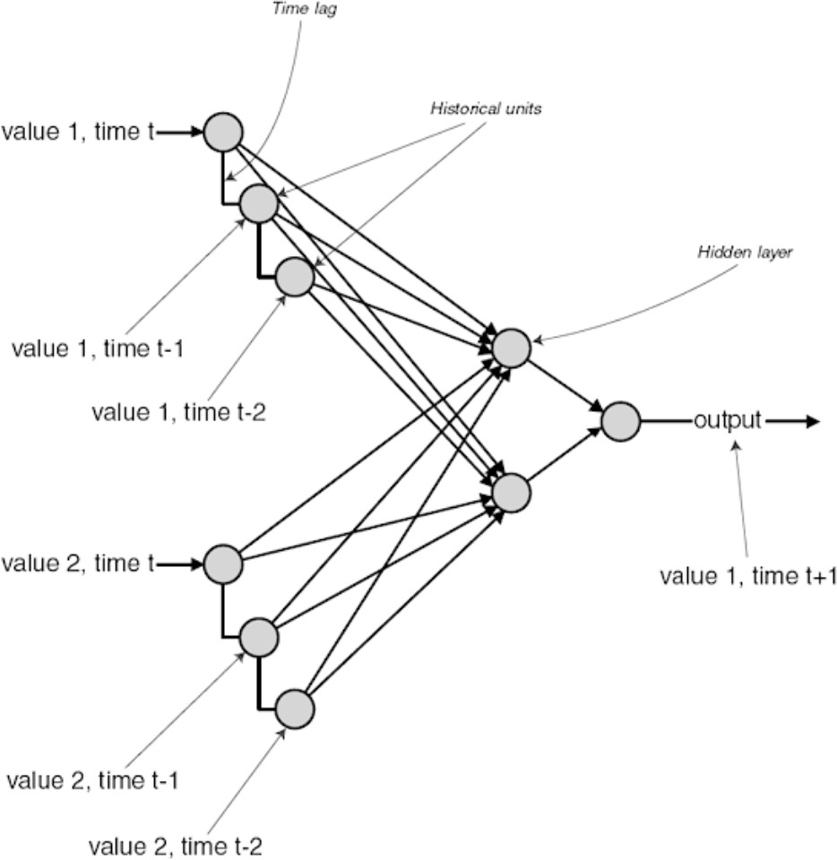
Time Delay Neural Networks (TDNNs)
Deep Learning Srihari
TDNNs use convolution for a 1-D temporal sequence
  Convolution allows shared parameters across time, but is space limited
    Each output is dependent upon a small number of neighboring inputs
    Parameter sharing manifests in the application of the same convolutional kernel at each time step
A TDNN remembers the previous few training examples and uses them as input into the network.
The network then works like a
feed-forward, back propagation network.

Slide 19
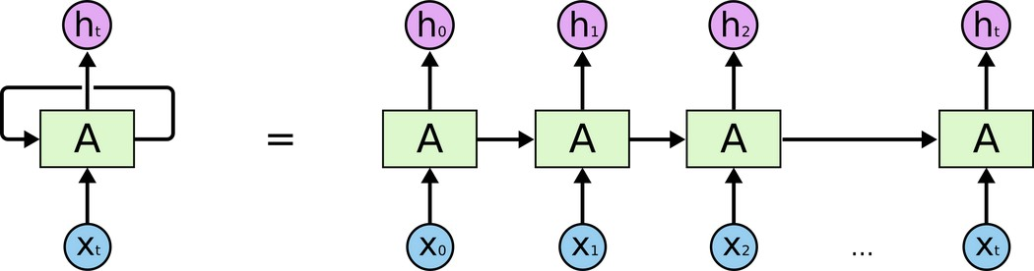
RNN vs. TDNN
Deep Learning Srihari
RNNs share parameters in a different way than TDNN
  Each member of output is a function of previous members of output
  Each output produced using same update rule applied to previous outputs
  This recurrent formulation results in sharing of parameters through a very deep computational graph
An unrolled RNN

Slide 20
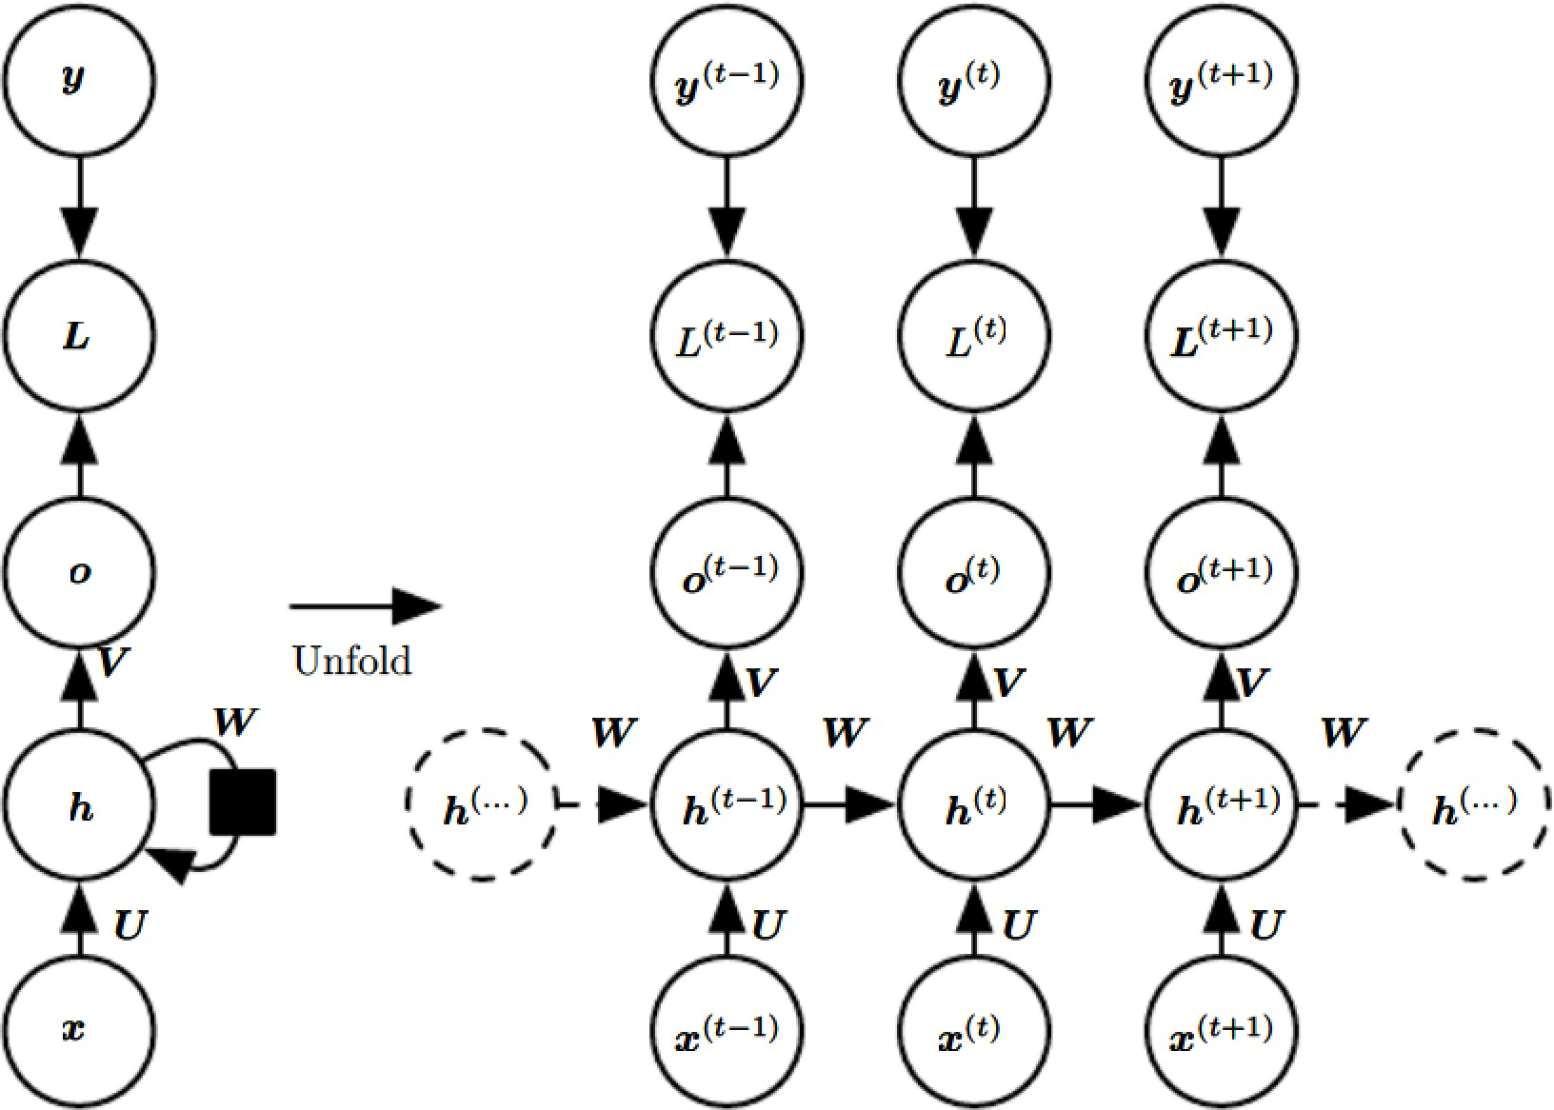
Computational Graphs for RNNs
We extend computational graphs to include cycles
  Cycles represent the influence of the present value of a variable on its own value at a future time step
  In a computational graph, nodes are variables/operations
  RNN maps and input sequence of x values to output sequence of o values
    Loss L measures how far each output o is from the training target y
Forward propagation is given as follows:
For each time step t, t=1 to t=τ
Apply the following equations
_{o}(t)_{=c+Vh}(t)
h^{(t)}=tanh(a^{(t)})
_{a}(t)_{=b+Wh}(t-1)_{+Ux}(t)

Slide 21
RNN Operating on a Sequence
RNNs operate on a sequence that contain vector x^{(t)} with time step index t, ranging from 1 to τ
  Sequence: x⁽¹⁾,..,x^{(τ)}
  RNNs operate on minibatches of sequences of length τ
Remarks about sequences
  The steps need not refer to passage of time in the real world
  RNNs can be applied in two-dimensions across spatial data such as an image or text in an image
  Even when applied to time sequences, network may have connections going backwards in time, provided entire sequence is observed before it is provided to network

Slide 22
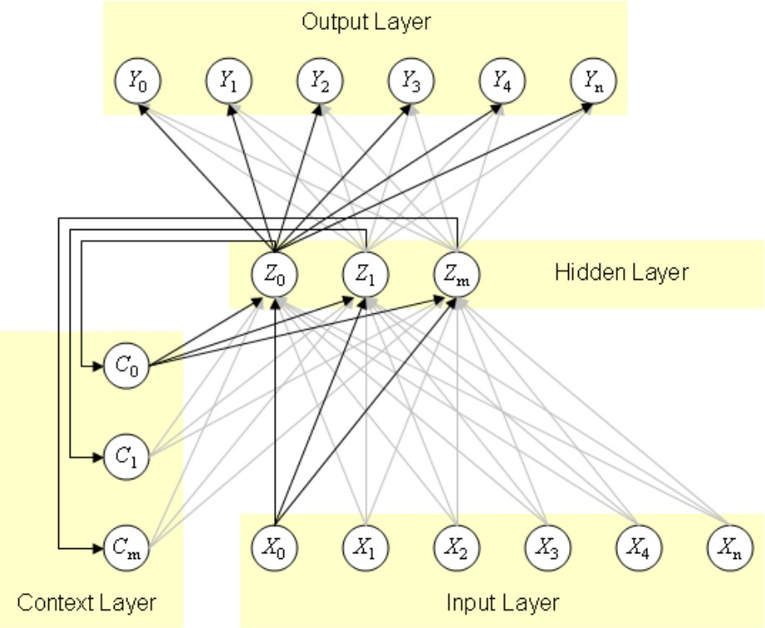
RNN as a Network with Cycles
An RNN is a class of neural networks where connections between units form a directed cycle
This creates an internal state of the network which allows it to exhibit dynamic temporal behavior
The internal memory can be used to process arbitrary sequences of inputs
Three layer network with input x , hidden layer z and output y
Context units c maintain a copy of the previous value of the hidden units

Slide 23
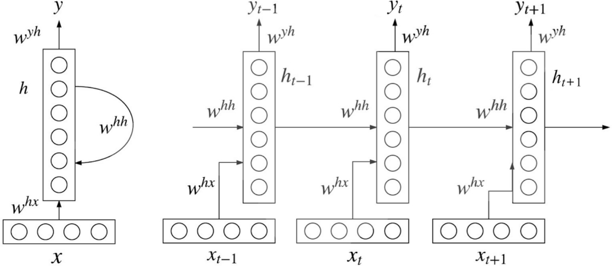
RNN Parameters
Folded network with cycles
Unfolded sequence network with three time steps
h = f (w^{hh}h
t t−1
+ w^{hx}x )
t
y = softmax(w^{yh}h )
t t
Unlike a feedforward neural network which uses different parameters at each layer, RNN shares the same parameters (W^{hx},W^{hh},W^{yh}) across all steps

Slide 24
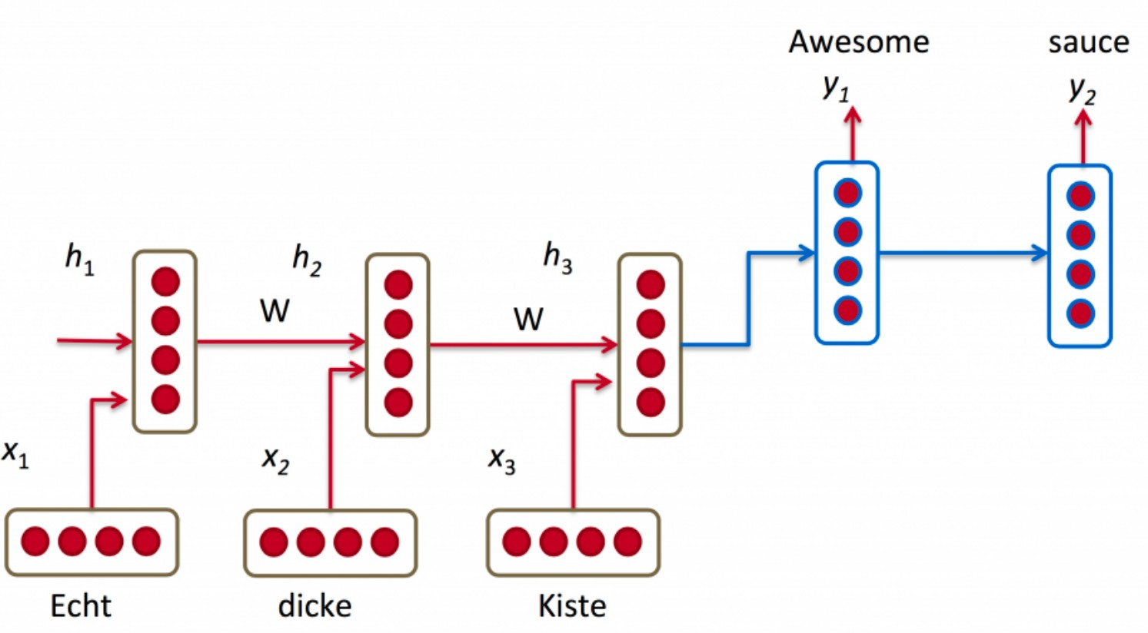
RNN for Machine Translation

Slide 25
Limitation of Length of Time Steps
Length of time steps is determined by length of input
  e.g., if word sequence to be processed is a sentence of six words, RNN would be unfolded into a neural net with six time steps or layers.
    One layer corresponds to a word
Theoretically, a RNN can make use of the information in arbitrarily long sequences
  In practice, RNN is limited to looking back only a few steps due to the vanishing gradient or exploding gradient problem

Slide 26
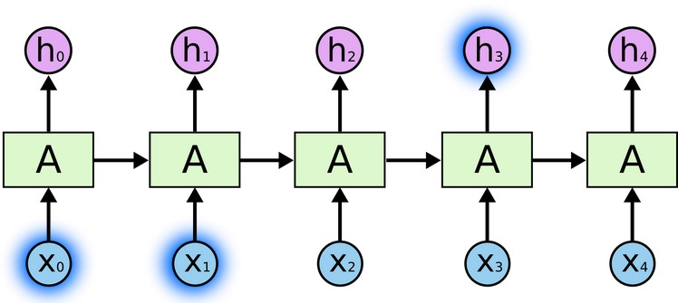
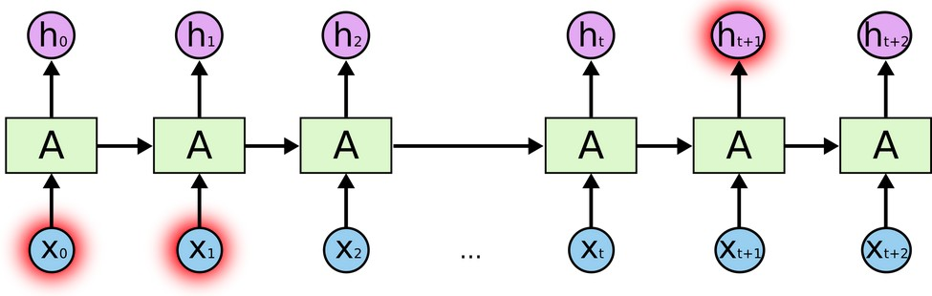
Problem of Long-Term Dependencies
Easy to predict last word in “the clouds are in the sky,”
  When gap between relevant information and place that it’s needed is small, RNNs can learn to use the past information
“I grew up in France… I speak fluent French.”
  We need the context of France from further back.
  Large gap between relevant information and point where it is needed
In principle RNNs can handle it, but fail in practice
  LSTMs and others try to offer a solution

Slide 27
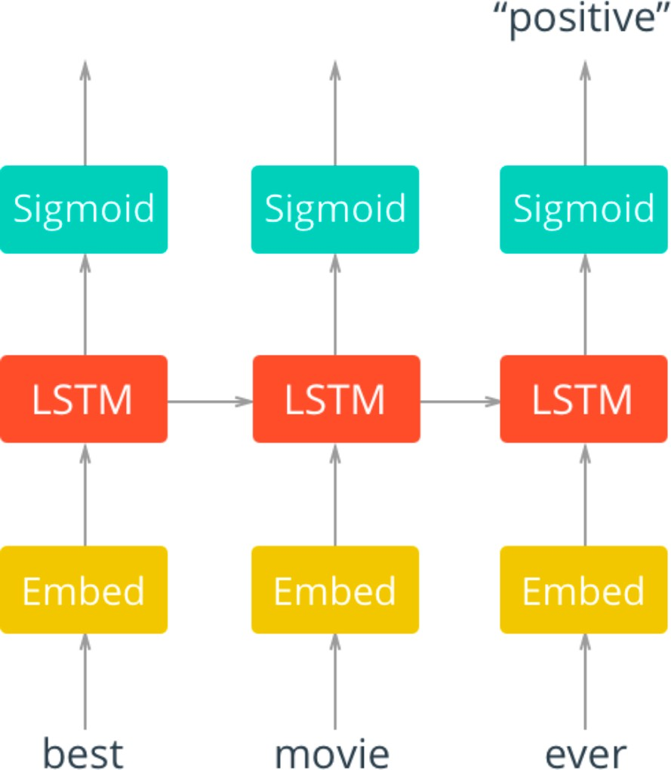
RNN for sentiment analysis
Embedding Layer
We pass in words to an embedding layer
Options
Train up an embedding with Word2vec
It is good enough to just have an embedding layer and let the network learn the embedding table on its own.

Slide 28
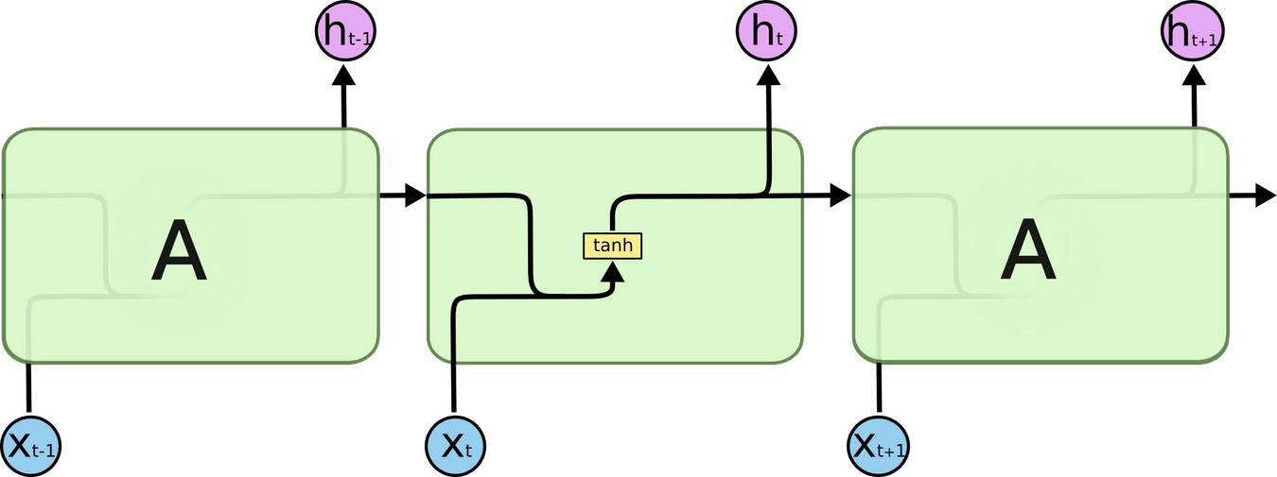
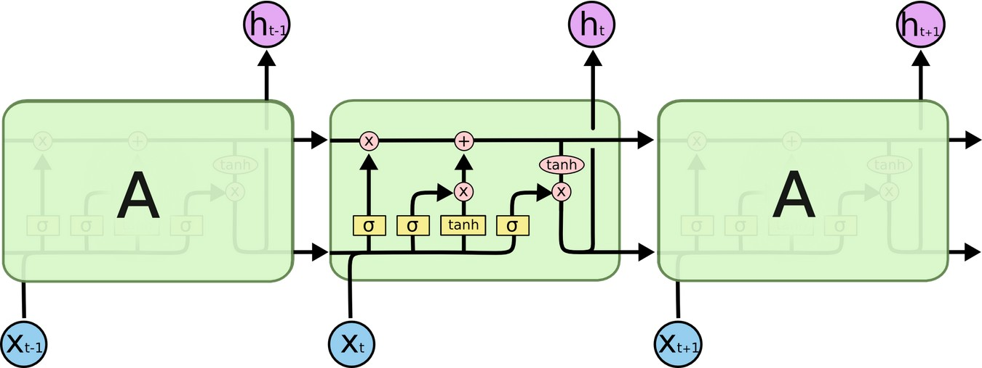
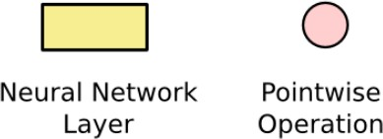
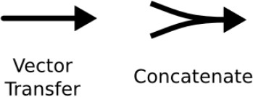

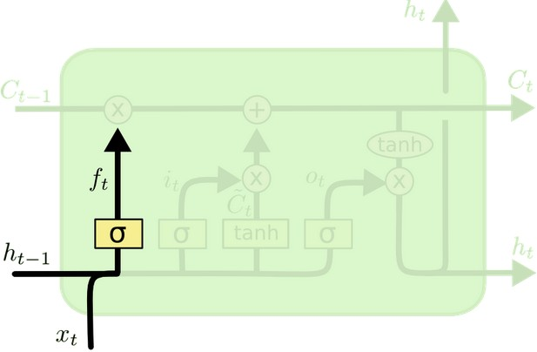
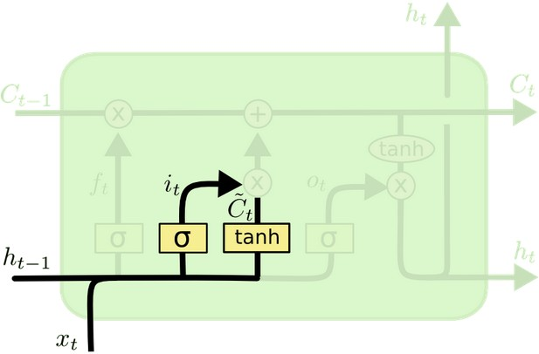
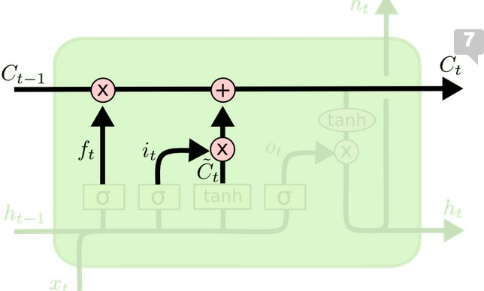
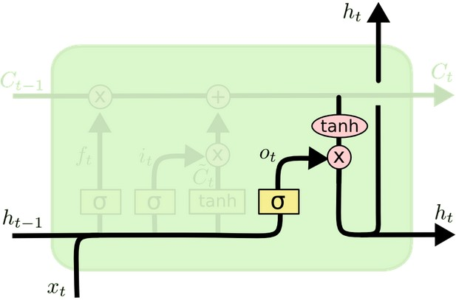
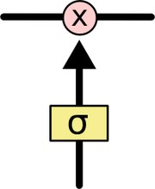
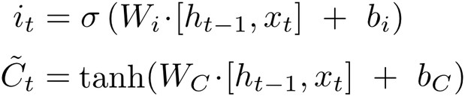

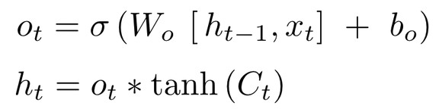
RNN vs LSTM
RNN
Repeating module has a simple structure Such as a tanh layer
LSTM
Repeating module has four interacting Layers, with notation:
Three gates of the form
Forget gate
Input gate
Output gate
Sigmoid is 0 or 1
Allows input to go through or not
Forget gender of old subject
Actually drop old Add new
Whether subject is singular or plural
Input gender of new subject

Slide 29
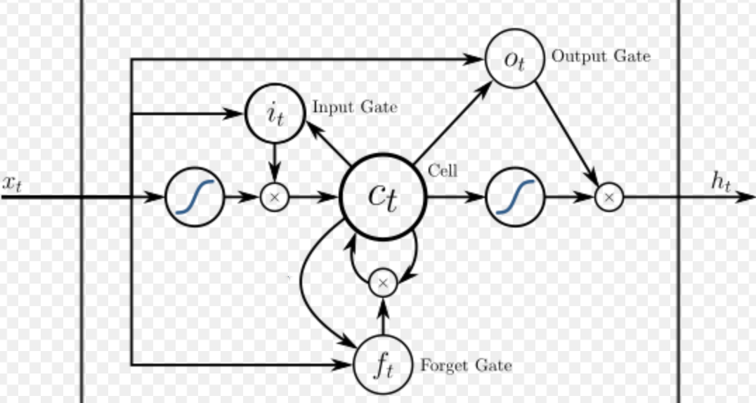
An LSTM Variant
A common LSTM unit is composed of
  a cell, an input gate, an output gate and a forget gate
The cell remembers values over arbitrary time intervals and
the three gates regulate the flow of information into and out of the cell.
A peephole LSTM is shown below

Slide 30

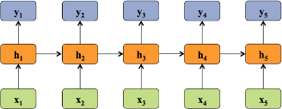
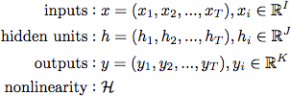


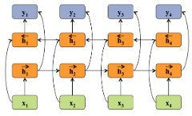
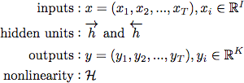


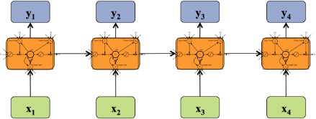
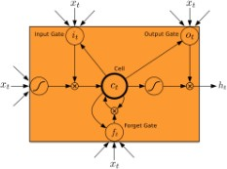
Summary of some Neural Sequential Models
Recurrent Neural Network
RNN Unrolled RNN
Definition
Activation Functions
 | Bidirectional RNN
Deep Bidirectional RNN
LSTM
Source: http://www.cs.cmu.edu/~epxing/Class/10708-16/note/10708_scribe_lecture27.pdf

Slide 31
Attention Mechanisms
Long range dependencies are still a problem with LSTMs
With an attention mechanism we no longer encode the full source sentence into a fixed-length vector
  Rather, we allow the decoder to “attend” to different parts of the source sentence at each step of the output generation
Attention is simply a vector which is often the outputs of dense layer using a softmax function.

Slide 32
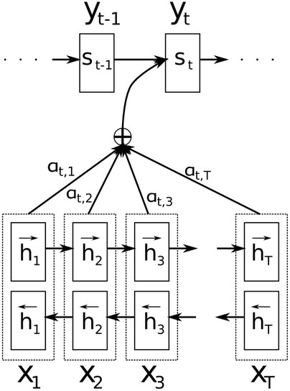
Attention Mechanism in Translation
y : translated words
x : source words.
  Use of bidirectional RNN is unimportant
Each decoder output word now depends on
weighted combination of all the input states,
  not just the last state.
a‘s are weights for each input state
  if a_{3,2} is large, decoder pays attention to second state in source sentence while producing third word of target
a’s are normalized to sum to 1

Slide 33
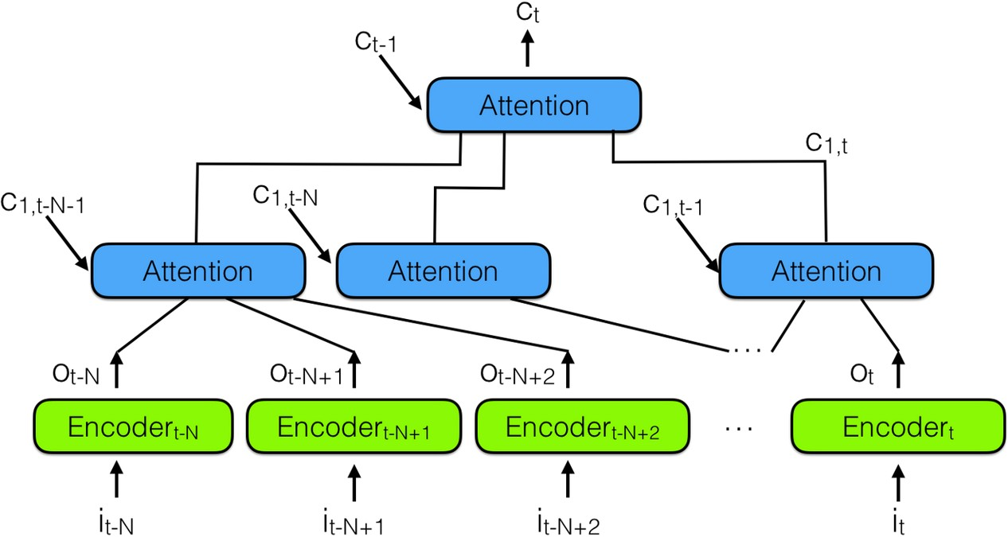
Hierarchical Neural Attention Encoder

Slide 34
Deep Learning and Graphical Models
In deep learning:
  Tasks of interest:
    Classification
    Feature learning
  Method of learning
    Backpropagation and gradient descent
In graphical models:
  Tasks of interest:
    Transfer learning
    Latent variable inference
  Methods of learning
    Parameter learning methods
    Structure learning methods
Hybrid graphical models combine the two types of models
  They are trained using backpropagation

Slide 35
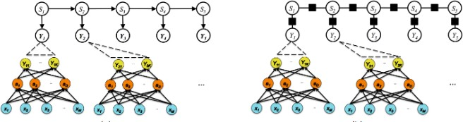
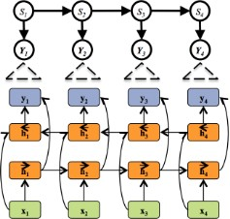
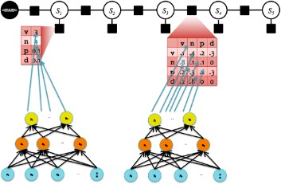
Hybrid Graphical Models and Neural Networks
Hybrid NN and HMM
Hybrid RNN+HMM
Hybrid CNN+CRF

Slide 36
Topics in Sequence Modeling
Sequential Data and Overview
Unfolding Computational Graphs
Recurrent Neural Networks
Bidirectional RNNs
Encoder-Decoder Sequence-to-Sequence Architectures
Deep Recurrent Networks
Recursive Neural Networks
The Challenge of Long-Term Dependencies
Echo-State Networks
Leaky Units and Other Strategies for Multiple Time Scales
LSTM and Other Gated RNNs
Optimization for Long-Term Dependencies
Explicit Memory

Slide 37
Unfolding Computational Graphs
A Computational Graph is a way to formalize the structure of a set of computations
  A mapping inputs and parameters to outputs and loss
We can unfold a recursive or recurrent computation into a computational graph that has a repetitive structure
  Corresponding to a chain of events
Unfolding this graph results in sharing of parameters across a deep network structure

Slide 38
Example of Unfolding a Recurrent Equation
Classical form of a dynamical system is
_{s}(t)_{=f (s}(t-1)_{; θ)}
  where s^{(t)} is called the state of the system
  which is recurrent because the definition of s at time t refers back to the same definition at time t-1
For a finite number of time steps τ, the graph can be unfolded by applying the definition τ-1 times
  E,g, for τ = 3 time steps we get
s⁽³⁾= f (s⁽²⁾; θ)
= f (f (s⁽¹⁾; θ); θ)
Unfolding equation by repeatedly applying the definition gives an expression without recurrence
s⁽¹⁾ is ground state and s⁽²⁾ computed by applying f
Such an expression can be represented by a traditional acyclic computational graph (as shown next)

Slide 39

Unfolded Dynamical System
The classical dynamical system described by
s^{(t)}=f (s^{(t-1)}; θ ) and s⁽³⁾= f (f (s⁽¹⁾; θ); θ)
is illustrated as an unfolded computational graph
Each node represents state at some time t
Function f maps state at time t to the state at t+1
The same parameters ( the same value of θ used to parameterize f ) are used for all time steps

Slide 40
Dynamical System Driven by an External Signal
As another example, consider a dynamical system driven by external (input) signal x^{(t)}
_{s}(t)_{=f ( s}(t-1)_{, x}(t)_{; θ )}
  State now contains information about the whole past input sequence
  Note that the previous dynamic system was simply s^{(t)}=f (s^{(t-1)}; θ)
  Now have an exogenous network (NARX networks)
Recurrent neural networks can be built in many ways
  Just as almost any function is a feedforward neural network, any function involving recurrence can be considered to be a recurrent neural network

Slide 41
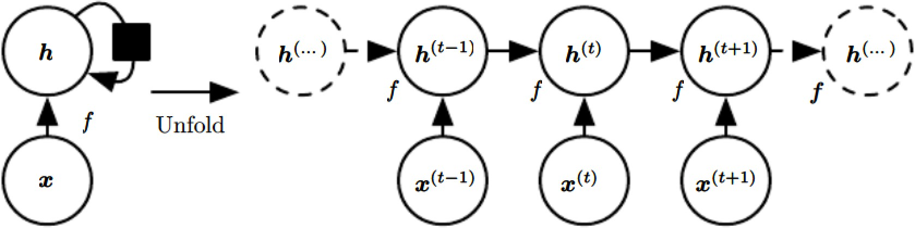
Defining Values of Hidden Units in RNNs
Many recurrent neural nets use same equation (as a dynamical system with external input) to define values of hidden units
  To indicate that the state is hidden rewrite using variable h for state:
_{h}(t)_{=f ( h}(t-1)_{, x}(t)_{; θ )}
  Illustrated below:
Typical RNNs have extra architectural features such as output layers that read information out of state h to make predictions

Slide 42
A Recurrent Network with No Outputs
This network just processes information from input x by incorporating it into state h that is passed forward through time
Circuit diagram:
Black square indicates
Delay of one time step
Unfolded computational graph:
each node is now
associated with one time instance
State now contains information
Typical RNNs will add extra architectural features such as output layers to read information out of the state h to make predictions

Slide 43
Predicting the Future from the Past
When a RNN is required to perform a task of predicting the future from the past, network typically learns to use h^{(t)} as a lossy summary of the relevant task aspects of the past sequence of inputs up to t
The summary is in general lossy since it maps a sequence of arbitrary length (x^{(t)}, x^{(t-1)},..,x⁽²⁾,x⁽¹⁾) to a fixed length vector h^{(t)}

Slide 44
Information Contained in the Summary
Depending on the criterion, the summary keeps some aspects of past sequence more precisely than other aspects
Examples:
  RNN used in statistical language modeling typically to predict next word from past words
    it may not be necessary to store all information up to time t but only enough information to predict the rest of sentence
  More demanding problem: ask h^{(t)} to be rich enough to allow one to approximately recover the input sequence as in autoencoders

Slide 45
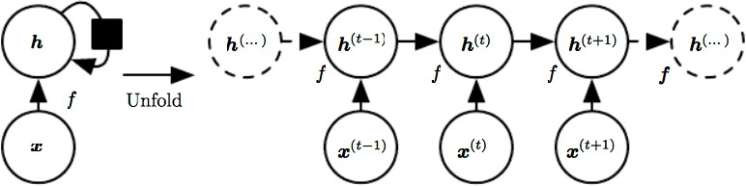
Unfolding: from Circuit Diagram to Computational Graph
Deep Learning Srihari
Hidden units h^{(t)}=f ( h^{(t-1)}, x^{(t)}; θ ) can be written in two different ways: circuit diagram or an unfolded computational graph
Unfolding is the operation that maps a circuit to a computational graph with repeated pieces
The unfolded graph has a size dependent on the sequence length

Slide 46
Process of Unfolding
We can represent unfolded recurrence after t steps with a function g^{(t)}:
_{h}(t)_{=g}(t) _{(x}(t)_{, x}(t-1)_{,..,x}(2)_{,x}(1)₎
=f (h^{(t-1)} , x^{(t)}; θ )
Function g^{(t)} takes in whole past sequence (x^{(t)}, x^{(t-1)},..,x⁽²⁾,x⁽¹⁾) as input and produces the current state but the unfolded recurrent structure allows us to factorize g^{(t)} into repeated application of a function f
The unfolding process introduces two major advantages

Slide 47
Unfolding Process allows Learning a Single Model
The unfolding process introduces two major advantages:
  Regardless of sequence length, learned model has same input size
    because it is specified in terms of transition from one state to another state rather than specified in terms of a variable length history of states
  Possible to use same function f with same parameters at every step
These two factors make it possible to learn a single model f
that operates on all time steps and all sequence lengths
rather than needing separate model g^{(t)} for all possible time steps
Learning a single shared model allows:
Generalization to sequence lengths that did not appear in the training
Allows model to be estimated with far fewer training examples than would be required without parameter sharing

Slide 48
Both Recurrent Graph and Unrolled Graph are Useful
Recurrent graph is succinct
Unrolled graph provides explicit description of what computations to perform
  Helps illustrate the idea of information flow forward in time
    Computing outputs and losses
  And backwards in time
    Computing gradients
  By explicitly showing path along which information flows

Slide 49

Unfolding Computational Graphs
Computational graph is a way to formalize the structure of a set of computations
  Example - mapping inputs and parameters to outputs and loss
Can unfold a recursive or recurrent computation into a computational graph that has a repetitive structure
  corresponding to a chain of events
Unfolding this graph results in sharing of parameters across a deep network structure
_{o}(t)_{=c+Vh}(t)
h^{(t)}=tanh(a^{(t)})
_{a}(t)_{=b+Wh}(t-1)_{+Ux}(t)

Slide 50
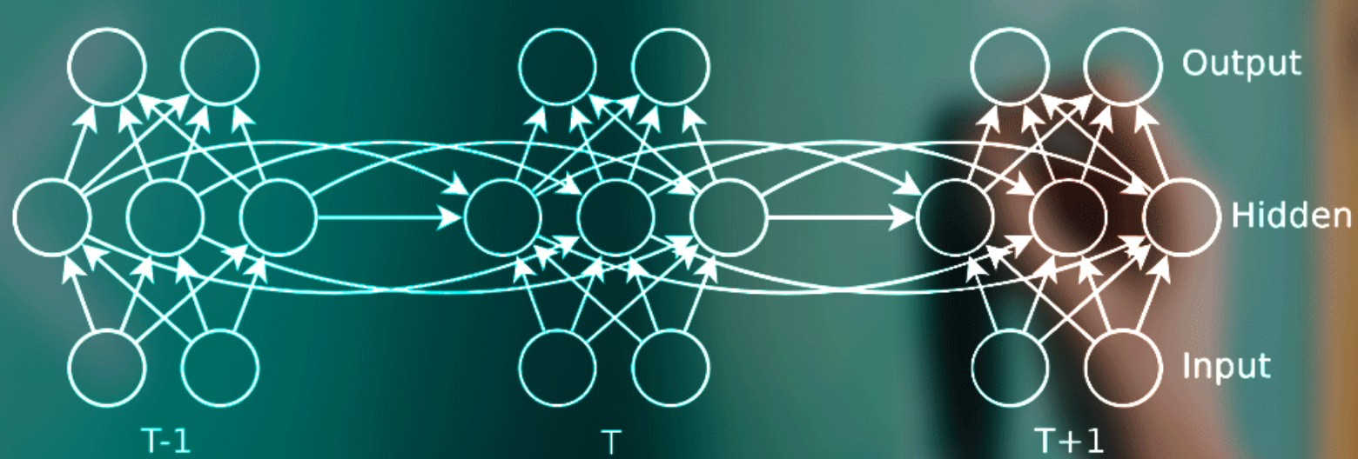
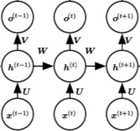
A more Complex Unfolded Computational Graph
Source: Indico corporation
Two units in input layer, instead of 1 Three units in hidden layer, instead of 1 Two units in output layer, instead of 1
Previous one:

Slide 51
Topics in Sequence Modeling
Sequential Data and Overview
Unfolding Computational Graphs
Recurrent Neural Networks
Bidirectional RNNs
Encoder-Decoder Sequence-to-Sequence Architectures
Deep Recurrent Networks
Recursive Neural Networks
The Challenge of Long-Term Dependencies
Echo-State Networks
Leaky Units and Other Strategies for Multiple Time Scales
LSTM and Other Gated RNNs
Optimization for Long-Term Dependencies
Explicit Memory

Slide 52
Topics in Recurrent Neural Networks
Overview
  Design patterns for RNNs
  RNN with recurrence between hidden units
  Forward propagation equations
  Loss function for a sequence
  RNN with recurrence from output units to hidden units
Teacher forcing for output-to-hidden RNNs
  Backward Propagation through time (BPTT)
Computing the gradient in a RNN
RNNs as directed graphical models
Modeling Sequences conditioned on context with RNNs

Slide 53
Graph Unrolling/parameter Sharing in RNN Design
Process of graph unrolling:
_{h}(t)_{=g}(t) _{(x}(t)_{, x}(t-1)_{,..,x}(2)_{,x}(1)₎
=f (h^{(t-1)} , x^{(t)}; θ )
  Function g^{(t)} takes in whole past sequence (x^{(t)}, x^{(t-1)},..,x⁽²⁾,x⁽¹⁾) as input and produces the current state but the unfolded recurrent structure allows us to factorize g^{(t)} into repeated application of a function f
  No need for a separate model g^{(t)} for all possible time steps
Process of unrolling and parameter sharing allows us to design a wide variety of recurrent neural networks
Examples of important design patterns shown next

Slide 54
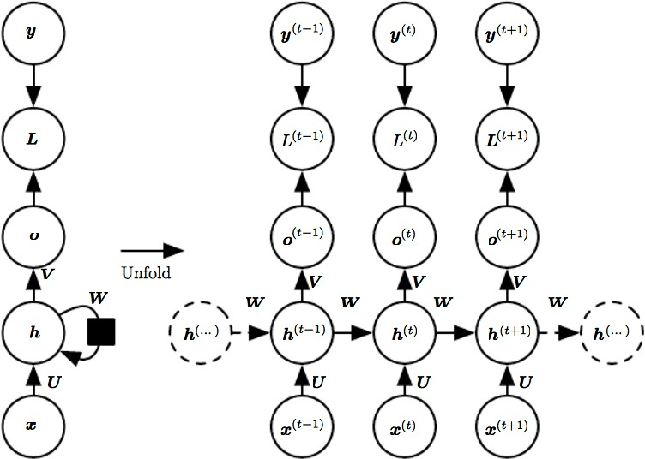
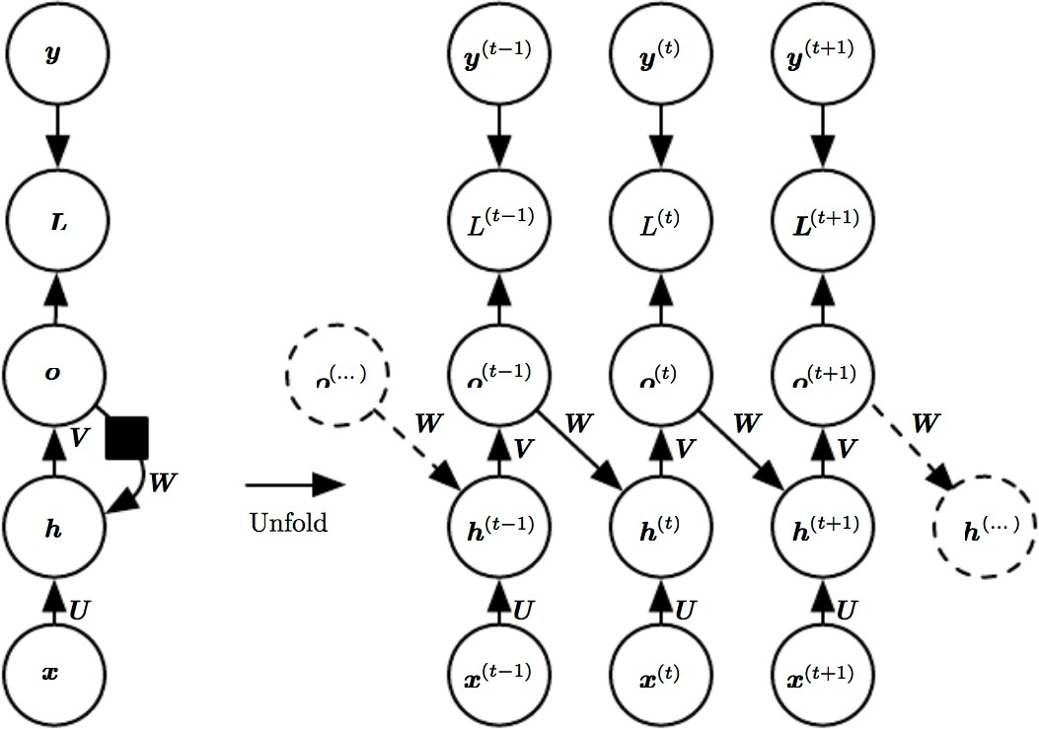
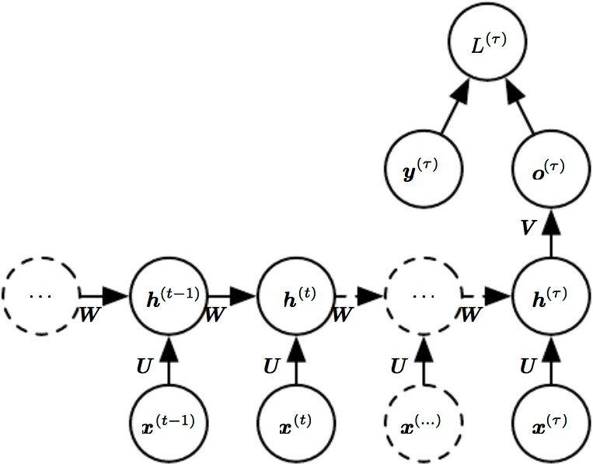
Three Design Patterns of RNNs
Among Many
p Learning
1
1. Produce output at each time step and have recurrent connections between hidden units
2. Produce output at each time step and have recurrent connections only from output at one time step to hidden units at next time step
2
Recurrent connections between hidden units to read entire input sequence and produce a single output
  Can summarize sequence to produce a fixed size representation for further processing
3
5

Slide 55
Design 1: RNN with Recurrence Between Hidden Units
Maps input sequence x
to output o values
  Loss L measures how far each o is from the corresponding target y
    With softmax outputs we assume o is the unnormalized log probabilities
    Loss L internally computes y=softmax(o) and compares to target y
Update equation
_{a}(t)_{=b+Wh}(t-1)_{+Ux}(t)

Slide 56
RNN as a Universal Turing Machine (TM)
RNN with hidden unit connections together with
_{a}(t)_{=b+Wh}(t-1)_{+Ux}(t)
is Universal, i.e.,
Any function computable by a TM is computable by such an RNN of finite size
Output can be read from the RNN after a number of steps that is asymptotically linear in number of steps used by the TM and asymptotically linear in length of input

Slide 57
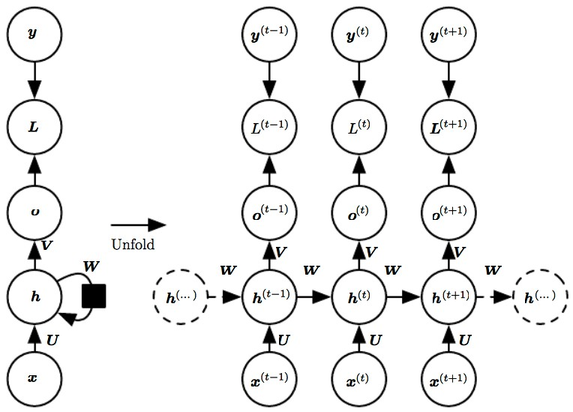
Forward Prop for RNN with Hidden Unit Recurrence
This design does not specify
  activation functions for hidden units
  form of output
  loss function
Assume for this graph:
  Hyperbolic tangent activation function
  Output is discrete
E.g., RNN predicts words/characters
Natural way to represent discrete vars:
  Output o gives unnormalized log probabilities of each possible value
yˆ
Can apply softmax as a postprocessing step to obtain vector of normalized probabilities over the output
Forward prop begins with specification of initial state h⁽⁰⁾

Slide 58
Forward Prop for RNN with Hidden Unit Recurrence
Begins with initial specification of h⁽⁰⁾
Then for each time step from t=1 to t=τ we apply the following update equations
_{o}(t)_{=c+Vh}(t)
h^{(t)}=tanh(a^{(t)})
_{a}(t)_{=b+Wh}(t-1)_{+Ux}(t)
yˆ^{(t)} = softmax(o^{(t)})
Where the parameters are:
  bias vectors b and c
  weight matrices U (input-to-hidden), V (hidden-to-output) and W (hidden- to-hidden) connections

Slide 59
Loss Function for a Given Sequence
This is an example of an RNN that maps an input sequence to an output sequence of the same length
Total loss for a given sequence for a given sequence of x values with a sequence of y values is the sum of the losses over the time steps
If L^{(t)} is the negative log-likelihood of y^{(t)} given x⁽¹⁾,..x^{(t)} then
_{L({x}(1)_{,..x}(t) _{},{y}(1)_{,..y}(t) _{})= ∑L}(t)
t
_{(y}(t) _{|{x}(1)_{,..x}(t) _{})}
=-∑logp
t
model
where p_{model} is given by reading the entry for y^{(t)} from the model’s output
vector
_{yˆ}(t)

Slide 60
Computing Gradient of Loss Function
Computing gradient of this loss function wrt parameters is expensive
  Involves performing a forward propagation pass moving left to right through the unrolled graph followed by a backward propagation moving right to left through the graph
Run time is O(τ) and cannot be reduced by parallelization
  Because forward propagation graph is inherently sequential
    Each time step computable only after previous step
  States computed during forward pass must be stored until reused in the backward pass
    Memory cost is also O(τ)
Backpropagation applied to the unrolled graph with O(τ) cost is called Backward Propagation through time (BPTT)

Slide 61
Backward Propagation Through Time (BPTT)
RNN with hidden unit recurrence is very powerful but also expensive to train

Slide 62
Topics in Sequence Modeling
Sequential Data and Overview
Unfolding Computational Graphs
Recurrent Neural Networks
Bidirectional RNNs
Encoder-Decoder Sequence-to-Sequence Architectures
Deep Recurrent Networks
Recursive Neural Networks
The Challenge of Long-Term Dependencies
Echo-State Networks
Leaky Units and Other Strategies for Multiple Time Scales
LSTM and Other Gated RNNs
Optimization for Long-Term Dependencies
Explicit Memory

Slide 63
Topics in Recurrent Neural Networks
Overview
  Design patterns for RNNs
  RNN with recurrence between hidden units
  Forward propagation equations
  Loss function for a sequence
  RNN with recurrence from output units to hidden units
Teacher forcing and Networks with Output Recurrences
Computing the gradient in a RNN
Recurrent Networks as Graphical Models
Modeling Sequences Conditioned on Context with RNNs

Slide 64

Models with Recurrence from Output to Hidden Units
Less powerful than with hidden-to- hidden recurrent connections
  It cannot simulate a universal TM
  It requires that the output capture all information of past to predict future
Advantage
  In comparing loss function to output, all time steps are decoupled
    Each step can be trained in isolation
  Training can be parallelized
    Gradient for each step t computed in isolation
    No need to compute output for the previous step first, because training set provides ideal value of output
Can be trained with Teacher Forcing

Slide 65
Teacher Forcing
Used for training models with recurrent connections from their outputs
Teacher forcing during training means
  Instead of summing activations from incoming units (possibly erroneous)
  Each unit sums correct teacher activations as input for the next iteration

Slide 66
Teacher Forcing Procedure
Teacher forcing is a procedure for training RNNs with output-to- hidden recurrence
Emerges from the maximum likelihood criterion
During training time model receives ground truth output y^{(t)} as input at time t+1
  We can see this by examining a sequence with two time steps (next)

Slide 67
Maximum Likelihood in Teacher Forcing
Consider a sequence with two time steps
The conditional maximum likelihood criterion is
log (p(y⁽¹⁾, y⁽²⁾| x⁽¹⁾, x⁽²⁾) = log p(y⁽²⁾| y⁽¹⁾, x⁽¹⁾, x⁽²⁾) + log p(y⁽¹⁾| x⁽¹⁾, x⁽²⁾)
  At time t=2, model is trained to maximize conditional probability of y⁽²⁾ given both the x sequence so far and the previous y value from the training set.
    We are using y⁽¹⁾ as teacher forcing, rather than only x^{(i)}.
  Maximum likelihood specifies that during training, rather than feeding the model’s own output back to itself, target values should specify what the correct output should be

Slide 68


Illustration of Teacher Forcing
Teacher Forcing is a training technique applicable to RNNs that have connections from output to hidden states at next time step
Train time: We feed the correct output y^{(t)}
(from teacher) drawn from the training set as input to h^{(t+1)}
Test time:
True output is not known.
We approximate the correct output y^{(t)} with the model’s output o^{(t)} and feed the output back to the model

Slide 69


RNNs without and with Teacher Forcing
Without Teacher forcing:
Output of previous time step
acts as input during RNN training
RNN learns to generate
next output in a sequence based upon the previous value
With Teacher forcing:
Source: https://www.quora.com/What-is-the-teacher-forcing-in-RNN

Slide 70

Visualizing Teacher Forcing
Consider that the network is learning to follow a trajectory
It goes astray (because the weights are wrong) but teacher forcing puts the net back on its trajectory
  By setting the state of all the units to that of teacher’s.
    Without teacher forcing, trajectory runs astray (solid lines) while the correct trajectory are the dotted lines
    With teacher forcing trajectory corrected at each step

Slide 71
Teacher Forcing for Hidden-to-hidden
Originally motivated teacher forcing to allow avoidance of backpropagation through time for models that lack hidden-to- hidden connections
Teacher forcing can still be applied to models that have hidden- to-hidden connections
  As long as they have connections from the output at one time step to values computed at the next time step
  As soon as the hidden units become functions of earlier time steps, BPTT algorithm is necessary

Slide 72
Training with Both Teacher Forcing and BPTT
Some models may be trained with both Teacher forcing and Backward Propagation through time (BPTT)
  When there are both hidden-to-hidden recurrences as well as output-to- hidden recurrences

Slide 73
Disadvantage of Teacher Forcing
Issues for a network used in an open-loop mode with network with outputs samples from the output distribution fed back as inputs
  In this case the kind of inputs that it will see during training time could be quite different from that it will see at test time
Solutions for this:
Train with both teacher-forced inputs and free running inputs
  E.g., predicting the correct target a number of steps in the future through the unfolded recurrent output-to-input paths
  Thus network can learn to take into account input conditions not seen during training
Mitigate the gap between inputs seen at training time and test time by
generating values as input
  This approach exploits a curriculum learning strategy to gradually use more of the generated values as input

Slide 74
Professor Forcing
Teacher forcing trains RNNs by supplying observed sequence values as inputs during training and using the network’s own one-step-ahead predictions to do multi-step sampling
Professor forcing algorithm
  Uses adversarial domain adaptation to encourage the dynamics of the RNN to be the same when training the network and when sampling from the network over multiple time steps.
  Applied to
    language modeling
    vocal synthesis on raw waveforms
    handwriting generation
    image generation
Professor forcing is an adversarial method for learning generative models
  It is closely related to Generative Adversarial Networks

Slide 75
Topics in Sequence Modeling
Sequential Data and Overview
Unfolding Computational Graphs
Recurrent Neural Networks
Bidirectional RNNs
Encoder-Decoder Sequence-to-Sequence Architectures
Deep Recurrent Networks
Recursive Neural Networks
The Challenge of Long-Term Dependencies
Echo-State Networks
Leaky Units and Other Strategies for Multiple Time Scales
LSTM and Other Gated RNNs
Optimization for Long-Term Dependencies
Explicit Memory

Slide 76
Topics in Recurrent Neural Networks
Overview
Teacher forcing and Networks with Output Recurrence
Computing the gradient in a RNN
RNNs as Directed Graphical Models
Modeling Sequences Conditioned on Context with RNNs

Slide 77
Training an RNN is Straightforward
Determine gradient using backpropagation
  Apply generalized backpropagation to the unrolled computational graph (algorithm repeated in next slide)
  No specialized algorithms are necessary
Gradient Descent
  Gradients obtained by backpropagation are used with any general purpose gradient-based techniques to train an RNN
Described as Back Propagation Through Time (BPTT)

Slide 78

General Backpropagation to Compute Gradient
To compute gradients T of variable z wrt variables in computational graph G

Slide 79

Build-grad Function of Generalized Backprop
Ob.bprop(inputs,X,G)
returns
Which is just an implementation of chain rule
∑(∇_{X}op.f(inputs)_{i} )G_{i}
i
If y=g(x) and z=f(y) from chain rule
dz ₌ dz dy
dx dy dx
∂z | = | ∑ | _{∂z} ∂y_{j}
∂x_{i} | j |  | ∂y_{j} ∂x
⎛_{∂y} ⎞^{T}
Equivalently, in vector notation
∇_{x}z = ⎟ ∇ z
⎝∂x ⎟⎠
y
where is the n x n Jacobian matrix of g
∂y
∂x

Slide 80


Example of the BPTT Algorithm Working
BPTT (Back Propagation Through Time)
Dominant RNN training algorithm
Provide an example of how to compute gradients by BPTT for the RNN equations

Slide 81


Intuition of How BPTT Algorithm Behaves
Ex: Gradients by BPTT for previous RNN eqns
Nodes of our computational graph include the parameters
U, V, W, b, c
as well as the sequence of nodes
indexed by t for x^{(t)}, h^{(t)}, o^{(t)} and L^{(t)}
For each node N we need to compute the gradient
recursively

Slide 82



Computing BPTT Gradients Recursively
Start recursion with nodes immediately preceding final loss
∂L ₌ ₁
_{∂L}(t )
We assume that the outputs o^{(t)} are used as arguments to softmax to obtain vector of probabilities over the output. Also that loss is the negative log-likelihood of the true target y^{(t)} given the input so far.
The gradient on the outputs at time step t is
Work backwards starting from the end of the sequence.
At the final time step τ, h^{(τ)} has only o^{(τ)} as a descendent. So

Slide 83


Gradients over Hidden Units
Iterate backwards in time iterating to backpropagate gradients through time from t =τ-1 down to t =1
where indicates a diagonal matrix with elements within parentheses. This is the Jacobian of the hyperbolic tangent associated with the hidden unit i at time t+1

Slide 84

Gradients over Parameters
Once gradients on internal nodes of the computational graph are obtained, we can obtain gradients on the parameters
  Because parameters are shared across time steps some care is needed

Slide 85
10.2 Topics in Recurrent Neural Networks
    Overview
    Teacher forcing for output-to-hidden RNNs
    Computing the gradient in a RNN
    RNNs as Directed Graphical Models
    Modeling Sequences Conditioned on Context with RNNs

Slide 86
10.2.3 Topics in RNNs as Directed Graphical Models
Motivation
What are directed graphical models?
RNNs as Directed Graphical Models
  Conditioning Predictions on Past Values
  Fully connected graphical model for a sequence
  Hidden units as random variables
  Efficiency of RNN parameterization
How to draw samples from the model

Slide 87

Motivation: from Images to Text
Combining ConvNets and Recurrent Net Modules
Caption generated by a recurrent neural network (RNN) taking as input:
  Representation generated by a deep CNN
  RNN trained to translate high-level representations of images into captions

Slide 88


Better Translation of Images to Captions
Different focus (lighter patches given more attention)
As it generates each word (bold), it exploits it to achieve better translation of images to captions

Slide 89
Directed Graphical Model
Specifies a joint distribution ^{p(x) = p(x}₁^{,..x}_{n} ⁾ in terms of
conditional distributions (called a Bayesian Network)
N
p(x) = ∏ p(x_{i} | pa(x_{i} ))
i =1
p(x_{i} | pa(x_{i} ))
where are conditional distributions
pa represents parents in a directed graph
Computational efficiency is obtained by omitting edges that do not correspond to strong interactions
Model is generative:
  We can easily sample from a BN (ancestral sampling)
We will see here that RNNs have an interpretation as an efficient directed graphical model

Slide 90

Example of a directed graphical model (Bayesian Net)
Instead of 2x2x3x2x2=48 parameters we need
18 parameters using the directed graphical model
(which makes certain condition independence assumptions)
P(D, I, G, S, L) = P(D)P(I )P(G | D, I )P(S | I )P(L | G)
P(i¹, d ⁰, g², s¹, l⁰ ) = P(i¹ )P(d ⁰ )P(g² | i¹, d ⁰ )P(s¹ | i¹ )P(l⁰ | g² )
=0.3⋅ 0.6 ⋅ 0.08 ⋅ 0.8 ⋅ 0.4=0.004608

Slide 91
Conditional distributions of model depend on RNN designs
1
1. Recurrent connections between hidden units
2
2. Recurrent connections only from output at one time step to hidden units at next time step

Slide 92

Loss Function for RNNs
In feed-forward networks our goal is to minimize
Which is the cross-entropy between distribution of training set (data) and probability distribution defined by model
  Definition of cross entropy between distributions p and q is
H(p,q)=E_{p}[-log q]=H(p)+D_{KL}(p||q)
  For discrete distributions H(p,q)=-Σ_{x}p(x)log q(x)
As with a feedforward network, we wish to interpret the output of the RNN as a probability distribution
  With RNNs the losses L^{(t)} are cross entropies between training targets y^{(t)} and outputs o^{(t)}
    Mean squared error is the cross-entropy loss associated with an
output distribution that is a unit Gaussian

Slide 93
Types of conditional distributions in an RNN
1. With a predictive log-likelihood training objective:
L({x ⁽¹⁾,..x^{(t)} },{y⁽¹⁾,..y^{(t)} })= ∑L^{(t)} =-∑logp
t t
_{(y}(t) _{|{x} (1)_{,..x}(t) _{})}
model
we train the RNN to estimate the conditional distribution of next sequence element y^{(t)} given past inputs. This means that we maximize log-likelihood
log p(y^{(t)}|x⁽¹⁾,..x^{(t)})
2. Alternatively if the model includes connections from output at one time step to the next
log p(y^{(t)}|x⁽¹⁾,..x^{(t)}, y⁽¹⁾,..y^{(t-1)})

Slide 94
Conditioning predictions on past y values
Decomposing joint probability over sequence of y values as a series of one-step probabilistic predictions
is one way to capture the full joint distribution across the whole sequence.
Do not feed past y values as inputs for next step prediction,
directed model contains no edges from any y^{(i)} in the past to current y^{(t)} . In this case outputs y^{(i)} are conditionally independent given the x values
Do feed the actual y values (not their prediction, but the actual observed or generated values) back into the network
the directed PGM contains edges from all y^{(i)} values in the past to the current y^{(t)} value.

Slide 95
A simple example
RNN models a sequence of scalar random variables
Y={y⁽¹⁾,..y^{(τ)}} with no additional inputs x.
  Input at time step t is simply the output at time step t-1
  RNN defines a directed graphical model over y variables
Parameterize joint distribution of observations using the chain rule for conditional probabilities:
τ
P(Y ) = P(y⁽¹⁾,..y^{(τ)}) = ∏ P(y^{(t )} | y^{(t −1)},y^{(t −2)},..,y⁽¹⁾)
t =1
where the right hand side of the bar | is empty for t=1
Hence the negative log-likelihood of a set of values
{y⁽¹⁾,..y^{(τ)}} according to such a model is
_{L= ∑L}(t)
t
where L^{(t)} =-∑log P(y^{(t)} = y^{(t)} |y^{(t-1)},y^{(t-2)},..,y⁽¹⁾ )
t

Slide 96

Fully connected graphical model for a sequence
Every past observation y^{(i)} may influence the conditional distribution of some y^{(t)} for t >1
  Parameterizing this way is inefficient.
RNNs obtain the same full connectivity but efficient parameterization as shown next

Slide 97

Introducing the state variable in the probabilistic graphical model (PGM) of an RNN
Introduce the state variable in the PGM of RNN
even though it is a deterministic function of its inputs, helps see we get efficient parameterization
_{h}(t)_{=f (h}(t-1) _{, x}(t)_{; θ )}
Every stage in the sequence for h^{(t)} and y^{(t)} involves the same structure and can share the parameters with other stages

Slide 98
Efficient parameterization in RNNs
If y can take on k different values, the tabular representation would have O(k ^{τ}) parameters
  By comparison because of parameter sharing the no of parameters in the RNN is O(1) as a function of sequence length
Even with efficient parameterization of PGM, some operations are computationally challenging
  Difficult to predict missing values in the middle of the sequence
Price RNNs pay for reduced no of parameters is that oprimizing parameters may be difficult

Slide 99
Stationarity in RNNs
Parameter sharing in RNNs relies on assuming same parameters can be used in different time steps
Equivalently CPD over variables at time t+1 given the variables at time t is stationary
In principle it is possible to use t as an extra input at each time step
  Learner discovers time dependence

Slide 100
How to draw samples from the model
Sample from the conditional distribution at each time step
One additional complication
  RNN must have some mechanism for determining the length of the sequence

Slide 101
Methods for predicting end of sequence
Methods
  Adding a special symbol for end of sequence
    When the symbol is generated, the sampling process stops
  Introduce an extra Bernoulli output
    It represents the decision to either continue generation or halt generation at each time step
      More general than previous method as it can be added to any RNN rather than only RNNs that output a sequence of symbols, e.g., RNN that emits sequence of real numbers
  Add an extra output to the model to predict τ
    Model can sample value of τ and then sample τ steps worth of data

Slide 102
10.2 Topics in Recurrent Neural Networks
Overview
Teacher forcing for output-to-hidden RNNs
Computing the gradient in a RNN
RNNs as Directed Graphical Models
Modeling Sequences Conditioned on Context with RNNs

Slide 103


Graphical models of RNNs without/with inputs
Directed graphical models of RNNs without inputs
  having a set of random variables y^{(t)} :
Fully connected graphical model Efficient parameterization based on h^{(t)}=f(h^{(t-1)},x^{(t)};θ)
2. RNNs do include a sequence of inputs x⁽¹⁾, x⁽²⁾,..x^{(τ)}
_{o}(t)_{=c+Vh}(t)
h^{(t)}=tanh(a^{(t)})
_{a}(t)_{=b+Wh}(t-1)_{+Ux}(t)
RNNs allow the extension of the graphical model view to represent not only the joint distribution view over y variables but also a conditional distribution over y given x

Slide 104
Conditional distribution of model depends on RNN designs
1
1. Recurrent connections between hidden units
2. Recurrent connections only from output at one time step to hidden units at next time step
2
5

Slide 105
Extending RNNs to represent conditional P(y|x)
A model representing a variable P(y; θ) can be reinterpreted as a model representing a conditional distribution P(y|ω) with ω=θ
We can extend such a model to represent a distribution P(y|x) by using the same P(y|ω) as before but making ω a function of x
In the case of an RNN this can be achieved in several ways

Slide 106
Taking a single vector x as an extra input
Instead of taking a sequence x^{(t)}, t =1,..,τ as input we can take a single vector x as input
When x is a fixed-size vector we can simply make it an extra input of the RNN that generates the y sequence
Common ways of providing an extra input to RNN are
  An extra input at each time step, or
  As the initial state h⁽⁰⁾, or
  Both
The first and common approach is illustrated next

Slide 107

Mapping vector x into distribution over sequences Y
An extra input at each time step
Interaction between input x and hidden unit vector h^{(t)}
is parameterized by a newly introduced weight matrix R
that was absent from the model with only y values
Appropriate for tasks such as image captioning
where a single image x is input which produces a sequence of words describing the image
Each element of the observed output y^{(t)} of the observed output sequence serves both as input (for the current time step) and during training as target

Slide 108
RNN to receive a sequence of vectors x^{(t)} as input
RNN described by a^{(t)}=b +Wh^{(t-1)}+Ux^{(t)} corresponds to a conditional distribution P(y⁽¹⁾,.., y^{(τ)}|x⁽¹⁾,.., x^{(τ)})
It makes a conditional independence assumption that this distribution factorizes as
∏P(y^{(t )} |x⁽¹⁾,..,x^{(t )})
t
To remove the conditional independence assumption, we can add connections from the output at time t to the hidden unit at time t+1 (see next slide)
The model can then represent arbitrary probability distributions over the
y sequence
Limitation: both sequences must be of same length
  Removing this restriction is discussed in Section 10.4

Slide 109


Removing conditional independence assumption
Connections from previous output to current state allow RNN to model arbitrary distribution over sequences of y
Conditional RNN mapping a variable-length sequence of x values into a distribution over sequences of y values of same length
Compare it to model that is only able to represent distributions in which the
y values are conditionally independent from each other given x values
1
0

Slide 110
Topics in Sequence Modeling
Overview
Unfolding Computational Graphs
Recurrent Neural Networks
Bidirectional RNNs
Encoder-Decoder Sequence-to-Sequence Architectures
Deep Recurrent Networks
Recursive Neural Networks
The Challenge of Long-Term Dependencies
Echo-State Networks
Leaky Units and Other Strategies for Multiple Time Scales
LSTM and Other Gated RNNs
Optimization for Long-Term Dependencies
Explicit Memory

Slide 111
Need for bidirectionality
In speech recognition, the correct interpretation of the current sound may depend on the next few phonemes because of co- articulation and the next few words because of linguistic dependencies
Also true of handwriting recognition

Slide 112
A birectional RNN
Combine an RNN that moves forward through time from the start of the sequence
Another RNN that moves backward through time beginning from the end of the sequence
A bidirectional RNN consists of two RNNs which are stacked on the top of each other.
  The one that processes the input in its original order and the one that processes the reversed input sequence.
  The output is then computed based on the hidden state of both RNNs.

Slide 113

A typical bidirectional RNN
Maps input sequences x to target sequences y with loss L^{(t)} at each step t
h recurrence propagates to the right
g recurrence propagates to the left.
This allows output units o^{(t)} to compute a representation that depends both the past and the future

Slide 114


Parameters of a bidirectional RNN
Deep Bidirectional RNN Has multiple layers per time step
Bidirectional RNN
6

Slide 115
Topics in Sequence Modeling
Overview
Unfolding Computational Graphs
Recurrent Neural Networks
Bidirectional RNNs
Encoder-Decoder Sequence-to-Sequence Architectures
Deep Recurrent Networks
Recursive Neural Networks
The Challenge of Long-Term Dependencies
Echo-State Networks
Leaky Units and Other Strategies for Multiple Time Scales
LSTM and Other Gated RNNs
Optimization for Long-Term Dependencies
Explicit Memory

Slide 116






Previously seen RNNs
An RNN to map an input sequence to a fixed-size vector
RNN to map a fixed-size vector to a sequence
How an RNN can map an input sequence to an output sequence of the same length

Slide 117
RNN when input/output are not same length
Here we consider how an RNN can be trained to map an input sequence to an output sequence which is not necessarily the same length
Comes up in applications such as speech recognition, machine translation or question-answering where the input and output sequences in the training set are generally not of the same length (although their lengths might be related)

Slide 118

An encoder-decoder or sequence-to-sequence RNN
Learns to generate an output sequence
(y⁽¹⁾,..,y^{(ny )})
given an input sequence
(x⁽¹⁾,..,x^{(nx )})
It consists of an encoder RNN that reads an input sequence and a decoder RNN that generates the output sequence
or computes the probability of a given
output sequence)
The final hidden state of the encoder RNN Is used to compute a fixed size context C which represents a semantic summary of the input sequence and is given as input to the decoder

Slide 119
Topics
Recurrent Neural Networks
Unfolding Computational Graphs
Recurrent Neural Networks
Bidirectional RNNs
Encoder-Decoder Sequence-to-Sequence Architectures
Deep Recurrent Networks
Recursive Neural Networks
The Challenge of Long-Term Dependencies
Echo-State Networks
Leaky Units and Other Strategies for Multiple Time Scales
LSTM and Other Gated RNNs
Optimization for Long-Term Dependencies
Explicit Memory

Slide 120
Computation in RNNs: parameter blocks
The computation in most recurrent neural networks can be decomposed into three blocks of parameters and associated transformations:
  From the input to the hidden state
  From the previous hidden state to the next hidden state
  From the hidden state to the output

Slide 121
Blocks of parameters as a shallow transformation
With the RNN architecture shown each of these three blocks is associated with a single weight matrix, i.e.,
  When the network is unfolded, each of these corresponds to a shallow transformation.
  By a shallow transformation we mean a transformation that would
be represented a single layer within a deep MLP.
  Typically this is a transformation represented by a learned affine transformation followed by a fixed nonlinearity
Would it be advantageous to introduce depth into each of these operations?
.
Experimental evidence strongly suggests so.
That we need enough depth in order to perform the required transformations

Slide 122



Ways of making an RNN deep
1. Hidden recurrent state can be broken down into groups organized hierarchically
2. Deeper computation can be introduced in the input-hidden, hidden-hidden and hidden-output parts. This may lengthen the shortest path linking different time steps
3. The path- lengthening effect can be mitigated by introducing skip connections.
5

Slide 123
1. Recurrent states broken down into groups
We can think of lower levels of the hierarchy play a role of transforming the raw input into a representation that is more appropriate at the higher levels of the hidden state

Slide 124
2. Deeper computation in hidden-to-hidden
Go a step further and propose to have a separate MLP (possibly deep) for each of the three blocks:
  From the input to the hidden state
  From the previous hidden state to the next hidden state
  From the hidden state to the output
Considerations of representational capacity suggest that to allocate enough capacity in each of these three steps
But doing so by adding depth may hurt learning by making optimization difficult
In general it is easier to optimize shallower architectures
Adding the extra depth makes the shortest time of a variable from time step t to a variable in time step t+1 beome longer

Slide 125
3. Introducing skip connections
For example, if an MLP with a single hidden layer is used for the state-to- state transition, we have doubled the length of the shortest path between variables in any two different time steps compared with the ordinary RNN.
This can be mitigated by introducing skip connections in the hidden-to-hidden path as illustrated here

Slide 126
Topics
Sequence Data and Overview
Unfolding Computational Graphs
Recurrent Neural Networks
Bidirectional RNNs
Encoder-Decoder Sequence-to-Sequence Architectures
Deep Recurrent Networks
Recursive Neural Networks
The Challenge of Long-Term Dependencies
Echo-State Networks
Leaky Units and Other Strategies for Multiple Time Scales
LSTM and Other Gated RNNs
Optimization for Long-Term Dependencies
Explicit Memory

Slide 127
Recursive Neural Networks
They are yet another generalization of recurrent networks with a different kind of computational graph
It is structured as a deep tree, rather than the chain structure of RNNs
The typical computational graph for a recursive network is shown next

Slide 128

Computational Graph of a Recursive Network
It generalizes a recurrent network from a chain to a tree
A variable sequence x⁽¹⁾,x⁽²⁾,,x^{(t)} can be mapped to a fixed size representation (the output o), with a fixed set of parameters (the weight matrices U,V,W)
Figure illustrates supervised learning case in which target y is provided that is associated with the whole sequence
4

Slide 129
Advantage of Recursive over Recurrent Nets
For a sequence of the same length τ, the depth (measured as the no. of compositions of nonlinear operations) can be reduced from τ to O(log τ), which might help deal with long-term dependencies
An open question is how best to structure the tree

Slide 130
Need for Recursive Nets in NLP
Deep learning based methods learn low-dimensional, real- valued vectors for word tokens, mostly from a large data corpus, successfully capturing syntactic and semantic aspects of text
For tasks where the inputs are larger text units, e.g., phrases, sentences or documents, a compositional model is first needed to aggregate tokens into a vector with fixed dimensionality that can be used for other NLP tasks
Models for achieving this fall into two categories: recurrent models and recursive models

Slide 131
Recurrent Model for NLP
Recurrent models deal successfully with time series data
The recurrent models generally consider no linguistic structure aside from the word order
They were applied early on to NLP by modeling a sentence as tokens processed sequentially and at each step combining the current token with previously built embeddings
Recurrent models can be extended to bidirectional ones from both left to right and right to left
These models consider no linguistic structure aside from word order

Slide 132
Recursive Models for NLP
Recursive neural models (also referred to as tree models) by contrast are structured by syntactic parse trees
Instead of considering tokens sequentially, recursive models combine neighbors based on the recursive structure of parse trees, starting from the leaves and proceeding recursively in a bottom-up fashion until the root of the parse tree is reached
  Ex: for the phrase the food is delicious, following the operation sequence ((the food) (is delicious)) rather than the sequential order (((the food) is) delicious)

Slide 133
Advantage of Recursive Model for NLP
They have the potential of capturing long-distance dependencies
Two tokens may be structurally closer to each other even though they are far away in word sequence
Ex: a verb and its corresponding direct object can be far away in terms of tokens if many adjectives lie inbetween, but they are adjacent in the parse tree
However parsing is slow and domain dependent
See performance comparison with LSTM on four NLP tasks at
https://nlp.stanford.edu/pubemnlp2015_2_jiwei.pdf

Slide 134
Structure of the Tree
One option is to have a tree structure that does not depend on the data, such as a balanced binary tree
In some application domains, external methods can suggest the appropriate tree structure
  Ex: when processing natural language sentences, the tree structure for the recursive network can be fixed to the structure of the parse tree of the sentence provided by a natural language parse
Ideally, one would like the learner itself to discover and infer the tree structure that is appropriate for any given input

Slide 135
Variants of Recursive Net Model
Associate data with a tree structure and associate inputs and targets with individual nodes of the tree
  The computation performed for each node does not have to be the artificial neuron computation (affine transformation of all inputs followed by a monotone nonlinearity)
  Can use a tensor operations of bilinear forms
    Previously found useful to model linear relationships between concepts when the concepts are represented by continuous vectors

Slide 136

Recursive Neural Networks
Recursive neural networks are also called Tree Nets
  Useful for learning tree-like structures
  They are highly useful for parsing natural scenes and language
12

Slide 137
Unrolling Recurrent and Tree Nets
In RNNs, at each time step the network takes as input its previous state s^{(t-1)} and its current input x^{(t)} and produces an output y^{(t)} and a new hidden state s^{(t)}.
TreeNets, on the other hand, don’t have a simple linear structure like that.
With RNNs, you can ‘unroll’ the net and think of it as a large feedforward net with inputs x⁽⁰⁾, x⁽¹⁾, …, x^{(T)}, initial state s⁽⁰⁾, and outputs y⁽⁰⁾,y⁽¹⁾,…,y^{(T)}, with T varying depending on the input data stream, and the weights in each of the cells tied with each other.
You can also think of TreeNets by unrolling them – the weights in each branch node are tied with each other, and the weights in each leaf node are tied with each other.

Slide 138
Advantage of Recursive Nets
The advantage of Recursive Nets is that they can be very powerful in learning hierarchical, tree-like structure.
The disadvantages are, firstly, that the tree structure of every input sample must be known at training time.

Slide 139
Topics in Sequence Modeling
Sequential Data and Overview
Unfolding Computational Graphs
Recurrent Neural Networks
Bidirectional RNNs
Encoder-Decoder Sequence-to-Sequence Architectures
Deep Recurrent Networks
Recursive Neural Networks
The Challenge of Long-Term Dependencies
Echo-State Networks
Leaky Units and Other Strategies for Multiple Time Scales
LSTM and Other Gated RNNs
Optimization for Long-Term Dependencies
Explicit Memory

Slide 140
Challenge of Long-term Dependencies
Neural network optimization faces issues when computational graphs become deep, e.g.,
  Feedforward networks with many layers
  RNNs that repeatedly apply the same operation at each time step of a long temporal sequence
Gradients propagated over many stages tend to either vanish (most of the time) or explode (damaging optimization)
The difficulty with long-term dependencies arise from exponentially smaller weights given to long-term interactions (involving multiplication of many Jacobians)

Slide 141
Vanishing and Exploding Gradient Problem
Suppose a computational graph consists of repeatedly multiplying by a matrix W
After t steps this is equivalent to multiplying by W^{t}
Suppose W has an eigendecomposition W=Vdiag(λ)V⁻¹
  In this case it is straightforward to see that
W^{t} =(Vdiag(λ)V⁻¹)^{t} =Vdiag(λ)^{t}V⁻¹
  Any eigenvalues λ_{i} that are not near an absolute value of 1 will either explode if they are greater than 1 in magnitude and vanish if they are less than 1 in magnitude
Vanishing gradients make it difficult to know which direction the parameters should move to improve the cost function
Exploding gradients make learning unstable

Slide 142

Function Composition in RNNs
RNNs involve composition of the same function multiple times, one per step
These compositions can result in extremely nonlinear behavior
Composing many nonlinear functions:
tanh here
h has 100 dimensions mapped to a single
dimension
Most of the space it has a small derivative and highly nonlinear elsewhere
A problem particular to RNNs

Slide 143
A Scalar Case and a Possible Solution
In the scalar case, imagine multiplying w by itself many times
The product w^{t} will either vanish or explode depending on the magnitude of w
However if we make a nonrecurrent network that has a different weight w^{t} at each step the situation is different
If the initial state is 1, the state at time t is ∏w^{(t )}
t
If w^{(t)} values are generated randomly, independently with zero
mean and variance v, then the variance of the product is O(v^{n})
To obtain some desired variance v*, we may choose individual weights with variance ^{n}√v*

Slide 144
Topics
Recurrent Neural Networks
Unfolding Computational Graphs
Recurrent Neural Networks
Bidirectional RNNs
Encoder-Decoder Sequence-to-Sequence Architectures
Deep Recurrent Networks
Recursive Neural Networks
The Challenge of Long-Term Dependencies
Echo-State Networks
Leaky Units and Other Strategies for Multiple Time Scales
LSTM and Other Gated RNNs
Optimization for Long-Term Dependencies
Explicit Memory

Slide 145
Echo state networks
Often called “reservoir computing” since the hidden units for a reservoir of temporal features that may capture different aspects of the history of the inputs
Similar to ”liquid state machines” which instead use spiking neurons
Similar to kernel machines – map an arbitrary sequence in time to a fixed length vector applied to a linear predictor.

Slide 146
Four effective ways to train an RNN - Hinton
Long Short Term Memory Make the RNN out of little modules that are designed to remember values for a long time.
Hessian Free Optimization: Deal with the vanishing gradients problem by using a fancy optimizer that can detect directions with a tiny gradient but even smaller curvature.
  The HF optimizer ( Martens & Sutskever, 2011) is good at this.
Echo State Networks: Initialize the input→hidden and hidden→hidden and output→hidden connections very carefully so that the hidden state has a huge reservoir of weakly coupled oscillators which can be selectively driven by the input.
  ESNs only need to learn the hidden→output connections.
Good initialization with momentum Initialize like in Echo State Networks, but then learn all of the connections using momentum.

Slide 147
Topics
Overview
Unfolding Computational Graphs
Recurrent Neural Networks
Bidirectional RNNs
Encoder-Decoder Sequence-to-Sequence Architectures
Deep Recurrent Networks
Recursive Neural Networks
The Challenge of Long-Term Dependencies
Echo-State Networks
Leaky Units and Other Strategies for Multiple Time Scales
LSTM and Other Gated RNNs
Optimization for Long-Term Dependencies
Explicit Memory

Slide 148
Multiple Time Scales
Goal: deal with long-term dependencies
Design a model so that
  Some model parts operate at fine-grained time scales
    Handles the small details
  Other parts operate at coarse time scales
    Transfer information from the distant past to the present more efficiently

Slide 149
Building Fine and Coarse Time Scales
Strategies to build fine and coarse time scales
  Adding skip connections through time
  Leaky units and a spectrum of different time scales
    To integrate signals with different time constants
  Removal of some connections to model fine- grained time scales

Slide 150
Adding Skip Connections Through Time
Add direct connections from variables in the distant past to variables in the present
In an ordinary RNN, recurrent connection goes from time t to time t+1. Can construct RNNs with longer delays
Gradients can vanish/explode exponentially wrt the number of time steps
Introduce time delay of d to mitigate this problem
Gradients diminish as a function of τ/d rather than τ
Allows the learning algorithm to capture longer dependencies
  Not all long-term dependencies can be captured this way

Slide 151
Leaky Units and a Spectrum of Time Scales
Rather than an integer skip of d time steps, the same effect can be obtained by smoothly adjusting a real-valued α
Running Average
  Running average μ^{(t)} of some value v^{(t)} is μ^{(t)}←αμ^{(t-1)}+(1-α)v^{(t)}
  Called a linear self-correction
  When α is close to 1, running average remembers information from the past for a long time and when it is close to 0, information is rapidly discarded.
Hidden units with linear self connections behave similar to running average. They are called leaky units.
Can obtain product of derivatives close to 1 by having linear
self-connections and a weight near 1 on those connections

Slide 152
Removing Connections
Another approach to handle long-term dependencies
Organize the state of the RNN to be at multiple time scales
  Information flowing more easily through long distances at the slower time scales
Involves actively removing length one connections and replacing them with longer connections
Skip connections add edges

Slide 153
Topics in Sequence Modeling
Overview
Unfolding Computational Graphs
Recurrent Neural Networks
Bidirectional RNNs
Encoder-Decoder Sequence-to-Sequence Architectures
Deep Recurrent Networks
Recursive Neural Networks
The Challenge of Long-Term Dependencies
Echo-State Networks
Leaky Units and Other Strategies for Multiple Time Scales
LSTM and Other Gated RNNs
Optimization for Long-Term Dependencies
Explicit Memory

Slide 154
Topics in LSTM and Other Gated RNNs
From RNN to LSTM
Problem of Long-Term Dependency
BPTT and Vanishing Gradients
Key intuition of LSTM as “state”
LSTM Cell (three gates and two activations)
LSTM usage example
Equations for: forget gate, state update, output gate
Step-by-Step LSTM Walk-through
Gated RNNs
3

Slide 155



Recurrent Neural Networks
RNNs have loops
A chunk of neural network A looks at some input x_{t} and outputs a value h_{t}
A loop allows information to be
passed from one step of the network to the next
An unrolled RNN
Chain-like structure reveals that RNNs are intimately related to sequences and lists
Application to Part of Speech (POS) Tagging

Slide 156

Different types of RNNs
Image captioning takes image and outputs a sentence
Sentiment Analysis sentence classified as positive or negative
Machine Translation
Synced sequence
input and output
(e.g. video classification label each frame of video)
RNNs mainly used for
Sequence Classification
Sentiment & Video Classification
Sequence Labeling
POS & NE Tagging
Sequence Generation
MT & Transliteration

Slide 157

Prediction with only recent previous information
RNNs connect previous information to the present task
  Previous video frames may help understand present frame
Sometimes we need only look at recent previous information to predict
  To predict the last word of “The clouds are in the sky” we don’t need any further context. It is obvious that the word is “sky”
h₃ depends on
x₀ and x₁

Slide 158
Long-term Dependency
RNNs work upon the fact that the result of an information is dependent on its previous state or previous n time steps.
They have difficulty in learning long range dependencies.
  For this they need memory structures.
Example sentence: The man who ate my pizza has purple hair
  Note: purple hair is for the man and not the pizza.
  So this is a long dependency

Slide 159

Long-term Dependency and Backprop
There are cases where we need even more context
  To predict last word in I grew up in France……I speak French
  Using only recent information suggests that the last word is the name of a language. But more distant past indicates that it is French
Gap between relevant information and where it is needed is large
Learning to store information over extended time intervals via RNN backpropagation takes a very long time due to decaying error backflow

Slide 160


Backpropagation Through Time (BPTT)
If y_{t} is predicted and
ȳ_{t} is training value
the cross entropy loss is
E_{t} (ȳ_{t},y_{t}) = – ȳ_{t} log(y_{t})
Total error is the sum
E (ȳ,y) = – ∑ ȳ_{t} log(y_{t})
To backpropagate error, apply the chain rule. The error after the third time step wrt the first:
∂E/∂W = ∂E/∂y₃ * ∂y₃/∂h₃ * ∂h₃/∂y₂ * ∂y₂/∂h₁ ..
and there is a long term dependency.
Vanishing gradient problem
If a single gradient approached 0, all gradients rush to zero exponentially fast due to the multiplication.
Such states would no longer help the network learn.

Slide 161

Vanishing and Exploding Gradients
Vanishing gradient problem over layers
Contribution from the earlier step becomes insignificant in the gradient
Exploding gradient problem:
  Gradients become very very large due to a single or multiple gradient values becoming very high.
Vanishing gradient problem:
  More concerning since the exploding gradient easily solved by clipping the gradients at a predefined threshold value.
Solution: gated RNNs
  LSTM and GRU (Gated Recurrent Units) a variant of LSTM

Slide 162

LSTMs have Other States
A persistent module called the cell-state
Note that “State” is a representation of past history
It comprises a common thread through time
Cells are connected recurrently to each other
  Replacing hidden units of ordinary recurrent networks
There are three sigmoid gates: An input gate (i),
A forget gate (f)
An output gate (o)

Slide 163


LSTM Usage Example
“long ago , the mice had a general council to consider what measures they could take to outwit their common enemy , the cat……” Aesop’s fables story with 112 words
Training
Prediction
https://towardsdatascience.com/lstm-by-example-using-tensorflow-feb0c1968537

Slide 164





LSTM in Tensorflow
Function for building the dictionary and reverse dictionary
Model with 512-unit LSTM
Constants and Training parameters
One hot vector as labe
Symbols to vector of int as input
Training set optimization
Loss and Optimizer
Sample prediction

Slide 165
LSTM Recurrent Network Cell
Input feature computed with regular artificial neuron unit
  Its value can be accumulated into the state
  if allowed by the sigmoidal input gate
State unit has linear self-loop
  Weight controlled by forget gate
Output of cell can be shut off by the output gate
All units: sigmoid nonlinearity
  Input gate can be any squashing fn
State unit can also be used as an extra input to gating units
Black square indicates delay of single time step

Slide 166
Core Contribution of LSTM
Very useful method for introducing self-loops to produce paths where the gradient can flow for a long time
A crucial addition: make weight on this self-loop conditioned on the context, rather than fixed
  Do this by making the weight of this self-loop gated (controlled by another hidden unit) so that the time scale can be changed dynamically
  Even for an LSTM with fixed parameters, time scale of integration can change based on the input sequence since time constants are outputs by the model itself

Slide 167
State Perturbed by Linear Operations
Cell-state perturbed only by a few linear operations at each time step
Since the cell state connection to previous cell states is interrupted only by the linear operations of multiplication and addition, LSTMs can remember short-term memories (i.e. activity belonging to the same “episode”) for a very long time

Slide 168
LSTM Use
LSTM extremely successful in:
  Unconstrained handwriting recognition
  Speech recognition
  Handwriting generation, Machine Translation
  Image Captioning, Parsing
“LSTM” over 20 million hits in Google

Slide 169



RNN vs LSTM Cell
RNNs have the form of a repeating chain structure
  The repeating module has a simple structure such as tanh
LSTMs also have a chain structure
  but the repeating module has a different structure

Slide 170


LSTM Cell
Like RNNs , LSTMs also have a chain like structure
  But repeating module has a slightly different structure
Instead of a single layer, multiple layers interact
  They have three sigmoid gates:
    An input gate (i),
    A forget gate (f)
    An output gate (o)

Slide 171






LSTM Cell Equations
Simple RNN
unit
Weights for an LSTM layer:
Vector formulas for LSTM forward pass:
BPTT deltas inside the LSTM block:
Sigmoid used for gate activation, tanh used as input and output activation, point-wise multiplication of vectors is ⊙
Source: Greff et.al., LSTM: a search space odyssey, Transactions on Neural networks and Learning Systems, arXiv 2017

Slide 172
Accumulating information over longer time durations
Leaky units allow the network to accumulate information
  Such as evidence for a particular feature or category
  Over a long duration
However, once the information has been used, it might be useful to forget the old state
  E.g., if a sequence is made of sub-sequences and want a leaky unit to accumulate evidence inside each sub-sequence,need a mechanism to forget the old state by setting it to zero
Gated RNN:
  Instead of manually deciding when to clear the state, let the neural network learn to decide when to do it

Slide 173
Description of the LSTM cell
Forward propagation equations for the LSTM cell are given in the next slide
  In the case of a shallow recurrent network architecture
  Deeper architectures have also been successively used
Instead of a unit that simply applies an elementwise nonlinearity to the affine transformation of inputs and recurrent units, LSTM recurrent units have LSTM cells that have an internal recurrence (a self-loop) in addition to the outer recurrence of the RNN
Each cell has the same inputs and outputs as an ordinary RNN
  But has more parameters and a system of gating units that controls the flow of information

Slide 174

Equation for LSTM forget gate
arning
The most important component is the state unit s_{i} that has a
(t)
linear self-loop similar to the leaky units
However the self-loop weight
(or the associated time constant)
is controlled by a forget gate unit f_{i}
(t)
(for time step t and cell i)
that sets this weight to a value between 0 and 1 via a
sigmoid unit
where x^{(t)} is the current input vector and h^{(t)} is the current hidden layer vector containing the outputs of all the LSTM cells, and b^{f}, u^{f} and W^{f} are respectively biases, input weights and recurrent weights for forget gates

Slide 175


Equation for LSTM internal state update
The LSTM cell internal state is updated as follows
But with conditional self-loop weight
_{f} (t )
i
where b, u and W respectively denote the biases, input weights and recurrent weights into the LSTM cell
(t )
External input gate unit
g
is
i
computed similar to forget gate
With a sigmoid unit to obtain a gating value between 0 and 1 but with its own parameters

Slide 176

Equation for output of LSTM cell
Output
_{h}(t )
of the LSTM cell can be shut off via
i
the output gate q^{(t )} which also uses a sigmoid unit for gating
i
b⁰, U⁰ and W⁰ are biases, input weights and recurrent weights
Among the variants one can
choose to use the cell state s_{i}
(t)
as an extra input (with its weight) into the three gates of the i-th unit This would require three additional parameters

Slide 177
Power of LSTMs
LSTM networks have been shown to learn long-term dependencies more easily than simple recurrent architectures
  First on artificial data sets
  Then on challenging sequential tasks
Variants and alternatives to LSTM have been studied and used
Still has problems with some complex extremely long strings

Slide 178
Variants of LSTMS - other gated RNNs
What pieces of the LSTM architecture are actually necessary?
What other successful architectures could be designed that allow the network to dynamically control the time scale and forgetting behavior of different units?
Some answers to these questions are given with the recent work on gated RNNs, whose units are also known as gated recurrent units (GRUs)
Main difference with LSTM
  Single gating unit simultaneously controls the forgetting factor and decision to update state unit

Slide 179

GRUs
GRUs have simpler structure and are easier to train.
Their success is primarily due to the gating network signals that control how the present input and previous memory are used to update the current activation and produce the current state.
These gates have their own sets of weights that are adaptively updated in the learning phase.
Now have just two gates
  reset gate
  update gate

Slide 180
Idea of Gated RNNs
Like leaky units, gated RNNs are based on the idea of creating paths through time that have derivatives that neither vanish nor explode
Leaky units do this with connection weights that are manually chosen for parameters α
Generalizes the concept of discrete skipped connections
Gated RNNs generalize this to connection weights that may change with each time step

Slide 181

Update Equations for Gated RNNs
Update equations are
Where u stands for the update gate and r for reset gate. Their value is defined as usual:
Reset and update gates can individually ignore parts of the state vector
  Update gates act a conditional leaky integrators that can linearly gate any dimension thus choosing to copy it (at one extreme of sigmoid) or completely ignore it (at the other extreme) by replacing it by the new target state value towards which the leaky integrator converges
  Reset gates control which parts of the state get used to compute the next target state, introducing an additional nonlinear effect in the relationship between past state and future state

Slide 182


Slide 183


Core Idea behind LSTM
The key to LSTM is the cell state, C_{t} , the horizontal line running through the top of the diagram
Like a conveyor belt
  Runs through entire chain with minor interactions
  LSTM does have the ability to
remove/add information to cell state regulated by structures called gates
Gates are an optional way to let information through
Consist of a sigmoid and a multiplication operation
Sigmoid outputs a value between 0 and 1
0 means let nothing through
1 means let everything through
LSTM has three of these gates in order to protect and control the cell state

Slide 184

Step-by-step LSTM walk through
rning
Example of language model: predict next word based on previous ones
  Cell state may include the gender of the present subject
First step: information to throw away from cell state
Called forget gate layer
It looks at h_{t-1} and x_{t} and outputs a number between 0 and 1 for each member of C_{t-1} for whether to forget
In language model
consider trying to predict the next word based on all previous ones The cell state may include the gender of the present subject
so that the proper pronouns can be used
When we see a new subject we want to forget old subject

Slide 185


LSTM walk through: Second step
rning
Next step is to decide as to what new information we’re going to store in the cell state
This has two parts:
first a sigmoid layer called Input gate layer: decides which values we will update
Next a tanh layer creates a vector of
new candidate values added to the state.
_{C}!
that could be
t
In the third step we will combine these two to create an update to the state
In the Language model, we’d want to add the gender of the new subject to the cell state, to replace the old One we are forgetting

Slide 186


LSTM walk-through: Third Step
It’s now time to update old cell state C_{t-1} into new cell state C_{t}
  The previous step decided what we need to do
  We just need to do it
We multiply the old state by f_{t}, forgetting the things we decided to forget earlier.
Then we add i *C!
t t
This is the new candidate values, scaled by how much we decided to update each
state value
In the Language model, this is where we’d actually drop the information about the old subject’s gender and add the new information,
as we decided in previous steps

Slide 187


LSTM walk-through: Fourth Step
Finally we decide what we are going to output
This output will be based on our cell state, but will be a filtered version.
First we run a sigmoid layer which decides what parts of cell state we’re going to output. Then we put the cell state through tanh (to push values to be between -1 and 1)
and multiply it by the output of the sigmoid gate, so that we output only the parts we decided to
For the Language model, Since it just saw a subject it might want to output information
relevant to a verb, in case that is what is coming next, e.g., it might output whether the subject is singular or plural so that we know what form a verb should be conjugated into if that’s what follows next.

Slide 188


Variants of LSTM
There are several minor variants of LSTM
  LSTM with “peephole” connections
Coupled forget and input gates

Slide 189


Gated Recurrent Unit (GRU)
A dramatic variant of LSTM
  It combines the forget and input gates into a single update gate
  It also merges the cell state and hidden state, and makes some other changes
  The resulting model is simpler than LSTM models
  Has become increasingly popular

Slide 190


Slide 191
Topics
Sequential Data and Overview
Unfolding Computational Graphs
Recurrent Neural Networks
Bidirectional RNNs
Encoder-Decoder Sequence-to-Sequence Architectures
Deep Recurrent Networks
Recursive Neural Networks
The Challenge of Long-Term Dependencies
Echo-State Networks
Leaky Units and Other Strategies for Multiple Time Scales
LSTM and Other Gated RNNs
Optimization for Long-Term Dependencies
Explicit Memory

Slide 192

Clipping gradients
Optimization by gradient clipping

Slide 193
Topics
Sequential Data and Overview
Unfolding Computational Graphs
Recurrent Neural Networks
Bidirectional RNNs
Encoder-Decoder Sequence-to-Sequence Architectures
Deep Recurrent Networks
Recursive Neural Networks
The Challenge of Long-Term Dependencies
Echo-State Networks
Leaky Units and Other Strategies for Multiple Time Scales
LSTM and Other Gated RNNs
Optimization for Long-Term Dependencies
Explicit Memory

Slide 194

RNNs connected to and use external memory
RNNs

Slide 195
ML models need memory!
Deeper AI tasks require explicit memory and multi-hop reasoning over it
RNNs have short memory (e.g. LSTM)
Cannot increase memory without increasing number of parameters
Need for compartmentalized memory
External memory - linear exponential state power
Read/Write should be asynchronous?
Memory Networks, Weston et. al., ICLR 2015

Slide 196
Memory Network Models implemented models..
[Figure by Saina Sukhbaatar]
Memory Networks, Weston et. al., ICLR 2015

Slide 197

Neural Network Pushdown Automata (NNPDA)

Slide 198
Conclusions/What did we learn?
RNNs are stateful; CNNs are not
  (nearly all training is stateful)
Can combine the two and others in many ways
Several ways to train RNNs (BPTT most common)
Dealing with long-term dependencies is hard! We can use many tricks to try to make the process less difficult
  Leaky units, skip-connections, the idea of time-scales
  Differential State Framework architecture: gated models that try to create a form of “long-term memory” (LSTMs, GRUs, etc)
  Complexity of model is something to consider when training on sequential data
Most popular RNNs: LSTM, GRU

