Slide 1
Convolutional Networks (CNNs, ConvNets)
Thanks to Alexander Ororbia, John Canny, Andrej Karpathy, Fei-Fei Li, Justin Johnson, Geoffery Hinton, Sargur Srihari

Slide 2
Algorithmic complexity – big O
Measures of hardness (complicated; many issues remain open)
Decidable
Tractable
Reasonable
Practical
Impractical
Unreasonable
Intractable
NP (contains Polynomial class)
Undecidable
Many AI/ML problems undecidable
AI hard!
No matter what the class, approximations are often used

Slide 3
Previously
Principles of machine learning
Deep Feedforward NNs
Regularization
Optimization
Today - Convolutional NNs

Slide 4
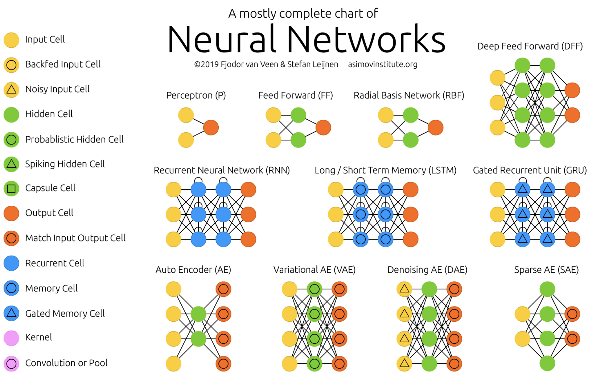
Generic Neural Architectures (1-11)
14 types of neurons

Slide 5
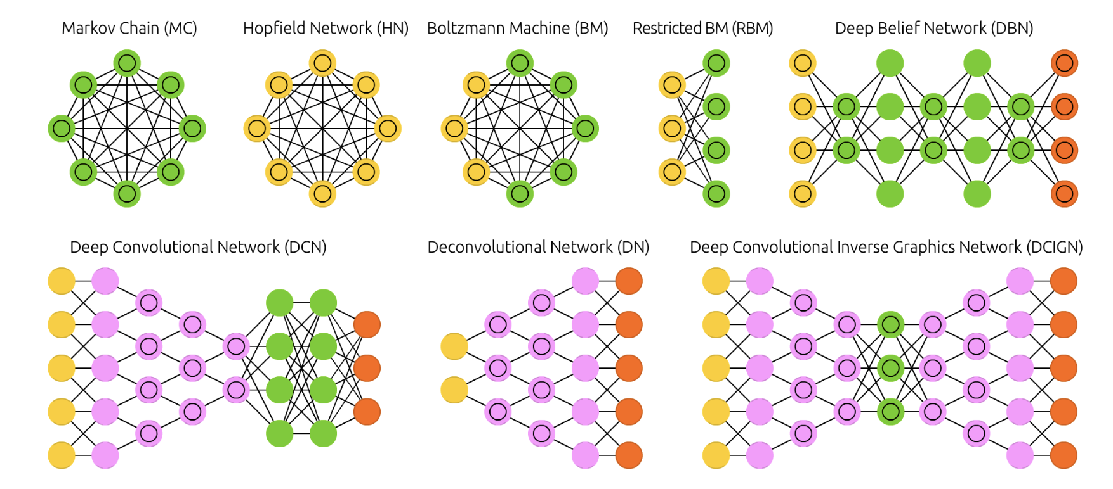
Generic Neural Architectures (12-19)

Slide 6
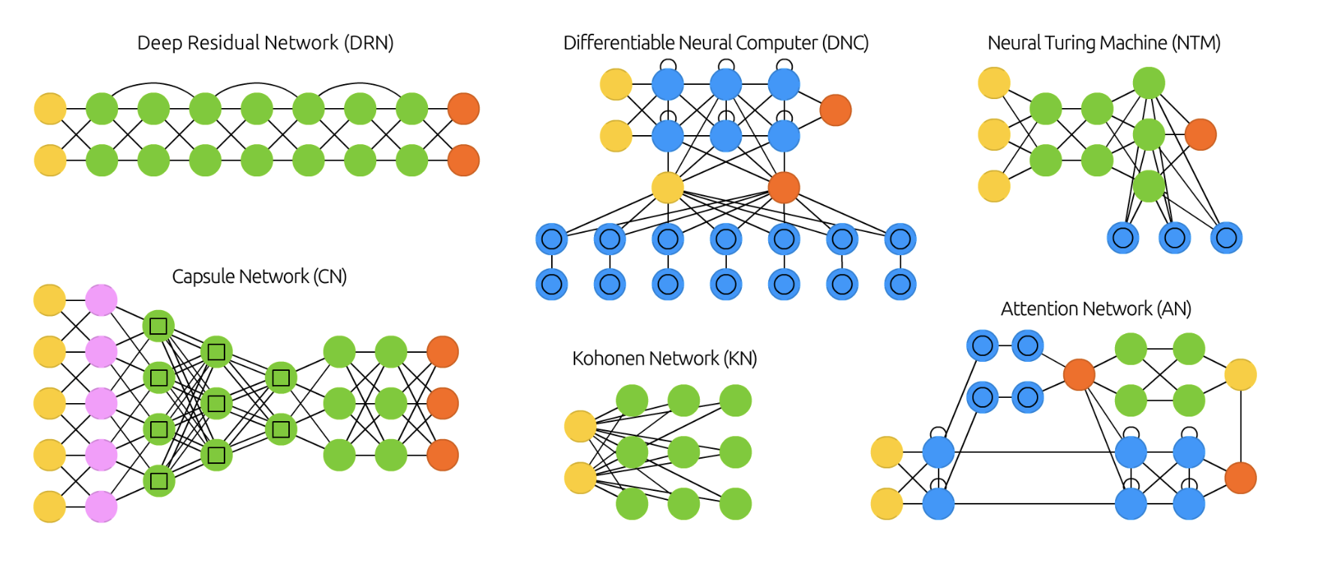
Generic Neural Architectures (20-26)

Slide 7
Data Sets
Training data
Testing data
Usually disjoint!
Training data can be divided into actual training and validation data
Testing data used after training – not used in training

Slide 8
Principles of machine learning
Principles of machine learning
ML recipe
Specification of a dataset
A cost function
A model
An optimization procedure
No free lunch theorem
No silver bullet

Slide 9
Deep Feedforward NNs
Deep feedforward neural networks
Learning issues - XOR
Gradient based Learning
Lots of neurons & hidden Units
Architecture Design
Deep vs wide networks
Universal approximation theorem
Backpropagation and related differentiation

Slide 10
What is Regularization?
Central problem of ML is to design algorithms that will perform well not just on training data but also on new inputs (i.e. generalize)
Regularization is:
“any modification made to a learning algorithm to reduce generalization error but not training error”
Implications
Reduce test error even at expense of higher training error
Improve performance!

Slide 11
Regularize Your Estimator!
In Deep Learning, regularization means regularizing estimators
Increased bias for reduced variance
– Good regularizers significantly reduce variance while not overly increasing bias

Slide 12
Optimization in Learning vs Pure Optimization
Optimization algorithms for deep learning differ from traditional optimization in several ways:
Machine learning acts indirectly
Care about some performance measure P defined wrt the training set and which may be intractable
Use a different cost function J(θ) in the hope that doing so will reduce P
Pure optimization: minimizing J is a goal in itself
But optimizing algorithms for training deep models also includes specialization on specific structures of a ML objective function

Slide 13
Choosing the Right Optimizer
We have discussed several methods of optimizing deep models by adapting the learning rate for each model parameter
Which algorithm to choose?
No consensus
Most popular algorithms actively in use:
SGD, SGD with momentum, RMSProp
RMSProp with momentum, AdaDelta and Adam
Choice depends on user’s familiarity with algorithm

Slide 14
Topics in Convolutional Networks
Overview
The Convolution Operation
Motivation
Pooling
Convolution and Pooling as an Infinitely Strong Prior
Variants of the Basic Convolution Function
Structured Outputs
Data Types
Efficient Convolution Algorithms
Random or Unsupervised Features
The Neuroscientific Basis for Convolutional Networks
11. Convolutional Networks and the History of Deep Learning

Slide 15
Overview
Overview of Convolutional Networks
Traditional versus Convolutional Networks
Topics in CNNs
One of the most well used deep learning network it seems; LLMs are competing however

Slide 16
Overview of Convolutional Networks
Convolutional networks, also known as Convolutional neural networks, CNNs, or ConvNets are a specialized kind of neural network
Used for processing data that has a known grid-like topology
Ex: time-series data, which is a 1-D grid, taking samples at intervals
Image data, which are 2-D grid of pixels
Utilize convolution, which is a specialized kind of linear operation

Slide 17
Neural Net Matrix Multiplication
Each layer produces values that are obtained from previous layer by performing a matrix-multiplication
In an unaugmented network
Hidden layer produces values z =h (W^{(1)T} x + b⁽¹⁾)
Output layer produces values y =σ(W^{(2)T} x + b⁽²⁾)
Note:W⁽¹⁾ and W⁽²⁾ are matrices rather than vectors
Augmented network
Example with D=3, M=3
x=[x₁,x₂,x₃]^{T}
We have two weight matrices W⁽¹⁾ and W⁽²⁾
First Network layer
Network layer output
In matrix multiplication notation

Slide 18
Matrix Multiplication for 2D Convolution
Far fewer weights needed than full matrix multiplication!

Slide 19
Convolutional Layer for Image Recognition

Slide 20
CNN - Neural Network with a Convolutional Layer
CNNs are simply neural networks that use convolution in place of general matrix multiplication in at least one of their layers
Convolution can be viewed as multiplication by a matrix
https://towardsdatascience.com/a-comprehensive-guide-to-convolutional-neural-networks-the-eli5-way-3bd2b1164a53

Slide 21
Specifying a convolutional layer in Keras
Conv1D
Conv2D
Arguments
filters: Integer, the dimensionality of the output space (i.e. the number of output filters in the convolution).
kernel_size: An integer or tuple/list of 2 integers, specifying the height and width of the 2D convolution window. Can be a single integer to specify the same value for all spatial dimensions.
strides: An integer or tuple/list of 2 integers, specifying the strides of the convolution along the height and width. Can be a single integer to specify the same value for all spatial dimensions. Specifying any stride value
!= 1 is incompatible with specifying any dilation_rate value != 1.
padding: one of "valid" or "same" (case-insensitive). Note that "same" is slightly inconsistent across backends with strides != 1, as described here
data_format: A string, one of "channels_last" or "channels_first". The ordering of the dimensions in the inputs. "channels_last" corresponds to inputs with shape (batch, height, width, channels) while "channels_first" corresponds to inputs with shape (batch, channels, height, width). It defaults to the image_data_format value found in your Keras config file at ~/.keras/keras.json. If you never set it, then it will be "channels_last".

Slide 22
Runtime of Traditional vs Convolutional Networks
Deep Learning Srihari
Traditional neural network layers use matrix multiplication by a matrix of parameters with a separate parameter describing the interaction between each input unit and each output unit
s =g(W^{T}x )
With m inputs and n outputs, matrix multiplication requires m x n
parameters and O(m×n) runtime per example
This means every output unit interacts with every input unit
Convolutional network layers have sparse interactions
If we limit no of connections for each input to k we need k x n parameters and O(k×n) runtime

Slide 23
Topics in Convolutional Networks
What convolution is
Motivation behind using convolution in a neural network
Pooling, which almost all convolutional networks employ
Usually the operation used in a convolutional neural network does not correspond precisely to convolution in math
We describe several variants on convolution function used in practice
Making convolution more efficient
Convolution networks stand out as an example of neuroscientific principles in deep learning
Very deep convolutional network architectures

Slide 24
Topics in Convolutional Networks
Overview
The Convolution Operation
Motivation
Pooling
Convolution and Pooling as an Infinitely Strong Prior
Variants of the Basic Convolution Function
Structured Outputs
Data Types
Efficient Convolution Algorithms
Random or Unsupervised Features
The Neuroscientific Basis for Convolutional Networks
11. Convolutional Networks and the History of Deep Learning

Slide 25
Data Encoding for CNN

Slide 26
Topics
What is convolution?
Convolution: continuous and discrete cases
Convolution in two dimensions
Discrete convolution viewed as matrix multiplication

Slide 27
What is Convolution?
Convolution is an operation on two functions of a real-valued argument and can be considered an averaging process
Examples of the two functions in one dimension
Tracking location of a spaceship by a laser sensor
A laser sensor provides a single output x(t), the position of spaceship at time t
w a function of a real-valued argument
If laser sensor is noisy, we want a weighted average that gives more weight to recent observations
Weighting function is w(a) where a is age of a measurement
Convolution is the weighted average or smoothed estimate of the position of the spaceship
A new function s
s(t) = ∫ x(a)w(t −a)da

Slide 28
Definition of Convolution of Input and Kernel
Convolution function s is a weighted average of x
s(t) = ∫ x(a)w(t −a)da
Convolution of f(u) and g(u)
This operation is typically denoted with an asterisk
s(t) = (x * w)(t)
w needs to be a valid probability density function, or the output is not a weighted average
w needs to be 0 for negative arguments, or we will look into the future
In convolution network terminology the first function x is referred to as the input, the second function w is referred to as the kernel
The output s is referred to as the feature map
Properties:
Commutative
Associative
Distributive

Slide 29
Performing 1-D Convolution
One-dimensional continuous case
Input f(t) is convolved with a kernel g(t)
(f * g) ≡ ∫ f (τ)g(t − τ)dτ
−∞
∞
Note that (f * g )=(g * f )
Express each function in terms of a dummy variable τ
Reflect one of the functions g(τ)→g(-τ)
Add a time offset t, which allows g(t-τ) to slide along the τ axis
4. Start t at -∞ and slide
all the way to +∞
Wherever the two functions intersect find the integral of their product
https://en.wikipedia.org/wiki/Convolution

Slide 30
Convolution with Discrete Variables
Ex: Laser sensor may only provide data at regular intervals
Time index t takes on only integer values
x and w are defined only on integer t
s(t) = (x * w)(t) = ∑ x(a)w(t −a)
a=−∞
∞
In ML applications, input is a multidimensional array of data and the kernel is a multidimensional array of parameters that are adapted by the learning algorithm
These arrays are referred to as tensors
Input and kernel are explicitly stored separately
The functions are zero everywhere except at these points

Slide 31
Convolution in Discrete Case
Here we have discrete functions f and g
(f * g)[t ] = ∑ f [τ]⋅ g[t − τ]
τ=−∞
∞
f [t ]
g [t-τ ]

Slide 32
Computation of 1-D Discrete Convolution
Parameters of convolution:
Kernel size (F) Padding (P) Stride (S)
(f *g)[t]
g[t-τ]
f [t]

Slide 33
Two-Dimensional Convolution
Convolutions over more than one axis
For a 2D image I as input and a 2D kernel K we have
S(i, j) = (I * K )(i, j) = ∑∑I(m,n)K(i − m, j − n)
m n
Sharply peaked kernel K for edge detection
I(i , j) K(i , j) S(i , j)
Kernels K₁-K₄ for line detection

Slide 34
Commutativity of Convolution
Convolution is commutative. We can equivalently write:
S(i, j) = (K * I )(i, j) = ∑∑I(i − m, j − n)K(m,n)
m n
This formula is easier to implement in a ML library since there is less variation in the range of valid values of m and n
Commutativity arises because we have flipped the kernel relative to the input
As m increases, index to the input increases, but index to the kernel decreases

Slide 35
Cross-Correlation
Same as convolution, but without flipping the kernel
S(i, j) = (K * I )(i, j) = ∑∑I(i + m, j + n)K(m,n)
m n
Both often referred to as convolution, and whether kernel is flipped or not
In ML, the learning algorithm will learn appropriate values of the kernel in the appropriate place

Slide 36
Example of 2D convolution
Convolution without kernel flipping applied to a 2D tensor
Output is restricted to case where kernel is situated entirely within the image
Arrows show how upper- left of input tensor is used to form upper-left of output tensor

Slide 37
Discrete Convolution Viewed as Matrix Multiplication
Convolution can be viewed as multiplication by a matrix
However the matrix has several entries constrained to be zero
Or constrained to be equal to other elements
For univariate discrete convolution: Univariate Toeplitz matrix:
Rows are shifted versions of previous row
2D case: doubly block circulant matrix
It corresponds to convolution

Slide 38
Topics in Convolutional Networks
Overview
The Convolution Operation
Motivation
Pooling
Convolution and Pooling as an Infinitely Strong Prior
Variants of the Basic Convolution Function
Structured Outputs
Data Types
Efficient Convolution Algorithms
Random or Unsupervised Features
The Neuroscientific Basis for Convolutional Networks
11. Convolutional Networks and the History of Deep Learning

Slide 39
Overview of Convolutional Networks
Convolutional networks, also known as Convolutional neural networks (CNNs or ConvNet) are a specialized kind of neural network
Used for processing data that has a known grid-like topology
Time-series data, which is a 1-D grid, taking samples at intervals
Image data, which are 2-D grid of pixels
Utilize convolution as a specialized kind of linear operation
The convolution operation is used in place of a general matrix multiplication in at least one layer

Slide 40
Motivation for Using Convolution Networks
Convolution leverages three important ideas to improve ML systems:
Sparse interactions
Parameter sharing
Equivariant representations
Convolution also allows for working with inputs of variable size

Slide 41
Sparse Connectivity Due to Image Convolution
Input image may have millions of pixels,
But we can detect edges with kernels of
hundreds of pixels
If limit number of connections for each input n to k
now need kxn parameters and O(k×n)
runtime
It is possible to get good performance with k<<n
Convolutional networks have sparse interactions
Accomplished by making the kernel smaller than the input Next slide shows graphical depiction
5

Slide 42
Neural Hetwork for 1-D convolution
Kernel g(t):
f [t]
Equations for outputs of this network:
etc. up to y₈
We can also write the equations in terms of elements of a general 8 ✕ 8 weight matrix W as:
where
http://colah.github.io/posts/2014-07-Understanding-Convolutions/

Slide 43
Sparse Connectivity, Viewed from Below
Highlight one input x₃ and output units s affected by it
Top: when s is formed by convolution with a kernel of width 3, only three outputs are affected by x₃
Bottom: when s is formed by matrix multiplication, connectivity is no longer sparse
Then all outputs are affected by x₃

Slide 44
Sparse Connectivity, Viewed from Above
Highlight one output s₃ and inputs x that affect this unit
These units are known as the receptive field of s₃
When s₃ is formed by convolution with a kernel of width 3
When s₃ is formed by matrix multiplication

Slide 45
Maintaining Performance with Reduced Connections
How is it possible to obtain good performance while keeping a number of k connections several magnitudes less than m inputs
In a deep neural network, units in deeper layers may indirectly interact with a larger portion of the input
Sparsely connected network requires only k x n parameters and O(kn) runtime where n is the number of outputs
Receptive field in deeper layers is larger than the receptive field in shallow layers
Reasoning: the deep network can efficiently describe complicated interactions between many variables from simple building blocks that only have sparse interactions

Slide 46
Convolution with a Stride s
Receptive field in deeper layers is larger than the receptive field in shallow layers
This effect increases if the network includes architectural features like strided convolution or pooling
Stride s denotes how many steps we are moving in each steps in convolution filters

Slide 47
Parameter Sharing
Parameter sharing refers to using the same parameter for more than one function in a model
In a traditional neural net each element of the weight matrix is used exactly once when computing the output of a layer
It is multiplied by one element of the input and never revisited
Parameter sharing is synonymous with tied weights
Value of the weight applied to one input is tied to a weight applied elsewhere
In a convolutional net, each member of the kernel is used in every position of the input (except at the boundary– subject to design decisions)

Slide 48
Efficiency of Parameter Sharing
Parameter sharing by convolution operation means that rather than learning a separate set of parameters for every location, we learn only one set
This does not affect runtime of forward propagation– which is still O(k ✕ n)
But further reduces the storage requirements to k
parameters
k is orders of magnitude less than inputs m
Since m inputs and n outputs are roughly the same size, k is much smaller than mxn

Slide 49
How Parameter Sharing Works
Black arrrows: connections that use a particular parameter
Convolutional model: Black arrows indicate uses of the central element of a 3-element kernel
Fully connected model: Single black arrow indicates use of the central element of the weight matrix
Model has no parameter sharing, so the parameter is used only once
Thus sparse connectivity and parameter sharing can dramatically improve efficiency of image edge detection as shown in next slide

Slide 50
Efficiency of Convolution for Edge Detection
Image on right formed by taking each pixel of input image and subtracting the value of its neighboring pixel on the left
This is a measure of all the vertically oriented edges in input image which is useful for object detection
Input image
Both images are 280 pixels tall Input image is 320 pixels wide Output image is 319 pixels wide
Transformation can be described by a convolution kernel containing two elements and requires 319×320×3=267,960 flops (2 multiplies, one add)
Same transformation would require 320×280×319×280,
i.e., 8 billion entries in the matrix
Convolution is 4 billion times more efficient

Slide 51
Equivariance of Convolution to Translation
This particular form of parameter sharing leads to equivariance to translation
Equivariant means that if the input changes, the output changes in the same way
A function f (x) is equivariant to a function g if f (g (x))=g (f (x))
If g is a function that translates the input, i.e., that shifts it, then the convolution function is equivariant to g
I(x,y) is image brightness at point (x,y)
I’=g(I) is image function with I’(x,y)=I(x-1,y), i.e., shifts every pixel of I
one unit to the right
If we apply g to I and then apply convolution, the output will be the same as if we applied convolution to I’, then applied transformation g to the output

Slide 52
Example of Equivariance
With 2D images convolution creates a map where certain features appear in the input
If we move the object in the input, the representation will move the same amount in the output
It is useful to detect edges in the first layer of a convolutional network
Same edges appear everywhere in image, so it is practical to share parameters across entire image

Slide 53
Absence of Equivariance
In some cases, we may not wish to share parameters across an entire image
If image is cropped to be centered on a face, we may want different features from different parts of the face
Part of the network processing the top of the face looks for eyebrows
Part of the network processing the bottom of the face looks for the chin
Certain image operations such as scale and rotation are not equivariant to convolution
Other mechanisms are needed for such transformations

Slide 54
Topics in Convolutional Networks
Overview
The Convolution Operation
Motivation
Pooling
Convolution and Pooling as an Infinitely Strong Prior
Variants of the Basic Convolution Function
Structured Outputs
Data Types
Efficient Convolution Algorithms
Random or Unsupervised Features
The Neuroscientific Basis for Convolutional Networks
11. Convolutional Networks and the History of Deep Learning

Slide 55
Topics in Pooling
What is Pooling?
Three stages of CNNs
Two terminologies: simple layers, complex layers
Types of Pooling functions: Max, Average
Translation invariance
Rotation invariance
Pooling with downsampling
ConvNet architectures
Shortcoming of pooling

Slide 56
What is Pooling?
Pooling in a CNN is a subsampling step
It replaces output at a location with a summary statistic of nearby outputs
E,g,, Max pooling reports the maximum output within a rectangular neighborhood
https://deepai.org/machine-learning-glossary-and-terms/max-pooling

Slide 57
The Pooling Stage in a CNN
Typical layer of a CNN consists of three stages
Stage 1:
perform several convolutions in parallel to produce a set of linear activations
Stage 2 (Detector):
each linear activation is run through a nonlinear activation function such as ReLU
Stage 3 (Pooling):
Use a pooling function to modify output of the layer further
5

Slide 58
Pooling Layer in Keras
MaxPooling 1D
Arguments
pool_size: Integer, size of the max pooling windows.
strides: Integer, or None. Factor by which to downscale. E.g. 2 will halve the input. If None, it will default to pool_size.
padding: One of "valid" or "same" (case-insensitive).
data_format: A string, one of channels_last (default) or channels_first. The ordering of the dimensions in the inputs. channels_last corresponds to inputs with shape (batch, steps, features) while channels_first corresponds to inputs with shape (batch, features, steps)
MaxPooling 2D

Slide 59
Typical Subsampling in a Deep Network
Input image is filtered by 4 5×5 convolutional kernels which create 4 feature maps,
Feature maps are subsampled by max pooling.
The next layer applies ten 5×5 convolutional kernels to these subsampled images and again we pool the feature maps.
The final layer is a fully connected layer where all generated features are combined and used in the classifier (essentially logistic regression).

Slide 60
Two Terminologies for a Typical CNN Layer
CNN viewed as a small number of complex layers, each layer having many stages
1-1 mapping between kernel tensors and network layers
CNN viewed as a larger number of simple layers
Every processing step is a layer in its own right
Not every layer has parameters

Slide 61
Effect of Pooling
Pooling is performed for two reasons
Dimensionality reduction
Invariance to transformations of rotation and translation

Slide 62
Some Types of Linear Transformations

Slide 63
Types of Pooling functions
A pooling function replaces the output of the net at a certain location with a summary statistic of the nearby inputs
Popular pooling functions:
max pooling operation reports the maximum output within a rectangular neighborhood
Average of a rectangular neighborhood
L² norm of a rectangular neighborhood
Weighted average based on the distance from the central pixel

Slide 64
Pooling Causes Translation Invariance
In all cases, pooling helps make the representation become approximately invariant to small translations of the input
If we translate the input by a small amount values of most of the outputs does not change (example next slide)
Pooling can be viewed as adding a strong prior that the function the layer learns must be invariant to small translations

Slide 65
Max Pooling Introduces Invariance to Translation
View of middle of output of a convolutional layer
Outputs of maxpooling
Outputs of nonlinearity
Same network after the input has been shifted by one pixel
Every input value has changed, but only half the values of output have changed because maxpooling units are only sensitive to maximum value in neighborhood not exact value

Slide 66
Importance of Translation Invariance
Invariance to translation is important if we care about whether a feature is present rather than exactly where it is
Ex: for detecting a face just need to know that an eye is present in a region, not its exact location
In other context it is more important to preserve location of a feature
Ex: to determine a corner we need to know whether two edges are present and test whether they meet

Slide 67
Learning other Invariances
Pooling over spatial regions produces invariance to translation
But if we pool over the results of separately parameterized convolutions, the features can learn which transformations to become invariant to

Slide 68
Learning Invariance to Rotation
A pooling unit that pools over multiple features that are learned with separate parameters can learn to be invariant to transformations of the input
Input tilted left
gets large response from unit tuned to left-tilted images
Tilted Right

Slide 69
Using Fewer Pooling Units than Detector Units
Because pooling summarizes the responses over a whole neighborhood, it is possible to use fewer pooling units than detector units
This is due to the effect of reporting summary statistics for pooling regions spaced k pixels apart rather than one pixel apart
This improves computational efficiency because the next layer has k
times fewer inputs to process
An example is given next

Slide 70
Pooling with Downsampling
Max-pooling with a pool width of three and a stride between pools of two
This reduces representation size by a factor of two
Which reduces computational burden of next layer
Rightmost pooling region has a smaller size but must be included if we don’t want to ignore some of the detector units
Downsampling makes a digital audio signal smaller by lowering its sampling rate or sample size (bits per sample). It decreases the bit rate when transmitting over a limited bandwidth or to convert to a more limited audio format

Slide 71
Subsampling as Average Pooling

Slide 72
Theoretical Guidance on Pooling
Which kind of pooling should one use in different situations
Possible to dynamically pool features together
Run a clustering algorithm on locations of interesting features
Yields a different set of pooling regions for each image
Another approach: learn a single pooling structure
Pooling can complicate architectures that use top-down information
E.g., Boltzmann machines and autoencoders

Slide 73
Examples of Architectures for Classification with CNNs
Deep Learning Srihari
CNN that processes Processes variable- a fixed size image sized image
Does not have any fully-connected layer
Architectures shown are illustrative and not designed for real use
Real networks have branching structures
Chain structures shown for simplicity

Slide 74
A ConvNet architecture
INPUT: 32x32x3 holds raw pixel values: an image of width 32, height 32 and 3 color channels RGB CONV layer will compute the output of neurons connected to local regions in the input
Each computing a dot product between their weights and a small region they are connected to
In the input volume. This may result in a volume such as 32x32x12 if we used 12 filters POOL layer will perform a down-sampling operation along spatial dimensions (width, height) resulting in a volume such as 12x16x12
Activations of an example ConvNet architecture.
Initial volume stores raw image pixels (left) and the last volume stores class scores (right)
Each volume of activations along the processing path is shown as a column.
Since it is difficult to visualize 3D volumes, each volume’s slices are laid out in rows

Slide 75
VGG (Visual Geometry Group) Net
VGG is a convolutional neural network model
K. Simonyan and A. Zisserman, University of Oxford
“Very Deep Convolutional Networks for Large-Scale Image Recognition”
The model achieves 93% top-5 test accuracy in ImageNet
which is a dataset of over 14 million images belonging to 1000 classes.

Slide 76
VGG 16
Source: https://www.cs.toronto.edu/~frossard/post/vgg16/

Slide 77
VGG-16 pre-trained model for Keras
https://gist.github.com/baraldilorenzo/07d7802847aaad0a35d3
25

Slide 78
Pooling, Invariance, Equivariance
Pooling is supposed to obtain positional, orientational, proportional or rotational invariance.
However it is a very crude approach
In reality it removes all sorts of positional invariance
Leads to detecting right image in Fig. 1 as a correct ship
1. Disfiguration Transformation 2. Proportional Transformation
Equivariance makes network understand the rotation or
proportion change and adapt itself accordingly so that the spatial positioning inside an image is not lost
A solution is capsule nets
Source: https://hackernoon.com/what-is-a-capsnet-or-capsule-network-2bfbe48769cc

Slide 79
Definition of Equivariance
Generalizes the concept of invariance
Invariance is a property which remains unchanged when transformations of a certain type are applied to the objects
Area and perimeter of a triangle are invariants
Translating/rotating a triangle does not change its area or perimeter
Triangle centers such as the centroid, circumcenter, are not invariant
Because moving a triangle will cause its centers to move
Instead, these centers are equivariant
Applying any Euclidean congruence (a combination of a translation and rotation) to a triangle, and then constructing its center, produces the same point as constructing the center first, and then applying the same congruence to the center.
O=Triangle; t=translation
f(g•x)=g•f(x)
Area(O)=Area(t(O)) Center (O)≠Center(t(O)) g(x) =center(x) f(x)=translation (x)

Slide 80
Topics in Convolutional Networks
Overview
The Convolution Operation
Motivation
Pooling
Convolution and Pooling as an Infinitely Strong Prior
Variants of the Basic Convolution Function
Structured Outputs
Data Types
Efficient Convolution Algorithms
Random or Unsupervised Features
The Neuroscientific Basis for Convolutional Networks
11. Convolutional Networks and the History of Deep Learning

Slide 81
Topics in Infinitely Strong Prior
Weak and Strong Priors
Convolution as an infinitely strong prior
Pooling as an infinitely strong prior
Under-fitting with convolution and pooling
Permutation invariance

Slide 82
Prior Parameter Distribution
Role of a prior probability distribution over the parameters of a model is to encode our belief as to what models are reasonable before seeing the data

Slide 83
Weak and Strong Priors
A weak prior
A distribution with high entropy
e.g., Gaussian with high variance
The data can move parameters more or less freely
A strong prior
Very low entropy
E.g., a Gaussian with low variance
Such a prior plays a more active role in determining where the parameters end up

Slide 84
Infinitely Strong Prior
An infinitely strong prior places zero probability on some parameters
It says that some parameter values are forbidden regardless of their support from data
With an infinitely strong prior, irrespective of the data the prior cannot be changed

Slide 85
Convolutional Network
Convolutional networks are simply neural networks that use convolution in place of general matrix multiplication in at least one of their layers

Slide 86
Convolution as Infinitely Strong Prior
Convolutional net is similar to a fully connected net but with an infinitely strong prior over its weights
It says that the weights for one hidden unit must be identical to the weights of its neighbor, but shifted in space
Prior also says that the weights must be zero, except for in the small spatially contiguous receptive field assigned to that hidden unit
Convolution with a kernel of width 3 s₃ is a hidden unit. It has 3 weights which are the same as for s₄
Convolution introduces an infinitely strong prior probability distribution over the parameters of a layer
This prior says that the function the layer should learn contains only local interactions and is equivariant to translation

Slide 87
Pooling as an Infinitely Strong Prior
The use of pooling is an infinitely strong prior such that each unit should be invariant to small translations
Maxpooling example:

Slide 88
Implementing as a Prior
Implementing a convolutional net as a fully connected net with an infinitely strong prior would be computationally wasteful
However, thinking of a convolutional net as a fully connected net with an infinitely strong prior can give us insights into how convolutional nets work

Slide 89
Key Insight: Underfitting
Convolution and pooling can cause under-fitting
Under-fitting happens when model has high bias
Convolution and pooling are only
useful when the assumptions made by the prior are reasonably accurate
Pooling may be inappropriate in some cases
If the task relies on preserving spatial information, using pooling on all features can increase training error
High Bias/Underfit can be countered by:
Add hidden layers
Increase hidden units/layer
Decrease regular. parameter λ
Add features

Slide 90
When Pooling may be Inappropriate
Some convolutional architectures are designed to use pooling on some channels but not on other channels
Thus highly invariant features and features will not under-fit when the translation invariance prior is incorrect
When a task involves incorporating information from a very distant locations in the input, the prior imposed by convolution may be inappropriate

Slide 91
Comparing Model Performance with/without Convolution
Convolutional models have built in spatial relationships
In benchmarks of statistical learning performance we should only compare convolutional models to other convolutional models – since they have
hard coded knowledge of spatial relationships
Models without convolution will be able to learn even if we permuted all pixels in the image
Permutation invariance: f (x₁,x₂,x₃)=f (x₂,x₁,x₃)=f(x₃,x₁,x₂)
There are separate benchmarks for models that are permutation invariant

Slide 92
Topics in Convolutional Networks
Overview
The Convolution Operation
Motivation
Pooling
Convolution and Pooling as an Infinitely Strong Prior
Variants of the Basic Convolution Function
Structured Outputs
Data Types
Efficient Convolution Algorithms
Random or Unsupervised Features
The Neuroscientific Basis for Convolutional Networks
11. Convolutional Networks and the History of Deep Learning

Slide 93
Topics in
Variants of Convolution Functions
Neural net convolution is not same as mathematical convolution
How convolution in neural networks is different
Multichannel convolution due to image color and batches
Convolution with a stride
Locally connected layers (unshared convolution)
Tiled convolution
Implementation of a convolutional network

Slide 94
Neural Net Convolution is Different
Convolution in the context of neural networks does not refer exactly to the standard convolution operation in mathematics
The functions used are slightly different
Next describe the differences in detail and highlight their useful properties

Slide 95
Convolution Operation in Neural Networks
Refers to an operation that consists of many applications of convolution in parallel
This is because convolution with a single kernel can only extract one
kind of feature, albeit at many locations
Usually want to extract many kinds of features at many locations
Input is usually not a grid of real values
Rather it is a vector of observations
E.g., a color image has R ,G, B values at each pixel
Input to the next layer is the output of the first layer which has many different convolutions at each position
When working with images, input and output are 3-D tensors

Slide 96
Four Indices for Weights for Image algorithms
One index for Channel
Two indices for spatial coordinates of each channel
Fourth index for different samples in a batch
We omit the batch axis for simplicity of discussion
f (w_{i,j,k,l})

Slide 97
Multichannel Convolution
Because we are dealing with multichannel convolution, linear operations are not usually commutative, even of kernel flipping is used
These multi-channel operations are only commutative if each operation has the same number of output channels as input channels.

Slide 98
Definition of 4-D kernel tensor
Assume we have a 4-D kernel tensor K with element
K_{i,j,k,l} giving the connection strength between
a unit in channel i of the output and
a unit in channel j of the input,
with an offset of k rows and l columns between output and input units
Assume our input consists of observed data V with element
V_{i,j,k} giving the value of the input unit
within channel i at row j and column k.
Assume our output consists of Z with the same format as V
If Z is produced by convolving K across V without flipping K, then

Slide 99
Convolution with a Stride: Definition
We may want to skip over some positions in the kernel to reduce computational cost
At the cost of not extracting fine features
We can think of this as down-sampling the output of the full convolution function
If we want to sample only every s pixels in each direction of output, then we can define a down-sampled convolution function c such that
Denote s as the stride. It is possible to define a different
stride for each direction
Strided convolution video

Slide 100
Convolution with Stride: Implementation
Here we use a stride of 2
Convolution with a stride of length two implemented in a single operation
Convolution with a stride greater than one pixel is mathematically equivalent to convolution with a unit stride followed by downsampling.
Two-step approach is computationally wasteful, because it computers many values that are discarded
Downsampling makes a digital audio signal smaller by lowering its sampling rate or sample size (bits per sample). It decreases the bit rate when transmitting over a limited bandwidth or to convert to a more limited audio format

Slide 101
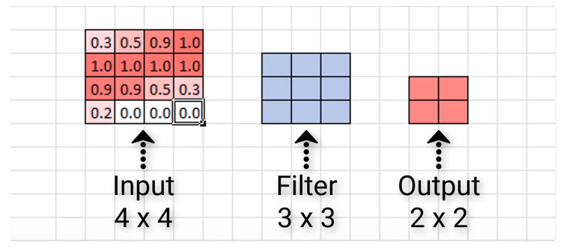
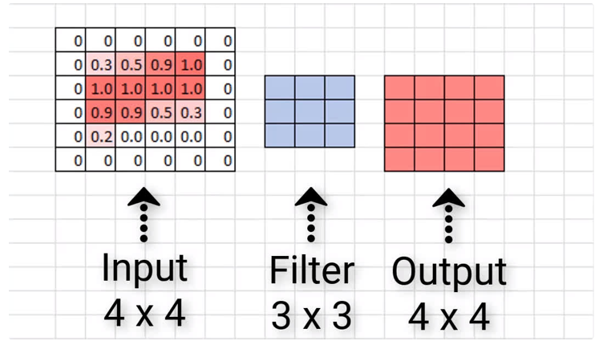
Padding to CNN Sides and Size
Add zero units to the edges on the sides of the network to reduce shrinking over the depth so as to maintain performance
No padding
Zero padding
DeepLizard

Slide 102
Effect of Zero-padding on Network Size
Convolutional net with a kernel of width 6 at every layer No pooling, so only convolution shrinks network size
We do not use any implicit zero padding
Causes representation to shrink by five pixels at each layer
Starting from an input of 16 pixels
we are only able to have 3
convolutional layers and the last layer does not ever move the kernel, so only two layers are convolutional
By adding 5 implicit zeroes to Each layer, we prevent the representation from shrinking with depth
This allows us to make an arbitrarily deep convolutional network
11
Padding video

Slide 103
Locally Connected Layer
In some cases, we do not actually want to use convolution, but rather locally connected layers
adjacency matrix in the graph of our MLP is the same, but every connection has its own weight, specified by a 6-D tensor W.
The indices into W are respectively:
i, the output channel,
j, the output row,
k, the output column,
l, the input channel,
m, the row offset within the input, and
n, the column offset within the input.
The linear part of a locally connected layer is then given by
Also called unshared convolution

Slide 104
Local Connections, Convolution, vs full Connections
A locally connected layer with a patch size of two pixels. Each edge is labeled with a unique letter to show that each edge is associated with its own weight parameter.
A convolutional layer with a kernel width of two pixels. Has exactly the same connectivity as the locally connected layer. The difference lies not in which units interact with each other, but in how the parameters are shared. Locally connected layer has no parameter sharing. The convolutional layer uses the same two weights repeatedly across the entire input, as indicated by the repetition of the letters labeling each edge.
A fully connected layer resembles a locally connected layer in the sense that each
edge has its own parameter (there are too many to label explicitly with letters in this
diagram). It does not, however, have the restricted connectivity of the locally connected layer.

Slide 105
Use of Locally Connected Layers
Locally connected layers are useful when
we know that each feature should be a function of a small part of space, but there is no reason to think that the same feature should occur across all of space
Ex: if we want to tell if an image is a picture of a face, we only need to look for the mouth in the bottom half of the image

Slide 106
Constraining Outputs
Constrain each output channel i to be a function of only a subset of the input channels l
Make the first m output channels connect to only the first n input channels,
The second m output channels connect to only the second n input channels, etc
Modeling interactions between few channels allows fewer parameters to:
Reduce memory, increase statistical efficiency, reduce computation for forward/back-propagation.
It accomplishes these goals without reducing number of hidden units.

Slide 107
Network with Further Restricted Connectivity
A convolutional network with the first two output channels connected to only the first two input channels, and the second two output channels connected to only the second two input channels

Slide 108
Tiled Convolution
Compromise between a convolutional layer and a locally connected layer.
Rather than learning a separate set of weights at every spatial location, we learn a set of kernels that we pass through as we move through space.
This means that immediately neighboring locations will have different filters, like in a locally connected layer,
Now the memory requirements for storing the parameters will increase only by a factor of the size of this set of kernels rather than the size of the entire output feature map

Slide 109
Comparison of locally connected layers, tiled convolution and standard convolution
A locally connected layer that has no sharing at all Each connection has its
own weight
Tiled convolution
has a set of t different kernels With t=2
Traditional convolution equivalent to tiled convolution with t=1
There is only one kernel and it is applied everywhere

Slide 110
Defining Tiled Convolution Algebraically
Let k be a 6-D tensor, where two of the dimensions correspond to different locations in the output map.
Rather than having a separate index for each location in the output map, output locations cycle through a set of t different choices of kernel stack in each direction.
If t is equal to the output width, this is the same as a locally connected layer
where % is the modulo operation, with t%t = 0, (t + 1)%t = 1, etc

Slide 111
Operations to Implement CNNs
Besides convolution, other operations are necessary to implement a convolutional network.
To perform learning, need to compute gradient with respect to the kernel, given the gradient with respect to the outputs.
In some simple cases, this operation can be performed using the convolution operation, but with a stride greater than 1, there are issues.

Slide 112
Implementation of Convolution
Convolution is a linear operation and can thus be described as a matrix multiplication
First reshape the input tensor into a flat vector
Matrix is then a function of the convolution kernel
Matrix is sparse and each element of the kernel is copied to several elements of the matrix.
This view helps us to derive some of the other operations needed to implement a convolutional network

Slide 113
Topics in Convolutional Networks
Overview
The Convolution Operation
Motivation
Pooling
Convolution and Pooling as an Infinitely Strong Prior
Variants of the Basic Convolution Function
Structured Outputs
Data Types
Efficient Convolution Algorithms
Random or Unsupervised Features
The Neuroscientific Basis for Convolutional Networks
11. Convolutional Networks and the History of Deep Learning

Slide 114
CNNs to Output a High Dimensional Object
Convolutional networks can be used to output a high-dimensional structured object, rather than just predicting a class label for a classiﬁcation task or a real value fora regression task.
Typically this object is just a tensor, emitted by a standard convolutional layer.
Example, the model might emit a tensor S, where S_{i,j,k} is the probability that pixel (j, k) of the input to the network belongs to class i.
This allows the model to label every pixel in an image and draw precise masks that follow the outlines of individual objects

Slide 115
CNNs to Output a High Dimensional Object
CNNs can be used to output a high-dimensional structured object, rather than just predicting a class label for a classiﬁcation task or a real value fora regression task.
Typically this object is just a tensor, emitted by a standard convolutional layer.
Example, the model might emit a tensor S, where S_{i,j,k} is the probability that pixel (j, k) of the input to the network belongs to class i.
This allows the model to label every pixel in an image and draw precise masks that follow the outlines of individual objects
Change architecture for large D outputs

Slide 116
Recurrent CNN for Pixel Labeling

Slide 117
Topics in Convolutional Networks
Overview
The Convolution Operation
Motivation
Pooling
Convolution and Pooling as an Infinitely Strong Prior
Variants of the Basic Convolution Function
Structured Outputs
Data Types
Efficient Convolution Algorithms
Random or Unsupervised Features
The Neuroscientific Basis for Convolutional Networks
11. Convolutional Networks and the History of Deep Learning

Slide 118
Data for CNNs
The data used with a convolutional network usually consist of several channels, each channel being the observation of a different quantity at some point in space or time.
Data sizes and types
Number vs volume
1 billion tweets – 130 Gs (140bytes – tweet)
ImageNet - over 14 million labeled high-resolution images belonging to roughly 22,000 categories – 150 Gs
Normalize the data to [0,1]
Deep learning likes normalized vectors

Slide 119
Benefits of Normalization
Normalization has always been an active area of research in deep learning. Normalization techniques can decrease your model’s training time by a huge factor.
It normalizes each feature so that they maintains the contribution of every feature, as some feature has higher numerical value than others. This way our network can be unbiased(to higher value features).
It reduces Internal Covariate Shift. It is the change in the distribution of network activations due to the change in network parameters during training. To improve the training, we seek to reduce the internal covariate shift.
In this paper, authors claims that Batch Norm makes loss surface smoother(i.e. it bounds the magnitude of the gradients much more tightly).
It makes the Optimization faster because normalization doesn’t allow weights to explode all over the place and restricts them to a certain range.
An unintended benefit of Normalization is that it helps network in Regularization(only slightly, not significantly).
https://medium.com/techspace-usict/normalization-techniques-in-deep-neural-networks-9121bf100d8

Slide 120
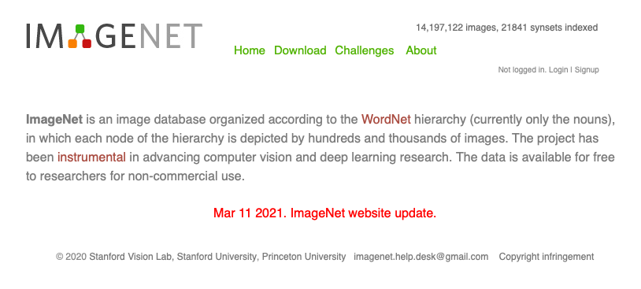
ImageNet

Slide 121
https://www.image-net.org
A synset is WordNet's terminology for a synonym ring. WordNet is a database of English words grouped into sets of synonyms. WordNet's synsets are often useful in information retrieval and natural language processing tasks to discover when two different words can mean similar things
https://machinelearning.wtf/terms/synset/

Slide 122
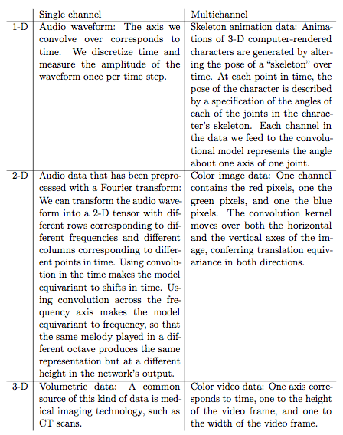
Example of different
data types for CNNs

Slide 123
When Not to Use Convolution
The use of convolution for processing variably sized inputs makes sense only for inputs that have variable size because they contain varying amounts of observation of the same kind of thing—diﬀerent lengths of recordings over time, diﬀerent widths of observations over space, etc.
Convolution does not make sense if the input has variable size because it can optionally include diﬀerent kinds of observations.
Example: if we are processing college applications, and our features consist of both grades and standardized test scores, but not every applicant took the standardized test, then it does not make sense to convolve the same weights over features corresponding to the grades as well as the features corresponding to the test scores.

Slide 124
Topics in Convolutional Networks
Overview
The Convolution Operation
Motivation
Pooling
Convolution and Pooling as an Infinitely Strong Prior
Variants of the Basic Convolution Function
Structured Outputs
Data Types
Efficient Convolution Algorithms
Random or Unsupervised Features
The Neuroscientific Basis for Convolutional Networks
11. Convolutional Networks and the History of Deep Learning

Slide 125
Efficient Convolution
When a d-dimensional kernel can be expressed as the outer product of d vectors, one vector per dimension, the kernel is called separable. When the kernel is separable, naive convolution is ineﬃcient.
It is equivalent to composed one-dimensional convolutions with each of these vectors. The composed approach is signiﬁcantly faster than performing one d-dimensional convolution with their outer product.
The kernel also takes fewer parameters to represent as vectors.If the kernel is w elements wide in each dimension, then naive multidimensional convolution requires O(w^{d}) runtime and parameter storage space, while separable convolution requires O(w × d) runtime and parameter storage space. Not every convolution can be represented in this way.

Slide 126
Topics in Convolutional Networks
Overview
The Convolution Operation
Motivation
Pooling
Convolution and Pooling as an Infinitely Strong Prior
Variants of the Basic Convolution Function
Structured Outputs
Data Types
Efficient Convolution Algorithms
Random or Unsupervised Features
The Neuroscientific Basis for Convolutional Networks
11. Convolutional Networks and the History of Deep Learning

Slide 127
Reduced Cost of Training
Typically, the most expensive part of convolutional network training is learning the features,
Three basic strategies for obtaining convolution kernels without supervised training.
Initialize them randomly.
Design them by hand, for example, by setting each kernel to detect edges at a certain orientation or scale.
Learn the kernels with an unsupervised criterion.

Slide 128
Topics in Convolutional Networks
Overview
The Convolution Operation
Motivation
Pooling
Convolution and Pooling as an Infinitely Strong Prior
Variants of the Basic Convolution Function
Structured Outputs
Data Types
Efficient Convolution Algorithms
Random or Unsupervised Features
The Neuroscientific Basis for Convolutional Networks
11. Convolutional Networks and the History of Deep Learning

Slide 129
A bit of history:
Hubel & Wiesel, 1959
RECEPTIVE FIELDS OF SINGLE NEURONES IN
THE CAT'S STRIATE CORTEX
1962
RECEPTIVE FIELDS, BINOCULAR INTERACTION
AND FUNCTIONAL ARCHITECTURE IN THE CAT'S VISUAL CORTEX
1968...
Cat image by CNX OpenStax is licensed under CC BY 4.0; changes made
Lecture 5 -

Slide 130
A bit of history
Human brain
Topographical mapping in the cortex:
nearby cells in cortex represent nearby regions in the visual field
Visual cortex
Retinotopy images courtesy of Jesse Gomez in the Stanford Vision & Perception Neuroscience Lab.
Lecture 5 -

Slide 131
Hierarchical organization
Illustration of hierarchical organization in early visual pathways by Lane McIntosh, copyright CS231n 2017
Lecture 5 -

Slide 132
A bit of history:
Neocognitron
[Fukushima 1980]
“sandwich” architecture (SCSCSC…) simple cells: modifiable parameters complex cells: perform pooling
Lecture 5 -

Slide 133
Topics in Convolutional Networks
Overview
The Convolution Operation
Motivation
Pooling
Convolution and Pooling as an Infinitely Strong Prior
Variants of the Basic Convolution Function
Structured Outputs
Data Types
Efficient Convolution Algorithms
Random or Unsupervised Features
The Neuroscientific Basis for Convolutional Networks
11. Convolutional Networks and the History of Deep Learning

Slide 134
A bit of history...
The Mark I Perceptron machine was the first implementation of the perceptron algorithm.
The machine was connected to a camera that used 20×20 cadmium sulfide photocells to produce a 400-pixel image.
recognized
letters of the alphabet
update rule:
Frank Rosenblatt, ~1957: Perceptron
This image by Rocky Acosta is licensed under CC-BY 3.0
Lecture 5 -
134
Fei-Fei Li & Justin Johnson & Serena Yeung Lecture 5 - April 18, 2017

Slide 135
A bit of history...
Widrow and Hoff, ~1960: Adaline/Madaline
These figures are reproduced from Widrow 1960, Stanford Electronics Laboratories Technical Report with permission from Stanford University Special Collections.
Lecture 5 -
135
Fei-Fei Li & Justin Johnson & Serena Yeung Lecture 5 - April 18, 2017

Slide 136
A bit of history...
recognizable math
Illustration of Rumelhart et al., 1986 by Lane McIntosh, copyright CS231n 2017
Rumelhart et al., 1986: First time back-propagation became popular
Lecture 5 -
136
Fei-Fei Li & Justin Johnson & Serena Yeung Lecture 5 - April 18, 2017

Slide 137
A bit of history:
Gradient-based learning applied to document recognition
[LeCun, Bottou, Bengio, Haffner 1998]
LeNet-5
Lecture 5 -

Slide 138
A bit of history...
[Hinton and Salakhutdinov 2006]
Reinvigorated research in Deep Learning
Illustration of Hinton and Salakhutdinov 2006 by Lane McIntosh, copyright CS231n 2017
Lecture 5 -
138
Fei-Fei Li & Justin Johnson & Serena Yeung Lecture 5 - April 18, 2017

Slide 139
A bit of history:
ImageNet Classification with Deep Convolutional Neural Networks [Krizhevsky, Sutskever, Hinton, 2012]
Figure copyright Alex Krizhevsky, Ilya Sutskever, and Geoffrey Hinton, 2012. Reproduced with permission.
“AlexNet”
Lecture 5 -

Slide 140
First strong results
Acoustic Modeling using Deep Belief Networks
Abdel-rahman Mohamed, George Dahl, Geoffrey Hinton, 2010
Context-Dependent Pre-trained Deep Neural Networks for Large Vocabulary Speech Recognition
George Dahl, Dong Yu, Li Deng, Alex Acero, 2012
Imagenet classification with deep convolutional neural networks
Alex Krizhevsky, Ilya Sutskever, Geoffrey E Hinton, 2012
Illustration of Dahl et al. 2012 by Lane McIntosh, copyright CS231n 2017
Figures copyright Alex Krizhevsky, Ilya Sutskever, and Geoffrey Hinton, 2012. Reproduced with permission.
Lecture 5 -
140
Fei-Fei Li & Justin Johnson & Serena Yeung Lecture 5 - April 18, 2017

Slide 141
Best deep CNN architectures and their principles: from AlexNet to EfficientNet
Nikolas Adaloglou (1/21/21)
https://theaisummer.com/cnn-architectures/

Slide 142
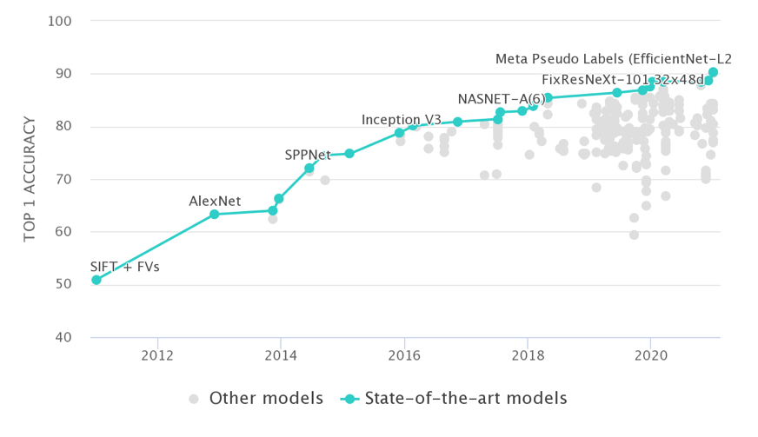
Progress of CNN Architectures on ImageNet
https://paperswithcode.com/sota/image-classification-on-imagenet

Slide 143
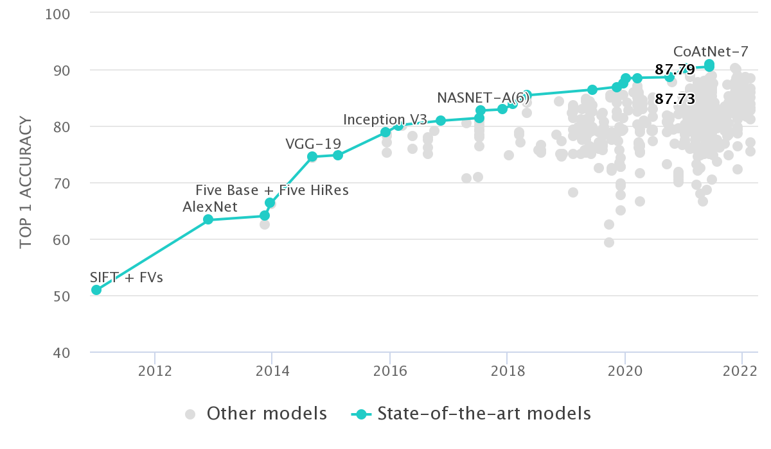
Progress of CNN Architectures on ImageNet
https://paperswithcode.com/sota/image-classification-on-imagenet

Slide 144
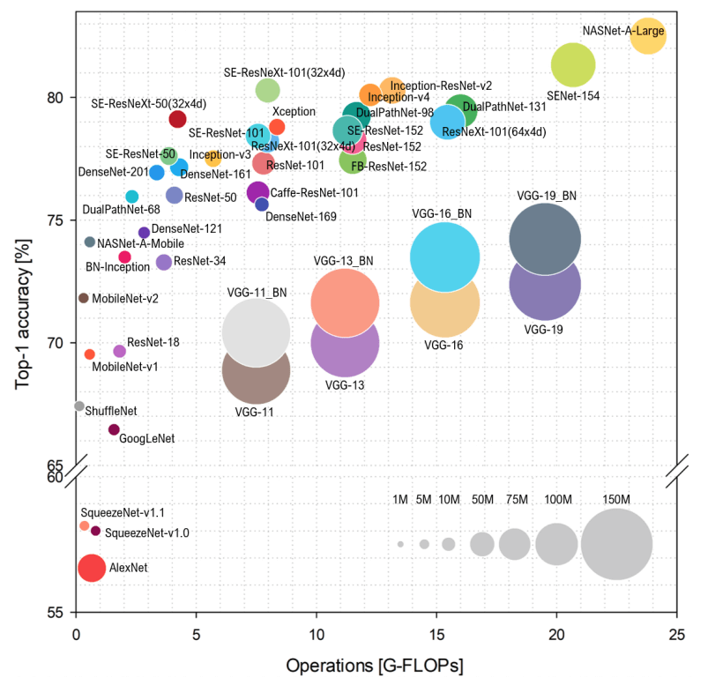
Accuracy vs G-FLOPs
Number of parameters does
not mean greater accuracy!
Number of parameters
Bianco ‘18, arXiv

Slide 145
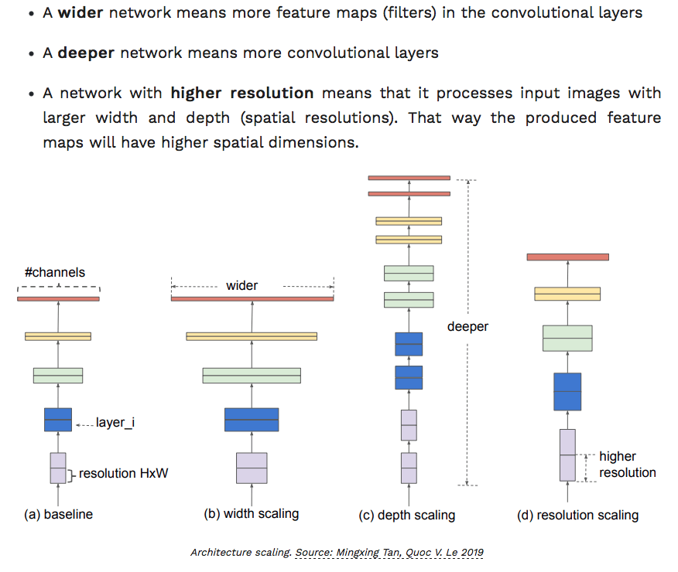
Focus on Scaling

Slide 146
Types of Scaling
Individual scaling:
With more layers (depth) one can capture richer and more complex features, but such models are hard to train (due to the vanishing gradients)
Wider networks are much easier to train. They tend to be able to capture more fine-grained features but saturate quickly.
By training with higher resolution images, convnets are in theory able to capture more fine-grained details. Again, the accuracy gain diminishes for quite high resolutions
Compound scaling:
Scale up network depth (more layers), width (more channels per layer), resolution (input image) simultaneously

Slide 147
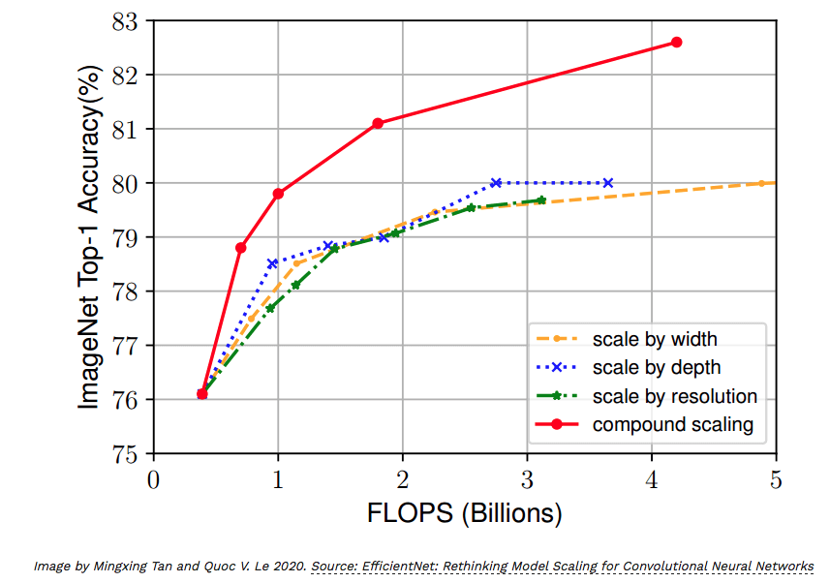
Compound Scaling – EfficientNet-B0

Slide 148
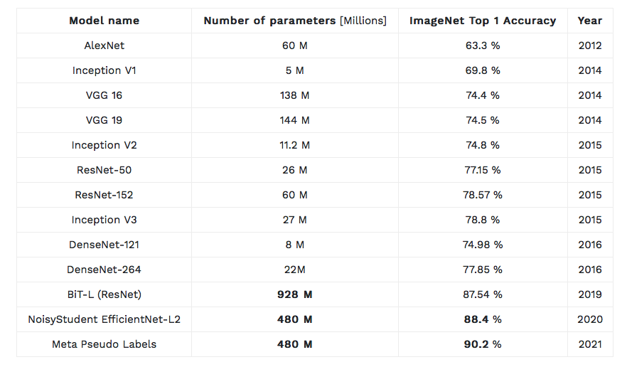
Summary of ConvNet Results
Big nets can win

Slide 150
Topics in Convolutional Networks
The Convolution Operation
Motivation
Pooling
Convolution and Pooling as an Infinitely Strong Prior
Variants of the Basic Convolution Function
Structured Outputs
Data Types
Efficient Convolution Algorithms
Random or Unsupervised Features
The Neuroscientific Basis for Convolutional Networks
Convolutional Networks and the History of Deep Learning

Slide 151
Why are CNNs so Good?
Maybe they’re not
Classification problems are overrated
Idiot savant problems (just need a good AI idiot savant)
Do not have autonomous driving with only a CNN
Most serious AI problems are stateful, CNNs are not
So are many stateful problems in physics, chemistry, biology, economics and engineering
But many stateful problems have stateless components
What is the difference and how do we know what to use?
Open question(s)!!!
How to mix stateful and stateless problems in a meaningful way!
See this already with CNNs combined with RNNs

Slide 152
Popular CNNs
LeNet-5
AlexNet
VGG-16
Inception-v1
ResNet-50

