Slide 1
Deep Feedforward Networks
Thanks to Sargur Srihari, Alexander Ororbia, Christopher Olah, Ray Mooney

Slide 2
What did we learn last time
ML as a 4 stage recipe for all ML
Capacity
  Ability to learn or represent
Bias vs variance
  Over fitting vs under fitting
Effect of training set size
Generalization error tradeoffs
Intro to Regularization & hyperparamaters

Slide 3
What did we learn last time
Measures
  MSE
  Maximum likelihood as a cost function
VC dimension as a measure of model capacity
PAC measures of computational learning
No free lunch theorem
  No silver bullet algorithm – many deep learning architectures need be considered

Slide 4
Algorithmic complexity – big O
Measures of hardness (complicated; many issues remain open)
Decidable
  Tractable
    Reasonable
      Practical
      Impractical
    Unreasonable
  Intractable
  NP (contains Polynomial class)
Undecidable
Many AI/ML problems undecidable
No matter what the class, approximations are often used

Slide 5
Specifically
Definition of a learning algorithm
How fitting data differs from generalizing to new data (optimization vs generalization)
ML algorithms have hyperparameters determined outside of learning algorithm – how to determine using additional data
Statistical approaches: frequentist vs Bayesian
Supervised versus unsupervised learning
Optimization using stochastic gradient descent (skipped)
Combining components into an ML algorithm
  Optimization, cost function, model, and dataset
Factors that have limited traditional ML to generalize
  Motivating deep learning to overcome these obstacles

Slide 6
Today
Graphs for computation
1.Stochastic Gradient Descent (SGD)
2.Perceptrons & example Learning XOR
3.Gradient-Based Learning
4.Hidden Units
5.Architecture Design
6.Backpropagation and Other Differentiation
7.Historical Notes

Slide 7
Stochastic Gradient Descent (SGD)
Nearly all deep learning is powered by one very important algorithm: SGD
SGD is an extension of the gradient descent algorithm
A recurring problem in machine learning:
  large training sets are necessary for good generalization
  but large training sets are also computationally expensive to train

Slide 8
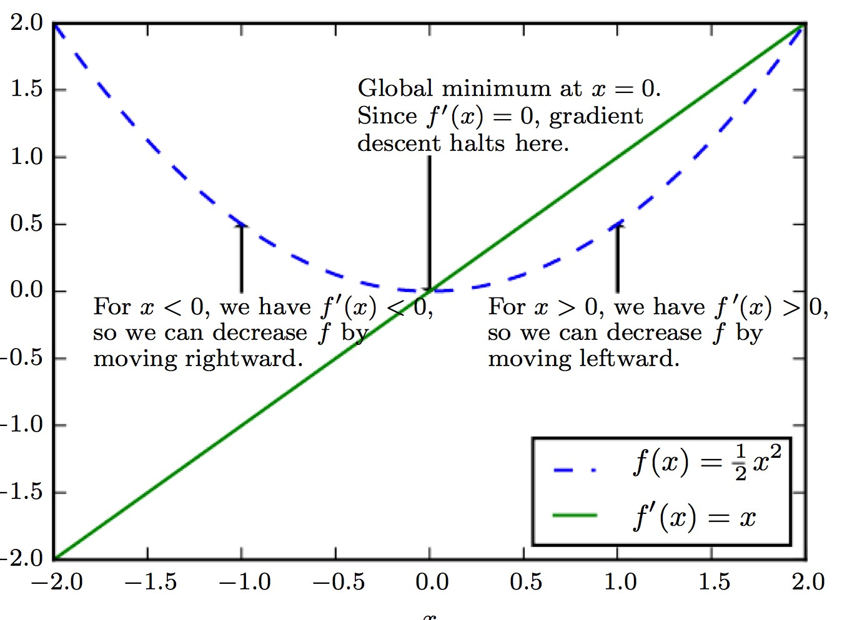
Method of Gradient Descent
Criterion f(x) is minimized by moving from the current solution in direction of the negative of gradient
Steepest descent proposes a new point
x' = x − ε∇_{x} f (x)
– where ε is the learning rate, a scalar set to a small constant.

Slide 9
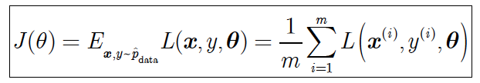
Cost function is sum over samples
Criterion in machine learning is a cost function
Cost function often decomposes as a sum of per sample loss function
– E.g., Negative conditional log-likelihood of training data is
where m is the number of samples and
L is the per-example loss L(x,y,θ)= - log p(y|x;θ)

Slide 10
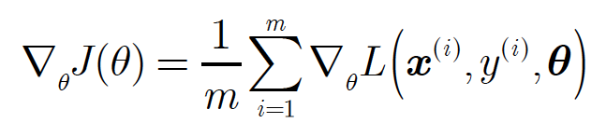
Gradient is also sum over samples
For these additive cost functions, gradient descent requires computing
Computational cost of this operation is O(m)
As training set size grows to billions, time taken for single gradient step becomes prohibitively long

Slide 11
Insight of SGD
Insight: Gradient descent is an expectation
  Expectation may be approximated using small set of samples
In each step of SGD we can sample a
minibatch of examples B ={x⁽¹⁾,..,x^{(m’)}}
  drawn uniformly from the training set
  Minibatch size m’ is typically chosen to be small: 1
to a hundred
    Crucially m’ is held fixed even if sample set is in billions
    We may fit a training set with billions of examples using updates computed on only a hundred examples

Slide 12


SGD Estimate on minibatch
Estimate of gradient can be written as
– using examples from minibatch B
SGD then follows the estimated gradient downhill
– where ε is the learning rate

Slide 13
How good is SGD?
In the past gradient descent was regarded as slow and unreliable
Application of gradient descent to non-convex optimization problems was regarded as unprincipled
SGD is not guaranteed to arrive at even a local minumum in reasonable time
But it often finds a very low value of the cost function quickly enough

Slide 14
SGD and Training Set Size
SGD is the main way to train large linear models on very large data sets
For a fixed model size, the cost per SGD update does not depend on the training set size m
As m→ ∞ model will eventually converge to its best possible test error before SGD has sampled every example in the training set
Asymptotic cost of training a model with SGD is
O(1) as a function of m

Slide 15
Feedforward Neural Networks:
quintessential deep learning models
Deep Feedforward Networks are also called as
  Feedforward neural networks or
  Multilayer Perceptrons (MLPs)
Their Goal is to approximate some function f *
  E.g., a classifier y = f * (x) maps an input x to a category y
  Feedforward Network defines a mapping
y = f * (x ; θ )
    and learns the values of the parameters θ that result in
the best function approximation

Slide 16
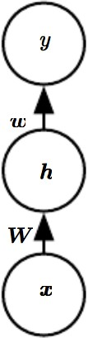
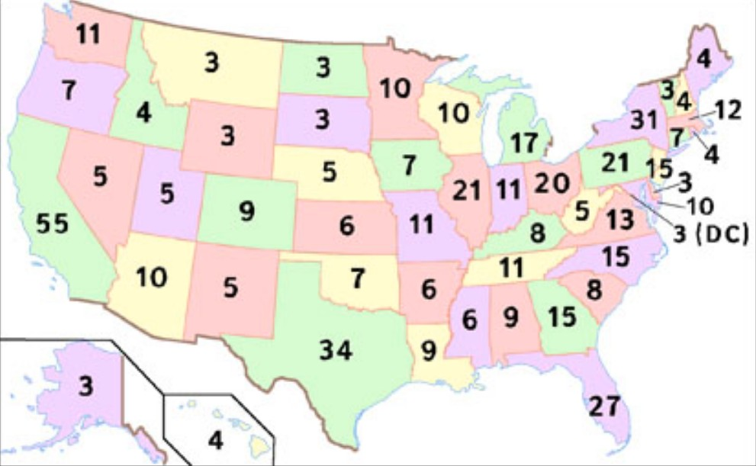
Feedforward Network
Models are called Feedforward because:
  Information flows through function being evaluated from x through intermediate computations used to define f and finally to output y
There are no feedback connections
  No outputs of the model are fed back
US Presidential Election
Inputs are raw votes cast
Hidden layer is electoral college
Output are candidates
4

Slide 17
Perceptrons
Single layer neural networks have been well analyzed
Preceded layered networks

Slide 18
Artificial Neuron Model
Model network as a graph with cells as nodes and synaptic connections as weighted edges from node i to node j, w_{ji}
Model net input to cell as
Cell output is:
1
w₁₂
w₁₅
w₁₆
w₁₃
w₁₄
2
3
4
5
6
o_{j}
1
(T_{j} is threshold for unit j)
0
T_{j}
net_{j}

Slide 19
Neural Computation
McCollough and Pitts (1943) showed how such model neurons could compute logical functions and be used to construct finite-state machines.
Can be used to simulate logic gates:
  AND: Let all w_{ji} be T_{j}/n, where n is the number of inputs.
  OR: Let all w_{ji} be T_{j}
  NOT: Let threshold be 0, single input with a negative weight.
Can build arbitrary logic circuits, sequential machines, and computers with such gates.
Given negated inputs, two layer network can compute any boolean function using a two level AND-OR network.

Slide 20
Perceptron Training
Assume supervised training examples giving the desired output for a unit given a set of known input activations.
Learn synaptic weights so that unit produces the correct output for each example.
Perceptron uses iterative update algorithm to learn a correct set of weights.

Slide 21
Perceptron Learning Rule
Update weights by:
where η is the “learning rate”
t_{j} is the teacher specified output for unit j.
Equivalent to rules:
  If output is correct do nothing.
  If output is high, lower weights on active inputs
  If output is low, increase weights on active inputs
Also adjust threshold to compensate:

Slide 22
Perceptron Learning Algorithm
Iteratively update weights until convergence.
Each execution of the outer loop is typically called an epoch.
Initialize weights to random values
Until outputs of all training examples are correct
For each training pair, E, do:
Compute current output o_{j} for E given its inputs
Compare current output to target value, t_{j ,} for E
Update synaptic weights and threshold using learning rule

Slide 23
Perceptron as a Linear Separator
Since perceptron uses linear threshold function, it is searching for a linear separator that discriminates the classes.
o₃
??
Or hyperplane in
n-dimensional space
o₂

Slide 24
Concept Perceptron Cannot Learn
Cannot learn exclusive-or (XOR), or parity function in general.
o₃
1
+
–
??
–
+
0
o₂
1

Slide 25
Perceptron Limits
System obviously cannot learn concepts it cannot represent.
Minksy and Papert (1969) wrote a book analyzing the perceptron and demonstrating many functions it could not learn.
These results discouraged further research on neural nets; and symbolic AI became the dominate paradigm.

Slide 26
Perceptron Convergence and Cycling Theorems
Perceptron convergence theorem: If the data is linearly separable and therefore a set of weights exist that are consistent with the data, then the Perceptron algorithm will eventually converge to a consistent set of weights.
Perceptron cycling theorem: If the data is not linearly separable, the Perceptron algorithm will eventually repeat a set of weights and threshold at the end of some epoch and therefore enter an infinite loop.
  By checking for repeated weights+threshold, one can guarantee termination with either a positive or negative result.

Slide 27
Perceptron as Hill Climbing
The hypothesis space being search is a set of weights and a threshold.
Objective is to minimize classification error on the training set.
Perceptron effectively does hill-climbing (gradient descent) in this space, changing the weights a small amount at each point to decrease training set error.
For a single model neuron, the space is well behaved with a single minima.
training
error
0
weights

Slide 28
Perceptron Performance
Linear threshold functions are restrictive (high bias) but still reasonably expressive; more general than:
  Pure conjunctive
  Pure disjunctive
  M-of-N (at least M of a specified set of N features must be present)
In practice, converges fairly quickly for linearly separable data.
Can effectively use even incompletely converged results when only a few outliers are misclassified.
Experimentally, Perceptron does quite well on many benchmark data sets.

Slide 29
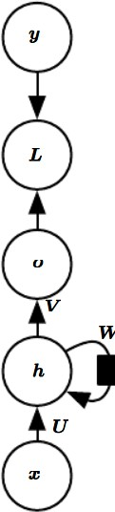
Feedforward vs. Recurrent
When feedforward neural networks are extended to include feedback connections they are called Recurrent Neural Networks
Feedforward networks are stateless
  Except when being trained
How much of a stateful problem can they learn?

Slide 30
Importance of Feedforward Networks
They are extremely important to ML practice
Form basis for many commercial applications
  Convolutional networks are a special kind of feedforward networks
    used for recognizing objects from photos
  They are a conceptual stepping stone on path to recurrent networks
    Which power many NLP applications

Slide 31
Feedforward Neural Network Structures
They are called networks because they are composed of many different functions
Model is associated with a directed acyclic graph describing how functions composed
  E.g., functions f ⁽¹⁾, f ⁽²⁾, f ⁽³⁾ connected in a chain to form f (x)= f ⁽³⁾ [ f ⁽²⁾ [ f ⁽¹⁾(x)]]
    f ⁽¹⁾ is called the first layer of the network
    f ⁽²⁾ is called the second layer, etc
These chain structures are the most commonly
used structures of neural networks

Slide 32
Definition of Depth
Overall length of the chain is the depth of the model
The name deep learning arises from this terminology
Final layer of a feedforward network is called the output layer

Slide 33
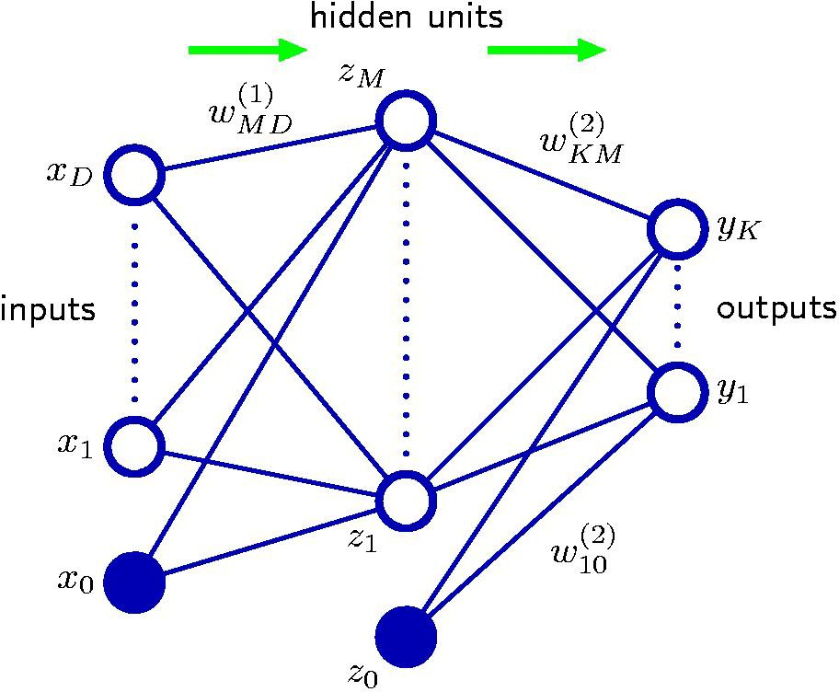
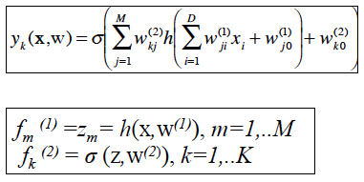
A Feed-forward Neural Network
K outputs y₁,..y_{K} for a given input x
Hidden layer consists of M units

Slide 34
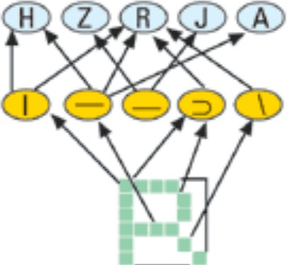
Example of Feedforward Network
Optical Character Recognition (OCR)
Hidden layer compares raw pixel inputs to component patterns

Slide 35
Training the Network
In network training we drive f(x) to match f*(x)
Training data provides us with noisy, approximate examples of f*(x) evaluated at different training points
Each example accompanied by label y ≈ f*(x)
Training examples specify directly what the output layer must do at each point x
– It must produce a value that is close to y

Slide 36
What are Hidden Layers?
Behavior of other layers is not directly specified by the data
Learning algorithm must decide how to use those layers to produce value that is close to y
Training data does not say what individual layers should do
Since the desired output for these layers is not shown, they are called hidden layers

Slide 37
Networks and Neuroscience
These networks are loosely inspired by neuroscience
Each hidden layer is typically vector-valued
  Dimensionality of hidden layer is width of the model
  Each element of vector viewed as a neuron
  Instead of thinking of it as a vector-vector function, they are regarded as units in parallel
Each unite receives inputs from many other units and computes its own activation value

Slide 38
Function Approximation as a goal
Choice of functions f ^{(i)}(x):
  Loosely guided by neuroscientific observations about biological neurons
    Modern neural networks are guided by many mathematical and engineering disciplines
    Not perfectly model the brain
Think of feedforward networks as function approximation machines
  Designed to achieve statistical generalization
  Occasionally draw insights from what we know about the brain
  Rather than as models of brain function

Slide 39
Extending Linear Models
To represent non-linear functions of x apply linear model not to x but to a transformed input ϕ(x) where ϕ is a nonlinear model
  The SVM kernel trick obtains a nonlinearity
SVM: f (x)=w^{T}x+b written as b + Σ_{i} α_{i} ϕ(x) ϕ(x^{(i)})
    Choose k(x,x^{(i)})=ϕ(x) ϕ(x^{(i)})
    Use linear regression on Lagrangian for weights α_{i}
    Evaluate f over samples for non-zero (support vectors)
ϕ provides a set of features describing x
So, replace x by function ϕ(x)

Slide 40


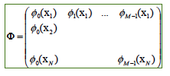


View as Extension of Linear Models
Start with linear models and see limitations
– Linear regression:
Simple closed form solutions:
Or solved with convex optimization:
Logistic regression: y(x,w)= σ (w^{T}φ (x))
  No closed-form solution
Convex Optimization:
If ϕ (x) =x model capacity is limited to linear functions and model has no understanding of
interaction between any two input variables

Slide 41
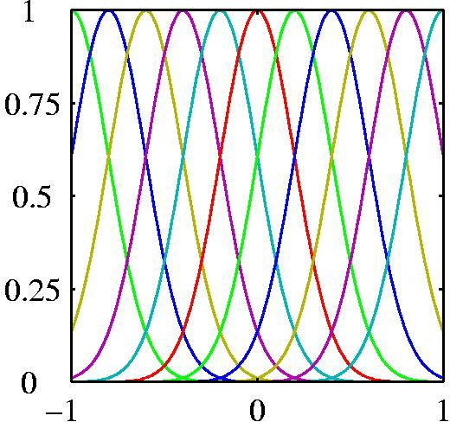
How to choose ϕ
Generic feature function ϕ (x)
RBF: N(x; x^{(i)}, σ²I) centered at x^{(i)}
Manually engineer ϕ
  Dominant approach until arrival of deep learning
  Required much effort over time
    e.g., speech recognition, computer vision
  Labor intensive
  Nontransferable between domains
Principle of Deep Learning: Learn ϕ
Approach used in deep learning

Slide 42
Approach 3: Learn Features
Model is y=f (x;θ,w) = ϕ(x;θ)^{T} w
– θ used to learn ϕ from broad class of functions
Parameters w map from ϕ (x) to outputs
Example of a feedforward NN where ϕ defines a hidden layer
Unlike the other two (basis functions or manual engineering), this approach gives-up on convexity of training
– But its benefits outweigh other costs

Slide 43
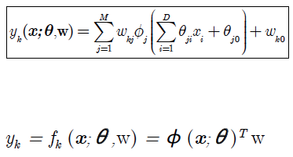
Extend Linear Methods to Learn ϕ
ϕ_{M}
^{θ}MD
^{w}KM
K outputs y₁,..y_{K} for a given input x
Hidden layer consists of M units
ϕ₁
^{w}10
ϕ₀
Can be viewed as a generalization of linear models
Nonlinear function f_{k} with M+1 parameters w_{k}= (w_{k0} ,..w_{kM} ) with
M basis functions, ϕ_{j} j=1,..M each with D parameters θ_{j}= (θ_{j1},..θ_{jD})
Both w_{k} and θ_{j} are learnt from data

Slide 44
Approaches to Learning ϕ
Parameterize the basis functions as ϕ(x;θ)
  Use optimization to find θ that corresponds to a good representation
This has the benefit of first approach (fixed basis functions) by being highly generic
  Use a broad family for ϕ(x;θ)
Can also capture benefits of second approach
  Human practitioners design families of ϕ(x;θ) that will perform well
  Need only find right general function family rather than finding the precisely right function

Slide 45
Importance of Learning ϕ
Learning ϕ will be discussed beyond this introduction to feed-forward networks
  Recurring theme throughout deep learning applicable to all kinds of models
Feedforward networks are an application of this principle which learns deterministic mappings from x to y that lack feedback connections
Applicable to topics such as
  learning stochastic mappings
  functions with feedback
  learning probability distributions over a single vector

Slide 46
Topics
Overview
1.Example: Learning XOR 2.Gradient-Based Learning 3.Hidden Units 4.Architecture Design
5.Backpropagation and Other Differentiation 6.Historical Notes

Slide 47
Plan of Discussion: Feedforward Networks
A simple example: learning XOR
Design decisions for a feedforward network
  Many are same as designing a linear model
    Basics of gradient descent
      Choosing the optimizer, cost function, form of output units
  Some are unique
    Concept of hidden layer
      Makes it necessary to have activation functions
    Architecture of network
      How many layers , how are they connected to each other, how many units in each later
    Learning requires gradients of complicated functions
– Backpropagation and modern generalizations

Slide 48
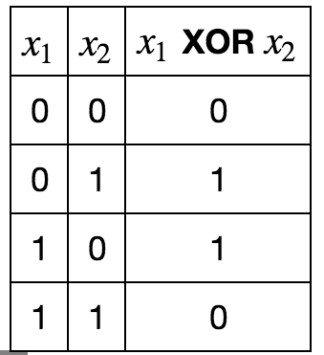
1. Ex: XOR problem
XOR: an operation on binary variables x₁ and x₂
  When exactly one value equals 1 it returns 1
otherwise it returns 0
  Target function is y=f *(x) which we want to learn
    Our model is y =f ([x₁, x₂] ; θ) where we learn or adapt parameters θ to make it similar to f *
Not concerned with statistical generalization
  Perform correctly on four training points:
X={[0,0]^{T}, [0,1]^{T},[1,0]^{T}, [1,1]^{T}}
Challenge is to fit the training set
  We want f ([0,0]^{T}; θ) = f ([1,1]^{T}; θ) = 0
f ([0,1]^{T}; θ) = f ([1,0]^{T}; θ) = 1

Slide 49

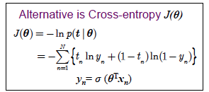


ML for XOR: linear model doesn’t fit
Treat as regression with MSE loss function
Usually not used for binary data
Math is straightforward
We must choose the form of the model
Consider a linear model with θ ={w,b} where
– Minimize
to get closed-form solution
Differentiate wrt w and b to obtain w = 0 and b=½
– Then the linear model f(x;w,b)=½ simply outputs 0.5 everywhere
– Why does this happen?

Slide 50
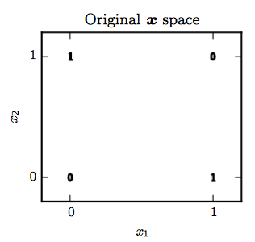
Linear model cannot solve XOR
Bold numbers are values system must output
  When x₁=0, output has to increase with x₂
  When x₁=1, output has to decrease with x₂
  Linear model f (x;w,b)= x₁w₁+x₂w₂+b has to assign a single weight to x₂, so it cannot solve this problem
A better solution:
Use a model to learn a different representation
  Such that a linear model is able to represent the solution
Lets use a simple feedforward network
  one hidden layer containing two hidden units

Slide 51
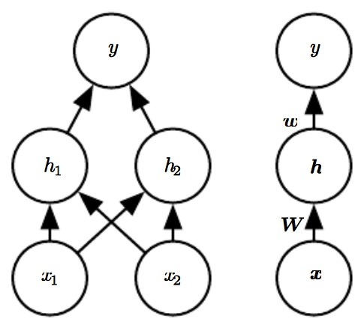
Feedforward Network for XOR
Introduce a simple feedforward network
  with one hidden layer containing two units
Same network drawn in two different styles
  Matrix W describes mapping from x to h
  Vector w describes mapping from h to y
  Intercept parameters b are omitted

Slide 52
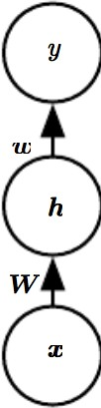
Functions computed by Network
Layer 1 (hidden layer): vector of hidden units h computed by function f ⁽¹⁾(x; W,c)
  c are bias variables
Layer 2 (output layer) computes
f ⁽²⁾(h; w,b)
  w are linear regression weights
– Output is linear regression applied to h
rather than to x
Complete model is
f (x; W,c,w,b)=f ⁽²⁾(f ⁽¹⁾(x))

Slide 53
Linear vs Nonlinear functions
If we choose both f ⁽¹⁾ and f ⁽²⁾ to be linear, the total function will still be linear f (x)=x^{T}w’
– Suppose f ⁽¹⁾(x)= W^{T}x and f ⁽²⁾(h)=h^{T}w
– Then we could represent this function as
f (x)=x^{T}w’ where w’=Ww
f (x)=x^{T}w’
Since linear is insufficient, we must use a nonlinear function to describe the features
  Use the design of neural networks by using a nonlinear activation function
h=g(W^{T}x+c)
28

Slide 54
Activation Function
In linear regression we used a vector of weights
w and scalar bias b
f (x;w,b) = x^{T}w + b
– This describes an affine transformation from an input vector to an output scalar
Now we describe an affine transformation from a vector x to a vector h, so an entire vector of bias parameters is needed
Activation function g is typically chosen to be applied element-wise h_{i}=g(x^{T}W:,_{i}+c_{i})

Slide 55
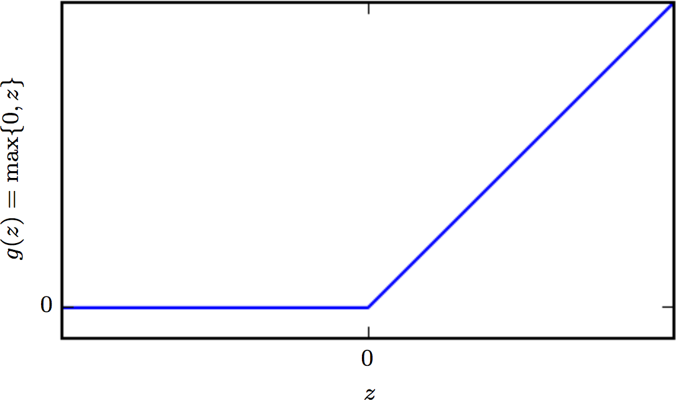
Default Activation Function
Activation: g(z)=max{0,z}
  Applying this to the output of a linear transformation yields a nonlinear transformation
  However function remains close to linear
    Piecewise linear with two pieces
    Therefore preserve properties that make linear models easy to optimize with gradient-based methods
    Preserve many properties that make linear models generalize well
Rectified Linear Unit (ReLU)
Computer Science:
Build complicated
systems from minimal components.
A Turing Machine Memory needs only 0
and 1 states.
We can build Universal Function approximator from ReLUs

Slide 56
Specifying the Network using ReLU
Activation: g(z)=max{0,z}
We can now specify the complete network as
f (x; W,c,w,b)=f ⁽²⁾(f ⁽¹⁾(x))=w^{T} max {0,W^{T}x+c}+b

Slide 57

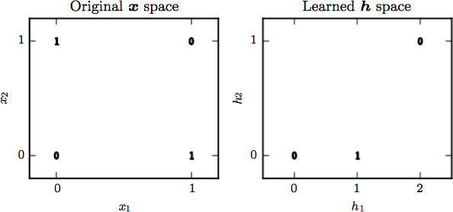
Steps of XOR Solution
Let
f (x; W,c,w,b)=
w^{T} max {0,W^{T}x+c}+b
Step through how our model processes a
batch of inputs
⎡ ⎤
⎢ 0 0 ⎥
⎢ ₀ ₁ ⎥
⎥
1 0
⎢ 1 1
Design matrix X of all four points:
⎢
⎡ ⎤
⎢ 0 0 ⎥
⎢ ₁ ₁ ⎥
⎥
1 1
X = ⎢
⎥
⎢
⎥
⎦
First step is XW:
⎡
⎤
⎢
⎣
⎢ 0 −1 ⎥
1 0
1 0
⎢⎣ 2 1 ⎥⎦
XW = ⎢
⎥
⎥
In this space all points lie
⎢
⎥
⎢
⎥
Adding c: along a line with slope 1. Cannot
⎢
⎥
⎢ 2 2 ⎦⎥
XW + c = ⎢
⎥
⎣
be implemented by a linear model
⎢
⎥
Compute h Using ReLU
⎢
⎥
⎡ ₀ ₀ ⎤
⎢ ⎥
⎢ ⎥
1 0
1 0
⎢⎣ 2 1 ⎥⎦
Has changed relationship among examples. They no longer lie on a single line.
max{0, XW + c} = ⎢
⎥
⎢
⎥
⎢
⎥
⎢
⎥
A linear model suffices
Finish by multiplying by w:
⎡
⎢
⎢
f (x) = ⎢
⎢
0
1
1
⎤
Network has obtained
correct answer for all 4 examples
⎥
⎥
⎥
⎢
⎥
⎢ 0
⎥
⎦
⎣
32

Slide 58
Learned representation for XOR
Two points that must have output 1 have been collapsed into one
Points x=[0,1]^{T} and x=[1,0]^{T} have been mapped into h=[0,1]^{T}
When x₁=0, output has to increase with x₂
When x₁=1, output has to decrease with x₂
Described in linear model
– For fixed h₂, output increases in h
When h₁=0, output is constant 0 with h₂
When h₁=1, output is constant 1 with h₂
When h₁=2, output is constant 0
1
with h₂

Slide 59
About the XOR example
We simply specified the solution
  Then showed that it achieves zero error
In real situations there might be billions of parameters and billions of training examples
  So one cannot simply guess the solution
Instead gradient descent optimization will find parameters that produce very little error
  The solution described is at the global minimum
    Gradient descent could converge to this solution
    Convergence depends on initial values
    Would not always find easily understood integer solutions

Slide 60
Topics
Overview
1.Example: Learning XOR 2.Gradient-Based Learning 3.Hidden Units 4.Architecture Design
5.Backpropagation and Other Differentiation 6.Historical Notes

Slide 61
Gradient-based Learning
Overview
Cost Functions
  Learning Conditional Distributions with Max Likelihood
  Learning Conditional Statistics
Output Units
  Linear Units for Gaussian Output Distributions
  Sigmoid Units for Bernoulli Output Distributions
  Softmax Units for Multinoulli Output Distributions
  Other Output Types

Slide 62
Overview of Gradient-based Learning

Slide 63
Standard ML Training vs NN Training
Neural Network training is not different from ML models that use gradient descent.
This requires
  optimization procedure, e.g., gradient descent
  cost function, e.g., MLE
  model family, e.g., linear with basis functions
Difference: nonlinearity causes nonconvex loss
Use iterative gradient-based optimizers that drives cost to a low value, rather than
  Exact linear equation solvers used for linear regression or
  convex optimization algorithms used for logistic regression or SVMs

Slide 64
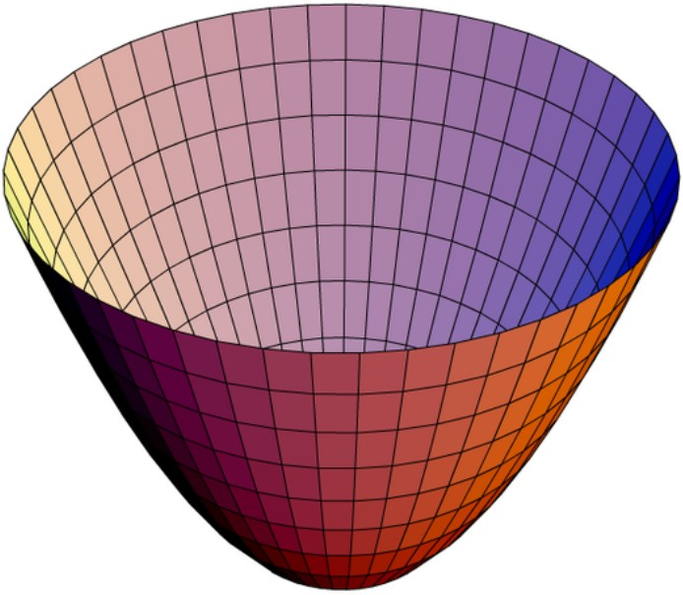
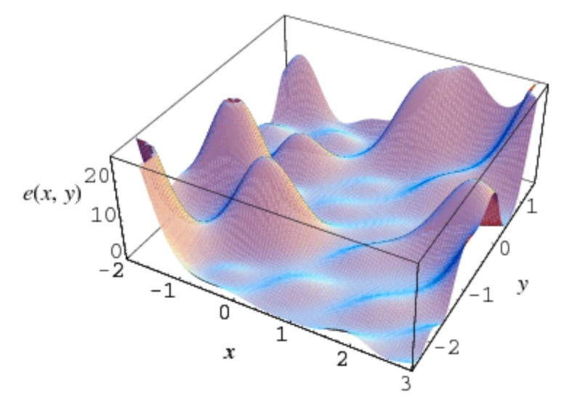
Convex vs Non-convex
Convex methods:
Linear Regression with Basis Functions:
2
1
N
∑{ }
E (w) =
t −w
T
ϕ(x )
D
² n=1
n
n
Converge from any initial parameters
Robust-- but can encounter numerical problems
SGD with non-convex:
  Sensitive to initial parameters
  For feedforward networks, important to initialize
    Weights to small values, biases to zero or small positives
  SGD can also train Linear Regression and SVM especially with large training sets
  Training neural net similar to training other models
Except computing gradient is more complex

Slide 65
Cost Functions

Slide 66

Cost Functions for Deep Learning
Important part of design of deep neural networks is the cost function
– They are similar to those for parametric models such as linear models
Parametric model: logistic regression
– Binary Training data defines a likelihood
p(y |x ;θ)
– and we use the principle of maximum likelihood
J(θ) = −ln p(t | θ) = −∑{t_{n} ln y_{n} +(1 − t_{n} )ln(1 − y_{n} )}
n=1
N
Cost function: cross-entropy between training data t_{n} and the model’s prediction y_{n}
Gradient of the error function is
Using dσ(a)/da =σ(1-σ)
∇J(θ) = ∑(y_{n} − t_{n} )φ_{n}
n=1
N

Slide 67

Learning Conditional Distributions with maximum likelihood
Specifying the model p(y|x) automatically determines a cost function log p(y|x)
– Equivalently described as the cross-entropy between the training data and the model distribution
J(θ) = −E_{x,y∼pˆ} log p_{model}(y | x)
data
Gaussian case:
  If p_{model}(y|x) =N ( y| f (x ; θ), I)
then we recover the mean squared error cost
J(θ) = − ¹ E
2
y − f (x;θ) + const
2
x,y∼pˆ_{data}
upto a scaling factor ½ and a term independent of θ
– const depends on the variance of Gaussian which we chose not to parameterize

Slide 68
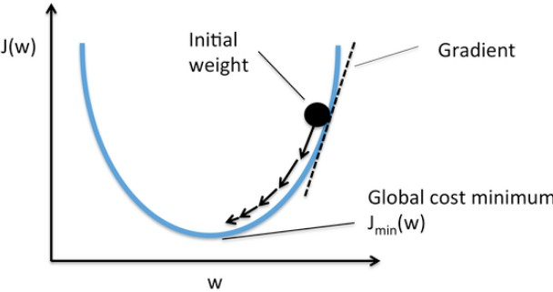
Desirable Gradient Property
Recurring theme in neural network design is:
  Gradient must be large and predictable enough to serve as good guide to the learning algorithm
Functions that saturate (become very flat) undermine this objective
  This is because the gradient becomes very small
    Happens when activation functions producing output of hidden/output units saturate

Slide 69
Keeping the Gradient Large
Negative log-likelihood helps avoid saturation problem for many models
  Once saturated, learning is slow if at all
  Many output units involve exponential functions that saturate when its argument is very negative
  Log function in negative log likelihood cost function undoes exponential outputs of some units

Slide 70
Cross Entropy and Gradient
Property of cross-entropy cost used for max likelihood is that it does not have a minimum value
  For discrete output variables, they cannot represent probability of zero or one but can come arbitrarily close
    Logistic Regression is an example
  For real-valued output variables it becomes possible to assign extremely high density to correct training set outputs, e.g, variance parameter of Gaussian output, and cross-entropy approaches negative infinity
Regularization modifies learning problem so model cannot reap unlimited rewards this way

Slide 71
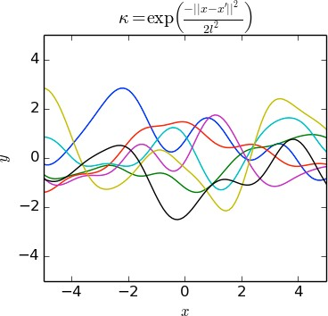
Learning Conditional Statistics
Instead of learning a full probability distribution, learn just one conditional statistic of y given x
  E.g., we may have a predictor f (x ;θ) which gives the mean of y
Consider a neural network as being powerful method to determine any function f
  This function is limited only by
    boundedness and
    continuity
    but not having a specific parameteric form
  From this point of view, a cost function is a functional rather than a function

Slide 72
Cost Function vs Cost Functional
Cost function is a functional, not a function
  A functional is a mapping from functions to real numbers and takes other functions as an argument
Then, learning is the task of choosing a function rather than a set of parameters
Cost functional has a minimum that occurs at a function we desire
  E.g., Design the cost functional to have a minimum of that lies on function that maps x to the expected value of y given x

Slide 73
Optimization via Calculus of Variations
Solving the optimization problem requires a mathematical tool: calculus of variations
  E.g., Minimum of Cost functional is:
    function that maps x to the expected value of y given x
Need to understand that calculus of variations can be used to derive two results

Slide 74
First Result from Calculus of Variations
Solving the optimization problem
f * = arg min E_{x,y∼pˆ} y - f(x)
2
f
data
yields
f *(x) = E
⎡_{y}⎤
y∼p_{data} ( y|x) ⎢⎣ ⎥⎦
which means if we could train infinitely many samples from the true data generating distribution
– minimizing MSE gives a function that predicts the
mean of y for each value of x

Slide 75
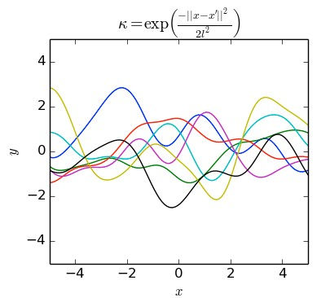
Second Result from Calculus of Variations
A different cost function is
f * = arg min E_{x,y~p} || y - f(x) ||₁
f
data
yields a function that minimizes the median of y for each each x
Referred to as mean absolute error
MSE/median saturate: produce small gradients
  This is one reason cross-entropy cost is more popular than mean square error and mean absolute error
    Even when it is not necessary to estimate the entire
distribution p(y|x)

Slide 76
Output Units

Slide 77
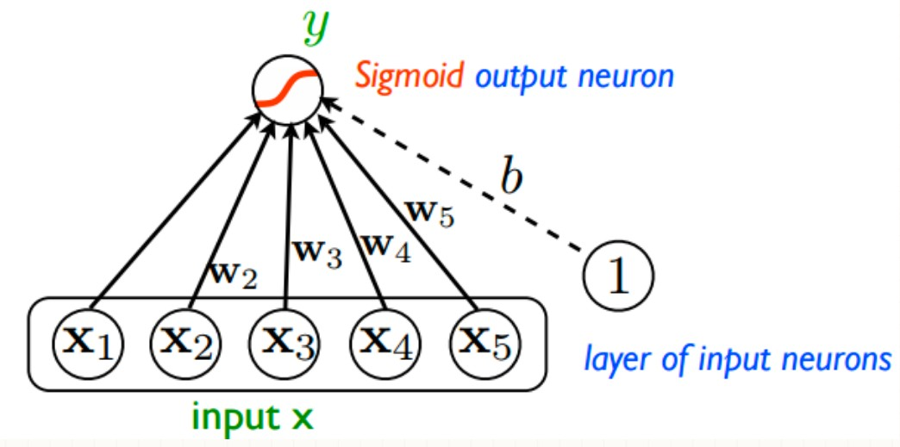
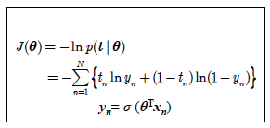
Output Units
Choice of the cost function is tightly coupled to choice of output units
  Much of the time use cross-entropy between data distribution and model distribution
    Choice of how to represent the output then determines the form of the cross-entropy function
Cross-entropy in logistic regression
θ={w,b}

Slide 78
Role of Output Units
Any output unit is also usable as a hidden unit
A feedforward network provides a hidden set of
features h =f (x ; θ)
Role of output layer is to provide some additional transformation from the features generated before the output layer

Slide 79
Types of output units
Linear units: no nonlinearity
– for Gaussian Output distributions
Sigmoid units
  for Bernoulli Output Distributions
Softmax units
  for Multinoulli Output Distributions
Other Output Types
  Not direct prediction of y but provide parameters of distribution over y

Slide 80
Linear Units for Gaussian Output Distributions
Linear unit: simple output based on affine transformation with no nonlinearity
– Given features h, a layer of linear output units produces a vector
yˆ =W^{T}h + b
Linear units are often used to produce the mean yˆ of a conditional Gaussian distribution
P(y | x) = N(y;yˆ,I )
Maximizing the output is equivalent to using MSE cost function
Can be used to learn the covariance of a Gaussian

Slide 81
Sigmoid Units for Bernoulli Output Distributions
Task of predicting value of binary variable y
  Classification problem with two classes
Maximum likelihood approach is to define a Bernoulli distribution over y conditioned on x
Neural net needs to predict p(y=1|x)
  which lies in the interval [0,1]
Additional restrictions
P(y = 1 | x) = max{0, min {1,w^{T}h + b}}
– Use
Defines a valid conditional distribution, but cannot train it effectively with gradient descent
A gradient of 0: learning algorithm cannot be guided

Slide 82
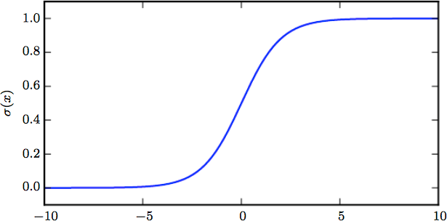
Sigmoid and Logistic Regression
Using sigmoid always gives a strong gradient
– Sigmoid output units combined with maximum
likelihood
yˆ = σ (w^{T}h + b)
where σ (x) is the logistic sigmoid f
σ(x ) = ¹
unction:
1 + exp(−x)
Sigmoid output unit has two components:
1. A linear layer to compute
z = w^{T}h + b
2. Use sigmoid activation function to convert z into a
probability

Slide 83

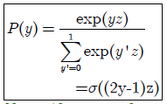
Probability distribution using Sigmoid
Describe probability distribution over y using z
z = w^{T}h + b
y is output, z is input
Construct unnormalized probability distribution P!
  Assuming unnormalized log probability is linear in y and z
Normalizing yields a Bernoulli distribution controlled by σ
Probability distributions based on exponentiation and normalization are common throughout statistical modeling
  z variable defining such a distribution over binary
variables is called a logit

Slide 84
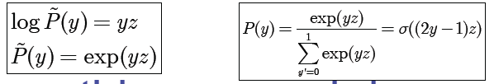
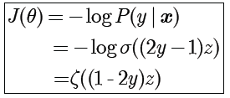
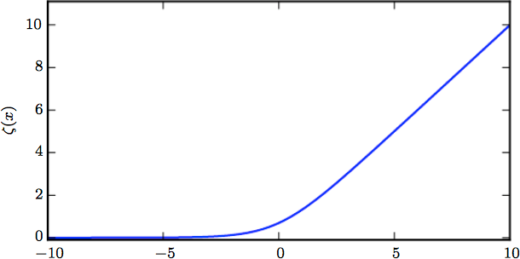
Max Likelihood Loss Function
Given binary y and some z, an normalized probability distribution over y is
Use this approach in maximum likelihood learning
– Loss for max likelihood learning is –log P(y|x)
ζ is the softplus function
This is for a single sample

Slide 85
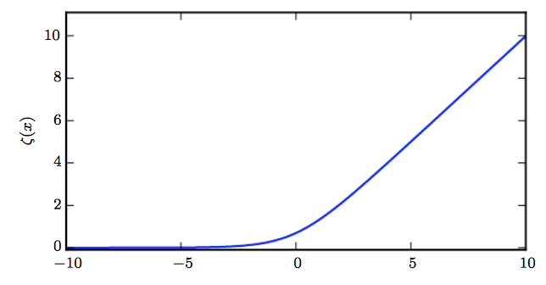
Softplus function
Sigmoid saturates when its argument is very positive or very negative
  i.e., function is insensitive to small changes in input
Softplus function - generalization of sigmoid
ζ(x) = log(1+ exp(x))
  Its range is (0,∞) & arises in expressions involving sigmoids.

Slide 86
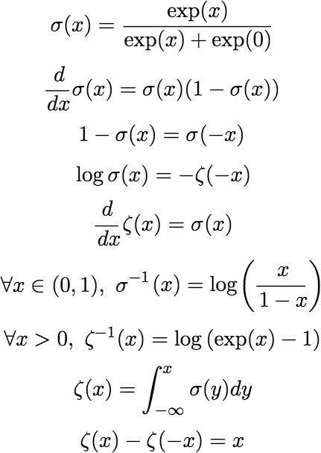
Properties of Sigmoid & Softplus
Last equation provides justification for the name ‘softplus’
Smoothed version of positive part function
x⁺=max{0,x}
The positive part function is the counterpart of the negative part function x ⁻=max{0,-x}

Slide 87
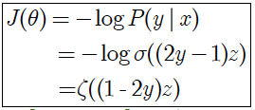
Loss Function Bernoulli Max LE
By rewriting the loss in terms of the softplus function, we can see that it saturates only when (1-2y)z <<0.
Saturation occurs only when model already has the right answer
  i.e., when y=1 and z>>0 or y=0 and z <<0
  When z has the wrong sign (1-2y)z can be simplified to |z|
    As |z| becomes large while z has the wrong sign, softplus asymptotes towards simply returning argument |z| & derivative wrt z asymptotes to sign(z), so, in the limit of extremely incorrect z softplus does not shrink the gradient at all
    This is a useful property because gradient-based learning can act quickly to correct a mistaken z

Slide 88
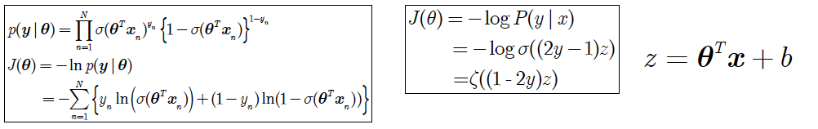
Cross-Entropy vs Softplus Loss
Cross-entropy loss can saturate anytime σ(z)
saturates
  Sigmoid saturates to 0 when z becomes very negative and saturates to 1 when z becomes very positive
Gradient can shrink to too small to be useful for learning, whether model has correct or incorrect answer
We have provided an alternative implementation of logistic regression!

Slide 89
Softmax units for Multinoulli Output
For a probability distribution over a discrete variable with n values can use the softmax function
  Can be seen as a generalization of sigmoid function used to represent probability distribution over a binary variable
Softmax most often used for output of classifier to represent distribution over n classes
Multinoulli special case of multinomial distribution

Slide 90

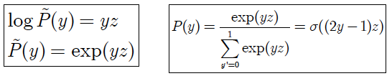
From Sigmoid to Softmax
For binary outputs, desire one number
yˆ = P(y = 1 | x )
Since (i) this number needed to lie between 0 and 1 and
(ii) because we wanted its logarithm to be well-behaved for a gradient-based optimization of log-likelihood, we chose instead to predict a number
Exponentiating and normalizing, gave us a Bernoulli distribution controlled by the sigmoidal transformation of z
For n values: need to produce vector yˆ
with values
yˆ_{i} = P(y = i | x)

Slide 91
Softmax definition
Produces a vector yˆ with values
yˆ_{i} = P(y = i | x)
  Elements of y^{ˆ} lie in [0,1] and sum to 1
For multinoulli distribution
  a linear layer predicts unnormalized log probabilities
z =W^{T}h+b
– where
z_{i} = log P^{ˆ}(y = i | x)
Softmax can then exponentiate and normalize z
to obtain the desired ^{yˆ}
Softmax is given by:
exp(z_{i} )
softmax(z) =
∑ exp(z )
i
j
j

Slide 92
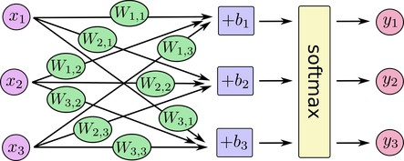


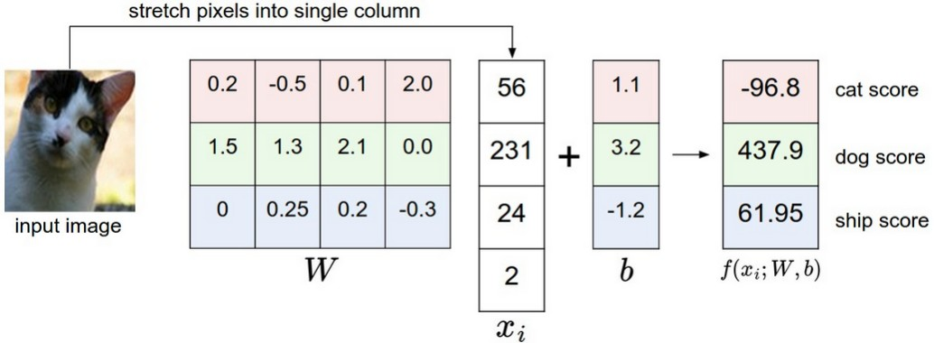
Softmax Regression
Generalization of Logistic Regression to multivalued output
Softmax definition
y = softmax(z)_{i}
exp(z_{i} )
=
∑_{j} exp(z_{j} )
Network Computes
In matrix multiplication notation
z =W^{T}x+b
An example

Slide 93
Intuition of Log-likelihood Terms
softmax(z) =
exp(z_{i} )
The exp within softmax works
i
∑ exp(z )
j j
very well when training using log-likelihood
– Log-likelihood can undo the exp of softmax
log softmax(z)_{i} = z_{i} − log ∑_{j} exp(z_{j} )
Input z_{i} always has a direct contribution to cost
  Because this term cannot saturate, learning can proceed even if second term becomes very small
First term encourages z_{i} to be pushed up
Second term encourages all z to be pushed down

Slide 94
Intuition of Second Term of Likelihood
Log likelihood is
log softmax(z)_{i} = z_{i} − log ∑_{j} exp(z_{j} )
Consider second term:
log ∑_{j} exp(z_{j} )
It can be approximated by max_{j} z_{j}
  Based on the idea that exp(z_{k}) is insignificant for any z_{k} noticeably less that max_{j} z_{j}
Intuition gained:
  Cost penalizes most active incorrect prediction
  If the correct answer already has the largest input to
softmax, then -z_{i} term and
log ∑_{j} exp(z_{j} ) ≈ max_{j} z_{j} = z_{i}
terms will roughly cancel. This example will then
contribute little to overall training cost
Which will be dominated by other incorrect examples

Slide 95
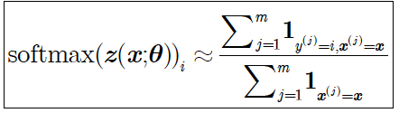
Generalization to Training Set
So far we discussed only a single example
Overall, unregularized maximum likelihood will drive the model to learn parameters that drive the softmax to predict a fraction of counts of each outcome observed in training set

Slide 96
Softmax and Objective Functions
Objective functions that do not use a log to undo the exp of softmax fail to learn when argument of exp becomes very negative, causing gradient to vanish
Squared error is a poor loss function for softmax units
– Fail to train model change its output even when the model makes highly incorrect predictions

Slide 97
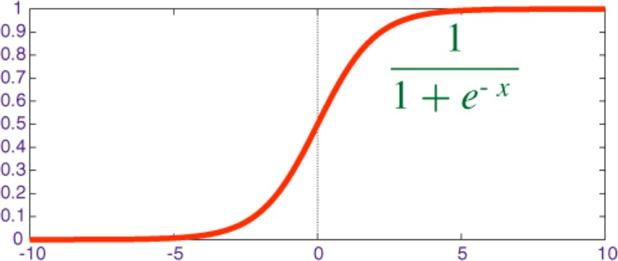
Saturation of Sigmoid and Softmax
Sigmoid has a single output that saturates
– When input is extremely negative or positive
Like sigmoid, softmax activation can saturate
  In case of softmax there are multiple output values
    These output values can saturate when the differences between input values become extreme
  Many cost functions based on softmax also saturate

Slide 98
Softmax & Input Difference
Softmax invariant to adding the same scalar to all inputs:
softmax(z) = softmax(z+c)
Using this property we can derive a numerically stable variant of softmax
softmax(z) = softmax(z – max_{i} z_{i})
Reformulation allows us to evaluate softmax
  With only small numerical errors even when z
contains extremely large/small numbers
  It is driven by amount that its inputs deviate from
max_{i} z_{i}

Slide 99
Saturation of Softmax
An output softmax(z)_{i} saturates to 1 when the corresponding input is maximal (z_{i}= max_{i} z_{i}) and z_{i} is much greater than all the other inputs
The output can also saturate to 0 when is not maximal and the maximum is much greater
This is a generalization of the way the sigmoid units saturate
– They can cause similar difficulties in learning if the loss function is not designed to compensate for it

Slide 100
Other Output Types
Linear, Sigmoid and Softmax output units are the most common
Neural networks can generalize to any kind of output layer
Principle of maximum likelihood provides a guide for how to design a good cost function for any output layer
– If we define conditional distribution p(y|x), principle of maximum likelihood suggests we use
log p(y|x) for our cost function

Slide 101
Determining Distribution Parameters
We can think of the neural network as representing a function f (x ; θ)
Outputs are not direct predictions of value of y
Instead f (x ; θ)=ω provides the parameters for a distribution over y
Our loss function can then be interpreted as
-log p(y ; ω(x))

Slide 102
Ex: Learning a Distribution Parameter
We wish to learn the variance of a conditional Gaussian of y given x
Simple case: variance σ² is constant
  Has closed-form expression: empirical mean of squared difference between observations y and their expected value
  Computationally more expensive approach
    Does not require writing special-case code
    Include variance as one of the properties of distribution
p(y |x) that is controlled by ω = f (x ; θ)
    Negative log-likelihood -log p(y ; ω(x)) will then provide cost function with appropriate terms to learn variance

Slide 103
Topics in Deep Feedforward Networks
Overview
Example: Learning XOR
Gradient-Based Learning
Hidden Units
Architecture Design
Backpropagation and Other Differentiation
Historical Notes

Slide 104
Hidden Units
ReLU and their generalizations
Logistic sigmoid and Hyperbolic tangent
Other hidden units

Slide 105
Choice of hidden unit
Design choices for neural networks are similar to those for parametric learning models trained with gradient optimization
What about hidden units in the hidden layers
Design of hidden units is an active research area that does not have much guidance in theory

Slide 106
Choice of hidden unit
ReLU (rectified linear unit) is an excellent default choice
When to use which kind (though ReLU is usually an acceptable choice)?
Motivations behind choice of hidden unit
  Difficult to predict in advance which will work best
  Design process is trial and error
    Evaluate performance on a validation set

Slide 107
Is Differentiability necessary?
Some hidden units are not differentiable at all input points
– Rectified Linear Function g(z)=max{0,z} is not differentiable at z=0
Does this invalidate use in gradient-based learning
In practice gradient descent still performs well enough for these models to be used

Slide 108
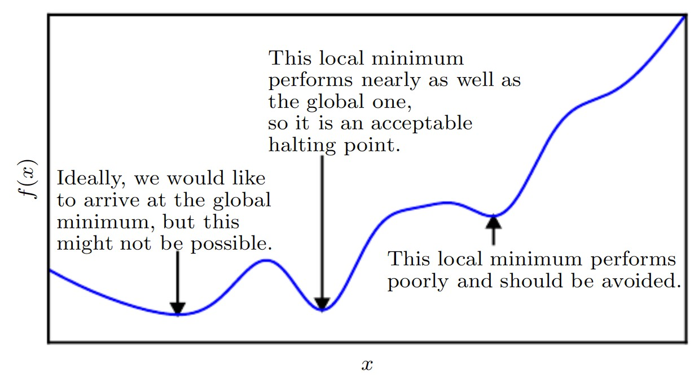
Differentiability ignored
Neural network training
  not usually arrives at a local minimum of cost function
Do not expect training to reach a point where gradient is 0,
  Accept minima to correspond to points of undefined gradient
Hidden units that are not differentiable are usually for only a small number of points

Slide 109


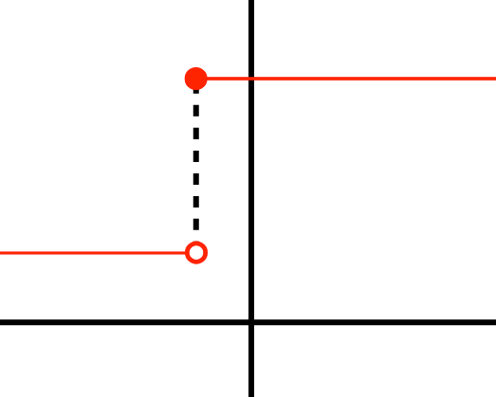
Left and Right Differentiability
Function g(z) has a left derivative defined by the slope immediately to the left of z
Right derivative defined by the slope of the function immediately to the right of z
Function is differentiable at z=a only if both
  the left derivative and
  the right derivative are equal
Function is not continuous: No derivative at marked point
However it has a right derivative at all points with δ₊f(a)=0 at all points

Slide 110
Software Reporting of Non-differentiability
In the case of g(z)=max{0,z}, the left derivative at z = 0 is 0 and right derivative is 1
Software for neural network training usually returns:
  one of the one-sided derivatives rather than reporting that derivative is undefined or in error
    When a function is asked to evaluate g(0), it is very unlikely that the underlying value was truly 0, instead it
was a small value ε that was rounded to 0

Slide 111
What a Hidden Unit Does
Accepts a vector of inputs x and computes an affine transformation z = W^{T}x+b
Computes an element-wise non-linear function
g(z)
Most hidden units are distinguished from each other by the choice of activation function g(z)
– Examples: ReLU, Sigmoid and tanh, and other hidden units

Slide 112
Rectified Linear Unit & Generalizations
Rectified linear units use the activation function
g(z)=max{0,z}
  They are easy to optimize due to their similarity to linear units
    Only difference with linear units that they output 0 across half their domain
    Derivative is 1 everywhere that the unit is active
    Allows gradient computation that is far more useful than with activation functions that have second-order effects

Slide 113
Use of ReLU
Usually used as an affine transformation
h=g(W^{T}x+b)
Good practice to set all elements of b to small value such as 0.1
– As such the ReLU will be initially active for most training samples and allow derivatives to work

Slide 114
Generalizations of ReLU
Perform comparably to ReLU and occasionally perform better
ReLU cannot learn on examples for which the activation is zero
Generalizations guarantee that they receive a gradient everywhere

Slide 115
Three Generalizations of ReLU
Three methods based on using a non-zero slope α_{i} when z_{i}<0:
h_{i}=g(z,α)_{i}=max(0,z_{i})+α_{i} min(0,z_{i})
  Absolute-value rectification:
    fixes α_{i}=-1 to obtain g(z)=|z|
  Leaky ReLU:
    fixes α_{i} to a small value like 0.01
  Parametric ReLU or PReLU:
    treats α_{i} as a parameter

Slide 116
Maxout Units
Maxout units another generalized ReLUs
Instead of applying element-wise function g(z), maxout units divide z into groups of k values
Each maxout unit then outputs the maximum element of one of these groups: g(z)_{i}=max_{jεG(i)}z_{j}
– where G(i) is the set of indices into the inputs for group i, {(i-1)k+1,..,ik}
Provides a way of learning a piecewise linear function that responds to multiple
directions in the input x space

Slide 117
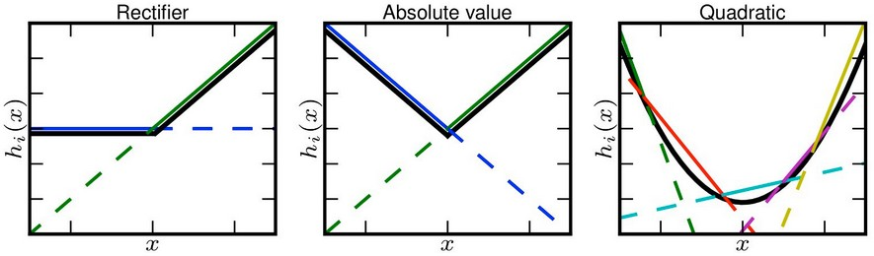
Maxout as Learning Activation
Maxout unit can learn a piecewise linear, convex function with up to k pieces
  Seen as learning the activation function itself rather than just the relationship between units
    With large enough k, approximate any convex function
– Maxout layer with two pieces can learn to implement the same function of the input x as a traditional layer using ReLU or its generalizations

Slide 118
Learning Dynamics of Maxout
Parameterized differently
Learning dynamics different even in case of implementing same function of x as one of the other layer types
  Each maxout unit parameterized by k weight vectors instead of one
    Requires more regularization than ReLU
    Can work well without regularization if training set is large and number of pieces per unit is kept low

Slide 119
Benefits of Maxout
Statistical and computational advantages by requiring fewer parameters
If the features captured by n different linear filters can be summarized without losing information by taking max over each group of k features, then next layer gets by with k times fewer weights
Because of multiple filters, their redundancy helps them avoid catastrophic forgetting
– Case where network forgets how to perform tasks they were trained to perform

Slide 120
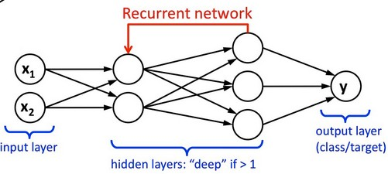
Principle of Linearity
ReLU based on principle that models are easier to optimize if their behavior is closer to linear
  Principle applies beyond deep linear networks
    Recurrent networks can learn from sequences and produce a sequence of states and outputs
Also when training need to propagate information through several steps
– Much easier for some linear computations where some directional derivatives are of magnitude near 1

Slide 121
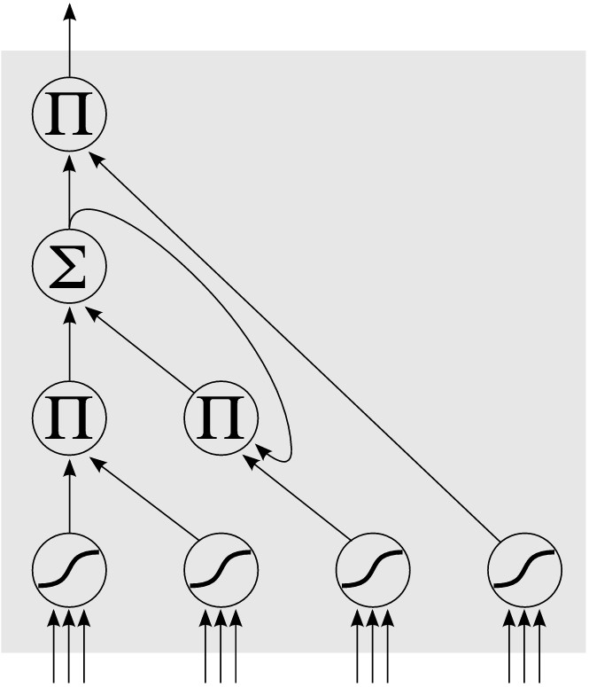
Linearity in LSTM
LSTM most used recurrent architecture
– Propagates information through time via summation
Has a type of linear activation
LSTM: an ANN that contains LSTM blocks in addition to
LSTM
Block
regular network units
y = ∑w_{i}x_{i}
Input gate: when its output is close to zero, it zeros the input
y = ∏x_{i}
Forget gate: when close to zero block forgets whatever value
it was remembering
y = σ(∑w_{i}x_{i} )
Conditional Input
Input gate
Forget gate
Output gate
Output gate: when unit should output its value
Determine when inputs are allowed to flow into block

Slide 122
Logistic Sigmoid
Prior to introduction of ReLU, most neural networks used logistic sigmoid activation
g(z)=σ(z)
Or the hyperbolic tangent
g(z)=tanh(z)
These activation functions are closely related because
tanh(z)=2σ(2z)-1
Sigmoid units are used to predict probability
that a binary variable is 1

Slide 123
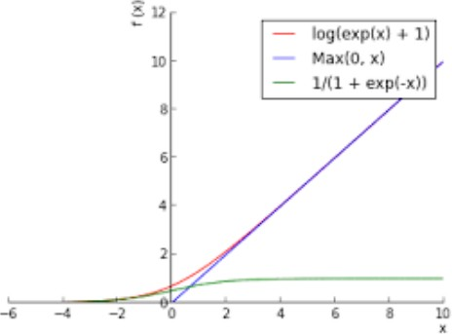
Sigmoid Saturation
Sigmoidals saturate across most of domain
  Saturate to 1 when z is very positive and 0 when z is very negative
  Strongly sensitive to input when z is near 0
  Saturation makes gradient-learning difficult
ReLU and Softplus increase for input >0
Sigmoid can still be used when cost function undoes the Sigmoid in the output layer

Slide 124
Sigmoid vs tanh Activation
Hyperbolic tangent typically performs better than logistic sigmoid
It resembles the identity function more closely
tanh(0)=0 while σ(0)=½
Because tanh is similar to identity near 0,
training a deep neural network
yˆ = w^{T} tanh(U^{T} tanh(V^{T}x ))
resembles training a linear model
yˆ = w^{T}U^{T}V^{T}x
so long as the activations can be kept small

Slide 125
Sigmoidal Units Still Useful
Sigmoids more common in settings other than feed forward networks
Recurrent networks, many probabilistic models, and autoencoders have additional requirements that rule out piecewise linear activation functions
Makes sigmoid units appealing despite saturation

Slide 126
Other Hidden Units
Many other types of hidden units possible, but used less frequently
  Feed-forward network using h = cos(Wx + b)
    on MNIST obtained error rate of less than 1%
– Radial Basis
⎛ ⎞
h = exp⎜−
1
_{σ}2
||W − x ||
2
⎟
i
⎝
:,i
⎟⎠
Becomes more active as x approaches a template W_{:,i}
– Softplus
g(a) = ζ(a) = log(1 + eª )
Smooth version of the rectifier
Hard tanh
  Shaped similar to tanh and the rectifier but it is bounded
g(a) = max(−1, min(1,a))

Slide 127
Topics
Overview
1.Example: Learning XOR 2.Gradient-Based Learning 3.Hidden Units 4.Architecture Design
5.Backpropagation and Other Differentiation 6.Historical Notes

Slide 128
Architecture Design
Chart of 27 neural network designs (generic)
Specific deep learning architectures
Architecture Terminology
Equations for Layers
Theoretical underpinnings
  Universal Approximation Theorem
  No Free Lunch Theorem
Advantages of deeper networks

Slide 129
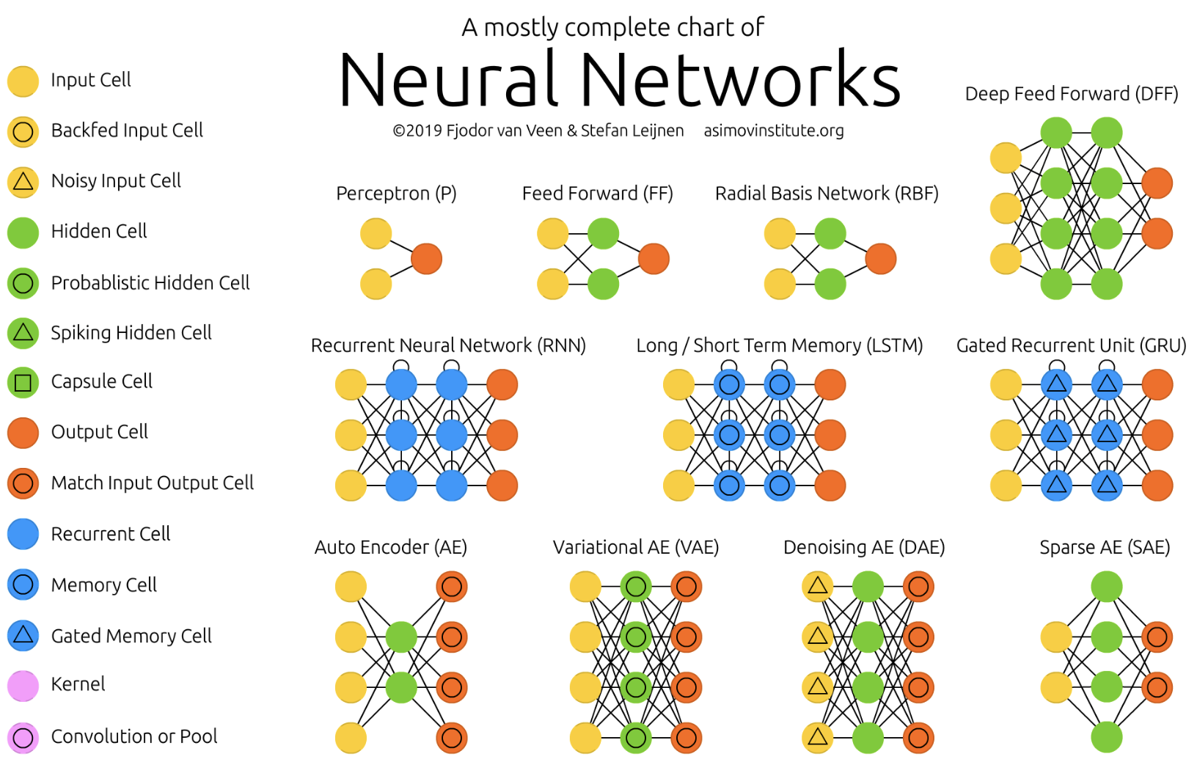
Generic Neural Architectures (1-11)
14 types of neurons

Slide 130
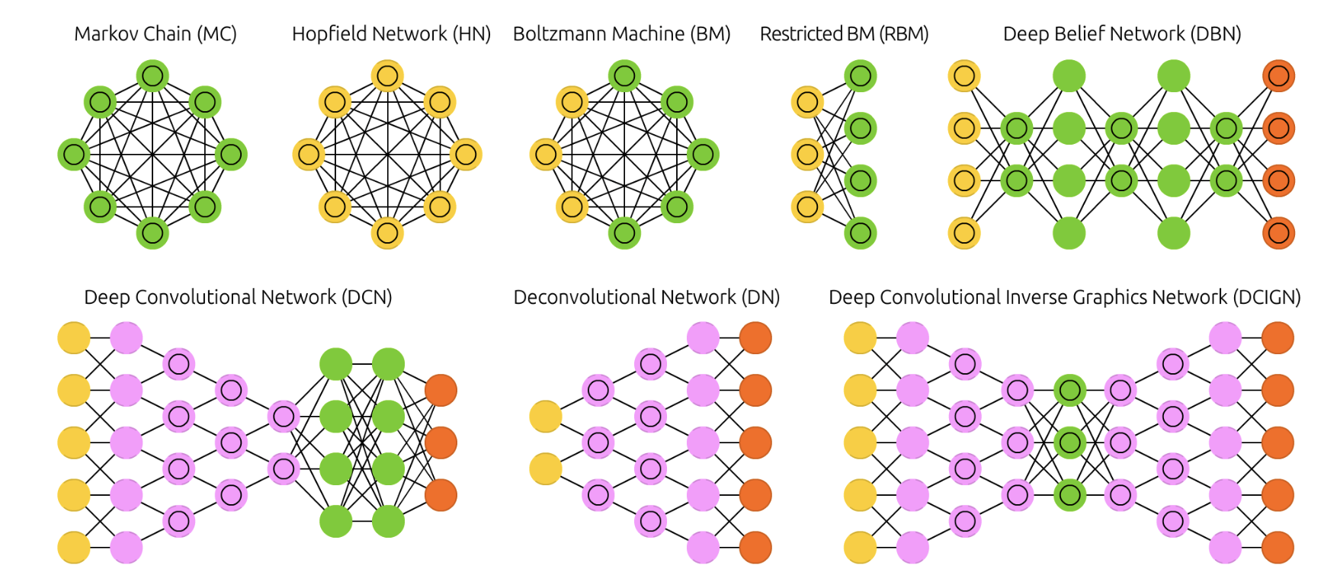
Generic Neural Architectures (12-19)

Slide 131
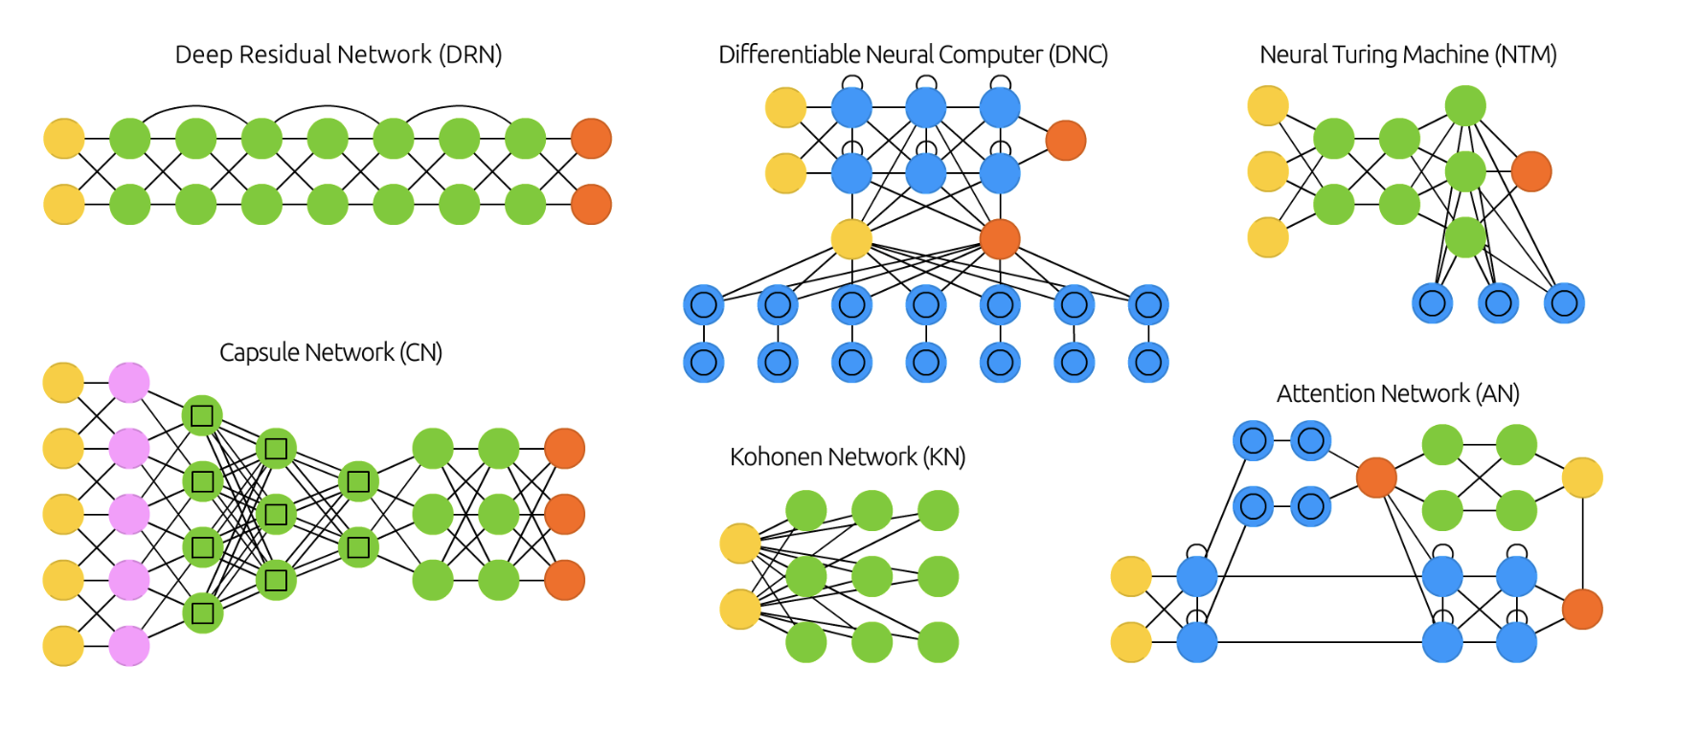
Generic Neural Architectures (20-26)

Slide 132
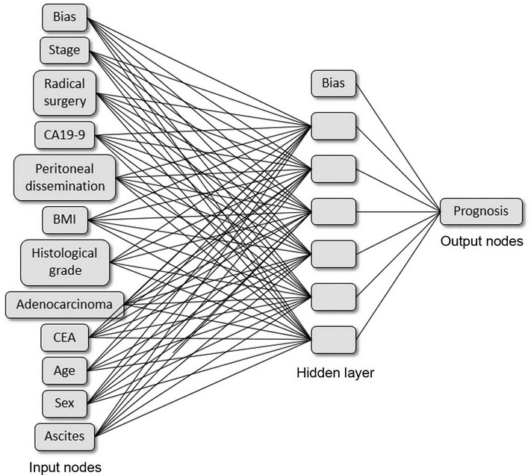

Specific Application Architectures
Cancer Prognosis
Architecture to study how images in the mind
can influence movements and motor skills (RNN)
7

Slide 133




An Architecture for Game Design

Slide 134


CNN Architectures
More complex features captured
In deeper
layers

Slide 135

Architecture Blending Deep Learning and Reinforcement Learning
Human Level Control Through Deep Reinforcement Learning

Slide 136
Architecture Terminology
Architecture refers to the overall structure of the network:
  How many units should it have?
  How are the units connected to each other?
Most neural networks are organized into units called layers
  Most neural network architectures arrange these layers in a chain structure
  Each layer a function of the layer that proceeded it

Slide 137



Equations for Layers
Organized units are layers
Layers are arranged in a chain structure
Each layer is a function of the layer that preceded it
  First layer is given by h⁽¹⁾=g⁽¹⁾(W^{(1)T}x + b⁽¹⁾)
  Second layer is h⁽²⁾=g⁽²⁾(W^{(2)T}x + b⁽²⁾), etc.
One Network layer
Network layer input
In matrix multiplication notation
12

Slide 138

Main Architectural Considerations
Choice of depth of network
Choice of width of each layer
Network with even one hidden layer is sufficient to fit a training set

Slide 139
Advantage of Deeper Networks
Deep networks usually have
  Far fewer units in each layer
  Far fewer parameters
  Often generalize well on the test set
  But are usually more difficult to optimize
Best network architecture must be found via experimentation guided by validation error

Slide 140
Theoretical Results
Mathematical theory regarding artificial neural networks
  Linear versus Nonlinear Models
  Universal Approximation Theorem
No Free Lunch Theorem
Size of network
Turing equivalence
…

Slide 141
Linear vs Nonlinear Models
A linear model with features to output via matrix multiplication only represents linear functions
  Easy to train
    Why - loss functions result in convex optimization
Often need to learn nonlinear functions
  Not necessary to define a family of nonlinear functions
  Why? Feedforward neural networks with hidden layers provide a universal approximation

Slide 142
Universal Approximation Theorem (UAP)
A feed-forward network with a single hidden layer containing a finite number of neurons can approximate continuous functions on compact subsets of R^{n}, under mild assumptions on the activation function (Borel measurable).
  Simple neural networks can represent a wide variety of interesting functions when given appropriate parameters
  However, it does address the algorithmic learnability of those parameters.

Slide 143
Formal Theorem
Let φ(⋅) be continuous (activation function)
  Non-constant, bounded, monotonic increasing function
– I_{m} is the unit hypercube [0,1]^{m} (m inputs, values in [0,1] )
Space of continuous functions on I_{m} is C(I_{m})
  Then, given any function f ∈ C(I_{m}) and ε>0, there exists an integer N, (no. of outputs)
  real constants v_{i},b_{i} ∈ R, (output weights, input bias)
  real vectors w_{i}∈R^{m}, i =1, ⋯ ,N, (input weights)
  such that we may define:
F(x) = ∑_{i=1,..N} v_{i}φ(w_{i} x+b_{i}) as an approximation of f
T
where f is independent of φ; i.e.,
|F(x)−f (x)|<εfor all x ∈ I_{m}
i.e., functions of the form F(x) are dense in C(I_{m})

Slide 144
Implication of UPT
A feedforward network with a linear output layer and at least one hidden layer with any “squashing” activation function (such as logistic sigmoid) can approximate:
  Any Borel measurable function from one finite-dimensional space to another
  With any desired non-zero amount of error
  Provided the network is given enough hidden units
The derivatives of the network can also approximate derivates of the function

Slide 145
Applicability of UPT
Any continuous function on a closed and bounded subset of R^{n} is Borel measurable
  Therefore approximated by a neural network
Discrete case:
  A neural network may also approximate any function mapping from any finite dimensional discrete space to another
Original theorems were for activations that saturate for very negative/positive arguments
  Now proved for a wider class of activation functions including ReLU

Slide 146
UPT and Training
Whatever function to be learned, a large MLP will be able to represent it
There are no guarantees that the training algorithm will learn this function!!
  Optimizing algorithms may not find the parameters
  May choose wrong function due to over-fitting
No Free Lunch: There is no universal procedure for examining a training set of samples and choosing a function that will generalize to points not in training set

Slide 147
Feed forward & No Free Lunch
Feed forward networks provide a universal system for representing functions
– Given a function, there is a feed forward network that approximates the function
There is no universal procedure for examining a training set of specific examples and choosing a function that will generalize to points not in training set

Slide 148
Size of the Network
Universal Approximation Theorem
  Implies there is a network large enough to achieve any degree of accuracy
  But does not say how large the network will be
Some bounds on size of the single-layer network exist for a broad class of functions
  Worst case is exponential number of hidden units
    No. of possible binary functions on vectors v ∈ {0,1}^{n} is
2²**^{n}
    Selecting one such function requires 2^{n} bits which will require O(2^{n}) degrees of freedom

Slide 149
Summary/Implications of UPT
A feedforward network with a single layer is sufficient to represent any function
However, the layer may be unreasonable large and may fail to generalize well
Using deeper models can reduce the number of units required and reduce generalization error

Slide 150
Function Families and Depth
Some families of functions can be represented efficiently for depth >d but require a much larger model for depth <d
In some cases number of hidden units required by a shallow model is exponential in n
  Functions representable with a deep rectifier net can require an exponential no. of hidden units with a shallow (one hidden layer) network
    Piecewise linear networks (which can be obtained from
rectifier nonlinearities or maxout units) can represent functions with a no. of regions that is exponential in d

Slide 151

Advantage of Deeper Networks
Absolute value rectification creates mirror images of function computed on top of some hidden unit wrt the input of that hidden unit.
Each hidden unit specifies where to fold the input space in order to create mirror responses.
By composing these folding operations we obtain an exponentially large no. of piecewise linear regions which can capture all kinds of repeating patterns
Has same output for every pair of mirror points in input. Mirror axis of symmetry
Is given by weights and bias
of unit. Function computed on top of unit (green decision
surface) will be a mirror image of simpler pattern across
axis of symmetry
Function can be obtained By folding the space around axis of
symmetry
Another repeating Pattern can be folded on Top of the first
(by another downstream
unit) to obtain another symmetry (which is now repeated four times with two hidden layers)

Slide 152

Montufar Theorem on Depth
Number of linear regions carved out by a deep rectifier network with d inputs, depth l and n units per hidden layer is
– i.e., exponential in the depth l.
In the case of maxout networks with k filters per unit, the number of linear regions is
_{O (k}(l−1)+d ₎
There is no guarantee that the functions we want to learn in AI share such a property

Slide 153
Statistical Justification for Depth
Any time we choose a ML algorithm, this means implicitly stating a set of beliefs about what kind of functions that algorithm should learn
Choosing a deep model implies a belief that the function should be a composition of several simpler functions

Slide 154
Intuition on Depth
The use of a deep architecture implies that the function we want to learn is a computer program consisting of m multiple steps where each step makes use of the previous step’s output
The intermediate outputs are not necessarily factors of variation, but can be analogous to counters or pointers used for organizing its internal processing
Empirically greater depth results in better
generalization

Slide 155


Empirical Results
Deeper networks perform better
Test accuracy consistently increases with depth
Increasing parameters without increasing depth is not as effective (depth, 3,3,11)
Deep architectures can express a useful prior over the space of functions the model learns

Slide 156
Other Architectural Considerations
Specialized architectures can have a significant impact!
Convolutional Networks
  Used for computer vision
Recurrent Neural Networks
  Used for sequence processing
  Have their own architectural considerations
  Handles stateful problems
    What is a stateful problem?

Slide 157
Nonchain Architecture
Layers connected in a chain is common
Skipping: can skip from layer i to layer i+2 or higher
– During learning, this makes it easier for a gradient to flow from output layers to a layer nearer its input

Slide 158
Connecting a Pair of Layers
Consider the default neural network layer described by a linear transformation via a matrix W
Every input unit connected to every output unit
Specialized networks have fewer connections
  Each unit in input layer is connected to only small subset of units in output layer
  Reduces number of parameters and computation for evaluation
  E.g., CNNs use specialized patterns of sparse connections that are effective for computer vision

Slide 159
Topics (Deep Feedforward Networks)
Overview
1.Example: Learning XOR 2.Gradient-Based Learning 3.Hidden Units 4.Architecture Design
Backpropagation and Other Differentiation Algorithms
Historical Notes

Slide 160
Backpropagation
Overview
Computational Graphs
Chain Rule of Calculus
Recursively applying the chain rule to obtain backprop
Backpropagation computation in fully-connected MLP
Symbol-to-symbol derivatived
General backpropagation
Ex: backpropagation for MLP training
Complications
Differentiation outside the deep learning community
Higher-order derivatives

Slide 161
Overview of Backpropagation

Slide 162
Forward Propagation
rning Srihari
Producing an output from input
  Let a Feed-Forward Network accept an input x and produce an output y^{ˆ} such that information x propagates through hidden units at each layer and finally produces the output yˆ
  This is called forward propagation
During training as quality of result is evaluated:
  Forward propagation can continue until it produces a scalar cost J (θ) over N training samples (x_{n},y_{n})

Slide 163


Equations for Forward Propagation
Producing an output:
First layer given by h⁽¹⁾=g⁽¹⁾(W^{(1)T}x + b⁽¹⁾)
Second layer is h⁽²⁾=g⁽²⁾(W^{(2)T}h⁽²⁾+ b⁽²⁾),
…..
Final output is
yˆ
_{=g}(d)_{(W}(d)T_{h}(d)_{+ b}(d)₎
During training, cost over n exemplars:

Slide 164
Back-Propagation Algorithm
Often simply called backprop
  Allows information from the cost to flow back through network to compute the gradient
Computing an analytical expression for the gradient is straightforward
  Numerically evaluating the gradient is computationally expensive
Backpropagation algorithm does this using a simple and inexpensive procedure

Slide 165



Analytical Expression for Gradient
Sum-of-squares criterion over n samples
– Expression of the gradient
Another way of saying the same with cost J(θ):

Slide 166
Backpropagation is not Learning
Backpropagation is NOT the complete learning algorithm for multilayer networks
  It only refers to method of computing gradient
Another algorithm, e.g., SGD, is used to perform learning using the gradient
  Learning is updating weights using the gradient:
w = w − η∇J (θ )
(τ +1) (τ )
n
Backpropagation is NOT specific to multilayer neural networks
– It can be used to compute derivatives for any
function (or report that the derivative as undefined)

Slide 167
Importance of Backpropagation
Backprop is a technique for computing derivatives quickly
  It is the key algorithm that makes training deep models computationally tractable
  For modern neural networks it can make training with gradient descent 10 million times faster relative to naiive implementation
    This is the difference between a model that takes a week to train instead of 200,000 years

Slide 168

Computing Gradient for Arbitrary Function
Deep Learning Srihari
Arbitrary function f(x,y)
– x variables for which derivatives∇_{x} ^{f (x,y)} are desired
– y is an additional set of variables that are inputs to the function but whose derivatives are not required
Gradient is of cost function wrt parameters,
Backprop is also useful for other ML tasks
  Any that need derivatives, as part of learning process or to analyze a learned model
  To compute Jacobian of a function f with multiple outputs

Slide 169
Computational Graphs

Slide 170

Computational Graphs
Formal way to describe BP
Used in software implementations

Slide 171
Computational Graphs
Describe backpropagation in a precise computational graph language
  Each node is either
    A variable
      Scalar, vector, matrix, tensor, or other type
    Or an Operation
      Simple function of one or more variables
      Functions more complex than operations are obtained by composing operations
  If variable y is computed by applying operation to variable x , then draw a directed edge from x to y

Slide 172

Ex: Computational Graph of xy
(a) Compute z = xy

Slide 173

Ex: Graph of Logistic Regression
(b) Logistic Regression Prediction
yˆ = σ(x^{T}w + b)
– Variables in graph u⁽¹⁾ and u⁽²⁾ are not in original expression, but are needed in graph

Slide 174

Ex: Graph for ReLU
(c) Compute expression H=max{0,XW+b}
– Computes a design matrix of Rectified linear unit activations H given design matrix of minibatch of inputs X

Slide 175

Ex: Two operations on input
Perform more than one operation to a variable
Weights w are used in two operations:
  to make prediction yˆ and
  the weight decay penalty
λ
∑
w
2
i
i

Slide 176
Chain Rule of Calculus

Slide 177
Calculus Chain Rule for Scalars
Formula for computing derivatives of functions formed by composing other functions whose derivatives are known
  Backpropagation is an algorithm that computes the chain rule, with a specific order of operations that is highly efficient
    Let x be a real number
    Let f and g be functions mapping from a real number to a real number
If y=g(x) and z=f (g(x))=f (y)
Then the chain rule states that
dz ₌ dz ⋅ dy dx dy dx

Slide 178



Generalizing Chain Rule to Vectors
Deep Learning Srihari
Suppose x ∈R^{m} ,y ∈R^{n}
g maps from R^{m} to R^{n} and
f from R^{n} to R
If y=g(x) and z=f (y) then
∂z _{= ∑} ∂z ⋅ ^{∂y}_{j}
∂x_{i} ^{j} ∂y_{j} ∂x
y
g
In vector notation this is
x
where
is the n x m Jacobian matrix of g
Thus gradient of z wrt x is product of:
Jacobian matrix
∂y
∂x
and gradient vector
∇_{y}z
Backprop algorithm consists of performing
Jacobian-gradient product for each step of graph

Slide 179

Generalizing Chain Rule to Tensors
Backpropagation is usually applied to tensors with arbitrary dimensionality
This is exactly the same as with vectors
  Only difference is how numbers are arranged in a grid to form a tensor
    We could flatten each tensor into a vector, compute a vector-valued gradient and reshape it back to a tensor
In this view backpropagation is still multiplying
Jacobians by gradients

Slide 180

Chain Rule for Tensors
To denote gradient of value z wrt a tensor
X we write as if X were a vector
∇_{X} z
For 3-D tensor, X has three coordinates
– We can abstract this away by using a single
variable i to represent complete tuple of indices
For all possible tuples i
( )
gives
∇ z
∂z
X
i
∂X_{i}
Exactly same as how for all possible indices i into a
(∇ z ) gives
∂z
vector,
X
i
∂X_{i}
Chain rule for tensors
∑ ( )
∂z
– If Y=g (X) and z=f (Y) then
∇ (z)=
∇ Y
X
X j
∂Y
j
j

Slide 181
Recursively applying the chain rule to obtain backprop

Slide 182
Backprop as Recursive Chain Rule
Backprop is obtained by recursively applying the chain rule
Using chain rule it is straightforward to write expression for gradient of a scalar wrt any node in graph for producing that scalar
However, evaluating that expression on a computer has some extra considerations
  E.g., many subexpressions may be repeated several times within overall expression
    Whether to store subexpressions or recompute them

Slide 183

Example of Repeated Subexpressions
Deep Learning Srihari
Let w be the input to the graph
– We use same function f: R→R at every step:
x=f (w), y=f (x), z=f (y)
∂z
∂z ₌ ∂z ∂y ∂x
To compute
apply
∂w ∂y ∂x ∂w
= f '(y)f '(x)f '(w) (1)
= f '(f (f (w)))f '(f (w))f '(w) (2)
∂w
Eq. (1): compute f (w) once and store it in x
– The approach taken by backprop
Eq. (2): expression f(w) appears more than once
f(w) is recomputed each time it is needed
For little memory, (1) preferable: reduced runtime
(2) is also a valid chain rule, useful for limited memory
For complicated graphs,
exponentially wasted computations making naiive implementation of chain rule infeasible

Slide 184
Simplified Backprop Algorithm
Version that directly computes actual gradient
  In the order it will actually be done according to recursive application of the chain rule
    Algorithm Simplified Backprop along with associated
    Forward Propagation
Could either directly perform these operations
  Or view algorithm as symbolic specification of computational graph for computing backprop
This formulation does not make specific the manipulation and construction of symbolic graph that performs gradient computation

Slide 185
Computing a Single Scalar
Consider computational graph of how to compute scalar u^{(n)}
– say loss on a training example
We want gradient of this scalar u^{(n)} wrt n_{i} input
nodes u⁽¹⁾,..u^{(ni)}
i.e., we compute
_{∂u}(n)
∂u_{i}
for all i =1,..,n
i
In application of backprop to computing gradients for gradient descent over parameters
  u^{(n)} will be cost associated with an example or a minibatch, while
  u⁽¹⁾,..u^{(ni)} correspond to model parameters

Slide 186
Nodes of Computational Graph
Assume that nodes of the graph have been ordered such that
– We can compute their output one after another
_{u}(n_{i} +1)
– Starting at
and going to u^{(n)}
As defined in Algorithm shown next
  Each node u^{(i)} is associated with operation f ^{(i)} and is computed by evaluating the function
_{u}(i) _{= f (A}(i)₎
where A^{(i)} = Pa(u^{(i)}) is set of nodes that are parents of u^{(i)}
Algorithm specifies a computational graph G
  Computation in reverse order gives back-
propagation computational graph B

Slide 187
Forward Propagation Algorithm
Deep Learning Srihari
Algorithm 1: Performs computations mapping n_{i} inputs u⁽¹⁾,..u^{(ni)} to an output u^{(n)}. This defines computational graph G where each node computes numerical value u^{(i)} by applying a function f ^{(i)} to a set of arguments A^{(i)} that comprises values of previous nodes u^{(j)},
j < i with j ε Pa(u^{(i)}). Input to G is x set to the first n_{i} nodes
u⁽¹⁾,..u^{(ni)} . Output of G is read off the last (output) node for u^{(n)}.
for i =1,..,n_{i} do
_{u}(i)_{← xi}
end for
for i=n_{i}+1,.., n do
A^{(i)}←{u^{(j)}| j ε Pa(u^{(i)}) }
_{u}(i)_{←f} (i) _{(A}(i)₎
end for
return u^{(n)}

Slide 188
Computation in B
Proceeds exactly in reverse order of computation in G
Each node in B computes the derivative
_{∂u}(n)
∂u_{i}
associated with the forward graph node u^{(i)}
This is done using the chain rule wrt the scalar output u^{(n)}
_{∂u}(n) _{= ∂u}(n) _{∂u}(i)
∑
_{∂u}(j)
i:jÎPa(u
_{∂u}(i) _{∂u}(j)
(i)
)

Slide 189
Preamble to Simplified Backprop
Objective is to compute derivatives of u^{(n)} with respect to variables in the graph
  Here all variables are scalars and we wish to compute derivatives wrt
  We wish to compute the derivatives wrt u⁽¹⁾,..u^{(ni)}
Algorithm computes the derivatives of all nodes in the graph

Slide 190
Simplified Backprop Algorithm
Algorithm 2: For computing derivatives of u^{(n)} wrt variables in
G. All variables are scalars and we wish to compute derivatives wrt u⁽¹⁾,..u^{(ni)} . We compute derivatives of all nodes in G.
Run forward propagation to obtain network activations
Initialize grad-table, a data structure that will store derivatives that have been computed, The entry grad-table [u^{(i)}] will store the
computed value of
_{∂u}(n)
∂u_{i}
Step 2 computes
_{∂u}(n) ₌
_{∂u}(n) _{∂u}(i )
_{∂u}(i ) _{∂u}( j )
1. grad-table [u ] ←1
∑
(n)
_{∂u}( j )
i: j∈Pa(u
( i )
)
for j=n-1 down to 1 do
grad-table [u^{(j)}] ←
endfor
4. return {[u^{(i)}] |i=1,.., n_{i}}
_{(i ) ⎤ ∂u}(i )
∑
⎡
grad- table ⎣u
⎦ _{∂u}( j )
i: j∈Pa(u^{( i )} )
32

Slide 191
Computational Complexity
Computational cost is proportional to number of edges in graph (same as for forward prop)
– Each
_{∂u}(i)
_{∂u}(j)
is a function of the parents of u^{(j)} and u^{(i)}
thus linking nodes of the forward graph to those added for B
Backpropagation thus avoids exponential explosion in repeated subexpressions by simplifications in the computational graph

Slide 192
Generalization to Tensors
Backprop is designed to reduce the number of common sub-expressions without regard to memory
It performs on the order of one Jacobian product per node in the graph

Slide 193
Backprop in fully connected MLP

Slide 194
Backprop in Fully Connected MLP
Consider specific graph associated with fully-connected multilayer perceptron
Algorithm discussed next shows forward propagation
– Maps parameters to supervised loss
L( yˆ , y )
associated with a single training example (x,y)
with the output when x is the input
yˆ

Slide 195
Forward Prop: deep nn & cost computation
Deep Learning Srihari
Algorithm 3: The loss L(yˆ,y )depends on output yˆ
L(y,y
and on the
target y. To obtain total cost J the loss may be added to a regularizer Ω(θ) where θ contains all the parameters (weights and biases).Algorithm 4 computes gradients of J wrt parameters W and b. This demonstration uses only single input example x.
Require: Net depth l; Weight matrices W^{(i)}, i ε{1,..,l};
bias parameters b^{(i)}, i ε{1,..,l}; input x; 1. h⁽⁰⁾ = x
for k =1 to l do
_{a}(k) _{= b}(k)_{+W}(k)_{h}(k-1)
_{h}(k)_{=f(a}(k)₎
end for
target output y
4.
yˆ
_{= h}(l)
J= ^{L}(^{yˆ,y} ) + λΩ(θ)
37

Slide 196
Backward compute: deep NN of Algorithm 3
Deep Learning Srihari
Algorithm 4: uses in addition to input x a target y. Yields gradients on activations a^{(k)} for each layer starting from output layer to first hidden layer. From these gradients one can obtain gradient on parameters of each layer, Gradients can be used as part of SGD.
After forward computation compute gradient on output layer
g ←
∇ _{yˆ} J = ∇ _{yˆ} L( yˆ , y)
for k= l , l -1,..1 do
Convert gradient on layer’s output into a gradient into the pre-
nonlinearity activation (elementwise multiply if f is elementwise)
J = g ⊙ f '(a^{(k )} )
g ←∇
_{a}( k )
Compute gradients on weights biases (incl. regularizn term)
∇ J = g + λ∇ Ω(θ ), ∇ J = gh^{(k−1)T} + λ∇ Ω(θ )
_{b}( k ) _{b}( k ) _{W} ( k ) _{W} ( k )
Propagate the gradients wrt the next lower-level hidden layer’s
activations: g←
end for
_{J = W} (k )T _{g}
∇
_{h}( k−1 )
38

Slide 197
Symbol-to-Symbol Derivatives
Both algebraic expressions and computational graphs operate on symbols, or variables that do not have specific values
They are called symbolic representations
When we actually use or train a neural network, we must assign specific values for these symbols
We replace a symbolic input to the network with a specific numeric value
– E.g., [2.5, 3.75, -1.8]^{T}

Slide 198
Two Approaches to Backpropagation
Symbol-to-number differentiation
  Take a computational graph and a set of numerical values for inputs to the graph
  Return a set of numerical values describing gradient at those input values
  Used by libraries: Torch and Caffe
Symbol-to-symbol differentiation
  Take a computational graph
  Add additional nodes to the graph that provide a symbolic description of desired derivatives
– Used by libraries: Theano and Tensorflow

Slide 199
Symbol-to-symbol Derivatives
To compute derivative using this approach, backpropagation does not need to ever access any actual numerical values
  Instead it adds nodes to a computational graph describing how to compute the derivatives for any specific numerical values
  A generic graph evaluation engine can later compute derivatives for any specific numerical values

Slide 200

Ex: Symbol-to-symbol Derivatives
Begin with graph representing
z=f ( f ( f (w)))

Slide 201

Symbol-to-Symbol Derivative Computation
We run BP instructing it to construct graph for expression corresponding to dz/dw
Result is a computational graph with a symbolic description of the derivative

Slide 202
Advantages of this Approach
Derivatives are described in the same language as the original expression
Because the derivatives are just another computational graph, it is possible to run back-propagation again
  Differentiating the derivatives
  Yields higher-order derivatives

Slide 203

General Backpropagation
To compute gradient of scalar z wrt one of its ancestors x in the graph
– Begin by observing that gradient wrt z is
dz ₌ ₁
dz
y
– Then compute gradient wrt each parent of z by multiplying current gradient by Jacobian of: operation that produced z
g
x
– We continue multiplying by Jacobians traveling backwards until we reach x
⎛ ∂y ⎞^{T}
∇_{x} z = _{⎜⎝ ∂x ⎟⎠} ∇_{y}z
– For any node that can be reached by going backwards from z through two or more paths sum the gradients from different paths at that node

Slide 204
Formal Notation for Backprop
Each node in the graph G corresponds to a variable
Each variable is described by a tensor V
  Tensors have any no. of dimensions
  They subsume scalars, vectors and matrices

Slide 205
Each variable V is associated with the following subroutines
get_operation (V)
  Returns the operation that computes V represented by the edges coming into V in G
  Suppose we have a variable that is computed by matrix multiplication C=AB
    Then get_operation (V) returns a pointer to an instance of the corresponding C++ class

Slide 206
Other Subroutines of V
get_consumers (V, G)
  Returns list of variables that are children of V in the computational graph G
get_inputs (V, G)
  Returns list of variables that are parents of V in the computational graph G

Slide 207

bprop operation
Each operation op is associated with a bprop operation
bprop operation can compute a Jacobian vector product
This is how the backpropagation algorithm can achieve generality
– Each operation is responsible for knowing how to backpropagate through the edges in the graph that it participates in

Slide 208
Example of bprop
Suppose we have
  a variable computed by matrix multiplication C=AB
– the gradient of a scalar z wrt C is given by G
The matrix multiplication operation is responsible for two back propagation rules
One for each of its input arguments
  If we call bprop to request the gradient wrt A given that the gradient on the output is G
    Then bprop method of matrix multiplication must state that gradient wrt A is given by GB^{T}
  If we call bprop to request the gradient wrt B
    Then matrix operation is responsible for implementing the bprop
and specifying that the desired gradient is A^{T}G

Slide 209

Inputs, Outputs of bprop
Backprogation algorithm itself does not need to know any differentiation rules
– It only needs to call each operation’s bprop rules with the right arguments
Formally op.bprop (inputs X, G) must return
∑(∇_{x}op.f(inputs)_{i} ) G_{i}
i
which is just an implementation of the chain rule
inputs is a list of inputs that are supplied to the operation,
op.f is a math function that the operation implements,
X is the input whose gradient we wish to compute,
G is the gradient on the output of the operation

Slide 210
Computing Derivative of x²
Example: The mul operator is passed to two copies of x to compute x²
The ob.prop still returns x as derivative wrt to both inputs
Backpropagation will add both arguments together to obtain 2x

Slide 211
Software Implementations
Usually provide both:
  Operations
  Their bprop methods
Users of software libraries are able to backpropagate through graphs built using common operations like
– Matrix multiplication, exponents, logarithms, etc
To add a new operation to existing library must derive ob.prop method manually

Slide 212
Formal Backpropagation Algorithm
Algorithm 5: Outermost skeleton of backprop
This portion does simple setup and cleanup work, Most of the important work happens in the build_grad subroutine of Algorithm 6
Require: T, Target set of variables whose gradients must be computed
Require: G, the computational graph
  Let G’ be G pruned to contain only nodes that are ancestors of z and descendants of nodes in T
  for V in T do
build-grad (V,G , G’, grad-table) endfor
4. Return grad-table restricted to T
54

Slide 213
Inner Loop: build-grad
Deep Learning Srihari
Algorithm 6: Innerloop subroutine build-grad(V,G,G’,grad-table) of the back-propagation algorithm, called by Algorithm 5
Require: V, Target set of variables whose gradients to be computed; G, the graph to modify; G’, the restriction of G to modify; grad-table,a data structure mapping nodes to their gradients
if V is in grad-table, then return grad-table [V] endif i←1
for C in get-customers(V,G’) do
op←get-operation(C)
D←build-grad(C,G,G’,grad-table) G(i)←ob.bprop(get-inputs(C,G’),V,D) i←i+1
endfor
G←
_{ΣiG}(i)
grad-table[V] = G
Insert G and the operations creating it into G
Return G
55

Slide 214
Ex: Backprop for MLP Training
Deep Learning Srihari
As an example, walk through back-propagation algorithm as it is used to train a multilayer perceptron
We use Minibatch stochastic gradient descent
Backpropagation algorithm is used to compute the gradient of the cost on a single minibatch
We use a minibatch of examples from the training set formatted as a design matrix X, and a vector of associated class labels y

Slide 215
Ex: details of MLP Training
Network computes a layer hidden features
H=max{0,XW⁽¹⁾}
  No biases in model
Graph language has relu to compute max{0,Z}
Prediction: log-probs(unnorm) over classes: HW⁽²⁾
Graph language includes cross-entropy
operation
  computes cross-entropy between targets y and probability distribution defined by log probs
  Resulting cross-entropy defines cost JMLE
– We include a regularization term

Slide 216


Forward Propagation Graph
Total cost:

Slide 217
Computational Graph of Gradient
It would be large and tedious for this example
One benefit of back-propagation algorithm is that it can automatically generate gradients that would be straightforward but tedious manually for a software engineer to derive

Slide 218
Tracing Behavior of Backprop
Looking at forward prop graph
To train we wish to compute _{both} ∇_{W (1 )} J and ∇_{W ( 2)} J
There are two different paths leading backward from J to the weights:
  one through weight decay cost
    It will always contribute 2λW^{(i)} to the gradient on W^{(i)}
  other through cross-entropy cost
    It is more complicated

Slide 219
Cross-entropy Cost
Let G be gradient on unnormalized log probabilities U⁽²⁾ given by cross-entropy op.
Backprop needs to explore two branches:
  On shorter branch adds H^{T}G to the gradient on W⁽²⁾
    Using the backpropagation rule for the second argument to the matrix multiplication operation
  Other branch: longer descending along network
First backprop computes
∇_{H} J = GW
(2)T
Next relu operation uses backpropagation rule to zero out components of gradient corresponding to entries of U⁽¹⁾ that were less than 0. Let result be called G’
Use backpropagation rule for the second argument of
matmul to add X^{T}G’ to the gradient on W⁽¹⁾

Slide 220
After Gradient Computation
It is the responsibility of SGD or other optimization algorithm to use gradients to update parameters

Slide 221

Neural Network Training
Step 1: Compute Errors on mini-batch [F-Pass]
Slide Credit: Marc'Aurelio Ranzato, Yann LeCun

Slide 222
Neural Network Training
Step 1: Compute Errors on mini-batch [F-Pass]
Slide Credit: Marc'Aurelio Ranzato, Yann LeCun

Slide 223
Neural Network Training
Step 1: Compute Errors on mini-batch [F-Pass]
Slide Credit: Marc'Aurelio Ranzato, Yann LeCun

Slide 224
Neural Network Training
Step 1: Compute Errors on mini-batch [F-Pass]
Step 2: Compute gradients wrt parameters [B-Pass]
Slide Credit: Marc'Aurelio Ranzato, Yann LeCun

Slide 225
Neural Network Training
Step 1: Compute Errors on mini-batch [F-Pass]
Step 2: Compute gradients wrt parameters [B-Pass]
Slide Credit: Marc'Aurelio Ranzato, Yann LeCun

Slide 226
Neural Network Training
Step 1: Compute Errors on mini-batch [F-Pass]
Step 2: Compute gradients wrt parameters [B-Pass]
Slide Credit: Marc'Aurelio Ranzato, Yann LeCun

Slide 227

Neural Network Training
Step 1: Compute Errors on mini-batch [F-Pass]
Step 2: Compute gradients wrt parameters [B-Pass]
Step 3: Use gradient to update parameters
Slide Credit: Marc'Aurelio Ranzato, Yann LeCun

Slide 228

Neural Network Training
Step 1: Compute Errors on mini-batch [F-Pass]
Step 2: Compute gradients wrt parameters [B-Pass]
Step 3: Use gradient to update parameters
  With momentum
Slide Credit: Marc'Aurelio Ranzato, Yann LeCun

Slide 229

When to stop training
Measure how well each iteration of the model performs. Up to certain number of iterations, new iterations improve the model. After that point, the model’s ability to generalize weakens as it begins to overfit the training data.
Early stopping means halting the training process before the learner passes that point.

Slide 230

Training visualizations online
DL Training also known in other communities as
Automatic Differentiation
https://google-developers.appspot.com/machine-learning/crash-course/backprop-scroll/
  https://playground.tensorflow.org/
http://experiments.mostafa.io/public/ffbpann/

Slide 231

Made by Favio Vazquez

Slide 232

2012-23
https://towardsdatascience.com/ten-years-of-ai-in-review-85decdb2a540

Slide 233

Backpropagation (BP) as automatic differentiation (AD)

Slide 234
AD vs BP
Very old field
BP is a special case of AD
  BP does the only the reverse computation no the forward one
Rall, Louis B. (1981). Automatic Differentiation: Techniques and Applications. Lecture Notes in Computer Science. Vol. 120. Springer. ISBN 978-3-540-10861-0.

Slide 235
Most commonly used
Softmax for outputs
ReLU for hidden units
MSE & log likelihood for cost function
Lots of depth

Slide 236
Universal Approximation Theorem (UAP)
A feed-forward network with a single hidden layer containing a finite number of neurons can approximate continuous functions on compact subsets of R^{n}, under mild assumptions on the activation function (Borel measurable).
  Simple neural networks can represent a wide variety of interesting functions when given appropriate parameters
  However, it does address the algorithmic learnability of those parameters.

Slide 237
Summary
Neurons are arranged into fully-connected layers
The abstraction of a layer has the nice property that it allows us to use efficient vectorized code (e.g. matrix multiplications)
Neural networks are not really neural
Neural networks: bigger = better (but might have to
regularize more strongly)
Backpropagation a type of automatic differentiation with all computations local
  Disadvantage: Define bprop for every operation – limited use
  Advantage: Customized rule for every operation - speed
Maybe other methods can be used – open question

Slide 238
References
Calculus on Computational Graphs: Backpropagation
  https://colah.github.io/posts/2015-08-Backprop/

