Slide 1
Introduction to Machine Learning
Thanks to Sargur Srihari, Alexander Ororbia, Pedro Domingos, Andrew Ng, Ray Mooney, Oznur Tastan and the Deep Learning guys

Slide 2
Notations used
Please see the notation page for the textbook.
Available from book link on course homepage
http://www.deeplearningbook.org/contents/notation

Slide 3
Overview of Presentation
Deep learning is a specific kind of Machine Learning (ML)
– To understand deep learning well, one needs a solid understanding of th basic principles in ML
This is a brief presentation on important general principles of ML
Good Reference:
  Intro to ML (Bishop 2006)
  Learning from Data (Abu-Mostafa, 2012)

Slide 4
Last time: Algorithmic complexity – big O
Measures of hardness (complicated; many issues remain open)
Decidable
  Tractable
    Reasonable
      Practical
      Impractical
    Unreasonable
  Intractable
  NP (contains Polynomial class)
Undecidable
Many AI/ML problems undecidable
No matter what the complexity of the problem, approximations are often used

Slide 5
All machine learning algorithms are instances of a recipe
  Specification and representation of a dataset
  Math model of the ML architecture
  Evaluation (training/generalization) with a cost function
  Optimization procedure for training
Machine learning vs pure optimization:
ML derives the data generating distribution vs pure optimization derives the experimental data distribution

Slide 6
Outline
Definition of a learning algorithm
How fitting data differs from generalizing to new data
ML algorithms have hyperparameters determined outside of the learning algorithm – how to determine using additional data
Statistical approaches: frequentist and Bayesian
Supervised versus unsupervised learning
Optimization using stochastic gradient descent
Combining components into an ML algorithm
  Optimization, cost function, model, and dataset
Factors that have limited traditional ML to generalize
  Motivating deep learning to overcome these obstacles

Slide 7
Topics in Machine Learning Basics
Learning Algorithms
Capacity, Overfitting and Underfitting
Hyperparameters and Validation Sets
Estimators, Bias and Variance
Maximum Likelihood Estimation
Bayesian Statistics
Supervised Learning Algorithms
Unsupervised Learning Algorithms
Stochastic Gradient Descent
Building a Machine Learning Algorithm
11. Challenges Motivating Deep Learning

Slide 8
1. Learning Algorithms
Definition (well-posed learning problem):
  A computer program is said to learn from
experience E
  with respect to some class of tasks T and
performance measure P,
  if its performance at task T, as measured by P, improves with experience E

Slide 9
The Task, T
ML enables us to tackle tasks too difficult to solve with fixed programs written and designed manually
Scientific and philosophical perspective:
  ML is interesting because developing and understanding ML entails understanding principles that underlie intelligence
Process of learning itself is not the task
  Learning is the acquisition of the ability to perform the task
  How to learn is another type of problem and there are many methods

Slide 10
Machine Learning Task Description
Usually described in terms of how the machine learning system should process an example
An example is a collection of features (data) that have been quantitatively measured for some object/event that we want the ML system to process
Typically represent an example as a vector x εR^{n} where each entry x_{i} of the vector is another example

Slide 11
After the task is learned
Processing of new data is called inference
Inference, itself, can have issues
Computational costs can be significant

Slide 12
Various Tasks solved using ML
Classification
Classification with missing inputs
Regression
Transcription
Machine Translation
Structured Output
Anomaly Detection
Synthesis and Sampling
Imputation of Missing Values
Denoising
11. Density Estimation

Slide 13
1. Classification
The computer program is asked to specify which of k categories an input belongs to
Learning algorithm is asked to produce a function f : R^{n}→{1,..,k}, where n = number of input variables
When y=f(x) the model assigns an input described by a vector x to a category identified by a numeric code y
Other variants of classification task
– f outputs a probability distribution over classes

Slide 14
2. Classification with Missing Inputs
Classification more challenging when not every measurement in its input vector is present
  Simple classification requires a single function mapping from a vector input to a category output
  When some inputs are missing, must learn a set of functions
    Each corresponds to classifying x with a different subset of its missing inputs
– Example is in medical diagnosis when medical tests are expensive/invasive
  Solution: learn a distribution over all relevant
variables, & solve by marginalizing over missing variables

Slide 15
3. Regression
The computer program is required to predict a numerical value given some input
Learning algorithm is asked to output a function
f : R^{n}→R
  Task is similar to classification except that format of the output is different
  Ex: expected claim amount an insured person will make (used to set insurance premiumums) or prediction of future prices of securities
    Also used for algorithmic trading

Slide 16
4. Transcription
ML system is asked to observe a relatively unstructured representation of some kind of data and transcribe the information into a discrete textual form
OCR: the computer program is shown a photograph containing an image of text
  asked to return this text in the form of a sequence of characters in ASCII/Unicode
    Google Streetview uses deep learning for address nos.
Speech recognition: an audio waveform is
converted to word ID codes

Slide 17
5. Machine Translation
Input already consists of a sequence of symbols in some language
Computer program must convert it into a sequence of symbols in another language
Commonly applied to natural languages, such as translating from English to French
Deep learning has had a significant impact - transformers

Slide 18
6. Structured Output
Any task where the output is a data structure with relationships between elements. Examples:
  Parsing: mapping a sentence into a tree
    Nodes tagged as verbs, adverbs,..
  Pixel-wise segmentation: every pixel in image is specified to a specific category
  Image captioning: observe an image and output a sentence describing the image
Called structured because outputs of several values are inter-related
  Words produced by captioning program must form a valid sentence

Slide 19
7. Anomaly Detection
Computer program sifts through a set of events or objects and flags some as being unusual or atypical
Ex: credit card fraud detection
  By modeling purchase habits detect misuse of cards
  Identification fraudulent purchases come from probability distributions different than your own

Slide 20
8. Synthesis and Sampling
ML algorithm is asked to generate new samples similar to those in the training data
Useful in media applications when generating large volumes of content manually is expensive, tedious or requires too much time.
Examples:
  Videogames can automatically generate textures for large objects or landscapes rather than requiring an artist to manually label pixels
  Speech synthesis: provide input sentence and use a program to generate audio waveform containing a spoken version, but requiring large variation in the output so as to seem natural

Slide 21
9. Imputation of Missing Values
ML algorithm is given a new example x ε R^{n}
– But with some entries x_{i} of x missing
The algorithm provides a prediction of the values of the missing entries

Slide 22
10. Denoising
The ML algorithm is given as an input corrupted examples x~ε R^{n} from an unknown corruption process
Learner must predict the clean example x from its corrupted version x~
Or more generally the conditional probability distribution p(x|x~)

Slide 23
11. Density Estimation or Probability Mass Function Estimation
Learn a function p_{model}: R^{n}→R where p_{model} (x) can be interpreted as a pdf if x is continuous and pmf if x is discrete
It must know where examples cluster tightly and where they are unlikely to cluster
If we can explicitly cature the distribution we can solve other tasks as well
– If we can capture p(x) we can solve missing value imputation task. If x_{i} is missing and values of x_{-i} are given then we get p(x|x_{-i})

Slide 24
Two Examples of ML problems
A Robot Driving Learning Problem
  Task T : driving on public highway using vision sensors
  Performance measure P : average distance traveled before an error (as judged by human overseer)
  Training experience E : sequence of images and steering commands recorded observing a human driver
Text Categorization Problem
  Task T : assign a document to its content category
  Performance measure P : Precision and Recall
  Training experience E : Example pre-classified documents

Slide 25
The Performance Measure, P
Measure of performance specific to tasks T
  For classification, classification with missing inputs and transcription:
    Accuracy: Proportion of samples for which the correct output is produced
– Equivalent to error rate, proportion of examples for which model produces incorrect output
» Called 0-1 loss, 0 loss if correct, 1 loss if incorrect
  For density estimation
    Average log probability assigned to some examples
On data not seen before
  Use a separate test set
Often difficult to choose a good measure

Slide 26
The Experience E
What kind of experience E the ML is allowed during the learning process
  Broadly categorized as unsupervised or supervised
Most algorithms experience an entire dataset
  A collection of many examples
  Also called data points

Slide 27



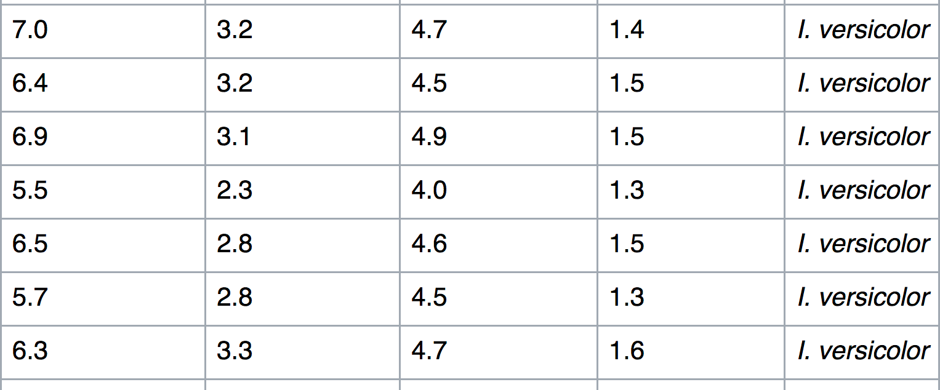
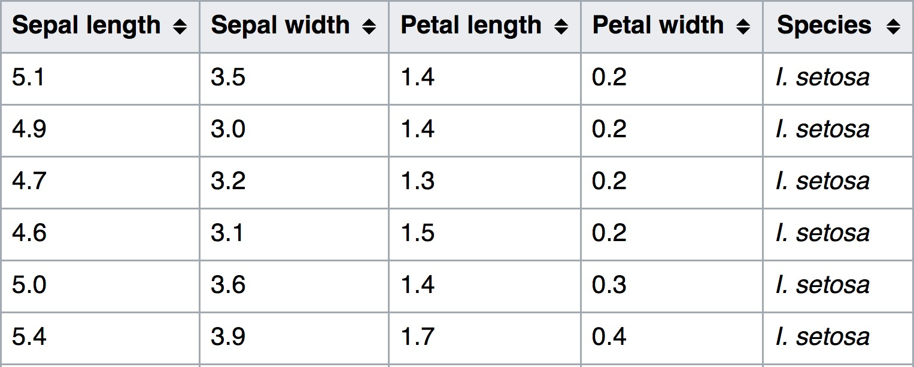
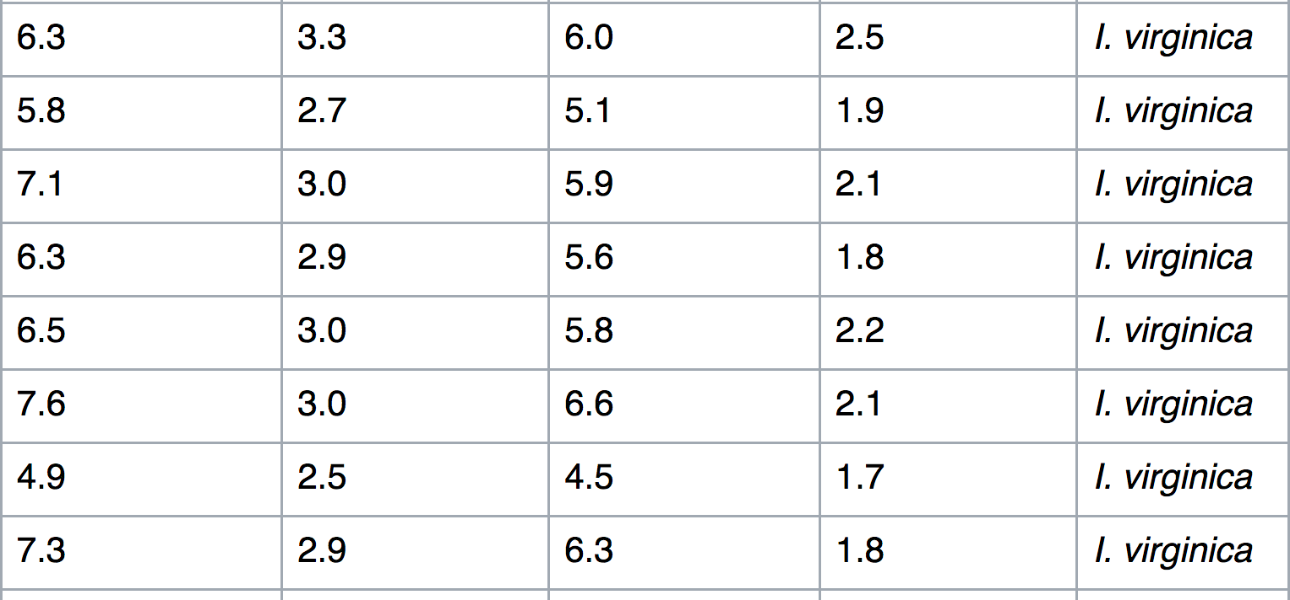
Example of a data set
Anderson’s Iris data (oldest set in stat/ML 1936)
  Measurements of 150 iris flowers
    sepal length, sepal width, petal length, petal width
– in 3 species: Setosa, versicolor, virginica
23
https://en.wikipedia.org/wiki/Iris_flower_data_set

Slide 28

ML datasets - Kaggle

Slide 29
Unsupervised Learning Experience
Data set contains many useful features
Learn the structure of this data set
Learn the entire probability distribution that generated this data set
  Explicitly for density estimation
  Implicitly for synthesis or denoising
Perform a role such as clustering
  i.e., dividing data set into clusters of similar examples

Slide 30

Supervised Learning Experience
Data set contains features, but each example is associated with a label or target
Iris dataset is annotated with the species of each iris plant
A supervised learning algorithm can learn to classify iris plants into three different species
Sample test case

Slide 31
Blur between supervised/unsupervised
Supervised/unsupervised not formally defined terms
Unsupervised: observe several examples of x
and learn p(x)
Supervised: observe examples of x and y and learn to estimate p(y|x)
Many ML methods can be used for both tasks
– E.g., Use the chain rule of probability, for xεR^{n}
n
p(x) = ∏ p(x_{i} | x₁,..,x_{i −1})
i =1
Model p(x) by splitting it into n supervised learning problems
Alternatively solve supervised problem of learning p(y|x) by using unsupervised learning to determine p(x,y) and then inferring p(y|x)

Slide 32
Semi-supervised Learning
Some examples include a supervision target but others do not
In multi-instance learning, an entire collection of samples is labeled as containing or not containing an example of a class, but individual members of the collection are not labeled

Slide 33
Reinforcement Learning
Reinforcement algorithms interact with an environment, no fixed data set
There is a feedback loop between the learning system and its experience
No supervised output but delayed reward
  Credit assignment problem
    what action was responsible for outcome
Applications:
  Game playing, robot in a maze, multiple agents, partial observability, LLMs,…

Slide 34
Describing a Data Set – Design Matrix
Common way of describing a data set is with a design matrix
Different examples in each row
Each column corresponds to a different feature
Iris data set contains 150 examples with 4 features for each example for 3 species
Data set is a design matrix XεR^{150✕4}
X_{i,1} is sepal length of plant i, X_{i,2} is sepal width of plant i

Slide 35
Example of a Design Matrix
Anderson’s Iris data (oldest set in stat/ML 1936)
  Measurements of 150 iris flowers
    sepal length, sepal width, petal length, petal width
– in 3 species: Setosa, versicolor, virginica
23
https://en.wikipedia.org/wiki/Iris_flower_data_set

Slide 36
Dealing with Varying Sizes
For a design matrix, each example is a vector of same size
  However photos of varying size contain different numbers of pixels
Rather than describing the matrix with m rows we describe it as a set of m elements
{x⁽¹⁾,x⁽²⁾,..,x^{(m)}}. It does not imply that vectors
x^{{i}} and x^{{j}} have the same size
  Instead of multiplying by a weight matrix of fixed size, convolution with a kernel is applied to a different number of times depending on the size of input

Slide 37
Topics
Learning Algorithms
Capacity, Overfitting and Underfitting
Hyperparameters and Validation Sets
Estimators, Bias and Variance
Maximum Likelihood Estimation
Bayesian Statistics
Supervised Learning Algorithms
Unsupervised Learning Algorithms
Stochastic Gradient Descent
Building a Machine Learning Algorithm
11. Challenges Motivating Deep Learning

Slide 38
Generalization
Major challenge of ML is generalization
  Perform well on previously unseen outputs
ML training algorithm reduces training error, which is the task of optimization
What differentiates ML from pure optimization is that the test error (generalization error) needs to be low as well
Generalization error definition
  Expected error on a new input
– Here the expectation is taken across different possible inputs drawn wrt the expected distribution encountered in practice

Slide 39
Data Set Generating Function
Assumptions:
Training and test data generated by a probability distribution over the data
Typically make i.i.d assumptions
  Samples are independent from each other
  Training and test sets are identically distributed (drawn from the same distribution)

Slide 40
Under- and Over-fitting
How well an ML algorithm will perform depends on its ability to:
  Make the training error small
  Make the gap between training and test error small
This corresponds to two ML challenges
  Underfitting
    When not able to obtain sufficiently low error rate
  Overfitting
    When gap between training error and testing error is large

Slide 41
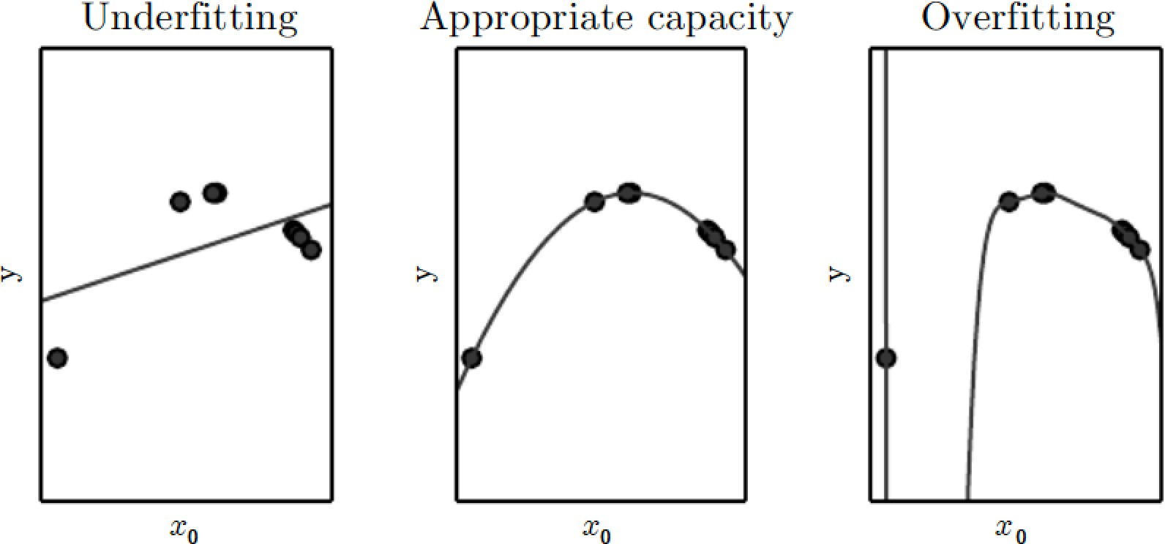
Capacity of a Model
Controls over- and under-fitting
Model capacity is its ability to fit variety of functions
  Low capacity: struggles to fit the training set
  High capacity: overfit by memorizing properties of training set that don’t serve well on test set
    Lower capacity may struggle to fit the training data
    Higher capacity, model overfits
Fitting curves to points

Slide 42
Capacity of a Model Choice
One way to control the capacity of a learning algorithm is by choosing its hypothesis space, the set of functions that the learning algorithm is allowed to select as being the solution.
In practice, the learning algorithm does not actually find the best function, but one that significantly reduces the training error.
These additional limitations, such as the imperfection of the optimization algorithm, mean that the learning algorithm’s effective capacity may be less than the representational capacity of the model family.

Slide 43
Occam’s Razor
Modern ideas about improving the generalization of machine learning models are refinements of thought dating back to philosophers at least as early as Ptolemy.
Many early scholars invoke a principle of parsimony that is now most widely known as Occam’s razor (c. 1287–1347). This principle states that among competing hypotheses that explain known observations equally well, we should choose the “simplest” one.
This idea was formalized and made more precise in the twentieth century by the founders of statistical learning theory (Vapnik and Chervonenkis, 1971; Vapnik, 1982; Blumer et al., 1989; Vapnik, 1995).

Slide 44
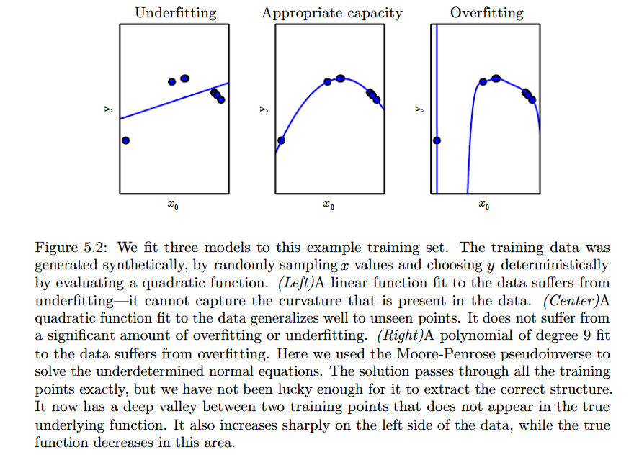
Capacity of a Model

Slide 45
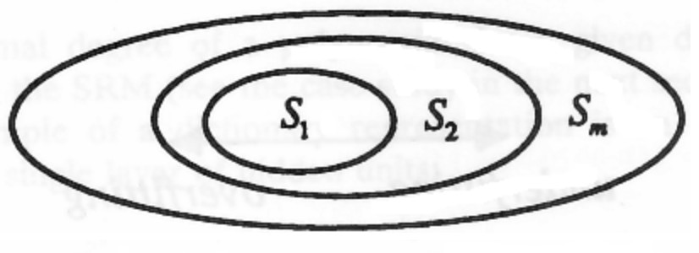
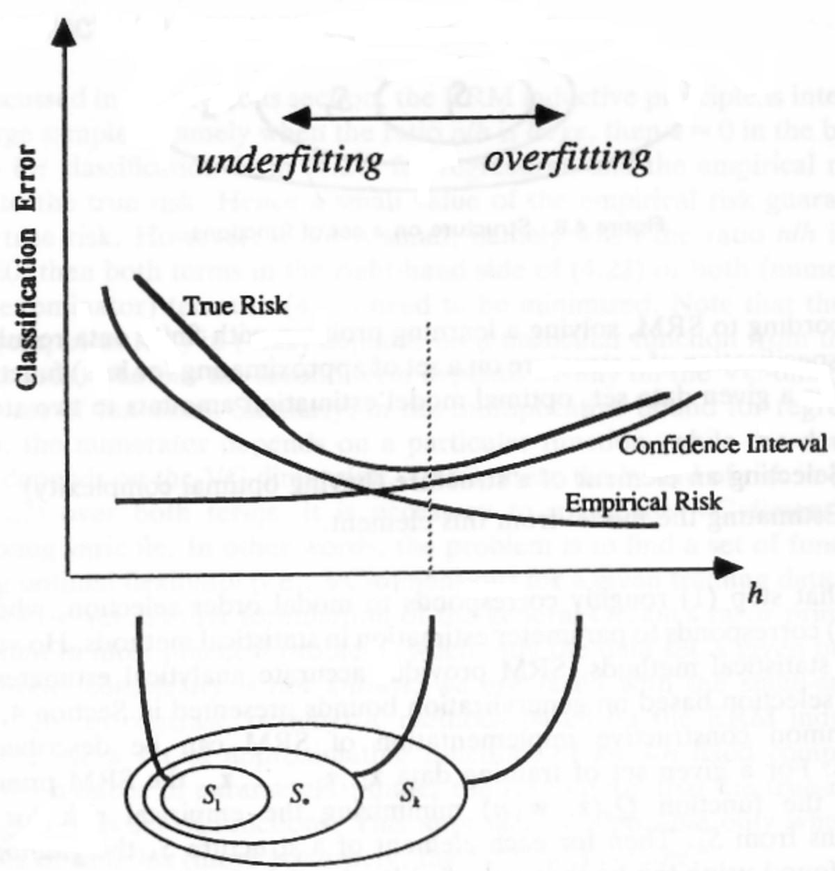
Quantifying Learning Machines by Capacity –
VC dimension
Goal of learning is to choose an optimal element of a structure (e.g., polynomial degree) and estimate its coefficients from a given training sample.
For approximating functions linear in parameters such as polynomials, complexity is given by the no. of free parameters.
For functions nonlinear in parameters, the complexity is defined as VC-dimension.
The optimal choice of model complexity provides the minimum of the expected risk.

Slide 46
Representational and Effective Capacity
Representational capacity:
  Specifies family of functions a learning algorithm can choose from
Effective capacity:
  Imperfections in optimization algorithm can limit representational capacity
Occam’s razor:
  Among competing hypotheses that explain known observations equally well, choose the simplest one
This is formalized in the VC (Vapnik-Chervonenkis) dimension

Slide 47
VC Dimension
Statistical learning theory quantifies model capacity
VC dimension quantifies capacity of a binary classifier
VC dimension is the largest value of m for which there exists a training set of m different points that the classifier can label arbitrarily

Slide 48
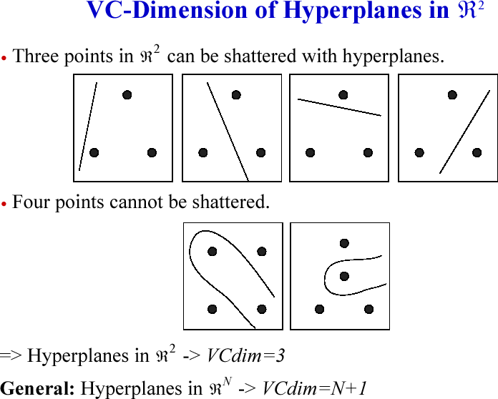
VC dimension (capacity) of a Linear classifier in
_{R}2
is 3
9

Slide 49
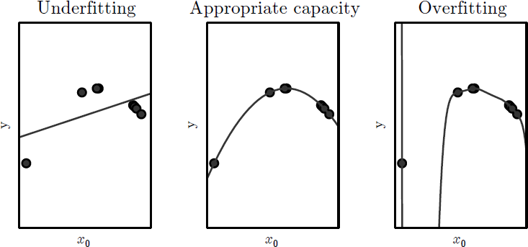
Capacity & Hypothesis Spaces
Capacity = ability to fit wide variety of functions
  Low → model struggles to fit training data (underfit)
  High → model can “memorize” data (overfit)
Hypothesis space = set of functions learning algorithm is allowed to learn
  Bias: linear regression → linear functions

Slide 50
Vapnik–Chervonenkis (VC) Dimension
Measure of capacity (complexity, expressive power, richness, or flexibility) of a space of functions learnable by a statistical (binary) classification algorithm
Largest possible value of m for which there exists training
set of different points (x) that algorithm/classifier label arbitrarily
  Discrepancy between training & generalization (test) error
bounded above
    Bound grows as capacity grows but shrinks as number of training samples increases
  More data = better worst case generalization error!
Infinite for unbounded strings

Slide 51
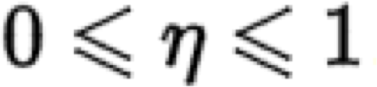

VC Dimension Intuition
Classification model f(θ) shatters set of samples {x1, x2,…, xn} if for all label assignments to those points, there exists a θ such that f makes NO errors when evaluated on that set of points
VC Dimension = maximum number of points arranged so that f shatters them
  Maximum integer D s.t. |i.i.d. dataset| = D is shattered by f
Example:
  f is a constant classifier (θ is empty) → VC dim = 0 (cannot shatter a single point)
D is VC dimension, N is size of train set,
,

Slide 52
Probably Approximately Correct (PAC Framework)
Learner receives samples & must select a generalization function (hypothesis) from certain class of possible functions
Goal: with high probability ("probably"), the selected function will have low generalization error ("approximately correct")
– Learner must be able to learn the concept given any arbitrary approximation ratio, probability of success, or distribution of the samples

Slide 53
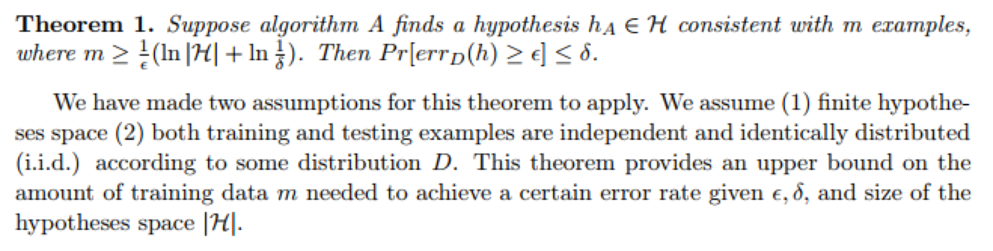
PAC Bound
Intuition: when hypothesis space H is finite, a consistent algorithm A is a PAC-learning algorithm
Theorem provides upper bound on how much data we need to achieve a certain general error rate
  Bound captures a general relation between learning performance, size of hypothesis space, and number of training examples
  More data → the lower the upper bound of error achievable
  Smaller hypothesis size |H| is (by knowing more about the concept space), the less data we need to achieve a certain general error rate

Slide 54
Fundamental Principle of Statistical Learning
When sample size is small → model should be simple
  We must deliberately oversimplify our models!
  Can use the VC/PAC to guide us
    Occam’s Razor = parsimony, choose “the simplest one”
model complexity
error rate ∝
sample size
– What does this mean for deeper architectures & non- parametric models??

Slide 55
Capacity and Learning Theory
Quantifying the capacity of a model enables statistical learning theory to make quantitative predictions
Most important results in statistical learning theory show that:
  The discrepancy between training error and generalization error
    Is bounded from above by a quantity that grows as the model capacity grows
    But shrinks as the number of training examples increases

Slide 56
Statistical Learning Theory
Provides intellectual justification that machine learning algorithms can work
But rarely used in practice with deep learning
This is because:
  The bounds are loose
  Also difficult to determine capacity of deep learning algorithms

Slide 57
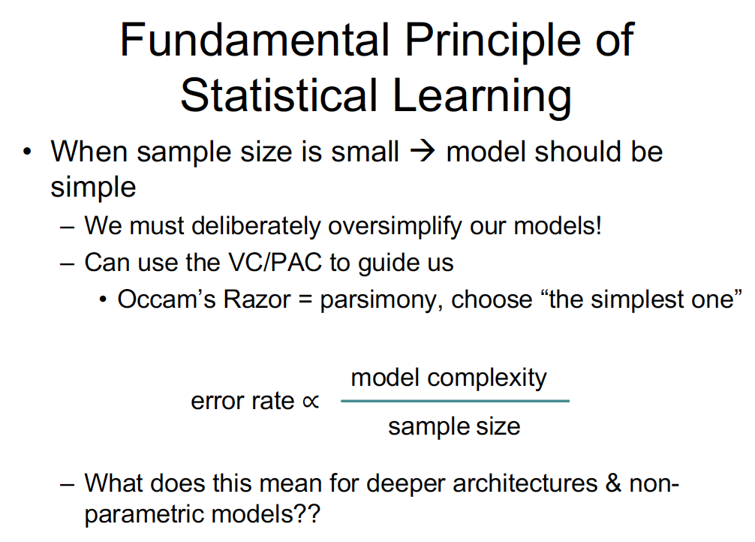

Slide 58
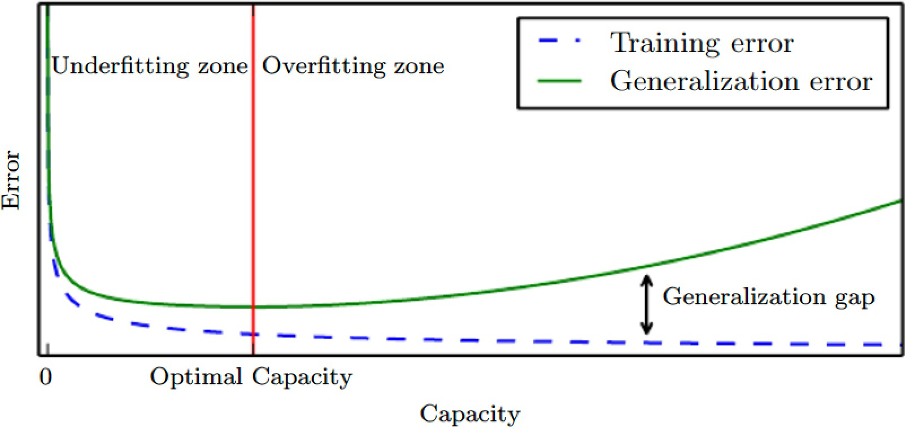
Typical Generalization Error
Relationship between capacity and error
Typically generalization error has a U-shaped curve

Slide 59
Arbitrarily High Capacity: Nonparametric Models
What are the most extreme case of arbitrarily high capacity?
Parametric models such as linear regression:
  learn a function described by a parameter whose size is finite and fixed before data is observed
Nonparametric models have no such limitation
  Such as Deep Learning
Nearest-neighbor regression is an example
  Their complexity is a function of training set size

Slide 60
Nearest Neighbor Regression
Simply store the X and y from the training set
When asked to classify a test point x the model looks up the nearest entry in the training set and returns the associated target, i.e.,
yˆ = y where i = arg min || X − x ||²
i i,: 2
Algorithm can be generalized to distance metrics other than L² norm such as learned distance metrics

Slide 61
Bayes Error
Ideal model is an oracle that knows the true probability distributions that generate the data
Even such a model incurs some error due to noise/overlap in the distributions
The error incurred by an oracle making predictions from the true distribution p(x,y) is called the Bayes error

Slide 62
Effect of Training Set Size
Expected generalization error can never increase as the number of training examples increases
For nonparametric models, more data yields better generalization until best possible error is achieved
Any fixed parametric model with less than optimal capacity will asymptote to an error value that exceeds the Bayes error

Slide 63
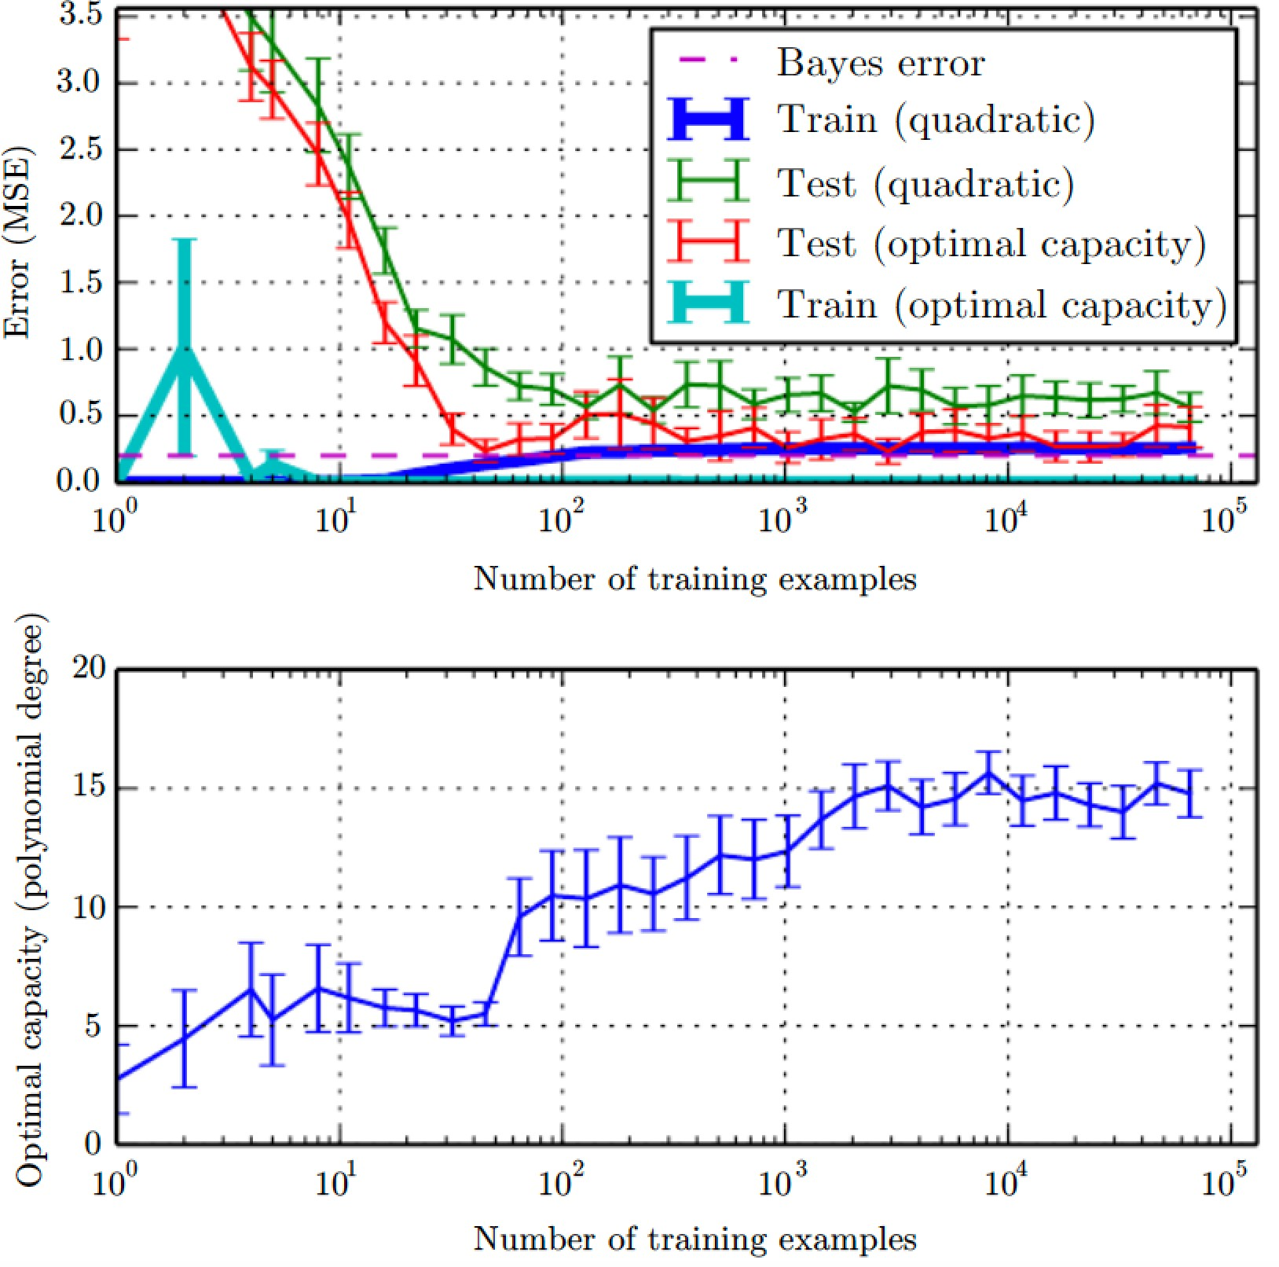
Effect of Training Set Size
Synthetic regression problem Noise added to a 5th degree polynomial.
Generated a single test set
and several different sizes of training sets.
Error bars show 95% Confidence interval.
As training set size increases optimal capacity increases.
Plateaus after reaching
sufficient complexity.
17

Slide 64
Probably Approximately Correct (PAC)
Learning theory claims that a ML algorithm generalizes from a finite number training set of examples
  This contradicts basic principles of logic
  Inductive reasoning, or inferring general rules from a limited no of samples is not logically valid
    To infer a rule describing every member of a set, one must have information about every member of the set
ML avoids this problem with probabilistic rules
  Rather than rules of logical reasoning
  Find rules that are probably correct about most
members of the set they concern
Valiant, ‘84

Slide 65
The no-free Lunch Theorem (NFLT)
No free lunch theorem states:
  Averaged over all distributions, every algorithm has same error classifying unobserved points
    i.e., no ML algorithm universally better than any other
      Most sophisticated algorithm has same error rate that merely predicts that every point belongs to same class
Fortunately results hold only when we average over all possible data generating distributions
  if distribution assumptions are made, can perform well
We don’t seek a universal learning algorithm because there isn’t one
Wolpert & Macready, ‘97

Slide 66
NFLT & Regularization
No free lunch theorem implies that we must design our ML algorithms to perform well on a specific task
We do so by building a set of preferences into learning algorithm – regularization
When these preferences are aligned with the learning problems, have better performance

Slide 67
Regularization Defined
Regularization is any modification we make to a learning algorithm that is intended to reduce its generalization error but not its training error
Choose a form of regularization that is well-suited to the particular task
Usually add a penalty function called a regularizer to the cost function.

Slide 68
Other Ways of Solution Preference
Only method so far for modifying learning algo is to change the representational capacity
  Adding/removing functions from hypothesis space
    Specific example: degree of polynomial
Specific identity of those functions can also affect behavior of our algorithm
  Ex of linear regression: include weight decay
T
Where J is the cost function
J(w) = MSE + λw w
train
λ chosen to control preference for smaller weights

Slide 69
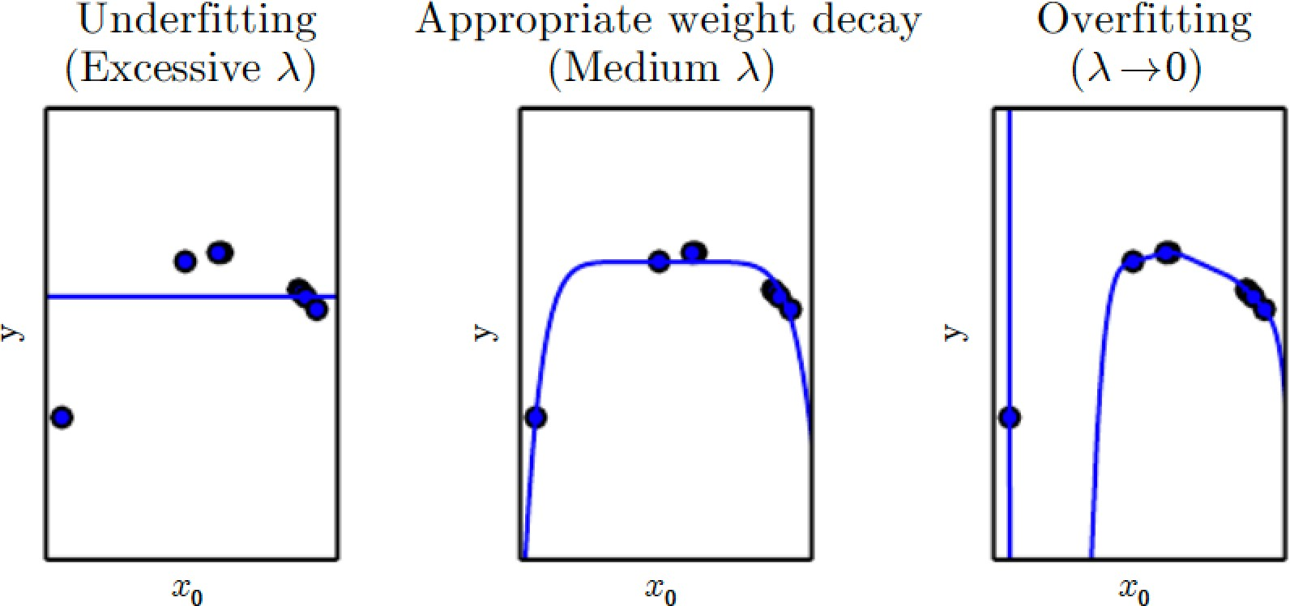
Tradeoff between fitting data and^{i} being small
Controlling a model’s tendency to overfit or underfit via weight decay
Weight decay for high degree polynomial (degree 9) while the data comes from a quadratic

Slide 70
Topics
Learning Algorithms
Capacity, Overfitting and Underfitting
Hyperparameters and Validation Sets
Estimators, Bias and Variance
Maximum Likelihood Estimation
Bayesian Statistics
Supervised Learning Algorithms
Unsupervised Learning Algorithms
Stochastic Gradient Descent
10. Building a Machine Learning Algorithm
11. Challenges Motivating Deep Learning

Slide 71
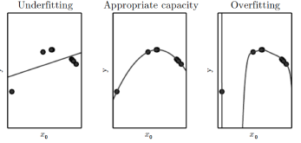
Hyperparameters - ML Behavior
Most ML algorithms have hyperparameters
  To control algorithm behavior
  Are values not adapted by learning algorithm itself
    Although, can design nested learning where a learning algo learns best hyperparams for another learning algo
In polynomial regression, a single hyperparam acts a capacity hyperparameter
Low capacity: Struggles to fit
High capacity: Overfit
J(w) = MSE
T
λw w
train
– Weight decay λ is also a hyperparameter

Slide 72
Reasons for Hyperparameters
Sometimes setting is chosen as a hyperparam because it is too difficult to optimize
More frequently, the setting is a hyperparam because it is not appropriate to learn that hyperparam on the training set
  Applies to all hyperparameters for model capacity
    If learned on a training set, it would always choose a maximum model capacity which results in overfitting
Can always fit the training set better with a higher degree polynomial and weight decay λ=0

Slide 73
Validation Set
Validation set for hyperparameter over-fitting
  Examples that training algorithm does not observe
Test examples should not be used to make choices about the model hyperparameters
Training data is split into two disjoint sets
  One to learn the parameters
  Other is the validation set to estimate generalization error during or after training
    This allows for the hyperparameters to be updated
  Typically 80% of training data for training and 20%
for validation

Slide 74
Data Sets
Training data
Testing data
  Usually disjoint!
Training data can be divided into
  actual training data
  validation data

Slide 75
Test sets also need to change and are changing
Over many years, the same test set used repeatedly to evaluate performance of different algorithms
With repeated attempts to beat state-of-the-art performance, over optimistic evaluations with these test set as well
  Test sets become stale
Tendency now to move to new, usually more ambitious and larger benchmark data sets

Slide 76
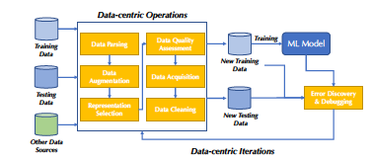
Data-centric AI (DC-AI)
Focus on the data, not the model
Mainly driven by commercial apps
DataPerf

Slide 77
DataPerf Goals
Focus research and development on improving ML dataset quality
Improve ML training datasets to increase accuracy and/or reduce data required to train
Improve ML test datasets to drive ML solution fidelity and reliability
Motivate datasets that increase representation and decrease bias
Drive development of better techniques and tools for creating and optimizing datasets
Provide consistent metrics for researchers and commercial developers
Enforce replicability to ensure reliable results
Keep benchmarking effort affordable so all can participate

Slide 78
Cross-Validation
When data set is too small, a fixed test set is problematic
k - fold cross-validation
  A partition of the data is formed by splitting it into k
nonoverlapping subsets
  On trial i, the i ^{th} subset of the data is used as the test set
  Rest of the data is used as the training set
Problem: no unbiased estimators of the average error exist; approximations are used

Slide 79

k –fold Cross validation Variables^{i}
Used to estimate generalization error of a learning algorithm A
  When the given data set D is too small to yield an accurate estimate of generalization error
    Mean loss Lon small test set has too high variance
A returns vector of errors e for examples in D
  Whose mean is the estimated generalization error
  The errors can be used to compute a confidence interval around the mean
    95% confidence interval centered around mean μˆ_{m} is
(μˆ_{m} − 1.96SE(μˆ_{m} ), μˆ_{m} + 1.96SE(μˆ_{m} ))
⎡
1
m
⎤
σ
m
SE(μˆ ) = Var
⎢_{m} ∑
(i )
where the standard error of the mean is:
Which is square root of variance of the estimator
x =
m
⎣
⎥
i =1
⎦

Slide 80
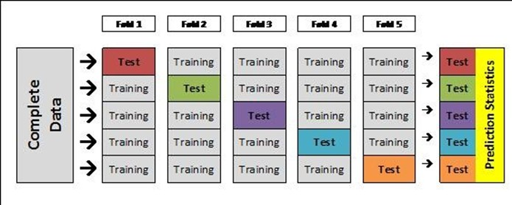
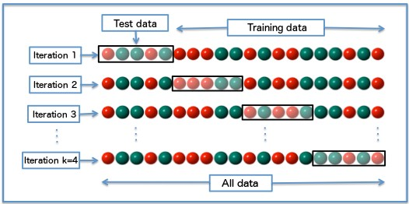
Cross-Validation
Good for when dataset is small! Average over trials/folds to get a biased estimator of generalization error.

Slide 81
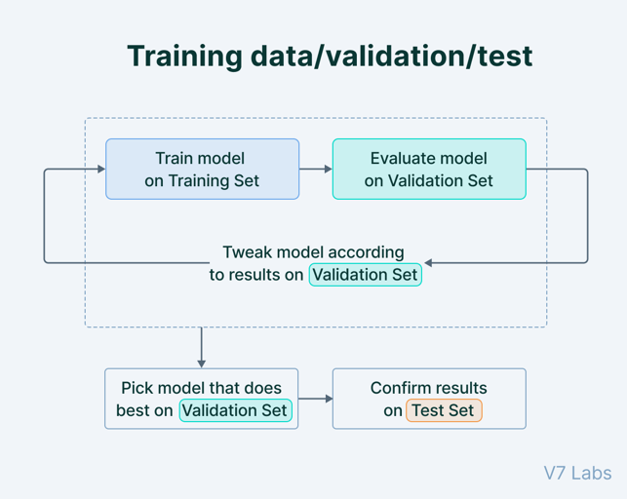

Slide 82
Topics
Learning Algorithms
Capacity, Overfitting and Underfitting
Hyperparameters and Validation Sets
Estimators, Bias and Variance
Maximum Likelihood Estimation
Bayesian Statistics
Supervised Learning Algorithms
Unsupervised Learning Algorithms
Stochastic Gradient Descent
Building a Machine Learning Algorithm
11. Challenges Motivating Deep Learning

Slide 83
Topics in Estimators, Bias, Variance
Statistical tools useful for generalization
Point estimation
Bias
Variance and Standard Error
Bias-Variance tradeoff to minimize MSE
Consistency

Slide 84
Statistics Tools for ML
To solve ML tasks not only on the training set but also to generalize
  Statistics gives us many tools
To formally characterize notions of generalization, over- and under-fitting concepts use:
  Parameter estimation
  Bias
  Variance

Slide 85
Point Estimation
It is the attempt to provide the single best prediction of some quantity of interest
  Quantity of interest can be:
    A single parameter
    A vector of parameters
– E.g., weights in linear regression
    A whole function
In order to distinguish estimates of parameters from their true value, a point estimate of a parameter θ is represented by θ^{ˆ}

Slide 86
Point Estimator is a Statistic
A statistic is any function of the data
Let {x⁽¹⁾, x⁽²⁾,..x^{(m)}} be m independent and identically distributed (i.i.d.) data points
– Then a point estimator or statistic is any function of the data
_{θˆ} (1) (m )
_{m} = g(x ,...x )
A good estimator is a function whose output is close to the true underlying θ that generated the data

Slide 87
Determining a Function as Point Estimation
Establishing a relationship between input and target variables can also be a point estimation
Here we predict a variable y given input x
We assume a function f(x) that describes the approximate relationship between x and y
  We may assume y=f(x)+ε
    Where ε stands for a part that is not predictable from x
  Let’s approximate f with a model f^{ˆ}
  Function estimation is same as estimating a parameter θ; where f^{ˆ} is a point in function space

Slide 88

Bias of an Estimator
An estimator θ^{ˆ} = g(x⁽¹⁾,...x^{(m )}) for parameter θ
m
has bias( θ^{ˆ} ) defined as
m
The estimator is unbiased if bias( θ^{ˆ} )=0
m
Look at estimators of the following parameters to determine whether there is bias:
  Bernoulli distribution: mean θ
  Gaussian distribution: mean µ
  Gaussian distribution: variance σ²

Slide 89

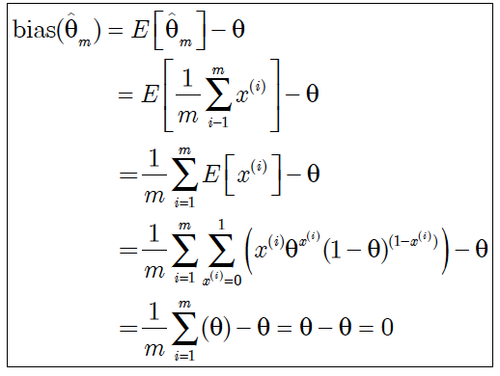
Estimator of Bernoulli Mean
Bernoulli distribution for binary variable x ε{0,1}
with mean θ has the form
P(x;θ) = θ^{x} (1 − θ)^{1−x}
Estimator for θ given samples {x⁽¹⁾,..x^{(m)}} is
To determine whether this estimator is biased
determine
– Since
bias( )=0 we say that the estimator is unbiased
ˆ
θ
9
m

Slide 90
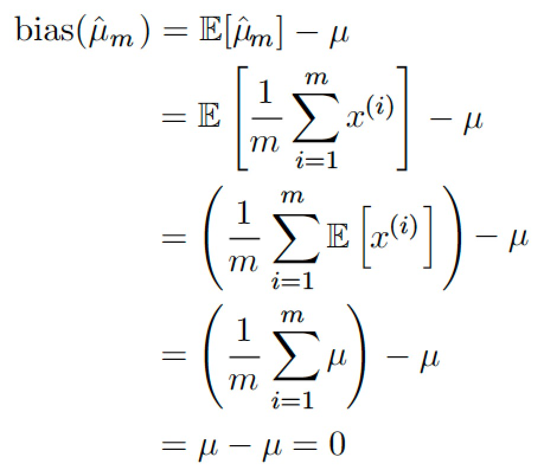
Estimator of Gaussian Mean
Samples {x⁽¹⁾,..x^{(m)}} are independently and identically distributed according to p(x^{(i)})=N(x^{(i)};µ,σ²)
– Sample mean is an estimator of the mean parameter
m
₌ 1 ∑
μˆ
_{x}(i)
m
^{m} i =1
– To determine bias of the sample mean:
– Thus the sample mean is an unbiased estimator of the Gaussian mean

Slide 91
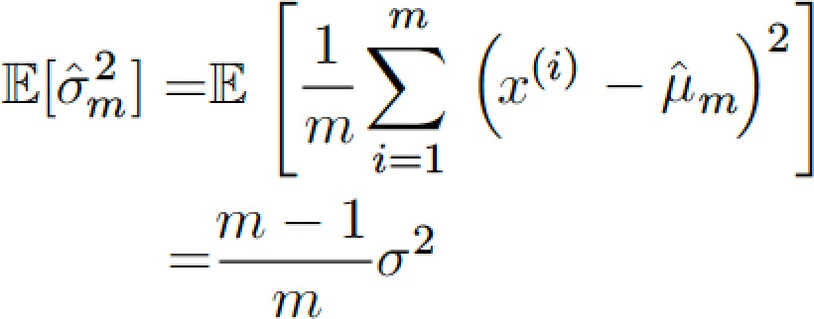
Estimator for Gaussian Variance
∑( )
The sample variance is
_{σˆ}2
=
1
m
(i)
2
x − μˆ
m
^{m} i =1
m
We are interested in computing
bias( ) =E( ) - σ
2
ˆ
2
m m
σ
ˆ
2
σ
We begin by evaluating →
Thus the bias of
_{σˆ}2
is –σ²/m
m
Thus the sample variance is a biased estimator
The unbiased sample variance estimator is
_{σˆ}2
1
m
( )
2
=
∑
(i )
ˆ
x − μ
m
m − 1 _{i =1}
m

Slide 92
Variance and Standard Error
How much we expect the estimator to vary as a function of the data sample – use its variance
Just as we computed the expectation of the estimator to determine its bias, we can compute its variance
The variance of an estimator is simply Var( θˆ)
where the random variable is the training set
The square root of the the variance is called the Standard Error, denoted SE(θ^{ˆ})

Slide 93
Importance of Standard Error
It measures how we would expect the estimate to vary as we obtain different samples from the same distribution
The standard error of the mean is given by
SE (μˆ ) = Var
⎡ ⎤
1
m
σ
⎢_{m} ∑
x
(i)
⎥
=
where m is the number of samples
m
⎣ ⎦
m
i =1
where σ² is the true variance of the samples x^{(i)}
Standard error often estimated using estimate of σ
  Although not unbiased, approximation is reasonable
– The standard deviation is less of an underestimate than variance

Slide 94
Standard Error in Machine Learning
We often estimate generalization error by computing error on the test set
  No of samples in the test set determines its accuracy
  Since mean can be normally distributed, (according to Central Limit Theorem), we can compute probability that true expectation falls in any chosen interval
    Ex: 95% confidence interval centered on mean μˆ_{m} is
(μˆ_{m}
− 1.96SE (μˆ_{m} ), μˆ_{m} + 1.96SE (μˆ_{m} ))
ML algorithm A is better than ML algorithm B if
– upperbound of A is less than lower bound of B

Slide 95
Tradeoff - Bias vs Variance
Bias and Variance measure two different sources of error of an estimator
Bias measures the expected deviation from the true value of the function or parameter
Variance provides a measure of the expected deviation that any particular sampling of the data is likely to cause

Slide 96
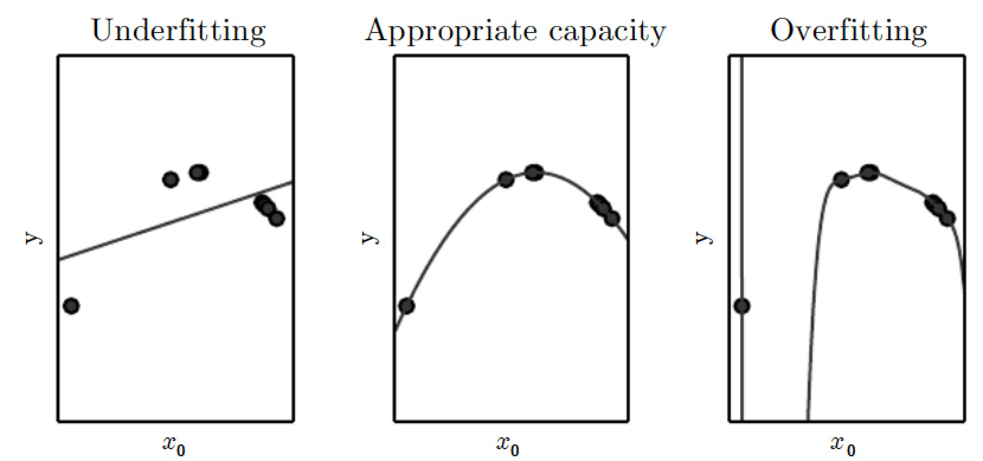
Negotiating Between Bias vs Tradeoff
How to choose between two algorithms, one with a large bias and another with a large variance?
Most common approach is to use cross-validation
Alternatively we can minimize Mean Squared Error which incorporates both bias and variance

Slide 97
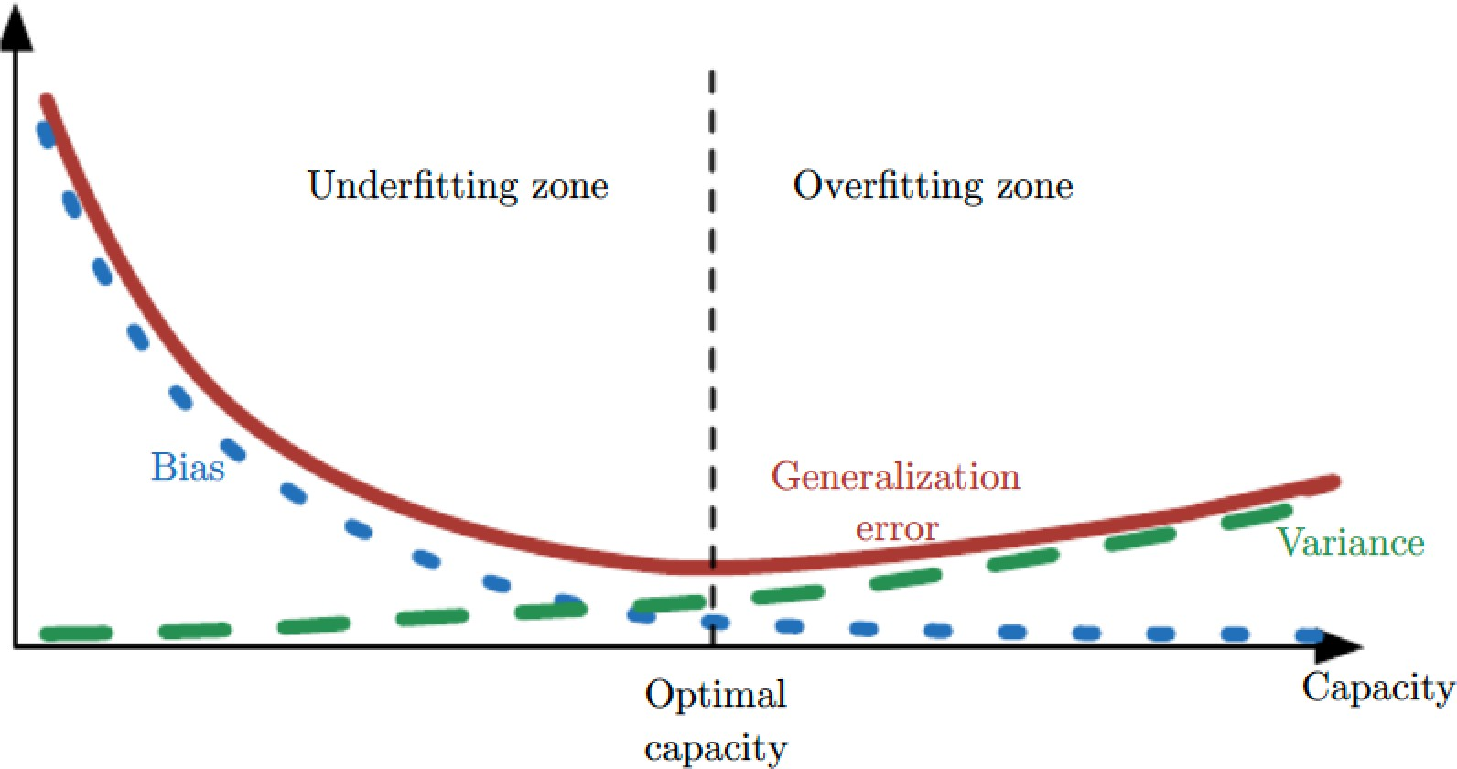
Mean Squared Error
Mean Squared Error of an estimate is
MSE = E ⎡(θ^{ˆ} − θ
)
2
⎤
⎢⎣
m
⎥⎦
( )
2
+ Var(θ^{ˆ} )
=Bias θ
ˆ
m m
Minimizing the MSE keeps both bias and variance in check

Slide 98
Underfit-Overfit : Bias-Variance
Both have a U-shaped curve of generalization Error as a function of capacity

Slide 99
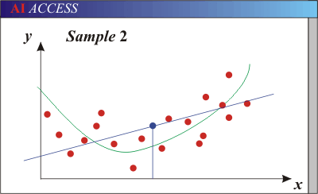
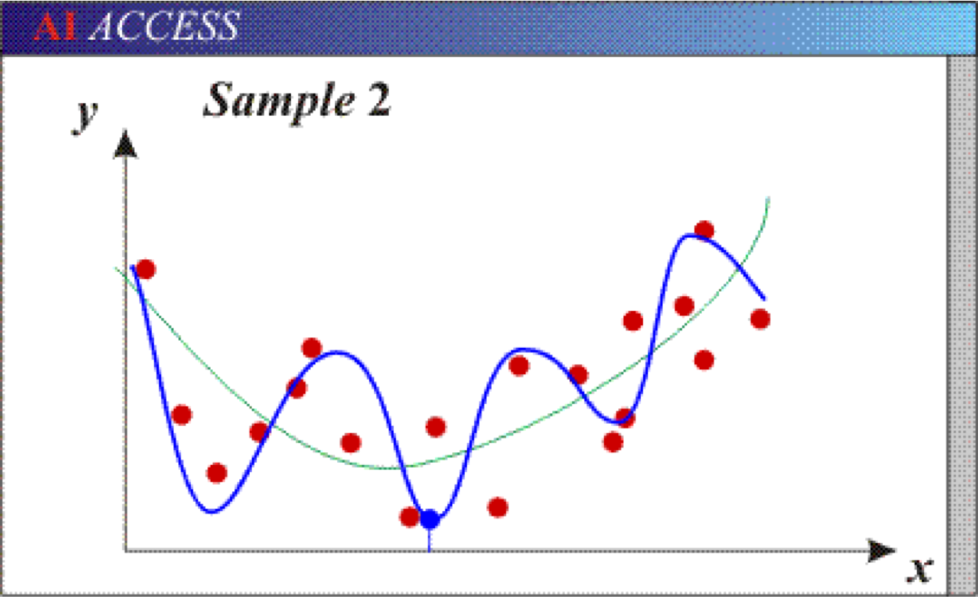
Bias-Variance Trade-off
Models with too few parameters are inaccurate because of a large bias (not enough flexibility).
Models with too many parameters are inaccurate because of a large variance (too much sensitivity to the sample).
Slide credit: D. Hoiem

Slide 100
The Bias-Variance Trade-off
Point estimation (or statistic) = provide single “best” prediction of some quantity of interest
E(MSE) = noise² + bias² + variance
Error due to variance of training samples
Unavoidable error
Error due to incorrect assumptions
Increasing capacity increases variance but decreases bias!
We will want to regularize = modification to learning algorithm intended to reduce its generalization error but NOT training error!
See the following for explanations of bias-variance:
http://www.inf.ed.ac.uk/teaching/courses/mlsc/Notes/Lecture4/BiasVariance.pdf
Bishop’s “Neural Networks” book
Slide credit: D. Hoiem

Slide 101
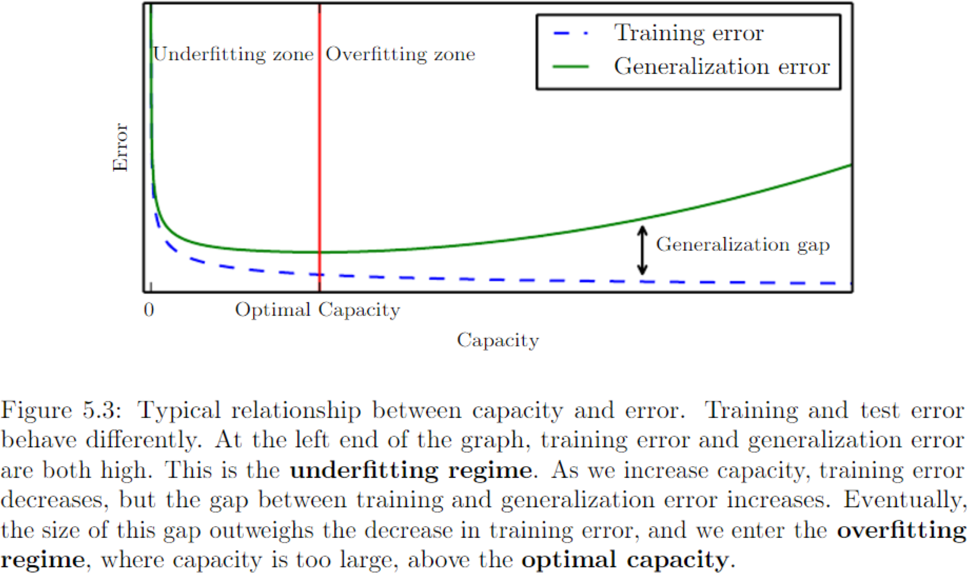

Slide 102
Bias-Variance Trade-off: Underfitting & Overfitting
Underfitting
Overfitting
Error
Test error
Training error
High Bias Low Variance
Complexity
Low Bias High Variance
Slide credit: D. Hoiem

Slide 103
Bias-Variance Trade-off: Effect of Sample Size
Few training examples
Test Error
Many training examples
High Bias Low Variance
Complexity
Low Bias High Variance
Slide credit: D. Hoiem

Slide 104
Effect of Training Size on Generalization Error
Fixed prediction model
Error
Testing
Generalization Error
Training
Number of Training Examples
Slide credit: D. Hoiem

Slide 105
The perfect classification algorithm
Objective function: encodes the right loss for the problem
Parametrization: makes assumptions that fit the problem
Regularization: right level of regularization for amount of training data
Training algorithm: can find parameters that maximize objective on training set
Inference algorithm: can solve for the objective function in evaluation
Slide credit: D. Hoiem

Slide 106
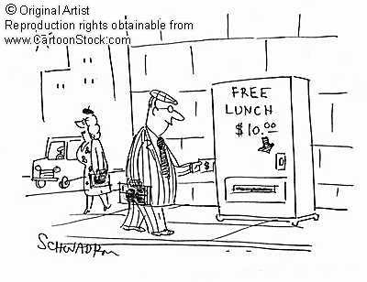
Remember…
No classifier is inherently better than any other: you need to make assumptions to generalize
Three kinds of error
  Inherent: unavoidable (noise in the system)
  Bias: due to over-simplifications
  Variance: due to inability to perfectly estimate parameters from limited data

Slide 107


Remember…
No classifier is inherently better than any other: you need to make assumptions to generalize
Three kinds of error
  Inherent: unavoidable
  Bias: due to over-simplifications
  Variance: due to inability to perfectly estimate parameters from limited data
There is NO
free lunch!!
SliSdelidcerecdreitd: iDt:.DH.oHieomiem

Slide 108
How to reduce variance?
Choose a simpler classifier
  Occam’s Razor: Among competing hypotheses, the one with the fewest assumptions should be selected.
Regularize the parameters
  Think of L1/L2 penalties in regression
  Think of Laplacian/Gaussian priors from a Bayesian probabilistic perspective
Get more training data
  BIG data
Slide credit: D. Hoiem

Slide 109
Consistency
So far we have discussed behavior of an estimator for a fixed training set size
We are also interested with the behavior of the estimator as training set grows
As the number of data points m in the training set grows, we would like our point estimates to converge to the true value of the parameters:
plim_{m→∞}θ^{ˆ} = θ
m
  plim, known as consistency, is probability in the limit
    Also known as weak consistency
– Consistency ensures that bias decreases with m

Slide 110
Topics
Learning Algorithms
Capacity, Overfitting and Underfitting
Hyperparameters and Validation Sets
Estimators, Bias and Variance
Maximum Likelihood Estimation
Bayesian Statistics
Supervised Learning Algorithms
Unsupervised Learning Algorithms
Stochastic Gradient Descent
Building a Machine Learning Algorithm
11. Challenges Motivating Deep Learning

Slide 111
Topics in Maximum Likelihood
The maximum likelihood principle
– Maximizing likelihood is minimizing KL divergence
Conditional log-likelihood & MSE
  Minimizing negative log-likelihood is equivalent to minimizing MSE in linear regression with Gaussian noise
Properties of maximum likelihood
  No consistent estimator has lower MSE than maximum likelihood estimator

Slide 112
How to Obtain Good Estimators?
We have seen some definitions of common estimators and their properties
– Ex: sample mean, bias-variance
Where do they come from?
Rather than guessing some function and determining its bias and variance, better to have some principle from which we can derive specific functions that are good estimators
The most common such principle is maximum likelihood

Slide 113
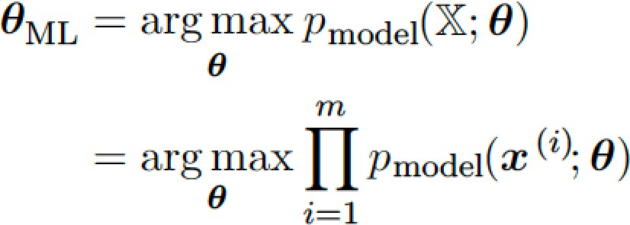
Maximum Likelihood Principle
Set of m examples X={x⁽¹⁾, x⁽²⁾,..x^{(m)}}
  Drawn independently from the true but unknown data generating distribution p_{data}(x)
Let p_{model}(x;θ) be a parametric family of distributions
  indexed over same space indexed by θ
    i.e., p_{model}(x;θ) maps any configuration of x to a real number estimating the true probability p_{data}(x)
The maximum likelihood estimator for θ is:

Slide 114
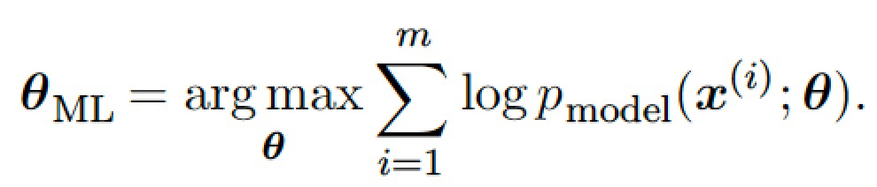
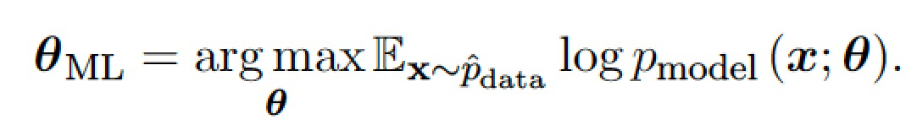
Alternative Form of Max Likelihood
The product over many probabilities is inconvenient, ex: underflow
An equivalent optimization problem is to take logarithm of the likelihood
– This maximization can be written as
Since dividing by m does not change the problem
The expectation is wrt the empirical distribution ^{pˆ}_{data} defined by the training data

Slide 115

Maximizing Likelihood & KL Divergence
Max likelihood =minimizing KL diverg. between:
  the empirical distribution pˆ_{data} and
  the model distribution p_{model}(x)
The K-L divergence is
  First Term a function of data generation, not model
– Thus we only need to minimize
i.e., cross entropy between distribution of training set and probability distribution defined by model
– Definition of cross entropy between distributions p and q is
H(p,q)=E_{p}[-log q]=H(p)+D_{KL}(p||q)
– For discrete distributions H(p,q)=-Σ_{x}p(x)log q(x)

Slide 116
Summary of Maximum Likelihood
It is an attempt to make model distribution ^{p}model
match the empirical distribution ^{pˆ}_{data}
– Ideally we would like to match the unknown
The optimal θ is the same whether we
pˆ
maximize likelihood or minimize KL divergence
In software both are phrased as minimization
  Maximum likelihood becomes minimization of negative log-likelihood (NLL)
    Equivalently minimization of cross entropy
  KL divergence has a minimal value 0
  Negative log-likelihood is negative with no bound

Slide 117
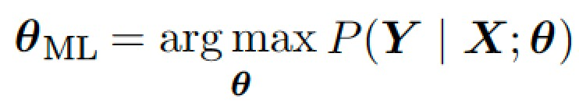
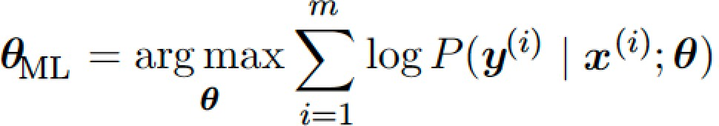
Conditional Log-likelihood and MSE
Maximum likelihood estimator can be readily generalized to parameters of an input-output relationship
  Goal is prediction: conditional probability P(y|x;θ)
  Which forms the basis of most supervised learning
If X represents all our inputs and Y represents all our targets then the conditional maximum likelihood estimator is
  If examples are i.i.d. then

Slide 118
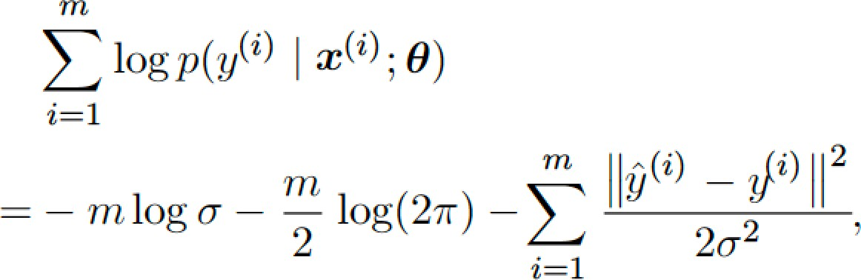
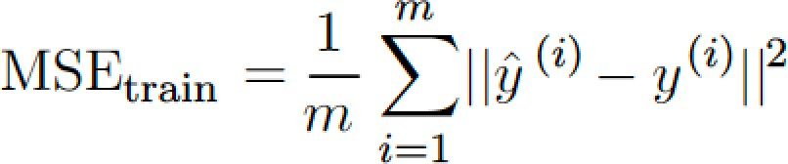
Linear Regression as Maximum Likelihood
Basic linear regression:
  Takes an input x and produce an output yˆ
  Mapping from x to yˆ is chosen to minimize MSE
Revisit linear regression as maximum likelihood
  Think of model as producing a conditional distribution p(y|x)
To derive same algorithm, define
p(y | x) = N(y;yˆ(x,w), σ² )
– Function predicts mean of Gaussian
yˆ(x,w)
– Since samples are i.i.d.
Thus maximizing the log-likelihood is same as minimizing MSE

Slide 119
Properties of Maximum Likelihood
Main appeal of maximum likelihood estimator:
  It is the best estimator asymptotically
    In terms of its rate of converges, as samples m→∞
  Under some conditions, it has a consistency property
    As m→∞ it converges to the true parameter value
    Conditions for consistency
      p_{data} must lie within model family p_{model}(.,θ)
      p_{data} must correspond to exactly one value of θ

Slide 120
Statistical Efficiency
Several estimators, based on inductive principles other than MSE, can be consistent
Define Statistical efficiency - estimator has lower generalization error for fixed number of samples
  Or equivalently, needs fewer examples to obtain a fixed generalization error
Means measuring closeness to true parameters
MSE between estimated and true parameter values
Parameter MSE decreases as m increases
From Cramer-Rao lower bound
  No consistent estimator has lower MSE than Maximum Likelihood Estimator

Slide 121
Topics in Machine Learning Basics
Learning Algorithms
Capacity, Overfitting and Underfitting
Hyperparameters and Validation Sets
Estimators, Bias and Variance
Maximum Likelihood Estimation
Bayesian Statistics
Supervised Learning Algorithms
Unsupervised Learning Algorithms
Stochastic Gradient Descent
10. Building a Machine Learning Algorithm
11. Challenges Motivating Deep Learning

Slide 122
Topics in Bayesian Statistics
Frequentist versus Bayesian Statistics
Prior Probability Distribution
Bayesian Estimation
Ex: Bayesian Linear Regression
Maximum A Posteriori (MAP) Estimation

Slide 123
Frequentist Statistics
So far we have discussed frequentist statistics
The approaches are based on estimating a single value of θ, then making all predictions thereafter based on that one estimate
Summary of the frequentist perspective:
  True parameter value θ is fixed but unknown
  Point estimate θ^{ˆ} is a random variable
    On account of it being a function of the dataset
The Bayesian perspective is quite different

Slide 124
Bayesian Perspective
The Bayesian approach is to consider all possible values of θ before making predictions
The Bayesian approach uses probability to reflect degrees of uncertainty in states of knowledge
The dataset is directly observed and is not random
On the other hand, the true parameter θ is unknown or uncertain and is thus represented as a random variable

Slide 125
Prior Distribution
Before observing the data, we represent our knowledge of θ is using the prior probability distribution p(θ)
  Sometimes simply referred to as the prior
  ML practitioner selects prior distribution to be quite broad
    i.e., with high entropy to reflect high uncertainty
Examples
– θ is in a finite range/volume with uniform distribution
Many priors reflect preferences for “simpler” solutions
  Such as smaller magnitude coefficients
Or a function closer to being constant

Slide 126
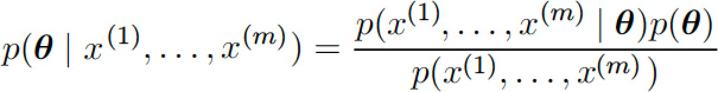
Bayes Rule in Bayesian Approach
Consider we have a set of samples {x⁽¹⁾,..,x^{(m)}}
We can recover the effect of data on our belief about θ by combining the data likelihood p(x⁽¹⁾,..,x^{(m)}|θ) with the prior p(θ) via Bayes rule:

Slide 127
From Prior to Posterior
In Bayesian estimation the prior begins as a relatively uniform or Gaussian with high entropy
Data causes the posterior to lose entropy
– And concentrate around a few highly likely values of parameters

Slide 128
Two Differences Between Maximum Likelihood and Bayesian Estimation
Making predictions
Contribution of the prior distribution

Slide 129
1. Making Predictions in Bayesian Approach
MLE predictions use point estimate θ
Bayesian predicts using full distribution over θ
  Ex: after m samples, prediction over sample x^{m+1} is
    Where
    Here each value of θ with positive probability density contributes to the prediction of the next example
– With the contribution weighted by the posterior density itself
    After having observed {x⁽¹⁾,..,x^{(m)}}, if we are still quite uncertain about the value of θ, then the uncertainty is incorporated directly into any predictions that are made

Slide 130
Handling Uncertainty in θ
In the frequentist approach, uncertainty in a given point estimate of θ is handled by evaluating its variance
– Variance of the estimator is an assessment of how the estimate might change with alternative samplings of the observed data
Bayesian answer to the question of how to handle uncertainty in the estimator is to simply integrate over it

Slide 131
Bayesian Approach Avoids Overfitting
Bayesian approach tends to protect well against overfitting
– In the Bayesian approach there is no fitting, just computing the posterior from the prior
Integral is just an application of the laws of probability making the Bayesian approach simple to justify
While the frequentist machinery for constructing an estimator is based on an ad-hoc decision to summarize all knowledge contained in the
dataset with a single point estimate

Slide 132
Second difference: Bayesian vs Maximum Likelihood
Contribution of the prior distribution
  Prior has influence of shifting probability mass function towards regions of the parameter space that are preferred a priori
  In practice prior expresses a preference over models that are simpler or more smooth
Critics of Bayesian approach identify the prior as a source of subjective human judgment that has affects on the predictions

Slide 133
When is Bayesian Approach Better?
Bayesian methods typically generalize much better when limited training data is available
Can suffer from high computational cost when the number of training examples is large

Slide 134
Ex: Bayesian Linear Regression
Consider the Bayesian estimation approach to learning linear regression parameters
Here we learn a linear mapping from an input vector x ε R^{n} to predict value of a scalar y ε R
The prediction is parameterized by the vector w
ε R^{n}:
yˆ = w^{T}x
Given a set of m training samples (X^{(train)},y^{(train)}),
– we can express the prediction of y over the entire
training set as
_{yˆ}(train) _{= X}(train)_{w}

Slide 135
Prediction as a Gaussian Conditional
Prediction y^{(train)} can be expressed as a Gaussian conditional distribution:
Where we follow the standard MSE formulation in assuming that the Gaussian variance on y is one
In what follows we refer to (X^{(train)},y^{(train)}) as simply
(X,y)

Slide 136
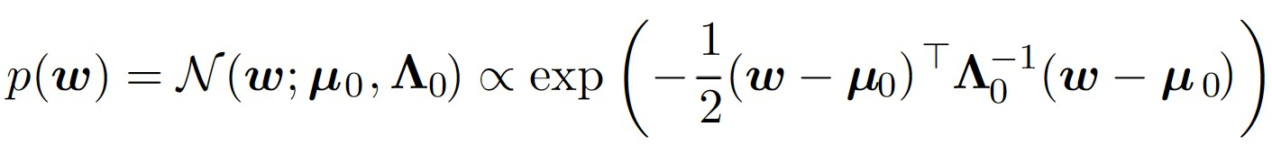
Gaussian Prior Distribution
To specify a posterior distribution over the parameters w, we first need to specify a prior
The prior should reflect our naiive belief about the value of these parameters
– Assume a fairly broad distribution to express high degree of uncertainty about θ
For real-valued parameters it is common to use a Gaussian as a prior distribution
  where µ₀ and Λ₀ are prior distribution mean and covariance matrix; typically assume diagonal Λ₀=diag(λ₀)

Slide 137
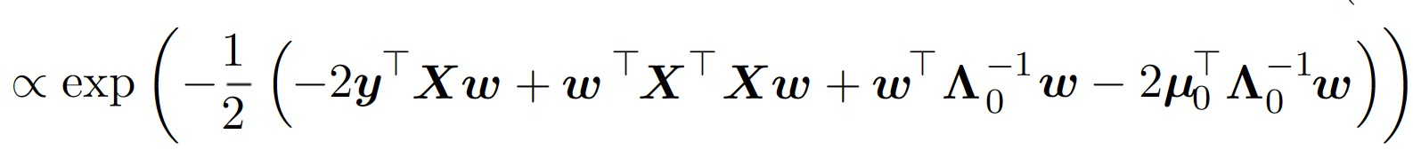


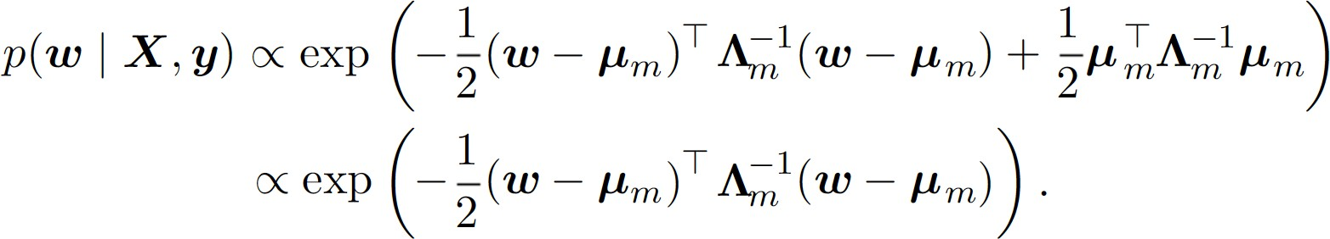
Posterior on the Weights
With prior specified, we can determine the posterior distribution over parameters
Now define and
– Using these new variables, we find that the posterior can be written as a Gaussian distribution:
 | All terms tha parameter ve They are imp | t do not include the ctor w have been omitted lied by normalization.

Slide 138
Maximum A Posteriori (MAP)
Estimation
Most principled approach is to use full posterior distribution over parameters θ, it is still often desirable to have a single point estimate
Most often a Bayesian posterior is intractable
A point estimate offers a tractable solution
Rather than simply returning the maximum likelihood estimate, we can still gain some benefit of the Bayesian approach by allowing the prior to influence the choice of the point
estimate

Slide 139
Intuition on Bayesian Inference
In most situations we set µ₀=0
If we set Λ₀=(1/α)I then µ_{m} gives the same estimate of w as does frequentist linear regression with a weight decay penalty of αw^{T}w
The most important difference is that the Bayesian estimate provides a covariance matrix, showing how likely all the different values of w are, rather than providing only the estimate µ_{m}

Slide 140
The MAP Point Estimate
The MAP estimate chooses the point of maximum a posteriori probability (or maximum probability density in the case of a continuous distribution)
In the right hand side log p(x|θ) is the standard log-
likelihood term
log p(θ) corresponds to the prior distribution

Slide 141
Example of MAP Estimate
Linear regression with Gaussian prior on w
If this prior is given by N(w;0, (1/λ)I²) then the log prior term is proportional to the familiar λw^{T}w weight decay penalty plus a term that does not depend on w and does not affect the learning process
MAP Bayesian inference with a Gaussian prior on the weights thus corresponds to weight decay

Slide 142
Advantage of MAP Point Estimate
Leverages information brought by the prior and cannot be found in the training data
It helps reduce the variance in the MAP point estimate (in comparison to the ML estimate)
However it does so at the risk of increased bias
A more complicated penalty term can be derived by using a mixture of Gaussians rather than a single Gaussian distribution as prior

Slide 143
Topics
Learning Algorithms
Capacity, Overfitting and Underfitting
Hyperparameters and Validation Sets
Estimators, Bias and Variance
Maximum Likelihood Estimation
Bayesian Statistics
Supervised Learning Algorithms
Unsupervised Learning Algorithms
Stochastic Gradient Descent
Building a Machine Learning Algorithm
11. Challenges Motivating Deep Learning

Slide 144
Topics in Supervised Learning
Definition of supervised learning
Probabilistic Supervised Learning
Support Vector Machines
Other simple supervised learning algorithms
  k-nearest neighbor
  Decision tree

Slide 145
What is Supervised Learning?
Refers to learning algorithms that learn to associate some input with some output given a training set of inputs x and outputs y
Outputs may be collected automatically or provided manually

Slide 146
Probabilistic Supervised Learning
Most supervised learning algorithms are based on estimating a probability distribution p(y|x)
We can do this by using MLE to find the best parameter vector θ for a parametric family of distributions p(y|x;θ)
Linear regression corresponds to the family
p(y|x;θ)=N(y|θ^{T}x,I)
We can generalize linear regression to classification by using a different family of
probability distributions

Slide 147
Probabilistic Supervised Classification
If we only have two classes, we only need to specify the distribution for one of these classes
– The probability of the other class is known
For linear regression, normal distribution p(y|x;θ)=N(y|θ^{T}x,I) was parameterized by its mean θ^{T}x
Any value we supply for this mean is valid
For classification, a distribution over a binary variable is more complex.
Its mean must be between 0 and 1.
Solved using logistic sigmoid to squash the output of a linear function into interval (0,1):
p(y=1|x;θ)=σ(θ^{T}x)
Known as logistic regression
Linear regression has a closed-form solution
But Logistic regression has no closed-form solution
  Negative log-likelihood is minimized with gradient descent

Slide 148
Strategy for Supervised Learning
Same strategy can be applied to any supervised learning problem
– Write down a parametric family of conditional probability distributions over the right kind of input and output variables

Slide 149
Support Vector Machines
An influential approach to supervised learning
Model is similar to logistic regression in that it is driven by a linear function w^{T}x+b
  Unlike logistic regression, SVM does not provide probabilities, but only outputs class identity
    SVM predicts positive class when w^{T}x+b>0
    SVM predicts negative class when w^{T}x+b<0

Slide 150
Kernel Trick
A key innovation associated with SVM
Many ML algorithms can be written as dot products between examples
– Ex: linear function used by SVM can be rewritten as
m
T
∑
T (i )
w x + b = b +
α x x
i =1
i
where x^{(i)} is a training example, α a vector of coefficients
Replace x by a feature function ϕ(x) and the dot product with a kernel function k(x,x^{(i)})=ϕ(x)•ϕ(x^{(i)})
  The • operator represents inner product ϕ(x)^{T}ϕ(x^{(i)})
  But we may not literally use the inner product

Slide 151
Prediction Using SVM
We can make predictions using
f (x) = b +
∑
(i )
α k(x,x )
i
i
Depending on whether f(x)>0
The function is nonlinear in x but the relationship between f(x) and ϕ(x) is linear
  Also the relationship between α and f(x) is linear
The kernel-based function is exactly equivalent to preprocessing the data by applying ϕ(x) to all inputs, then learning a linear model in the new transformed space

Slide 152
Efficacy & Efficiency of Kernel Tricks
Kernel trick allows us to learn models that are nonlinear as a function of x using convex optimization guaranteed to converge efficiently
– Possible because ϕ is fixed and optimize only α
Kernel k implemented more efficiently than constructing ϕ vectors and taking dot product
– k(x,x’) tractable even when ϕ(x) is intractable

Slide 153
Gaussian Kernel
Most commonly used kernel is k(u,v)=N(u-v;0,σ²I)
– Called radial basis: decreases along lines radiating from u
To see that it is a valid kernel
– Consider k(u,v) = exp (-||u-v||²/2σ²)
  By expanding the square ||u-v||² = u^{T}u + v^{T}v - 2u^{T}v
  we get k(u,v)=exp(-u^{T}u/2σ²)exp(-u^{T}v/σ²)exp(-v^{T}v/2σ²)
Validity follows from kernel construction rules
  If k₁(x,x’) is a valid kernel, so are
k(x,x’)=f(x)k₁(x,x’)f(x’) and k(x,x’)=exp(k₁(x,x’))
together with validity of linear kernel k(u,v)=u^{T}v

Slide 154
Intuition of Gaussian kernel
It performs a kind of template matching
When a test point x’ is near a template x its response is high, putting a large weight on the associated training label y
Overall, the prediction combines many such training labels weighted by the similarity of the corresponding training examples
SVM is not the only algorithm enhanced by the kernel trick
– Methods employing the kernel trick are kernel methods

Slide 155
Disadvantages of Kernel Methods
Cost of decision function evaluation: linear in m
  Because the i^{th} example contributes a term
α_{i}k(x,x^{(i)}) to the decision function
  Can mitigate this by learning an α with mostly zeros
    Classification requires evaluating the kernel function only for training examples that have a nonzero α_{i}
    These are known as support vectors
Cost of training: high with large data sets
Generic kernels struggle to generalize well
  Neural network outperformed RBF kernel SVM on
MNIST benchmark

Slide 156
Other Simple Supervised Learning
K-nearest neighbor
Decision trees

Slide 157
K-Nearest Neighbors
A family of techniques that can be used for regression or classification
As a nonparametric learning algorithm:
  it is not restricted to a fixed no of parameters
A simple function of the training data
  When we want to produce output y for input x, we find k-nearest neighbors to x in the training data X. We then return the average of the corresponding y values in the training set
    Works for any kind of supervised learning where we can
define average over y values

Slide 158
K-Nearest Neighbor Classification
We can average over one-hot-vectors c with
c_{y}=1 and c_{i}=0 for all other values of I
  Can interpret the average values as giving a probability distribution over classes
K-nn classification has high capacity
  High accuracy given a large training set
    1-nearest neighbor error rate approaches twice Bayes error rate, with training set size, assuming 0-1 loss
      Error in excess of Bayes rate because of choosing a neighbor by breaking ties between equally distant neighbors randomly
      If we chooses all neighbors to vote, we get Bayes rate
A weakness: cannot learn one feature more
discriminative than another

Slide 159
Learning Ensembles
Learn multiple alternative definitions of a concept using different training data or different learning algorithms.
Combine decisions of multiple definitions, e.g. using weighted voting.
Training Data
⋅ ⋅ ⋅ ⋅ ⋅ ⋅ ⋅ ⋅
Data1
Data2
Data m
Learner1
Learner2
⋅ ⋅ ⋅ ⋅ ⋅ ⋅ ⋅ ⋅
Learner m
⋅ ⋅ ⋅ ⋅ ⋅ ⋅ ⋅ ⋅
Model1
Model2
Model m
Model Combiner
Final Model

Slide 160
Value of Ensembles
When combing multiple independent and diverse decisions each of which is at least more accurate than random guessing, random errors cancel each other out, correct decisions are reinforced.
Human ensembles are demonstrably better
  How many jelly beans in the jar?: Individual estimates vs. group average.
  Who Wants to be a Millionaire: Expert friend vs. audience vote.

Slide 161
Homogenous Ensembles
Use a single, arbitrary learning algorithm but manipulate training data to make it learn multiple models.
  Data1 ≠ Data2 ≠ … ≠ Data m
  Learner1 = Learner2 = … = Learner m
Different methods for changing training data:
  Bagging: Resample training data
  Boosting: Reweight training data
  DECORATE: Add additional artificial training data
In WEKA, these are called meta-learners, they take a learning algorithm as an argument (base learner) and create a new learning algorithm.

Slide 162
Bagging
Create ensembles by repeatedly randomly resampling the training data (Brieman, 1996).
Given a training set of size n, create m samples of size n by drawing n examples from the original data, with replacement.
  Each bootstrap sample will on average contain 63.2% of the unique training examples, the rest are replicates.
Combine the m resulting models using simple majority vote.
Decreases error by decreasing the variance in the results due to unstable learners, algorithms (like decision trees) whose output can change dramatically when the training data is slightly changed.

Slide 163
Boosting
Originally developed by computational learning theorists to guarantee performance improvements on fitting training data for a weak learner that only needs to generate a hypothesis with a training accuracy greater than 0.5 (Schapire, 1990).
Revised to be a practical algorithm, AdaBoost, for building ensembles that empirically improves generalization performance (Freund & Shapire, 1996).
Examples are given weights. At each iteration, a new hypothesis is learned and the examples are reweighted to focus the system on examples that the most recently learned classifier got wrong.

Slide 164
Boosting: Basic Algorithm
General Loop:
  Set all examples to have equal uniform weights.
  For t from 1 to T do:
  Learn a hypothesis, h_{t}, from the weighted examples
  Decrease the weights of examples h_{t} classifies correctly
Base (weak) learner must focus on correctly classifying the most highly weighted examples while strongly avoiding over-fitting.
During testing, each of the T hypotheses get a weighted vote proportional to their accuracy on the training data.

Slide 165
Decision Tree
A learning algorithm that breaks the input space into regions and has separate parameters for each region
Each node is associated with with a region of input space
Internal nodes break that region into onr=e subregion for each child

Slide 166
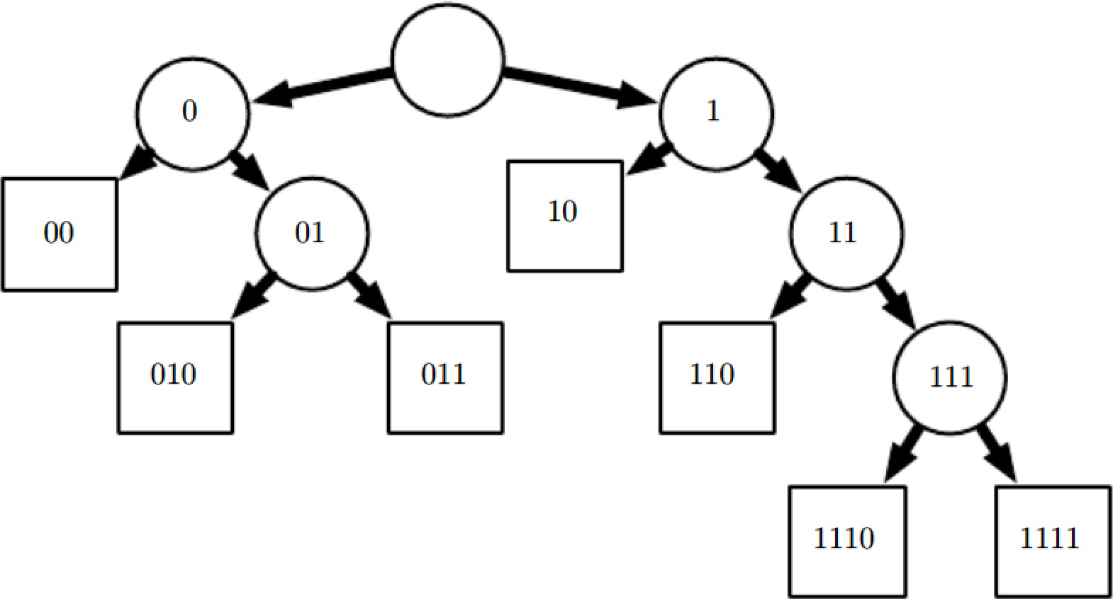
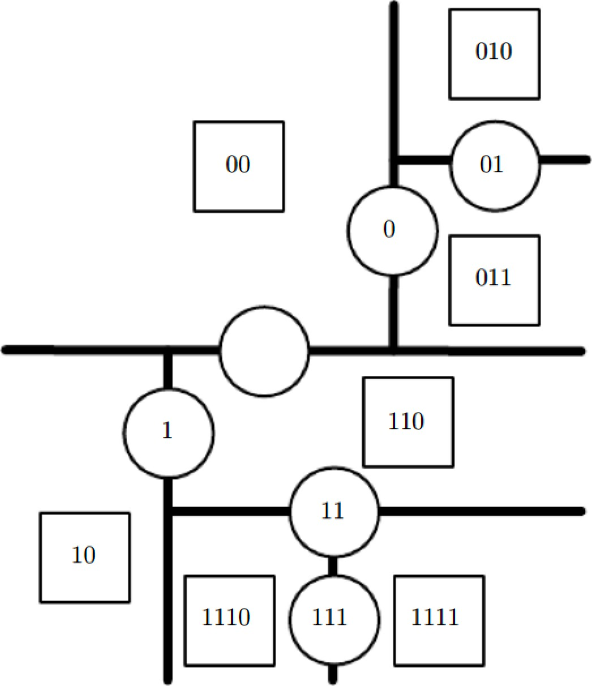
How a Decision Tree Works
Each node of the tree
chooses to send the input example to the
child node on the left (0) or the child node on the right (1). Internal nodes are circles Leaf nodes are squares.
The tree divides space into regions. This 2-D plane shows how a decision tree might divide R².
The nodes are plotted in this plane
with each internal node drawn along with the dividing line it uses to categorize examples and leaf nodes drawn in the center of the region of examples they receive. The result is a piecewise-constant function, with one piece per leaf.

Slide 167
Bagging
Create bootstrap samples
from the training data
M features
N examples
....…

Slide 168
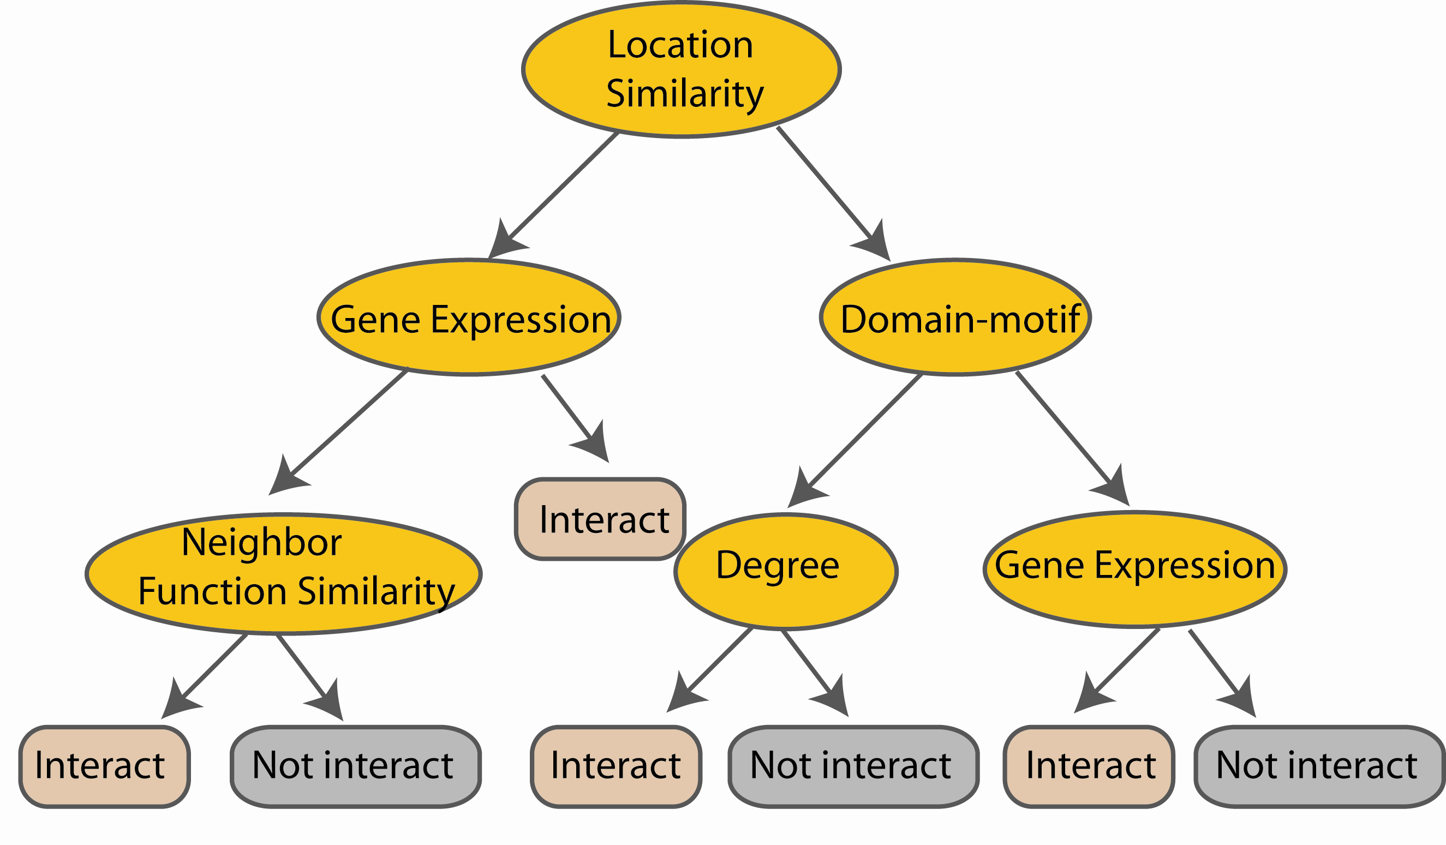
Random Forest Classifier
Construct a decision tree
M features
N examples
....…

Slide 169
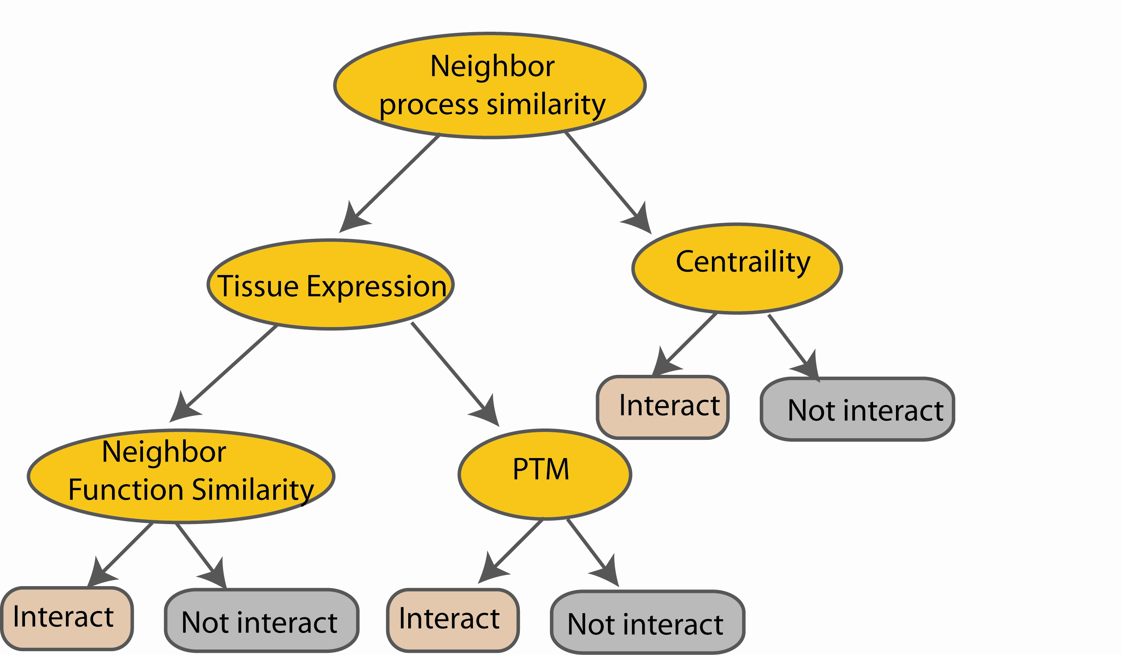
Random Forest Classifier
M features
N examples
Take the majority vote
....…
....…
Notes:
Finally the given an input data the decision is made as follows given an input data,

Slide 170
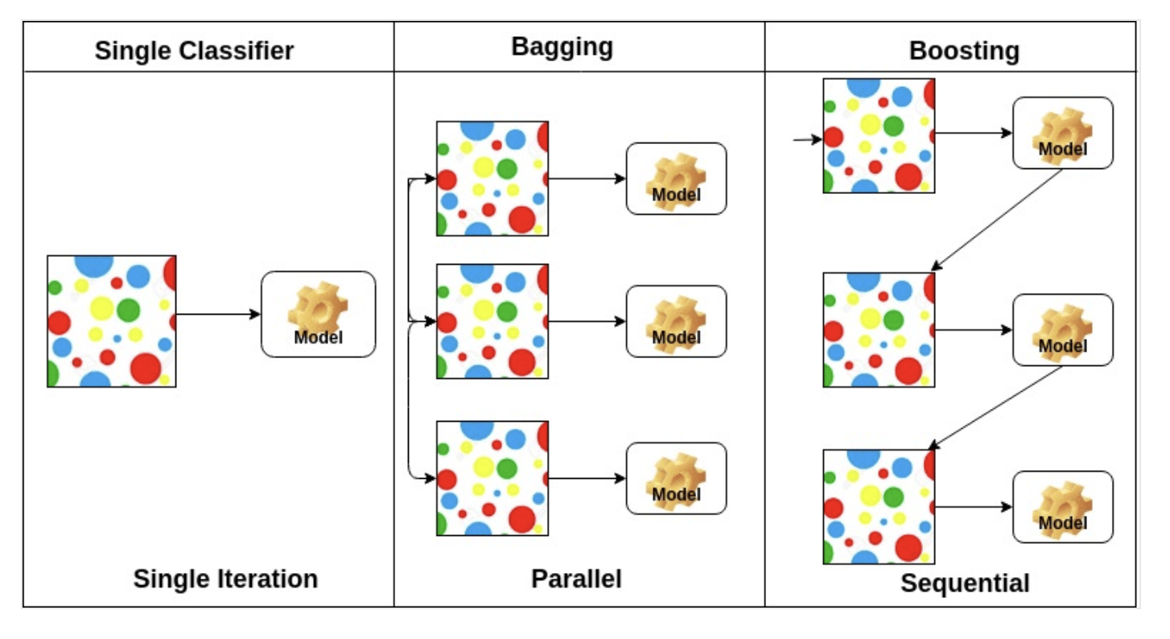

Slide 171
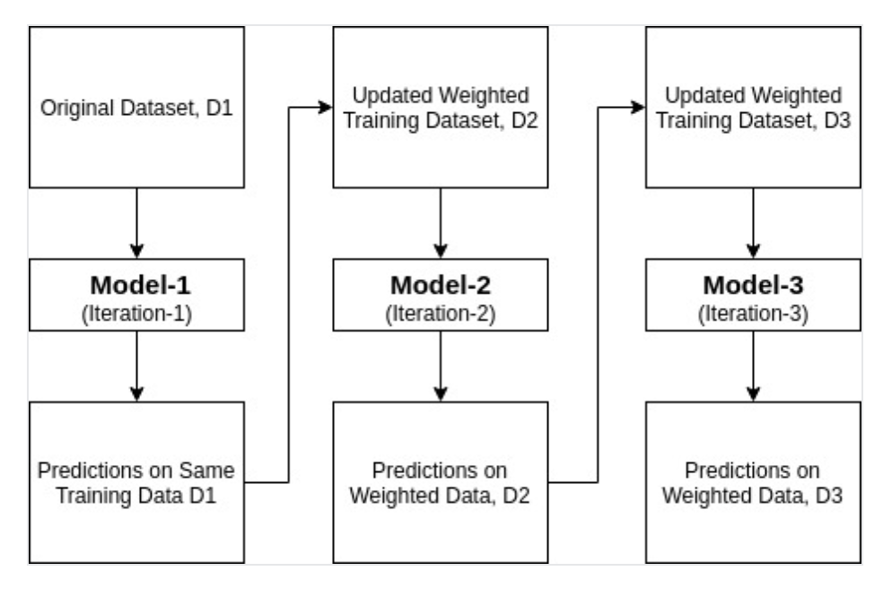
AdaBoost
The AdaBoost algorithm is iterative. The algorithm starts by training a weak classifier on the training data. The weak classifier is then weighted according to how well it performs. The algorithm then trains a second weak classifier using the weighted data. The second weak classifier is then weighted according to how well it performs. This process is repeated for a given number of iterations or until the error rate is below a threshold. The final classifier is the weighted average of all the weak classifiers. The weights are determined by the error rate of each weak classifier. The lower the error rate, the higher the weight.

Slide 172

Ensemble methods
Nearly always win competitions!

Slide 173
Topics in Machine Learning Basics
Learning Algorithms
Capacity, Overfitting and Underfitting
Hyperparameters and Validation Sets
Estimators, Bias and Variance
Maximum Likelihood Estimation
Bayesian Statistics
Supervised Learning Algorithms
Unsupervised Learning Algorithms
Stochastic Gradient Descent
Building a Machine Learning Algorithm
11. Challenges Motivating Deep Learning

Slide 174
Topics in Unsupervised Learning
Unsupervised learning
Principal Components Analysis
K-means clustering

Slide 175
Unsupervised Algorithms
They are algorithms that experience only “features” but not a supervision signal
Refers to extract information from a distribution with no human labor to annotate examples
Term refers to:
  Density estimation
  Learning to draw samples from a distribution
  Learning to denoise data from a distribution
  Finding a manifold that the data lies near
  Clustering the data into groups of related examples

Slide 176
Finding the “Best” Representation
A classic unsupervised learning task
Generally, ‘best’ is looking for a representation:
  that preserves as much information about x as possible while obeying some penalty or constraint
    aimed at keeping the representation simpler or more accessible than x itself
There are multiple ways of defining a simpler
representation:
Lower dimensional representations
Sparse representations
Independent representations

Slide 177
Three “Simpler” Representations
Low-dimensional representations
  Attempt to compress as much information about x
as possible in a smaller representation
Sparse representations
  Embed the dataset into a representation whose entries are mostly zero for most inputs
Independent representations
  Attempt to disentangle sources of variation underlying data distribution so that the dimensions of the distribution are statistically independent
Three criteria are not mutually exclusive
– Low dimensions yield weaker dependencies

Slide 178
Representation: Central to Deep Learning
Some simple examples of representation learning algorithms are:
Principal components analysis
k-means clustering

Slide 179
Principal Components Analysis
PCA is useful for compressing data
Can also view PCA as unsupervised learning to find a representation satisfying two conditions:
  Lower dimensionality than original input
  Independence (a representation with elements having no linear correlation with each other)
This is the first step towards a representation with statistically independent elements
  To achieve full independence, a representation learning algorithm must also remove nonlinear
relationships between variables

Slide 180
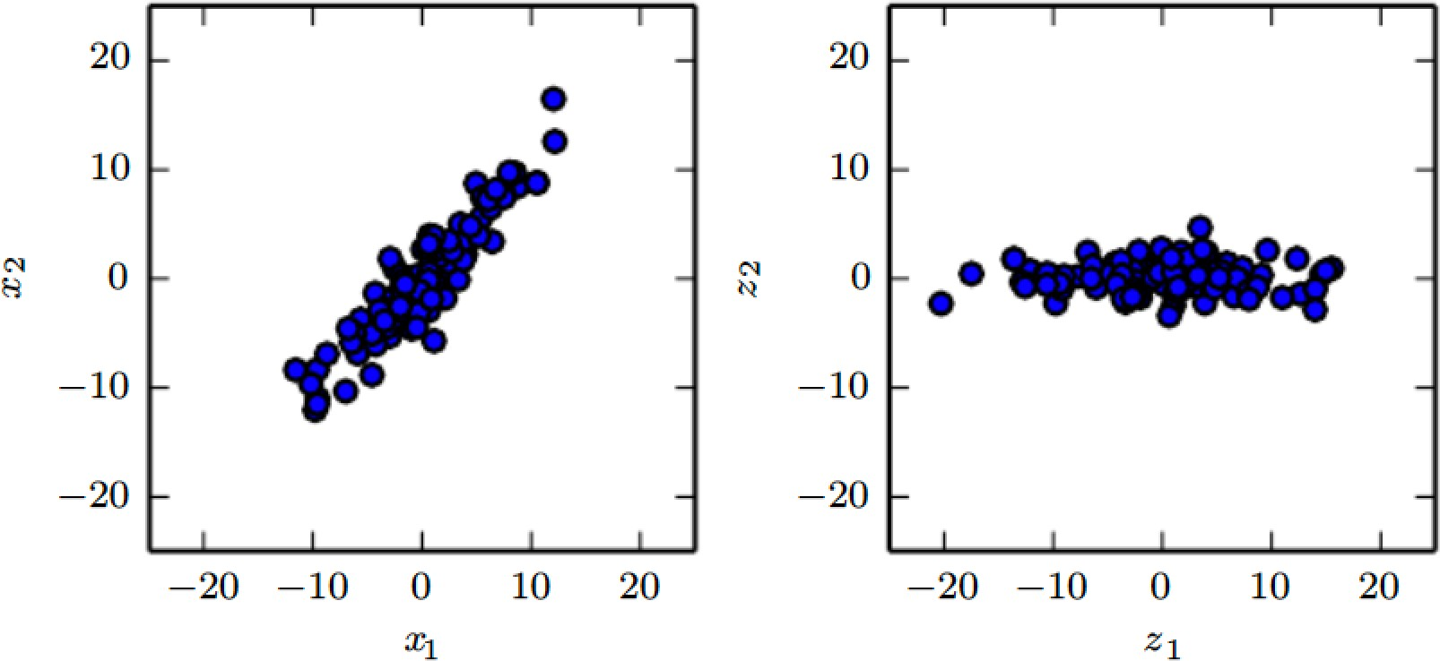
PCA Learns a Linear Projection
PCA projects an input x to a representation z
Original data with samples in x
Variance occurs along directions not axis-aligned
Transformed data
with samples in z=x^{T}W
Varies most along axis z₁
Direction of second most variance is z₂

Slide 181
Uses of PCA
Learn a one-dimensional representation that best reconstructs the original data
  It corresponds to the first principal component
PCA is a simple and effective dimensionality reduction method
  Preserves as much of the data as possible
    Measured by least squares reconstruction error
In the following we study how PCA decorrelates the original data representation X

Slide 182
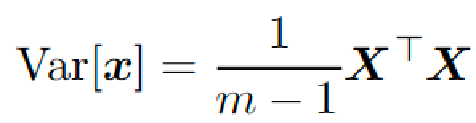
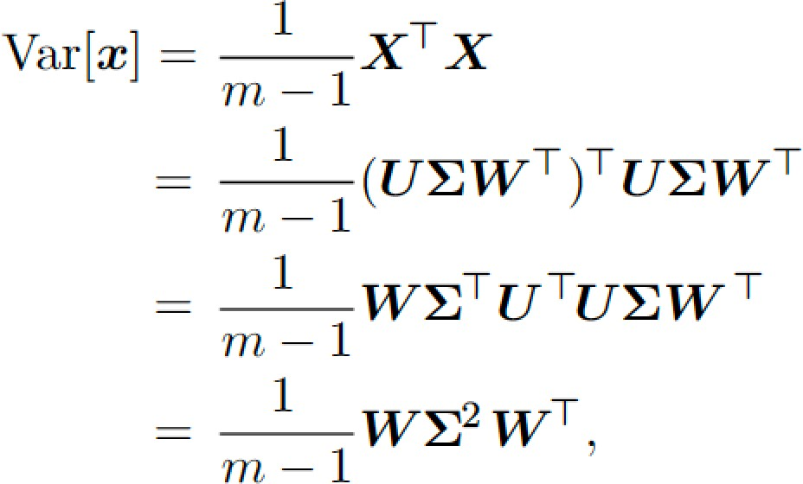
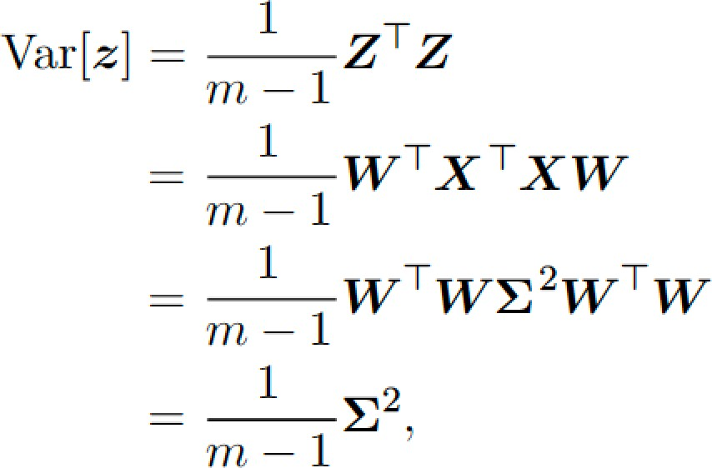
How PCA Uncorrelates the Data
Consider m x n dimensional design matrix X
  We assume data has mean zero, E[x]=0
    Otherwise, subtract the mean from all examples
  The unbiased sample covariance matrix associated with X is
PCA finds a representation (through a linear transformation) z = x^{T}W where Var[z] is diagonal
Using SVD: X=UΣW^{T}
The representation has a diagonal covariance matrix given by Σ² which implies that the elements of z are mutually uncorrelated

Slide 183
PCA as a Disentangler
Very important property of PCA:
  The ability to transform data into a representation where the elements are mutually uncorrelated
  A simple example of a representation that attempts to disentangle unknown factors of variation underlying the data
    PCA rotates input space (by W) that aligns the principal axes of variance with the basis of the new representation space associated with z
We are also interested in more complicated forms of feature dependencies than what can be done with a simple linear transformation

Slide 184
K-means Clustering and One-hot
Divides the training set into k clusters
  A cluster has examples near to each other
An input x is represented by a one-hot vector h
  If x is in cluster i then h_{i}=1 and all others are zero
One-hot vector code is a sparse representation
  All but one entry is zero for every input
  One-hot : Lose benefits of distributed representation but has statistical and computational advantages
    All examples similar to each other
    Entire representation captured by single integer

Slide 185
K-means Algorithm
Initialize k centroids {μ⁽¹⁾,..,μ^{(k)}} to different values
Alternate between two steps until convergence
  Step 1: assign sample to cluster i where i is the index of the nearest centroid μ^{(i)}
  Step 2: Each centroid μ^{(i)} is updated to the mean of all samples assigned to cluster i

Slide 186
One-hot vs Distributed Representation
A difficulty pertaining to clustering:
  Suppose we run two clustering algorithms on a data set of red cars, red trucks, gray cars, grey trucks
    Algo 1: red vehicles together, and grey vehicles together
    Algo 2: cars together, and trucks together
  Clustering along one feature may be relevant and irrelevant along another
    Third Algo obtains four clusters capturing both features but loses similarity
These illustrate as to why distributed representations may be better than one-hot
– It contains information about both attributes

Slide 187
Topics
Learning Algorithms
Capacity, Overfitting and Underfitting
Hyperparameters and Validation Sets
Estimators, Bias and Variance
Maximum Likelihood Estimation
Bayesian Statistics
Supervised Learning Algorithms
Unsupervised Learning Algorithms
Stochastic Gradient Descent - next time
Building a Machine Learning Algorithm
11. Challenges Motivating Deep Learning

Slide 188
Stochastic Gradient Descent (SGD)
Nearly all deep learning is powered by one very important algorithm: SGD
SGD is an extension of the gradient descent algorithm
A recurring problem in machine learning:
  large training sets are necessary for good generalization
  but large training sets are also computationally expensive

Slide 189

Method of Gradient Descent
Criterion f(x) is minimized by moving from the current solution in direction of the negative of gradient
Steepest descent proposes a new point
x' = x − ε∇_{x} f (x)
– where ε is the learning rate, a scalar set to a small constant.

Slide 190

Cost Function is Sum over Samples
Fundamental to machine learning is a cost function
Cost function often decomposes as a sum of per sample loss function
– E.g., Negative conditional log-likelihood of training data is
where m is the no. of samples and
L is the per-example loss L(x,y,θ)= - log p(y|x;θ)

Slide 191

Gradient is Also a Sum Over Samples
For these additive cost functions, gradient descent requires computing
Computational cost of this operation is O(m)
As training set size grows to billions, time taken for single gradient step becomes prohibitively long

Slide 192
Why SGD
Insight: Gradient descent is an expectation
  Expectation may be approximated using a small set of samples
In each step of SGD we can sample a
minibatch of examples B ={x⁽¹⁾,..,x^{(m’)}}
  drawn uniformly from the training set
  minibatch size m’ is typically chosen to be small: 1
to a hundred
    Crucially m’ is held fixed even if the sample set is in billions
    We now fit a training set with billions of examples using updates computed on only a hundred examples

Slide 193


SGD Estimate on Minibatch
Estimate of gradient can be written as
– using examples from minibatch B
SGD then follows the estimated gradient downhill
– where ε is the learning rate

Slide 194
How Good is SGD?
In the past gradient descent was regarded as slow and unreliable
Application of gradient descent to non-convex optimization problems was regarded as unprincipled
SGD is not guaranteed to arrive at even a local minumum in reasonable time
But it often finds a very low value of the cost function quickly

Slide 195
SGD and Training Set Size
SGD is the main way to train large linear models on very large data sets
For a fixed model size, the cost per SGD update does not depend on the training set size m
As m→ ∞ a model will eventually converge to its best possible test error before SGD has sampled every example in the training set
Asymptotic cost of training a model with SGD is
O(1) as a function of m

Slide 196
Deep Learning vs SVM
Prior to advent of DL main way to learn nonlinear models was to use the kernel trick in combination with a linear model
  Many kernel learning algorithms require constructing an m x m matrix G_{i,j}=k(x^{(i)},x^{(j)})
    Constructing this matrix is O(m²)
Growth of Interest in Deep Learning
  In the beginning because it performed better on medium sized data sets (thousands of examples)
  Additional interest in industry because it provided a scalable way of training nonlinear models on large
datasets

Slide 197
Topics
Learning Algorithms
Capacity, Overfitting and Underfitting
Hyperparameters and Validation Sets
Estimators, Bias and Variance
Maximum Likelihood Estimation
Bayesian Statistics
Supervised Learning Algorithms
Unsupervised Learning Algorithms
Stochastic Gradient Descent
Building a Machine Learning Algorithm
11. Challenges Motivating Deep Learning

Slide 198
Recipe for Machine Learning
All Machine Learning algorithms are instances of a recipe:
  Specification of a dataset
    In Linear regression X and y
2. A cost function
J(w,b) = −E_{x,y∼p}⌢ log p_{model}(y | x)
data
An optimization procedure
  In linear regression: normal equations
4. A model
T
p (y | x) = N(y;x w + b,1)
model
Example of building a linear regression algorithm is shown next

Slide 199

Ex: Linear Regression Algorithm
Data set : X and y
Cost function:
J(w,b) = −E_{x,y∼p}⌢ log p_{model}(y | x)
data
3. Model specification:
T
p (y | x) = N(y;x w + b,1)
model
4. Optimization algorithm: solving for where the cost is zero using the normal equations
We can replace any of these components
mostly independently from the others and obtain a variety of algorithms

Slide 200
Recipe for Cost Function
Cost function typically has a term that causes learning to perform statistical estimation
  Most common cost: negative log-likelihood
    Minimizing the cost maximizes the likelihood
Cost function may include additional terms
  E.g., we can add weight decay to get
J(w,b) = λ w
2
log p_{model}(y | x)
2
^{− E}x,y∼p⌢
data
which still allows closed-form optimization
If we change model to be nonlinear most cost functions cannot be optimized in closed-form
– Requires numerical optimization: gradient descen t

Slide 201
Recipe for Unsupervised Learning
Same recipe for both supervised and unsupervised learning
Data set contains only X
Cost and model needed
– Ex: we can obtain the first PCA vector by specifying loss
J(w) = E || x − r(x;w) ||²
^{x~pˆ}data
2
While model is defined to have w with norm one and reconstructed function r(x)=w^{T}xw

Slide 202
Recipe Explains all ML Algorithms
Most machine learning algorithms make use of this recipe
Some models such as decision trees and k- means require special case optimizers
– Because their cost functions have flat regions, gradient-based optimization is inappropriate
Recipe helps to see different algorithms as part of a taxonomy of methods for doing related tasks

Slide 203
Intractable Cost
Sometimes the cost function cannot be evaluated due to computational reasons
In these cases we can still minimize it using iterative numerical optimization
– As long as we have some way of approximating the gradient

Slide 204
Challenges/Motivation
Learning Algorithms
Capacity, Overfitting and Underfitting
Hyperparameters and Validation Sets
Estimators, Bias and Variance
Maximum Likelihood Estimation
Bayesian Statistics
Supervised Learning Algorithms
Unsupervised Learning Algorithms
Stochastic Gradient Descent
Building a Machine Learning Algorithm
11. Challenges Motivating Deep Learning

Slide 205
Topics in “Motivations”
Shortcomings of conventional ML
The curse of dimensionality
Local constancy and smoothness regularization
Manifold learning

Slide 206
Challenges Motivating DL
Simple ML algorithms work very well on a wide variety of important problems
However they have not succeeded in solving central problems of AI, such as recognizing speech and recognizing objects
Deep learning was motivated by failure of traditional algorithms to generalize well on such tasks

Slide 207

Curse of Dimensionality
No of possible distinct configurations of a set of
variables increases exponentially with no of variables
  Poses a statistical challenge
Ex: 10 regions of interest with one variable
  We need to track 100 regions with two variables
  1000 regions with three variables

Slide 208
Local Constancy & Smoothness
Regularization
Prior beliefs
  To generalize well ML algorithms need prior beliefs
    Form of probability distributions over parameters
    Influencing the function itself, while parameters are influenced only indirectly
    Algorithms biased towards preferring a class of functions
– These biases may not be expressed in terms of a probability distribution
Most widely used prior is smoothness
  Also called local constancy prior
  States that the function we learn should not change
very much within a small region

Slide 209
Local Constancy Prior
Function should not change very much within a small region
Many simpler algorithms rely exclusively on this prior to generalize well
– Thus fail to scale statistical challenges in AI tasks
Deep learning introduces additional (explicit and implicit) priors in order to reduce generalization error on sophisticated tasks
We now explain why smoothness alone is
insufficient

Slide 210
Specifying Smoothness
Several methods to encourage learning a function f* that satisfies the condition
f*(x)≈f*(x+ε)
  For most configurations x and small change ε
If we know a good answer for input x then that answer is good in the neighborhood of x
An extreme example is k-nearest neighbor
  Points having the same set of nearest neighbors all have the same prediction
– For k=1, no of regions ≤ no of training examples

Slide 211
Kernel Machines and Smoothness
Kernel machines interpolate between training set outputs associated with nearby training examples
With local kernels: k(u,v) is large when u=v
and decreases as u and v grow further apart
Can be thought of as a similarity function that performs template matching
– By measuring how closely test example x
resembles training example x^{(i)}
Much of deep learning is motivated by
limitations of template matching

Slide 212
Decision Trees and Smoothness
Also suffers from exclusively smoothness- based learning
  They break input space into as many regions as there are leaves and use a separate parameter in each region
  For n leaves, at least n training samples are required
  Many more needed for statistical confidence

Slide 213

no. of Examples and no. of Regions
All of the above methods require:
  O(k) regions need O(k) examples;
  O(k) parameters with O(1) parameters associated with O(k) regions
Nearest-neighbor : each training sample (circle) defines at most one region
  y value associated with each example defines the
output for all points within region

Slide 214
More Regions than Examples
Suppose we need more regions than examples
Two questions of interest
  Is it possible represent a complicated function efficiently?
  Is it possible for the estimated function to generalize well for new inputs?
Answer to both is yes
O(2^{k}) regions can be defined with O(k) examples
  By introducing dependencies between regions through
assumptions on data generating distribution

Slide 215

Core Idea of Deep Learning
Assume data was generated by composition of factors, at multiple levels in a hierarchy
  Many other similarly generic assumptions
These mild assumptions allow exponential gain in no of samples and no of regions
  An example of a distributed representation is a vector of n binary features
    It can take 2^{n} configurations
– Whereas in a symbolic representation, each input is associated with a single symbol (or category)
– Here h₁, h₂ and h₃ are three binary features

Slide 216
Manifold Learning
An important idea underlying many ideas in machine learning
A manifold is a connected region
  Mathematically it is a set of points in a neighborhood
  It appears to be in a Euclidean space
    E.g., we experience the world as a 2-D plane while it is a spherical manifold in 3-D space

Slide 217

Manifold in Machine Learning
Although manifold is mathematically defined, in machine learning it is loosely defined:
– A connected set of points that can be approximated well by considering only a small no of degrees of freedom embedded in a higher-dimensional space
Training data lying near a 1-D Manifold in a 2-D space
The solid line indicates the underlying manifold that the learner should infer
In machine learning we allow the dimensionality of the manifold to vary from one point to another.
This often happens when a manifold Intersects itself, as in a figure-eight

Slide 218
Manifold Learning over R^{n}
It is sometimes hopeless to learn functions with variations across all of R^{n}
Manifold learning algorithms surmount this obstacle by assuming most of R^{n} consists of invalid inputs
– And that intersecting inputs occur only along the manifolds
Introduced for continuous data and in unsupervised learning, the probability concentration idea can be generalized to discrete and unsupervised settings

Slide 219

Manifold Hypothesis for Images
Manifold assumption is justified since:
Distributions are highly concentrated
  Uniformly sampled points look like static noise, never structured
    Although there is a non-zero probability of generating a face, it is never observed

Slide 220
Manifold Justified in Text Domain
If you generate a document by randomly generating text, it is a near zero probability of generating meaningful text
Natural language sequences occupy a small volume of total space of sequences of letters

Slide 221

Manifolds Traced by Transformations
Manifolds can be traced by making small transformations
Manifold structure of a dataset of human faces

Slide 222

Manifolds Discovered for Human Faces
Variational autoencoder discovers underlying two-dimensional coordinate system:
  Rotation
  Emotion
20

Slide 223
All machine learning algorithms are instances of a recipe
  Specification and representation of a dataset
  Math model of the ML architecture
  Evaluation (training/generalization) with a cost function
  Optimization procedure for training
Machine learning vs optimization:
ML derives the data generating distribution
vs
optimization derives the experimental data distribution

Slide 224
Topics in Machine Learning
1. Learning Algorithms
2. Capacity, Overfitting and Underfitting
3. Hyperparameters and Validation Sets
4. Estimators, Bias and Variance
5. Maximum Likelihood Estimation
6. Bayesian Statistics
7. Supervised Learning Algorithms
8. Unsupervised Learning Algorithms
9. Stochastic Gradient Descent – next time
10. Building a Machine Learning Algorithm
11. Challenges Motivating Deep Learning

Slide 225
Why Machine Learning
Because there regularities in nature

Slide 226

Many ML platforms:
Most are open source, many in Python
Our favorite - PyTorch

