Slide 1
Science Inspired Deep Learning (SIDL) or Science Inspired Neural Networks (SINN) Replacing Science with Engineering?
Thanks to :
Paris Perdikaris, George Karniadakis, Juliane Braunsmann,
Maziar Raissi, Bhavesh Shrimali

Slide 2
Why is SIDL Popular
Knowledge of the science/engineering is more important than knowledge of deep learning
The deep learning methods are not that sophisticated and are easy to master
Problems solved by SIDL are numerically very difficult and requires serious computational resources

Slide 3
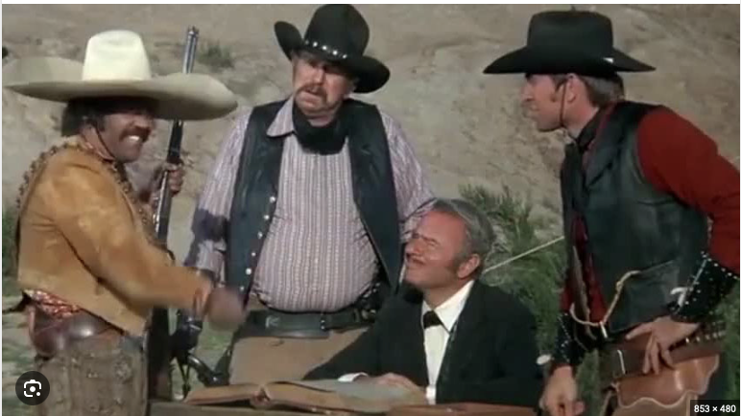
Badges as Computer Scientists
From the 1948 film The Treasure of the Sierra Madre
Mel Brooks's Western Blazing Saddles (1974) version:
"Badges? We don't need no stinking badges”
For SIDL this translates to:
“Computer scientists? We don’t need no stinking computer scientists”

Slide 4
Many models
Many types of science inspired deep learning models
Most are based on the universal function approximation of neural networks
Solve sophisticated PDEs, not simple ones.
Train the DLs on data with science constraints
Use the DL to solve for new unseen input
Earliest (seminal) work: Lagaris, I. E., Likas, A., & Fotiadis, D. I. (1998). Artificial neural networks for solving ordinary and partial differential equations. IEEE transactions on neural networks, 9(5), 987-1000.
Survey: Cuomo, S., Di Cola, V. S., Giampaolo, F., Rozza, G., Raissi, M., & Piccialli, F. (2022). Scientific Machine Learning through Physics-Informed Neural Networks: Where we are and What's next. arXiv preprint arXiv:2201.05624.

Slide 5
Universal Approximation Theorem (UAP)
A feed-forward network with a single hidden layer containing a finite number of neurons can approximate continuous functions on compact subsets of R^{n}, under mild assumptions on the activation function (Borel measurable).
Simple neural networks can represent a wide variety of interesting functions when given appropriate parameters
However, it does address the algorithmic learnability of those parameters.
Cybenko, G. (1989). Approximation by superpositions of a sigmoidal function. Mathematics of control, signals and systems, 2(4), 303-314.

Slide 6
Formal Theorem
Let φ(⋅) be continuous (activation function)
Non-constant, bounded, monotonic increasing function
– I_{m} is the unit hypercube [0,1]^{m} (m inputs, values in [0,1] )
Space of continuous functions on I_{m} is C(I_{m})
Then, given any function f ∈ C(I_{m}) and ε>0, there exists an integer N, (no. of outputs)
real constants v_{i},b_{i} ∈ R, (output weights, input bias)
real vectors w_{i}∈R^{m}, i =1, ⋯ ,N, (input weights)
such that we may define:
F(x) = ∑_{i=1,..N} v_{i}φ(w_{i} x+b_{i}) as an approximation of f
T
where f is independent of φ; i.e.,
|F(x)−f (x)|<εfor all x ∈ I_{m}
i.e., functions of the form F(x) are dense in C(I_{m})

Slide 7
Implications of UPT
A feedforward network with a linear output layer and at least one hidden layer with any “squashing” activation function (such as logistic sigmoid) can approximate:
Any Borel measurable function from one finite-dimensional space to another
With any desired non-zero amount of error
Provided the network is given enough hidden units
The derivatives of the network can also approximate derivates of the function

Slide 8
Applicability of UPT
Any continuous function on a closed and bounded subset of R^{n} is Borel measurable
Therefore approximated by a neural network
Discrete case:
A neural network may also approximate any function mapping from any finite dimensional discrete space to another
Original theorems were for activations that saturate for very negative/positive arguments
Now proved for a wider class including ReLU

Slide 9
UPT and Training
Whatever function to be learned, a large MLP will be able to represent it
There are no guarantees that the training algorithm will learn this function!!
Optimizing algorithms may not find the parameters
May choose wrong function due to over-fitting
No Free Lunch: There is no universal procedure for examining a training set of samples and choosing a function that will generalize to points not in training set

Slide 10
Feed Forward & No Free Lunch
Feed forward networks provide a universal system for representing functions
– Given a function, there is a feed forward network that approximates the function
There is no universal procedure for examining a training set of specific examples and choosing a function that will generalize to points not in training set

Slide 11
Size of the Network
Universal Approximation Theorem
Implies there is a network large enough to achieve any degree of accuracy
But does not say how large the network will be
Some bounds on size of the single-layer network exist for a broad class of functions
Worst case is exponential number of hidden units
No. of possible binary functions on vectors v ∈ {0,1}^{n} is
2²**^{n}
Selecting one such function requires 2^{n} bits which will require O(2^{n}) degrees of freedom

Slide 12
Summary/Implications of UPT
A feedforward network with a single layer is sufficient to represent any function
However, the layer may be unreasonable large and may fail to generalize well
Using deeper models can reduce the number of units required and reduce generalization error

Slide 13
Function Families and Depth
Some families of functions can be represented efficiently for depth >d but require much larger model for depth <d
In some cases number of hidden units required by a shallow model is exponential in n
Functions representable with a deep rectifier net can require an exponential no. of hidden units with a shallow (one hidden layer) network
Piecewise linear networks (which can be obtained from
rectifier nonlinearities or maxout units) can represent functions with a no. of regions that is exponential in d

Slide 14
Advantage of Deeper Networks
Absolute value rectification creates mirror images of function computed on top of some hidden unit wrt the input of that hidden unit.
Each hidden unit specifies where to fold the input space in order to create mirror responses.
By composing these folding operations we obtain an exponentially large no. of piecewise linear regions which can capture all kinds of repeating patterns
Has same output for every pair of mirror points in input. Mirror axis of symmetry
Is given by weights and bias
of unit.
Function computed on top of unit (green decision
surface) will be a mirror image of simpler pattern across
axis of symmetry
Function can be obtained by folding the space around axis of
symmetry
Another repeating pattern can be folded on top of the first
(by another downstream
unit) to obtain another symmetry (which is now repeated four times with two hidden layers)

Slide 15
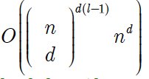
Montufar Theorem on Depth
Number of linear regions carved out by a deep rectifier network with d inputs, depth l and n units per hidden layer is
– i.e., exponential in the depth l.
In the case of maxout networks with k filters per unit, the number of linear regions is
_{O (k}(l−1)+d ₎
There is no guarantee that the functions we want to learn in AI share such a property

Slide 16
Statistical Justification for Depth
Any time we choose a ML algorithm, this means implicitly stating a set of beliefs about what kind of functions that algorithm should learn
Choosing a deep model implies a belief that the function should be a composition of several simpler functions

Slide 17
Intuition on Depth
The use of a deep architecture implies that the function we want to learn is a computer program consisting of m multiple steps where each step makes use of the previous step’s output
The intermediate outputs are not necessarily factors of variation, but can be analogous to counters or pointers used for organizing its internal processing
Empirically greater depth results in better
generalization

Slide 18
Empirical Results
Deeper networks perform better
Test accuracy consistently increases with depth
Increasing parameters without increasing depth is not as effective (depth, 3,3,11)
Deep architectures can express a useful prior over the space of functions the model learns

Slide 19
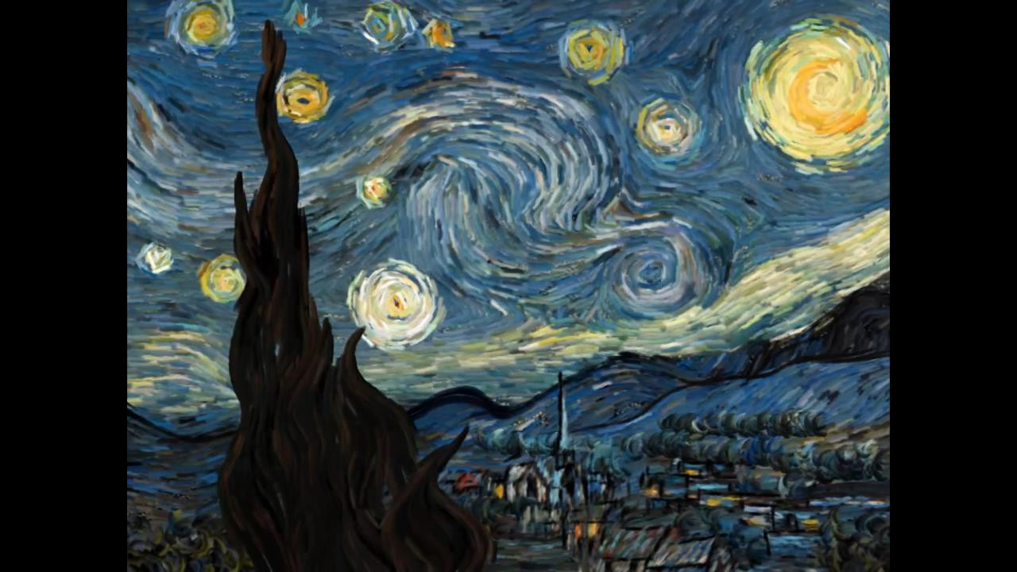
Physics-Informed Neural Networks (PINNs)
George Em Karniadakis
Division of Applied Mathematics, Brown University (also @MIT & PNNL)
The CRUNCH group: Home of “Math + Machine Learning + X” https://www.brown.edu/research/projects/crunch/home

Slide 20
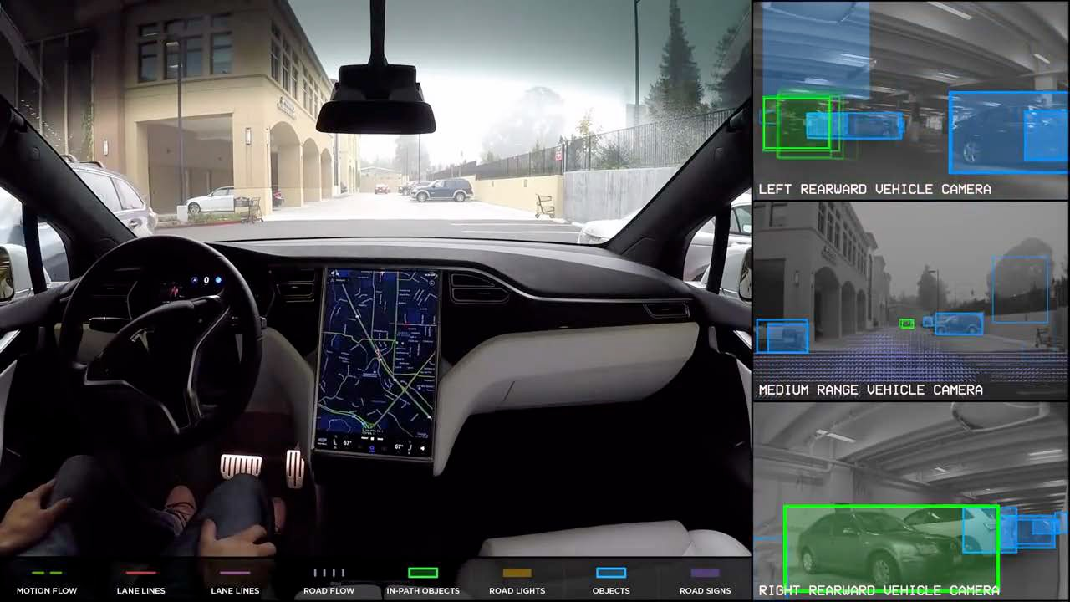
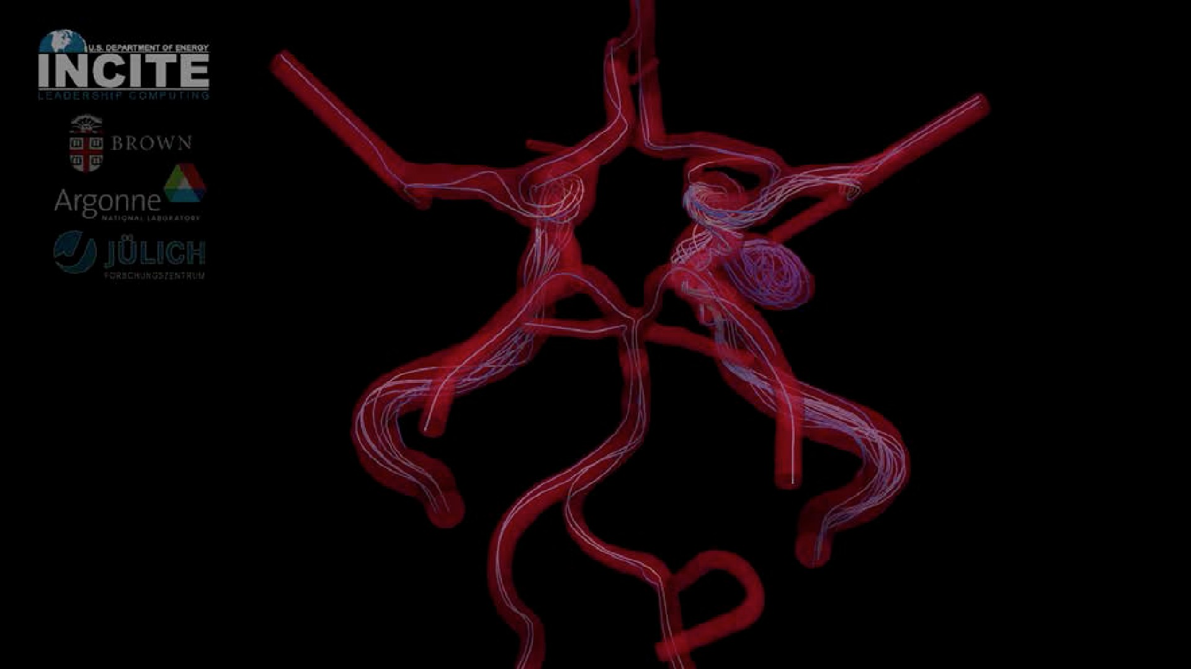
Motivation and open challenges
Goal: Predictive modeling, analysis and optimization of complex systems
ML
Data Prior knowledge
CSE
p($θ$|D) / p(D|$θ$)p($θ$)
Challenges:
•
•
•
•
•
•
•
High cost of data acquisition Limited and high-dimensional data
Multiple tasks and data modalities (e.g. images, time-series, scattered measurements, etc.) Large parameter spaces
Incomplete models, imperfect data (e.g., missing data, outliers, complex noise processes) Uncertainty quantification
Robust design/control
Hypothesis:
•
Can we bridge knowledge from scientific computing and machine learning to tackle these challenges?

Slide 22
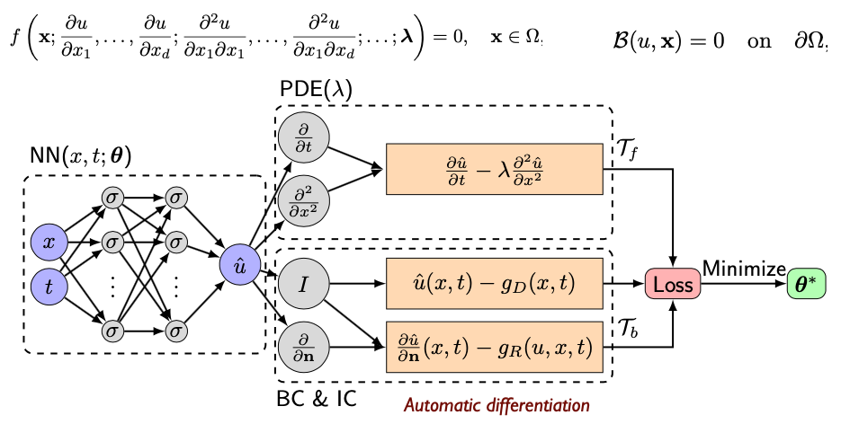
Physics-informed Neural Networks
Automatic differentiation
Psichogios, D. C., & Ungar, L. H. (1992). A hybrid neural network-first principles approach to process modeling. AIChE Journal, 38(10), 1499-1511.
Lagaris, I. E., Likas, A., & Fotiadis, D. I. (1998). Artificial neural networks for solving ordinary and partial differential equations. IEEE transactions on neural networks, 9(5), 987-1000.
Raissi, M., Perdikaris, P., & Karniadakis, G. E. (2019). Physics-informed neural networks: A deep learning framework for solving forward and inverse problems involving nonlinear partial differential equations. Journal of Computational Physics, 378, 686-707.
Lu, L., Meng, X., Mao, Z., & Karniadakis, G. E. (2019). DeepXDE: A deep learning library for solving differential equations. arXiv preprint arXiv: 1907.04502.

Slide 23
Introduction: PINNs
PINNs - Neural networks that are trained to
solve supervised learning tasks
while respecting physical laws (PDEs)
Data-driven solution [Raissi et al.(2017a)Raissi, Perdikaris, and Karniadakis]
Data-driven discovery of PDEs
[Raissi et al.(2017b)Raissi, Perdikaris, and Karniadakis]
Two distinct types of algorithms
New family of data-efficient spatio-temporal function approximators Arbitrary accurate RK time steppers with potentially unlimited number of stages
Paper: [Raissi et al.(2019)Raissi, Perdikaris, and Karniadakis]
PINNs
3 / 30

Slide 24
Runga-Kutta (RK)
• The Runge-Kutta method is the most popular method for solving ordinary differential equations (ODEs) by means of numerical approximations.
• There are several versions of the method depending on the desired accuracy.
• The most popular RK method is of fourth order (i.e., RK-4), which in simpler terms means that the error is of the order of h4 , abbreviated as O(h4).

Slide 25
DNNs: Universal Approximators
Identify a nonlinear map from a few – potentially very high dimensional – input and output pairs of data
PDEs
PINNs
4 / 30

Slide 26
DNNs: Universal Approximators
Identify a nonlinear map from a few – potentially very high dimensional – input and output pairs of data
However, many physical and biological systems consist of
prior knowledge
encoded in physical laws, e.g. Newton’s laws of motion, Maxwell’s laws of electromagnetism
PDEs
PINNs
4 / 30

Slide 27
DNNs: Universal Approximators
Identify a nonlinear map from a few – potentially very high dimensional – input and output pairs of data
However, many physical and biological systems consist of
prior knowledge
encoded in physical laws, e.g. Newton’s laws of motion, Maxwell’s laws of electromagnetism
This prior information can act as that reduces
a regularization constraint
the space of admissible solutions =⇒
remove unrealistic solutions that
violate fundamental conservation laws (mass, momentum, energy)
PDEs
PINNs
4 / 30

Slide 28
DNNs: Universal Approximators
Identify a nonlinear map from a few – potentially very high dimensional – input and output pairs of data
However, many physical and biological systems consist of
prior knowledge
encoded in physical laws, e.g. Newton’s laws of motion, Maxwell’s laws of electromagnetism
This prior information can act as that reduces
a regularization constraint
the space of admissible solutions =⇒
remove unrealistic solutions that
violate fundamental conservation laws (mass, momentum, energy)
Previous ideas employed Gaussian process regression, but these were limited in their ability to handle nonlinear problems
PDEs
PINNs
4 / 30

Slide 29
DNNs: Universal Approximators
Identify a nonlinear map from a few – potentially very high dimensional – input and output pairs of data
However, many physical and biological systems consist of
prior knowledge
encoded in physical laws, e.g. Newton’s laws of motion, Maxwell’s laws of electromagnetism
This prior information can act as that reduces
a regularization constraint
the space of admissible solutions =⇒
remove unrealistic solutions that
violate fundamental conservation laws (mass, momentum, energy)
Previous ideas employed Gaussian process regression, but these were limited in their ability to handle nonlinear problems
PDEs
Need both initial conditions and boundary conditions
PINNs
4 / 30

Slide 30
DNNs: Universal Approximators
Identify a nonlinear map from a few – potentially very high dimensional – input and output pairs of data
However, many physical and biological systems consist of
prior knowledge
encoded in physical laws, e.g. Newton’s laws of motion, Maxwell’s laws of electromagnetism
This prior information can act as that reduces
a regularization constraint
the space of admissible solutions =⇒
remove unrealistic solutions that
violate fundamental conservation laws (mass, momentum, energy)
Previous ideas employed Gaussian process regression, but these were limited in their ability to handle nonlinear problems
PDEs
Need both initial conditions and boundary conditions
Point Collocation methods: Function Approximation + point evaluation, e.g. consider an approximation problem for a function u(x ) on x ∈ (0, 1),
2
u(x ) ∼ u-(x ) = a₀ + a₁x + a₂x ; with u-(x_{j} ) = uˆ_{j} , j = 1, 2
PINNs
4 / 30

Slide 31
Problem setup
Problem setup
Parameterized, nonlinear PDE(s)
_{(·) =} ∂ (·)
u + N [u; λ] = 0, x ∈ Ω ⊂ R^{D}, t ∈ [0, T ];
t
t
∂t
PINNs
6 / 30

Slide 32
Problem setup
Parameterized, nonlinear PDE(s)
_{(·) =} ∂ (·)
u + N [u; λ] = 0, x ∈ Ω ⊂ R^{D}, t ∈ [0, T ];
t
t
∂t
where u(t, x ) denotes the latent (hidden) solution, N [·; λ] is a nonlinear operator parametrized by λ
PINNs
6 / 30

Slide 33
Problem setup
Parameterized, nonlinear PDE(s)
_{(·) =} ∂ (·)
u + N [u; λ] = 0, x ∈ Ω ⊂ R^{D}, t ∈ [0, T ];
t
t
∂t
where u(t, x ) denotes the latent (hidden) solution, N [·; λ] is a nonlinear operator parametrized by λ
The above setup covers a wide range of PDEs in math. physics, including conservation laws, diffusion, reac-diff-advec. PDE, kinetics etc. E.g., Burger’s equation in 2D
∂ (·) ∂² (·)
∂x ∂x ²
N [u; λ] = λ₁uu_{x} − λ₂u_{xx} and λ = (λ₁, λ₂) ; (·)_{x} =
(·)_{xx} =
Burgers' equation or Bateman–Burgers equation is a fundamental partial differential equation and convection–diffusion equation occurring in various areas of applied mathematics, such as fluid mechanics, nonlinear acoustics, gas dynamics, and traffic flow.
PINNs
6 / 30

Slide 34
Problem setup
Parameterized, nonlinear PDE(s)
_{(·) =} ∂ (·)
u + N [u; λ] = 0, x ∈ Ω ⊂ R^{D}, t ∈ [0, T ];
t
t
∂t
where u(t, x ) denotes the latent (hidden) solution, N [·; λ] is a nonlinear operator parametrized by λ
The above setup covers a wide range of PDEs in math. physics, including conservation laws, diffusion, reac-diff-advec. PDE, kinetics etc. E.g., Burger’s equation in 2D
∂ (·) ∂² (·)
∂x ∂x ²
N [u; λ] = λ₁uu_{x} − λ₂u_{xx} and λ = (λ₁, λ₂) ; (·)_{x} =
(·)_{xx} =
Given λ what is u(t, x ) (Inference, filtering and smoothing or simply
data-driven solutions of PDEs)
PINNs
6 / 30

Slide 35
Problem setup
Parameterized, nonlinear PDE(s)
_{(·) =} ∂ (·)
u + N [u; λ] = 0, x ∈ Ω ⊂ R^{D}, t ∈ [0, T ];
t
t
∂t
where u(t, x ) denotes the latent (hidden) solution, N [·; λ] is a nonlinear operator parametrized by λ
The above setup covers a wide range of PDEs in math. physics, including conservation laws, diffusion, reac-diff-advec. PDE, kinetics etc. E.g., Burger’s equation in 2D
∂ (·) ∂² (·)
∂x ∂x ²
N [u; λ] = λ₁uu_{x} − λ₂u_{xx} and λ = (λ₁, λ₂) ; (·)_{x} =
(·)_{xx} =
Given λ what is u(t, x ) (Inference, filtering and smoothing or simply
data-driven solutions of PDEs)
Find λ that best describes observations u (t_{i} , x_{j} ) (Learning, system identification, or data-driven discovery of PDEs)
PINNs
6 / 30

Slide 36
Physics-informed Neural Networks
IC – initial conditions
BC– boundary conditions
Automatic differentiation
Raissi, M., Perdikaris, P., & Karniadakis, G. E. (2019). Physics-informed neural networks: A deep learning framework for solving forward and inverse problems involving nonlinear partial differential equations. Journal of Computational Physics, 378, 686-707.

Slide 37
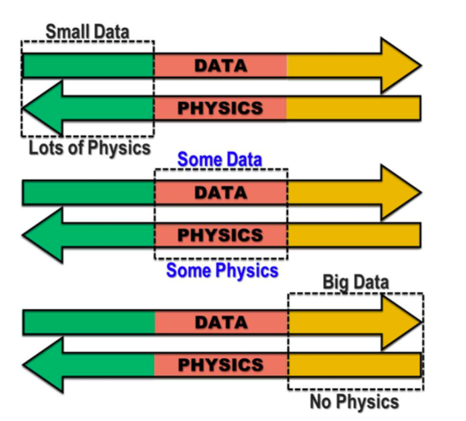
Data vs physics (or your science)

Slide 38
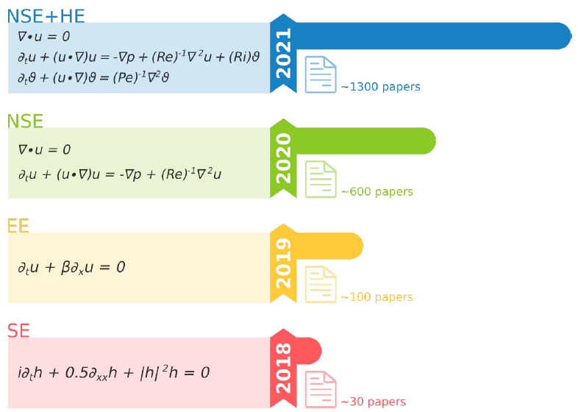
Different types of PDEs
Cuomo, 2022

Slide 39
PINN variations
NSE: Navier-Stokes equation
SE: 1D nonlinear Schrodinger equation
EE: Euler equations for aerodynamic floes
NSE+HE: NSE coupled with temperature equation

Slide 40
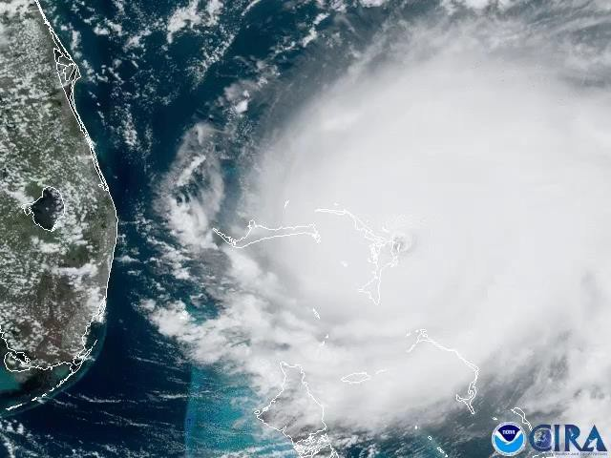
Aim: Extract quantitative information from videos for rescue operations and beyond!

Slide 41
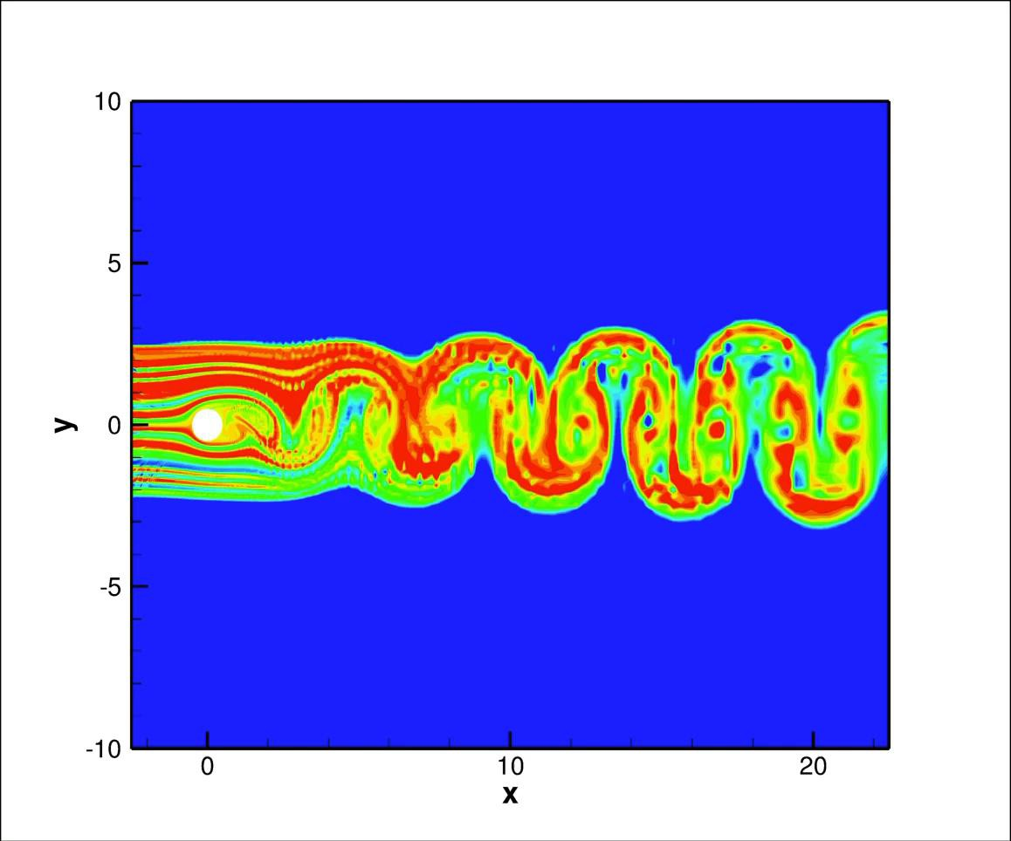
Hidden Fluid Mechanics
Can we compute the body forces based on flow viz only?

Slide 42
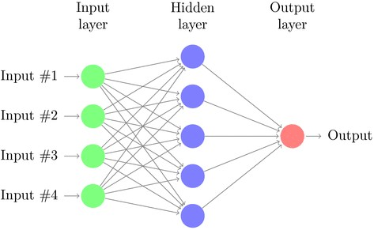
Neural Networks are Function Approximators, Not Predictors!
Theorem (Cybenko, 1989)
Let 𝜎 be any continuous sigmoidal function. Then, the finite sums of the form
𝑁
𝐺 𝑥
= 𝛼_{𝑗}𝜎 𝑦_{𝑗} ∙ 𝑥 + 𝜃_{𝑗}
𝑗=1
are dense in 𝐶 𝐼_{𝑑} .
G. Cybenko, “Approximation by superpositions of a sigmoidal function”, Mathematics of Control, Signals and Systems, 303-314, 2(4), 1989
Hornik et. al., 1989; Barron (1994); Mhaskar (1996)

Slide 43
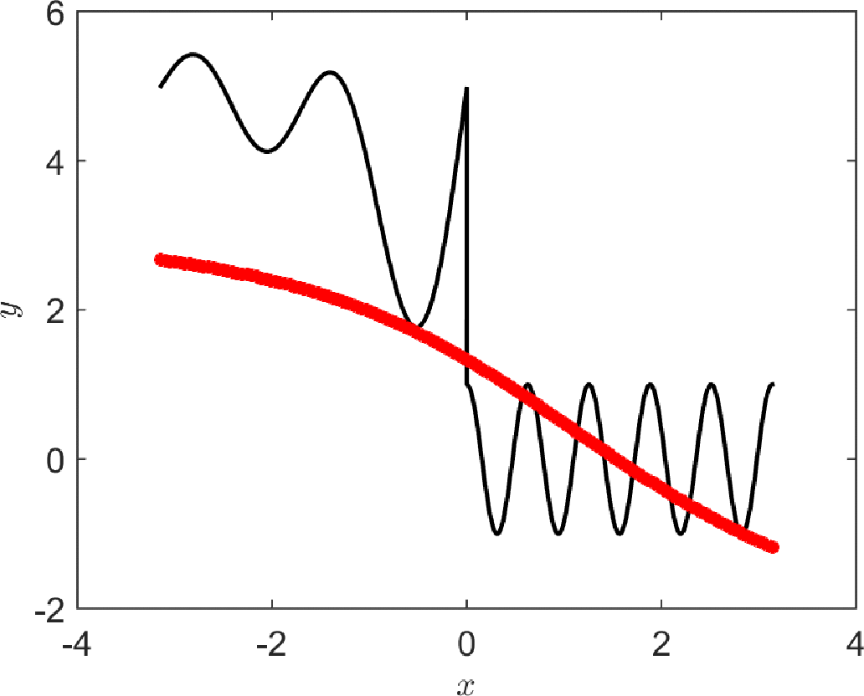
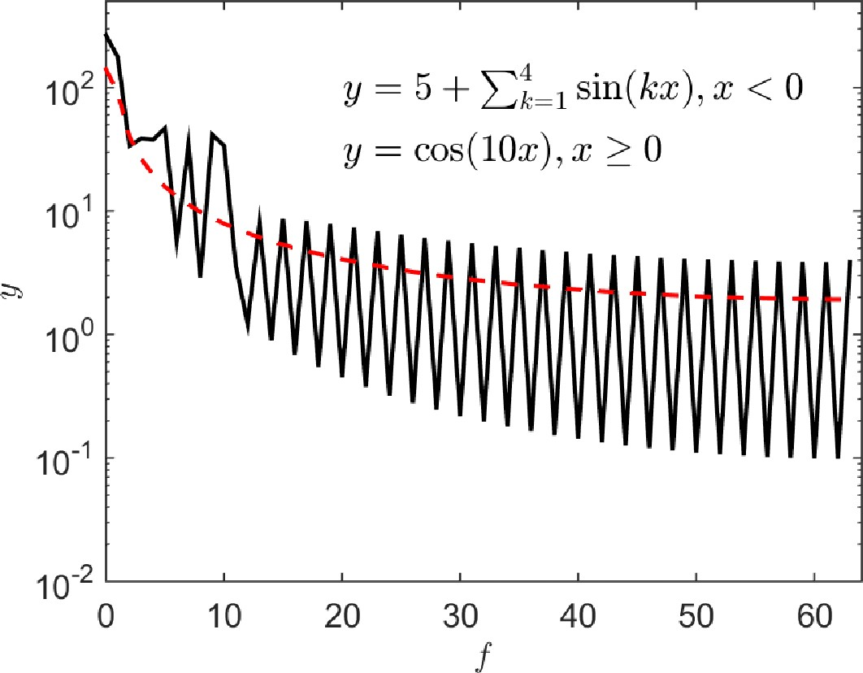
Learning a Discontinuous/Oscillatory Function in Physical & Fourier Domains
DNN: Fully Connected 2 x 20

Slide 44
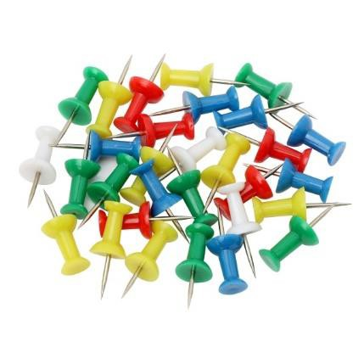
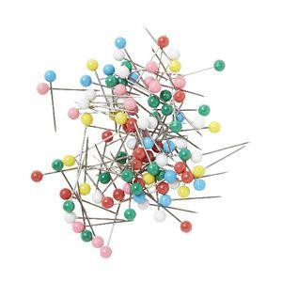
Data + Neural Networks + Physical Laws
*Physics-Informed Neural Networks (PINNs)
Physics-informed neural networks: A deep learning framework for solving forward and inverse problems involving nonlinear partial differential equations
M Raissi, P Perdikaris, GE Karniadakis
Journal of Computational Physics 378, 686-707
arXiv:1711.10561; arXiv:1711.10566 (2017)

Slide 45
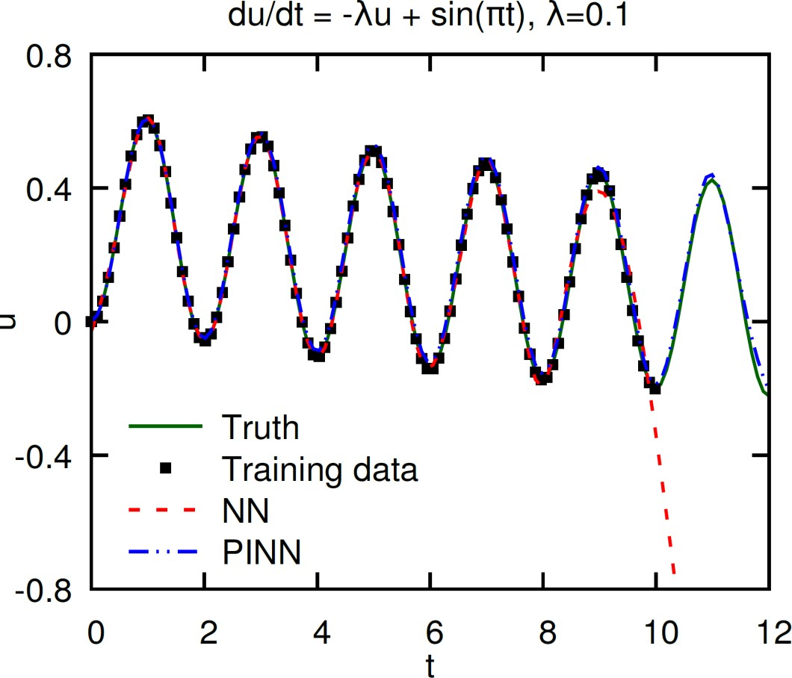
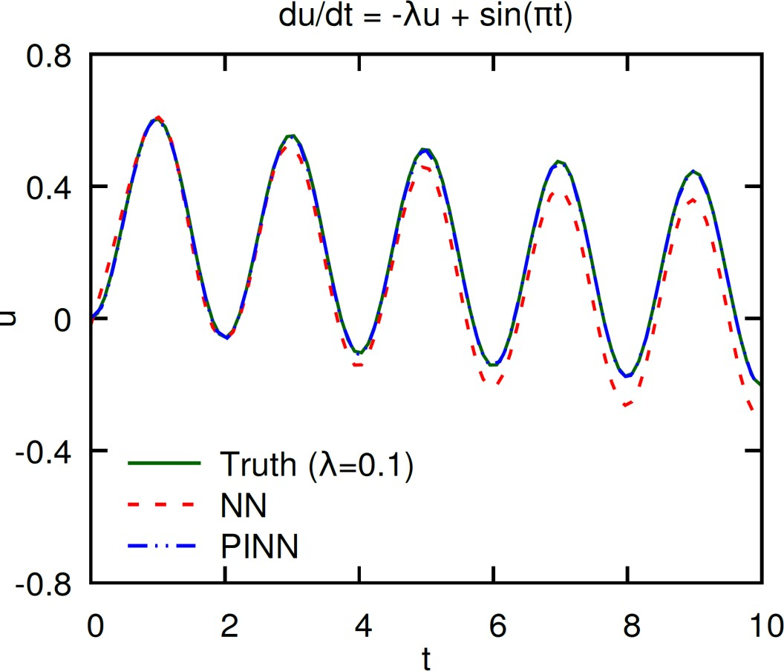
Physics-Informed Neural Networks (PINN) vs Neural Networks (NN)
to PINN or not to PINN?
- train for lambda = 0.3, 0.4, ..., 1 and t = [0, 10]
NN: 4 layers, 20 neurons per layer
Adam optimizer, learning rate 0.001, optimized for 10000 steps.

Slide 46
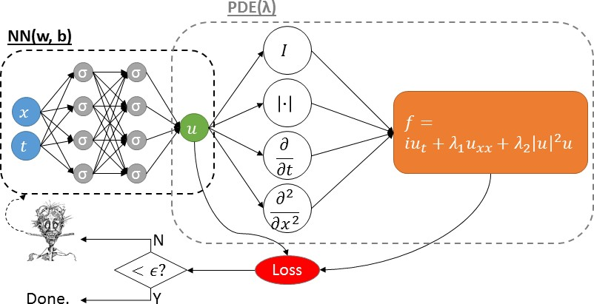
What is a PINN? Physics-Informed Neural Network
We employ two (or more) NNs that share the same parameters
Minimize:

Slide 47
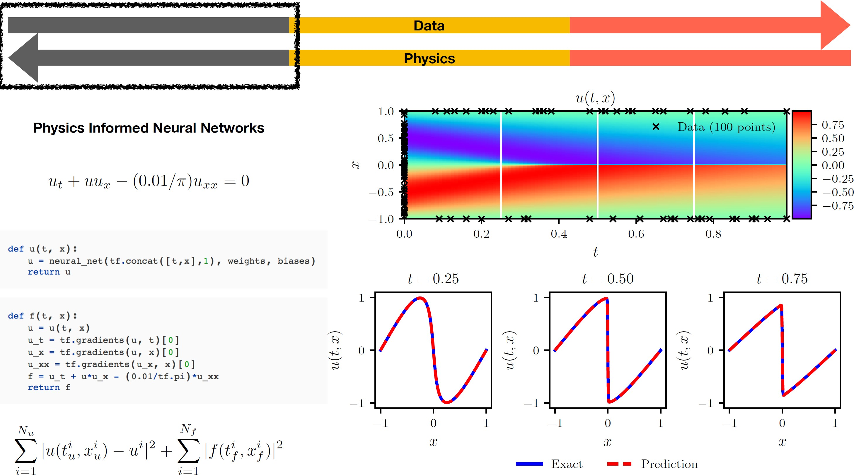

Slide 48
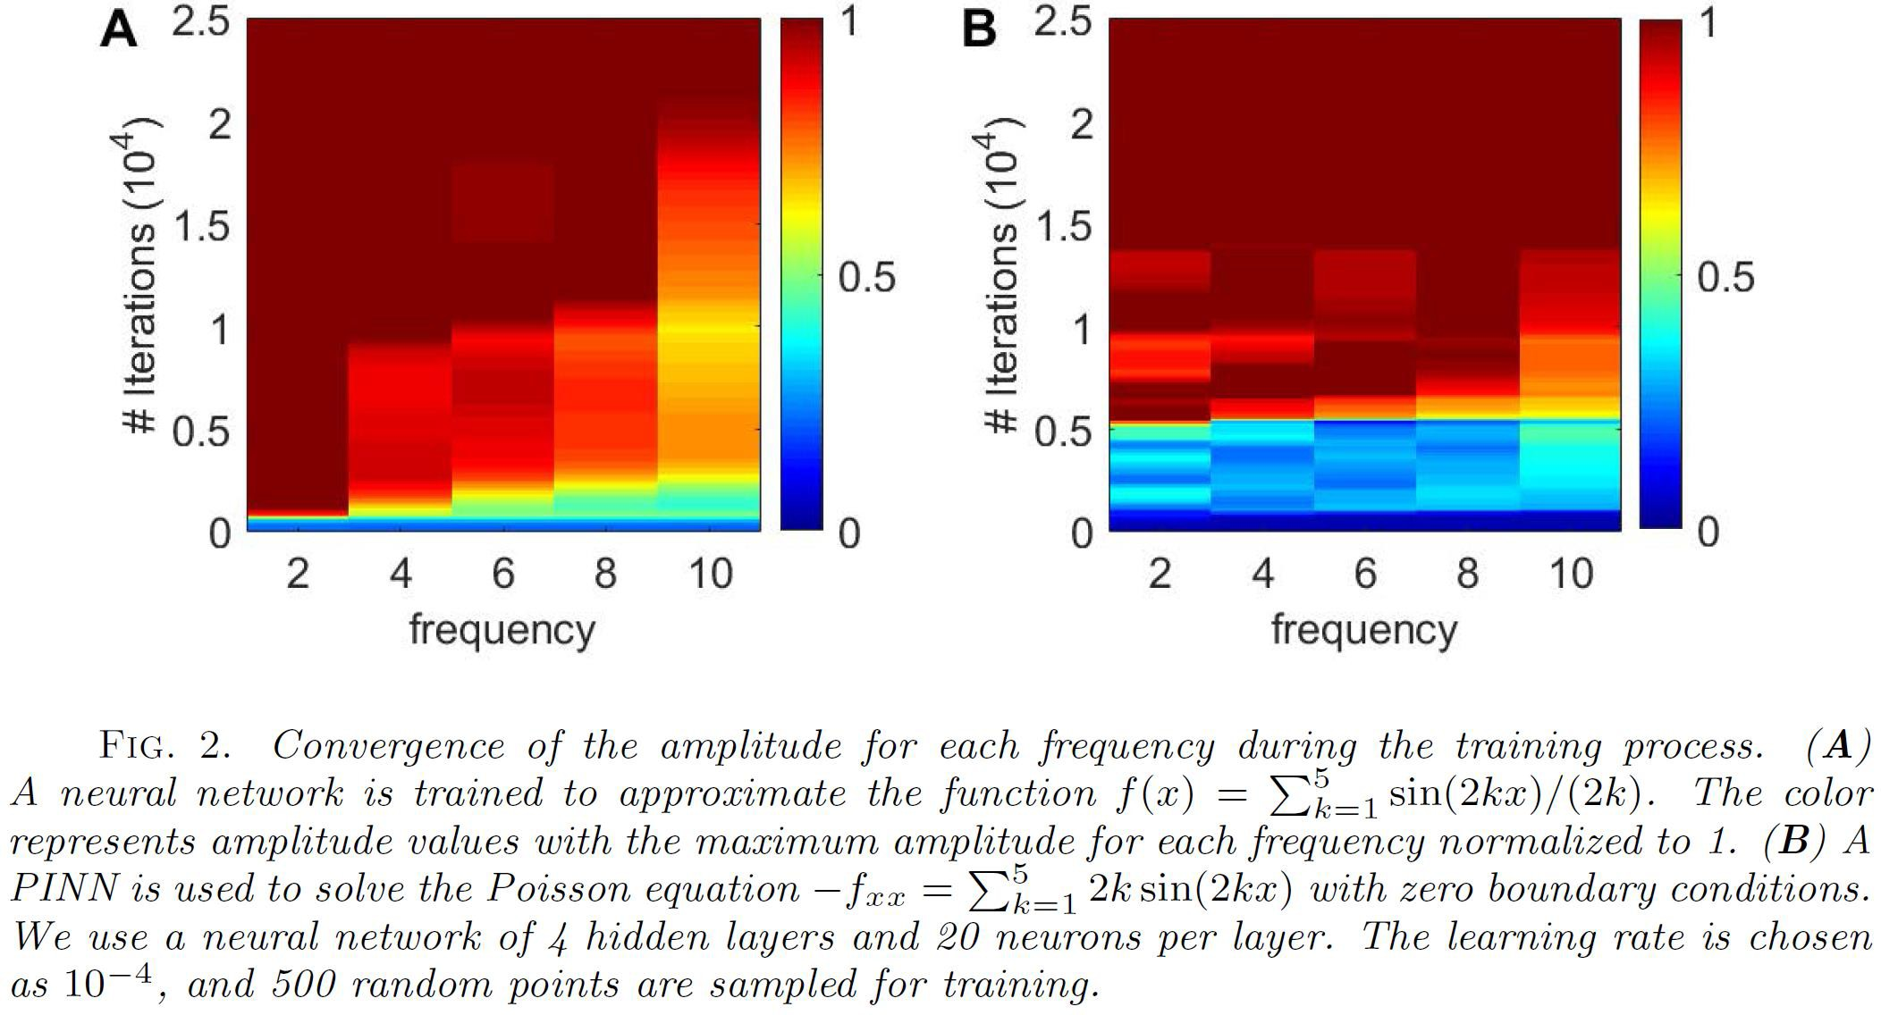
PINNs Change the Learning Mode of DNNs

Slide 49
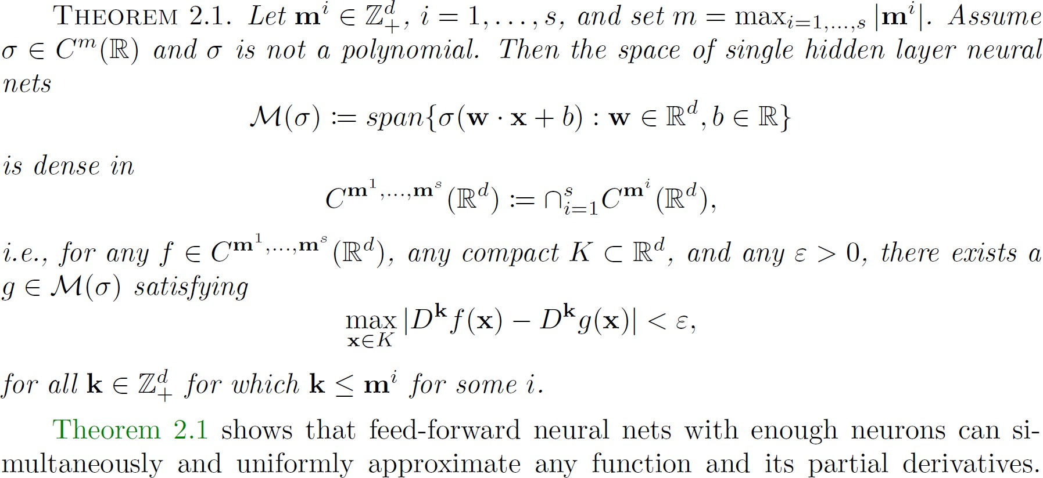
PINN Approximation Theorem
A. Pinkus, Acta Numerica, (1999)

Slide 50
Boundary conditions issues
Two methods to deal with boundary conditions:
use trial solutions that automatically satisfy the boundary conditions (“hard assignment”)
add a penalty term to the loss function (“soft assignment”)

Slide 51
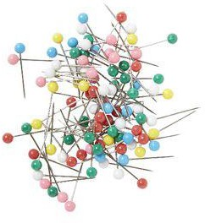
Physics-Informed Neural Networks (PINNs)
cPINNs: conservative PINNs
vPINNs: variational PINNs
pPINNs: parareal PINNs
sPINNs: stochastic PINNs
fPINNs: fractional PINNs
LePINNs: Levy process PINNs
nPINNs: Nonlocal PINNs…

Slide 52
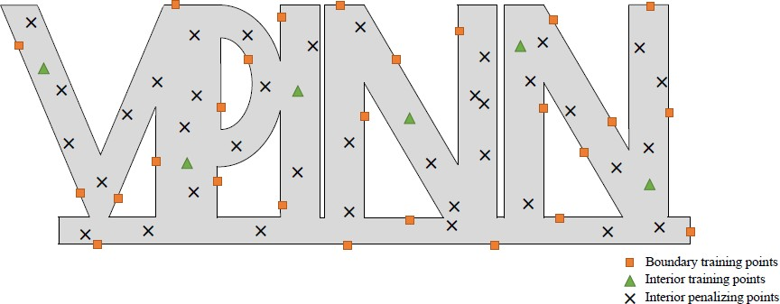
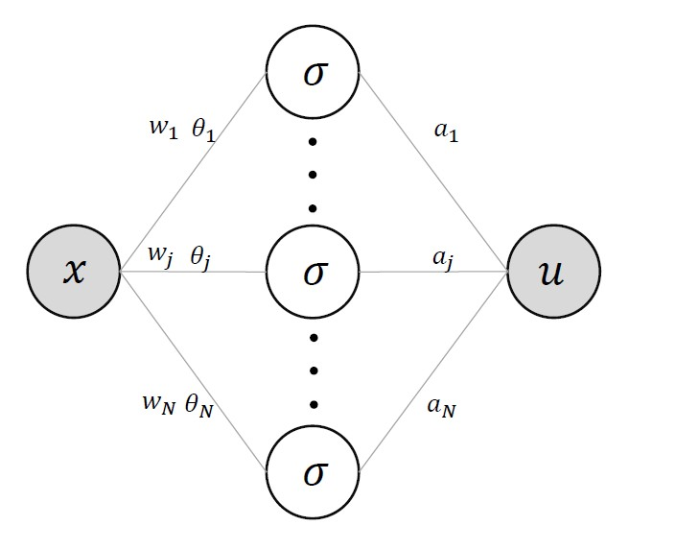
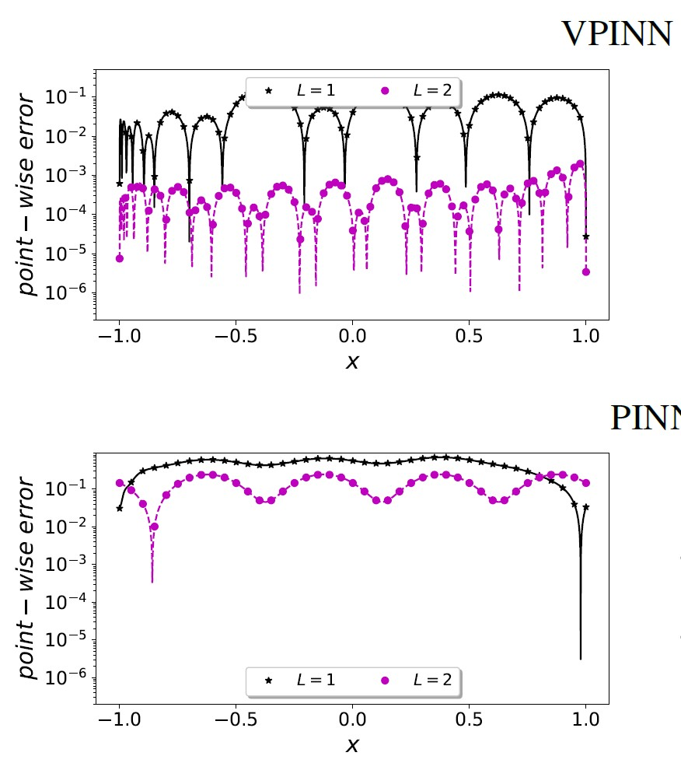
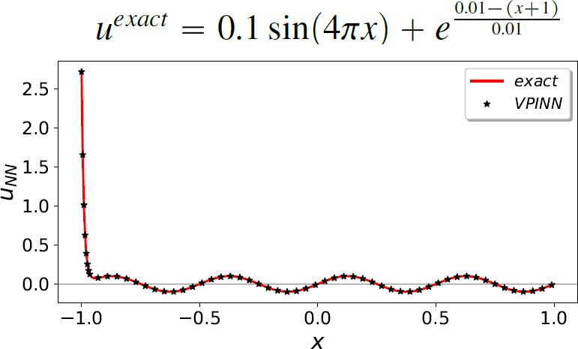
Variational PINNs

Slide 53
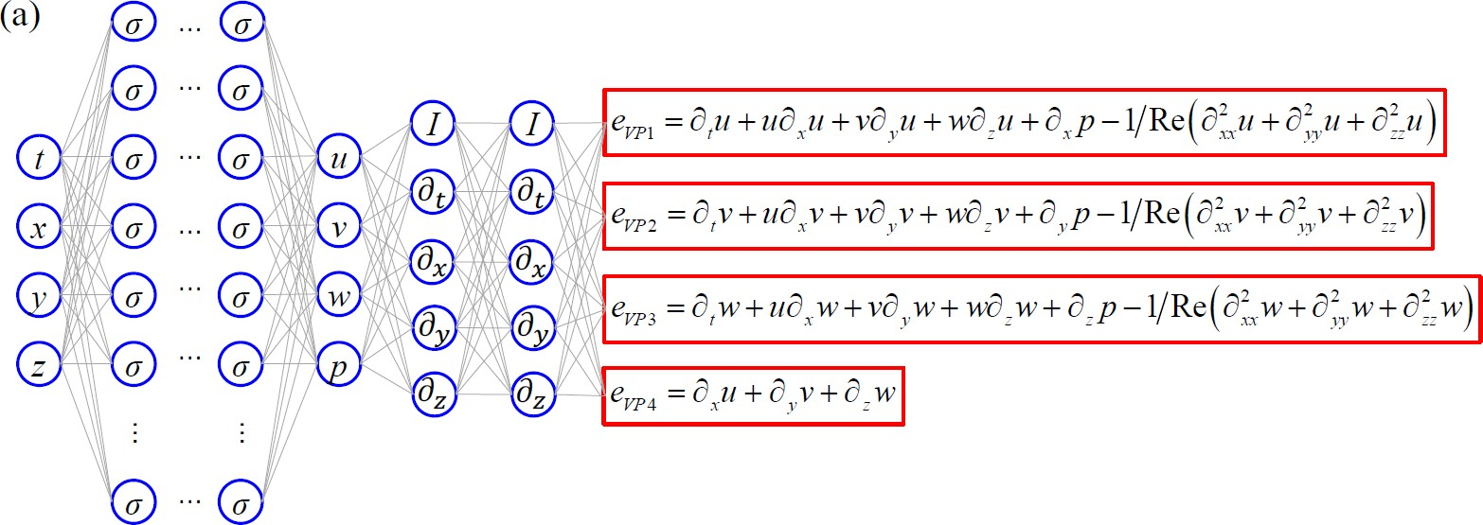
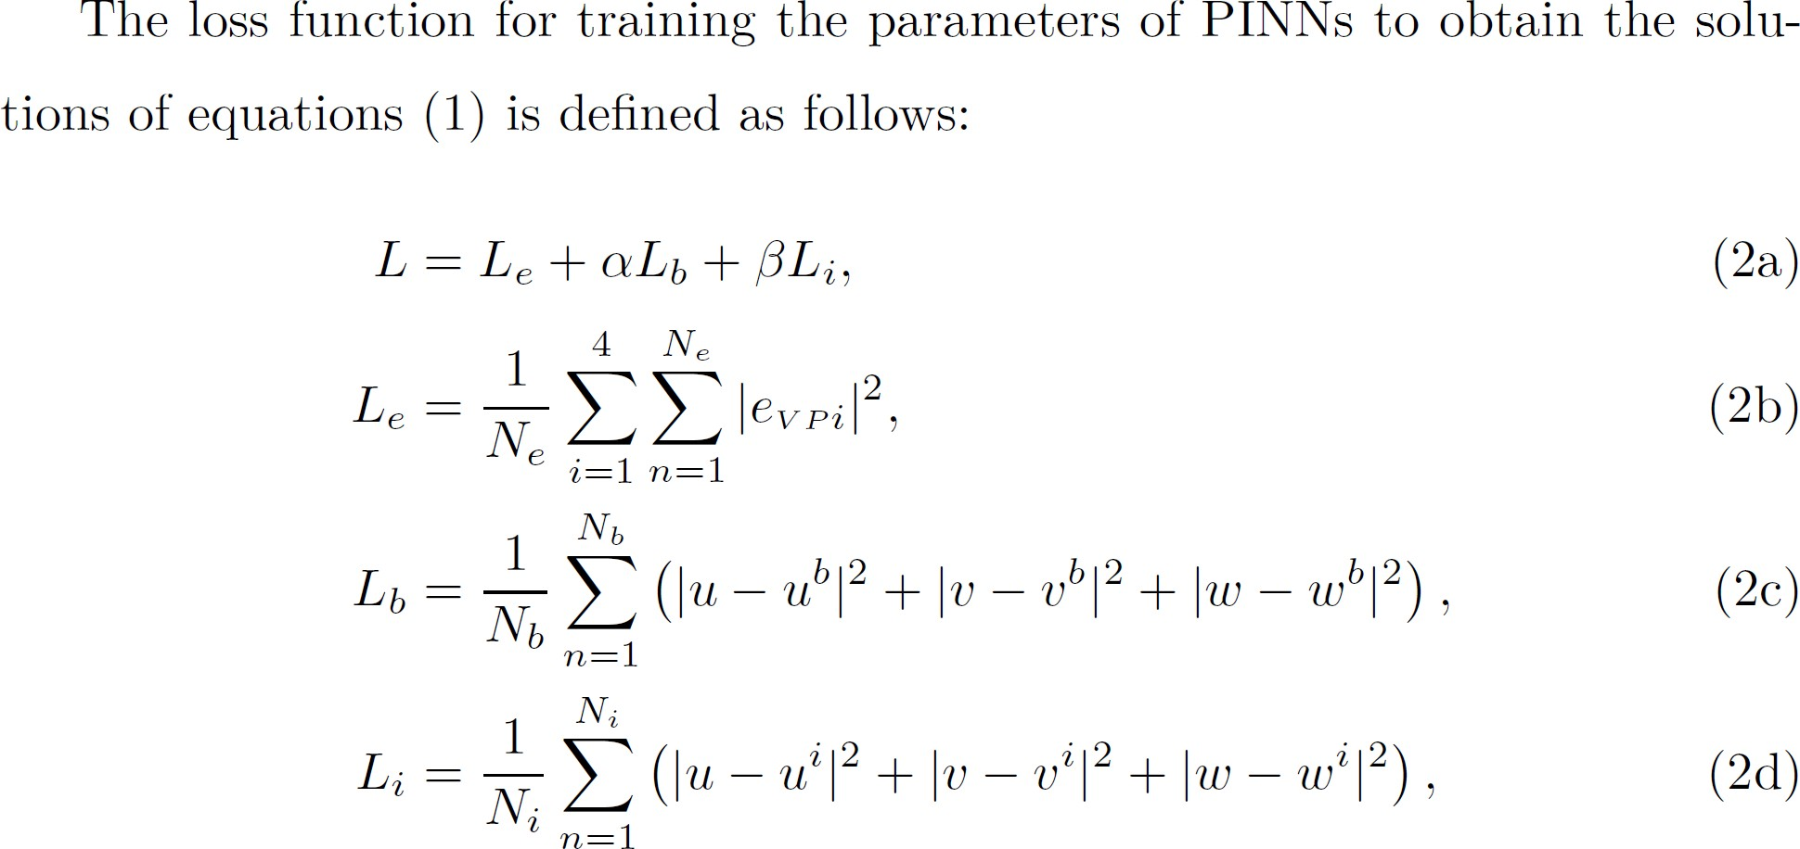
NSFnet

Slide 54
NSFnet
Navier-Stokes Flow net

Slide 55
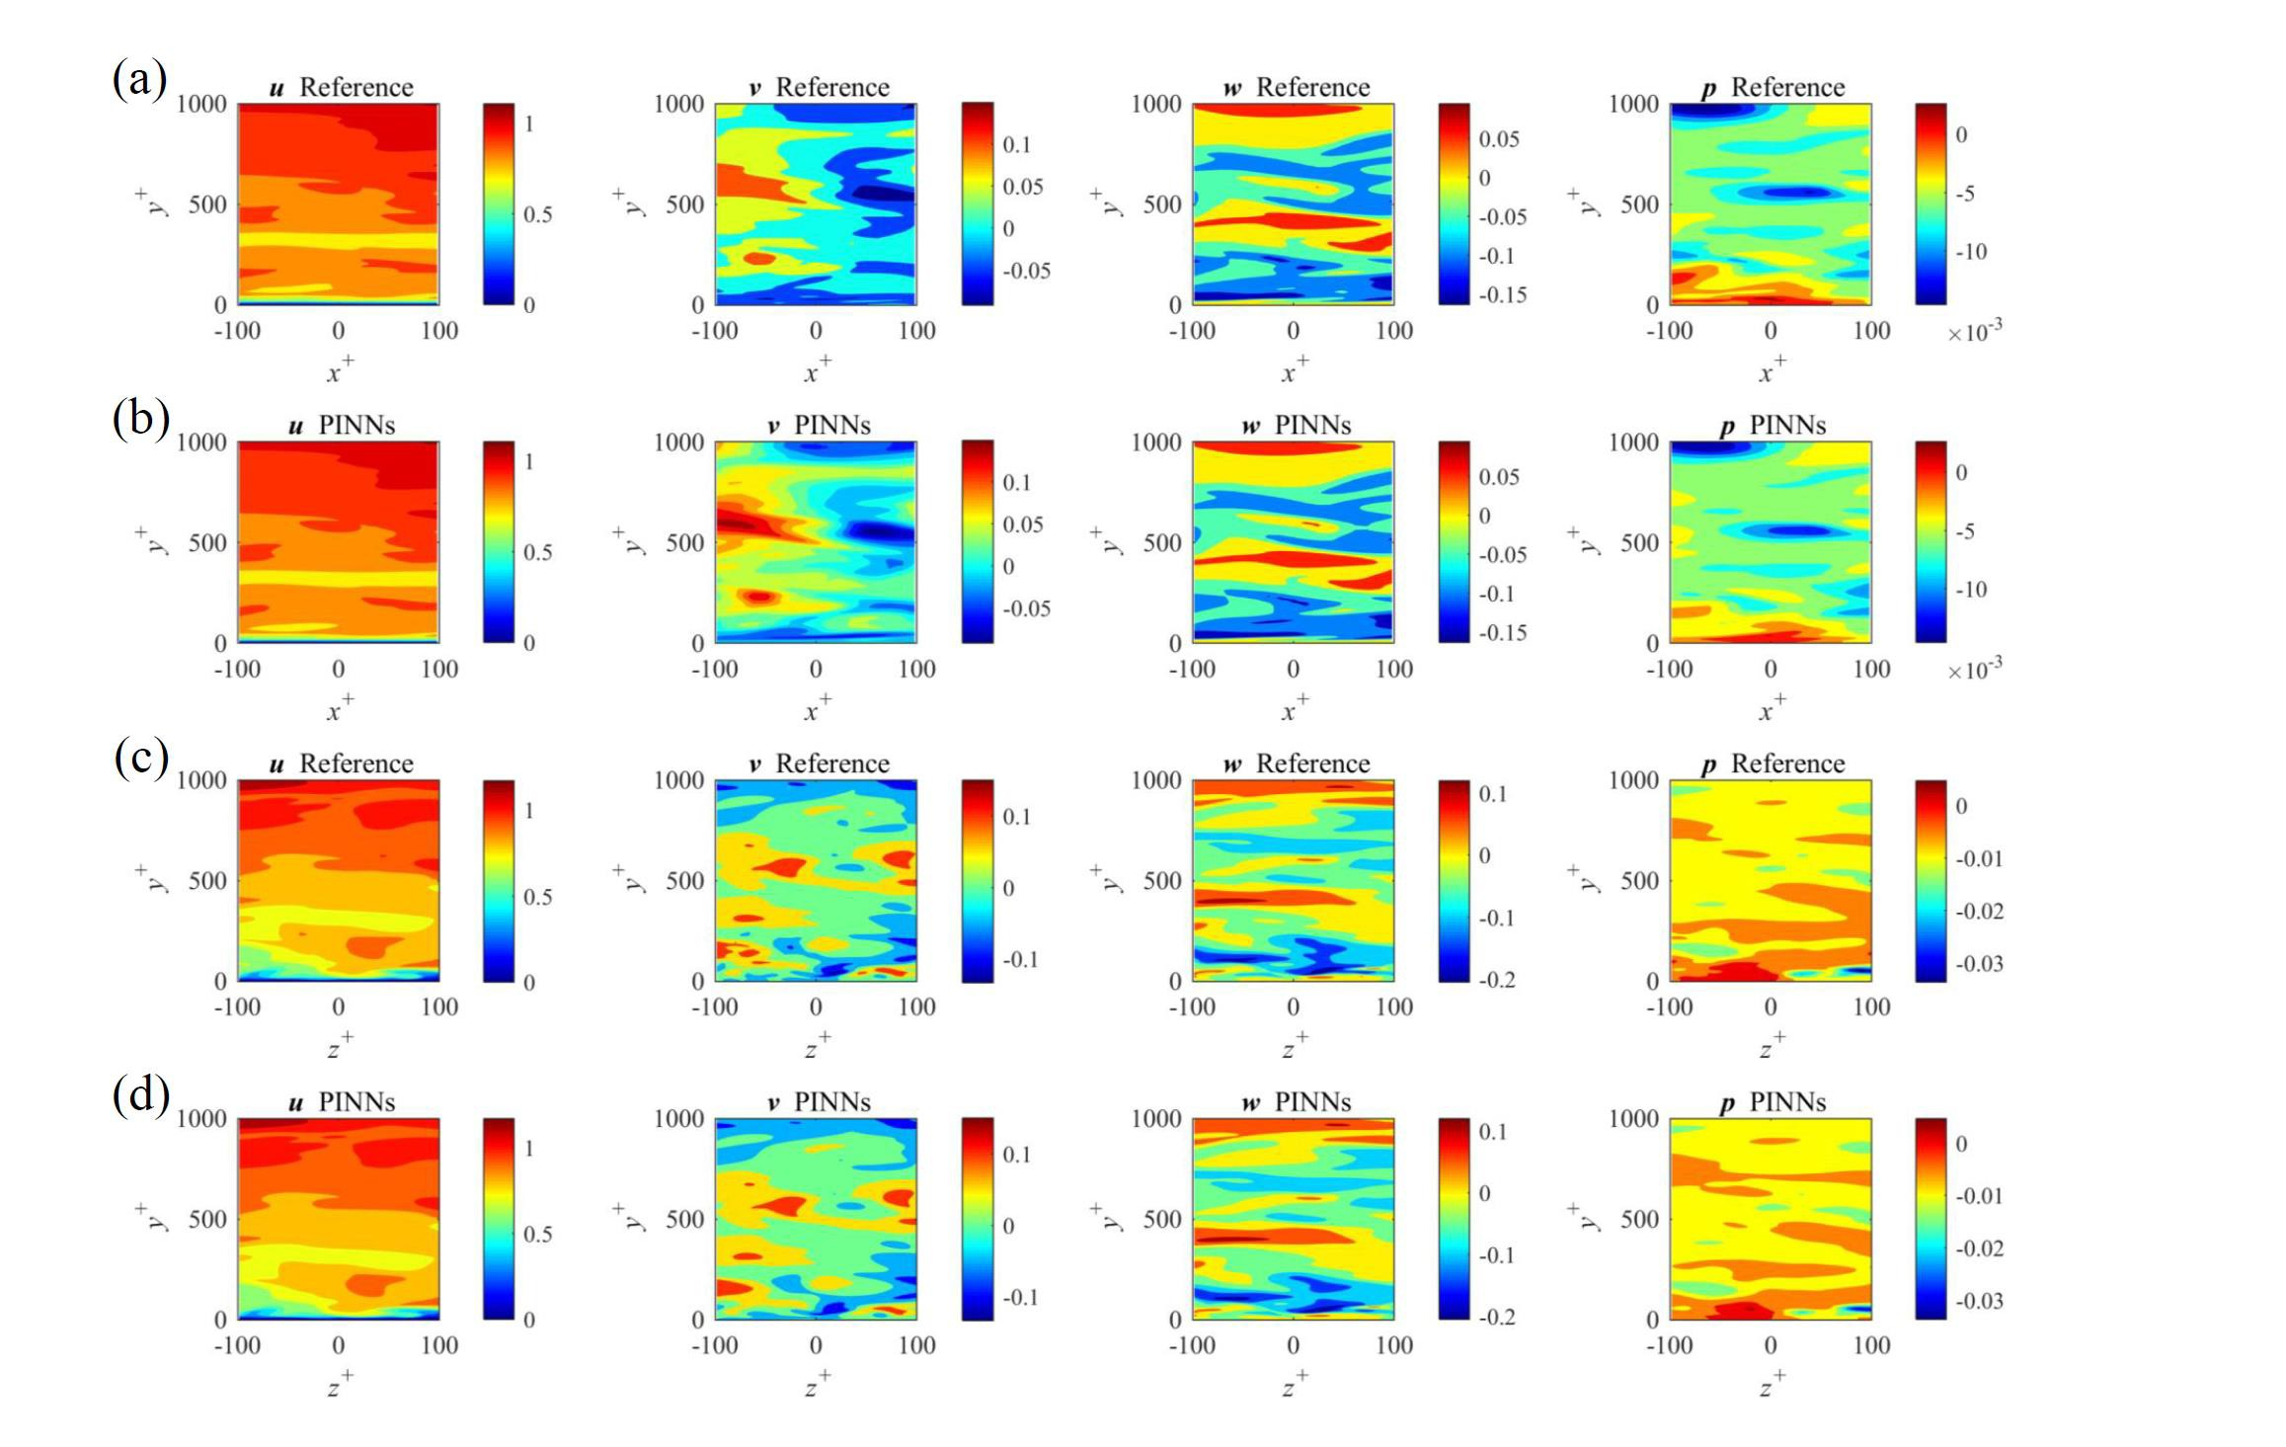
z_{x}
Can PINNs Sustain Turbulence?
Example 1: 150＜y⁺<200
y
Example 2: 0＜y⁺<23.8
Location: 12.47,12.66 × −1.00, −0.0031 × 4.61,4.82
Ne = 100 000 per time step; Nb = 26 048 and Ni = 147 968

Slide 56
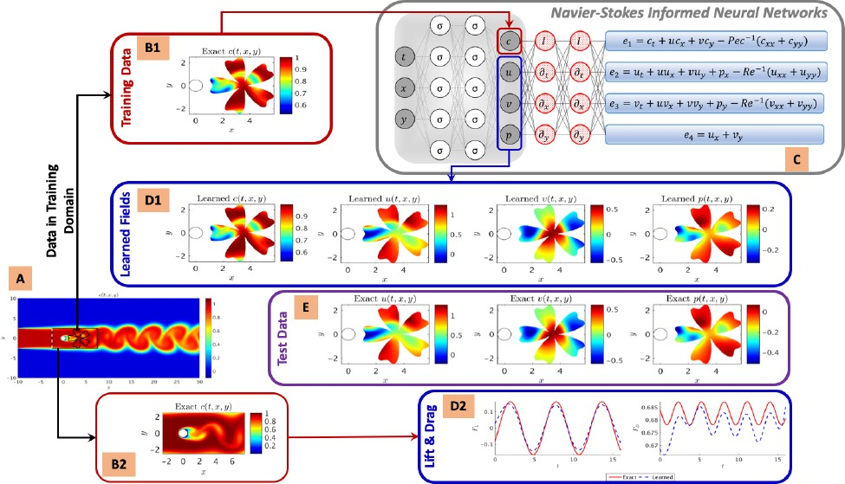
Hidden Fluid Mechanics
M. Raissi, A. Yazdani and G.E. Karniadakis, arXiv:1808.04327

Slide 57
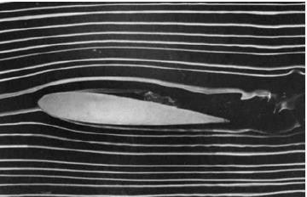
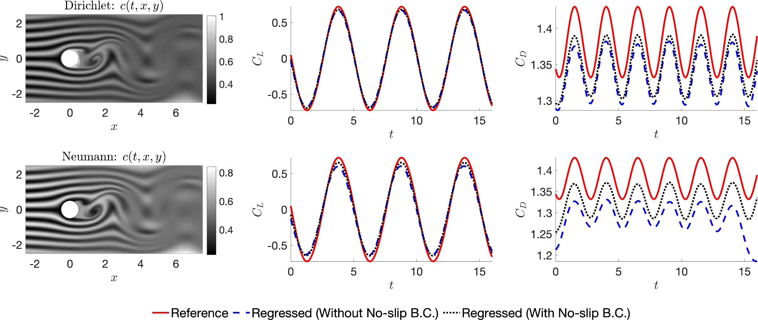
Smoke-type Visualizations
Re=200; Pe=2,000

Slide 58
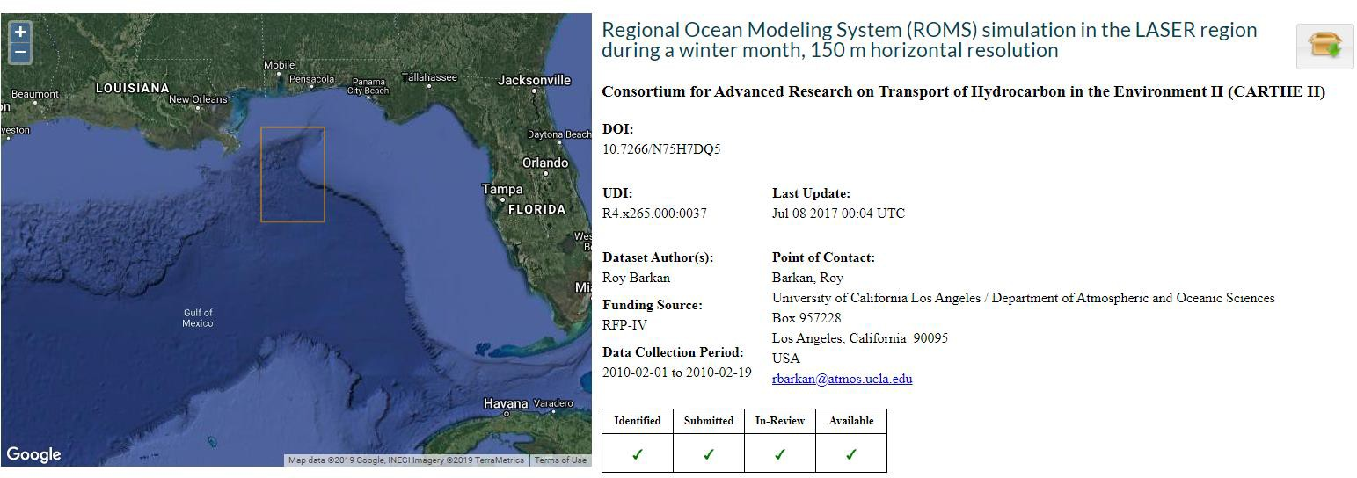
Gulf of Mexico Sea Surface Temperature
Regional Ocean Modeling System (ROMS) simulation in the LASER region during a winter month, 150 m horizontal resolution (from GRIIDC provided by Roy Barkan)

Slide 59
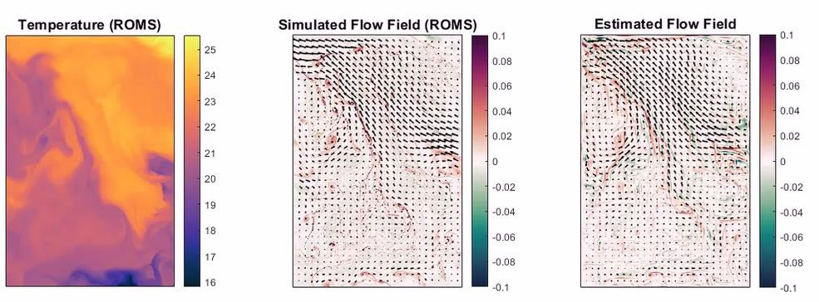
PINNs Estimate Velocity from SS Temperature
Velocity field and vorticity map (February)
Movie (ten hours per frame)

Slide 60
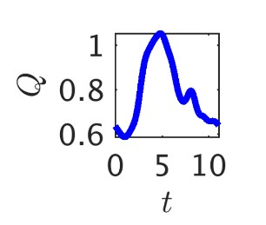
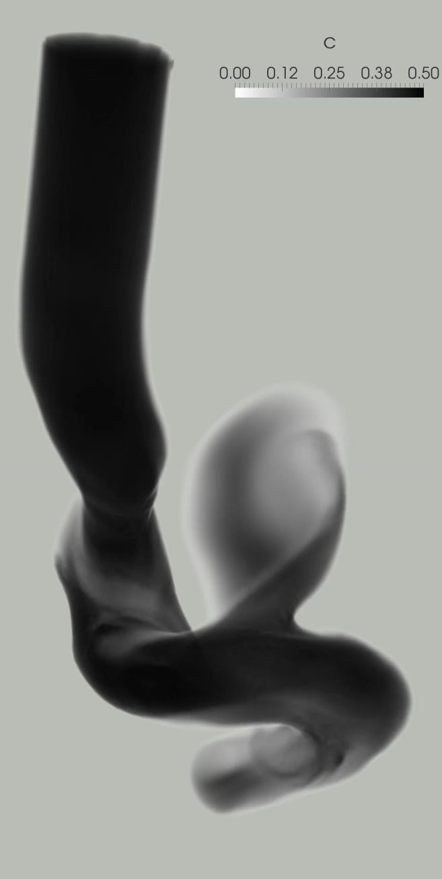
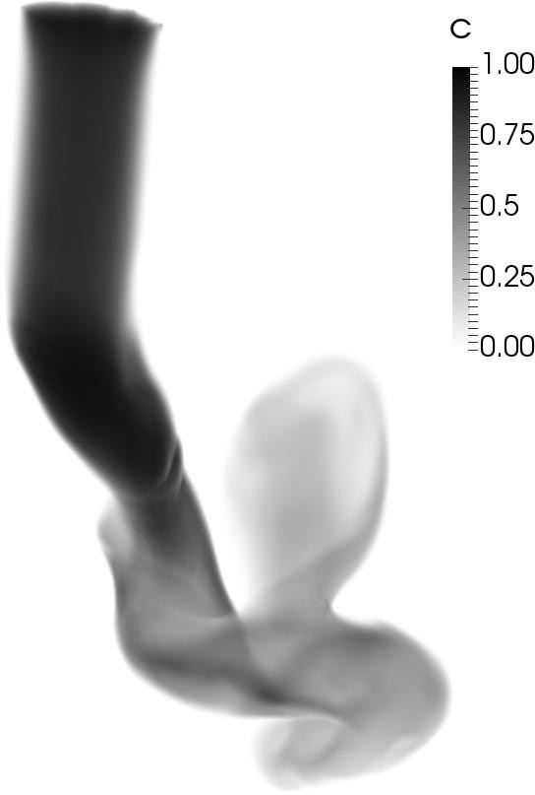
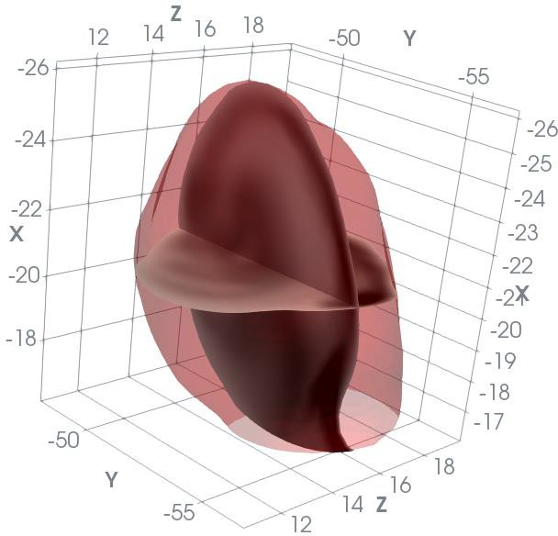
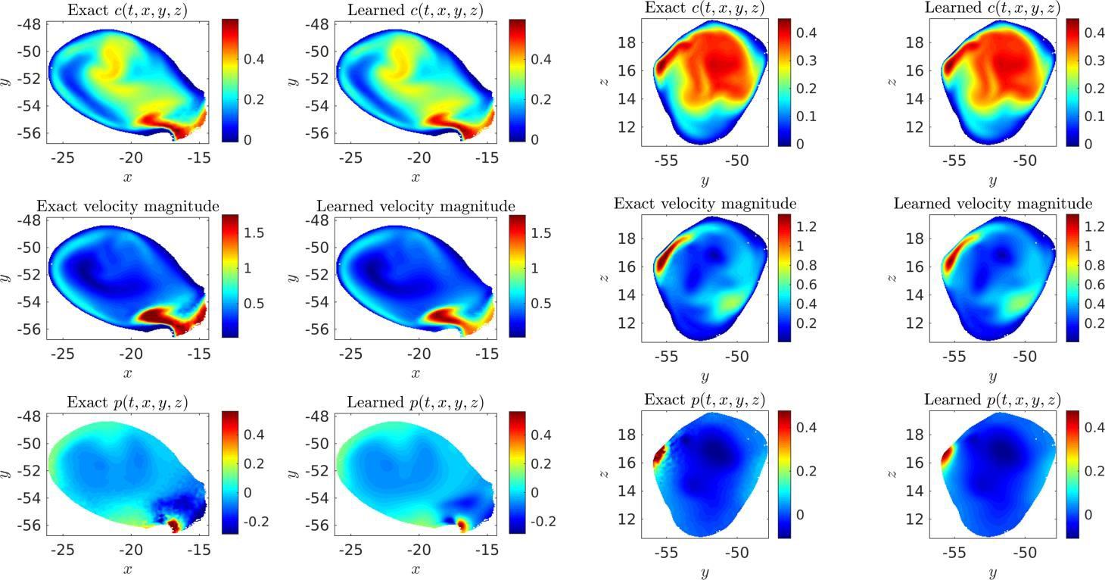
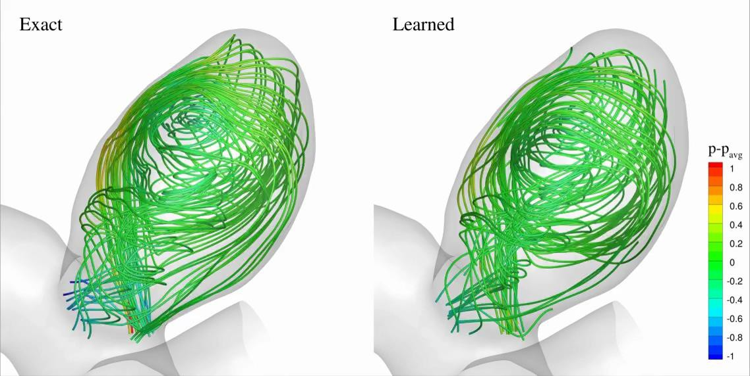
Hidden Fluid Mechanics:
flow dynamics in an intracranial aneurysm
Training Data
Inferred Hidden Physics

Slide 61
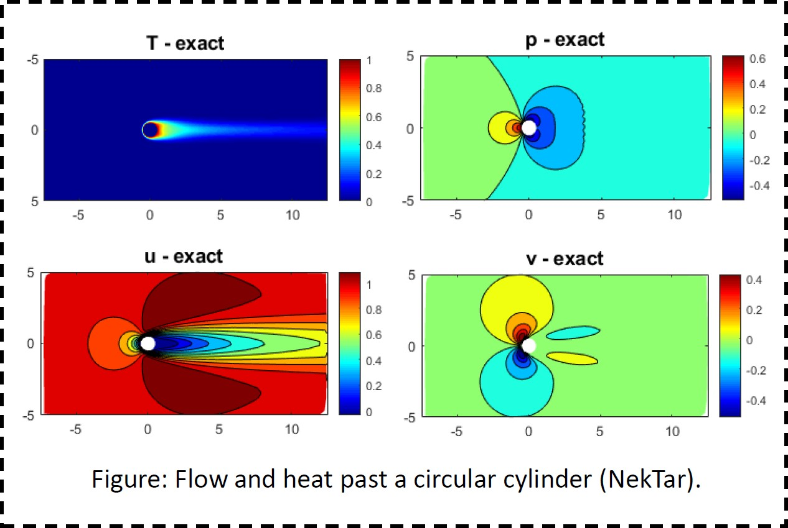
Heat Transfer: Hidden Thermal Boundary Conditions
We can simulate the flow but not HT because of lack of thermal BC.
In applications the thermal BC is neither constant T nor constant flux.
We assume that we have some thermocouple measurements available.
This problem is ill-posed with classical methods.

Slide 62
PINN Formulation for Convective Heat Transfer

Slide 63
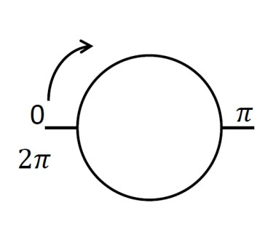
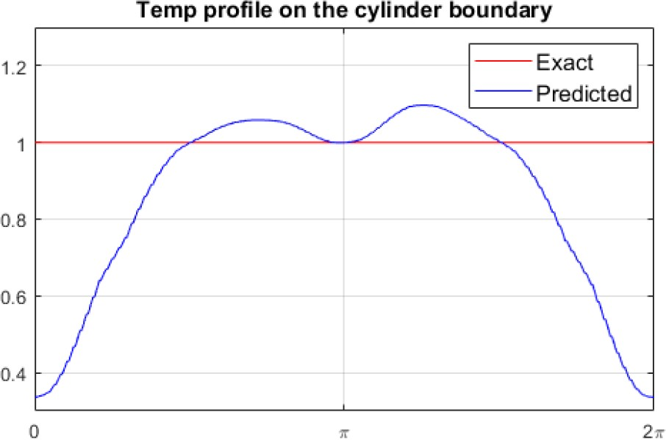
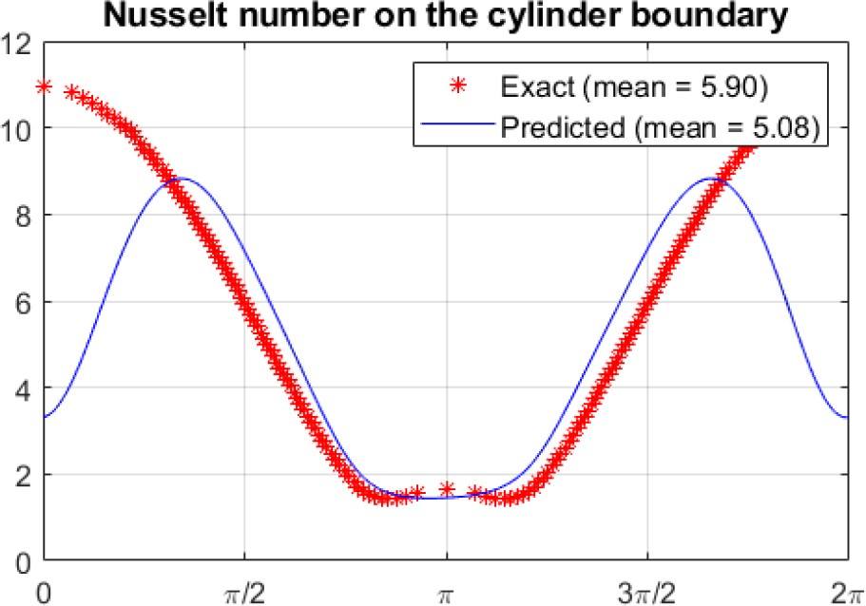
Discover constant Temperature on Cylinder

Slide 64
Discover constant Temperature on Cylinder
❑ Place a thermocouple on the front stagnation point

Slide 65
Discover constant Temperature on Cylinder
❑ Place a thermocouple on rear stagnation point

Slide 66
Discover constant Temperature on Cylinder
❑ Place two thermocouples close to front stagnation point

Slide 67
Active Sensor Placement

Slide 68
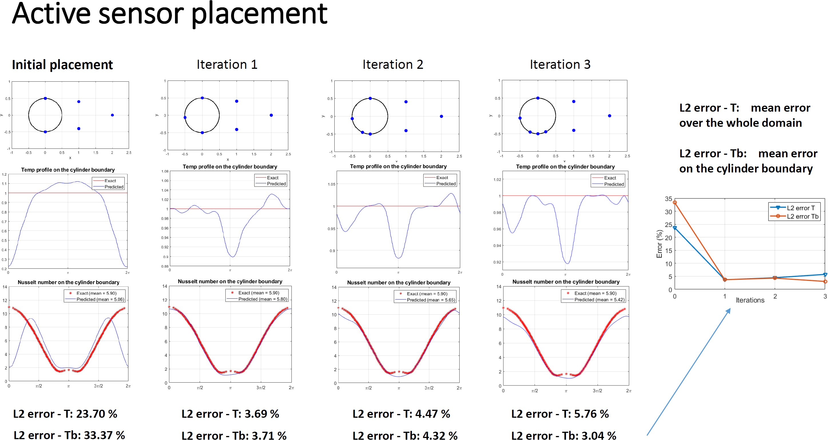

Slide 69
NVIDIA uses PINNs to design the new GPU chips

Slide 70
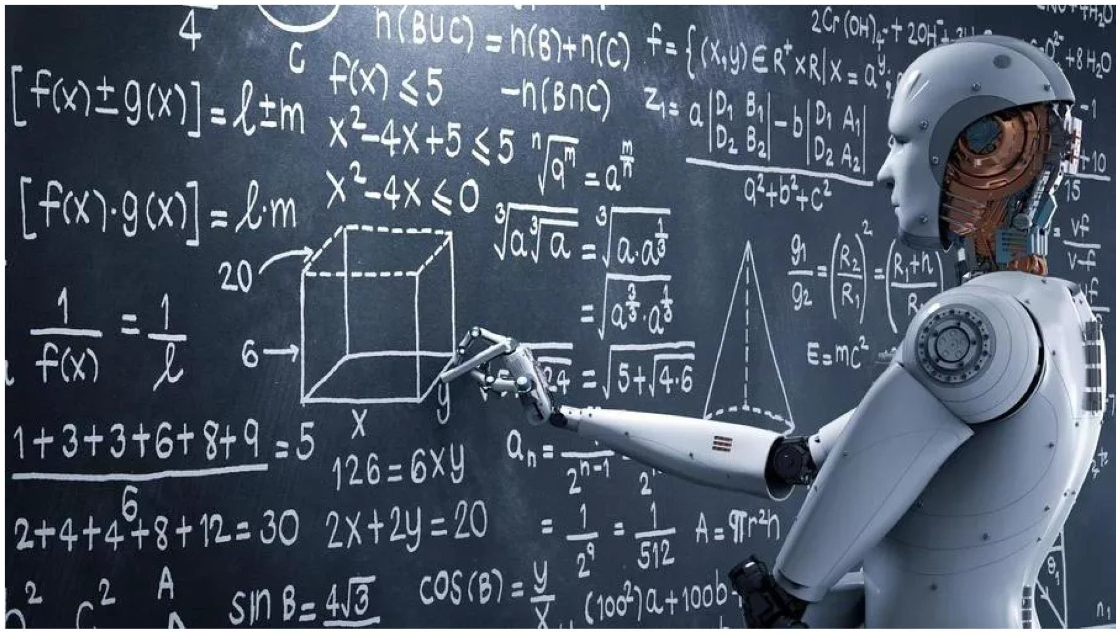
Do we need to teach Robots calculus?

Slide 72
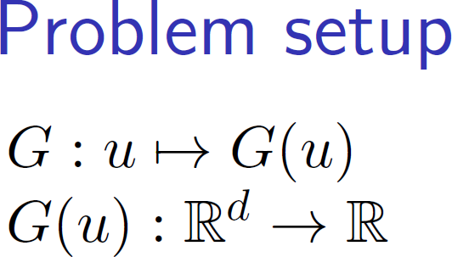
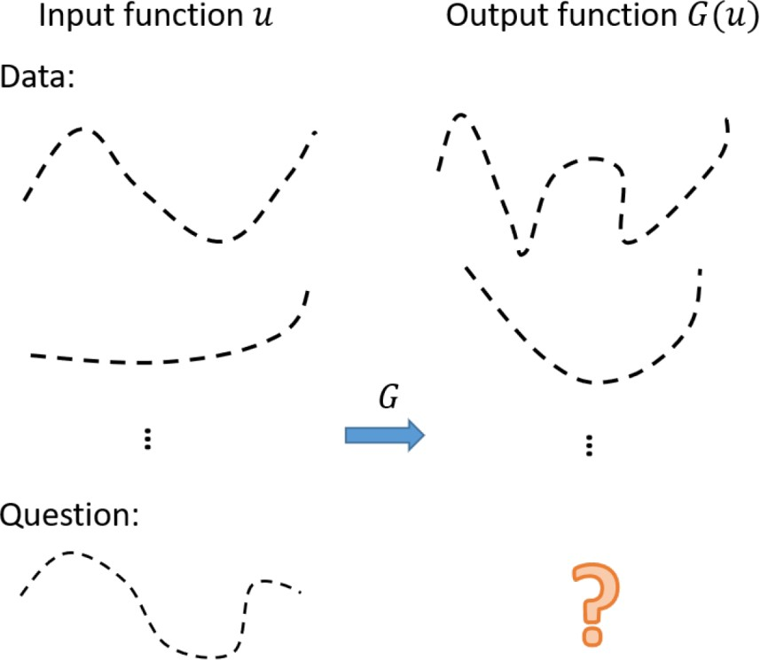

Slide 78
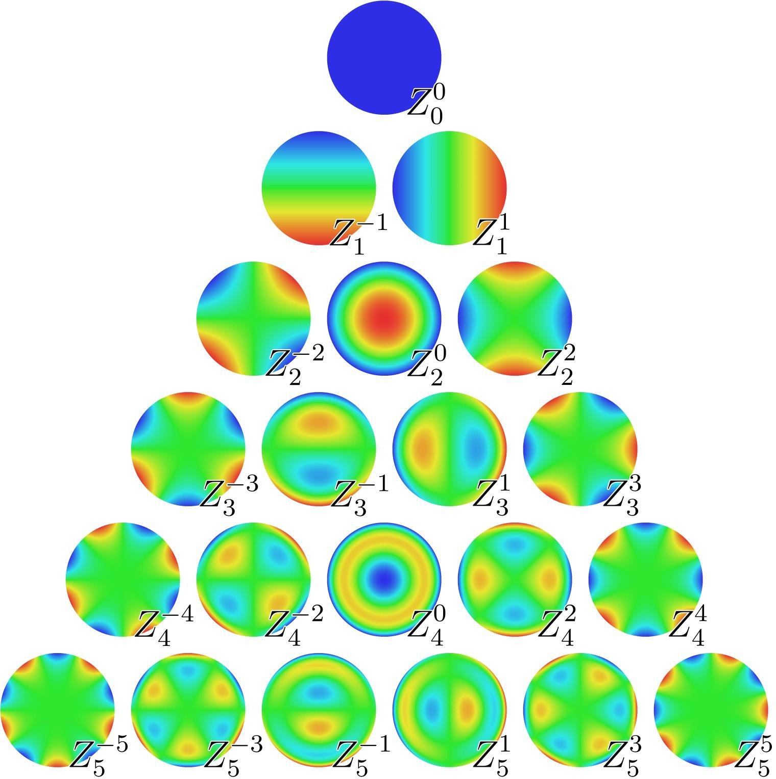
The second operator we approximate is a 2D Riesz fractional Laplacian
D^{α} = (-∆)^{α/2} defined on a unit disk
The function space V₁ where u stays is now assumed to be an orthogonal polynomial space spanned by 36 Zernike polynomials:
7 n
⎫
V = ⎧ (r,θ ) =
u
∑ ∑
a Z (r,θ ), r ∈[0,1],θ ∈[0, 2π ] ,
⎨
m
⎬
1
⎩
mn n
⎭
n=0 m=−n
where Z (r,θ ) ≡ 0 for n - m odd
m
n
The samples of u were generated by randomly selecting the coefficients a_{mn} ϵ [-1,1]
The first 21 Zernike polynomials Z^{m}
n≤5

Slide 79
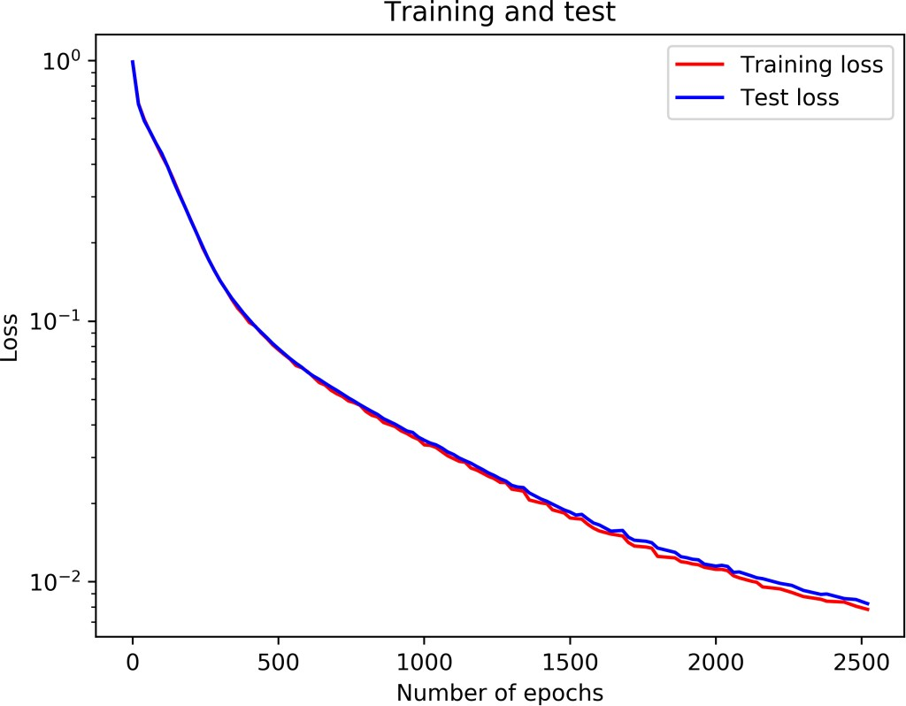
Ten million training points { (u_{i}(r,θ), y_{j}, α_{k})} for i=1,…,N_{u}; j=1,…,N_{y}; k=1,…,N_{a}, where N_{u} = 1e4, N_{y}=100, N_{a}=10 (thus N_{u}×N_{y} ×N_{a} = 10 millions) We employed mini-batch in training and set the batch-size to be 0.4 million.
The 10000 samples of u in the
training set were the orthogonal
generated by randomly selecting
A specific sample of u in the test set
expansion coefficients a_{mn} in [-1,1], while the 10000 u samples in the test set were also randomly sampled but with a different random seed.

Slide 80
Calculus-agnostic Simulation
DeepFnet: Functional Approximation

Slide 81
Predicting the motion of battleships in extreme sea states
DeepFnet: Functional Approximation

Slide 83
Long-Time Prediction of Catamaran SeaKeeping

Slide 84
SMU: Clements Scientific Computing Seminar Series
Speaker: Prof. George Karniadakis, Applied Math, Brown University, Tuesday 3:45-4:45p, February 11
Mathematics of PINNs
Multifidelity approximation
arXiv:1903.00104
Nonlinear approximation theory
Robust training & optimization
arXiv:1808.04947; arXiv:1903.06733
Learnability & small data
arXiv:1905.01205

Slide 86
SIAM Review – to appear
arXiv:1907.0402

Slide 88
Software Libraries for PINNs

Slide 89
Julia vs Python
One of the main factors that make Julia so appealing is how fast it is
Julia trumps Python in speed and performance.
Julia is a compiled language written on its base, whereas Python is an interpreted language meaning each line must be reprocessed, resulting in slower execution.
https://www.datacamp.com/blog/julia-vs-python-which-to-learn#

Slide 91
https://www.pnnl.gov/projects/philms
PhILMs: Collaboratory on Mathematics and Physics-Informed Learning Machines For Multiscale and Multiphysics Problems
Center Director: George Em Karniadakis
PNNL & Division of Applied Mathematics, Brown University
The CRUNCH group: Home of “Math + Machine Learning + X” https://www.brown.edu/research/projects/crunch/home

Slide 92
Science/engineering informed neural networks
Many applications & growing (SINNs or PINNs)
Some data prediction
Many solving sophisticated nonlinear PDEs which are very common in the real worlds
Data trained
Fast inference
Based on NNs for ODEs in ‘98
Most use science knowledge placed in
Cost function
NN structure
Changing the field of computational science and engineering (CSE)

