Slide 1
Transformer Models
Thanks to Sargur Srihari, Johhn Hewett, Richard Socher, Vagelis Hristidis, Jacob Devlin, Phạm Quang Nhật Minh, Yangqiu Song, Lucas Beyer, Giuseppe Attardi, Danqi Chen

Slide 2
Previously
Algorithmic complexity – Big O
Principles of machine learning
Deep Feedforward NNs
Regularization
Optimization
Convolutional NNs
Practical methodologies
Recurrent NNs
Autoencoders & GANs
Today Transformers

Slide 3
Transformer Videos
Illustrated Guide to Transformer Neural Network
NLP for Developers: Transformers | Rasa
NLP for Developers: BERT
BERT

Slide 4
Why Transformers
Initially proposed in 2017 – language focused
Relies on a parallel multi-head attention mechanism
Notable for requiring less training time than previous recurrent neural architectures, such as long short-term memory (LSTM)
Later variation has been prevalently adopted for training large language models on large (language) datasets

Slide 5
Motivation
The classic landscape:
One architecture per
"community"

Slide 6
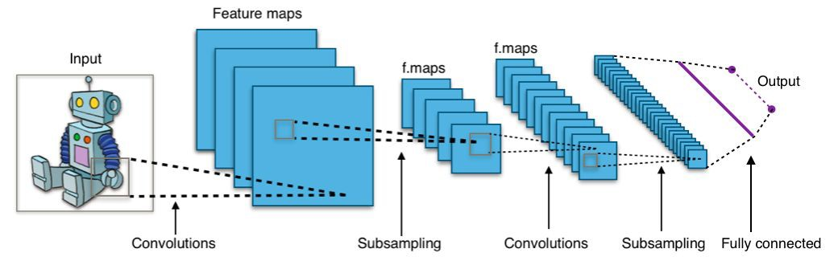
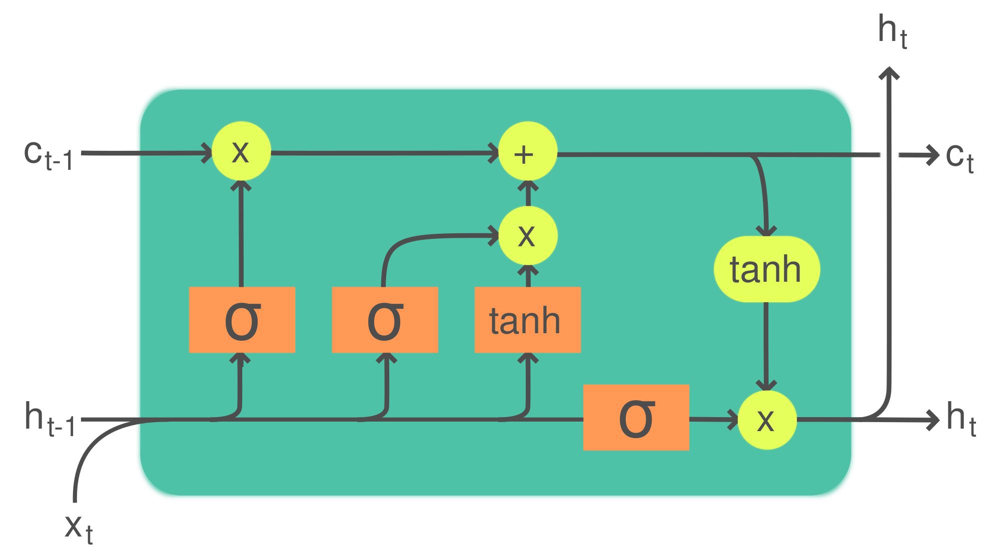
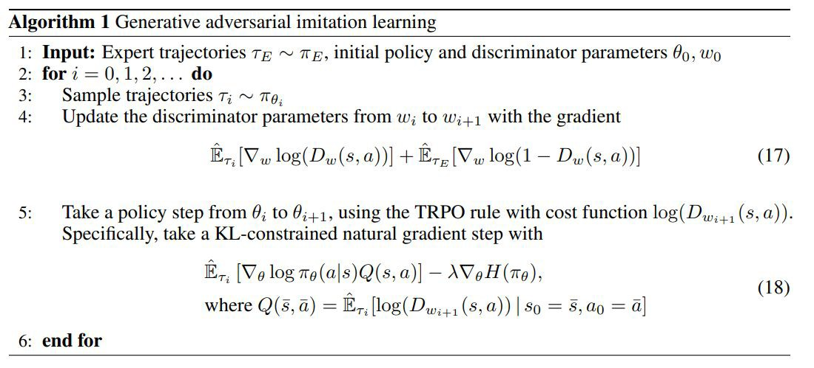

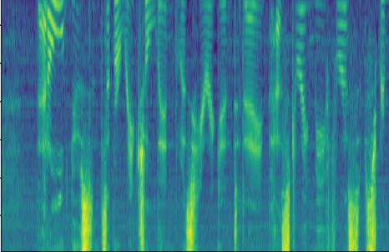
Computer Vision
Natural Lang. Proc.
Recurrent NNs (+LSTMs)
Convolutional NNs (+ResNets)
[2]
[1]
h e
Translation
Seq2Seq
s a l u t </s>
l
l
o
Speech
Deep Belief Nets (+non-DL)
RL
BC/GAIL
RBM
DBN
RBM
DBN
GRBM
DBN
h e l l o </s> s a l u t
CNN image CC-BY-SA by Aphex34 for Wikipedia https://commons.wikimedia.org/wiki/File:Typical_cnn.png
RNN image CC-BY-SA by GChe for Wikipedia https://commons.wikimedia.org/wiki/File:The_LSTM_Cell.svg

Slide 7
The Transformer's takeover:
One community at a time

Slide 8
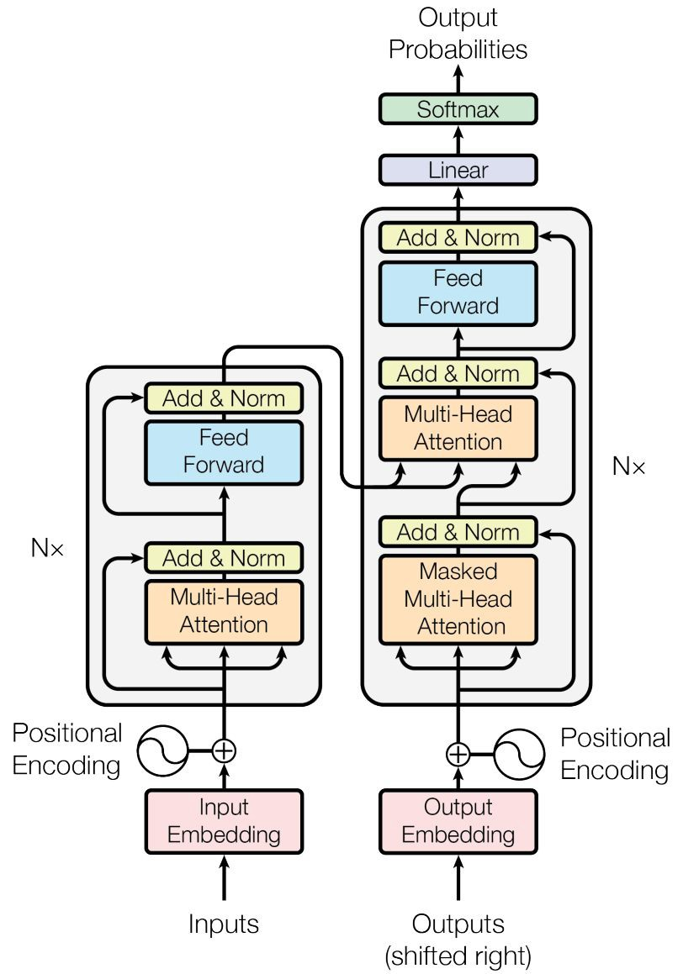
Computer Vision
Natural Lang. Proc.
Reinf. Learning
Speech
Translation
Graphs/Science
Transformer image source: "Attention Is All You Need" paper

Slide 9
Topics in Transformer Models
Types of Attention Models
Transformer Model
Full Transformer with Attention
Multi-head Attention
Improvements of Transformer
  Generative Pre-training (GPT)
  Bidirectional Encoder Representations from Transformers (BERT)

Slide 10
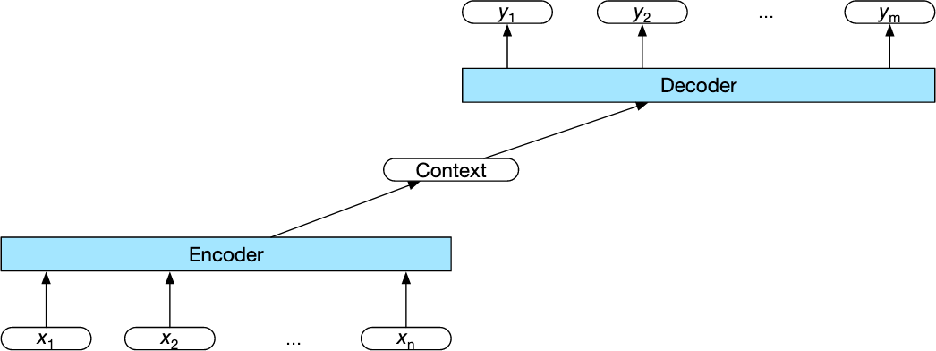
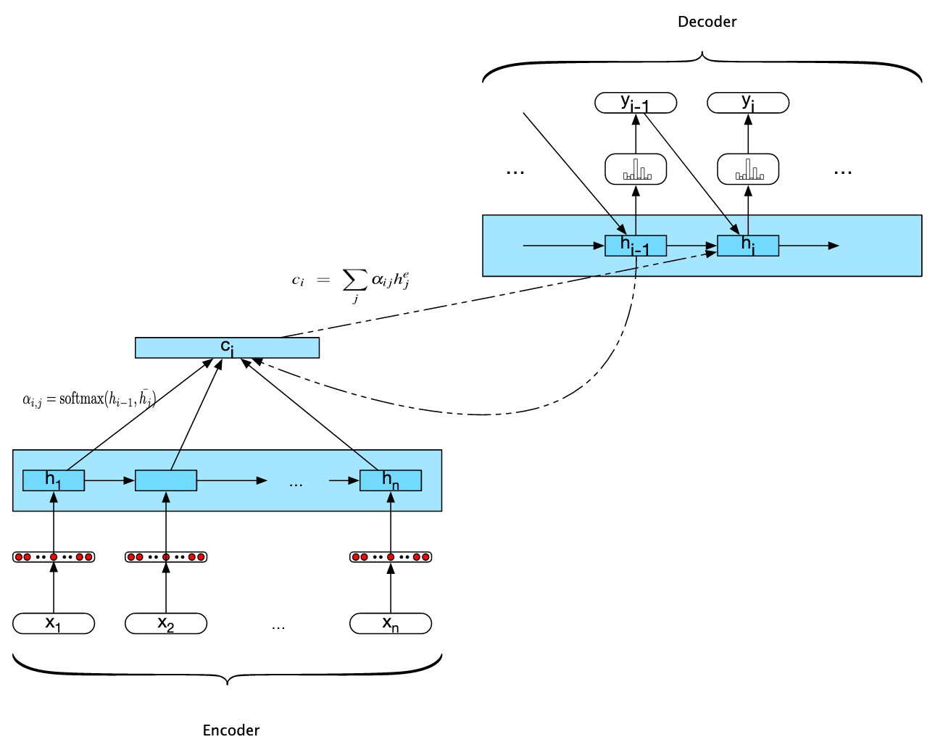
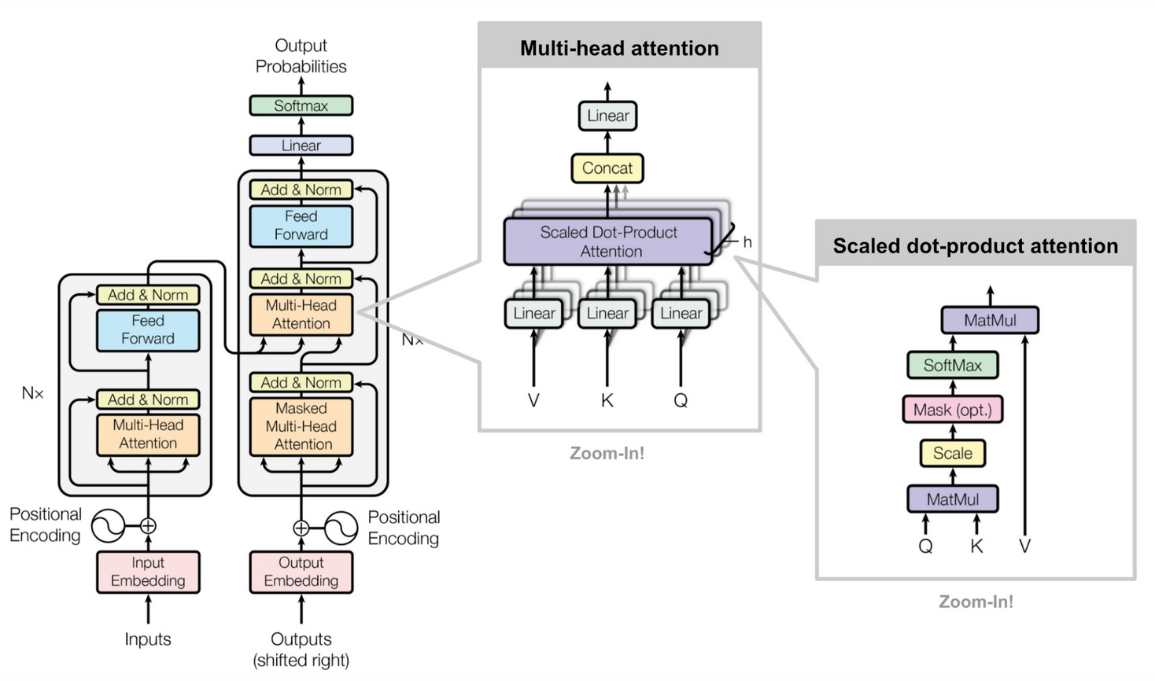
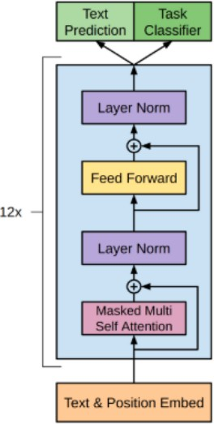
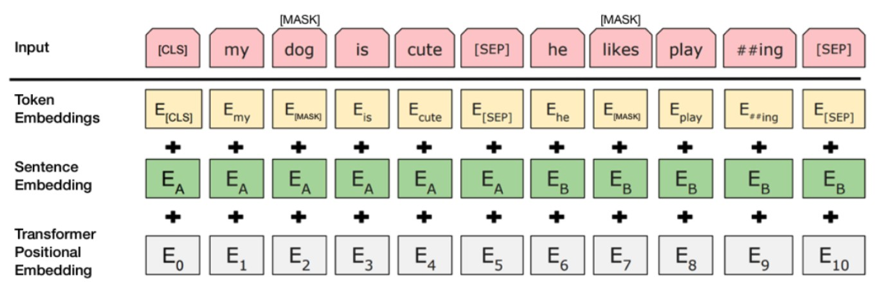
Types of Attention Models
Basic encoder-decoder RNN model
Encoder-decoder RNN with Attention
Transformer model with no recurrence
Generative pre-training of Attention model
5. BERT with no decoder, using bidirectionality
10

Slide 11
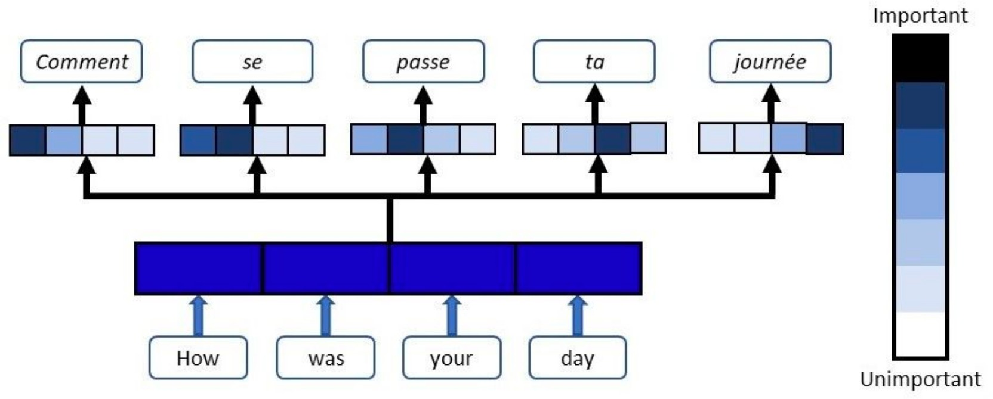
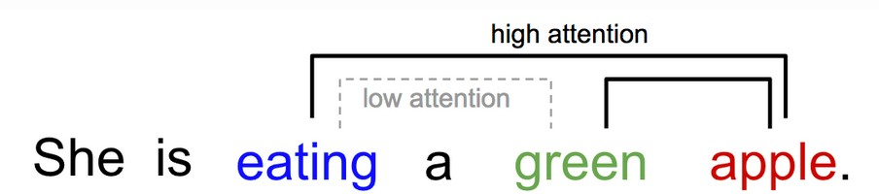
General and Self-Attention
The attention component of a network manages and quantifies the interdependence:
– General Attention: Between input and output elements
– Self Attention: Within input elements

Slide 12
Transformer has no recurrence
Transformer is an attention mechanism to learn contextual relations between words
  It includes two mechanisms
    An Encoder that reads text input
    A Decoder that produces a prediction for the task
Model has no recurrence
  Self-attention to represent input/output without an RNN
Allows more parallelism
  High translation quality: state-of-the-art
Training example: 12 hours on eight P100 GPUs

Slide 13
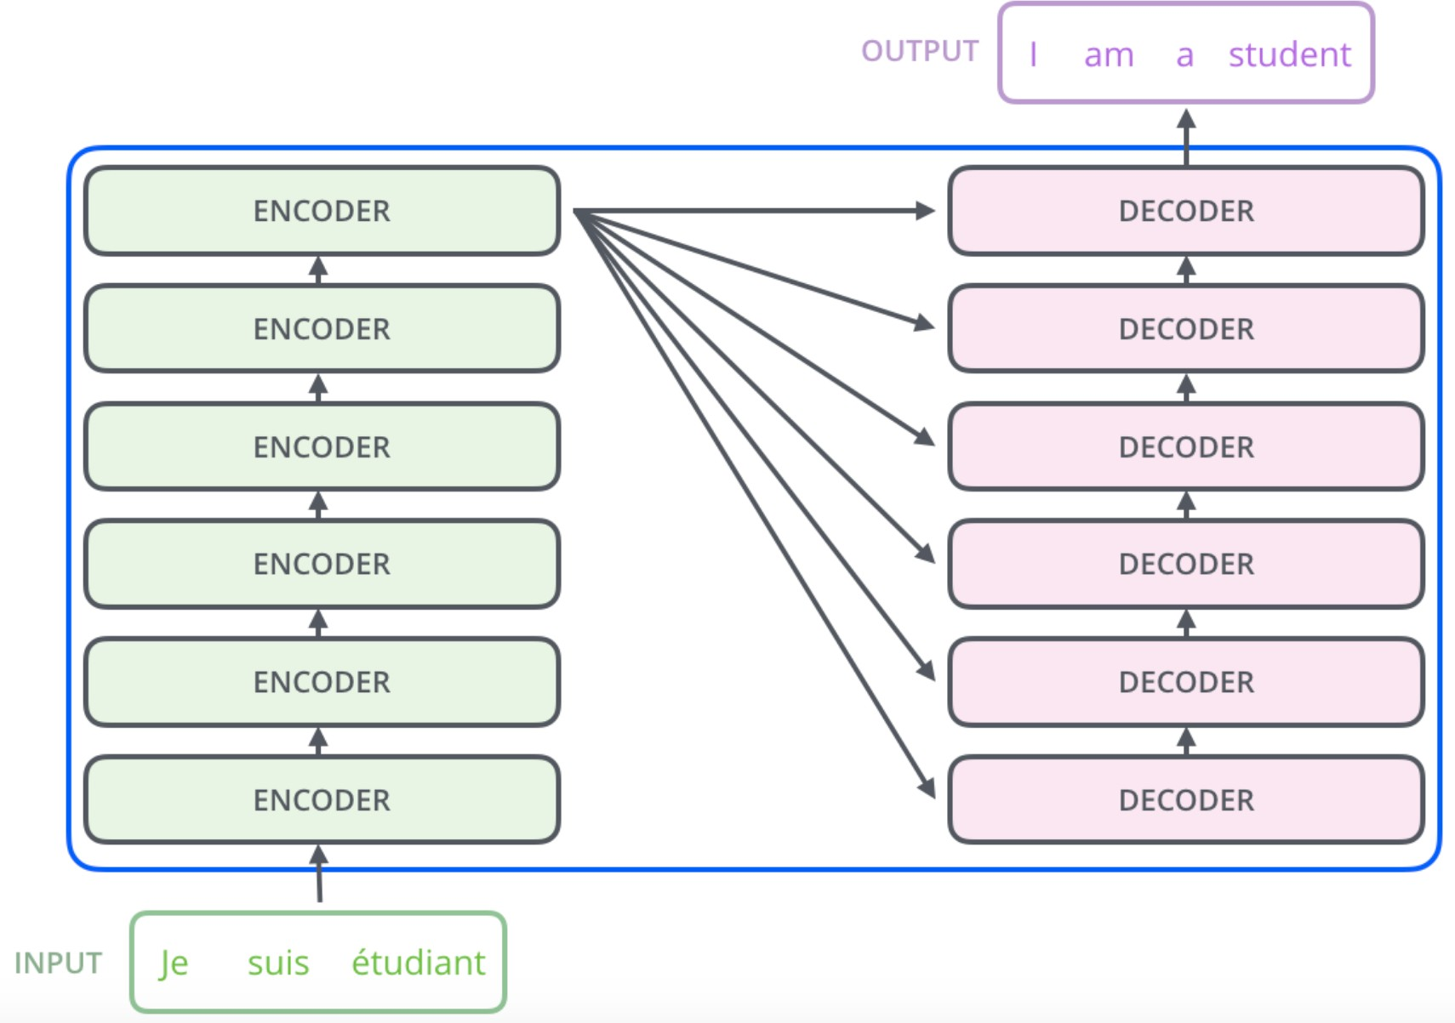
Transformer model
Has an encoder-decoder architecture
– Encoder maps input (x₁,.., x_{n}) to
representations z = (z₁,.., z_{n})
– Given z, decoder generates
(y₁,.., y_{m}) element-wise
At each step model is auto- regressive
– i.e., consumes previously
generated symbols as additional input when generating the next
A stack of encoders and a stack of decoders are used

Slide 14
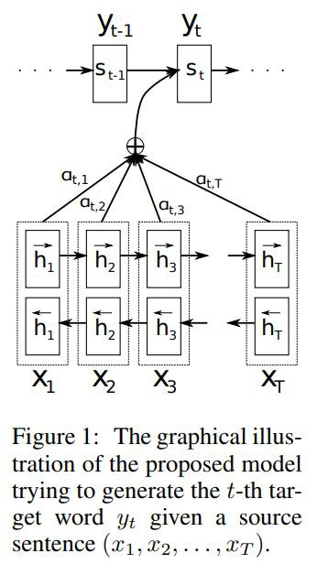
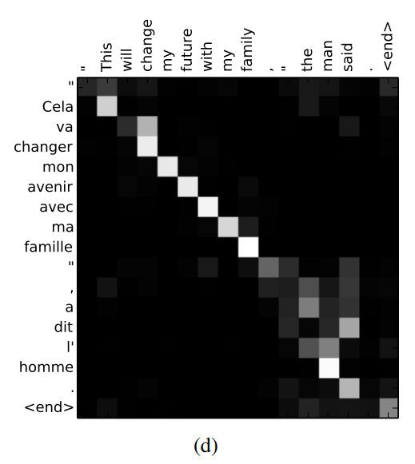
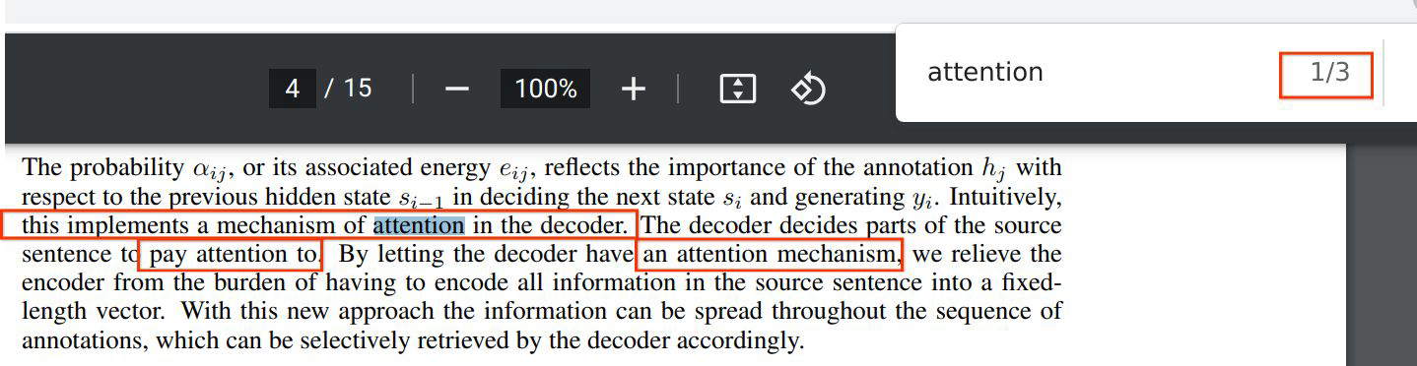
Neural Machine Translation by Jointly Learning to Align and Translate
2014, Dzmitry Bahdanau, KyungHyun Cho, Yoshua Bengio
Source (input)
Target (output)

Slide 15
Attention Is All You Need
2017, Ashish Vaswani, Noam Shazeer, Niki Parmar, Jakob Uszkoreit, Llion Jones, Aidan N. Gomez, Łukasz Kaiser, Illia Polosukhin
Attention is a function similar to a "soft" kv dictionary lookup:
1. Attention weights a_{1:N} are query-key similarities:
â_{i} = q · k_{i}
Query q
Output z
Normalized via softmax: a = e^{âi}/ ∑ e^{âj}
i j
2. Output z is attention-weighted average of values v_{1:N}: z = ∑_{i}â_{i}v_{i} = â · v
Attention weights a
Keys k
...
Values v
...
3. Usually, k and v are derived from the same input x:
k = W_{k} · x v = W_{v} · x
Dictionary
The query q can come from a separate input y:
q = W_{q} · y
Or from the same input x! Then we call it "self attention":
q = W_{q} · x
W
W
k
v
Input x
...
Historical side-note: "non-local NNs" in computer vision and "relational NNs" in RL appeared almost at the same time and contain the same core idea!

Slide 16
Attention Is All You Need
2017, Ashish Vaswani, Noam Shazeer, Niki Parmar, Jakob Uszkoreit, Llion Jones, Aidan N. Gomez, Łukasz Kaiser, Illia Polosukhin
But that's not actually it! There are a few more details:
1. We usually use many queries q_{1:M}, not just one. Stacking them leads to the Attention matrix A
Queries q_{1:M}
Attention matrix A
Outputs z_{1:M}
1:N,1:M
and subsequently to many outputs:
z_{1:M} = Attn(q_{1:M},x) = [Attn(q₁,x) | Attn(q₂,x) | ... | Attn(q_{M},x)]
2. We usually use "multi-head" attention. This means the
Attn (q ,x)
Outputs z_{1:M}
1 i
Queries q_{1:M}
Attention matrix A
Outputs z_{1:M}
operation is repeated K times and the results are
z_{i} = ⎛Attn₂(q_{i},x) ⎞
Queries q_{1:M}
Attention matrix A
Outputs z_{1:M}
Queries q_{1:M}
Attention matrix A
Outputs z_{1:M}
....
Queries q_{1:M}
Attention matrix A
concatenated along the feature dimension. Ws differ.
⎝ Attn (q ,x)⎠
K i
3. The most commonly seen formulation:
z = softmax(QK'/√d_{key})V
Note that the complexity is O(N²)
Queries q_{1:M}
Attention matrix A
Outputs z_{1:M}
Attention matrix A
Attention matrix A

Slide 17
Attention Is All You Need - The Transformer architecture
2017, Ashish Vaswani, Noam Shazeer, Niki Parmar, Jakob Uszkoreit, Llion Jones, Aidan N. Gomez, Łukasz Kaiser, Illia Polosukhin
Thanks to Basil Mustafa for slide inspiration
Transformer image source: "Attention Is All You Need" paper

Slide 18
Attention Is All You Need - The Transformer architecture
2017, Ashish Vaswani, Noam Shazeer, Niki Parmar, Jakob Uszkoreit, Llion Jones, Aidan N. Gomez, Łukasz Kaiser, Illia Polosukhin
Input (Tokenization and) Embedding
Input text is first split into pieces. Can be characters, word, "tokens":
"The detective investigated" -> [The_] [detective_] [invest] [igat] [ed_]
Tokens are indices into the "vocabulary":
[The_] [detective_] [invest] [igat] [ed_] -> [3 721 68 1337 42]
Each vocab entry corresponds to a learned d_{model}-dimensional vector.
[3 721 68 1337 42] -> [ [0.123, -5.234, ...], [...], [...], [...], [...] ]
Positional Encoding
Remember attention is permutation invariant, but language is not!
(“The mouse ate the cat” vs “The cat ate the mouse”)
Need to encode position of each word; just add something.
Think [The_] + 10 [detective_] + 20 [invest] + 30 ... but smarter.
Thanks to Basil Mustafa for slide inspiration
Transformer image source: "Attention Is All You Need" paper

Slide 19
Attention Is All You Need - The Transformer architecture
2017, Ashish Vaswani, Noam Shazeer, Niki Parmar, Jakob Uszkoreit, Llion Jones, Aidan N. Gomez, Łukasz Kaiser, Illia Polosukhin
Multi-headed Self-Attention
Meaning the input sequence is used to create queries, keys, and values!
Each token can "look around" the whole input, and decide how to update its representation based on what it sees.
MHSA
[The_] [detective_] [invest] [igat] [ed_]
Thanks to Basil Mustafa for slide inspiration
Transformer image source: "Attention Is All You Need" paper

Slide 20
Attention Is All You Need - The Transformer architecture
2017, Ashish Vaswani, Noam Shazeer, Niki Parmar, Jakob Uszkoreit, Llion Jones, Aidan N. Gomez, Łukasz Kaiser, Illia Polosukhin
Point-wise MLP
A simple MLP applied to each token individually:
z_{i} = W₂ GeLU(W₁x + b₁) + b₂
Think of it as each token pondering for itself about what it has observed previously.
There's some weak evidence this is where "world knowledge" is stored, too.
It contains the bulk of the parameters. When
GeLU
GeLU
GeLU
GeLU
GeLU
people make giant models and sparse/moe, this is what becomes giant.
[The_] [detective_]
[invest]
[igat] [ed_]
Some people like to call it 1x1 convolution.
Thanks to Basil Mustafa for slide inspiration
Transformer image source: "Attention Is All You Need" paper
A Gaussian error linear unit (GELU) layer weights the input by its probability under a Gaussian distribution. This operation is given by. GELU ( x ) = x 2 ( 1 + ​ erf ( x 2 ) ) , where erf denotes the error function.

Slide 21

Attention Is All You Need - The Transformer architecture
2017, Ashish Vaswani, Noam Shazeer, Niki Parmar, Jakob Uszkoreit, Llion Jones, Aidan N. Gomez, Łukasz Kaiser, Illia Polosukhin
Residual connections
Each module's output has the exact same shape as its input.
Following ResNets, the module computes a "residual" instead of a new value:
z_{i} = Module(x_{i}) + x_{i}
This was shown to dramatically improve trainability.
LayerNorm
"Skip connection" == "Residual block"
+
+
Block
Block
Normalization also dramatically improves trainability.
There's post-norm (original)
z_{i} = LN(Module(x_{i}) + x_{i})
and pre-norm (modern)
z_{i} = Module(LN(x_{i})) + x_{i}
Thanks to Basil Mustafa for slide inspiration
Transformer image source: "Attention Is All You Need" paper
LN: layer normalization

Slide 22
Attention Is All You Need - The Transformer architecture
2017, Ashish Vaswani, Noam Shazeer, Niki Parmar, Jakob Uszkoreit, Llion Jones, Aidan N. Gomez, Łukasz Kaiser, Illia Polosukhin
Encoding / Encoder
Since input and output shapes are identical, we can stack N such blocks.
Typically, N=6 ("base"), N=12 ("large") or more.
Encoder output is a "heavily processed" (think: "high level, contextualized") version of the input tokens, i.e. a sequence.
This has nothing to do with the requested output yet (think: translation). That comes with the decoder.
Thanks to Basil Mustafa for slide inspiration
Transformer image source: "Attention Is All You Need" paper

Slide 23
Attention Is All You Need - The Transformer architecture
2017, Ashish Vaswani, Noam Shazeer, Niki Parmar, Jakob Uszkoreit, Llion Jones, Aidan N. Gomez, Łukasz Kaiser, Illia Polosukhin
p(z₃|z₂,z₁,x)
Decoding / the Decoder (alternatively Generating / the Generator)
What we want to model: for example, in translation:
p(z|x)
p(z | "the detective investigated") ∀z
x
Seems impossible at first, but we can exactly decompose into tokens:
p(z|x) = p(z₁|x) p(z₂|z₁,x) p(z₃|z₂,z₁,x)...
Meaning, we can generate the answer one token at a time. Each p is a full pass through the model.
For generating p(z₃|z₂,z₁,x):
x comes from the encoder,
z₁, z₂ is what we have predicted so far, goes into the decoder.
Once we have p(z|x) we still need to actually sample a sentence such as "le détective a enquêté". Many strategies: greedy, beam-search, ...
z₁, z₂
Thanks to Basil Mustafa for slide inspiration
Transformer image source: "Attention Is All You Need" paper

Slide 24
Attention Is All You Need - The Transformer architecture
2017, Ashish Vaswani, Noam Shazeer, Niki Parmar, Jakob Uszkoreit, Llion Jones, Aidan N. Gomez, Łukasz Kaiser, Illia Polosukhin
At training time: Masked self-attention
This is regular self-attention as in the encoder, to process what's been decoded so far, eg z₂,z₁ in p(z₃|z₂,z₁,x), but with a trick...
If we had to train on one single p(z₃|z₂,z₁,x) at a time: SLOW! Instead, train on all p(z_{i}|z_{1:i},x) simultaneously.
How? In the attention weights for z_{i}, set all entries i:N to 0. This way, each token only sees the already generated ones.
At generation time
There is no such trick. We need to generate one z_{i} at a time. This is why autoregressive decoding is extremely slow.
Thanks to Basil Mustafa for slide inspiration
Transformer image source: "Attention Is All You Need" paper

Slide 25
Attention Is All You Need - The Transformer architecture
2017, Ashish Vaswani, Noam Shazeer, Niki Parmar, Jakob Uszkoreit, Llion Jones, Aidan N. Gomez, Łukasz Kaiser, Illia Polosukhin
"Cross" attention
Each decoded token can "look at" the encoder's output:
Attn(q=W_{q}x_{dec}, k=W_{k}x_{enc}, v=W_{v}x_{enc})
^{x}enc
This is the same as in the 2014 paper.
This is where |x in p(z₃|z₂,z₁,x) comes from.
^{x}dec
Because self-attention is so widely used, people have started just calling it "attention".
Hence, we now often need to explicitly call this "cross attention".
Thanks to Basil Mustafa for slide inspiration
Transformer image source: "Attention Is All You Need" paper ; heatmap image source: "Neural Machine Translation by Jointly Learning to Align and Translate" paper

Slide 26
Attention Is All You Need - The Transformer architecture
2017, Ashish Vaswani, Noam Shazeer, Niki Parmar, Jakob Uszkoreit, Llion Jones, Aidan N. Gomez, Łukasz Kaiser, Illia Polosukhin
Feedforward and stack layers.
Thanks to Basil Mustafa for slide inspiration
Transformer image source: "Attention Is All You Need" paper

Slide 27
Attention Is All You Need - The Transformer architecture
2017, Ashish Vaswani, Noam Shazeer, Niki Parmar, Jakob Uszkoreit, Llion Jones, Aidan N. Gomez, Łukasz Kaiser, Illia Polosukhin
Output layer
Assume we have already generated K tokens, generate the next one.
The decoder was used to gather all information necessary to predict a probability distribution for the next token (K), over the whole vocab.
Simple:
linear projection of token K SoftMax normalization
Thanks to Basil Mustafa for slide inspiration
Transformer image source: "Attention Is All You Need" paper

Slide 28

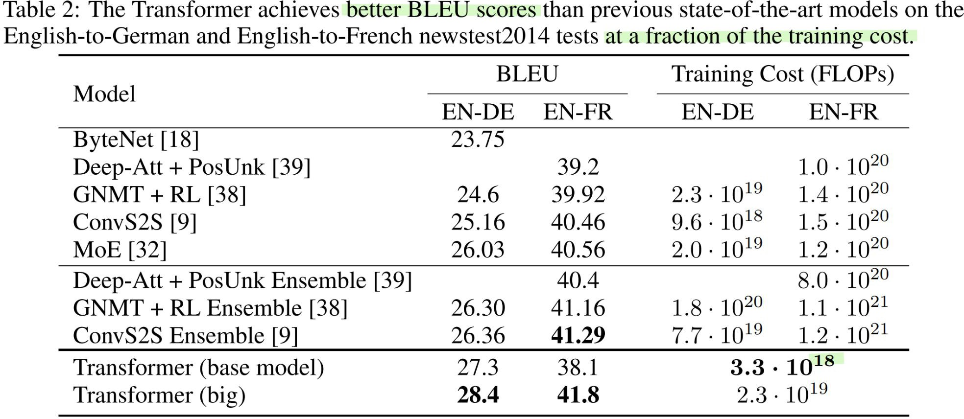
Attention Is All You Need - Summary and results
2017, Ashish Vaswani, Noam Shazeer, Niki Parmar, Jakob Uszkoreit, Llion Jones, Aidan N. Gomez, Łukasz Kaiser, Illia Polosukhin
Animation source: https://ai.googleblog.com/2017/08/transformer-novel-neural-network.html Table source: "Attention Is All You Need" paper

Slide 29
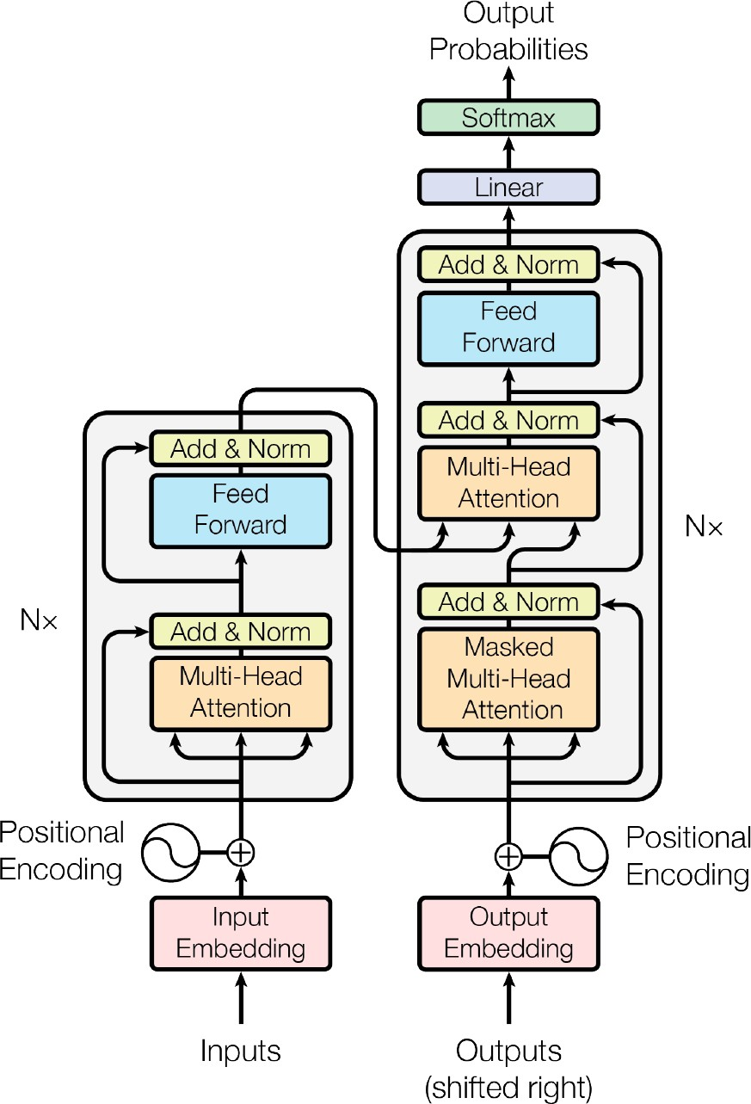
Encoder and Decoder uses Attention
Encoder
Decoder
Encoder & decoder are:
stacked (See next slide)
self-attention
point-wise
fully connected layers
Autoregression
ingests previously generated output
Source: Vaswani, Ashish, et al. "Attention is all you need." Advances in Neural Information Processing Systems. 2017.

Slide 30
Stacked Encoder, Decoder

Slide 31
Self-Attention
Input sentence to translate:
  Second Law of Robotics: A robot must obey the orders given it by human beings except where such orders would conflict with the First Law.
Highlighted words refer to other words
– it refers to the robot, such orders refers to the earlier part of the law, namely “the orders given it by human beings”, The First Law refers to the
entire First Law
What self-attention does
  It bakes-in the model’s understanding of relevant and associated words that explain the context of a certain word before processing that word
  Assigns scores to how relevant each word in the segment is and sums up their vector representation

Slide 32
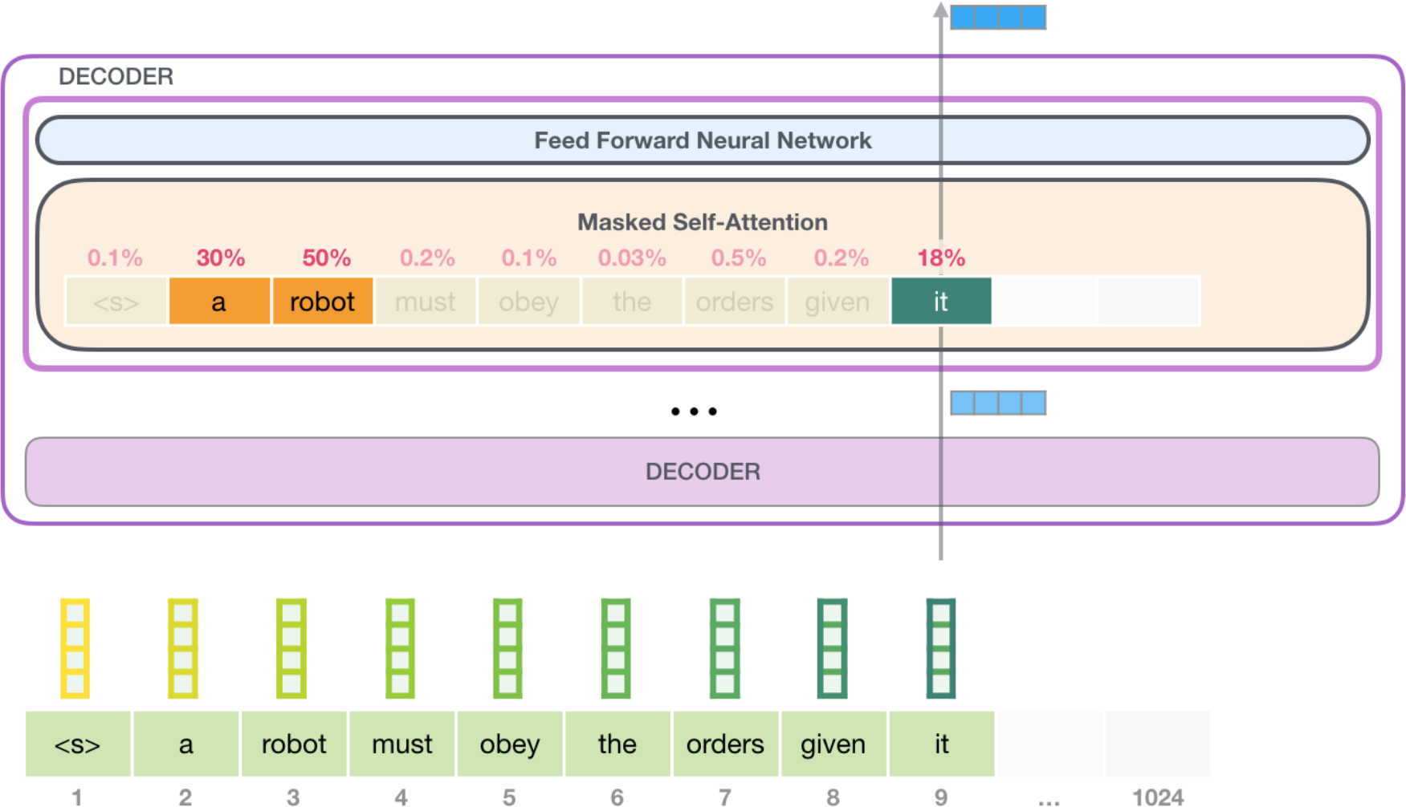
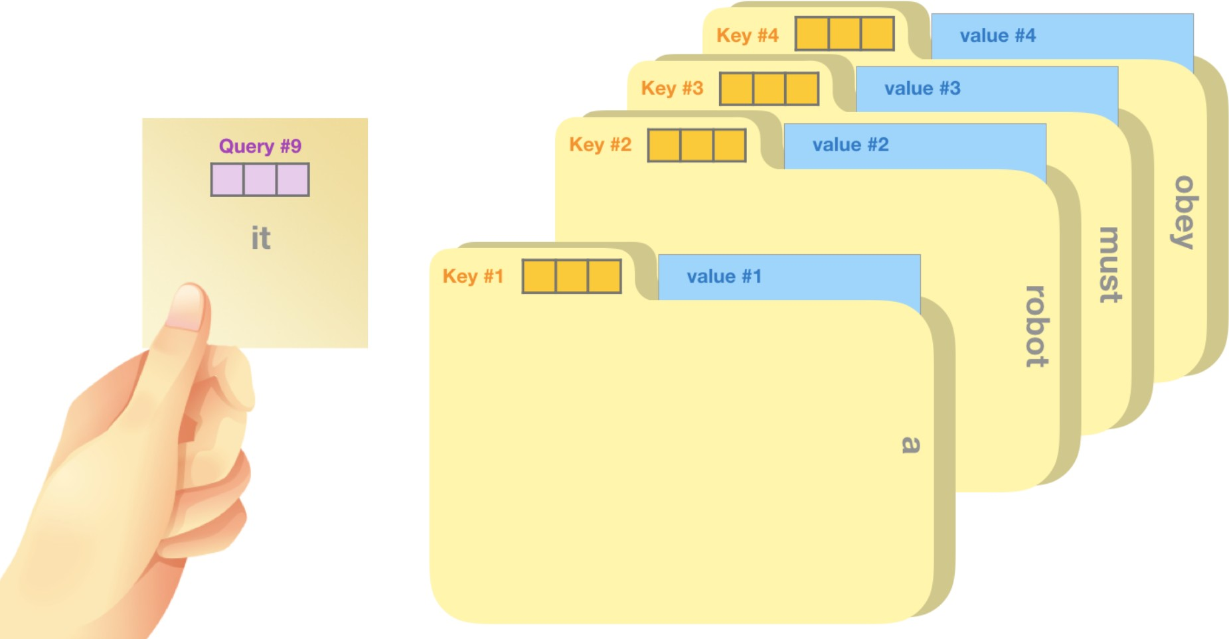
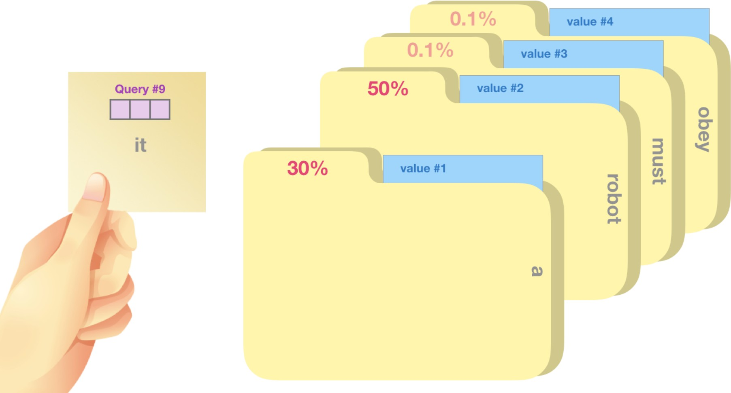
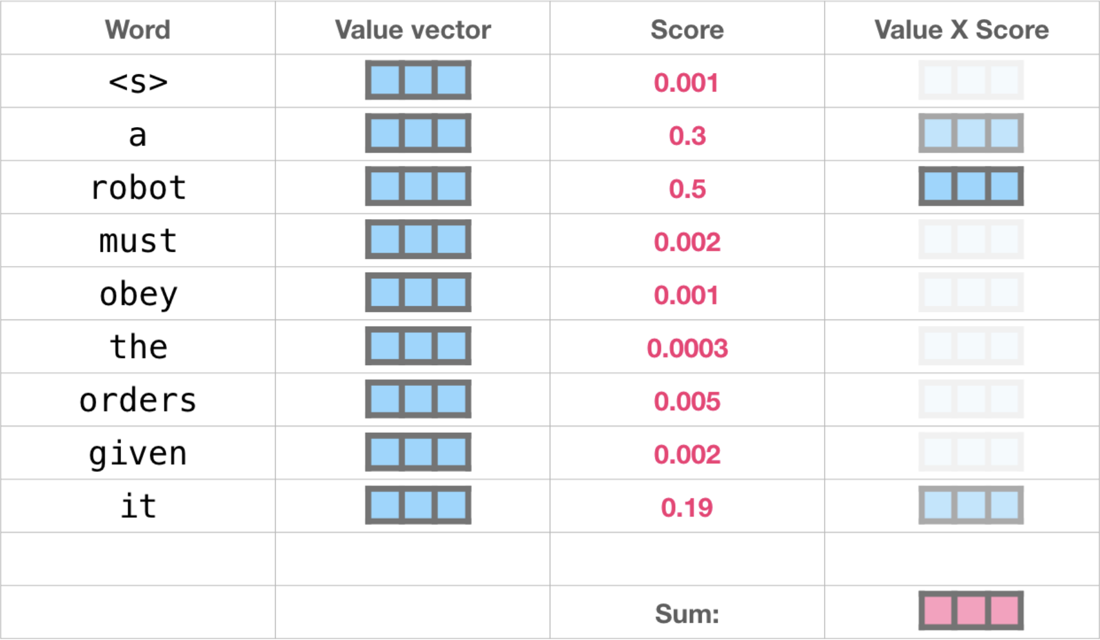
Self-Attention Process
This self-attention layer is paying attention to
“a robot” when it processes the word “it”. The vector it will pass to its neural network is a sum of the vectors for each of the three words multiplied by their scores.
Self-attention is processed along the path of each token in the segment.
The significant components are three vectors:
Query (Q), Key (K) and Value (V)

Slide 33
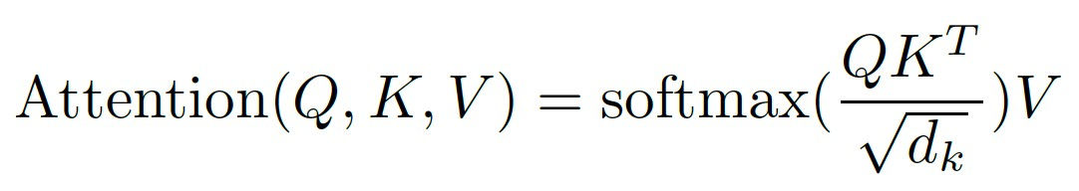
Full Transformer (with Attention)
Several attention layers run in parallel
MultiHead (Q, K, V) = Concat(head₁,.., head_{h}) where head_{i} =
Attention(QW_{i}^{Q} , KW_{i}^{K} ; VW_{i}^{V})

Slide 34
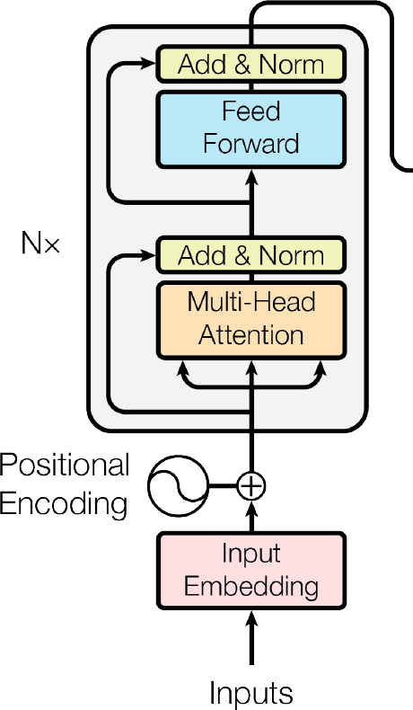
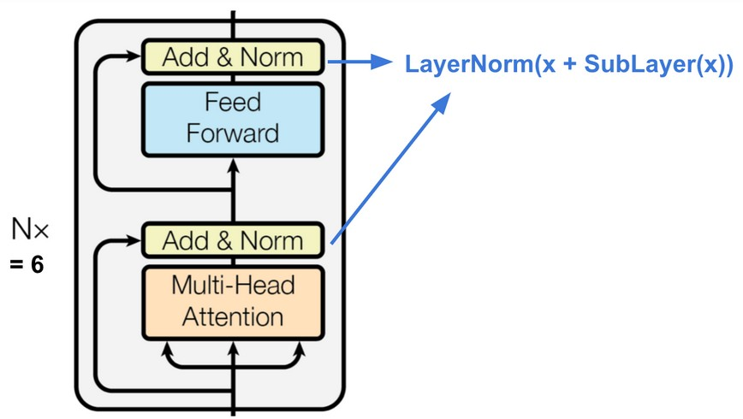
Transformer Encoder Detail
A stack of Nx = 6 identical layers
Each layer has two sub-layers:
  A multi-head self-attention mechanism
  A position-wise fully connected feed-forward network
A residual connection around each of
the two sub-layers, followed by layer normalization
Layer normalization: normalization statistics from the summed inputs to the neurons within a hidden layer
Output of each sub-layer is LayerNorm(x + Sublayer(x)),
where Sublayer(x) is the function implemented by the sub-layer itself.
Residual connections, sub-layers, embedding layers produce outputs of dimension d_{model} = 512

Slide 35
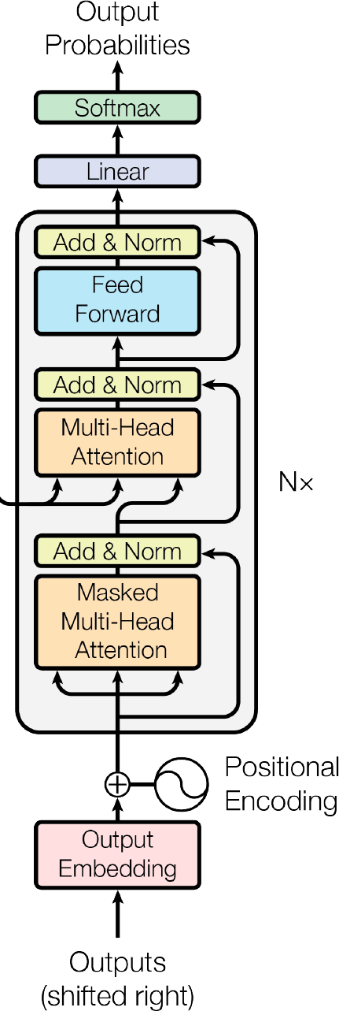
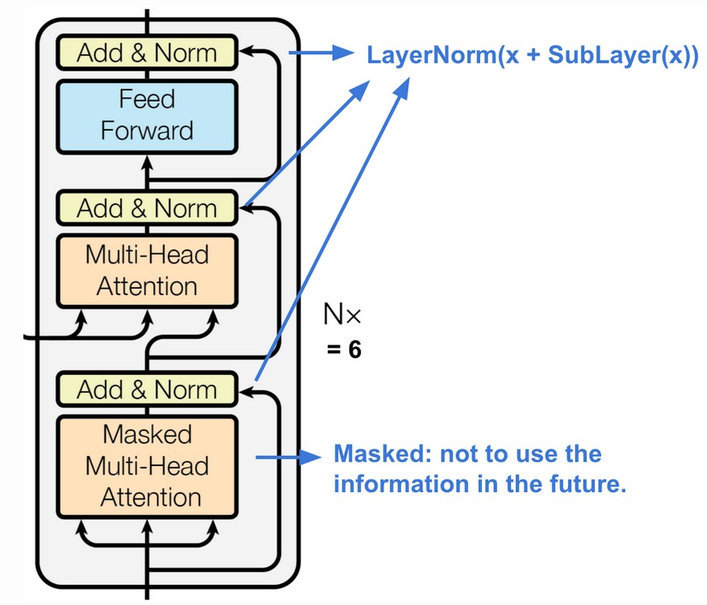
Transformer Decoder Detail
Decoder is also a stack of Nx = 6 identical layers.
Has a third sub-layer which performs
multi-head attention over the output of the encoder stack.
Residual connections around each of
the two sub-layers, followed by layer normalization
Self-attention sub-layer in the decoder stack is modified
to prevent positions from attending to subsequent positions.
This masking, and by off-setting output embeddings by one position, predictions for at i depend only on known outputs at positions < i

Slide 36
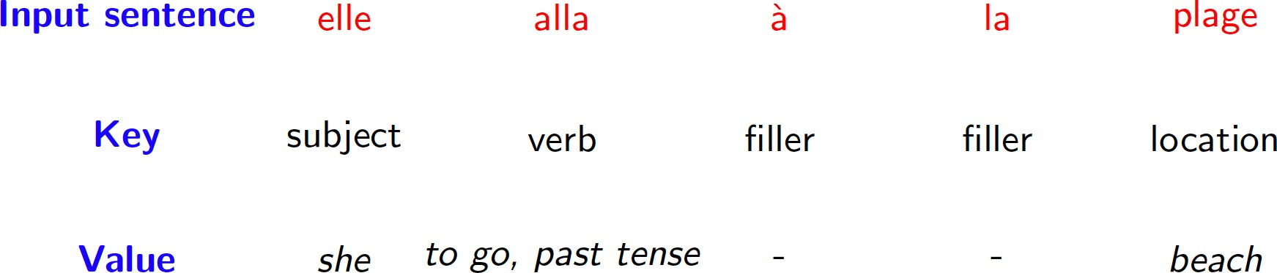
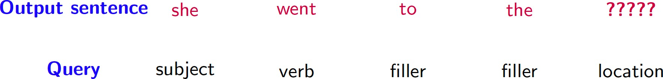
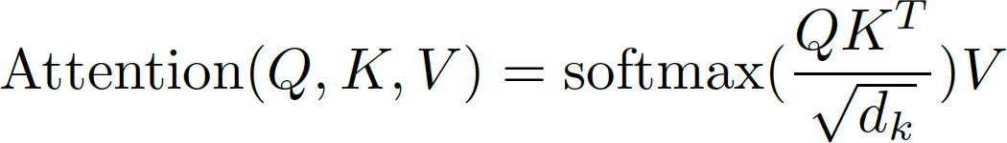
Query, Key and Value in Attention
To compute the next word in translation, the attention mechanism creates a vector using the source sentence and what has been generated so far

Slide 37
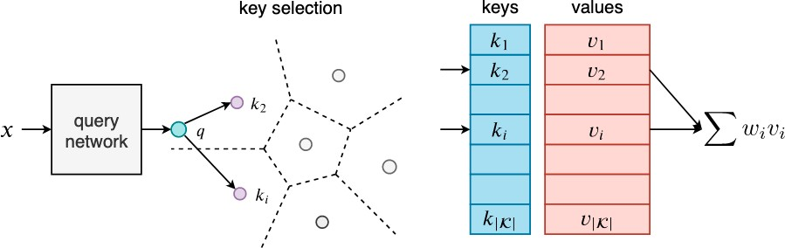
Query, Key and Value in QA
Key-Value Memory Networks for Question Answering
  Example
    Blade Runner directed-by Ridley Scott has the form subject- relation-object
    Key is composed of subject (Blade Runner) and relation
(directed by)
    Value is the object (Ridley Scott)
    Query is Who directed Blade Runner?
Source: https://arxiv.org/pdf/1907.05242v1.pdf

Slide 38
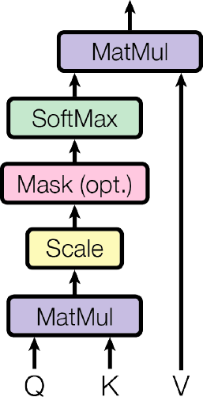
Detail of Scaled dot product attention
The input consists of queries and keys of dimension d_{k}, and values of dimension d_{k}. We compute the dot products of the query with all keys, divide each by √ d_{k}, and apply a softmax function to obtain the weights on the values.
We compute the attention function on a set of queries simultaneously, packed together into a matrix Q.
The keys and values are also packed together into matrices K and V . We compute the matrix of outputs as:

Slide 39
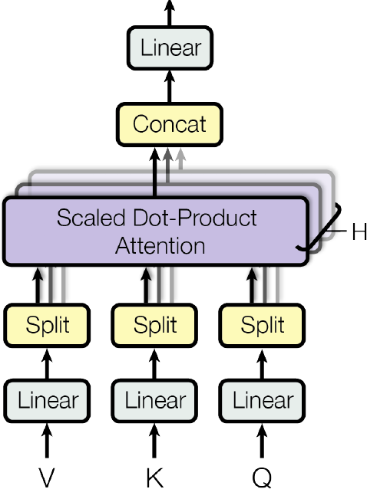

Detail of Multi-head attention
Several attention layers run in parallel
Outputs are concatenated and linearly transformed into the expected dimensions
Allows model to jointly attend to information from different representation
subspaces at different positions
MultiHead (Q, K, V) = Concat (head₁,.., head_{h}) where head_{i} = Attention(QW_{i}^{Q} , KW_{i}^{K} ; VW_{i}^{V})

Slide 40
Self-Attention
(example and picture from David Talbot)

Slide 41
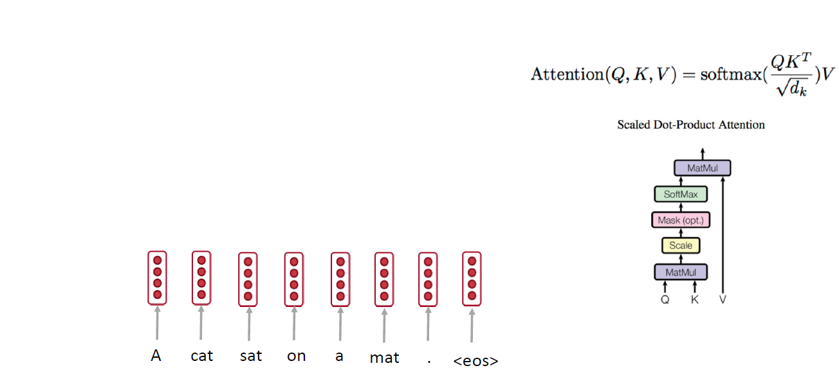
Self-attention: A Running Example

Slide 42
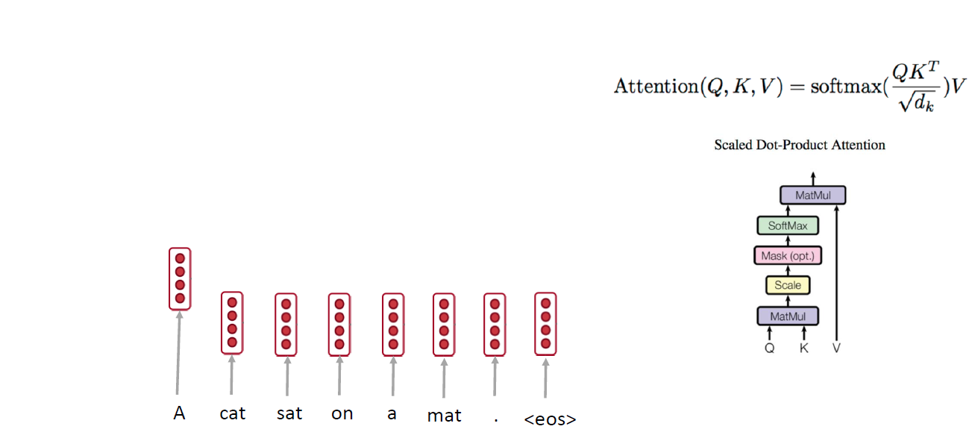
Self-attention: A Running Example

Slide 43
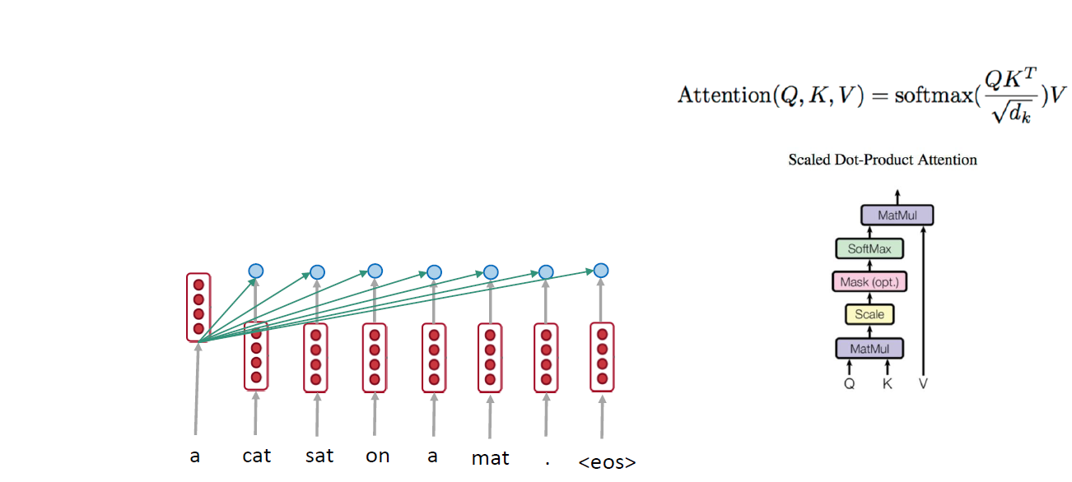
Self-attention: A Running Example

Slide 44
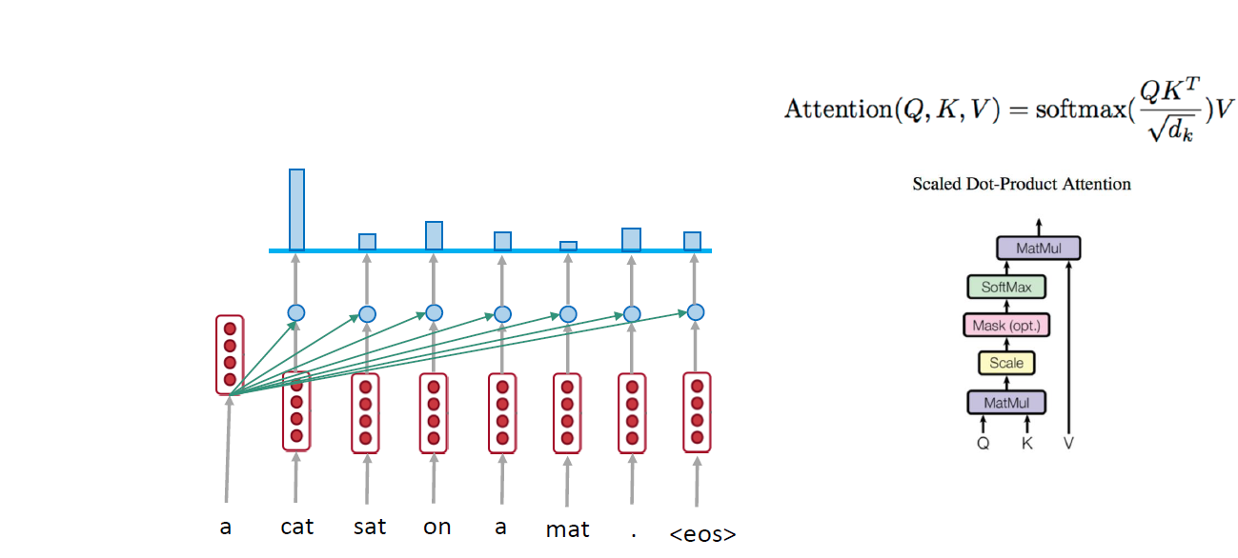
Self-attention: A Running Example

Slide 45
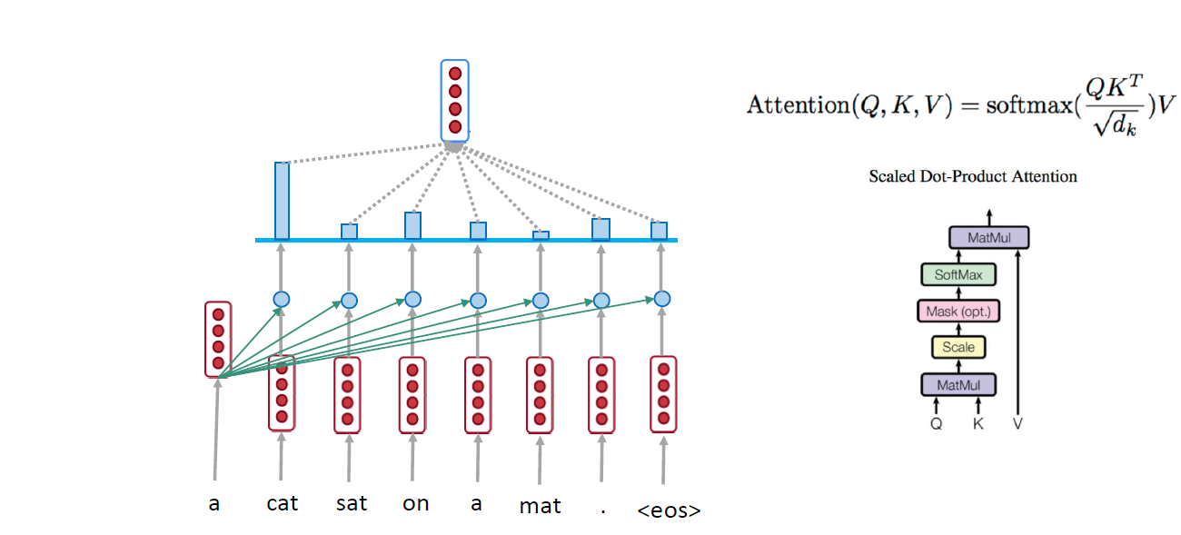
Self-attention: A Running Example

Slide 46
Self-attention: A Running Example

Slide 47
Self-attention: A Running Example

Slide 48
Self-attention: A Running Example

Slide 49
Self-attention: A Running Example

Slide 50
Self-attention: A Running Example

Slide 51
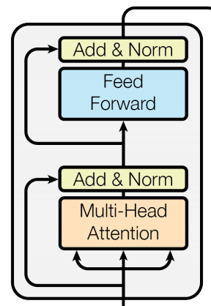
Complete transformer block
Each block has two “sublayers”
  1. Multihead attention
  2. 2 layer feed-forward Nnet (with relu)
Each of these two steps also has:
  Residual (short-circuit) connection and LayerNorm:
  LayerNorm(x + Sublayer(x))
    Layernorm changes input to have mean 0 and variance 1, per layer and per training point (and adds two more parameters)
Layer Normalization by Ba, Kiros and Hinton, https://arxiv.org/pdf/1607.06450.pdf

Slide 52
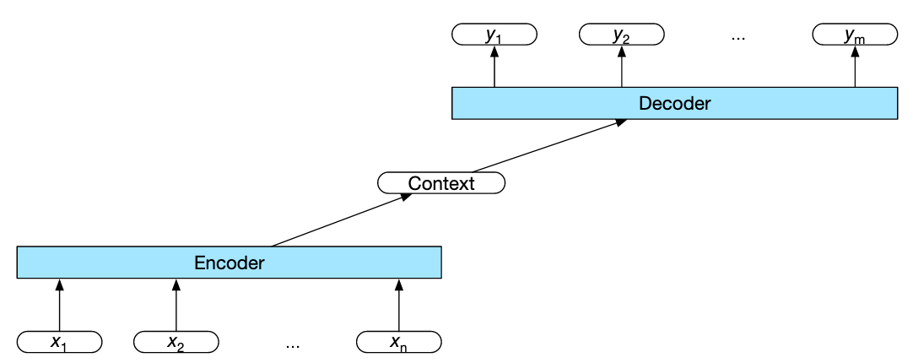
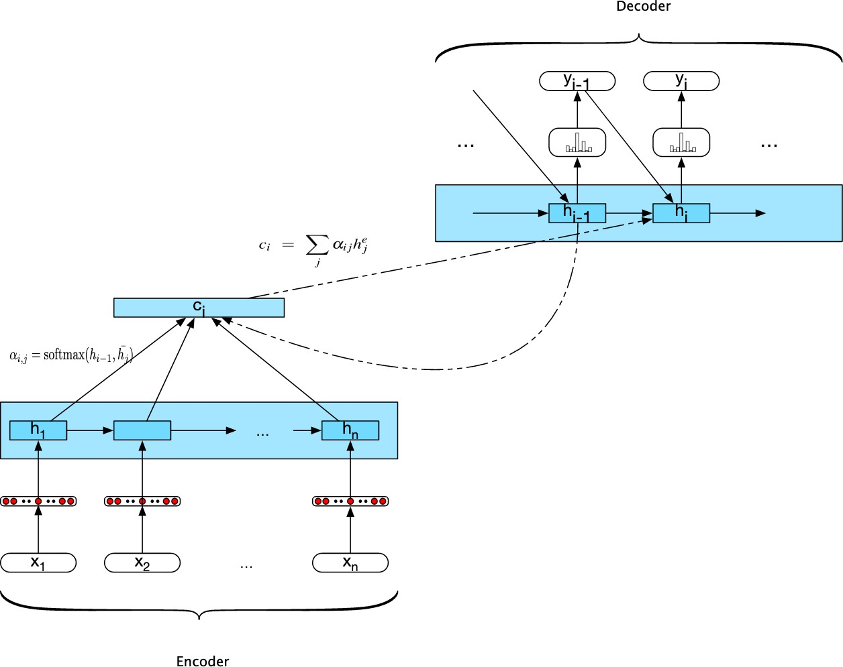
Types of Attention Models
Basic encoder-decoder RNN model
Encoder-decoder RNN with Attention
Transformer model with no recurrence
Generative pre-training of Attention model
5. BERT with no decoder, using bidirectionality

Slide 53
Improvements - Transformer
OpenAI’s Generative Pre-Training (GPT)
  Combines supervised and unsupervised learning to improve word vectors
    Performs Generative Pre-Training
State-of-the art for following tasks:
  Textual entailment, semantic similarity, reading comprehension, common sense reasoning, linguistic acceptability, multi-task benchmark
2. Google’s BERT
Bidirectional Encoder Representations from Transformers
BERT is an improvement of GPT
  Key technical innovation is bidirectional training of Transformer

Slide 54
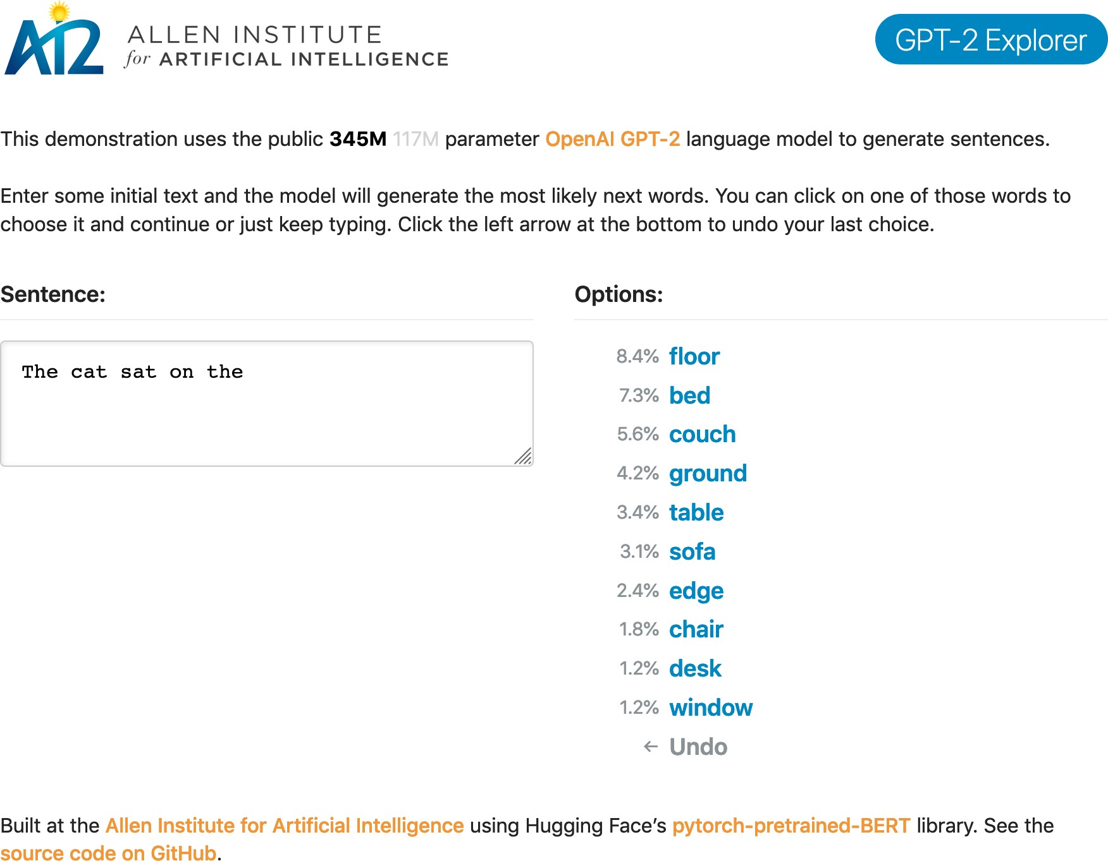
GPT-2 generates human-like output
Trained to predict next word (40GB of internet text)
While trained to predict the next word it surprisingly learned basic (simple?) competence in tasks like MT and QA.
– It was not evaluated on those tasks.

Slide 55
GPT-2 generated synthetic text
System Prompt (human-written)
In a shocking finding, scientist discovered a herd of unicorns living in a remote, previously unexplored valley, in the Andes Mountains. Even more surprising to the researchers was the fact that the unicorns spoke perfect English.
Model Completion (machine-written, 10 tries)
The scientist named the population, after their distinctive horn, Ovid’s Unicorn. These four-horned, silver-white unicorns were previously unknown to science.
Now, after almost two centuries, the mystery of what sparked this odd phenomenon is finally solved.
Dr. Jorge Pérez, an evolutionary biologist from the University of La Paz, and several companions, were exploring the Andes Mountains when they found a small valley, with no other animals or humans. Pérez noticed that the valley had what appeared to be a natural fountain, surrounded by two peaks of rock and silver snow.
Pérez and the others then ventured further into the valley. “By the time we reached the top of one peak, the water looked blue, with some crystals on top,” said Pérez.
Pérez and his friends were astonished to see the unicorn herd. These creatures could be seen from the air without having to move too much to see them – they were
so close they could touch their horns.

Slide 56
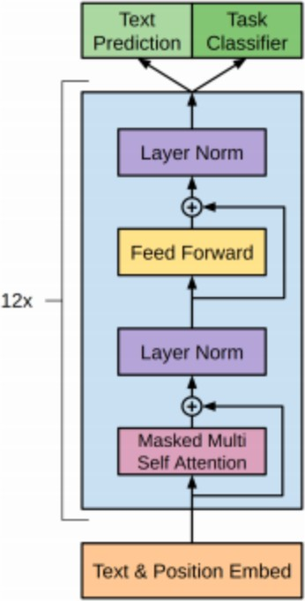
Architecture of GPT
Text and position will be transformed to a vectors
Pass to multi-head self-attention
Combining result from step 1 and step 2 and performing a normalization
Pass to a fully-connected feed-forward network
Combining result from step 3 and 4 and performing a normalization
Finally, combing multi-head (total 12 self-attention block) to together for computing vectors.

Slide 57
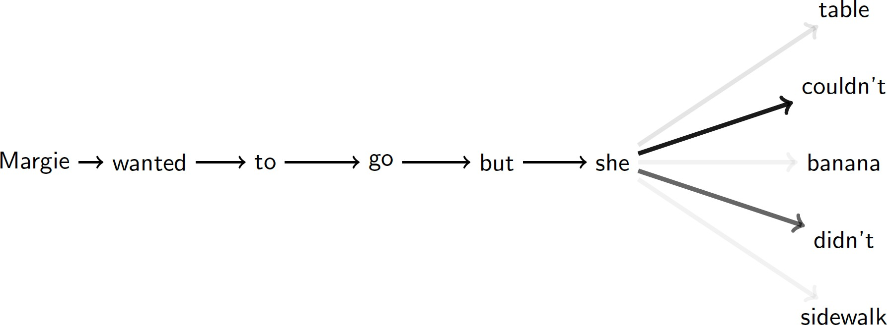
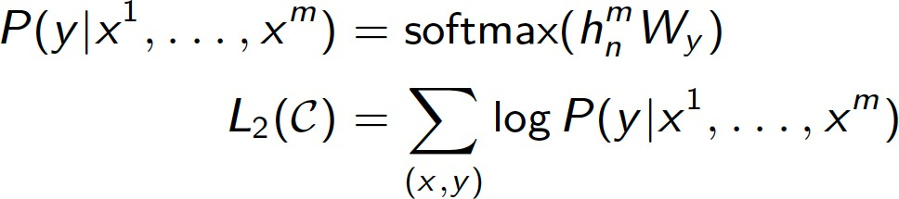
Generative Pre-training (GPT)
OpenAI multilayer decoder
W_{e} is the token embedding matrix W_{p} is the position embedding matrix h₀ = UW_{e} +W_{p}
h_{i} = transformer block (h_{i-1}) ∀i ∈ [1, n]
Unsupervised pretraining task
– Language Modeling
Language Modeling Loss
P(u) = softmax(h_{n}W_{e}^{T} )
L₁(U) =Σ_{i} log P(u_{i} |u_{i-k} ,.., u_{i-1}; 𝛳)
Classification Loss
Final Loss
Supervised fine-tuning
– Multitask learning

Slide 58
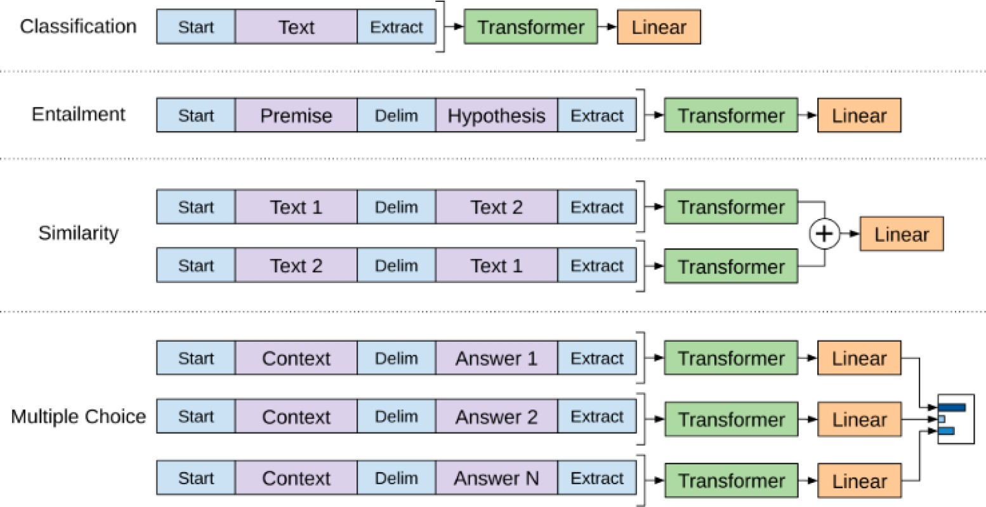
Input Formatting for GPT

Slide 59
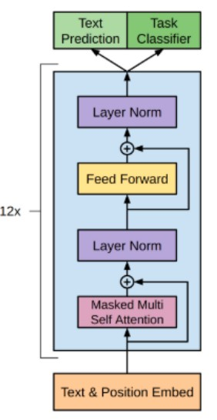
Types of Attention Models
Basic encoder-decoder RNN model
Encoder-decoder with Attention
Transformer model with no recurrence
Generative pre-training of Attention model
BERT with no decoder, using bidirectionality

Slide 60
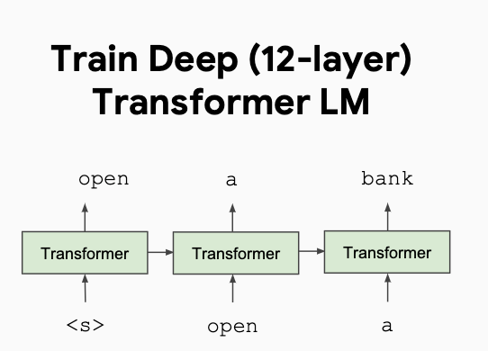
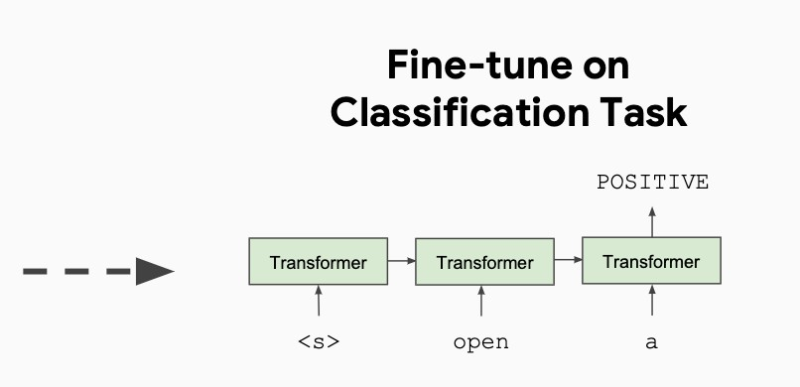
Prior work: OpenAI GPT
OpenAI GPT (Radford et al., 2018; released in 2018/6)
Train one unidirectional LM (left-to-right) based on a deep Transformer decoder
Fine-tuning approach: all pre-trained parameters are re-used & updated on downstream tasks
Trained on 512-token segments on BooksCorpus — much longer context!

Slide 61

BERT: key contributions
It is a fine-tuning approach based on a deep Transformer encoder
The key: learn representations based on bidirectional context
Why? Because both left and right contexts are important to understand the meaning of words.
Example #1: we went to the river bank.
Example #2: I need to go to bank to make a deposit.
Pre-training objectives: masked language modeling + next sentence prediction
State-of-the-art performance on a large set of sentence-level and token-level tasks

Slide 62
Google’s BERT
(Bidirectional Encoder Representations from Transformers)
Uses Transformer attention mechanism to learn contextual relations between words
  Transformer includes two mechanisms
    An Encoder that reads text input
    A Decoder that produces a prediction for the task
  Since BERT’s goal is to generate a language model, only the encoder mechanism is necessary
Uses Bidirectional training
  Deeper sense of context/flow than single-direction
Masked LM (MLM) allows bidirectional training

Slide 63
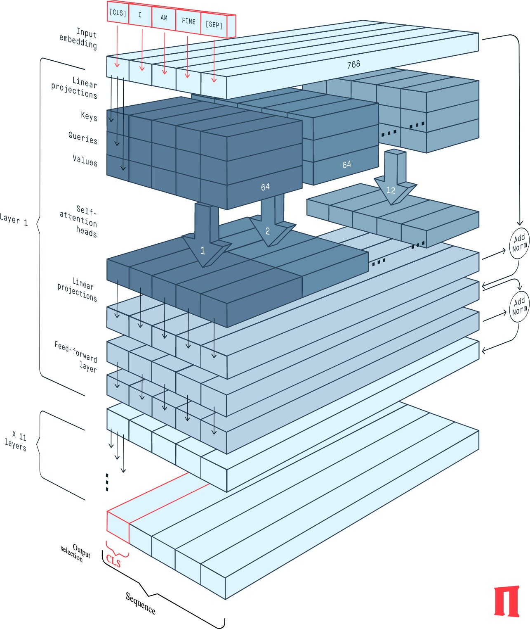
Structure of BERT
The BERT Encoder block implements the base version of the BERT network
It is composed of 12 successive transformer layers, each having 12 attention heads
The total number of parameters is 110 million.
https://peltarion.com/knowledge-center/documentation/modeling-view/build-an-ai-model/
blocks/bert-encoder?fbclid=IwAR2rt4ObbHCMvuGsfrNNOnotfW_Dfc-5y3QorqW1nQUbw4XzuwjjCbnQDy0

Slide 64
Comparison of BERT and GPT
BERT seems to be an improvement on GPT
The main differences are:
  Bidirectional training
  Different pre-training tasks (masked language model and next sentence prediction)
  Trained on a much bigger corpus (BookCorpus (800M words) + Wikipedia (2500M words))
– 3 x as many parameters for the large version
– Pre-trained model for 102 languages
Big difference!
pre-trained BERT models are open source and publicly available

Slide 65

Bidirectionality
Arrows indicate information flow from one layer to next
Green boxes at top indicate final contextualized representation of each input word
Evident from the above image:
BERT is bi-directional
GPT is unidirectional (information flows from left-to-right) ELMO is shallowly bidirectional

Slide 66

Input Representation
Use 30,000 WordPiece vocabulary on input.
Each token is sum of three embeddings
Single sequence is much more efficient

Slide 67

Text Pre-processing
Position Embeddings:
BERT learns and uses positional embeddings to express the position of words
in a sentence. These are added to overcome the Transformer limitation which, unlike an RNN, is not able to capture “sequence” or “order” information
Segment Embeddings:
BERT can also take sentence pairs as inputs for tasks (Question-Answering).
As such it learns a unique embedding for the first and the second sentences to help the model distinguish between them. In the above example, all the tokens marked as EA belong to sentence A (and similarly for EB)
Token Embeddings:
These are the embeddings learned for the specific token from the WordPiece token vocabulary

Slide 68
Pre-training BERT
BERT pre-trained on two NLP tasks:
  Masked Language Modeling(For Bidrectionality)
  Next Sentence Prediction

Slide 69
Masked Language Model
Before feeding word sequences 15% of words in each sequence replaced with a [MASK] token
Model attempts to predict original value of masked words, based on context provided by non-masked words in sequence
Prediction of the output words requires
  Adding a classifier layer on top of encoder output
  Multiplying output vectors by the embedding matrix, transforming them into the vocabulary dimension.
  Calculating probability of each word in the
vocabulary with softmax.

Slide 70

Word prediction using masking

Slide 71
Next Sentence Prediction
A text dataset of 100,000 sentences with 50,000 training examples or pairs of sentences as training data.
  For 50% of pairs, the second sentence would be the next sentence to the first sentence
  For the remaining 50% of pairs, second sentence would be a random sentence from corpus
    The labels for the first case would
be ‘IsNext’ and ‘NotNext’ for the second case

Slide 72
Model Details
Data: Wikipedia (2.5B words) + BookCorpus (800M words)
Batch Size: 131,072 words (1024 sequences * 128 length or 256 sequences * 512 length)
Training Time: 1M steps (~40 epochs)
Optimizer: Adam, 1e-4 learning rate, linear decay
BERT-Base: 12-layer, 768-hidden, 12-head,
  Total Parameters=110M
BERT-Large: 24-layer, 1024-hidden, 16-head
  Total Parameters=340M
Trained on 4x4 or 8x8 TPU slice for 4 days

Slide 73

BERT Architecture
BERT architecture builds on top of the Transformer
There are at least two variants:
  BERT Base:
    12 layers (transformer blocks), 12 attention heads, and 110 million parameters
  BERT Large:
    24 layers (transformer blocks), 16 attention heads and, 340 million parameters

Slide 74
What makes BERT different?
BERT is the first, deeply bidirectional, unsupervised language representation, pre-trained using only a plain text corpus
Pre-trained representation
Context free
word2vedc, GloVE
Contextual
unidirectional
GPT
biidirectional
ElMO (shallow), BERT

Slide 75
Experiments for evaluation
GLUE (General Language Understanding Evaluation)benchmark
  Distribute canonical Train, Dev and Test splits
  Labels for Test set are not provided
Datasets in GLUE:
  MNLI: Multi-Genre Natural Language Inference
  QQP: Quora Question Pairs
  QNLI: Question Natural Language Inference
  SST-2: Stanford Sentiment Treebank
  CoLA: The corpus of Linguistic Acceptability
  STS-B: The Semantic Textual Similarity Benchmark
  MRPC: Microsoft Research Paraphrase Corpus
  RTE: Recognizing Textual Entailment
  WNLI: Winograd NLI

Slide 76

GLUE Results

Slide 77

June, ‘19
https://towardsdatascience.com/a-review-of-bert-based-models-4ffdc0f15d58

Slide 78

Other Improvements
XLNet (CMU and Google Brain, June 2019)
  https://arxiv.org/abs/1906.08237
  Go back to language models but add some permutation of input

Slide 79


Other Improvement
RoBERTa (FAIR, July 2019)
  https://arxiv.org/abs/1907.11692
  present a replication study of BERT pretraining
  find that BERT was significantly undertrained, and can match or exceed the performance of every model published after it.

Slide 80

Other Improvement
RoBERTa (FAIR, July 2019)
  https://arxiv.org/abs/1907.11692

Slide 81


Other Improvement
Albert: A LITE BERT (Sept. 2019, ?)
  https://openreview.net/pdf?id=H1eA7AEtvS
  https://arxiv.org/abs/1904.00962

Slide 82

The BERT Zoo

Slide 83

The BERT Zoo
Transformer
Zoo

Slide 84

The BERT Zoo from huggingface
Over 200 Transformers at huggingface
https://github.com/huggingface/transformers

Slide 85


Slide 86


Slide 87


Slide 88

GPT-3
Most powerful language model ever
https://towardsdatascience.com/gpt-3-the-new-mighty-language-model-from-openai-a74ff35346fc
https://openai.com/blog/openai-api/

Slide 89

GPT-3

Slide 90

GPT-3 Models
$12 million cost for a single training run
https://www.springboard.com/blog/data-science/machine-learning-gpt-3-open-ai/

Slide 91

Deep Learning (GPT 3) has problems answering simple Math questions
https://lacker.io/ai/2020/07/06/giving-gpt-3-a-turing-test.html

Slide 92

An Others - reasoning

Slide 93

Others – related knowledge
GPT-3 has a limited short-term memory, and has trouble reasoning about more than one or two objects in a sentence.

Slide 94

OpenAI’s GPTs
https://beta.openai.com/docs/engines

Slide 95

OpenAI’s GPTs
https://platform.openai.com/docs/guides/gpt

Slide 96

OpenAI’s GPTs
https://platform.openai.com/docs/guides/gpt

Slide 97
Open Source GPTs?
GPT-Neo, GPT-J, GPT-NeoX
GPT-Neo released March 2021; GPT-J, June 2021, NeoX, Feb 2020
-- all created by EleutherAI (a collective of researchers working to open source AI).
GPT-Neo has 3 versions: 125 million parameters, 1.3 billion parameters (equivalent to GPT-3 Babbage), and 2.7 billion parameters.
GPT-J has 6 billion parameters. This is a direct equivalent of GPT-3 Curie.
GPT-NeoX is a 20 billion parameter (smaller versions available) model trained in collaboration with CoreWeave

Slide 98

GPT-4
GPT 3 to GPT 4
https://www.youtube.com/watch?v=rLE0b8_OQMk
https://towardsdatascience.com/gpt-4-will-have-100-trillion-parameters-500x-the-size-of-gpt-3-582b98d82253

Slide 99
Differences between GPT-3 and BERT
Most obvious difference between GPT-3 and BERT is their architecture.
  GPT-3 is an autoregressive model, while BERT is bidirectional.
  While GPT-3 only considers the left context when making predictions, BERT takes into account both left and right context. This makes BERT better suited for tasks such as sentiment analysis or NLU, where understanding the full context of a sentence or phrase is essential.
Another difference between the two models lies in their training datasets. While both models were trained on large datasets of text data from sources like Wikipedia and books
  GPT-3 was trained on 45TB of data, while BERT was trained on 3TB of data. So, GPT-3 has access to more information than BERT, which could give it an edge in specific tasks such as summarization or translation, where access to more data can be beneficial.
Finally, there are differences in terms of size as well.
  While both models are very large (GPT-3 has 1.5 billion parameters while BERT has 340 million parameters), GPT-3 is significantly larger than its predecessor due to its much more extensive training dataset size (470 times bigger than the one used to train BERT).
https://blog.invgate.com/gpt-3-vs-bert

Slide 100
Broad Classes of Transformers
Encoder only: These models are typically suited for tasks that can understand language, such as classification and sentiment analysis. Examples of encoder-only models include BERT (Bidirectional Encoder Representations from Transformers).
Decoder only: This class of models is extremely good at generating language and content. Some use cases include story writing and blog generation. Examples of decoder-only architectures include GPT-3 (Generative Pretrained Transformer 3).
Encoder-decoder: These models combine the encoder and decoder components of the transformer architecture to both understand and generate content. Some use cases where this architecture shines include translation and summarization. Examples of encoder-decoder architectures include T5 (Text-to-Text Transformer).
https://vitalflux.com/large-language-models-concepts-examples/

Slide 101
The first (1.5th) big takeover:
Language Modeling / NLP

Slide 102



Decoder-only GPT
Encoder-only BERT
Enc-Dec T5
Das ist gut.
A storm in Attala caused 6 victims. This is not toxic.
[sat_]
[*]
[*]
[sat_] [*] [the_]
[*]
Translate EN-DE: This is good. Summarize: state authorities dispatched… Is this toxic: You look beautiful today!
[START] [The_] [cat_]
[The_] [cat_] [MASK] [on_] [MASK] [mat_]
Transformer image source: "Attention Is All You Need" paper

Slide 103
The second big takeover:
Computer Vision

Slide 104



Many prior works attempted to introduce self-attention at the pixel level.
Previous approaches
For 224px², that's 50k sequence length, too much!
1. On pixels, but locally or factorized
Usually replaces 3x3 conv in ResNet:
Results:
Are usually "meh", nothing to call home about Do not justify increased complexity
Do not justify slowdown over convolutions
Examples:
Non-local NN (Wang et.al. 2017)
SASANet (Stand-Alone Self-Attention in Vision Models) HaloNet (Scaling Local Self-Attn for Parameter Efficient...) LR-Net (Local Relation Networks for Image Recognition) SANet (Exploring Self-attention for Image Recognition)
...
Image credit: Stand-Alone Self-Attention in Vision Models by Ramachandran et.al. Image credit: Local Relation Networks for Image Recognition by Hu et.al.

Slide 105


Previous approaches
2. Globally, after/inside a full-blown CNN, or even detector/segmenter!
Cons:
result is highly complex, often multi-stage trained architecture.
not from pixels, i.e. transformer can't "learn to fix" the (often frozen!) CNN's mistakes.
Examples:
DETR (Carion, Massa et.al. 2020) UNITER (Chen, Li, Yu et.al. 2019) VisualBERT (Li et.al. 20190)
Image credit: UNITER: UNiversal Image-TExt Representation Learning by Chen et.al.
Image credit: Visual Transformers: Token-based Image Representation and Processing for Computer Vision by Wu et.al.
Visual Transformers (Wu et.al. 2020)
ViLBERT (Lu et.al. 2019) etc...

Slide 106


An Image is Worth 16x16 Words: Transformers for Image Recognition at Scale
2020, A Dosovitskiy, L Beyer, A Kolesnikov, D Weissenborn, X Zhai, T Unterthiner, M Dehghani, M Minderer, G Heigold, S Gelly, J Uszkoreit, N Houlsby
Vision Transformer (ViT)
Many prior works attempted to introduce self-attention at the pixel level.
For 224px², that's 50k sequence length, too much!
Thus, most works restrict attention to local pixel neighborhoods, or as high-level mechanism on top of detections.
The key breakthrough in using the full Transformer architecture, standalone, was to "tokenize" the image by cutting it into patches of 16px², and treating each patch as a token, e.g. embedding it into input space.

Slide 107


Side-note: MLP-Mixer
2020, I Tolstikhin, N Houlsby, A Kolesnikov, L Beyer, X Zhai, T Unterthiner, J Yung, A Steiner, D Keysers, J Uszkoreit, M Lucic, A Dosovitskiy
After ViT answered the question "Are convolutions really needed to process images?" with NO... We wondered if self-attention is really needed?
The role of self-attention is to "mix" information across tokens.
Another simple way to achieve this, is to "transpose" tokens and run that through an MLP:

Slide 108
The third big takeover:
Speech

Slide 109





Conformer: Convolution-augmented Transformer for Speech Recognition
2020, A Gulati, J Qin, C-C Chiu, N Parmar, Y Zhang, J Yu, W Han, S Wang, Z Zhang, Y Wu, R Pang
[igat]
Largely the same story as in computer vision. But with spectrograms instead of images.
Conformer adds a third type of block using convolutions, and slightly reorder blocks, but overall very transformer-like.
Exists as encoder-decoder variant, or as encoder-only variant with CTC loss.
UPDATE Sept 2022: Plain transformer model in “Whisper” by
A Radford, J W Kim, T Xu, G Brockman, C McLeavey, I Sutskever
[The_] [detective_] [invest]
Transformer image source: "Attention Is All You Need" paper

Slide 110
The fourth big takeover:
Reinforcement Learning

Slide 111





Decision Transformer: Reinforcement Learning via Sequence Modeling
2021, L Chen, K Lu, A Rajeswaran, K Lee, A Grover, M Laskin, P Abbeel, A Srinivas, I Mordatch
Cast the (supervised/offline) RL problem into a sequence ("language") modeling task:
Can generate/decode sequences of actions with desired return (eg skill)
The trick is prompting: "The following is a trajectory of an expert player: [obs] ..."
Slide credit: Igor Mordatch

Slide 112
The Transformer's
Unification of communities

Slide 113



Anything you can tokenize, you can feed to Transformer
ca 2021 and onwards
[2]
Tokenize different modalities each in their own way (some kind of "patching"), and send them all jointly into a Transformer...
Seems to just work...
Currently an explosion of works doing this!
[3]
[1]
Images from:
LIMoE by B Mustafa, C Riquelme, J Puigcerver, R Jenatton, N Houlsby
MERLOT Reserve by R Zellers, J Lu, X Lu, Y Yu, Y Zhao, M Salehi, A Kusupati, J Hessel, A Farhadi, Y Choi
VATT by H Akbari, L Yuan, R Qian, W-H Chuang, S-F Chang, Y Cui, B Gong

Slide 114
A note on
Efficient Transformers

Slide 115


A note on Efficient Transformers
The self-attention operation complexity is O(N²) for sequence length N.
We'd like to use large N: Whole articles or books Full video movies
High resolution images
Many O(N) approximations to the full self-attention have been proposed in the past two years.
Unfortunately, none provides a clear improvement. They always trade-off between speed and quality.
LRA score (Long Range Arena) – evaluating
long context scenarios
"Efficient Transformers: A Survey" by Yi Tay, Mostafa Dehghani, Dara Bahri, Donald Metzler
"Long Range Arena: A Benchmark for Efficient Transformers" by Y Tay, M Dehghani, S Abnar, Y Shen, D Bahri, P Pham, J Rao, L Yang, S Ruder, D Metzler

Slide 116

O(n²) attention problem

Slide 117


Slide 118
5 most popular transformers
BERT (Bidirectional Encoder Representations from Transformers)
BERT is a pre-trained transformer developed by Google that has achieved state-of-the-art performance on a wide range of NLP tasks, including question answering, text classification, and named entity recognition. It is a bi-directional model that learns the context of a word based on both its preceding and succeeding words. BERT has been widely adopted by many industries and research communities and has become a standard benchmark for evaluating NLP models.GPT-3 (Generative Pre-trained Transformer 3)
GPT-3 is a pre-trained transformer developed by OpenAI that is designed to generate human-like text. It has achieved remarkable performance on various language tasks such as language modeling, question answering, and text generation. GPT-3 uses a large number of parameters (175 billion) and has been trained on a massive amount of text data, making it one of the most powerful NLP models to date.
RoBERTa (Robustly Optimized BERT approach)
RoBERTa is a modified version of BERT that was developed by Facebook AI. It is pre-trained on a larger corpus of text data and uses an improved training method that makes it more robust to noise and variations in the input data. RoBERTa has shown significant improvement over BERT on various NLP benchmarks and has become a popular choice for many NLP applications.
T5 (Text-to-Text Transfer Transformer)
T5 is a pre-trained transformer developed by Google that is designed to perform a wide range of NLP tasks by converting input text to output text. It has achieved state-of-the-art performance on many NLP benchmarks, including machine translation, text summarization, and text classification. T5 has a simple architecture and can be fine-tuned for various NLP tasks with minimal effort, making it a popular choice for many NLP applications.
ELECTRA (Efficiently Learning an Encoder that Classifies Token Replacements Accurately)
ELECTRA is a pre-trained transformer developed by researchers at Google that uses a novel training method called “discriminator training” to improve the efficiency of pre-training. It has achieved state-of-the-art performance on various NLP tasks, including text classification and question answering. ELECTRA is designed to be computationally efficient and has a relatively small number of parameters compared to other large-scale NLP models.
https://www.codementor.io/@alinakhay/5-top-most-powerful-transformer-models-2023-24hb9azuzn

Slide 119
Summary
Attention has revolutionized NLP, Vision, Speech and other models
  Now a standard fixture for NLP
  Because it enables a model to “remember” all words (tokens) in the input and focus on specific words (tokens) when formulating a response
Early models: seq2seq models with RNNs
Recent: Transformer based models
Google’s BERT, OpenAI’s GPT and variations are popular today
  Based on self-attention and transformers
Anything that can be tokenized can be transformed
Foundation models now available

Slide 120
Foundational ML
Foundation models (BERT, GPT-3, CLIP, Codex) are models trained on broad data at scale such that they can be adapted to a wide range of downstream tasks.
These models will not only transform how AI systems are built, but will also lead to significant societal consequences.
Applications are built on these.
https://hai.stanford.edu/news/introducing-center-research-foundation-models-crfm

Slide 121


Slide 122
ChatGPT 2023 stats (2/8/23)
ChatGPT has created a blizzard on the internet. OpenAI’s chatbot has broken all the records and has crossed 1 million users within one week of its launch.
ChatGPT was made available for public testing on 30th November 2022. It is built by OpenAI, a San Francisco-based company. The company is responsible for creating software like GPT-3 and DALL-E2.
Hundreds of screenshots of the chatbot went viral on the internet, especially on Twitter. The fans of the ChatGPT spoke of the tool to be astonishing and scary at the same time.
https://www.demandsage.com/chatgpt-statistics/

Slide 123

How it works

Slide 124

Business models

Slide 125


Slide 126


Slide 127


Slide 128


Slide 129

Limitations

Slide 130
References
Encoder-decoder RNN
  Jurafsky and Martin, Speech and Language Processing, 2020
Transformer Attention Models
  A. Vaswani, et.al., All you need is Attention, NIPS 2017, https://arxiv.org/abs/1706.03762
Generative Pre-training
  G. Chatel Disaitek, Generative Pretraining of Transformer Networks
https://nlpparis.files.wordpress.com/2019/01/gchatel_pretrained_transformer.pdf
GPT
  J. Alammar, The Illustrated GPT-2 (Visualizing Transformer Language Models) https://jalammar.github.io/illustrated-gpt2/
BERT
  M. Rizvi, Demystifying BERT: A Comprehensive Guide to the Groundbreaking NLP Framework
https://www.analyticsvidhya.com/blog/2019/09/demystifying-bert-groundbreaking-nlp-. framework/

