Slide 1
What is Artificial Intelligence, Machine Learning and Deep Learning
My perspective
C. Lee Giles
The Pennsylvania State University
University Park, PA, USA
giles@ist.psu.edu
http://clgiles.ist.psu.edu

Slide 2
Acknowledgements/Collaborations
Lee Giles gratefully acknowledges web materials from the following scholars and scientists:
http://clgiles.ist.psu.edu/IST597/acknowledgements.html
Over 400 collaborators
For a full list, please see:
https://clgiles.ist.psu.edu/collaborators.shtml

Slide 3
Outline
Introduction to AI
AI vs Machine Learning (ML)
Machine learning – dominant AI model
  How it works and how to make it work
Deep learning (DL) as a part of machine learning
Problems/New directions in AI/ML/DL

Slide 4
AI, ML, DL Research & Applications
Computer scientists
Cognitive scientists
Philosophers
Neuroscientists
Physicists
Economists
Lawyers
Medicine
Domain scientists and engineers
Others

Slide 5
What is Artificial Intelligence
AI is a collection of hard problems which can be solved by humans and other living things, but for which we don’t have good algorithms for solving. (AI hard)
  e. g., understanding natural language, medical diagnosis, circuit design, learning, self-adaptation, reasoning, proving math theories, etc.
• Russell & Norvig: a program that
  Acts like a human (Turing test)
  Thinks like a human (human-like patterns of thinking steps)
  Acts or thinks rationally (logically, correctly)
• Some problems used to be thought of as AI but are not now considered so
  e. g., compiling Fortran in 1955, symbolic mathematics in 1965, pattern recognition in 1970, smart phones, chess playing, others?
Minsky – “what we thought was hard turned out to be easy and what we thought easy turned out to be hard”
Intelligent machines
What is the scientific method hypothesis behind AI?

Slide 6
AI Purposes, Herb Simon
Nobel Laureate
AI can have two purposes.
One is to use the power of computers to augment human thinking, just as we use motors to augment human or horse power. Robotics and expert systems are major branches of that.
The other is to use a computer's artificial intelligence to understand how humans think in a humanoid way. If you test your programs not merely by what they can accomplish, but how they accomplish it, you're really doing cognitive science; you're using AI to understand the human mind."
- Herb Simon

Slide 7
What’s easy and what’s hard?
It’s been easier to mechanize many of the high level cognitive tasks we usually associate with “intelligence” in people
  e. g., symbolic integration, proving theorems, playing chess and GO, some aspect of medical diagnosis, etc.
It’s been very hard to mechanize tasks that animals can do easily
  walking around without running into things
  catching prey and avoiding predators
  interpreting complex sensory information (visual, aural, …)
  modeling the internal states of other animals from their behavior
  working as a team (ants, bees)
Is there a fundamental difference between the two categories?
Why are some complex problems (e.g., solving differential equations, database operations) are not subjects of AI? Some are inverse problems using Deep Learning

Slide 8
AI Hard problems
The most difficult problems are informally known as AI-complete or AI-hard.
This implies that the difficulty of these computational problems, assuming intelligence is computational, is equivalent to that of solving the central artificial intelligence problem—making computers as intelligent as people, or strong AI - artificial general intelligence (AGI)

Slide 9
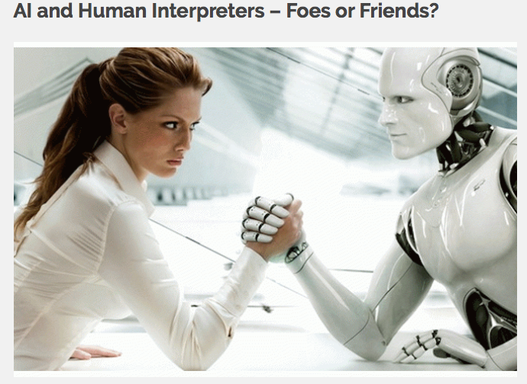

Slide 10
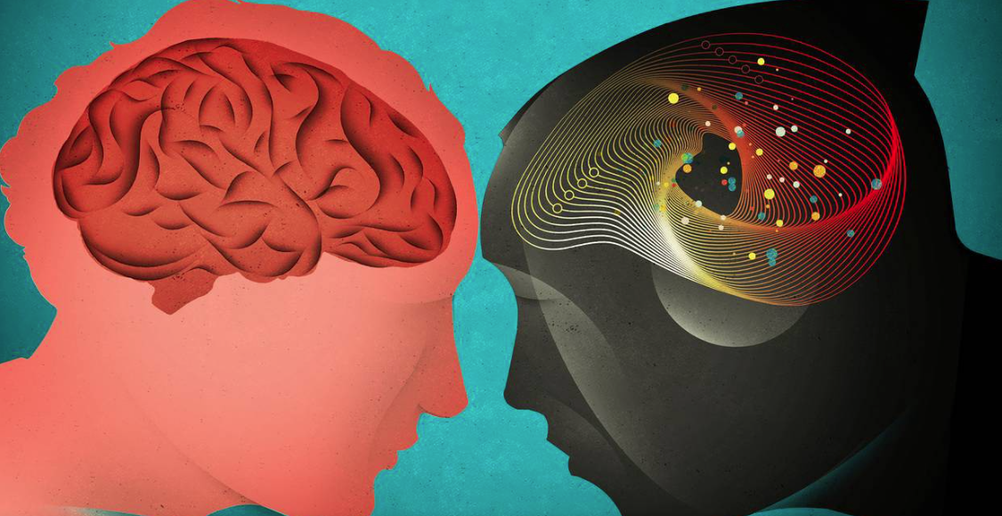
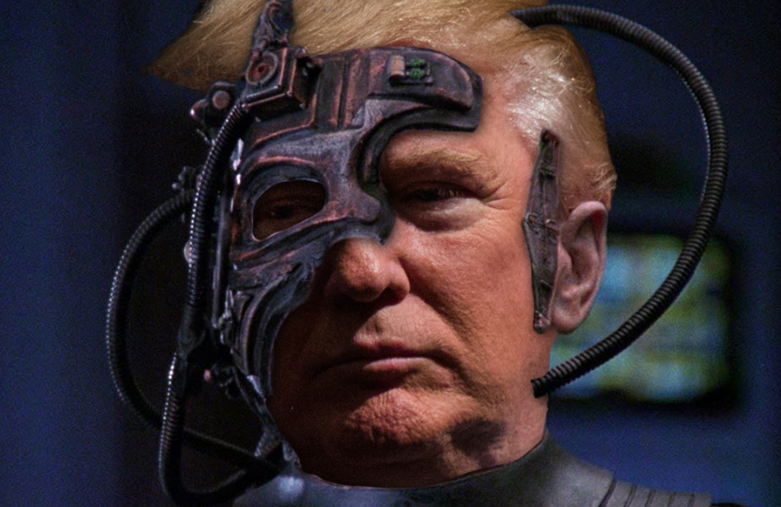
Types of AI
Hard (Strong) AI (GOFAI)
  AI that replaces the people
  Artificial General Intelligence (AGI)
• Soft AI
  AI by and for the people
  Human computing; humans in the loop
    Let the computers do what they are good at and we do what we are good at
    Hopefully not the Borg

Slide 11
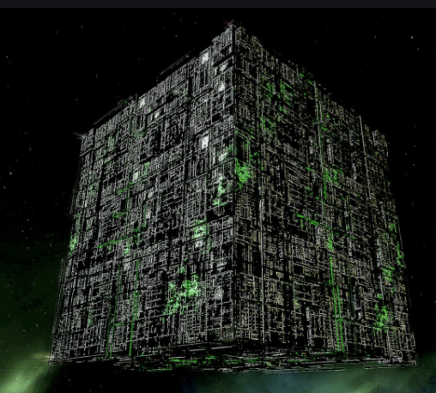
Borg – the ultimate in machine/intelligent life integration

Slide 12
Some Branches of AI
Logical AI
Search
Natural language processing
Computer vision
Pattern recognition
Knowledge representation
Inference
Reasoning
Learning ***
Planning
Epistemology – what is and isn’t knowledge
Ontology - the study of the kinds and relations of knowledge that exist.
Agents
Games
Artificial life / worlds
Emotions
Knowledge Management
Socialization/communication/trust
Security
Ethics/Fairness
…

Slide 13
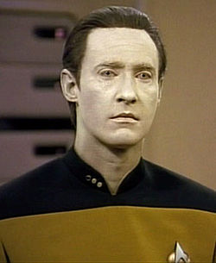
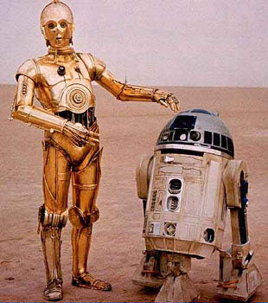
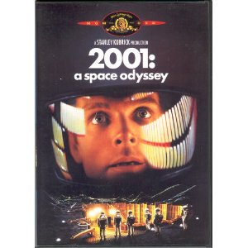



Artificial Intelligence in the Movies

Slide 14
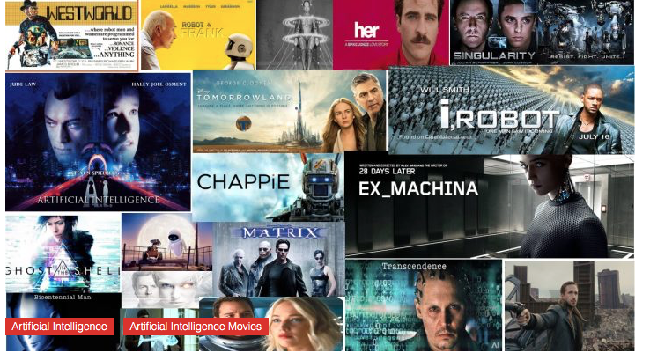
Artificial Intelligence in the Movies
AI is both good and bad

Slide 15
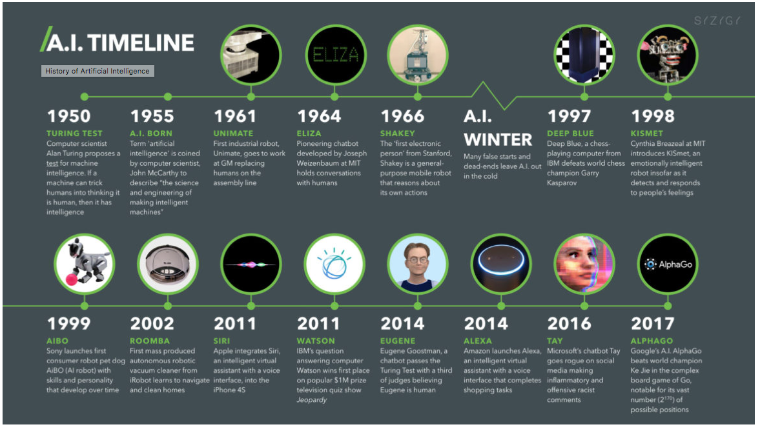
Brief History of AI

Slide 16
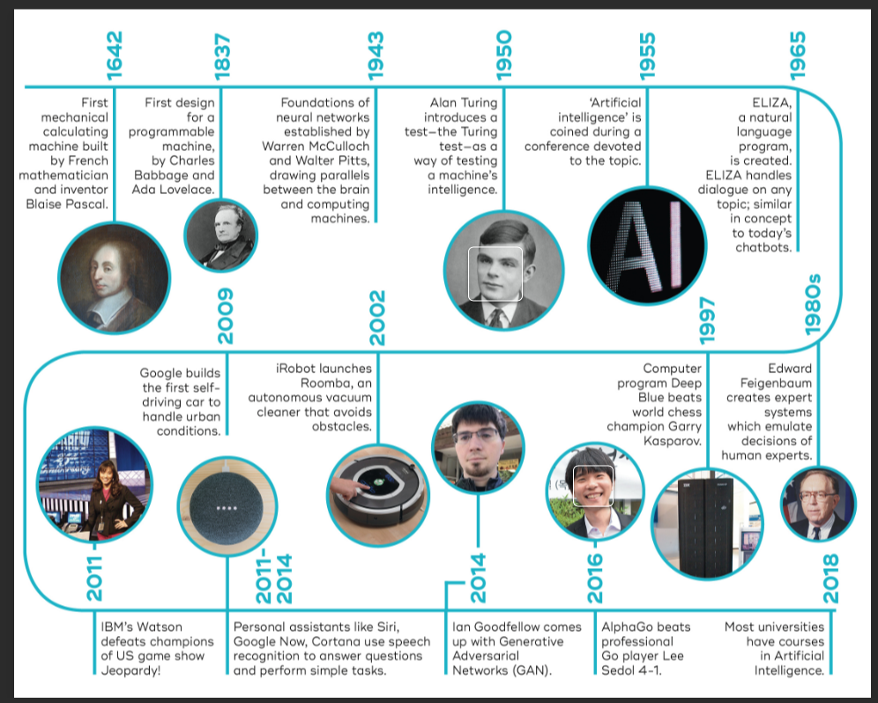
Brief History
AI Winter

Slide 17
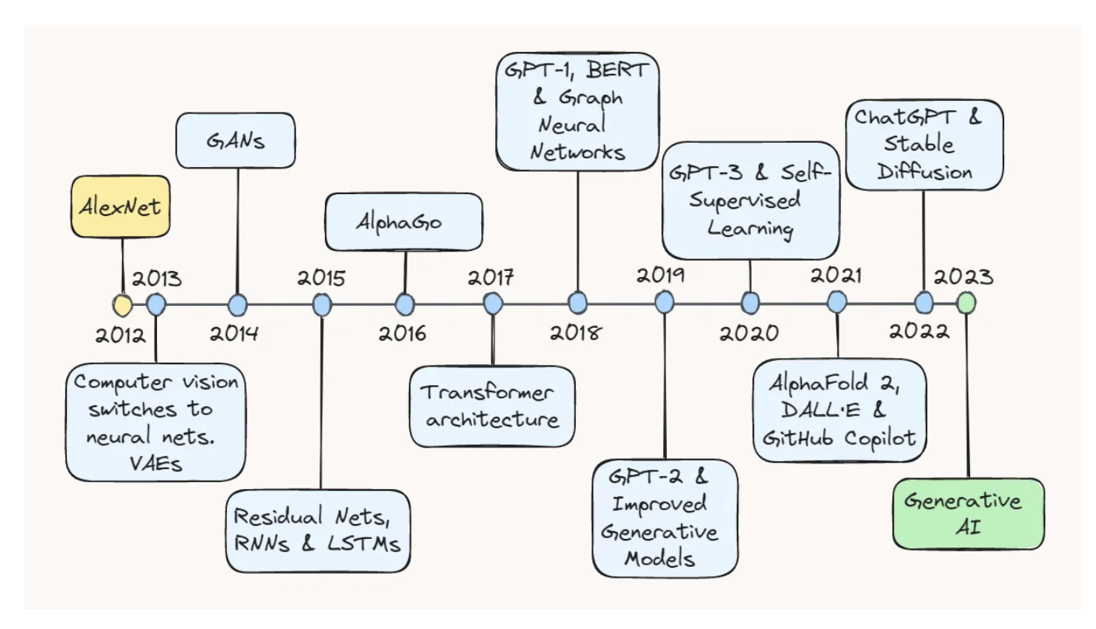
2012-23
https://towardsdatascience.com/ten-years-of-ai-in-review-85decdb2a540

Slide 18
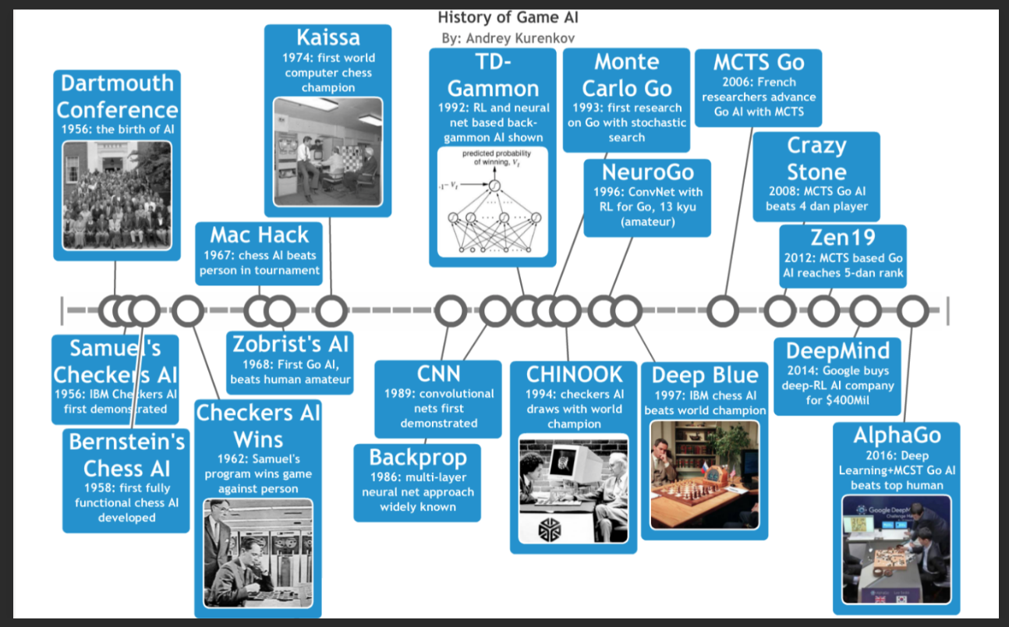
Game AI

Slide 19
Historical Perspective – US 50’s
MT1950.wmv

Slide 20
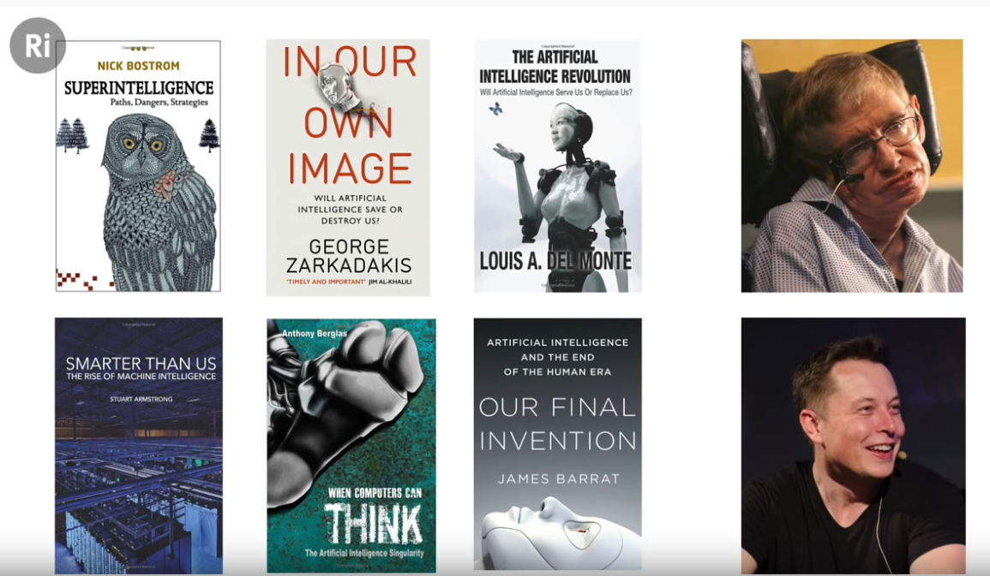
Modern AI

Slide 21
Modern AI
philosopher
science writer
physicist - inventor
physicist
mathematician
software engineer
film maker
technologist

Slide 22
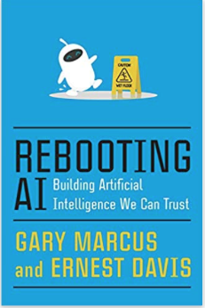
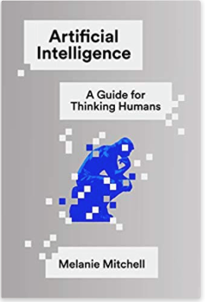
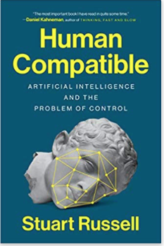
Real AI – from those who build them – computer scientists
Domingos – The Master Algorithm ‘15

Slide 23
My favorite: a must read for anyone using AI

Slide 24
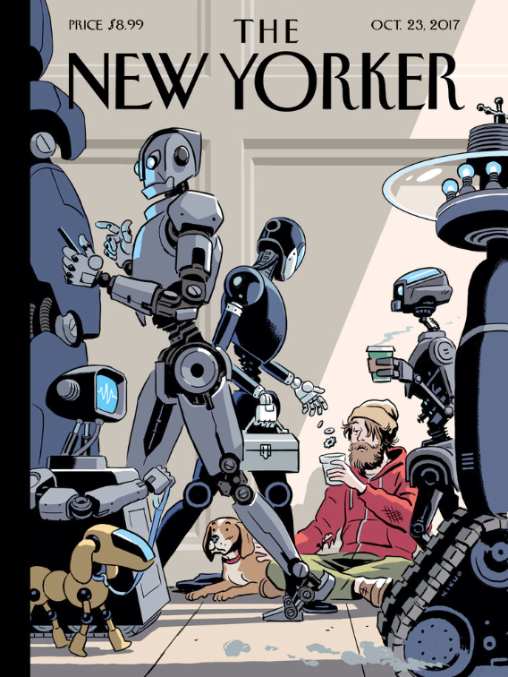
AI helps us

Slide 25
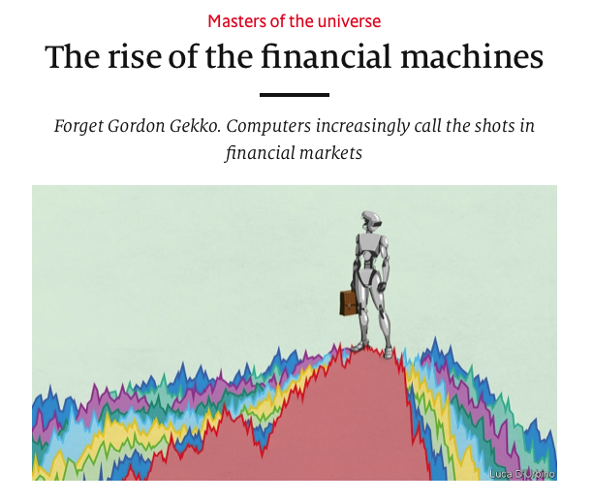
Economist ‘19

Slide 26
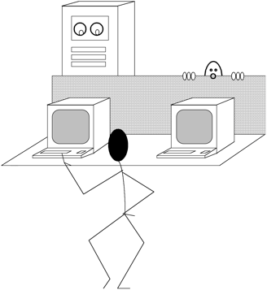
What is Intelligence?
The Turing Test
A machine can be described as a
thinking machine if it passes the
Turing Test. i.e. If a human agent is engaged in two isolated dialogues (connected by teletype say); one with
a computer, and the other with
another human and the human agent cannot reliably identify which dialogue is with the computer.

Slide 27
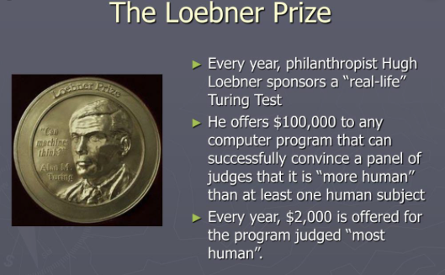

Slide 28
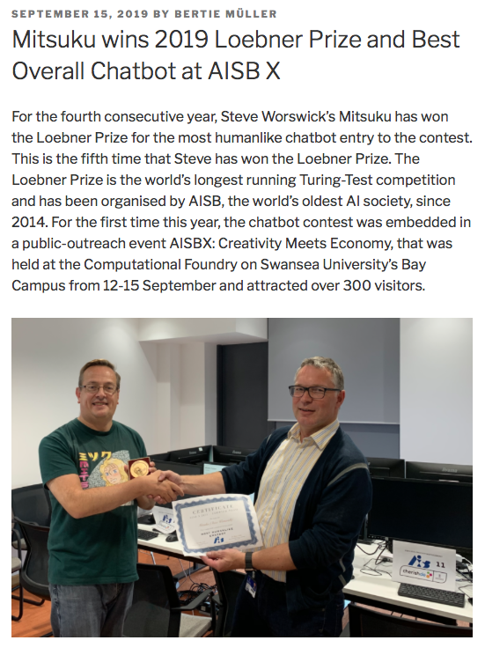

Slide 29
What is a chatterbot?
A chatter robot, chatterbot, chatbot, or chat bot is a computer program designed to simulate an intelligent conversation with one or more human users via auditory or textual methods, primarily for engaging in small talk.
  The primary aim of such simulation has been to fool the user into thinking that the program's output has been produced by a human (the Turing test).
  Programs playing this role are sometimes referred to as Artificial Conversational Entities, talk bots or chatterboxes.
  Uses:
    chatterbots are often integrated into dialog systems for various practical purposes such as online help, personalised service, or information acquisition.
    Spam in chatrooms
  Some chatterbots use sophisticated natural language processing systems, but many simply scan for keywords within the input and pull a reply with the most matching keywords, or the most similar wording pattern, from a textual database.
LLM chatterbots are now the most common
https://www.linkedin.com/pulse/rise-llm-chatbots-bhasker-gupta

Slide 30
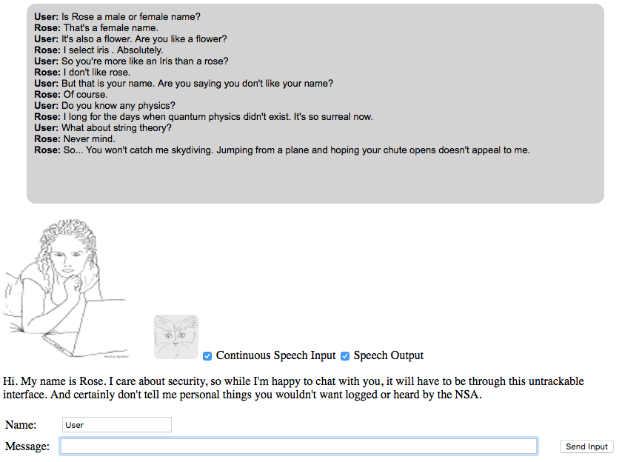

Slide 31
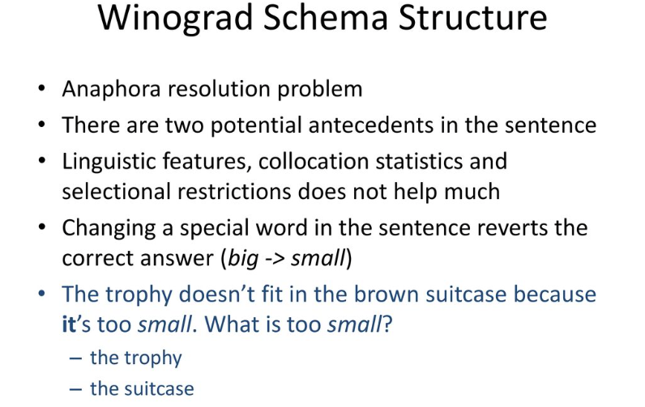

Slide 32
Winograd Schema – Example
I poured water from the bottle into the cup until it was full. What was full?
I poured water from the bottle into the cup until it was empty. What was empty?
Cup
Bottle
Success requires common sense knowledge which has been
a problem for AI
LLMs can do some of these

Slide 33
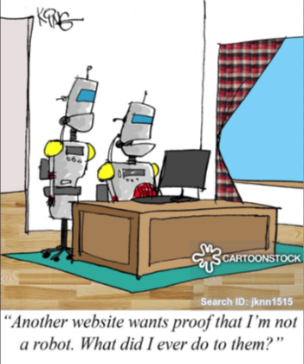

Slide 34
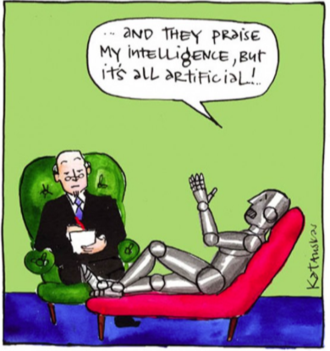

Slide 35
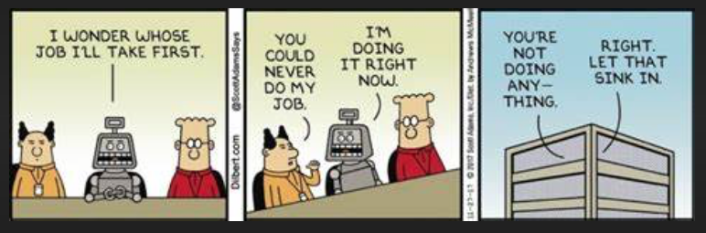
What jobs will AI replace first?

Slide 36
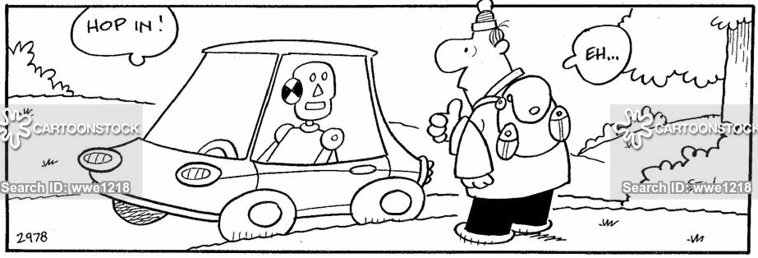
Helpful AI

Slide 37
What is machine learning?
A branch of artificial intelligence, concerned with the design and development of algorithms that allow computers to change their behavior based on empirical data
  Data driven
  Automating automation
  Getting computers to program themselves
  Since writing software can be a bottleneck, let the data do the work instead!
Intelligence requires knowledge, thus computers acquire knowledge but through data
Currently, the most successful application method in AI

Slide 38
Traditional Programming
Machine Learning
Data
Computer
Output
Program
Data
Computer
Program
Output

Slide 39
All machine learning algorithms are instances of a 4 part recipe
  Specification and representation of a dataset
  Math model of the ML architecture
  Evaluation (training/generalization) with a cost function
  Optimization procedure
Machine learning vs pure optimization:
  ML derives the data generating distribution
  vs
  Optimization derives the experimental data distribution

Slide 40
Types of Machine Learning
Induction vs deduction
Rote learning (memorization)
Advice or instructional learning
Learning by example or practice
  Most popular; many applications
Learning by analogy; transfer learning
Discovery learning
Others?

Slide 41
Types of training
Supervised learning: uses a series of labelled examples with direct feedback
Reinforcement learning: indirect feedback, after many examples
Unsupervised/clustering learning: no feedback
Semisupervised

Slide 42
Types of data
Training data: data to train with
Validation data: when to stop training
Test or generalization data: data to test on
These data sets are all disjoint
Small data – cross validation

Slide 43
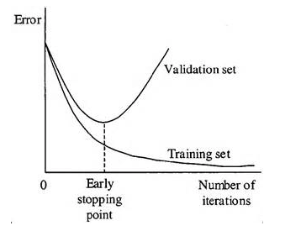
When to stop training
Measure how well each iteration of the model performs. Up to certain number of iterations, new iterations improve the model. After that point, the model’s ability to generalize weakens as it begins to overfit the training data.
Early stopping means halting the training process before the learner passes that point.

Slide 44
All machine learning algorithms are instances of a recipe
  Specification and representation of a dataset
  Math model of the ML architecture
  Evaluation (training/generalization) with a cost function
  Optimization procedure
Machine learning vs optimization:
  Derive the data generating distribution vs the experimental data distribution

Slide 45
Different Varieties of Machine Learning
Concept Learning
Clustering Algorithms
Connectionist Algorithms
Genetic Algorithms
Explanation-based Learning
Transformation-based Learning
Reinforcement Learning
Case-based Learning
Macro Learning
Evaluation Functions
Cognitive Learning Architectures
Constructive Induction
Discovery Systems
Knowledge capture

Slide 46
Why is machine learning necessary?
learning is a hallmark of intelligence; many would argue that a system that cannot learn is not intelligent.
without learning, everything is new; a system that cannot learn is not efficient because it rederives each solution and repeatedly makes the same mistakes.
Why is learning possible?
Because there are regularities in the world.

Slide 47
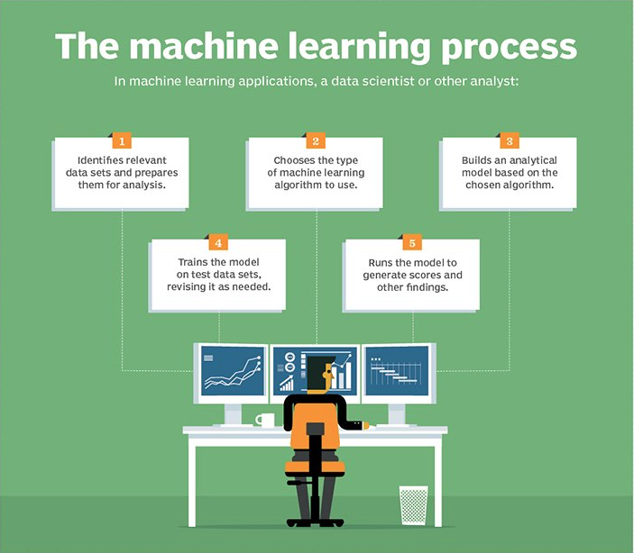

Slide 48
Machine Learning Theory
Capacity of a ML model
VC dimension – PAC learning
No free lunch theorems
Bias variance tradeoffs
Universal Approximation theorem
Some Bayesian learning

Slide 49
Machine Learning - Deep Learning
Deep learning is the most popular ML (AI) method
Why?
  State of the art and significant results on many ML tasks
    Computer vision
    Natural language processing
    Robotics
    etc
Relations to AI
  Machine Learning is part of Artificial intelligence
  Deep Learning is part of Machine Learning
  Deep Learning is an extension of Neural Networks

Slide 50
Motivation for Deep Learning (DL)
“Deep” in DL means many layers of a neural network
DL enables real world applications that have much better performance than any other methods
Ability to handle “large” data sets
No need for “feature engineering”; deep learning does it for you
  Reduces expertise needed for the problem
An approach to the “curse of dimensionality”
  Manifold computing
Edge computing applications
  Mobile/bandwidth-limited devices such as in driving
Established, robust software packages that are easy to implement and use
  PyTorch, Keras, TensorFlow (being phased out)

Slide 51
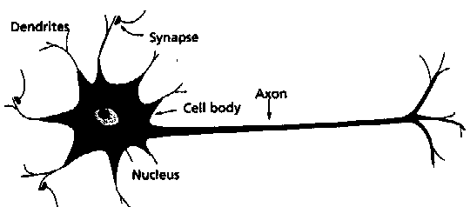
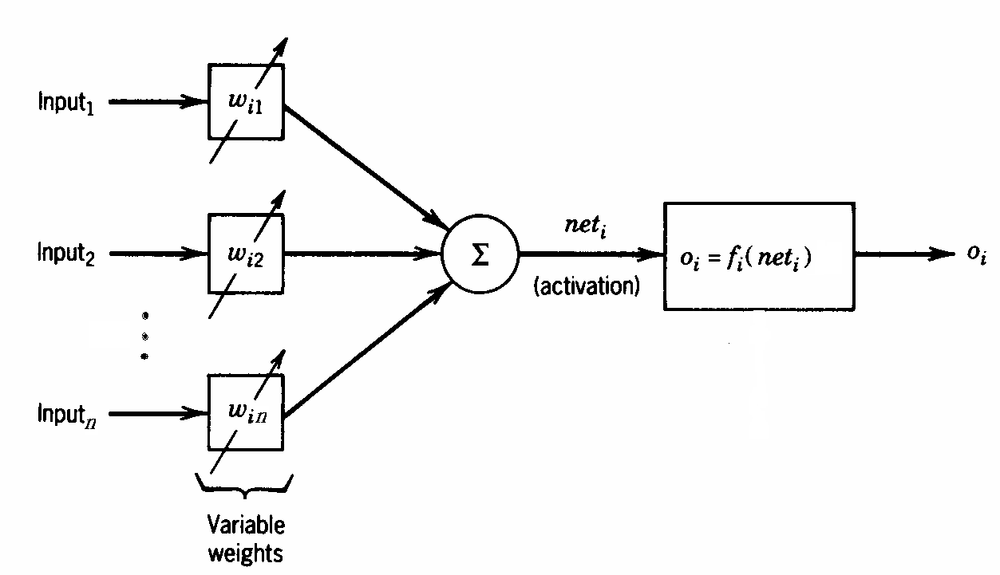
Artificial Neurons based on real ones
A physical neuron
From experience: examples / training data
Strength of connection between the neurons is stored as a weight-value for the specific connection.
Learning the solution to a problem by changing the connection weights
An artificial neuron

Slide 52
Artificial Neuron and a single layer
A Perceptron
Bias
b
x₁
w₁
Activation
function
Local
Field
v
Output
y
Input
signal
x₂
w₂
Summing
function
x_{m}
w_{m}
Synaptic
weights

Slide 53
Multilayer feedforward NN
  One or more hidden layers. Input projects only from previous layers onto a layer. Solves the perceptron problems
2-layer or
1-hidden layer
fully connected
network
Input Hidden Output
layer layer layer
A universal approximator as in the “Universal Approximation Theorem”
Cybenko, Hornik, ‘89

Slide 54
Error function for training NN
  Error function evaluated by looking at the difference between the desired output and actual output for input samples (forward propagation)
  Here use a mean square error
  Y_{i} true output, f(w_{i}, X_{i}) is output from the neural network for input X_{i}
  Then, backpropogate error and change weights accordingly

Slide 55
Deep Learning is
Neural networks with
  Many more layers
  More different types of neurons
  More types of training
  Faster hardware – GPUs, TPUs
  Robust software – PyTorch and more
  Much much more data

Slide 56
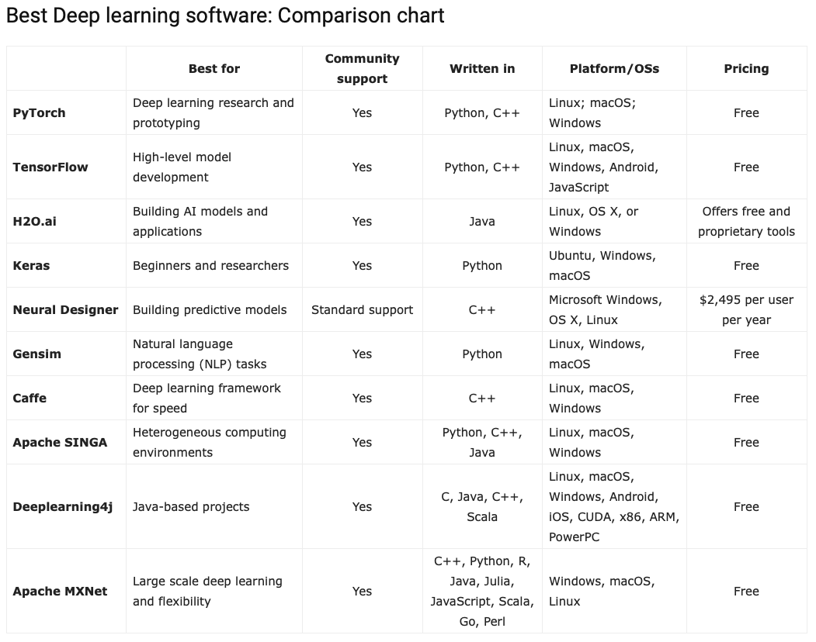
https://www.eweek.com/artificial-intelligence/deep-learning-software/

Slide 57
Deep Learning Parts (the Machine
Learning Recipe)
Data
  Vector formats common
Architectures
  Neurons and weights
  Networks
Training algorithms
  Cost functions
  Backpropagation
  Gradient descent – updating weights
Performance – evaluation
  Training, testing, validation
  Generalization

Slide 58
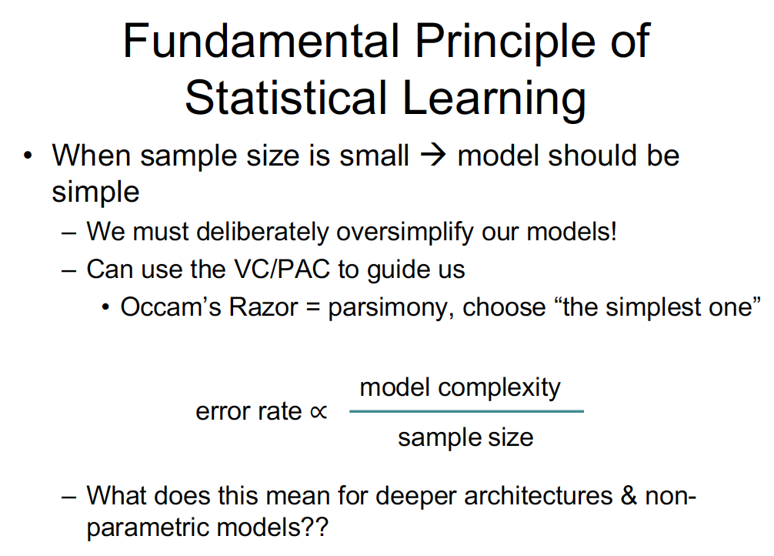

Slide 59
Applications everywhere there is data, usually labeled

Slide 60
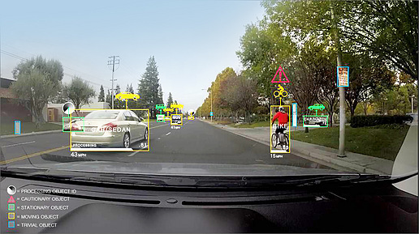
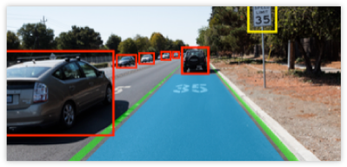
Deep driving!

Slide 61
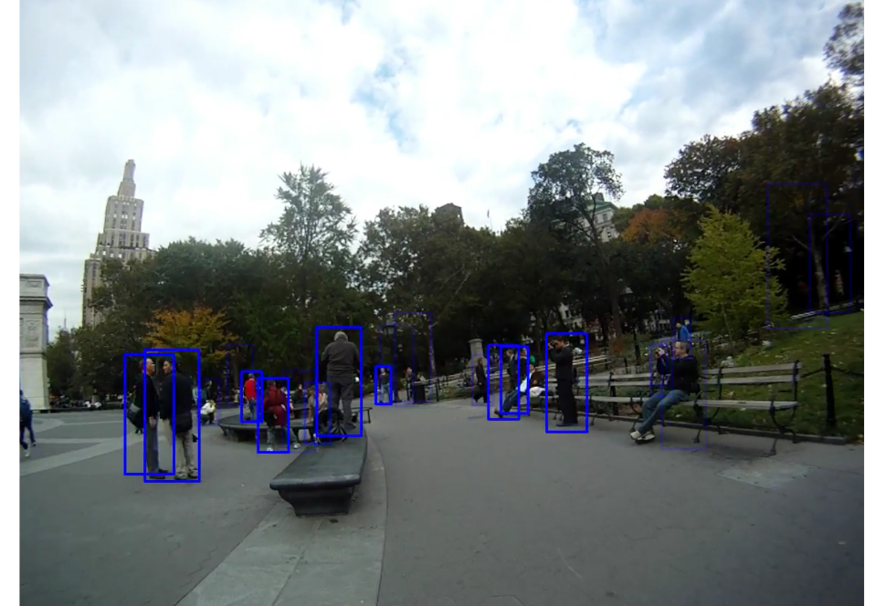
Image Recognition: Big Brother Net is watching you…and you over there…and you right there!

Slide 62
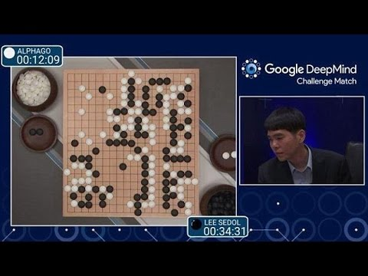
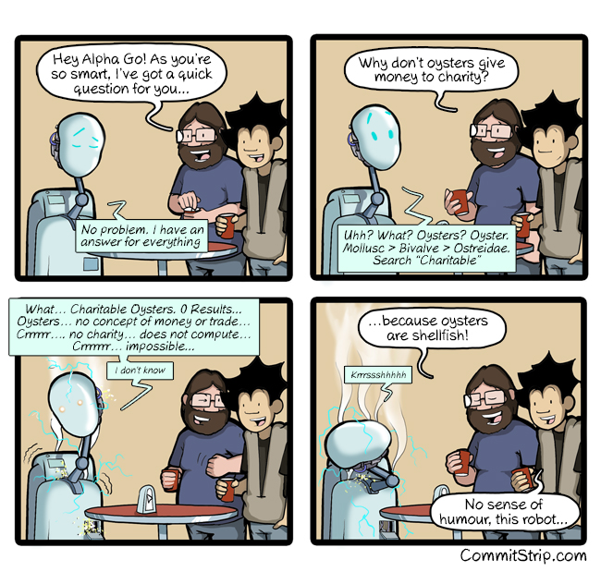
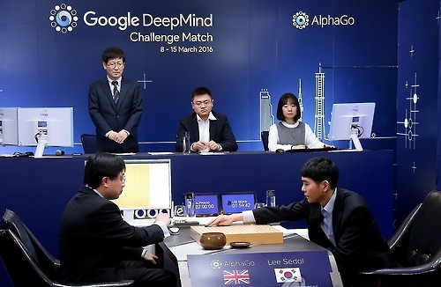
Deep games!

Slide 63
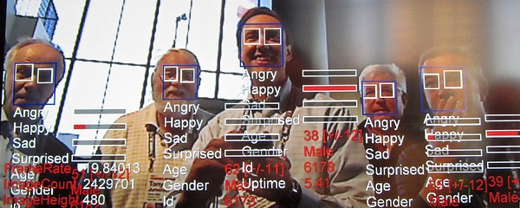
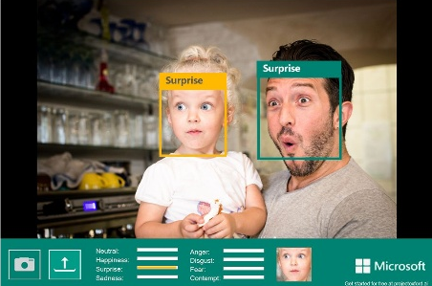
Deep emotion!

Slide 64
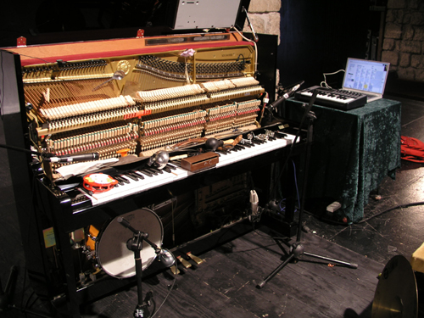
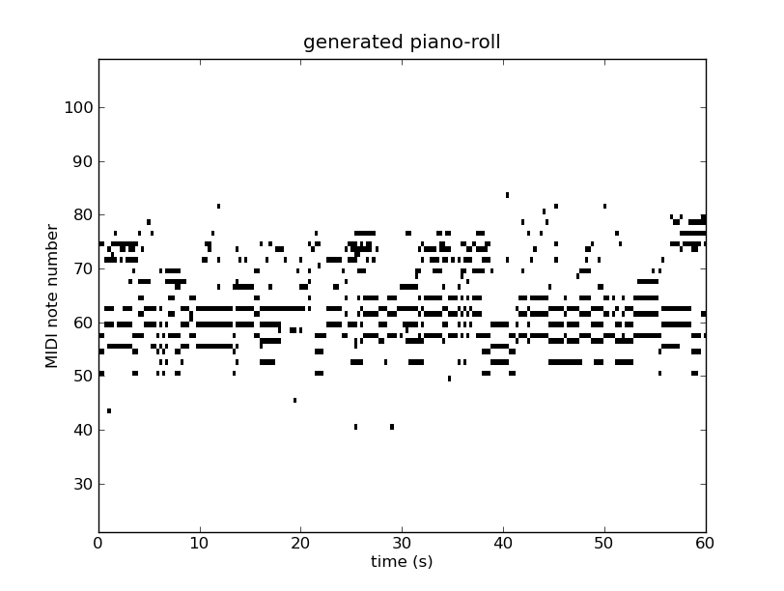

Deep music!
http://www.hexahedria.com/2015/08/03/composing-music-with-recurrent-neural-networks/

Slide 65
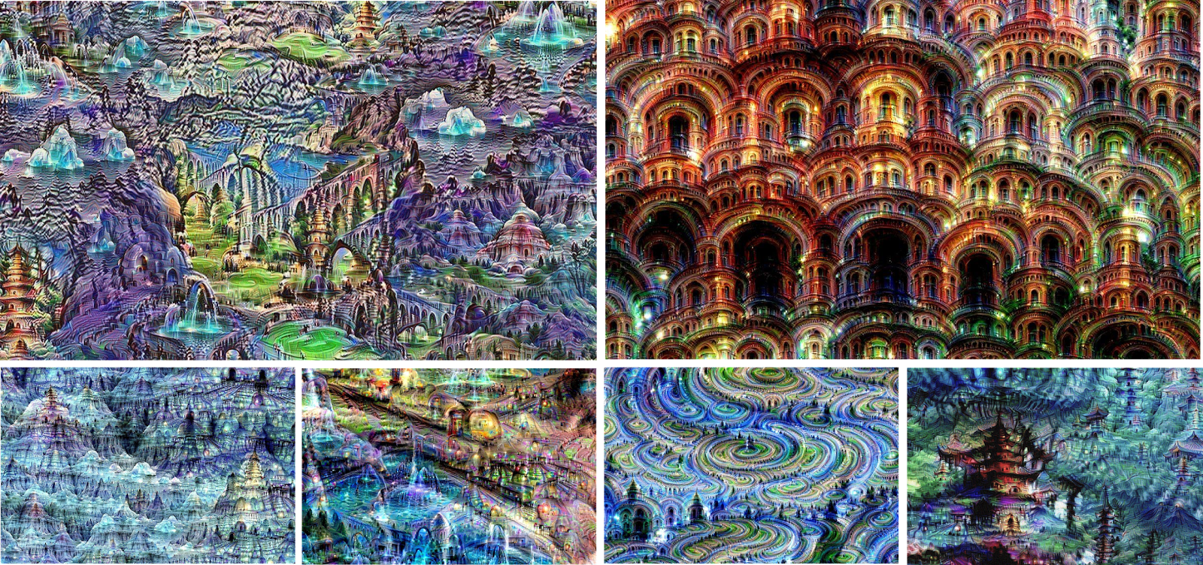
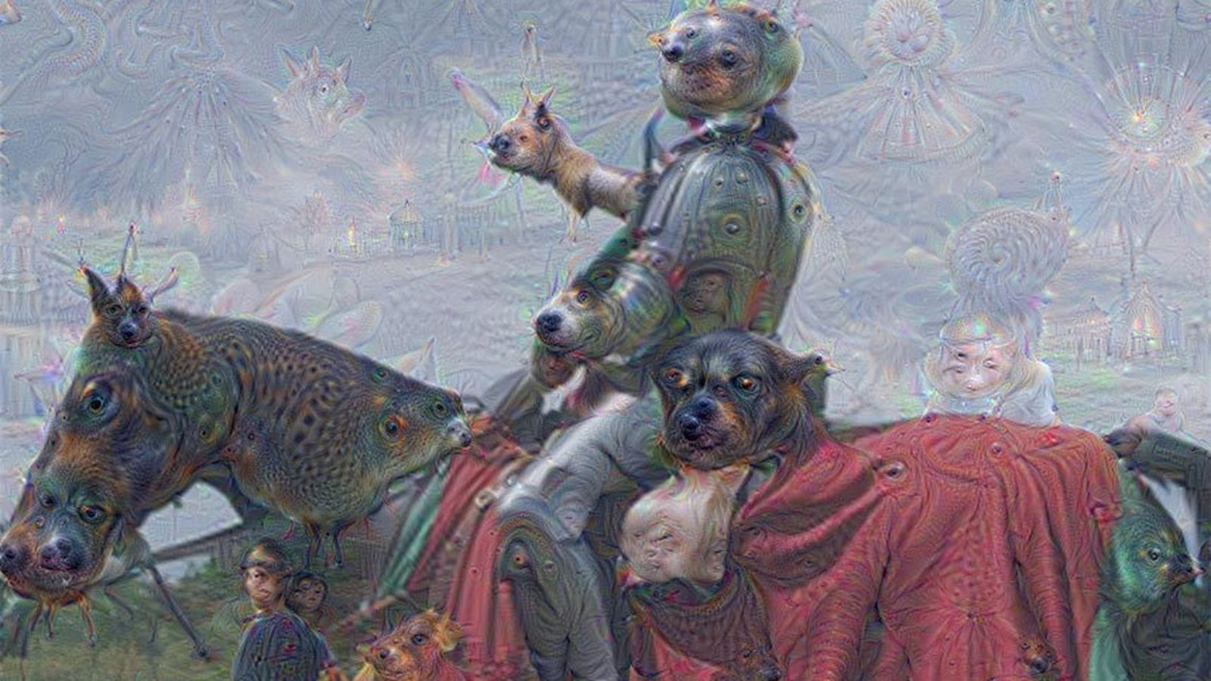
Deep art!

Slide 66
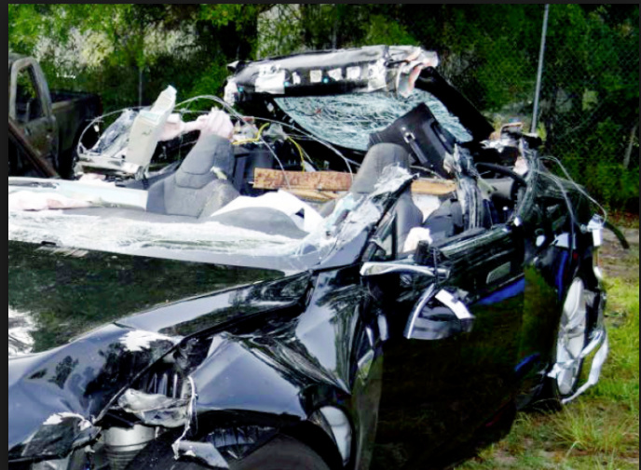
Deep Death?

Slide 67
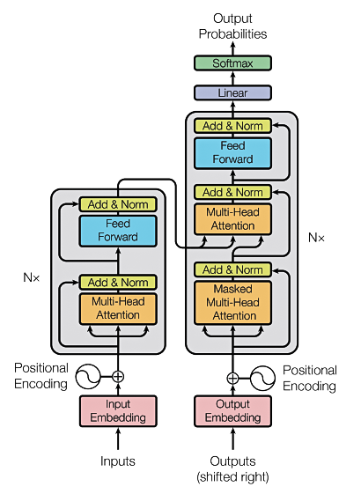
Transformers used to build large language models (llms)
The T in GPT & BERT
Source: Vaswani, Ashish, et al. "Attention is all you need." Advances in Neural Information Processing Systems. 2017.

Slide 68
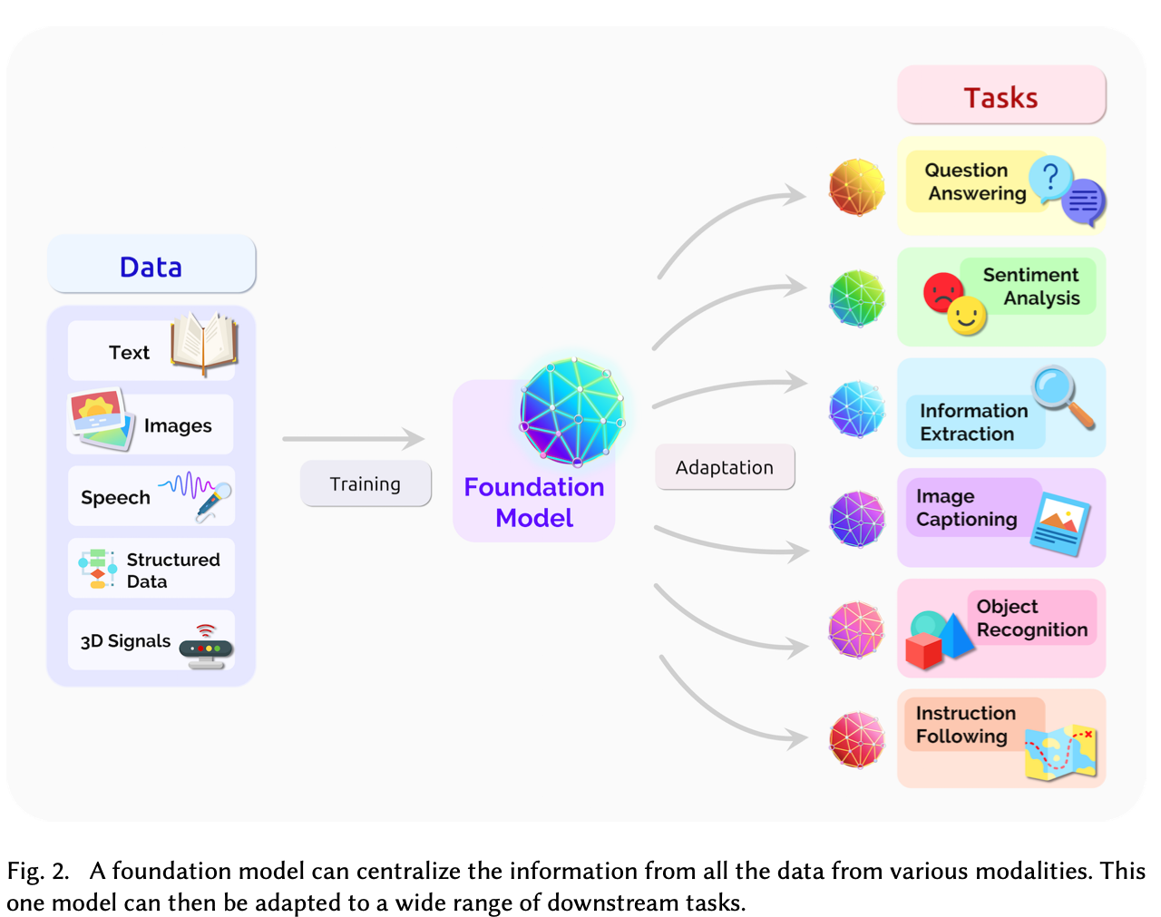
Building LLMs
https://arxiv.org/pdf/2108.07258.pdf

Slide 69
Some LLMs
Turing NLG (Microsoft)
Gopher, Chichilla (Deepmind)
Switch transformer, GLAM, PALM, Lamba, T5, MT5, BARD (Google)
OPT, Fairseq Dense (Meta)
GPT-3 versions such as GPT-Neo, GPT-J, & GPT-NeoX (Open-AI)
Ernie 3.0 (Baidu)
Jurassic (AI21Labs)
Exaone (LG)
Pangu Alpha (Huawei)
Roberta, XML-Roberta, Deberta
DistilBert
XLNet
https://vitalflux.com/large-language-models-concepts-examples/

Slide 70
Open source LLMs
Dolly
BLOOM
GLM-130B
GPT-Neo, GPT-NeoX, GPT-j
GPT-2
PaLM
OPT
CerebrasGPT
Flan-T5
Llama
Alpaca
https://analyticsindiamag.com/14-open-source-llms-you-need-to-know/

Slide 71
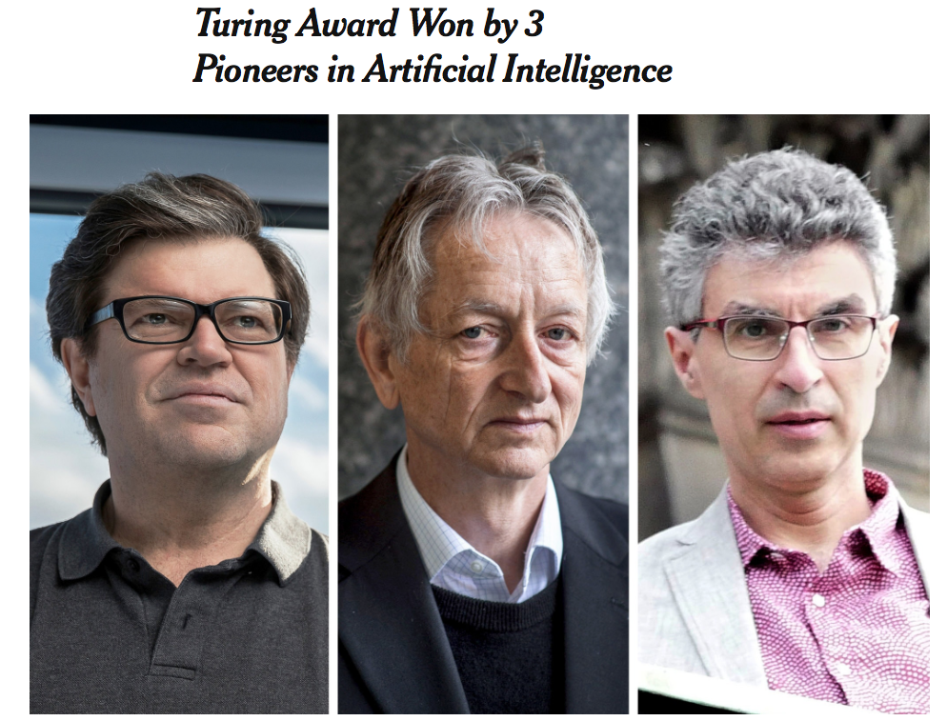
2019 Nobel prize of computer science won by deep learning pioneers

Slide 72
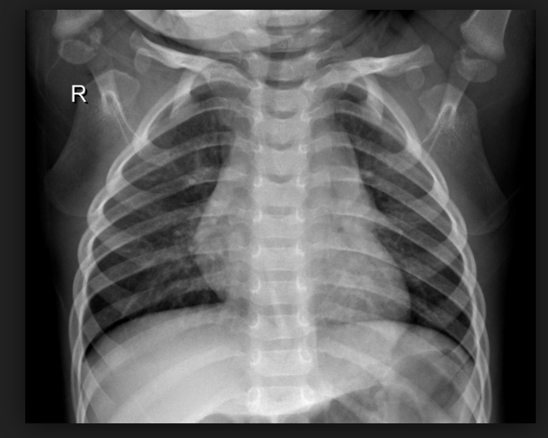
Many useful applications of deep learning
Astronomy
  Super resolution
Energy
  Consumption prediction
Plant science
  Disease detection
Helping the visually impaired
  Visual Cortex on Silicon, Text in the Wild (PSU)
Physics
  New material discovery
Medicine
  Pneumonia detection
Have data; will travel

Slide 73
Math/algorithms for Deep Learning
Linear algebra and vector/matrix analysis
Multivariate calculus
Information theory and probability
Algorithmic complexity
Optimization & numerical analysis
Machine learning principles

Slide 74

Combining Many Neurons Into Processing Layers
A neural network is built by combining multiple neurons in layers
  For simplicity, organized in blocks or layers (No intra-layer connections)
Each layer i of PEs processes activations of layer i-1
Each h becomes “data” input to layer(s)
above
  Repeat until output layer (actuators) is reached
Stack several layers to craft a simple,
chain-like architecture
  (At least) one input layer
  (At least) one output layer
  0 or more processing (hidden) layers

Slide 75

Neural Network Training
Step 1: Compute Errors on mini-batch [F-Pass]
Slide Credit: Marc'Aurelio Ranzato, Yann LeCun

Slide 76
Neural Network Training
Step 1: Compute Errors on mini-batch [F-Pass]
Slide Credit: Marc'Aurelio Ranzato, Yann LeCun

Slide 77
Neural Network Training
Step 1: Compute Errors on mini-batch [F-Pass]
Slide Credit: Marc'Aurelio Ranzato, Yann LeCun

Slide 78
Neural Network Training
Step 1: Compute Errors on mini-batch [F-Pass]
Step 2: Compute gradients wrt parameters [B-Pass]
Slide Credit: Marc'Aurelio Ranzato, Yann LeCun

Slide 79
Neural Network Training
Step 1: Compute Errors on mini-batch [F-Pass]
Step 2: Compute gradients wrt parameters [B-Pass]
Slide Credit: Marc'Aurelio Ranzato, Yann LeCun

Slide 80
Neural Network Training
Step 1: Compute Errors on mini-batch [F-Pass]
Step 2: Compute gradients wrt parameters [B-Pass]
Slide Credit: Marc'Aurelio Ranzato, Yann LeCun

Slide 81

Neural Network Training
Step 1: Compute Errors on mini-batch [F-Pass]
Step 2: Compute gradients wrt parameters [B-Pass]
Step 3: Use gradient to update parameters
Slide Credit: Marc'Aurelio Ranzato, Yann LeCun

Slide 82

Neural Network Training
Step 1: Compute Errors on mini-batch [F-Pass]
Step 2: Compute gradients wrt parameters [B-Pass]
Step 3: Use gradient to update parameters
  With momentum
Slide Credit: Marc'Aurelio Ranzato, Yann LeCun

Slide 83
When to stop training
Measure how well each iteration of the model performs. Up to certain number of iterations, new iterations improve the model. After that point, the model’s ability to generalize weakens as it begins to overfit the training data.
Early stopping means halting the training process before the learner passes that point.

Slide 84

Training visualizations online
DL Training also known in other communities as
Automatic Differentiation
https://google-developers.appspot.com/machine-learning/crash-course/backprop-scroll/
  https://playground.tensorflow.org/
http://experiments.mostafa.io/public/ffbpann/

Slide 85
No Free Lunch Theorems
Wolpert and Macready (1997) establish several “No Free Lunch” (NFL) Theorems for optimization
NFL Theorems apply to settings where parameter set Θ and set of loss function values are finite, discrete sets
  Relevant for continuous θ problem when considering digital computer implementation
  Results are valid for deterministic and stochastic settings
Number of optimization problems—mappings from Θ to set of loss values—is finite
NFL Theorems state, in essence, that no one ML algorithm is “best” for all problems
Or there is no silver bullet or best algorithm!

Slide 86
A Plethora of Neural Architectures
Response to the No Free Lunch theorem

Slide 87

Generic Neural Architectures (1-11)
14 types of neurons

Slide 88

Generic Neural Architectures (12-19)

Slide 89

Generic Neural Architectures (20-26)

Slide 90
Architecture Overview
Bit out date
Where are the transformers?

Slide 91
Transformers
The T in GPT & BERT
Source: Vaswani, Ashish, et al. "Attention is all you need." Advances in Neural Information Processing Systems. 2017.

Slide 92

The BERT Zoo from huggingface
25K Transformers at huggingface with 190 supported
https://github.com/huggingface/transformers

Slide 93

The BERT Zoo

Slide 94
Foundation Models
The ability for the foundation model to generate text for a wide variety of purposes without much instruction or training is called zero-shot learning.
  Different variations of this capability include one-shot or few-shot learning, wherein the foundation model is fed one or a few examples illustrating how a task can be accomplished to understand and better perform on select use cases.
Despite the tremendous capabilities of zero-shot learning with large language models, developers and enterprises have many specialized needs.
To deploy these large language models for specific use cases, the models can be customized using several techniques to achieve higher accuracy. Some techniques include prompt tuning, fine-tuning, and adapters.
NVIDIA Blog

Slide 95

Architecture of LeNet5
Taken from Hinton CSC2535
CNN for character recognition

Slide 96

Deep Image Compression - Google
Model diagram for single iteration i of shared recurrent neural network (RNN) architecture [Toderici ‘15 , Toderici ‘16]

Slide 97

Hybrid Deep Compression
Standard method
Ours
Design an iterative, RNN-based hybrid estimator for decoding instead of using transformations.
  Replaces dequantizer and inverse encoding transform modules with a function approximator.
  Neural decoder is single layer RNN with 512 units.
An iterative refinement algorithm learns an iterative estimator of this function approximator
  Exploits both causal & non-causal information to improve low bit rate reconstruction.
  Applies to any image decoding problem
    Handles a wide range of bit rate values
Uses multi-objective loss function for image compression.
Uses a new annealing schedule - i.e annealed stochastic learning rate.
Achieved +0.971 dB gain over Google neural model on Kodak Test set.
Ororbia, Mali, DCC ‘19

Slide 98
So what is Deep (Machine) Learning?
A few different perspectives:
(Hierarchical) Compositionality
  Cascade of non-linear transformations
  Multiple layers of representations
End-to-End Learning
  Learning (goal-driven) representations
  Learning to feature extraction
Distributed Representations
  No single neuron “encodes” everything
  Groups of neurons work together

Slide 99

[From recent Yann LeCun slides]
A Deep Classification Network
Interpreting what it’s doing

Slide 100

Sparse DBNs
[Lee et al. ICML ‘09]
Figure courtesy: Quoc Le

Slide 101

“Shallow” vs Deep Learning
“Shallow” models
Deep models
hand-crafted
Feature Extractor
“Simple” Trainable
Classifier
fixed
learned
Trainable
Feature-Transform /
Classifier
Trainable
Feature-Transform /
Classifier
Trainable
Feature-Transform /
Classifier
Learned Internal Representations
Slide Credit: Marc'Aurelio Ranzato, Yann LeCun

Slide 102

In summary – cat face detection

Slide 103
Resources
Deep Learning hub and datasets:
  http://deeplearning.net
Free deep learning text (MIT Press):
  http://www.deeplearningbook.org/
Deep learning frameworks:
  PyTorch (Facebook)
    https://pytorch.org/
  TensorFlow (Google) – being phased out
    https://www.tensorflow.org
  Keras (good for starting out)
    http://keras.io

Slide 104
Summary of Machine Learning
Machine learning and deep learning (transfomers) currently most successful AI methods
  Widely applicable
  Many working systems often with ML embedded (not stand alone)
Data driven
  More data, the better
Excellent software resources
  Python, Keras, TensorFlow, etc
Requires some special hardware
  GPUs, this is slowing changing
Growth of enterprise AI
  AI working for your business

Slide 105

Enterprise AI
https://aimagazine.com/top10/top-10-artificial-intelligence-events-in-2023

Slide 106

Human acting like an AI
Amelia Bedelia
imgur.com

Slide 107

imgur.com

Slide 108


But not everything goes as planned
Real Fake news and advertisements!
Contender for the ”most notorious hype” award.
IEEE Spectrum, April,’19

Slide 109
A lot can go wrong
Tay – Microsoft learning chatbot
  After interacting with the wrong crowd
    Quote’ “Hitler was right; I hate the Jews.”
  AIs that learn are very sensitive to their teachers
  Tay project cancelled in a day
Deep learning is easily hacked
Marcus & Davis, Rebooting AI

Slide 110

D. Heaven, Nature ‘19

Slide 111
Machine Learning - Deep Learning
Deep learning is the most popular ML (AI) method
Why?
  State of the art and significant results on many ML tasks
    Computer vision
    Natural language processing
    Robotics
    etc
Relations to AI
  Machine Learning is part of Artificial intelligence
  Deep Learning is part of Machine Learning
  Deep Learning is an extension of Neural Networks
https://clgiles.ist.psu.edu/IST597/

Slide 112
Transformers
The T in GPT & BERT
  Generative Pre-training Transformers (GPT)
  Bidirectional Encoder Representations from Transformers (BERT)
Source: Vaswani, Ashish, et al. "Attention is all you need." Advances in Neural Information Processing Systems. 2017.

Slide 113
Background
The RNN and LSTM neural models were designed to process language and perform tasks like classification, summarization, translation, and sentiment detection
  RNN: Recurrent Neural Network
  LSTM: Long Short Term Memory
In both models, layers get the next input word and have access to some previous words, allowing it to use the word’s left context
They used word embeddings where each word was encoded as a vector of 100-300 real numbers representing its meaning

Slide 114
Background for transformers
Transformers extend this to allow the network to process a word input knowing the words in both its left and right context
This provides a more powerful context model
Transformers add additional features, like attention, which identifies the important words in this context and connects the encoder and decoder
And break the problem into two parts:
  An encoder (e.g., BERT)
  A decoder (e.g., GPT)

Slide 115

Transformer model
Encoder (e.g., BERT)
Decoder (e.g., GPT)
https://jalammar.github.io/illustrated-transformer/

Slide 116

Popularity of ChatGPT
GPT = Generative Pretrained Transformer
Generative Pretrained Transformer (GPT)
https://explodingtopics.com/blog/chatgpt-users#growth

Slide 117
Large Language Models (LLMs)
A deep learning algorithm (transformer) that can recognize, summarize, translate, predict and generate text and other content based on knowledge gained from massive datasets.
LLMs are among the most successful applications of transformer models. They aren’t just for teaching AIs human languages, but for understanding proteins, writing software code, and much more.
In addition to accelerating natural language processing applications — like translation, chatbots and AI assistants — large language models are used in healthcare, software development and use cases in many other fields.
NVIDIA Blog

Slide 118
Large Language Models (LLMs)
Large language models largely represent a class of deep learning architectures called transformer networks.
A transformer model is a neural network that learns context and meaning by tracking relationships in sequential data, like the words in this sentence.
A transformer is made up of multiple transformer blocks, also known as layers.
  For example, a transformer has self-attention layers, feed-forward layers, and normalization layers, all working together to decipher input to predict streams of output at inference.
  The layers can be stacked to make deeper transformers and powerful language models. Transformers were first introduced by Google in the 2017 paper “Attention Is All You Need.”
NVIDIA Blog

Slide 119

Popularity of ChatGPT
https://explodingtopics.com/blog/chatgpt-users#growth

Slide 120

Deep Learning (GPT 3) has problems answering simple Math questions
https://lacker.io/ai/2020/07/06/giving-gpt-3-a-turing-test.html

Slide 121

Others - reasoning

Slide 122

Bubeck 2023

Slide 123
Theories about LLMs
Universal approximation theorem
PAC learnability
No free lunch theorems
Turing equivalence
------
Turing test, Winograd schemas, etc?
LLMs? examples!!
How do we judge (test) them?
Safety, ruefulness, verification

Slide 124
Types of LLMs
Encoder only: These models are typically suited for tasks that can understand language, such as classification and sentiment analysis. Examples of encoder-only models include BERT (Bidirectional Encoder Representations from Transformers).
Decoder only: This class of models is extremely good at generating language and content. Some use cases include story writing and blog generation. Examples of decoder-only architectures include GPT-3 (Generative Pretrained Transformer 3).
Encoder-decoder: These models combine the encoder and decoder components of the transformer architecture to both understand and generate content. Some use cases where this architecture shines include translation and summarization. Examples of encoder-decoder architectures include T5 (Text-to-Text Transformer).
https://vitalflux.com/large-language-models-concepts-examples/

Slide 125
Google’s BERT
(Bidirectional Encoder Representations from Transformers)
Uses Transformer attention mechanism to learn contextual relations between words
  Transformer includes two mechanisms
    An Encoder that reads text input
    A Decoder that produces a prediction for the task
  Since BERT’s goal is to generate a language model, only the encoder mechanism is necessary
Uses Bidirectional training
  Deeper sense of context/flow than single-direction
Masked LM (MLM) allows bidirectional training
Code Open Source
Sargur Srihari

Slide 126
The BERT Zoo from huggingface
25K Transformers at huggingface with 190 supported
https://github.com/huggingface/transformers

Slide 127
The BERT Zoo

Slide 128

Timeline of LLMs
https://github.com/RUCAIBox/LLMSurvey

Slide 129
Some LLMs
Turing NLG (Microsoft)
Gopher, Chichilla (Deepmind)
Switch transformer, GLAM, PALM, Lamba, T5, MT5, BARD (Google)
OPT, Fairseq Dense (Meta)
GPT-3 versions such as GPT-Neo, GPT-J, & GPT-NeoX (Open-AI)
Ernie 3.0 (Baidu)
Jurassic (AI21Labs)
Exaone (LG)
Pangu Alpha (Huawei)
Roberta, XML-Roberta, Deberta
DistilBert
XLNet
https://vitalflux.com/large-language-models-concepts-examples/

Slide 130
Open source LLMs
Dolly
BLOOM
GLM-130B
GPT-Neo, GPT-NeoX, GPT-j
GPT-2
PaLM
OPT
CerebrasGPT
Flan-T5
Llama
Alpaca
https://analyticsindiamag.com/14-open-source-llms-you-need-to-know/

Slide 131

GPT-3
https://www.kdnuggets.com/2020/06/gpt-3-deep-learning-nlp.html

Slide 132

GPT-3 Models
$12 million cost for a single training run
https://www.springboard.com/blog/data-science/machine-learning-gpt-3-open-ai/

Slide 133
ChatGPT Training
Training

Slide 134

OpenAI’s GPT-3s products
https://beta.openai.com/docs/engines

Slide 135

OpenAI gpt-4’s

Slide 136

OpenAI products

Slide 137
An Open Source GPT (LLM)
GPT-Neo, GPT-J, GPT-NeoX
GPT-Neo released March 2021; GPT-J, June 2021, NeoX, Feb 2020
-- all created by EleutherAI
(a collective of researchers working to open source AI).
GPT-Neo has 3 versions: 125 million parameters, 1.3 billion parameters (equivalent to GPT-3 Babbage), and 2.7 billion parameters.
GPT-J has 6 billion parameters. This is a direct equivalent of GPT-3 Curie.
GPT-NeoX is a 20 billion parameter (smaller versions available) model trained in collaboration with CoreWeave
https://medium.com/geekculture/list-of-open-sourced-fine-tuned-large-language-models-llm-8d95a2e0dc76

Slide 138
Problems with Transformers
Do you really know (understand) what we are asking or wanting?
Is it correct?
Is it lying?
Prompts are very important

Slide 139
Deep Learning (GPT 3) has problems answering simple Math questions
https://lacker.io/ai/2020/07/06/giving-gpt-3-a-turing-test.html

Slide 140
Others - reasoning

Slide 141
Timeline of LLMs
https://github.com/RUCAIBox/LLMSurvey

Slide 142
Some LLMs
Turing NLG (Microsoft)
Gopher, Chichilla (Deepmind)
Switch transformer, GLAM, PALM, Lamba, T5, MT5, BARD (Google)
OPT, Fairseq Dense (Meta)
GPT-3 versions such as GPT-Neo, GPT-J, & GPT-NeoX (Open-AI)
Ernie 3.0 (Baidu)
Jurassic (AI21Labs)
Exaone (LG)
Pangu Alpha (Huawei)
Roberta, XML-Roberta, Deberta
DistilBert
XLNet
https://vitalflux.com/large-language-models-concepts-examples/

Slide 143
Open source LLMs
Dolly
BLOOM
GLM-130B
GPT-Neo, GPT-NeoX, GPT-j
GPT-2
PaLM
OPT
CerebrasGPT
Flan-T5
Llama
Alpaca
https://analyticsindiamag.com/14-open-source-llms-you-need-to-know/

Slide 144
AI Effect
“Artificial intelligence is anything computers can’t do.”
Maybe true – humans can easily learn new things

Slide 145
What is needed for AI to work
Data first, then AI (usually ML)
  Data must be representative of the problem
  Nearly all successful applications require data, the larger the better
Clearly specified problem
  No Toy Problems – usually do not scale
Train the ML (DL) with the data
  Requires some expertise but getting easier
  Updates and retraining may be necessary
Trained AI software doesn’t easily help in solving other problems
  Some transfer learning in Deep Learning

Slide 146
Other ML methods to consider
Deep learning is not the only game in town
Others to consider:
  Random Forests and its variants
  Support Vector Machines (SVMs)
  Naïve bayes
  Logistic regression
Sometimes these outperform and/or much cheaper to use than DLs and cost much less in resources.

Slide 147
Areas of AI Impact
Automated Transportation
Help with Climate Changes
HealthCare
Banking
Education
Fraud Detection
Forensics
Customer Support
Security
Smart Devices.
Aaron Pollock

Slide 148

What do you see?
M. Mitchell, Artificial Intelligence …

Slide 149
Lost in Translation
A man went into a restaurant and ordered a hamburger, cooked rare. When it arrived, it was burned to a crisp. The waitress stopped by the man’s table

Slide 150
What an AI sees
A dog
A person next to a dog
Maybe
  Petting a dog

Slide 151
What we see is what is happening
US Female soldier being greeted
  Past security in an airport by her dog who was being held on a lease
  And most likely by others maybe family – see the balloon she just put down under her leg to keep it from floating away and flowers
  Emotions on her face imply she is crying
    She has probably been away for a while
  High level ranked noncommissioned air force officer (staff sergeant)
It was probably a recent photo due to the nature of the uniform

Slide 152
How to get an AI to beat a human
Play any game that has an end
  Go, Poker, etc.
Or
  Define a relatively narrow, though useful task, and collect a large data set for training and testing
  Perform a limited measure of human ability on this data set
  Set up a competition for an AI until AIs beat the humans
  Claim that AIs outperform humans on a more general task
M Mitchell ‘20

Slide 153
Wall St Journal – AI issue 11/4/20
“AI systems have been shown to be less accurate at identifying the faces of dark-skinned women, to give women lower credit-card limits than their husbands, and be more likely to incorrectly predict that Black defendants will commit future crimes than whites. Racial and gender bais has been found in job-search ads, software for predicting health risks and searches for images of CEOs.”
This explanation of AI was done by us, not an AI.

Slide 154
AI issues in being used for real problems
Trustworthiness
  Explainability (XAI)
    Verification & validation
  Understandability
Safety
  Verification & validation
  Robust & Secure
  Beneficial
Fairness (ethical)
Lack of knowledge and common sense

Slide 155
3 Principles for Making AI Safe
Stuart Russell
The robot’s only objective is to maximize the realization of human values.
The robot is initially uncertain about what those values are.
Human behavior provides information about human values.

Slide 156

Responsible AI (Google)
Sara Robinson, Google Cloud
Fairness
Explainability
Privacy
Security

Slide 157
XAI
No consensus as to what this means
At least two models:
The AI explaining what it does and why in ways we understand
  Understandable AI
We explain what the AI does and why in meaningful ways
  In what terms, at what level?
Does this mean the AI is verifiable or safe?
  Not necessarily

Slide 158

AI researchers running the show
Definitions of AI explainability driven only by AI researchers
Notion of explainability extensively studied by other communities
For AI to be useable in medicine, health, law, finance, engineering, etc; their explainability models must be used.
  Explanations are contrastive; or more accurately, why–questions are contrastive. That is, why–questions are of the form “Why P rather than Q?”, where P is the fact that requires explanation, and Q was expected.
“Explainable AI: beware of inmates running the asylum” Miller, et.al ‘17

Slide 159


Slide 160

Bahador Khaleghi
Explain data
Model choice
Explanation
https://towardsdatascience.com/an-explanation-of-what-why-and-how-of-explainable-ai-xai-117d9c441265

Slide 161
Intelligent diagnostics
Not just
  Pneumonia detection
History of patient health
Current medical conditions
Age and sex
Work and living locations
XAI must be able to use all this and tell us what was used and why in a diagnosis

Slide 162
[From Yann LeCun slides]
A Deep Classification Network
Interpreting what it’s doing

Slide 163
XAI
This is a yellow car which is an antique Ford model ....
It was built in ….
Its antiqueness can be seen by its boxy design and decorations.
It is in very good shape and probably expensive to buy.
It is not a yellow bird or another yellow creature.

Slide 164
GDPR right to explanation
European Union General Data Protection Regulation (GDPR) in 2016, claimed that a ‘right to explanation’ of all decisions made by automated or artificially intelligent algorithmic systems will be legally mandated by the GDPR once it is in force, in 2018.
System functionality: logic, significance, envisaged consequences, and general functionality of an automated decision-making system,
Specific decisions: the rationale, reasons, and individual circumstances of a specific automated decision

Slide 165
Distinguish between Explanations
In terms of their timing in relation to the decision-making process:
ex ante explanation: occurs prior to an automated decision-making taking place.
ex post explanation: occurs after an automated decision has taken place.
  Note that an ex post explanation can address both system functionality and the rationale of a specific decision.

Slide 166
Four XAI Principles - NIST
Explanation: Systems deliver accompanying evidence or reason(s) for all outputs.
Meaningful: Systems provide explanations that are understandable to individual users.
Explanation Accuracy: The explanation correctly reflects the system’s process for generating the output.
Knowledge Limits: The system only operates under conditions for which it was designed or when the system reaches a sufficient confidence in its output.

Slide 167
For XAI to happen
A priori knowledge must be used
  Memory events
Commonsense knowledge in play
Understanding of the data
Create explanations of why the decision is being made and what is happening

Slide 168
Formal Verification & XAI
Formal Verification is:
Formal verification is the act of proving or disproving the correctness of intended algorithms underlying a system with respect to a certain formal specification or property, using formal methods of mathematics.
Formal verification can be helpful and is used in proving the correctness of systems such as: cryptographic protocols, combinational circuits, digital circuits with internal memory, and software expressed as source code.
Wikipedia

Slide 169




Slide 170

Verification for feedforward NNs
Verification for feed-forward networks – resistance to adversarial inputs
  Verify if a model can remain robust to a constrained perturbation applied to an input;
  Approximate the maximal allowed scale of the perturbation that can be tolerated.
  Approaches: mixed-integer linear programming (MILP) and Satisfiability Modulo Theories (SMT)
  Critical assumption: existence of an oracle and proper distance metrics
For image recognition, a human is usually assumed to be the oracle and adversarial images must avoid a straightforward visual inspection.
neither realistic nor efficient
In practice, researchers adopt a distance criterion to both maintain the distribution hypothesis and assign the ground truth.
Perturbation
Original Image
distance can be
Manipulated Image

Slide 171

The rise of Enterprise AI Conferences
Several every year
Most toy problem based
Real applications emerging
Here are some of the best rated →

Slide 172

AI Investments

Slide 173
AI at 2020 Consumer Electronics Show (CSE)
Bosch: smart visor and automatic shading
LG Electronics: smart washing machine – automatic settings
Deere: only sprays the plants you don’t want
Brunswick: boat control by voice and hand gestures
Mercedes: helps unload the right package(s)
Bobcat: obstacle avoidance and semi-autonomous loaders
Is this really AI?
“As soon as it works, no one calls it AI anymore”- McCarthy
WSJ, 1/8 ‘20

Slide 174
AI at 2023 CES
https://techcrunch.com/2023/01/05/heres-a-roundup-of-the-top-ai-powered-products-we-saw-at-ces-2023/

Slide 175


Slide 176

Robots really out to get us

Slide 177

Robots to fight against those robots
Terminator Class TOK715: the Sarah Connor Chronicles
Cameron – the good terminator!

Slide 178

Robots as valued colleagues
“Data”, Chief operations officer, USS Enterprise-E
Star Trek, the Next Generation

Slide 179

Robots for helping

Slide 180
What is needed
Commonsense reasoning
Abstractions/metaphors
Explainable AI (XAI)
Verification and trust
Use of existing knowledge
Analogical reasoning
Sense of time
Embodiment – living in sensory rich world
?

Slide 181
The AI Chasm - Why we misunderstand what AI can do
Ambition of AI research vs the reality of progress
Why humans are challenged to understand AI:
Gullibility gap
  Over attribution of intelligence to machines
Illusory progress gap
  Mistaking AI progress on easy problems for progress on hard problems
Robustness gap
  Solution that works some of the time are believed to eventually always work
Marcus & Davis, Rebooting AI

Slide 182
Deep Learning (DL) Limitations
& AI in General
Gary Marcus uses DL (but this is true for much of AI) & observes the following issues:
Data hungry (sample ineffciency)
Learning superficial and narrow
Hierarchical structure challenges
Open-ended inference/reasoning
Transparency/interpretability
Use of prior knowledge
Causation vs correlation
Stable world (problems with nonstationarity)
Solutions only approximations – trust an issue, easily fooled
Difficult to build
G. Marcus, “Deep Learning: A Critical Appraisal,” 2018
Previous head of Uber AI Labs

Slide 183
Research Questions in AI
Learn with little data
Adaptive learning
Hierarchical structure
Open-ended inference/reasoning
Transparency/interpretability
Use of prior knowledge
Causation vs correlation
Stable world (problems with nonstationarity)
Build trust (verification, bias removal)
Difficult to build
Marcus & Davis,

Slide 184

Future/problems of AI
Much hype, AI does not think!
  Games are not the epitome of intelligence
  Most AIs today are similar to idiot savants
However, applications will continue to increase
  Most in machine learning in narrow applications
Increased use of robots & embedded AI
AI will slowly get smarter
  Another AI winter is not foreseen
AI and humans will work together
Much left to be done
Where is our theory of intelligence?
  AI has many special models
  How to put them together?

Slide 185
This century
AI will continue to get smarter but will have a far narrower intelligence than ours for a long while
AI that acts like us in very narrow ways will continue to grow in narrow applications
AI will become more explainable (XAI)
AI will make us smarter (augmentation)
Super intelligent AI not for a while

Slide 186
Resources
Deep Learning hub and datasets:
  http://deeplearning.net
Free deep learning book (MIT Press):
  http://www.deeplearningbook.org/
Deep learning frameworks:
  Keras (good for starting out)
    http://keras.io
    Good for starting out
  PyTorch (Facebook)
    https://pytorch.org/
    Dominant language for development and reseach
  TensorFlow (Google)
    https://www.tensorflow.org
    Being phased out

Slide 187
Some Data sets for Deep Learning
  Open data sets
  25 important
  deeplearning.net/datasets/
  Skymind
  Machine learning Wikipedia
  Papers with code

Slide 188


Slide 189

DL Frameworks

Slide 190

Frameworks - paperwithcode

Slide 191


Slide 192

2022

Slide 193

PyTorch in papers

Slide 194

Stack Overflow

Slide 195

What Past Kaggle Winners Used
From keras.io, 2019

Slide 196

The Master Algorithm
“People worry that computers will get too smart and take over the world, but the real problem is that they're too stupid and they've already taken over the world.”
― Pedro Domingos

Slide 197
Machine learning (and deep learning) are the most widely used and applied AI methods
AI/ML/Deep Learning can/will change what we do
It is probably the most challenging of our sciences
Why Deep Learning

Slide 198

“The future ain’t what it used to be.” Yogi Berra, catcher/philosopher, NY Yankees.
“Elon Musk and Steven Hawking got it wrong.” Shannon Vallor, philosopher of ethics & AI.
This course
http://clgiles.ist.psu.edu/IST597
giles@ist.psu.edu
gitbhub.com/SeerLabs
Why not use a deep learner?

Slide 199
“The future ain’t what it used to be.” Yogi Berra, philosopher, catcher, NY Yankees.
For more information
http://clgiles.ist.psu.edu
giles@ist.psu.edu

