Slide 2
The “Heilmeier catechism,” as it became known among DARPA employees (and remains an article of faith among some DARPA program managers), consists of a series of nine questions. Heilmeier insisted that every proposal to DARPA answer these nine questions.
Every one of your proposals should, too.
For a brief biography of Heilmeier, see http://www.ieeeghn.org/wiki/index.php/George_H._Heilmeier.
Heilmeier photo is courtesy of The Institute of Electrical and Electronics Engineers, and is used under the terms of the GNU Free Documentation License, Version 1.2.

Slide 3
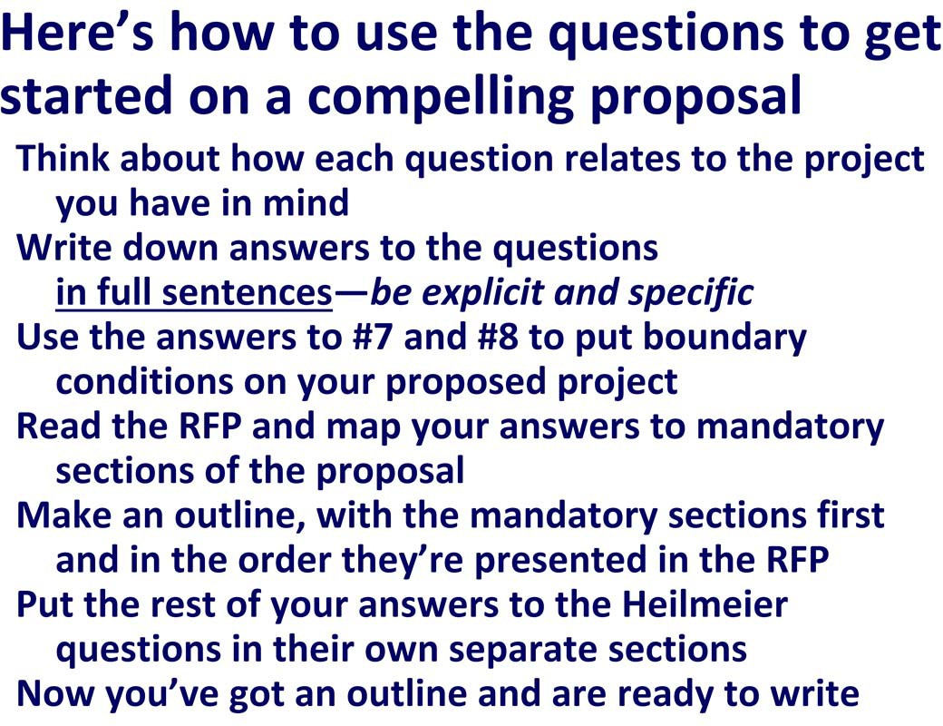
Thinking about the questions is a great way to get started in writing your proposal, the answers to the questions (particularly 7 & 8) will help you put necessary boundary conditions on your project before you get too far into the process, and incorporating the answers in your project narrative will help the reviewers positively assess your proposal.
For a brief biography of Heilmeier, see http://www.ieeeghn.org/wiki/index.php/George_H._Heilmeier.
Heilmeier photo is courtesy of The Institute of Electrical and Electronics Engineers, and is used under the terms of the GNU Free Documentation License, Version 1.2.

Slide 4
Federal funding agencies want to support hypothesis‐driven research. Instead of saying “we will study this process” or “we will measure x,” state the overall goal of your project in terms of a question to be answered or an hypothesis to be tested.
Make a distinction between “goals” (hypothesis to be tested) and “objectives” (intermediate steps along the path to answering the overarching question) and state them both.
NIH requires a “specific aims” section for every proposal submitted to it. I think adopting a “specific aims” section is a useful exercise for a proposer and reassures reviewers and program officers that you’ve thought carefully not only about what you want to do (goal), but specifically how you’re going to go about accomplishing it (objectives).
The “no jargon” rule is a good one. Not everybody who reads your proposal (and decides its fate) may be an expert in your narrow field.
If you have to use jargon, explain your terms. And never, ever use undefined acronyms. Ever.

Slide 5
Explicitly address this question in your “background and introduction” section. Cite freely.

Slide 6
Explicitly state why your approach is faster, better, cheaper—don’t rely on the reviewers to intuit it.
Show how you’ve tested your approach and its promise; provide preliminary data.
Discuss your “Plan B.” If your approach doesn’t work, what is your alternative plan to save the project (and the funding agency’s investment)?

Slide 7
Is the problem important to anybody besides your research group? Tell the program officer and reviewers who benefits.

Slide 8
What will your successful project mean for your research? For the infrastructure of your institution and future capabilities? For your discipline? For related disciplines? For society? For the funding agency??
Will it create new knowledge?
Train the next generation of scientists and engineers?
Contribute to the nation’s research infrastructure and technical capabilities? Solve an important scientific, technological, or societal problem?
Contribute to economic development?
Why should a Congressman care?

Slide 9
Candidly discuss risks, but use positive language. Don’t ever say a proposal is “risky.” (Funding agency employees tend to be risk averse.) “Speculative” or “promising” or “potential high‐payoff” is okay—”risky” is the kiss of death.

Slide 10
Think not only of dollars, but of time and resources (personnel and infrastructure).
The program announcement will often specify the maximum funds that can be requested. Typically, if you exceed that limit, your proposal will be deemed “non‐ responsive” and will be returned without review.
If the program announcement does not specify a budget limit, it will often indicate how much money has been allocated for the program and how many awards the agency expects to make. Use that information to set boundary conditions for your budget.

Slide 11
Read the program announcement carefully and be sure your proposal fits the prescribed duration.
A great addition to any proposal is a narrative or figural timeline for the project.

Slide 12
How are you going to evaluate the project as it proceeds, so that you know when to make mid‐course corrections?
What metrics will you use to evaluate progress?
How will you analyze and evaluate your data? How will you know when you’re “done”?

Slide 13
Put a section in the project description titled “Qualifications of Key Personnel” and tell the reviewers why you and your team are uniquely positioned to succeed.
Describe your expertise and success in related work. Mention the facilities you have at your disposal and your organization’s institutional strengths, including the availability of other experts to assist you.
Not every reviewer will look at the biosketches or the facilities description, but they will read the project description.

Slide 14
Talk about “opportunity costs.” “Opportunity cost” means what is the cost of not doing the project NOW? What will be lost if the agency decides “Not this year.
Maybe next year.”?

Slide 15
Notes:

