Slide 1
Using a Google Programmable Search Engine (GPSE)
Thanks to Prakhar Biyani, Sally Kuhlenschmidt and Dale Vidmar

Slide 2
Goals:
Explore ideas for using a Google programmable search engine (GPSE), including one successful example.
Overview of how to create your own GPSE.

Slide 3
Enterprise Search vs. Web Search
Retrieval in the intranet
More accurate results (for proprietary data)
img source http://www.intranetconnections.com/blog/benefits-enterprise-search-intranet-site/
Refined for info in the Web
Graph, popularity of nodes, …
img source http://news.softpedia.com/news/Add-Custom-Search-Engines-in-Chrome-480755.shtml

Slide 4
What is a Custom Search Engine (CSE)
Specialized Search Engine – search select sites
Uses the expertise of the author
Controls the results of a query
Adds a human element into a search engine algorithm

Slide 5
Why Bother Creating a Custom Search Engine (CSE)
Focus search on “good” sites
Find specific information from a list of sites in a subject area
Make a webliographies searchable
Search deep Web sites
Effectively assist others in finding better information

Slide 6
Some uses
List of CSEs
Search your personal bookmarks
Research on websites (e.g., X vs Y type of sites)
Professional organization—websites of members

Slide 7
Steps for building a Google PSE
Google Account
Create GPSE
Enter formatted URLs
Use is only you – by accessing your Google Account

Slide 8
1. Google Account
http://www.google.com/
Sign In (upper right)…Create an account.

Slide 9
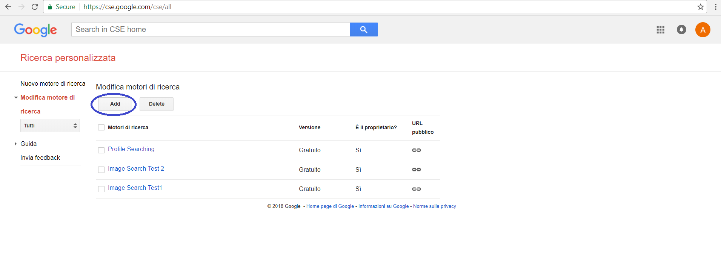
Add GPSE to your account
Search for Google Custom Search
Programmable Search - Create search engine (google.com)
Create a new search engine (click add)

Slide 10
2. Create GPSE
Complete the 1 page form.
Do a simple one first, 4-6 URLs.
*Read the Tips on Formatting URLs. Documentation is to the left.

Slide 11
3. Enter formatted URLs
www.example.com/* to get everything beginning with www.example.com/
www.example.com/ only gives that single page.

Slide 12
Returning later
Login…Upper left: More ….Even More….Custom Search.
Option to create new one or manage current (in small print under Create New…) (My Search Engines)

Slide 13
Managing Your GPSE
Options
Statistics
Delete– destroys the whole GPSE
Control Panel -(change settings.)
Aka Edit this Search Engine

Slide 14
4. For you only
Who can access?
Only you right now and only from your Google Account.

Slide 15
Sharing Your GPSE w/the World
Place code in a website
Control Panel…Code
Copy code for Search box
Paste in your page

Slide 16
Some advanced features
Add refinements to your search.
Ask Google for immediate indexing of newly updated web pages.
Change look and feel of your custom search engine.
Add promotions i.e., triggering special results for a query or set of queries.
More: https://developers.google.com/custom-search/

Slide 17
Add Refinements
You might know some sites are more important than the others.
You can add labels to them.
Set up -> website -> add labels.
Add a refinement in advanced options.
Search feature -> refinements -> add

Slide 18
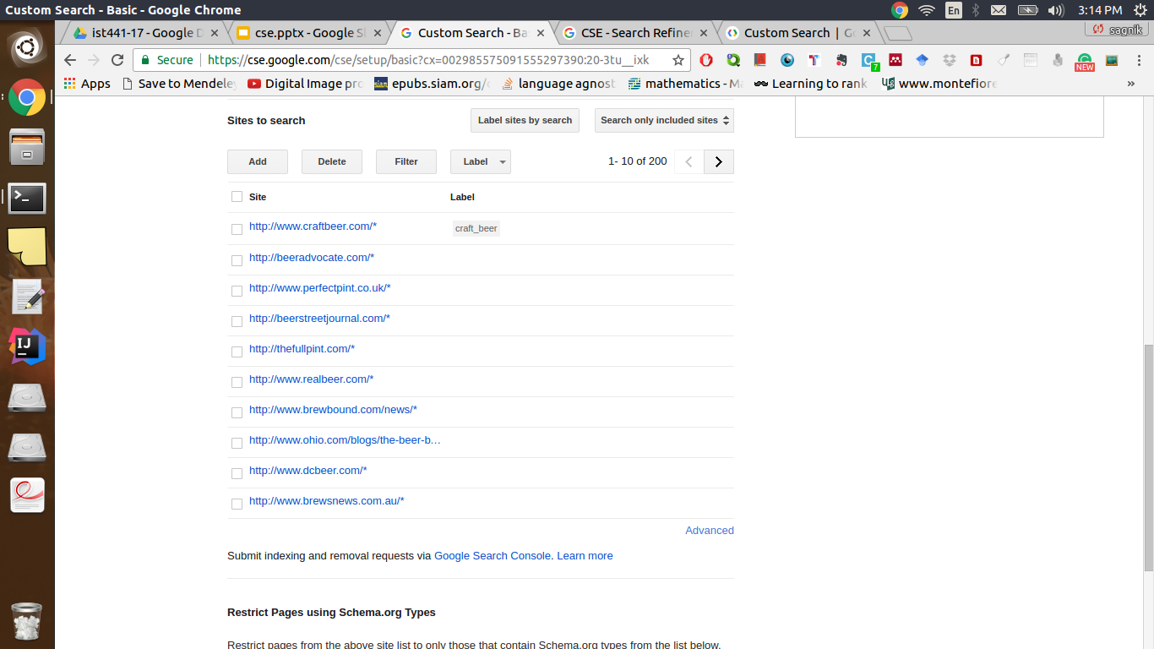
Refinements: Adding Labels Seed URLs

Slide 19
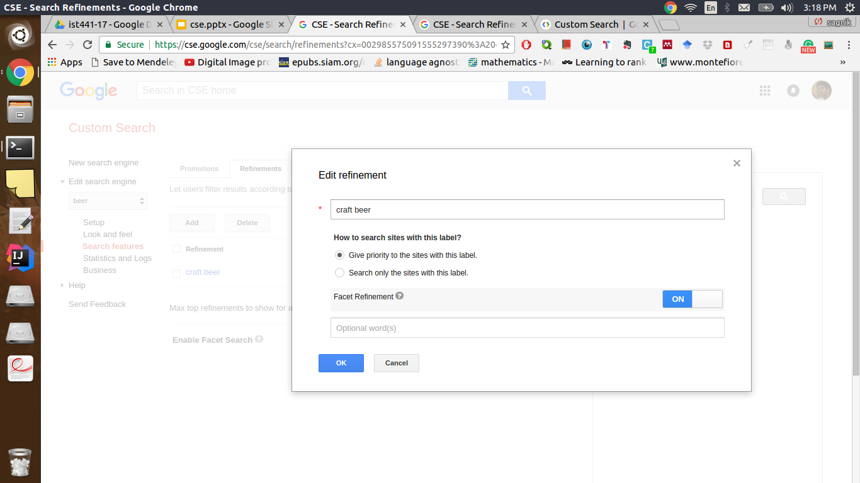
Refinements: Refinements in Search Features

Slide 20
Keep in Mind !
Use the updated code under Get code tab (in the control panel).

Slide 21
GPSE summary/history
The Google Programmable Search platform consisted of three services:
Programmable Search Engine (GPSE)
Subscribed Links (no longer available)
Topics

Slide 22
CSE
Released on October 23, 2006, Google Custom Search allows anyone to create their own search engine by themselves. Search engines can be created to search for information on particular topics chosen by the creator. Google Custom Search Engine allows creators to select what websites will be used to search for information which helps to eliminate any unwanted websites or information. Creators can also attach their custom search engine to any blog or webpage.[4] Google AdSense results can also be triggered from certain search queries, which would generate revenue for the site owner.[5]

Slide 23
Topics
Topics are specific areas of search, which can be developed by people with knowledge of a certain subject. These topics are then displayed at the top of relevant Google web searches, so the user can refine the searches to what they want.[7] Currently, there is a limited number of topics that Google is wanting to develop, namely Health, Destination Guides, Autos, Computer games, Photography and Home Theater.[citation needed]
One of the topics with many contributions is Health.[citation needed] They include the National Library of Medicine, Centers for Disease Control and Prevention, Health On the Net Foundation, Harvard Medical School, Mayo Clinic and others.[citation needed]
Google CSE's may offer better topical search results than the standard Google search.[citation needed]

Slide 24
Subscribed Links
Provided as part of the original service, subscribed links were discontinued on 15 September 2011.[6]
Subscribed Links were web results that users could manually subscribe to. Anyone was allowed to make a new Subscribed Link, and did not necessarily need knowledge on how to create a feed, as a basic link could be created. Subscriptions were then available in a special directory.

Slide 25
