Slide 1
Vector Methods Classical IR
Thanks to:
SIMS
W. Arms
C. Manning

Slide 2
What we have covered
What is IR
Evaluation
Precision – Recall, F measure
Tokenization and properties of text
Web crawling
Robots.txt

Slide 3
Today
Vector methods for documents and queries
Text embeddings
Bag of words
Measures of similarity – vector scoring
Similarity scoring as ranking
Query models
Queries as small documents

Slide 4
Motivation
How to enable computers to process words
Need to use words (tokens)
How do we do this?
Vector methods for words
vectorization
word embeddings
Same process for understanding words in
Natural language processing
AI and machine learning
Recommender systems
Computational advertising

Slide 5
Vectorization (embeddings)
Document representation
Used for document
Encoding
Similarity
Ranking
Importance
In AI and machine learning, this is called representations

Slide 6
Query Engine
Index
Interface
Indexer
Users
Crawler
Web
A Typical Web Search Engine

Slide 7
Query Engine
Index
Users
Interface
Online
Indexer
Crawler
Offline
Web
Online vs Offline processing
Notes:
7

Slide 8
Representation
Query Engine
Index
Interface
Indexer
Users
Crawler
Web
A Typical Web Search Engine

Slide 9
Indexing Subsystem
documents
Documents
assign document IDs
text
document numbers and *field numbers
break into tokens
tokens
stop list*
non-stoplist tokens
stemming*
*Indicates optional operation.
stemmed terms
term weighting*
terms with weights
Index database

Slide 10
Search Subsystem
query
parse query
query tokens
ranked document set
stop list*
non-stoplist tokens
ranking*
stemming*
stemmed terms
Boolean operations*
*Indicates optional operation.
retrieved document set
Index database
relevant document set

Slide 11
Terms vs tokens
Terms are what results after tokenization and linguistic processing.
Examples
knowledge -> knowledg
The -> the
Removal of stop words

Slide 12
Matching/Ranking of Textual Documents
Major Categories of Methods
Exact matching (Boolean)
Ranking by similarity to query (vector space model)
Ranking by probabilistic methods (Indri)
Ranking of matches by importance of documents (PageRank)
Combination methods
What happens in major search engines (Googlerank)

Slide 13
Vector representation of documents and queries
Why do this?
Represents a large space for documents
Compare
Documents
Documents with queries
Retrieve and rank documents with regards to a specific query
- Enables methods of similarity
All search engines do this and some text processing methods.
Gerald Salton ’75 – SMART system

Slide 14
Boolean queries
Document is relevant to a query if the query itself is in the document.
Query blue and red brings back all documents with blue and red in them
Document is either relevant or not relevant to the query.
What about relevance ranking – partial relevance. Vector model deals with this.

Slide 15
Matching - similarity
Matching will be based on document similarity
Define methods of similarity for documents and queries
Use similarity for document scoring or ranking

Slide 16
Similarity (Scoring) Measures and Relevance
Retrieve the most similar documents to a query
Equate similarity to relevance
Most similar are the most relevant
This measure is one of “text similarity”
The matching of text or words

Slide 17
Similarity Ranking Methods
Query
Index database
Documents
Mechanism for determining the similarity of the query to the document.
Set of documents ranked by how similar they are to the query

Slide 18
Similarity Ranking Methods
Methods that look for matches (e.g., Boolean) assume that a document is either relevant to a query or not relevant.
Similarity ranking methods: measure the degree of similarity between a query and a document and then rank accordingly
Similar
Query
Documents
Similar: How similar is document to a request?

Slide 19
Term Similarity: Example
Problem: Given two text documents, how similar are they?
[Methods that measure similarity do not assume exact matches.]
Example (assume tokens converted to terms)
Here are three documents. How similar are they?
d₁ ant ant bee
d₂ dog bee dog hog dog ant dog
d₃ cat gnu dog eel fox
Documents can be any length from one word to thousands.
A query is a special type of document.

Slide 20
Bag of words view of a document
Tokens are extracted from text and thrown into a “bag” without order and labeled by document.
Thus the doc
John is quicker than Mary.
is indistinguishable from the doc
Mary is quicker than John.
Tokens are then in an array based
on some order.
is
Mary
John
than
quicker
is
john
mary
quicker
than

Slide 21
All words into an array with weights on how often they appear

Slide 22
Bag of words models
Often used in NLP
https://www.youtube.com/watch?v=QCk1iDQlaWA

Slide 23
Term Similarity: Basic Concept
Two documents are similar if they contain some of the same terms.
Possible measures of similarity might take into consideration:
(a) The lengths of the documents
(b) The number of terms in common
(c) Whether the terms are common or unusual
(d) How many times each term appears

Slide 24
TERM VECTOR SPACE
Term vector space (token embedding)
n-dimensional space, where n is the number of different terms/tokens used to index a set of documents.
Vector
Document i, d_{i}, represented by a vector. Its magnitude in dimension j is w_{ij}, where:
w_{ij} > 0 if term j occurs in document i
w_{ij} = 0 otherwise
w_{ij} is the weight of term j in document i.

Slide 25
A Document Represented in a 3-Dimensional Term Vector Space
t₃
d₁
t₁₃
t₂
t₁₂
t₁₁
t₁

Slide 26
Basic Method: Incidence Matrix (Binary Weighting)
document text terms
d₁ ant ant bee ant bee
d₂ dog bee dog hog dog ant dog ant bee dog hog
d₃ cat gnu dog eel fox cat dog eel fox gnu
ant bee cat dog eel fox gnu hog
d₁ 1 1
d₂ 1 1 1 1
d₃ 1 1 1 1 1
3 vectors in
8-dimensional term vector space
Weights: t_{ij} = 1 if document i contains term j and zero otherwise

Slide 27
Basic Vector Space Methods: Similarity between 2 documents
t₃
The similarity between two documents is a function of the angle between their vectors in the term vector space.
d₁
d₂
θ
t₂
t₁

Slide 28
Two Documents Represented in 3-Dimensional Term Vector Space
t₃
d₁
d₂
θ
t₂
t₁

Slide 29
Vector Space Revision
x = (x₁, x₂, x₃, ..., x_{n}) is a vector in an n-dimensional vector space
Length of x is given by (extension of Pythagoras's theorem)
|x|² = x₁² + x₂² + x₃² + ... + x_{n}²
|x| = ( x₁² + x₂² + x₃² + ... + x_{n}² )^{1/2}
If x₁ and x₂ are vectors:
Inner product (or dot product) is given by
x₁.x₂ = x₁₁x₂₁ + x₁₂x₂₂ + x₁₃x₂₃ + ... + x_{1n}x_{2n}
Cosine of the angle between the vectors x₁ and x_{2:}
cos (θ) =
x₁.x₂ |x₁| |x₂|

Slide 30
Document similarity (Vector Space Scoring)
d = (w₁, w₂,w₃, ..., w_{n}) is a vector in an n-dimensional vector space
Length of d is given by (extension of Pythagoras's theorem)
|d|² = w₁² + w₂² + w₃² + ... + w_{n}²
|d| = (w₁² + w₂² + w₃² + ... + w_{n}² )^{1/2}
If d₁ and d₂ are document vectors:
Inner product (or dot product) is given by
d₁.d₂ = w₁₁w₂₁ + w₁₂w₂₂ + w₁₃w₂₃ + ... + w_{1n}w_{2n}
Cosine angle between the docs d₁ and d₂ determines doc similarity
cos (θ) =
d₁.d₂ |d₁| |d₂|
cos (θ) = 1; documents exactly the same; = 0, totally different

Slide 31
Example 1 No Weighting
ant bee cat dog eel fox gnu hog length
d₁ 1 1 √2
d₂ 1 1 1 1 √4
d₃ 1 1 1 1 1 √5
Ex: length d₁ = (1²+1²)^{1/2}

Slide 32
Example 1 (continued)
ant bee cat dog eel fox gnu hog length
d₁ 1 1 √2
d₂ 1 1 1 1 √4
d₃ 1 1 1 1 1 √5
d₁ d₂ d₃
d₁ 1 0.71 0
d₂ 0.71 1 0.22
d₃ 0 0.22 1
Similarity of
documents in
example:
Use cosine measure

Slide 33
Weighting Methods: tf and idf
Term frequency (tf)
A term that appears several times in a document is weighted more heavily than a term that appears only once.
Inverse document frequency (idf)
A term that occurs in a few documents is likely to be a better discriminator that a term that appears in most or all documents.

Slide 34
Digression: terminology
WARNING: In a lot of IR literature, “frequency” is used to mean “count”
Thus term frequency in IR literature is used to mean number of occurrences in a doc
Not divided by document length (which would actually make it a frequency)
We will conform to this misnomer
In saying term frequency we mean the number of occurrences of a term in a document.

Slide 35
Example 2 Weighting by Term Frequency (tf)
document text terms
d₁ ant ant bee ant bee
d₂ dog bee dog hog dog ant dog ant bee dog hog
d₃ cat gnu dog eel fox cat dog eel fox gnu
ant bee cat dog eel fox gnu hog length
d₁ 2 1 √5
d₂ 1 1 4 1 √19
d₃ 1 1 1 1 1 √5
Weights: t_{ij} = frequency that term j occurs in document i

Slide 36
Vector Space Calculation for Example 1
x = (x₁, x₂, x₃, ..., x_{n}) is a vector in an n-dimensional vector space
Length of x is given by (extension of Pythagoras's theorem)
|d₂|² = 1² + 1² + 4² + 1²
|d₂| = ( 1+1+16+1)^{1/2} = (19)^{1/2} ; |d₁| = ( 2²+1)^{1/2} = (5)^{1/2}
If d₁ and d₂ are vectors:
Inner product (or dot product) is given by
d₁.d₂ = 2*1 + 1*1 +0*4 + 0*1 = 3
Cosine of the angle between the vectors d₁ and d_{2:}
cos (θ) = =
d₁.d₂ |d₁||d₂|
= 3/ (√5*√19) = 0.31

Slide 37
Example 2 (continued)
Similarity of documents in example:
d₁ d₂ d₃
d₁ 1 0.31 0
d₂ 0.31 1 0.41
d₃ 0 0.41 1
Similarity depends upon the weights given to the terms.
[Note differences in results from Example 1.]

Slide 38
Summary: Vector Similarity Computation with Weights
Documents in a collection are assigned terms from a set of n terms
The term vector space W is defined as:
if term k does not occur in document d_{i}, w_{ik} = 0
if term k occurs in document d_{i}, w_{ik} is greater than zero
(w_{ik} is called the weight of term k in document d_{i})
Similarity between d_{i} and d_{j} is defined as:
Σ w_{ik}w_{jk}
|d_{i}| |d_{j}|
Where d_{i} and d_{j} are the corresponding weighted term vectors and |d_{i}| is the length of the document vector d_{i}
_{n}
cos(d_{i}, d_{j}) =
^{k=1}

Slide 39
Summary: Vector Similarity Computation with Weights Query as a “little” documents
Inner product (or dot product) between documents
d₁.d₂ = w₁₁w₂₁ + w₁₂w₂₂ + w₁₃w₂₃ + ... + w_{1n}w_{2n}
Inner product (or dot product) is between a document and query
d₁.q₁ = w₁₁w_{q11} + w₁₂w_{q12} + w₁₃w_{q13} + ... + w_{1n}w_{q1n}
where w_{qij} is the weight of the _{j}th term of the _{i}th query

Slide 40
Approaches to Weighting
Boolean information retrieval:
Weight of term k in document d_{i}:
w(i, k) = 1 if term k occurs in document d_{i}
w(i, k) = 0 otherwise
General weighting methods
Weight of term k in document d_{i}:
0 < w(i, k) <= 1 if term k occurs in document d_{i}
w(i, k) = 0 otherwise

Slide 41
Simple Uses of Vector Similarity in Information Retrieval
Threshold
For query q, retrieve all documents with similarity above a threshold, e.g., similarity > 0.50.
Ranking
For query q, return the n most similar documents ranked in order of similarity.
[This is the standard practice.]

Slide 42
Simple Example of Ranking with a Query (Weighting by Term Frequency)
query
q ant dog
document text terms
d₁ ant ant bee ant bee
d₂ dog bee dog hog dog ant dog ant bee dog hog
d₃ cat gnu dog eel fox cat dog eel fox gnu
ant bee cat dog eel fox gnu hog length
q 1 1 √2
d₁ 2 1 √5
d₂ 1 1 4 1 √19
d₃ 1 1 1 1 1 √5

Slide 43
Calculate Scoring or Ranking
Similarity of query to documents in example:
d₁ d₂ d₃
q 2/√10 5/√38 1/√10
0.63 0.81 0.32
If the query q is searched against this document set, the ranked results are:
d₂, d₁, d₃
SERP
d₂
d₁
d₃

Slide 44
Contrast of Ranking with Matching
With matching, a document either matches a query exactly or not at all
• Encourages short queries
• Requires precise choice of index terms
• Requires precise formulation of queries (professional training)
With retrieval using similarity measures, similarities range from 0 to 1 for all documents
• Encourages long queries, to have as many dimensions as possible
• Benefits from large numbers of index terms
• Benefits from queries with many terms, not all of which need
match the document

Slide 45
Document Vectors as Points on a Surface
• Normalize all document vectors to be of length 1
• Then the ends of the vectors all lie on a surface
with unit radius
• For similar documents, we can represent parts of
this surface as a flat region
• Similar document are represented as points that are
close together on this surface

Slide 46
Results of a Search
x
x
hits from search
x
Δ
x
x
x
x
x documents found by search
Δ query

Slide 47
Relevance Feedback (Concept)
x
hits from original search
x
o
Δ
x
x
Δ
o
o
x documents identified as non-relevant
o documents identified as relevant
Δ original query
reformulated query
Δ

Slide 48
Document Clustering (Concept)
x
x
x
x
x
x
x
x
x
x
x
x
x
x
x
x
x
x
x
Document clusters are a form of automatic classification.
A document may be in several clusters.

Slide 49
Best Choice of Weights?
query
q ant dog
document text terms
d₁ ant ant bee ant bee
d₂ dog bee dog hog dog ant dog ant bee dog hog
d₃ cat gnu dog eel fox cat dog eel fox gnu
ant bee cat dog eel fox gnu hog
q ? ?
d₁ ? ?
d₂ ? ? ? ?
d₃ ? ? ? ? ?
What weights lead to the best information retrieval?

Slide 50
Methods for Selecting Weights
Empirical
Test a large number of possible weighting schemes with actual data. (Salton, et al.)
Model based
Develop a mathematical model of word distribution and derive weighting scheme theoretically. (Probabilistic model of information retrieval.)

Slide 51
Weighting Term Frequency (tf)
Suppose term j appears f_{ij} times in document i. What weighting should be given to a term j?
Term Frequency: Concept
A term that appears many times within a document is likely to be more important than a term that appears only once.

Slide 52
Term Frequency: Free-text Document
Length of document
Simple method is to use w_{ij} as the term frequency.
...but, in free-text documents, terms are likely to appear more often in long documents. Therefore w_{ij} should be scaled by some variable related to document length.

Slide 53
Term Frequency: Free-text Document
A standard method for free-text documents
Scale f_{ij} relative to the frequency of other terms in the document. This partially corrects for variations in the length of the documents.
Let m_{i} = max (f_{ij}) i.e., m_{i} is the maximum frequency of any term in document i.
Term frequency (tf):
tf_{ij} = f_{ij} / m_{i} when f_{ij} > 0
Note: There is no special justification for taking this form of term frequency except that it works well in practice and is easy to calculate.
_{i}

Slide 54
Weighting Inverse Document Frequency (idf)
Suppose term j appears f_{ij} times in document i. What weighting should be given to a term j?
Inverse Document Frequency: Concept
A term that occurs in a few documents is likely to be a better discriminator that a term that appears in most or all documents.

Slide 55
Inverse Document Frequency
Suppose there are n documents and that the number of documents in which term j occurs is n_{j}.
A possible method might be to use n/n_{j} as the inverse document frequency.
A standard method
The simple method over-emphasizes small differences. Therefore use a logarithm.
Inverse document frequency (idf):
idf_{j} = log₂ (n/n_{j}) + 1 n_{j} > 0
Note: There is no special justification for taking this form of inverse document frequency except that it works well in practice and is easy to calculate.

Slide 56
Example of Inverse Document Frequency
Example
n = 1,000 documents; n_{j} # of docs term appears in
term j n_{j} idf_{j}
A 100 4.32
B 500 2.00
C 900 1.13
D 1,000 1.00
From: Salton and McGill

Slide 57
Example 2 Weighting by idf
document text terms
d₁ ant ant bee ant bee
d₂ dog bee dog hog dog ant dog ant bee dog hog
d₃ cat gnu dog eel fox cat dog eel fox gnu
ant bee cat dog eel fox gnu hog length
d₁ 2 1 √5
d₂ 1 1 4 1 √19
d₃ 1 1 1 1 1 √5
Term appears in 2 2 1 2 1 1 1 1 documents

Slide 58
Example 2 idf
document text terms
d₁ ant ant bee ant bee
d₂ dog bee dog hog dog ant dog ant bee dog hog
d₃ cat gnu dog eel fox cat dog eel fox gnu
ant bee cat dog eel fox gnu hog length
d₁ 2 1 √5
d₂ 1 1 4 1 √19
d₃ 1 1 1 1 1 √5
Term appears in 2 2 1 2 1 1 1 1 documents

Slide 59
Inverse Document Frequency
idf_{j} modifies only the columns not the rows!
log₂ (N/n_{j}) + 1 = log₂ N – log₂ n_{j} + 1
ant idf = log₂ 3/2 + 1 = .58 + 1 = 1.58
bee, dog idf same as ant
cat idf = log₂ 3/1 + 1 = 1.58 + 1 = 2.58
eel, fox, gnu, hog idf same as cat

Slide 60
Example 2 Weighting by idf
document text terms
d₁ ant ant bee ant bee
d₂ dog bee dog hog dog ant dog ant bee dog hog
d₃ cat gnu dog eel fox cat dog eel fox gnu
ant bee cat dog eel fox gnu hog length
d₁ 3.16 1.58
d₂ 1.58 1.58 6.32 2.58
d₃ 2.58 1.58 2.58 2.58 2.58
Multiply ant, bee, dog by 1.58;
Multiply cat, eel, fox, gnu, hog by 2.58 for all appearances.
Recalculate length for all documents

Slide 61
Vector Space Calculation for Example 2
x = (x₁, x₂, x₃, ..., x_{n}) is a vector in an n-dimensional vector space
Length of x is given by (extension of Pythagoras's theorem)
|d₂|² = 1.58² + 1.58² + 6.32² + 2.58²
|d₂| = (51.59)^{1/2} ; |d₁| = ( 3.16²+1.58²)^{1/2} = (14.98)^{1/2}
If d₁ and d₂ are vectors:
Inner product (or dot product) is given by
d₁.d₂ = 3.16*1.58 + 1.58*1.58 +0*6.32 + 0*2.58 = 7.49
Cosine of the angle between the vectors d₁ and d_{2:}
cos (θ) = =
d₁.d₂ |d₁||d₂|
= 7.49/ (√14.98*√51.59) = 0.72

Slide 62
Full Weighting: A Standard Form of tf.idf
Practical experience has demonstrated that weights of the following form perform well in a wide variety of circumstances:
(weight of term j in document i)
= (term frequency) * (inverse document frequency)
A standard tf.idf weighting scheme, for free text documents, is:
t_{ij} = tf_{ij} * idf_{j}
= (f_{ij} / m_{i}) * (log₂ (n/n_{j}) + 1) when n_{j} > 0
where m_{i} = max (f_{ij}) i.e., m_{i} is the maximum frequency of any term in document i.

Slide 63
Structured Text
Structured text
Structured texts, e.g., queries, catalog records or abstracts, have different distribution of terms from free-text. A modified expression for the term frequency is:
tf_{ij} = K + (1 - K)*f_{ij} / m_{i} when f_{ij} > 0
K is a parameter between 0 and 1 that can be tuned for a specific collection.
Query
To weigh terms in the query, Salton and Buckley recommend K equal to 0.5.
_{i}

Slide 64
Summary: Similarity Calculation
The similarity between query q and document i is given by:
Σ w_{qk}w_{ik}
|d_{q}| |d_{i}|
Where d_{q} and d_{i} are the corresponding weighted term vectors, with components in the k dimension (corresponding to term k) given by:
w_{qk} = (0.5 + 0.5*f_{qk} / m_{q})*(log₂ (n/n_{k}) + 1) when f_{qk} > 0
w_{ik} = (f_{ik} / m_{i}) * (log₂ (n/n_{k}) + 1) when f_{ik} > 0
_{n}
cos(d_{q}, d_{i}) =
^{k=1}

Slide 65
Discussion of Similarity
The choice of similarity measure is widely used and works
well on a wide range of documents, but has no theoretical
basis.
There are several possible measures other that angle between vectors
There is a choice of possible definitions of tf and idf
With fielded searching, there are various ways to adjust the weight given to each field.

Slide 66
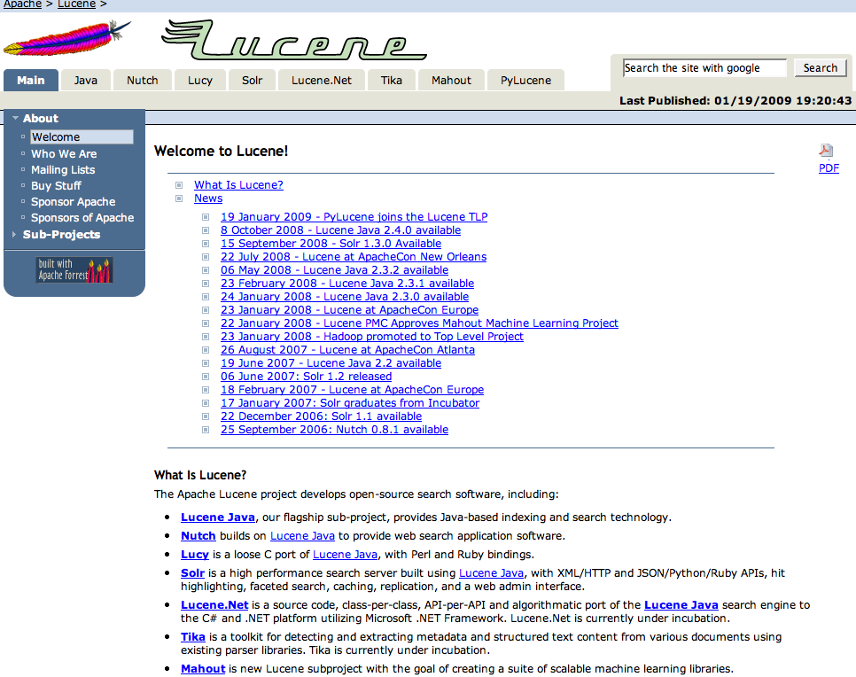

Slide 67
Apache Lucene
Apache Lucene is a high-performance, full-featured text search engine library written entirely in Java. The technology is suitable for nearly any application that requires full-text search, especially cross-platform.
Apache Lucene is an open source project available for free download from Apache Jakarta.
Versions are also available is several other languages, including C++.
The original author was Doug Cutting.
http://apache.org/lucene/docs/

Slide 68
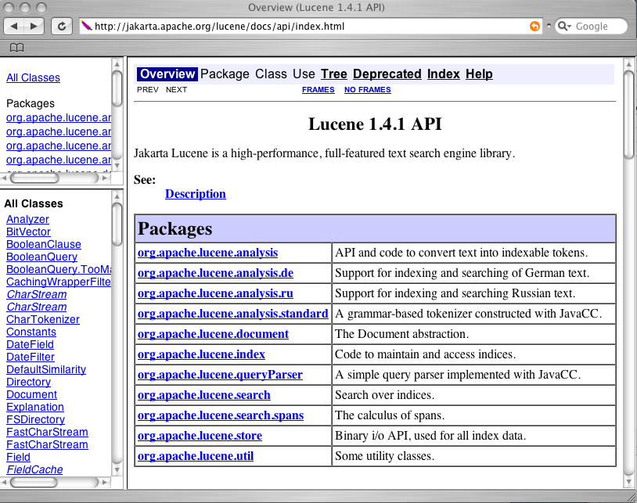

Slide 69
Similarity and DefaultSimilarity
public abstract class Similarity
The score of query q for document d is defined in terms of these methods as follows:
score(q, d) =
∑ tf(t in d)*idf(t)*getBoost(t.field in d)*
lengthNorm(t.field in d)*coord(q, d)*queryNorm(q)
public class DefaultSimilarity
extends Similarity
t in q

Slide 70
Class DefaultSimilarity
tf
public float tf(float freq)
Implemented as: sqrt(freq)
lengthNorm
public float lengthNorm(String fieldName, int numTerms)
Implemented as: 1/sqrt(numTerms)
Parameters: numTokens - the total number of tokens contained in fields named fieldName of document
idf
public float idf(int docFreq, int numDocs)
Implemented as: log(numDocs/(docFreq+1)) + 1

Slide 71
Class DefaultSimilarity
coord
public float coord(int overlap, int maxOverlap)
Implemented as overlap / maxOverlap.
Parameters:
overlap - the number of query terms matched in the document
maxOverlap - the total number of terms in the query
getBoost returns the boost factor for hits on any field of this document (set elsewhere)
queryNorm does not affect ranking, but rather just attempts to make scores from different queries comparable.

Slide 72
Document & query space
Documents are organized in some manner - exist as points in a document space
Documents treated as text, etc.
Match query with document - approaches
Query similar to document space
Query not similar to document space and becomes a characteristic function on the document space
Documents most similar are the ones we retrieve
Reduce this a computable measure of similarity

Slide 73
Query similar to document space
Query is a point in document space
Documents “near” to the query are the ones we want.
Near:
Distance
Lying in similar direction as other documents
Others

Slide 74
Document Clustering
Term 1
Term 2

Slide 75
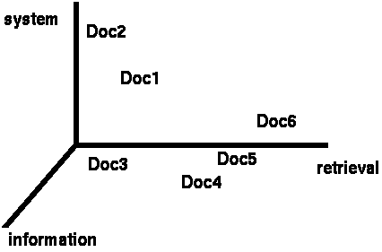
Documents in 3D Space
Document clustering
Assumption: Documents that are “close together”
in space are similar in meaning.

Slide 76
Term Weights: Term Frequency
More frequent terms in a document are more important, i.e. more indicative of the topic.
f_{ij} = frequency of term i in document j
May want to normalize term frequency (tf) across the entire corpus:
tf_{ij} = f_{ij} / max{f_{ij}}

Slide 77
Assigning Weights
tf idf measure:
term frequency (tf)
inverse document frequency (idf) -- a way to deal with the problems of the Zipf distribution
Goal: assign a tf idf weight to each term in each document
A term occurring frequently in the document but rarely in the rest of the collection is given high weight.
Many other ways of determining term weights have been proposed.
Experimentally, tf-idf has been found to work well.

Slide 78
TF x IDF (term frequency-inverse document frequency)
w_{ij} = tf_{ij} [log₂ (N/n_{j}) + 1]
w_{ij} = weight of Term T_{j} in Document D_{i}
tf_{ij} = frequency of Term T_{j} in Document D_{i}
N = number of Documents in collection
n_{j} = number of Documents where term T_{j} occurs at least once
Red text is the Inverse Document Frequency measure idf_{j}

Slide 79
Document Similarity
With a query what do we want to retrieve?
Relevant documents
Similar documents
Query should be similar to the document?
Innate concept – want a document without your query terms?

Slide 80
Similarity Measures
Queries are treated like documents
Documents are ranked by some measure of closeness to the query
Closeness is determined by a Similarity Measure σ
Ranking is usually σ(1) > σ(2) > σ(3)

Slide 81
Document Similarity
Types of similarity
Text
Content
Authors
Date of creation
Images
Etc.

Slide 82
Similarity Measure - Inner Product
Similarity between vectors for the document d_{i} and query q can be computed as the vector inner product:
σ = sim(d_{j},q) = d_{j}•q = w_{ij} · w_{iq}
where w_{ij} is the weight of term i in document j and w_{iq} is the weight of term i in the query
For binary vectors, the inner product is the number of matched query terms in the document (size of intersection).
For weighted term vectors, it is the sum of the products of the weights of the matched terms.

Slide 83
Properties of Inner Product
The inner product is unbounded.
Favors long documents with a large number of unique terms.
Measures how many terms matched but not how many terms are not matched.

Slide 84
Cosine Similarity Measure
t₃
Cosine similarity measures the cosine of the angle between two vectors.
Inner product normalized by the vector lengths.
Normalized document length
Bounded value less that 1
θ₁
D₁
Q
θ₂
t₁
t₂
D₂

Slide 85
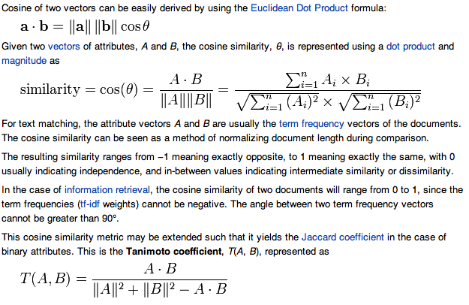
Cosine Similarity Measure

Slide 86
Similarity Measures Compared
Simple matching (coordination level match)
Dice’s Coefficient
Jaccard’s Coefficient
Cosine Coefficient (what we studied)
Overlap Coefficient

Slide 87
Properties of similarity or matching metrics
is the similarity measure such a cosine
Symmetric (commutative)
σ(D_{i},D_{k}) = σ(D_{k},D_{i})
Normalization
σ is close to 1 if very similar
σ is close to 0 if very different
Others?

Slide 88
Similarity Measures
A similarity measure is a function which computes the degree of similarity between a pair of vectors or documents
since queries and documents are both vectors, a similarity measure can represent the similarity between two documents, two queries, or one document and one query
There are a large number of similarity measures proposed in the literature, because the best similarity measure doesn't exist (yet!)
Will best be domain dependent?
With similarity measure between query and documents
it is possible to rank the retrieved documents in the order of presumed importance
it is possible to enforce certain threshold so that the size of the retrieved set can be controlled
the results can be used to reformulate the original query in relevance feedback (e.g., combining a document vector with the query vector)

Slide 89
MORE ABOUT SIMILARITY

Slide 90
idf example, suppose N = 1 million
Sec. 6.2.1
term | df_{t} | idf_{t}
calpurnia | 1
animal | 100
sunday | 1,000
fly | 10,000
under | 100,000
the | 1,000,000
There is one idf value for each term t in a collection.
Notes:
6 4 3 2 1 0

Slide 91
Effect of idf on ranking
Does idf have an effect on ranking for one-term queries, i.e.?
iPhone
idf has no effect on ranking one term queries
idf affects the ranking of documents for queries with at least two terms
For the query capricious person, idf weighting makes occurrences of capricious count for much more in the final document ranking than occurrences of person.

Slide 92
tf-idf weighting has many variants
Sec. 6.4
Columns headed ‘n’ are acronyms for weight schemes.
Why is the base of the log in idf immaterial?
Notes:
n default is just term frequency
ltc is best known form of weighting

Slide 93
Weighting may differ in queries vs documents
Sec. 6.4
Many search engines allow for different weightings for queries vs. documents
SMART Notation: denotes the combination in use in an engine, with the notation ddd.qqq, using the acronyms from the previous table
A very standard weighting scheme is: lnc.ltc
Document: logarithmic tf (l as first character), no idf and cosine normalization
Query: logarithmic tf (l in leftmost column), idf (t in second column), no normalization …
A bad idea?
Notes:
Leaving off idf weighting on documents is good for both efficiency and system effectiveness reasons.

Slide 94
Types of word embeddings
Frequency based Embedding:
a. Count Vectors
b. TF-IDF
c. Co-Occurrence Matrix
Prediction based Embedding(word2vec)
a. CBOW
b. Skip-Gram
gloVe(Global Vector)
BERT (local global)

Slide 95
Types of word embeddings
Frequency based Embedding:
a. Count Vectors
b. TF-IDF
c. Co-Occurrence Matrix
Prediction based Embedding(word2vec)
a. CBOW
b. Skip-Gram
gloVe(Global Vector)
BERT (local global)

Slide 96
What we covered
Vector models of documents and queries
Used everywhere
Bag of words model
Similarity measures
Text similarity typically used for scoring documents
Similarity is a measure of relevance (and ranking)
Match query to document
Rank is based on document score
All stored and indexed before a query is matched.

