Slide 1
A Search Engine for Author Name Disambiguation in Scholarly Databases
Kunho Kim

Slide 2
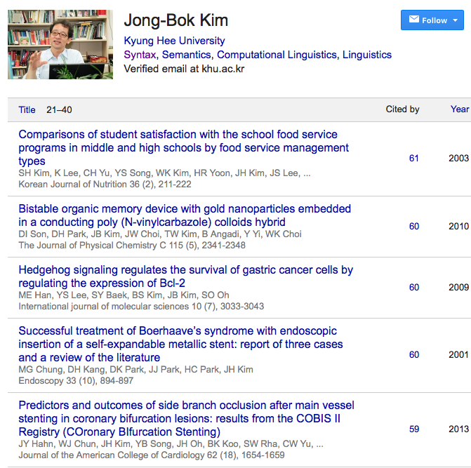
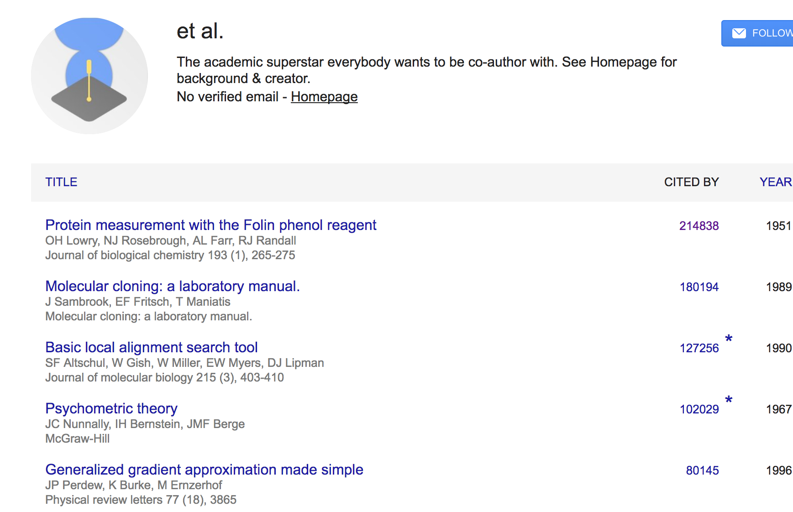
Why We Need Author Name Disambiguation?

Slide 3
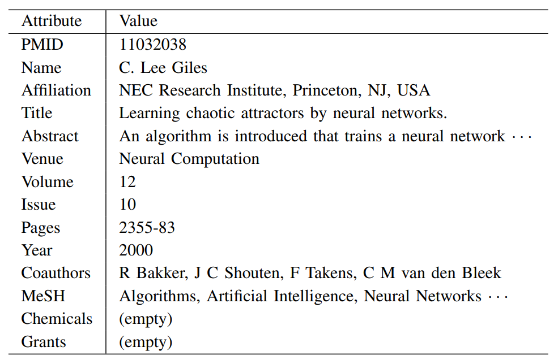
Definition of AND
Task of clustering unique author names from publication records in scholarly and related databases
Let D_{i}={p_{i1}, p_{i2}, … , p_{in}} be a database D_{i}, where each record p_{im} has set of values of the attribute set T_{i} = {t_{i1}, t_{i2}, …, t_{ik}}.
Find an assignment function Θ:D_{i} → E_{i} where E_{i} is the set of real name entity, and Θ(p_{ix}) = Θ(p_{iy}) if and only if p_{ix} and p_{iy} refer to the same entity
Author Record Example

Slide 4
Motivation
AND is a continuing problem (Torvik and Smalheiser 2009, Levin et al. 2012, Liu et al. 2014, Khabsa et al. 2014, Kim et al. 2016) with issues of limited access to disambiguated names and lack of integration between author databases.
Status:
Few publicly available disambiguation code : Early version of CiteSeerX, AMiner
Some scholarly search engines provide author search, but users need to explicitly use their interface without an API
Some organizations are registering researchers and give unique ID
ORCID : 4.3M IDs, 1.7M with records
High quality but very incomplete - citations

Slide 5
Author Search APIs for Scholarly Databases
Available with limitations
AMiner : query available with some attributes, only returns basic information
Microsoft Academic: limited access for all users
DBLP, Semantic Scholar: No direct APIs, requires multiple steps to search
No API available
Google Scholar: Disambiguation of questionable quality
No API and even not disambiguated
ArXiv
PubMed: Author-ity Exporter is available but out of date for PubMed (built 2009)

Slide 6
Our approach
Provide appropriate author search engine and web service with the APIs for users to easily use disambiguated author data
Two methods
Attribute-based Query
Use internal resources to query authors
Query with name, affiliation, ...
Record-based Query
Use external resources provided by user
Query with a thesis or publication record outside the DB in which it is in

Slide 7
Use Cases
Understand how scientific research impacts technological progress
Record-based query will allow the identification of related scientific research with patents
Understand how academic training in universities translates into subsequent research
Find subsequent research articles by querying the dissertation
Investigate how the size and composition of teams is related to the quantity and quality of research they produce
Use the attribute-based queries to link teams to the articles they publish
Investigate the relationship between age and scientific productivity at scale

Slide 8
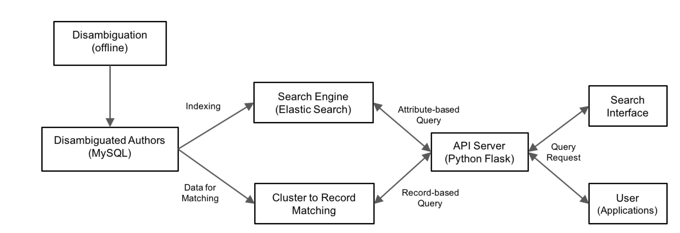
Architecture
Django

Slide 9
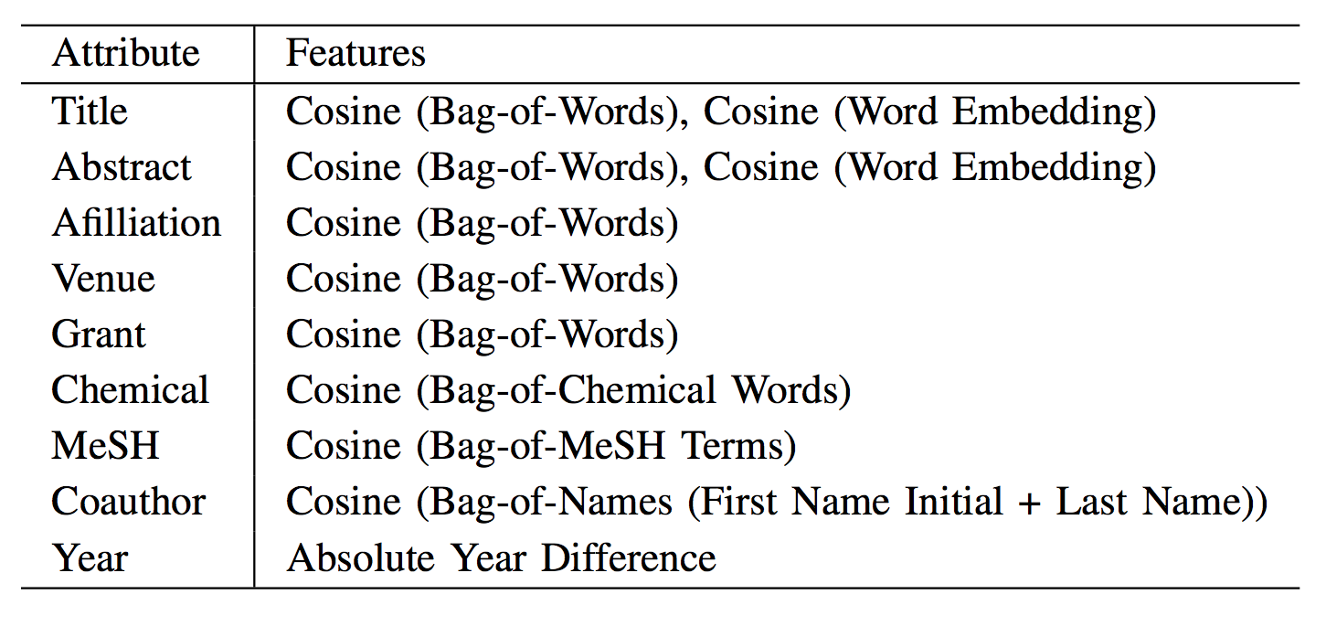
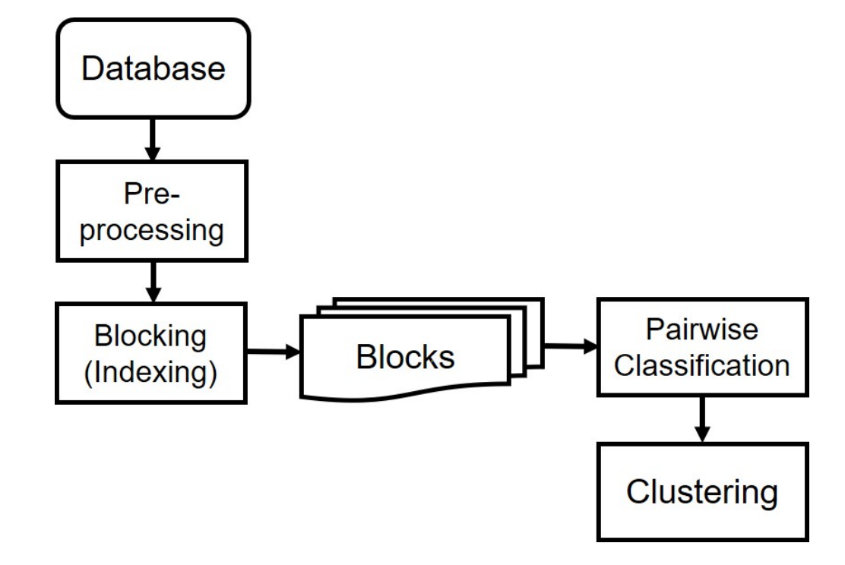
AND Process
Blocking : First name (initial) + last name(full)
Pairwise Classification: Gradient boosted trees (XGBoost)
Clustering: DBSCAN

Slide 10
Preprocessing
Normalize the representation of each attribute
Example: & → and, Dr → Doctor
Parse some attributes if necessary
Example: Full name → First + middle + last name
Remove punctuations, diacritics
Domain specific, differs from database to database
Typically done with lookup tables and regular expressions

Slide 11
Blocking
Essential step to make the algorithm scale
Separates all data into small blocks with blocking key(s)
Sherri M
Schwartz
Simon D Schwartz
Robert B Schwartz
Simon F
Schwartz
Tony
Schwartz
Seth
Schwartz
R + Schwartz
S + Schwartz
T + Schwartz

Slide 12
Pairwise Classification and Clustering
Classifies whether each pair of records is from the same entity or not
Set of string distances of Bag-of-Words with Term Frequency-Inverse Document Frequency (TF-IDF) weight
Average of word embedding vectors with TF-IDF weight
Clustering: Form clustered authors based on the pairwise classification results

Slide 13
Our approach
Provide appropriate author search engine and web service with the APIs for users to easily use disambiguated author data
Two methods
Attribute-based Query
Use internal resources to query authors
Query with name, affiliation, ...
Record-based Query
Use external resources provided by user
Query with a thesis or publication record outside the DB in which it is in

Slide 14
Attribute-based Query
Queries with attributes within the database
Search engine is build on top of the disambiguated result
Elastic Search¹ with the Apache Lucene Core is used for building index with attributes offline
Title, name, coauthors, affiliation, venue, MeSH
Apache Lucene and Elastic Search is used for indexing - Elastic Search is selected since it seems to have better scalability and flexibility of schema
¹ https://www.elastic.co/products/elasticsearch

Slide 15
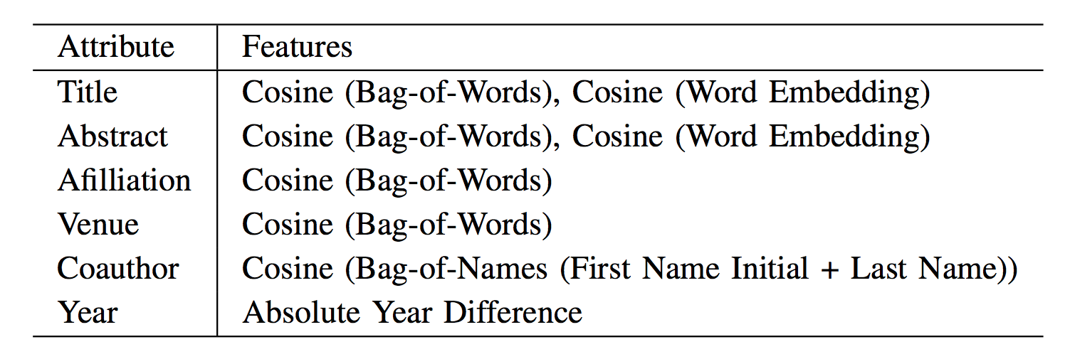
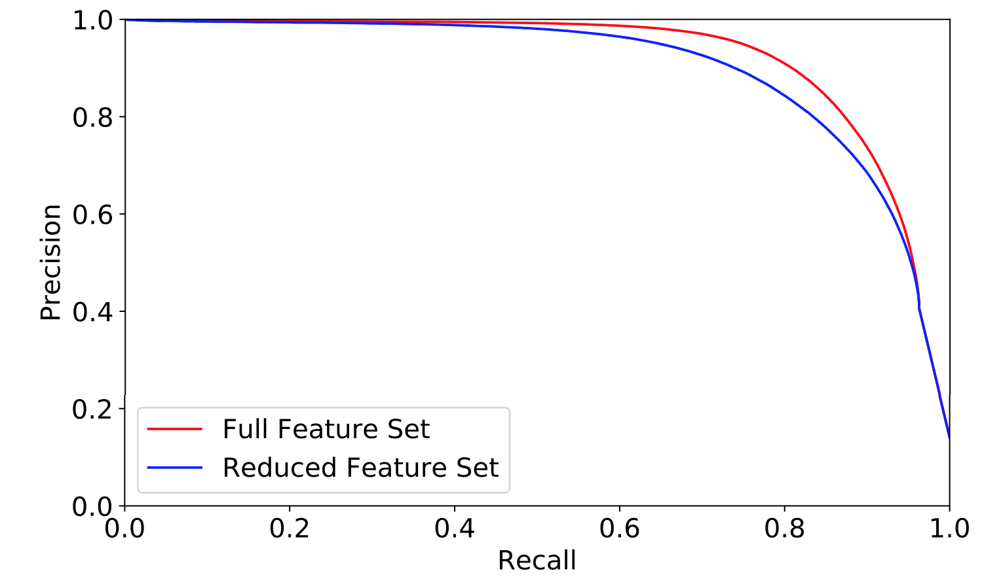
Record-Based Query : Pairwise Classifier
Querying with an external publication record
Uses extracted metadata to query relevant disambiguated author cluster
Machine-learning based pairwise classifier is used for finding relevant clusters
Similar to the classifier used for AND process, but reduced feature set is used
Feature set used and accuracy comparison with the full feature set used during AND

Slide 16
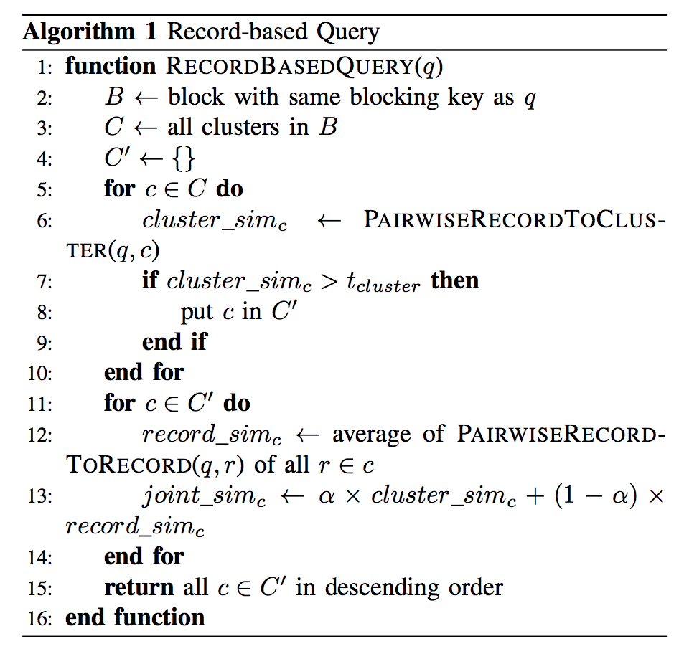
Record-based Query: Algorithm
Cluster-wise similarity
Fast and rough approximation of the distance between the query record and each clusters
Record-wise similarity
Slow and precise distance measurement between the query record and each record in the cluster
Cluster-wise similarity is used to filter out candidate clusters

Slide 17
Cluster-wise similarity
Calculates the approximate similarity with cluster-wise feature vector
Each Bag-of-words(BoW) vector is calculated as the sum of BoW vectors of records in the cluster
Clusters with low similarities are eliminated for the next step

Slide 18
Record-wise Similarity
Calculates the precise similarity between query and cluster
Uses average similarity of all pairs
Final similarity is calculated with the mixture of cluster-wise and record-wise similarity
Parameters tuned with grid search

Slide 19
Available RESTful APIs
RESTful APIs are used for effective external resource management

Slide 20
API Server
Flask¹ server to handle all APIs
GET request
Sends the request to record-based / attribute-based query modules
Result is returned in the JSON format
POST request
Accepts the resource data with BibTeX and PDF format
Metadata extraction is done with BibTeXParser² and GROBID³ respectively
Assigns a unique ID with mkstemp
DELETE request
Deletes the specifed resources
Also tracks time to live (TTL) for each resources for automatic deletion
¹http://flask.pocoo.org/
²https://github.com/sciunto-org/python-bibtexparser
³https://github.com/kermitt2/grobid

Slide 21
System
Environment
Intel Xeon CPU E5-2630 V3 @ 2.40 GHz (32 threads), 64GB memory, RHEL Server 7.4
Implemented with Python 2.7
PubMed raw data downloaded from late 2017
Evaluation Dataset : NIH PI dataset (54,260 individuals, 1,178,459 publication records)
Top 100 popular name blocks are used for development / test dataset
Rest are used for training dataset
Attribute-based query: avg. 2.03, 3.04, 5.35s for 2,3,4 attributes respectively

Slide 22
Record-based query evaluation
Sampled records from dev / test dataset and use them as query
Compared with the baseline method (only with record-wise similarity), then using cluster-wise similarity and by using both
Total 3,538 queries tested, with recall@K and MAP

Slide 23
PubMed Evaluation
Record-based query
To measure the actual performance, tested with 300 queries with whole PubMed database
Calculating features for each record takes majority of the time, we also measured by caching those features by calculating them ahead

Slide 24
Demo

