Slide 1
Review for IST 441 exam
Fall 2022

Slide 2
Exam structure
Closed book and notes
Exam counts 30% of grade
Graduate students will answer all questions (150 pts – converted to 30)
Undergraduates answer selected questions with extra credit given for answers to other questions (100 pts plus extra credit converted to 30 or more points)

Slide 3
Hints
All questions covered in the exercises are appropriate exam questions
Past exams are good study guides
There will be new questions this year

Slide 4
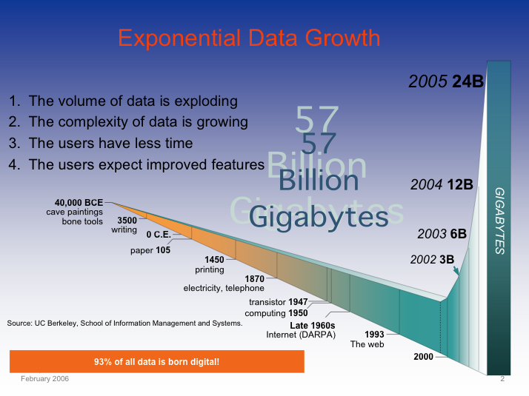
Digitization of Everything: the Zettabytes are coming
Soon most everything will be recorded and indexed
Much will remain local
Most bytes will never be seen by humans.
Search, data summarization, trend detection, information and knowledge extraction and discovery are key technologies
So will be infrastructure to manage this.

Slide 5
How much information is there in the world
Informetrics - the measurement of information
What can we store
What do we intend to store.
What is stored.
Why are we interested.

Slide 6
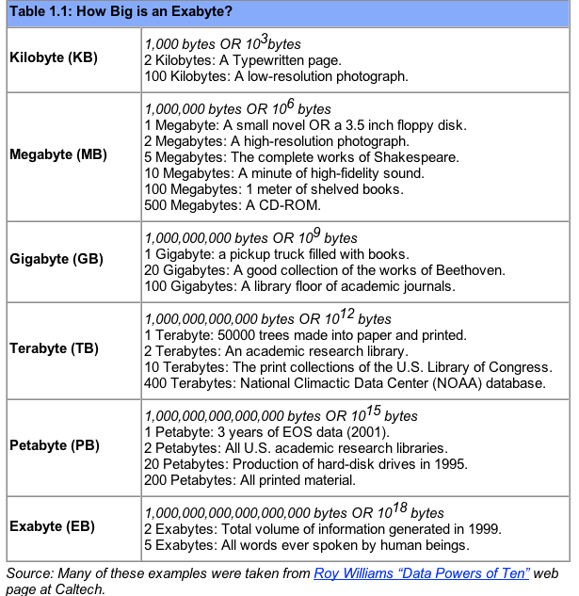

Slide 7
What is information retrieval
Gathering information from a source(s) based on a need
  Major assumption - that information exists.
  Broad definition of information
Sources of information
  Other people
  Archived information (libraries, maps, etc.)
  Web
  Radio, TV, etc.

Slide 8
Information retrieved
Impermanent information
  Conversation
Documents
  Text
  Video
  Files
  Etc.

Slide 9
The information acquisition process
Know what you want and go get it
Ask questions to information sources as needed (queries) - SEARCH
Have information sent to you on a regular basis based on some predetermined information need
Push/pull models

Slide 10
What IR assumes
Information is stored (or available)
A user has an information need
An automated system exists from which information can be retrieved
Why an automated system?
The system works!!

Slide 11
What IR is usually not about
Usually just unstructured data
Retrieval from databases is usually not considered
  Database querying assumes that the data is in a standardized format
  Transforming all information, news articles, web sites into a database format is difficult for large data collections

Slide 12
What an IR system should do
Store/archive information
Provide access to that information
Answer queries with relevant information
Stay current
WISH list
  Understand the user’s queries
  Understand the user’s need
  Acts as an assistant

Slide 13
How good is the IR system
Measures of performance based on what the system returns:
Relevance
Coverage
Recency
Functionality (e.g. query syntax)
Speed
Availability
Usability
Time/ability to satisfy user requests

Slide 14
How do IR systems work
Algorithms implemented in software
Gathering methods
Storage methods
Indexing
Retrieval
Interaction

Slide 15
Query Engine
Index
Interface
Indexer
Users
Crawler
Web
A Typical Web Search Engine

Slide 16
Query Engine
Index
Interface
Indexer
Users
Crawler
No Databases!
Use an index
Web
A Typical Web Search Engine

Slide 17
Specialty Search Engines
Focuses on a specific type of information
  Subject area, geographic area, resource type, enterprise
Can be part of a general purpose engine
Often use a crawler to build the index from web pages specific to the area of focus, or combine crawler with human built directory
Advantages:
  Save time
  Greater relevance
  Vetted database, unique entries and annotations

Slide 18
Information Seeking Behavior
Two parts of the process:
  search and retrieval
  analysis and synthesis of search results

Slide 19
What is knowledge?
Data - Facts, observations, or perceptions.
Information - Subset of data, only including those data that possess context, relevance, and purpose.
Knowledge - A more simplistic view considers knowledge as being at the highest level in a hierarchy with data (at the lowest level) and information (at the middle level).
Data refers to bare facts void of context.
  A telephone number.
Information is data in context.
  A phone book.
Knowledge is information that facilitates action.
  Recognizing that a phone number belongs to a good client, who needs to be called once per week to get his orders.

Slide 20
From Facts to Wisdom
(Haeckel & Nolan, 1993) one example of the hierarchy

Slide 21
Size of information resources
Why important?
Scaling
  Time
  Space
  Which is more important?

Slide 22
Scalability for Search
Scaling means how a system must grow if resources or work grows
  Scalability is the ability of a system, network, or process, to handle growing amounts of work in a graceful manner or its ability to be enlarged to accommodate that growth (wikipedia)
Search usually must scale in various ways:
Number of things searched – N
Number of searchers – M
Algorithms for indexing, ranking, etc.

Slide 23
Measuring the Growth of Work or Hardness of a Problem
While it is possible to measure the work done by an algorithm for a given set of inputs, we need a way to:
Measure the rate of growth of an algorithm based upon the size of the input (or output)
Compare algorithms to determine which is better for the situation
Compare and analyze for large problems
  Examples of large problems?

Slide 24
Time vs. Space
Very often, we can trade space for time:
For example: maintain a collection of students’ with ID information.
  Use an array of a billion elements and have immediate access (better time)
  Use an array of number of students and have to search (better space)

Slide 25
Introducing Big O Notation
Will allow us to evaluate algorithms and understand scaling.
Has precise mathematical definition
Used in a sense to put algorithms into families
Worst case scenario
  What does this mean?
  Other types of cases?

Slide 26
Size of Input
(measure of work)
In analyzing rate of growth based upon size of input, we’ll use a variable
Why?
  For each factor in the size, use a new variable
  n is most common…
Examples:
  A linked list of n elements
  A 2D array of n x m elements
  A Binary Search Tree of p elements

Slide 27
Simplifying O( ) Answers
We say Big O complexity of
3n² + 2 = O(n²) ← drop constants!
because we can show that there is a n₀ and a c such that:
0 ≤ 3n² + 2 ≤ cn² for n ≥ n₀
i.e. c = 4 and n₀ = 2 yields:
0 ≤ 3n² + 2 ≤ 4n² for n ≥ 2
What does this mean?

Slide 28
Big O issues
Useful for scaling
Sometimes constants matter for real problems
  c is .0001 vs c is 10⁶
Use Big O carefully

Slide 29
Two Categories of Algorithms
Lifetime of the universe 10¹⁰ years = 10¹⁷ sec
Unreasonable
10³⁵
10³⁰
10²⁵
10²⁰
10¹⁵
trillion
billion
million
1000
100
10
N^{N}
2^{N}
Reasonable
Runtime sec
N⁵
N
Don’t Care!
2 4 8 16 32 64 128 256 512 1024
Size of Input (N)

Slide 30
Measuring the Growth of Work
As input size N increases, how well does our automated system work?
  Depends on what you want to do!
Use algorithmic complexity theory:
  Use measure big O: O(N) which means worst case
Important for
  Search engines
  Databases
  Social networks
  Crime/terrorism
Performance classes
Polynomial
Sub-linear O(Log N)
Linear O(N)
Nearly linear O(N Log N)
Quadratic O(N²)
Exponential O(2^{N})
O(N!)
O(N^{N})
practical
Usually death to
scaling
impractical
MapReduce
may help

Slide 31
Reasonable vs. Unreasonable
Reasonable algorithms have polynomial factors
  O (Log N)
  O (N)
  O (N^{K}) where K is a constant
Unreasonable algorithms have exponential factors
  O (2^{N})
  O (N!)
  O (N^{N})

Slide 32
Reasonable vs. Unreasonable
Reasonable algorithms
May be usable depending upon the input size
Unreasonable algorithms
Are impractical and useful to theorists
Demonstrate need for approximate solutions
Remember we’re dealing with large N (input size)

Slide 33
Trying to fill a terabyte in a year
Item | Items/TB | Items/day
300 KB JPEG | 3 M | 9,800
1 MB Doc | 1 M | 2,900
1 hour 256 kb/s MP3 audio | 9 K | 26
1 hour 1.5 Mbp/s MPEG video | 290 | 0.8
Moore’s Law and its impact!
Notes:
Bottom line: we will be able to keep LOTS of video, and vast amounts of smaller data types (audio, photos, documents).
Note: probably not worth the time to delete an object

Slide 34
Definitions for IR
Document
  what we will index, usually a body of text which is a sequence of terms
Tokens or terms
  semantic word or phrase
Collections or repositories
  particular collections of documents
  sometimes called a database
Query
  request for documents on a topic

Slide 35
What is a Document?
A document is a digital object
  Indexable
  Can be queried and retrieved.
Many types of documents
  Text
  Image
  Audio
  Video
  data

Slide 36
Text Documents
A text digital document consists of a sequence of words and other symbols, e.g., punctuation.
The individual words and other symbols are known as tokens or terms.
A textual document can be:
• Free text, also known as unstructured text, which is a
continuous sequence of tokens.
• Fielded text, also known as structured text, in which the text
is broken into sections that are distinguished by tags or other
markup.

Slide 37
Why the focus on text?
Language is the most powerful query model
Language can be treated as text
Others?

Slide 38
Information Retrieval from Collections of Textual Documents
Major Categories of Methods
Exact matching (Boolean)
Ranking by similarity to query (vector space model)
Ranking of matches by importance of documents (PageRank)
Combination methods
  What happens in major search engines

Slide 39
Text Based Information Retrieval
Most matching methods are based on Boolean operators.
Most ranking methods are based on the vector space model.
Web search methods combine vector space model with ranking based on importance of documents.
Many practical systems combine features of several approaches.
In the basic form, all approaches treat words as separate tokens with minimal attempt to interpret them linguistically.

Slide 40
Statistical Properties of Text
Token occurrences in text are not uniformly distributed
They are also not normally distributed
They do exhibit a Zipf distribution

Slide 41
Zipf Distribution
The Important Points:
  a few elements occur very frequently
  a medium number of elements have medium frequency
  many elements occur very infrequently

Slide 42
Zipf Distribution
The product of the frequency of words (f) and their rank (r) is approximately constant
  Rank = order of words’ frequency of occurrence
Another way to state this is with an approximately correct rule of thumb:
  Say the most common term occurs C times
  The second most common occurs C/2 times
  The third most common occurs C/3 times
  …

Slide 43
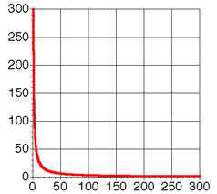
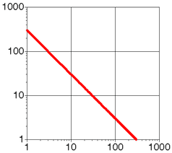
Zipf Distribution
(linear and log scale)

Slide 44
What Kinds of Data Exhibit a Zipf Distribution?
Words in a text collection
  Virtually any language usage
Library book checkout patterns
Incoming Web Page Requests (Nielsen)
Outgoing Web Page Requests (Cunha & Crovella)
Document Size on Web (Cunha & Crovella)

Slide 45
Why the interest in Queries?
Queries are ways we interact with IR systems
Nonquery methods?
Types of queries?

Slide 46
Query Engine
Index
Users
Interface
On-line
Indexer
Crawler
Off-line
Web
Online vs offline processing

Slide 47
Queries
Query Engine
Index
Interface
Indexer
Users
Crawler
Web
A Typical Web Search Engine

Slide 48
Issues with Query Structures
Matching Criteria
Given a query, what document is retrieved?
In what order?

Slide 49
Types of Query Structures
Query Models (languages) – most common
Boolean Queries
Extended-Boolean Queries
Natural Language Queries
Vector queries
Others?

Slide 50
Simple query language: Boolean
  Earliest query model
  Terms + Connectors (or operators)
  terms
    words
    normalized (stemmed) words
    phrases
    thesaurus terms
  connectors
    AND
    OR
    NOT

Slide 51
Simple query language: Boolean
  Geek-speak
  Variations are still used in search engines!

Slide 52
Truth Tables – Boolean Logic
Presence of P, P = 1
Absence of P, P = 0
True = 1
False = 0

Slide 53
Problems with Boolean Queries
Incorrect interpretation of Boolean connectives AND and OR
Example - Seeking Saturday entertainment
Queries:
Dinner AND sports AND symphony
Dinner OR sports OR symphony
Dinner AND sports OR symphony

Slide 54
Order of precedence of operators
Example of query. Is
A AND B
the same as
B AND A
Why?

Slide 55
Order of Preference
  Define order of preference
    EX: a OR b AND c
  Infix notation
    Parenthesis evaluated 1st with left to right precedence of operators
    Next NOT’s are applied
    Then AND’s
    Then OR’s
  a OR b AND c becomes
  a OR (b AND c)

Slide 56
Infix Notation
  Usually expressed as INFIX operators in IR
    ((a AND b) OR (c AND b))
  NOT is UNARY PREFIX operator
    ((a AND b) OR (c AND (NOT b)))
  AND and OR can be n-ary operators
    (a AND b AND c AND d)
  Some rules - (De Morgan revisited)
    NOT(a) AND NOT(b) = NOT(a OR b)
    NOT(a) OR NOT(b)= NOT(a AND b)
    NOT(NOT(a)) = a

Slide 57
Pseudo-Boolean Queries
A new notation, from web search
  +cat dog +collar leash
Does not mean the same thing!
Need a way to group combinations.
Phrases:
  “stray cat” AND “frayed collar”
  +“stray cat” + “frayed collar”

Slide 58
Ordering (ranking) of Retrieved Documents
Pure Boolean has no ordering
Term is there or it’s not
In practice:
  order chronologically
  order by total number of “hits” on query terms
    What if one term has more hits than others?
    Is it better to have one of each term or many of one term?

Slide 59
Boolean Query - Summary
Advantages
  simple queries are easy to understand
  relatively easy to implement
Disadvantages
  difficult to specify what is wanted
  too much returned, or too little
  ordering not well determined
Dominant language in commercial systems until the WWW

Slide 60
Representation
Query Engine
Index
Interface
Indexer
Users
Crawler
Web
A Typical Web Search Engine

Slide 61
Vector Space Model
Documents and queries are represented as vectors in term space
  Terms are usually stems
  Documents represented by binary vectors of terms
Queries represented the same as documents
Query and Document weights are based on length and direction of their vector
A vector distance measure between the query and documents is used to rank retrieved documents

Slide 62
Document Vectors
Documents are represented as “bags of words”
Represented as vectors when used computationally
  A vector is like an array of floating point values
  Has direction and magnitude
  Each vector holds a place for every term in the collection
  Therefore, most vectors are sparse

Slide 63
Queries
Vocabulary (dog, house, white)
Queries:
dog (1,0,0)
house (0,1,0)
white (0,0,1)
house and dog (1,1,0)
dog and house (1,1,0)
Show 3-D space plot

Slide 64
Documents (queries) in Vector Space
t₃
D₁
D₉
D₁₁
D₃
D₅
D₁₀
D₄
D₂
t₁
D₇
D₈
D₆
t₂

Slide 65
Vector Query Problems
Significance of queries
  Can different values be placed on the different terms – eg. 2dog 1house
Scaling – size of vectors
Number of words in the dictionary?
100,000

Slide 66
Proximity Searches
Proximity: terms occur within K positions of one another
  pen w/5 paper
A “Near” function can be more vague
  near(pen, paper)
Sometimes order can be specified
Also, Phrases and Collocations
  “United Nations” “Bill Clinton”
Phrase Variants
  “retrieval of information” “information retrieval”

Slide 67
Representation of documents and queries
Why do this?
Want to compare documents
Want to compare documents with queries
Want to retrieve and rank documents with regards to a specific query
A document representation permits this in a consistent way (type of conceptualization)

Slide 68
Measures of similarity
Retrieve the most similar documents to a query
Equate similarity to relevance
  Most similar are the most relevant
This measure is one of “lexical similarity”
  The matching of text or words

Slide 69
Document space
Documents are organized in some manner - exist as points in a document space
Documents treated as text, etc.
Match query with document
  Query similar to document space
  Query not similar to document space and becomes a characteristic function on the document space
Documents most similar are the ones we retrieve
Reduce this a computable measure of similarity

Slide 70
Representation of Documents
Consider now only text documents
Words are tokens (primitives)
  Why not letters?
  Stop words?
How do we represent words?
  Even for video, audio, etc documents, we often use words as part of the representation

Slide 71
Documents as Vectors
Documents are represented as “bags of words”
  Example?
Represented as vectors when used computationally
  A vector is like an array of floating point values
  Has direction and magnitude
  Each vector holds a place for every term in the collection
  Therefore, most vectors are sparse

Slide 72
Vector Space Model
Documents and queries are represented as vectors in term space
  Terms are usually stems
  Documents represented by binary vectors of terms
Queries represented the same as documents
Query and Document weights are based on length and direction of their vector
A vector distance measure between the query and documents is used to rank retrieved documents

Slide 73
The Vector-Space Model
Assume t distinct terms remain after preprocessing; call them index terms or the vocabulary.
These “orthogonal” terms form a vector space.
  Dimension = t = |vocabulary|
Each term i in a document or query j is given a real-valued weight, w_{ij.}
Both documents and queries are expressed as t-dimensional vectors:
  d_{j} = (w_{1j}, w_{2j}, …, w_{tj})

Slide 74
The Vector-Space Model
3 terms, t1, t2, t3 for all documents
Vectors can be written differently
  d1 = (weight of t1, weight of t2, weight of t3)
  d1 = (w1,w2,w3)
  d1 = w1,w2,w3
  or
  d1 = w1 t1 + w2 t2 + w3 t3

Slide 75
Definitions
Documents vs terms
Treat documents and queries as the same
  4 docs and 2 queries => 6 rows
Vocabulary in alphabetical order – dimension 7
  be, forever, here, not, or, there, to => 7 columns
6 X 7 doc-term matrix
4 X 4 doc-doc matrix (exclude queries)
7 X 7 term-term matrix (exclude queries)

Slide 76
Document Collection
A collection of n documents can be represented in the vector space model by a term-document matrix.
An entry in the matrix corresponds to the “weight” of a term in the document; zero means the term has no significance in the document or it simply doesn’t exist in the document.
T₁ T₂ …. T_{t}
D₁ w₁₁ w₂₁ … w_{t1}
D₂ w₁₂ w₂₂ … w_{t2}
: : : :
: : : :
D_{n} w_{1n} w_{2n} … w_{tn}
Queries are treated just like documents!

Slide 77
Assigning Weights to Terms
w_{ij} is the weight of term j in document i
Binary Weights
Raw term frequency
tf x idf
  Deals with Zipf distribution
  Want to weight terms highly if they are
    frequent in relevant documents … BUT
    infrequent in the collection as a whole

Slide 78
TF x IDF (term frequency-inverse document frequency)
w_{ij} = tf_{ij} [log₂ (N/n_{j}) + 1]
w_{ij} = weight of Term T_{j} in Document D_{i}
tf_{ij} = frequency of Term T_{j} in Document D_{i}
N = number of Documents in collection
n_{j} = number of Documents where term T_{j} occurs at least once
Red text is the Inverse Document Frequency measure idf_{j}

Slide 79
Inverse Document Frequency
idf_{j} modifies only the columns not the rows!
log₂ (N/n_{j}) + 1 = log N - log n_{j} + 1
Consider only the documents, not the queries!
N = 4

Slide 80
Document Similarity
With a query what do we want to retrieve?
Relevant documents
Similar documents
Query should be similar to the document?
Innate concept – want a document without your query terms?

Slide 81
Similarity Measures
Queries are treated like documents
Documents are ranked by some measure of closeness to the query
Closeness is determined by a Similarity Measure σ
Ranking is usually σ(1) > σ(2) > σ(3)

Slide 82
Document Similarity
Types of similarity
Text
Content
Authors
Date of creation
Images
Etc.

Slide 83
Similarity Measure - Inner Product
Similarity between vectors for the document d_{i} and query q can be computed as the vector inner product:
σ = sim(d_{j},q) = d_{j}•q = w_{ij} · w_{iq}
  where w_{ij} is the weight of term i in document j and w_{iq} is the weight of term i in the query
For binary vectors, the inner product is the number of matched query terms in the document (size of intersection).
For weighted term vectors, it is the sum of the products of the weights of the matched terms.

Slide 84
Cosine Similarity Measure
t₃
Cosine similarity measures the cosine of the angle between two vectors.
Inner product normalized by the vector lengths.
θ₁
D₁
Q
θ₂
t₁
t₂
D₂
CosSim(d_{j}, q) =

Slide 85
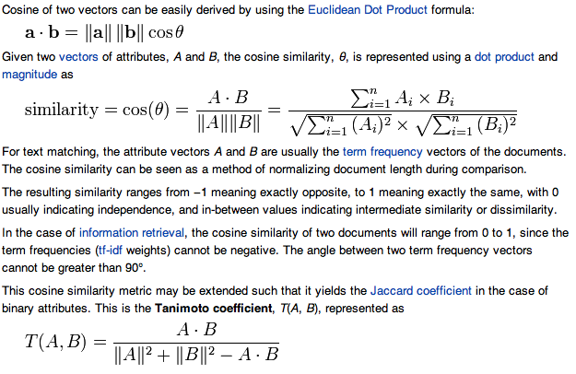
Cosine Similarity Measure

Slide 86
Properties of similarity or matching metrics
  is the similarity measure
Symmetric
  σ(D_{i},D_{k}) = σ(D_{k},D_{i})
  σ is close to 1 if similar
  σ is close to 0 if different
Others?

Slide 87
Similarity Measures
A similarity measure is a function which computes the degree of similarity between a pair of vectors or documents
  since queries and documents are both vectors, a similarity measure can represent the similarity between two documents, two queries, or one document and one query
There are a large number of similarity measures proposed in the literature, because the best similarity measure doesn't exist (yet!)
With similarity measure between query and documents
  it is possible to rank the retrieved documents in the order of presumed importance
  it is possible to enforce certain threshold so that the size of the retrieved set can be controlled
  the results can be used to reformulate the original query in relevance feedback (e.g., combining a document vector with the query vector)

Slide 88
Query Engine
Index
Pre-indexing
Interface
Indexer
Text processing
(preprocessing)
Users
Crawler
Web
A Typical Web Search Engine

Slide 89
Stemming
Reduce terms to their roots before indexing
  language dependent
  e.g., automate(s), automatic, automation all reduced to automat.
for example compressed
and compression are both
accepted as equivalent to
compress.
for exampl compres and
compres are both accept as
equival to compres.

Slide 90
Automated Methods
Powerful multilingual tools exist for morphological analysis
  PCKimmo, Xerox Lexical technology
  Require a grammar and dictionary
  Use “two-level” automata
Stemmers:
  Very dumb rules work well (for English)
  Porter Stemmer: Iteratively remove suffixes
  Improvement: pass results through a lexicon

Slide 91
Elastic/Lucene
Query Engine
Index
Interface
Users
Indexer
Crawler
Heritrix
Web
A Typical Web Search Engine

Slide 92
Indexing
Query Engine
Index
Interface
Indexer
Users
Crawler
Web
A Typical Web Search Engine

Slide 93
Why indexing?
For efficient searching of a document
  Sequential text search
    Small documents
    Text volatile
  Data structures
    Large, semi-stable document collection
    Efficient search

Slide 94
Representation of Inverted Files
Index (word list, vocabulary) file: Stores list of terms (keywords). Designed for searching and sequential processing, e.g., for range queries, (lexicographic index). Often held in memory.
Postings file: Stores an inverted list (postings list) of postings for each term. Designed for rapid merging of lists and calculation of similarities. Each list is usually stored sequentially.
Document file: Stores the documents. Important for user interface design.

Slide 95
Organization of Inverted Files
Index file
Postings file
Documents file
Term Pointer to
postings
ant
bee
cat
dog
elk
fox
gnu
hog
Inverted lists

Slide 96
Inverted Index
This is the primary data structure for text indexes
Basically two elements:
  (Vocabulary, Occurrences)
Main Idea:
  Invert documents into a big index
Basic steps:
  Make a “dictionary” of all the tokens in the collection
  For each token, list all the docs it occurs in.
    Possibly location in document
  Compress to reduce redundancy in the data structure
    Also reduces I/O and storage required

Slide 97
How Are Inverted Files Created
Documents are parsed one document at a time to extract tokens. These are saved with the Document ID.
<token, DID>
Doc 1
Doc 2
Now is the time
for all good men
to come to the aid
of their country
It was a dark and
stormy night in
the country
manor. The time
was past midnight

Slide 98
How Inverted
Files are Created
Multiple term entries for a single document are merged.
Within-document term frequency information is compiled.
Result <token,DID,tf>
<the,1,2>

Slide 99
Dictionary and Posting Files
Dictionary Postings

Slide 100
Inverted indexes
Permit fast search for individual terms
For each term, you get a list consisting of:
  document ID
  frequency of term in doc (optional)
  position of term in doc (optional)
  <token,DID,tf,position>
  <token,(DID_{i},tf,position_{ij}),…>
These lists can be used to solve Boolean queries:
    country -> d1, d2
    manor -> d2
    country AND manor -> d2

Slide 101
Position in inverted file posting
  POSTING LIST example
    now (d1;1,1)
    …
    time (d1;1,10) (d2;1,126)
Doc 1
Doc 2
1 4 6 10
Now is the time
for all good men
to come to the aid
of their country
69
It was a dark and
stormy night in
the country
manor. The time
was past midnight

Slide 102
Change weight
Multiple term entries for a single document are merged.
Within-document term frequency information is compiled.
Replace term freq by tfidf.

Slide 103
Index File Structures: Linear Index
Advantages
Can be searched quickly, e.g., by binary search, O(log n)
Good for sequential processing, e.g., comp*
Convenient for batch updating
Economical use of storage
Disadvantages
Index must be rebuilt if an extra term is added

Slide 104
Query Engine
Index
Evaluation
Interface
Indexer
Users
Crawler
Web
A Typical Web Search Engine

Slide 105
Evaluation of IR Systems
Quality of evaluation - Relevance
Measurements of Evaluation
  Precision vs recall
Test Collections/TREC

Slide 106
Relevant vs. Retrieved Documents
Retrieved
Relevant
All docs available

Slide 107
Contingency table of relevant nd retrieved documents
Retrieved
Not retrieved
w
x
Relevant
Relevant = w + x
y
z
Not relevant
Not Relevant = y + z
Retrieved = w + y
Not Retrieved = x + z
Total # of documents available N = w + x + y + z
Precision: P= w / Retrieved = w/(w+y)
Recall: R = w / Relevant = w/(w+x)
P = [0,1]
R = [0,1]

Slide 108
Retrieval example
Documents available: D1,D2,D3,D4,D5,D6,D7,D8,D9,D10
Relevant to our need: D1, D4, D5, D8, D10
Query to search engine retrieves: D2, D4, D5, D6, D8, D9
 | retrieved | not retrieved
relevant
not relevant

Slide 109
Precision and Recall – Contingency Table
Retrieved
Not retrieved
w=3
x=2
Relevant
Relevant = w+x= 5
y=3
z=2
Not relevant
Not Relevant = y+z = 5
Retrieved = w+y = 6
Not Retrieved = x+z = 4
Total documents N = w+x+y+z = 10
Precision: P= w / w+y =3/6 =.5
Recall: R = w / w+x = 3/5 =.6

Slide 110
What do we want
Find everything relevant – high recall
Only retrieve those – high precision

Slide 111
Precision vs. Recall
All docs
Retrieved
Relevant

Slide 112
Retrieved vs. Relevant Documents
Very high precision, very low recall
retrieved
Relevant

Slide 113
Retrieved vs. Relevant Documents
High recall, but low precision
Relevant
retrieved

Slide 114
Retrieved vs. Relevant Documents
Very low precision, very low recall (0 for both)
retrieved
Relevant

Slide 115
Retrieved vs. Relevant Documents
High precision, high recall (at last!)
retrieved
Relevant

Slide 116
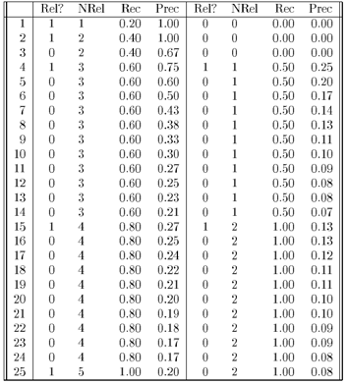
Rec- recall NRel - # relevant
Prec - precision
Retrieve one document at a time without replacement and in order.
Given: only 25 documents of which 5 are relevant (D1, D2, D4, D15, D25)
Calculate precision and recall after each document retrieved
Retrieve D1
Have D1
Retrieve D2
Have D1, D2
Retrieve D3
Now have D1, D2, D3

Slide 117
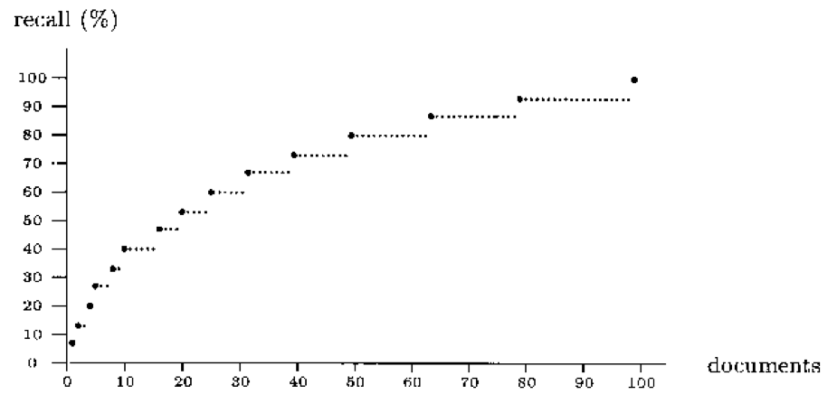
Recall Plot
Recall when more and more documents are retrieved.
Why this shape?

Slide 118
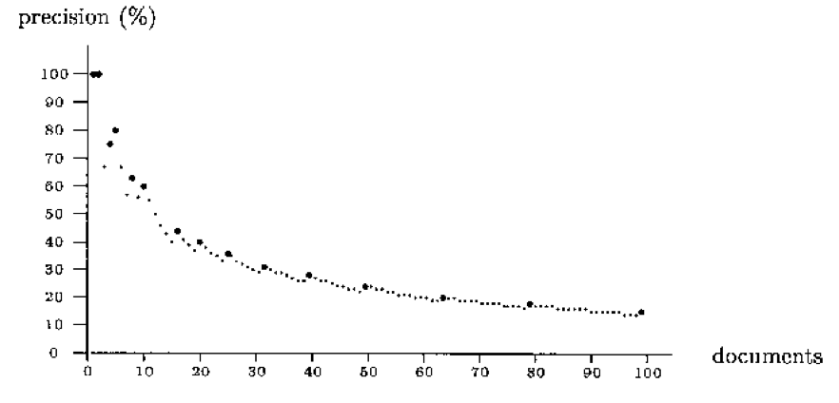
Precision Plot
Precision when more and more documents are retrieved.
Note shape!

Slide 119
Precision/recall plot
Sequences of points (p, r)
Similar to y = 1 / x:
  Inversely proportional!
  Sawtooth shape - use smoothed graphs
How we can compare systems?

Slide 120
Precision/Recall Curves
There is a tradeoff between Precision and Recall
So measure Precision at different levels of Recall
Note: this is an AVERAGE over MANY queries
Note that
there are
two separate
entities plotted on the x axis, recall and numbers of
Documents.
precision
x
x
x
x
recall
Number of documents retrieved

Slide 121
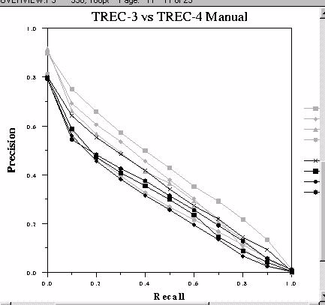
Precision/Recall Curves

Slide 122
The F-Measure
Combine Precision and Recall into one number
P = precision
R = recall
F = [0,1]
F = 1; when all ranked documents are relevant
F = 0; no relevant documents have been retrieved
Harmonic mean – average of rates
AKA
F₁ measure,
F-score

Slide 123
Query Engine
Index
Interface
Indexer
Users
Crawler
Web
A Typical Web Search Engine

Slide 124
Crawlers
Web crawlers (spiders) gather information (files, URLs, etc) from the web.
Primitive IR systems

Slide 125
Web Search
Goal
Provide information discovery for large amounts of open access material on the web
Challenges
• Volume of material -- several billion items, growing steadily
• Items created dynamically or in databases
• Great variety -- length, formats, quality control, purpose, etc.
• Inexperience of users -- range of needs
• Economic models to pay for the service

Slide 126
Strategies
Subject hierarchies
• Yahoo! -- use of human indexing
Web crawling + automatic indexing
• General -- AltaVista, Google, ...
Mixed models
• Graphs - kartoo; clusters - vivisimo

Slide 127
Components of Web Search Service
Components
• Web crawler
• Indexing system
• Search system
Considerations
• Economics
• Scalability
• Legal issues

Slide 128
Economic Models
Subscription
Monthly fee with logon provides unlimited access (introduced by InfoSeek)
Advertising
Access is free, with display advertisements (introduced by Lycos)
  Can lead to distortion of results to suit advertisers
  Focused advertising - Google, Overture
Licensing
Cost of company are covered by fees, licensing of software and specialized services

Slide 129
What is a Web Crawler?
Web Crawler
• A program for downloading web pages.
• Given an initial set of seed URLs, it recursively downloads every page that is linked from pages in the set.
• A focused web crawler downloads only those pages whose content satisfies some criterion.
Also known as a web spider

Slide 130
Web Crawler
A crawler is a program that picks up a page and follows all the links on that page
Crawler = Spider
Types of crawler:
  Breadth First
  Depth First

Slide 131
Breadth First Crawlers
Use breadth-first search (BFS) algorithm
Get all links from the starting page, and add them to a queue
Pick the 1st link from the queue, get all links on the page and add to the queue
Repeat above step till queue is empty

Slide 132
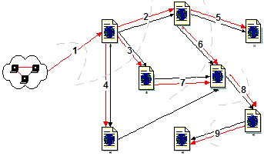
Breadth First Crawlers

Slide 133
Depth First Crawlers
Use depth first search (DFS) algorithm
Get the 1st link not visited from the start page
Visit link and get 1st non-visited link
Repeat above step till no no-visited links
Go to next non-visited link in the previous level and repeat 2nd step

Slide 134
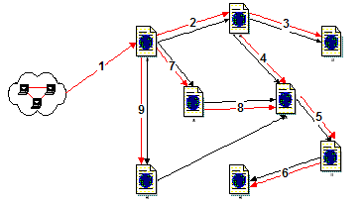
Depth First Crawlers

Slide 135
Query Engine
Index
Interface
Indexer
Users
Crawler
Characteristics
Web
A Typical Web Search Engine

Slide 136
Robots Exclusion
The Robots Exclusion Protocol
A Web site administrator can indicate which parts of the site should not be visited by a robot, by providing a specially formatted file on their site, in http://.../robots.txt.
The Robots META tag
A Web author can indicate if a page may or may not be indexed, or analyzed for links, through the use of a special HTML META tag
See: http://www.robotstxt.org/wc/exclusion.html

Slide 137
Internet vs. Web
Internet:
  Internet is a more general term
  Includes physical aspect of underlying networks and mechanisms such as email, FTP, HTTP…
Web:
  Associated with information stored on the Internet
  Refers to a broader class of networks, i.e. Web of English Literature
  Both Internet and web are networks

Slide 138
Essential Components of WWW
Resources:
  Conceptual mappings to concrete or abstract entities, which do not change in the short term
  ex: IST411 website (web pages and other kinds of files)
Resource identifiers (hyperlinks):
  Strings of characters represent generalized addresses that may contain instructions for accessing the identified resource
  http://clgiles.ist.psu.edu/IST441 is used to identify our course homepage
Transfer protocols:
  Conventions that regulate the communication between a browser (web user agent) and a server

Slide 139
Search Engines
What is connectivity?
Role of connectivity in ranking
  Academic paper analysis
  Hits - IBM
  Google
  CiteSeer

Slide 140
Concept of Relevance
Document measures
Relevance, as conventionally defined, is binary (relevant or not relevant). It is usually estimated by the similarity between the terms in the query and each document.
Importance measures documents by their likelihood of being useful to a variety of users. It is usually estimated by some measure of popularity.
Web search engines rank documents by combination of relevance and importance. The goal is to present the user with the most important of the relevant documents.

Slide 141
Ranking Options
1. Paid advertisers
2. Manually created classification
3. Vector space ranking with corrections for document length
4. Extra weighting for specific fields, e.g., title, anchors, etc.
5. Popularity, e.g., PageRank
Not all these factors are made public.

Slide 142
Ranking: query (in)dependence
Query independent ranking
  Important pages; no need for queries
  Trusted pages?
  PageRank can do this
Query dependent ranking
  Combine importance with query evaluation
  Hits is query based.
  So is GoogleRank (combine PageRank with some similarity measure)

Slide 143
HTML Structure & Feature Weighting
Weight tokens under particular HTML tags more heavily:
  <TITLE> tokens (Google seems to like title matches)
  <H1>,<H2>… tokens
  <META> keyword tokens
Parse page into conceptual sections (e.g. navigation links vs. page content) and weight tokens differently based on section.

Slide 144
Query Engine
Index
Interface
Indexer
Users
Crawler
Ranking by web graph
Web
A Typical Web Search Engine

Slide 145
Link Analysis
What is link analysis?
For academic documents
CiteSeer is an example of such a search engine
Others
  Google Scholar
  SMEALSearch
  eBizSearch

Slide 146
HITS
Algorithm developed by Kleinberg in 1998.
IBM search engine project
Attempts to computationally determine hubs and authorities on a particular topic through analysis of a relevant subgraph of the web.
Based on mutually recursive facts:
  Hubs point to lots of authorities.
  Authorities are pointed to by lots of hubs.

Slide 147
Authorities
Authorities are pages that are recognized as providing significant, trustworthy, and useful information on a topic.
In-degree (number of pointers to a page) is one simple measure of authority.
However in-degree treats all links as equal.
Should links from pages that are themselves authoritative count more?

Slide 148
Hubs
Hubs are index pages that provide lots of useful links to relevant content pages (topic authorities).
Ex: pages are included in the course home page

Slide 149
Google Search Engine Features
Two main features to increase result precision:
Uses link structure of web (PageRank)
Uses text surrounding hyperlinks to improve accurate document retrieval
Other features include:
Takes into account word proximity in documents
Uses font size, word position, etc. to weight word
Storage of full raw html pages

Slide 150
PageRank
Link-analysis method used by Google (Brin & Page, 1998).
Does not attempt to capture the distinction between hubs and authorities.
Ranks pages just by authority.
Applied to the entire web rather than a local neighborhood of pages surrounding the results of a query.

Slide 151
Initial PageRank Idea
Can view it as a process of PageRank “flowing” from pages to the pages they cite.
.1
.08
.05
.05
.03
.09
.08
.03
.03
.03

Slide 152
Sample Stable Fixpoint
0.4
0.2
0.2
0.2
0.2
0.4
0.4

Slide 153
Rank Source
Introduce a “rank source” E that continually replenishes the rank of each page, p, by a fixed amount E(p).

Slide 154
PageRank Algorithm
Let S be the total set of pages.
Let ∀p∈S: E(p) = α/|S| (for some 0<α<1, e.g. 0.15)
Initialize ∀p∈S: R(p) = 1/|S|
Until ranks do not change (much) (convergence)
For each p∈S:
For each p∈S: R(p) = cR´(p) (normalize)

Slide 155
Justifications for using PageRank
Attempts to model user behavior
Captures the notion that the more a page is pointed to by “important” pages, the more it is worth looking at
Takes into account global structure of web

Slide 156
Google Ranking
Complete Google ranking includes (based on university publications prior to commercialization).
  Vector-space similarity component.
  Keyword proximity component.
  HTML-tag weight component (e.g. title preference).
  PageRank component.
Details of current commercial ranking functions are trade secrets.

Slide 157
PageRank vs Hits
Web site classification
  Hubs
  Authorities
Hubs & Authorities: → Hits
Authorities: → PageRank

Slide 158
Link Analysis Conclusions
Link analysis uses information about the structure of the web graph to aid search.
It is one of the major innovations in web search.
It is the primary reason for Google’s success.

Slide 159
Specialty Search Engines
Focuses on a specific type of information
  Subject area, geographic area, resource type, enterprise
  Also called
    Niche search
    Vertical search
    Enterprise search
Can be part of a general purpose engine
Often uses a crawler to build the index from
  web pages
  other information specific to the area of focus, or combine crawler with human built directory
  Crawler is focused (focused crawler)
Information resources
  Internal to an organization
  External - web
  Both

Slide 160
Enterprise search: how it’s different
Expected to be the killer app for search, not web search!
  Now catching up
Search is not the business of the enterprise
  Most organizations do not invest any time in search
  As opposed to companies whose life-blood is improving search
User task is different
  Internet: find an answer or a starting point
  Intranet: find the right answer, know it’s the right answer
Statistical data is usually not there (but this is changing)
  Fewer searches per day
  Less content
In-links are not there (importance measure)
  Crucial for improving relevancy on the Internet
  In-link ranking nearly impossible; importance measure up for grabs
  Uses old ranking methods – word frequency, etc.
Notes:
Most organizations do not invest resources in improving search, whereas Internet search engine companies employee hundreds, and thousands in some cases, of developers whose sole mission is to improve search.
User task
Searching on the Internet is more frequently geared towards finding a starting point and gathering background information on a particular topic, whereas searching at work is focused more on finding the right answer to a specific question, which is a much harder goal to achieve.
Statistical Data
Internet search engines are able to constantly analyze and improve their ranking algorithms based large amounts of statistical data they collect about their users searches. One example is click through rates on documents that are returned for a particular query. Enterprises, IF they have the resources to purchase or build functionality like this, have far fewer data points on which to base these calculations. Some of the algorithms in use on the Internet simply won’t work in the Enterprise.
Another major difference is with Enterprise content. Documents within organizations tend not to contain many links to each other – so the use of in-link analysis also will not work for most Enterprises.

Slide 161
Enterprise search: Challenges
The major challenge: index documents from a variety of sources such as: file systems, intranets, document management systems, e-mail, and databases
  Adapters to index content from a variety of repositories, such as databases and content management systems.
Provide effective federated search
  (1) transforming a query and broadcasting it to a group of disparate databases with the appropriate syntax
  (2) merging the results collected from the databases
  (3) presenting them in a succinct and unified format with minimal duplication,
  (4) providing a means, performed either automatically or by the portal user, to sort the merged result set.
Entity extraction that seeks to locate and classify elements in text into predefined categories such as the names of persons, organizations, locations, expressions of times, quantities, monetary values, percentages, etc.
Faceted search for accessing a collection of information represented using a faceted classification, allowing users to explore by filtering available information.
Access control, usually in the form of an Access control list (ACL) to restrict access to documents based on individual user identities. There are many types of access control mechanisms for different content sources making this a complex task to address comprehensively in an enterprise search environment.
Notes:
Most organizations do not invest resources in improving search, whereas Internet search engine companies employee hundreds, and thousands in some cases, of developers whose sole mission is to improve search.
User task
Searching on the Internet is more frequently geared towards finding a starting point and gathering background information on a particular topic, whereas searching at work is focused more on finding the right answer to a specific question, which is a much harder goal to achieve.
Statistical Data
Internet search engines are able to constantly analyze and improve their ranking algorithms based large amounts of statistical data they collect about their users searches. One example is click through rates on documents that are returned for a particular query. Enterprises, IF they have the resources to purchase or build functionality like this, have far fewer data points on which to base these calculations. Some of the algorithms in use on the Internet simply won’t work in the Enterprise.
Another major difference is with Enterprise content. Documents within organizations tend not to contain many links to each other – so the use of in-link analysis also will not work for most Enterprises.

Slide 162


Slide 163
Specialty Search Engines - Advantages
Saves time
Greater relevance
  Unique indexes
    Car search: Jaguar, etc
    CiteSeerX
      Searches academic documents
Vetted database, unique entries and annotations

Slide 164
Elastic/Lucene
Query Engine
Index
Interface
Users
Indexer
Crawler
Scrapy
Heritrix
Web/Enterprise
A Typical Enterprise Search Engine

Slide 165
Specialty Search Engines -Disadvantages
Maintenance overhead
  Constant crawling
  System management
    Google custom search (CSE) eliminates this
Interface design
  Naïve users
Freshness

Slide 166


Metadata is semi-structured data conforming to commonly
agreed upon models, providing operational interoperability
in a heterogeneous environment

Slide 167
What might metadata "say"?
What is this called?
What is this about?
Who made this?
When was this made?
Where do I get (a copy of) this?
When does this expire?
What format does this use?
Who is this intended for?
What does this cost?
Can I copy this? Can I modify this?
What are the component parts of this?
What else refers to this?
What did "users" think of this?
(etc!)

Slide 168
What is XML?
XML – eXtensible Markup Language
designed to improve the functionality of the Web by providing more flexible and adaptable information and identification
“extensible” because not a fixed format like HTML
a language for describing other languages (a meta-language)
design your own customised markup language

Slide 169
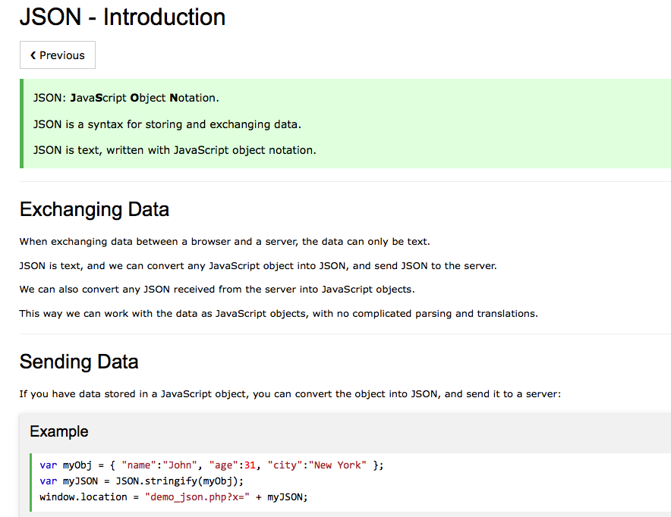

Slide 170
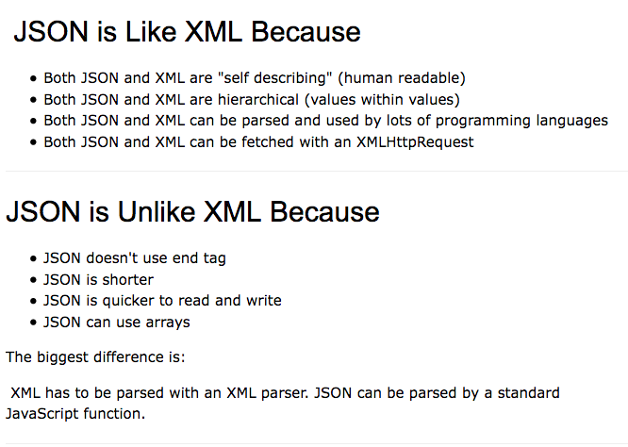

Slide 171
Web 2.0 vs Web 3.0
The Web and Web 2.0 were designed with humans in mind.
(Human Understanding)
The Web 3.0 will anticipate our needs! Whether it is State Department information when traveling, foreign embassy contacts, airline schedules, hotel reservations, area taxis, or famous restaurants: the information. The new Web will be designed for computers.
(Machine Understanding)
The Web 3.0 will be designed to anticipate the meaning of the search.

Slide 172
Google Knowledge Graph (GKG)
First step towards providing users with answers, rather than a collection of search results
Attempts to turn ambiguous words into actual concepts understandable by search engine
Distinguishes between homophones (eg –two, to)
The knowledge graph only appears when you are searching for data already in its continuously growing database

Slide 173
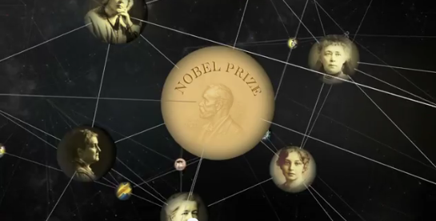
What is it?
“A huge knowledge graph of interconnected entities and their attributes”.
Amit Singhal, Senior Vice President at Google
“A knowledge based used by Google to enhance its search engine’s results with semantic-search information gathered from a wide variety of sources”
http://en.wikipedia.org/wiki/Knowledge_Graph

Slide 174
General idea of Semantic Web
Make current web more machine accessible and intelligent!
(currently all the intelligence is in the user)
Motivating use-cases
Search engines
  concepts, not keywords
  semantic narrowing/widening of queries
Shopbots
  semantic interchange, not screenscraping
E-commerce
  Negotiation, catalogue mapping, personalisation
Web Services
  Need semantic characterisations to find them
Navigation
  by semantic proximity, not hardwired links
.....

Slide 175

General idea of Semantic Web
Do this by:
Somehow making data and metadata available on the Web in machine-understandable form (formalized)
Structure the data and meta-data in ontologies
These are non-trivial
design decisions.
Would we have:

Slide 176
SEARCH ENGINES VS. RECOMMENDER SYSTEMS –
Search Engines
Goal – answer users ad hoc queries
Input – user ad-hoc need defined as a query
Output- ranked items relevant to user need (based on her preferences???)
Methods - Mainly IR based methods
Recommender Systems
Goal – recommend services or items to user
Input - user preferences defined as a profile
Output - ranked items based on her preferences
Methods – variety of methods, IR, ML, UM
The two are starting to combine

Slide 177
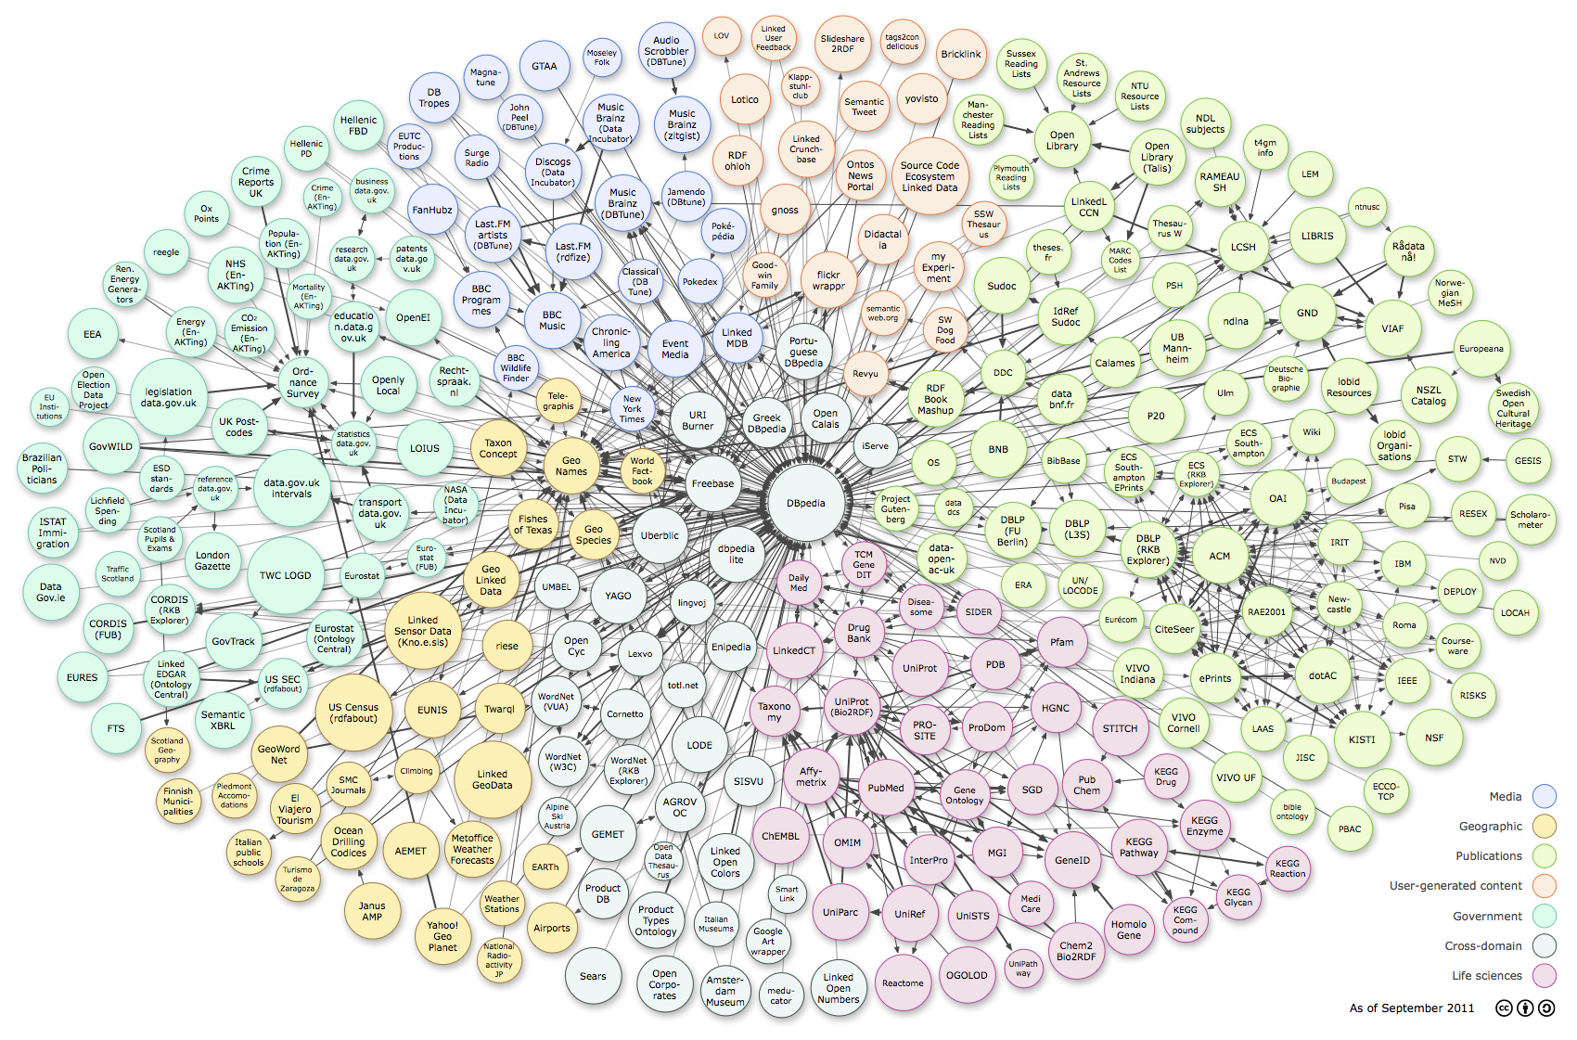
DBpedia – starting the semantic web
CiteSeer
Extracted structured content from information created as part of the Wikipedia project

Slide 178

Linked Open Data
Use Semantic Web Technology to publish shared data & knowledge
LOD is the new Cyc: a common source of background
knowledge
Data is inter-
linked to support inte-
gration and fusion of knowledge
2011: 31B facts in 295 datasets interlinked by 504M assertions on ckan.net

Slide 179
Pretrained Transformers for Text Ranking:
BERT and Beyond

Slide 180
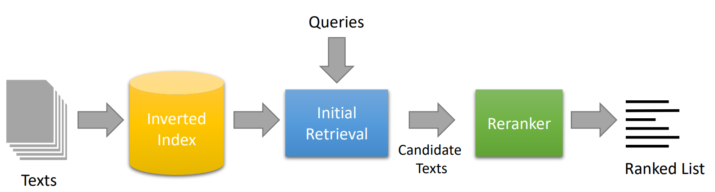
A Simple Search Engine with a Reranker
e.g., BM25

Slide 181
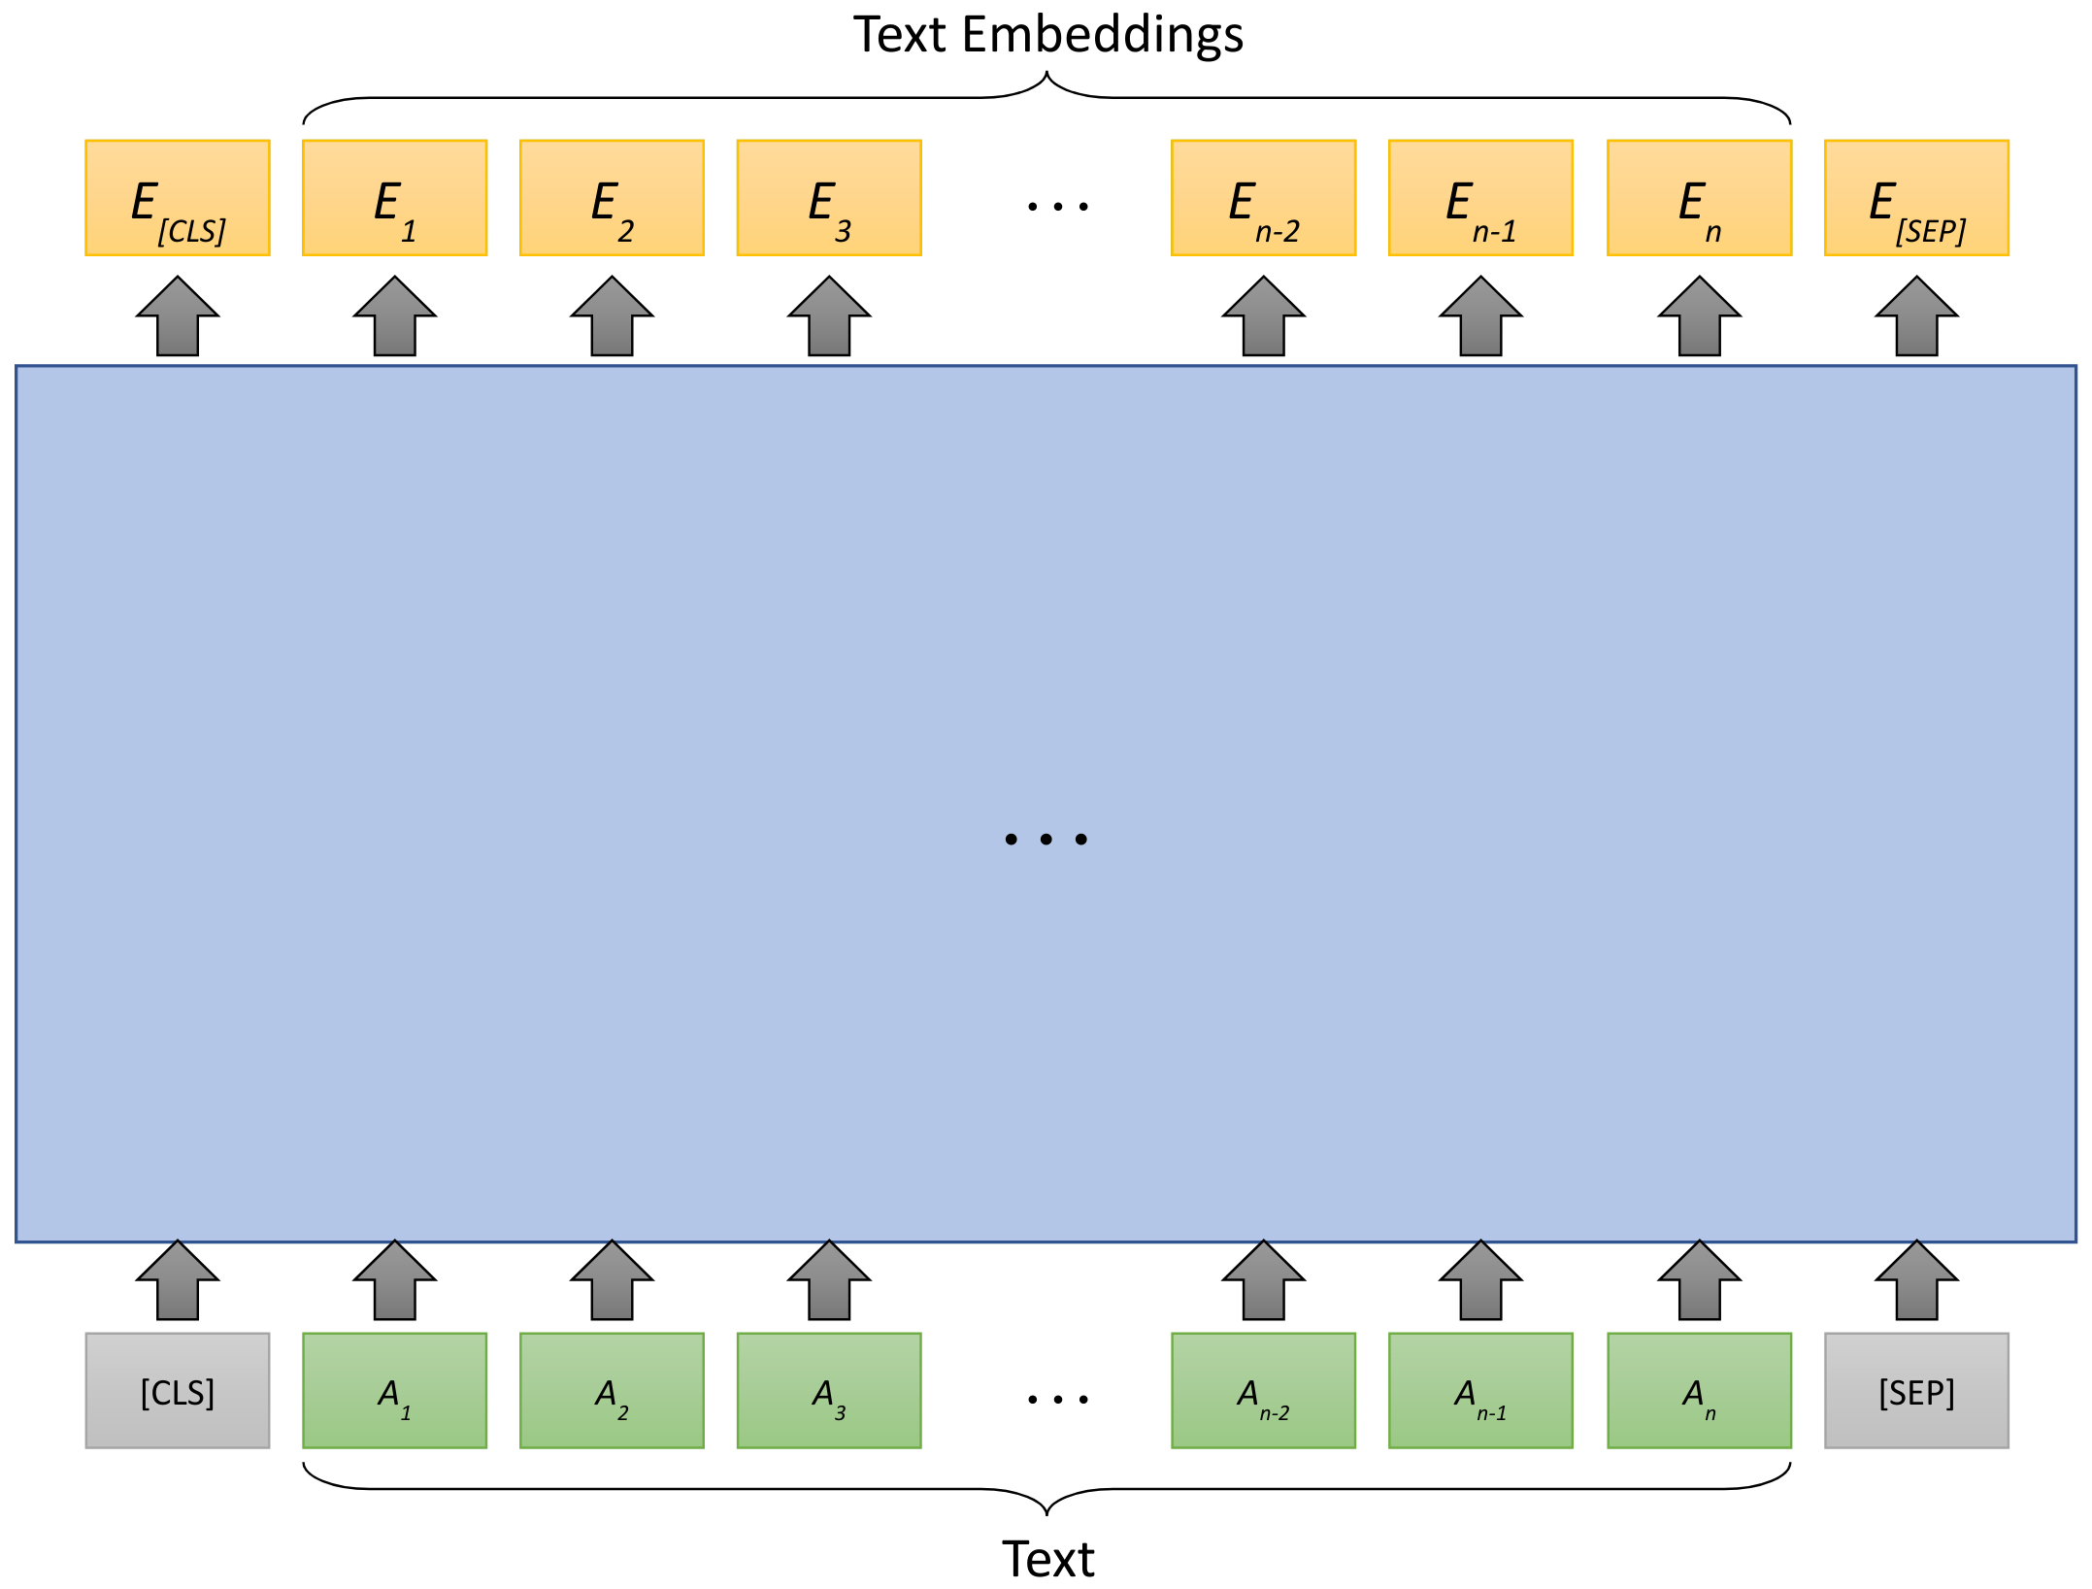
Transformers

Slide 182
Pretrained Transformers
Initialized via pretraining

Slide 183
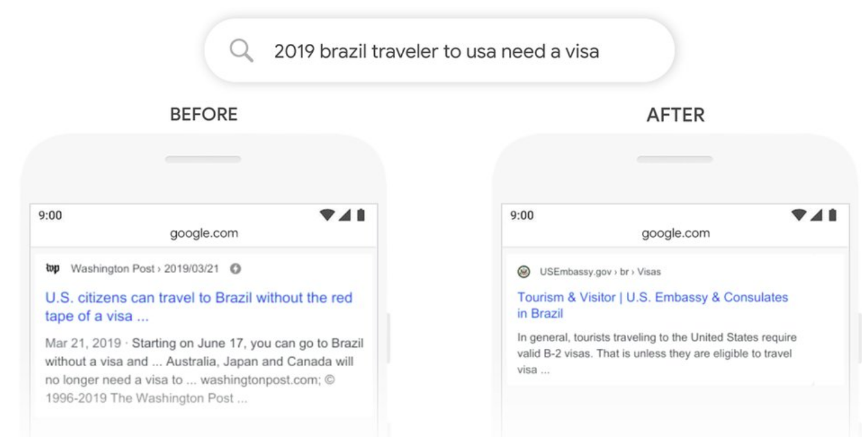
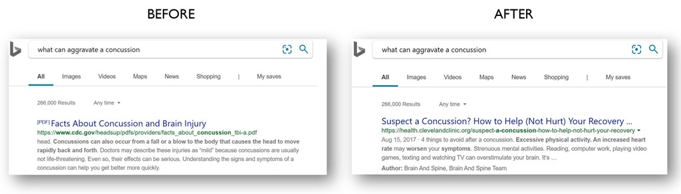
Adoption by Commercial Search Engines
Google Search
MS Bing
We’re making a significant improvement to how we understand queries, representing the biggest leap forward in the past five years, and one of the biggest leaps forward in the history of Search.
Starting from April of this year (2019), we used large transformer models to deliver the largest quality improvements to our Bing customers in the past year.
source
source

Slide 184
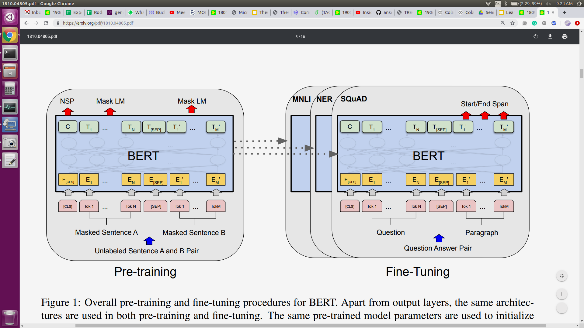
What is BERT?
Self-supervised: ∞ training data
Supervised: (few) labeled examples
Devlin, Chang, Lee, Toutanova. BERT: Pre-training of Deep Bidirectional Transformers for Language Understanding. NAACL 2019.

Slide 185
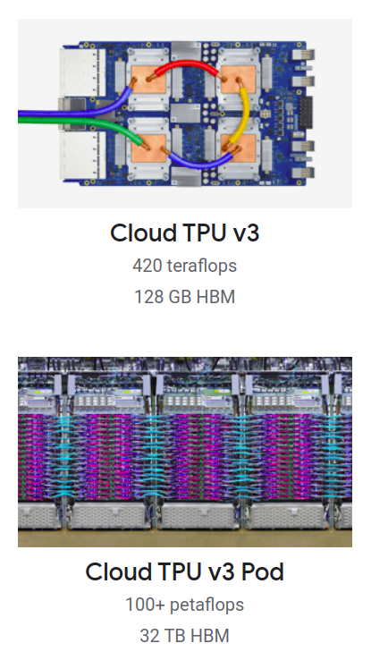
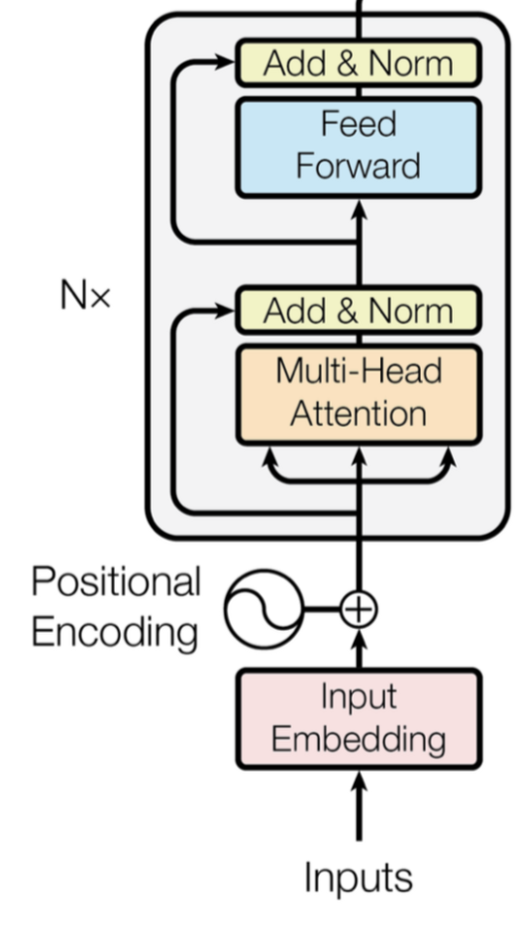


BERT's Pretraining Ingredients
+
+
Transformer (encoder-only)
with lots of parameters
Lots of texts
Lots of Compute

Slide 186
BERT
T_{[CLS]}
T₁
T₂
T₃
T₄
T₅
T₆
T₇
T_{[SEP]}
string → sequence of vectors
…
…
…
…
…
…
…
…
…
E_{[CLS]}
E₁
E₂
E₃
E₄
E₅
E₆
E₇
E_{[SEP]}
[CLS]
t₇
[SEP]
[CLS]
A₁
t₁
A₂
t₂
A₃
t₃
[SEP]
t₄
B₁
t₅
B₂
Token
Embeddings
t₆
+
+
+
+
+
+
+
+
+
Segment
Embeddings
E_{A}
E_{A}
E_{A}
E_{A}
E_{A}
E_{A}
E_{A}
E_{A}
E_{A}
+
+
+
+
+
+
+
+
+
Position
Embeddings
P₀
P₁
P₂
P₃
P₄
P₅
P₆
P₇
P₈
Tokens
[CLS]
The
bank
makes
loans
to
clients
.
[SEP]
String
The bank makes loans to clients.

Slide 187
Loss = -log (P("to" | masked input))
Pretraining - Masked Language Modeling
softmax
D ྾ V
T_{[CLS]}
T₁
T₂
T₃
T₄
T₅
T₆
T₇
T_{[SEP]}
…
…
…
…
…
…
…
…
…
E_{[CLS]}
E₁
E₂
E₃
E₄
E₅
E₆
E₇
E_{[SEP]}
[CLS]
t.
[SEP]
[CLS]
A₁
t_{The}
A₂
t_{bank}
A₃
t_{makes}
[SEP]
t_{loans}
B₁
t_{[MASK]}
B₂
Token
Embeddings
t_{clients}
+
+
+
+
+
+
+
+
+
Segment
Embeddings
E_{A}
E_{A}
E_{A}
E_{A}
E_{A}
E_{A}
E_{A}
E_{A}
E_{A}
+
+
+
+
+
+
+
+
+
Position
Embeddings
P₀
P₁
P₂
P₃
P₄
P₅
P₆
P₇
P₈
Random masking
The
bank
makes
loans
[MASK]
clients
.

Slide 188
Conclusions
Pretrained Transformers showed significant improvements in various IR benchmarks
Reproduced and adopted by many in academia and industry
No doubt we are in the age of BERT and Transformers

Slide 189
Exam
More detail in an answer is better than less.
Show your work - get partial credit.
Review homework and old exams where appropriate
Extra credit varies from exam to exam
Comments made during class are appropriate questions to put on the exam

