Slide 1
Survival Linux
IST 441
Spring 2020
Shaurya Rohatgi
source ~/.bashrc

Slide 2
Objective
A brief intro to linux
See commands which are helpful in navigating folders and modifying files
https://www.reddit.com/r/linuxmasterrace/comments/7diwwi/linux_distro_timeline/
Shaurya Rohatgi - IST441
Notes:
For yourself
For the course

Slide 3
For those of you who know Linux -
People who know the following commands, shortcuts or files -
sudo !!
source ~/.bashrc
awk
Ctrl + R
touch
chmod
history
sudo rm -r /*
cat <file> | wc -l
~/.vimrc
:se nu
Shaurya Rohatgi - IST441
Notes:
It is a big class and I will need help

Slide 4
For those of you who know Linux -
People who know the following commands, shortcuts or files -
sudo !!
source ~/.bashrc
awk
Ctrl + R
touch
chmod
history
sudo rm -r /*
cat <file> | wc -l
~/.vimrc
:se nu
Stay and help your teammates or people around you !
Shaurya Rohatgi - IST441
Notes:
It is a big class and I will need help

Slide 5
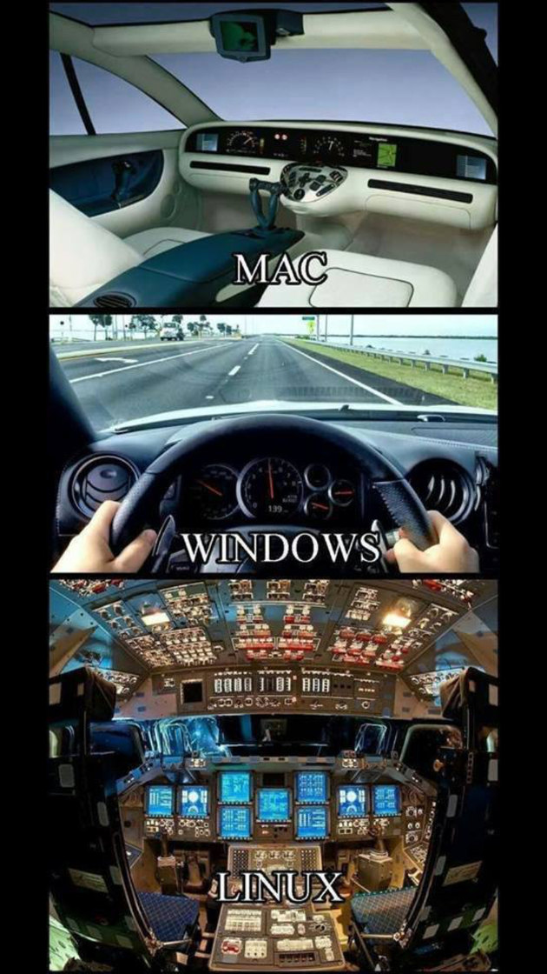
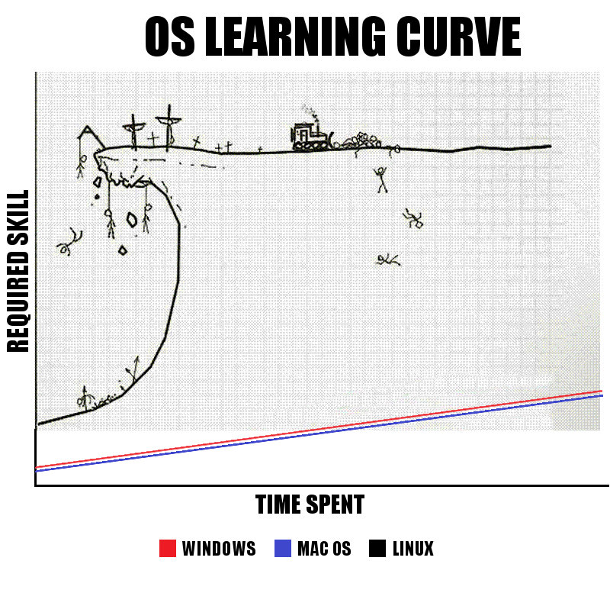
Some Comparisons
https://hddmag.com/windows-vs-mac-vs-linux/
Shaurya Rohatgi - IST441
https://www.memedroid.com/memes/tag/linux/2
Notes:
Get it out of the way

Slide 6
History and some Facts
Linux is a fork from the original UNIX
Linux is a kernel not a OS - GNU Linux OS is based on that Kernel
The penguin’s name is TUX
Shaurya Rohatgi - IST441

Slide 7
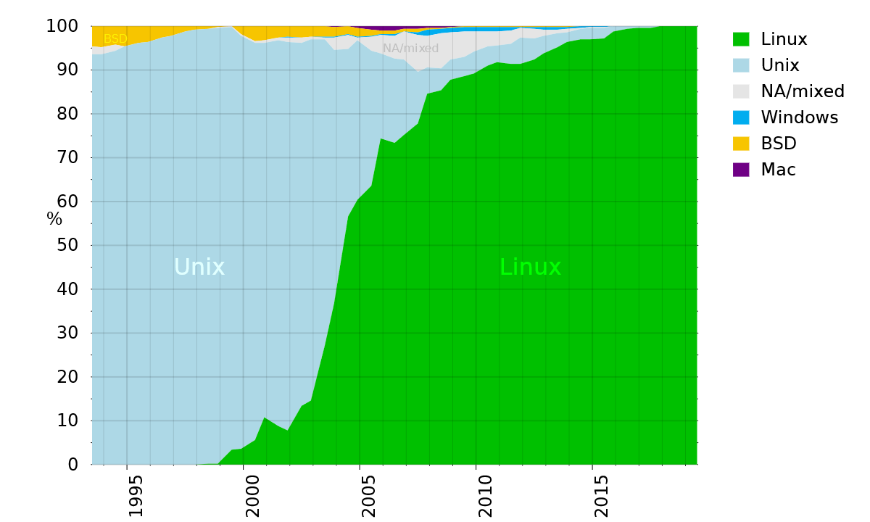
Why should I care about learning Linux ?
It is FASTER than other operating systems - designed for efficiency - https://www.techspot.com/review/1683-linux-vs-windows-threadripper-vs-core-i9/
More than 90% supercomputers use Linux
Easier for certain tasks
Open source <3
https://commons.wikimedia.org/wiki/File:Operating_systems_used_on_top_500_supercomputers.svg
Shaurya Rohatgi - IST441

Slide 8
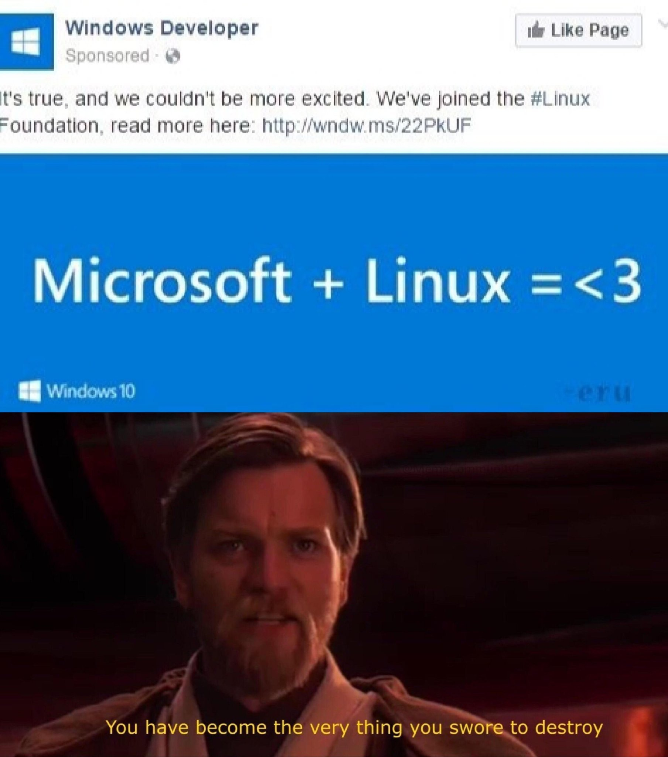
If those reasons are not enough . .
Source - https://www.ubuntupit.com/interesting-facts-about-linux/
Shaurya Rohatgi - IST441

Slide 9
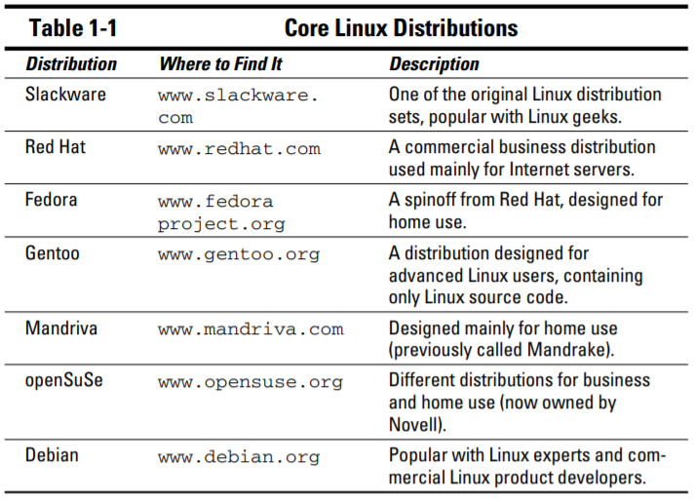
What distribution (distro) of Linux we will be using ?
https://www.amazon.com/Linux-Dummies-9th-Richard-Blum/dp/0470467010
Shaurya Rohatgi - IST441
Notes:
We want you to be an expert after this course
Android - Linux

Slide 10
Connecting to the IST441 Server
Shaurya Rohatgi - IST441

Slide 11
Accessing the ist441 server - A linux machine
● About PUTTY
A open source terminal emulator, that, among
other protocols, supports SSH (Secure Shell).
Normally used for Microsoft Windows
● Ensuring secure login to remote server
● Each team is assigned a dedicated folder, with writing/reading and executing permissions only under that folder
Shaurya Rohatgi - IST441

Slide 12
Instructions to access
● Access to VLABS at https://svg.up.ist.psu.edu from browser
● Download PUTTY from
https://the.earth.li/~sgtatham/putty/latest/w32/putty.exe
● Double click on the downloaded file and ignore the warning to proceed
Shaurya Rohatgi - IST441

Slide 13
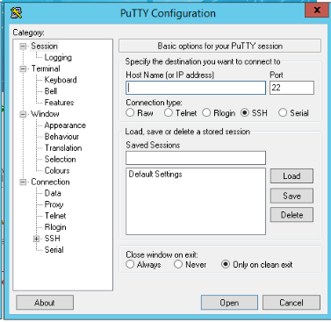
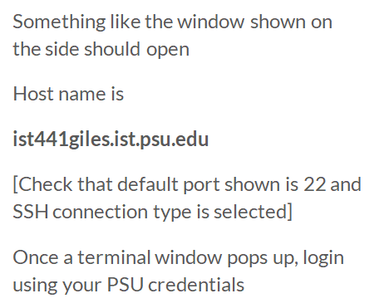
ist441.ist.psu.edu
Shaurya Rohatgi - IST441

Slide 14
Understanding File Structure of Linux
Shaurya Rohatgi - IST441

Slide 15
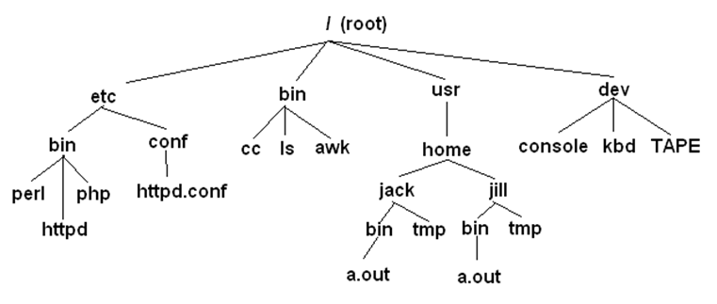
The Linux Directory Hierarchy
Linux directories are arranged in a Hierarchy with the / or root directory at the top.
unix.stackexchange.com
Shaurya Rohatgi - IST441

Slide 16
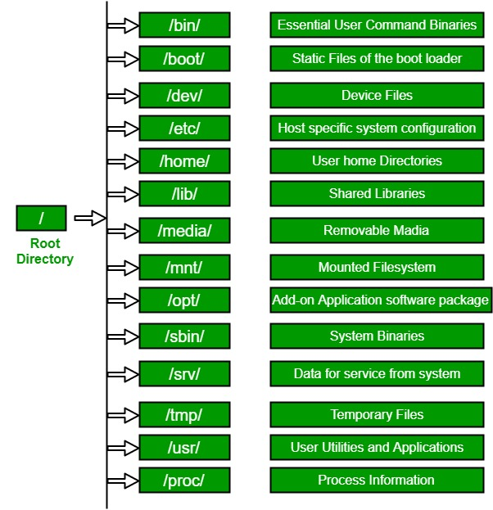
https://www.geeksforgeeks.org/
Shaurya Rohatgi - IST441

Slide 17
Accessing The Terminal from your PCs
Mac -
https://support.apple.com/en-gb/guide/terminal/apd5265185d-f365-44cb-8b09-71a064a42125/mac
Best Application (IMO) - iTerm - https://iterm2.com/
Windows -
https://docs.microsoft.com/en-us/windows/wsl/install-win10
Best Application (IMO) - Termius - https://termius.com/
Web -
https://linuxcontainers.org/lxd/try-it/
Shaurya Rohatgi - IST441

Slide 18
Important Commands
Shaurya Rohatgi - IST441

Slide 19
Print Working Directory
Shaurya Rohatgi - IST441

Slide 20
List Files in a directory
Shaurya Rohatgi - IST441

Slide 21
Change Directory
Shaurya Rohatgi - IST441
Notes:
● Navigate to your team’s folder
cd /data/team<team_number>

Slide 22
Modifying Files
Shaurya Rohatgi - IST441

Slide 23
Copy file
Shaurya Rohatgi - IST441

Slide 24
Delete File or Folder
Shaurya Rohatgi - IST441

Slide 25
Rename File
Shaurya Rohatgi - IST441

Slide 26
Create Folder or Directory
Shaurya Rohatgi - IST441

Slide 27
See File Contents
Shaurya Rohatgi - IST441

Slide 28
Peeking a file
head <file_name> print first 10 lines of a file
tail <file_name> print last 10 lines of a file
wc -l <file_name> Get number of lines in a file
Shaurya Rohatgi - IST441

Slide 29
Redirecting Output
cat old.txt > new.txt
Redirects output of left side to file on the right
Shaurya Rohatgi - IST441

Slide 30
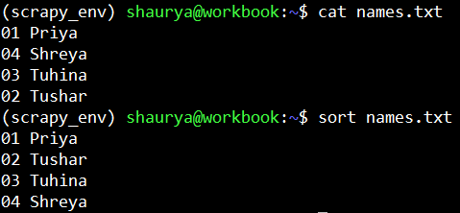
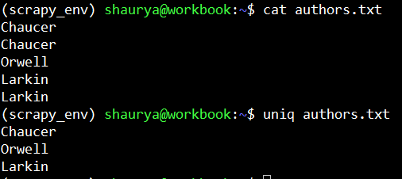
Sort and Uniq
sort - sort lines of text files
uniq - report or omit repeated lines
Shaurya Rohatgi - IST441

Slide 31
Intro to VI
Default text editor in most Linux distros
What is VIM then ?
Vim (Vi IMproved) has added a lot of extra features that make it a double-edged sword
We use VIM
Shaurya Rohatgi - IST441

Slide 32
Lightening Fast VIM Editor - Tutorial
a Enter Edit mode
Esc key Exit Edit Mode
:w Save :wq Save and close file
:q Close file :q! Close file, abandon changes
Shaurya Rohatgi - IST441

Slide 33
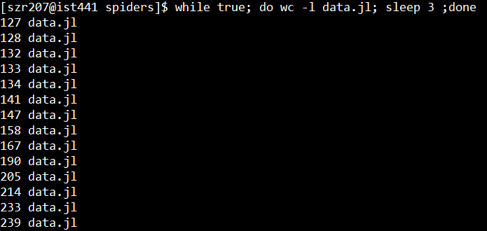
Some Other Useful Scripts
while true; do <command>; sleep 3 ;done
Shaurya Rohatgi - IST441

Slide 34
Never Do This
sudo rm -r /*
Shaurya Rohatgi - IST441

Slide 35
References and Useful links
Linux Cheat Sheet - https://files.fosswire.com/2007/08/fwunixref.pdf
VIM Cheat Sheet - https://devhints.io/vim
Learn More - https://www.w3resource.com/linux-system-administration/working-with-directories.php
Go Deeper - https://github.com/aleksandar-todorovic/awesome-linux
Shaurya Rohatgi - IST441

Slide 36
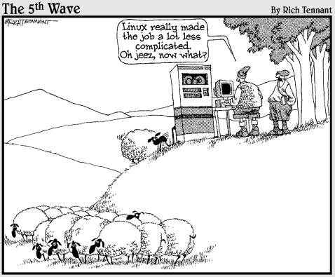
exit
Shaurya Rohatgi - IST441

